Slide 1
Iterative Methods
a₁₁x₁ + a₁₂x₂ + a₁₃x₃ • • • • • • • • + a_{1n}x_{n} = b₁
a₂₁x₁ + a₂₂x₂ + a₂₃x₃ • • • • • • • • + a_{2n}x_{n} = b₂
a₃₁x₁ + a₃₂x₂ + a₃₃x₃ • • • • • • • • + a_{3n}x_{n} = b₃
• • • • •
a_{i1}x₁ + a_{i2}x₂ + a_{i3}x₃ • • • • • • • • + a_{in}x_{n} = b_{i}
• • • • •
a_{n1}x₁ + a_{n2}x₂ + a_{n3}x₃ • • • • • • • • + a_{nn}x_{n} = b_{n}
Assume (initialize) a solution vector x
Compute a new solution vector x_{new}
Iterate until ║ x- x_{new} ║∞ ≤ ε
We learnt two methods: Jacobi and Gauss Seidel

Slide 2
Questions?
What are the conditions of convergence for the iterative methods?
Rate of convergence? Can we make them converge faster?

Slide 3
Iterative Schemes in Matrix Forms
A = L + D + U
Ax = b translates to (L + D + U)x = b
Jacobi: for an iteration counter k
Gauss Seidel: for an iteration counter k

Slide 4
Iterative Methods: Convergence
For all iterative methods:
Jacobi:
Gauss Seidel:
True error: e^{(k)} = x - x^{(k)}
We showed that e^{(k+1)} = Se^{(k)}
This constant matrix S governs whether error at each iteration step will increase or decrease: Stationery Iterative Methods
Thus, e^{(k)} = S^{k}e⁽⁰⁾
Methods will converge if:

Slide 5
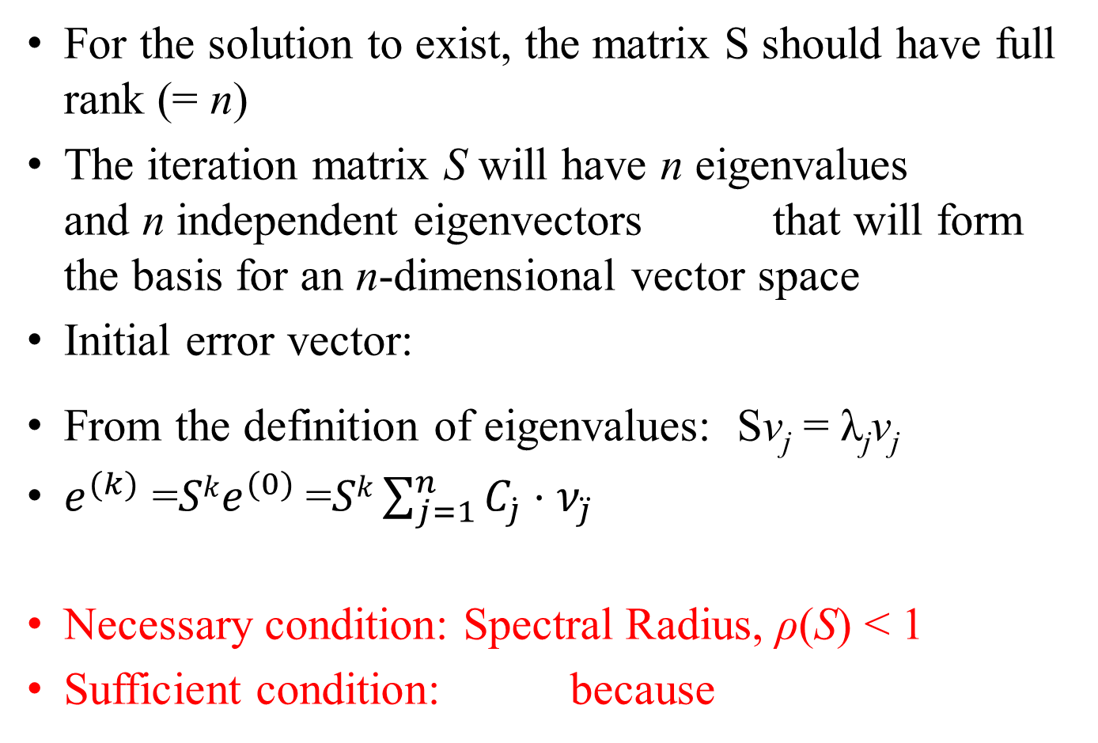
Iterative Methods: Convergence
For the solution to exist, the matrix S should have full rank (= n)
The iteration matrix S will have n eigenvalues and n independent eigenvectors that will form the basis for an n-dimensional vector space
Initial error vector:
From the definition of eigenvalues: Sv_{j} = λ_{j}v_{j}
$e^{(k)}$ =$Ske^{(0)}$=$Sk\sum_{j=1}^{n}{C_{\dot{j}}⋅ν_{\ddot{j}}}{ }^{}$
Necessary condition: Spectral Radius, ρ(S) < 1
Sufficient condition: because

Slide 6
Defining Vector and Matrix Norms

Slide 7
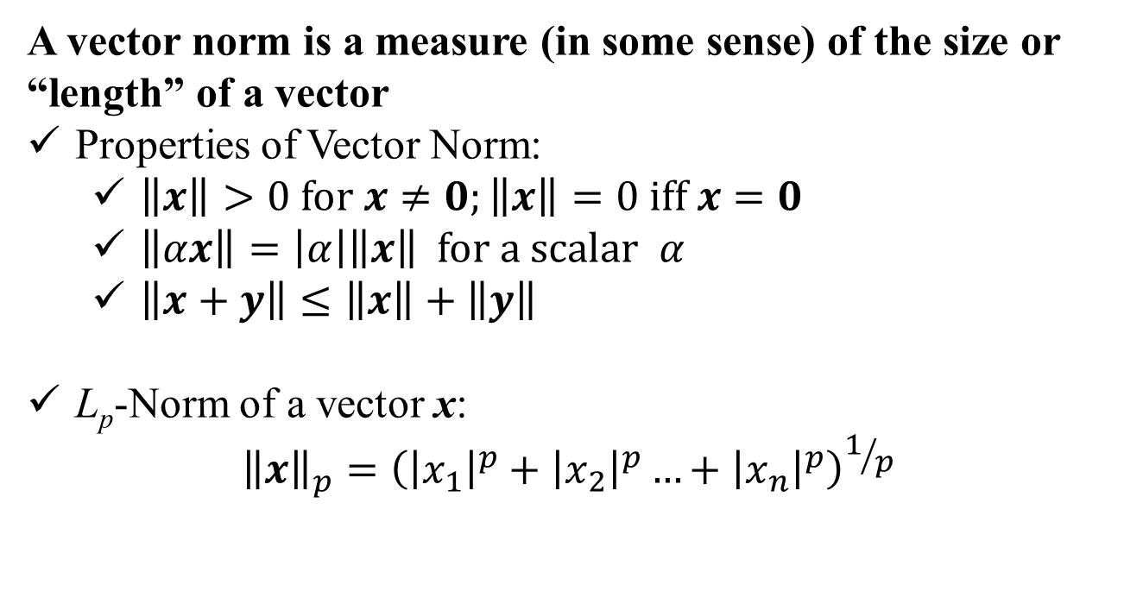
Vector Norms:
A vector norm is a measure (in some sense) of the size or “length” of a vector
Properties of Vector Norm:
$\left\|x\right\|>0 for x≠0;\left\|x\right\|=0 iff x=0$
$\left\|αx\right\|=\left|α\right|\left\|x\right\| for a scalar α$
$\left\|x+y\right\|≤\left\|x\right\|+\left\|y\right\|$
L_{p}-Norm of a vector x:
$${\left\|x\right\|}_{p}={\left({\left|x_{1}\right|}^{p}+{\left|x_{2}\right|}^{p}…+{\left|x_{n}\right|}^{p}\right)}^{1/p}$$

Slide 8
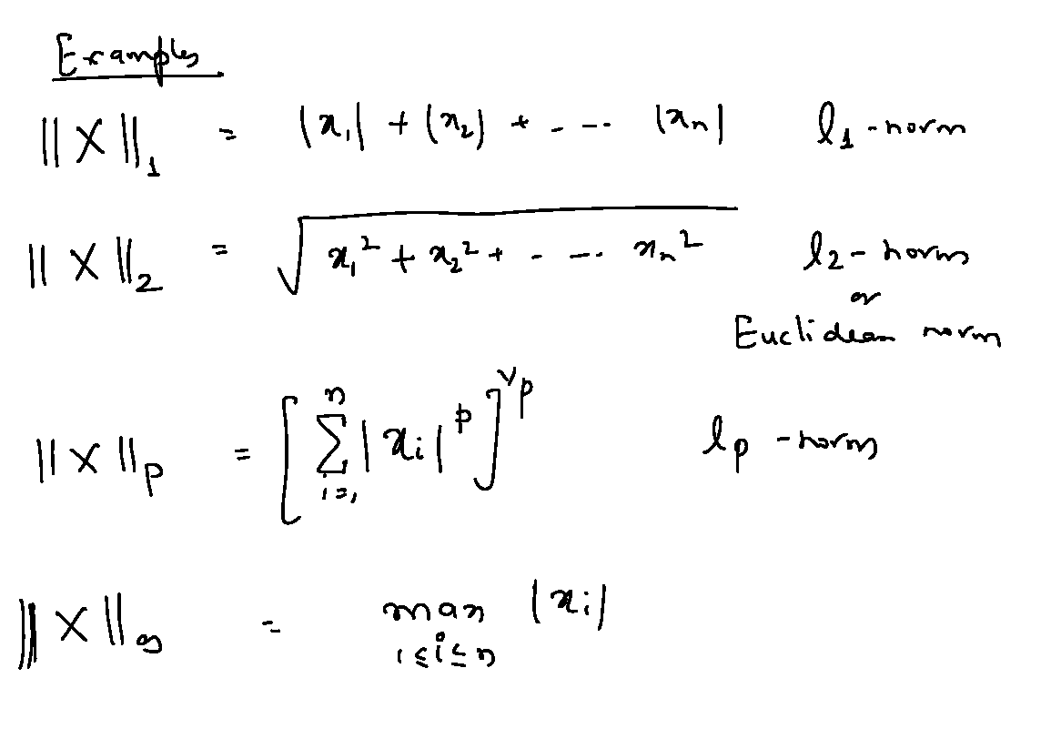
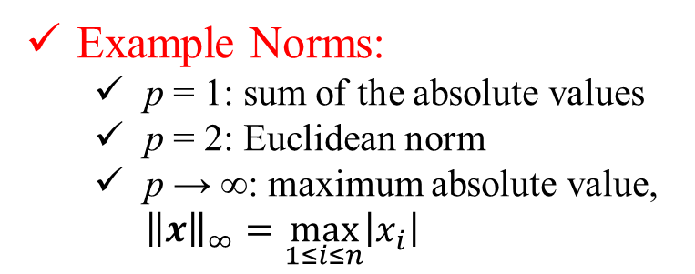
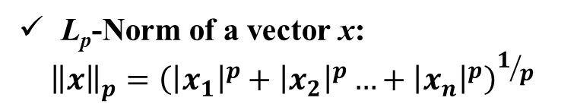
L_{p}-Norm of a vector x:
$${\left\|x\right\|}_{p}={\left({\left|x_{1}\right|}^{p}+{\left|x_{2}\right|}^{p}…+{\left|x_{n}\right|}^{p}\right)}^{1/p}$$
Example Norms:
p = 1: sum of the absolute values
p = 2: Euclidean norm
p → ∞: maximum absolute value, ${\left\|x\right\|}_{∞}=\max_{1≤i≤n}\left|x_{i}\right|$

Slide 9
L_{p}-Norm of a vector x:
$${\left\|x\right\|}_{p}={\left({\left|x_{1}\right|}^{p}+{\left|x_{2}\right|}^{p}…+{\left|x_{n}\right|}^{p}\right)}^{1/p}$$
Example Norms:
p = 1: sum of the absolute values
p = 2: Euclidean norm
p → ∞: maximum absolute value, ${\left\|x\right\|}_{∞}=\max_{1≤i≤n}\left|x_{i}\right|$

Slide 10
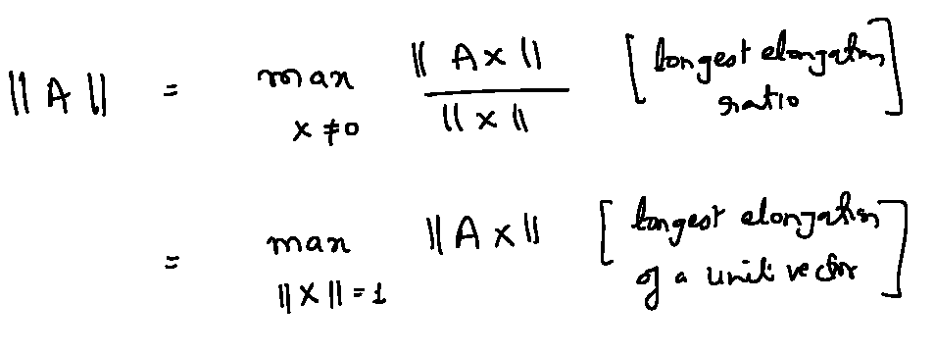
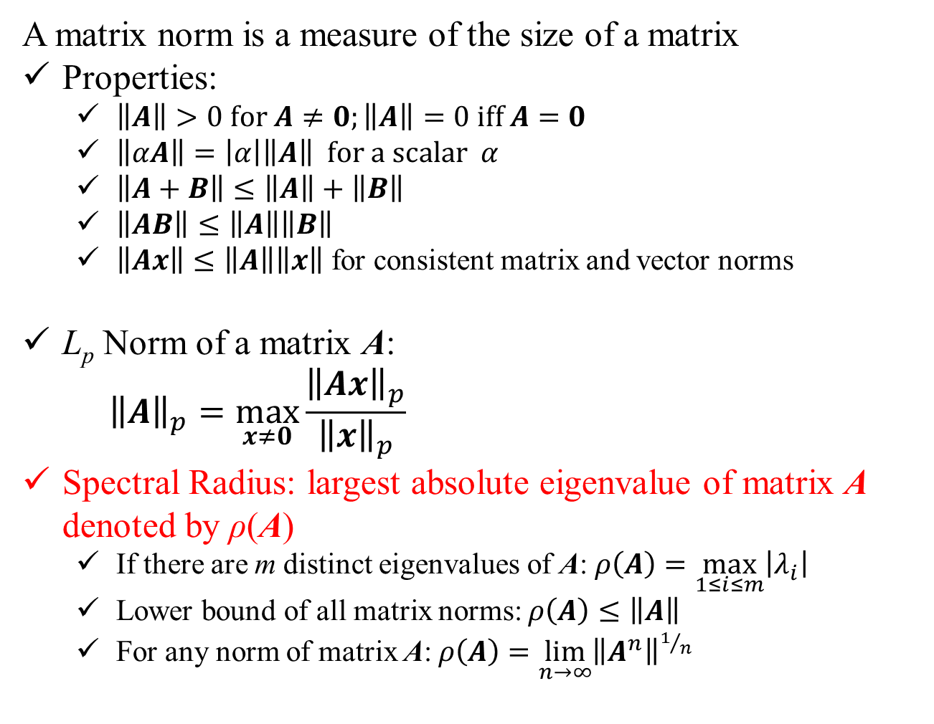
Matrix Norms:
A matrix norm is a measure of the size of a matrix
Properties:
$\left\|A\right\|>0 for A≠0;\left\|A\right\|=0 iff A=0$
$\left\|αA\right\|=\left|α\right|\left\|A\right\| for a scalar α$
$\left\|A+B\right\|≤\left\|A\right\|+\left\|B\right\|$
$\left\|AB\right\|≤\left\|A\right\|\left\|B\right\|$
$\left\|Ax\right\|≤\left\|A\right\|\left\|x\right\|$ for consistent matrix and vector norms
L_{p} Norm of a matrix A:
$${\left\|A\right\|}_{p}=\max_{x≠0}{\frac{{\left\|Ax\right\|}_{p}}{{\left\|x\right\|}_{p}}}$$
Spectral Radius: largest absolute eigenvalue of matrix A denoted by ρ(A)
If there are m distinct eigenvalues of A: $ρ\left(A\right)=\max_{1≤i≤m}\left|λ_{i}\right|$
Lower bound of all matrix norms: $ρ\left(A\right)≤\left\|A\right\|$
For any norm of matrix A: $ρ\left(A\right)=\lim_{n→∞}{{\left\|A^{n}\right\|}^{1/n}}$

Slide 11
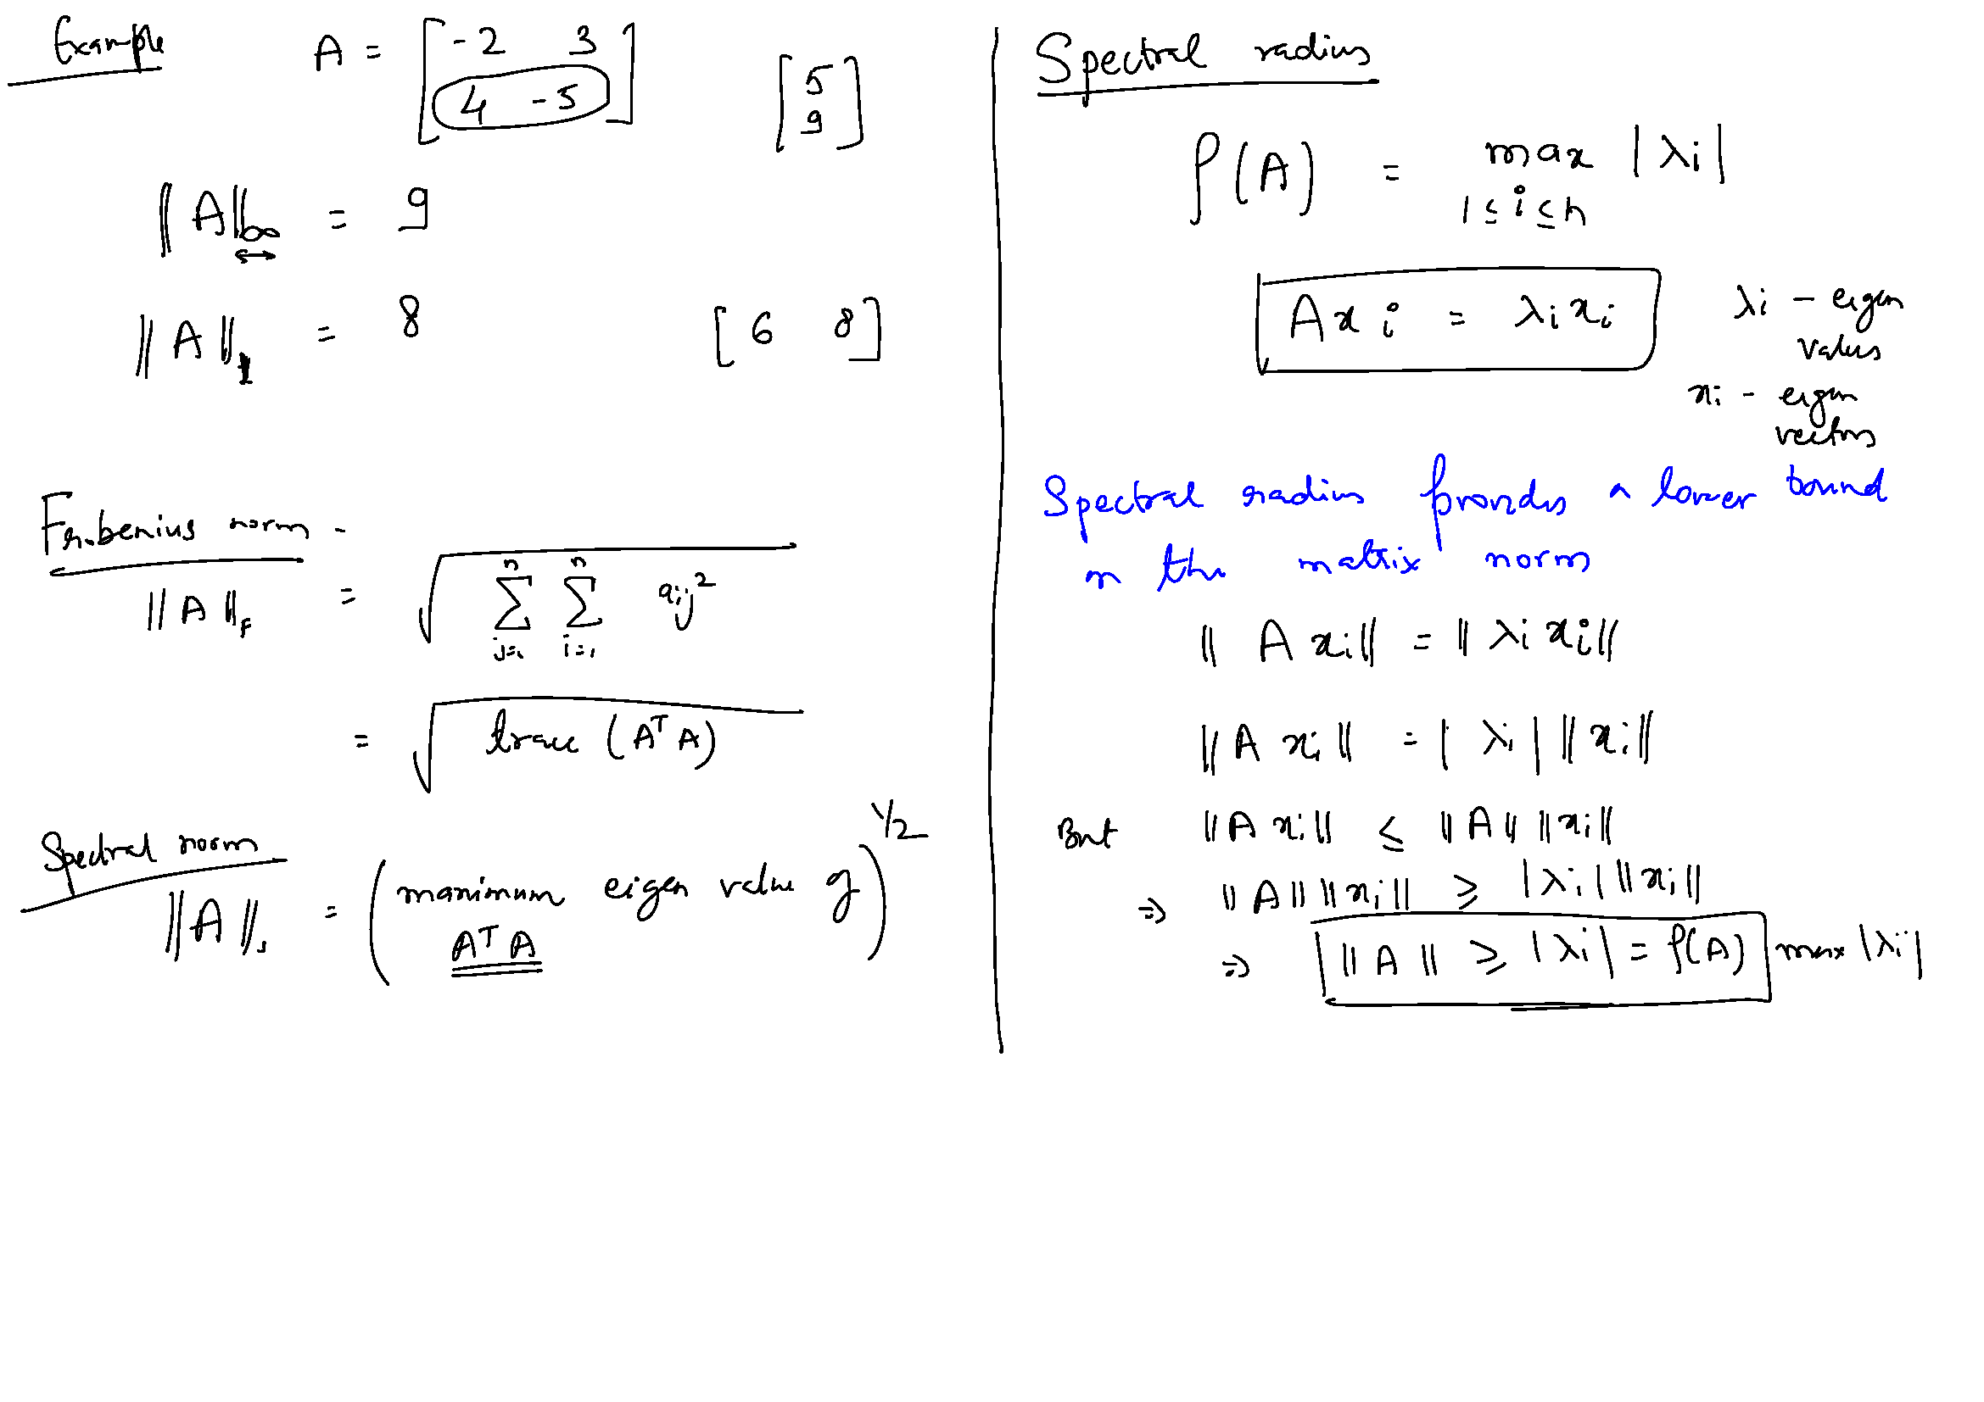

Slide 12
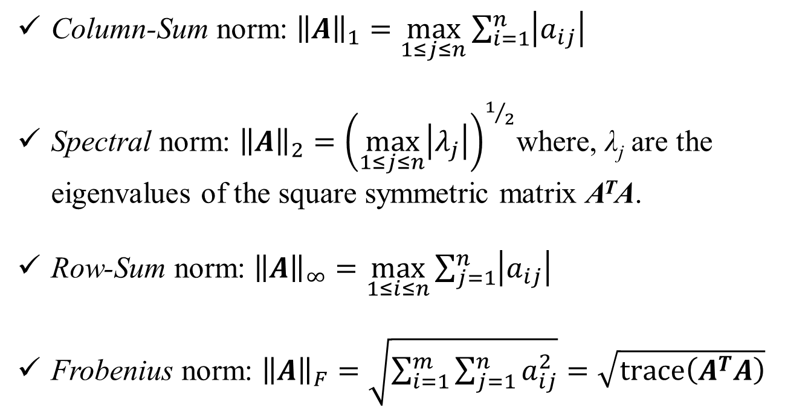
Matrix Norms:
Column-Sum norm: ${\left\|A\right\|}_{1}=\max_{1≤j≤n}{\sum_{i=1}^{n}{\left|a_{ij}\right|}}$
Spectral norm: ${\left\|A\right\|}_{2}={\left(\max_{1≤j≤n}\left|λ_{j}\right|\right)}^{1/2}$where, λ_{j} are the eigenvalues of the square symmetric matrix A^{T}A.
Row-Sum norm: ${\left\|A\right\|}_{∞}=\max_{1≤i≤n}{\sum_{j=1}^{n}{\left|a_{ij}\right|}}$
Frobenius norm: ${\left\|A\right\|}_{F}=\sqrt{\sum_{i=1}^{m}{\sum_{j=1}^{n}{a_{ij}^{2}}}}=\sqrt{\operatorname{trace}\left(A^{T}A\right)}$
Trace of a matrix is the sum of elements on the main diagonal

Slide 14
Jacobi Convergence
S = - D⁻¹(L+U)
If we use row-sum norm:
Recall, Sufficient Condition for Convergence:

Slide 15
Iterative Methods: Convergence
Using the definition of S and using row-sum norm for matrix S, we obtain the following as the sufficient condition for convergence for both Jacobi and Gauss Seidel:
If the original matrix is diagonally dominant, it will always converge!

Slide 16
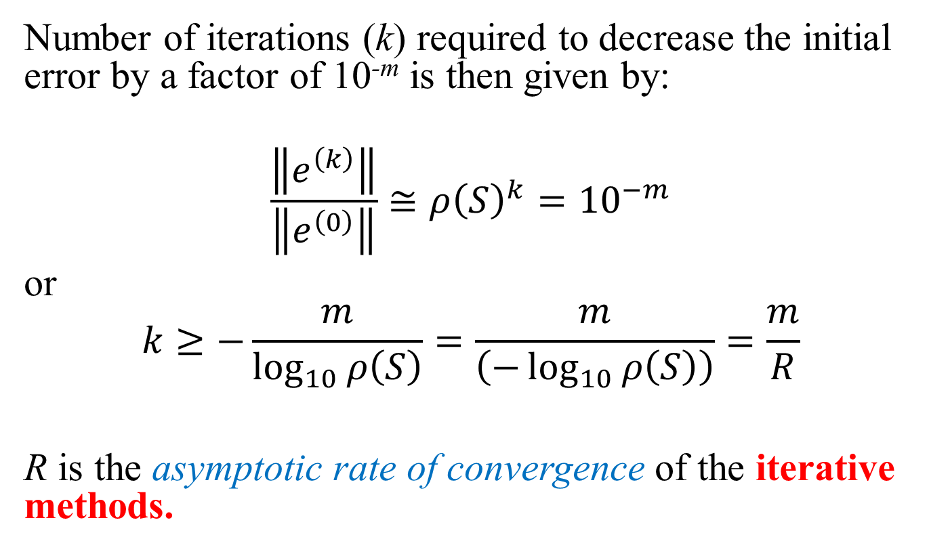
Rate of Convergence
Number of iterations (k) required to decrease the initial error by a factor of 10^{-m} is then given by:
$$\frac{\left\|e^{\left(k\right)}\right\|}{\left\|e^{\left(0\right)}\right\|}≅{ρ\left(S\right)}^{k}={10}^{−m}$$
or
$$k≥−\frac{m}{\log_{10}{ρ\left(S\right)}}=\frac{m}{\left(−\log_{10}{ρ\left(S\right)}\right)}=\frac{m}{R}$$
R is the asymptotic rate of convergence of the iterative methods.

Slide 17
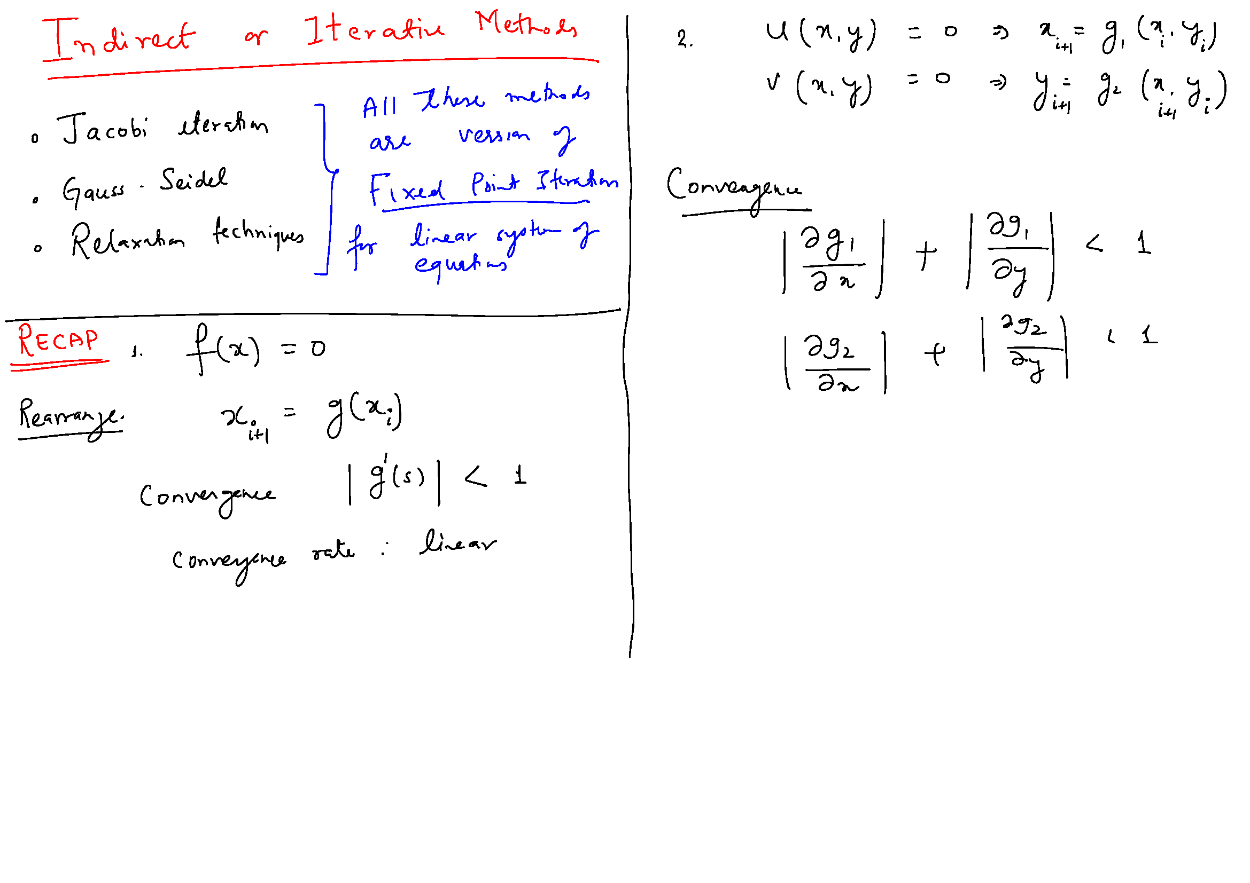

Slide 18
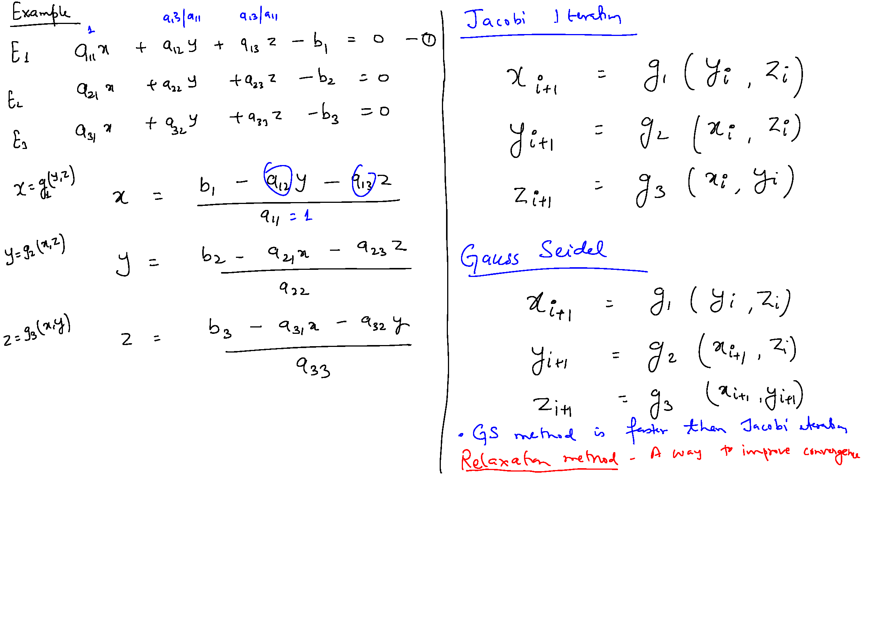

Slide 19
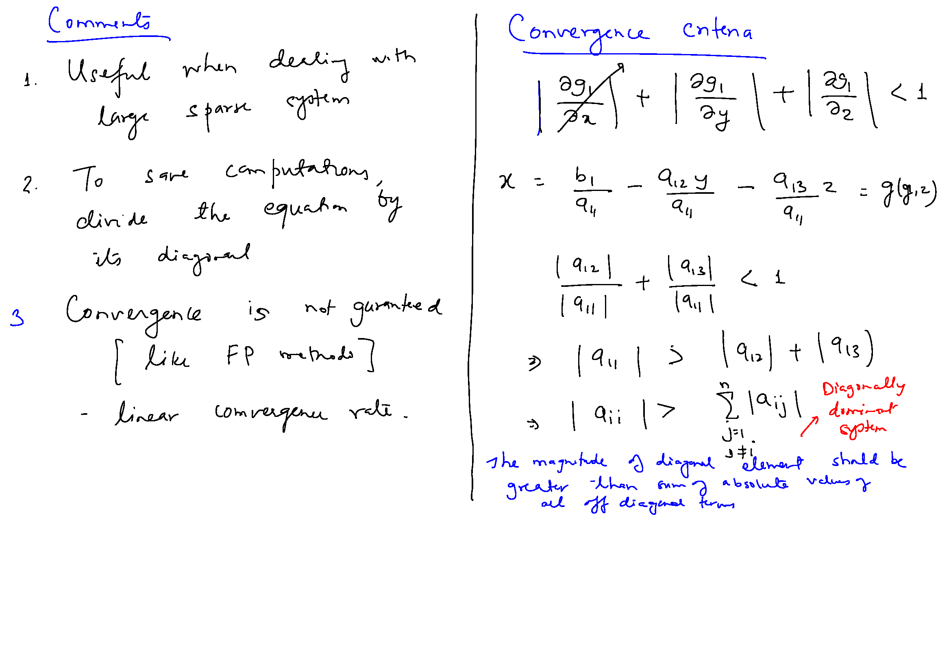

Slide 21
Improving Convergence
Recall Gauss Seidel:
Re-Write As:

Slide 22
Successive Over/Under Relaxation
0 < ω < 1 : Under relaxation
ω = 1 : Gauss Seidel
1 < ω < 2 : Over Relaxation

Slide 23
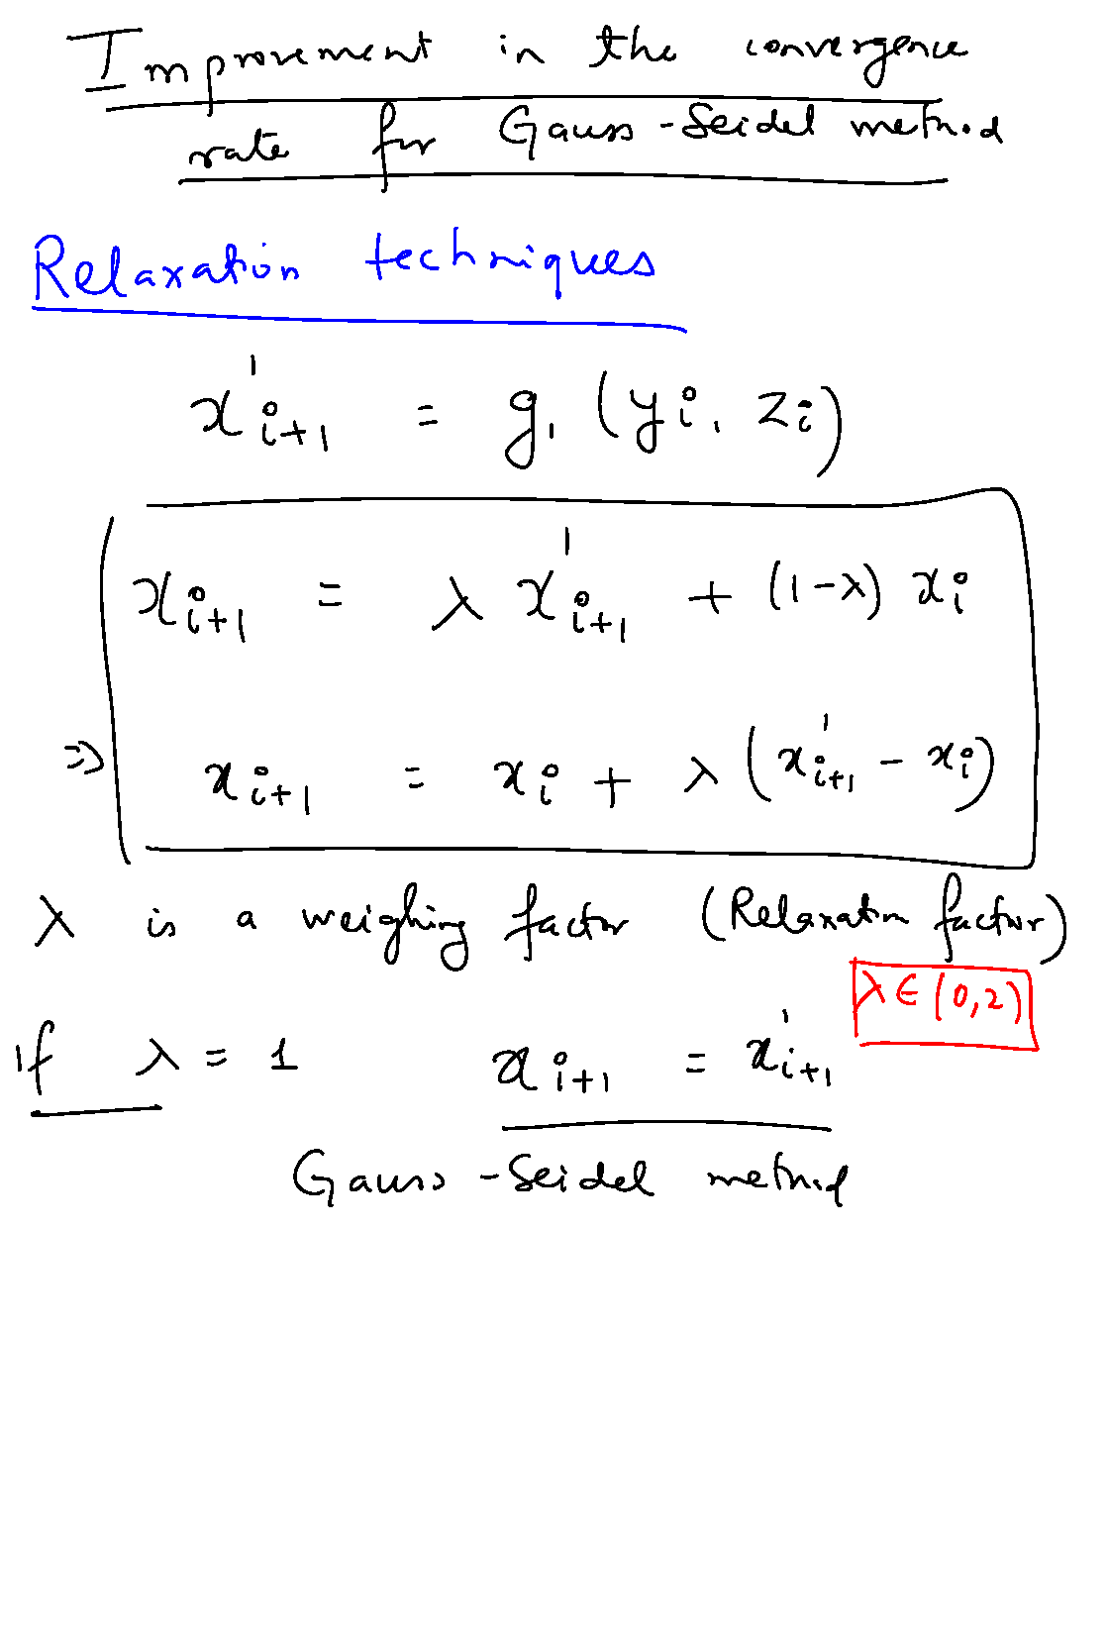

Slide 24
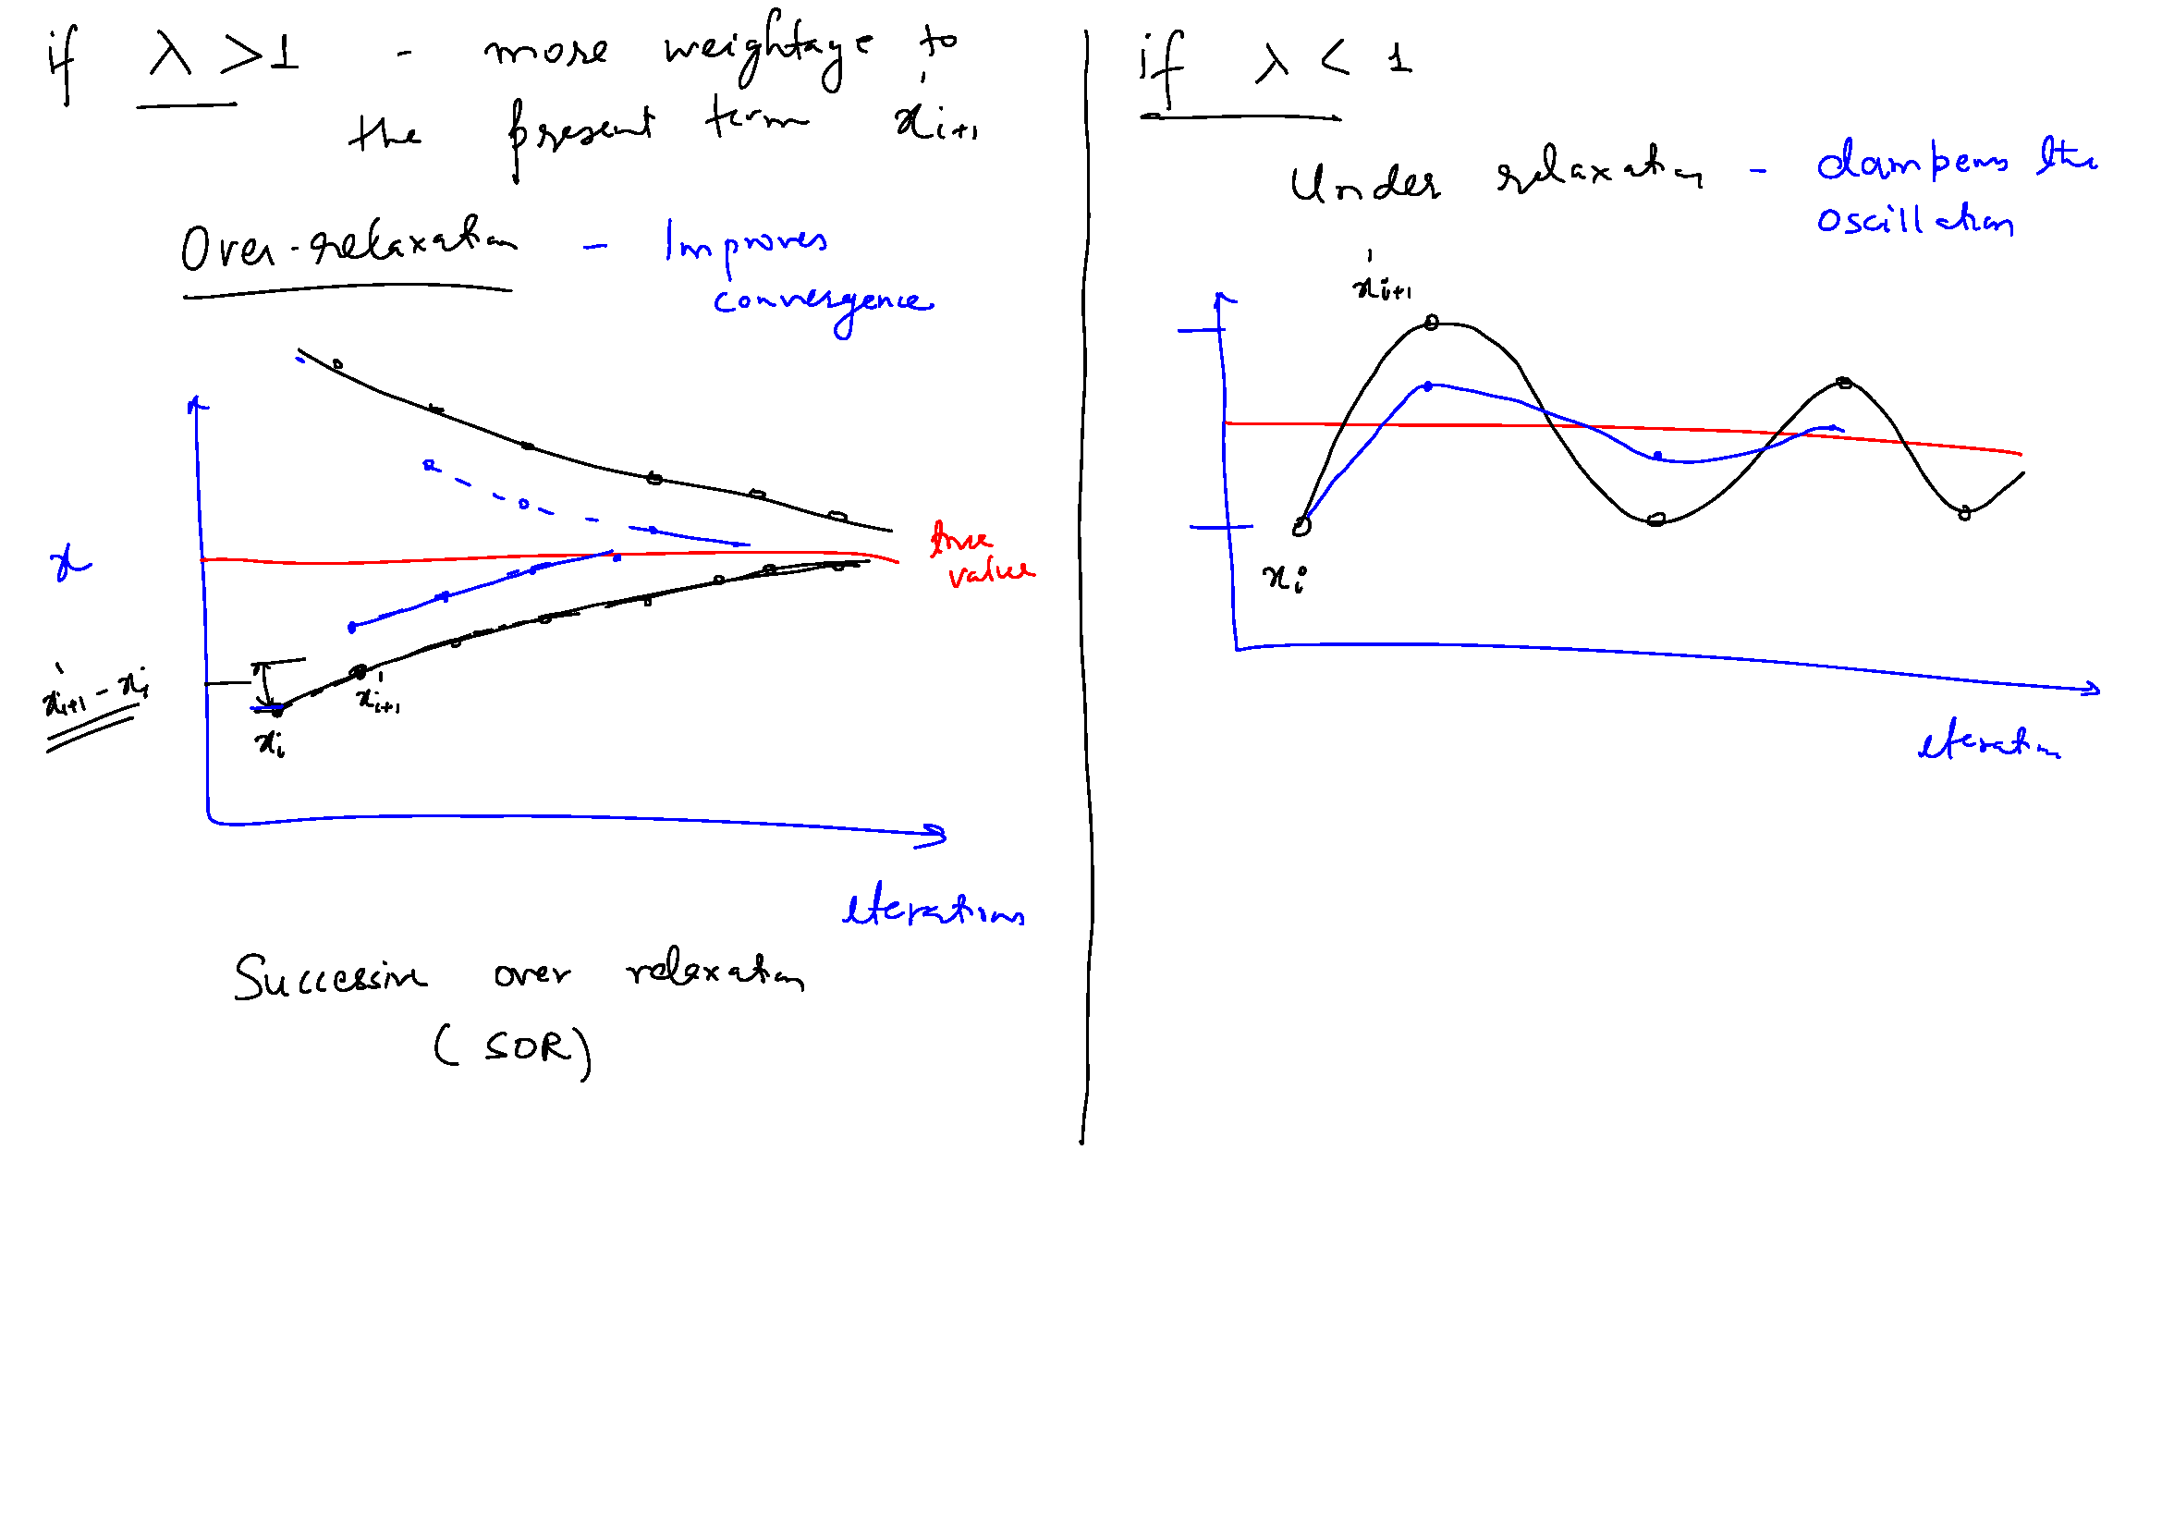

Slide 26
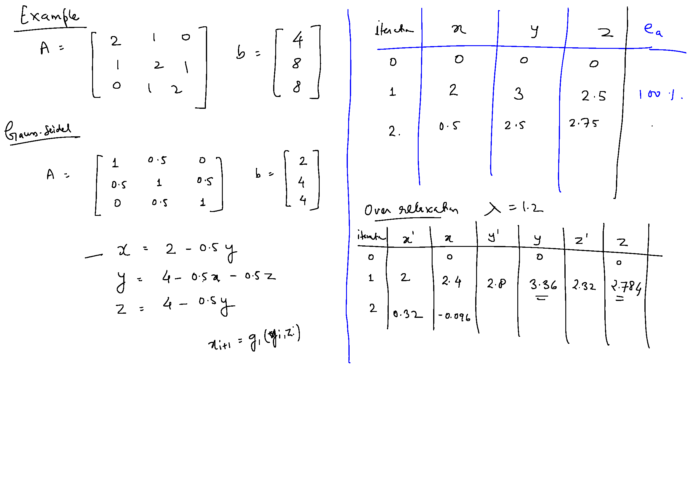

Slide 28
Pivoting, Scaling and Equilibration, Perturbation Analysis

Slide 29
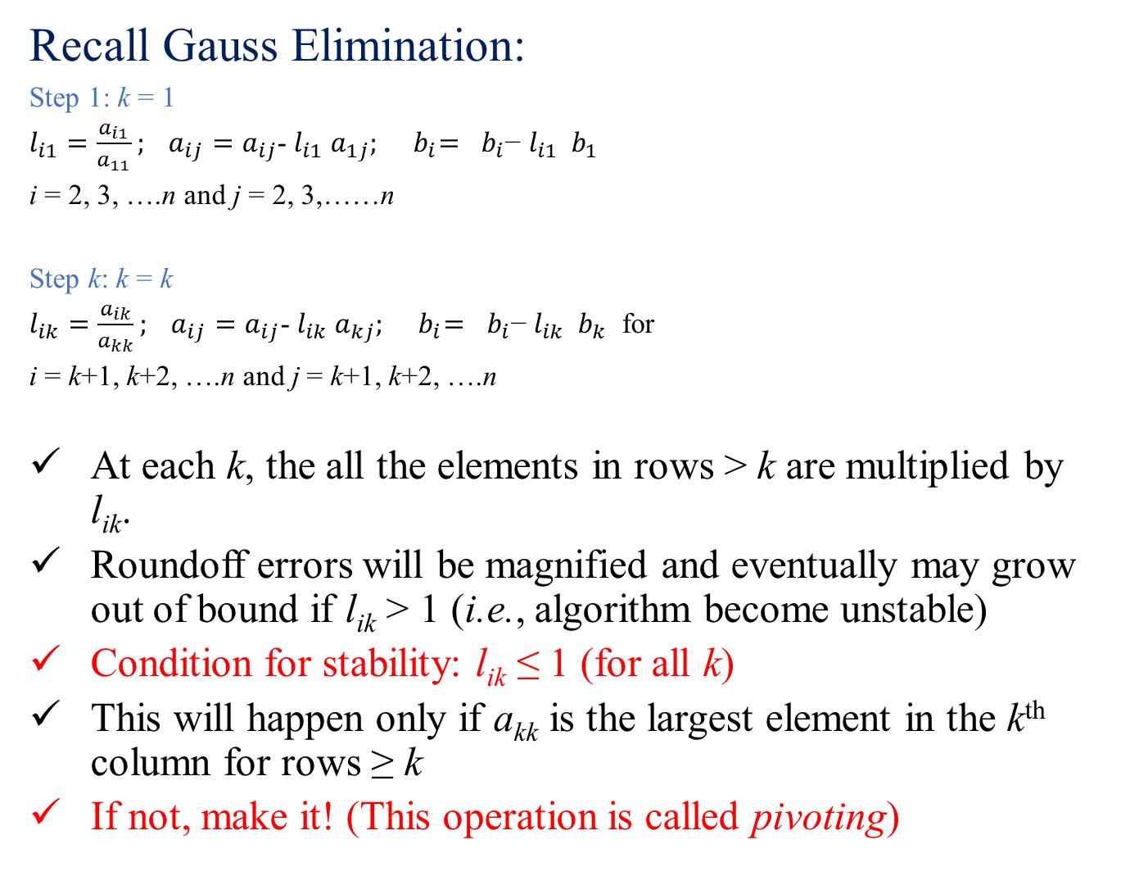
Recall Gauss Elimination:
Step 1: k = 1
$l_{i1}=\frac{a_{i1}}{a_{11}}; a_{ij}=a_{ij}$- $l_{i1}$ $a_{1j}; { b}_{i}={ b}_{i}\text{−} l_{i1}{ b}_{1}$
i = 2, 3, ….n and j = 2, 3,……n
Step k: k = k
$l_{ik}=\frac{a_{ik}}{a_{kk}}; a_{ij}=a_{ij}$- $l_{ik}$ $a_{kj}; { b}_{i}={ b}_{i}\text{−} l_{ik}{ b}_{k}$ for
i = k+1, k+2, ….n and j = k+1, k+2, ….n
At each k, the all the elements in rows > k are multiplied by l_{ik}.
Roundoff errors will be magnified and eventually may grow out of bound if l_{ik} > 1 (i.e., algorithm become unstable)
Condition for stability: l_{ik} ≤ 1 (for all k)
This will happen only if a_{kk} is the largest element in the k^{th} column for rows ≥ k
If not, make it! (This operation is called pivoting)

Slide 30
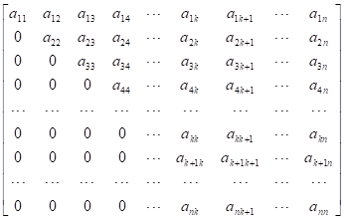
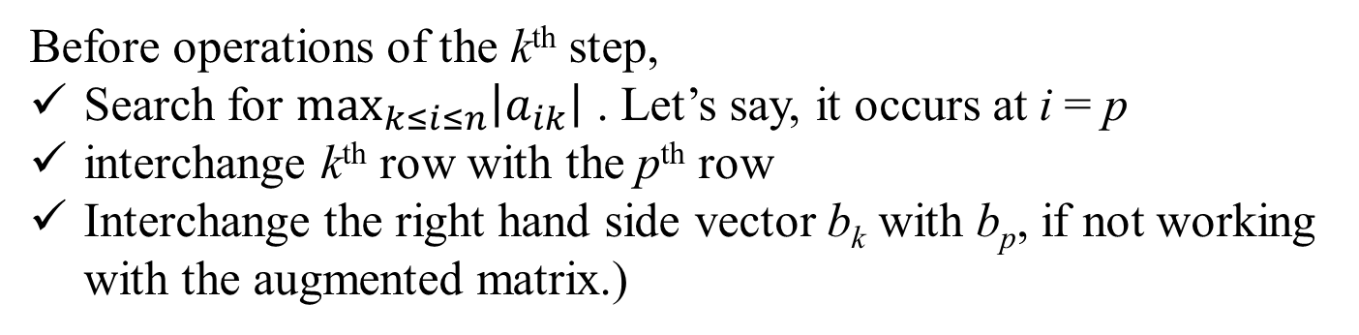
Partial Pivoting: Matrix at the start of the k^{th} Step:
Row Exchange
a_{pk}
Before operations of the k^{th} step,
Search for $\max_{k≤i≤n}\left|a_{ik}\right|$ . Let’s say, it occurs at i = p
interchange k^{th} row with the p^{th} row
Interchange the right hand side vector b_{k} with b_{p}, if not working with the augmented matrix.)

Slide 31
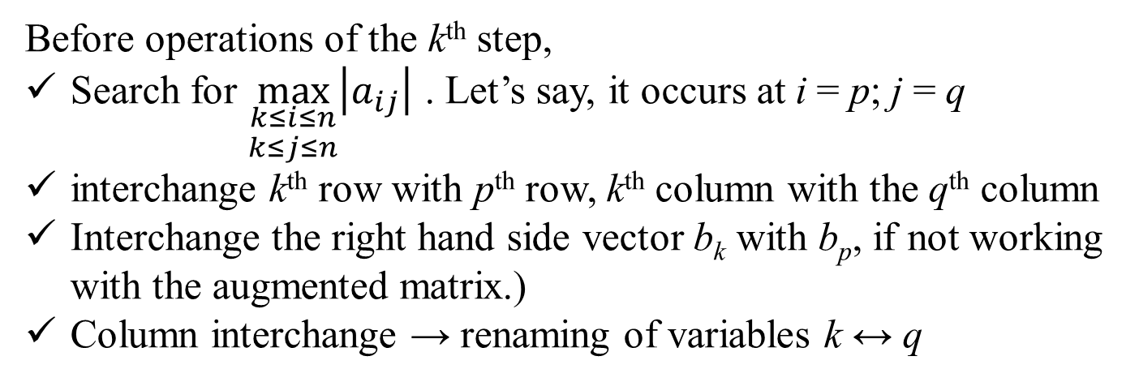
Full Pivoting: Matrix at the start of the k^{th} Step:
Column Exchange
Row Exchange
a_{pq}
Before operations of the k^{th} step,
Search for $\max_{\begin{aligned}k≤i≤n \\ k≤j≤n\end{aligned}}\left|a_{ij}\right|$ . Let’s say, it occurs at i = p; j = q
interchange k^{th} row with p^{th} row, k^{th} column with the q^{th} column
Interchange the right hand side vector b_{k} with b_{p}, if not working with the augmented matrix.)
Column interchange → renaming of variables k ↔ q

Slide 32
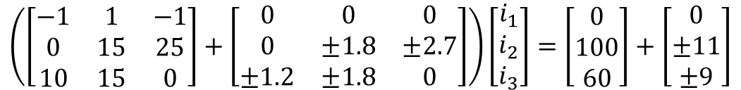
Perturbation Analysis
Consider the system of equation Ax = b
Question: If small perturbation is given in the matrix A and/or the vector b, what is the effect on the solution vector x ? Alternatively, how sensitive is the solution to small perturbations in the coefficient matrix and the forcing function.
Example:
R₁ = 10.0 ± 1.2 Ω; R₂ = 15.0 ± 1.8 Ω; R₃ = 25.0 ± 2.7 Ω
V_{A} - V_{C} = 100.0 ± 11.0 V; V_{A} - V_{B}= 60.0 ± 9.0 V
C
Let’s denote the resulting perturbation in the solution vector x as δx
R₃
B
i₃
R₁
i₁
A
δA
b
δb
i₂
$$\left(\left[\begin{matrix}−1 & 1 & −1 \\ 0 & 15 & 25 \\ 10 & 15 & 0\end{matrix}\right]+\left[\begin{matrix}0 & 0 & 0 \\ 0 & ±1.8 & ±2.7 \\ ±1.2 & ±1.8 & 0\end{matrix}\right]\right)\left[\begin{matrix}i_{1} \\ i_{2} \\ i_{3}\end{matrix}\right]=\left[\begin{matrix}0 \\ 100 \\ 60\end{matrix}\right]+\left[\begin{matrix}0 \\ ±11 \\ ±9\end{matrix}\right]$$
R₂
A
Notes:
Solve tutorial pbm here

Slide 33
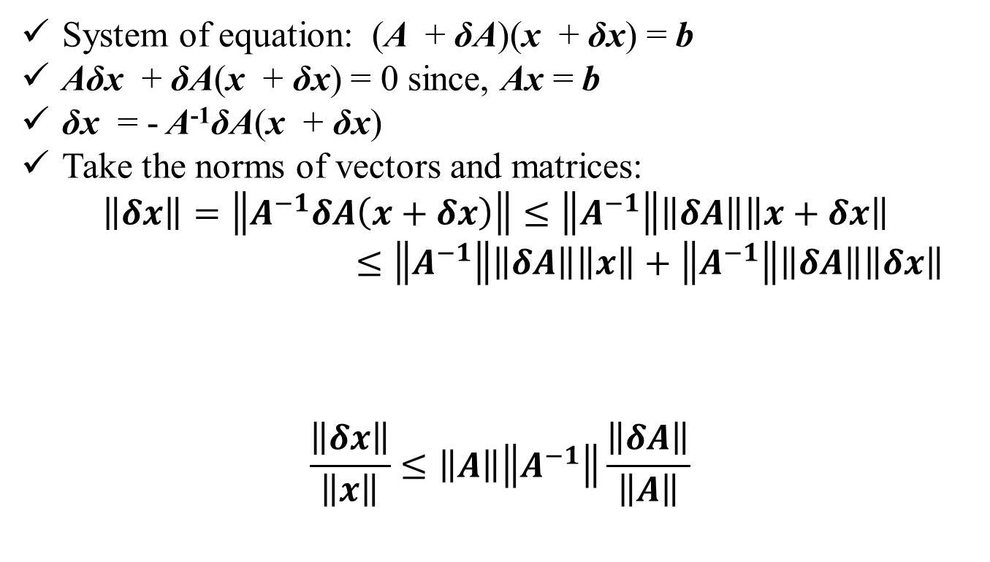
Perturbation in matrix A:
System of equation: (A + δA)(x + δx) = b
Aδx + δA(x + δx) = 0 since, Ax = b
δx = - A⁻¹δA(x + δx)
Take the norms of vectors and matrices:
$$\left\|δx\right\|=\left\|A^{−1}δA\left(x+δx\right)\right\|≤\left\|A^{−1}\right\|\left\|δA\right\|\left\|x+δx\right\|$$
$≤\left\|A^{−1}\right\|\left\|δA\right\|\left\|x\right\|+\left\|A^{−1}\right\|\left\|δA\right\|\left\|δx\right\|$
$$\frac{\left\|δx\right\|}{\left\|x\right\|}≤\left\|A\right\|\left\|A^{−1}\right\|\frac{\left\|δA\right\|}{\left\|A\right\|}$$
Product of perturbation quantities

Slide 34
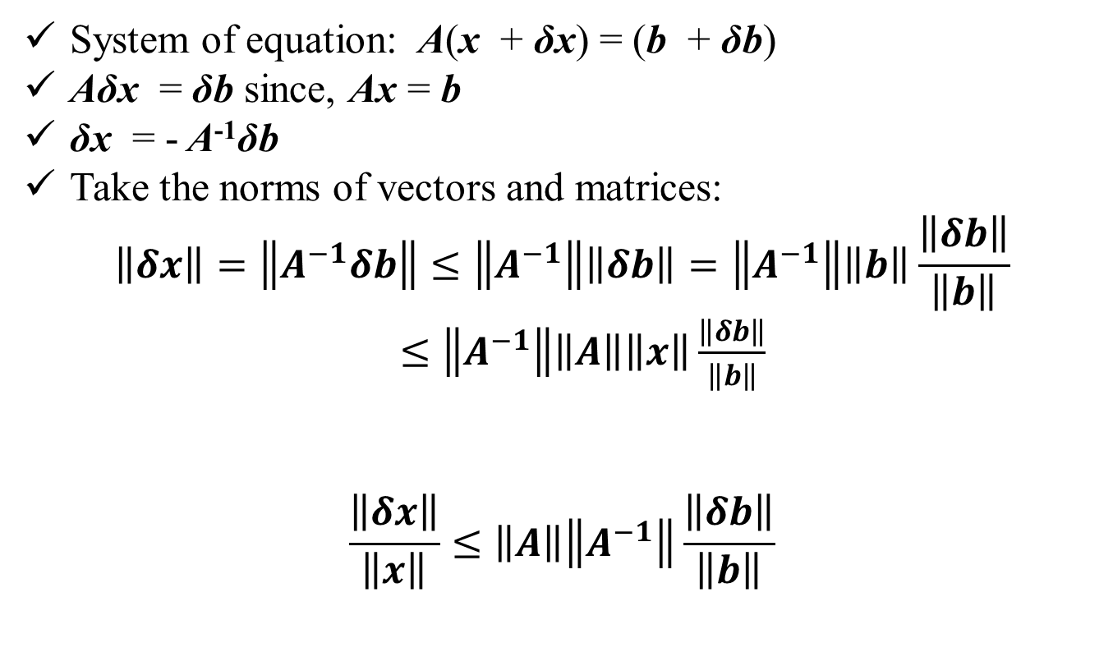
Perturbation in forcing vector b:
System of equation: A(x + δx) = (b + δb)
Aδx = δb since, Ax = b
δx = - A⁻¹δb
Take the norms of vectors and matrices:
$$\left\|δx\right\|=\left\|A^{−1}δb\right\|≤\left\|A^{−1}\right\|\left\|δb\right\|=\left\|A^{−1}\right\|\left\|b\right\|\frac{\left\|δb\right\|}{\left\|b\right\|}$$
$≤\left\|A^{−1}\right\|\left\|A\right\|\left\|x\right\|\frac{\left\|δb\right\|}{\left\|b\right\|}$
$$\frac{\left\|δx\right\|}{\left\|x\right\|}≤\left\|A\right\|\left\|A^{−1}\right\|\frac{\left\|δb\right\|}{\left\|b\right\|}$$

Slide 35
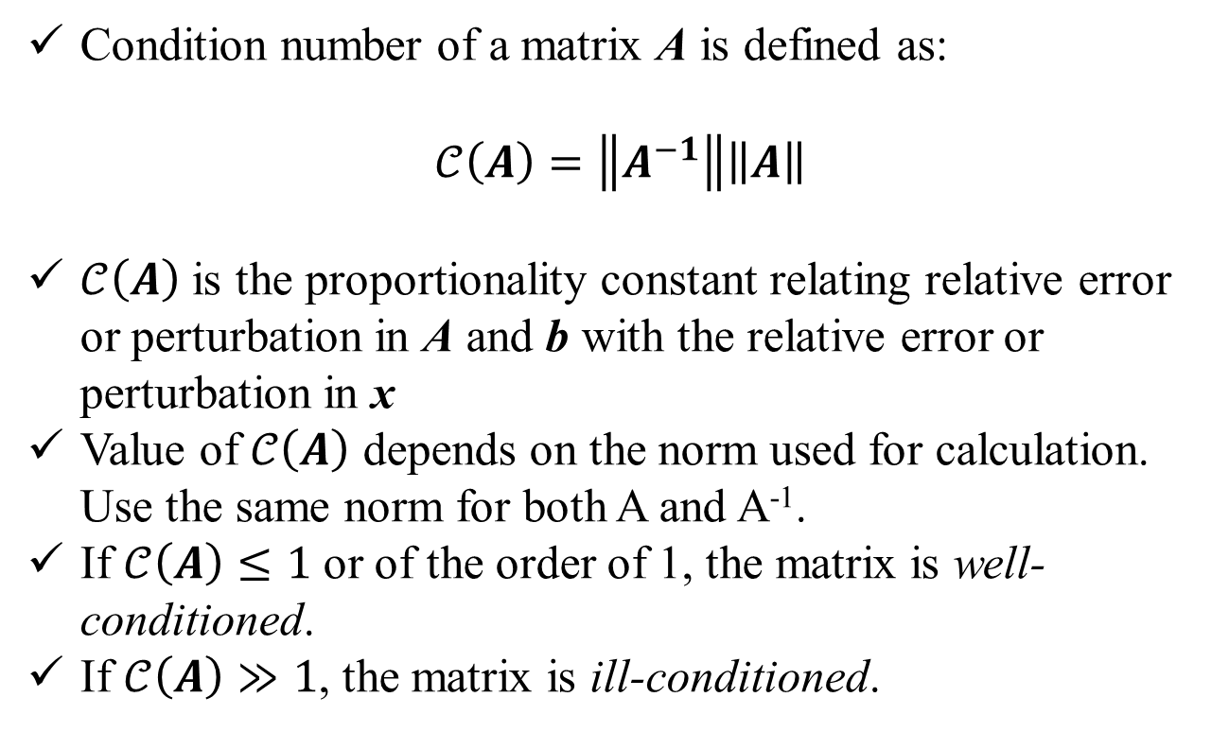
Condition Number:
Condition number of a matrix A is defined as:
$$𝒞\left(A\right)=\left\|A^{−1}\right\|\left\|A\right\|$$
$𝒞\left(A\right)$ is the proportionality constant relating relative error or perturbation in A and b with the relative error or perturbation in x
Value of $𝒞\left(A\right)$ depends on the norm used for calculation. Use the same norm for both A and A⁻¹.
If $𝒞\left(A\right)≤1$ or of the order of 1, the matrix is well-conditioned.
If $𝒞\left(A\right)≫1$, the matrix is ill-conditioned.

Slide 36
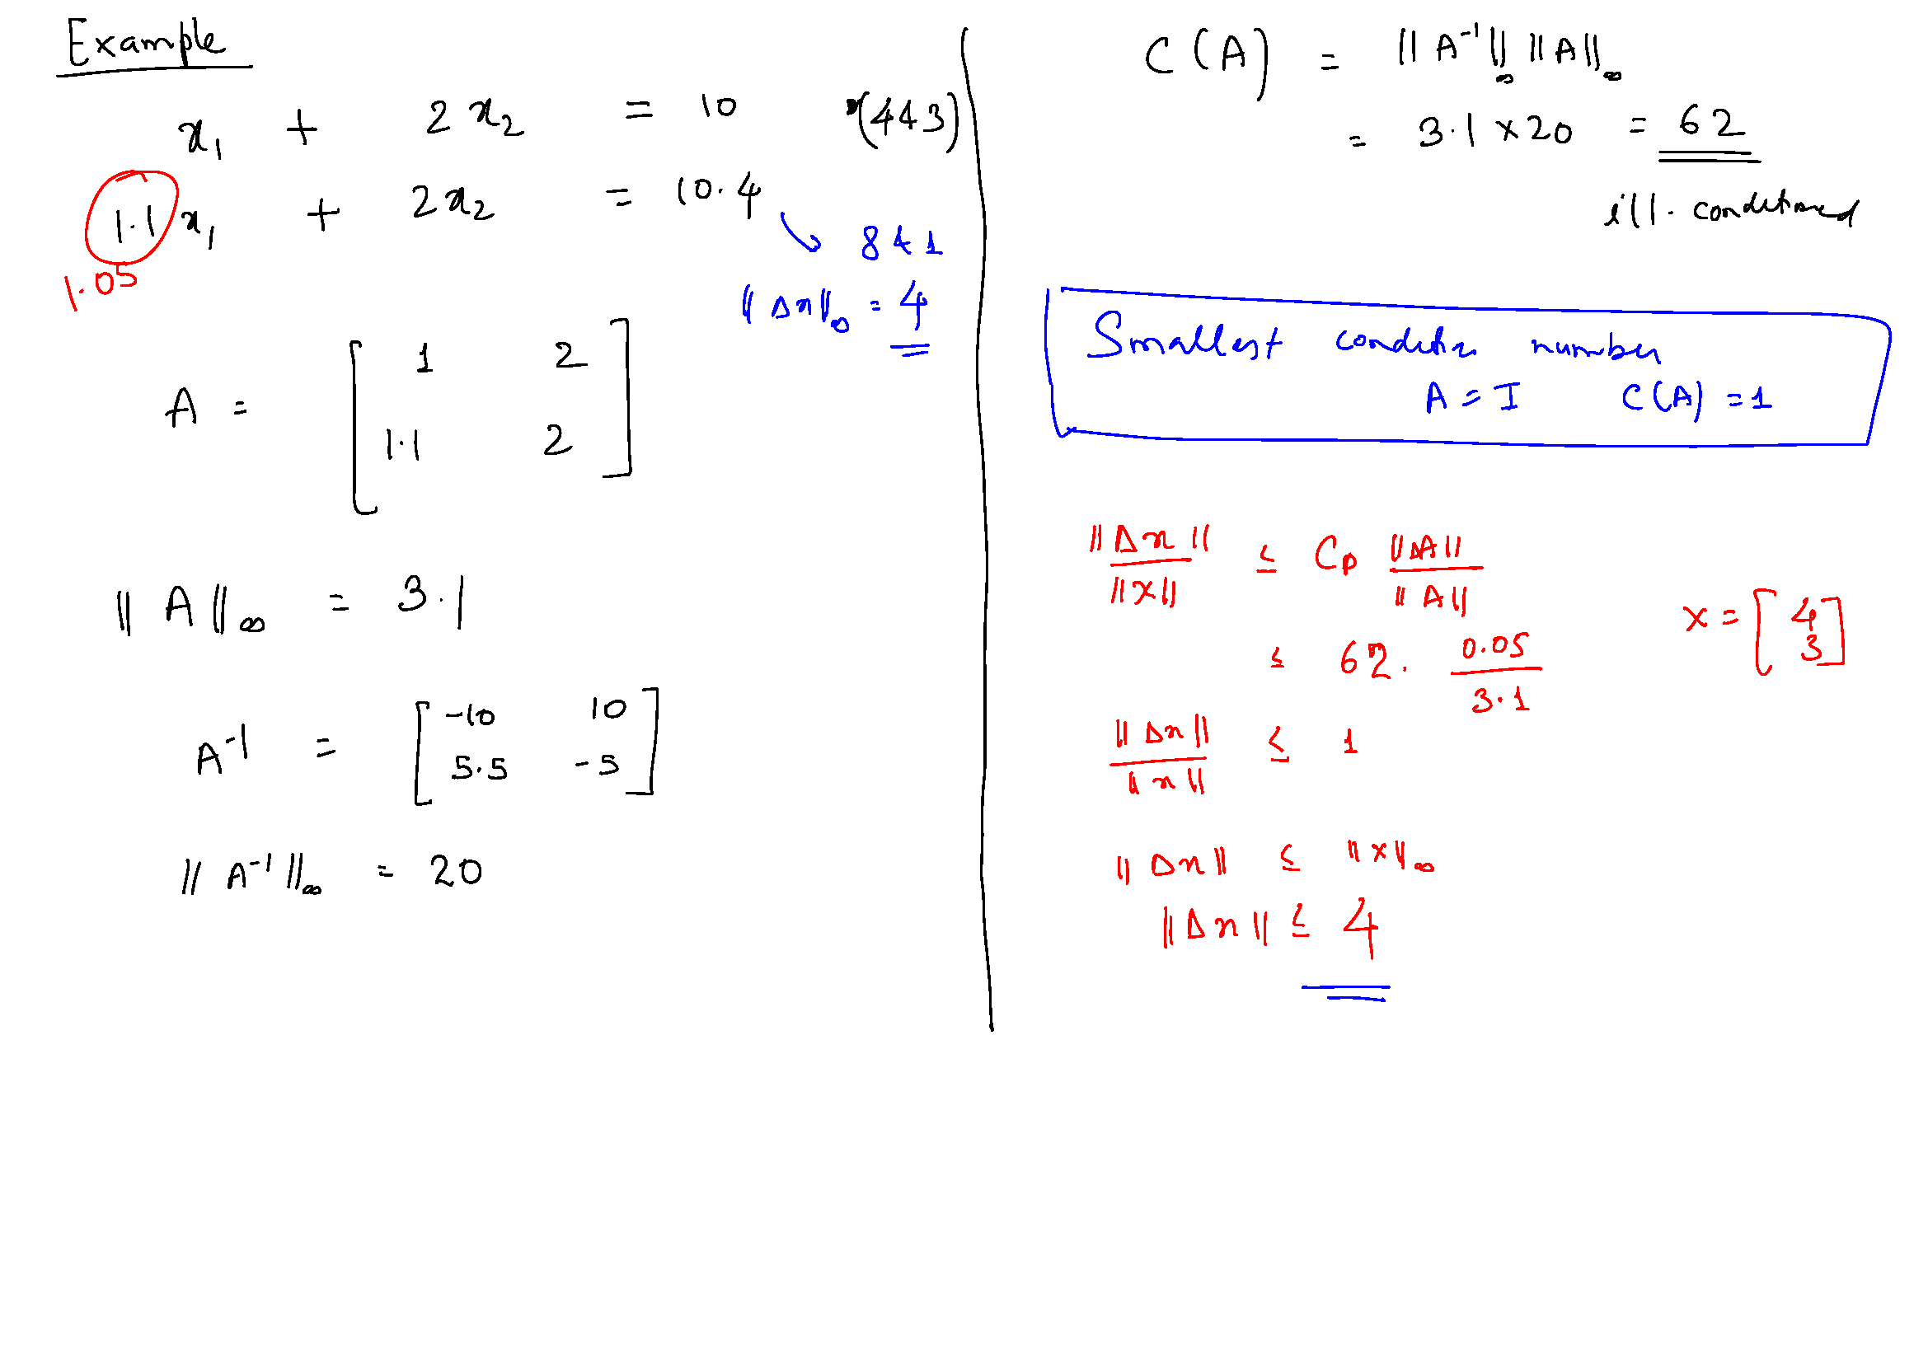

Slide 37
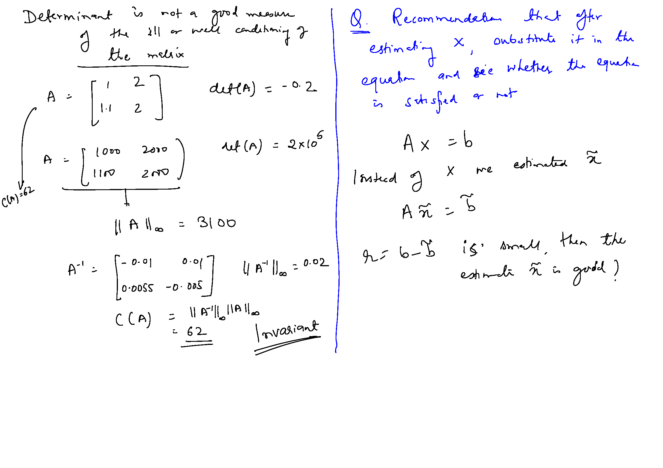

Slide 39
