Slide 1
Pivoting, Perturbation Analysis, Scaling and Equilibration

Slide 2
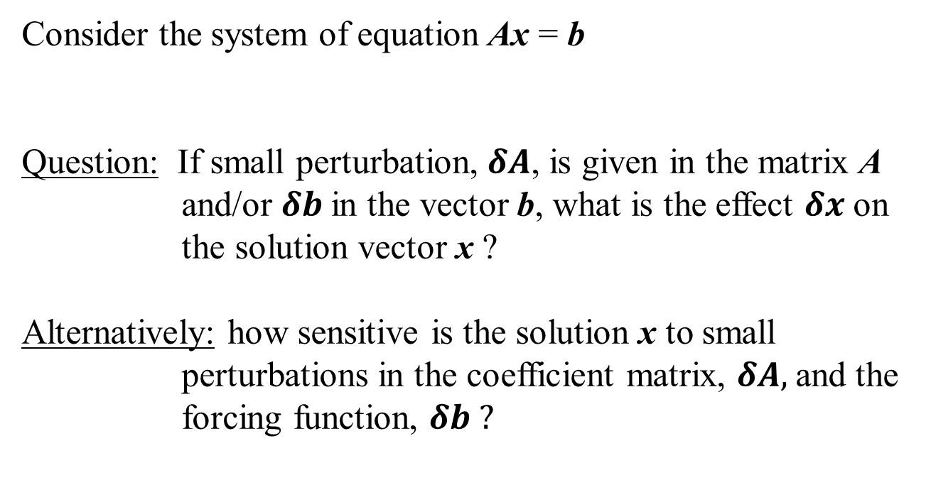
Perturbation Analysis
Consider the system of equation Ax = b
Question: If small perturbation, $δA$, is given in the matrix A and/or $δb$in the vector b, what is the effect $δx$on the solution vector x ?
Alternatively: how sensitive is the solution x to small perturbations in the coefficient matrix, $δA,$and the forcing function, $δb ?$
Notes:
Solve tutorial pbm here

Slide 3
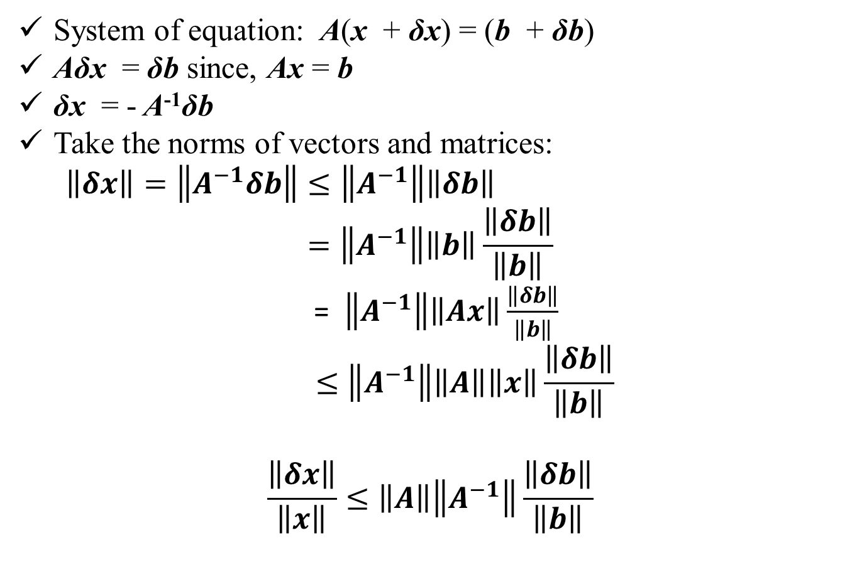
Perturbation in forcing vector b:
System of equation: A(x + δx) = (b + δb)
Aδx = δb since, Ax = b
δx = - A⁻¹δb
Take the norms of vectors and matrices:
$\left\|δx\right\|=\left\|A^{−1}δb\right\|≤\left\|A^{−1}\right\|\left\|δb\right\|$
$$=\left\|A^{−1}\right\|\left\|b\right\|\frac{\left\|δb\right\|}{\left\|b\right\|}$$
= $\left\|A^{−1}\right\|\left\|Ax\right\|\frac{\left\|δb\right\|}{\left\|b\right\|}$
$$≤\left\|A^{−1}\right\|\left\|A\right\|\left\|x\right\|\frac{\left\|δb\right\|}{\left\|b\right\|}$$
$$\frac{\left\|δx\right\|}{\left\|x\right\|}≤\left\|A\right\|\left\|A^{−1}\right\|\frac{\left\|δb\right\|}{\left\|b\right\|}$$

Slide 4
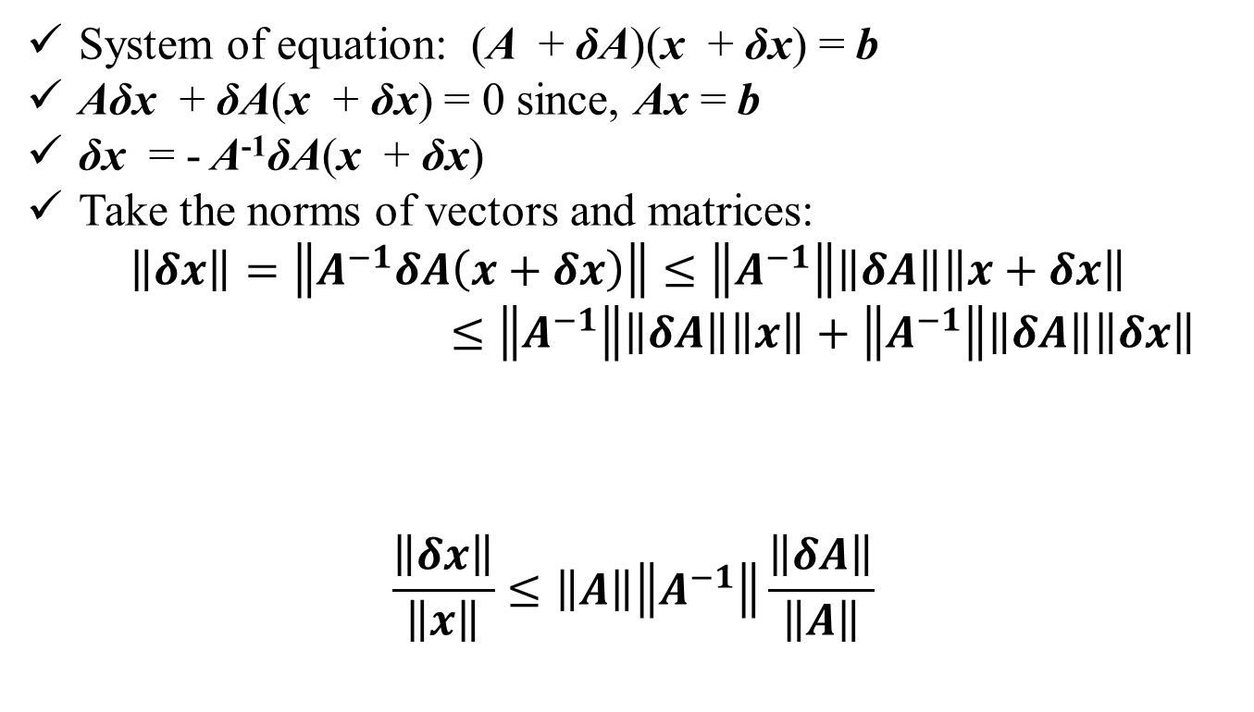
Perturbation in matrix A:
System of equation: (A + δA)(x + δx) = b
Aδx + δA(x + δx) = 0 since, Ax = b
δx = - A⁻¹δA(x + δx)
Take the norms of vectors and matrices:
$$\left\|δx\right\|=\left\|A^{−1}δA\left(x+δx\right)\right\|≤\left\|A^{−1}\right\|\left\|δA\right\|\left\|x+δx\right\|$$
$≤\left\|A^{−1}\right\|\left\|δA\right\|\left\|x\right\|+\left\|A^{−1}\right\|\left\|δA\right\|\left\|δx\right\|$
$$\frac{\left\|δx\right\|}{\left\|x\right\|}≤\left\|A\right\|\left\|A^{−1}\right\|\frac{\left\|δA\right\|}{\left\|A\right\|}$$
Product of perturbation quantities (negligible)

Slide 5
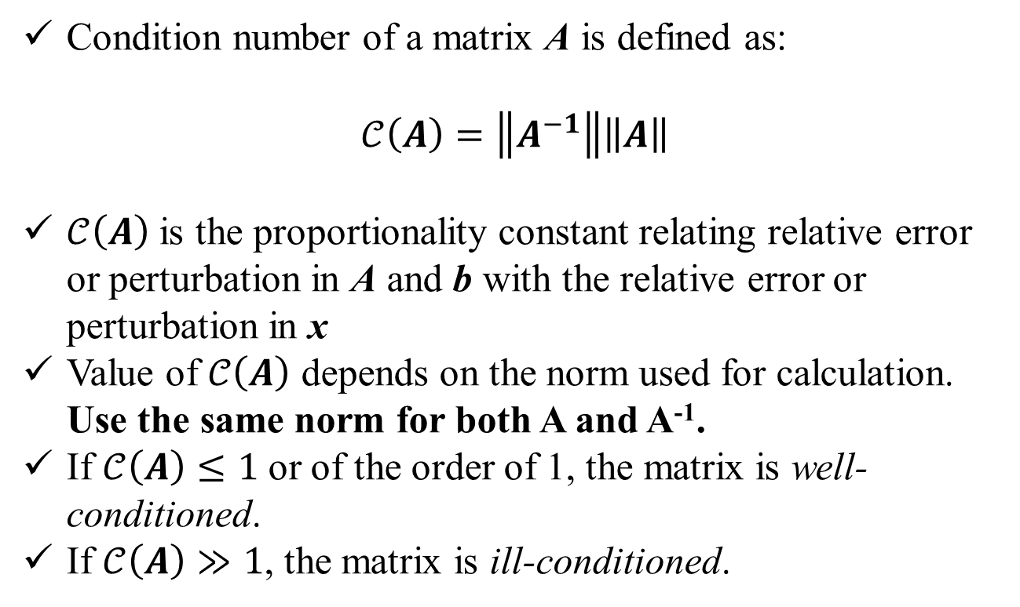
Condition Number:
Condition number of a matrix A is defined as:
$$𝒞\left(A\right)=\left\|A^{−1}\right\|\left\|A\right\|$$
$𝒞\left(A\right)$ is the proportionality constant relating relative error or perturbation in A and b with the relative error or perturbation in x
Value of $𝒞\left(A\right)$ depends on the norm used for calculation. Use the same norm for both A and A⁻¹.
If $𝒞\left(A\right)≤1$ or of the order of 1, the matrix is well-conditioned.
If $𝒞\left(A\right)≫1$, the matrix is ill-conditioned.

Slide 6
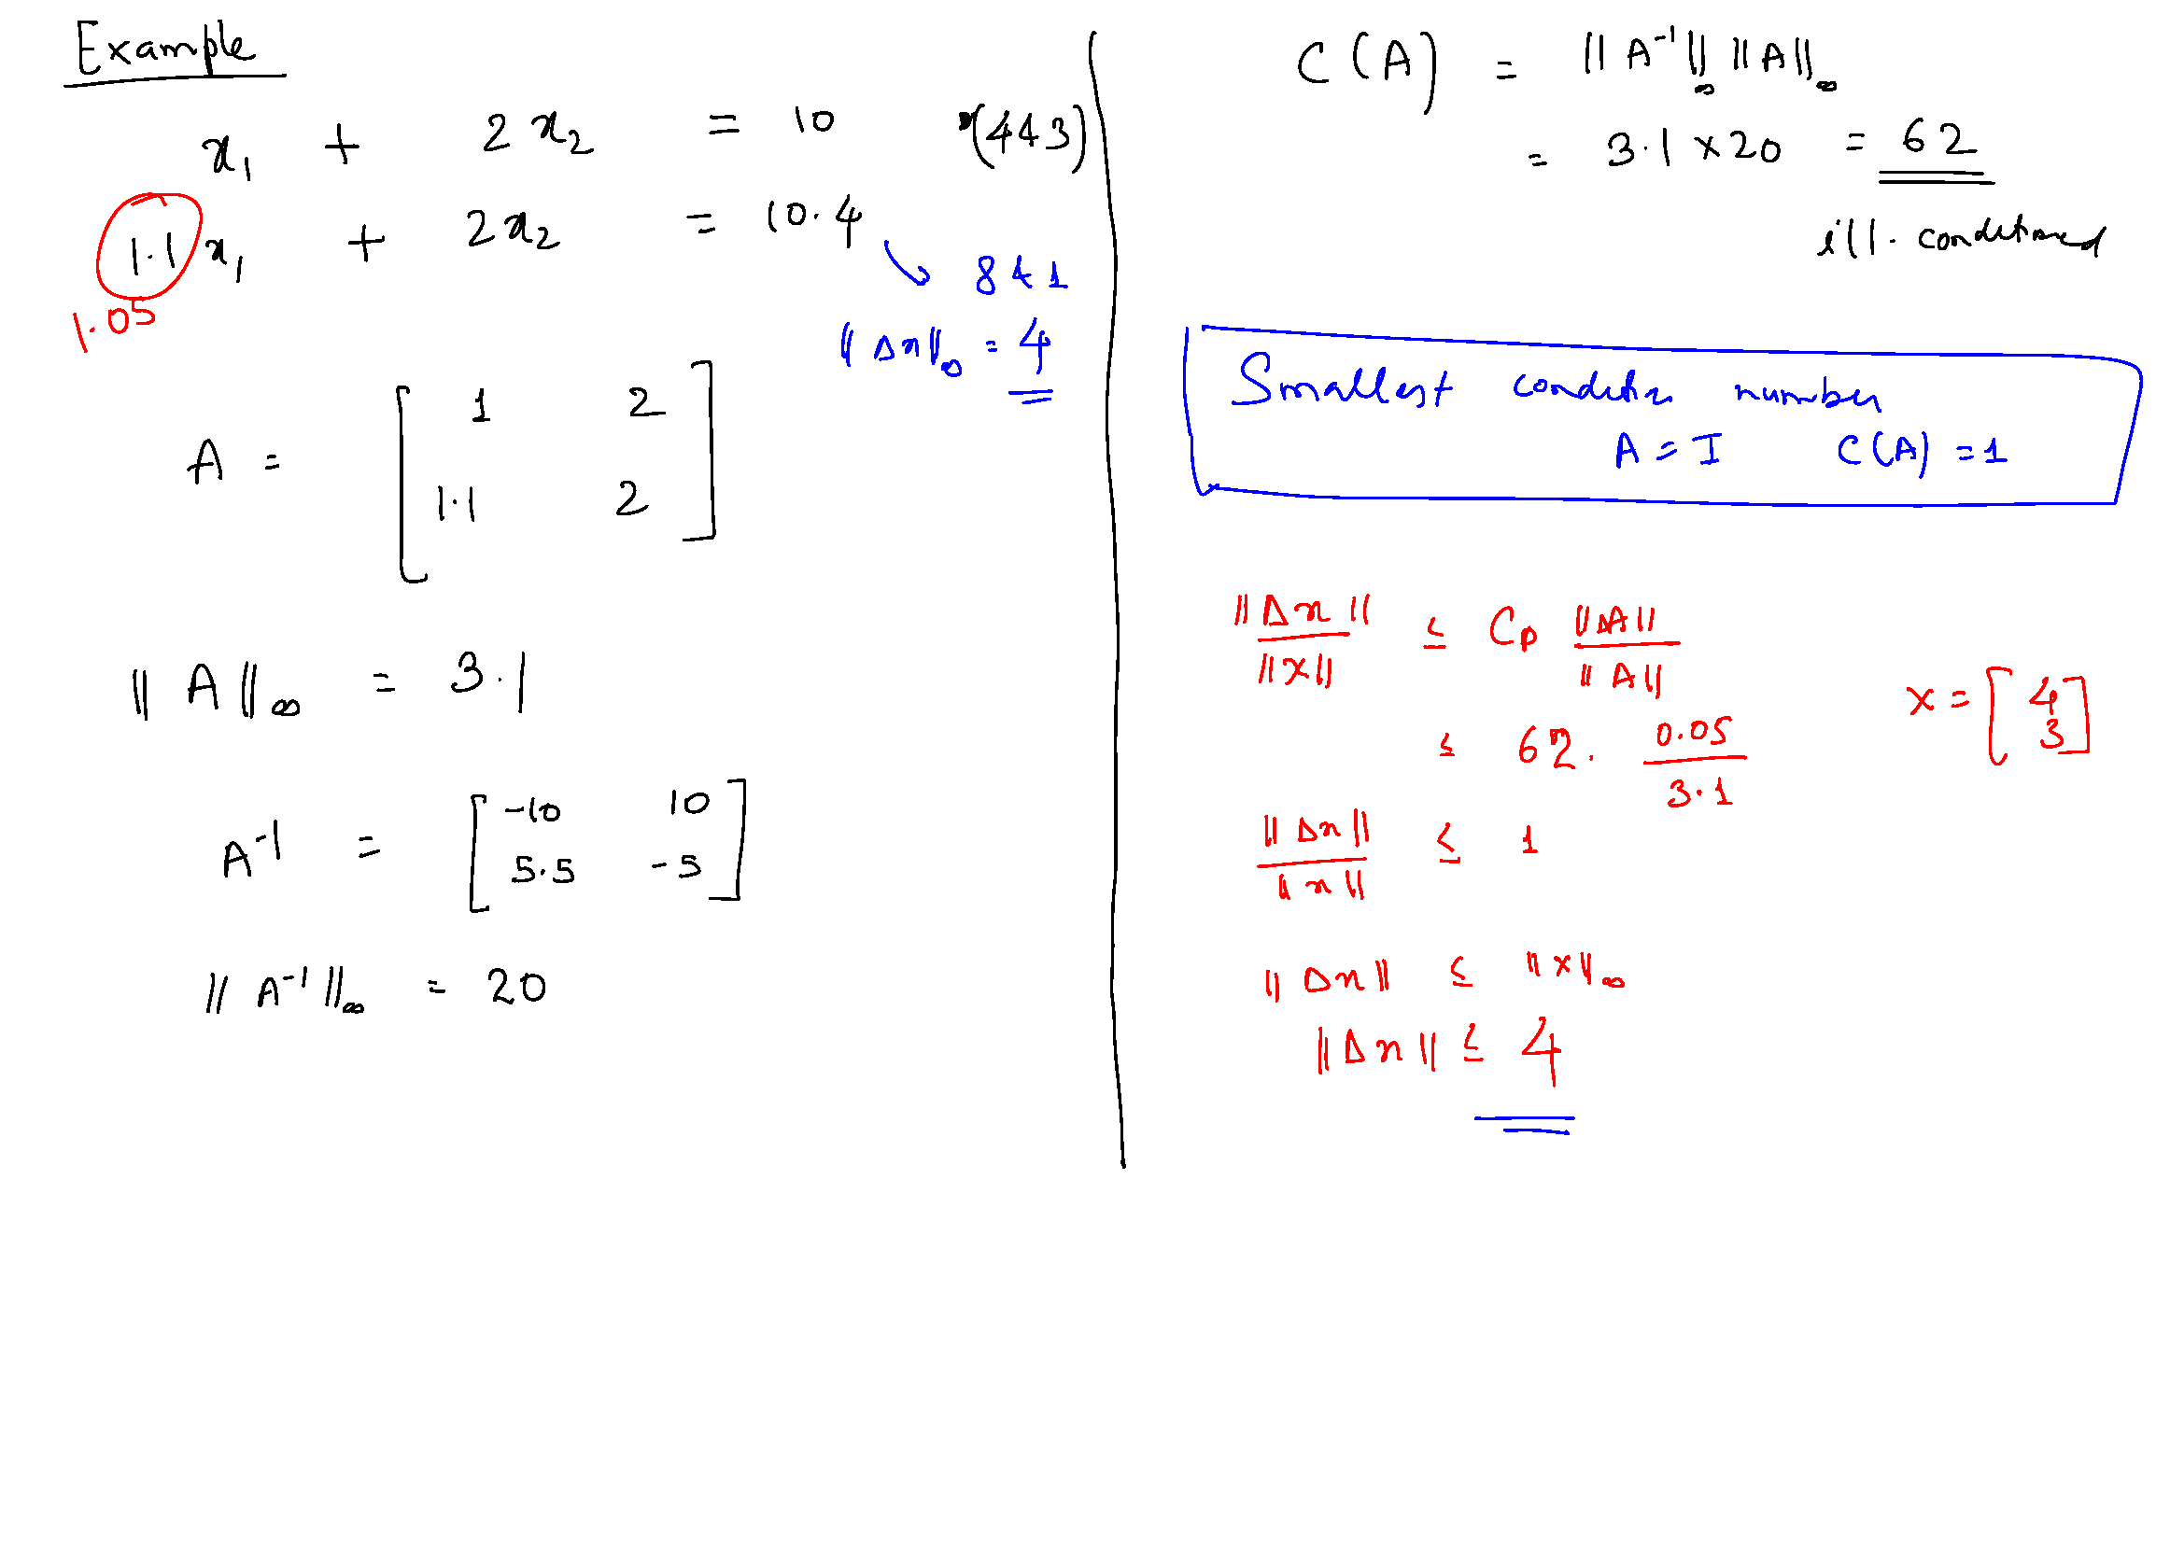

Since $𝒞\left(A\right)≫1$,
the matrix is ill-conditioned.

Slide 8
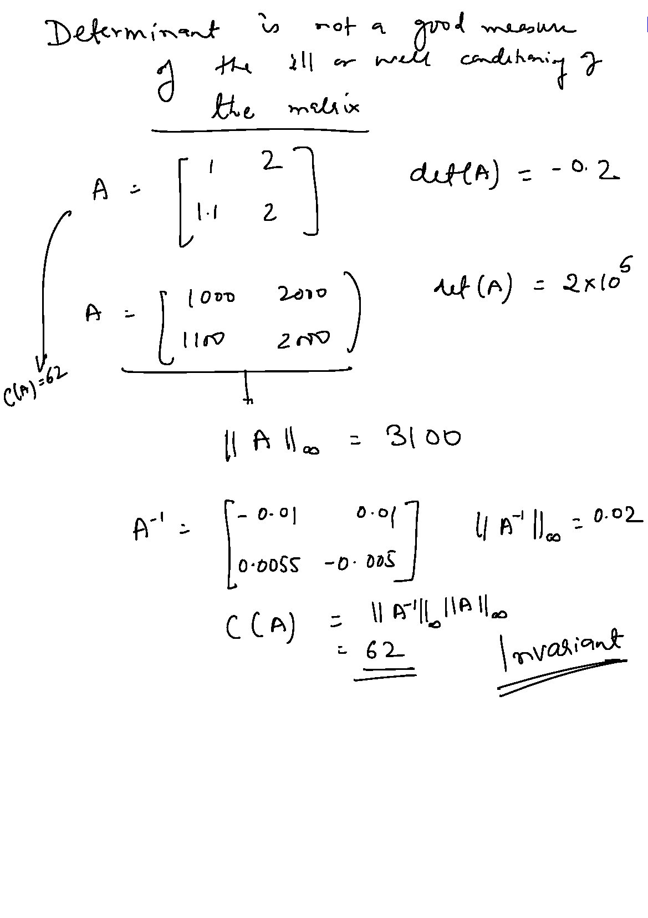
Is determinant a good measure of matrix conditioning?

Slide 9


Scaling and Equilibration:
It helps to reduce the truncation errors during computation.
Helps to obtain a more accurate solution for moderately ill-conditioned matrix.
Example: Consider the following set of equations
Scale variable x₁ = 10³ × x₁ʹ and multiply the second equation by 100. Resulting equation is:

Slide 10


Scaling
Vector x is replaced by xʹ such that, x = Sxʹ.
S is a diagonal matrix containing the scale factors!
For the example problem:
Ax = b becomes: Ax = ASxʹ = Aʹxʹ = b where, Aʹ = AS
For the example problem:
Scaling operation is equivalent to post-multiplication of the matrix A by a diagonal matrix S containing the scale factors on the diagonal

Slide 11
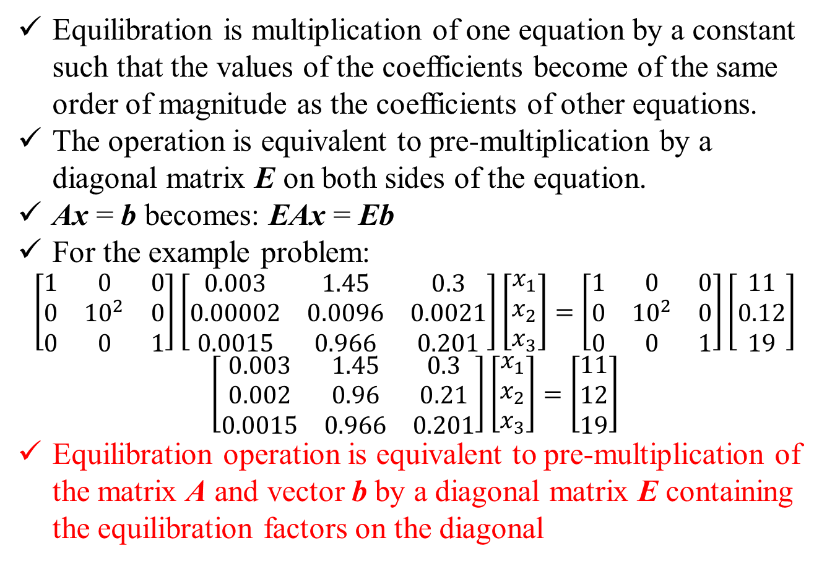
Equilibration
Equilibration is multiplication of one equation by a constant such that the values of the coefficients become of the same order of magnitude as the coefficients of other equations.
The operation is equivalent to pre-multiplication by a diagonal matrix E on both sides of the equation.
Ax = b becomes: EAx = Eb
For the example problem:
$$\left[\begin{matrix}1 & 0 & 0 \\ 0 & {10}^{2} & 0 \\ 0 & 0 & 1\end{matrix}\right]\left[\begin{matrix}0.003 & 1.45 & 0.3 \\ 0.00002 & 0.0096 & 0.0021 \\ 0.0015 & 0.966 & 0.201\end{matrix}\right]\left[\begin{matrix}x_{1} \\ x_{2} \\ x_{3}\end{matrix}\right]=\left[\begin{matrix}1 & 0 & 0 \\ 0 & {10}^{2} & 0 \\ 0 & 0 & 1\end{matrix}\right]\left[\begin{matrix}11 \\ 0.12 \\ 19\end{matrix}\right]$$
$$\left[\begin{matrix}0.003 & 1.45 & 0.3 \\ 0.002 & 0.96 & 0.21 \\ 0.0015 & 0.966 & 0.201\end{matrix}\right]\left[\begin{matrix}x_{1} \\ x_{2} \\ x_{3}\end{matrix}\right]=\left[\begin{matrix}11 \\ 12 \\ 19\end{matrix}\right]$$
Equilibration operation is equivalent to pre-multiplication of the matrix A and vector b by a diagonal matrix E containing the equilibration factors on the diagonal

Slide 12
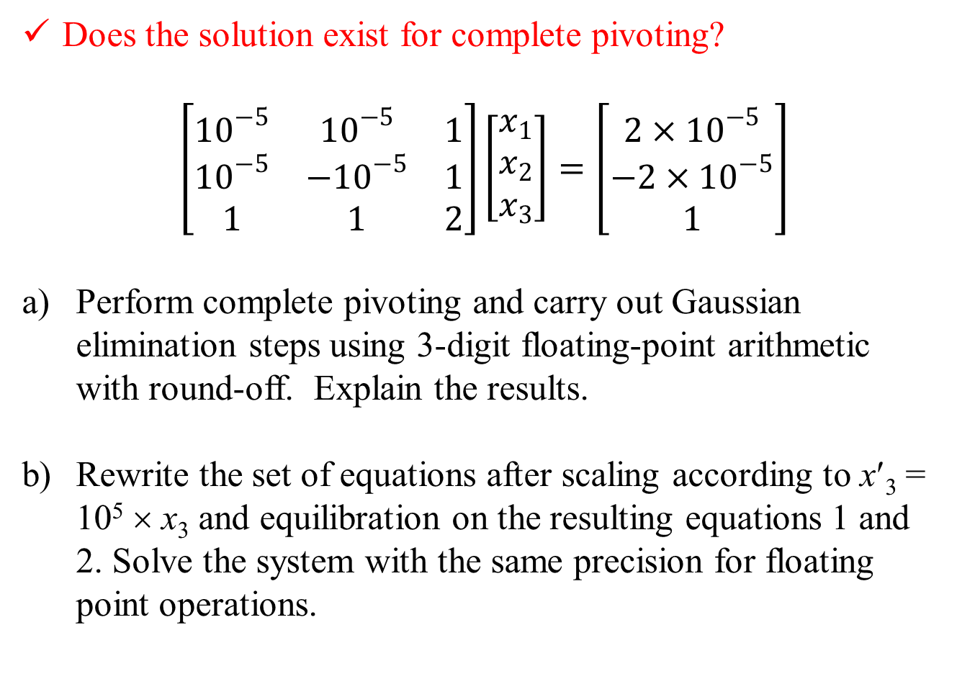
Example Problem
Does the solution exist for complete pivoting?
$$\left[\begin{matrix}{10}^{−5} & {10}^{−5} & 1 \\ {10}^{−5} & −{10}^{−5} & 1 \\ 1 & 1 & 2\end{matrix}\right]\left[\begin{matrix}x_{1} \\ x_{2} \\ x_{3}\end{matrix}\right]=\left[\begin{matrix}{2×10}^{−5} \\ −2×{10}^{−5} \\ 1\end{matrix}\right]$$
Perform complete pivoting and carry out Gaussian elimination steps using 3-digit floating-point arithmetic with round-off. Explain the results.
b) Rewrite the set of equations after scaling according to x′₃ = 10⁵ × x₃ and equilibration on the resulting equations 1 and 2. Solve the system with the same precision for floating point operations.

Slide 13
Pivoting, Scaling and Equilibration (Recap)
Before starting the solution algorithm, take a look at the entries in A and decide on the scaling and equilibration factors. Construct matrices E and S.
Transform the set of equation Ax = b to EASxʹ = Eb
Solve the system of equation Aʹxʹ = bʹ for xʹ, where Aʹ = EAS and bʹ = Eb
Compute: x = Sxʹ
Gauss Elimination: perform partial pivoting at each step k
For all other methods: perform full pivoting before the start of the algorithm to make the matrix diagonally dominant, as far as practicable!
These steps will guarantee the best possible solution for all well-conditioned and mildly ill-conditioned matrices!
However, none of these steps can transform an ill-conditioned matrix to a well-conditioned one.

Slide 14
Iterative Improvement by Direct Methods
For moderately ill-conditioned matrices an approximate solution x͂ to the set of equations Ax = b can be improved through iterations using direct methods.
Compute: r = b - A x͂
Recognize: r = b - A x͂ + Ax - b
Therefore: A(x - x͂ ) = AΔx = r
Compute: x = x͂ + Δx
The iteration sequence can be repeated until ǁ Δx ǁ ≤ ε

Slide 15
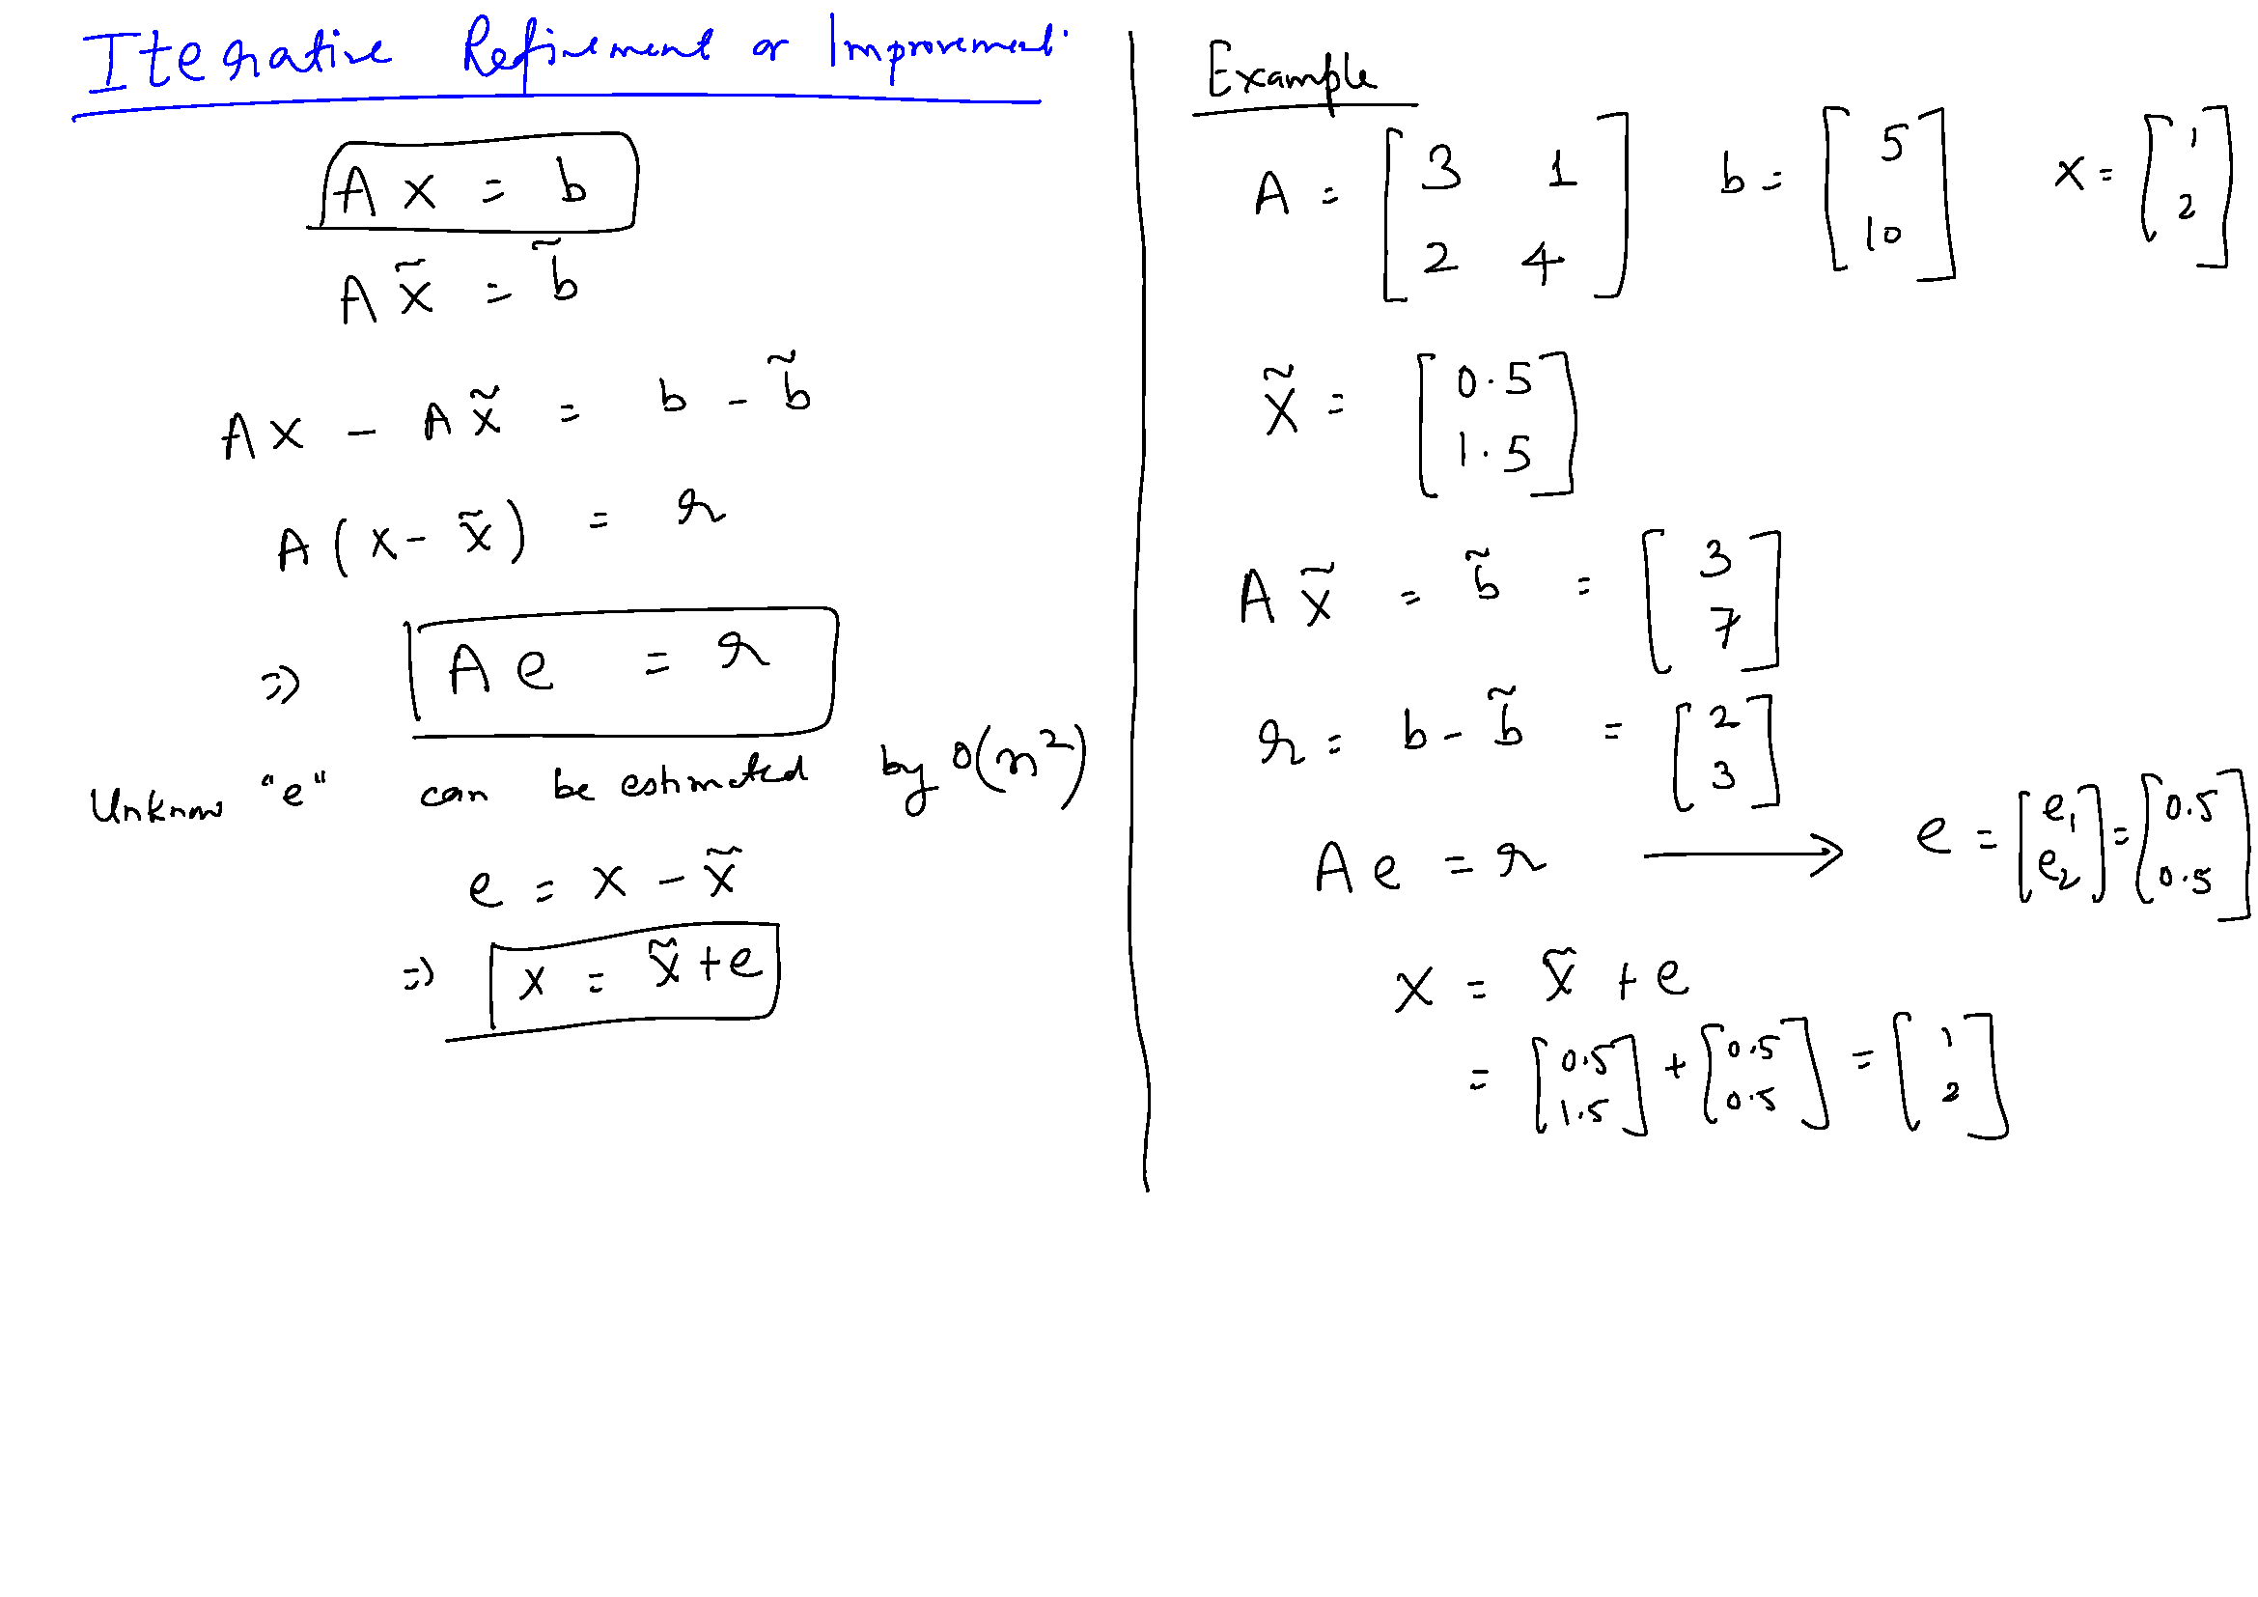

Slide 17
Solution of System of Nonlinear Equations

Slide 18
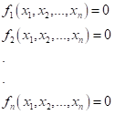
System of Non-Linear Equations
f(x) = 0
f is now a vector of functions: f = {f₁, f₂, … f_{n}}^{T}
x is a vector of independent variables: x = {x₁, x₂, … x_{n}}^{T}
Open methods: Fixed point, Newton-Raphson, Secant

Slide 19
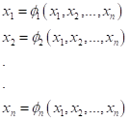
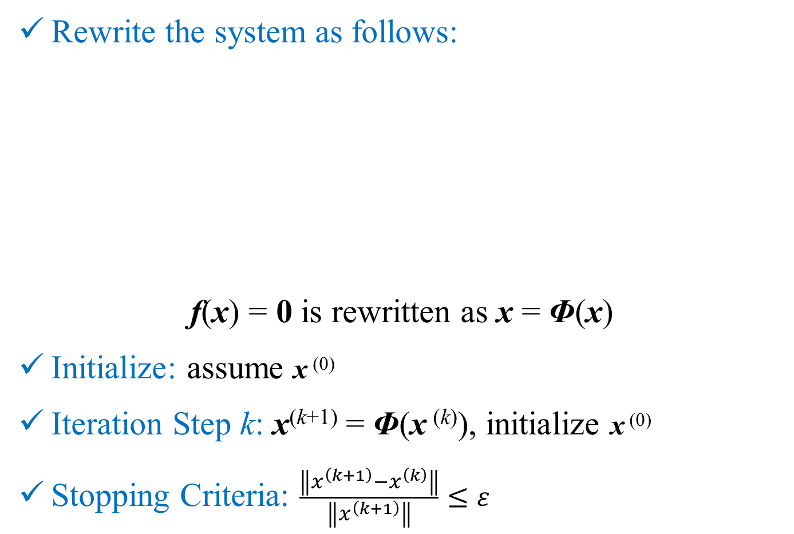
Open Methods: Fixed Point
Rewrite the system as follows:
f(x) = 0 is rewritten as x = Φ(x)
Initialize: assume x ⁽⁰⁾
Iteration Step k: x^{(k+1)} = Φ(x ^{(k)}), initialize x ⁽⁰⁾
Stopping Criteria: $\frac{\left\|x^{\left(k+1\right)}−x^{\left(k\right)}\right\|}{\left\|x^{\left(k+1\right)}\right\|}≤ε$

Slide 20
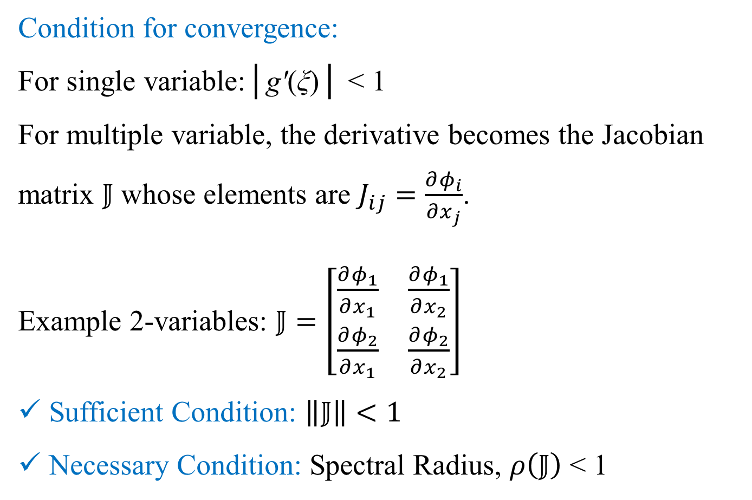
Open Methods: Fixed Point
Condition for convergence:
For single variable:│gʹ(ξ)│ < 1
For multiple variable, the derivative becomes the Jacobian matrix $𝕁$ whose elements are $J_{ij}=\frac{∂φ_{i}}{∂x_{j}}$.
Example 2-variables: $𝕁=\left[\begin{matrix}\frac{∂φ_{1}}{∂x_{1}} & \frac{∂φ_{1}}{∂x_{2}} \\ \frac{∂φ_{2}}{∂x_{1}} & \frac{∂φ_{2}}{∂x_{2}}\end{matrix}\right]$
Sufficient Condition: $\left\|𝕁\right\|<1$
Necessary Condition: Spectral Radius, $ρ\left(𝕁\right)$ < 1

Slide 21
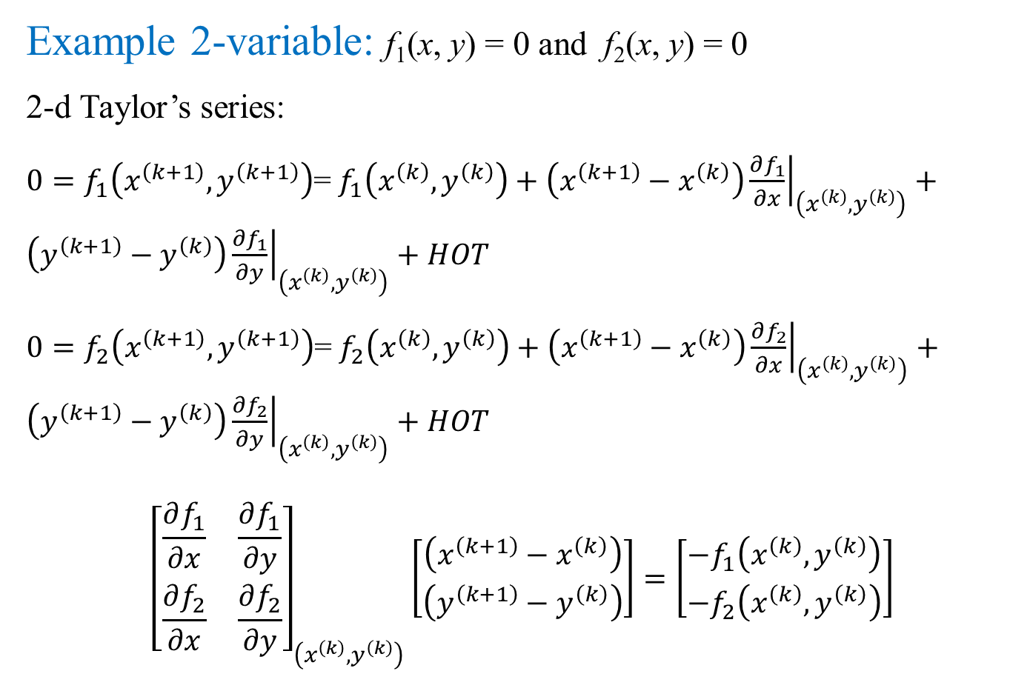
Open Methods: Newton-Raphson
Example 2-variable: f₁(x, y) = 0 and f₂(x, y) = 0
2-d Taylor’s series:
$0=f_{1}\left(x^{\left(k+1\right)},y^{\left(k+1\right)}\right)$= $f_{1}\left(x^{\left(k\right)},y^{\left(k\right)}\right)+\left(x^{\left(k+1\right)}−x^{\left(k\right)}\right){\left.\frac{∂f_{1}}{∂x}\right|}_{\left(x^{\left(k\right)},y^{\left(k\right)}\right)}+\left(y^{\left(k+1\right)}−y^{\left(k\right)}\right){\left.\frac{∂f_{1}}{∂y}\right|}_{\left(x^{\left(k\right)},y^{\left(k\right)}\right)}+HOT$
$0=f_{2}\left(x^{\left(k+1\right)},y^{\left(k+1\right)}\right)$= $f_{2}\left(x^{\left(k\right)},y^{\left(k\right)}\right)+\left(x^{\left(k+1\right)}−x^{\left(k\right)}\right){\left.\frac{∂f_{2}}{∂x}\right|}_{\left(x^{\left(k\right)},y^{\left(k\right)}\right)}+\left(y^{\left(k+1\right)}−y^{\left(k\right)}\right){\left.\frac{∂f_{2}}{∂y}\right|}_{\left(x^{\left(k\right)},y^{\left(k\right)}\right)}+HOT$
$${\left[\begin{matrix}\frac{∂f_{1}}{∂x} & \frac{∂f_{1}}{∂y} \\ \frac{∂f_{2}}{∂x} & \frac{∂f_{2}}{∂y}\end{matrix}\right]}_{\left(x^{\left(k\right)},y^{\left(k\right)}\right)}\left[\begin{matrix}\left(x^{\left(k+1\right)}−x^{\left(k\right)}\right) \\ \left(y^{\left(k+1\right)}−y^{\left(k\right)}\right)\end{matrix}\right]=\left[\begin{matrix}−f_{1}\left(x^{\left(k\right)},y^{\left(k\right)}\right) \\ −f_{2}\left(x^{\left(k\right)},y^{\left(k\right)}\right)\end{matrix}\right]$$

Slide 22
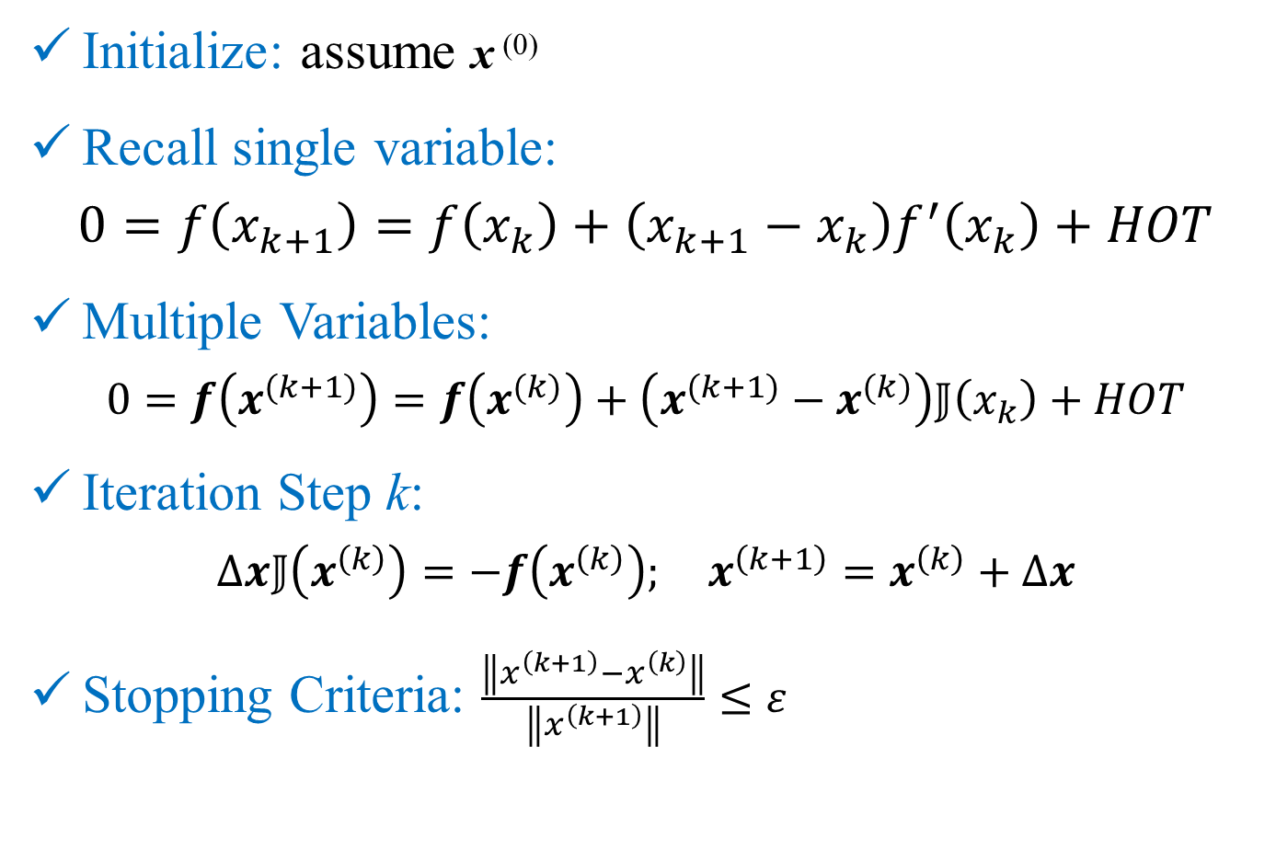
Open Methods: Newton-Raphson
Initialize: assume x ⁽⁰⁾
Recall single variable:
$$0=f\left(x_{k+1}\right)=f\left(x_{k}\right)+\left(x_{k+1}−x_{k}\right)f^{′}\left(x_{k}\right)+HOT$$
Multiple Variables:
$$0=f\left(x^{(k+1)}\right)=f\left(x^{(k)}\right)+\left(x^{(k+1)}−x^{(k)}\right)𝕁\left(x_{k}\right)+HOT$$
Iteration Step k:
$$∆x𝕁\left(x^{\left(k\right)}\right)=−f\left(x^{\left(k\right)}\right); x^{\left(k+1\right)}=x^{\left(k\right)}+∆x$$
Stopping Criteria: $\frac{\left\|x^{\left(k+1\right)}−x^{\left(k\right)}\right\|}{\left\|x^{\left(k+1\right)}\right\|}≤ε$
Notes:
Solve tutorial pbm here

Slide 23
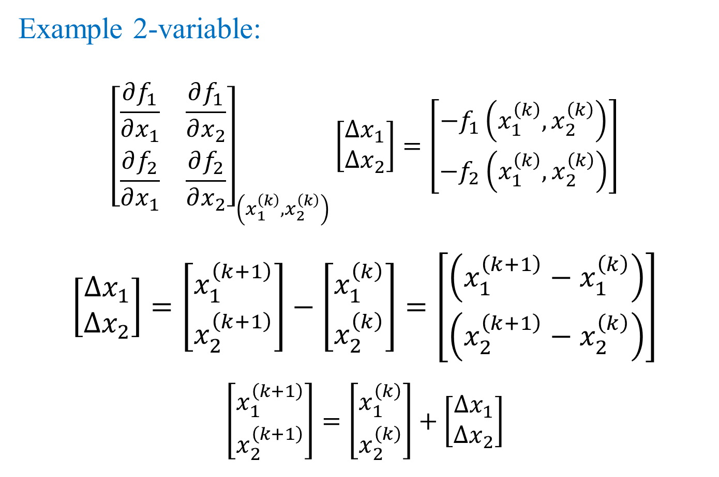
Open Methods: Newton-Raphson
Example 2-variable:
$${\left[\begin{matrix}\frac{∂f_{1}}{∂x_{1}} & \frac{∂f_{1}}{∂x_{2}} \\ \frac{∂f_{2}}{∂x_{1}} & \frac{∂f_{2}}{∂x_{2}}\end{matrix}\right]}_{\left(x_{1}^{\left(k\right)},x_{2}^{\left(k\right)}\right)}\left[\begin{matrix}∆x_{1} \\ ∆x_{2}\end{matrix}\right]=\left[\begin{matrix}{−f}_{1}\left(x_{1}^{\left(k\right)},x_{2}^{\left(k\right)}\right) \\ {−f}_{2}\left(x_{1}^{\left(k\right)},x_{2}^{\left(k\right)}\right)\end{matrix}\right]$$
$$\left[\begin{matrix}∆x_{1} \\ ∆x_{2}\end{matrix}\right]=\left[\begin{matrix}x_{1}^{\left(k+1\right)} \\ x_{2}^{\left(k+1\right)}\end{matrix}\right]−\left[\begin{matrix}x_{1}^{\left(k\right)} \\ x_{2}^{\left(k\right)}\end{matrix}\right]=\left[\begin{matrix}\left(x_{1}^{\left(k+1\right)}−x_{1}^{\left(k\right)}\right) \\ \left(x_{2}^{\left(k+1\right)}−x_{2}^{\left(k\right)}\right)\end{matrix}\right]$$
$$\left[\begin{matrix}x_{1}^{\left(k+1\right)} \\ x_{2}^{\left(k+1\right)}\end{matrix}\right]=\left[\begin{matrix}x_{1}^{\left(k\right)} \\ x_{2}^{\left(k\right)}\end{matrix}\right]+\left[\begin{matrix}∆x_{1} \\ ∆x_{2}\end{matrix}\right]$$

Slide 24
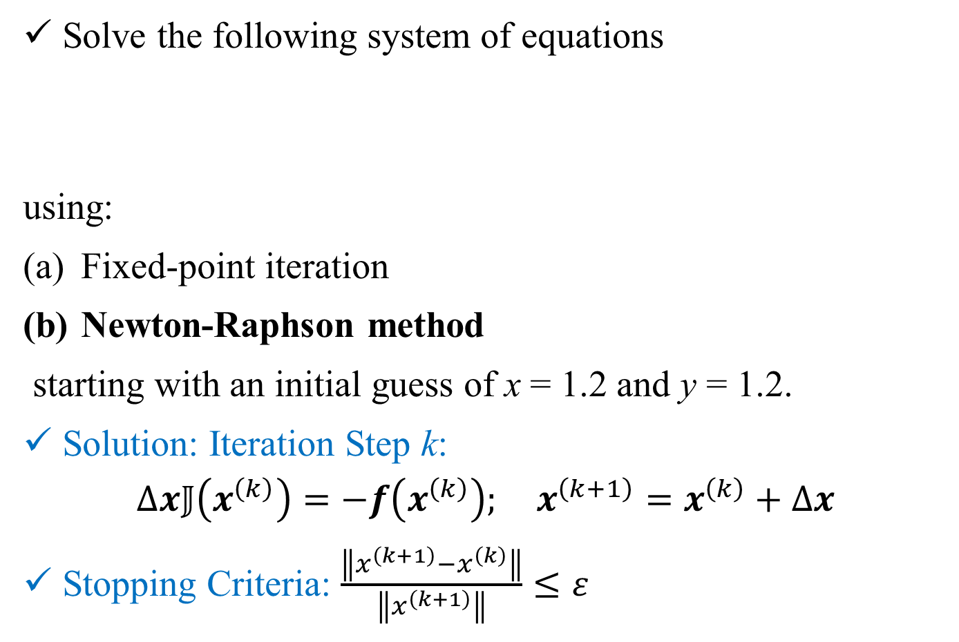
Example Problem: Tutorial 3 Q2
Solve the following system of equations
using:
Fixed-point iteration
Newton-Raphson method
starting with an initial guess of x = 1.2 and y = 1.2.
Solution: Iteration Step k:
$$∆x𝕁\left(x^{\left(k\right)}\right)=−f\left(x^{\left(k\right)}\right); x^{\left(k+1\right)}=x^{\left(k\right)}+∆x$$
Stopping Criteria: $\frac{\left\|x^{\left(k+1\right)}−x^{\left(k\right)}\right\|}{\left\|x^{\left(k+1\right)}\right\|}≤ε$
f(x) = 0
Notes:
Solve tutorial pbm here

Slide 25

Open Methods: Newton-Raphson
Example 2-variable:
$${\left[\begin{matrix}\frac{∂u}{∂x_{1}} & \frac{∂u}{∂x_{2}} \\ \frac{∂v}{∂x_{1}} & \frac{∂v}{∂x_{2}}\end{matrix}\right]}_{\left(x_{1}^{\left(k\right)},x_{2}^{\left(k\right)}\right)}\left[\begin{matrix}∆x_{1} \\ ∆x_{2}\end{matrix}\right]=\left[\begin{matrix}{−u}_{}\left(x_{1}^{\left(k\right)},x_{2}^{\left(k\right)}\right) \\ −v\left(x_{1}^{\left(k\right)},x_{2}^{\left(k\right)}\right)\end{matrix}\right]$$
$$\left[\begin{matrix}∆x_{1} \\ ∆x_{2}\end{matrix}\right]=\left[\begin{matrix}x_{1}^{\left(k+1\right)} \\ x_{2}^{\left(k+1\right)}\end{matrix}\right]−\left[\begin{matrix}x_{1}^{\left(k\right)} \\ x_{2}^{\left(k\right)}\end{matrix}\right]=\left[\begin{matrix}\left(x_{1}^{\left(k+1\right)}−x_{1}^{\left(k\right)}\right) \\ \left(x_{2}^{\left(k+1\right)}−x_{2}^{\left(k\right)}\right)\end{matrix}\right]$$
$$\left[\begin{matrix}x_{1}^{\left(k+1\right)} \\ x_{2}^{\left(k+1\right)}\end{matrix}\right]=\left[\begin{matrix}x_{1}^{\left(k\right)} \\ x_{2}^{\left(k\right)}\end{matrix}\right]+\left[\begin{matrix}∆x_{1} \\ ∆x_{2}\end{matrix}\right]$$

Slide 26
Open Methods: Secant
Jacobian of the Newton-Raphson method is evaluated numerically using difference approximation.
Numerical methods for estimation of derivative of a function will be covered in detail later.
Rest of the method is same.

