Slide 1
Estimation of Eigenvalues
Largest eigenvalue: Power Method
Smallest eigenvalue: Inverse Power Method
All Eigenvalues:
Inverse power method with shift
Faddeev-Leverrier method
QR Decomposition

Slide 2
The Power Method
Works if:
There is a unique eigenvalue of maximum magnitude!
There are n independent eigenvectors corresponding to n eigenvalues

Slide 3
The Power Method
Initialize an arbitrary non-zero vector (z⁽⁰⁾) of length n (same as that of the size of the square matrix)
Iteration Scheme:
The vector (z^{(k)}) converges to the eigenvector corresponding to the eigenvalue of the maximum magnitude! Why? How?

Slide 4
Proof of Convergence: Power Method
Denote x_{i} as the eigenvector corresponding to the eigenvalue λ_{i}
α_{i}’s are the constants
Since,

Slide 5
Proof of Convergence: Power Method
Denote x_{i} as the eigenvector corresponding to the eigenvalue λ_{i}
α_{i}’s are the constants
Since,

Slide 6
Proof of Convergence: Power Method
Denote x_{i} as the eigenvector corresponding to the eigenvalue λ_{i}
α_{i}’s are the constants
Since,

Slide 7
Proof of Convergence: Power Method
Denote x_{i} as the eigenvector corresponding to the eigenvalue λ_{i}
α_{i}’s are the constants
Since,
For Large k:

Slide 8
Power Method Algorithm
Initialize an arbitrary non-zero vector z⁽⁰⁾
Iterate:
Stop when:
Compute the largest eigenvalue as:
since

Slide 9
The Inverse Power Method
Apply power method on matrix A⁻¹ to obtain the largest eigenvalue. Inverse of this eigenvalue is the smallest eigenvalue of A
Proposition: Inverse of the largest eigenvalue of A⁻¹ is the smallest eigenvalue of A
For any eigenvalue λ_{i} and corresponding eigenvector x_{i} of matrix A: Ax_{i} = λ_{i}x_{i}
Since λ_{i} is a scalar, (1/λ_{i})x_{i} = A⁻¹x_{i}
If λ_{i} is an eigenvalue of matrix A, (1/λ_{i}) is an eigenvalue of A⁻¹ with the same corresponding eigenvector x_{i}

Slide 10
Inverse Power Method with Shift
Apply power method on matrix (A – αI)⁻¹ to obtain the eigenvalue that is closest to constant α.
For any eigenvalue λ_{i} and corresponding eigenvector x_{i} of matrix A: Ax_{i} = λ_{i}x_{i}
For a scalar constant α, Ax_{i} - αx_{i} = λ_{i}x_{i} - αx_{i}
(A – αI)x_{i} = (λ_{i} - α)x_{i}, (λ_{i} - α) is an eigenvalue of the matrix (A – αI).
Smallest eigenvalue of matrix (A – αI) corresponds to that eigenvalue of matrix A that is closest in magnitude to the scalar constant α
This gives an algorithm to estimate an eigenvalue of a matrix that is closest to a given constant!

Slide 11
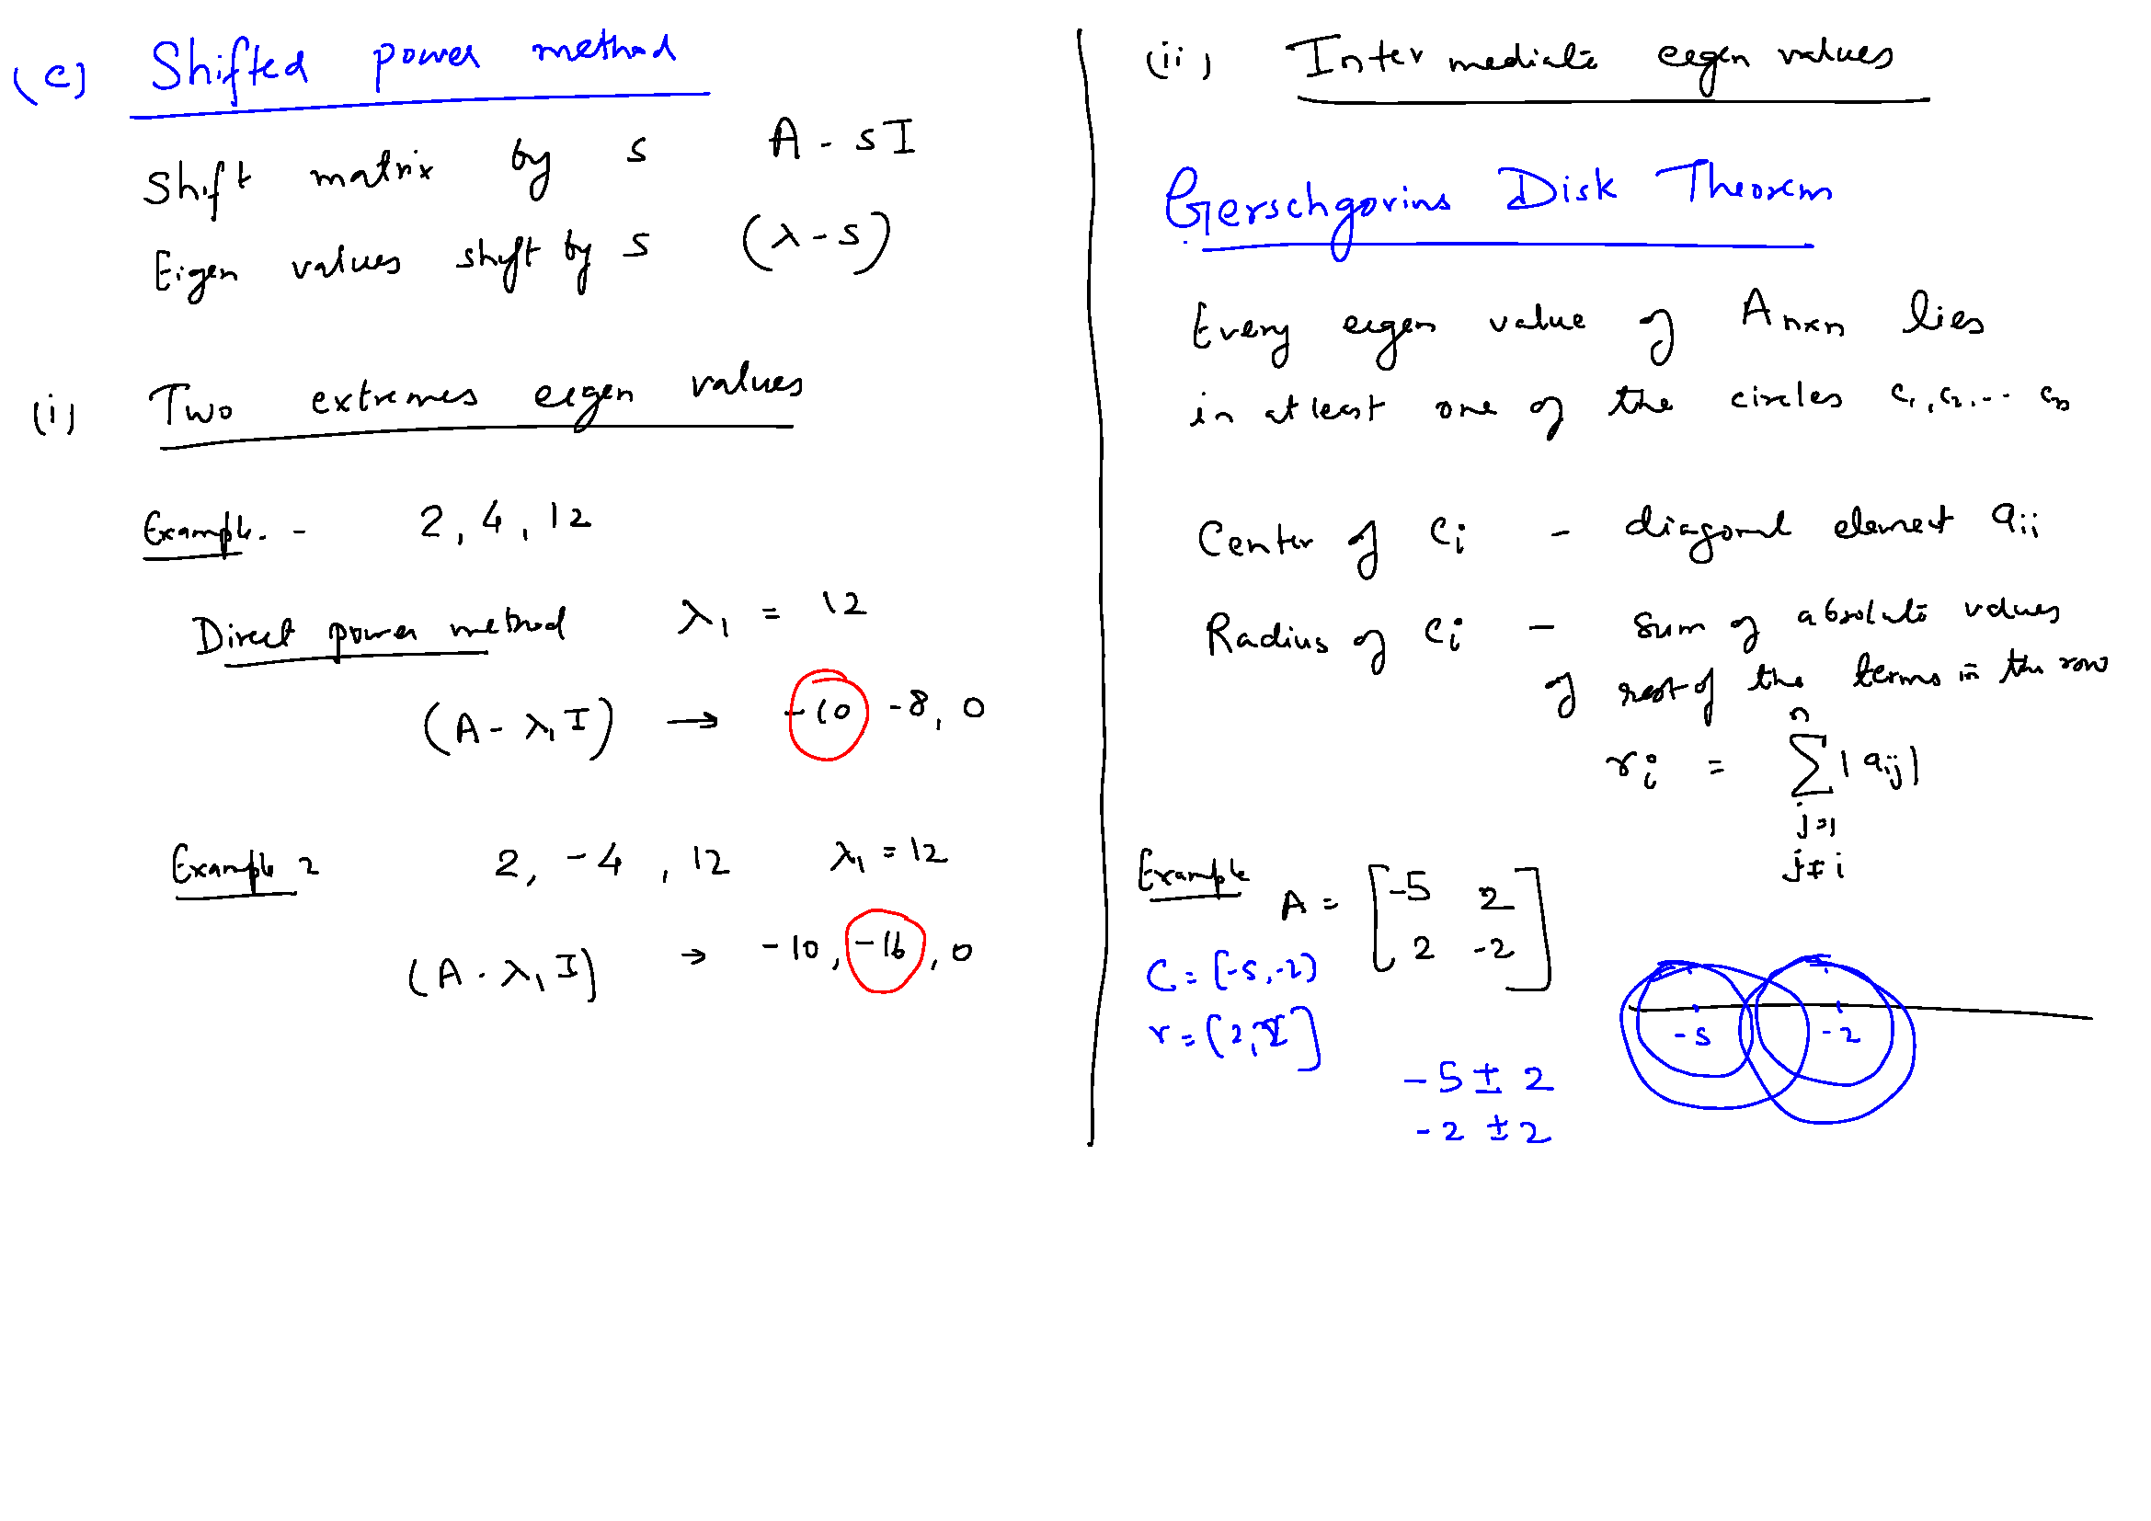

Slide 13
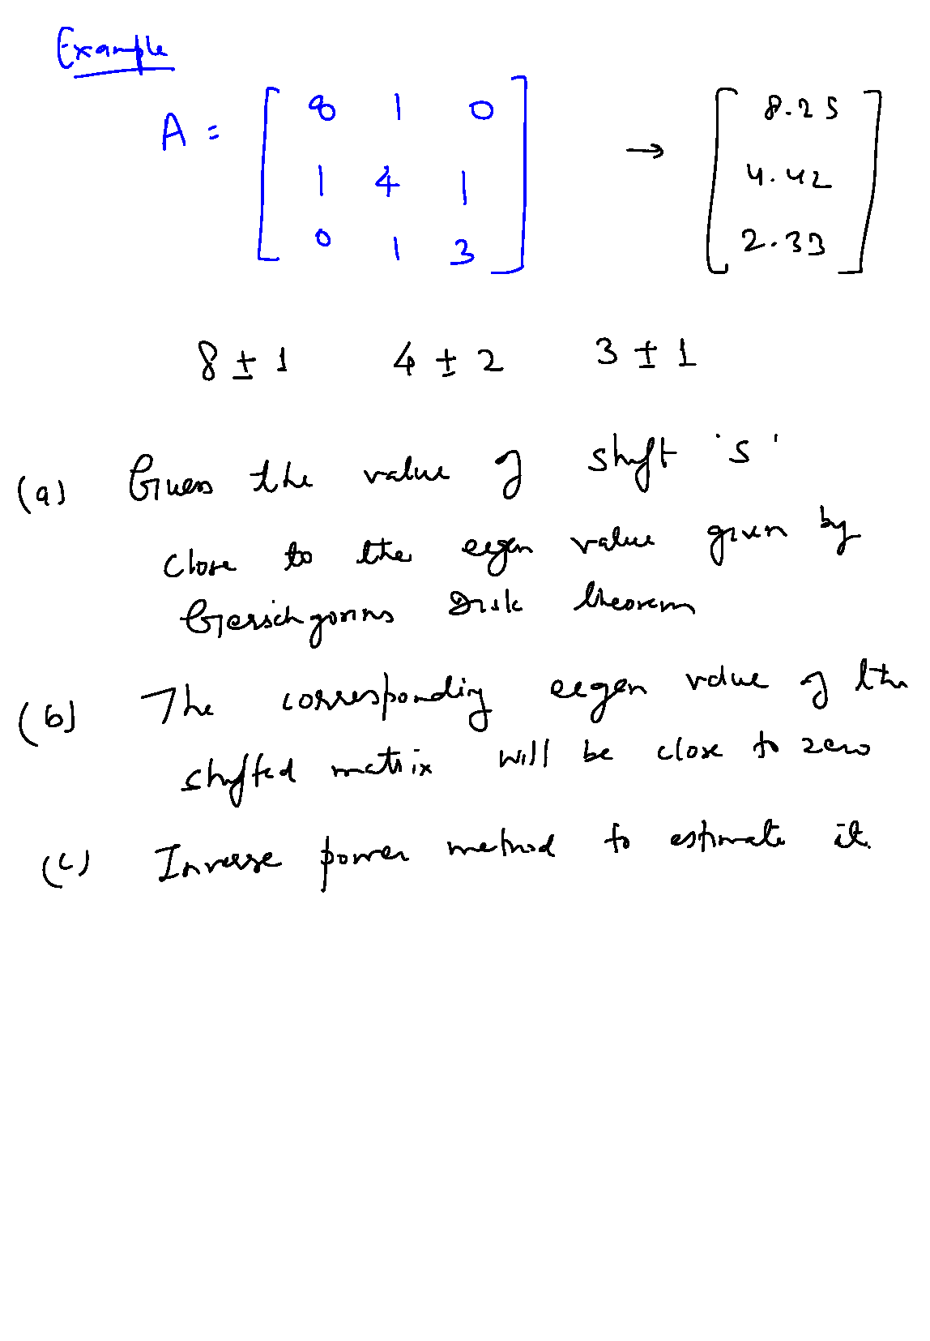

Slide 14
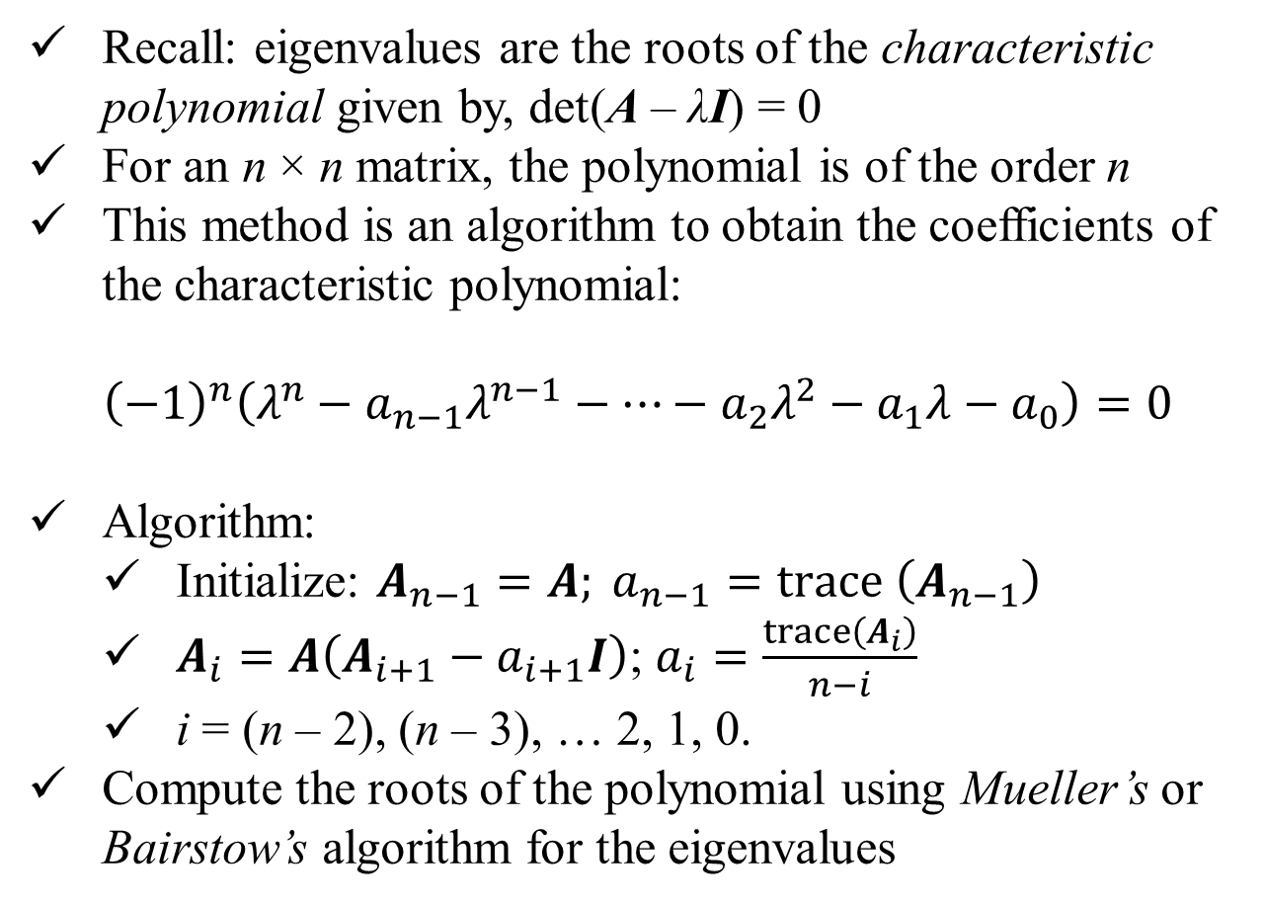
Faddeev Leverrier Method
Recall: eigenvalues are the roots of the characteristic polynomial given by, det(A – λI) = 0
For an n × n matrix, the polynomial is of the order n
This method is an algorithm to obtain the coefficients of the characteristic polynomial:
$${\left(−1\right)}^{n}\left(λ^{n}−a_{n−1}λ^{n−1}−⋯−a_{2}λ^{2}−a_{1}λ−a_{0}\right)=0$$
Algorithm:
Initialize: $A_{n−1}=A; a_{n−1}=trace \left(A_{n−1}\right)$
$A_{i}=A\left(A_{i+1}−a_{i+1}I\right)$; $a_{i}=\frac{trace\left(A_{i}\right)}{n−i}$
i = (n – 2), (n – 3), … 2, 1, 0.
Compute the roots of the polynomial using Mueller’s or Bairstow’s algorithm for the eigenvalues

Slide 15
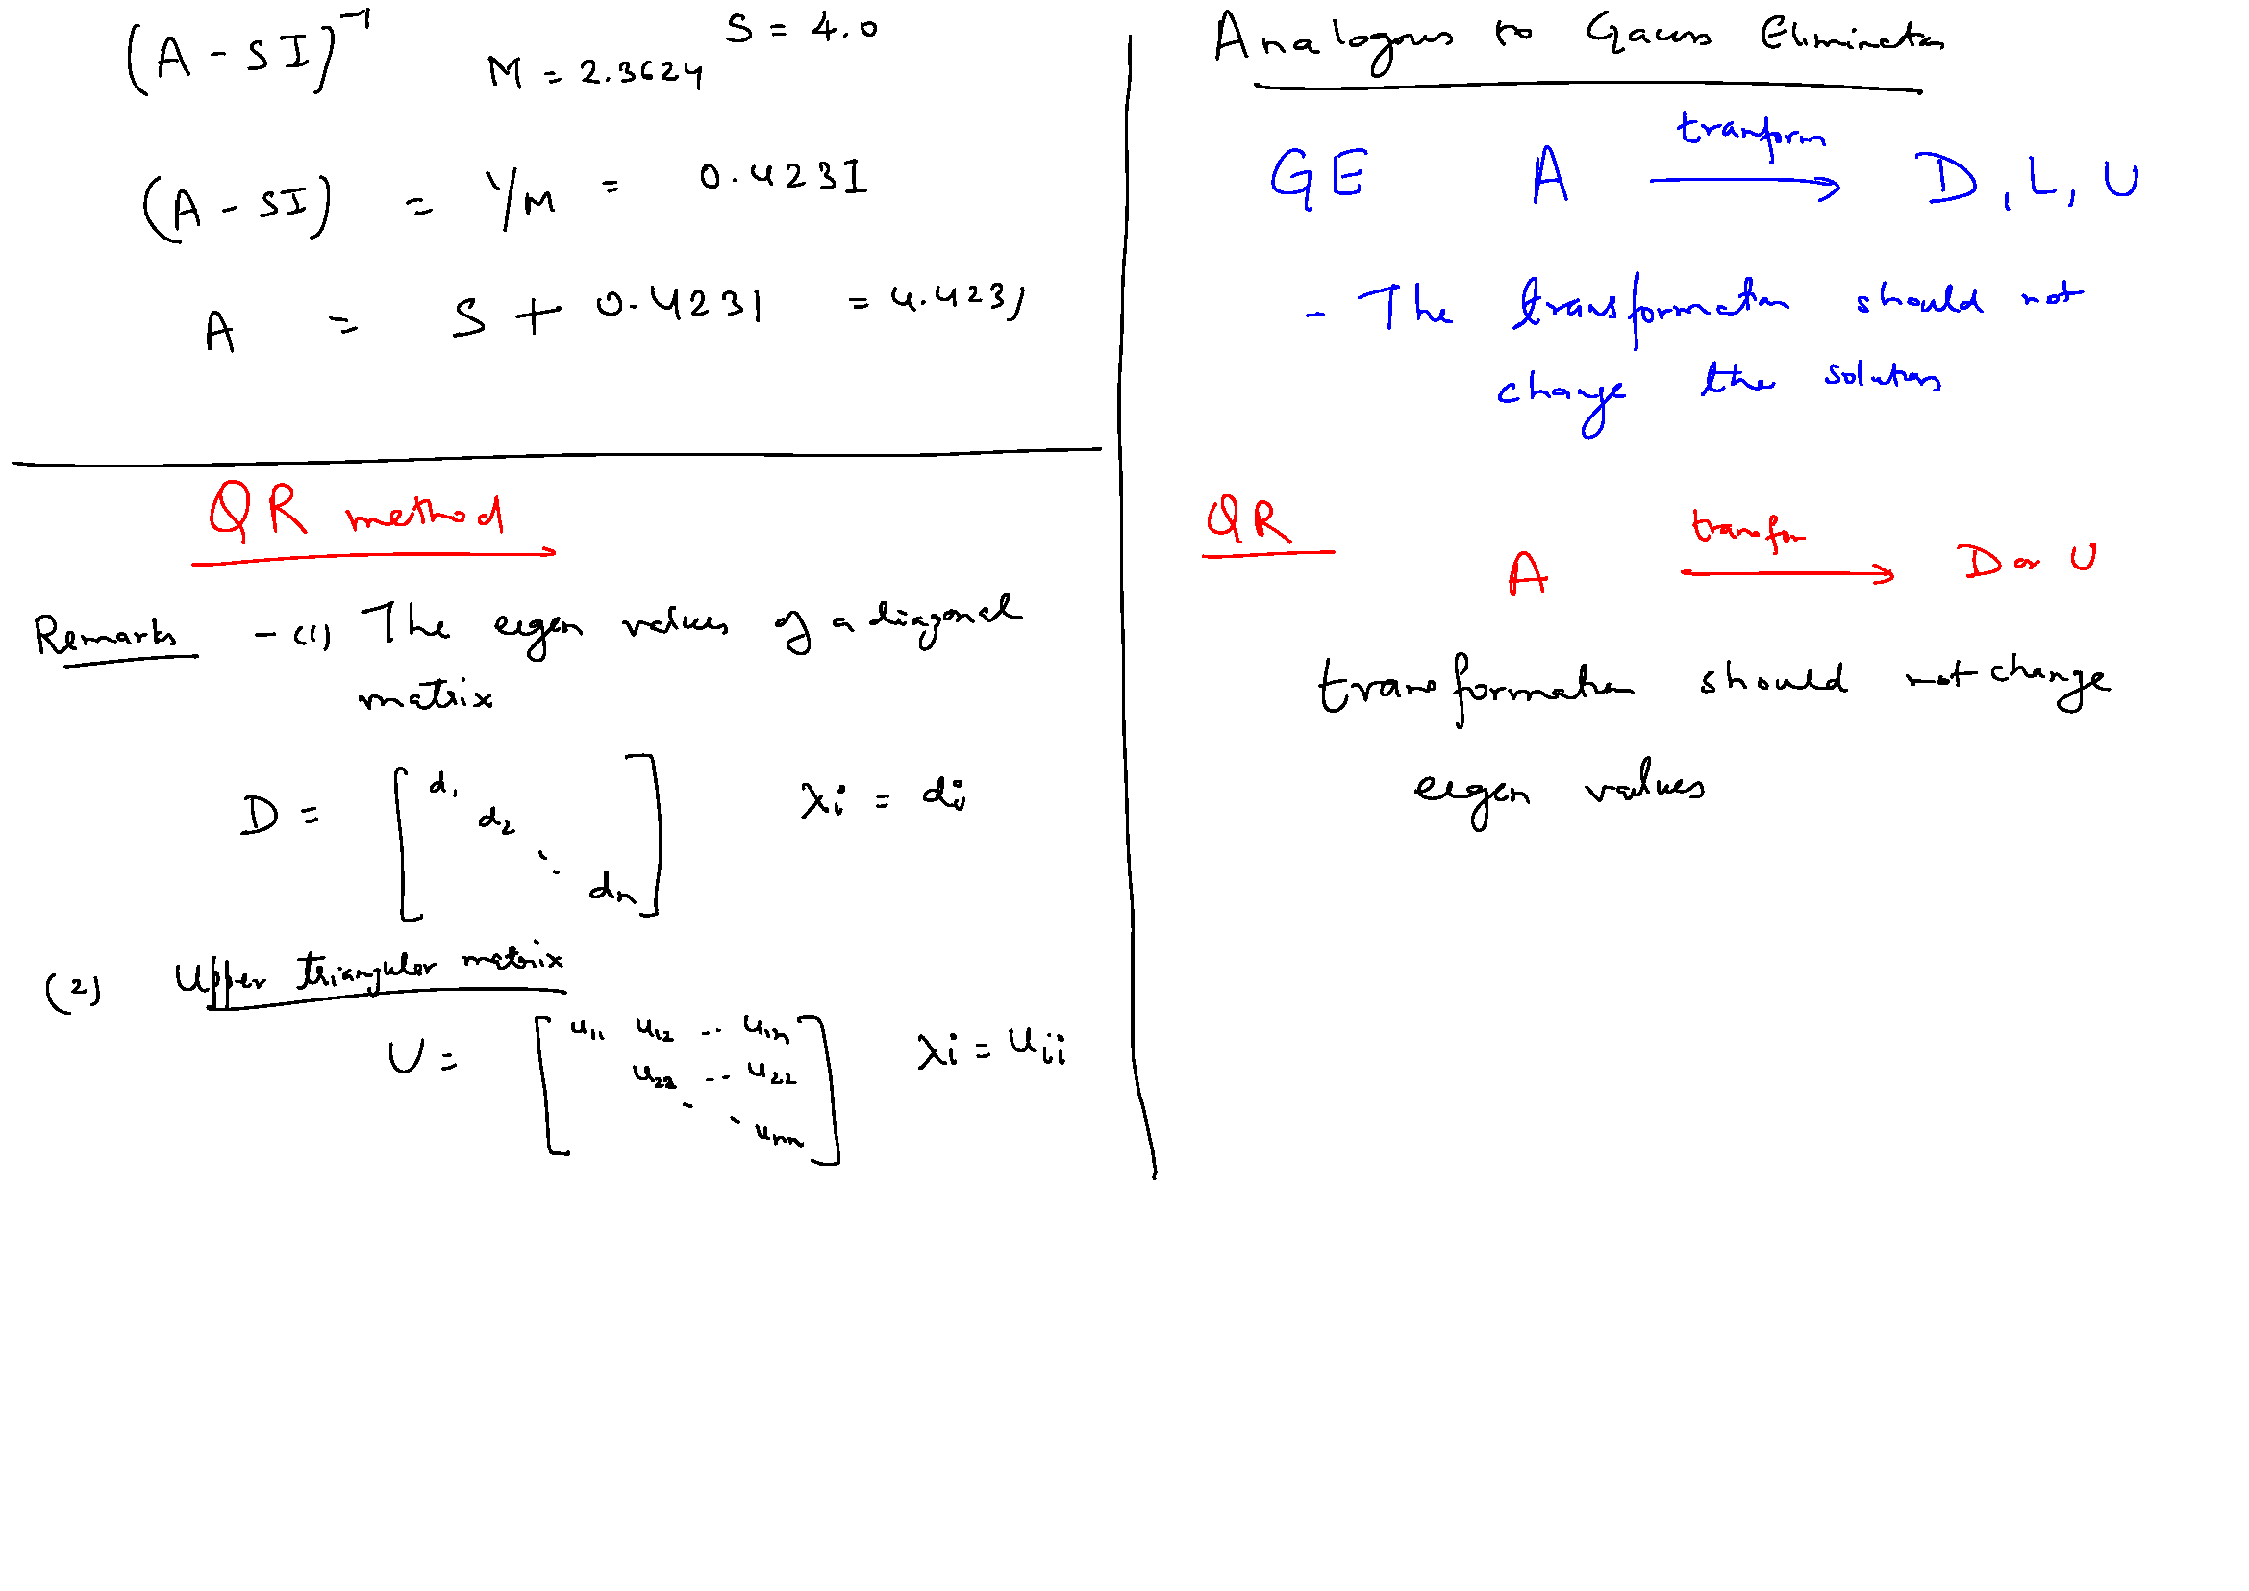

Slide 16
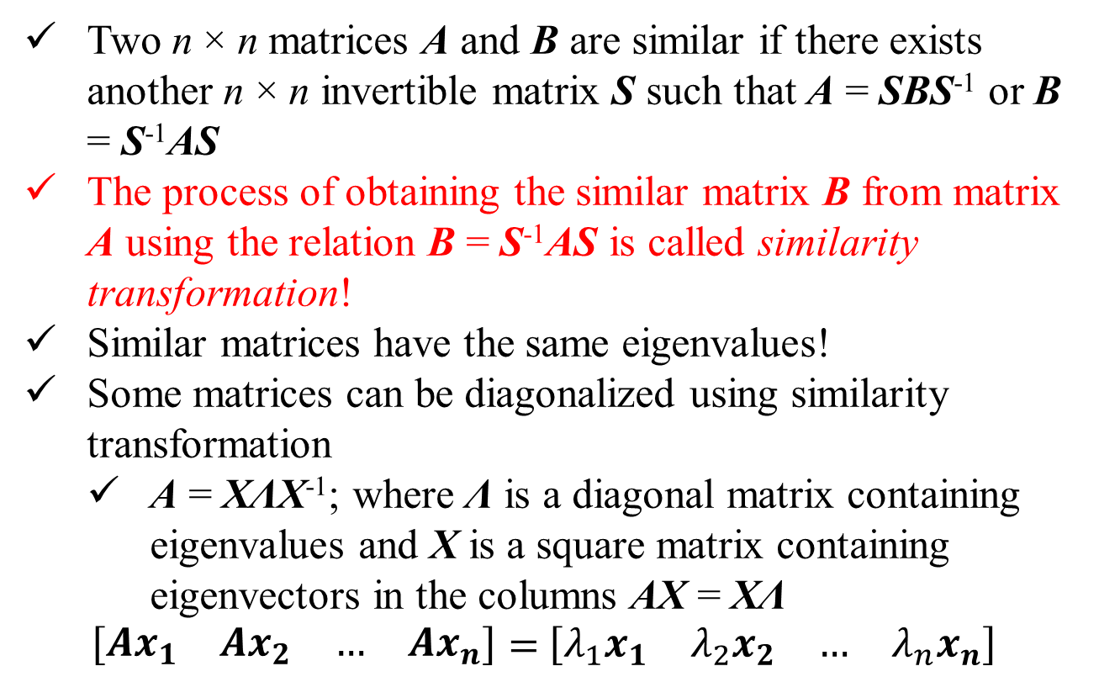
Similarity Transformation
Two n × n matrices A and B are similar if there exists another n × n invertible matrix S such that A = SBS⁻¹ or B = S⁻¹AS
The process of obtaining the similar matrix B from matrix A using the relation B = S⁻¹AS is called similarity transformation!
Similar matrices have the same eigenvalues!
Some matrices can be diagonalized using similarity transformation
A = XΛX⁻¹; where Λ is a diagonal matrix containing eigenvalues and X is a square matrix containing eigenvectors in the columns AX = XΛ
$\left[\begin{matrix}{Ax}_{1} & {Ax}_{2} & … & {Ax}_{n}\end{matrix}\right]=$ $\left[\begin{matrix}{λ_{1}x}_{1} & {λ_{2}x}_{2} & … & {λ_{n}x}_{n}\end{matrix}\right]$

Slide 17
Computation of Eigenvalues
Recall: What is an orthogonal matrix?
Each column vector is orthonormal to each other
Q^{T}Q = I or Q^{T} = Q⁻¹
A n × n matrix is non-defective if it has n independent eigenvectors (rank n, non-zero determinant, inverse exists, etc.)
For every non-defective real matrix A with real eigenvalues, there is an orthogonal matrix Q and an upper-triangular matrix U such that A = QUQ^{T}
If A is complex, Q is unitary such that A = QUQ^{H}
Therefore, A and U are similar matrices, A = QUQ^{T}
The upper triangular matrix U contains the eigenvalues of A on its diagonal.

Slide 18
Computation of Eigenvalues
All non-defective matrices are similar to upper triangular matrices
A = QUQ^{T} or U = Q^{T}AQ, U contains the eigenvalues of A on its diagonal.
Therefore, a non-defective matrix A can be transformed to an upper-triangular matrix U through similarity transformation and the diagonal elements of U will be the eigenvalues.
This transformation cannot be achieved in one step. It is achieved through a sequence of similarity transformation using QR-decomposition!

Slide 19
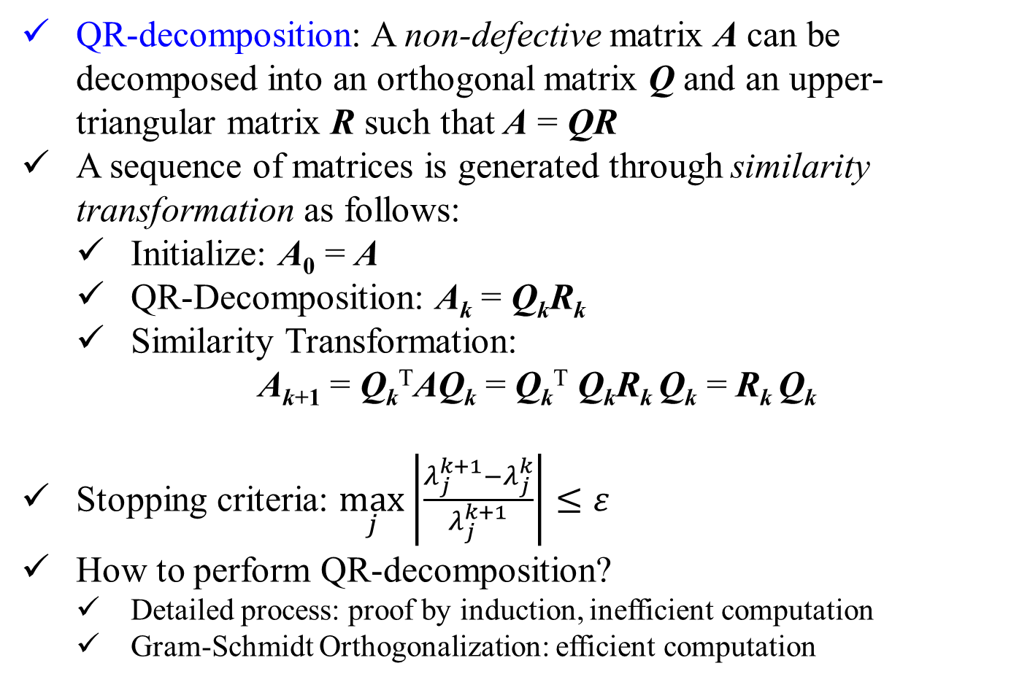
Computation of Eigenvalues
QR-decomposition: A non-defective matrix A can be decomposed into an orthogonal matrix Q and an upper-triangular matrix R such that A = QR
A sequence of matrices is generated through similarity transformation as follows:
Initialize: A₀ = A
QR-Decomposition: A_{k} = Q_{k}R_{k}
Similarity Transformation:
A_{k+1} = Q_{k}^{T}AQ_{k} = Q_{k}^{T} Q_{k}R_{k} Q_{k} = R_{k} Q_{k}
Stopping criteria: $\max_{j}\left|\frac{λ_{j}^{k+1}−λ_{j}^{k}}{λ_{j}^{k+1}}\right|≤ε$
How to perform QR-decomposition?
Detailed process: proof by induction, inefficient computation
Gram-Schmidt Orthogonalization: efficient computation

Slide 20
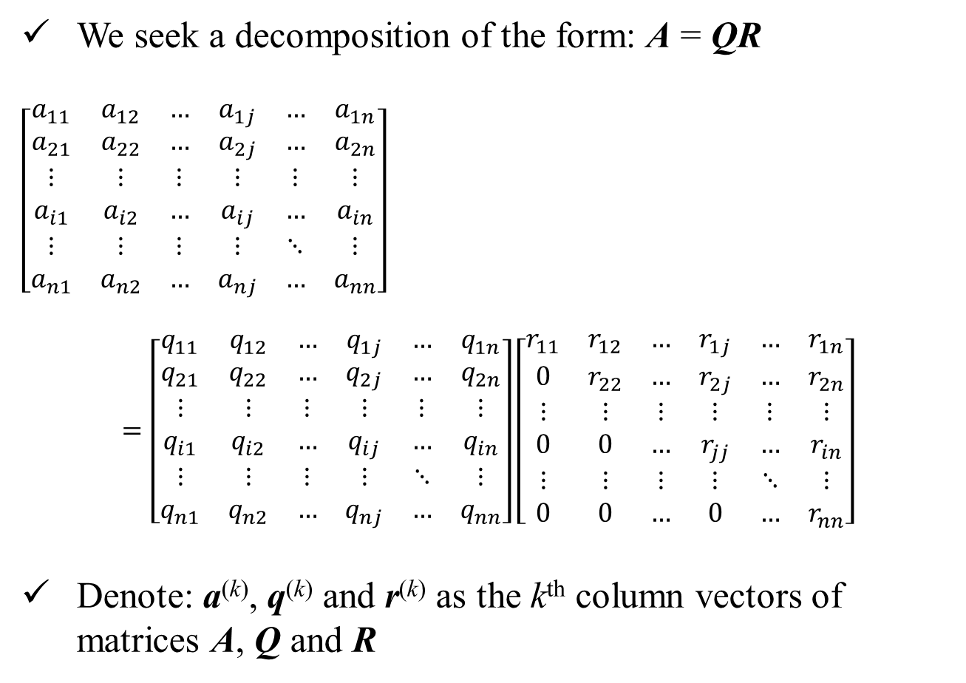
QR-Decomposition
We seek a decomposition of the form: A = QR
$$\left[\begin{matrix}a_{11} & a_{12} & … & a_{1j} & … & a_{1n} \\ a_{21} & a_{22} & … & a_{2j} & … & a_{2n} \\ ⋮ & ⋮ & ⋮ & ⋮ & ⋮ & ⋮ \\ a_{i1} & a_{i2} & … & a_{ij} & … & a_{in} \\ ⋮ & ⋮ & ⋮ & ⋮ & ⋱ & ⋮ \\ a_{n1} & a_{n2} & … & a_{nj} & … & a_{nn}\end{matrix}\right]$$
$$=\left[\begin{matrix}q_{11} & q_{12} & … & q_{1j} & … & q_{1n} \\ q_{21} & q_{22} & … & q_{2j} & … & q_{2n} \\ ⋮ & ⋮ & ⋮ & ⋮ & ⋮ & ⋮ \\ q_{i1} & q_{i2} & … & q_{ij} & … & q_{in} \\ ⋮ & ⋮ & ⋮ & ⋮ & ⋱ & ⋮ \\ q_{n1} & q_{n2} & … & q_{nj} & … & q_{nn}\end{matrix}\right]\left[\begin{matrix}r_{11} & r_{12} & … & r_{1j} & … & r_{1n} \\ 0 & r_{22} & … & r_{2j} & … & r_{2n} \\ ⋮ & ⋮ & ⋮ & ⋮ & ⋮ & ⋮ \\ 0 & 0 & … & r_{jj} & … & r_{in} \\ ⋮ & ⋮ & ⋮ & ⋮ & ⋱ & ⋮ \\ 0 & 0 & … & 0 & … & r_{nn}\end{matrix}\right]$$
Denote: a^{(k)}, q^{(k)} and r^{(k)} as the k^{th} column vectors of matrices A, Q and R
a⁽¹⁾
a⁽²⁾
a^{(j)}
a^{(n)}
q⁽¹⁾
q⁽²⁾
q^{(j)}
q^{(n)}
r⁽¹⁾
r⁽²⁾
r^{(j)}
r^{(n)}

Slide 21
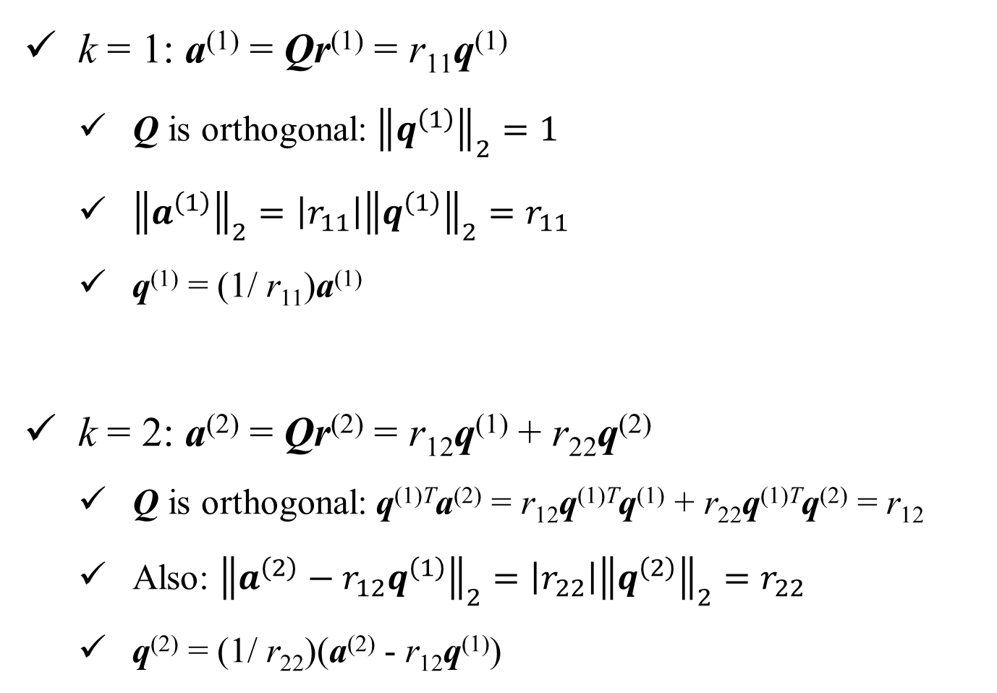
QR-Decomposition: proof by induction
k = 1: a⁽¹⁾ = Qr⁽¹⁾ = r₁₁q⁽¹⁾
Q is orthogonal: ${\left\|q^{\left(1\right)}\right\|}_{2}=1$
${\left\|a^{\left(1\right)}\right\|}_{2}=\left|r_{11}\right|{\left\|q^{\left(1\right)}\right\|}_{2}=r_{11}$
q⁽¹⁾ = (1/ r₁₁)a⁽¹⁾
k = 2: a⁽²⁾ = Qr⁽²⁾ = r₁₂q⁽¹⁾ + r₂₂q⁽²⁾
Q is orthogonal: q^{(1)T}a⁽²⁾ = r₁₂q^{(1)T}q⁽¹⁾ + r₂₂q^{(1)T}q⁽²⁾ = r₁₂
Also: ${\left\|a^{\left(2\right)}−r_{12}q^{\left(1\right)}\right\|}_{2}=\left|r_{22}\right|{\left\|q^{\left(2\right)}\right\|}_{2}=r_{22}$
q⁽²⁾ = (1/ r₂₂)(a⁽²⁾ - r₁₂q⁽¹⁾)

Slide 22
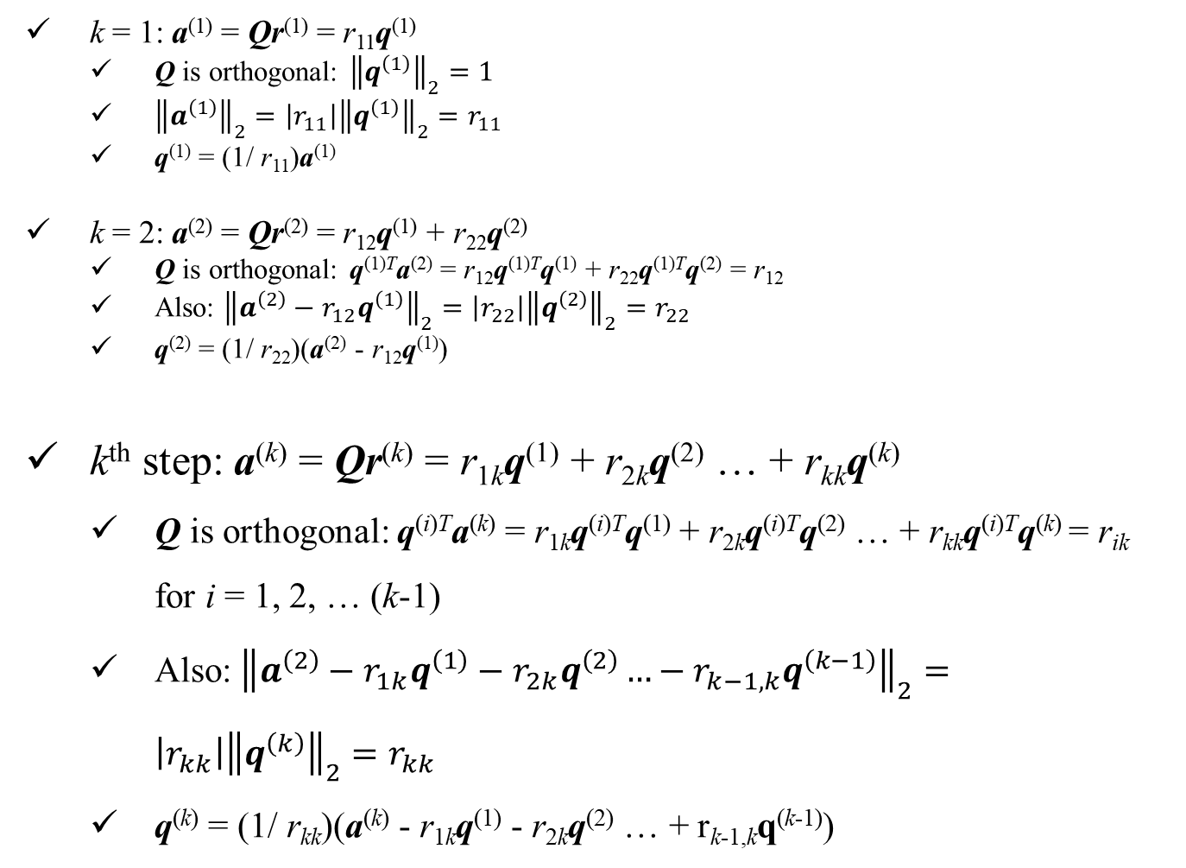
QR-Decomposition: proof by induction
k = 1: a⁽¹⁾ = Qr⁽¹⁾ = r₁₁q⁽¹⁾
Q is orthogonal: ${\left\|q^{\left(1\right)}\right\|}_{2}=1$
${\left\|a^{\left(1\right)}\right\|}_{2}=\left|r_{11}\right|{\left\|q^{\left(1\right)}\right\|}_{2}=r_{11}$
q⁽¹⁾ = (1/ r₁₁)a⁽¹⁾
k = 2: a⁽²⁾ = Qr⁽²⁾ = r₁₂q⁽¹⁾ + r₂₂q⁽²⁾
Q is orthogonal: q^{(1)T}a⁽²⁾ = r₁₂q^{(1)T}q⁽¹⁾ + r₂₂q^{(1)T}q⁽²⁾ = r₁₂
Also: ${\left\|a^{\left(2\right)}−r_{12}q^{\left(1\right)}\right\|}_{2}=\left|r_{22}\right|{\left\|q^{\left(2\right)}\right\|}_{2}=r_{22}$
q⁽²⁾ = (1/ r₂₂)(a⁽²⁾ - r₁₂q⁽¹⁾)
k^{th} step: a^{(k)} = Qr^{(k)} = r_{1k}q⁽¹⁾ + r_{2k}q⁽²⁾ … + r_{kk}q^{(k)}
Q is orthogonal: q^{(i)T}a^{(k)} = r_{1k}q^{(i)T}q⁽¹⁾ + r_{2k}q^{(i)T}q⁽²⁾ … + r_{kk}q^{(i)T}q^{(k)} = r_{ik} for i = 1, 2, … (k-1)
Also: ${\left\|a^{\left(2\right)}−r_{1k}q^{\left(1\right)}−r_{2k}q^{\left(2\right)}…−r_{k−1,k}q^{\left(k−1\right)}\right\|}_{2}=\left|r_{kk}\right|{\left\|q^{\left(k\right)}\right\|}_{2}=r_{kk}$
q^{(k)} = (1/ r_{kk})(a^{(k)} - r_{1k}q⁽¹⁾ - r_{2k}q⁽²⁾ … + r_{k-1,k}q^{(k-1)})

Slide 24
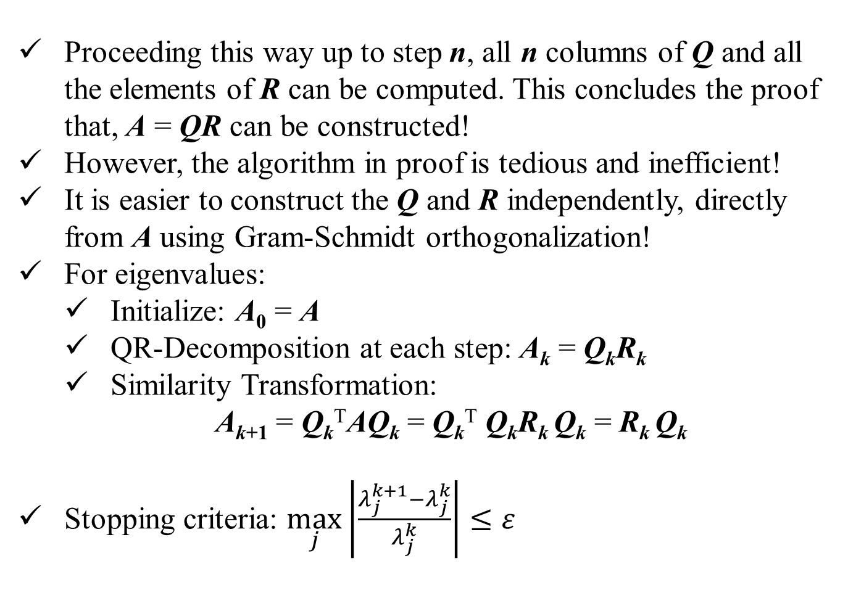
QR-Decomposition: proof by induction
Proceeding this way up to step n, all n columns of Q and all the elements of R can be computed. This concludes the proof that, A = QR can be constructed!
However, the algorithm in proof is tedious and inefficient!
It is easier to construct the Q and R independently, directly from A using Gram-Schmidt orthogonalization!
For eigenvalues:
Initialize: A₀ = A
QR-Decomposition at each step: A_{k} = Q_{k}R_{k}
Similarity Transformation:
A_{k+1} = Q_{k}^{T}AQ_{k} = Q_{k}^{T} Q_{k}R_{k} Q_{k} = R_{k} Q_{k}
Stopping criteria: $\max_{j}\left|\frac{λ_{j}^{k+1}−λ_{j}^{k}}{λ_{j}^{k}}\right|≤ε$

Slide 25
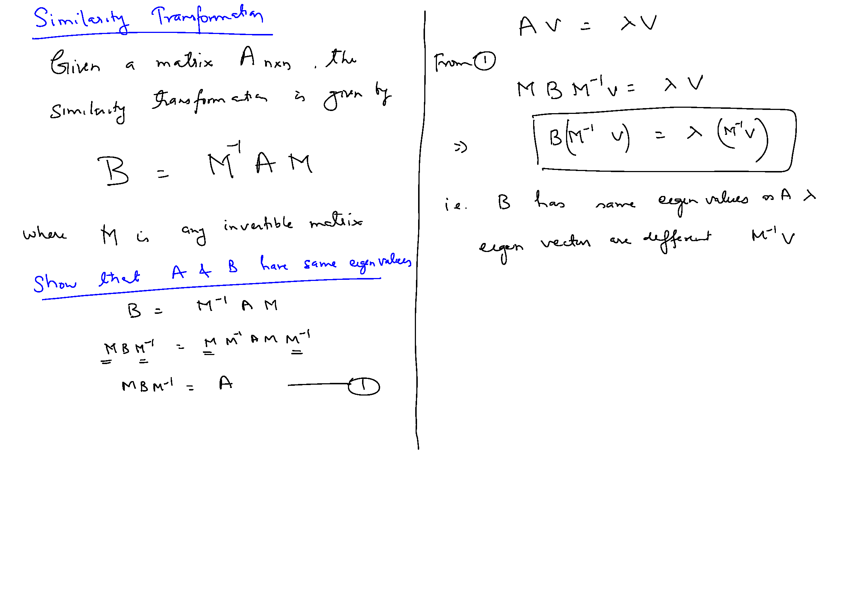

Slide 26
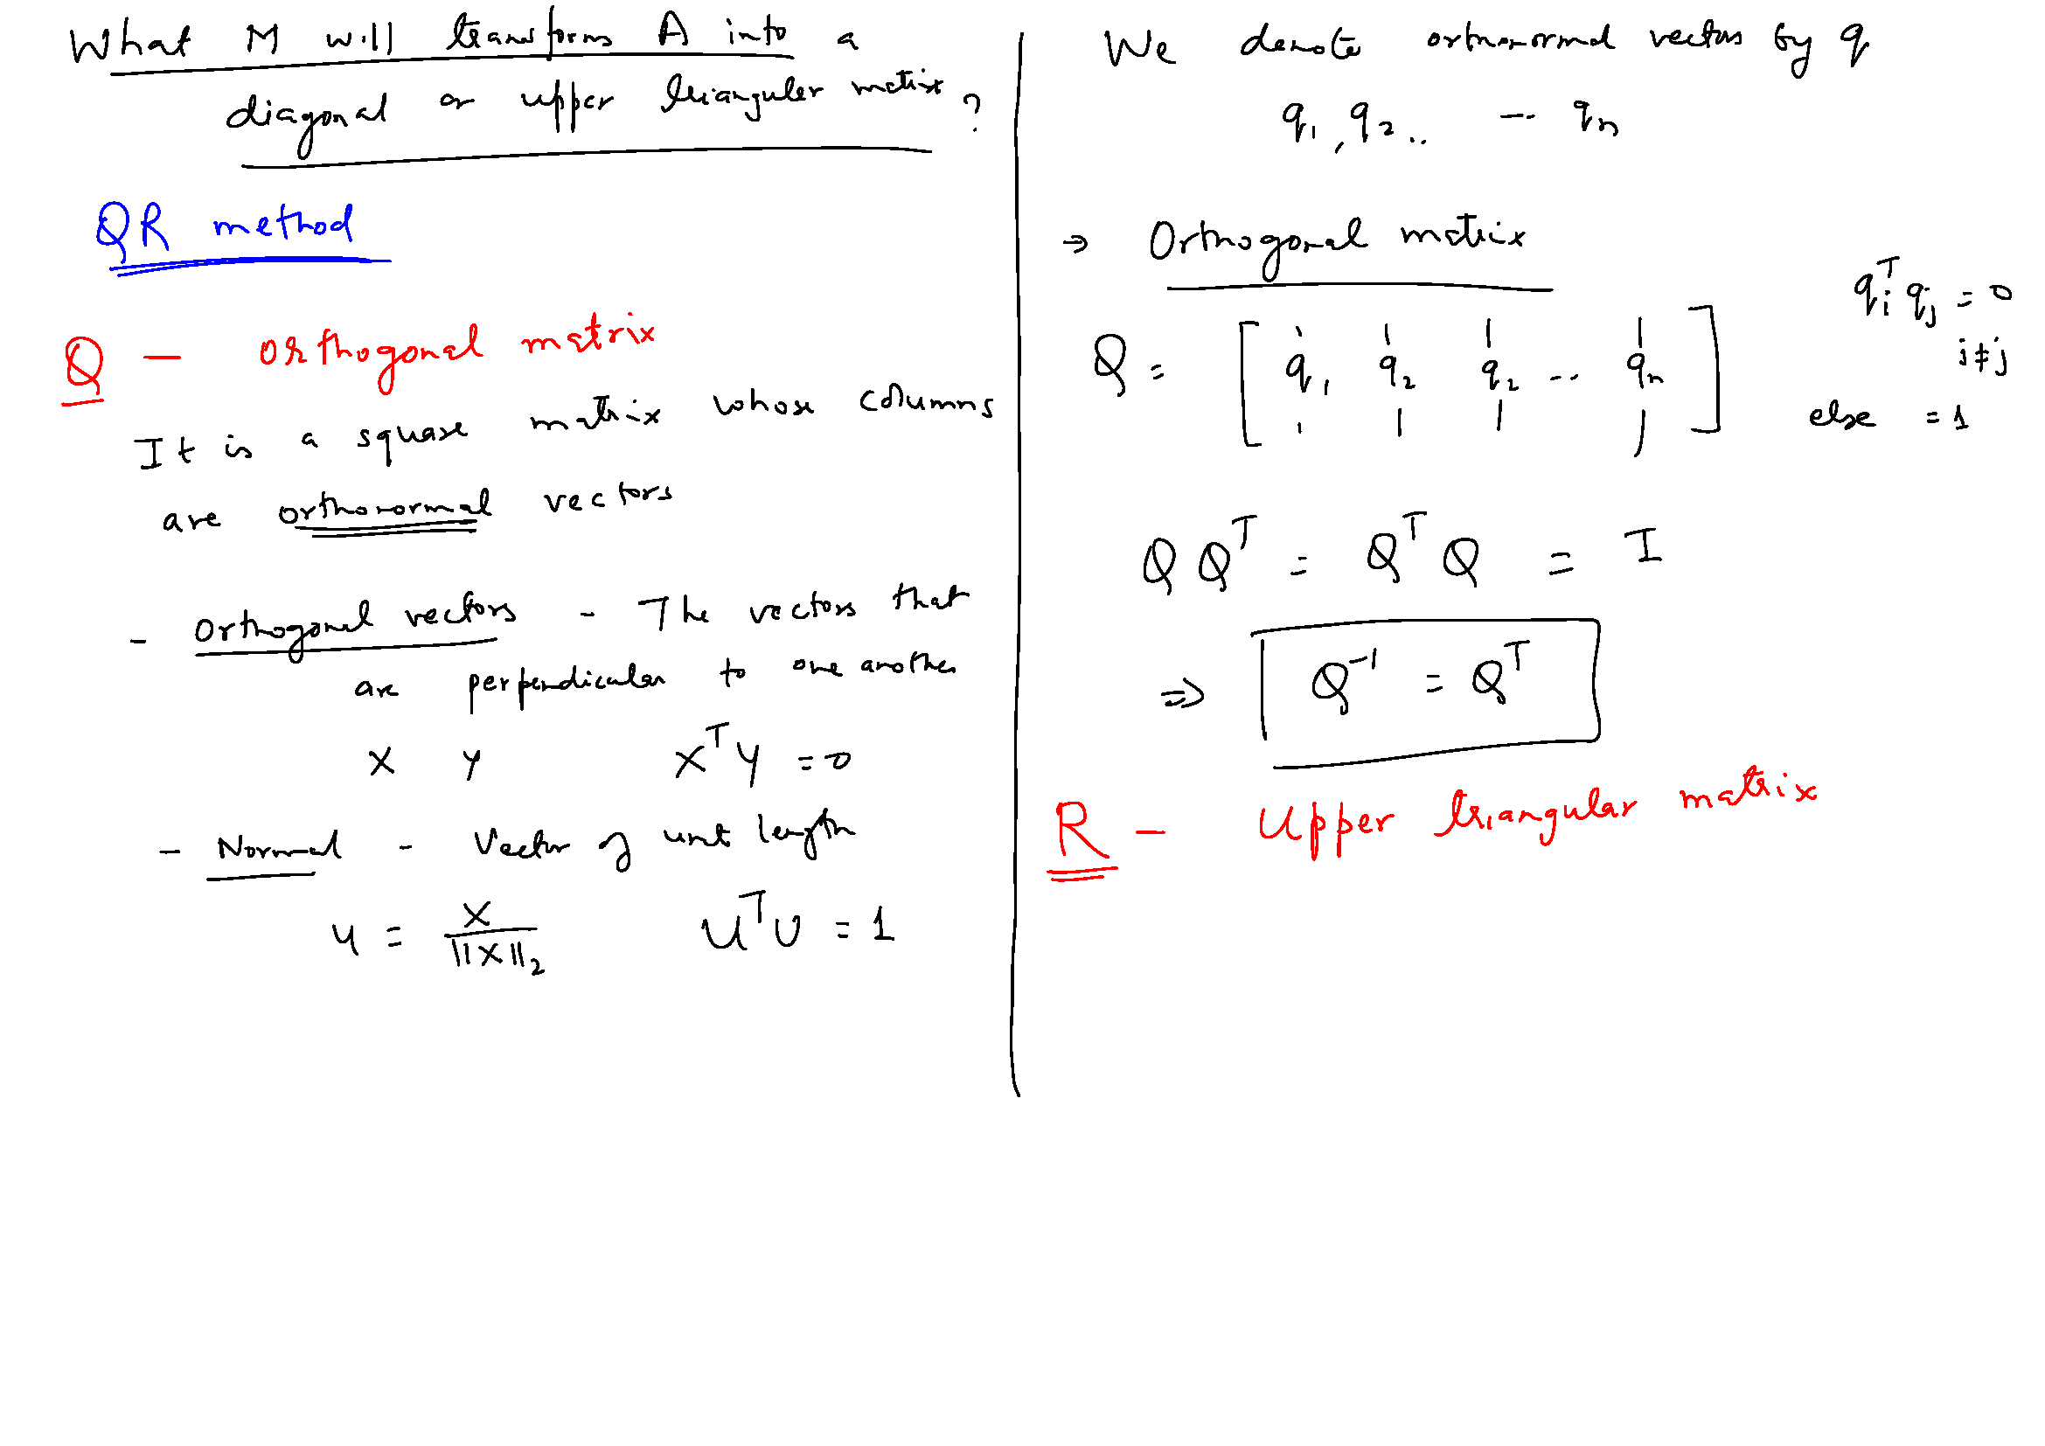

Slide 27
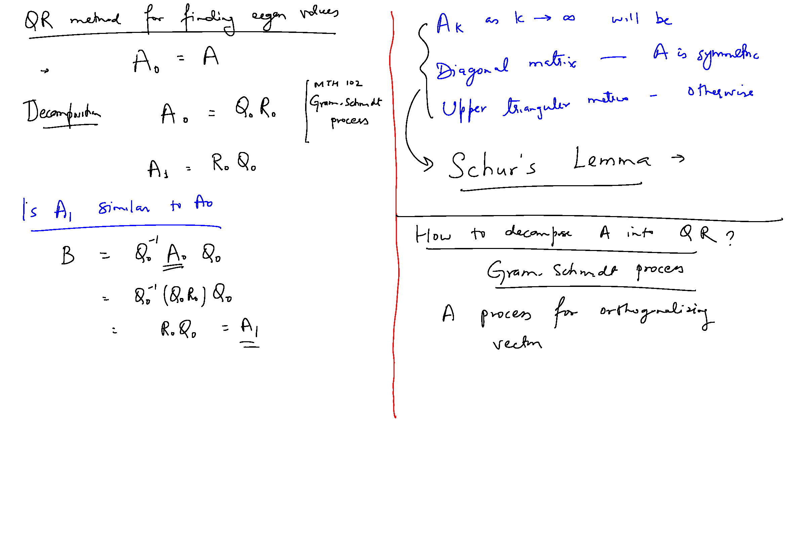

Slide 28
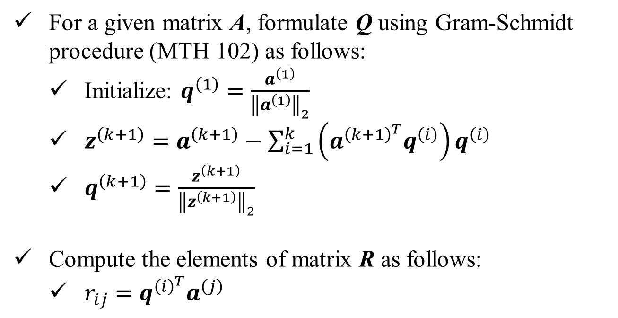
QR-Decomposition: Algorithm
For a given matrix A, formulate Q using Gram-Schmidt procedure (MTH 102) as follows:
Initialize: $q^{\left(1\right)}=\frac{a^{\left(1\right)}}{{\left\|a^{\left(1\right)}\right\|}_{2}}$
$z^{\left(k+1\right)}=a^{\left(k+1\right)}−\sum_{i=1}^{k}{\left(a^{{\left(k+1\right)}^{T}}q^{\left(i\right)}\right)q^{\left(i\right)}}$
$q^{\left(k+1\right)}=\frac{z^{\left(k+1\right)}}{{\left\|z^{\left(k+1\right)}\right\|}_{2}}$
Compute the elements of matrix R as follows:
$r_{ij}=q^{{\left(i\right)}^{T}}a^{\left(j\right)}$

Slide 29
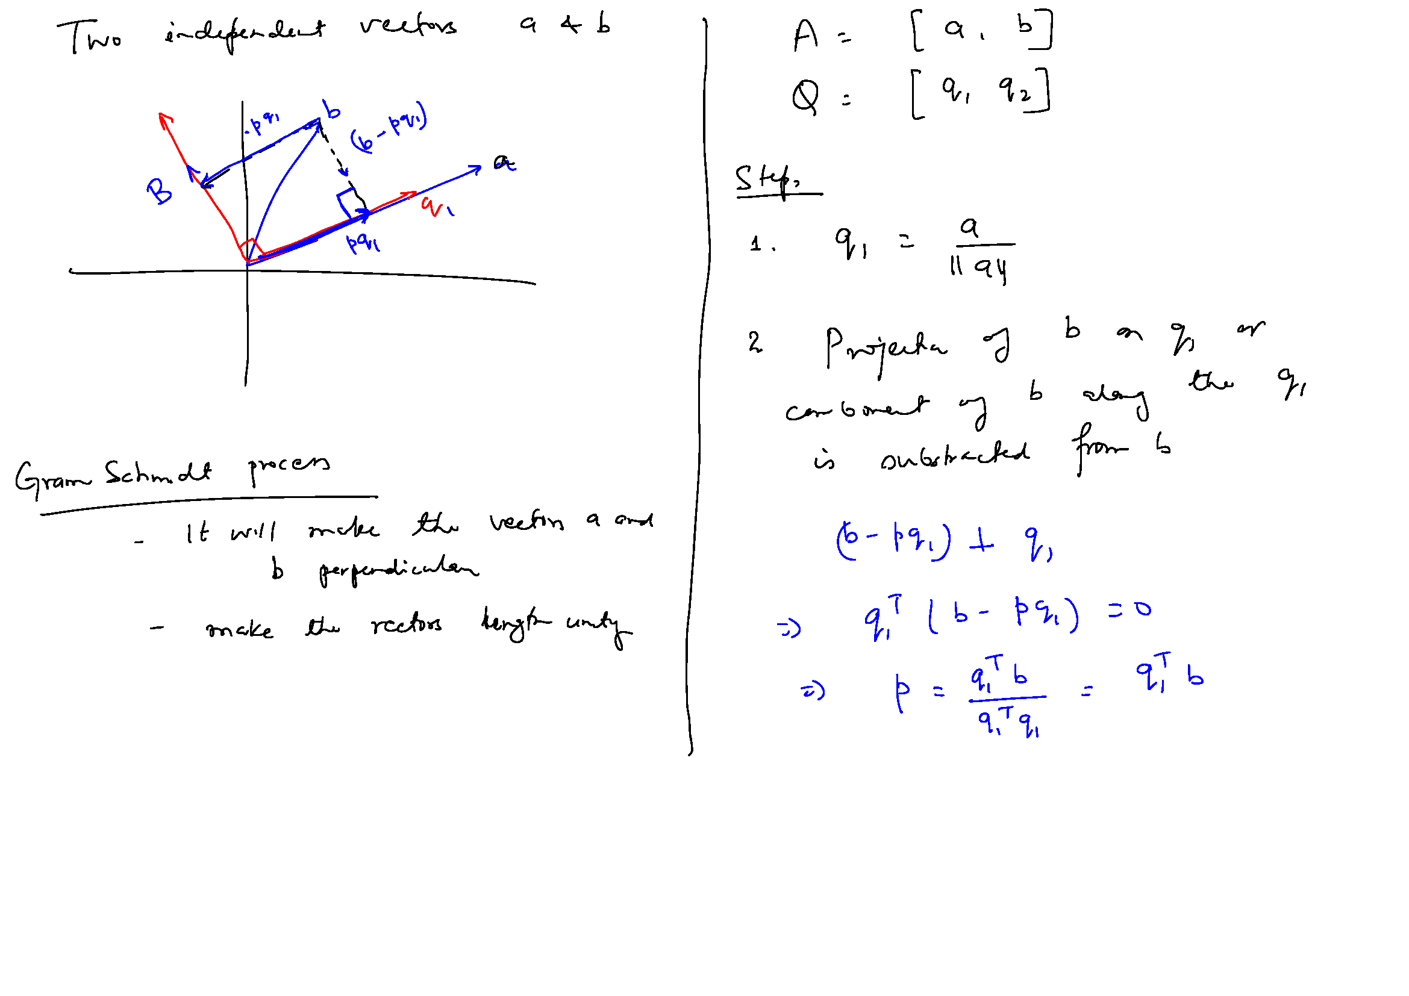
Gram-Schmidt Orthogonalization

Slide 30
Gram-Schmidt Orthogonalization

Slide 31
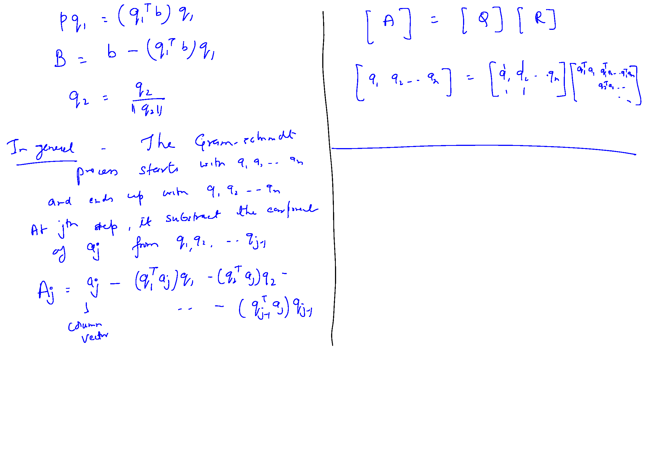
Gram-Schmidt Orthogonalization

Slide 32
Gram-Schmidt Orthogonalization

Slide 33
Gram-Schmidt Orthogonalization

