Slide 1
Estimation of Eigenvalues
Largest eigenvalue: Power Method
Smallest eigenvalue: Inverse Power Method
All Eigenvalues:
Inverse power method with shift
Faddeev-Leverrier method
QR Decomposition

Slide 2
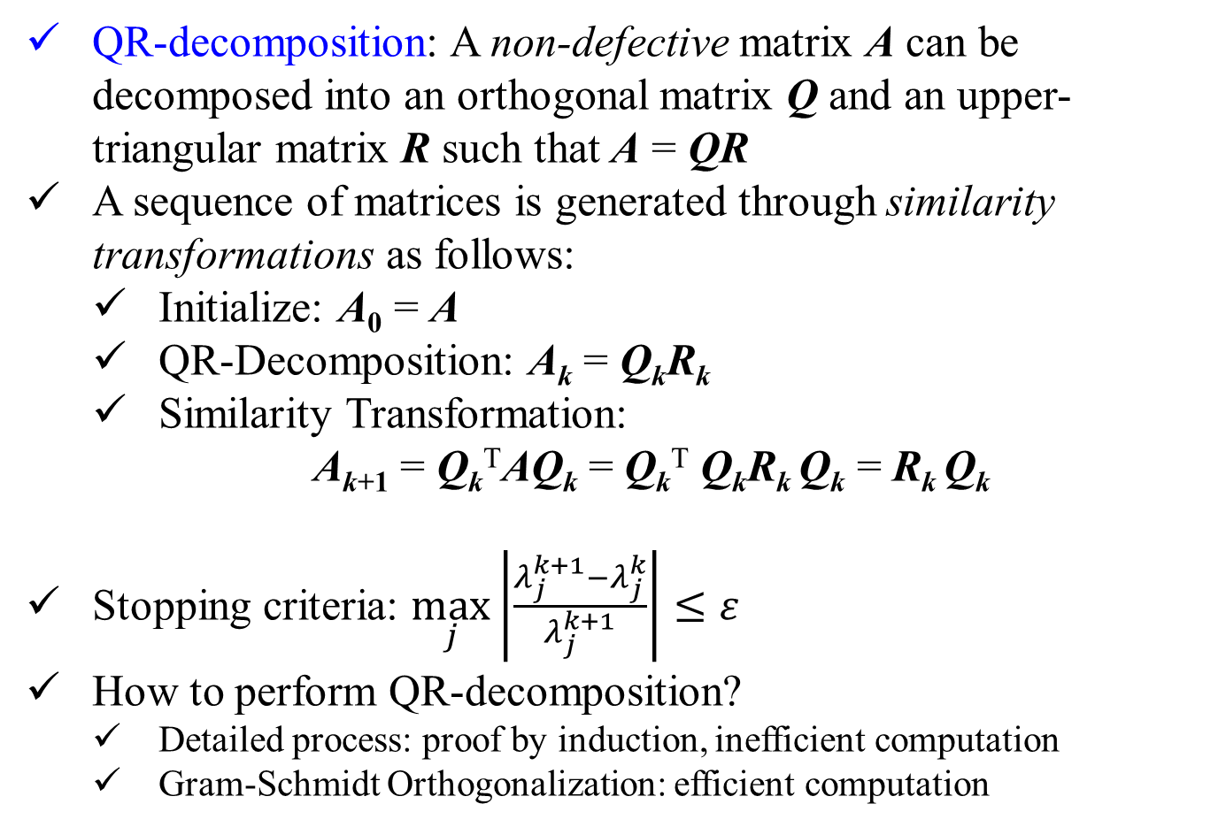
Computation of Eigenvalues
QR-decomposition: A non-defective matrix A can be decomposed into an orthogonal matrix Q and an upper-triangular matrix R such that A = QR
A sequence of matrices is generated through similarity transformations as follows:
Initialize: A₀ = A
QR-Decomposition: A_{k} = Q_{k}R_{k}
Similarity Transformation:
A_{k+1} = Q_{k}^{T}AQ_{k} = Q_{k}^{T} Q_{k}R_{k} Q_{k} = R_{k} Q_{k}
Stopping criteria: $\max_{j}\left|\frac{λ_{j}^{k+1}−λ_{j}^{k}}{λ_{j}^{k+1}}\right|≤ε$
How to perform QR-decomposition?
Detailed process: proof by induction, inefficient computation
Gram-Schmidt Orthogonalization: efficient computation

Slide 3
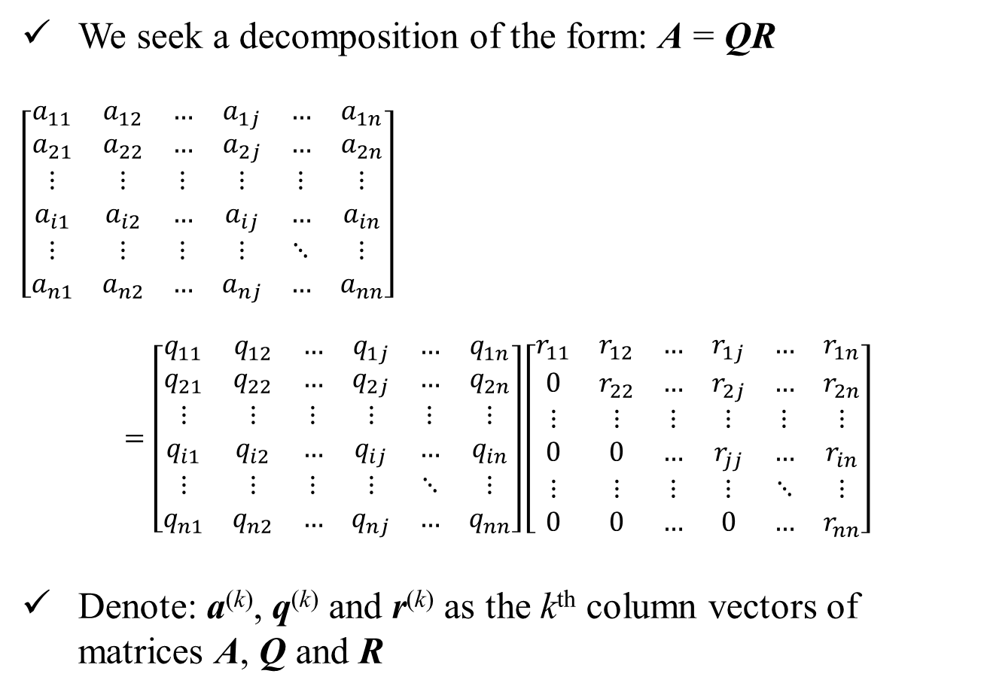
QR-Decomposition
We seek a decomposition of the form: A = QR
$$\left[\begin{matrix}a_{11} & a_{12} & … & a_{1j} & … & a_{1n} \\ a_{21} & a_{22} & … & a_{2j} & … & a_{2n} \\ ⋮ & ⋮ & ⋮ & ⋮ & ⋮ & ⋮ \\ a_{i1} & a_{i2} & … & a_{ij} & … & a_{in} \\ ⋮ & ⋮ & ⋮ & ⋮ & ⋱ & ⋮ \\ a_{n1} & a_{n2} & … & a_{nj} & … & a_{nn}\end{matrix}\right]$$
$$=\left[\begin{matrix}q_{11} & q_{12} & … & q_{1j} & … & q_{1n} \\ q_{21} & q_{22} & … & q_{2j} & … & q_{2n} \\ ⋮ & ⋮ & ⋮ & ⋮ & ⋮ & ⋮ \\ q_{i1} & q_{i2} & … & q_{ij} & … & q_{in} \\ ⋮ & ⋮ & ⋮ & ⋮ & ⋱ & ⋮ \\ q_{n1} & q_{n2} & … & q_{nj} & … & q_{nn}\end{matrix}\right]\left[\begin{matrix}r_{11} & r_{12} & … & r_{1j} & … & r_{1n} \\ 0 & r_{22} & … & r_{2j} & … & r_{2n} \\ ⋮ & ⋮ & ⋮ & ⋮ & ⋮ & ⋮ \\ 0 & 0 & … & r_{jj} & … & r_{in} \\ ⋮ & ⋮ & ⋮ & ⋮ & ⋱ & ⋮ \\ 0 & 0 & … & 0 & … & r_{nn}\end{matrix}\right]$$
Denote: a^{(k)}, q^{(k)} and r^{(k)} as the k^{th} column vectors of matrices A, Q and R
a⁽¹⁾
a⁽²⁾
a^{(j)}
a^{(n)}
q⁽¹⁾
q⁽²⁾
q^{(j)}
q^{(n)}
r⁽¹⁾
r⁽²⁾
r^{(j)}
r^{(n)}

Slide 4
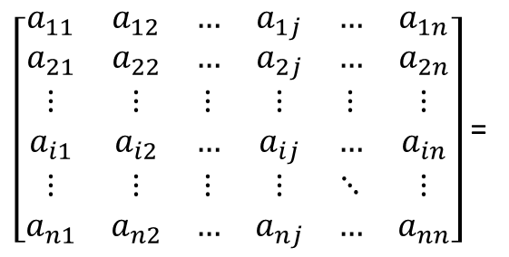
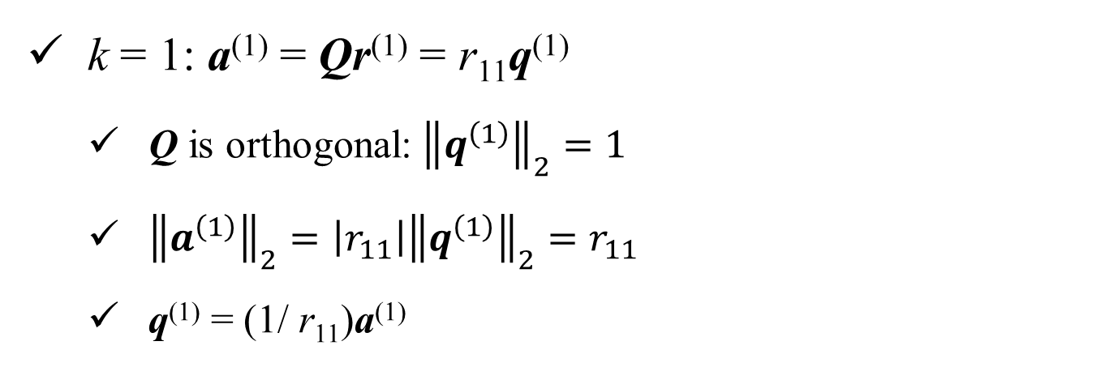
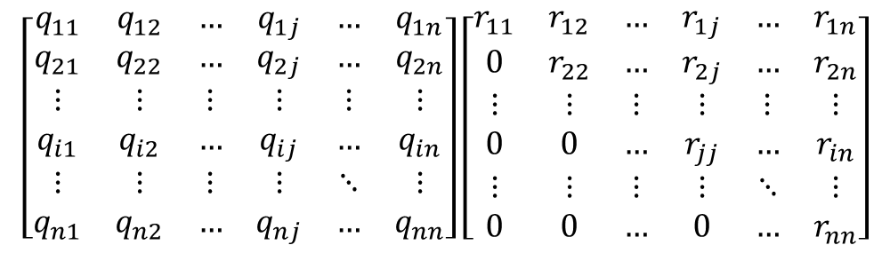
QR-Decomposition: Proof by Induction
k = 1: a⁽¹⁾ = Qr⁽¹⁾ = r₁₁q⁽¹⁾
Q is orthogonal: ${\left\|q^{\left(1\right)}\right\|}_{2}=1$
${\left\|a^{\left(1\right)}\right\|}_{2}=\left|r_{11}\right|{\left\|q^{\left(1\right)}\right\|}_{2}=r_{11}$
q⁽¹⁾ = (1/ r₁₁)a⁽¹⁾
a⁽¹⁾
q⁽¹⁾
r⁽¹⁾
$\left[\begin{matrix}a_{11} & a_{12} & … & a_{1j} & … & a_{1n} \\ a_{21} & a_{22} & … & a_{2j} & … & a_{2n} \\ ⋮ & ⋮ & ⋮ & ⋮ & ⋮ & ⋮ \\ a_{i1} & a_{i2} & … & a_{ij} & … & a_{in} \\ ⋮ & ⋮ & ⋮ & ⋮ & ⋱ & ⋮ \\ a_{n1} & a_{n2} & … & a_{nj} & … & a_{nn}\end{matrix}\right]$ =
$$\left[\begin{matrix}q_{11} & q_{12} & … & q_{1j} & … & q_{1n} \\ q_{21} & q_{22} & … & q_{2j} & … & q_{2n} \\ ⋮ & ⋮ & ⋮ & ⋮ & ⋮ & ⋮ \\ q_{i1} & q_{i2} & … & q_{ij} & … & q_{in} \\ ⋮ & ⋮ & ⋮ & ⋮ & ⋱ & ⋮ \\ q_{n1} & q_{n2} & … & q_{nj} & … & q_{nn}\end{matrix}\right]\left[\begin{matrix}r_{11} & r_{12} & … & r_{1j} & … & r_{1n} \\ 0 & r_{22} & … & r_{2j} & … & r_{2n} \\ ⋮ & ⋮ & ⋮ & ⋮ & ⋮ & ⋮ \\ 0 & 0 & … & r_{jj} & … & r_{in} \\ ⋮ & ⋮ & ⋮ & ⋮ & ⋱ & ⋮ \\ 0 & 0 & … & 0 & … & r_{nn}\end{matrix}\right]$$

Slide 5
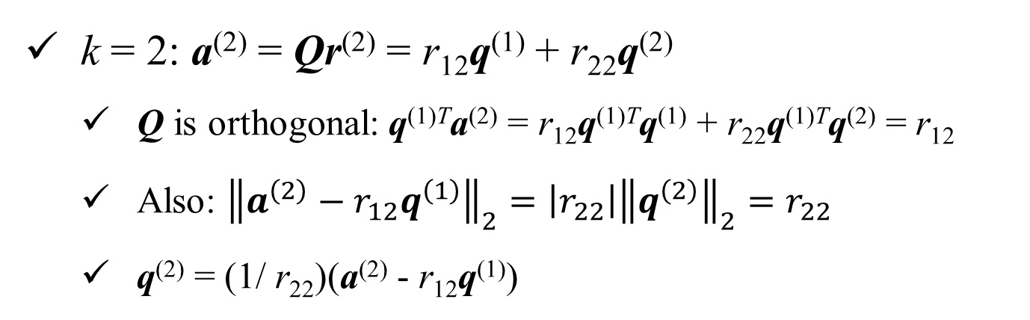
QR-Decomposition: Proof by Induction
k = 2: a⁽²⁾ = Qr⁽²⁾ = r₁₂q⁽¹⁾ + r₂₂q⁽²⁾
Q is orthogonal: q^{(1)T}a⁽²⁾ = r₁₂q^{(1)T}q⁽¹⁾ + r₂₂q^{(1)T}q⁽²⁾ = r₁₂
Also: ${\left\|a^{\left(2\right)}−r_{12}q^{\left(1\right)}\right\|}_{2}=\left|r_{22}\right|{\left\|q^{\left(2\right)}\right\|}_{2}=r_{22}$
q⁽²⁾ = (1/ r₂₂)(a⁽²⁾ - r₁₂q⁽¹⁾)
0
a⁽²⁾
q⁽¹⁾
q⁽²⁾
r⁽²⁾
$\left[\begin{matrix}a_{11} & a_{12} & … & a_{1j} & … & a_{1n} \\ a_{21} & a_{22} & … & a_{2j} & … & a_{2n} \\ ⋮ & ⋮ & ⋮ & ⋮ & ⋮ & ⋮ \\ a_{i1} & a_{i2} & … & a_{ij} & … & a_{in} \\ ⋮ & ⋮ & ⋮ & ⋮ & ⋱ & ⋮ \\ a_{n1} & a_{n2} & … & a_{nj} & … & a_{nn}\end{matrix}\right]$ =
$$\left[\begin{matrix}q_{11} & q_{12} & … & q_{1j} & … & q_{1n} \\ q_{21} & q_{22} & … & q_{2j} & … & q_{2n} \\ ⋮ & ⋮ & ⋮ & ⋮ & ⋮ & ⋮ \\ q_{i1} & q_{i2} & … & q_{ij} & … & q_{in} \\ ⋮ & ⋮ & ⋮ & ⋮ & ⋱ & ⋮ \\ q_{n1} & q_{n2} & … & q_{nj} & … & q_{nn}\end{matrix}\right]\left[\begin{matrix}r_{11} & r_{12} & … & r_{1j} & … & r_{1n} \\ 0 & r_{22} & … & r_{2j} & … & r_{2n} \\ ⋮ & ⋮ & ⋮ & ⋮ & ⋮ & ⋮ \\ 0 & 0 & … & r_{jj} & … & r_{in} \\ ⋮ & ⋮ & ⋮ & ⋮ & ⋱ & ⋮ \\ 0 & 0 & … & 0 & … & r_{nn}\end{matrix}\right]$$

Slide 6
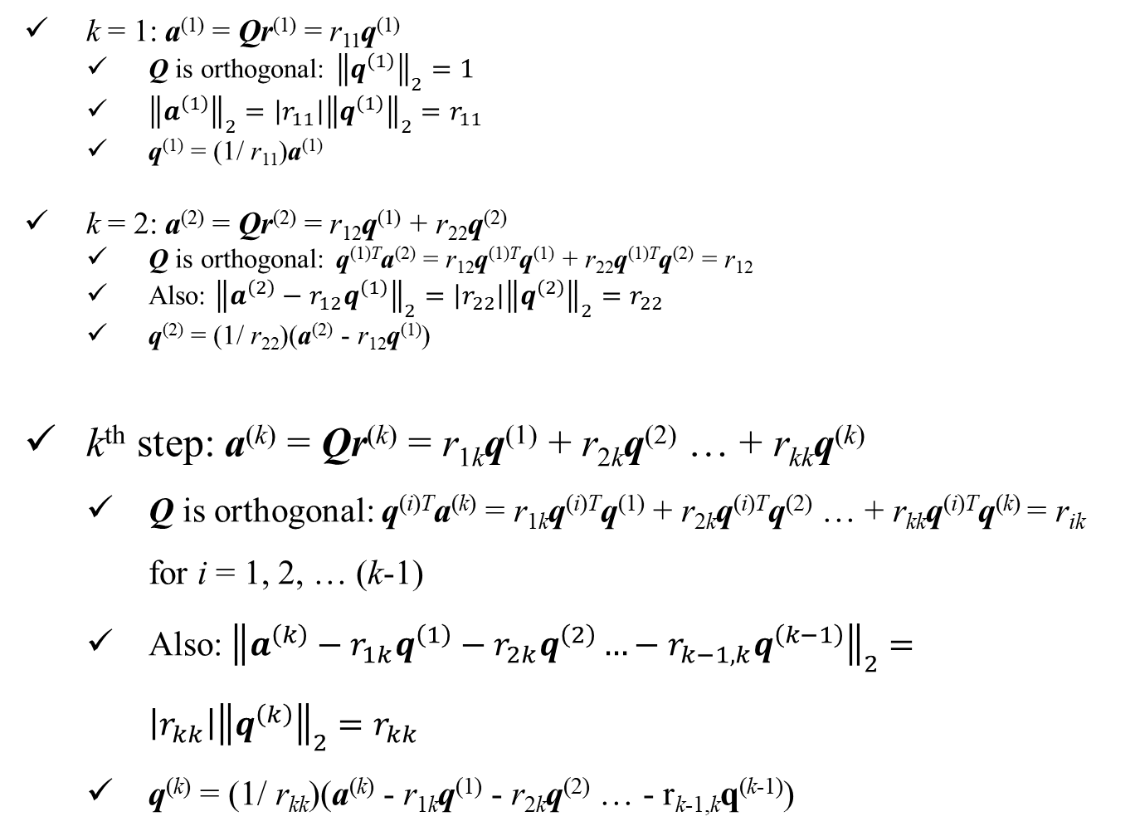
QR-Decomposition: proof by induction
k = 1: a⁽¹⁾ = Qr⁽¹⁾ = r₁₁q⁽¹⁾
Q is orthogonal: ${\left\|q^{\left(1\right)}\right\|}_{2}=1$
${\left\|a^{\left(1\right)}\right\|}_{2}=\left|r_{11}\right|{\left\|q^{\left(1\right)}\right\|}_{2}=r_{11}$
q⁽¹⁾ = (1/ r₁₁)a⁽¹⁾
k = 2: a⁽²⁾ = Qr⁽²⁾ = r₁₂q⁽¹⁾ + r₂₂q⁽²⁾
Q is orthogonal: q^{(1)T}a⁽²⁾ = r₁₂q^{(1)T}q⁽¹⁾ + r₂₂q^{(1)T}q⁽²⁾ = r₁₂
Also: ${\left\|a^{\left(2\right)}−r_{12}q^{\left(1\right)}\right\|}_{2}=\left|r_{22}\right|{\left\|q^{\left(2\right)}\right\|}_{2}=r_{22}$
q⁽²⁾ = (1/ r₂₂)(a⁽²⁾ - r₁₂q⁽¹⁾)
k^{th} step: a^{(k)} = Qr^{(k)} = r_{1k}q⁽¹⁾ + r_{2k}q⁽²⁾ … + r_{kk}q^{(k)}
Q is orthogonal: q^{(i)T}a^{(k)} = r_{1k}q^{(i)T}q⁽¹⁾ + r_{2k}q^{(i)T}q⁽²⁾ … + r_{kk}q^{(i)T}q^{(k)} = r_{ik} for i = 1, 2, … (k-1)
Also: ${\left\|a^{\left(k\right)}−r_{1k}q^{\left(1\right)}−r_{2k}q^{\left(2\right)}…−r_{k−1,k}q^{\left(k−1\right)}\right\|}_{2}=\left|r_{kk}\right|{\left\|q^{\left(k\right)}\right\|}_{2}=r_{kk}$
q^{(k)} = (1/ r_{kk})(a^{(k)} - r_{1k}q⁽¹⁾ - r_{2k}q⁽²⁾ … - r_{k-1,k}q^{(k-1)})

Slide 7
QR-Decomposition: proof by induction
Proceeding this way up to step n, all n columns of Q and all the elements of R can be computed. This concludes the proof that, A = QR can be constructed!
However, the algorithm in proof is tedious and inefficient!
It is easier to construct the Q and R independently, directly from A using Gram-Schmidt orthogonalization!

Slide 8
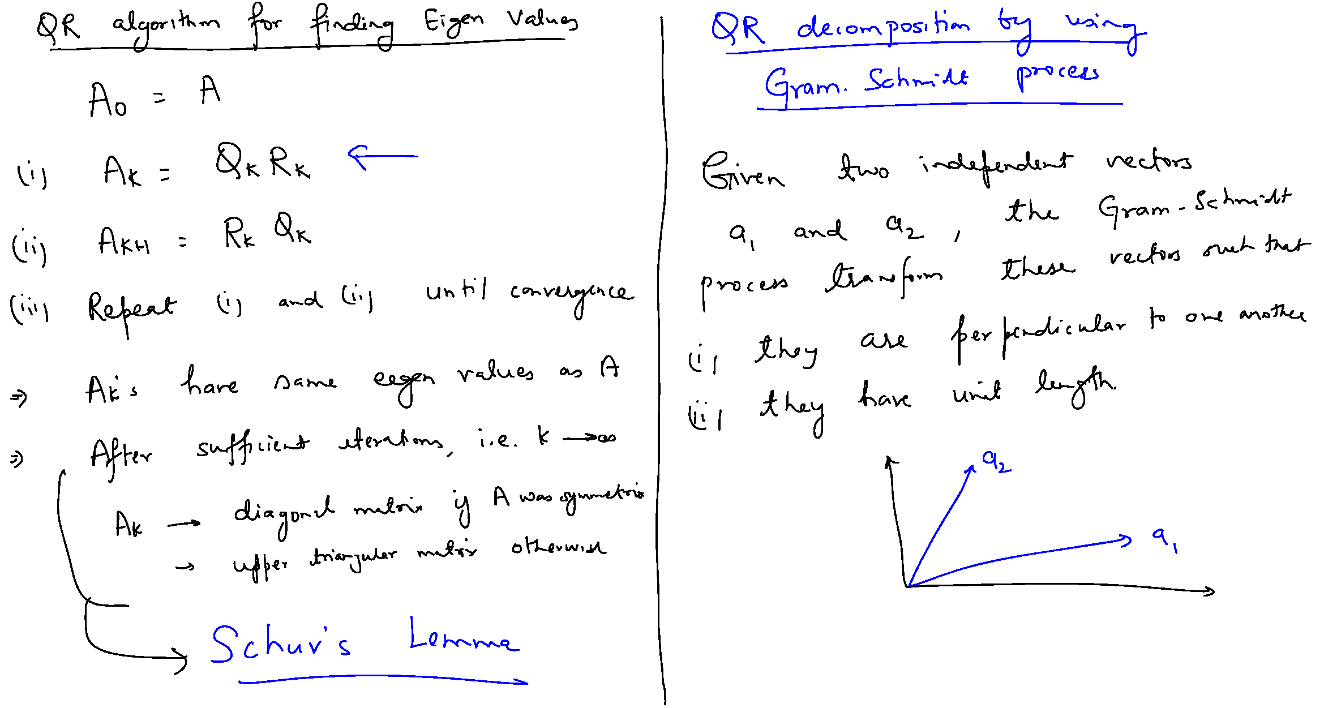
QR decomposition by Gram-Schmidt Orthogonalization

Slide 9
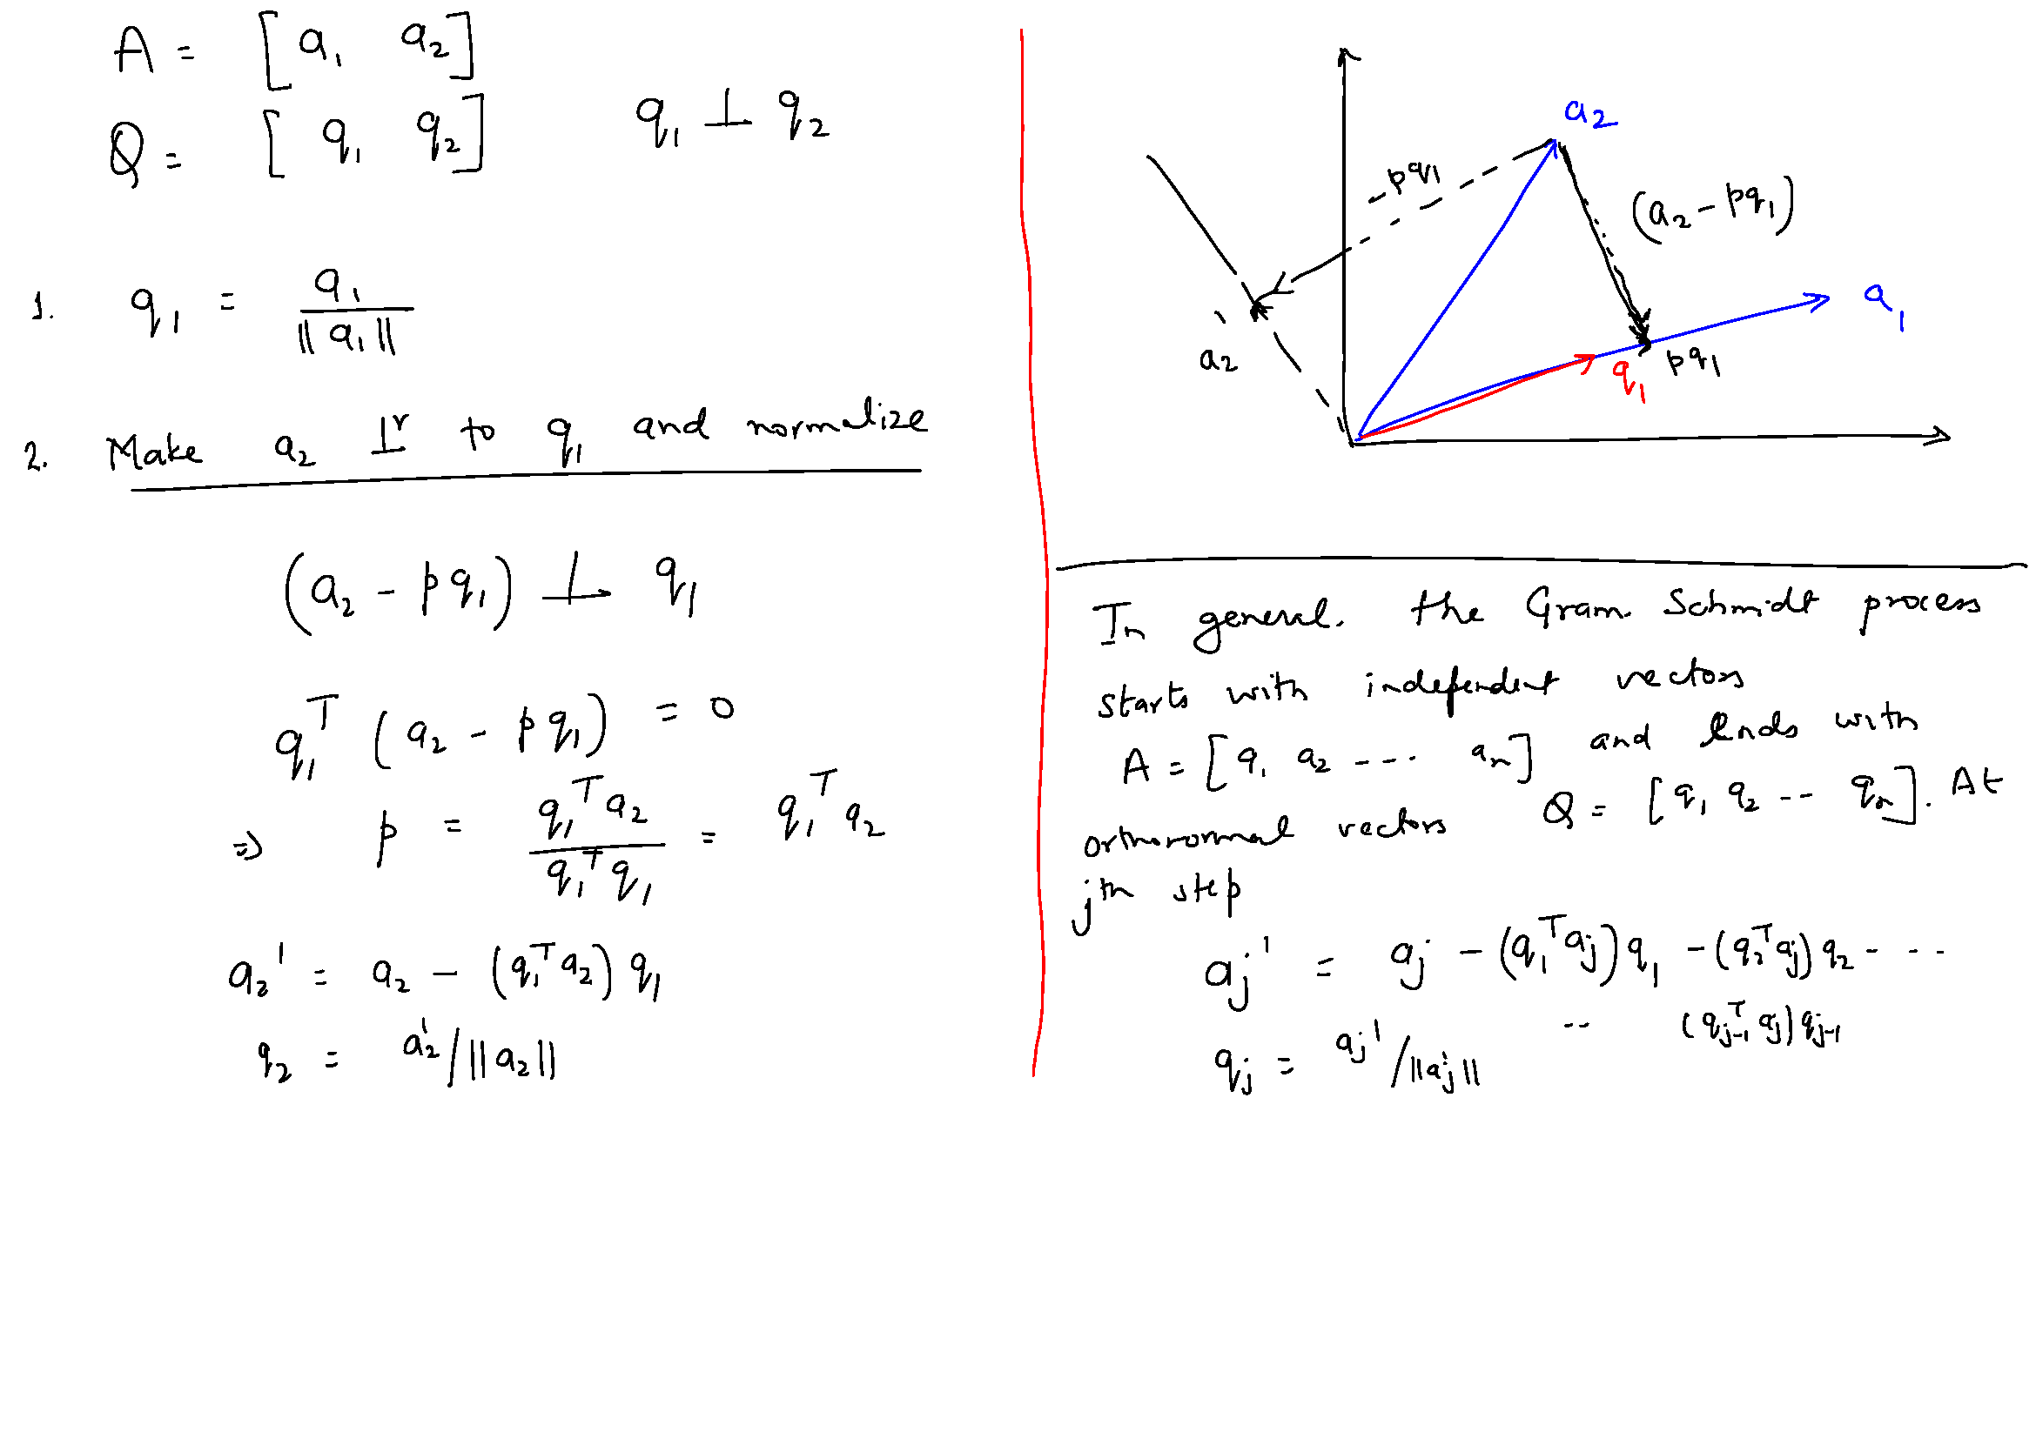
Gram-Schmidt Orthogonalization

Slide 10
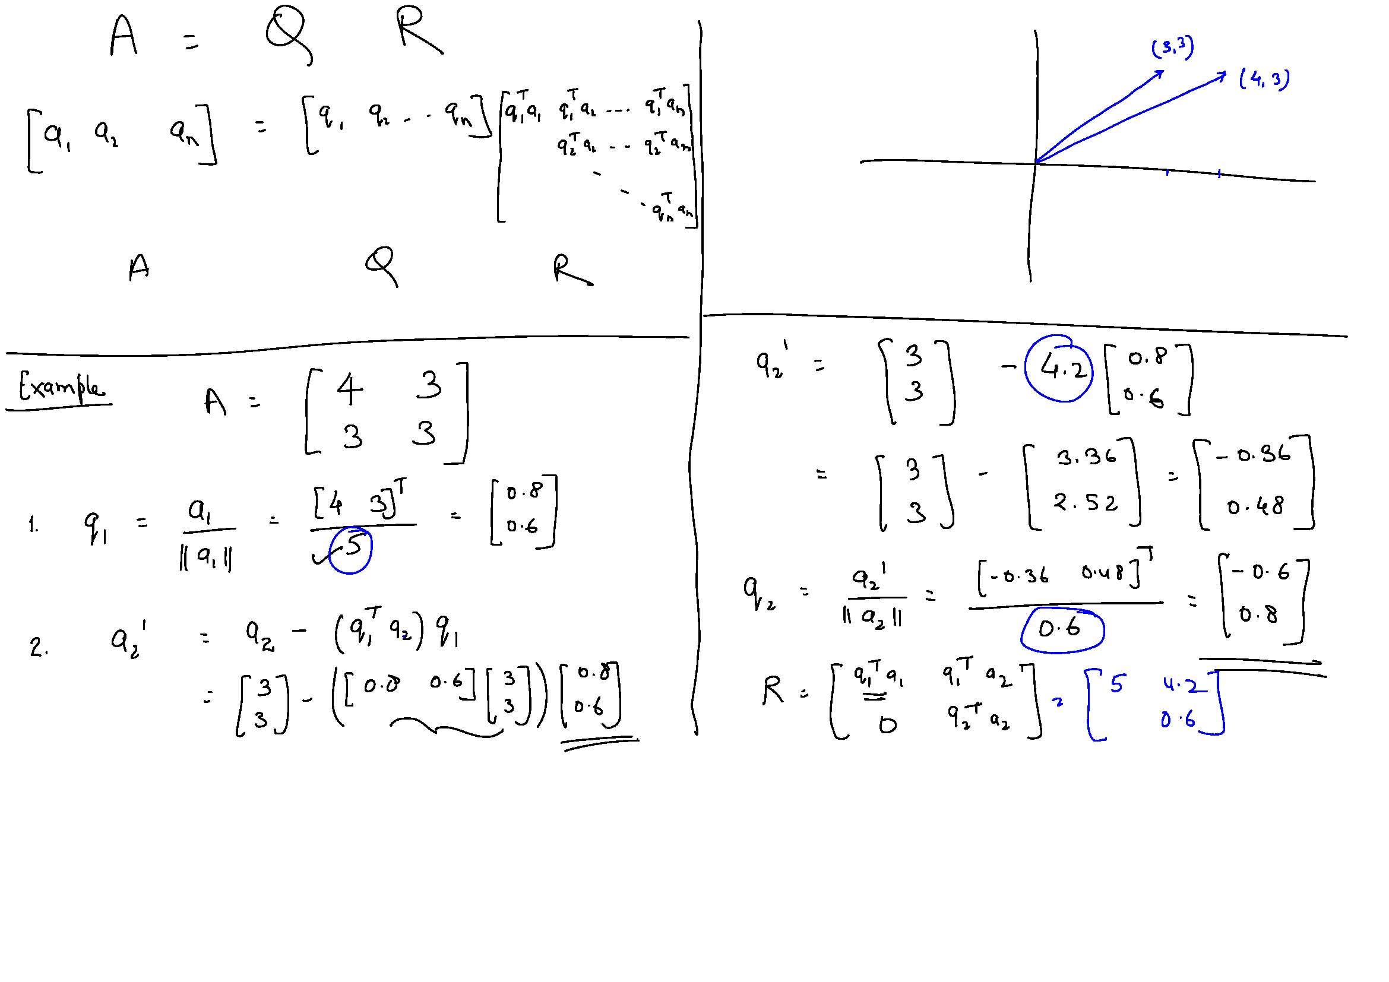
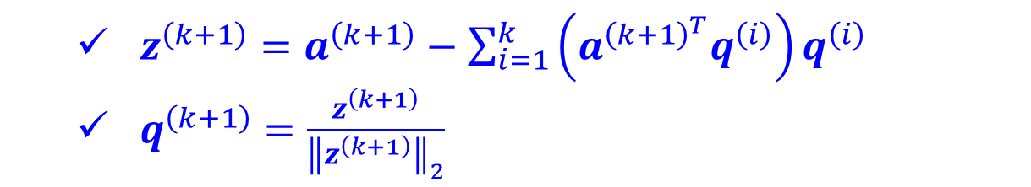
$z^{\left(k+1\right)}=a^{\left(k+1\right)}−\sum_{i=1}^{k}{\left(a^{{\left(k+1\right)}^{T}}q^{\left(i\right)}\right)q^{\left(i\right)}}$
$q^{\left(k+1\right)}=\frac{z^{\left(k+1\right)}}{{\left\|z^{\left(k+1\right)}\right\|}_{2}}$

Slide 11
$z^{\left(k+1\right)}=a^{\left(k+1\right)}−\sum_{i=1}^{k}{\left(a^{{\left(k+1\right)}^{T}}q^{\left(i\right)}\right)q^{\left(i\right)}}$
$q^{\left(k+1\right)}=\frac{z^{\left(k+1\right)}}{{\left\|z^{\left(k+1\right)}\right\|}_{2}}$

Slide 12
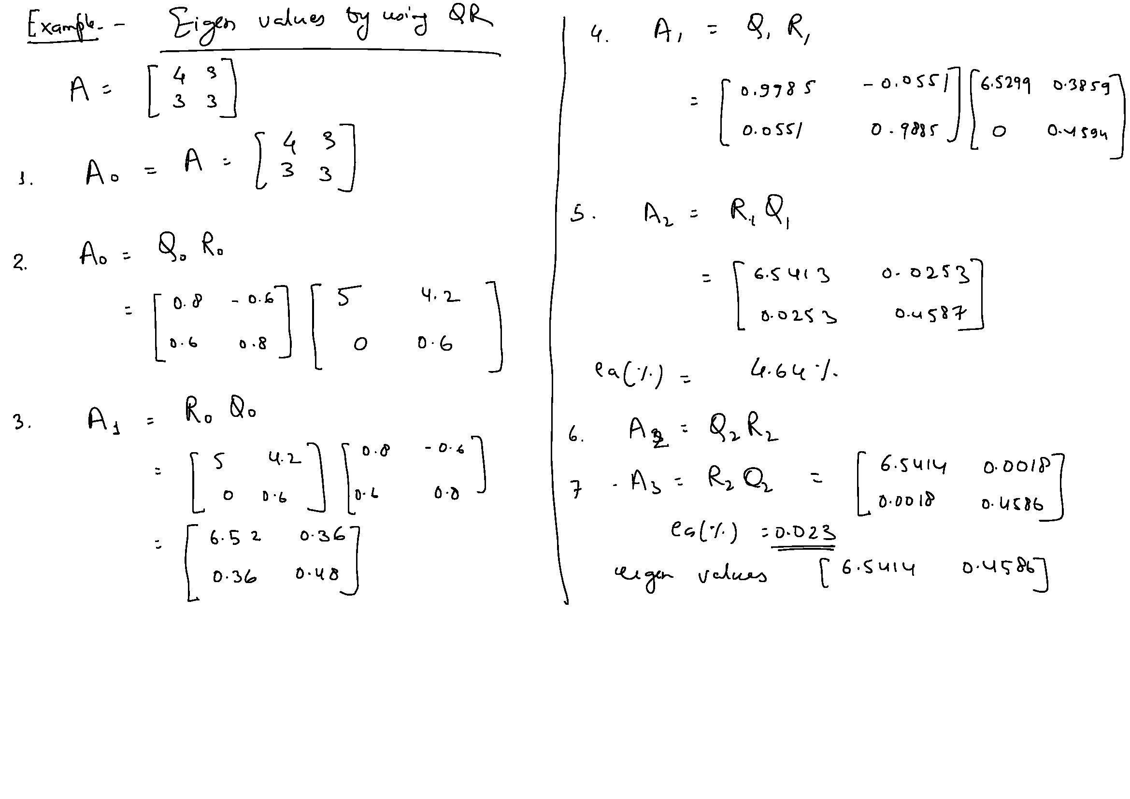

Slide 13
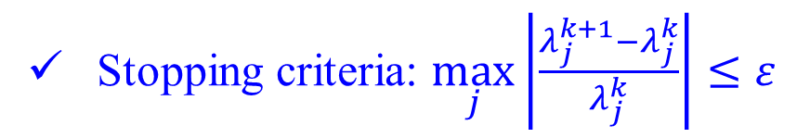
Gram-Schmidt Orthogonalization
Stopping criteria: $\max_{j}\left|\frac{λ_{j}^{k+1}−λ_{j}^{k}}{λ_{j}^{k}}\right|≤ε$

Slide 14
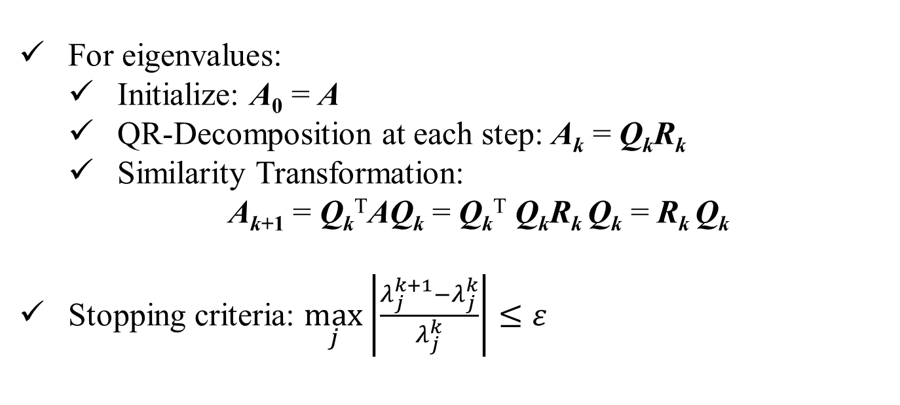
QR-Decomposition: Calculating Eigenvalues
For eigenvalues:
Initialize: A₀ = A
QR-Decomposition at each step: A_{k} = Q_{k}R_{k}
Similarity Transformation:
A_{k+1} = Q_{k}^{T}AQ_{k} = Q_{k}^{T} Q_{k}R_{k} Q_{k} = R_{k} Q_{k}
Stopping criteria: $\max_{j}\left|\frac{λ_{j}^{k+1}−λ_{j}^{k}}{λ_{j}^{k}}\right|≤ε$

Slide 15
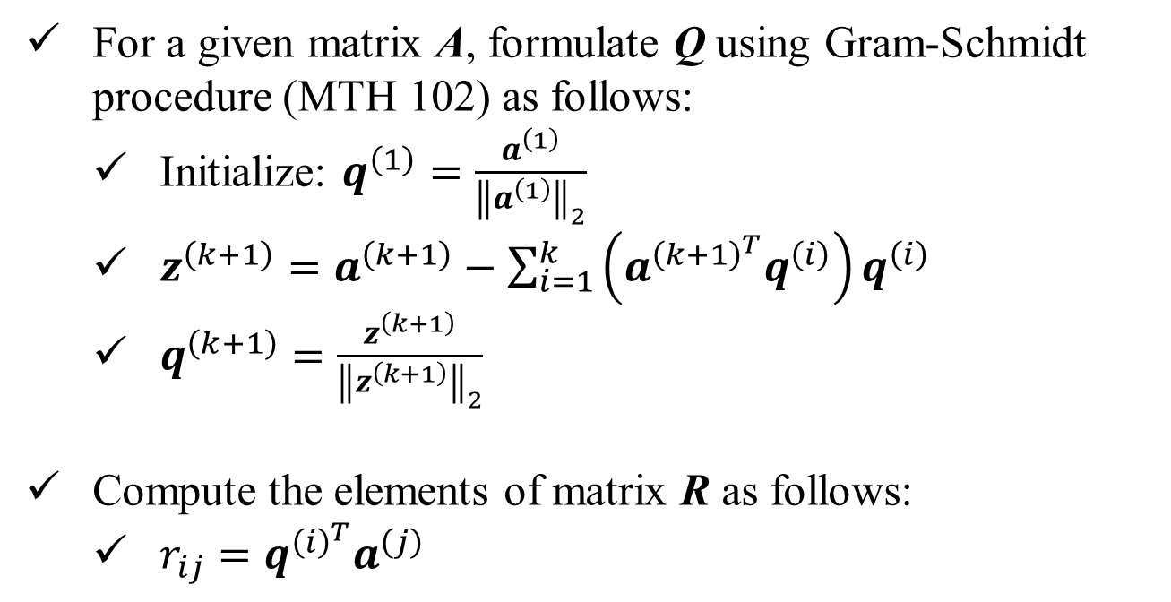
QR-Decomposition: Algorithm
For a given matrix A, formulate Q using Gram-Schmidt procedure (MTH 102) as follows:
Initialize: $q^{\left(1\right)}=\frac{a^{\left(1\right)}}{{\left\|a^{\left(1\right)}\right\|}_{2}}$
$z^{\left(k+1\right)}=a^{\left(k+1\right)}−\sum_{i=1}^{k}{\left(a^{{\left(k+1\right)}^{T}}q^{\left(i\right)}\right)q^{\left(i\right)}}$
$q^{\left(k+1\right)}=\frac{z^{\left(k+1\right)}}{{\left\|z^{\left(k+1\right)}\right\|}_{2}}$
Compute the elements of matrix R as follows:
$r_{ij}=q^{{\left(i\right)}^{T}}a^{\left(j\right)}$

Slide 16





Example: QR-Decomposition
A =

Slide 17



Example: QR-Decomposition

Slide 18

Example: QR-Decomposition

Slide 19
Example: Eigenvalues by Similarity Transformation
k | A_{k} = R_{k}Q_{k} |  |  | Q_{k} |  |  | R_{k} |  |  | e (%)
0 | 3.0000 | 4.0000 | 1.0000 | 0.6396 | -0.1980 | -0.7428 | 4.6904 | 6.6092 | 1.7056
 | 3.0000 | 5.0000 | 1.0000 | 0.6396 | 0.6730 | 0.3714 | 0.0000 | 1.1481 | -0.2375
 | 2.0000 | 2.0000 | 1.0000 | 0.4264 | -0.7126 | 0.5571 | 0.0000 | 0.0000 | 0.1857
1 | 7.9545 | 2.3043 | -0.0792 | 0.9968 | -0.0757 | -0.0257 | 7.9801 | 2.3703 | -0.0546 | 866
 | 0.6331 | 0.9420 | 0.2941 | 0.0793 | 0.9765 | 0.2004 | 0.0000 | 0.7721 | 0.2723
 | 0.0792 | -0.1323 | 0.1034 | 0.0099 | -0.2018 | 0.9794 | 0.0000 | 0.0000 | 0.1623
2 | 8.1420 | 1.7215 | 0.2166 | 1.0000 | -0.0078 | -0.0006 | 8.1423 | 1.7269 | 0.2199 | 34.92
 | 0.0640 | 0.6990 | 0.4214 | 0.0079 | 0.9988 | 0.0482 | 0.0000 | 0.6863 | 0.4116
 | 0.0016 | -0.0328 | 0.1589 | 0.0002 | -0.0482 | 0.9988 | 0.0000 | 0.0000 | 0.1790
3 | 8.1556 | 1.6505 | 0.2983 | 1.0000 | -0.0007 | 0.0000 | 8.1557 | 1.6509 | 0.2986 | 11.08
 | 0.0055 | 0.6656 | 0.4442 | 0.0007 | 0.9999 | 0.0130 | 0.0000 | 0.6645 | 0.4416
 | 0.0000 | -0.0086 | 0.1788 | 0.0000 | -0.0130 | 0.9999 | 0.0000 | 0.0000 | 0.1845
4 | 8.1568 | 1.6414 | 0.3199 | 1.0000 | -0.0001 | 0.0000 | 8.1568 | 1.6415 | 0.3199 | 3.1
 | 0.0004 | 0.6587 | 0.4502 | 0.0001 | 1.0000 | 0.0036 | 0.0000 | 0.6587 | 0.4495
 | 0.0000 | -0.0024 | 0.1845 | 0.0000 | -0.0036 | 1.0000 | 0.0000 | 0.0000 | 0.1861
5 | 8.1568 | 1.6398 | 0.3259 | 1.0000 | 0.0000 | 0.0000 | 8.1568 | 1.6398 | 0.3259 | 0.88
 | 0.0000 | 0.6570 | 0.4519 | 0.0000 | 1.0000 | 0.0010 | 0.0000 | 0.6570 | 0.4517
 | 0.0000 | -0.0007 | 0.1861 | 0.0000 | -0.0010 | 1.0000 | 0.0000 | 0.0000 | 0.1866
6 | 8.1569 | 1.6395 | 0.3276 | 1.0000 | 0.0000 | 0.0000 | 8.1569 | 1.6395 | 0.3276 | 0.25
 | 0.0000 | 0.6565 | 0.4524 | 0.0000 | 1.0000 | 0.0003 | 0.0000 | 0.6565 | 0.4523
 | 0.0000 | -0.0002 | 0.1866 | 0.0000 | -0.0003 | 1.0000 | 0.0000 | 0.0000 | 0.1867
7 | 8.1569 | 1.6394 | 0.3281 |  |  |  |  |  |  | 0.07
 | 0.0000 | 0.6564 | 0.4525
 | 0.0000 | -0.0001 | 0.1867

