Slide 1

ESO 208A: Computational Methods in Engineering Theory of Approximation
Abhas Singh
Department of Civil Engineering
IIT Kanpur
Acknowledgements: Profs. Saumyen Guha and Shivam Tripathi (CE)

Slide 2
Approximation of Functions (Curve Fitting)
Forms the basis of all numerical methods of interest in engineering and science – cannot emphasize enough!
Function approximation: monotone, periodic, pwc, etc.
Discrete and Fast Fourier Transform
Regression
Interpolation
Numerical Differentiation
Numerical Integration
Solution of ODE and PDE: both finite difference and finite element

Slide 3
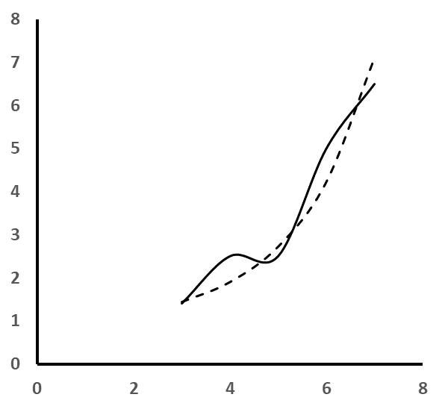
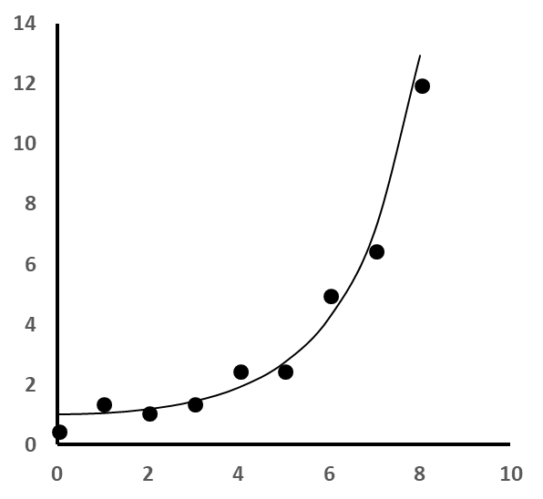
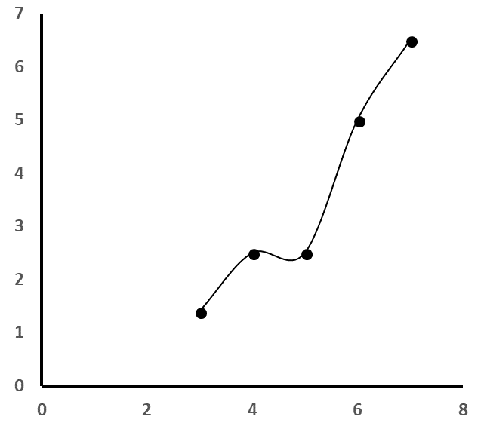
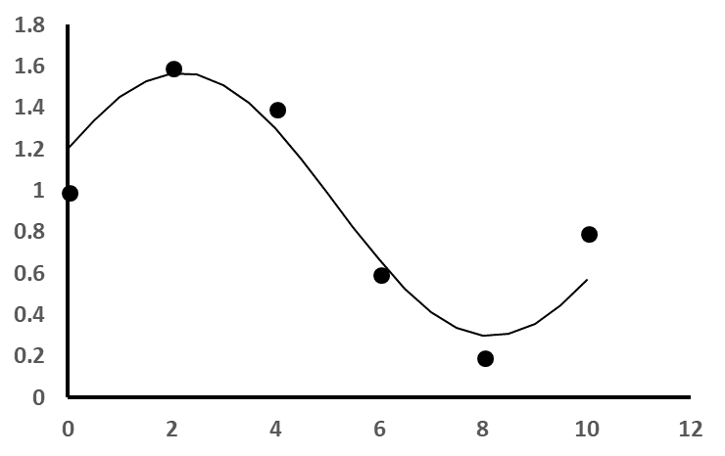
Approximation of Discrete data or tab (f): Regression
Approximation of Continuous Function f(x)
Complicated Analytical Function, Analog Signal from a measuring device
Discrete measurements of continuous experiments or phenomena
Missing Data, Derivative, Integration for tab (f): Interpolation
Approximation of Discrete data or tab (f): Regression

Slide 4
Attendance in ESO 208A until Major Quiz1
Percent Attendance
Lecture/ Tutorial/ Quiz No

Slide 5
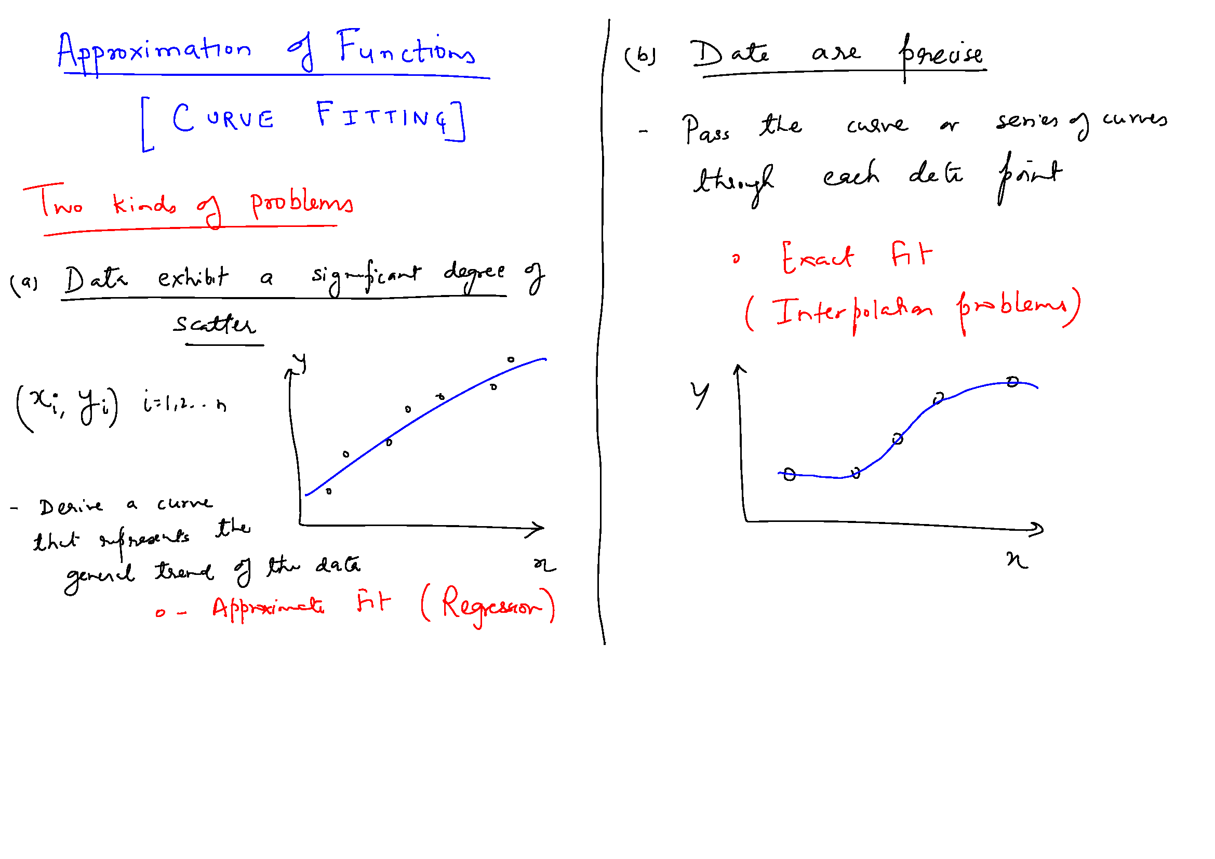

Slide 7
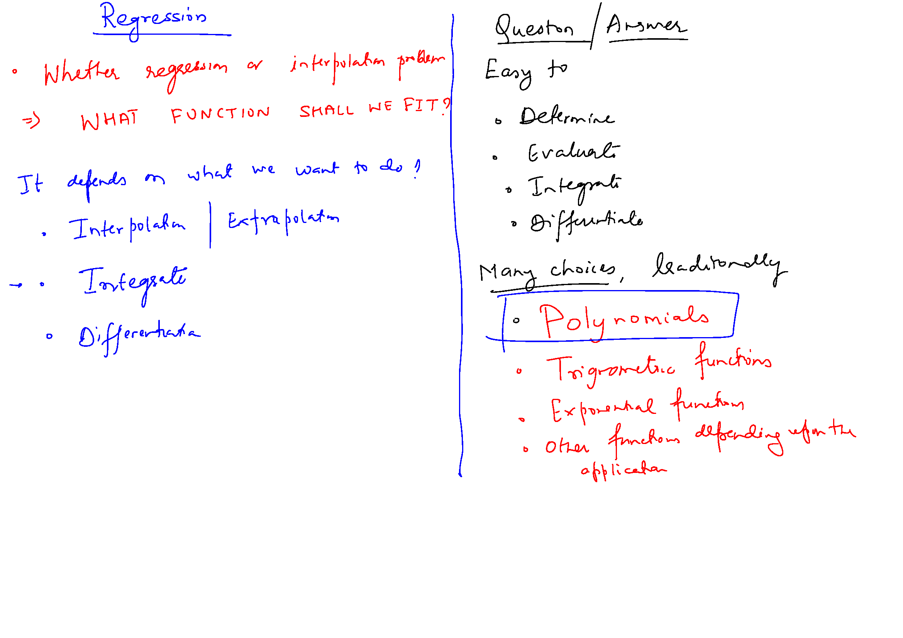

Slide 8
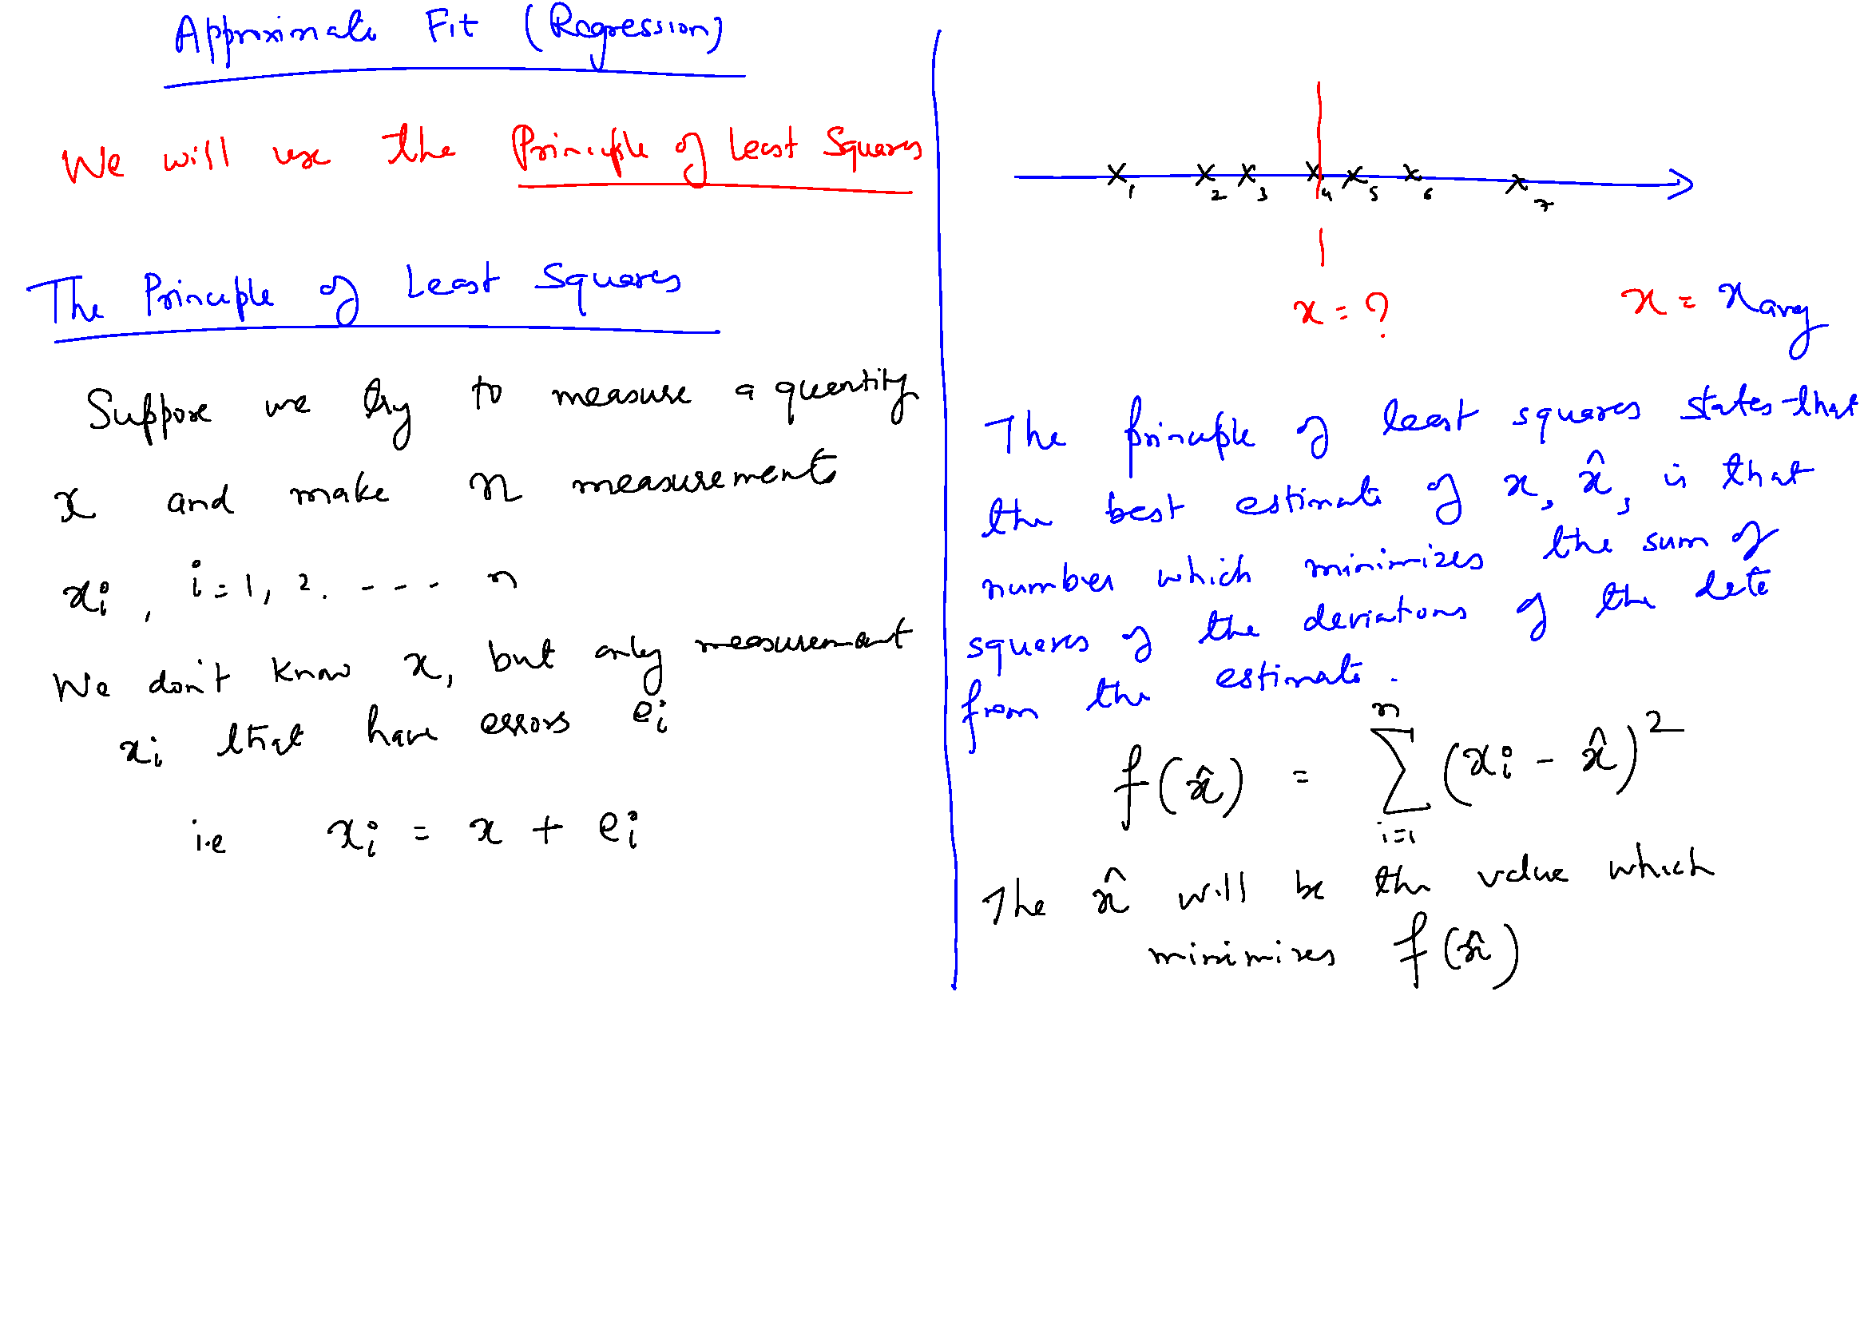

Slide 11
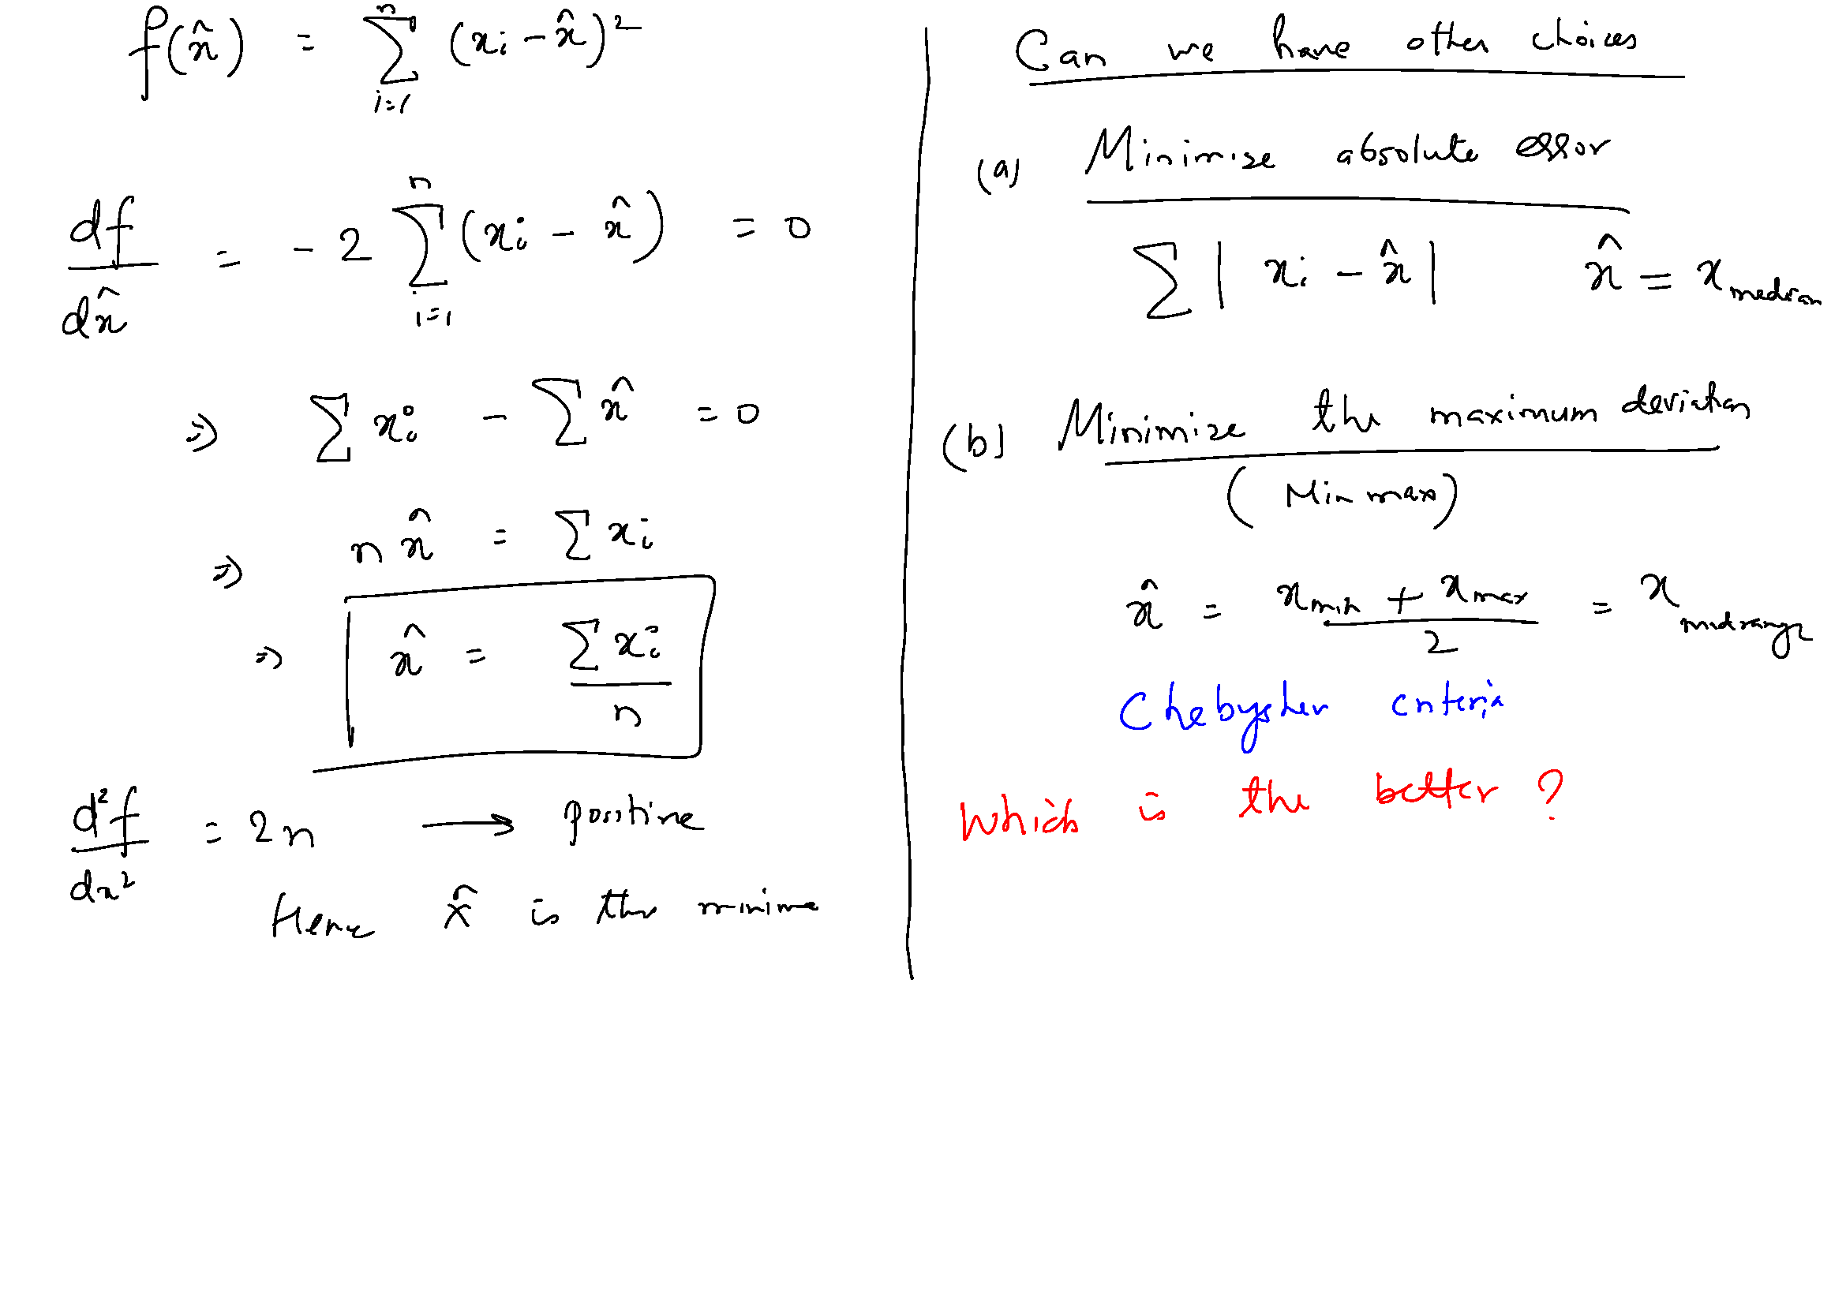

Slide 13
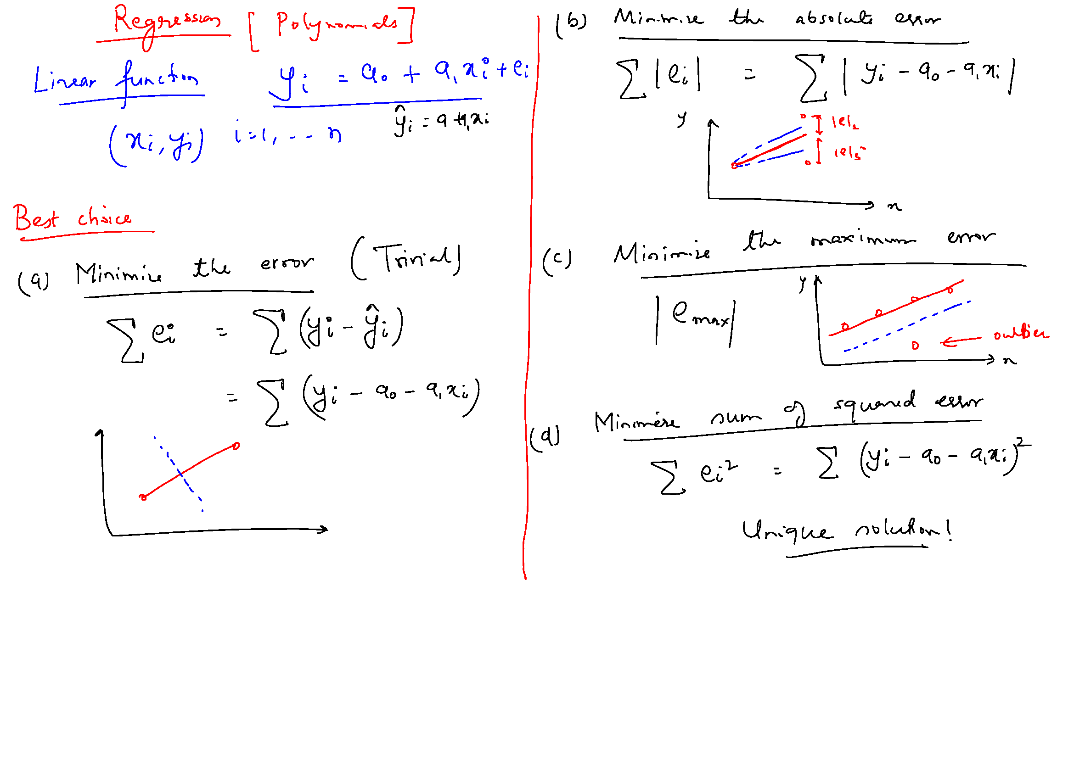

Slide 15
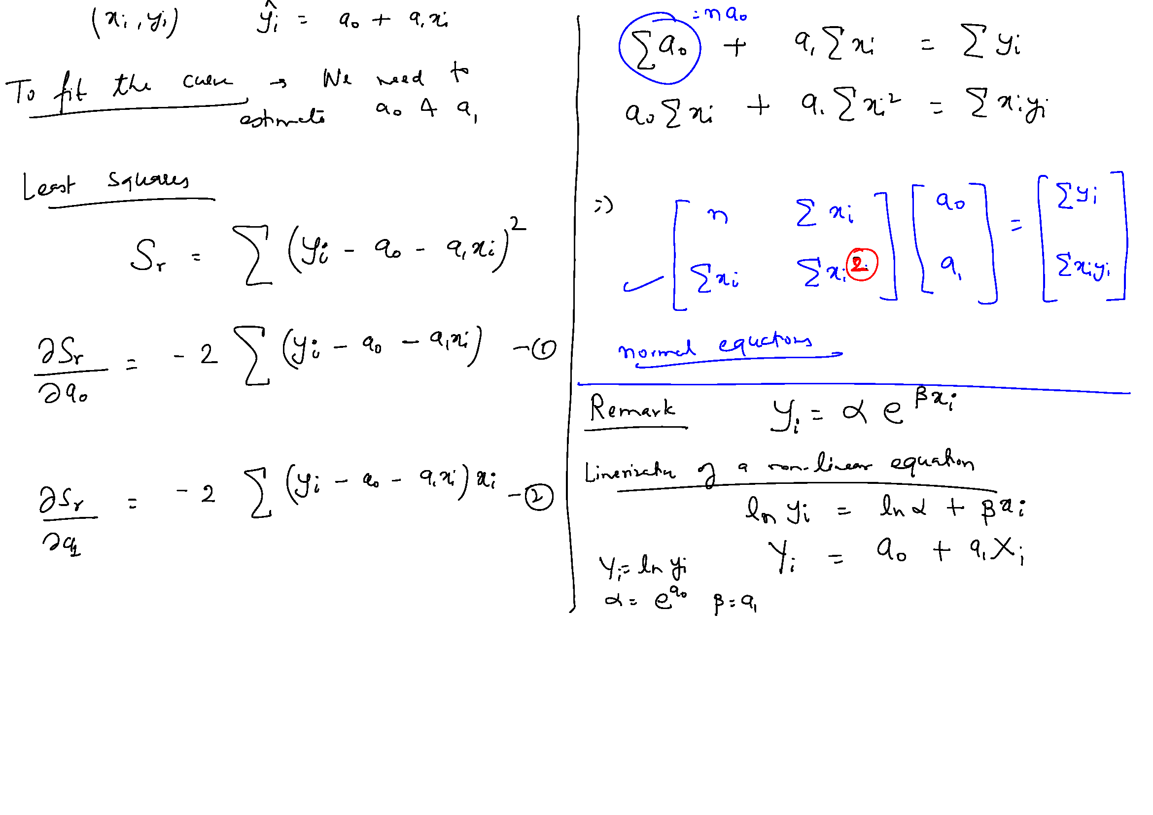

Slide 16
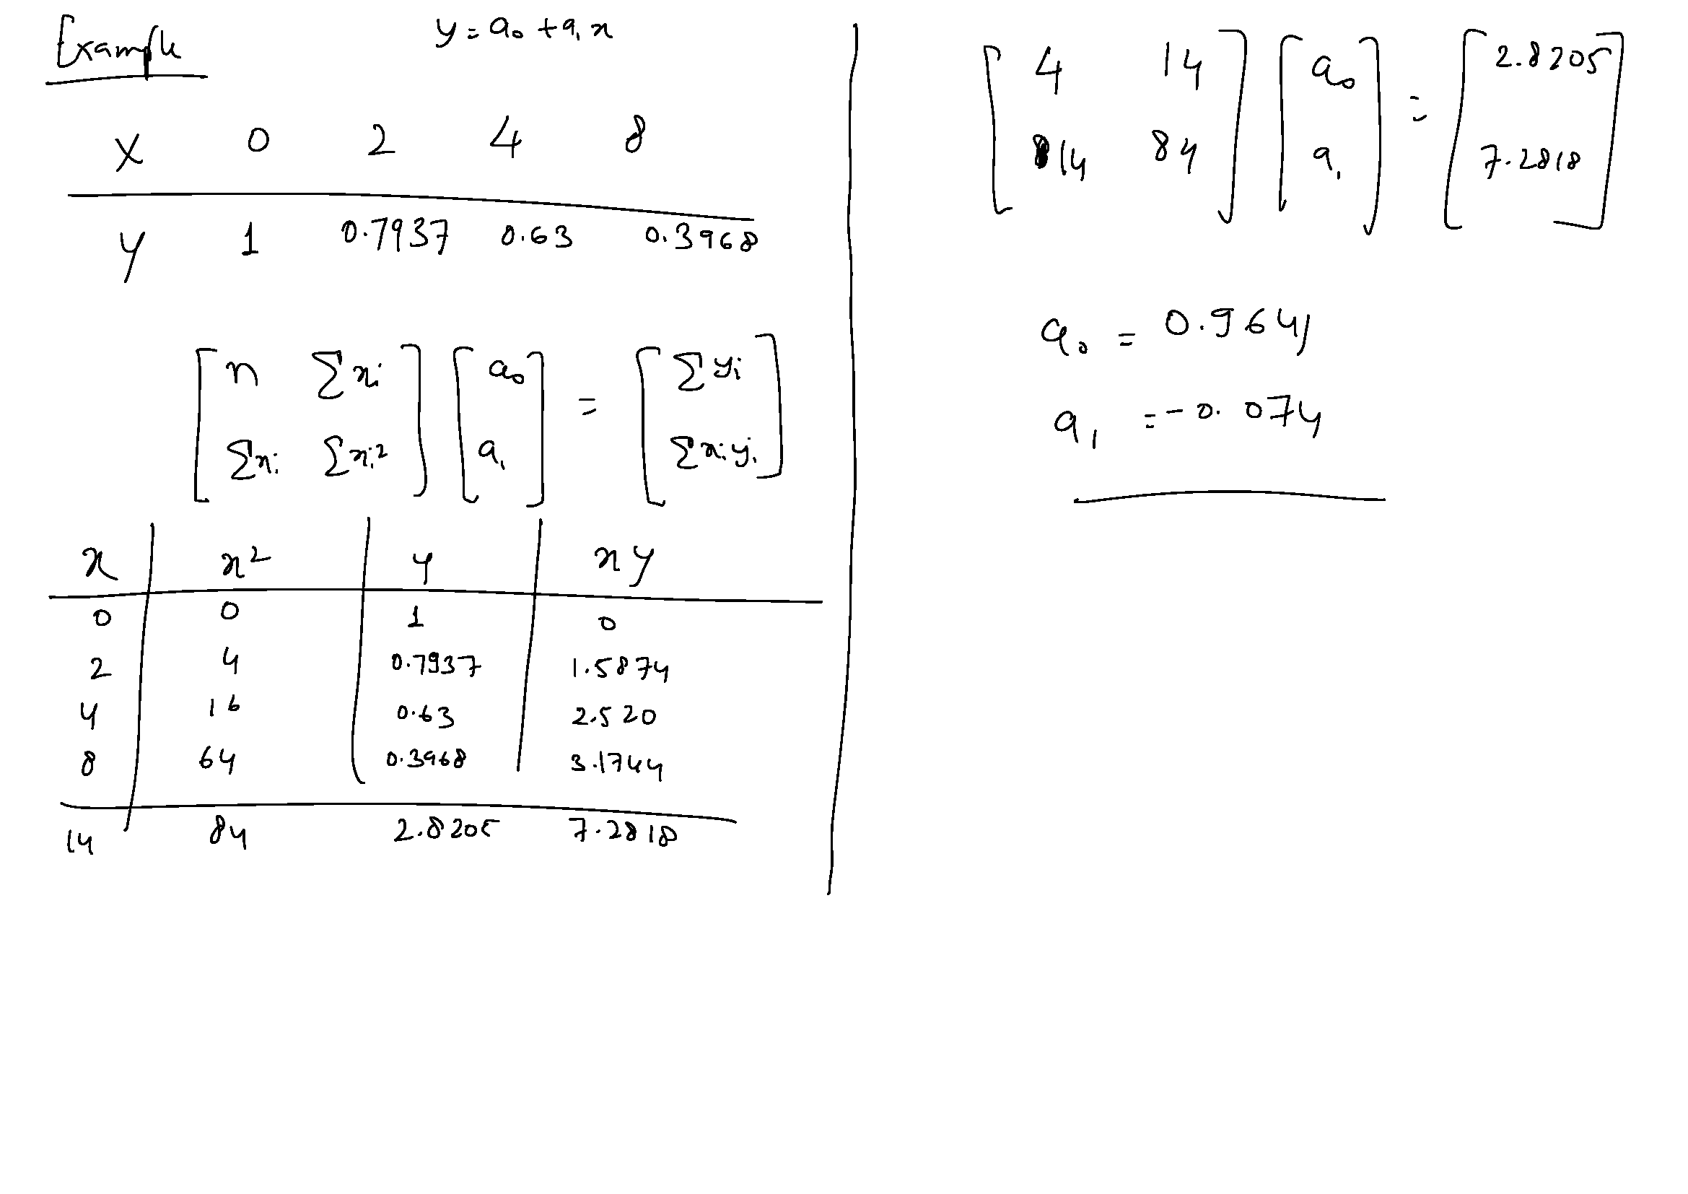

Slide 19
∑ =

Slide 20
∑ =

Slide 21
∑ =

Slide 23
Approximation of Functions
We shall divide the approximation problems into five parts:
Least square approximation of continuous function using various basis polynomials
Least square approximation of discrete functions or Regression
Orthogonal basis functions
Approximation of periodic functions
Interpolation

Slide 24
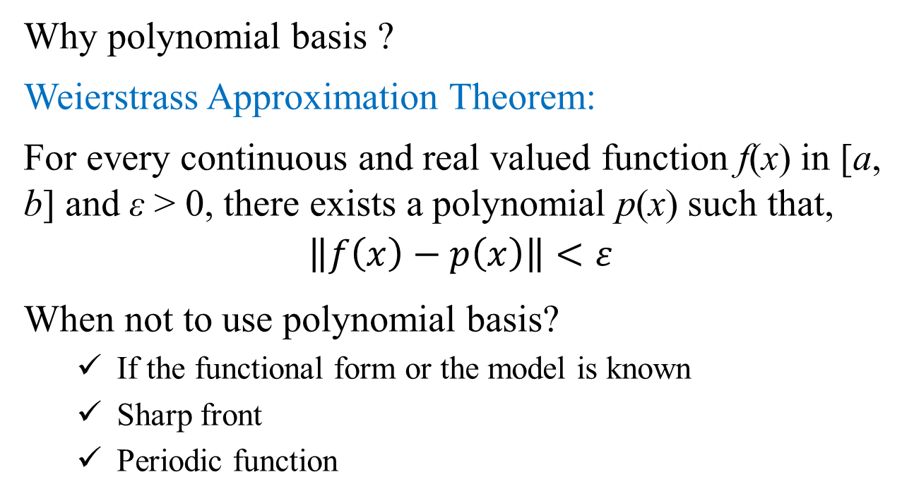
Approximation of Functions
Why polynomial basis ?
Weierstrass Approximation Theorem:
For every continuous and real valued function f(x) in [a, b] and ε > 0, there exists a polynomial p(x) such that,
$$\left\|f\left(x\right)−p\left(x\right)\right\|<ε$$
When not to use polynomial basis?
If the functional form or the model is known
Sharp front
Periodic function

Slide 25
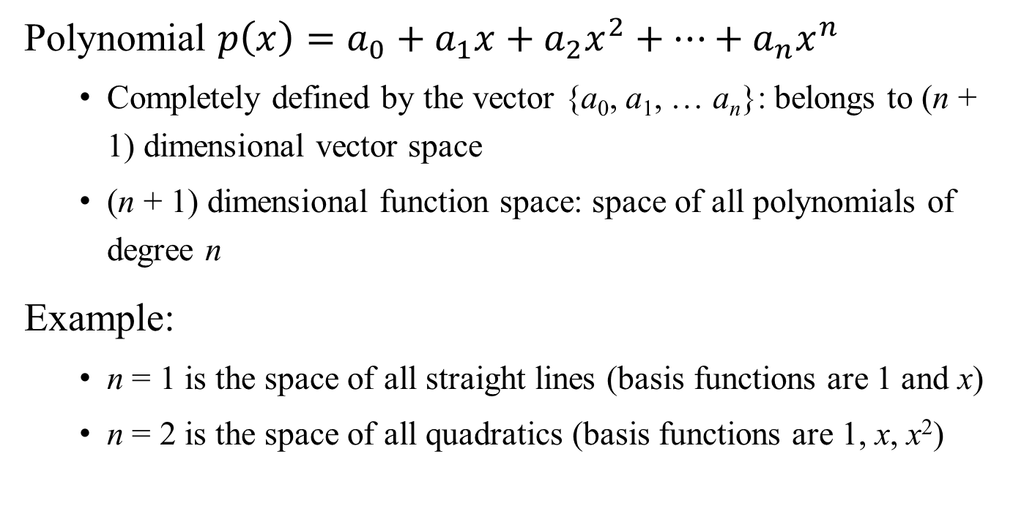
Function Space vs. Vector Space
Polynomial $p\left(x\right)=a_{0}+a_{1}x+a_{2}x^{2}+…+a_{n}x^{n}$
Completely defined by the vector {a₀, a₁, … a_{n}}: belongs to (n + 1) dimensional vector space
(n + 1) dimensional function space: space of all polynomials of degree n
Example:
n = 1 is the space of all straight lines (basis functions are 1 and x)
n = 2 is the space of all quadratics (basis functions are 1, x, x²)

