Slide 1
Errors and Error Analysis Lecture 2

Slide 2
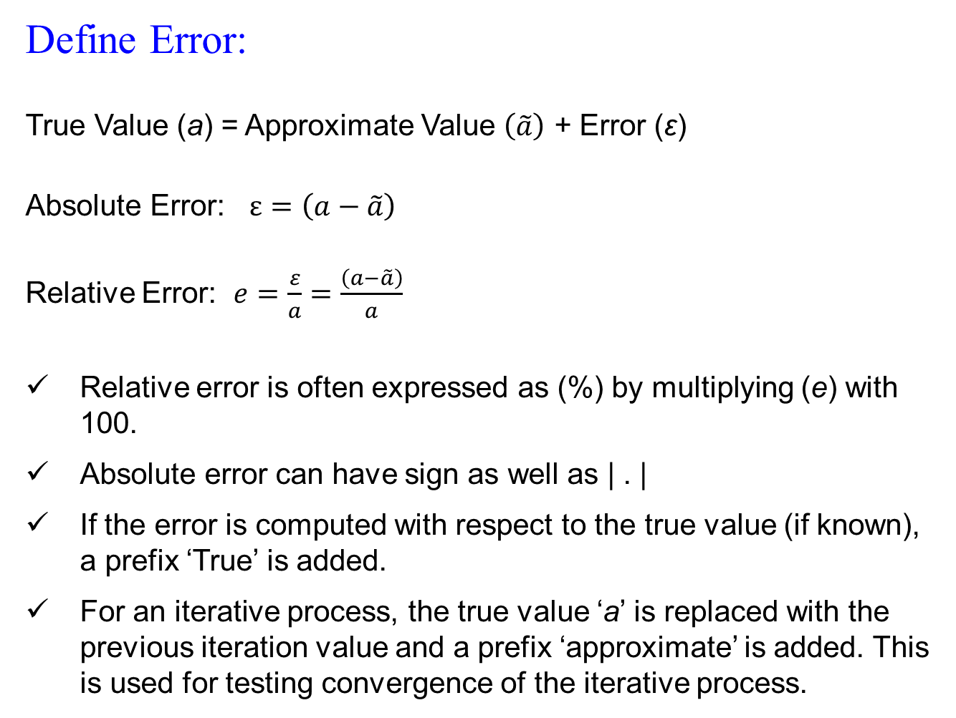
Define Error:
True Value (a) = Approximate Value $\left(\tilde{a}\right)$ + Error (ε)
Absolute Error: $ε=\left(a−\tilde{a}\right)$
Relative Error: $e=\frac{ε}{a}=\frac{\left(a−\tilde{a}\right)}{a}$
Relative error is often expressed as (%) by multiplying (e) with 100.
Absolute error can have sign as well as | . |
If the error is computed with respect to the true value (if known), a prefix ‘True’ is added.
For an iterative process, the true value ‘a’ is replaced with the previous iteration value and a prefix ‘approximate’ is added. This is used for testing convergence of the iterative process.

Slide 3
Sources of Error in computation?
Errors in the Input data: initial and boundary conditions, measured values of the parameters and constants in the model
Round-off error: irrational numbers, product and division of two numbers, limited by the machine capability
Truncation error: truncation of an infinite series, often arises in the design of the numerical method through approximation of the mathematical problem.

Slide 4
Summary
Significant digits/figures are the numbers that one can use with confidence
Example: d = 100 ± 1 m, t = 3.0 ± 0.1 s, v = d/t = ?
True error = True value – Measured/Computed value
approximate error
error bound
Typically, true error is never known

Slide 5
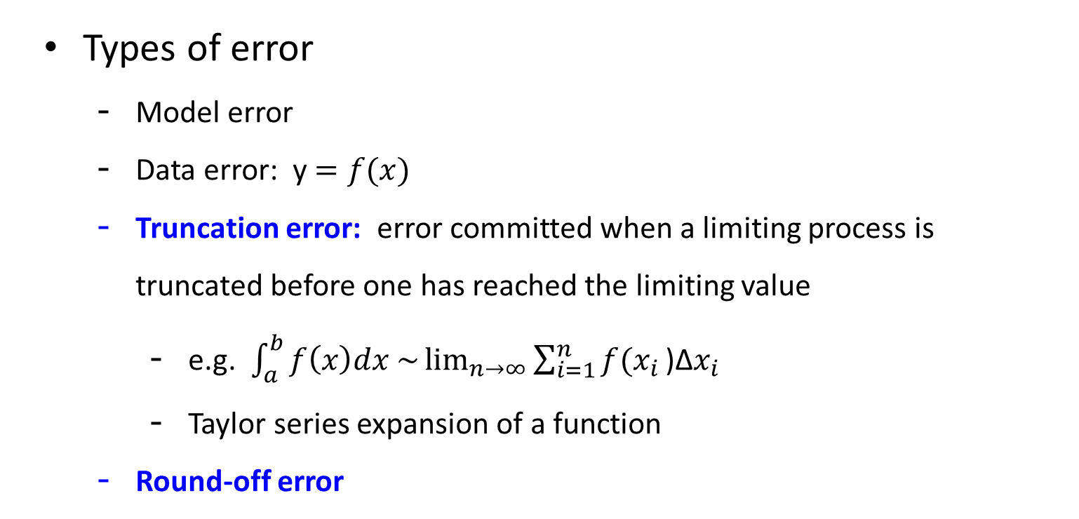
Summary
Types of error
Model error
Data error: y $=f(x)$
Truncation error: error committed when a limiting process is truncated before one has reached the limiting value
e.g. $\int_{a}^{b}{f\left(x\right)dx \sim \lim_{n→∞}{\sum_{i=1}^{n}{f(x_{i}}\text{)}\text{Δ}x_{i}}}$
Taylor series expansion of a function
Round-off error
because of finite nature of computer storage capacity

Slide 6
Error Analyses:
Forward Error Analysis:
How an error in the given input propagates through the system model. (Robustness of the model)
Backward Error Analysis:
Quantification of error resulting from interaction between round-off error and truncation error in the algorithm. (Robustness of the algorithm)
Error in the Input
Both computations are using the original Mathematical Model
Error in the Output
Computation using numerical algorithm
Computation using mathematical problem
Error in the Output

Slide 7
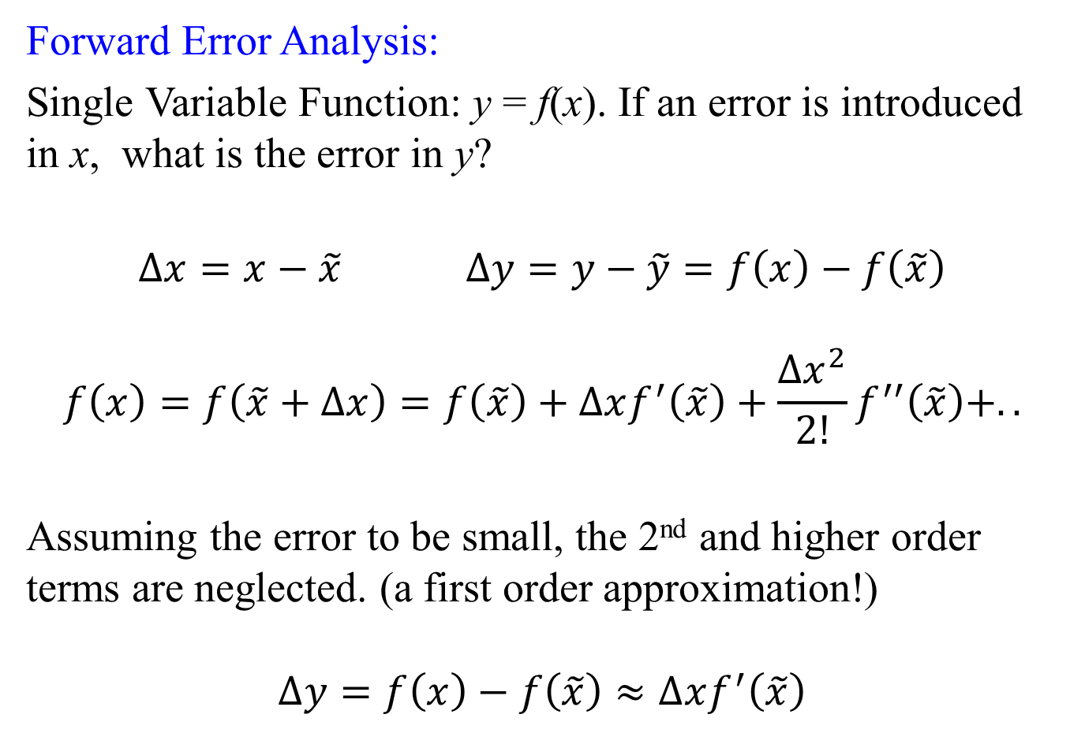
Forward Error Analysis:
Single Variable Function: y = f(x). If an error is introduced in x, what is the error in y?
$∆x=x−\tilde{x}$ $∆y=y−\tilde{y}=f\left(x\right)−f\left(\tilde{x}\right)$
$$f\left(x\right)=f\left(\tilde{x}+∆x\right)=f\left(\tilde{x}\right)+∆xf^{′}\left(\tilde{x}\right)+\frac{{∆x}^{2}}{2!}f^{′′}\left(\tilde{x}\right)+..$$
Assuming the error to be small, the 2nd and higher order terms are neglected. (a first order approximation!)
$$∆y=f\left(x\right)−f\left(\tilde{x}\right)≈∆xf^{′}\left(\tilde{x}\right)$$

Slide 8
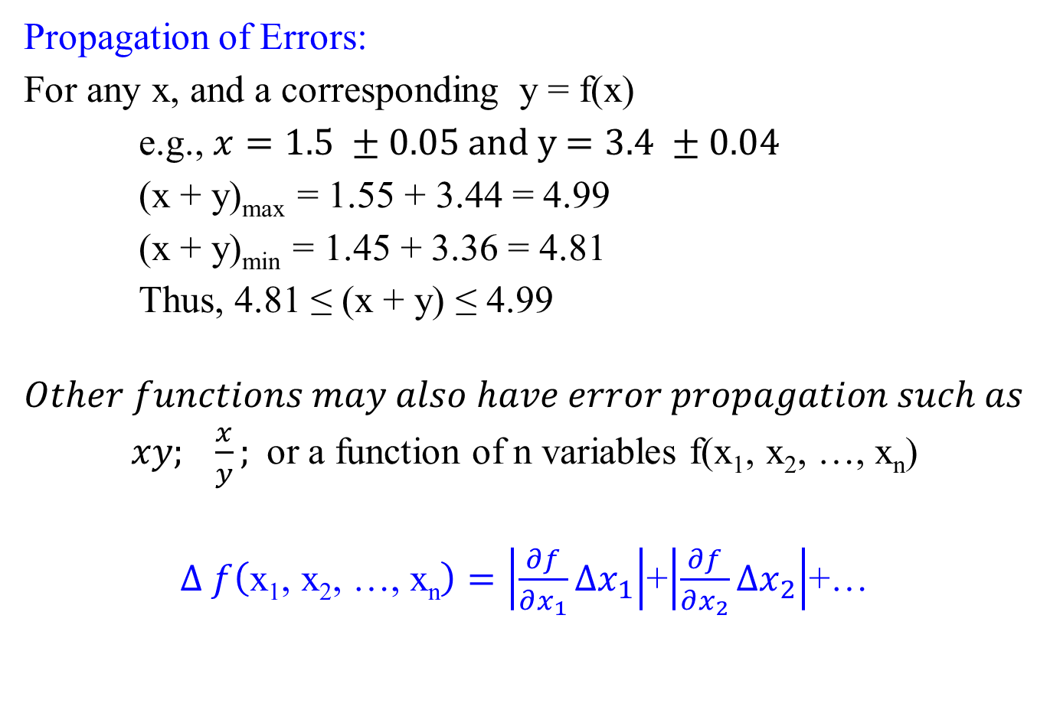
Propagation of Errors:
For any x, and a corresponding y = f(x)
e.g., $x=1.5 ±0.05$ and y$=3.4 ±0.04$
(x + y)_{max} = 1.55 + 3.44 = 4.99
(x + y)_{min} = 1.45 + 3.36 = 4.81
Thus, 4.81 ≤ (x + y) ≤ 4.99
$$Other functions may also have error propagation such as$$
$xy; \frac{x}{y};$or a function of n variables f(x₁, x₂, …, x_{n})
$∆ f\left(\text{x}\text{1}\text{, }\text{x}\text{2}\text{, …, }\text{xn}\right)=\left|\frac{∂f}{∂x_{1}}∆x_{1}\right|$+$\left|\frac{∂f}{∂x_{2}}∆x_{2}\right|$+…

Slide 9
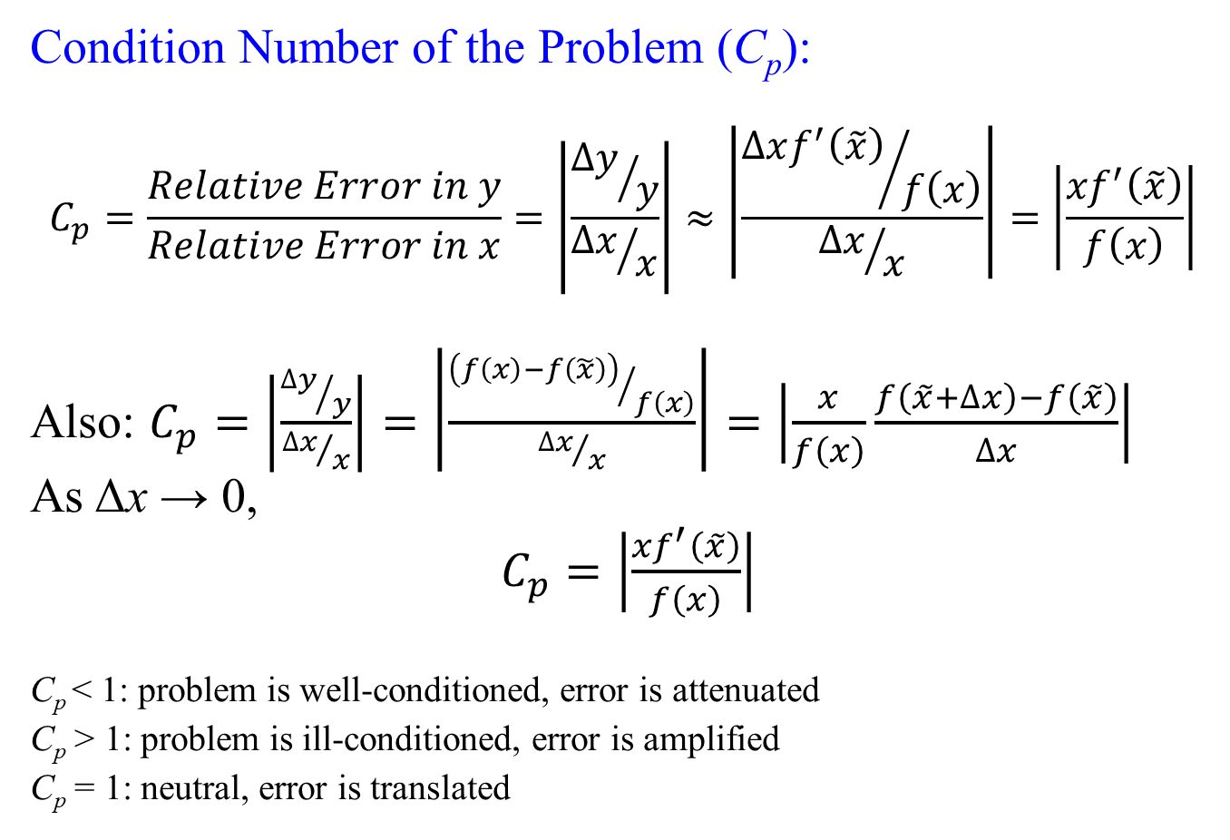
Condition Number of the Problem (C_{p}):
$$C_{p}=\frac{Relative Error in y}{Relative Error in x}=\left|\frac{{∆y}/y}{{∆x}/x}\right|≈\left|\frac{{∆xf^{′}\left(\tilde{x}\right)}/{f\left(x\right)}}{{∆x}/x}\right|=\left|\frac{{xf}^{′}\left(\tilde{x}\right)}{f\left(x\right)}\right|$$
Also: $C_{p}=\left|\frac{{∆y}/y}{{∆x}/x}\right|=\left|\frac{{\left(f\left(x\right)−f\left(\tilde{x}\right)\right)}/{f\left(x\right)}}{{∆x}/x}\right|=\left|\frac{x}{f\left(x\right)}\frac{f\left(\tilde{x}+∆x\right)−f\left(\tilde{x}\right)}{∆x}\right|$
As Δx → 0,
$C_{p}=\left|\frac{{xf}^{′}\left(\tilde{x}\right)}{f\left(x\right)}\right|$
C_{p} < 1: problem is well-conditioned, error is attenuated
C_{p} > 1: problem is ill-conditioned, error is amplified
C_{p} = 1: neutral, error is translated

Slide 10
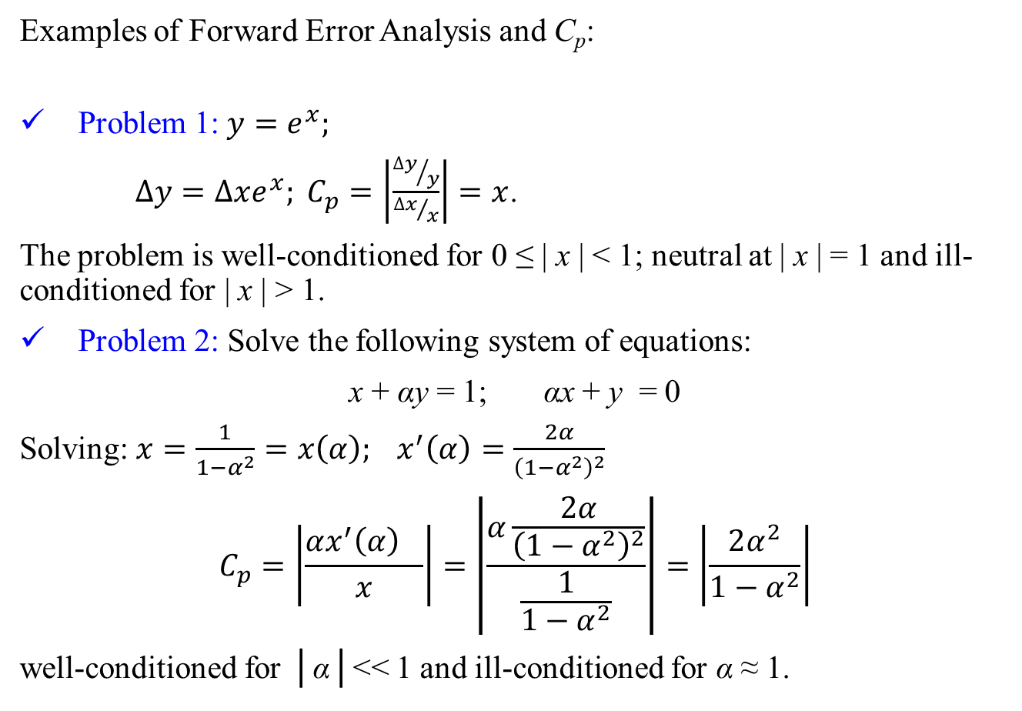
Examples of Forward Error Analysis and C_{p}:
Problem 1: $y=e^{x};$
$∆y=∆xe^{x}; C_{p}=\left|\frac{{∆y}/y}{{∆x}/x}\right|=x$.
The problem is well-conditioned for 0 ≤ | x | < 1; neutral at | x | = 1 and ill-conditioned for | x | > 1.
Problem 2: Solve the following system of equations:
x + αy = 1; αx + y = 0
Solving: $x=\frac{1}{1−α^{2}}=x\left(α\right); x^{′}\left(α\right)=\frac{2α}{{\left(1−α^{2}\right)}^{2}}$
$$C_{p}=\left|\frac{{αx^{′}\left(α\right)}^{}}{x}\right|=\left|\frac{α\frac{2α}{{\left(1−α^{2}\right)}^{2}}}{\frac{1}{1−α^{2}}}\right|=\left|\frac{2α^{2}}{1−α^{2}}\right|$$
well-conditioned for │α│<< 1 and ill-conditioned for α ≈ 1.

Slide 11
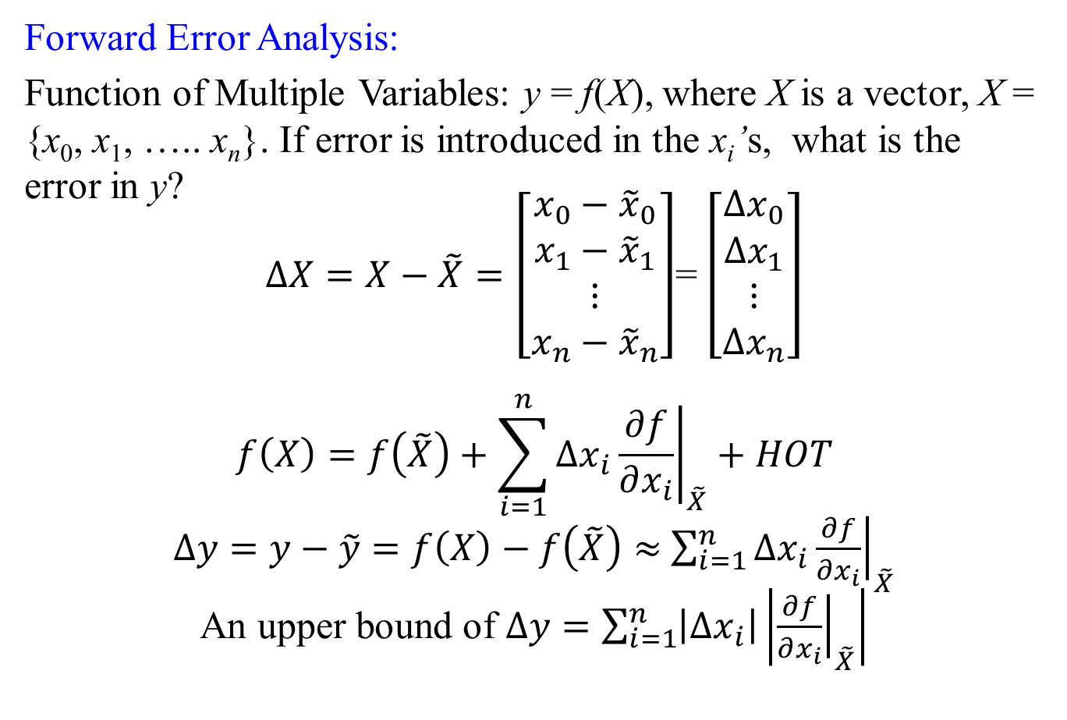
Forward Error Analysis:
Function of Multiple Variables: y = f(X), where X is a vector, X = {x₀, x₁, ….. x_{n}}. If error is introduced in the x_{i}’s, what is the error in y?
$∆X=X−\tilde{X}=\left[\begin{matrix}x_{0}−{\tilde{x}}_{0} \\ x_{1}−{\tilde{x}}_{1} \\ ⋮ \\ x_{n}−{\tilde{x}}_{n}\end{matrix}\right]$= $\left[\begin{matrix}∆x_{0} \\ ∆x_{1} \\ ⋮ \\ ∆x_{n}\end{matrix}\right]$
$$f\left(X\right)=f\left(\tilde{X}\right)+\sum_{i=1}^{n}{∆x_{i}}{\left.\frac{∂f}{∂x_{i}}\right|}_{\tilde{X}}+HOT$$
$∆y=y−\tilde{y}=f\left(X\right)−f\left(\tilde{X}\right)≈$ $\sum_{i=1}^{n}{∆x_{i}}{\left.\frac{∂f}{∂x_{i}}\right|}_{\tilde{X}}$
An upper bound of $∆y=\sum_{i=1}^{n}{\left|∆x_{i}\right|}\left|{\left.\frac{∂f}{∂x_{i}}\right|}_{\tilde{X}}\right|$

Slide 12
Backward Error Analysis:
What is the perturbation required in the input in order to explain the error in the output if the computation is carried out by true mathematical function without any error?
Computation using numerical algorithm
Computation using mathematical problem
Error in the Output
Hypothetical error in the Input computed using backward error analysis
Both computations are using the original Mathematical Model
Error in the Output

Slide 13
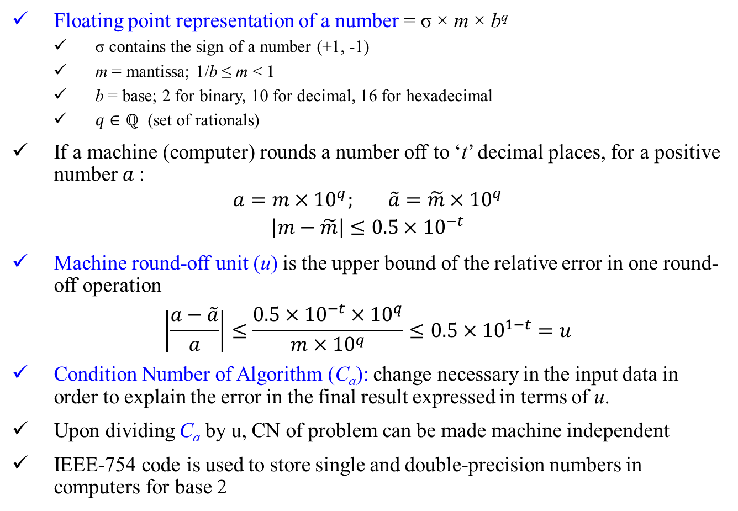
Floating point representation of a number = σ × m × b^{q}
σ contains the sign of a number (+1, -1)
m = mantissa; 1/b ≤ m < 1
b = base; 2 for binary, 10 for decimal, 16 for hexadecimal
$q∈ℚ$ (set of rationals)
If a machine (computer) rounds a number off to ‘t’ decimal places, for a positive number $a$:
$$a=m×{10}^{q}; \tilde{a}=\tilde{m}×{10}^{q}$$
$$\left|m−\tilde{m}\right|≤0.5×{10}^{−t}$$
Machine round-off unit (u) is the upper bound of the relative error in one round-off operation
$$\left|\frac{a−\tilde{a}}{a}\right|≤\frac{0.5×{10}^{−t}×{10}^{q}}{m×{10}^{q}}≤0.5×{10}^{1−t}=u$$
Condition Number of Algorithm (C_{a}): change necessary in the input data in order to explain the error in the final result expressed in terms of u.
Upon dividing C_{a} by u, CN of problem can be made machine independent
IEEE-754 code is used to store single and double-precision numbers in computers for base 2

Slide 14
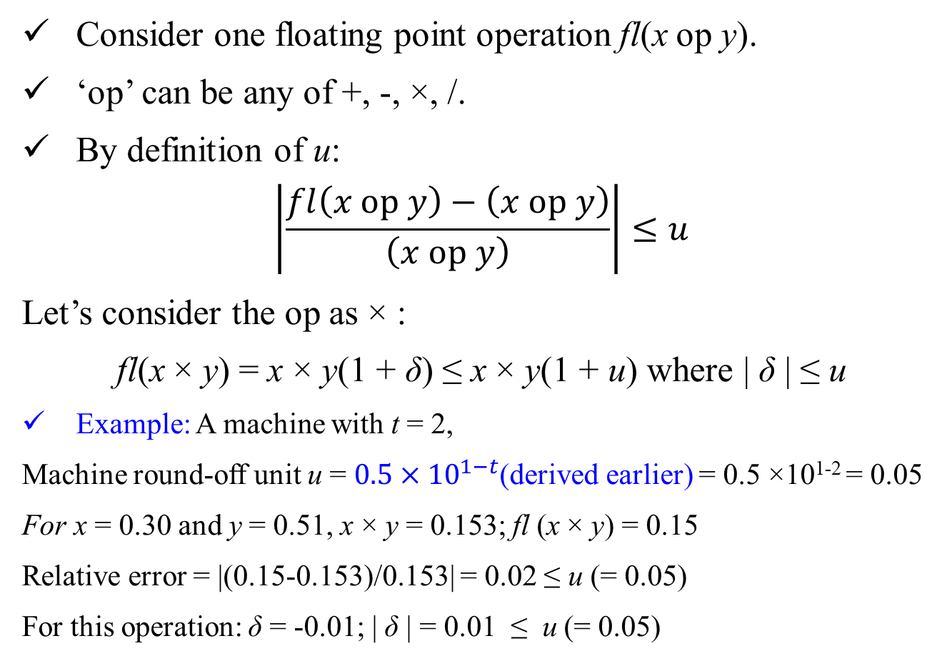
Consider one floating point operation fl(x op y).
‘op’ can be any of +, -, ×, /.
By definition of u:
$$\left|\frac{fl\left(x op y\right)−\left(x op y\right)}{\left(x op y\right)}\right|≤u$$
Let’s consider the op as × :
fl(x × y) = x × y(1 + δ) ≤ x × y(1 + u) where | δ | ≤ u
Example: A machine with t = 2,
Machine round-off unit u = $0.5×{10}^{1−t}$(derived earlier) = 0.5 ×10¹⁻² = 0.05
For x = 0.30 and y = 0.51, x × y = 0.153; fl (x × y) = 0.15
Relative error = |(0.15-0.153)/0.153| = 0.02 ≤ u (= 0.05)
For this operation: δ = -0.01; | δ | = 0.01 ≤ u (= 0.05)

Slide 15
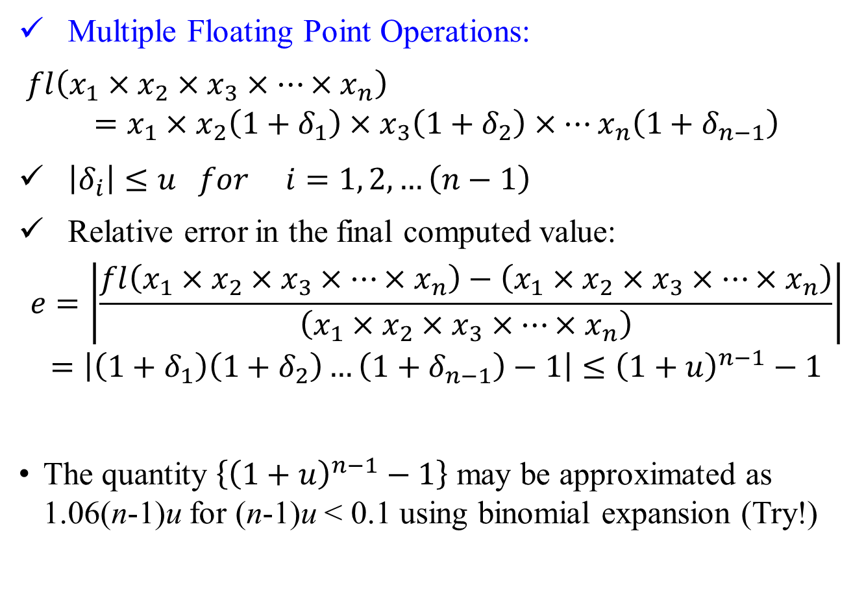
Multiple Floating Point Operations:
$fl\left(x_{1}×x_{2}×x_{3}×…×x_{n}\right)$
$$=x_{1}×x_{2}\left(1+δ_{1}\right)×x_{3}\left(1+δ_{2}\right)×…x_{n}\left(1+δ_{n−1}\right)$$
$\left|δ_{i}\right|≤u for i=1, 2, …\left(n−1\right)$
Relative error in the final computed value:
$$e=\left|\frac{fl\left(x_{1}×x_{2}×x_{3}×…×x_{n}\right)−\left(x_{1}×x_{2}×x_{3}×…×x_{n}\right)}{\left(x_{1}×x_{2}×x_{3}×…×x_{n}\right)}\right|$$
$$=\left|\left(1+δ_{1}\right)\left(1+δ_{2}\right)…\left(1+δ_{n−1}\right)−1\right|≤{\left(1+u\right)}^{n−1}−1$$
The quantity $\left\{{\left(1+u\right)}^{n−1}−1\right\}$ may be approximated as 1.06(n-1)u for (n-1)u < 0.1 using binomial expansion (Try!)

Slide 16
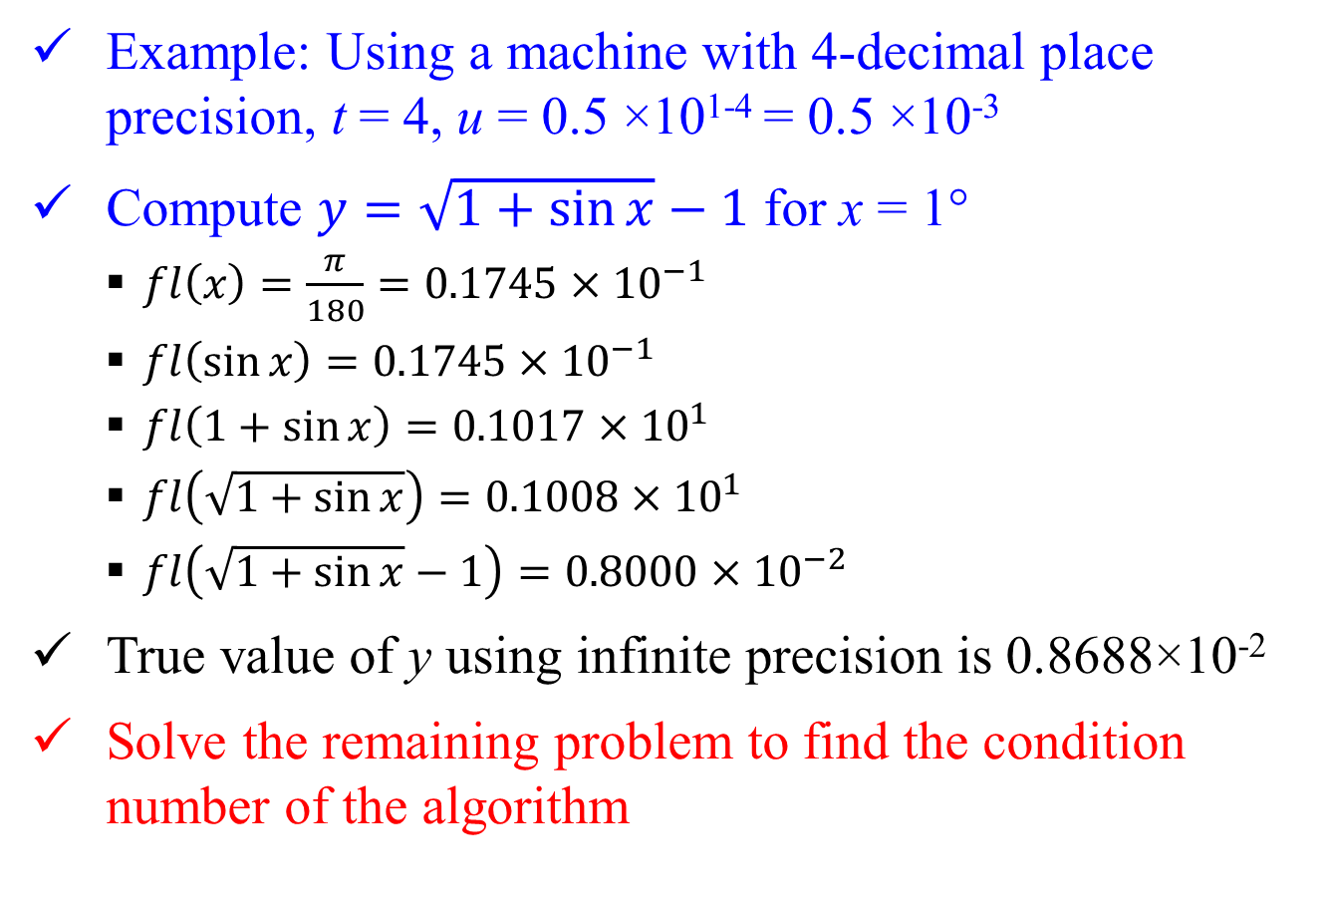
Example: Using a machine with 4-decimal place precision, t = 4, u = 0.5 ×10¹⁻⁴ = 0.5 ×10⁻³
Compute $y=\sqrt{1+\sin{x}}−1$ for x = 1°
$fl\left(x\right)=\frac{π}{180}=0.1745×{10}^{−1}$
$fl\left(\sin{x}\right)=0.1745×{10}^{−1}$
$fl\left(1+sin{x}\right)=0.1017×{10}^{1}$
$fl\left(\sqrt{1+\sin{x}}\right)=0.1008×{10}^{1}$
$fl\left(\sqrt{1+\sin{x}}−1\right)=0.8000×{10}^{−2}$
True value of y using infinite precision is 0.8688×10⁻²
Solve the remaining problem to find the condition number of the algorithm

