Slide 1
Approximation of Functions
Approximation problems divided into five parts:
Least square approximation of discrete functions or Regression
Least square approximation of continuous function using various basis polynomials
Orthogonal basis functions
Approximation of periodic functions
Interpolation

Slide 2
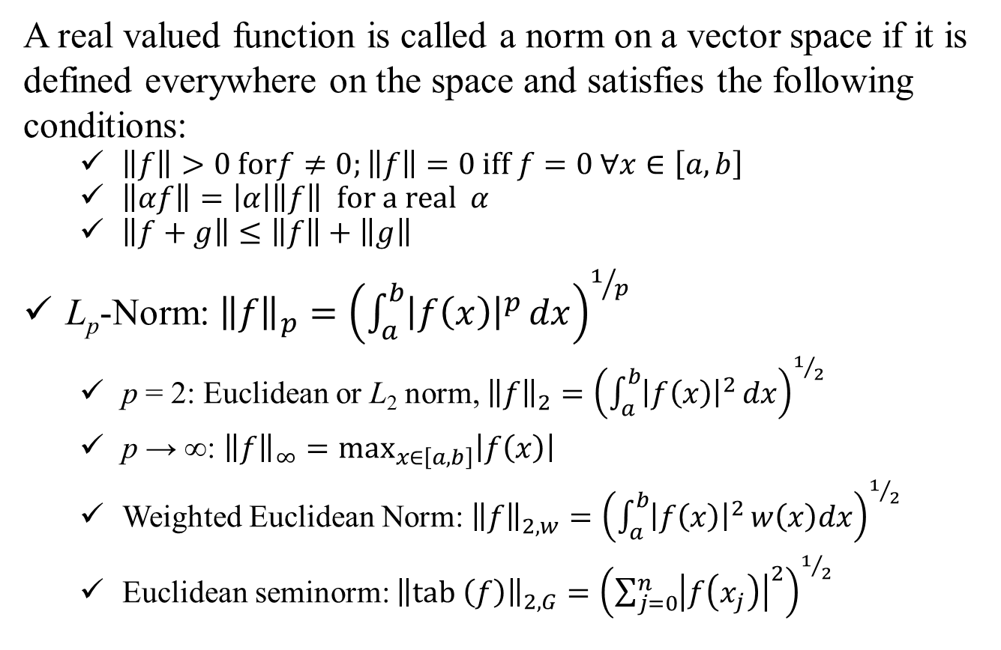
Norm and Seminorm
A real valued function is called a norm on a vector space if it is defined everywhere on the space and satisfies the following conditions:
$\left\|f\right\|>0 forf≠0;\left\|f\right\|=0 iff f=0 ∀x∈\left[a,b\right]$
$\left\|αf\right\|=\left|α\right|\left\|f\right\| for a real α$
$\left\|f+g\right\|≤\left\|f\right\|+\left\|g\right\|$
L_{p}-Norm: ${\left\|f\right\|}_{p}={\left(\int_{a}^{b}{{\left|f\left(x\right)\right|}^{p}}dx\right)}^{1/p}$
p = 2: Euclidean or L₂ norm, ${\left\|f\right\|}_{2}={\left(\int_{a}^{b}{{\left|f\left(x\right)\right|}^{2}}dx\right)}^{1/2}$
p → ∞: ${\left\|f\right\|}_{∞}=\max_{x∈\left[a,b\right]}\left|f\left(x\right)\right|$
Weighted Euclidean Norm: ${\left\|f\right\|}_{2,w}={\left(\int_{a}^{b}{{\left|f\left(x\right)\right|}^{2}}w\left(x\right)dx\right)}^{1/2}$
Euclidean seminorm: ${\left\|tab \left(f\right)\right\|}_{2, G}={\left(\sum_{j=0}^{n}{{\left|f\left(x_{j}\right)\right|}^{2}}\right)}^{1/2}$

Slide 3
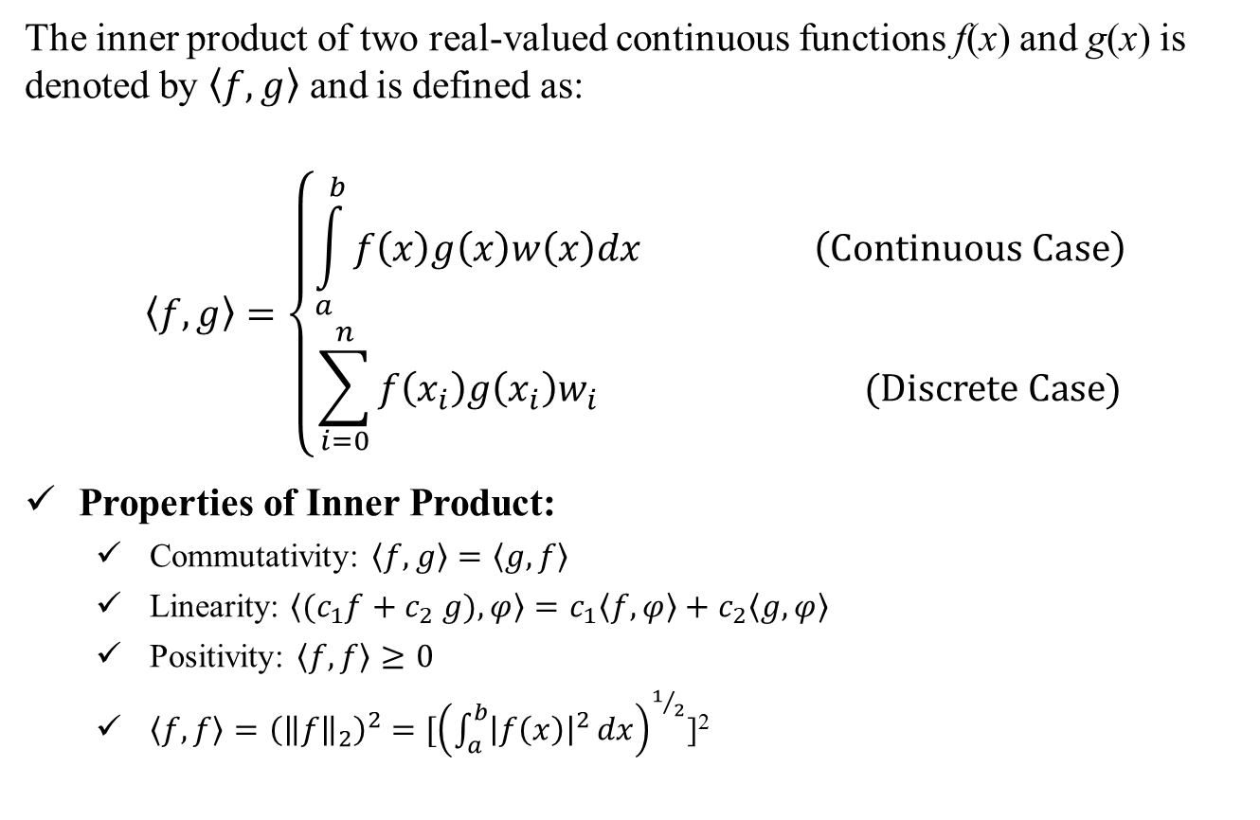
Inner Product
The inner product of two real-valued continuous functions f(x) and g(x) is denoted by $\left\langle f, g\right\rangle$ and is defined as:
$$\left\langle f, g\right\rangle =\left\{\begin{aligned}\int_{a}^{b}{f\left(x\right)g\left(x\right)w\left(x\right)dx \left(Continuous Case\right)} \\ \sum_{i=0}^{n}{f\left(x_{i}\right)g\left(x_{i}\right)w_{i}} (Discrete Case)\end{aligned}\right.$$
Properties of Inner Product:
Commutativity: $\left\langle f, g\right\rangle =\left\langle g, f\right\rangle$
Linearity: $\left\langle {(c}_{1}f+c_{2} g),φ\right\rangle =c_{1}\left\langle f, φ\right\rangle +c_{2}\left\langle g, φ\right\rangle$
Positivity: $\left\langle f, f\right\rangle ≥0$
$\left\langle f, f\right\rangle ={\left({\left\|f\right\|}_{2}\right)}^{2}$ $=[{\left(\int_{a}^{b}{{\left|f\left(x\right)\right|}^{2}}dx\right)}^{1/2}$]²

Slide 4
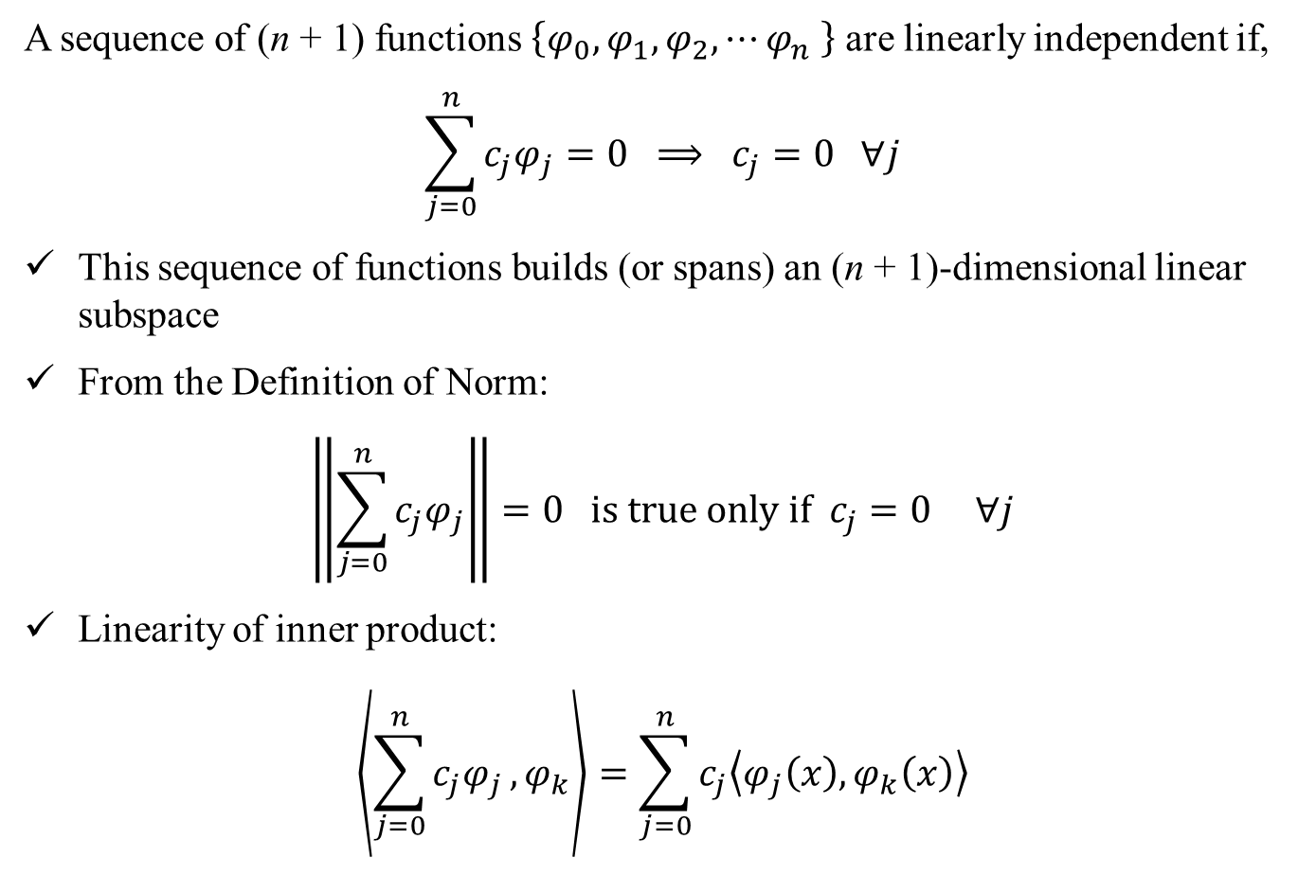
Basis Functions: Linear Independence
A sequence of (n + 1) functions $\left\{φ_{0},φ_{1},φ_{2},⋯φ_{n} \right\}$ are linearly independent if,
$$\sum_{j=0}^{n}{c_{j}φ_{j}}=0 ⟹ c_{j}=0 ∀j$$
This sequence of functions builds (or spans) an (n + 1)-dimensional linear subspace
From the Definition of Norm:
$$\left\|\sum_{j=0}^{n}{c_{j}φ_{j}}\right\|=0 is true only if c_{j}=0 ∀j$$
Linearity of inner product:
$$\left\langle \sum_{j=0}^{n}{c_{j}φ_{j}},φ_{k}\right\rangle =\sum_{j=0}^{n}{c_{j}\left\langle φ_{j}\left(x\right),φ_{k}\left(x\right)\right\rangle }$$

Slide 5
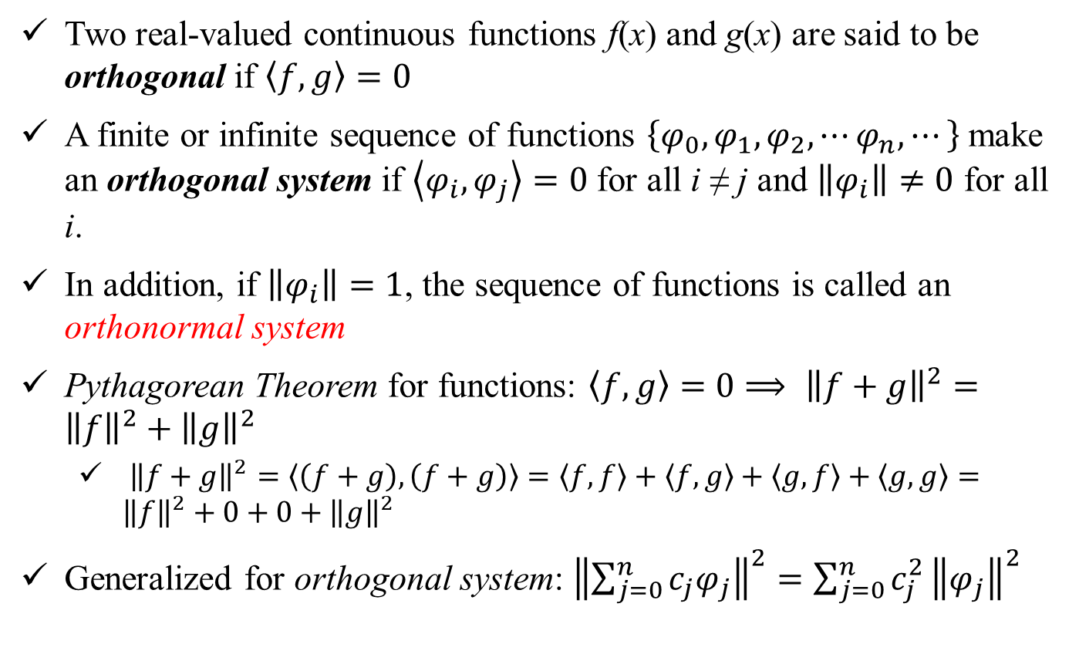
Orthogonal Functions
Two real-valued continuous functions f(x) and g(x) are said to be orthogonal if $\left\langle f, g\right\rangle =0$
A finite or infinite sequence of functions $\left\{φ_{0},φ_{1},φ_{2},⋯φ_{n},⋯\right\}$ make an orthogonal system if $\left\langle φ_{i},φ_{j}\right\rangle =0$ for all i ≠ j and $\left\|φ_{i}\right\|≠0$ for all i.
In addition, if $\left\|φ_{i}\right\|=1$, the sequence of functions is called an orthonormal system
Pythagorean Theorem for functions: $\left\langle f, g\right\rangle =0⟹ {\left\|f+g\right\|}^{2}={\left\|f\right\|}^{2}+{\left\|g\right\|}^{2}$
${\left\|f+g\right\|}^{2}=\left\langle \left(f+g\right),\left(f+g\right)\right\rangle =\left\langle f, f\right\rangle +\left\langle f, g\right\rangle +\left\langle g, f\right\rangle +\left\langle g, g\right\rangle ={\left\|f\right\|}^{2}+0+0+{\left\|g\right\|}^{2}$
Generalized for orthogonal system: ${\left\|\sum_{j=0}^{n}{c_{j}φ_{j}}\right\|}^{2}=\sum_{j=0}^{n}{c_{j}^{2}}{\left\|φ_{j}\right\|}^{2}$

Slide 6
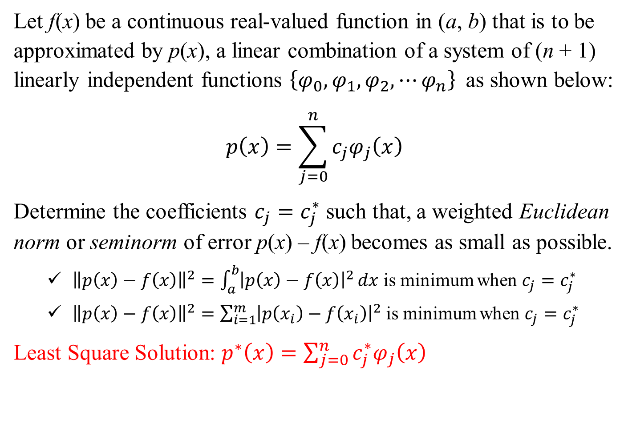
Least Square Problem
Let f(x) be a continuous real-valued function in (a, b) that is to be approximated by p(x), a linear combination of a system of (n + 1) linearly independent functions $\left\{φ_{0},φ_{1},φ_{2},⋯φ_{n}\right\}$ as shown below:
$$p\left(x\right)=\sum_{j=0}^{n}{c_{j}φ_{j}\left(x\right)}$$
Determine the coefficients $c_{j}=c_{j}^{∗}$ such that, a weighted Euclidean norm or seminorm of error p(x) – f(x) becomes as small as possible.
${\left\|p\left(x\right)−f\left(x\right)\right\|}^{2}=\int_{a}^{b}{{\left|p\left(x\right)−f\left(x\right)\right|}^{2}}dx$ is minimum when $c_{j}=c_{j}^{∗}$
${\left\|p\left(x\right)−f\left(x\right)\right\|}^{2}=\sum_{i=1}^{m}{{\left|p\left(x_{i}\right)−f\left(x_{i}\right)\right|}^{2}}$ is minimum when $c_{j}=c_{j}^{∗}$
Least Square Solution: $p^{∗}\left(x\right)=\sum_{j=0}^{n}{c_{j}^{∗}φ_{j}\left(x\right)}$

Slide 7
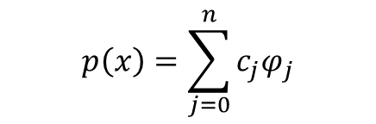
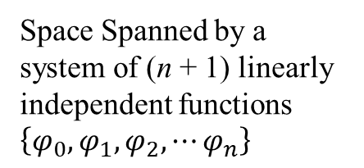
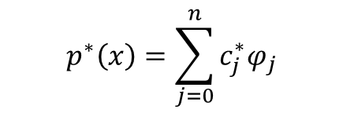
Schematic of Least Square Solution
f(x)
Space Spanned by a system of (n + 1) linearly independent functions $\left\{φ_{0},φ_{1},φ_{2},⋯φ_{n}\right\}$
$$p^{∗}\left(x\right)=\sum_{j=0}^{n}{c_{j}^{∗}φ_{j}}$$
$$p\left(x\right)=\sum_{j=0}^{n}{c_{j}φ_{j}}$$
Solution: $\left\langle \left(f\left(x\right)−p^{∗}\left(x\right)\right),φ_{k}\right\rangle =0$ for k = 0, 1, 2, … n

Slide 8
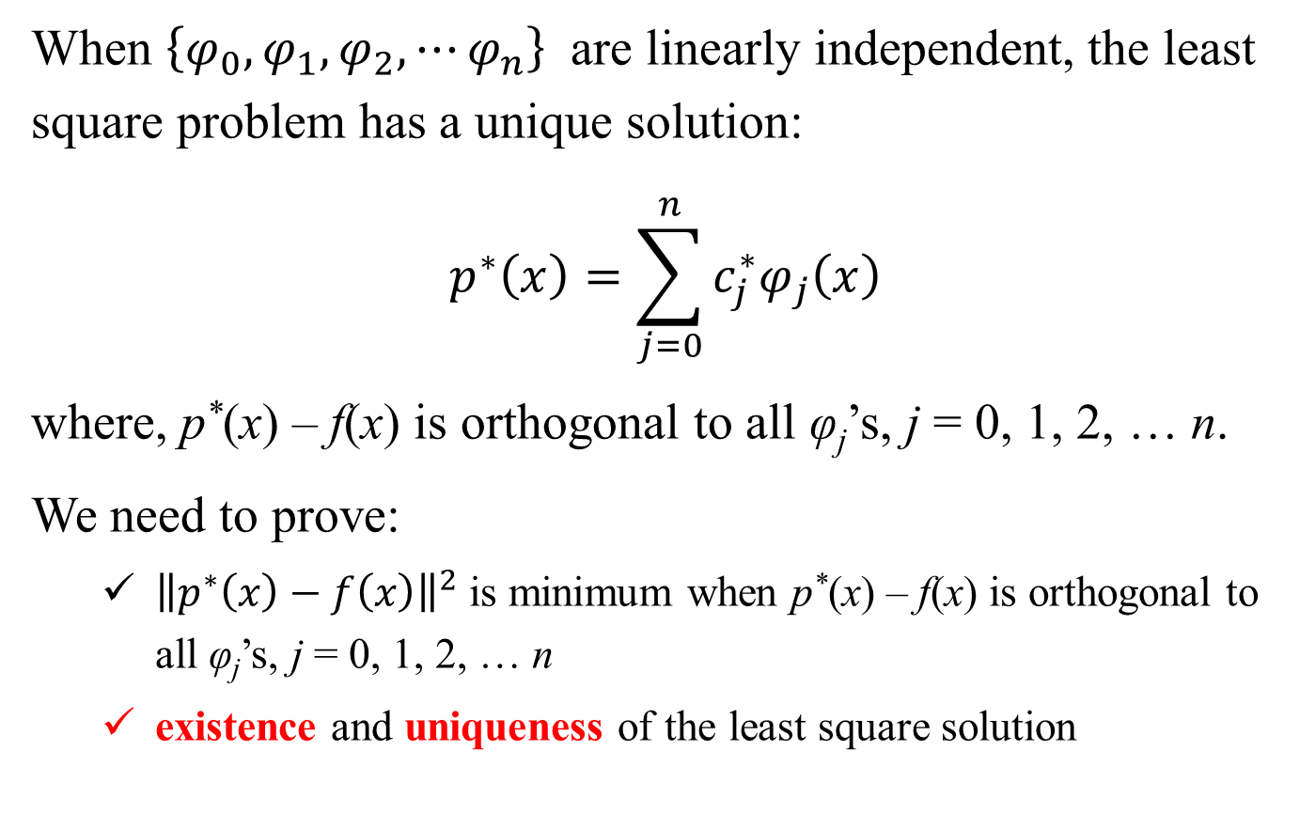
Least Square Solution: Proof
When $\left\{φ_{0},φ_{1},φ_{2},⋯φ_{n}\right\}$ are linearly independent, the least square problem has a unique solution:
$$p^{∗}\left(x\right)=\sum_{j=0}^{n}{c_{j}^{∗}φ_{j}\left(x\right)}$$
where, p*(x) – f(x) is orthogonal to all φ_{j}’s, j = 0, 1, 2, … n.
We need to prove:
${\left\|p^{∗}\left(x\right)−f\left(x\right)\right\|}^{2}$ is minimum when p*(x) – f(x) is orthogonal to all φ_{j}’s, j = 0, 1, 2, … n
existence and uniqueness of the least square solution

Slide 9
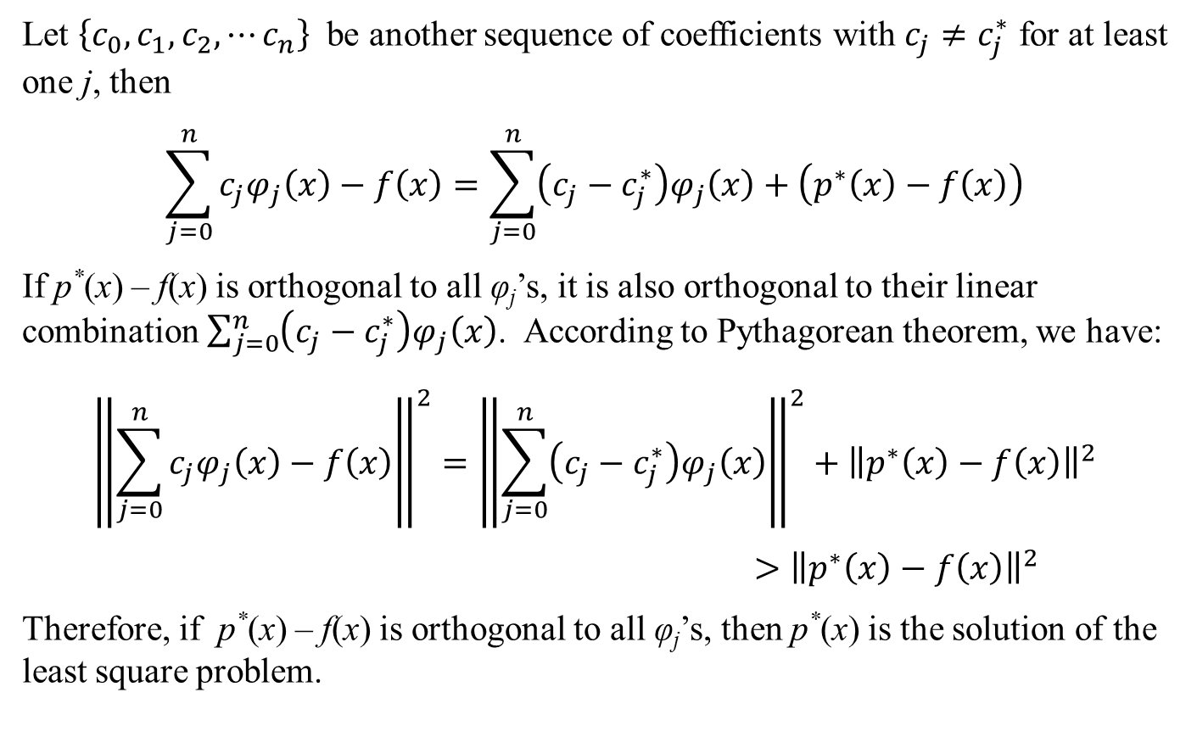
Least Square Solution: Proof
Let $\left\{c_{0},c_{1},c_{2},⋯c_{n}\right\}$ be another sequence of coefficients with $c_{j}≠c_{j}^{∗}$ for at least one j, then
$$\sum_{j=0}^{n}{c_{j}φ_{j}\left(x\right)}−f\left(x\right)=\sum_{j=0}^{n}{\left(c_{j}−c_{j}^{∗}\right)φ_{j}\left(x\right)}+\left(p^{∗}\left(x\right)−f\left(x\right)\right)$$
If p*(x) – f(x) is orthogonal to all φ_{j}’s, it is also orthogonal to their linear combination $\sum_{j=0}^{n}{\left(c_{j}−c_{j}^{∗}\right)φ_{j}\left(x\right)}$. According to Pythagorean theorem, we have:
$${\left\|\sum_{j=0}^{n}{c_{j}φ_{j}\left(x\right)}−f\left(x\right)\right\|}^{2}={\left\|\sum_{j=0}^{n}{\left(c_{j}−c_{j}^{∗}\right)φ_{j}\left(x\right)}\right\|}^{2}+{\left\|p^{∗}\left(x\right)−f\left(x\right)\right\|}^{2}$$
$>{\left\|p^{∗}\left(x\right)−f\left(x\right)\right\|}^{2}$
Therefore, if p*(x) – f(x) is orthogonal to all φ_{j}’s, then p*(x) is the solution of the least square problem.

Slide 10
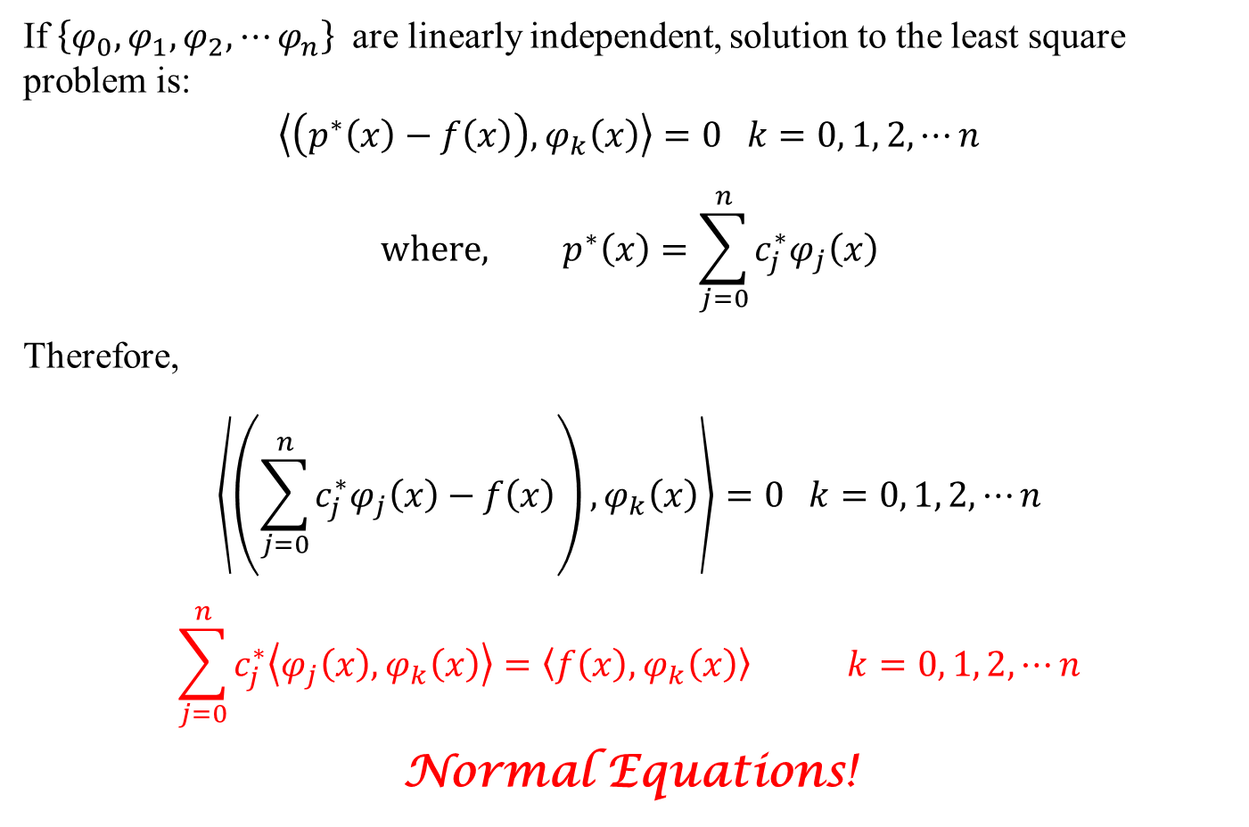
Least Square Solution: Normal Equations
If $\left\{φ_{0},φ_{1},φ_{2},⋯φ_{n}\right\}$ are linearly independent, solution to the least square problem is:
$$\left\langle \left(p^{∗}\left(x\right)−f\left(x\right)\right),φ_{k}\left(x\right)\right\rangle =0 k=0, 1, 2,⋯n$$
$$where, p^{∗}\left(x\right)=\sum_{j=0}^{n}{c_{j}^{∗}φ_{j}\left(x\right)}$$
Therefore,
$$\left\langle \left(\sum_{j=0}^{n}{c_{j}^{∗}φ_{j}\left(x\right)}−f\left(x\right)\right),φ_{k}\left(x\right)\right\rangle =0 k=0, 1, 2,⋯n$$
$$\sum_{j=0}^{n}{c_{j}^{∗}\left\langle φ_{j}\left(x\right),φ_{k}\left(x\right)\right\rangle =\left\langle f\left(x\right),φ_{k}\left(x\right)\right\rangle } k=0, 1, 2,⋯n$$
Normal Equations!

Slide 11
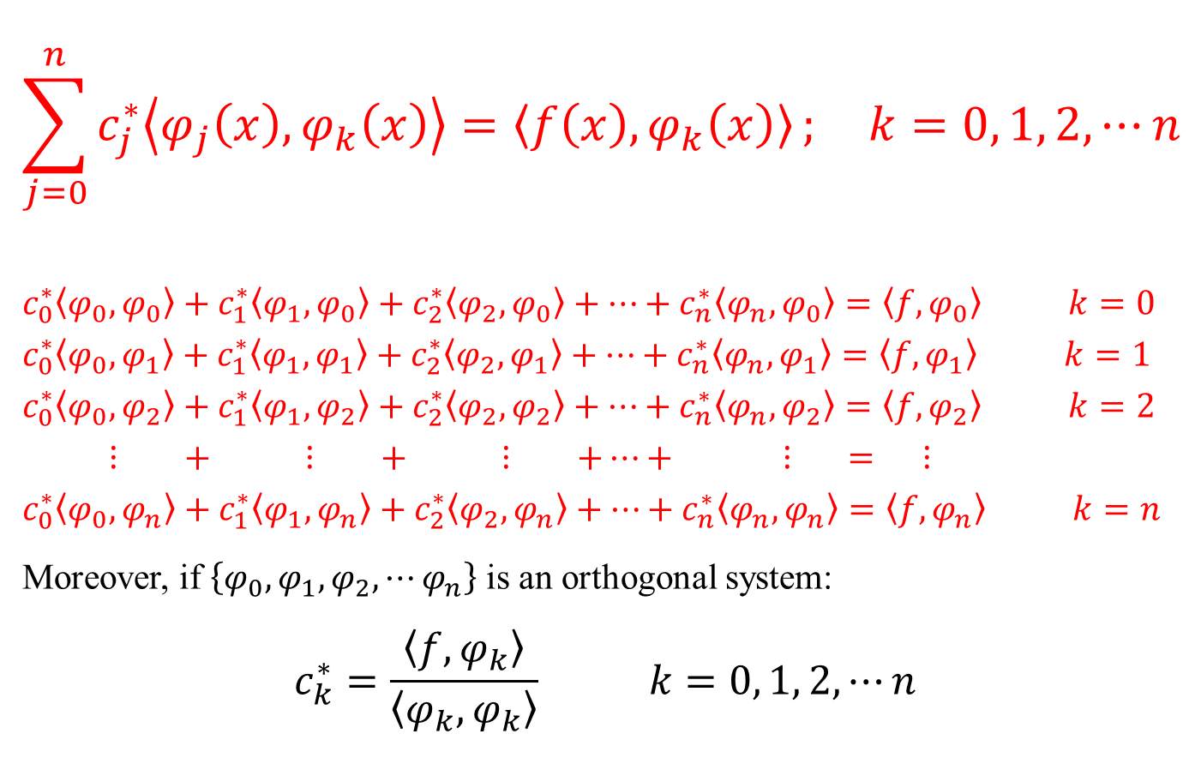
Least Square Solution: Normal Equations
$$\sum_{j=0}^{n}{c_{j}^{∗}\left\langle φ_{j}\left(x\right),φ_{k}\left(x\right)\right\rangle =\left\langle f\left(x\right),φ_{k}\left(x\right)\right\rangle }; k=0, 1, 2,⋯n$$
$$c_{0}^{∗}\left\langle φ_{0},φ_{0}\right\rangle +c_{1}^{∗}\left\langle φ_{1},φ_{0}\right\rangle +c_{2}^{∗}\left\langle φ_{2},φ_{0}\right\rangle +⋯+c_{n}^{∗}\left\langle φ_{n},φ_{0}\right\rangle =\left\langle f,φ_{0}\right\rangle k=0$$
$$c_{0}^{∗}\left\langle φ_{0},φ_{1}\right\rangle +c_{1}^{∗}\left\langle φ_{1},φ_{1}\right\rangle +c_{2}^{∗}\left\langle φ_{2},φ_{1}\right\rangle +⋯+c_{n}^{∗}\left\langle φ_{n},φ_{1}\right\rangle =\left\langle f,φ_{1}\right\rangle k=1$$
$$c_{0}^{∗}\left\langle φ_{0},φ_{2}\right\rangle +c_{1}^{∗}\left\langle φ_{1},φ_{2}\right\rangle +c_{2}^{∗}\left\langle φ_{2},φ_{2}\right\rangle +⋯+c_{n}^{∗}\left\langle φ_{n},φ_{2}\right\rangle =\left\langle f,φ_{2}\right\rangle k=2$$
$$⋮ + ⋮ + ⋮ +⋯+ ⋮ = ⋮$$
$$c_{0}^{∗}\left\langle φ_{0},φ_{n}\right\rangle +c_{1}^{∗}\left\langle φ_{1},φ_{n}\right\rangle +c_{2}^{∗}\left\langle φ_{2},φ_{n}\right\rangle +⋯+c_{n}^{∗}\left\langle φ_{n},φ_{n}\right\rangle =\left\langle f,φ_{n}\right\rangle k=n$$
Moreover, if $\left\{φ_{0},φ_{1},φ_{2},⋯φ_{n}\right\}$ is an orthogonal system:
$$c_{k}^{∗}=\frac{\left\langle f,φ_{k}\right\rangle }{\left\langle φ_{k},φ_{k}\right\rangle } k=0, 1, 2,⋯n$$

Slide 12
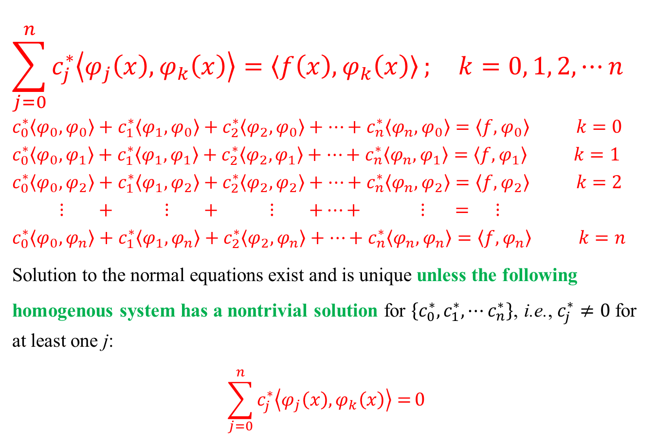
Least Square Solution: Existence and Uniqueness
$$\sum_{j=0}^{n}{c_{j}^{∗}\left\langle φ_{j}\left(x\right),φ_{k}\left(x\right)\right\rangle =\left\langle f\left(x\right),φ_{k}\left(x\right)\right\rangle }; k=0, 1, 2,⋯n$$
$$c_{0}^{∗}\left\langle φ_{0},φ_{0}\right\rangle +c_{1}^{∗}\left\langle φ_{1},φ_{0}\right\rangle +c_{2}^{∗}\left\langle φ_{2},φ_{0}\right\rangle +⋯+c_{n}^{∗}\left\langle φ_{n},φ_{0}\right\rangle =\left\langle f,φ_{0}\right\rangle k=0$$
$$c_{0}^{∗}\left\langle φ_{0},φ_{1}\right\rangle +c_{1}^{∗}\left\langle φ_{1},φ_{1}\right\rangle +c_{2}^{∗}\left\langle φ_{2},φ_{1}\right\rangle +⋯+c_{n}^{∗}\left\langle φ_{n},φ_{1}\right\rangle =\left\langle f,φ_{1}\right\rangle k=1$$
$$c_{0}^{∗}\left\langle φ_{0},φ_{2}\right\rangle +c_{1}^{∗}\left\langle φ_{1},φ_{2}\right\rangle +c_{2}^{∗}\left\langle φ_{2},φ_{2}\right\rangle +⋯+c_{n}^{∗}\left\langle φ_{n},φ_{2}\right\rangle =\left\langle f,φ_{2}\right\rangle k=2$$
$$⋮ + ⋮ + ⋮ +⋯+ ⋮ = ⋮$$
$$c_{0}^{∗}\left\langle φ_{0},φ_{n}\right\rangle +c_{1}^{∗}\left\langle φ_{1},φ_{n}\right\rangle +c_{2}^{∗}\left\langle φ_{2},φ_{n}\right\rangle +⋯+c_{n}^{∗}\left\langle φ_{n},φ_{n}\right\rangle =\left\langle f,φ_{n}\right\rangle k=n$$
Solution to the normal equations exist and is unique unless the following homogenous system has a nontrivial solution for $\left\{c_{0}^{∗},c_{1}^{∗},⋯c_{n}^{∗}\right\}$, i.e., $c_{j}^{∗}≠0$ for at least one j:
$$\sum_{j=0}^{n}{c_{j}^{∗}\left\langle φ_{j}\left(x\right),φ_{k}\left(x\right)\right\rangle =}0$$

Slide 13
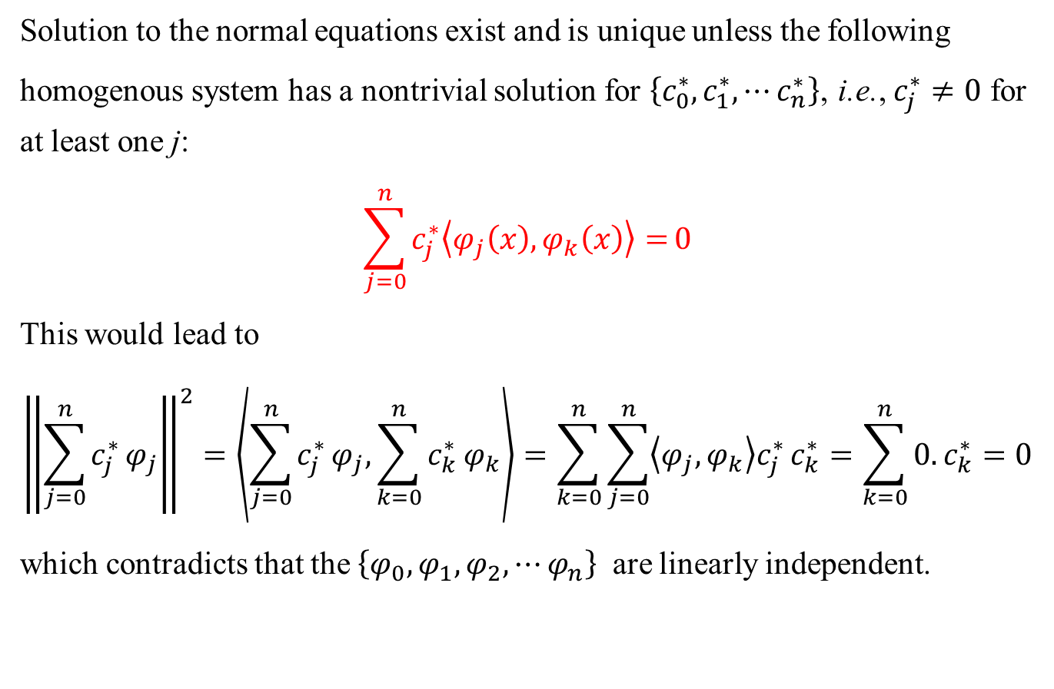
Least Square Solution: Existence and Uniqueness
Solution to the normal equations exist and is unique unless the following homogenous system has a nontrivial solution for $\left\{c_{0}^{∗},c_{1}^{∗},⋯c_{n}^{∗}\right\}$, i.e., $c_{j}^{∗}≠0$ for at least one j:
$$\sum_{j=0}^{n}{c_{j}^{∗}\left\langle φ_{j}\left(x\right),φ_{k}\left(x\right)\right\rangle =}0$$
This would lead to
$${\left\|\sum_{j=0}^{n}{c_{j}^{∗}}φ_{j}\right\|}^{2}=\left\langle \sum_{j=0}^{n}{c_{j}^{∗}}φ_{j},\sum_{k=0}^{n}{c_{k}^{∗}}φ_{k}\right\rangle =\sum_{k=0}^{n}{\sum_{j=0}^{n}{\left\langle φ_{j},φ_{k}\right\rangle c_{j}^{∗}}}c_{k}^{∗}=\sum_{k=0}^{n}{0.}c_{k}^{∗}=0$$
which contradicts that the $\left\{φ_{0},φ_{1},φ_{2},⋯φ_{n}\right\}$ are linearly independent.

Slide 14

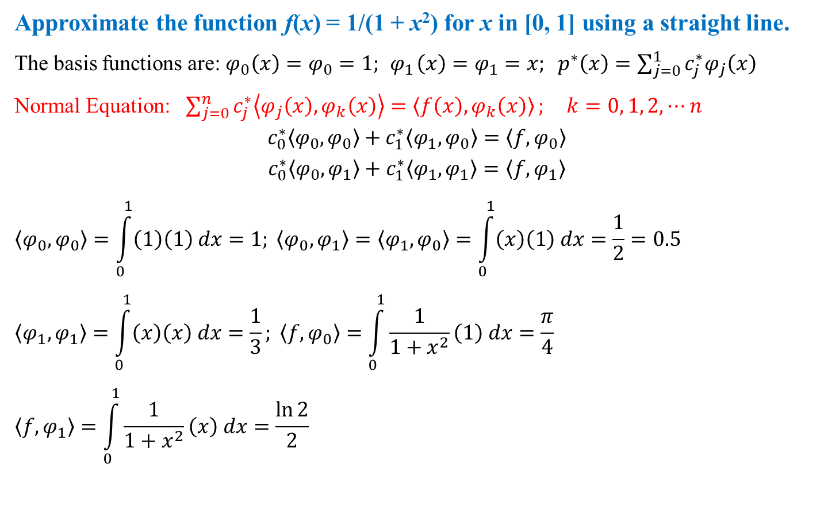
Least Square Solution: Example (Continuous)
Approximate the function f(x) = 1/(1 + x²) for x in [0, 1] using a straight line.
The basis functions are: $φ_{0}\left(x\right)=φ_{0}=1; { φ}_{1}\left(x\right)=φ_{1}=x; p^{∗}\left(x\right)=\sum_{j=0}^{1}{c_{j}^{∗}φ_{j}\left(x\right)}$
Normal Equation: $\sum_{j=0}^{n}{c_{j}^{∗}\left\langle φ_{j}\left(x\right),φ_{k}\left(x\right)\right\rangle =\left\langle f\left(x\right),φ_{k}\left(x\right)\right\rangle }; k=0, 1, 2,⋯n$
$$c_{0}^{∗}\left\langle φ_{0},φ_{0}\right\rangle +c_{1}^{∗}\left\langle φ_{1},φ_{0}\right\rangle =\left\langle f,φ_{0}\right\rangle$$
$$c_{0}^{∗}\left\langle φ_{0},φ_{1}\right\rangle +c_{1}^{∗}\left\langle φ_{1},φ_{1}\right\rangle =\left\langle f,φ_{1}\right\rangle$$
$$\left\langle φ_{0},φ_{0}\right\rangle =\int_{0}^{1}{\left(1\right)\left(1\right) dx}=1; \left\langle φ_{0},φ_{1}\right\rangle =\left\langle φ_{1},φ_{0}\right\rangle =\int_{0}^{1}{\left(x\right)\left(1\right) dx}=\frac{1}{2}=0.5$$
$$\left\langle φ_{1},φ_{1}\right\rangle =\int_{0}^{1}{\left(x\right)\left(x\right) dx}=\frac{1}{3}; \left\langle f,φ_{0}\right\rangle =\int_{0}^{1}{\frac{1}{1+x^{2}}\left(1\right) dx}=\frac{π}{4}$$
$$\left\langle f,φ_{1}\right\rangle =\int_{0}^{1}{\frac{1}{1+x^{2}}\left(x\right) dx}=\frac{\ln{2}}{2}$$
$$\left\langle f, g\right\rangle =\left\{\begin{aligned}\int_{a}^{b}{f\left(x\right)g\left(x\right)w\left(x\right)dx \left(Continuous Case\right)}\end{aligned}\right.$$

Slide 15
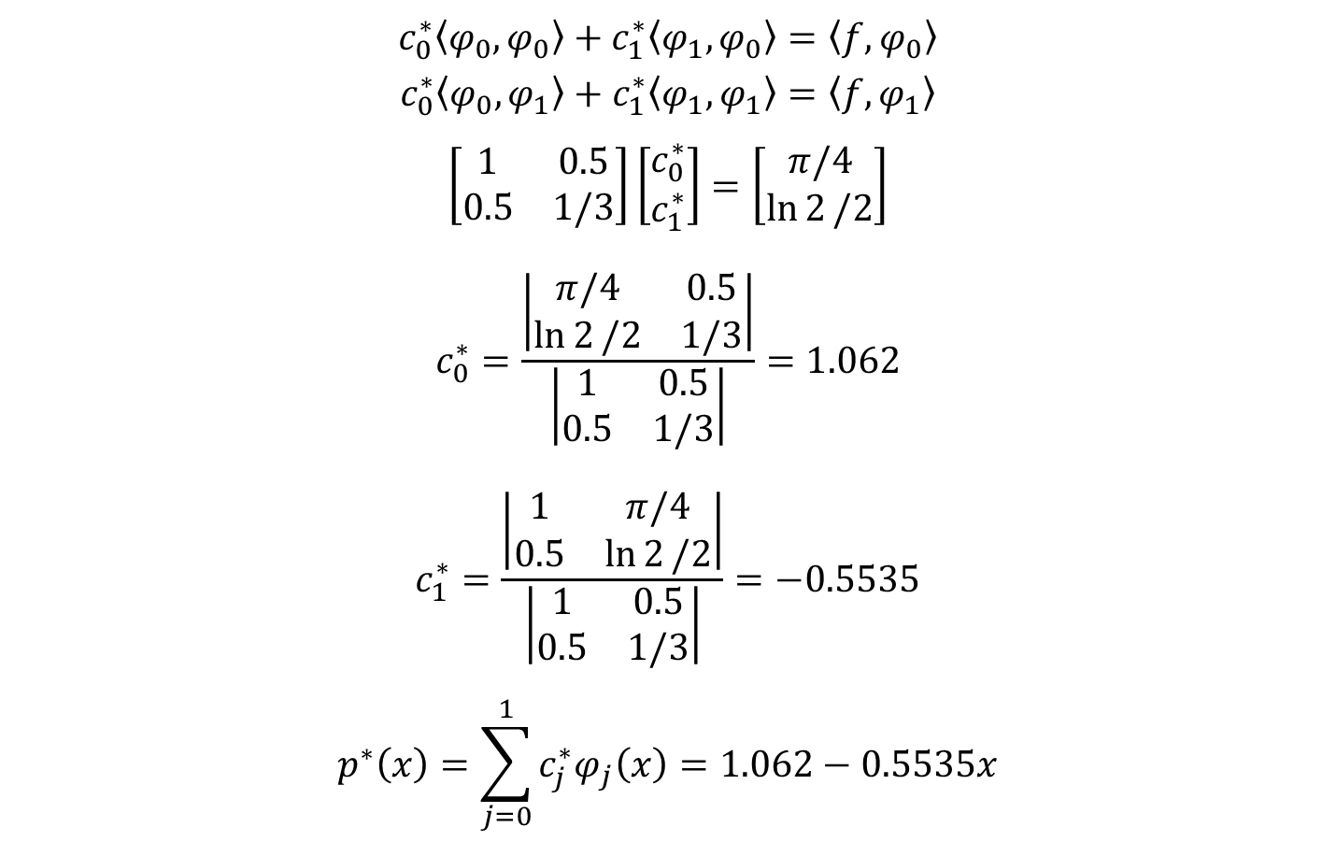
Least Square Solution: Example (Continuous)
$$c_{0}^{∗}\left\langle φ_{0},φ_{0}\right\rangle +c_{1}^{∗}\left\langle φ_{1},φ_{0}\right\rangle =\left\langle f,φ_{0}\right\rangle$$
$$c_{0}^{∗}\left\langle φ_{0},φ_{1}\right\rangle +c_{1}^{∗}\left\langle φ_{1},φ_{1}\right\rangle =\left\langle f,φ_{1}\right\rangle$$
$$\left[\begin{matrix}1 & 0.5 \\ 0.5 & 1/3\end{matrix}\right]\left[\begin{matrix}c_{0}^{∗} \\ c_{1}^{∗}\end{matrix}\right]=\left[\begin{matrix}π/4 \\ \ln{2}/2\end{matrix}\right]$$
$$c_{0}^{∗}=\frac{\left|\begin{matrix}π/4 & 0.5 \\ \ln{2}/2 & 1/3\end{matrix}\right|}{\left|\begin{matrix}1 & 0.5 \\ 0.5 & 1/3\end{matrix}\right|}=1.062$$
$$c_{1}^{∗}=\frac{\left|\begin{matrix}1 & π/4 \\ 0.5 & \ln{2}/2\end{matrix}\right|}{\left|\begin{matrix}1 & 0.5 \\ 0.5 & 1/3\end{matrix}\right|}=−0.5535$$
$$p^{∗}\left(x\right)=\sum_{j=0}^{1}{c_{j}^{∗}φ_{j}\left(x\right)}=1.062−0.5535x$$

Slide 16
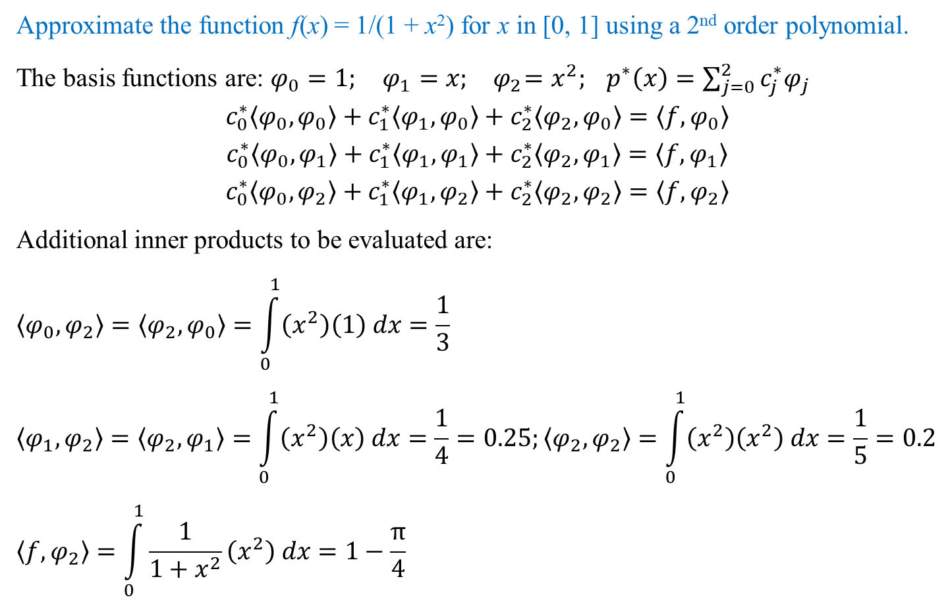
Least Square Solution: Example (Continuous)
Approximate the function f(x) = 1/(1 + x²) for x in [0, 1] using a 2nd order polynomial.
The basis functions are: $φ_{0}=1; φ_{1}=x; { φ}_{2}=x^{2}; p^{∗}\left(x\right)=\sum_{j=0}^{2}{c_{j}^{∗}φ_{j}}$
$$c_{0}^{∗}\left\langle φ_{0},φ_{0}\right\rangle +c_{1}^{∗}\left\langle φ_{1},φ_{0}\right\rangle +c_{2}^{∗}\left\langle φ_{2},φ_{0}\right\rangle =\left\langle f,φ_{0}\right\rangle$$
$$c_{0}^{∗}\left\langle φ_{0},φ_{1}\right\rangle +c_{1}^{∗}\left\langle φ_{1},φ_{1}\right\rangle +c_{2}^{∗}\left\langle φ_{2},φ_{1}\right\rangle =\left\langle f,φ_{1}\right\rangle$$
$$c_{0}^{∗}\left\langle φ_{0},φ_{2}\right\rangle +c_{1}^{∗}\left\langle φ_{1},φ_{2}\right\rangle +c_{2}^{∗}\left\langle φ_{2},φ_{2}\right\rangle =\left\langle f,φ_{2}\right\rangle$$
Additional inner products to be evaluated are:
$$\left\langle φ_{0},φ_{2}\right\rangle =\left\langle φ_{2},φ_{0}\right\rangle =\int_{0}^{1}{\left(x^{2}\right)\left(1\right) dx}=\frac{1}{3}$$
$$\left\langle φ_{1},φ_{2}\right\rangle =\left\langle φ_{2},φ_{1}\right\rangle =\int_{0}^{1}{\left(x^{2}\right)\left(x\right) dx}=\frac{1}{4}=0.25;\left\langle φ_{2},φ_{2}\right\rangle =\int_{0}^{1}{\left(x^{2}\right)\left(x^{2}\right) dx}=\frac{1}{5}=0.2$$
$$\left\langle f,φ_{2}\right\rangle =\int_{0}^{1}{\frac{1}{1+x^{2}}\left(x^{2}\right) dx}=1−\frac{π}{4}$$

Slide 17
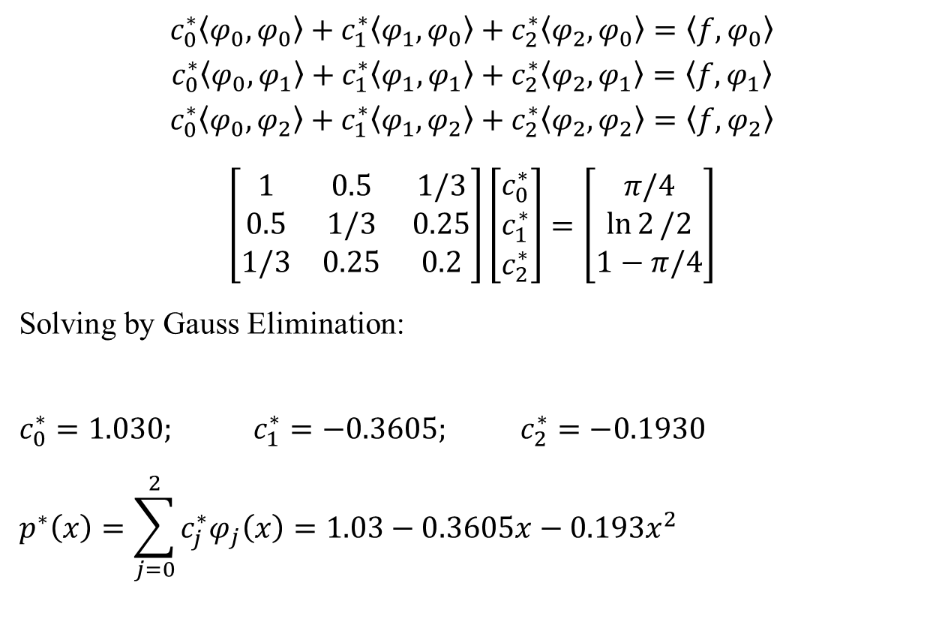
Least Square Solution: Example (Continuous)
$$c_{0}^{∗}\left\langle φ_{0},φ_{0}\right\rangle +c_{1}^{∗}\left\langle φ_{1},φ_{0}\right\rangle +c_{2}^{∗}\left\langle φ_{2},φ_{0}\right\rangle =\left\langle f,φ_{0}\right\rangle$$
$$c_{0}^{∗}\left\langle φ_{0},φ_{1}\right\rangle +c_{1}^{∗}\left\langle φ_{1},φ_{1}\right\rangle +c_{2}^{∗}\left\langle φ_{2},φ_{1}\right\rangle =\left\langle f,φ_{1}\right\rangle$$
$$c_{0}^{∗}\left\langle φ_{0},φ_{2}\right\rangle +c_{1}^{∗}\left\langle φ_{1},φ_{2}\right\rangle +c_{2}^{∗}\left\langle φ_{2},φ_{2}\right\rangle =\left\langle f,φ_{2}\right\rangle$$
$$\left[\begin{matrix}1 & 0.5 & 1/3 \\ 0.5 & 1/3 & 0.25 \\ 1/3 & 0.25 & 0.2\end{matrix}\right]\left[\begin{matrix}c_{0}^{∗} \\ c_{1}^{∗} \\ c_{2}^{∗}\end{matrix}\right]=\left[\begin{matrix}π/4 \\ \ln{2}/2 \\ 1−π/4\end{matrix}\right]$$
Solving by Gauss Elimination:
$$c_{0}^{∗}=1.030; c_{1}^{∗}=−0.3605; c_{2}^{∗}=−0.1930$$
$$p^{∗}\left(x\right)=\sum_{j=0}^{2}{c_{j}^{∗}φ_{j}\left(x\right)}=1.03−0.3605x−0.193x^{2}$$

Slide 18
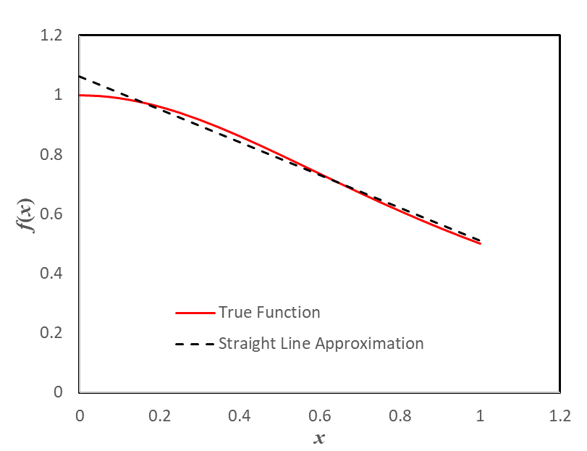
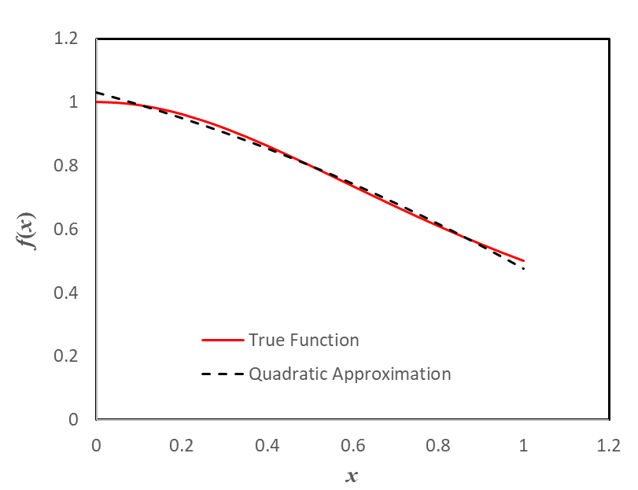
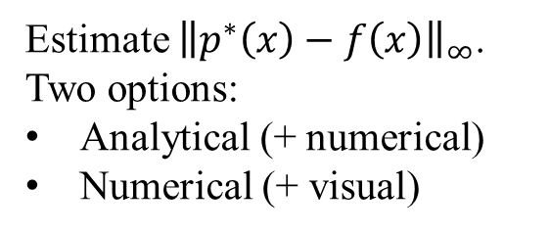
Least Square Solution: Example (Continuous)
How do you judge how good the fit is or how do you compare fit of two polynomials?
Estimate ${\left\|p^{∗}\left(x\right)−f\left(x\right)\right\|}_{∞}$. Two options:
Analytical (+ numerical)
Numerical (+ visual)

Slide 19
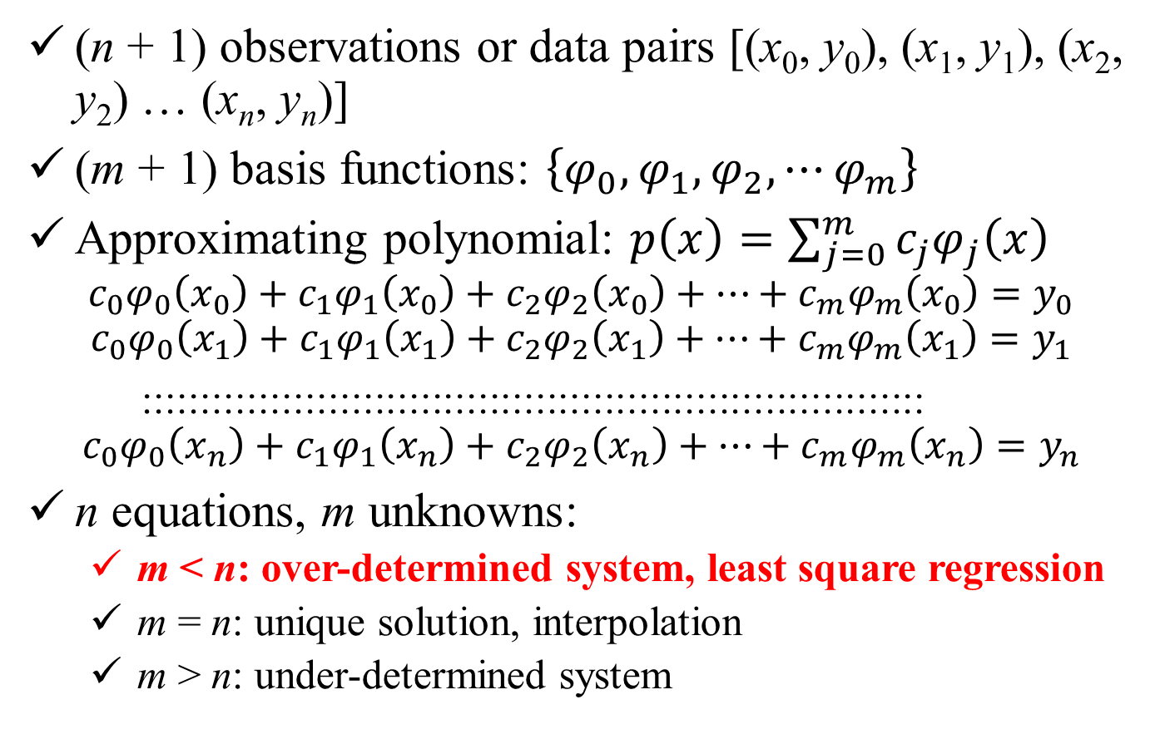
Discrete Data
(n + 1) observations or data pairs [(x₀, y₀), (x₁, y₁), (x₂, y₂) … (x_{n}, y_{n})]
(m + 1) basis functions: $\left\{φ_{0},φ_{1},φ_{2},⋯φ_{m}\right\}$
Approximating polynomial: $p\left(x\right)=\sum_{j=0}^{m}{c_{j}φ_{j}\left(x\right)}$
$$c_{0}φ_{0}\left(x_{0}\right)+c_{1}φ_{1}\left(x_{0}\right)+c_{2}φ_{2}\left(x_{0}\right)+⋯+c_{m}φ_{m}\left(x_{0}\right)=y_{0}$$
$$c_{0}φ_{0}\left(x_{1}\right)+c_{1}φ_{1}\left(x_{1}\right)+c_{2}φ_{2}\left(x_{1}\right)+⋯+c_{m}φ_{m}\left(x_{1}\right)=y_{1}$$
::::::::::::::::::::::::::::::::::::::::::::::::::::::::::::::::::::
$$c_{0}φ_{0}\left(x_{n}\right)+c_{1}φ_{1}\left(x_{n}\right)+c_{2}φ_{2}\left(x_{n}\right)+⋯+c_{m}φ_{m}\left(x_{n}\right)=y_{n}$$
n equations, m unknowns:
m < n: over-determined system, least square regression
m = n: unique solution, interpolation
m > n: under-determined system

Slide 20
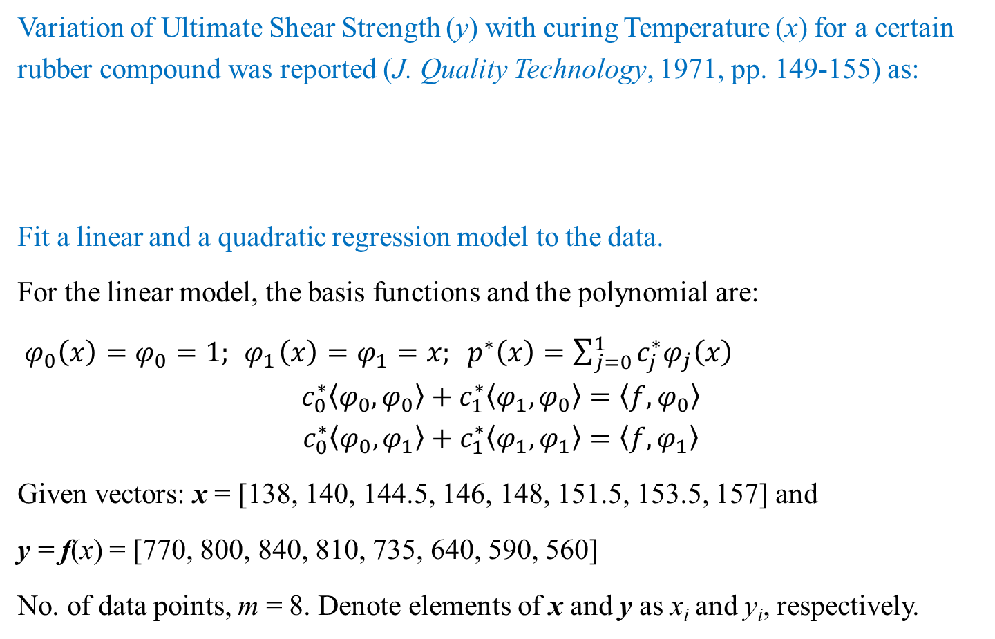
Least Square Solution: Example (Discrete Data)
Variation of Ultimate Shear Strength (y) with curing Temperature (x) for a certain rubber compound was reported (J. Quality Technology, 1971, pp. 149-155) as:
Fit a linear and a quadratic regression model to the data.
For the linear model, the basis functions and the polynomial are:
$φ_{0}\left(x\right)=φ_{0}=1; { φ}_{1}\left(x\right)=φ_{1}=x; p^{∗}\left(x\right)=\sum_{j=0}^{1}{c_{j}^{∗}φ_{j}\left(x\right)}$
$$c_{0}^{∗}\left\langle φ_{0},φ_{0}\right\rangle +c_{1}^{∗}\left\langle φ_{1},φ_{0}\right\rangle =\left\langle f,φ_{0}\right\rangle$$
$$c_{0}^{∗}\left\langle φ_{0},φ_{1}\right\rangle +c_{1}^{∗}\left\langle φ_{1},φ_{1}\right\rangle =\left\langle f,φ_{1}\right\rangle$$
Given vectors: x = [138, 140, 144.5, 146, 148, 151.5, 153.5, 157] and
y = f(x) = [770, 800, 840, 810, 735, 640, 590, 560]
No. of data points, m = 8. Denote elements of x and y as x_{i} and y_{i}, respectively.
x, in ºC | 138 | 140 | 144.5 | 146 | 148 | 151.5 | 153.5 | 157
y, in psi | 770 | 800 | 840 | 810 | 735 | 640 | 590 | 560

Slide 21
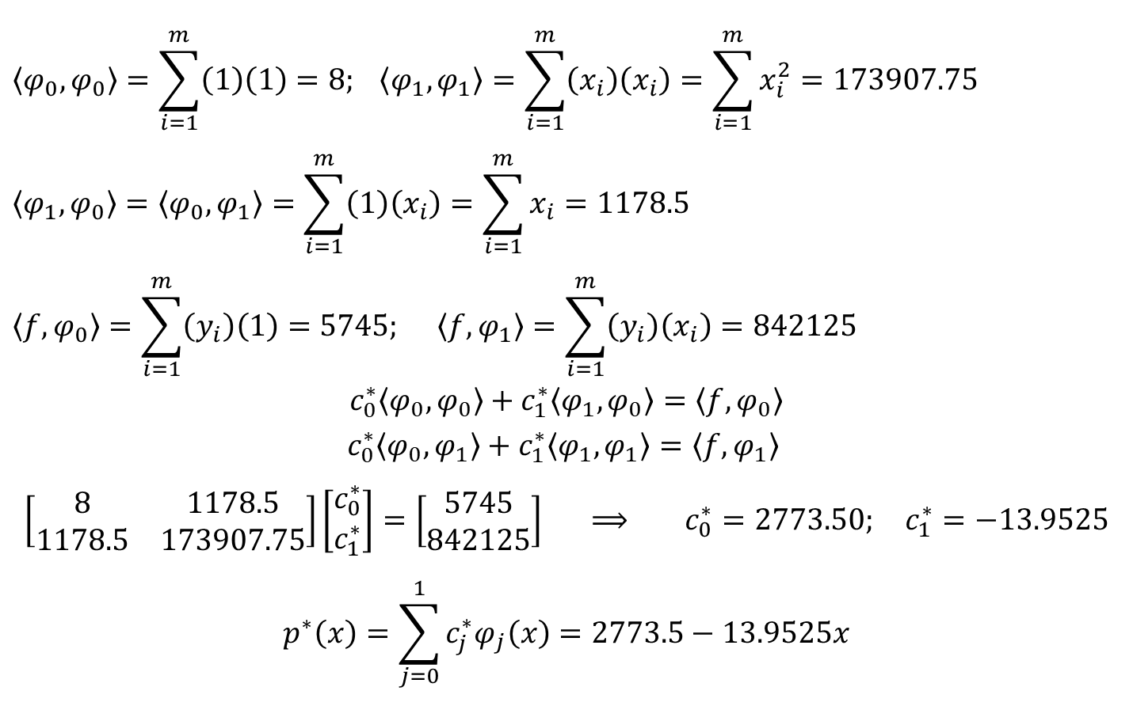
Least Square Solution: Example (Discrete Data)
$$\left\langle φ_{0},φ_{0}\right\rangle =\sum_{i=1}^{m}{\left(1\right)\left(1\right)}=8; \left\langle φ_{1},φ_{1}\right\rangle =\sum_{i=1}^{m}{\left(x_{i}\right)\left(x_{i}\right)}=\sum_{i=1}^{m}{x_{i}^{2}}=173907.75$$
$$\left\langle φ_{1},φ_{0}\right\rangle =\left\langle φ_{0},φ_{1}\right\rangle =\sum_{i=1}^{m}{\left(1\right)\left(x_{i}\right)}=\sum_{i=1}^{m}{x_{i}}=1178.5$$
$$\left\langle f,φ_{0}\right\rangle =\sum_{i=1}^{m}{\left(y_{i}\right)\left(1\right)}=5745; \left\langle f,φ_{1}\right\rangle =\sum_{i=1}^{m}{\left(y_{i}\right)\left(x_{i}\right)}=842125$$
$$c_{0}^{∗}\left\langle φ_{0},φ_{0}\right\rangle +c_{1}^{∗}\left\langle φ_{1},φ_{0}\right\rangle =\left\langle f,φ_{0}\right\rangle$$
$$c_{0}^{∗}\left\langle φ_{0},φ_{1}\right\rangle +c_{1}^{∗}\left\langle φ_{1},φ_{1}\right\rangle =\left\langle f,φ_{1}\right\rangle$$
$$\left[\begin{matrix}8 & 1178.5 \\ 1178.5 & 173907.75\end{matrix}\right]\left[\begin{matrix}c_{0}^{∗} \\ c_{1}^{∗}\end{matrix}\right]=\left[\begin{matrix}5745 \\ 842125\end{matrix}\right] ⟹ c_{0}^{∗}=2773.50; c_{1}^{∗}=−13.9525$$
$$p^{∗}\left(x\right)=\sum_{j=0}^{1}{c_{j}^{∗}φ_{j}\left(x\right)}=2773.5−13.9525x$$

Slide 22
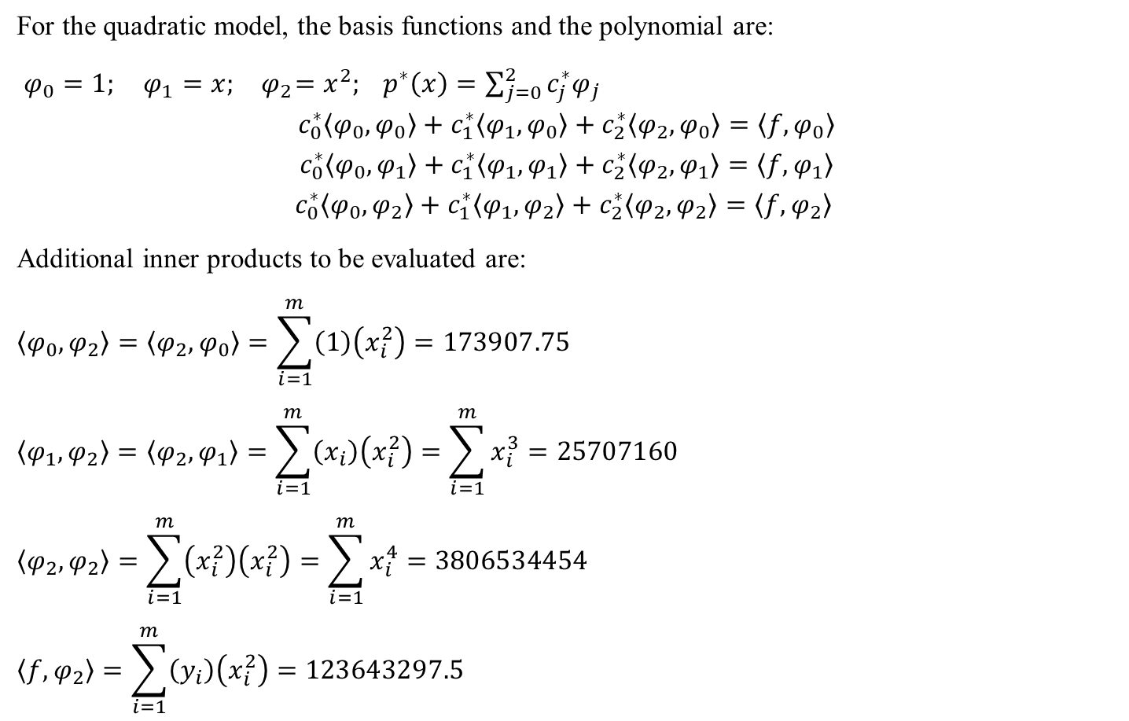
Least Square Solution: Example (Discrete Data)
For the quadratic model, the basis functions and the polynomial are:
$φ_{0}=1; φ_{1}=x; { φ}_{2}=x^{2}; p^{∗}\left(x\right)=\sum_{j=0}^{2}{c_{j}^{∗}φ_{j}}$
$$c_{0}^{∗}\left\langle φ_{0},φ_{0}\right\rangle +c_{1}^{∗}\left\langle φ_{1},φ_{0}\right\rangle +c_{2}^{∗}\left\langle φ_{2},φ_{0}\right\rangle =\left\langle f,φ_{0}\right\rangle$$
$$c_{0}^{∗}\left\langle φ_{0},φ_{1}\right\rangle +c_{1}^{∗}\left\langle φ_{1},φ_{1}\right\rangle +c_{2}^{∗}\left\langle φ_{2},φ_{1}\right\rangle =\left\langle f,φ_{1}\right\rangle$$
$$c_{0}^{∗}\left\langle φ_{0},φ_{2}\right\rangle +c_{1}^{∗}\left\langle φ_{1},φ_{2}\right\rangle +c_{2}^{∗}\left\langle φ_{2},φ_{2}\right\rangle =\left\langle f,φ_{2}\right\rangle$$
Additional inner products to be evaluated are:
$$\left\langle φ_{0},φ_{2}\right\rangle =\left\langle φ_{2},φ_{0}\right\rangle =\sum_{i=1}^{m}{\left(1\right)\left(x_{i}^{2}\right)}=173907.75$$
$$\left\langle φ_{1},φ_{2}\right\rangle =\left\langle φ_{2},φ_{1}\right\rangle =\sum_{i=1}^{m}{\left(x_{i}\right)\left(x_{i}^{2}\right)}=\sum_{i=1}^{m}{x_{i}^{3}}=25707160$$
$$\left\langle φ_{2},φ_{2}\right\rangle =\sum_{i=1}^{m}{\left(x_{i}^{2}\right)\left(x_{i}^{2}\right)}=\sum_{i=1}^{m}{x_{i}^{4}}=3806534454$$
$$\left\langle f,φ_{2}\right\rangle =\sum_{i=1}^{m}{\left(y_{i}\right)\left(x_{i}^{2}\right)}=123643297.5$$

Slide 23
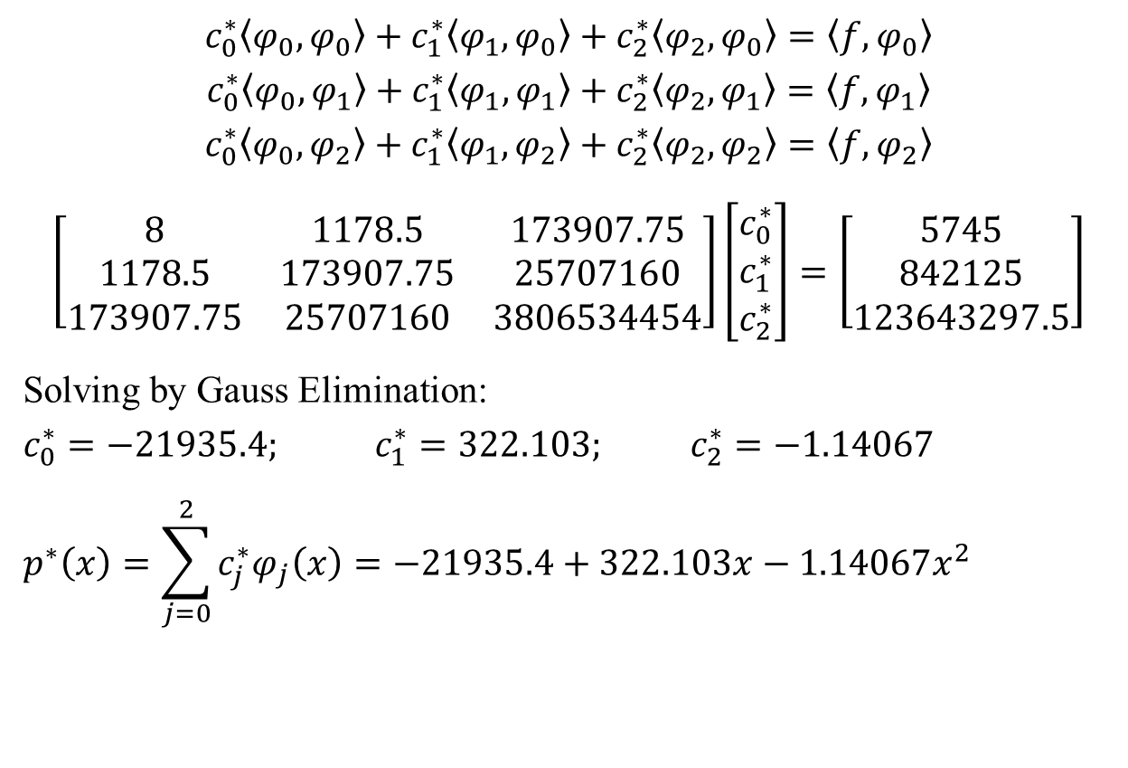
Least Square Solution: Example (Discrete Data)
$$c_{0}^{∗}\left\langle φ_{0},φ_{0}\right\rangle +c_{1}^{∗}\left\langle φ_{1},φ_{0}\right\rangle +c_{2}^{∗}\left\langle φ_{2},φ_{0}\right\rangle =\left\langle f,φ_{0}\right\rangle$$
$$c_{0}^{∗}\left\langle φ_{0},φ_{1}\right\rangle +c_{1}^{∗}\left\langle φ_{1},φ_{1}\right\rangle +c_{2}^{∗}\left\langle φ_{2},φ_{1}\right\rangle =\left\langle f,φ_{1}\right\rangle$$
$$c_{0}^{∗}\left\langle φ_{0},φ_{2}\right\rangle +c_{1}^{∗}\left\langle φ_{1},φ_{2}\right\rangle +c_{2}^{∗}\left\langle φ_{2},φ_{2}\right\rangle =\left\langle f,φ_{2}\right\rangle$$
$$\left[\begin{matrix}8 & 1178.5 & 173907.75 \\ 1178.5 & 173907.75 & 25707160 \\ 173907.75 & 25707160 & 3806534454\end{matrix}\right]\left[\begin{matrix}c_{0}^{∗} \\ c_{1}^{∗} \\ c_{2}^{∗}\end{matrix}\right]=\left[\begin{matrix}5745 \\ 842125 \\ 123643297.5\end{matrix}\right]$$
Solving by Gauss Elimination:
$$c_{0}^{∗}=−21935.4; c_{1}^{∗}=322.103; c_{2}^{∗}=−1.14067$$
$$p^{∗}\left(x\right)=\sum_{j=0}^{2}{c_{j}^{∗}φ_{j}\left(x\right)}=−21935.4+322.103x−1.14067x^{2}$$

Slide 24
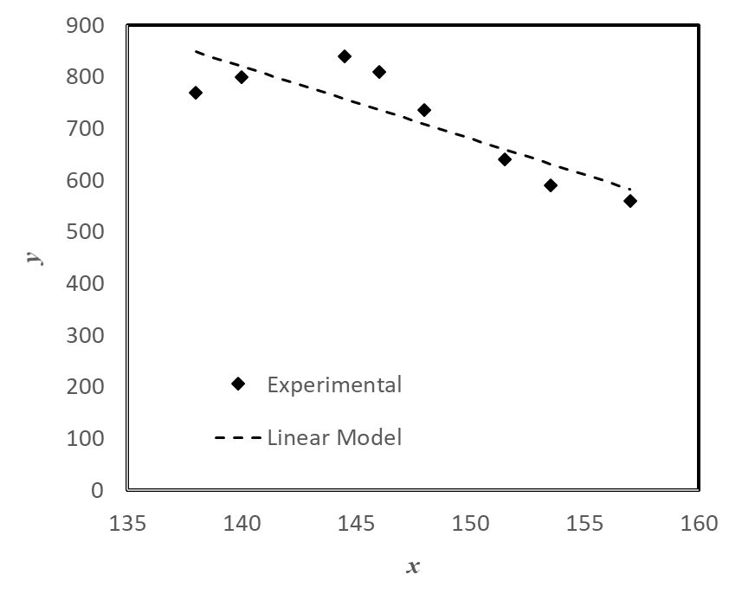
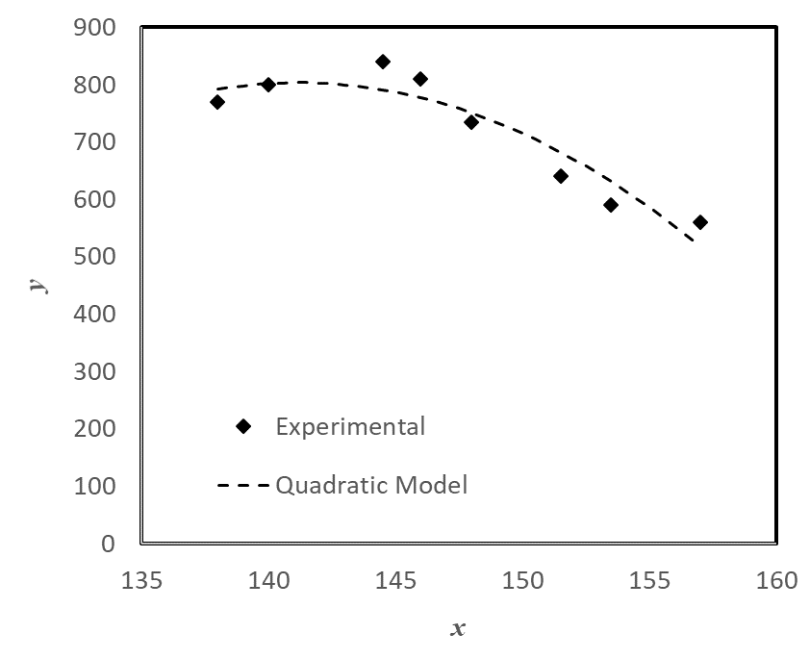
Least Square Solution: Example (Discrete Data)
How do you judge how good the fit is or how do you compare fit of two polynomials?
Square of errors!

Slide 25
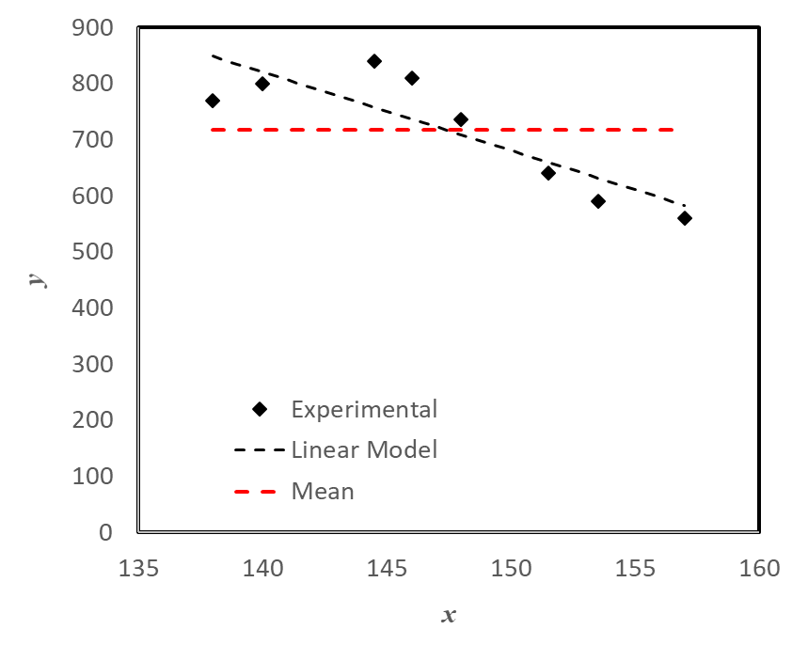
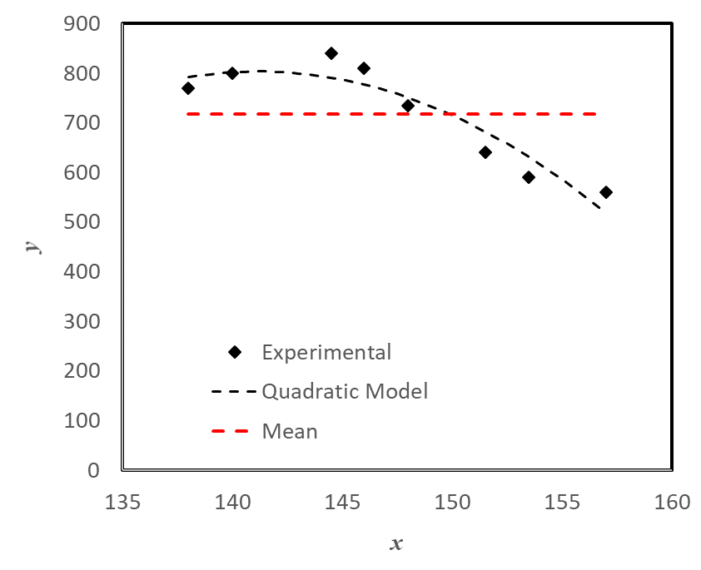
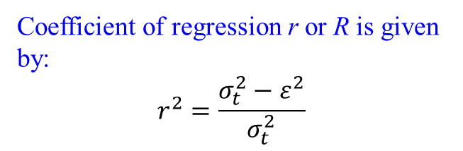
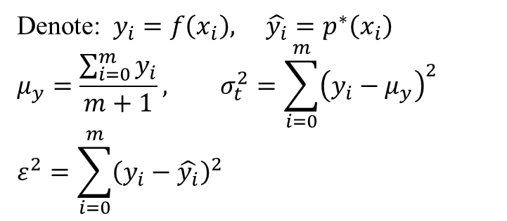
Least Square Solution: Example (Discrete Data)
Denote: $y_{i}=f\left(x_{i}\right), \hat{y_{i}}=p^{∗}\left(x_{i}\right)$
$$μ_{y}=\frac{\sum_{i=0}^{m}{y_{i}}}{m+1}, σ_{t}^{2}=\sum_{i=0}^{m}{{\left(y_{i}−μ_{y}\right)}^{2}}$$
$$ε^{2}=\sum_{i=0}^{m}{{\left(y_{i}−\hat{y_{i}}\right)}^{2}}$$
R² = 0.73
Coefficient of regression r or R is given by:
$$r^{2}=\frac{σ_{t}^{2}−ε^{2}}{σ_{t}^{2}}$$
R² = 0.88

Slide 26
Additional Points
You can do multiple regression using the same frame work.
Linearize some non-linear equations
Evaluate Integrals using Numerical Methods for Integration for functions that are not easy to integrate using analytical means!

Slide 27

ESO 208A: Computational Methods in Engineering Orthogonal Basis, Periodic Functions
Saumyen Guha
Department of Civil Engineering
IIT Kanpur

Slide 28
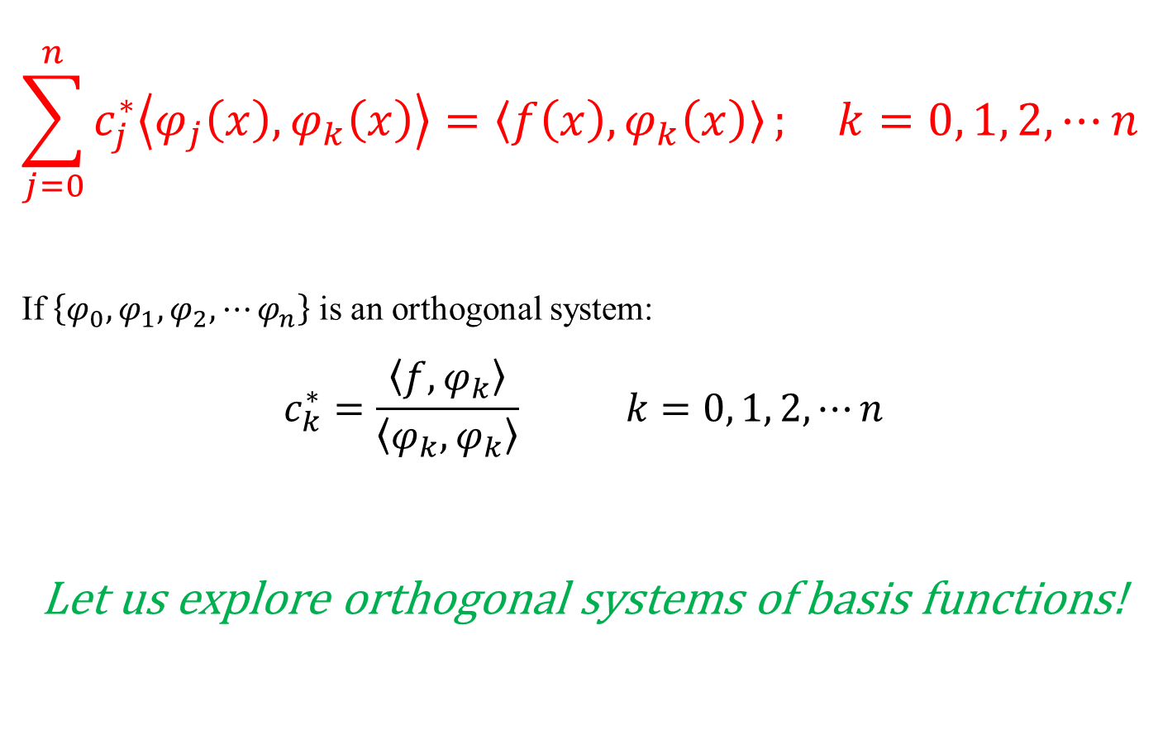
Least Square Solution: Normal Equations
$$\sum_{j=0}^{n}{c_{j}^{∗}\left\langle φ_{j}\left(x\right),φ_{k}\left(x\right)\right\rangle =\left\langle f\left(x\right),φ_{k}\left(x\right)\right\rangle }; k=0, 1, 2,⋯n$$
If $\left\{φ_{0},φ_{1},φ_{2},⋯φ_{n}\right\}$ is an orthogonal system:
$$c_{k}^{∗}=\frac{\left\langle f,φ_{k}\right\rangle }{\left\langle φ_{k},φ_{k}\right\rangle } k=0, 1, 2,⋯n$$
Let us explore orthogonal systems of basis functions!

Slide 29
Orthogonal Polynomials: Tchebycheff
Consider the Equality:
$$\cos\left(n+1\right)φ+\cos\left(n−1\right)φ=2\cos{φ}\cos{nφ} n≥1$$
n = 1: $\cos{2φ}=2\cos^{2}{φ}−1$
n = 2: $\cos{3φ}=2\cos{φ}\cos{2φ}−\cos{φ}=4\cos^{3}{φ}−3\cos{φ}$
Define: $x=\cos{φ},φ∈\left[0,π\right] and T_{n}\left(x\right)=\cos{nφ}=\cos\left(n\cos^{−1}{x}\right)$
Recursion Formula: $T_{n+1}\left(x\right)=2xT_{n}\left(x\right)−T_{n−1}\left(x\right)$
Example: $T_{0}\left(x\right)=1; T_{1}\left(x\right)=x; T_{2}\left(x\right)=2x^{2}−1$
Symmetry: $T_{n}\left(−x\right)={\left(−1\right)}^{n}T_{n}\left(x\right)$
Leading Coefficient: 2^{n-1} for n ≥ 1 and 1 for n = 0
T_{n}(x) constitutes an orthogonal family of polynomials in [-1, 1]!

Slide 30
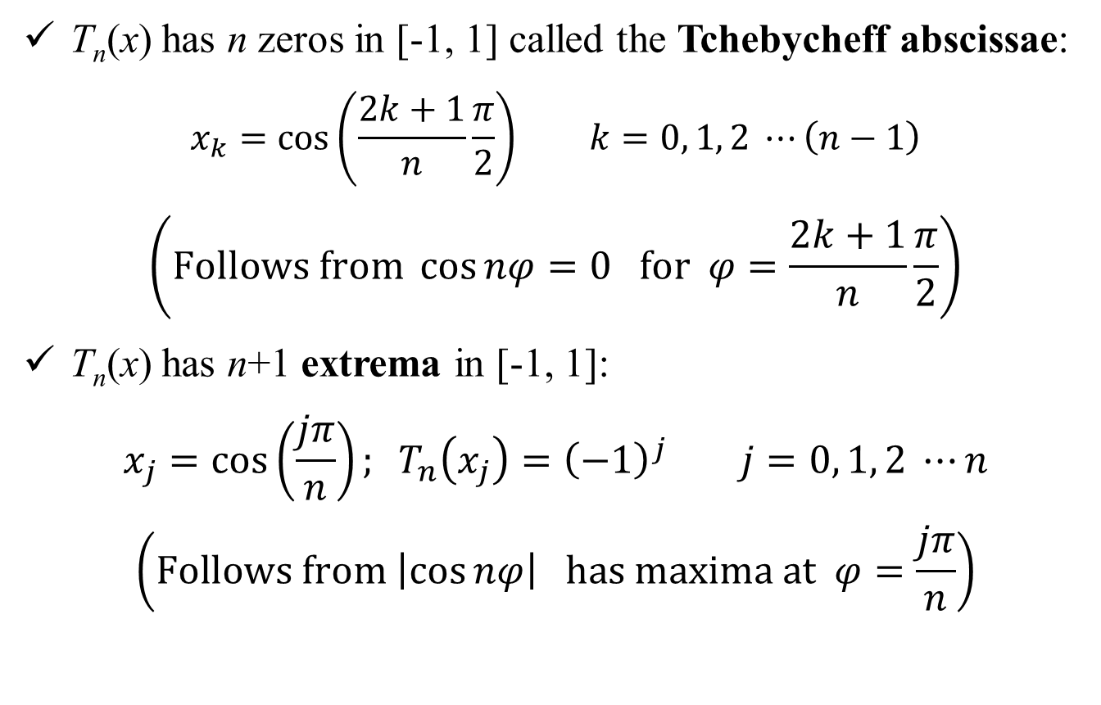
Orthogonal Polynomials: Tchebycheff
T_{n}(x) has n zeros in [-1, 1] called the Tchebycheff abscissae:
$$x_{k}=\cos\left(\frac{2k+1}{n}\frac{π}{2}\right) k=0, 1, 2 ⋯\left(n−1\right)$$
$$\left(Follows from \cos{nφ}=0 for φ=\frac{2k+1}{n}\frac{π}{2}\right)$$
T_{n}(x) has n+1 extrema in [-1, 1]:
$$x_{j}=\cos\left(\frac{jπ}{n}\right); T_{n}\left(x_{j}\right)={\left(−1\right)}^{j} j=0, 1, 2 ⋯n$$
$$\left(Follows from \left|\cos{nφ}\right| has maxima at φ=\frac{jπ}{n}\right)$$

Slide 31

Orthogonal Polynomials: Tchebycheff
Orthogonality (continuous):
$$\left\langle T_{m}\left(x\right),T_{n}\left(x\right)\right\rangle =\int_{0}^{π}{\cos{mφ}\cos{nφ}}dφ$$
$$=\int_{−1}^{1}{T_{m}\left(x\right)T_{n}\left(x\right)}\frac{1}{\sqrt{1−x^{2}}}dx$$
$$=\left\{\begin{matrix}0 if m≠n \\ \frac{π}{2} if m=n ≠0 \\ π if m=n=0\end{matrix}\right.$$
For arbitrary f(x), a ≤ x ≤ b: $x=\frac{b+a}{2}+\frac{b−a}{2}ξ −1≤ξ≤1$

Slide 32
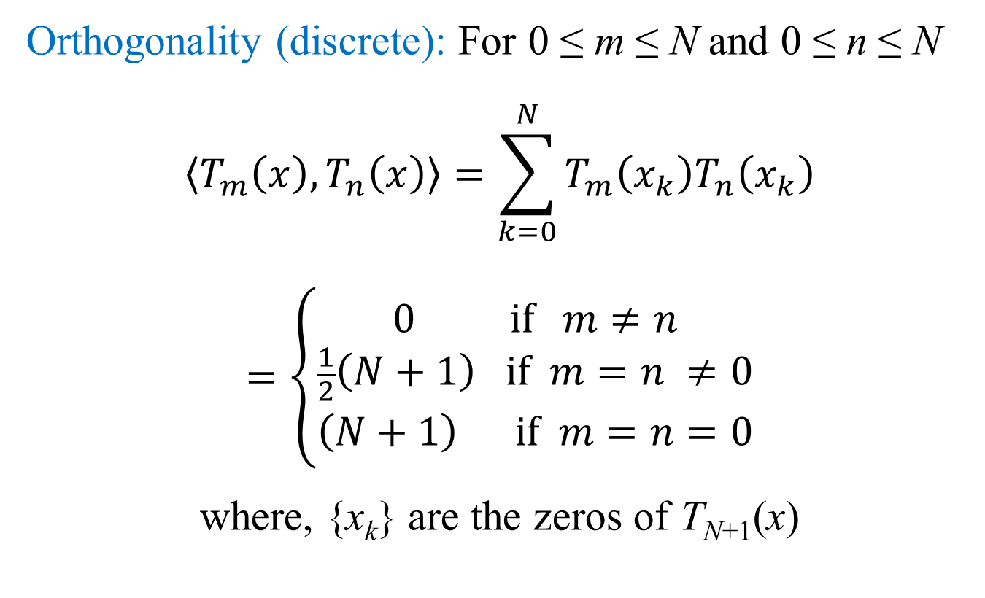
Orthogonal Polynomials: Tchebycheff
Orthogonality (discrete): For 0 ≤ m ≤ N and 0 ≤ n ≤ N
$$\left\langle T_{m}\left(x\right),T_{n}\left(x\right)\right\rangle =\sum_{k=0}^{N}{T_{m}\left(x_{k}\right)T_{n}\left(x_{k}\right)}$$
$$=\left\{\begin{matrix}0 if m≠n \\ \frac{1}{2}\left(N+1\right) if m=n ≠0 \\ \left(N+1\right) if m=n=0\end{matrix}\right.$$
where, {x_{k}} are the zeros of T_{N+1}(x)

Slide 33
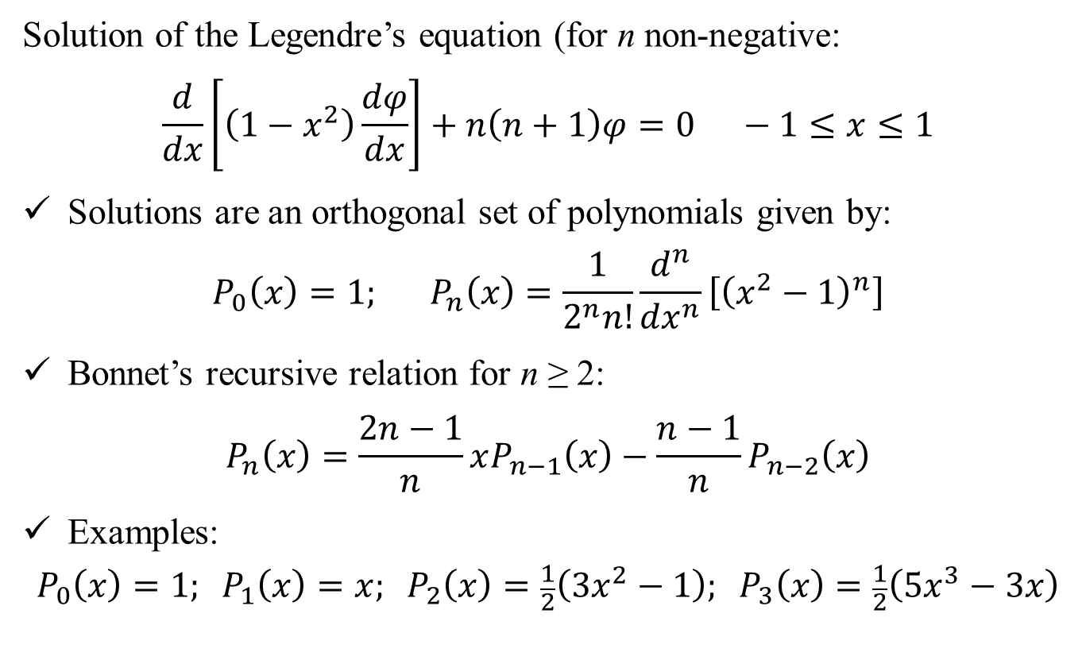
Orthogonal Polynomials: Legendre
Solution of the Legendre’s equation (for n non-negative:
$$\frac{d}{dx}\left[\left(1−x^{2}\right)\frac{dφ}{dx}\right]+n\left(n+1\right)φ=0 −1≤x≤1$$
Solutions are an orthogonal set of polynomials given by:
$$P_{0}\left(x\right)=1; P_{n}\left(x\right)=\frac{1}{2^{n}n!}\frac{d^{n}}{{dx}^{n}}\left[{\left(x^{2}−1\right)}^{n}\right]$$
Bonnet’s recursive relation for n ≥ 2:
$$P_{n}\left(x\right)=\frac{2n−1}{n}xP_{n−1}\left(x\right)−\frac{n−1}{n}P_{n−2}\left(x\right)$$
Examples:
$$P_{0}\left(x\right)=1; P_{1}\left(x\right)=x; P_{2}\left(x\right)=\frac{1}{2}\left(3x^{2}−1\right); P_{3}\left(x\right)=\frac{1}{2}\left(5x^{3}−3x\right)$$

Slide 34
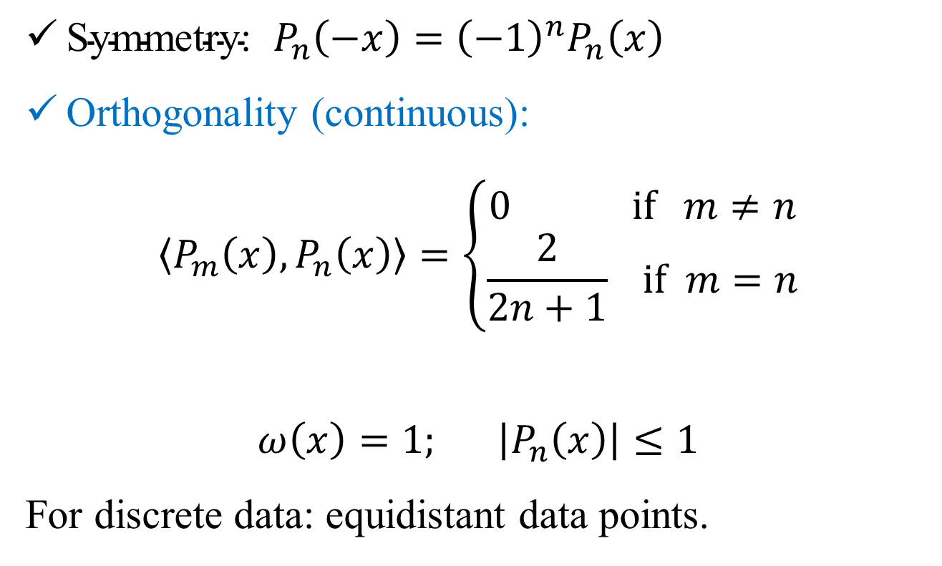
Orthogonal Polynomials: Legendre
$\text{Symmetry}\text{: }P_{n}\left(−x\right)={\left(−1\right)}^{n}P_{n}\left(x\right)$
Orthogonality (continuous):
$$\left\langle P_{m}\left(x\right),P_{n}\left(x\right)\right\rangle =\left\{\begin{matrix}0 if m≠n \\ \frac{2}{2n+1} if m=n\end{matrix}\right.$$
$$ω\left(x\right)=1; \left|P_{n}\left(x\right)\right|≤1$$
For discrete data: equidistant data points.

Slide 35
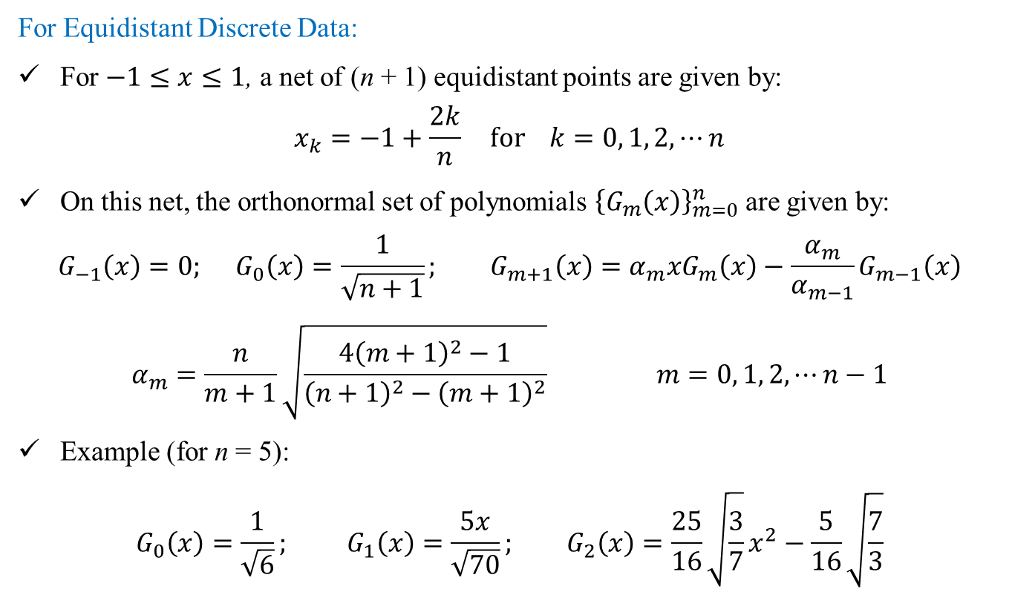
Orthonormal Polynomials: Gram
For Equidistant Discrete Data:
For $−1≤x≤1$, a net of (n + 1) equidistant points are given by:
$$x_{k}=−1+\frac{2k}{n} for k=0, 1, 2, ⋯n$$
On this net, the orthonormal set of polynomials ${\left\{G_{m}\left(x\right)\right\}}_{m=0}^{n}$ are given by:
$$G_{−1}\left(x\right)=0; G_{0}\left(x\right)=\frac{1}{\sqrt{n+1}}; G_{m+1}\left(x\right)=α_{m}xG_{m}\left(x\right)−\frac{α_{m}}{α_{m−1}}G_{m−1}\left(x\right)$$
$$α_{m}=\frac{n}{m+1}\sqrt{\frac{4{\left(m+1\right)}^{2}−1}{{\left(n+1\right)}^{2}−{\left(m+1\right)}^{2}}} m=0, 1, 2,⋯n−1$$
Example (for n = 5):
$$G_{0}\left(x\right)=\frac{1}{\sqrt{6}}; G_{1}\left(x\right)=\frac{5x}{\sqrt{70}}; G_{2}\left(x\right)=\frac{25}{16}\sqrt{\frac{3}{7}}x^{2}−\frac{5}{16}\sqrt{\frac{7}{3}}$$

Slide 36
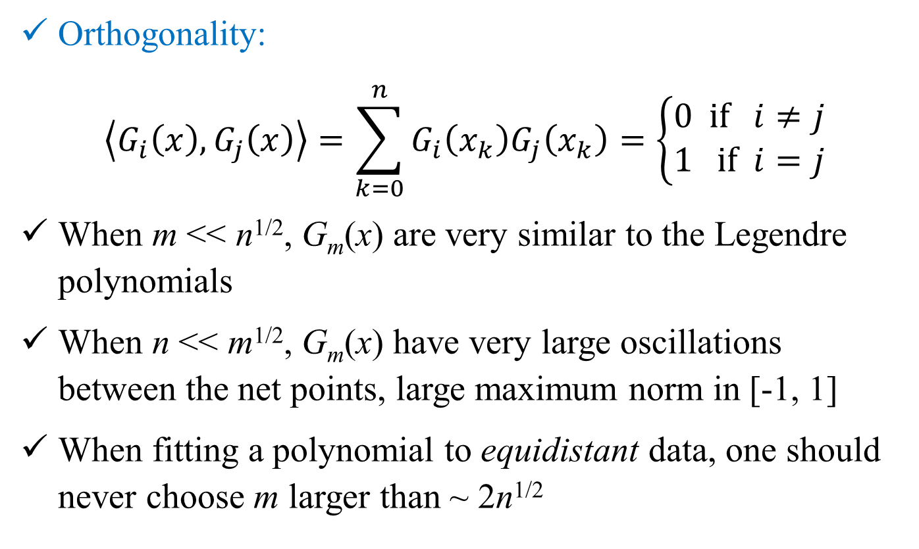
Orthonormal Polynomials: Gram
Orthogonality:
$$\left\langle G_{i}\left(x\right),G_{j}\left(x\right)\right\rangle =\sum_{k=0}^{n}{G_{i}\left(x_{k}\right)G_{j}\left(x_{k}\right)}=\left\{\begin{matrix}0 if i≠j \\ 1 if i=j\end{matrix}\right.$$
When m << n^{1/2}, G_{m}(x) are very similar to the Legendre polynomials
When n << m^{1/2}, G_{m}(x) have very large oscillations between the net points, large maximum norm in [-1, 1]
When fitting a polynomial to equidistant data, one should never choose m larger than ~ 2n^{1/2}

Slide 37
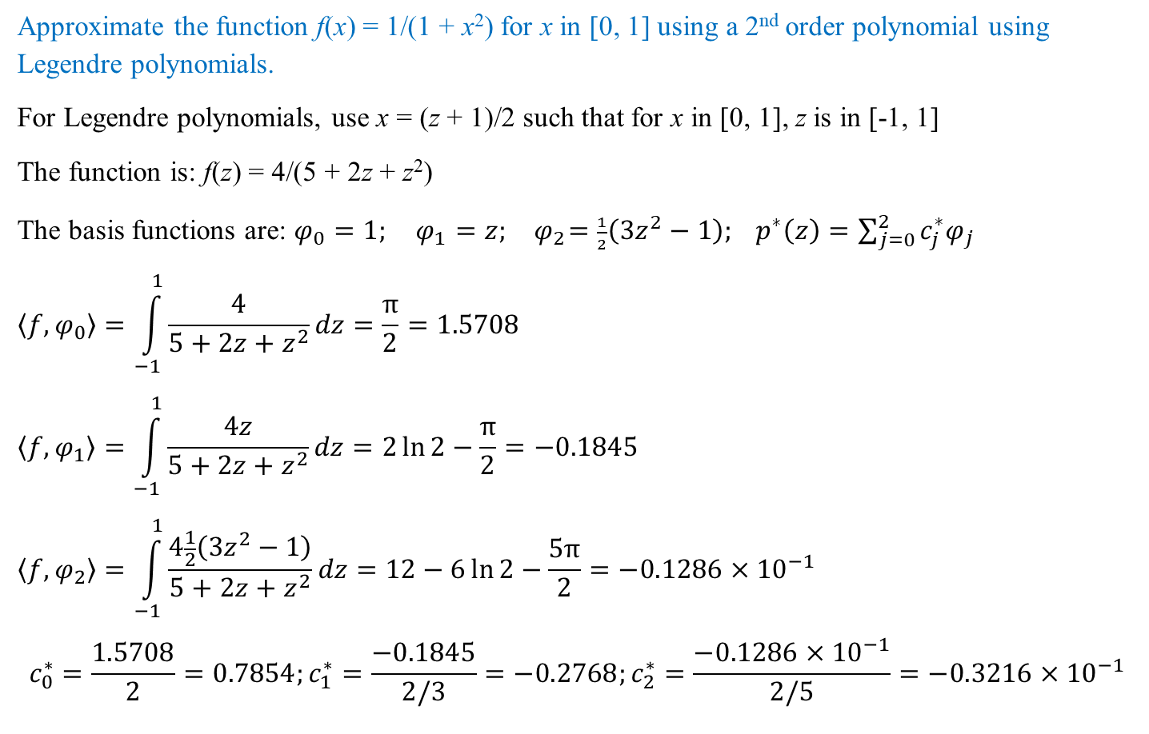
Least Square Solution: Example (Continuous)
Approximate the function f(x) = 1/(1 + x²) for x in [0, 1] using a 2nd order polynomial using Legendre polynomials.
For Legendre polynomials, use x = (z + 1)/2 such that for x in [0, 1], z is in [-1, 1]
The function is: f(z) = 4/(5 + 2z + z²)
The basis functions are: $φ_{0}=1; φ_{1}=z; { φ}_{2}=\frac{1}{2}\left(3z^{2}−1\right); p^{∗}\left(z\right)=\sum_{j=0}^{2}{c_{j}^{∗}φ_{j}}$
$$\left\langle f,φ_{0}\right\rangle =\int_{−1}^{1}{\frac{4}{5+2z+z^{2}}dz}=\frac{π}{2}=1.5708$$
$$\left\langle f,φ_{1}\right\rangle =\int_{−1}^{1}{\frac{4z}{5+2z+z^{2}}dz}=2\ln{2}−\frac{π}{2}=−0.1845$$
$$\left\langle f,φ_{2}\right\rangle =\int_{−1}^{1}{\frac{4\frac{1}{2}\left(3z^{2}−1\right)}{5+2z+z^{2}}dz}=12−6\ln{2}−\frac{5π}{2}=−0.1286×{10}^{−1}$$
$$c_{0}^{∗}=\frac{1.5708}{2}=0.7854;c_{1}^{∗}=\frac{−0.1845}{2/3}=−0.2768;c_{2}^{∗}=\frac{−0.1286×{10}^{−1}}{2/5}=−0.3216×{10}^{−1}$$

Slide 38
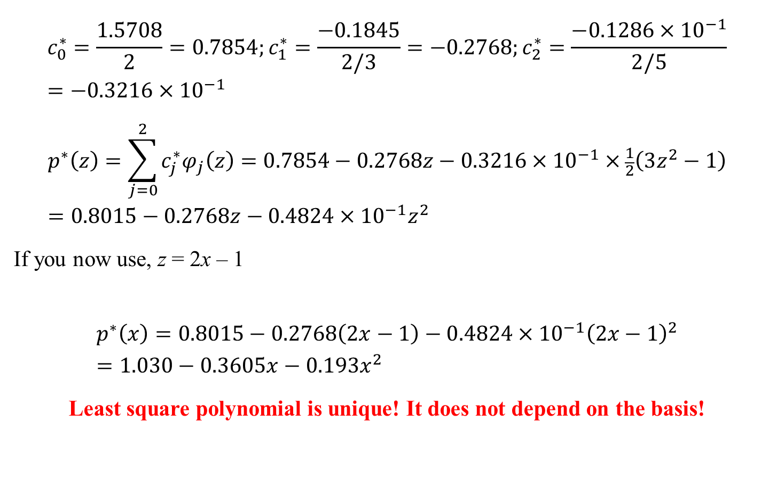
Least Square Solution: Example (Continuous)
$$c_{0}^{∗}=\frac{1.5708}{2}=0.7854;c_{1}^{∗}=\frac{−0.1845}{2/3}=−0.2768;c_{2}^{∗}=\frac{−0.1286×{10}^{−1}}{2/5}=−0.3216×{10}^{−1}$$
$$p^{∗}\left(z\right)=\sum_{j=0}^{2}{c_{j}^{∗}φ_{j}\left(z\right)}=0.7854−0.2768z−0.3216×{10}^{−1}×\frac{1}{2}\left(3z^{2}−1\right)=0.8015−0.2768z−0.4824×{10}^{−1}z^{2}$$
If you now use, z = 2x – 1
$$p^{∗}\left(x\right)=0.8015−0.2768\left(2x−1\right)−0.4824×{10}^{−1}{\left(2x−1\right)}^{2}=1.030−0.3605x−0.193x^{2}$$
Least square polynomial is unique! It does not depend on the basis!

