Slide 1
Theory of Approximation: Orthogonal Basis, Periodic Functions

Slide 2

Least Square Solution: Normal Equations
$$\sum_{j=0}^{n}{c_{j}^{∗}\left\langle φ_{j}\left(x\right),φ_{k}\left(x\right)\right\rangle =\left\langle f\left(x\right),φ_{k}\left(x\right)\right\rangle }; k=0, 1, 2,⋯n$$
If $\left\{φ_{0},φ_{1},φ_{2},⋯φ_{n}\right\}$ is an orthogonal system:
$$c_{k}^{∗}=\frac{\left\langle f,φ_{k}\right\rangle }{\left\langle φ_{k},φ_{k}\right\rangle } k=0, 1, 2,⋯n$$
Orthogonal Polynomials:
Tchebycheff
Legendre
Gram

Slide 3
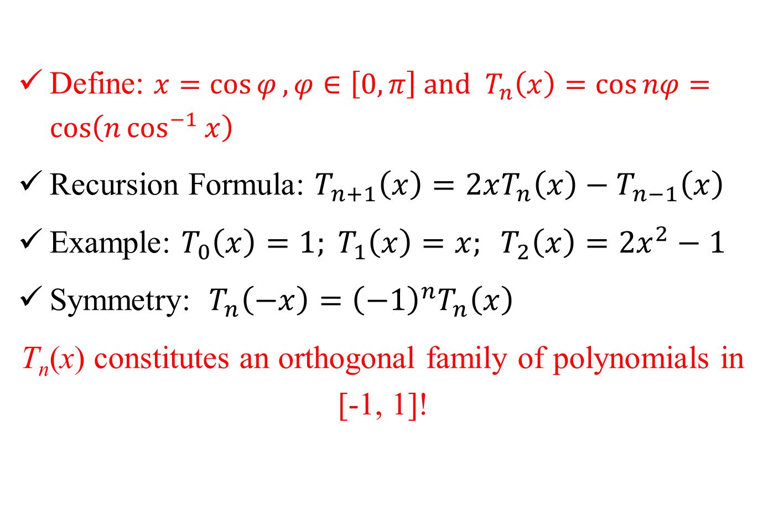
Orthogonal Polynomials: Tchebycheff
Define: $x=\cos{φ},φ∈\left[0,π\right] and T_{n}\left(x\right)=\cos{nφ}=\cos\left(n\cos^{−1}{x}\right)$
Recursion Formula: $T_{n+1}\left(x\right)=2xT_{n}\left(x\right)−T_{n−1}\left(x\right)$
Example: $T_{0}\left(x\right)=1; T_{1}\left(x\right)=x; T_{2}\left(x\right)=2x^{2}−1$
Symmetry: $T_{n}\left(−x\right)={\left(−1\right)}^{n}T_{n}\left(x\right)$
T_{n}(x) constitutes an orthogonal family of polynomials in [-1, 1]!

Slide 4

Orthogonal Polynomials: Tchebycheff
Orthogonality (continuous):
$$\left\langle T_{m}\left(x\right),T_{n}\left(x\right)\right\rangle =\int_{0}^{π}{\cos{mφ}\cos{nφ}}dφ$$
$$=\int_{−1}^{1}{T_{m}\left(x\right)T_{n}\left(x\right)}\frac{1}{\sqrt{1−x^{2}}}dx$$
$$=\left\{\begin{matrix}0 if m≠n \\ \frac{π}{2} if m=n ≠0 \\ π if m=n=0\end{matrix}\right.$$
For arbitrary f(x), a ≤ x ≤ b: $x=\frac{b+a}{2}+\frac{b−a}{2}ξ −1≤ξ≤1$

Slide 5
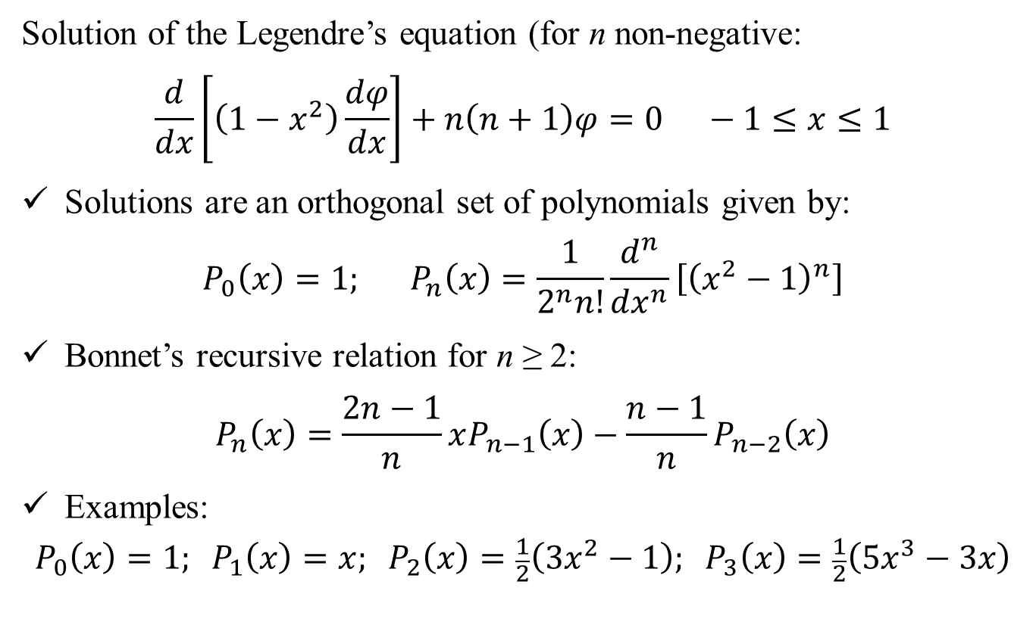
Orthogonal Polynomials: Legendre
Solution of the Legendre’s equation (for n non-negative:
$$\frac{d}{dx}\left[\left(1−x^{2}\right)\frac{dφ}{dx}\right]+n\left(n+1\right)φ=0 −1≤x≤1$$
Solutions are an orthogonal set of polynomials given by:
$$P_{0}\left(x\right)=1; P_{n}\left(x\right)=\frac{1}{2^{n}n!}\frac{d^{n}}{{dx}^{n}}\left[{\left(x^{2}−1\right)}^{n}\right]$$
Bonnet’s recursive relation for n ≥ 2:
$$P_{n}\left(x\right)=\frac{2n−1}{n}xP_{n−1}\left(x\right)−\frac{n−1}{n}P_{n−2}\left(x\right)$$
Examples:
$$P_{0}\left(x\right)=1; P_{1}\left(x\right)=x; P_{2}\left(x\right)=\frac{1}{2}\left(3x^{2}−1\right); P_{3}\left(x\right)=\frac{1}{2}\left(5x^{3}−3x\right)$$

Slide 6
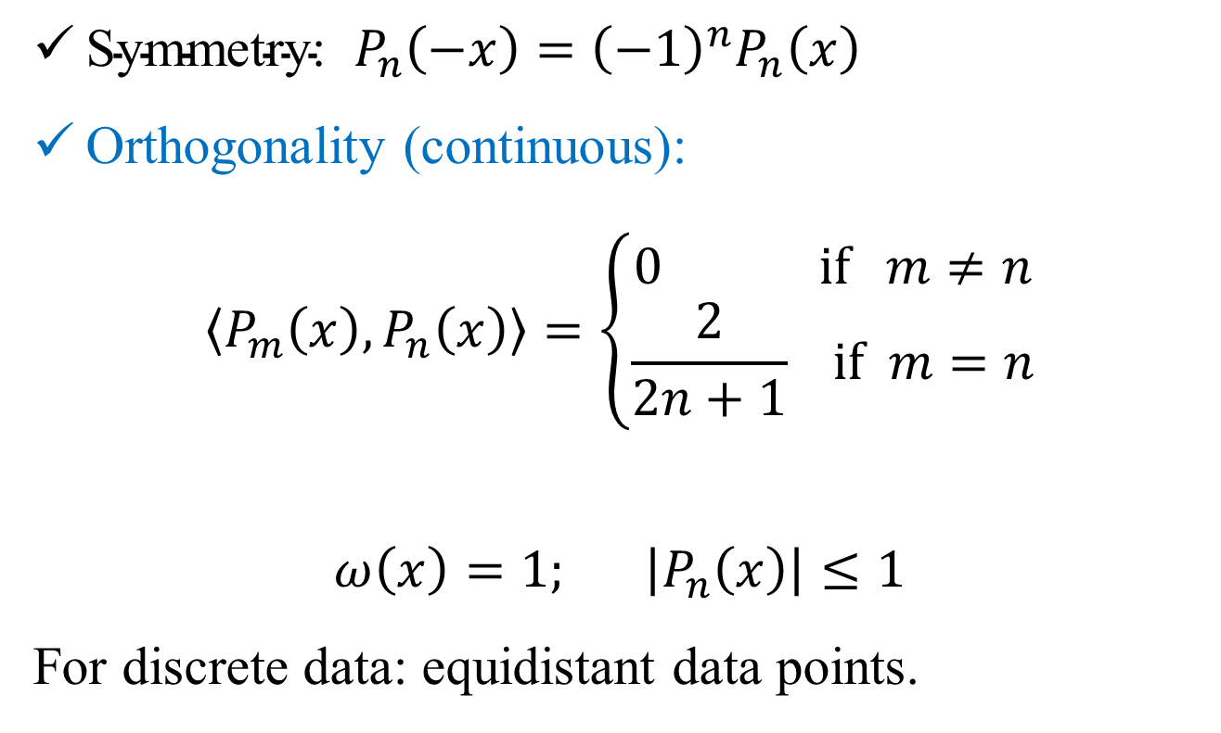
Orthogonal Polynomials: Legendre
$\text{Symmetry}\text{: }P_{n}\left(−x\right)={\left(−1\right)}^{n}P_{n}\left(x\right)$
Orthogonality (continuous):
$$\left\langle P_{m}\left(x\right),P_{n}\left(x\right)\right\rangle =\left\{\begin{matrix}0 if m≠n \\ \frac{2}{2n+1} if m=n\end{matrix}\right.$$
$$ω\left(x\right)=1; \left|P_{n}\left(x\right)\right|≤1$$
For discrete data: equidistant data points.

Slide 7
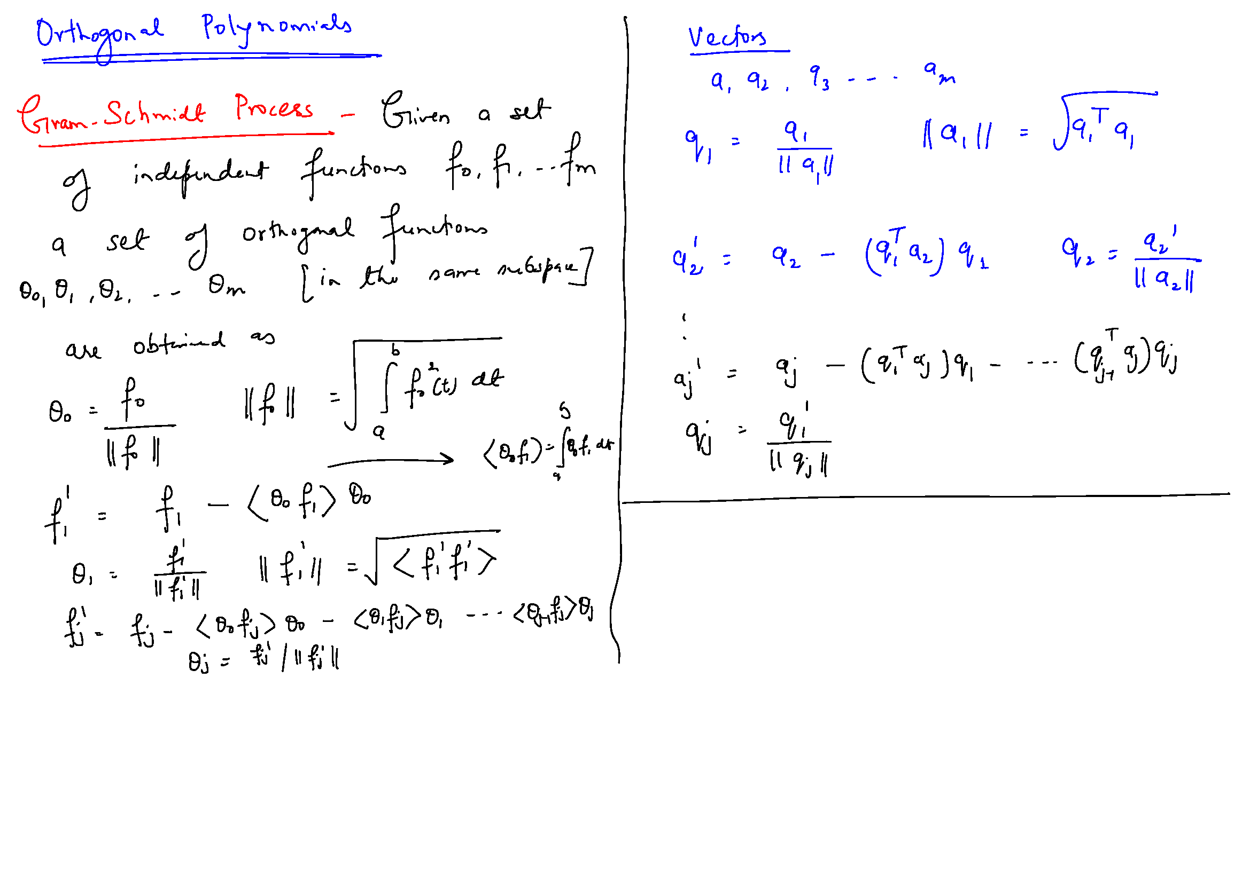

Slide 9
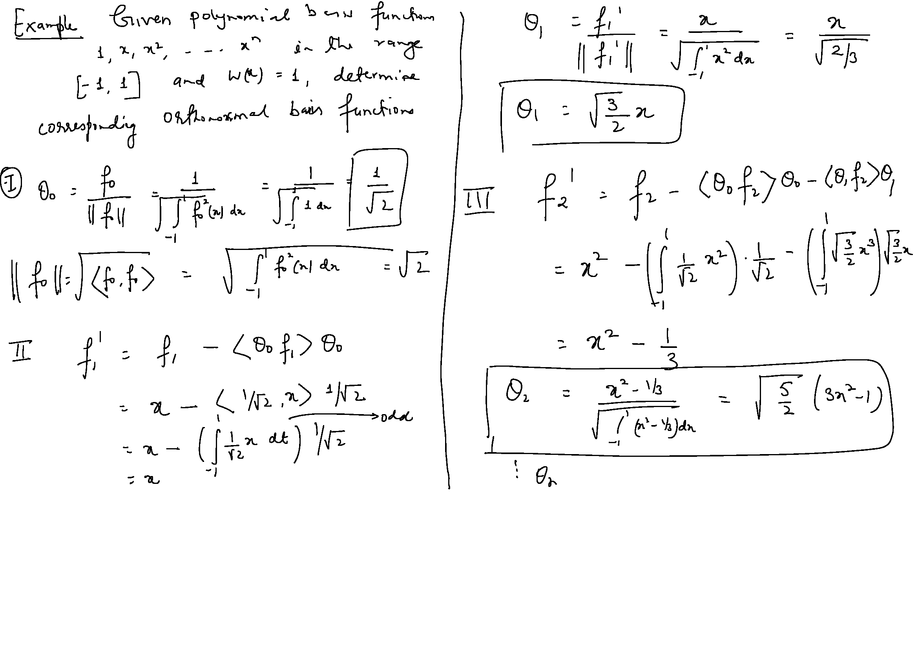

Slide 10
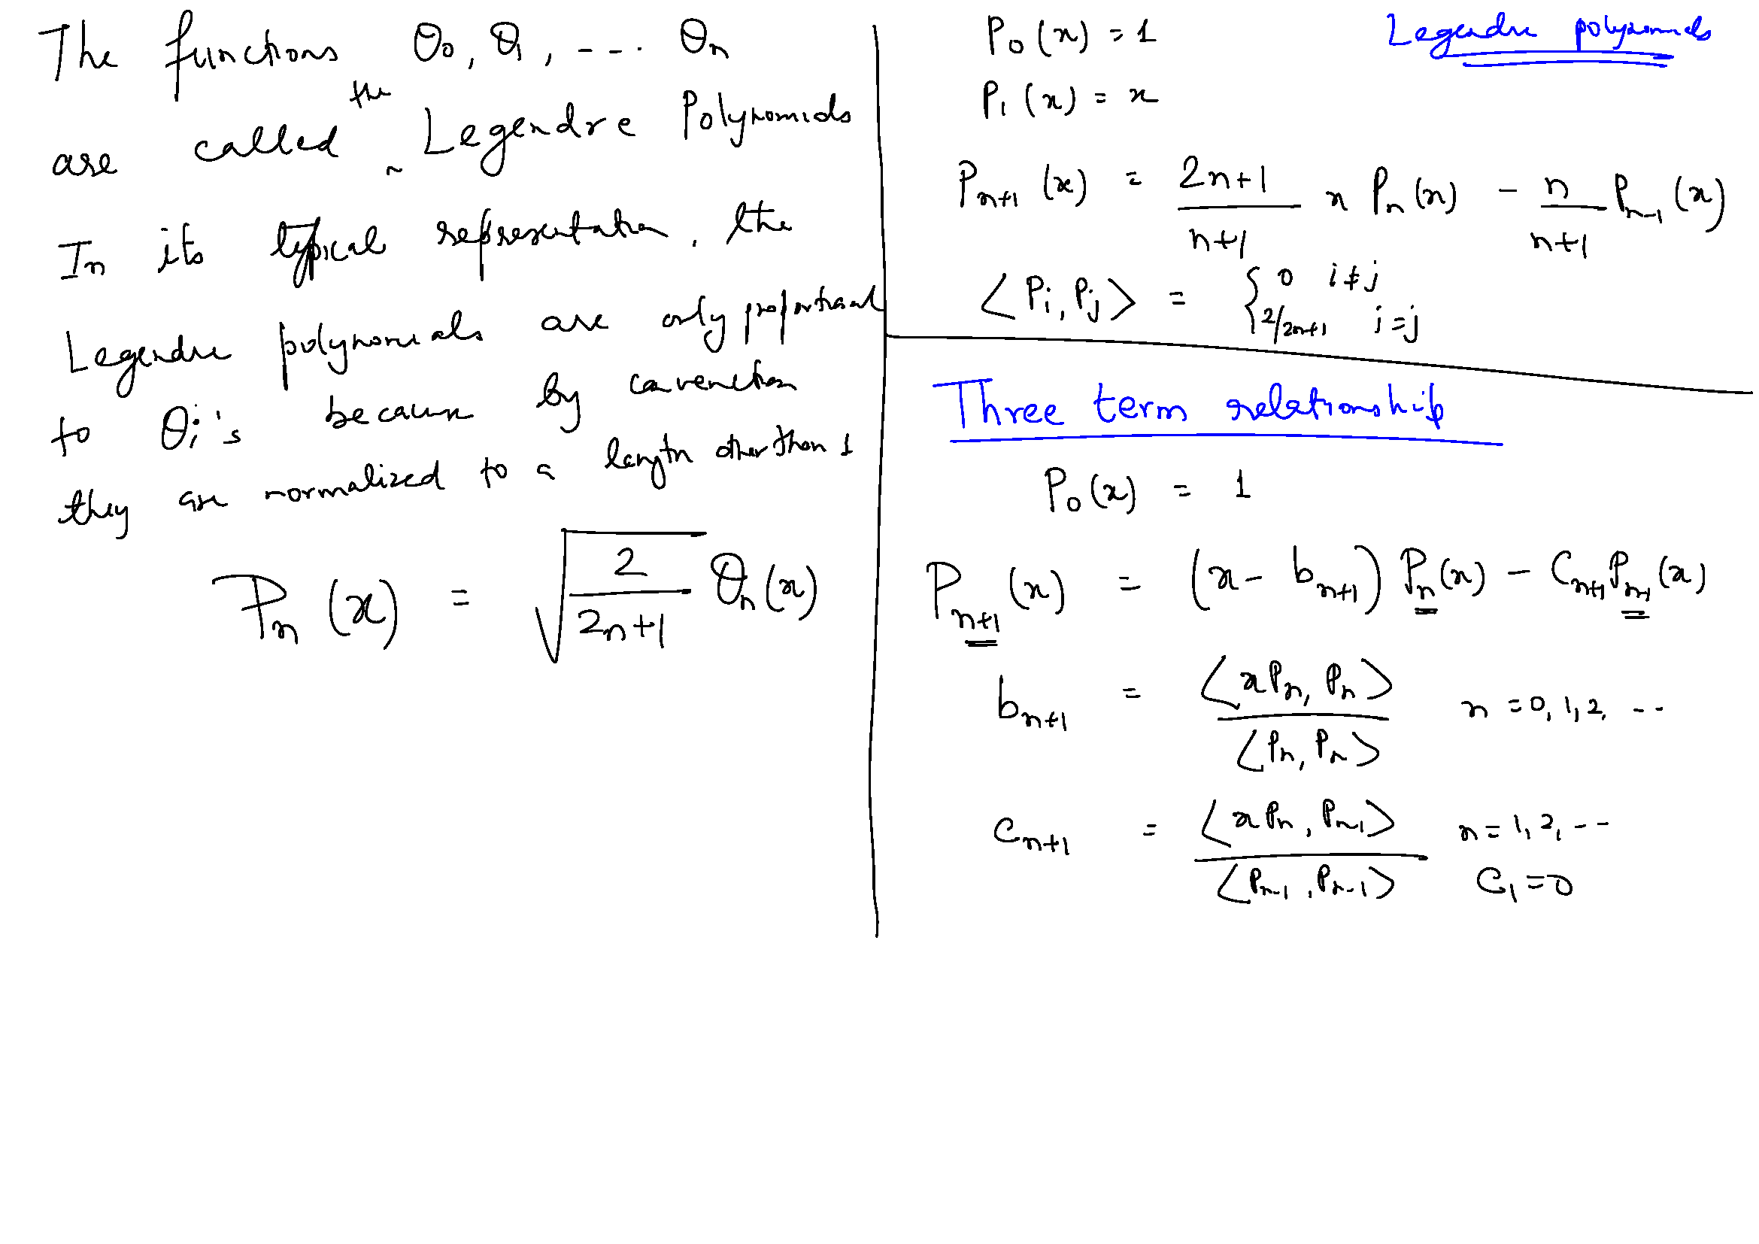

Slide 11
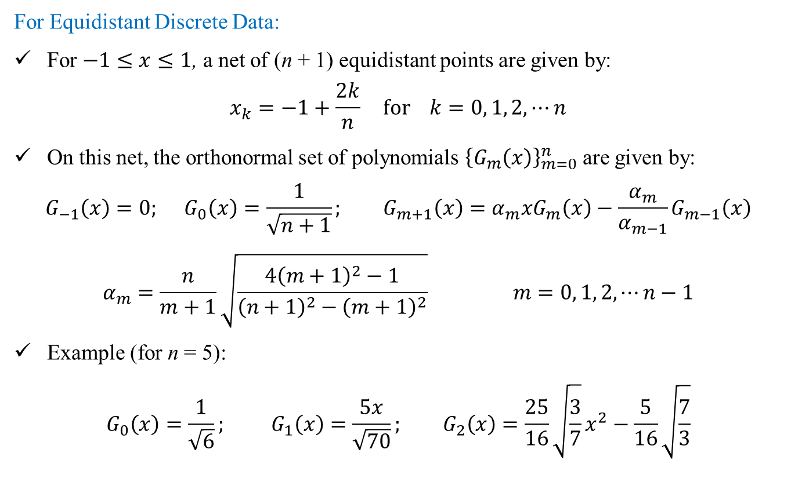
Orthonormal Polynomials: Gram
For Equidistant Discrete Data:
For $−1≤x≤1$, a net of (n + 1) equidistant points are given by:
$$x_{k}=−1+\frac{2k}{n} for k=0, 1, 2, ⋯n$$
On this net, the orthonormal set of polynomials ${\left\{G_{m}\left(x\right)\right\}}_{m=0}^{n}$ are given by:
$$G_{−1}\left(x\right)=0; G_{0}\left(x\right)=\frac{1}{\sqrt{n+1}}; G_{m+1}\left(x\right)=α_{m}xG_{m}\left(x\right)−\frac{α_{m}}{α_{m−1}}G_{m−1}\left(x\right)$$
$$α_{m}=\frac{n}{m+1}\sqrt{\frac{4{\left(m+1\right)}^{2}−1}{{\left(n+1\right)}^{2}−{\left(m+1\right)}^{2}}} m=0, 1, 2,⋯n−1$$
Example (for n = 5):
$$G_{0}\left(x\right)=\frac{1}{\sqrt{6}}; G_{1}\left(x\right)=\frac{5x}{\sqrt{70}}; G_{2}\left(x\right)=\frac{25}{16}\sqrt{\frac{3}{7}}x^{2}−\frac{5}{16}\sqrt{\frac{7}{3}}$$

Slide 12
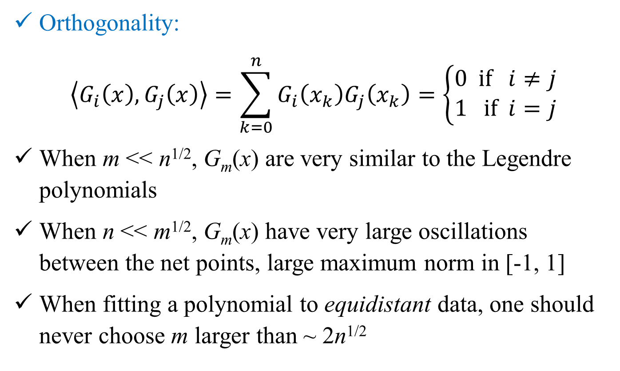
Orthonormal Polynomials: Gram
Orthogonality:
$$\left\langle G_{i}\left(x\right),G_{j}\left(x\right)\right\rangle =\sum_{k=0}^{n}{G_{i}\left(x_{k}\right)G_{j}\left(x_{k}\right)}=\left\{\begin{matrix}0 if i≠j \\ 1 if i=j\end{matrix}\right.$$
When m << n^{1/2}, G_{m}(x) are very similar to the Legendre polynomials
When n << m^{1/2}, G_{m}(x) have very large oscillations between the net points, large maximum norm in [-1, 1]
When fitting a polynomial to equidistant data, one should never choose m larger than ~ 2n^{1/2}

Slide 13
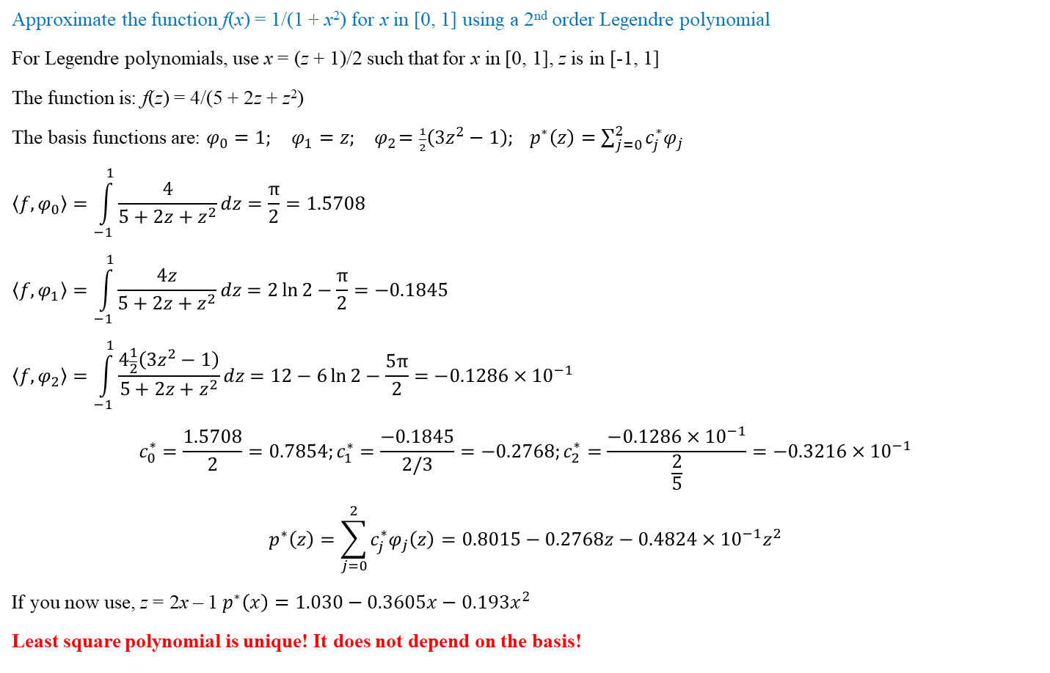
Least Square Solution: Example (Continuous)
Approximate the function f(x) = 1/(1 + x²) for x in [0, 1] using a 2nd order Legendre polynomial
For Legendre polynomials, use x = (z + 1)/2 such that for x in [0, 1], z is in [-1, 1]
The function is: f(z) = 4/(5 + 2z + z²)
The basis functions are: $φ_{0}=1; φ_{1}=z; { φ}_{2}=\frac{1}{2}\left(3z^{2}−1\right); p^{∗}\left(z\right)=\sum_{j=0}^{2}{c_{j}^{∗}φ_{j}}$
$$\left\langle f,φ_{0}\right\rangle =\int_{−1}^{1}{\frac{4}{5+2z+z^{2}}dz}=\frac{π}{2}=1.5708$$
$$\left\langle f,φ_{1}\right\rangle =\int_{−1}^{1}{\frac{4z}{5+2z+z^{2}}dz}=2\ln{2}−\frac{π}{2}=−0.1845$$
$$\left\langle f,φ_{2}\right\rangle =\int_{−1}^{1}{\frac{4\frac{1}{2}\left(3z^{2}−1\right)}{5+2z+z^{2}}dz}=12−6\ln{2}−\frac{5π}{2}=−0.1286×{10}^{−1}$$
$$c_{0}^{∗}=\frac{1.5708}{2}=0.7854;c_{1}^{∗}=\frac{−0.1845}{2/3}=−0.2768;c_{2}^{∗}=\frac{−0.1286×{10}^{−1}}{\frac{2}{5}}=−0.3216×{10}^{−1}$$
$$p^{∗}\left(z\right)=\sum_{j=0}^{2}{c_{j}^{∗}φ_{j}\left(z\right)}=0.8015−0.2768z−0.4824×{10}^{−1}z^{2}$$
If you now use, z = 2x – 1 $p^{∗}\left(x\right)=1.030−0.3605x−0.193x^{2}$
Least square polynomial is unique! It does not depend on the basis!

Slide 14
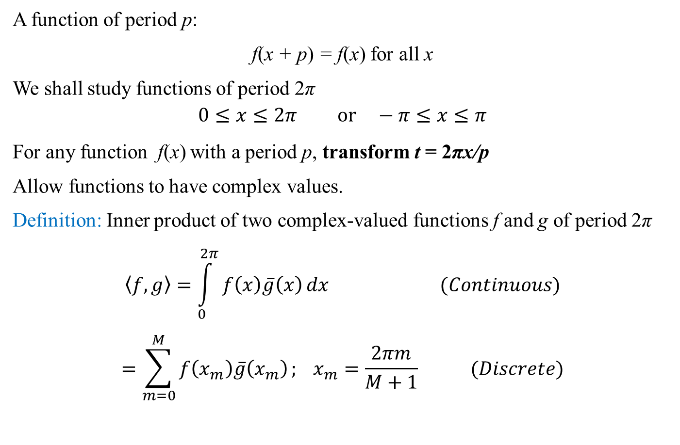
Periodic Functions
A function of period p:
f(x + p) = f(x) for all x
We shall study functions of period 2π
$$0≤x≤2π or −π≤x≤π$$
For any function f(x) with a period p, transform t = 2πx/p
Allow functions to have complex values.
Definition: Inner product of two complex-valued functions f and g of period 2π
$$\left\langle f,g\right\rangle =\int_{0}^{2π}{f\left(x\right)\overline{g}\left(x\right)}dx (Continuous)$$
$$=\sum_{m=0}^{M}{f\left(x_{m}\right)\overline{g}\left(x_{m}\right)}; x_{m}=\frac{2πm}{M+1} (Discrete)$$

Slide 15
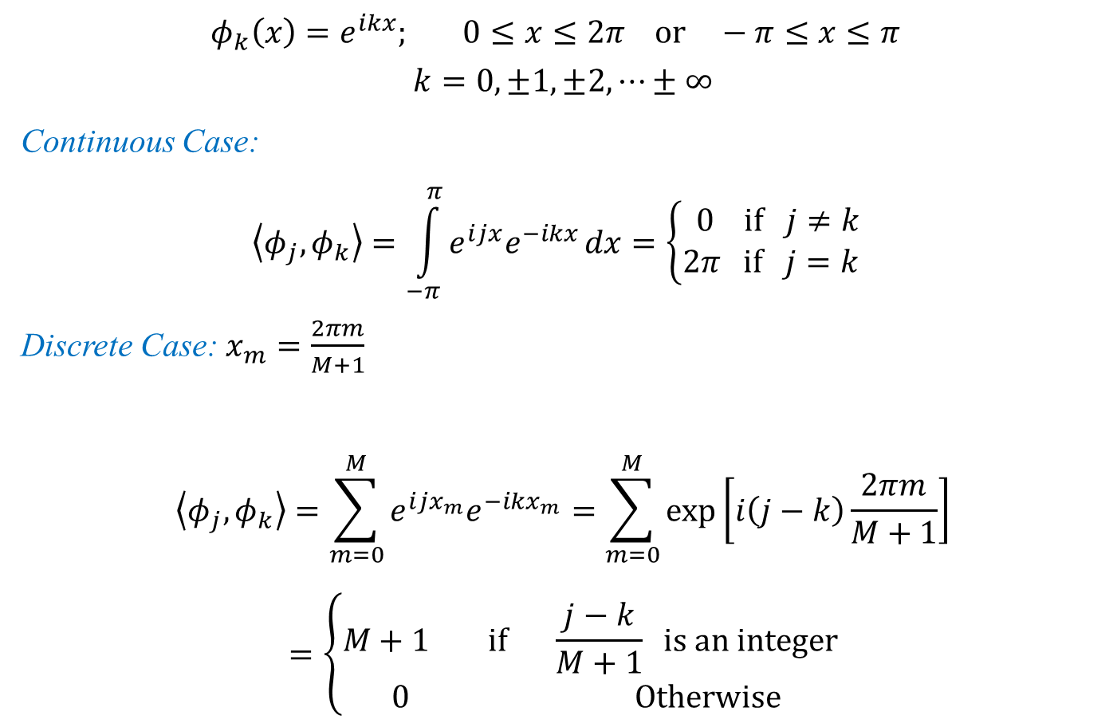
Periodic Orthogonal Basis Functions
$$φ_{k}\left(x\right)=e^{ikx}; 0≤x≤2π or −π≤x≤π$$
$$k=0, ±1, ±2,⋯±∞$$
Continuous Case:
$$\left\langle φ_{j},φ_{k}\right\rangle =\int_{−π}^{π}{e^{ijx}e^{−ikx}}dx=\left\{\begin{matrix}0 if j≠k \\ 2π if j=k \end{matrix}\right.$$
Discrete Case: $x_{m}=\frac{2πm}{M+1}$
$$\left\langle φ_{j},φ_{k}\right\rangle =\sum_{m=0}^{M}{e^{ijx_{m}}e^{−ikx_{m}}}=\sum_{m=0}^{M}{\exp\left[i\left(j−k\right)\frac{2πm}{M+1}\right]}$$
$$=\left\{\begin{matrix}M+1 if \frac{j−k}{M+1} is an integer \\ 0 Otherwise \end{matrix}\right.$$

Slide 16
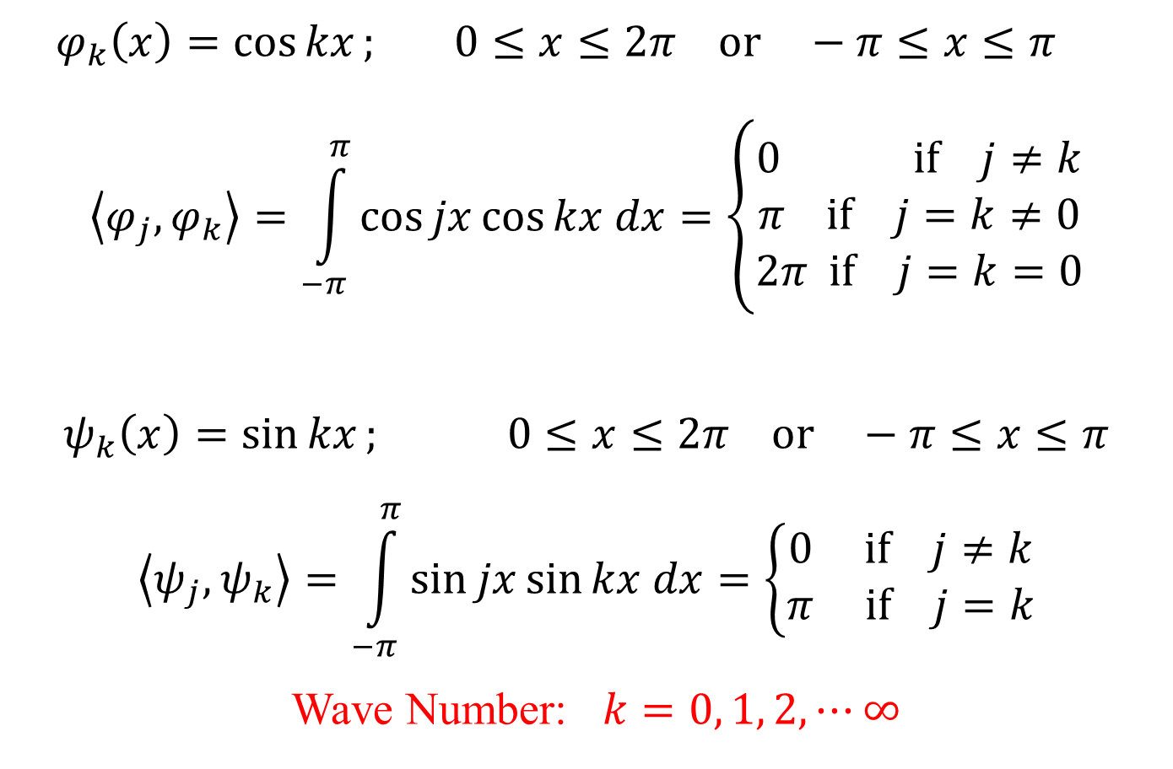
Periodic Orthogonal Basis Functions
$$φ_{k}\left(x\right)=\cos{kx}; 0≤x≤2π or −π≤x≤π$$
$$\left\langle φ_{j},φ_{k}\right\rangle =\int_{−π}^{π}{\cos{jx\cos{kx dx}}}=\left\{\begin{matrix}0 if j≠k \\ π if j=k≠0 \\ 2π if j=k=0\end{matrix}\right.$$
$$ψ_{k}\left(x\right)=\sin{kx}; 0≤x≤2π or −π≤x≤π$$
$$\left\langle ψ_{j},ψ_{k}\right\rangle =\int_{−π}^{π}{\sin{jx\sin{kx dx}}}=\left\{\begin{matrix}0 if j≠k \\ π if j=k\end{matrix}\right.$$
Wave Number: $k=0, 1, 2,⋯∞$

Slide 17
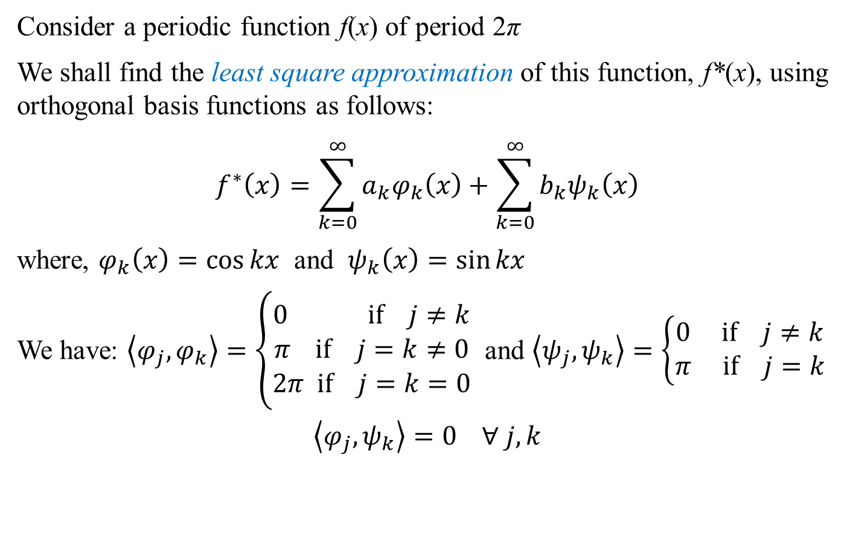
Least Square Approximation of Periodic Functions
Consider a periodic function f(x) of period 2π
We shall find the least square approximation of this function, f*(x), using orthogonal basis functions as follows:
$$f^{∗}\left(x\right)=\sum_{k=0}^{∞}{a_{k}φ_{k}\left(x\right)}+\sum_{k=0}^{∞}{b_{k}ψ_{k}\left(x\right)}$$
where, $φ_{k}\left(x\right)=\cos{kx}$ and $ψ_{k}\left(x\right)=\sin{kx}$
We have: $\left\langle φ_{j},φ_{k}\right\rangle =\left\{\begin{matrix}0 if j≠k \\ π if j=k≠0 \\ 2π if j=k=0\end{matrix}\right.$ and $\left\langle ψ_{j},ψ_{k}\right\rangle =\left\{\begin{matrix}0 if j≠k \\ π if j=k\end{matrix}\right.$
$$\left\langle φ_{j},ψ_{k}\right\rangle =0 ∀ j, k$$

Slide 18
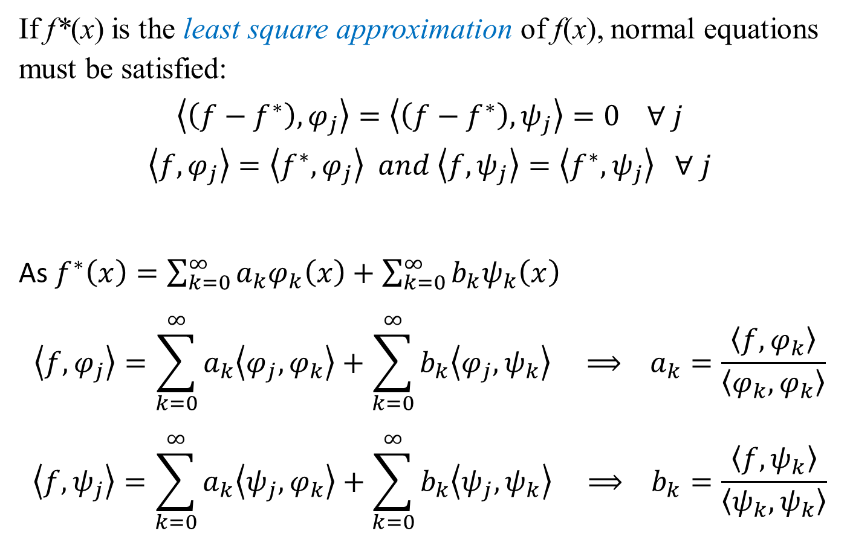
Least Square Approximation of Periodic Functions
If f*(x) is the least square approximation of f(x), normal equations must be satisfied:
$$\left\langle \left(f−f^{∗}\right),φ_{j}\right\rangle =\left\langle \left(f−f^{∗}\right),ψ_{j}\right\rangle =0 ∀ j$$
$$\left\langle f,φ_{j}\right\rangle =\left\langle f^{∗},φ_{j}\right\rangle and \left\langle f,ψ_{j}\right\rangle =\left\langle f^{∗},ψ_{j}\right\rangle ∀ j$$
As $f^{∗}\left(x\right)=\sum_{k=0}^{∞}{a_{k}φ_{k}\left(x\right)}+\sum_{k=0}^{∞}{b_{k}ψ_{k}\left(x\right)}$
$$\left\langle f,φ_{j}\right\rangle =\sum_{k=0}^{∞}{a_{k}\left\langle φ_{j},φ_{k}\right\rangle }+\sum_{k=0}^{∞}{b_{k}\left\langle φ_{j},ψ_{k}\right\rangle } ⟹ a_{k}=\frac{\left\langle f,φ_{k}\right\rangle }{\left\langle φ_{k},φ_{k}\right\rangle }$$
$$\left\langle f,ψ_{j}\right\rangle =\sum_{k=0}^{∞}{a_{k}\left\langle ψ_{j},φ_{k}\right\rangle }+\sum_{k=0}^{∞}{b_{k}\left\langle ψ_{j},ψ_{k}\right\rangle } ⟹ b_{k}=\frac{\left\langle f,ψ_{k}\right\rangle }{\left\langle ψ_{k},ψ_{k}\right\rangle }$$

Slide 19
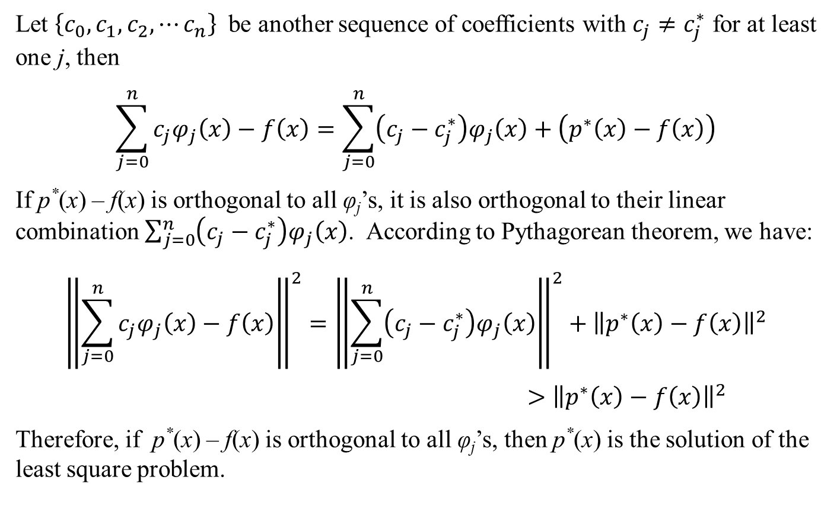
Least Square Approximation of Periodic Functions
$$a_{k}=\frac{\left\langle f,φ_{k}\right\rangle }{\left\langle φ_{k},φ_{k}\right\rangle }=\frac{1}{\left\langle φ_{k},φ_{k}\right\rangle }\int_{−π}^{π}{f\left(x\right)φ_{k}\left(x\right)}dx=\frac{1}{\left\langle φ_{k},φ_{k}\right\rangle }\int_{−π}^{π}{f\left(x\right)\cos{kx}}dx$$
$$a_{0}=\frac{1}{2π}\int_{−π}^{π}{f\left(x\right)}dx; a_{k}=\frac{1}{π}\int_{−π}^{π}{f\left(x\right)\cos{kx}}dx; k=1,2,⋯∞$$
$$b_{k}=\frac{\left\langle f,ψ_{k}\right\rangle }{\left\langle ψ_{k},ψ_{k}\right\rangle }=\frac{1}{\left\langle ψ_{k},ψ_{k}\right\rangle }\int_{−π}^{π}{f\left(x\right)ψ_{k}\left(x\right)}dx=\frac{1}{\left\langle ψ_{k},ψ_{k}\right\rangle }\int_{−π}^{π}{f\left(x\right)\sin{kx}}dx$$
$$b_{0}=0; b_{k}=\frac{1}{π}\int_{−π}^{π}{f\left(x\right)\sin{kx}}dx; k=1,2,⋯∞$$

Slide 20
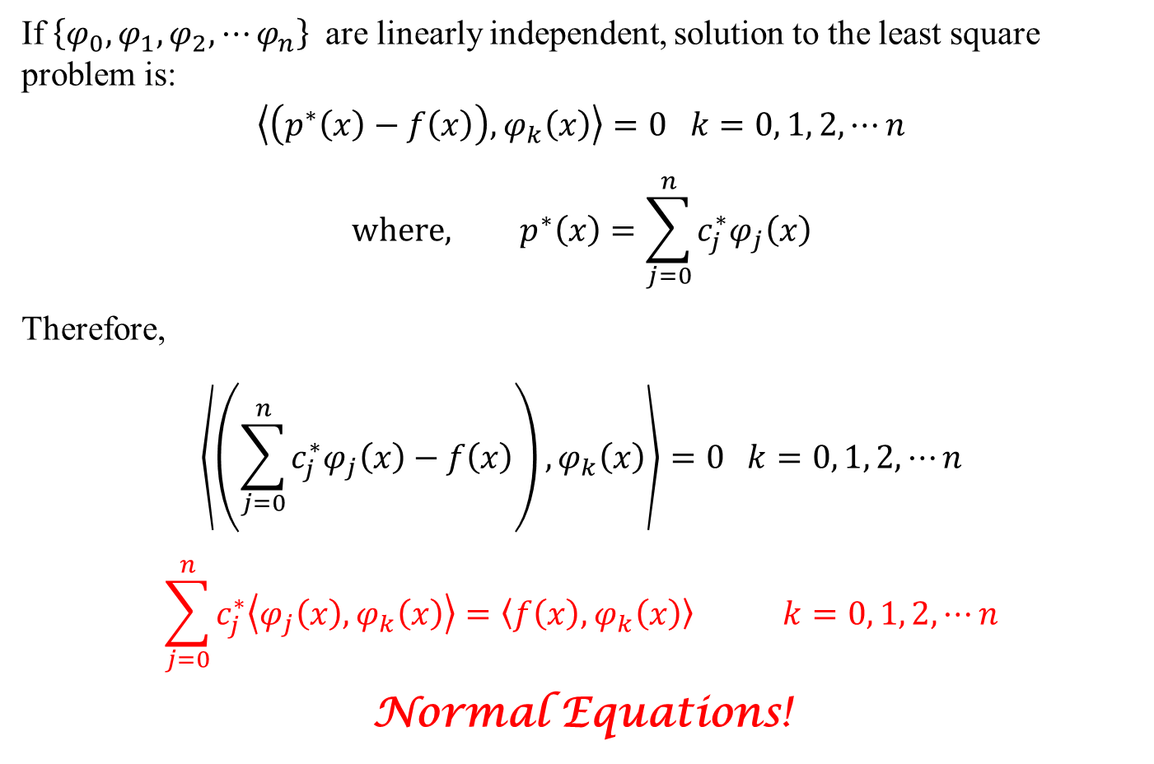
Least Square Approximation of Periodic Functions
$$f^{∗}\left(x\right)=\sum_{k=0}^{∞}{a_{k}φ_{k}\left(x\right)}+\sum_{k=0}^{∞}{b_{k}ψ_{k}\left(x\right)}$$
where, $φ_{k}\left(x\right)=\cos{kx}$ and $ψ_{k}\left(x\right)=\sin{kx}$
$$f^{∗}\left(x\right)=\sum_{k=0}^{∞}{a_{k}\cos{kx}}+\sum_{k=0}^{∞}{b_{k}\sin{kx}}$$
$$=a_{0}+\sum_{k=1}^{∞}{a_{k}\cos{kx}}+\sum_{k=1}^{∞}{b_{k}\sin{kx}}$$
where,
$$a_{0}=\frac{1}{2π}\int_{−π}^{π}{f\left(x\right)}dx; a_{k}=\frac{1}{π}\int_{−π}^{π}{f\left(x\right)\cos{kx}}dx; b_{k}=\frac{1}{π}\int_{−π}^{π}{f\left(x\right)\sin{kx}}dx$$
Fourier Series is the Least Square Approximation of a periodic function!

Slide 21
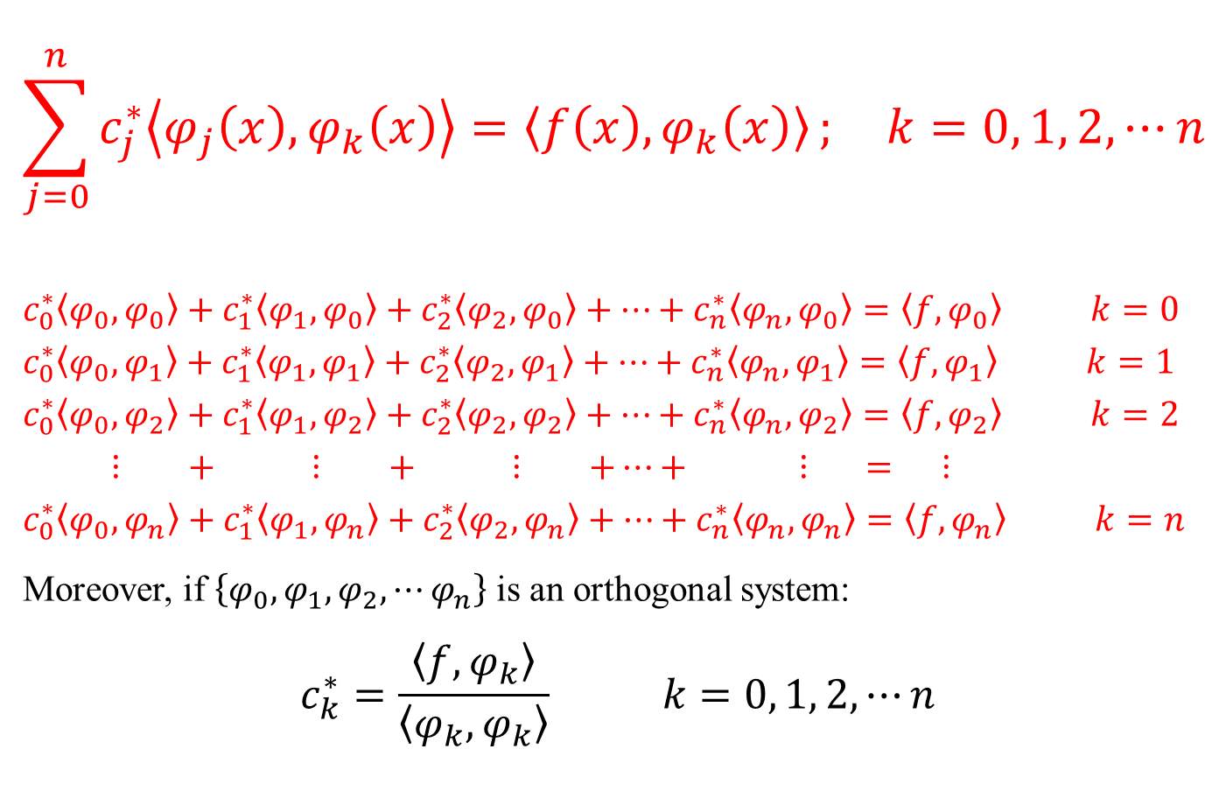
Fourier Series Approximation: Alternate Basis Functions
Consider a periodic function f(x) of period 2π
We shall find the least square approximation of this function f*(x) using orthogonal basis functions as follows:
$$f^{∗}\left(x\right)=\sum_{k=−∞}^{∞}{c_{k}φ_{k}\left(x\right)}; φ_{k}\left(x\right)=e^{ikx}$$
We have: $\left\langle φ_{j},φ_{k}\right\rangle =\left\{\begin{matrix}0 if j≠k \\ π if j=k \end{matrix}\right.$

Slide 22
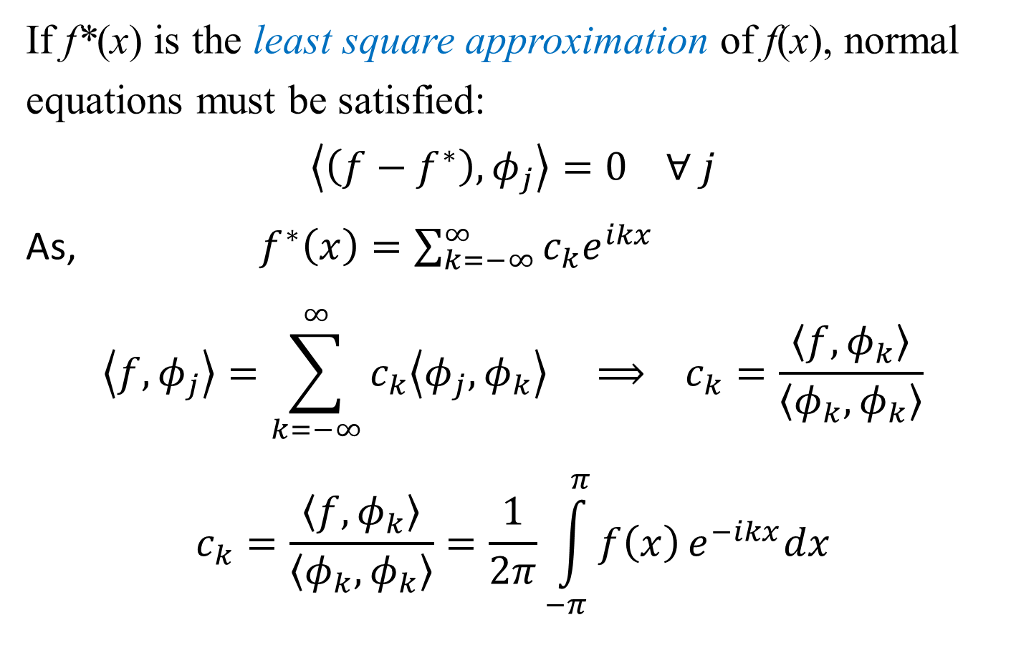
Least Square Approximation of Periodic Functions
If f*(x) is the least square approximation of f(x), normal equations must be satisfied:
$$\left\langle \left(f−f^{∗}\right),φ_{j}\right\rangle =0 ∀ j$$
As, ${ f}^{∗}\left(x\right)=\sum_{k=−∞}^{∞}{c_{k}e^{ikx}}$
$$\left\langle f,φ_{j}\right\rangle =\sum_{k=−∞}^{∞}{c_{k}\left\langle φ_{j},φ_{k}\right\rangle } ⟹ c_{k}=\frac{\left\langle f,φ_{k}\right\rangle }{\left\langle φ_{k},φ_{k}\right\rangle }$$
$$c_{k}=\frac{\left\langle f,φ_{k}\right\rangle }{\left\langle φ_{k},φ_{k}\right\rangle }=\frac{1}{2π}\int_{−π}^{π}{f\left(x\right)}e^{−ikx}dx$$

Slide 23
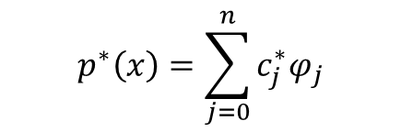
Least Square Approximation of Periodic Functions
$$f^{∗}\left(x\right)=\sum_{k=−∞}^{∞}{c_{k}e^{ikx}}=c_{0}+\sum_{k=−∞}^{−1}{c_{k}e^{ikx}}+\sum_{k=1}^{∞}{c_{k}e^{ikx}}$$
$$=c_{0}+\sum_{k=1}^{∞}{c_{−k}e^{−ikx}}+\sum_{k=1}^{∞}{c_{k}e^{ikx}}=c_{0}+\sum_{k=1}^{∞}{\left(c_{k}+c_{−k}\right)\cos{kx}}+\sum_{k=1}^{∞}{i\left(c_{k}−c_{−k}\right)\sin{kx}}$$
$$=a_{0}+\sum_{k=1}^{∞}{a_{k}\cos{kx}}+\sum_{k=1}^{∞}{b_{k}\sin{kx}}$$
where, $a_{0}=c_{0};a_{k}=\left(c_{k}+c_{−k}\right);b_{k}=i\left(c_{k}−c_{−k}\right)$

Slide 24
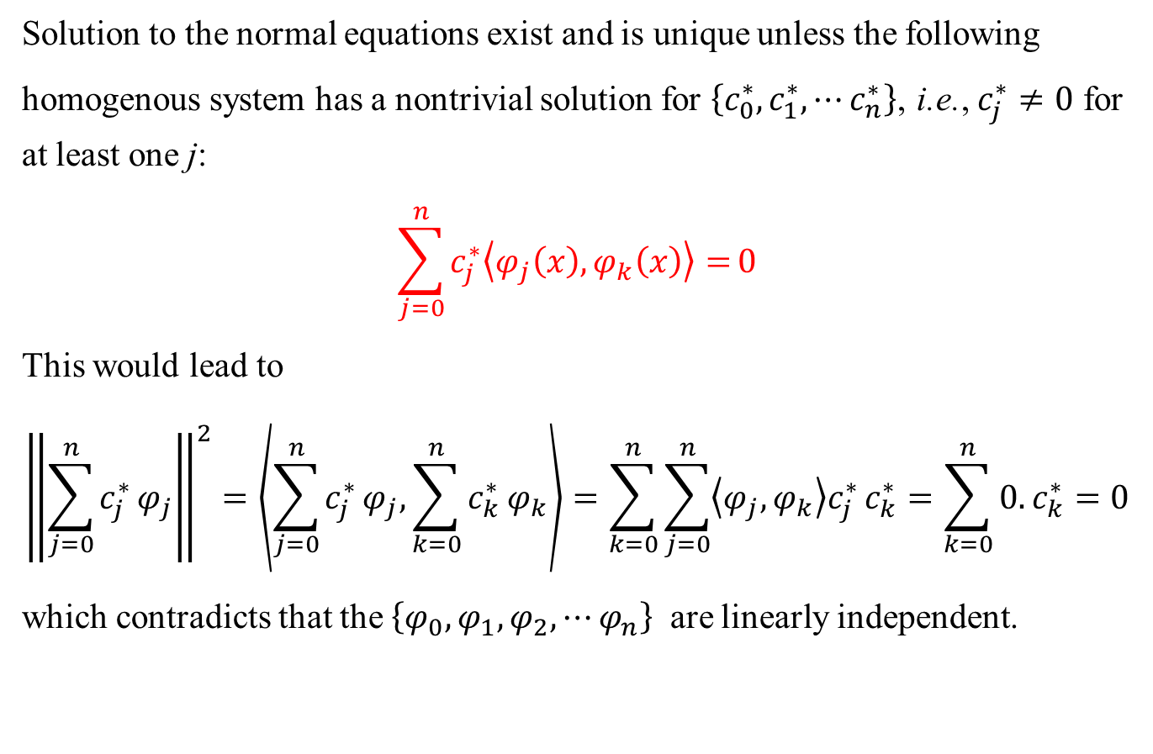
Fourier Series Approximation: Alternate Basis Functions
$$c_{k}=\frac{1}{2π}\int_{−π}^{π}{f\left(x\right)}e^{−ikx}dx$$
$$a_{0}=c_{0}=\frac{1}{2π}\int_{−π}^{π}{f\left(x\right)}dx$$
$$a_{k}=\left(c_{k}+c_{−k}\right)=\frac{1}{2π}\int_{−π}^{π}{f\left(x\right)}\left(e^{−ikx}+e^{ikx}\right)dx=\frac{1}{π}\int_{−π}^{π}{f\left(x\right)}\cos{kx}dx$$
$$b_{k}=i\left(c_{k}−c_{−k}\right)=\frac{1}{2π}\int_{−π}^{π}{f\left(x\right)}\left(i\right)\left(e^{−ikx}−e^{ikx}\right)dx=\frac{1}{π}\int_{−π}^{π}{f\left(x\right)}\sin{kx}dx$$
Both are Fourier Series, one is the exponential form and the other is the sine-cosine form!

Slide 25
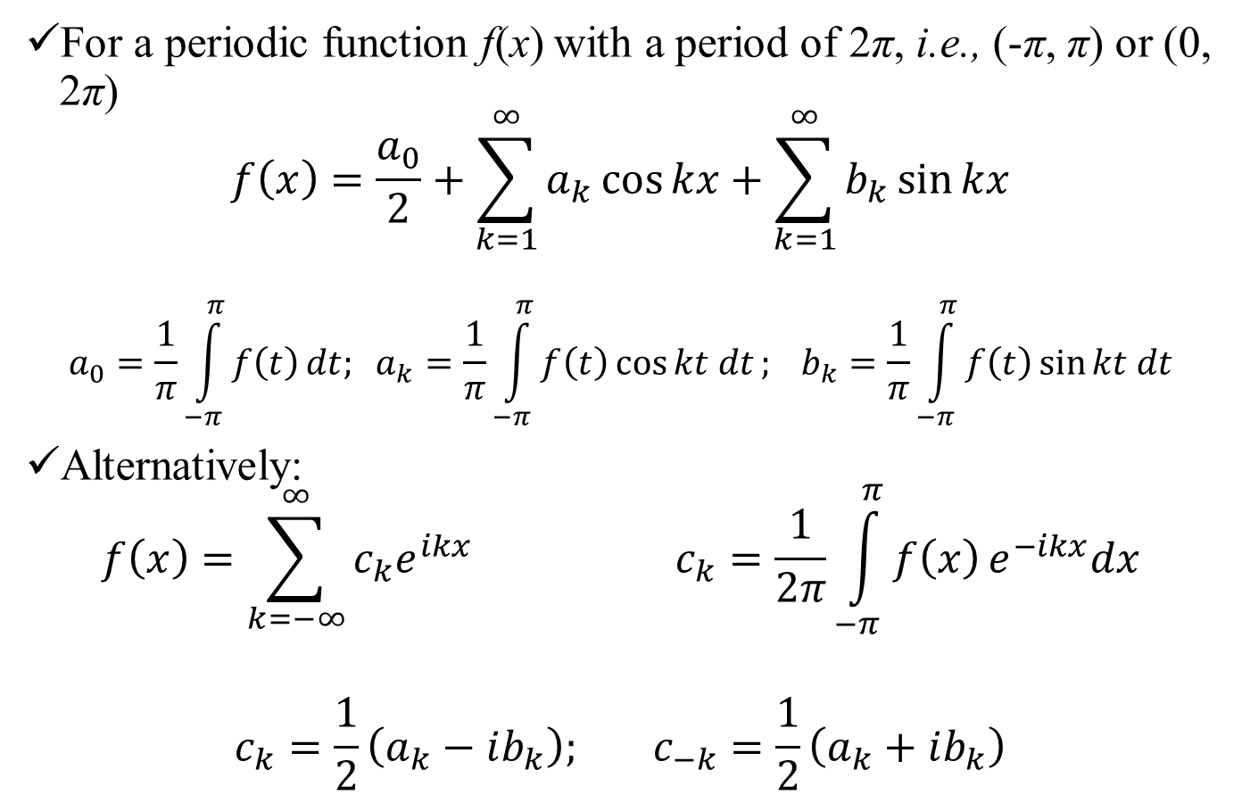
The Fourier Series
For a periodic function f(x) with a period of 2π, i.e., (-π, π) or (0, 2π)
$$f\left(x\right)=\frac{a_{0}}{2}+\sum_{k=1}^{∞}{a_{k}\cos{kx}}+\sum_{k=1}^{∞}{b_{k}\sin{kx}}$$
$$a_{0}=\frac{1}{π}\int_{−π}^{π}{f\left(t\right)}dt; a_{k}=\frac{1}{π}\int_{−π}^{π}{f\left(t\right)\cos{kt dt}}; b_{k}=\frac{1}{π}\int_{−π}^{π}{f\left(t\right)\sin{kt dt}}$$
Alternatively:
$$f\left(x\right)=\sum_{k=−∞}^{∞}{c_{k}e^{ikx}} c_{k}=\frac{1}{2π}\int_{−π}^{π}{f\left(x\right)}e^{−ikx}dx$$
$$c_{k}=\frac{1}{2}\left(a_{k}−ib_{k}\right); c_{−k}=\frac{1}{2}\left(a_{k}+ib_{k}\right)$$

Slide 26
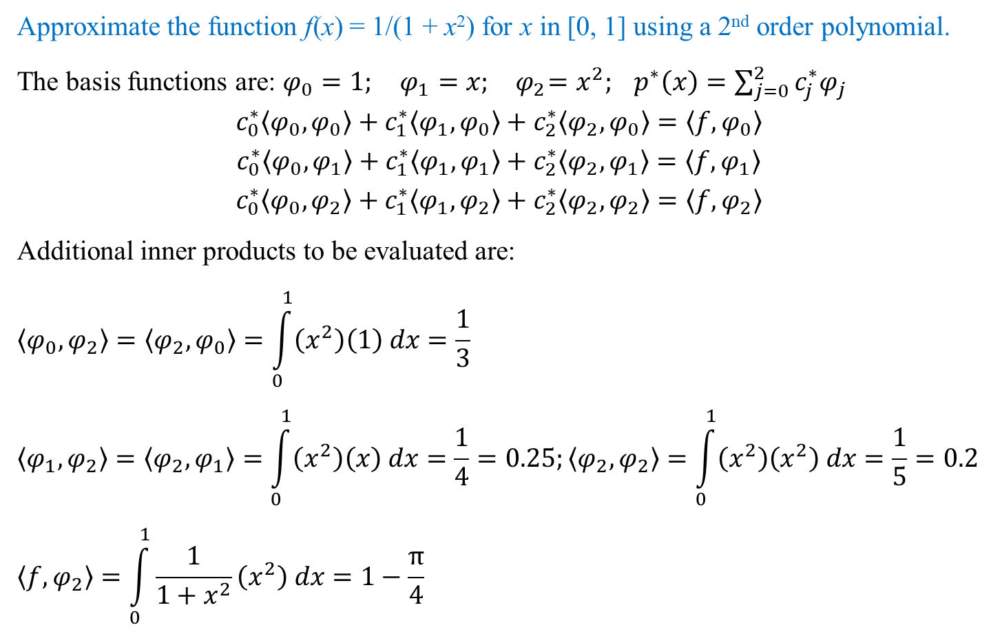
The Fourier Series
For a periodic function of any period 2L i.e., (-L, L) or (0, 2L), simply scale the variable x. That is, replace x by πx/L
$$f\left(x\right)=\frac{a_{0}}{2}+\sum_{k=1}^{∞}{a_{k}\cos{\frac{kπx}{L}}}+\sum_{k=1}^{∞}{b_{k}\sin{\frac{kπx}{L}}}$$
$$a_{k}=\frac{1}{L}\int_{−L}^{L}{f\left(t\right)\cos{\frac{kπt}{L}dt}}; b_{k}=\frac{1}{L}\int_{−L}^{L}{f\left(t\right)\sin{\frac{kπt}{L}dt}}$$
$$f\left(x\right)=\sum_{k=−∞}^{∞}{c_{k}e^{i\frac{kπx}{L}}} ; c_{k}=\frac{1}{2L}\int_{−L}^{L}{f\left(x\right)}e^{−i\frac{kπx}{L}}dx$$

Slide 27
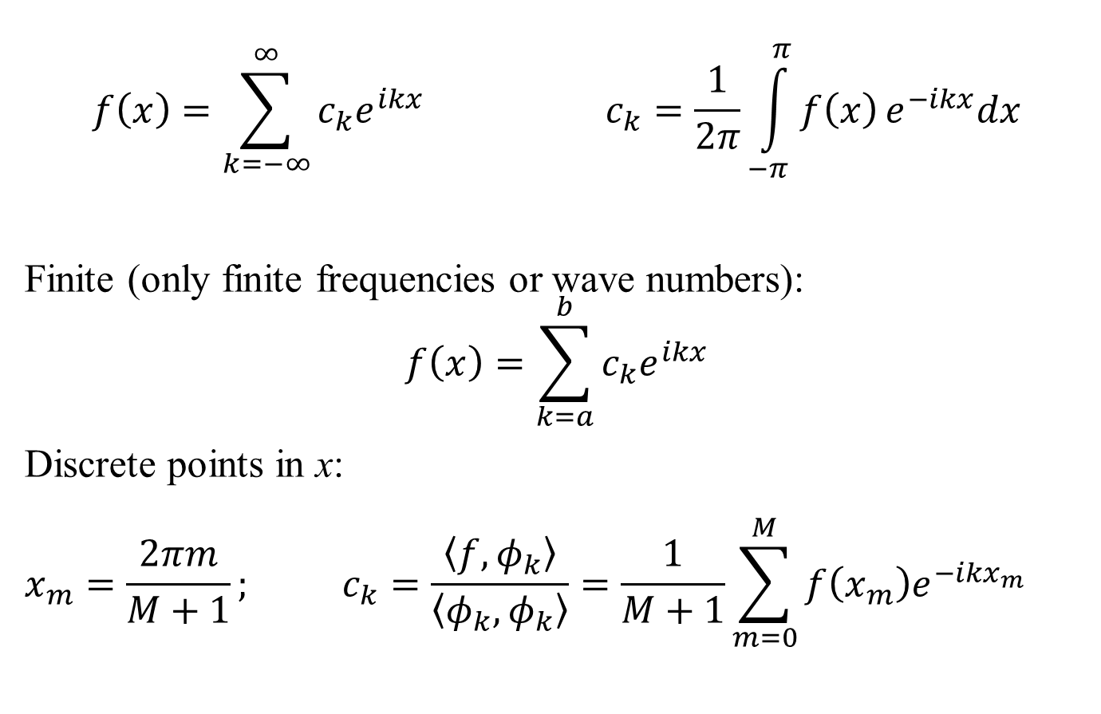
The Discrete and Finite Fourier Series
$$f\left(x\right)=\sum_{k=−∞}^{∞}{c_{k}e^{ikx}} c_{k}=\frac{1}{2π}\int_{−π}^{π}{f\left(x\right)}e^{−ikx}dx$$
Finite (only finite frequencies or wave numbers):
$$f\left(x\right)=\sum_{k=a}^{b}{c_{k}e^{ikx}}$$
Discrete points in x:
$$x_{m}=\frac{2πm}{M+1}; c_{k}=\frac{\left\langle f,φ_{k}\right\rangle }{\left\langle φ_{k},φ_{k}\right\rangle }=\frac{1}{M+1}\sum_{m=0}^{M}{f\left(x_{m}\right)e^{−ikx_{m}}}$$

Slide 28
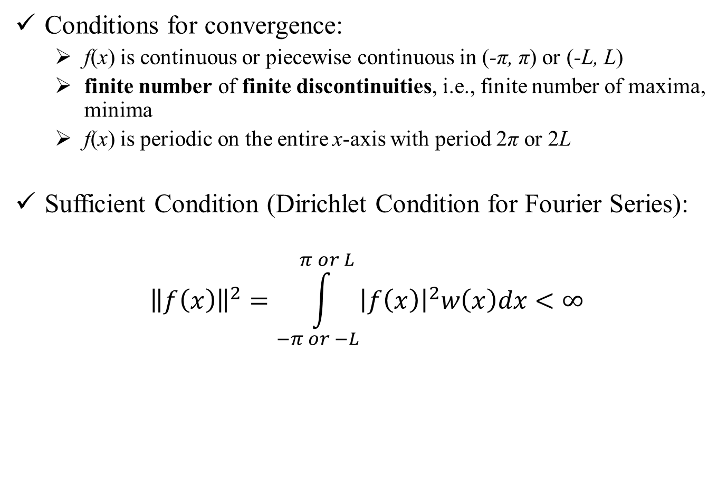
The Fourier Series
Conditions for convergence:
f(x) is continuous or piecewise continuous in (-π, π) or (-L, L)
finite number of finite discontinuities, i.e., finite number of maxima, minima
f(x) is periodic on the entire x-axis with period 2π or 2L
Sufficient Condition (Dirichlet Condition for Fourier Series):
$${\left\|f\left(x\right)\right\|}^{2}=\int_{−π or −L}^{π or L}{{\left|f\left(x\right)\right|}^{2}w\left(x\right)dx}<∞$$

Slide 29

Theory of Approximation: Interpolation
Abhas Singh
Department of Civil Engineering
IIT Kanpur
Acknowledgements: Profs. Saumyen Guha and Shivam Tripathi (CE)

Slide 30
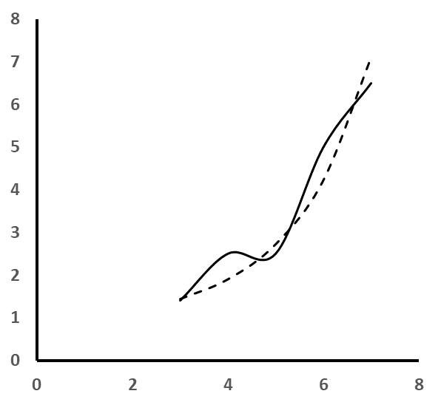
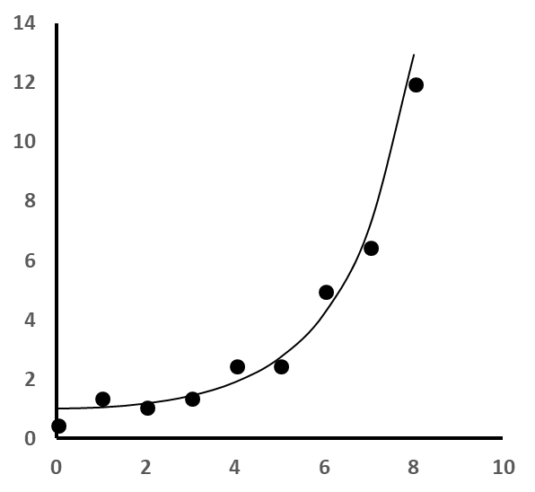
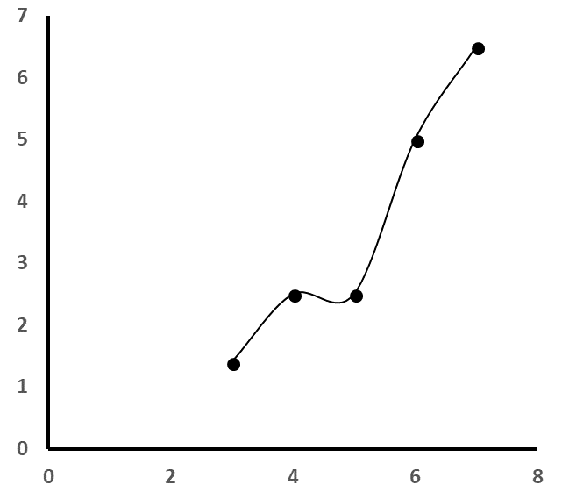
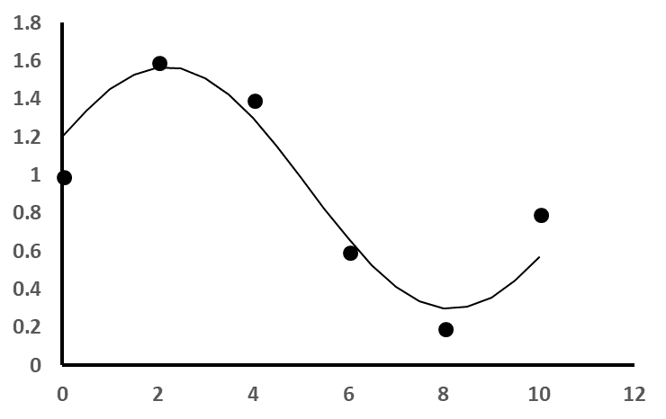
Approximation of Discrete data or tab (f): Regression
Approximation of Continuous Function f(x)
Complicated Analytical Function, Analog Signal from a measuring device
Discrete measurements of continuous experiments or phenomena
Missing Data, Derivative, Integration for or tab (f): Interpolation
Approximation of Discrete data or tab (f): Regression

Slide 31
Discrete Data
(n + 1) observations or data pairs [(x₀, y₀), (x₁, y₁), (x₂, y₂) … (x_{n}, y_{n})]
(m + 1) basis functions: $\left\{φ_{0},φ_{1},φ_{2},⋯φ_{m}\right\}$
Approximating polynomial: $p\left(x\right)=\sum_{j=0}^{m}{c_{j}φ_{j}\left(x\right)}$
$$c_{0}φ_{0}\left(x_{0}\right)+c_{1}φ_{1}\left(x_{0}\right)+c_{2}φ_{2}\left(x_{0}\right)+⋯+c_{m}φ_{m}\left(x_{0}\right)=y_{0}$$
$$c_{0}φ_{0}\left(x_{1}\right)+c_{1}φ_{1}\left(x_{1}\right)+c_{2}φ_{2}\left(x_{1}\right)+⋯+c_{m}φ_{m}\left(x_{1}\right)=y_{1}$$
::::::::::::::::::::::::::::::::::::::::::::::::::::::::::::::::::::
$$c_{0}φ_{0}\left(x_{n}\right)+c_{1}φ_{1}\left(x_{n}\right)+c_{2}φ_{2}\left(x_{n}\right)+⋯+c_{m}φ_{m}\left(x_{n}\right)=y_{n}$$
n equations, m unknowns:
m < n: over-determined system, least square regression
m = n: unique solution, interpolation
m > n: under-determined system

Slide 32
Interpolation Polynomials
Newton’s Divided Difference
Lagrange Polynomials
Gram’s polynomials (introduced earlier)
Spline Interpolation: piecewise continuous, smoothing

Slide 33
Newton’s Divided Difference
Triangular set of basis polynomials
$$φ_{0}\left(x\right)=1$$
$$φ_{1}\left(x\right)=\left(x−x_{0}\right)$$
$$φ_{2}\left(x\right)=\left(x−x_{0}\right)\left(x−x_{1}\right)$$
$$φ_{3}\left(x\right)=\left(x−x_{0}\right)\left(x−x_{1}\right)\left(x−x_{2}\right)$$
$$⋮ ⋮ ⋮ ⋮$$
$$φ_{i}\left(x\right)=\left(x−x_{0}\right)\left(x−x_{1}\right)⋯\left(x−x_{i−1}\right)$$
$$⋮ ⋮ ⋮ ⋮$$
$$φ_{n}\left(x\right)=\left(x−x_{0}\right)\left(x−x_{1}\right) ⋯ ⋯ \left(x−x_{n−1}\right)$$

Slide 34
Newton’s Divided Difference
Consider a net of points $\left\{x_{0},x_{1},x_{2},⋯x_{n}\right\}$ and the corresponding function values as $\left\{f_{0},f_{1},f_{2},⋯f_{n}\right\}$
Newton’s polynomial is:
$$p\left(x\right)=c_{0}+c_{1}\left(x−x_{0}\right)+c_{2}\left(x−x_{0}\right)\left(x−x_{1}\right)$$
$+c_{3}\left(x−x_{0}\right)\left(x−x_{1}\right)\left(x−x_{2}\right)⋯ ⋯$
$+c_{n}\left(x−x_{0}\right)\left(x−x_{1}\right)⋯\left(x−x_{n−1}\right)$
True function:
$$f\left(x\right)=p\left(x\right)+\frac{f^{n+1}\left(ξ\right)}{\left(n+1\right)!}\left(x−x_{0}\right)\left(x−x_{1}\right)⋯\left(x−x_{n}\right)$$
for some $ξ∈\operatorname{int}\left(x, x_{0}, x_{1} ⋯x_{n}\right)$

