Slide 1

Theory of Approximation: Interpolation
Abhas Singh
Department of Civil Engineering
IIT Kanpur
Acknowledgements: Profs. Saumyen Guha and Shivam Tripathi (CE)

Slide 2
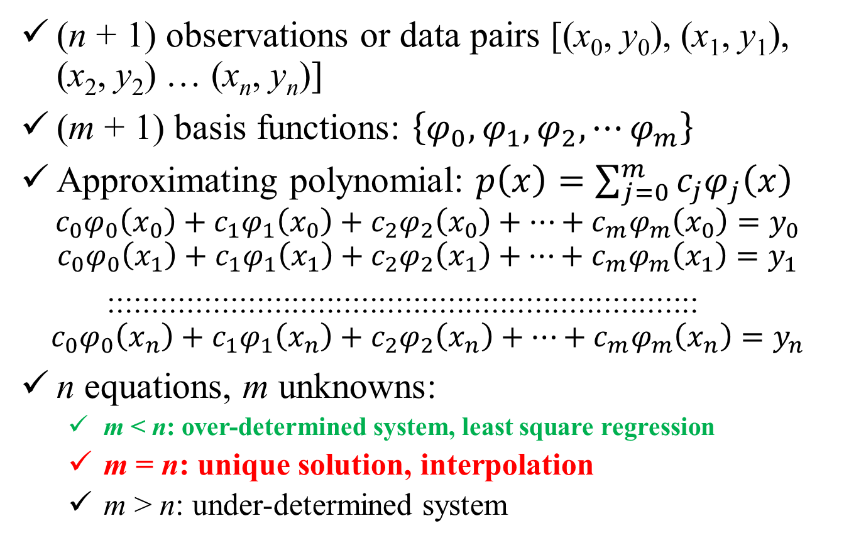
Discrete Data
(n + 1) observations or data pairs [(x₀, y₀), (x₁, y₁), (x₂, y₂) … (x_{n}, y_{n})]
(m + 1) basis functions: $\left\{φ_{0},φ_{1},φ_{2},⋯φ_{m}\right\}$
Approximating polynomial: $p\left(x\right)=\sum_{j=0}^{m}{c_{j}φ_{j}\left(x\right)}$
$$c_{0}φ_{0}\left(x_{0}\right)+c_{1}φ_{1}\left(x_{0}\right)+c_{2}φ_{2}\left(x_{0}\right)+⋯+c_{m}φ_{m}\left(x_{0}\right)=y_{0}$$
$$c_{0}φ_{0}\left(x_{1}\right)+c_{1}φ_{1}\left(x_{1}\right)+c_{2}φ_{2}\left(x_{1}\right)+⋯+c_{m}φ_{m}\left(x_{1}\right)=y_{1}$$
::::::::::::::::::::::::::::::::::::::::::::::::::::::::::::::::::::
$$c_{0}φ_{0}\left(x_{n}\right)+c_{1}φ_{1}\left(x_{n}\right)+c_{2}φ_{2}\left(x_{n}\right)+⋯+c_{m}φ_{m}\left(x_{n}\right)=y_{n}$$
n equations, m unknowns:
m < n: over-determined system, least square regression
m = n: unique solution, interpolation
m > n: under-determined system

Slide 3
Interpolation Polynomials
Newton’s Divided Difference
Lagrange Polynomials
Gram’s polynomials (introduced earlier)
Spline Interpolation: piecewise continuous, smoothing

Slide 4
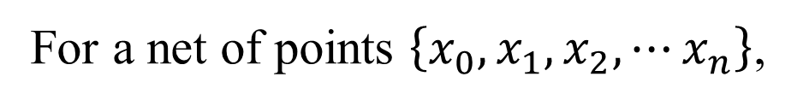
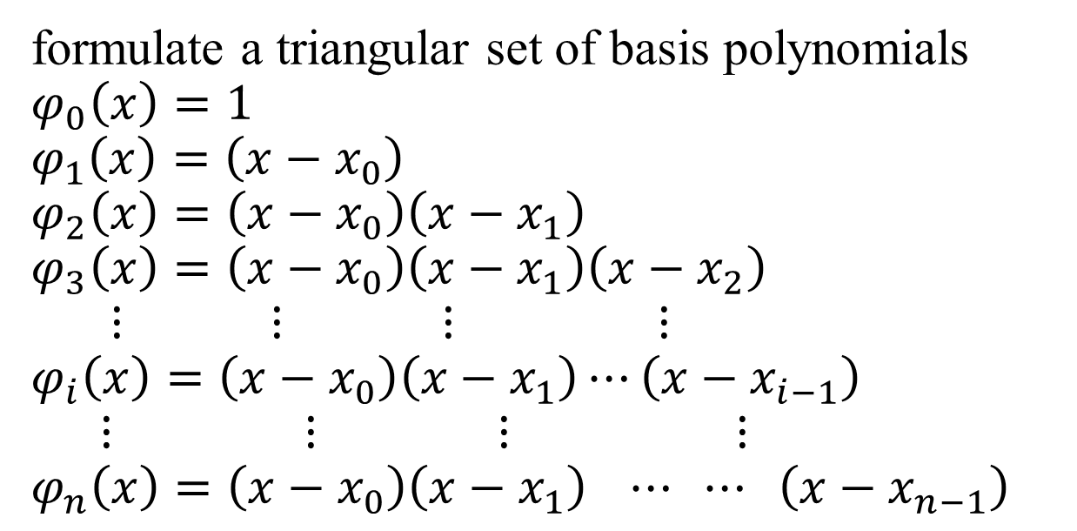
Newton’s Divided Difference
For a net of points $\left\{x_{0},x_{1},x_{2},⋯x_{n}\right\}$,
formulate a triangular set of basis polynomials
$$φ_{0}\left(x\right)=1$$
$$φ_{1}\left(x\right)=\left(x−x_{0}\right)$$
$$φ_{2}\left(x\right)=\left(x−x_{0}\right)\left(x−x_{1}\right)$$
$$φ_{3}\left(x\right)=\left(x−x_{0}\right)\left(x−x_{1}\right)\left(x−x_{2}\right)$$
$$⋮ ⋮ ⋮ ⋮$$
$$φ_{i}\left(x\right)=\left(x−x_{0}\right)\left(x−x_{1}\right)⋯\left(x−x_{i−1}\right)$$
$$⋮ ⋮ ⋮ ⋮$$
$$φ_{n}\left(x\right)=\left(x−x_{0}\right)\left(x−x_{1}\right) ⋯ ⋯ \left(x−x_{n−1}\right)$$

Slide 5
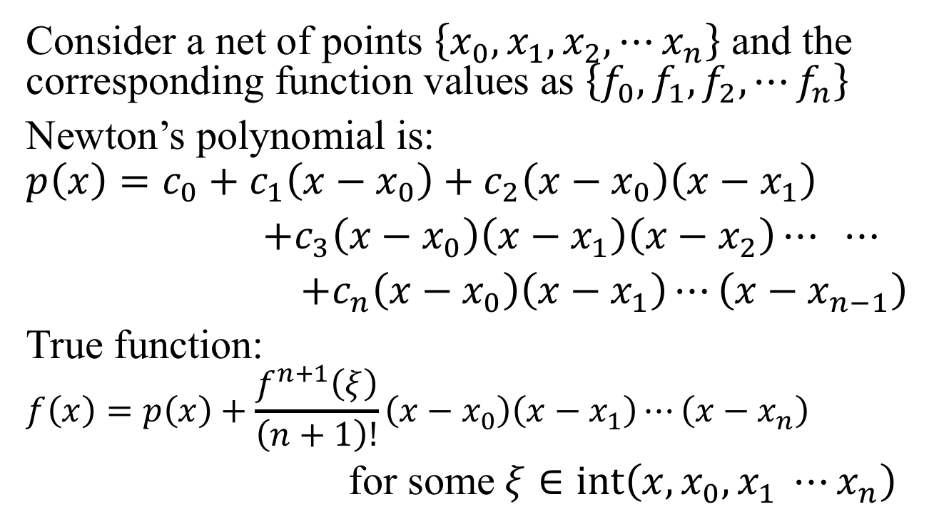
Newton’s Divided Difference
Consider a net of points $\left\{x_{0},x_{1},x_{2},⋯x_{n}\right\}$ and the corresponding function values as $\left\{f_{0},f_{1},f_{2},⋯f_{n}\right\}$
Newton’s polynomial is:
$$p\left(x\right)=c_{0}+c_{1}\left(x−x_{0}\right)+c_{2}\left(x−x_{0}\right)\left(x−x_{1}\right)$$
$+c_{3}\left(x−x_{0}\right)\left(x−x_{1}\right)\left(x−x_{2}\right)⋯ ⋯$
$+c_{n}\left(x−x_{0}\right)\left(x−x_{1}\right)⋯\left(x−x_{n−1}\right)$
True function:
$$f\left(x\right)=p\left(x\right)+\frac{f^{n+1}\left(ξ\right)}{\left(n+1\right)!}\left(x−x_{0}\right)\left(x−x_{1}\right)⋯\left(x−x_{n}\right)$$
for some $ξ∈\operatorname{int}\left(x, x_{0}, x_{1} ⋯x_{n}\right)$

Slide 6
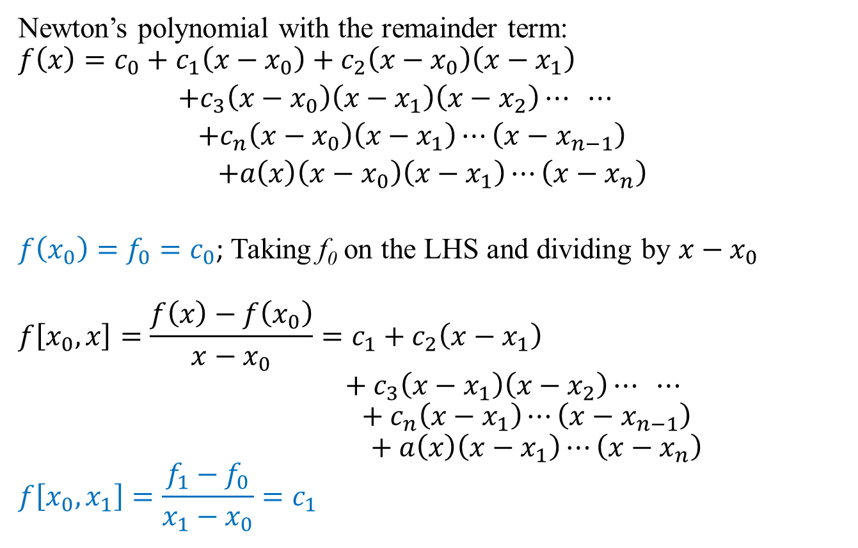
Newton’s Divided Difference
Newton’s polynomial with the remainder term:
$$f\left(x\right)=c_{0}+c_{1}\left(x−x_{0}\right)+c_{2}\left(x−x_{0}\right)\left(x−x_{1}\right)$$
$+c_{3}\left(x−x_{0}\right)\left(x−x_{1}\right)\left(x−x_{2}\right)⋯ ⋯$
$+c_{n}\left(x−x_{0}\right)\left(x−x_{1}\right)⋯\left(x−x_{n−1}\right)$
$+a\left(x\right)\left(x−x_{0}\right)\left(x−x_{1}\right)⋯\left(x−x_{n}\right)$
$f\left(x_{0}\right)=f_{0}=c_{0}$; Taking f₀ on the LHS and dividing by $x−x_{0}$
$$f\left[x_{0},x\right]=\frac{f\left(x\right)−f\left(x_{0}\right)}{x−x_{0}}=c_{1}+c_{2}\left(x−x_{1}\right)$$
$$+c_{3}\left(x−x_{1}\right)\left(x−x_{2}\right)⋯ ⋯$$
$$+c_{n}\left(x−x_{1}\right)⋯\left(x−x_{n−1}\right)$$
$$+a\left(x\right)\left(x−x_{1}\right)⋯\left(x−x_{n}\right)$$
$$f\left[x_{0},x_{1}\right]=\frac{f_{1}−f_{0}}{x_{1}−x_{0}}=c_{1}$$

Slide 7
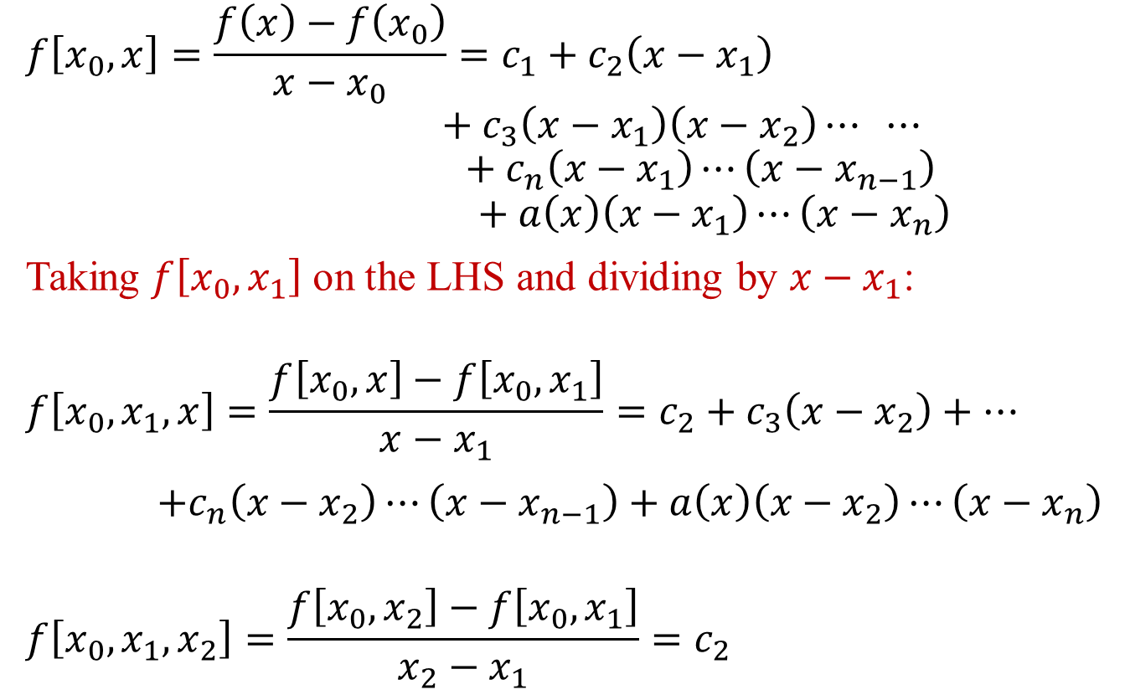
Newton’s Divided Difference
$$f\left[x_{0},x\right]=\frac{f\left(x\right)−f\left(x_{0}\right)}{x−x_{0}}=c_{1}+c_{2}\left(x−x_{1}\right)$$
$$+c_{3}\left(x−x_{1}\right)\left(x−x_{2}\right)⋯ ⋯$$
$$+c_{n}\left(x−x_{1}\right)⋯\left(x−x_{n−1}\right)$$
$$+a\left(x\right)\left(x−x_{1}\right)⋯\left(x−x_{n}\right)$$
Taking $f\left[x_{0},x_{1}\right]$ on the LHS and dividing by $x−x_{1}$:
$$f\left[x_{0},x_{1},x\right]=\frac{f\left[x_{0},x\right]−f\left[x_{0},x_{1}\right]}{x−x_{1}}=c_{2}+c_{3}\left(x−x_{2}\right)+⋯$$
$+c_{n}\left(x−x_{2}\right)⋯\left(x−x_{n−1}\right)+a\left(x\right)\left(x−x_{2}\right)⋯\left(x−x_{n}\right)$
$$f\left[x_{0},x_{1},x_{2}\right]=\frac{f\left[x_{0},x_{2}\right]−f\left[x_{0},x_{1}\right]}{x_{2}−x_{1}}=c_{2}$$

Slide 8
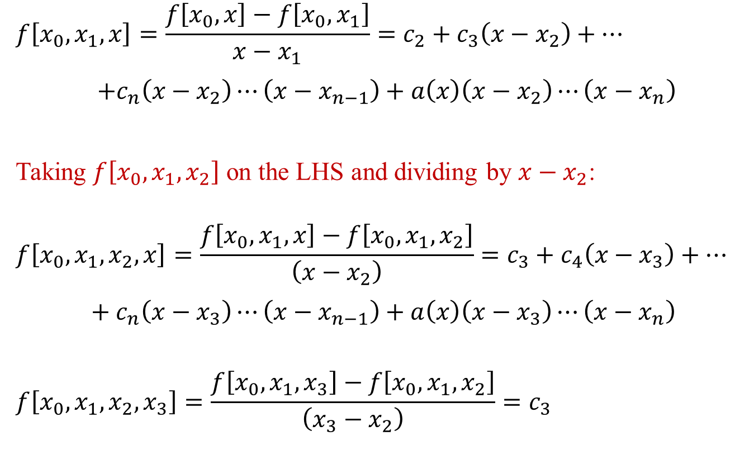
Newton’s Divided Difference
$$f\left[x_{0},x_{1},x\right]=\frac{f\left[x_{0},x\right]−f\left[x_{0},x_{1}\right]}{x−x_{1}}=c_{2}+c_{3}\left(x−x_{2}\right)+⋯$$
$+c_{n}\left(x−x_{2}\right)⋯\left(x−x_{n−1}\right)+a\left(x\right)\left(x−x_{2}\right)⋯\left(x−x_{n}\right)$
Taking $f\left[x_{0},x_{1},x_{2}\right]$ on the LHS and dividing by $x−x_{2}$:
$$f\left[x_{0},x_{1},x_{2},x\right]=\frac{f\left[x_{0},x_{1},x\right]−f\left[x_{0},x_{1},x_{2}\right]}{\left(x−x_{2}\right)}=c_{3}+c_{4}\left(x−x_{3}\right)+⋯$$
$+c_{n}\left(x−x_{3}\right)⋯\left(x−x_{n−1}\right)+a\left(x\right)\left(x−x_{3}\right)⋯\left(x−x_{n}\right)$
$$f\left[x_{0},x_{1},x_{2},x_{3}\right]=\frac{f\left[x_{0},x_{1},x_{3}\right]−f\left[x_{0},x_{1},x_{2}\right]}{\left(x_{3}−x_{2}\right)}=c_{3}$$

Slide 9
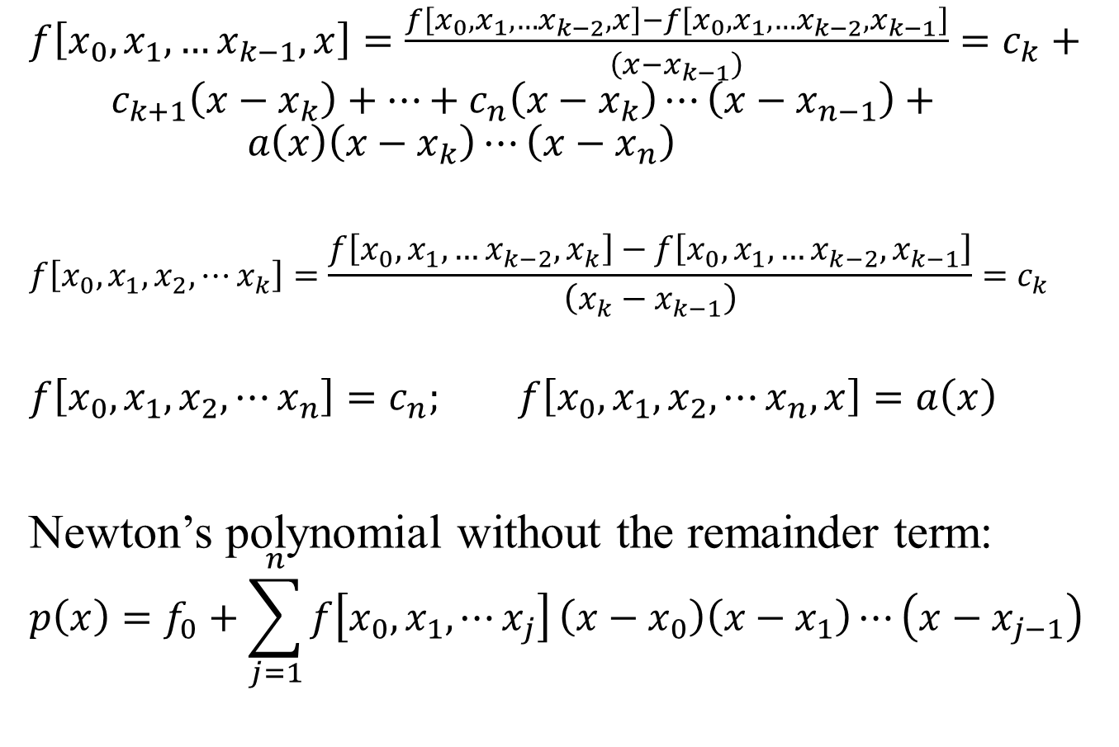
Newton’s Divided Difference
$f\left[x_{0},x_{1},…x_{k−1},x\right]=\frac{f\left[x_{0},x_{1},…x_{k−2},x\right]−f\left[x_{0},x_{1},…x_{k−2},x_{k−1}\right]}{\left(x−x_{k−1}\right)}=c_{k}+ c_{k+1}\left(x−x_{k}\right)+…+c_{n}\left(x−x_{k}\right)⋯\left(x−x_{n−1}\right)+ a\left(x\right)\left(x−x_{k}\right)⋯\left(x−x_{n}\right)$
$$f\left[x_{0},x_{1},x_{2},⋯x_{k}\right]=\frac{f\left[x_{0},x_{1},…x_{k−2},x_{k}\right]−f\left[x_{0},x_{1},…x_{k−2},x_{k−1}\right]}{\left(x_{k}−x_{k−1}\right)}=c_{k}$$
$$f\left[x_{0},x_{1},x_{2},⋯x_{n}\right]=c_{n}; f\left[x_{0},x_{1},x_{2},⋯x_{n},x\right]=a\left(x\right)$$
Newton’s polynomial without the remainder term:
$$p\left(x\right)=f_{0}+\sum_{j=1}^{n}{f\left[x_{0},x_{1}, ⋯x_{j}\right]}\left(x−x_{0}\right)\left(x−x_{1}\right)⋯\left(x−x_{j−1}\right)$$

Slide 10
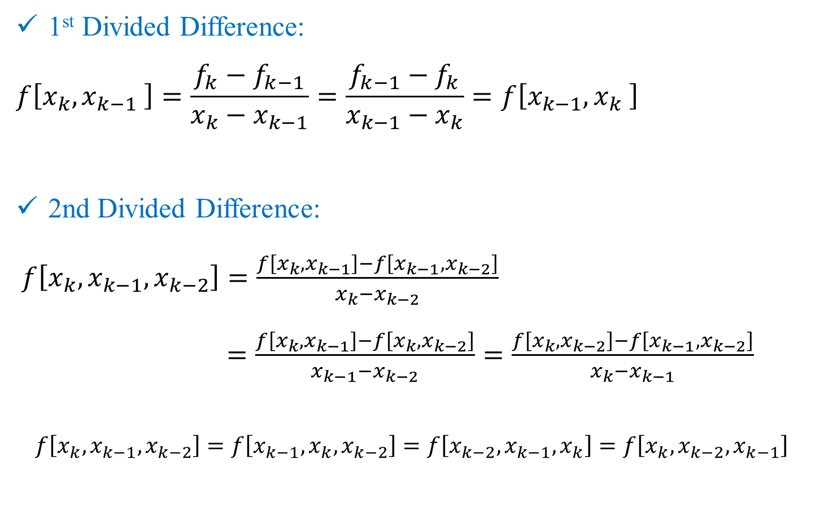
Recall: Properties of Divided Differences
1st Divided Difference:
$$f\left[x_{k},x_{k−1} \right]=\frac{f_{k}−f_{k−1}}{x_{k}−x_{k−1}}=\frac{f_{k−1}−f_{k}}{x_{k−1}−x_{k}}=f\left[x_{k−1},x_{k} \right]$$
2nd Divided Difference:
$f\left[x_{k},x_{k−1},x_{k−2}\right]=\frac{f\left[x_{k},x_{k−1}\right]−f\left[x_{k−1},x_{k−2}\right]}{x_{k}−x_{k−2}}$
$=\frac{f\left[x_{k},x_{k−1}\right]−f\left[x_{k},x_{k−2}\right]}{x_{k−1}−x_{k−2}}=\frac{f\left[x_{k},x_{k−2}\right]−f\left[x_{k−1},x_{k−2}\right]}{x_{k}−x_{k−1}}$
$$f\left[x_{k},x_{k−1},x_{k−2}\right]=f\left[x_{k−1},x_{k},x_{k−2}\right]=f\left[x_{k−2},x_{k−1},x_{k}\right]=f\left[x_{k},x_{k−2},x_{k−1}\right]$$

Slide 11

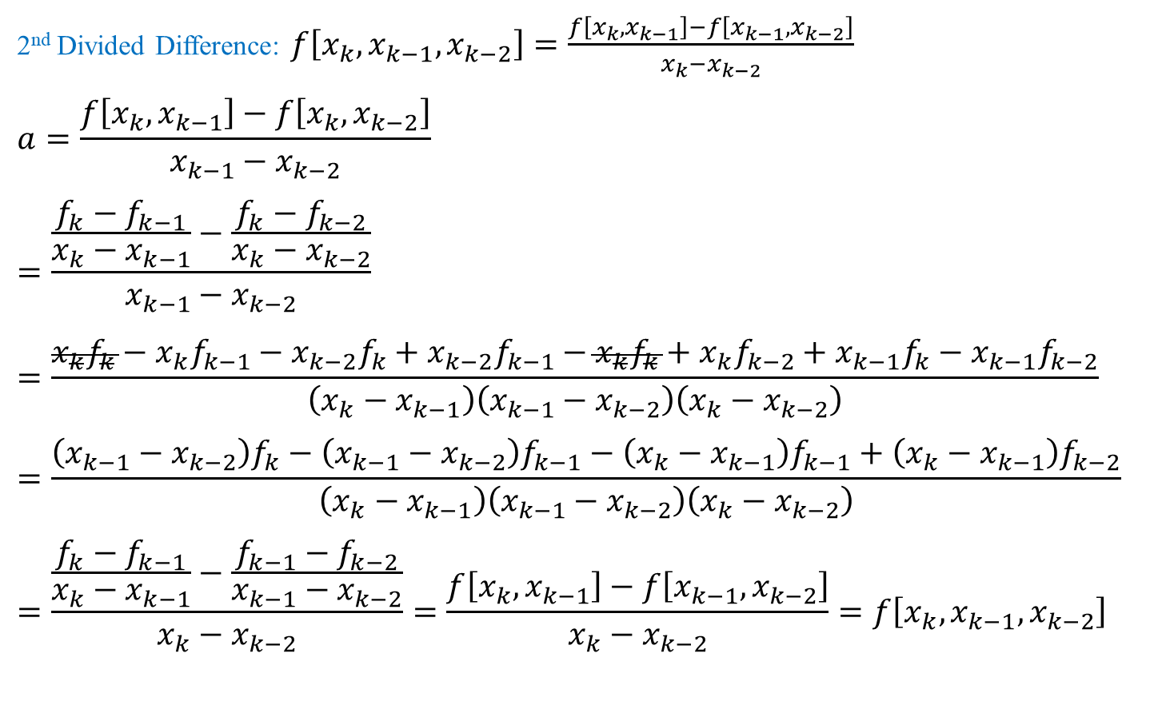
Properties of Divided Differences
2nd Divided Difference: $f\left[x_{k},x_{k−1},x_{k−2}\right]=\frac{f\left[x_{k},x_{k−1}\right]−f\left[x_{k−1},x_{k−2}\right]}{x_{k}−x_{k−2}}$
$$a=\frac{f\left[x_{k},x_{k−1}\right]−f\left[x_{k},x_{k−2}\right]}{x_{k−1}−x_{k−2}}$$
$$=\frac{\frac{f_{k}−f_{k−1}}{x_{k}−x_{k−1}}−\frac{f_{k}−f_{k−2}}{x_{k}−x_{k−2}}}{x_{k−1}−x_{k−2}}$$
$$=\frac{x_{k}f_{k}−x_{k}f_{k−1}−x_{k−2}f_{k}+x_{k−2}f_{k−1}−x_{k}f_{k}+x_{k}f_{k−2}+x_{k−1}f_{k}−x_{k−1}f_{k−2}}{\left(x_{k}−x_{k−1}\right)\left(x_{k−1}−x_{k−2}\right)\left(x_{k}−x_{k−2}\right)}$$
$$=\frac{\left(x_{k−1}−x_{k−2}\right)f_{k}−\left(x_{k−1}−x_{k−2}\right)f_{k−1}−\left(x_{k}−x_{k−1}\right)f_{k−1}+\left(x_{k}−x_{k−1}\right)f_{k−2}}{\left(x_{k}−x_{k−1}\right)\left(x_{k−1}−x_{k−2}\right)\left(x_{k}−x_{k−2}\right)}$$
$$=\frac{\frac{f_{k}−f_{k−1}}{x_{k}−x_{k−1}}−\frac{f_{k−1}−f_{k−2}}{x_{k−1}−x_{k−2}}}{x_{k}−x_{k−2}}=\frac{f\left[x_{k},x_{k−1}\right]−f\left[x_{k−1},x_{k−2}\right]}{x_{k}−x_{k−2}}=f\left[x_{k},x_{k−1},x_{k−2}\right]$$
$$+x_{k−1}f_{k−1}−x_{k−1}f_{k−1}$$

Slide 12
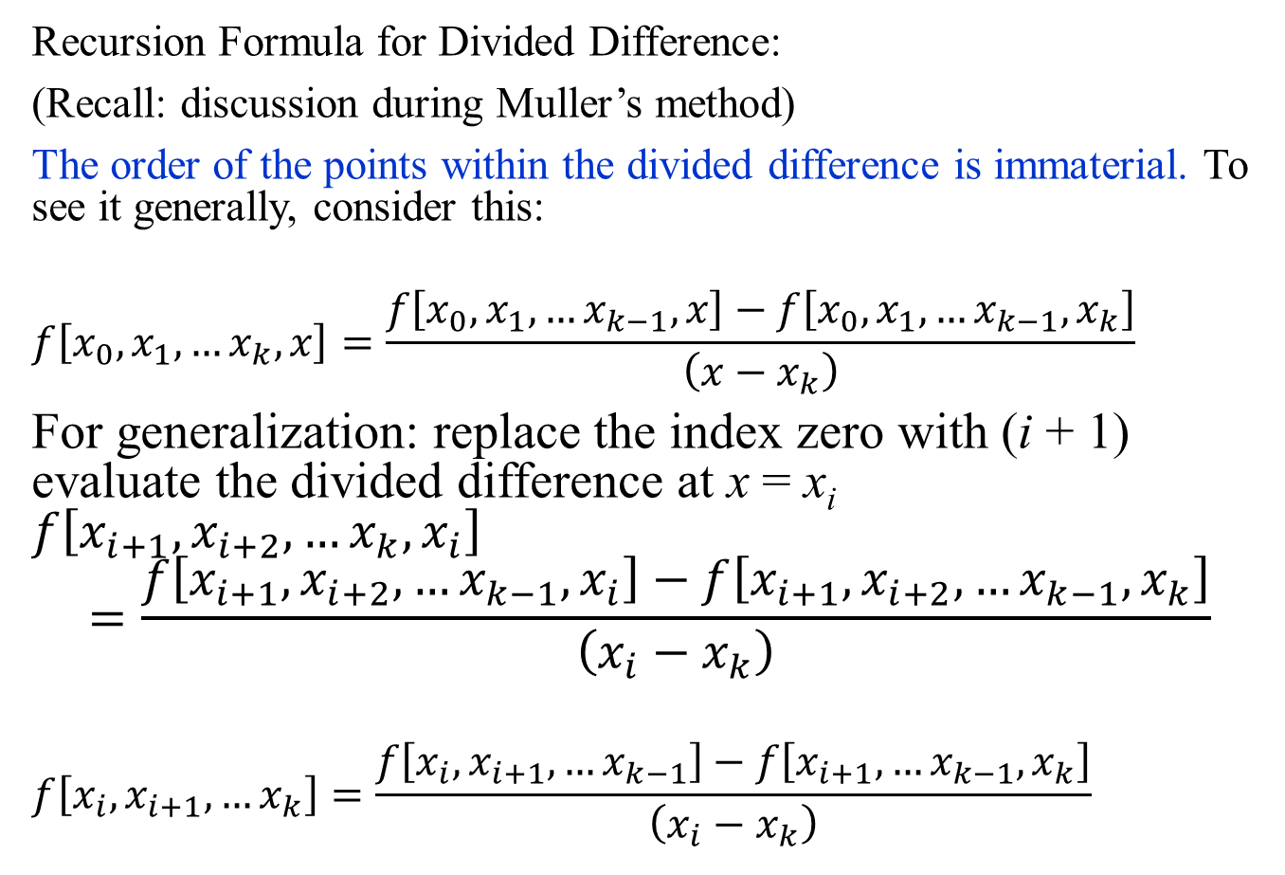
Newton’s Divided Difference
Recursion Formula for Divided Difference:
(Recall: discussion during Muller’s method)
The order of the points within the divided difference is immaterial. To see it generally, consider this:
$$f\left[x_{0},x_{1},…x_{k},x\right]=\frac{f\left[x_{0},x_{1},…x_{k−1},x\right]−f\left[x_{0},x_{1},…x_{k−1},x_{k}\right]}{\left(x−x_{k}\right)}$$
For generalization: replace the index zero with (i + 1) evaluate the divided difference at x = x_{i} $f\left[x_{i+1},x_{i+2},…x_{k},x_{i}\right]$
$$=\frac{f\left[x_{i+1},x_{i+2},…x_{k−1},x_{i}\right]−f\left[x_{i+1},x_{i+2},…x_{k−1},x_{k}\right]}{\left(x_{i}−x_{k}\right)}$$
$$f\left[x_{i},x_{i+1}, …x_{k}\right]=\frac{f\left[x_{i},x_{i+1}, …x_{k−1}\right]−f\left[x_{i+1},…x_{k−1},x_{k}\right]}{\left(x_{i}−x_{k}\right)}$$

Slide 13
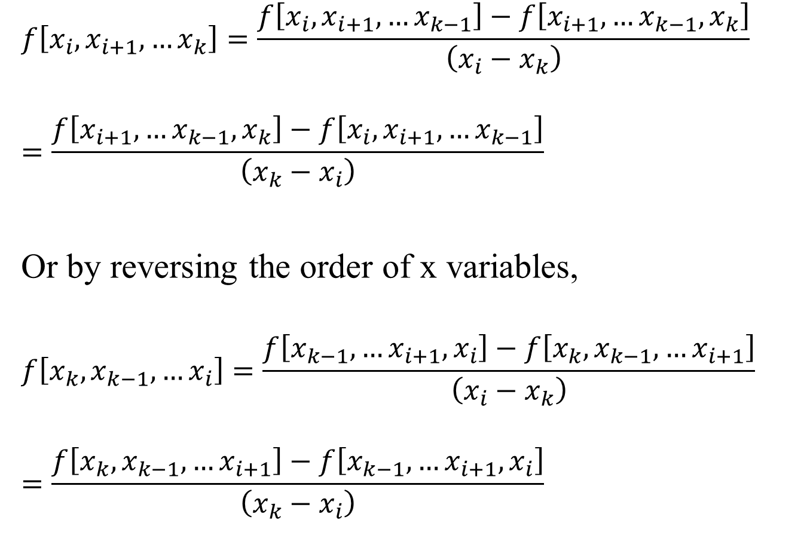
Newton’s Divided Difference
$$f\left[x_{i},x_{i+1}, …x_{k}\right]=\frac{f\left[x_{i},x_{i+1}, …x_{k−1}\right]−f\left[x_{i+1},…x_{k−1},x_{k}\right]}{\left(x_{i}−x_{k}\right)}$$
$$=\frac{f\left[x_{i+1},…x_{k−1},x_{k}\right]−f\left[x_{i},x_{i+1}, …x_{k−1}\right]}{\left({x_{k}−x}_{i}\right)}$$
Or by reversing the order of x variables,
$$f\left[x_{k},x_{k−1}, …x_{i}\right]=\frac{f\left[x_{k−1},…x_{i+1},x_{i}\right]−f\left[x_{k},x_{k−1}, …x_{i+1}\right]}{\left(x_{i}−x_{k}\right)}$$
$$=\frac{f\left[x_{k},x_{k−1}, …x_{i+1}\right]−f\left[x_{k−1},…x_{i+1},x_{i}\right]}{\left({x_{k}−x}_{i}\right)}$$

Slide 14
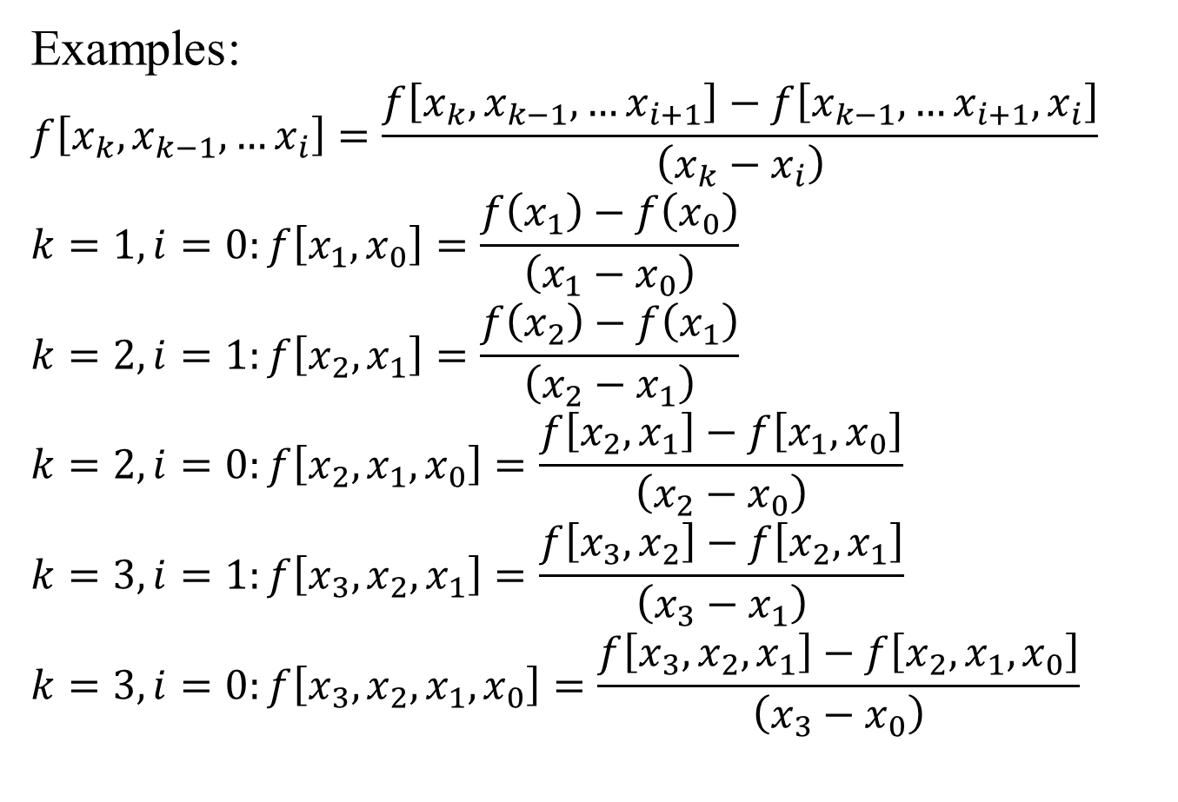
Newton’s Divided Difference
Examples:
$$f\left[x_{k},x_{k−1}, …x_{i}\right]=\frac{f\left[x_{k},x_{k−1}, …x_{i+1}\right]−f\left[x_{k−1},…x_{i+1},x_{i}\right]}{\left({x_{k}−x}_{i}\right)}$$
$$k=1, i=0:f\left[x_{1},x_{0}\right]=\frac{f\left(x_{1}\right)−f\left(x_{0}\right)}{\left({x_{1}−x}_{0}\right)}$$
$$k=2, i=1:f\left[x_{2},x_{1}\right]=\frac{f\left(x_{2}\right)−f\left(x_{1}\right)}{\left({x_{2}−x}_{1}\right)}$$
$$k=2, i=0:f\left[x_{2},x_{1},x_{0}\right]=\frac{f\left[x_{2},x_{1}\right]−f\left[x_{1},x_{0}\right]}{\left({x_{2}−x}_{0}\right)}$$
$$k=3, i=1:f\left[x_{3},x_{2},x_{1}\right]=\frac{f\left[x_{3},x_{2}\right]−f\left[x_{2},x_{1}\right]}{\left({x_{3}−x}_{1}\right)}$$
$$k=3, i=0:f\left[x_{3},x_{2},x_{1},x_{0}\right]=\frac{f\left[x_{3},x_{2},x_{1}\right]−f\left[x_{2},x_{1},x_{0}\right]}{\left({x_{3}−x}_{0}\right)}$$

Slide 15
Newton’s Divided Difference:Example
x₀ , f(x₀)
f[x₁, x₀]
f[x₂, x₁, x₀]
f[x₃, x₂, x₁, x₀]
x₁ , f(x₁)
f[x₂, x₁]
f[x₃, x₂, x₁]
x₂ , f(x₂)
f[x₃, x₂]
x₃ , f(x₃)
p(x) = f(x₀) + f[x₁, x₀](x - x₀) + f[x₂, x₁, x₀](x - x₀)(x – x₁) + f[x₃, x₂, x₁, x₀](x - x₀)(x – x₁)(x – x₂)

Slide 16
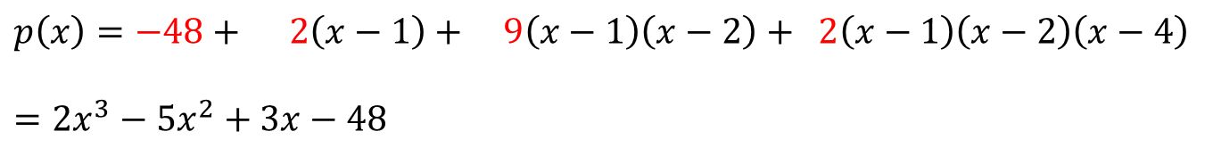
Newton’s Divided Difference: Example
1 , -48
2
9
2
2 , -46
29
17
4, 12
80
5 , 92
$$p\left(x\right)=−48+ 2\left(x−1\right)+ 9\left(x−1\right)\left(x−2\right)+ 2\left(x−1\right)\left(x−2\right)\left(x−4\right)$$
$$=2x^{3}−5x^{2}+3x−48$$
p(x) = f(x₀) + f[x₁, x₀](x - x₀) + f[x₂, x₁, x₀](x - x₀)(x – x₁) + f[x₃, x₂, x₁, x₀](x - x₀)(x – x₁)(x – x₂)

Slide 17
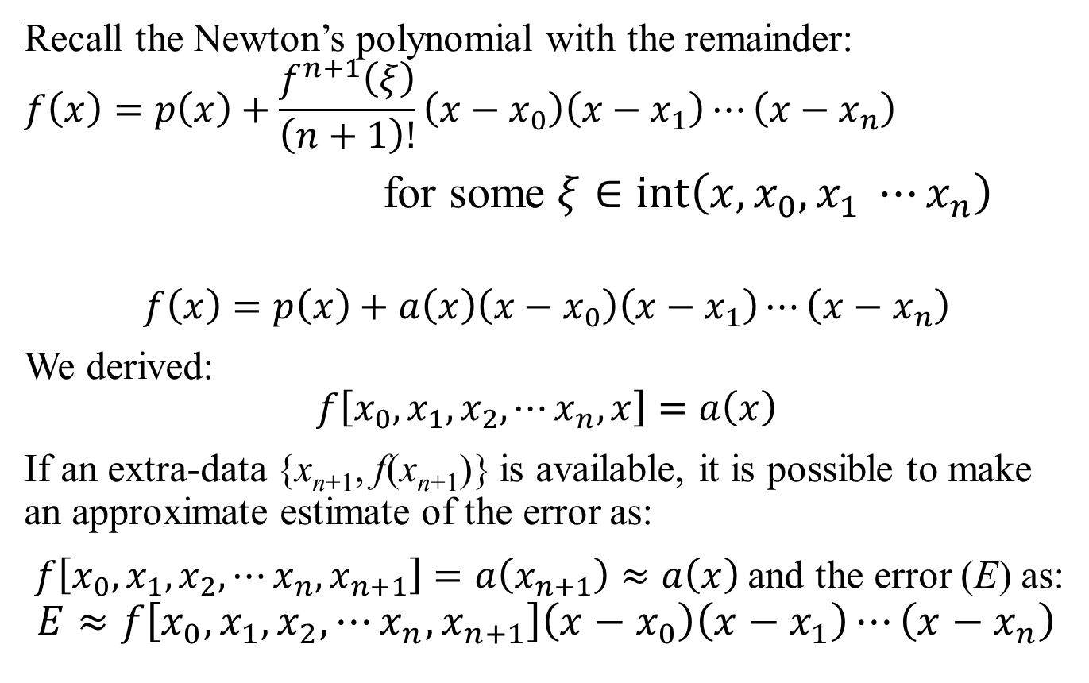
Newton’s Divided Difference: Error Estimate
Recall the Newton’s polynomial with the remainder:
$$f\left(x\right)=p\left(x\right)+\frac{f^{n+1}\left(ξ\right)}{\left(n+1\right)!}\left(x−x_{0}\right)\left(x−x_{1}\right)⋯\left(x−x_{n}\right)$$
for some $ξ∈\operatorname{int}\left(x, x_{0}, x_{1} ⋯x_{n}\right)$
$$f\left(x\right)=p\left(x\right)+a\left(x\right)\left(x−x_{0}\right)\left(x−x_{1}\right)⋯\left(x−x_{n}\right)$$
We derived:
$$f\left[x_{0},x_{1},x_{2},⋯x_{n},x\right]=a\left(x\right)$$
If an extra-data {x_{n+1}, f(x_{n+1})} is available, it is possible to make an approximate estimate of the error as:
$f\left[x_{0},x_{1},x_{2},⋯x_{n},x_{n+1}\right]=a\left(x_{n+1}\right)≈a\left(x\right)$ and the error (E) as:
$$E≈f\left[x_{0},x_{1},x_{2},⋯x_{n},x_{n+1}\right]\left(x−x_{0}\right)\left(x−x_{1}\right)⋯\left(x−x_{n}\right)$$

Slide 18
Newton’s Divided Difference
$f\left[x_{0},x_{1},…x_{k−1},x\right]=\frac{f\left[x_{0},x_{1},…x_{k−2},x\right]−f\left[x_{0},x_{1},…x_{k−2},x_{k−1}\right]}{\left(x−x_{k−1}\right)}=c_{k}+ c_{k+1}\left(x−x_{k}\right)+…+c_{n}\left(x−x_{k}\right)⋯\left(x−x_{n−1}\right)+ a\left(x\right)\left(x−x_{k}\right)⋯\left(x−x_{n}\right)$
$$f\left[x_{0},x_{1},x_{2},⋯x_{k}\right]=\frac{f\left[x_{0},x_{1},…x_{k−2},x_{k}\right]−f\left[x_{0},x_{1},…x_{k−2},x_{k−1}\right]}{\left(x_{k}−x_{k−1}\right)}=c_{k}$$
$$f\left[x_{0},x_{1},x_{2},⋯x_{n}\right]=c_{n}; f\left[x_{0},x_{1},x_{2},⋯x_{n},x\right]=a\left(x\right)$$
Newton’s polynomial without the remainder term:
$$p\left(x\right)=f_{0}+\sum_{j=1}^{n}{f\left[x_{0},x_{1}, ⋯x_{j}\right]}\left(x−x_{0}\right)\left(x−x_{1}\right)⋯\left(x−x_{j−1}\right)$$

Slide 19
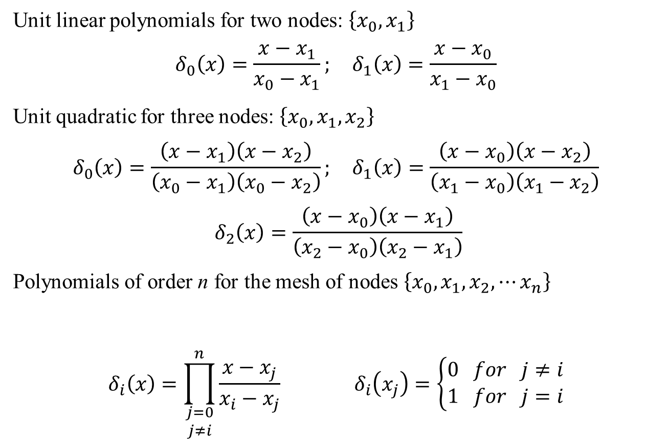
Lagrange Polynomials
Unit linear polynomials for two nodes: $\left\{x_{0},x_{1}\right\}$
$$δ_{0}\left(x\right)=\frac{x−x_{1}}{x_{0}−x_{1}}; δ_{1}\left(x\right)=\frac{x−x_{0}}{x_{1}−x_{0}}$$
Unit quadratic for three nodes: $\left\{x_{0},x_{1},x_{2}\right\}$
$$δ_{0}\left(x\right)=\frac{\left(x−x_{1}\right)\left(x−x_{2}\right)}{\left(x_{0}−x_{1}\right)\left(x_{0}−x_{2}\right)}; δ_{1}\left(x\right)=\frac{\left(x−x_{0}\right)\left(x−x_{2}\right)}{\left(x_{1}−x_{0}\right)\left(x_{1}−x_{2}\right)}$$
$$δ_{2}\left(x\right)=\frac{\left(x−x_{0}\right)\left(x−x_{1}\right)}{\left(x_{2}−x_{0}\right)\left(x_{2}−x_{1}\right)}$$
Polynomials of order n for the mesh of nodes $\left\{x_{0},x_{1},x_{2},⋯x_{n}\right\}$
$$δ_{i}\left(x\right)=\prod_{\begin{matrix}j=0 \\ j≠i\end{matrix}}^{n}{\frac{x−x_{j}}{x_{i}−x_{j}}} δ_{i}\left(x_{j}\right)=\left\{\begin{matrix}0 for j≠i \\ 1 for j=i\end{matrix}\right.$$

Slide 20
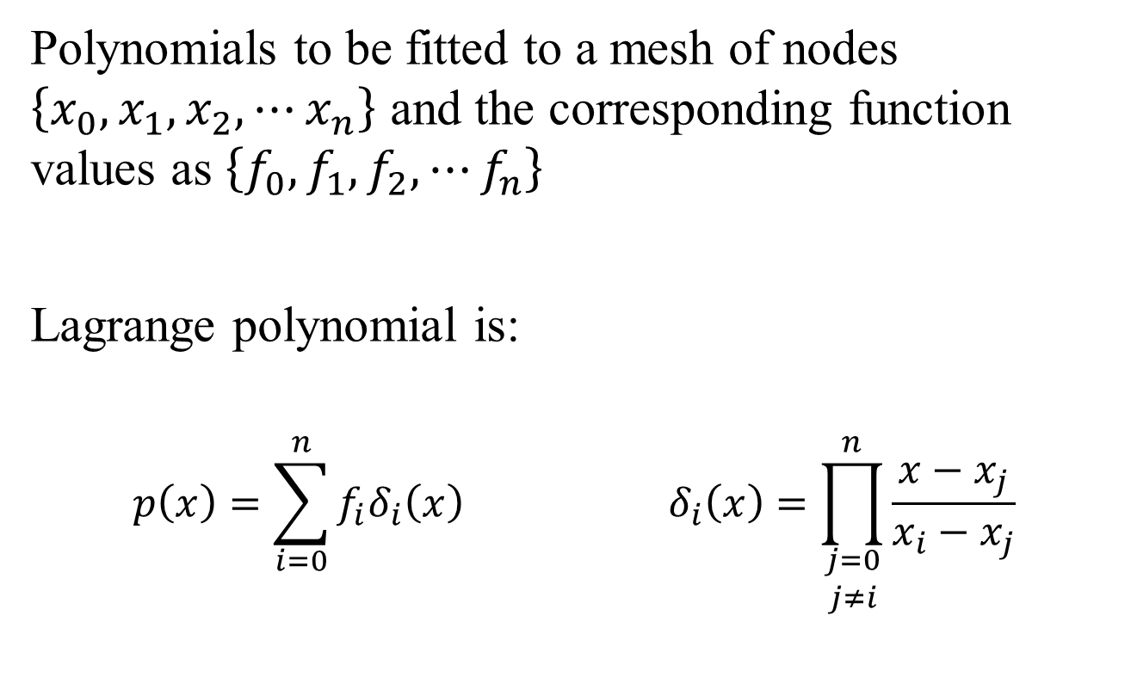
Lagrange Polynomials
Polynomials to be fitted to a mesh of nodes $\left\{x_{0},x_{1},x_{2},⋯x_{n}\right\}$ and the corresponding function values as $\left\{f_{0},f_{1},f_{2},⋯f_{n}\right\}$
Lagrange polynomial is:
$$p\left(x\right)=\sum_{i=0}^{n}{f_{i}δ_{i}\left(x\right)} δ_{i}\left(x\right)=\prod_{\begin{matrix}j=0 \\ j≠i\end{matrix}}^{n}{\frac{x−x_{j}}{x_{i}−x_{j}}}$$

Slide 21
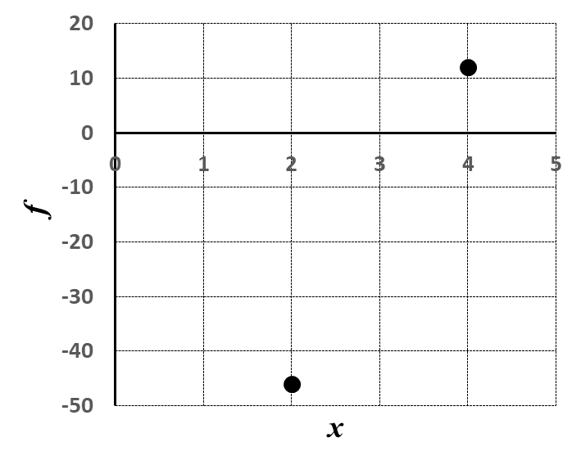
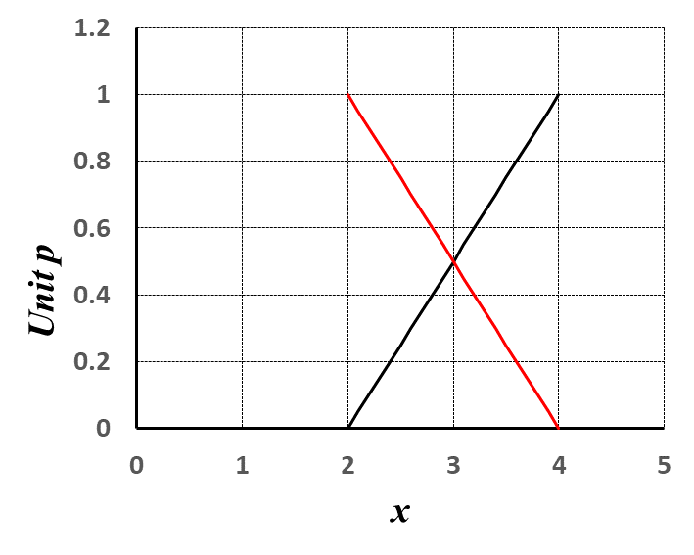
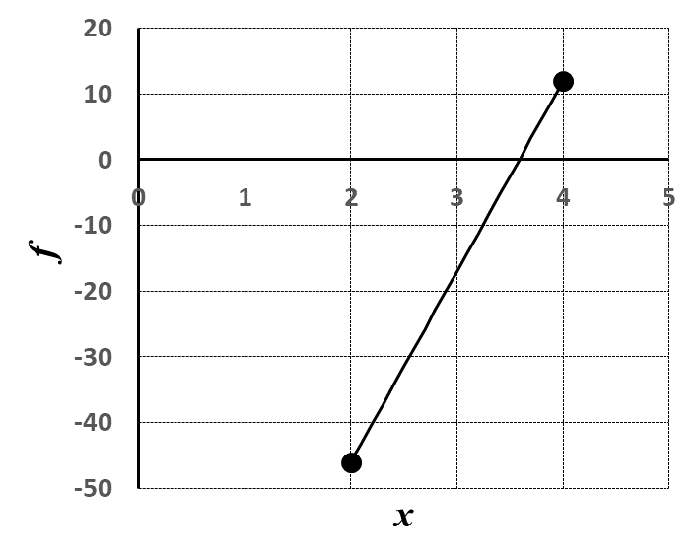
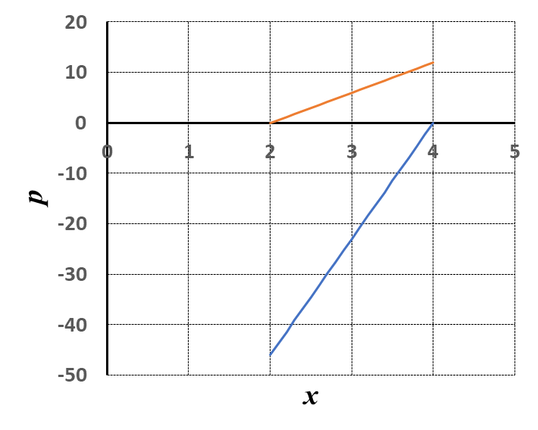
Lagrange Polynomials: Linear

Slide 22
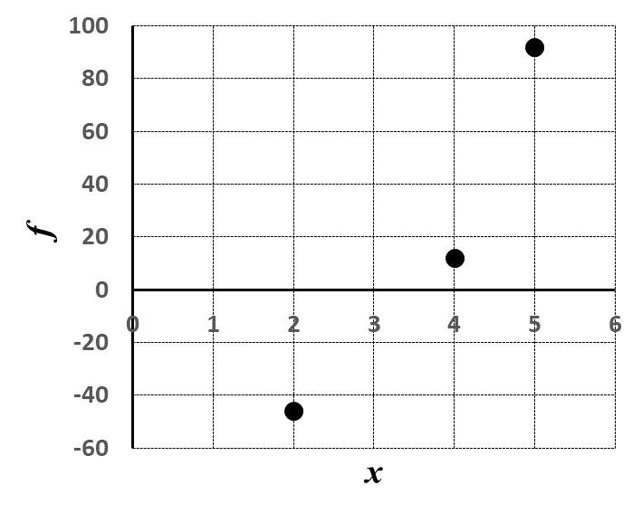
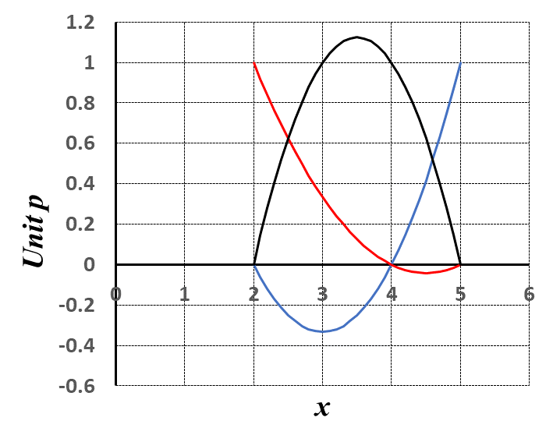
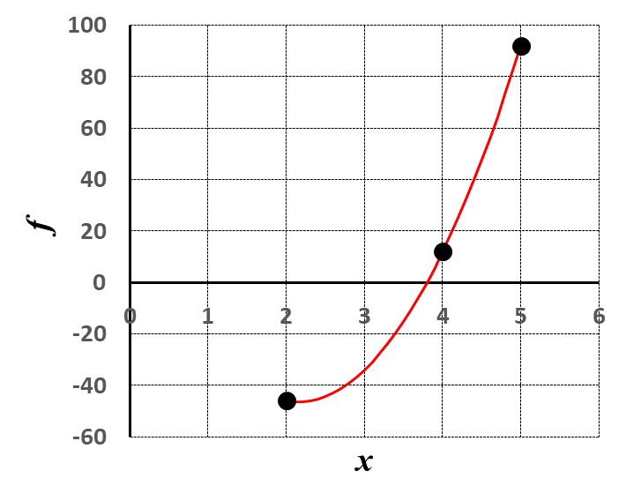
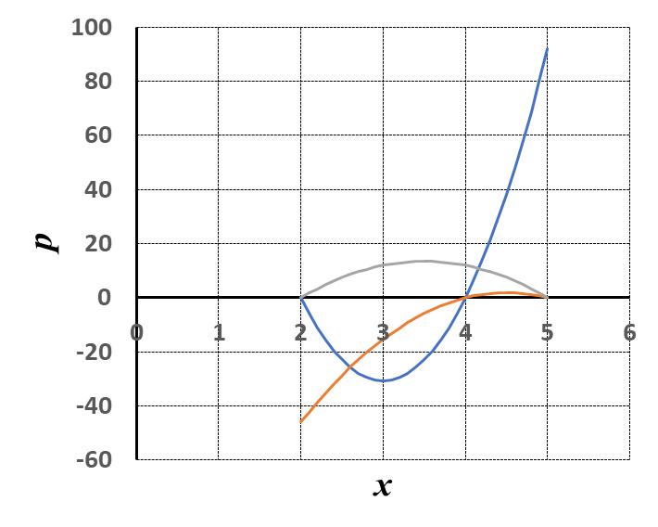
Lagrange Polynomials: Quadratic

Slide 23
Lagrange Polynomials
Polynomials to be fitted to a mesh of nodes $\left\{x_{0},x_{1},x_{2},⋯x_{n}\right\}$ and the corresponding function values as $\left\{f_{0},f_{1},f_{2},⋯f_{n}\right\}$
Lagrange polynomial is:
$$p\left(x\right)=\sum_{i=0}^{n}{f_{i}δ_{i}\left(x\right)} δ_{i}\left(x\right)=\prod_{\begin{matrix}j=0 \\ j≠i\end{matrix}}^{n}{\frac{x−x_{j}}{x_{i}−x_{j}}}$$

Slide 24
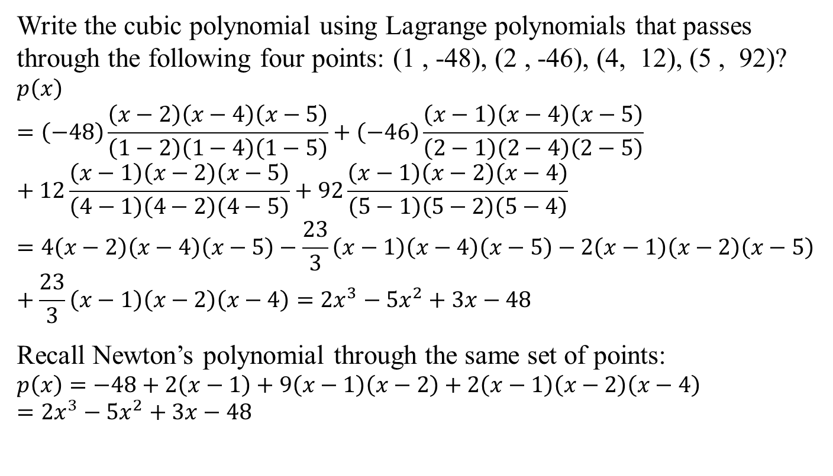
Lagrange Polynomial: Example
Write the cubic polynomial using Lagrange polynomials that passes through the following four points: (1 , -48), (2 , -46), (4, 12), (5 , 92)?
$$p\left(x\right)=\left(−48\right)\frac{\left(x−2\right)\left(x−4\right)\left(x−5\right)}{\left(1−2\right)\left(1−4\right)\left(1−5\right)}+\left(−46\right)\frac{\left(x−1\right)\left(x−4\right)\left(x−5\right)}{\left(2−1\right)\left(2−4\right)\left(2−5\right)}+12\frac{\left(x−1\right)\left(x−2\right)\left(x−5\right)}{\left(4−1\right)\left(4−2\right)\left(4−5\right)}+92\frac{\left(x−1\right)\left(x−2\right)\left(x−4\right)}{\left(5−1\right)\left(5−2\right)\left(5−4\right)}=4\left(x−2\right)\left(x−4\right)\left(x−5\right)−\frac{23}{3}\left(x−1\right)\left(x−4\right)\left(x−5\right)−2\left(x−1\right)\left(x−2\right)\left(x−5\right)+\frac{23}{3}\left(x−1\right)\left(x−2\right)\left(x−4\right)=2x^{3}−5x^{2}+3x−48$$
Recall Newton’s polynomial through the same set of points:
$$p\left(x\right)=−48+2\left(x−1\right)+9\left(x−1\right)\left(x−2\right)+2\left(x−1\right)\left(x−2\right)\left(x−4\right)=2x^{3}−5x^{2}+3x−48$$

Slide 25
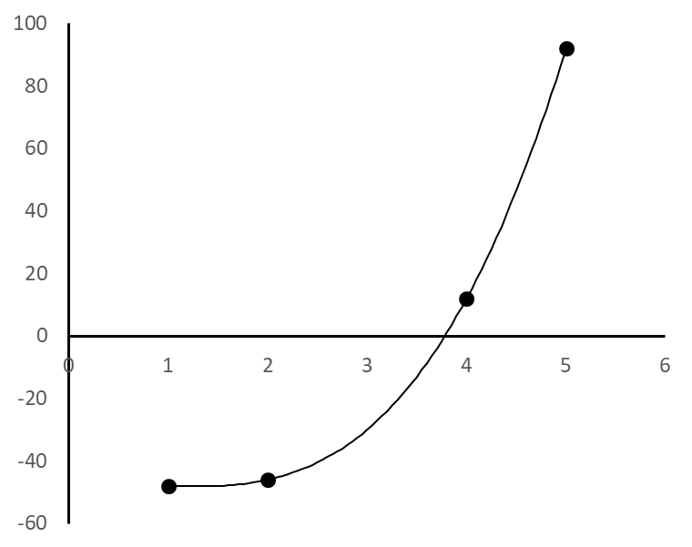
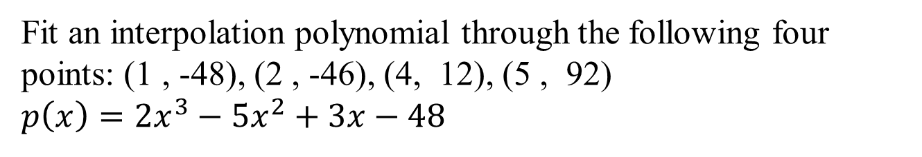
Example Fit
Fit an interpolation polynomial through the following four points: (1 , -48), (2 , -46), (4, 12), (5 , 92)
$$p\left(x\right)=2x^{3}−5x^{2}+3x−48$$

