Slide 1

Theory of Approximation: Interpolation
Abhas Singh
Department of Civil Engineering
IIT Kanpur
Acknowledgements: Profs. Saumyen Guha and Shivam Tripathi (CE)

Slide 2
Interpolation Polynomials
Newton’s Divided Difference
Lagrange Polynomials
Direct Fit (Standard Format)
Gram’s polynomials (introduced earlier)
Spline Interpolation: piecewise continuous, smoothing

Slide 3
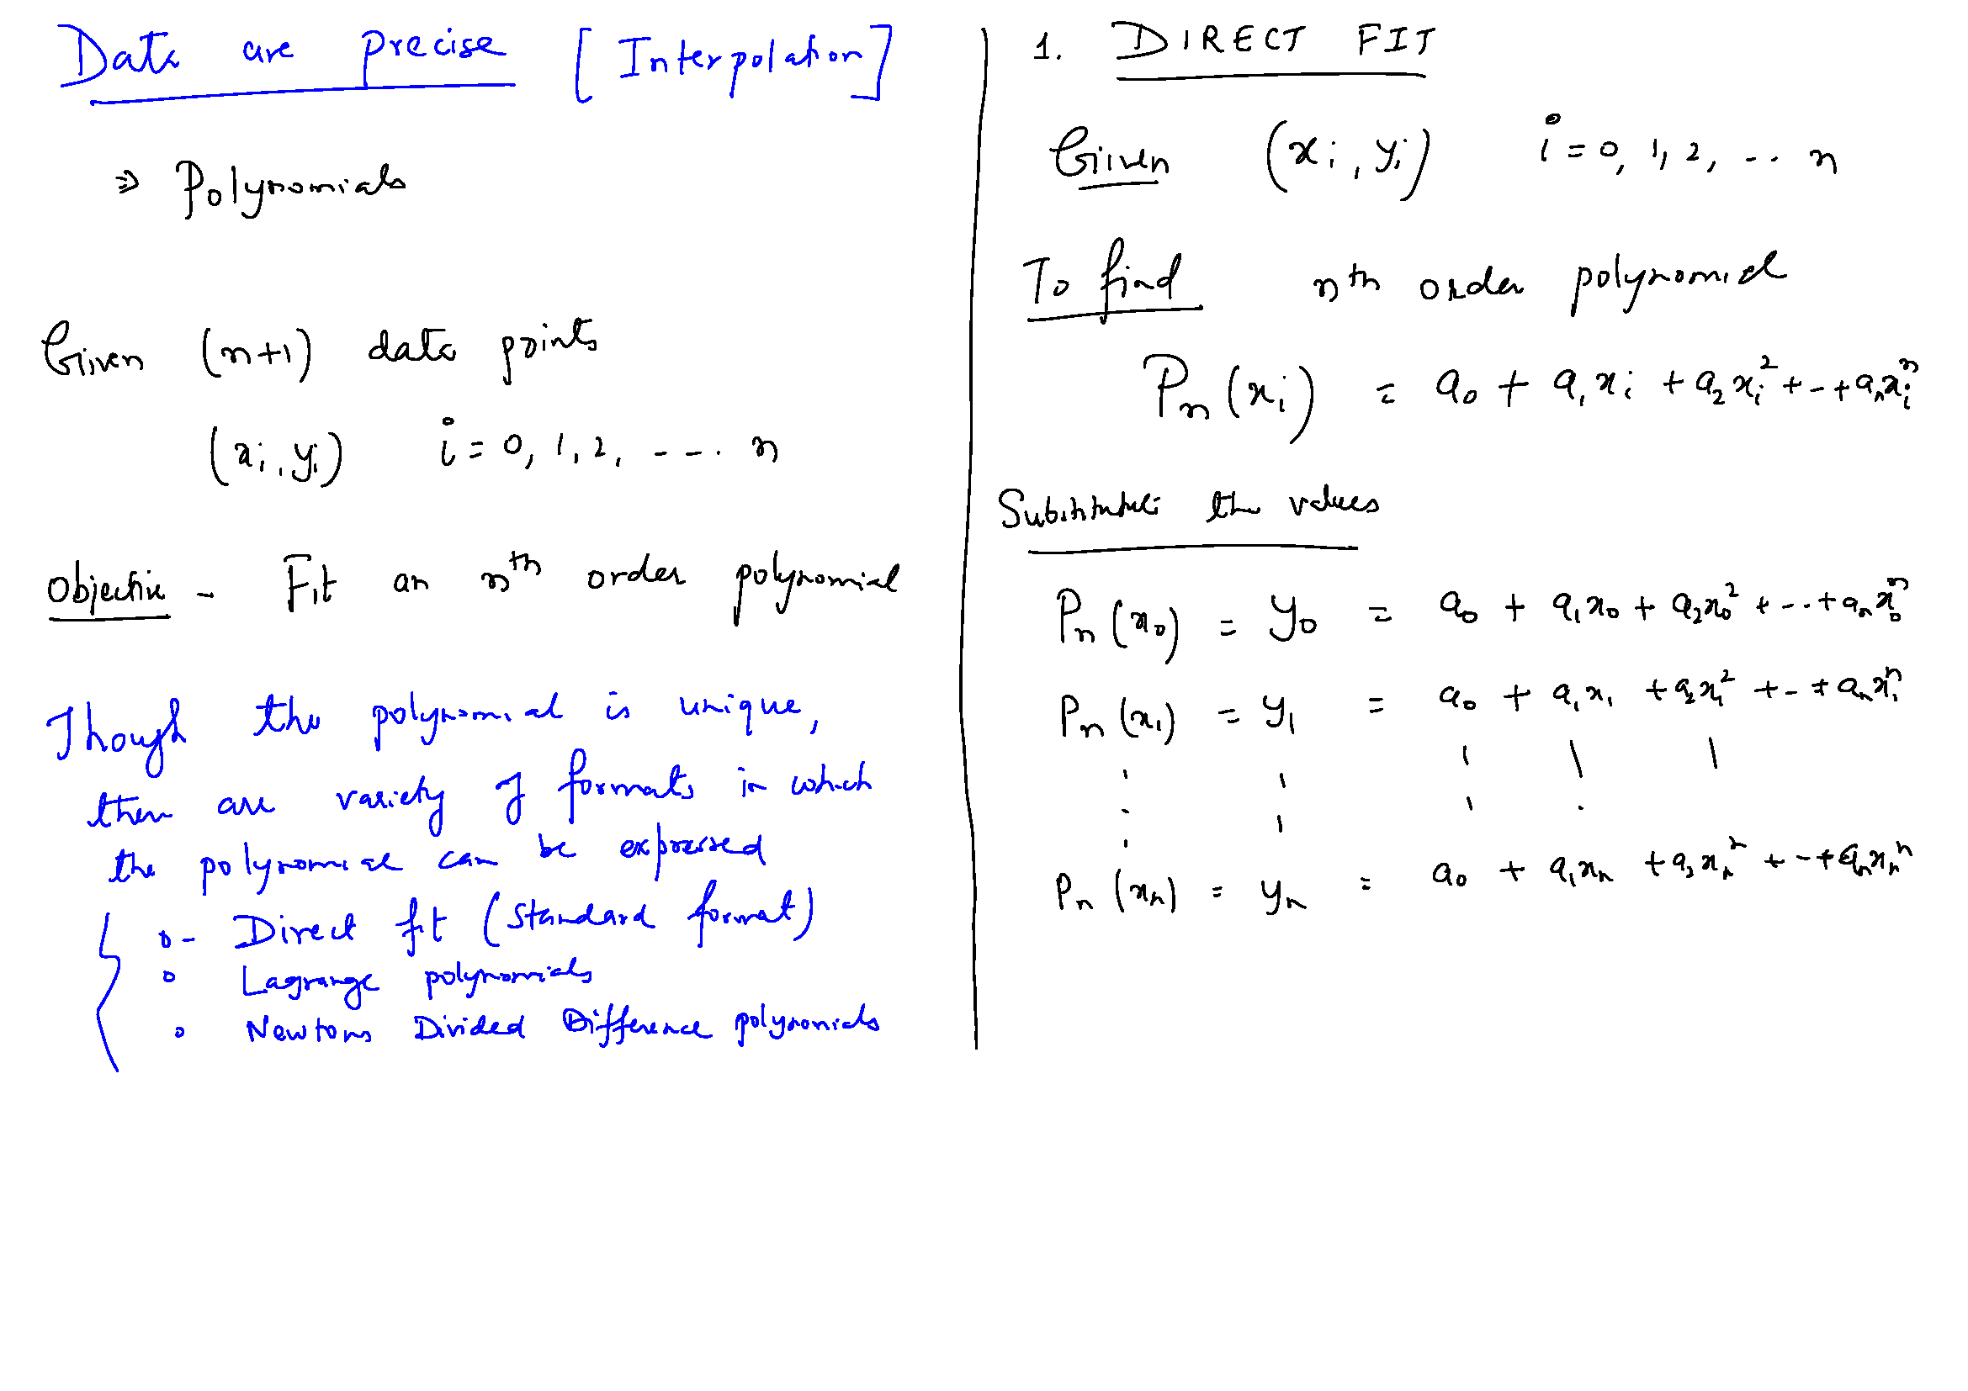

Slide 5
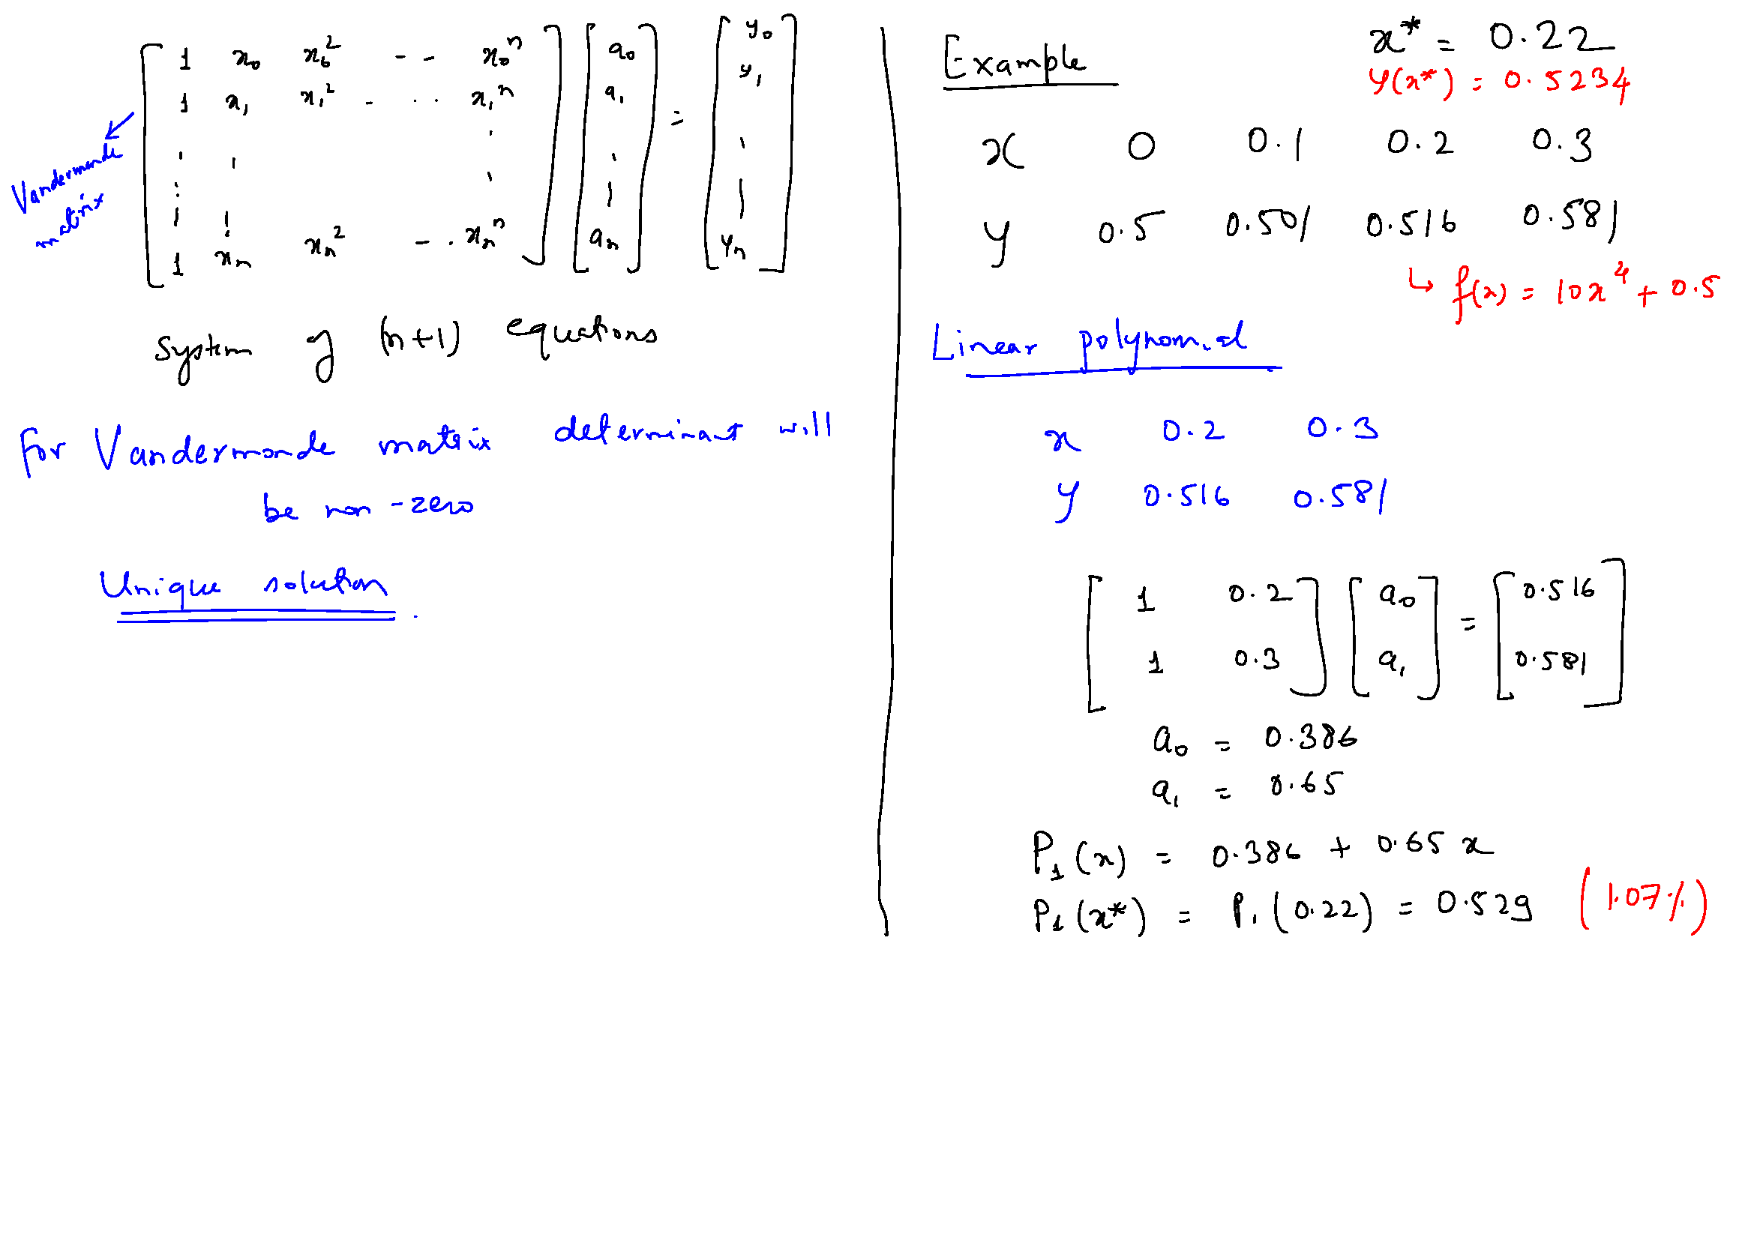

Slide 7
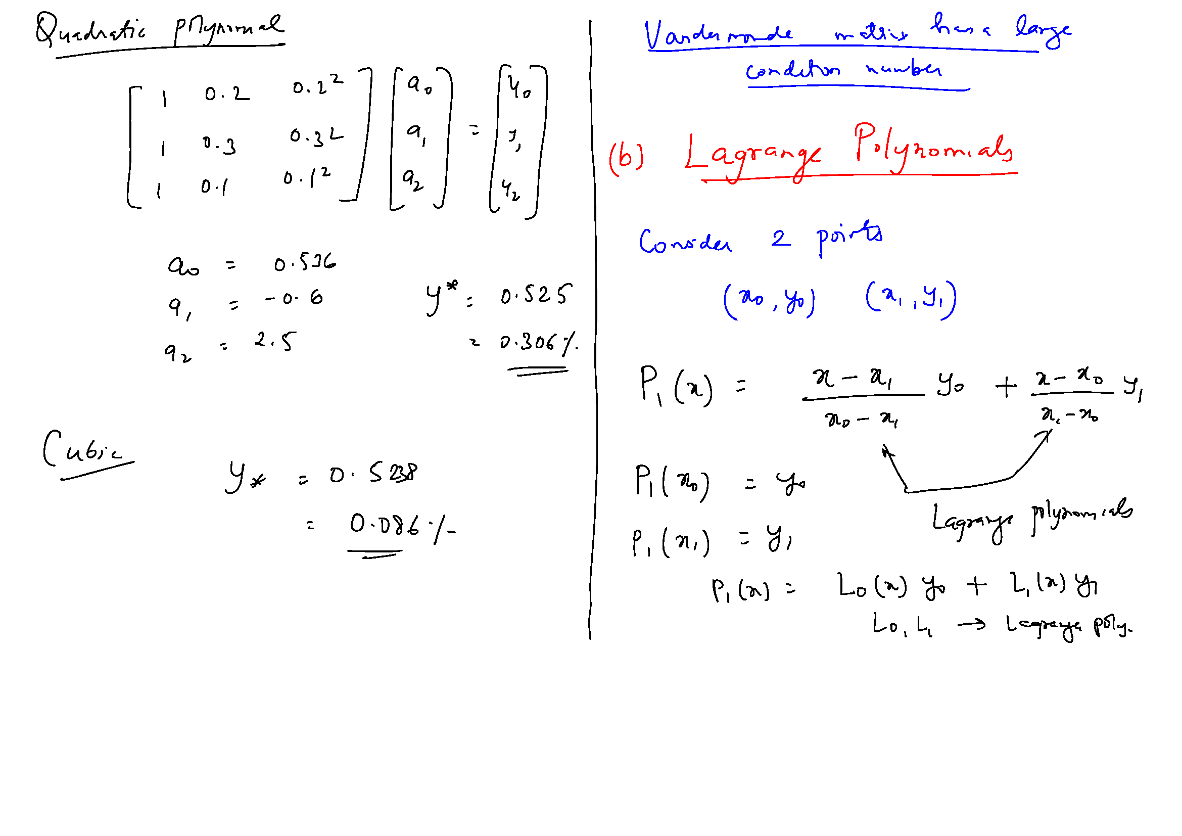

Slide 9
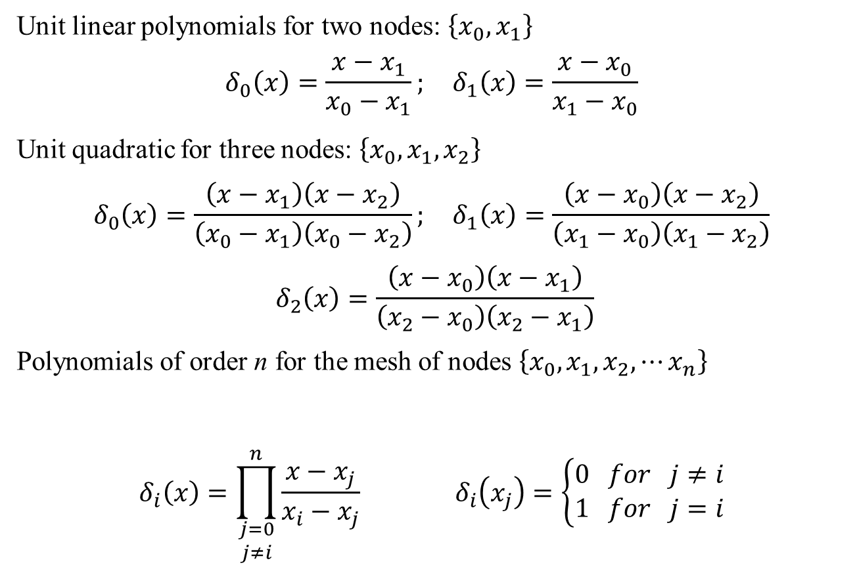
Unit Polynomials for Lagrange Formulation
Unit linear polynomials for two nodes: $\left\{x_{0},x_{1}\right\}$
$$δ_{0}\left(x\right)=\frac{x−x_{1}}{x_{0}−x_{1}}; δ_{1}\left(x\right)=\frac{x−x_{0}}{x_{1}−x_{0}}$$
Unit quadratic for three nodes: $\left\{x_{0},x_{1},x_{2}\right\}$
$$δ_{0}\left(x\right)=\frac{\left(x−x_{1}\right)\left(x−x_{2}\right)}{\left(x_{0}−x_{1}\right)\left(x_{0}−x_{2}\right)}; δ_{1}\left(x\right)=\frac{\left(x−x_{0}\right)\left(x−x_{2}\right)}{\left(x_{1}−x_{0}\right)\left(x_{1}−x_{2}\right)}$$
$$δ_{2}\left(x\right)=\frac{\left(x−x_{0}\right)\left(x−x_{1}\right)}{\left(x_{2}−x_{0}\right)\left(x_{2}−x_{1}\right)}$$
Polynomials of order n for the mesh of nodes $\left\{x_{0},x_{1},x_{2},⋯x_{n}\right\}$
$$δ_{i}\left(x\right)=\prod_{\begin{matrix}j=0 \\ j≠i\end{matrix}}^{n}{\frac{x−x_{j}}{x_{i}−x_{j}}} δ_{i}\left(x_{j}\right)=\left\{\begin{matrix}0 for j≠i \\ 1 for j=i\end{matrix}\right.$$

Slide 10
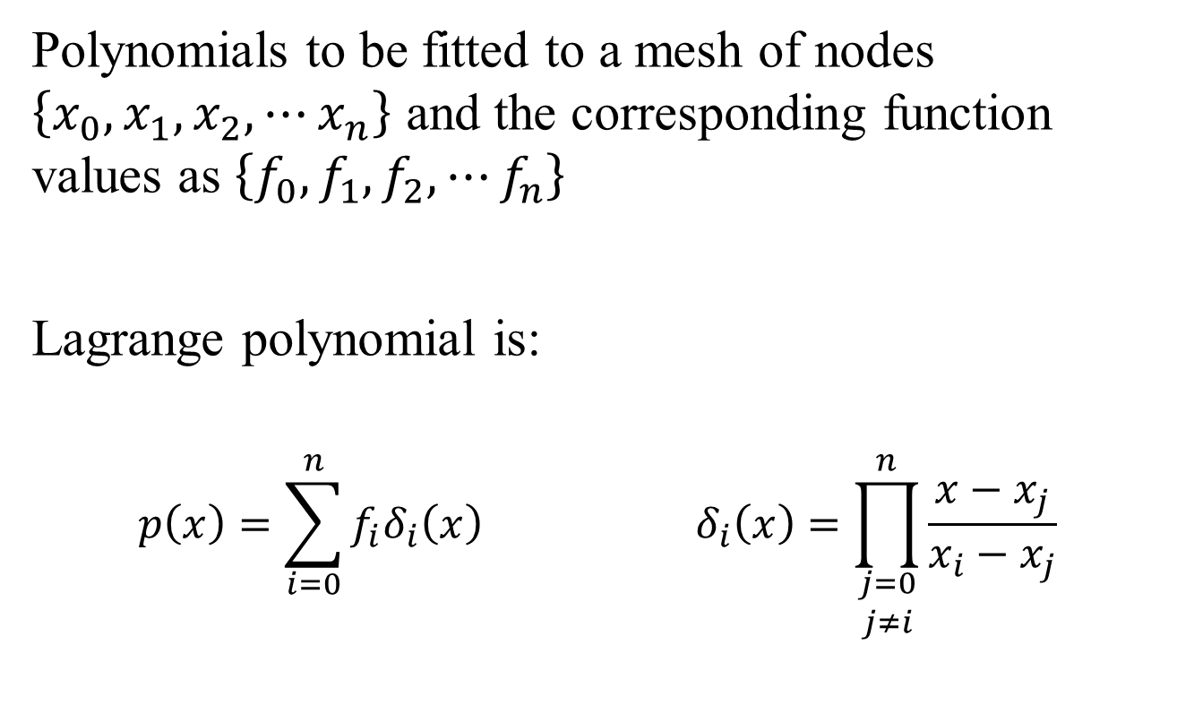
Lagrange Polynomials
Polynomials to be fitted to a mesh of nodes $\left\{x_{0},x_{1},x_{2},⋯x_{n}\right\}$ and the corresponding function values as $\left\{f_{0},f_{1},f_{2},⋯f_{n}\right\}$
Lagrange polynomial is:
$$p\left(x\right)=\sum_{i=0}^{n}{f_{i}δ_{i}\left(x\right)} δ_{i}\left(x\right)=\prod_{\begin{matrix}j=0 \\ j≠i\end{matrix}}^{n}{\frac{x−x_{j}}{x_{i}−x_{j}}}$$

Slide 11
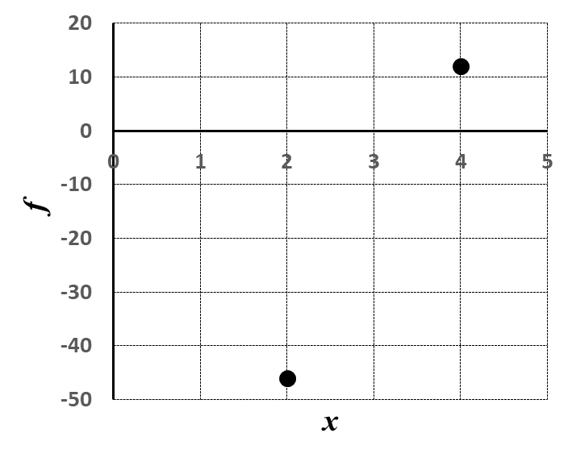
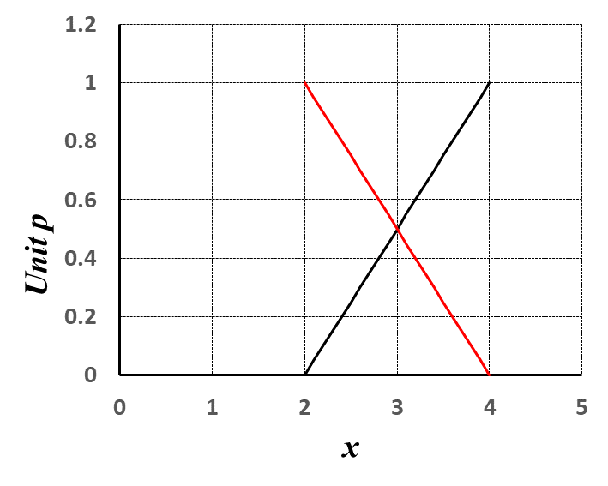
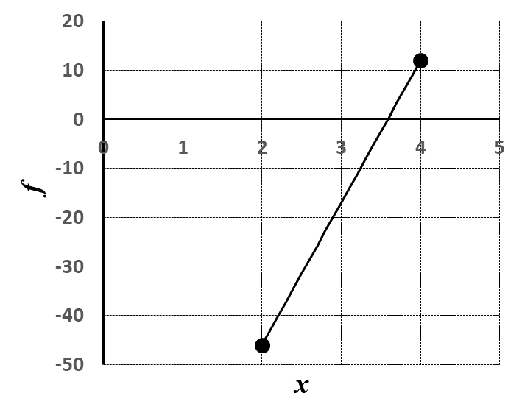
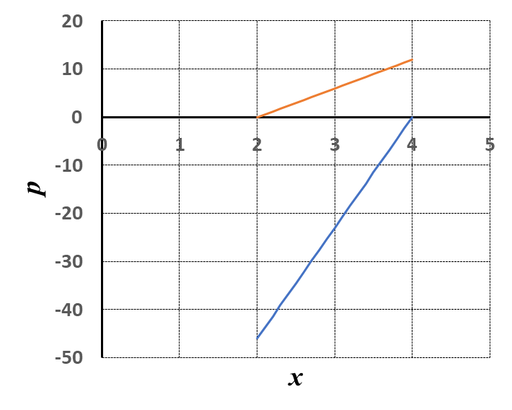


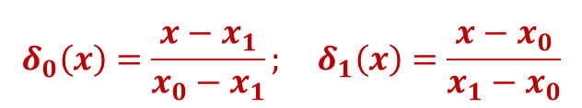
Lagrange Polynomials: Linear
$$δ_{0}\left(x\right)=\frac{x−x_{1}}{x_{0}−x_{1}}; δ_{1}\left(x\right)=\frac{x−x_{0}}{x_{1}−x_{0}}$$
$$pi\left(x\right)=\sum_{i=0}^{n}{f_{i}δ_{i}\left(x\right)}$$
$$pi\left(x\right)=f_{i}δ_{i}\left(x\right)$$

Slide 12
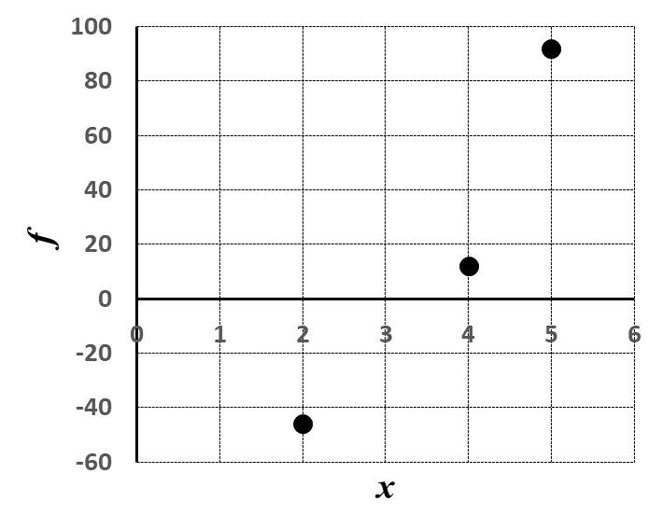
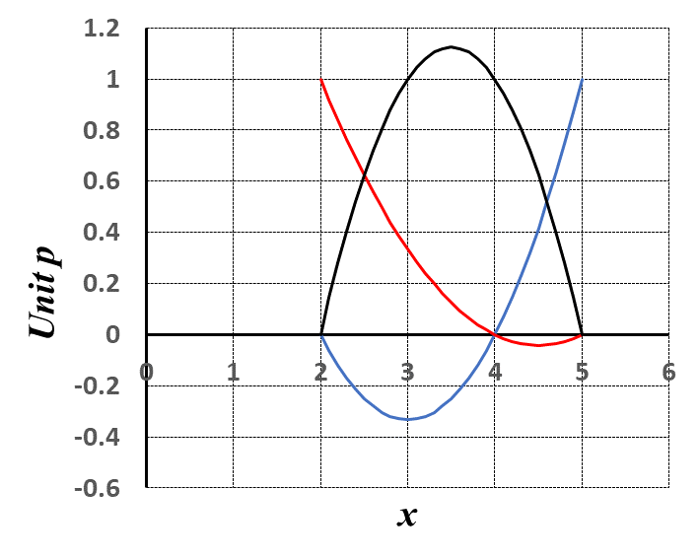
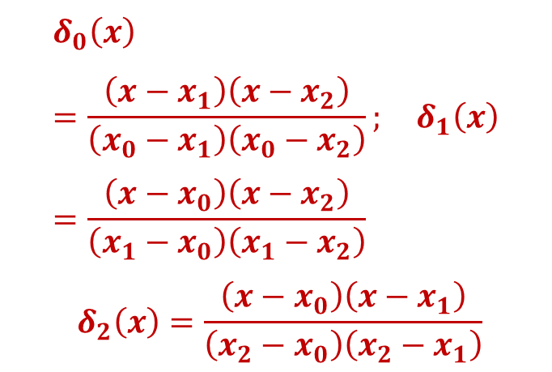
Lagrange Polynomials: Quadratic
$$δ_{0}\left(x\right)=\frac{\left(x−x_{1}\right)\left(x−x_{2}\right)}{\left(x_{0}−x_{1}\right)\left(x_{0}−x_{2}\right)}; δ_{1}\left(x\right)=\frac{\left(x−x_{0}\right)\left(x−x_{2}\right)}{\left(x_{1}−x_{0}\right)\left(x_{1}−x_{2}\right)}$$
$$δ_{2}\left(x\right)=\frac{\left(x−x_{0}\right)\left(x−x_{1}\right)}{\left(x_{2}−x_{0}\right)\left(x_{2}−x_{1}\right)}$$

Slide 13
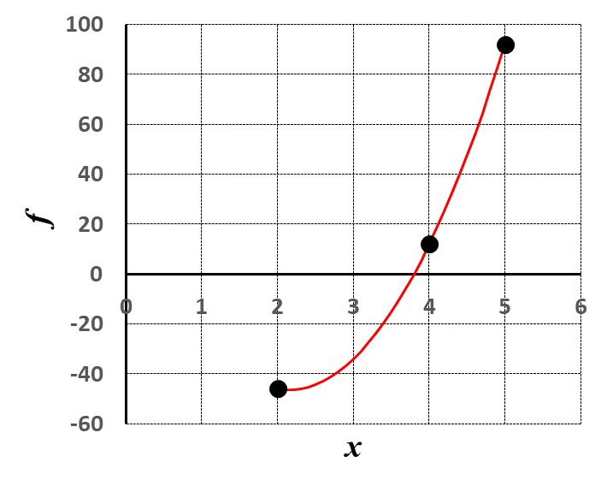
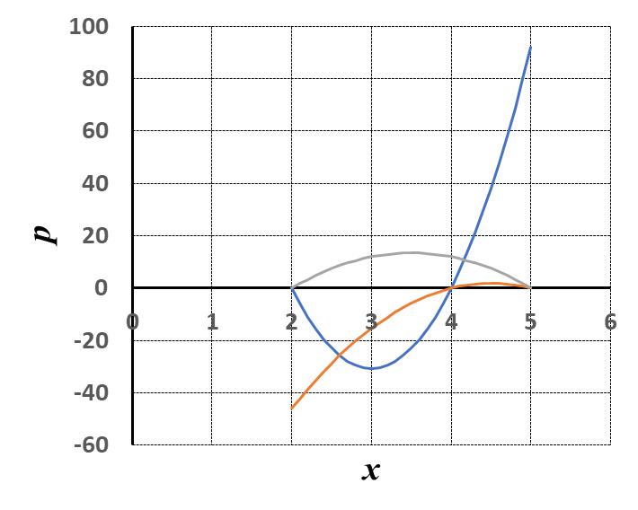

Lagrange Polynomials: Quadratic
$$pi\left(x\right)=\sum_{i=0}^{n}{f_{i}δ_{i}\left(x\right)}$$
$$pi\left(x\right)=f_{i}δ_{i}\left(x\right)$$

Slide 14
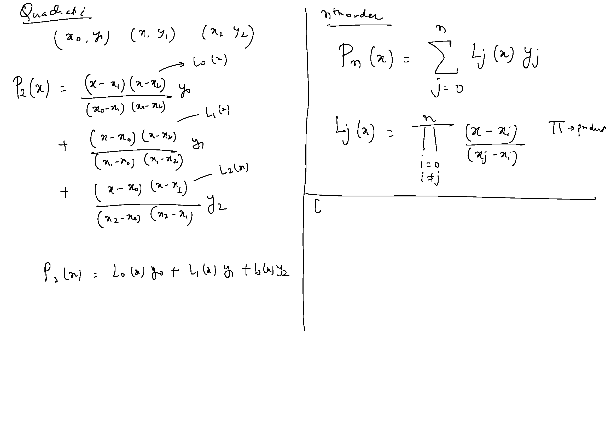

Slide 15
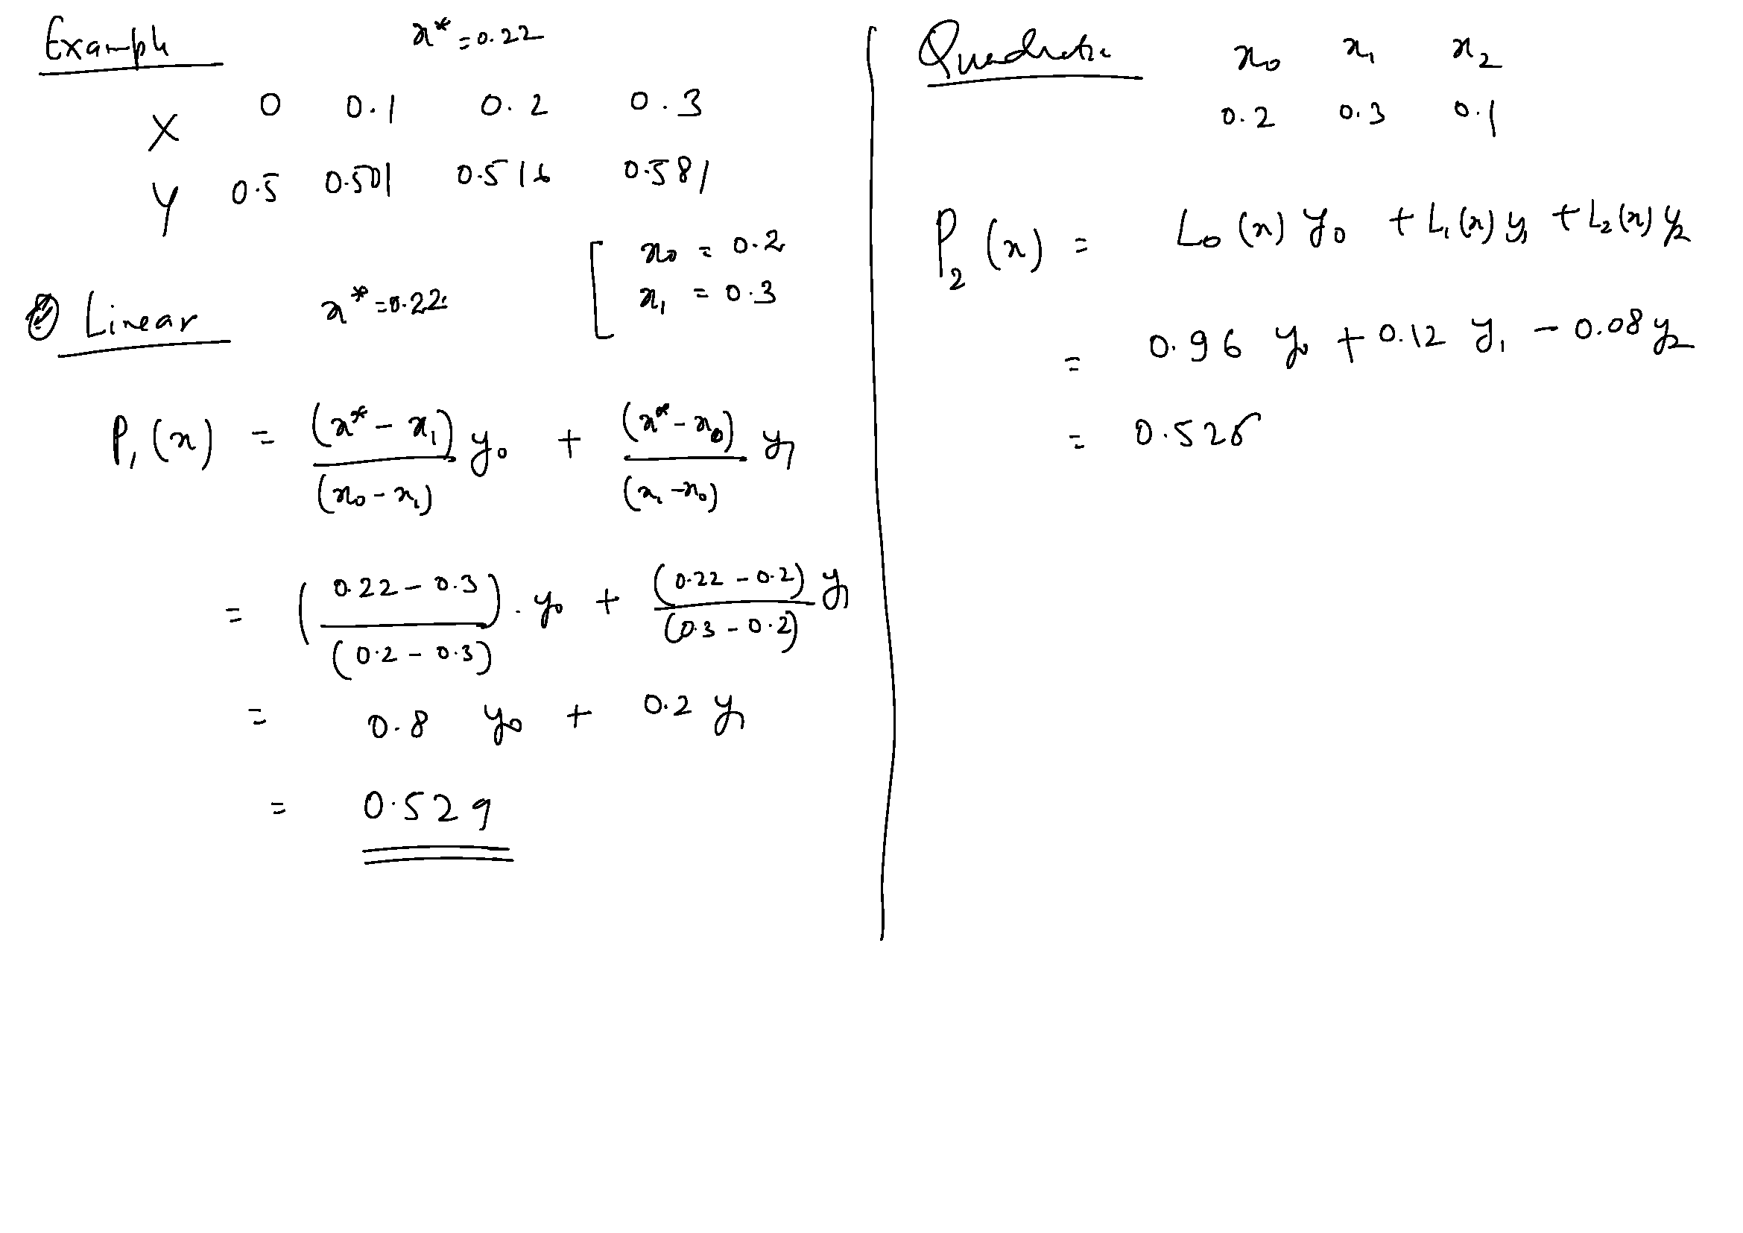
y* = 0.5234;
1.07 % error

Slide 16
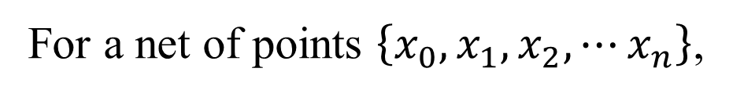
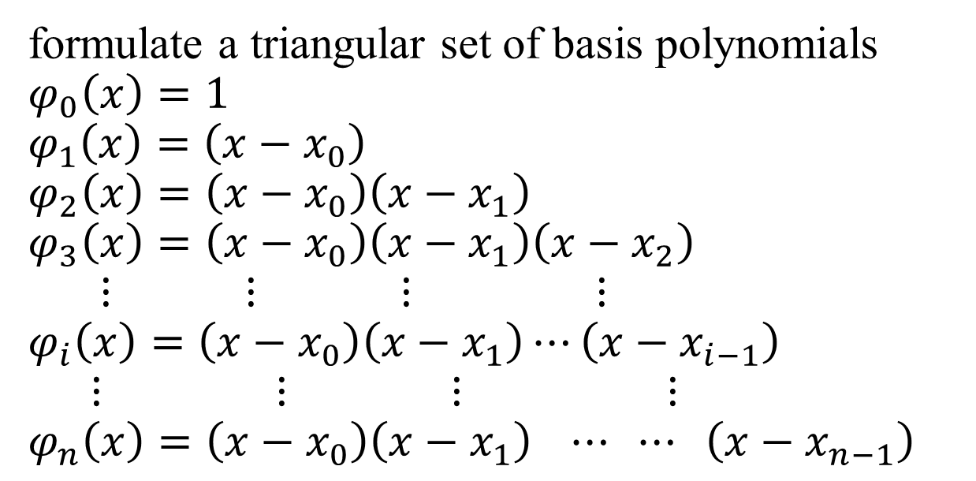
Newton’s Divided Difference
For a net of points $\left\{x_{0},x_{1},x_{2},⋯x_{n}\right\}$,
formulate a triangular set of basis polynomials
$$φ_{0}\left(x\right)=1$$
$$φ_{1}\left(x\right)=\left(x−x_{0}\right)$$
$$φ_{2}\left(x\right)=\left(x−x_{0}\right)\left(x−x_{1}\right)$$
$$φ_{3}\left(x\right)=\left(x−x_{0}\right)\left(x−x_{1}\right)\left(x−x_{2}\right)$$
$$⋮ ⋮ ⋮ ⋮$$
$$φ_{i}\left(x\right)=\left(x−x_{0}\right)\left(x−x_{1}\right)⋯\left(x−x_{i−1}\right)$$
$$⋮ ⋮ ⋮ ⋮$$
$$φ_{n}\left(x\right)=\left(x−x_{0}\right)\left(x−x_{1}\right) ⋯ ⋯ \left(x−x_{n−1}\right)$$

Slide 17
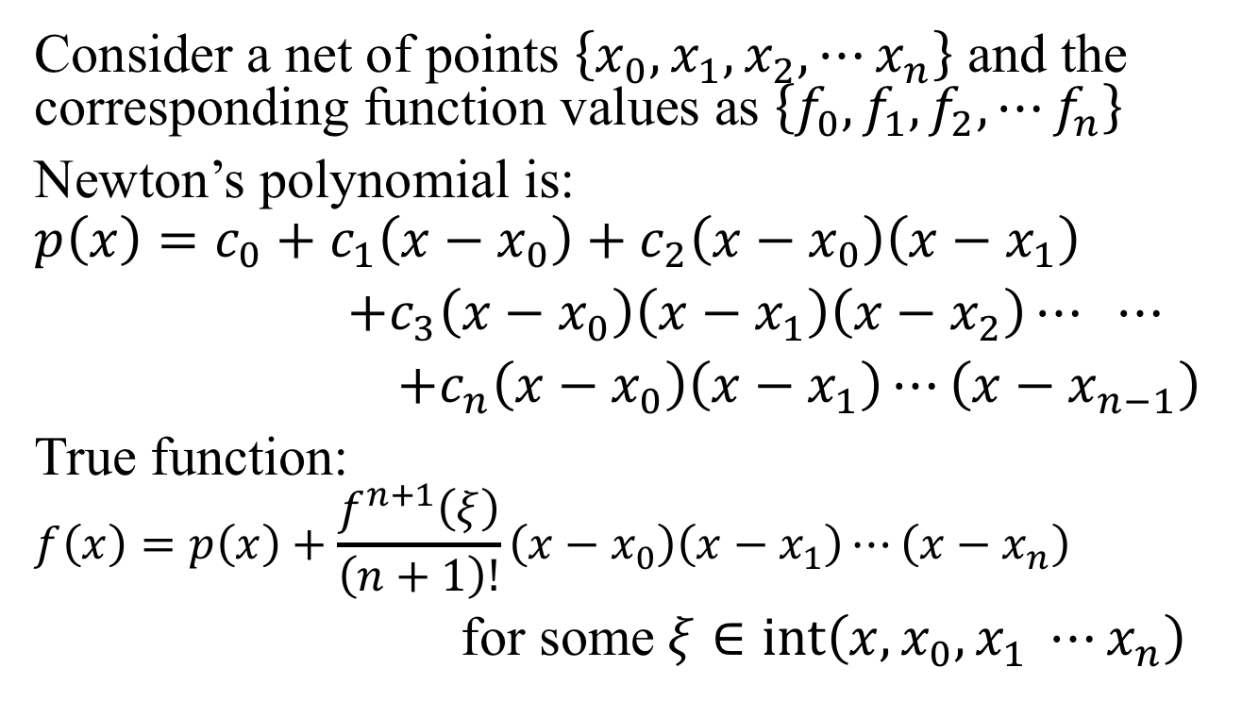
Newton’s Divided Difference
Consider a net of points $\left\{x_{0},x_{1},x_{2},⋯x_{n}\right\}$ and the corresponding function values as $\left\{f_{0},f_{1},f_{2},⋯f_{n}\right\}$
Newton’s polynomial is:
$$p\left(x\right)=c_{0}+c_{1}\left(x−x_{0}\right)+c_{2}\left(x−x_{0}\right)\left(x−x_{1}\right)$$
$+c_{3}\left(x−x_{0}\right)\left(x−x_{1}\right)\left(x−x_{2}\right)⋯ ⋯$
$+c_{n}\left(x−x_{0}\right)\left(x−x_{1}\right)⋯\left(x−x_{n−1}\right)$
True function:
$$f\left(x\right)=p\left(x\right)+\frac{f^{n+1}\left(ξ\right)}{\left(n+1\right)!}\left(x−x_{0}\right)\left(x−x_{1}\right)⋯\left(x−x_{n}\right)$$
for some $ξ∈\operatorname{int}\left(x, x_{0}, x_{1} ⋯x_{n}\right)$

Slide 18
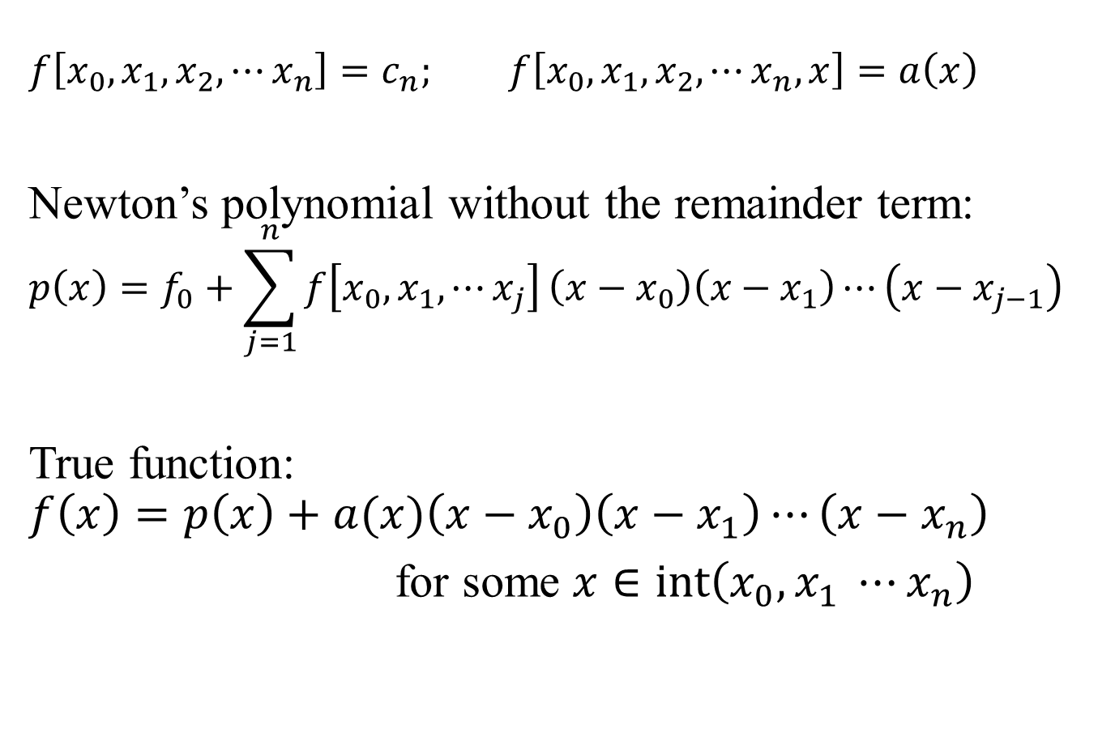
Newton’s Divided Difference
$$f\left[x_{0},x_{1},x_{2},⋯x_{n}\right]=c_{n}; f\left[x_{0},x_{1},x_{2},⋯x_{n},x\right]=a\left(x\right)$$
Newton’s polynomial without the remainder term:
$$p\left(x\right)=f_{0}+\sum_{j=1}^{n}{f\left[x_{0},x_{1}, ⋯x_{j}\right]}\left(x−x_{0}\right)\left(x−x_{1}\right)⋯\left(x−x_{j−1}\right)$$
True function:
$$f\left(x\right)=p\left(x\right)+a(x)\left(x−x_{0}\right)\left(x−x_{1}\right)⋯\left(x−x_{n}\right)$$
for some $x∈\operatorname{int}\left(x_{0}, x_{1} ⋯x_{n}\right)$

Slide 19
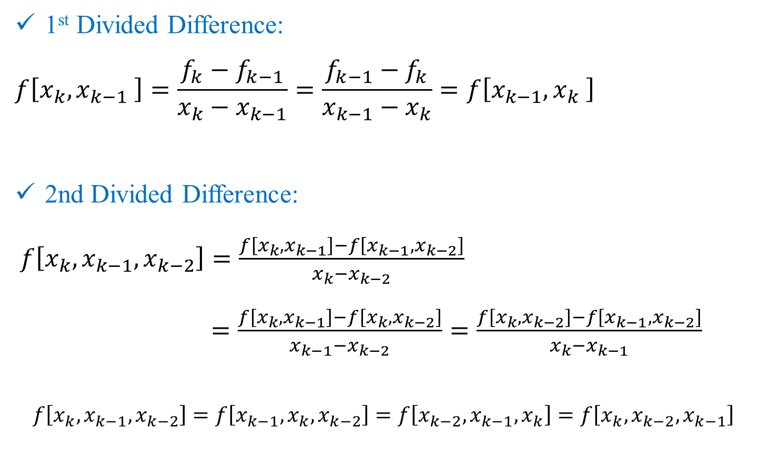
Recall: Properties of Divided Differences
1st Divided Difference:
$$f\left[x_{k},x_{k−1} \right]=\frac{f_{k}−f_{k−1}}{x_{k}−x_{k−1}}=\frac{f_{k−1}−f_{k}}{x_{k−1}−x_{k}}=f\left[x_{k−1},x_{k} \right]$$
2nd Divided Difference:
$f\left[x_{k},x_{k−1},x_{k−2}\right]=\frac{f\left[x_{k},x_{k−1}\right]−f\left[x_{k−1},x_{k−2}\right]}{x_{k}−x_{k−2}}$
$=\frac{f\left[x_{k},x_{k−1}\right]−f\left[x_{k},x_{k−2}\right]}{x_{k−1}−x_{k−2}}=\frac{f\left[x_{k},x_{k−2}\right]−f\left[x_{k−1},x_{k−2}\right]}{x_{k}−x_{k−1}}$
$$f\left[x_{k},x_{k−1},x_{k−2}\right]=f\left[x_{k−1},x_{k},x_{k−2}\right]=f\left[x_{k−2},x_{k−1},x_{k}\right]=f\left[x_{k},x_{k−2},x_{k−1}\right]$$

Slide 20
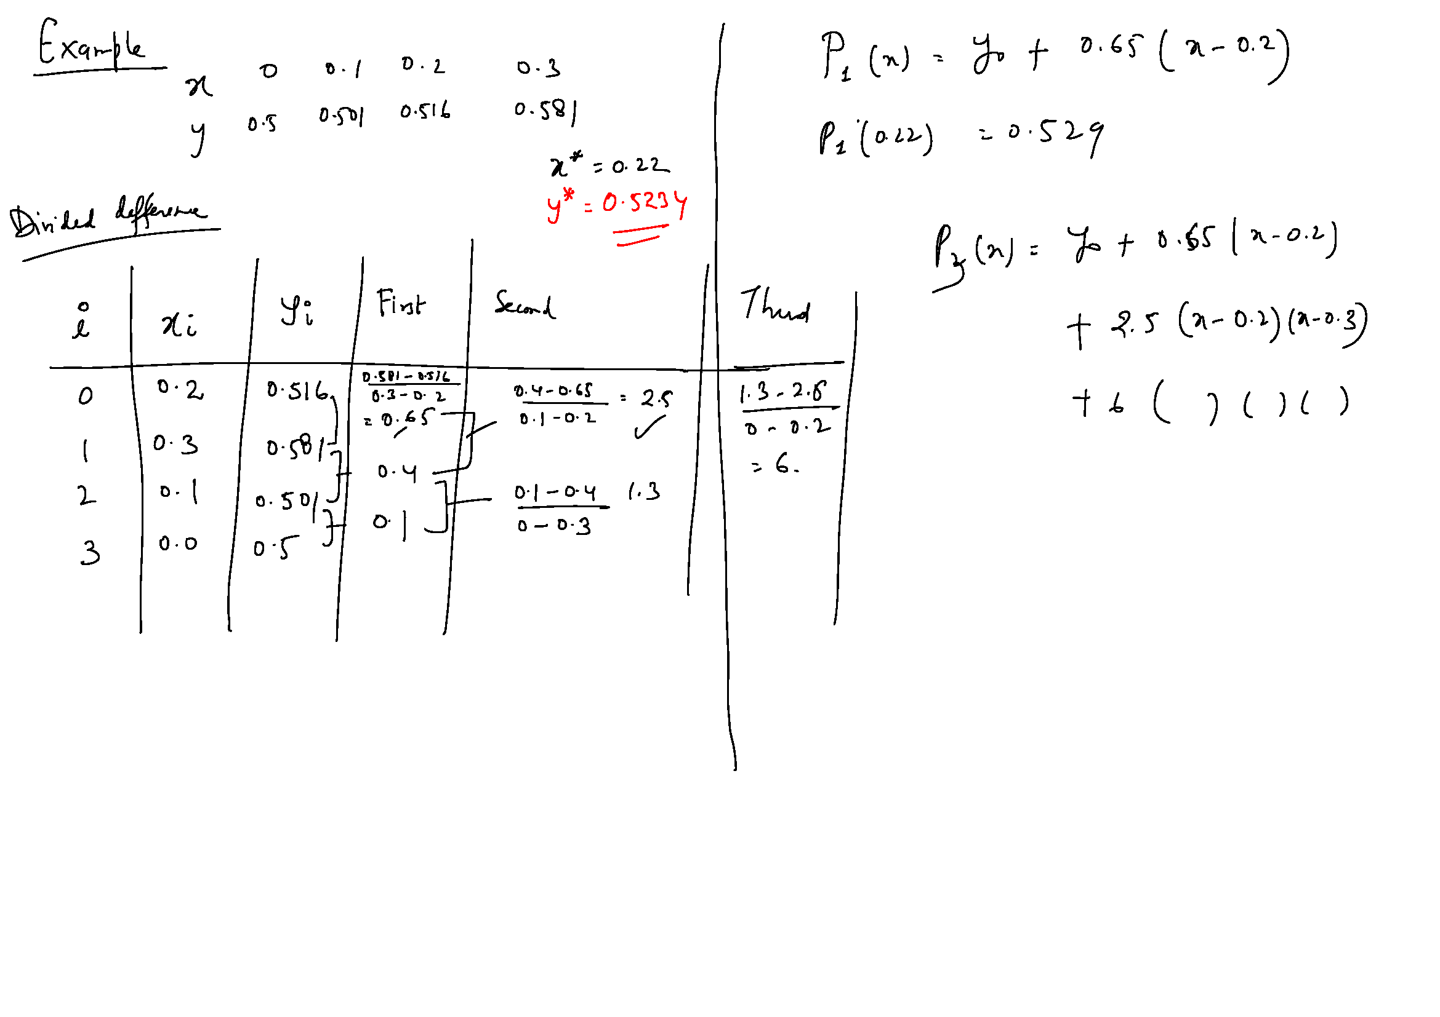

Slide 21
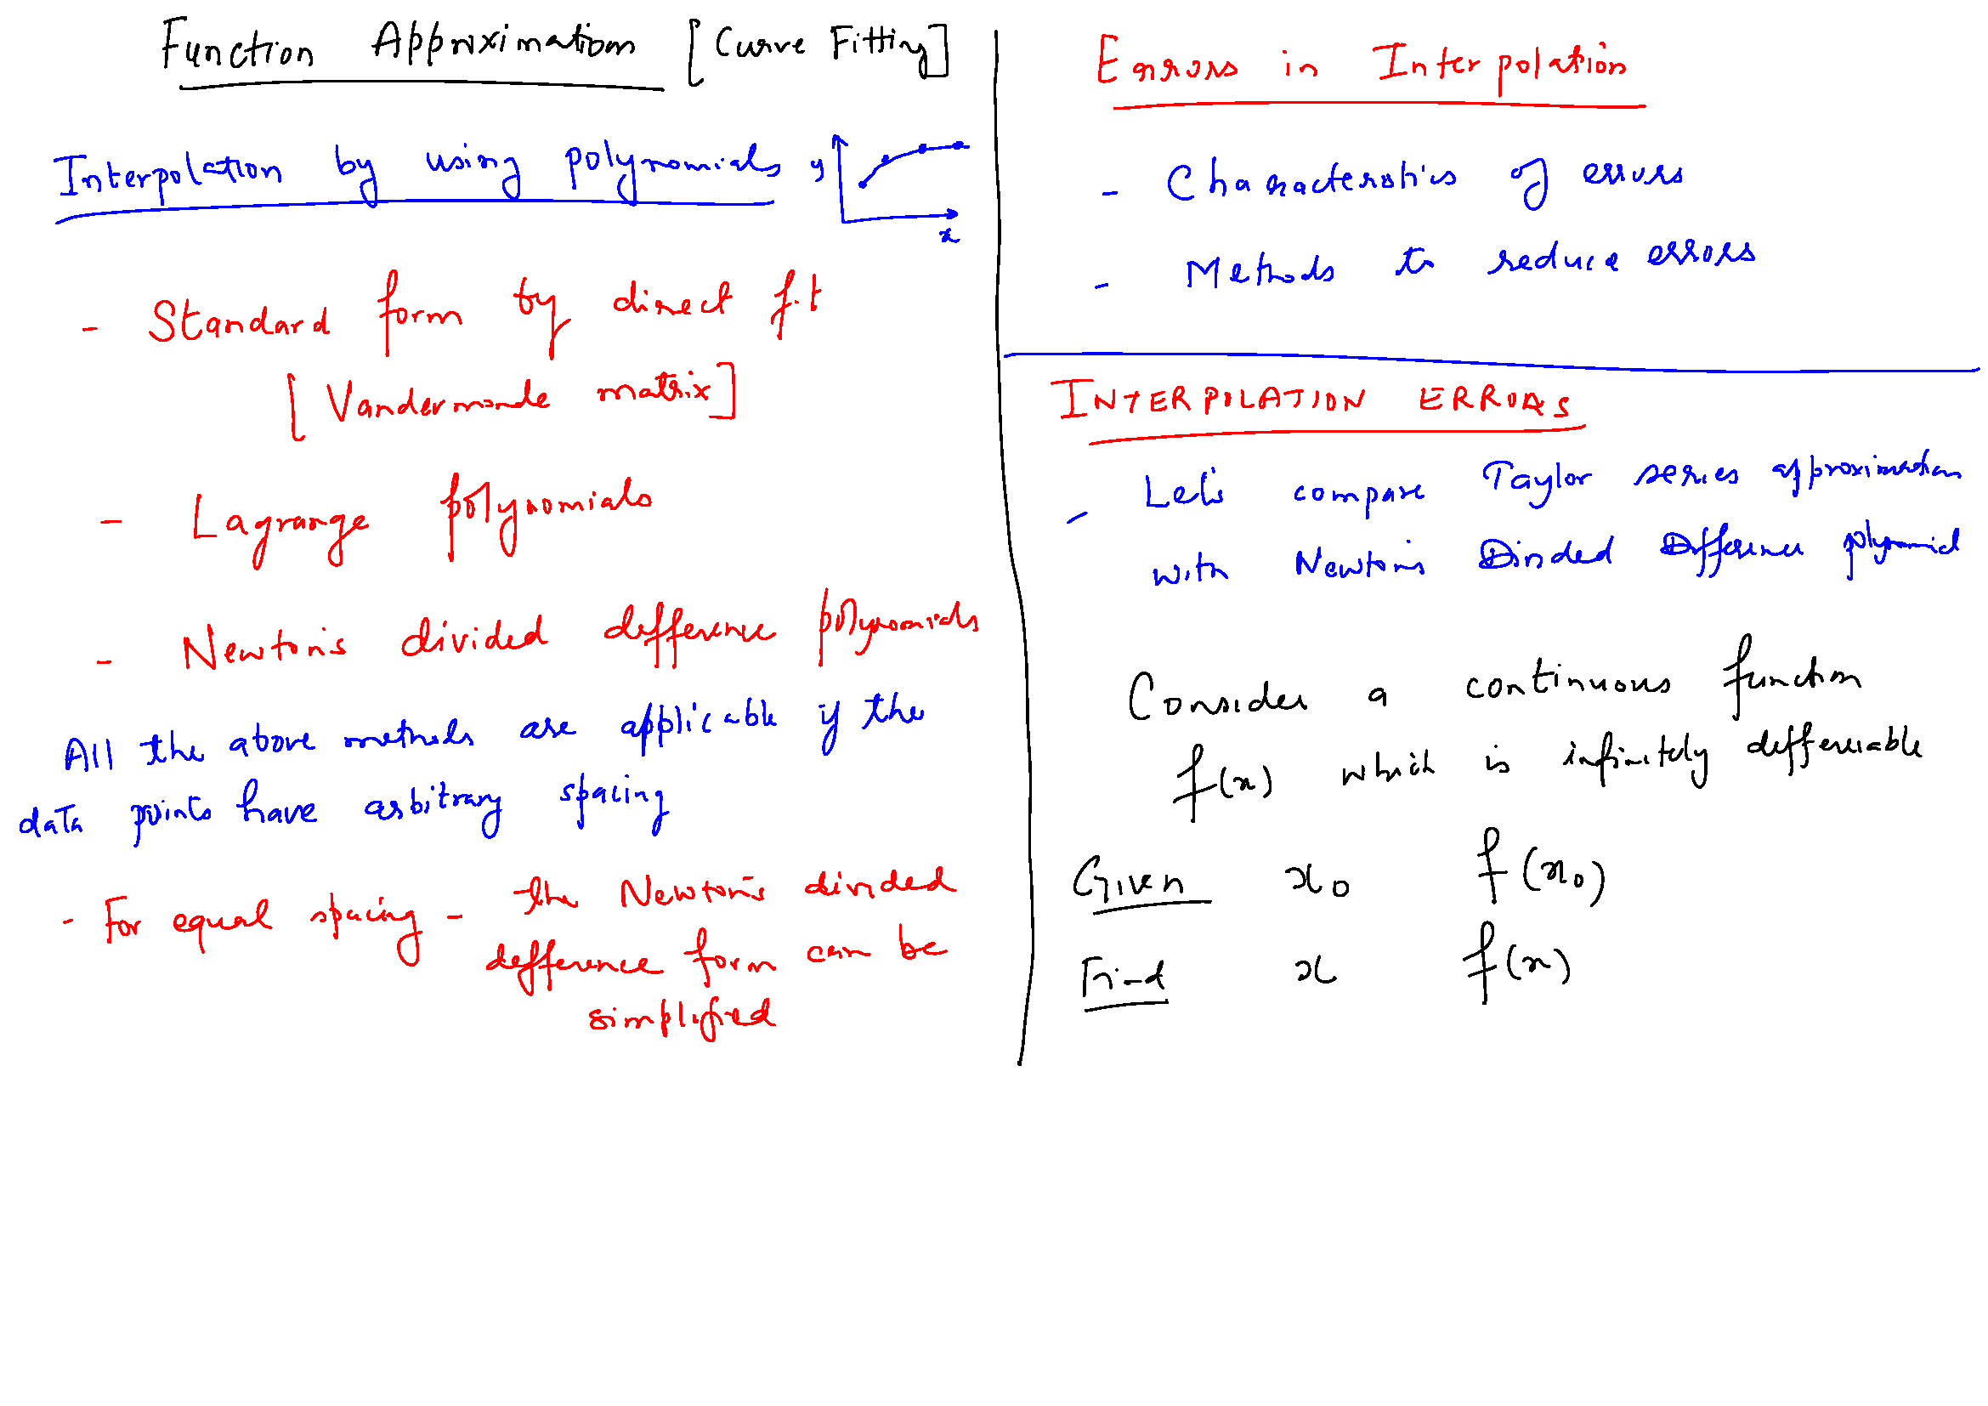

Slide 22
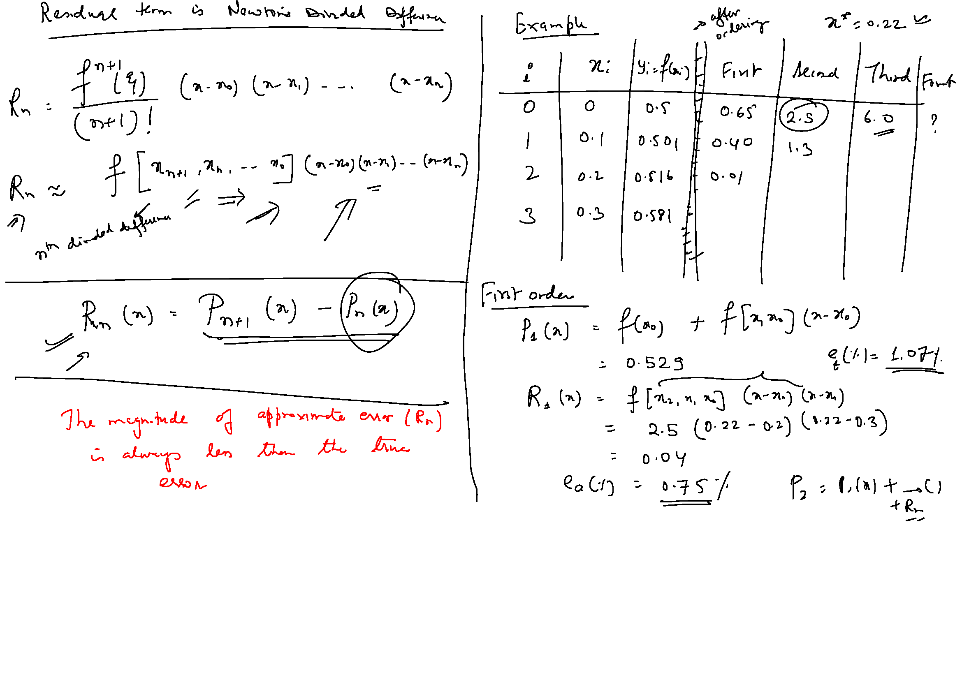

Slide 23
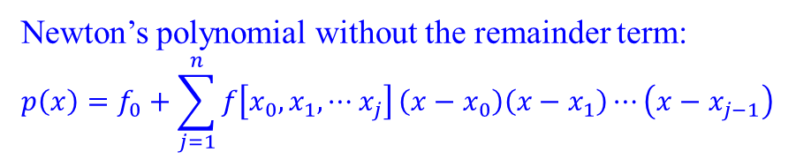
Newton’s polynomial without the remainder term:
$$p\left(x\right)=f_{0}+\sum_{j=1}^{n}{f\left[x_{0},x_{1}, ⋯x_{j}\right]}\left(x−x_{0}\right)\left(x−x_{1}\right)⋯\left(x−x_{j−1}\right)$$
$Remainder term= a(x)\left(x−x_{0}\right)\left(x−x_{1}\right)⋯\left(x−x_{n}\right)$; $a\left(x\right)=f\left[x_{0},x_{1},x_{2},⋯x_{n},x\right]$
for some $x∈\operatorname{int}\left(x_{0}, x_{1} ⋯x_{n}\right)$

Slide 24
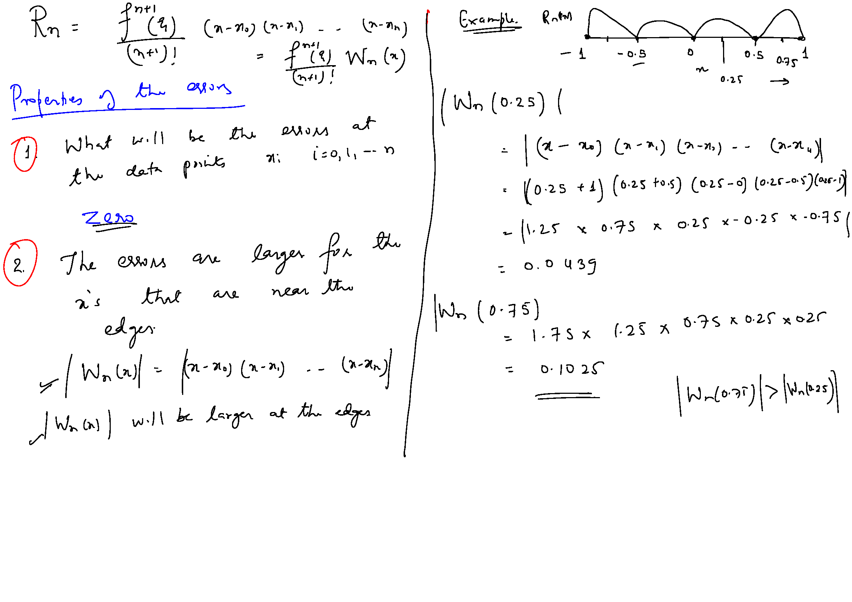

Slide 26
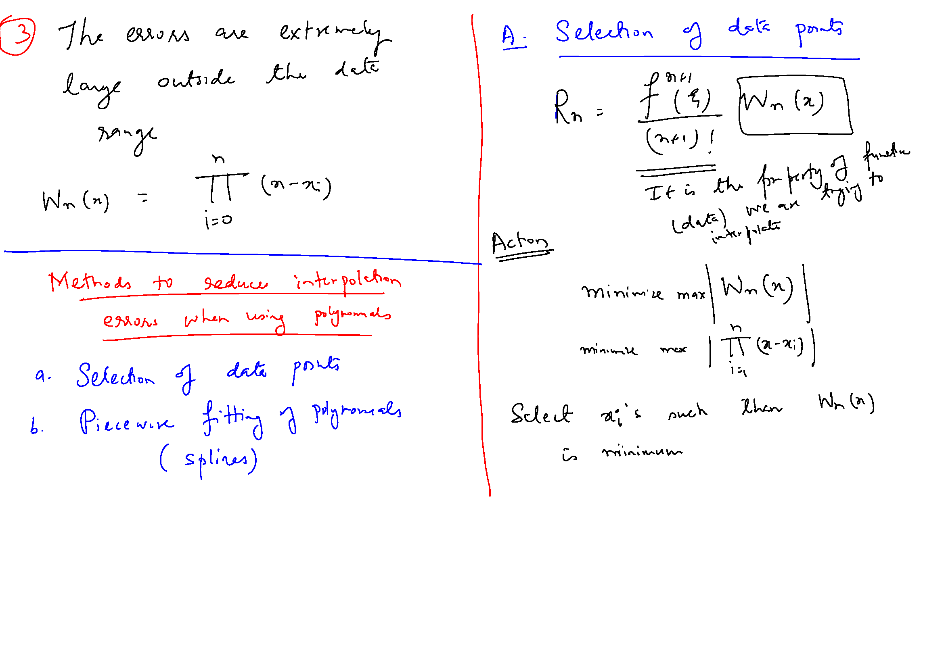

Slide 27
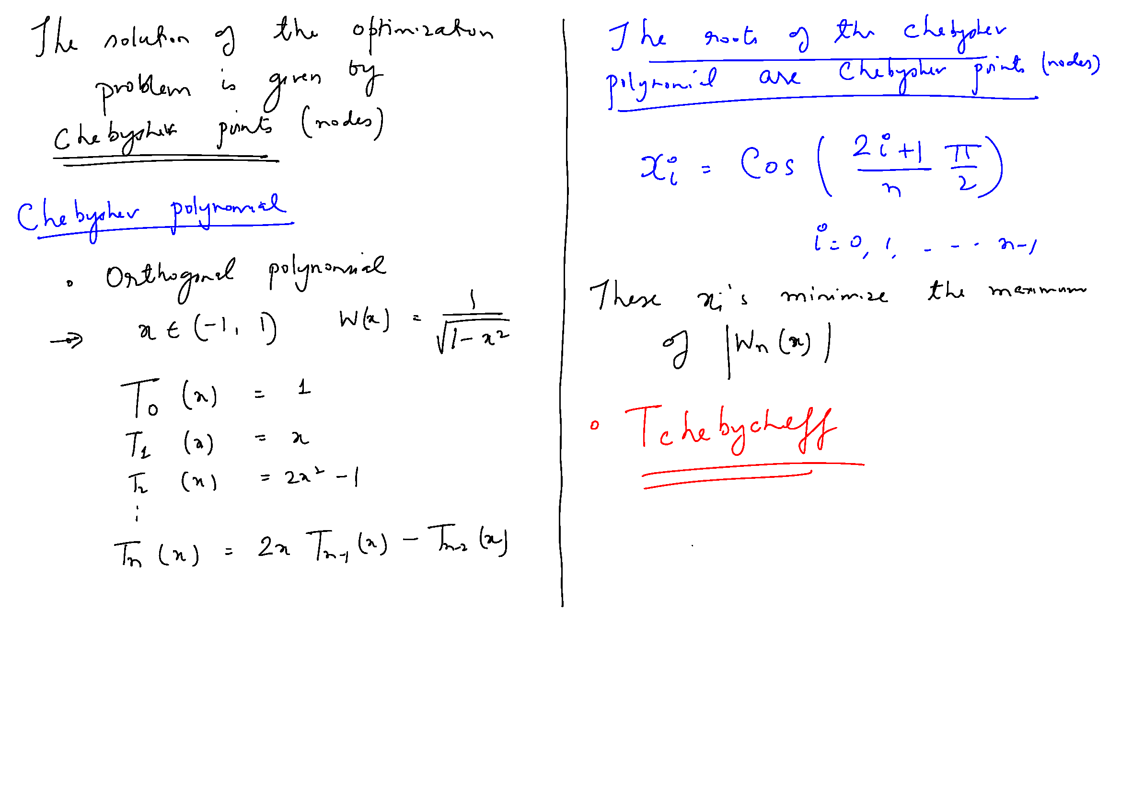

Slide 28
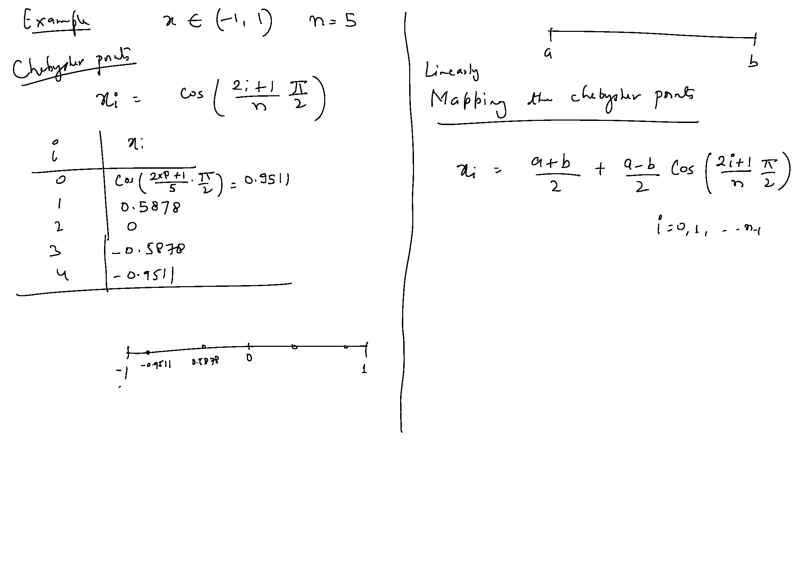

Slide 29
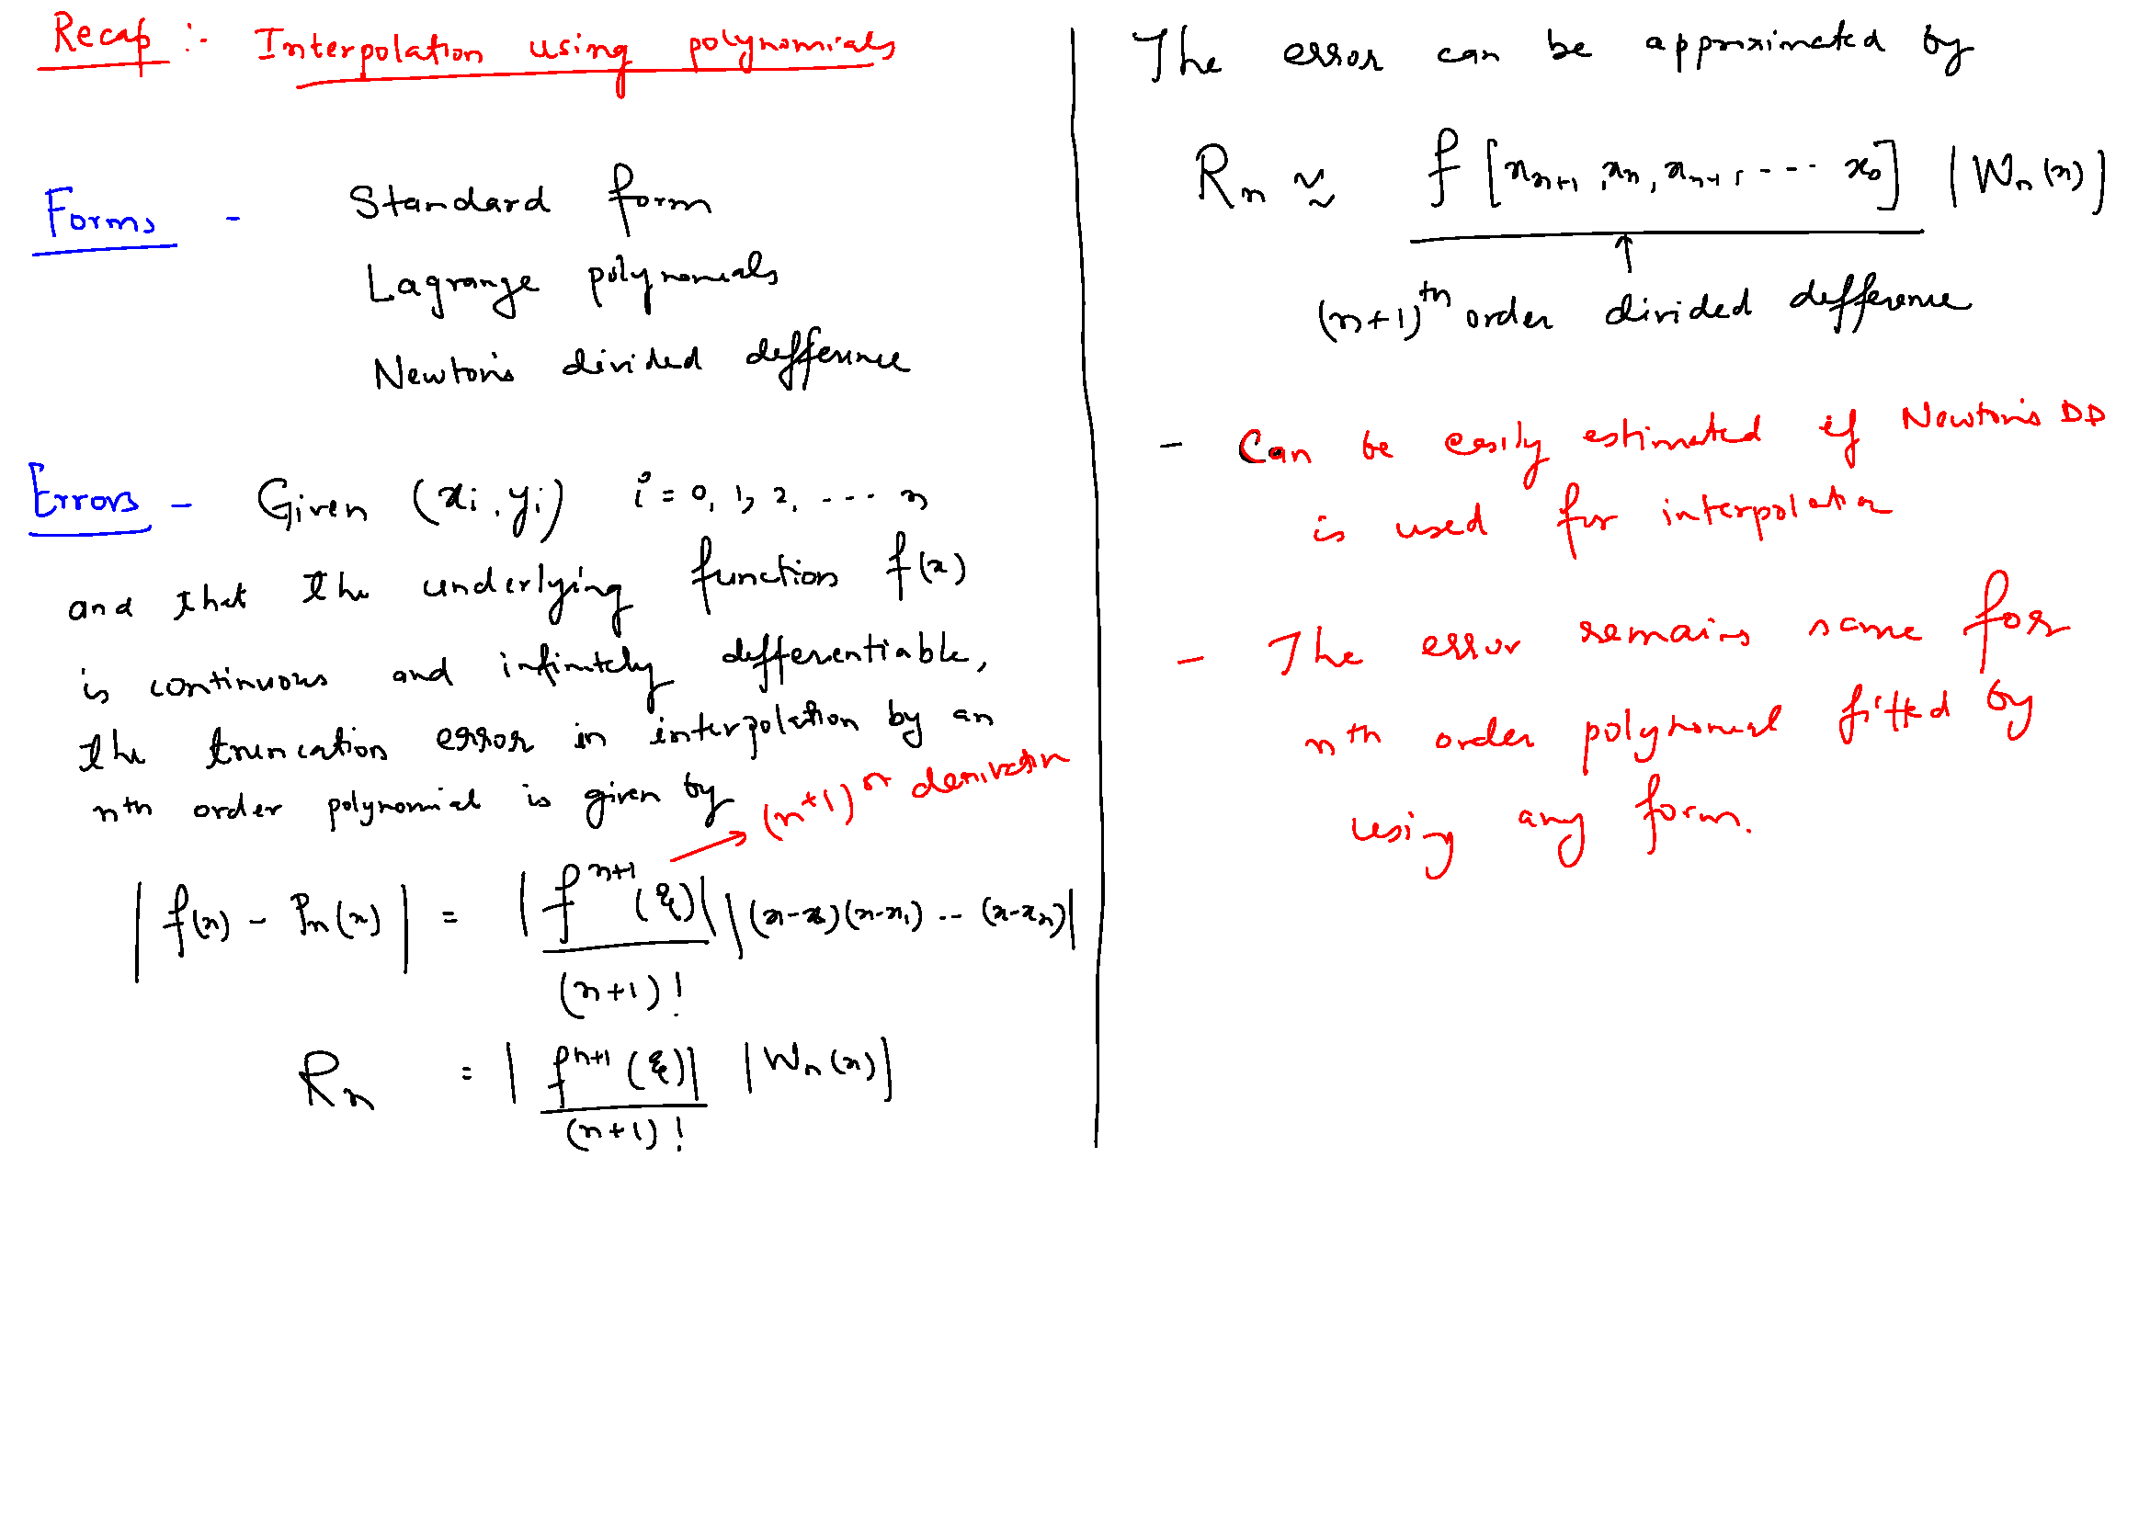

Slide 30
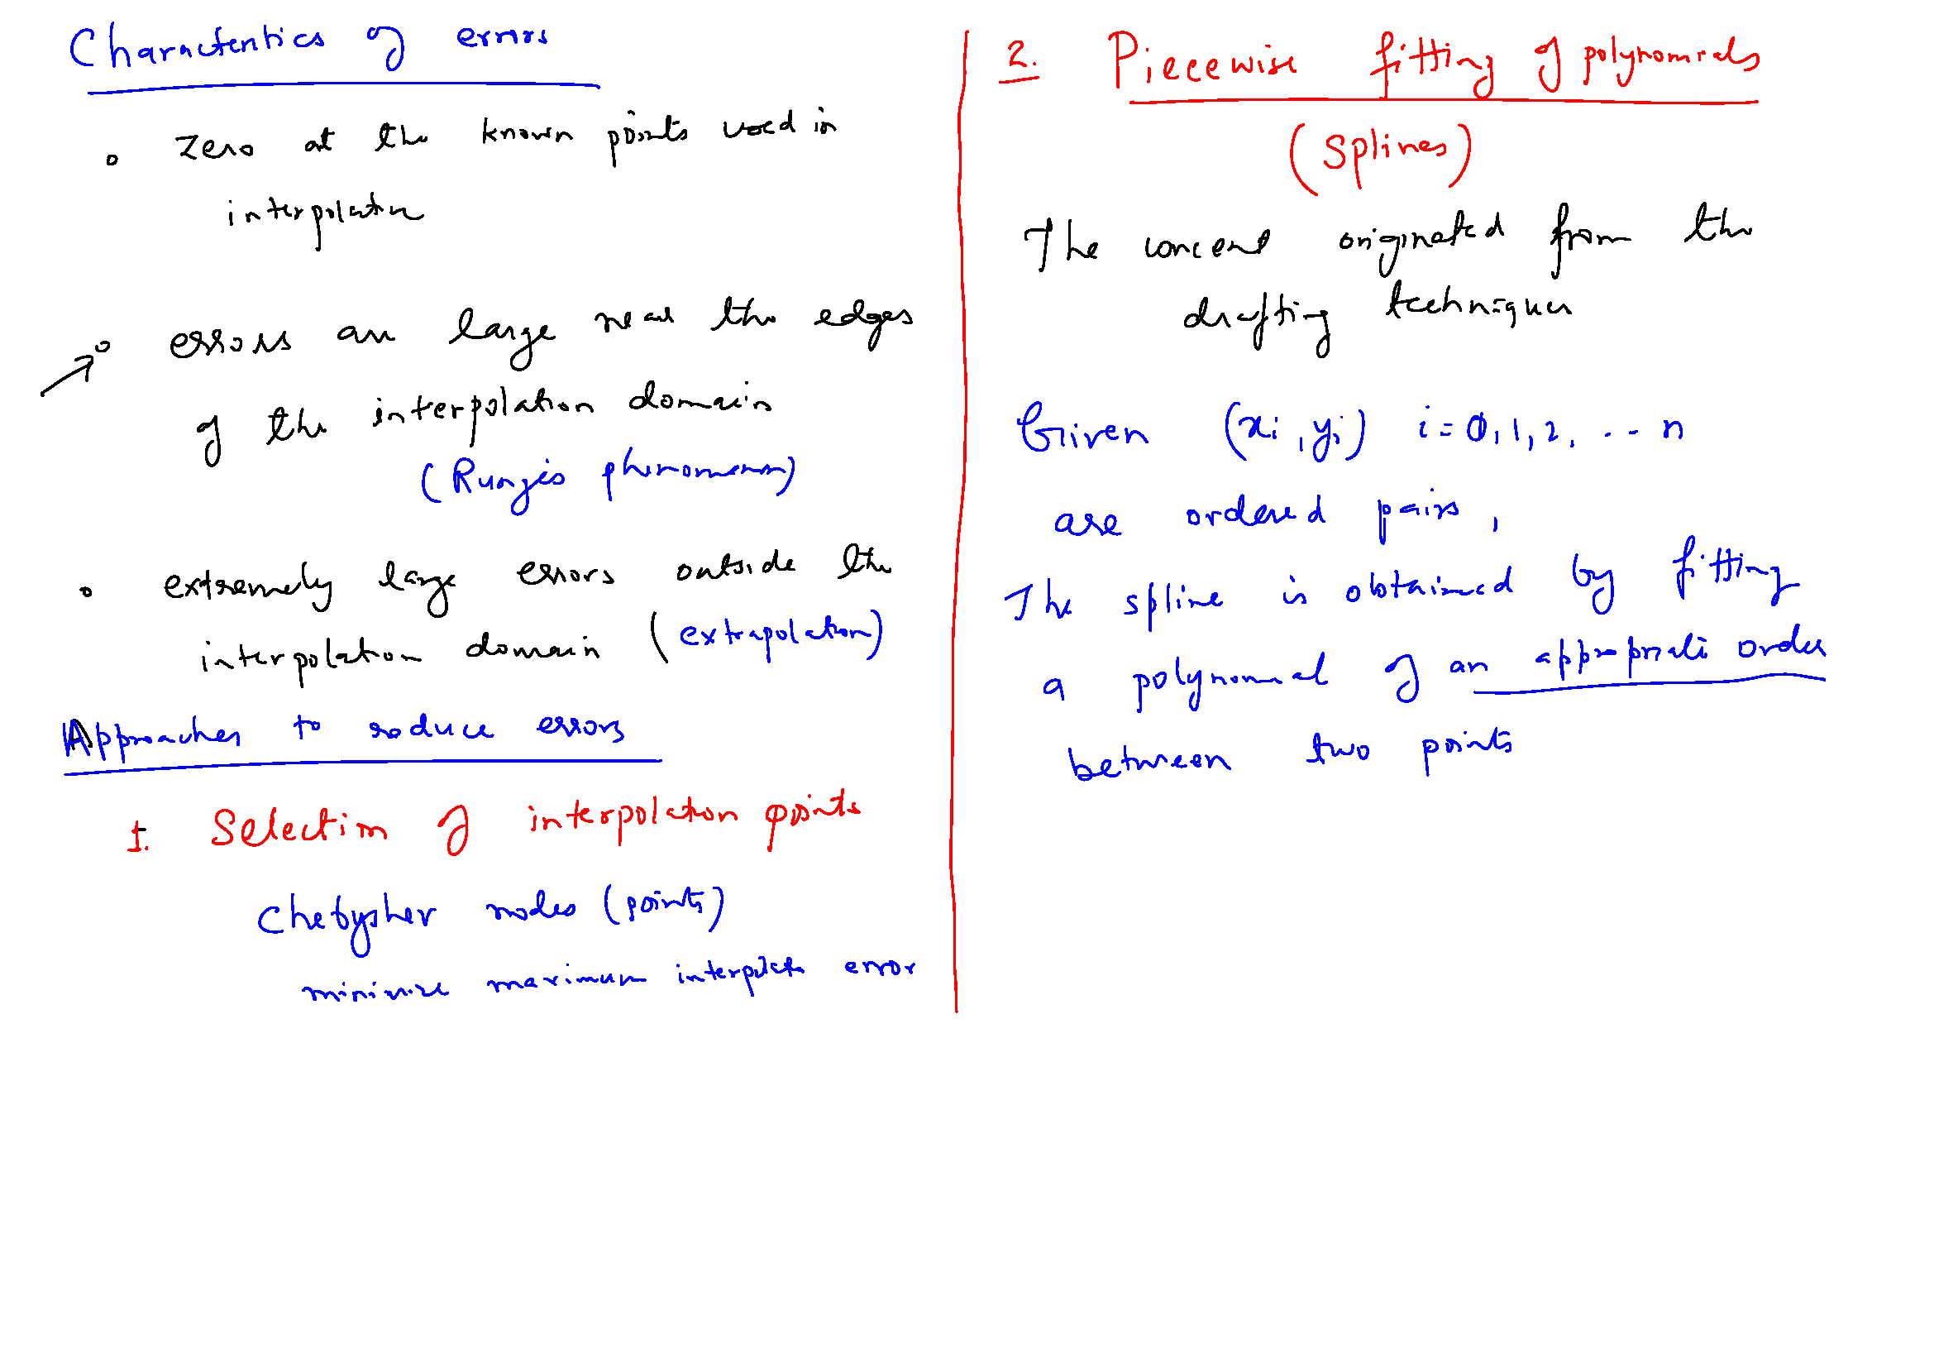

Slide 31
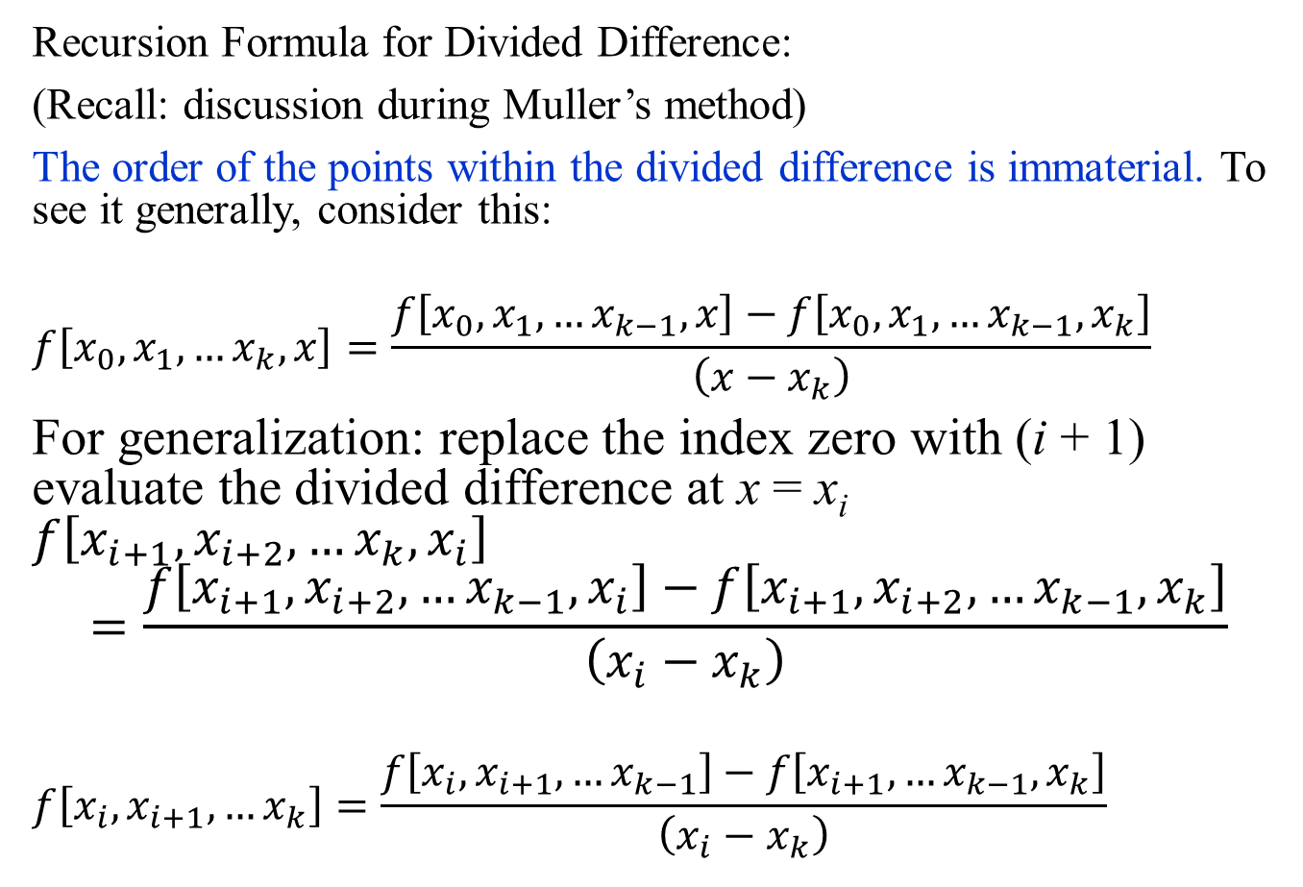
Newton’s Divided Difference (recap)
Recursion Formula for Divided Difference:
(Recall: discussion during Muller’s method)
The order of the points within the divided difference is immaterial. To see it generally, consider this:
$$f\left[x_{0},x_{1},…x_{k},x\right]=\frac{f\left[x_{0},x_{1},…x_{k−1},x\right]−f\left[x_{0},x_{1},…x_{k−1},x_{k}\right]}{\left(x−x_{k}\right)}$$
For generalization: replace the index zero with (i + 1) evaluate the divided difference at x = x_{i} $f\left[x_{i+1},x_{i+2},…x_{k},x_{i}\right]$
$$=\frac{f\left[x_{i+1},x_{i+2},…x_{k−1},x_{i}\right]−f\left[x_{i+1},x_{i+2},…x_{k−1},x_{k}\right]}{\left(x_{i}−x_{k}\right)}$$
$$f\left[x_{i},x_{i+1}, …x_{k}\right]=\frac{f\left[x_{i},x_{i+1}, …x_{k−1}\right]−f\left[x_{i+1},…x_{k−1},x_{k}\right]}{\left(x_{i}−x_{k}\right)}$$

Slide 32
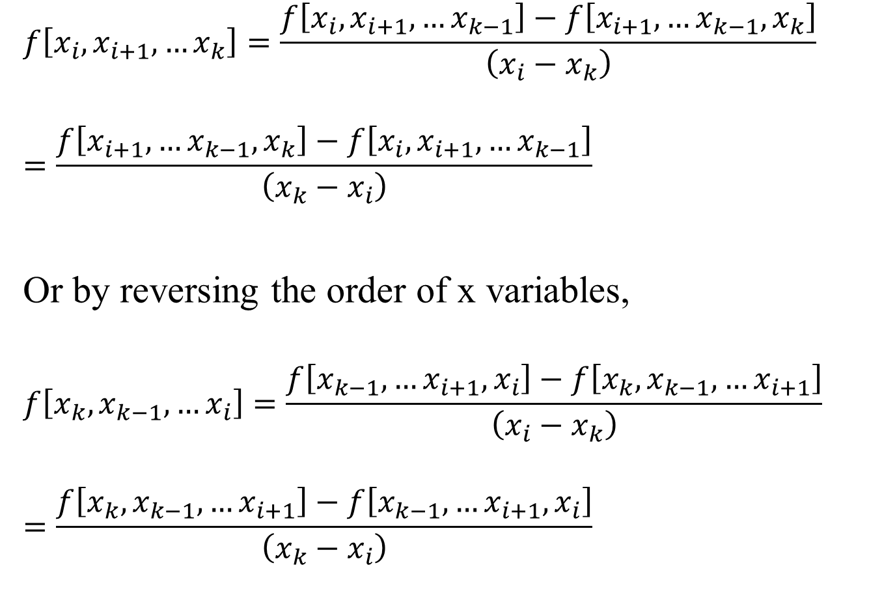
Newton’s Divided Difference (recap)
$$f\left[x_{i},x_{i+1}, …x_{k}\right]=\frac{f\left[x_{i},x_{i+1}, …x_{k−1}\right]−f\left[x_{i+1},…x_{k−1},x_{k}\right]}{\left(x_{i}−x_{k}\right)}$$
$$=\frac{f\left[x_{i+1},…x_{k−1},x_{k}\right]−f\left[x_{i},x_{i+1}, …x_{k−1}\right]}{\left({x_{k}−x}_{i}\right)}$$
Or by reversing the order of x variables,
$$f\left[x_{k},x_{k−1}, …x_{i}\right]=\frac{f\left[x_{k−1},…x_{i+1},x_{i}\right]−f\left[x_{k},x_{k−1}, …x_{i+1}\right]}{\left(x_{i}−x_{k}\right)}$$
$$=\frac{f\left[x_{k},x_{k−1}, …x_{i+1}\right]−f\left[x_{k−1},…x_{i+1},x_{i}\right]}{\left({x_{k}−x}_{i}\right)}$$

Slide 33
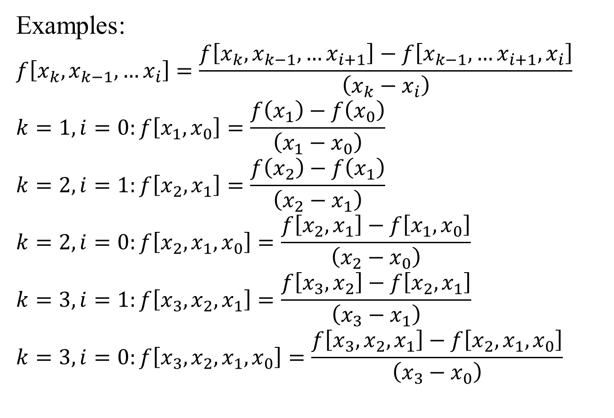
Newton’s Divided Difference (recap)
Examples:
$$f\left[x_{k},x_{k−1}, …x_{i}\right]=\frac{f\left[x_{k},x_{k−1}, …x_{i+1}\right]−f\left[x_{k−1},…x_{i+1},x_{i}\right]}{\left({x_{k}−x}_{i}\right)}$$
$$k=1, i=0:f\left[x_{1},x_{0}\right]=\frac{f\left(x_{1}\right)−f\left(x_{0}\right)}{\left({x_{1}−x}_{0}\right)}$$
$$k=2, i=1:f\left[x_{2},x_{1}\right]=\frac{f\left(x_{2}\right)−f\left(x_{1}\right)}{\left({x_{2}−x}_{1}\right)}$$
$$k=2, i=0:f\left[x_{2},x_{1},x_{0}\right]=\frac{f\left[x_{2},x_{1}\right]−f\left[x_{1},x_{0}\right]}{\left({x_{2}−x}_{0}\right)}$$
$$k=3, i=1:f\left[x_{3},x_{2},x_{1}\right]=\frac{f\left[x_{3},x_{2}\right]−f\left[x_{2},x_{1}\right]}{\left({x_{3}−x}_{1}\right)}$$
$$k=3, i=0:f\left[x_{3},x_{2},x_{1},x_{0}\right]=\frac{f\left[x_{3},x_{2},x_{1}\right]−f\left[x_{2},x_{1},x_{0}\right]}{\left({x_{3}−x}_{0}\right)}$$

Slide 34
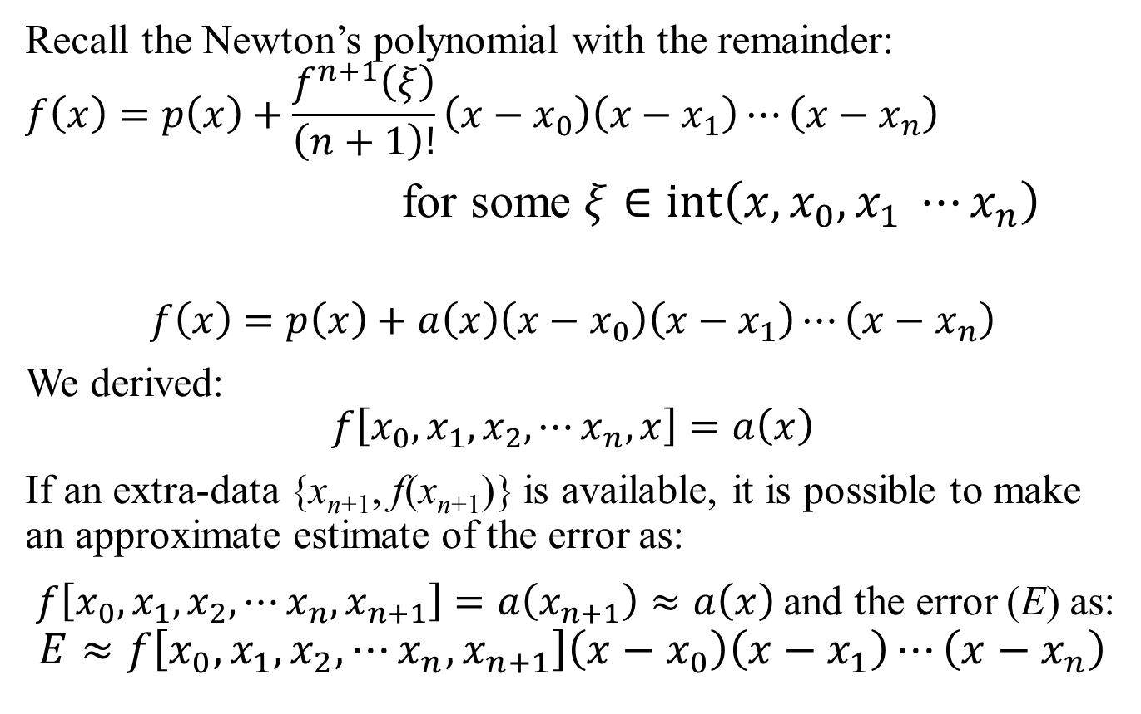
Newton’s Divided Difference: Error Estimate
Recall the Newton’s polynomial with the remainder:
$$f\left(x\right)=p\left(x\right)+\frac{f^{n+1}\left(ξ\right)}{\left(n+1\right)!}\left(x−x_{0}\right)\left(x−x_{1}\right)⋯\left(x−x_{n}\right)$$
for some $ξ∈\operatorname{int}\left(x, x_{0}, x_{1} ⋯x_{n}\right)$
$$f\left(x\right)=p\left(x\right)+a\left(x\right)\left(x−x_{0}\right)\left(x−x_{1}\right)⋯\left(x−x_{n}\right)$$
We derived:
$$f\left[x_{0},x_{1},x_{2},⋯x_{n},x\right]=a\left(x\right)$$
If an extra-data {x_{n+1}, f(x_{n+1})} is available, it is possible to make an approximate estimate of the error as:
$f\left[x_{0},x_{1},x_{2},⋯x_{n},x_{n+1}\right]=a\left(x_{n+1}\right)≈a\left(x\right)$ and the error (E) as:
$$E≈f\left[x_{0},x_{1},x_{2},⋯x_{n},x_{n+1}\right]\left(x−x_{0}\right)\left(x−x_{1}\right)⋯\left(x−x_{n}\right)$$

Slide 35

Newton’s Divided Difference (recap)
$$f\left[x_{0},x_{1},x_{2},⋯x_{n}\right]=c_{n}; f\left[x_{0},x_{1},x_{2},⋯x_{n},x\right]=a\left(x\right)$$
Newton’s polynomial without the remainder term:
$$p\left(x\right)=f_{0}+\sum_{j=1}^{n}{f\left[x_{0},x_{1}, ⋯x_{j}\right]}\left(x−x_{0}\right)\left(x−x_{1}\right)⋯\left(x−x_{j−1}\right)$$

Slide 36
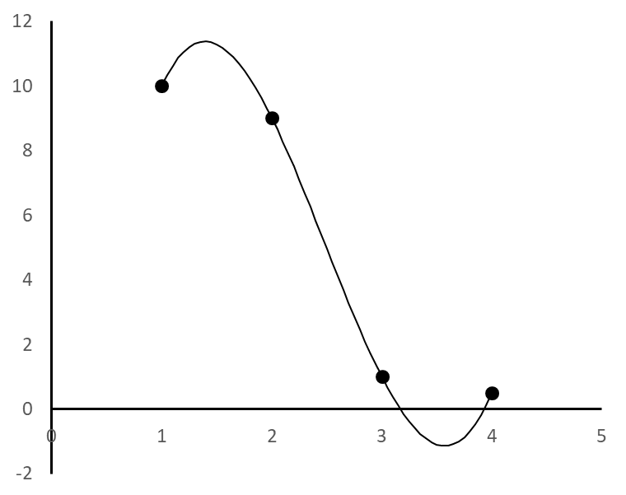
Interpolation: Example2
Fit an interpolation polynomial through the following four points: (1 , 10), (2 , 9), (3, 1), (4 , 0.5)
1 , 10
-1
-3.5
2.416667
2 , 9
-8
3.75
3, 1
-0.5
4 , 0.5
$$p\left(x\right)=10−\left(x−1\right)−3.5\left(x−1\right)\left(x−2\right)+2.41667\left(x−1\right)\left(x−2\right)\left(x−3\right)$$

Slide 37
Single Interpolation Polynomial
If a single polynomial is fitted through a given set of points, the polynomial is always the same, irrespective of the basis used.
Computation involved in obtaining the polynomial may vary depending on the basis.
Since the polynomials are same, the error in approximation may be obtained using the remainder term of the Newton’s polynomial for all cases.
So far, we have fitted one polynomial through all the n points.
For a large number of points, this may lead to oscillations between the points, especially at the end intervals for the equally spaced data.
Next we fit piecewise continuous polynomials or splines to the data!

Slide 39
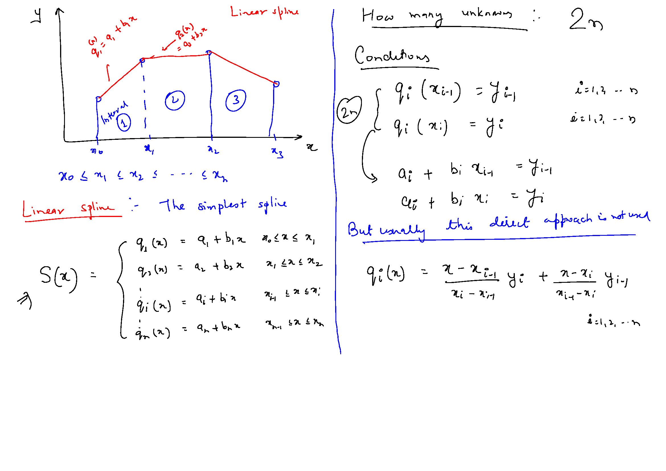

Slide 40
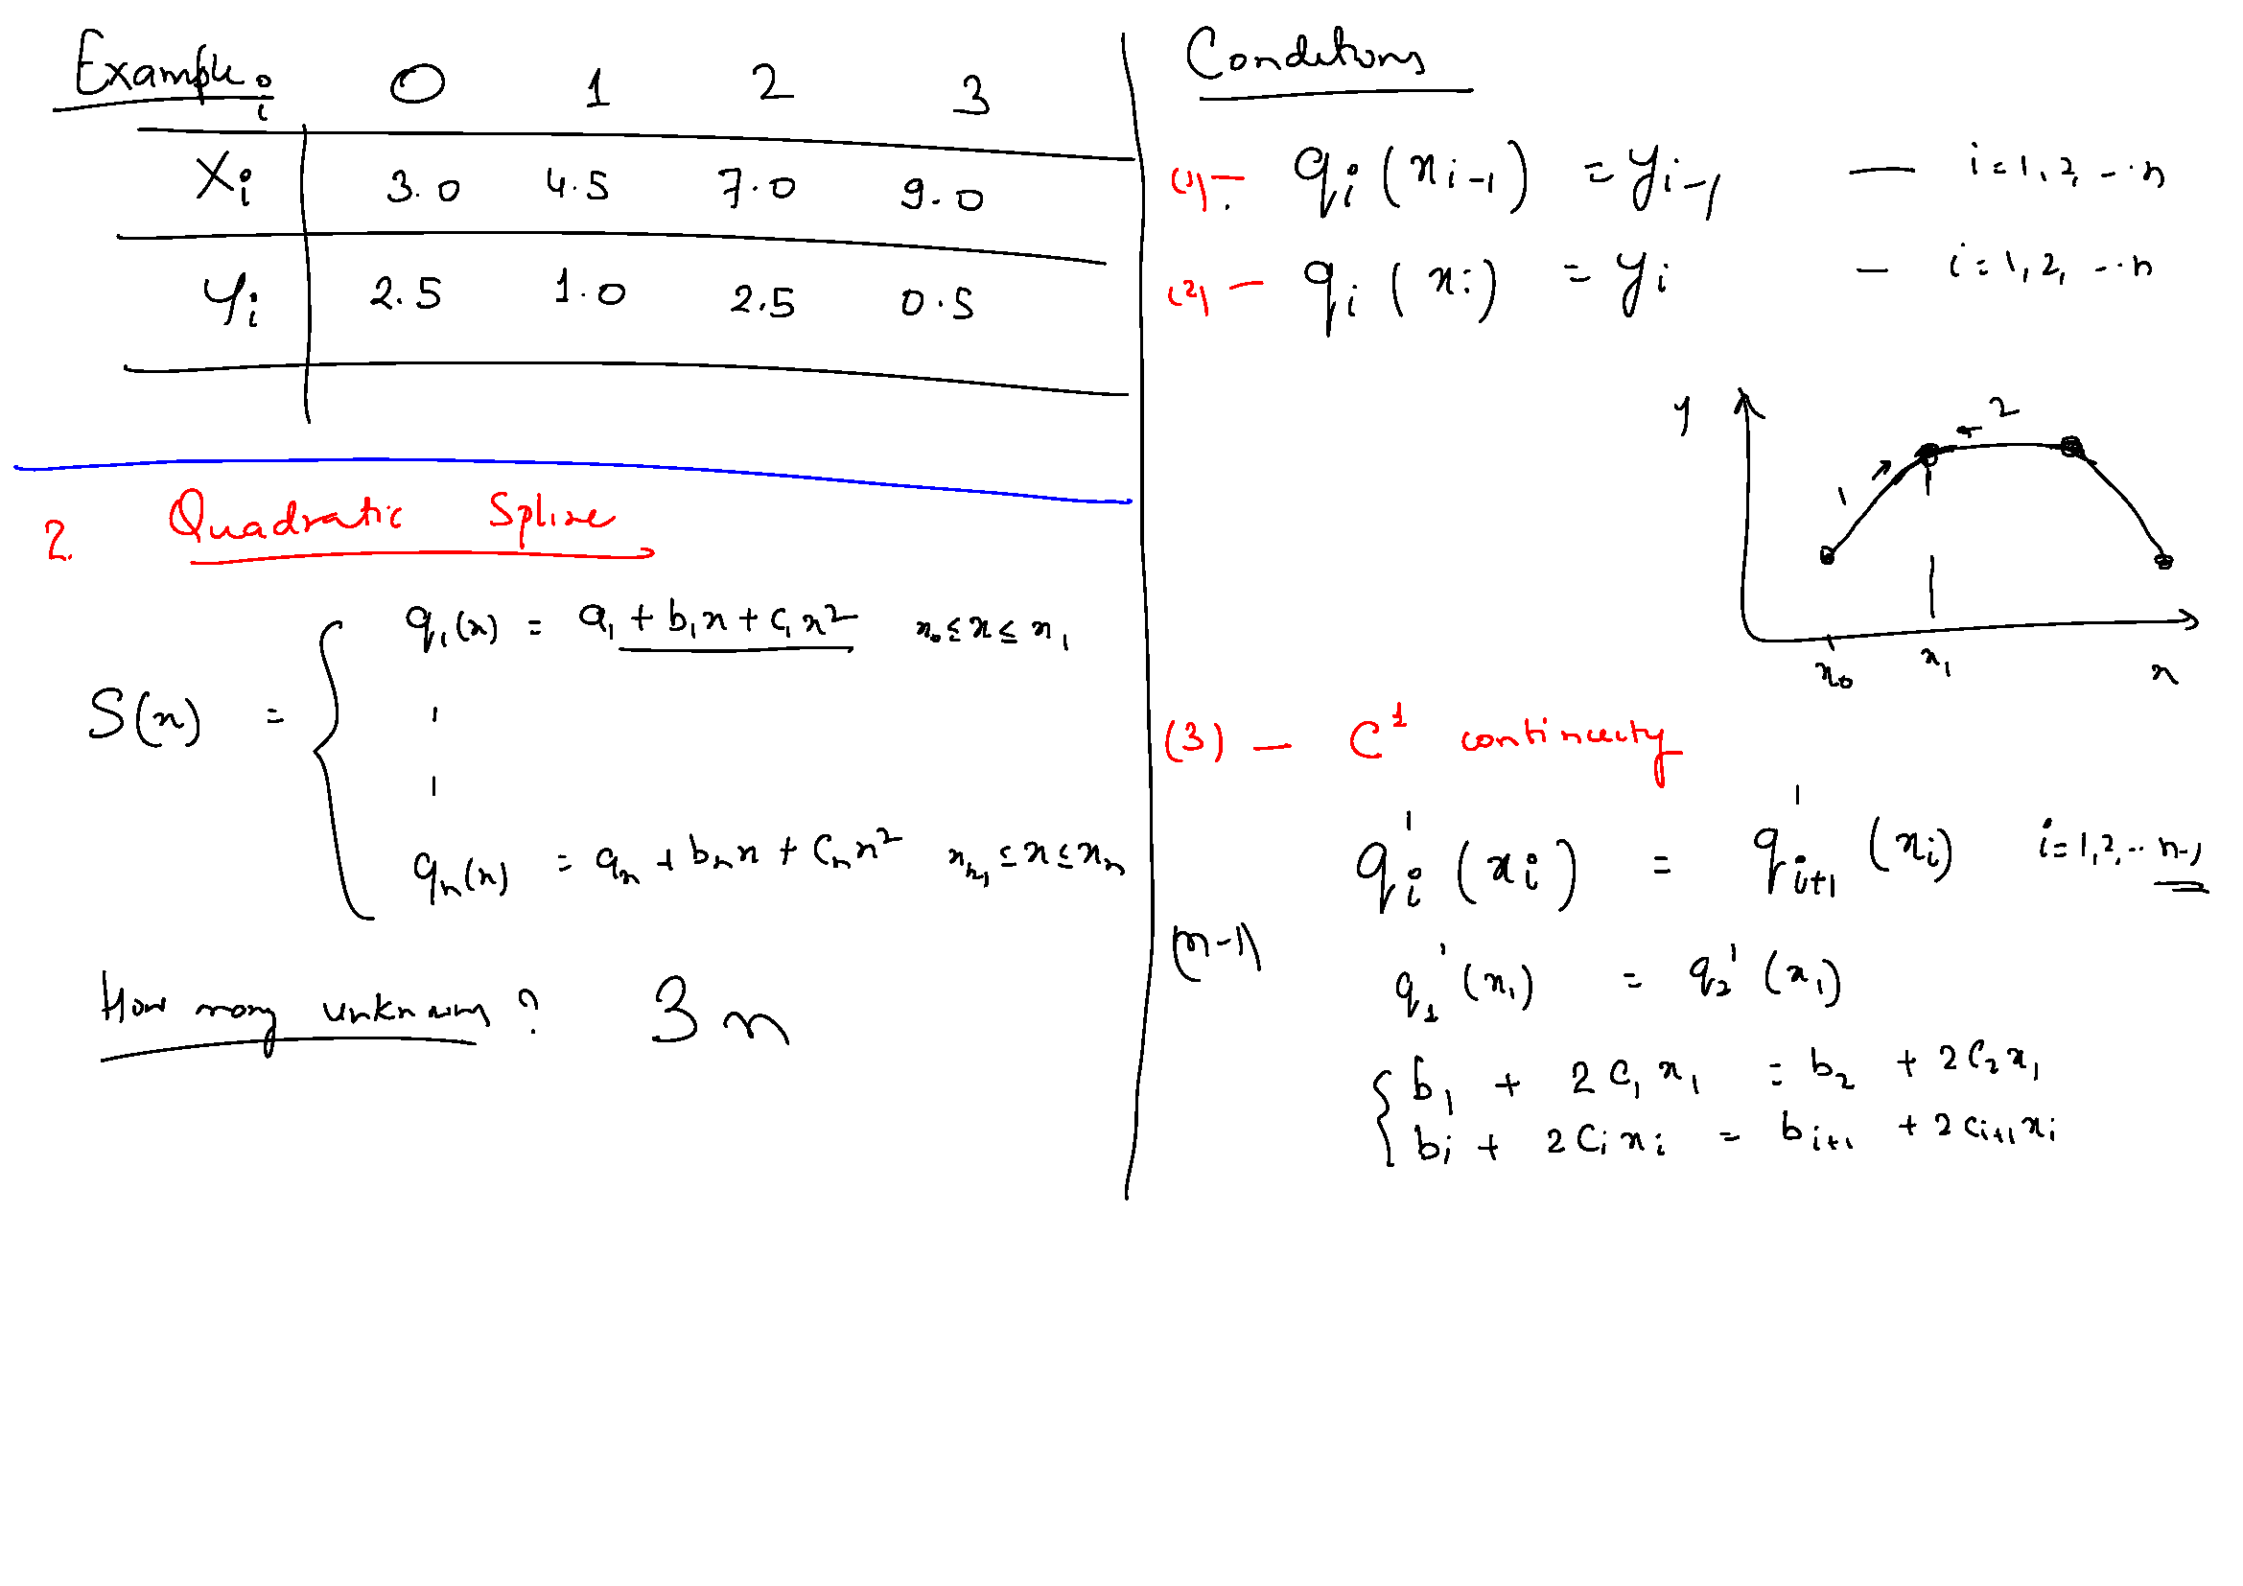

Slide 41
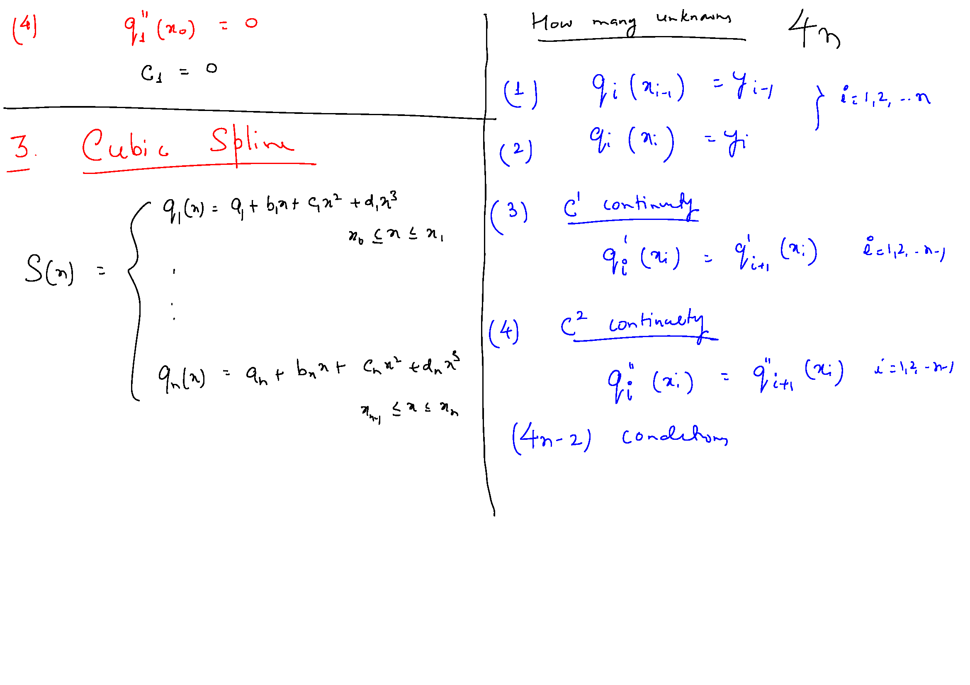

Slide 42
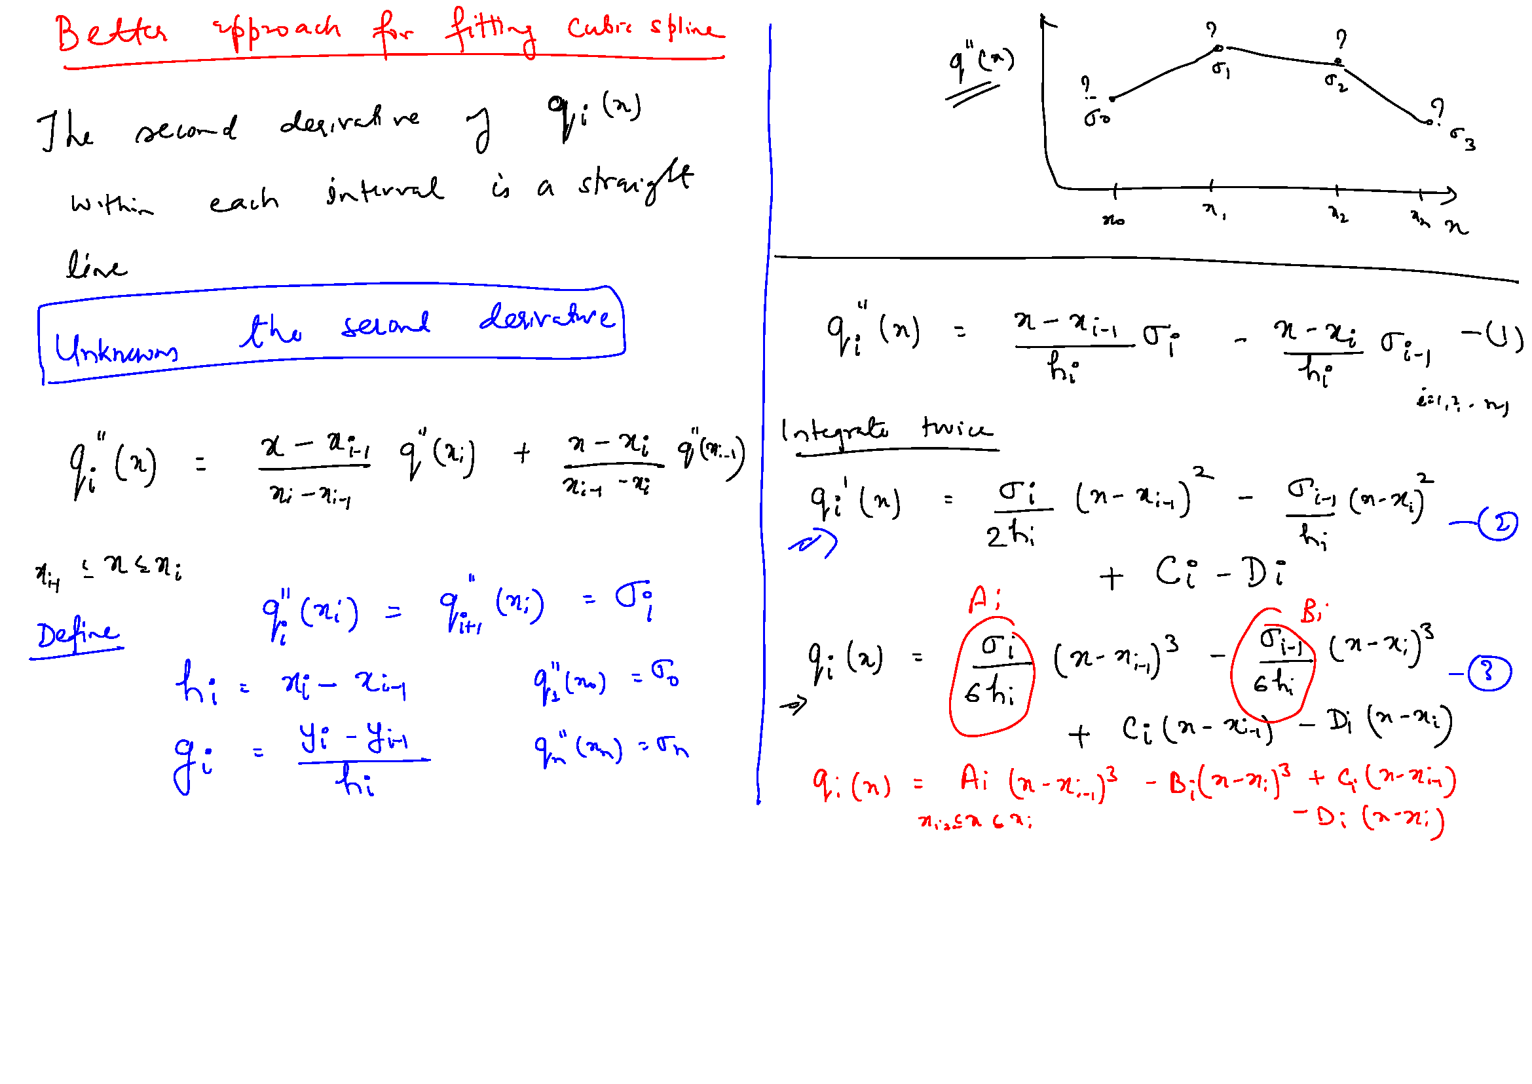

Slide 43
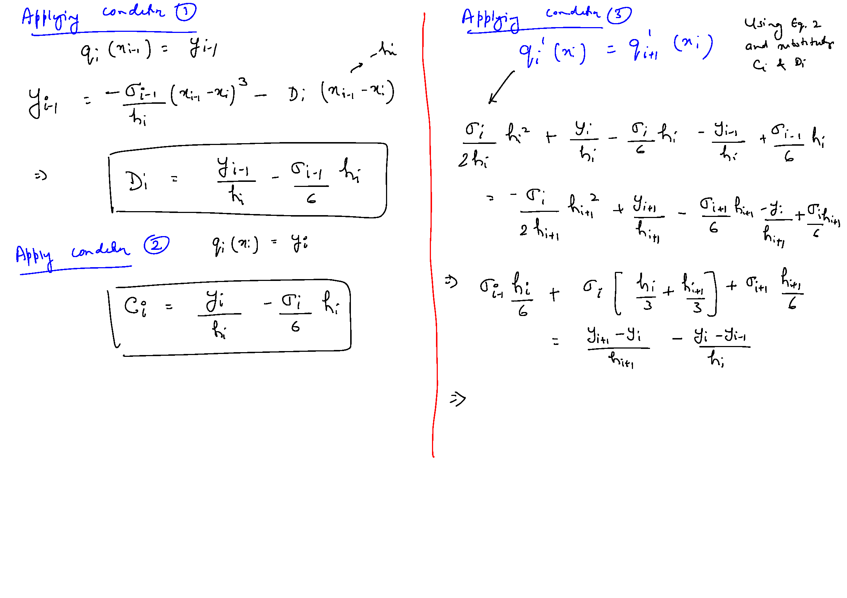

Slide 44
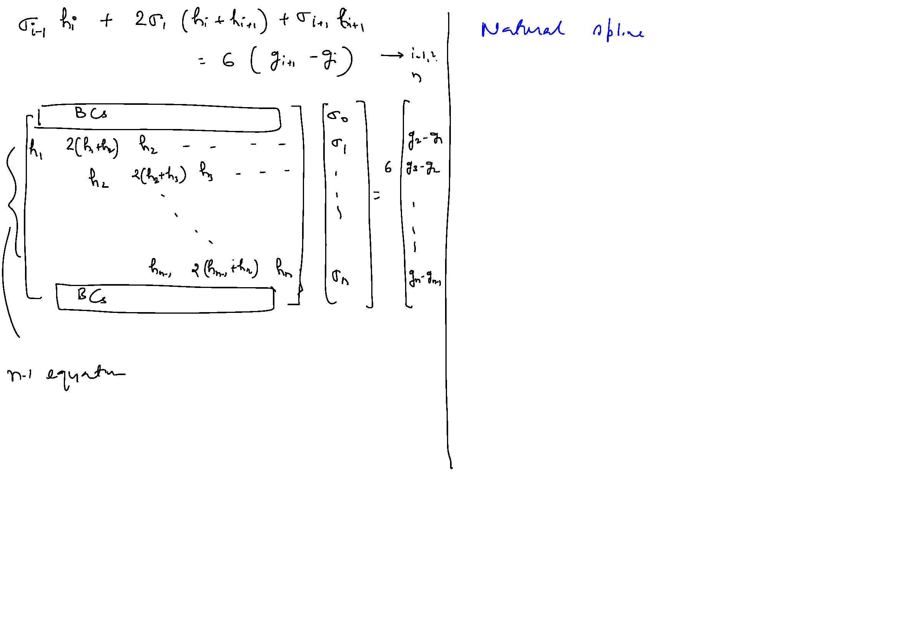

Slide 45
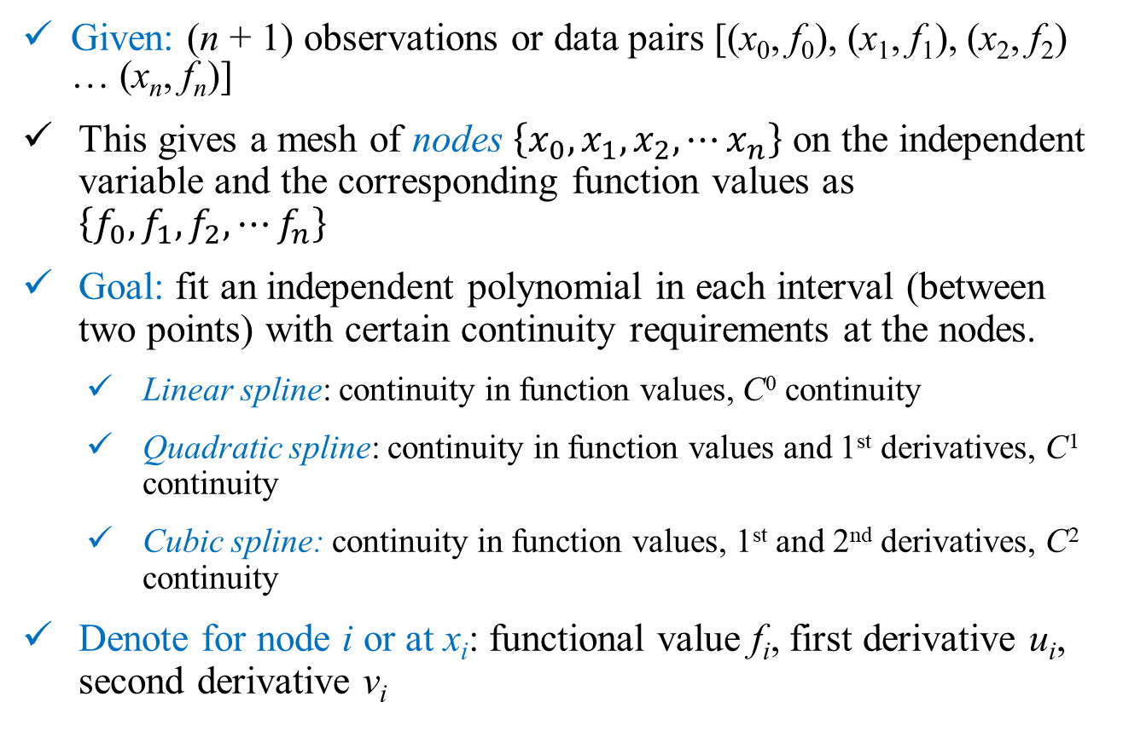
Spline Interpolation
Given: (n + 1) observations or data pairs [(x₀, f₀), (x₁, f₁), (x₂, f₂) … (x_{n}, f_{n})]
This gives a mesh of nodes $\left\{x_{0},x_{1},x_{2},⋯x_{n}\right\}$ on the independent variable and the corresponding function values as $\left\{f_{0},f_{1},f_{2},⋯f_{n}\right\}$
Goal: fit an independent polynomial in each interval (between two points) with certain continuity requirements at the nodes.
Linear spline: continuity in function values, C⁰ continuity
Quadratic spline: continuity in function values and 1st derivatives, C¹ continuity
Cubic spline: continuity in function values, 1st and 2nd derivatives, C² continuity
Denote for node i or at x_{i}: functional value f_{i}, first derivative u_{i}, second derivative v_{i}

Slide 46
Spline Interpolation: Linear
x_{i+2}, f_{i+2}
x_{i}, f_{i}
q_{i+1}(x)
q_{i}(x)
q_{i-1}(x)
x_{i+1}, f_{i+1}
q_{i}(x_{i}) = f_{i}
q_{i-1}(x_{i}) = q_{i}(x_{i})
x_{i-1}, f_{i-1}
A straight line in each interval: (n+1) points, n straight lines, 2n unknowns
Available conditions: (n+1) function values, (n-1) function continuity conditions
Straight lines can be uniquely estimated!

Slide 47
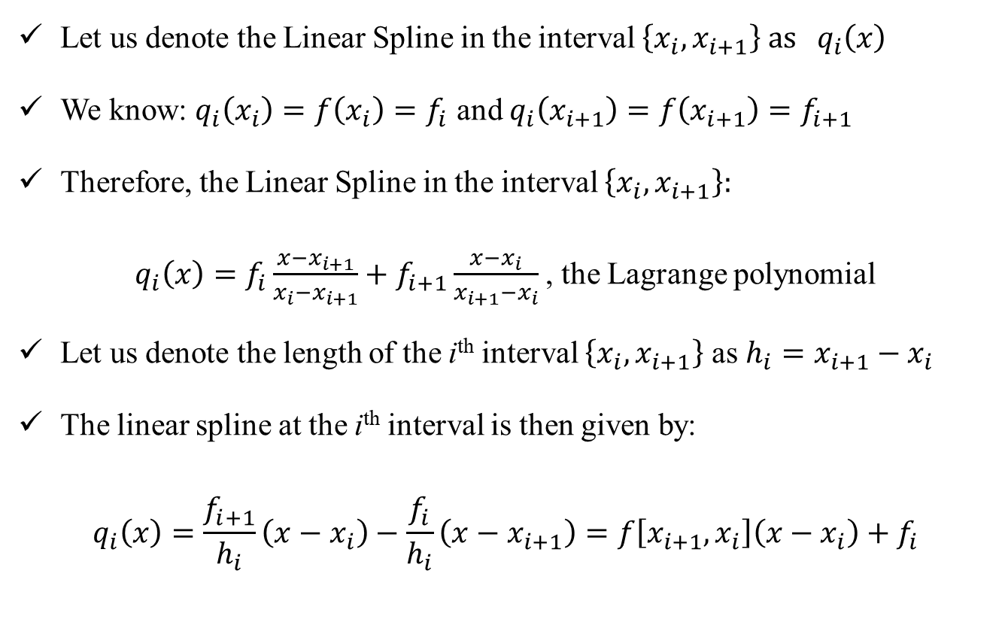
Spline Interpolation: Linear
Let us denote the Linear Spline in the interval $\left\{x_{i},x_{i+1}\right\} as q_{i}\left(x\right)$
We know: $q_{i}\left(x_{i}\right)=f\left(x_{i}\right)=f_{i}$ and $q_{i}\left(x_{i+1}\right)=f\left(x_{i+1}\right)=f_{i+1}$
Therefore, the Linear Spline in the interval $\left\{x_{i},x_{i+1}\right\}:$
$q_{i}\left(x\right)=f_{i}\frac{x−x_{i+1}}{x_{i}−x_{i+1}}+f_{i+1}\frac{x−x_{i}}{x_{i+1}−x_{i}}$, the Lagrange polynomial
Let us denote the length of the i^{th} interval $\left\{x_{i},x_{i+1}\right\}$ as $h_{i}=x_{i+1}−x_{i}$
The linear spline at the i^{th} interval is then given by:
$$q_{i}\left(x\right)=\frac{f_{i+1}}{h_{i}}\left(x−x_{i}\right)−\frac{f_{i}}{h_{i}}\left(x−x_{i+1}\right)=f\left[x_{i+1},x_{i}\right]\left(x−x_{i}\right)+f_{i}$$

Slide 48
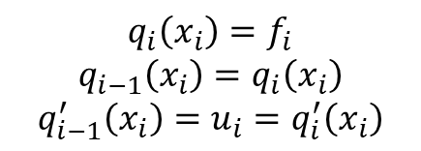
Spline Interpolation: Quadratic
x_{i+2}, f_{i+2}
x_{i}, f_{i}
q_{i}(x)
q_{i+1}(x)
q_{i-1}(x)
x_{i+1}, f_{i+1}
x_{i-1}, f_{i-1}
$$q_{i}\left(x_{i}\right)=f_{i}$$
$$q_{i−1}\left(x_{i}\right)=q_{i}\left(x_{i}\right)$$
$$q_{i−1}^{′}\left(x_{i}\right)=u_{i}=q_{i}^{′}\left(x_{i}\right)$$
A quadratic polynomial in each interval: (n+1) points, n quadratic polynomials, 3n unknowns
Available conditions: (n + 1) function values, (n - 1) function continuity and (n - 1) 1st derivative continuity conditions, total 3n-1 conditions.
1 free condition to be chosen by the user!

Slide 49
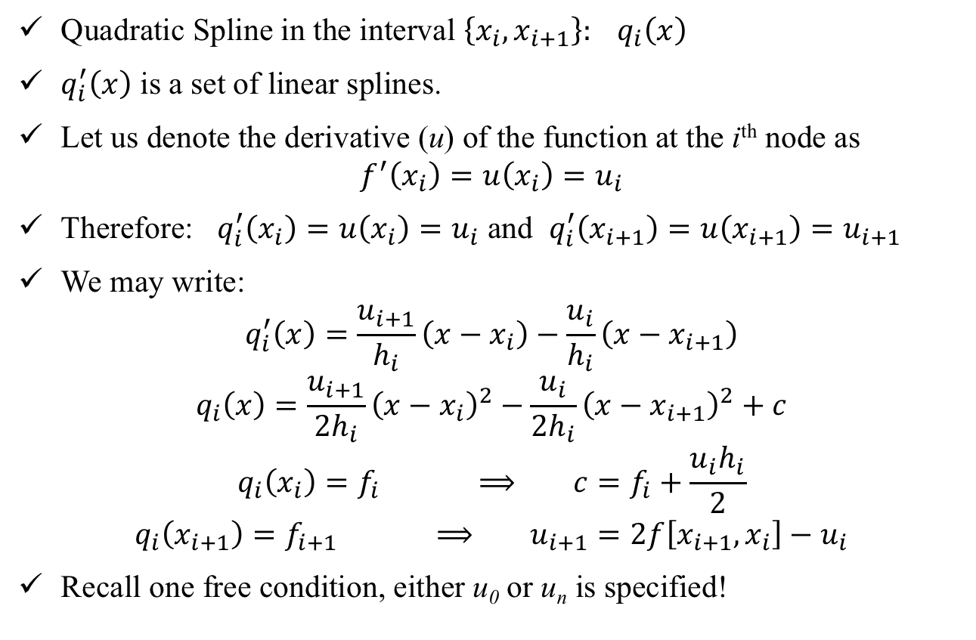
Spline Interpolation: Quadratic
Quadratic Spline in the interval $\left\{x_{i},x_{i+1}\right\}: q_{i}\left(x\right)$
$q_{i}^{′}\left(x\right)$ is a set of linear splines.
Let us denote the derivative (u) of the function at the i^{th} node as
$$f^{′}\left(x_{i}\right)=u\left(x_{i}\right)=u_{i}$$
Therefore: $q_{i}^{′}\left(x_{i}\right)=u\left(x_{i}\right)=u_{i}$ and $q_{i}^{′}\left(x_{i+1}\right)=u\left(x_{i+1}\right)=u_{i+1}$
We may write:
$$q_{i}^{′}\left(x\right)=\frac{u_{i+1}}{h_{i}}\left(x−x_{i}\right)−\frac{u_{i}}{h_{i}}\left(x−x_{i+1}\right)$$
$$q_{i}\left(x\right)=\frac{u_{i+1}}{{2h}_{i}}{\left(x−x_{i}\right)}^{2}−\frac{u_{i}}{{2h}_{i}}{\left(x−x_{i+1}\right)}^{2}+c$$
$$q_{i}\left(x_{i}\right)=f_{i} ⟹ c=f_{i}+\frac{u_{i}h_{i}}{2}$$
$$q_{i}\left(x_{i+1}\right)=f_{i+1} ⟹ u_{i+1}=2f\left[x_{i+1},x_{i}\right]−u_{i}$$
Recall one free condition, either u₀ or u_{n} is specified!

Slide 50
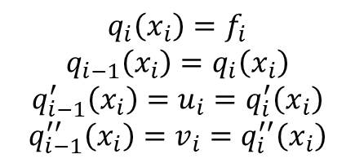
Spline Interpolation: Cubic
x_{i+2}, f_{i+2}
x_{i}, f_{i}
q_{i}(x)
q_{i+1}(x)
q_{i-1}(x)
x_{i+1}, f_{i+1}
x_{i-1}, f_{i-1}
$$q_{i}\left(x_{i}\right)=f_{i}$$
$$q_{i−1}\left(x_{i}\right)=q_{i}\left(x_{i}\right)$$
$$q_{i−1}^{′}\left(x_{i}\right)=u_{i}=q_{i}^{′}\left(x_{i}\right)$$
$$q_{i−1}^{′′}\left(x_{i}\right)=v_{i}=q_{i}^{′′}\left(x_{i}\right)$$
A cubic polynomial in each interval: (n+1) points, n cubic polynomials, 4n unknowns
Available conditions: (n + 1) function values, (n - 1) function continuity, (n - 1) 1st derivative continuity conditions and (n - 1) 2nd derivative continuity conditions, total 4n - 2 conditions.
2 free conditions to be chosen by the user!

