Slide 1

ESO 208A: Computational Methods in Engineering Numerical Differentiation
Abhas Singh
Department of Civil Engineering
IIT Kanpur
Acknowledgements: Profs. Saumyen Guha and Shivam Tripathi (CE)

Slide 2
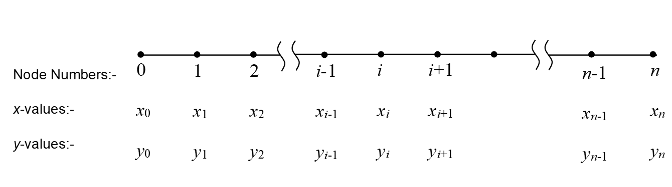
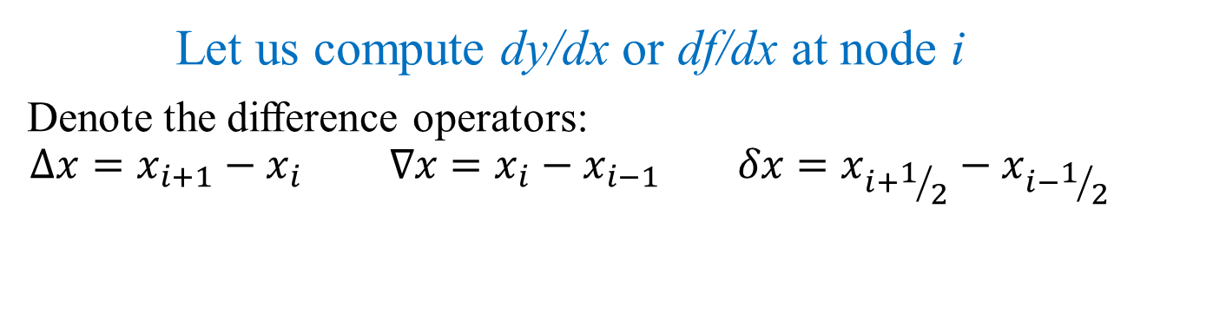
Numerical Differentiation
Let us compute dy/dx or df/dx at node i
Denote the difference operators:
$$∆x=x_{i+1}−x_{i} ∇x=x_{i}−x_{i−1} δx=x_{i+1/2}−x_{i−1/2}$$

Slide 3
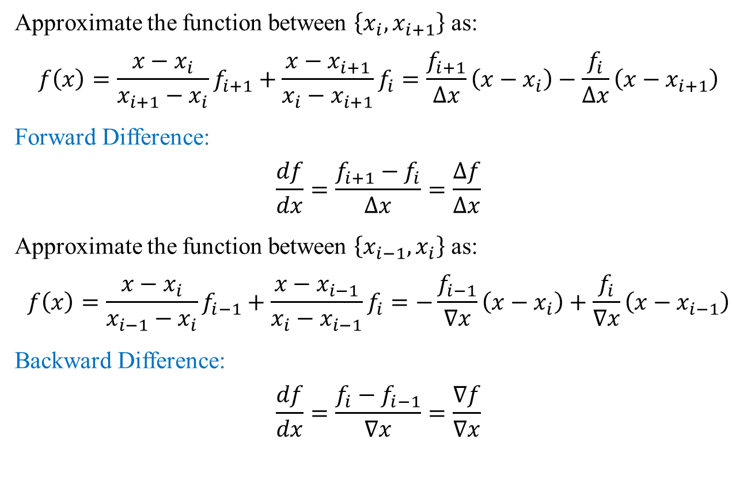
Numerical Differentiation: Finite Difference
Approximate the function between $\left\{x_{i},x_{i+1}\right\}$ as:
$$f\left(x\right)=\frac{x−x_{i}}{x_{i+1}−x_{i}}f_{i+1}+\frac{x−x_{i+1}}{x_{i}−x_{i+1}}f_{i}=\frac{f_{i+1}}{∆x}\left(x−x_{i}\right)−\frac{f_{i}}{∆x}\left(x−x_{i+1}\right)$$
Forward Difference:
$$\frac{df}{dx}=\frac{f_{i+1}−f_{i}}{∆x}=\frac{∆f}{∆x}$$
Approximate the function between $\left\{x_{i−1},x_{i}\right\}$ as:
$$f\left(x\right)=\frac{x−x_{i}}{x_{i−1}−x_{i}}f_{i−1}+\frac{x−x_{i−1}}{x_{i}−x_{i−1}}f_{i}=−\frac{f_{i−1}}{∇x}\left(x−x_{i}\right)+\frac{f_{i}}{∇x}\left(x−x_{i−1}\right)$$
Backward Difference:
$$\frac{df}{dx}=\frac{f_{i}−f_{i−1}}{∇x}=\frac{∇f}{∇x}$$

Slide 4
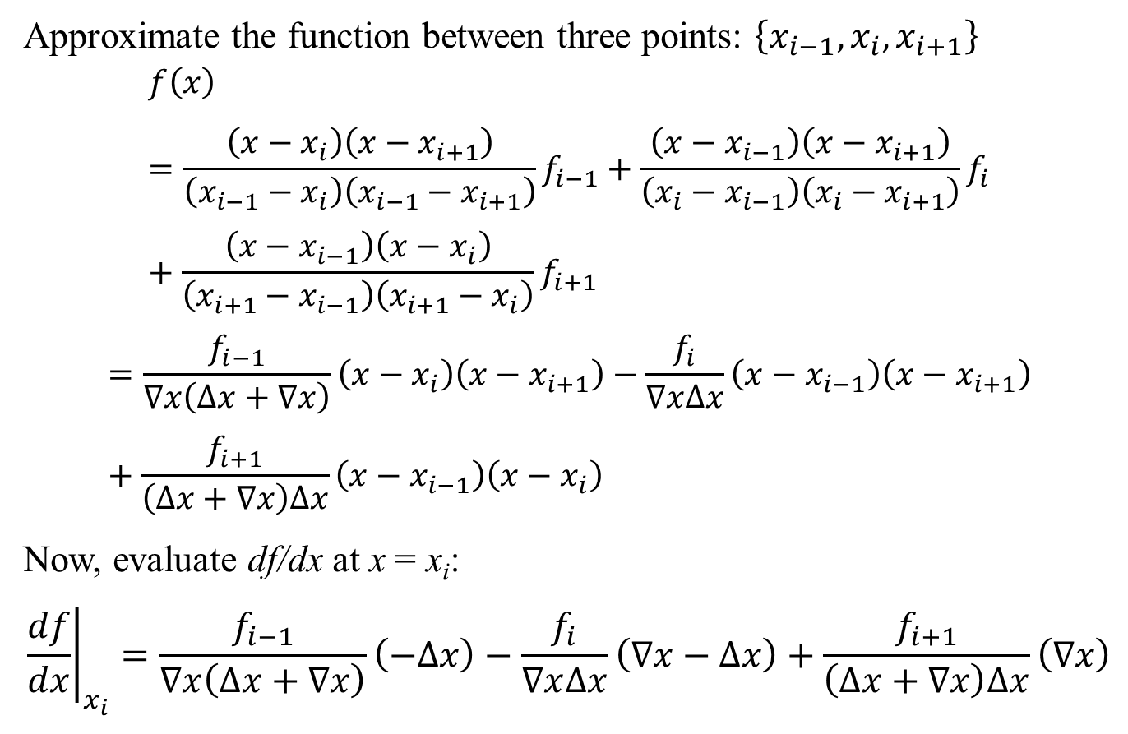
Numerical Differentiation: Finite Difference
Approximate the function between three points: $\left\{x_{i−1},x_{i},x_{i+1}\right\}$
$$f\left(x\right)=\frac{\left(x−x_{i}\right)\left(x−x_{i+1}\right)}{\left(x_{i−1}−x_{i}\right)\left(x_{i−1}−x_{i+1}\right)}f_{i−1}+\frac{\left(x−x_{i−1}\right)\left(x−x_{i+1}\right)}{\left(x_{i}−x_{i−1}\right)\left(x_{i}−x_{i+1}\right)}f_{i}+\frac{\left(x−x_{i−1}\right)\left(x−x_{i}\right)}{\left(x_{i+1}−x_{i−1}\right)\left(x_{i+1}−x_{i}\right)}f_{i+1}$$
$$=\frac{f_{i−1}}{∇x\left(∆x+∇x\right)}\left(x−x_{i}\right)\left(x−x_{i+1}\right)−\frac{f_{i}}{∇x∆x}\left(x−x_{i−1}\right)\left(x−x_{i+1}\right)+\frac{f_{i+1}}{\left(∆x+∇x\right)∆x}\left(x−x_{i−1}\right)\left(x−x_{i}\right)$$
Now, evaluate df/dx at x = x_{i}:
$${\left.\frac{df}{dx}\right|}_{x_{i}}=\frac{f_{i−1}}{∇x\left(∆x+∇x\right)}\left(−∆x\right)−\frac{f_{i}}{∇x∆x}\left(∇x−∆x\right)+\frac{f_{i+1}}{\left(∆x+∇x\right)∆x}\left(∇x\right)$$

Slide 5
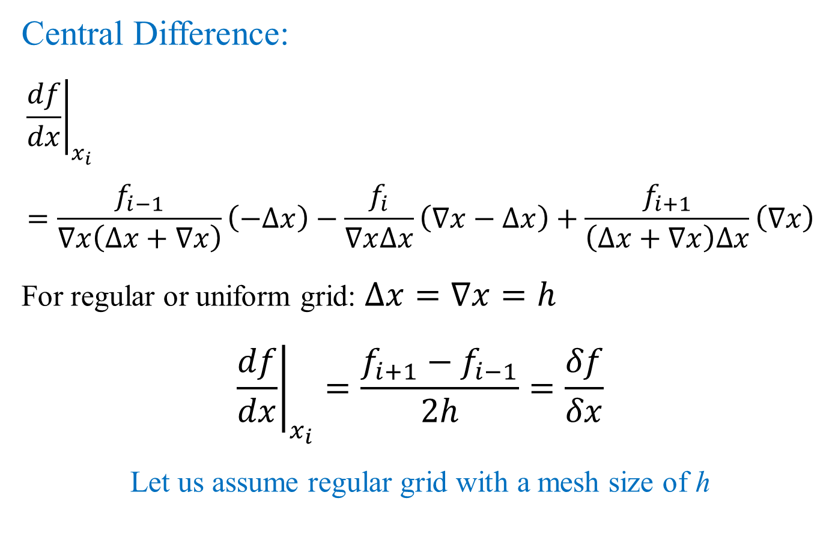
Numerical Differentiation: Finite Difference
Central Difference:
$${\left.\frac{df}{dx}\right|}_{x_{i}}=\frac{f_{i−1}}{∇x\left(∆x+∇x\right)}\left(−∆x\right)−\frac{f_{i}}{∇x∆x}\left(∇x−∆x\right)+\frac{f_{i+1}}{\left(∆x+∇x\right)∆x}\left(∇x\right)$$
For regular or uniform grid: $∆x=∇x=h$
$${\left.\frac{df}{dx}\right|}_{x_{i}}=\frac{f_{i+1}−f_{i−1}}{2h}=\frac{δf}{δx}$$
Let us assume regular grid with a mesh size of h

Slide 6
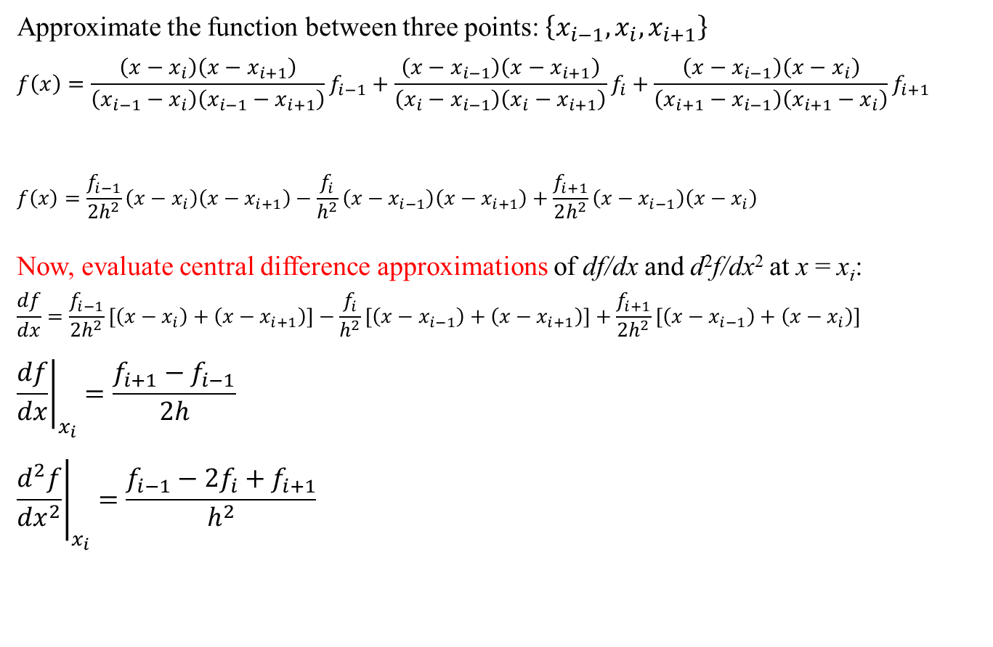
Numerical Differentiation: Finite Difference
Approximate the function between three points: $\left\{x_{i−1},x_{i},x_{i+1}\right\}$
$$f\left(x\right)=\frac{\left(x−x_{i}\right)\left(x−x_{i+1}\right)}{\left(x_{i−1}−x_{i}\right)\left(x_{i−1}−x_{i+1}\right)}f_{i−1}+\frac{\left(x−x_{i−1}\right)\left(x−x_{i+1}\right)}{\left(x_{i}−x_{i−1}\right)\left(x_{i}−x_{i+1}\right)}f_{i}+\frac{\left(x−x_{i−1}\right)\left(x−x_{i}\right)}{\left(x_{i+1}−x_{i−1}\right)\left(x_{i+1}−x_{i}\right)}f_{i+1}$$
$$f\left(x\right)=\frac{f_{i−1}}{2h^{2}}\left(x−x_{i}\right)\left(x−x_{i+1}\right)−\frac{f_{i}}{h^{2}}\left(x−x_{i−1}\right)\left(x−x_{i+1}\right)+\frac{f_{i+1}}{2h^{2}}\left(x−x_{i−1}\right)\left(x−x_{i}\right)$$
Now, evaluate central difference approximations of df/dx and d²f/dx² at x = x_{i}:
$$\frac{df}{dx}=\frac{f_{i−1}}{2h^{2}}\left[\left(x−x_{i}\right)+\left(x−x_{i+1}\right)\right]−\frac{f_{i}}{h^{2}}\left[\left(x−x_{i−1}\right)+\left(x−x_{i+1}\right)\right]+\frac{f_{i+1}}{2h^{2}}\left[\left(x−x_{i−1}\right)+\left(x−x_{i}\right)\right]$$
$${\left.\frac{df}{dx}\right|}_{x_{i}}=\frac{f_{i+1}−f_{i−1}}{2h}$$
$${\left.\frac{d^{2}f}{{dx}^{2}}\right|}_{x_{i}}=\frac{f_{i−1}−2f_{i}+f_{i+1}}{h^{2}}$$

Slide 7
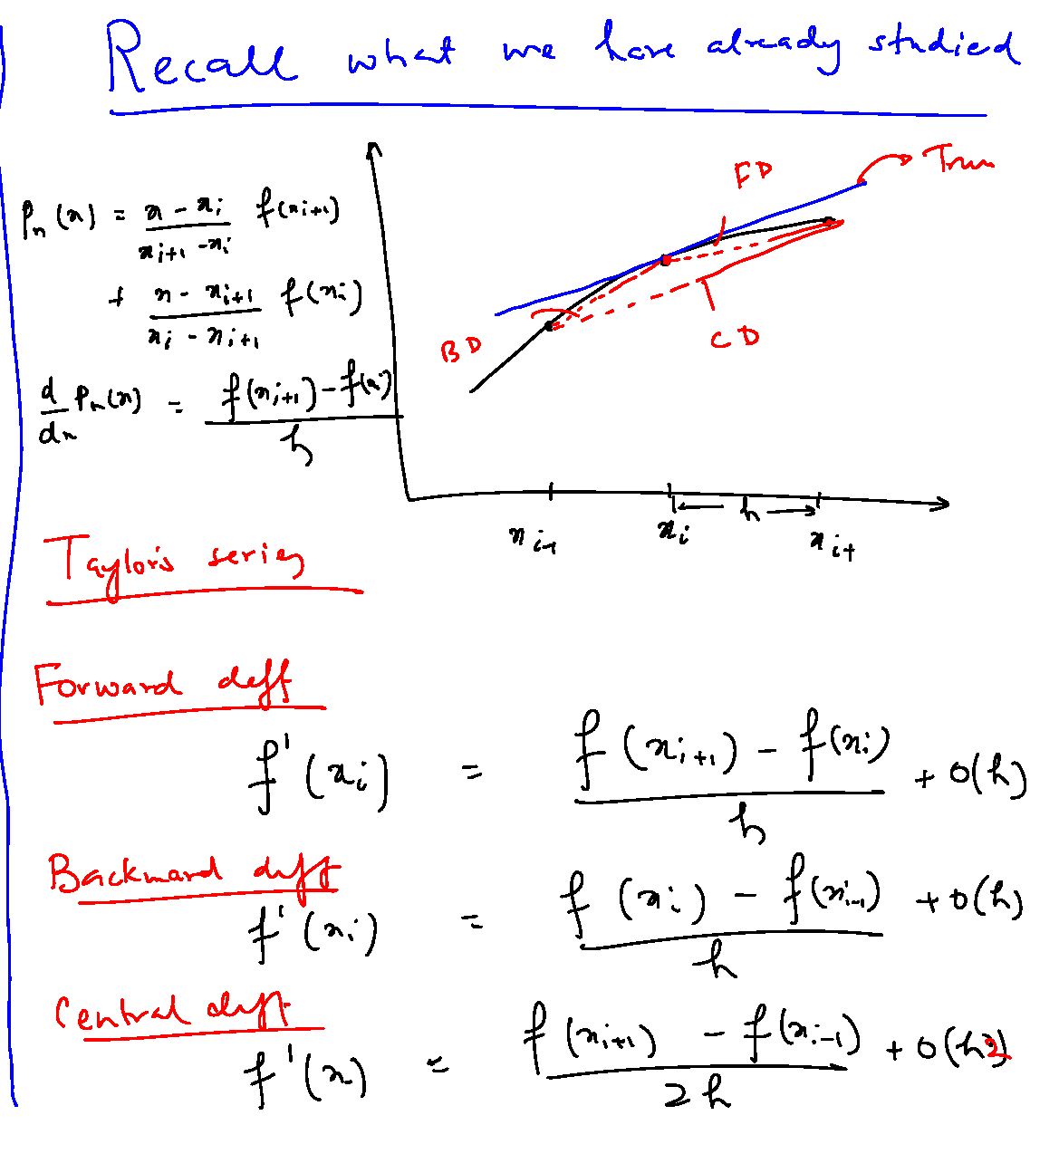

Slide 8
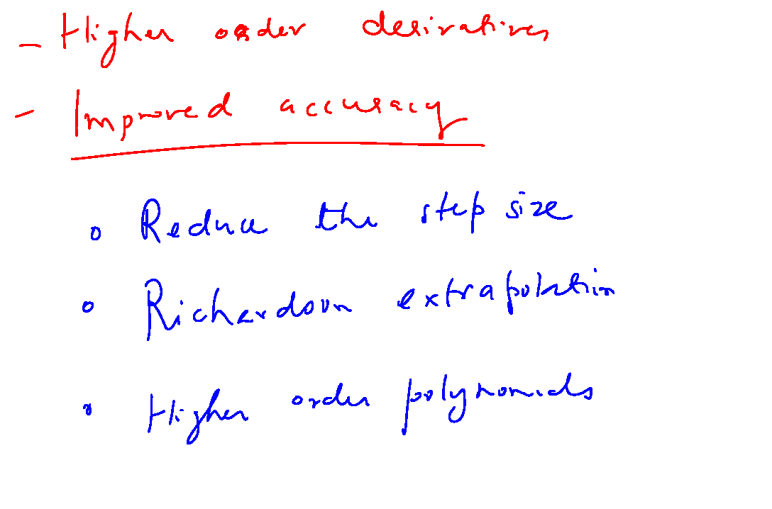

Slide 9
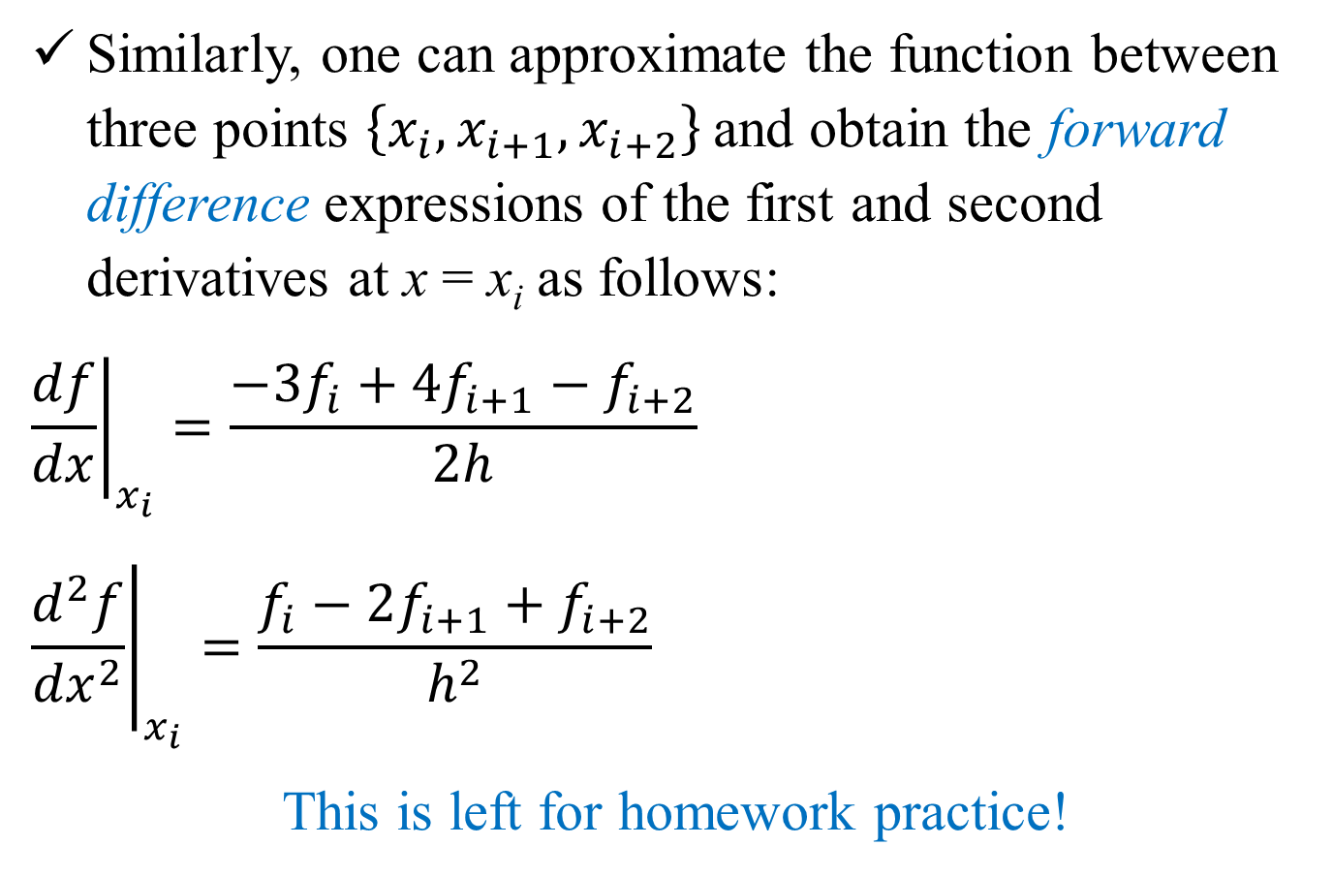
Numerical Differentiation: Finite Difference
Similarly, one can approximate the function between three points $\left\{x_{i},x_{i+1},x_{i+2}\right\}$ and obtain the forward difference expressions of the first and second derivatives at x = x_{i} as follows:
$${\left.\frac{df}{dx}\right|}_{x_{i}}=\frac{−3f_{i}+4f_{i+1}−f_{i+2}}{2h}$$
$${\left.\frac{d^{2}f}{{dx}^{2}}\right|}_{x_{i}}=\frac{f_{i}−2f_{i+1}+f_{i+2}}{h^{2}}$$
This is left for homework practice!

Slide 10
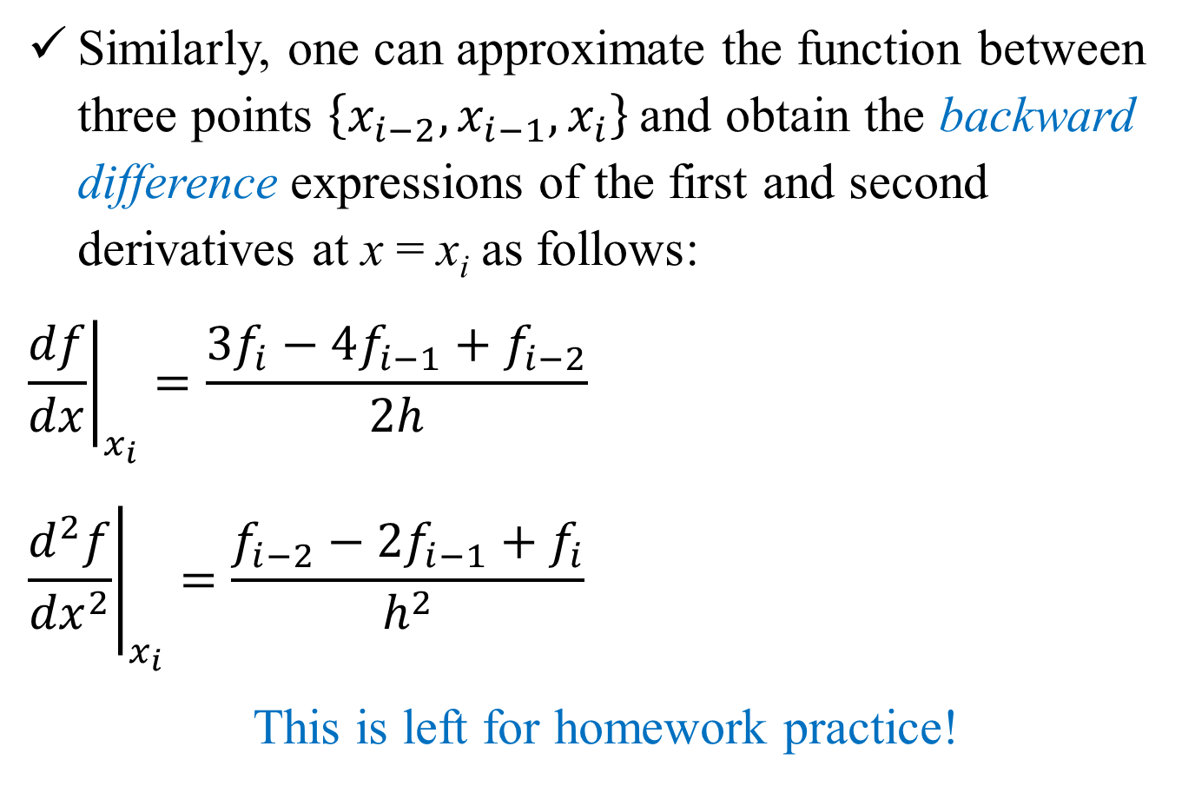
Numerical Differentiation: Finite Difference
Similarly, one can approximate the function between three points $\left\{x_{i−2},x_{i−1},x_{i}\right\}$ and obtain the backward difference expressions of the first and second derivatives at x = x_{i} as follows:
$${\left.\frac{df}{dx}\right|}_{x_{i}}=\frac{3f_{i}−4f_{i−1}+f_{i−2}}{2h}$$
$${\left.\frac{d^{2}f}{{dx}^{2}}\right|}_{x_{i}}=\frac{f_{i−2}−2f_{i−1}+f_{i}}{h^{2}}$$
This is left for homework practice!

Slide 11
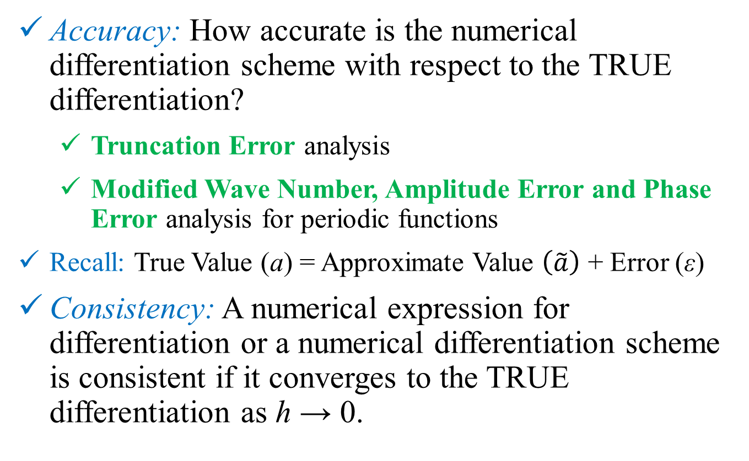
Numerical Differentiation: Finite Difference
Accuracy: How accurate is the numerical differentiation scheme with respect to the TRUE differentiation?
Truncation Error analysis
Modified Wave Number, Amplitude Error and Phase Error analysis for periodic functions
Recall: True Value (a) = Approximate Value $\left(\tilde{a}\right)$ + Error (ε)
Consistency: A numerical expression for differentiation or a numerical differentiation scheme is consistent if it converges to the TRUE differentiation as h → 0.

Slide 12
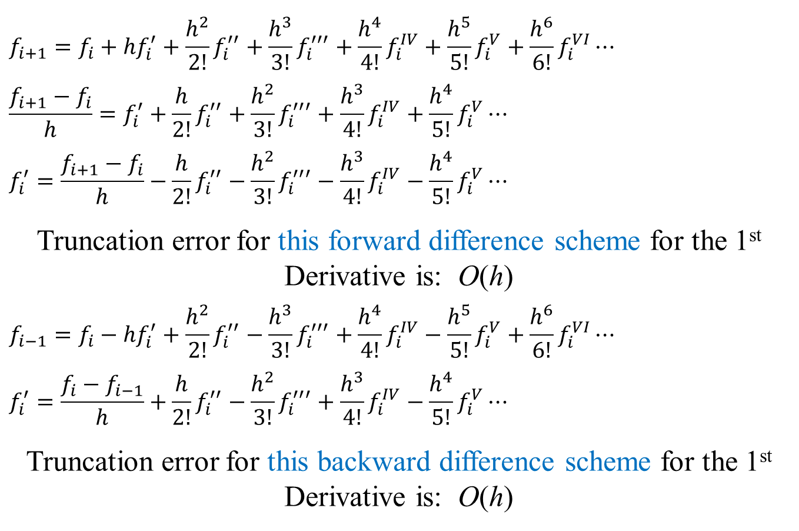
Numerical Differentiation: Truncation Error Analysis
$$f_{i+1}=f_{i}+hf_{i}^{′}+\frac{h^{2}}{2!}f_{i}^{′′}+\frac{h^{3}}{3!}f_{i}^{′′′}+\frac{h^{4}}{4!}f_{i}^{IV}+\frac{h^{5}}{5!}f_{i}^{V}+\frac{h^{6}}{6!}f_{i}^{VI}⋯$$
$$\frac{f_{i+1}−f_{i}}{h}=f_{i}^{′}+\frac{h}{2!}f_{i}^{′′}+\frac{h^{2}}{3!}f_{i}^{′′′}+\frac{h^{3}}{4!}f_{i}^{IV}+\frac{h^{4}}{5!}f_{i}^{V}⋯$$
$$f_{i}^{′}=\frac{f_{i+1}−f_{i}}{h}−\frac{h}{2!}f_{i}^{′′}−\frac{h^{2}}{3!}f_{i}^{′′′}−\frac{h^{3}}{4!}f_{i}^{IV}−\frac{h^{4}}{5!}f_{i}^{V}⋯$$
Truncation error for this forward difference scheme for the 1st Derivative is: O(h)
$$f_{i−1}=f_{i}−hf_{i}^{′}+\frac{h^{2}}{2!}f_{i}^{′′}−\frac{h^{3}}{3!}f_{i}^{′′′}+\frac{h^{4}}{4!}f_{i}^{IV}−\frac{h^{5}}{5!}f_{i}^{V}+\frac{h^{6}}{6!}f_{i}^{VI}⋯$$
$$f_{i}^{′}=\frac{f_{i}−f_{i−1}}{h}+\frac{h}{2!}f_{i}^{′′}−\frac{h^{2}}{3!}f_{i}^{′′′}+\frac{h^{3}}{4!}f_{i}^{IV}−\frac{h^{4}}{5!}f_{i}^{V}⋯$$
Truncation error for this backward difference scheme for the 1st Derivative is: O(h)

Slide 13
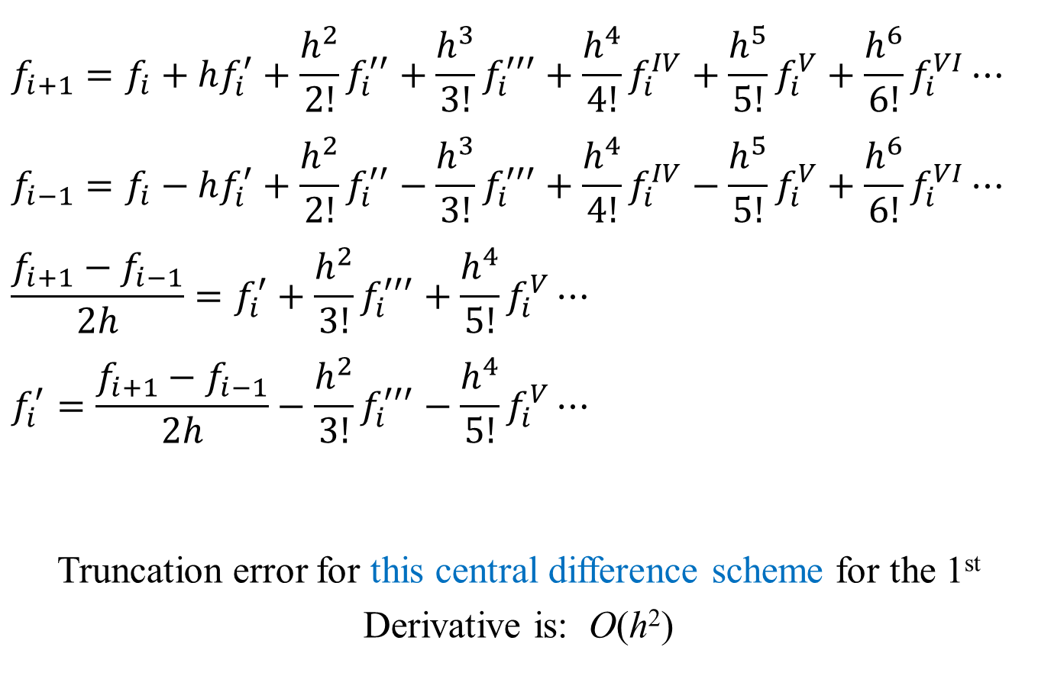
Numerical Differentiation: Truncation Error Analysis
$$f_{i+1}=f_{i}+hf_{i}^{′}+\frac{h^{2}}{2!}f_{i}^{′′}+\frac{h^{3}}{3!}f_{i}^{′′′}+\frac{h^{4}}{4!}f_{i}^{IV}+\frac{h^{5}}{5!}f_{i}^{V}+\frac{h^{6}}{6!}f_{i}^{VI}⋯$$
$$f_{i−1}=f_{i}−hf_{i}^{′}+\frac{h^{2}}{2!}f_{i}^{′′}−\frac{h^{3}}{3!}f_{i}^{′′′}+\frac{h^{4}}{4!}f_{i}^{IV}−\frac{h^{5}}{5!}f_{i}^{V}+\frac{h^{6}}{6!}f_{i}^{VI}⋯$$
$$\frac{f_{i+1}−f_{i−1}}{2h}=f_{i}^{′}+\frac{h^{2}}{3!}f_{i}^{′′′}+\frac{h^{4}}{5!}f_{i}^{V}⋯$$
$$f_{i}^{′}=\frac{f_{i+1}−f_{i−1}}{2h}−\frac{h^{2}}{3!}f_{i}^{′′′}−\frac{h^{4}}{5!}f_{i}^{V}⋯$$
Truncation error for this central difference scheme for the 1st Derivative is: O(h²)

Slide 14
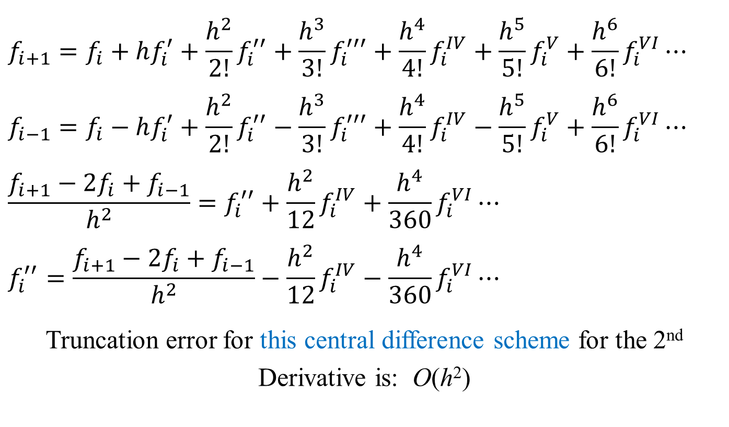
Numerical Differentiation: Truncation Error Analysis
$$f_{i+1}=f_{i}+hf_{i}^{′}+\frac{h^{2}}{2!}f_{i}^{′′}+\frac{h^{3}}{3!}f_{i}^{′′′}+\frac{h^{4}}{4!}f_{i}^{IV}+\frac{h^{5}}{5!}f_{i}^{V}+\frac{h^{6}}{6!}f_{i}^{VI}⋯$$
$$f_{i−1}=f_{i}−hf_{i}^{′}+\frac{h^{2}}{2!}f_{i}^{′′}−\frac{h^{3}}{3!}f_{i}^{′′′}+\frac{h^{4}}{4!}f_{i}^{IV}−\frac{h^{5}}{5!}f_{i}^{V}+\frac{h^{6}}{6!}f_{i}^{VI}⋯$$
$$\frac{f_{i+1}−2f_{i}+f_{i−1}}{h^{2}}=f_{i}^{′′}+\frac{h^{2}}{12}f_{i}^{IV}+\frac{h^{4}}{360}f_{i}^{VI}⋯$$
$$f_{i}^{′′}=\frac{f_{i+1}−2f_{i}+f_{i−1}}{h^{2}}−\frac{h^{2}}{12}f_{i}^{IV}−\frac{h^{4}}{360}f_{i}^{VI}⋯$$
Truncation error for this central difference scheme for the 2nd Derivative is: O(h²)

Slide 15
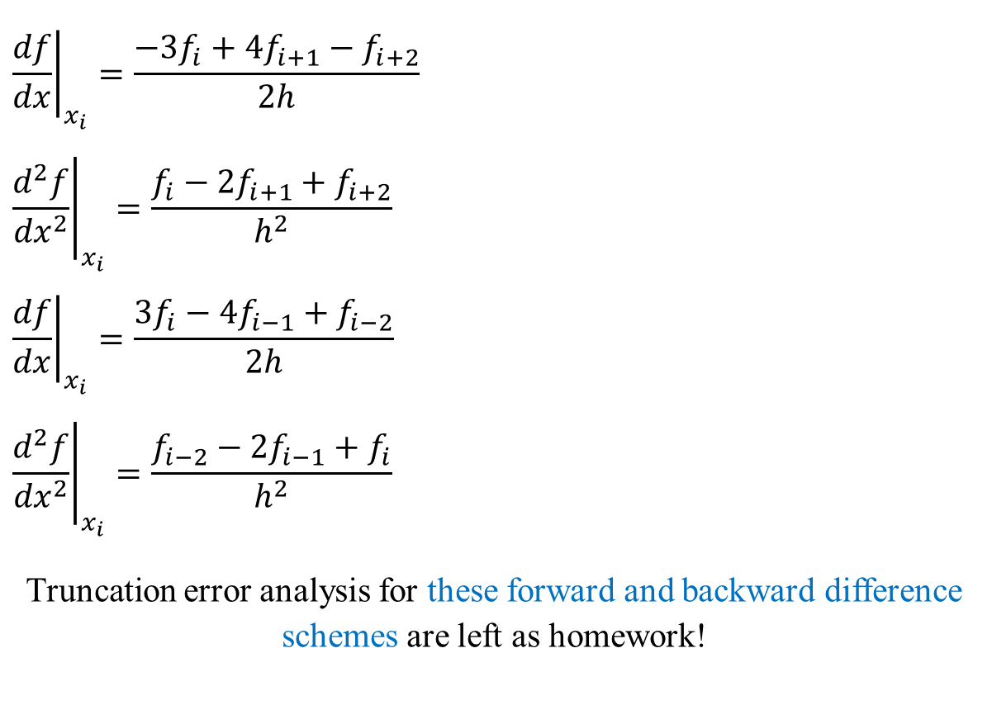
Numerical Differentiation: Truncation Error Analysis
$${\left.\frac{df}{dx}\right|}_{x_{i}}=\frac{−3f_{i}+4f_{i+1}−f_{i+2}}{2h}$$
$${\left.\frac{d^{2}f}{{dx}^{2}}\right|}_{x_{i}}=\frac{f_{i}−2f_{i+1}+f_{i+2}}{h^{2}}$$
$${\left.\frac{df}{dx}\right|}_{x_{i}}=\frac{3f_{i}−4f_{i−1}+f_{i−2}}{2h}$$
$${\left.\frac{d^{2}f}{{dx}^{2}}\right|}_{x_{i}}=\frac{f_{i−2}−2f_{i−1}+f_{i}}{h^{2}}$$
Truncation error analysis for these forward and backward difference schemes are left as homework!

Slide 16
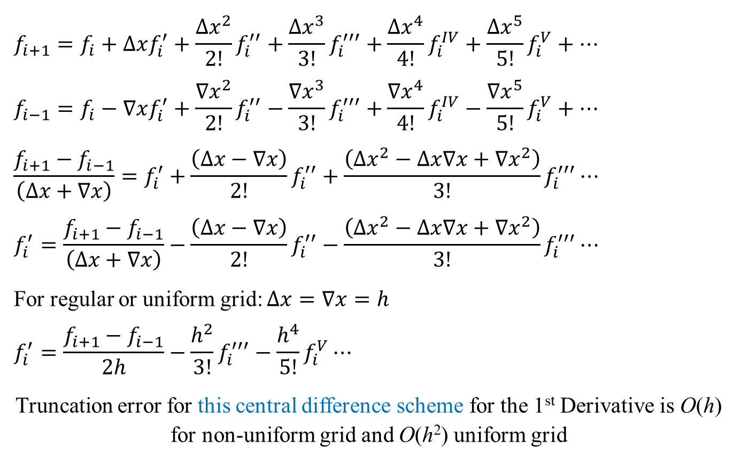
Numerical Differentiation: Truncation Error Analysis
$$f_{i+1}=f_{i}+∆xf_{i}^{′}+\frac{{∆x}^{2}}{2!}f_{i}^{′′}+\frac{∆x^{3}}{3!}f_{i}^{′′′}+\frac{{∆x}^{4}}{4!}f_{i}^{IV}+\frac{{∆x}^{5}}{5!}f_{i}^{V}+⋯$$
$$f_{i−1}=f_{i}−∇xf_{i}^{′}+\frac{{∇x}^{2}}{2!}f_{i}^{′′}−\frac{{∇x}^{3}}{3!}f_{i}^{′′′}+\frac{{∇x}^{4}}{4!}f_{i}^{IV}−\frac{{∇x}^{5}}{5!}f_{i}^{V}+⋯$$
$$\frac{f_{i+1}−f_{i−1}}{\left(∆x+∇x\right)}=f_{i}^{′}+\frac{\left(∆x−∇x\right)}{2!}f_{i}^{′′}+\frac{\left({∆x}^{2}−∆x∇x+{∇x}^{2}\right)}{3!}f_{i}^{′′′}⋯$$
$$f_{i}^{′}=\frac{f_{i+1}−f_{i−1}}{\left(∆x+∇x\right)}−\frac{\left(∆x−∇x\right)}{2!}f_{i}^{′′}−\frac{\left({∆x}^{2}−∆x∇x+{∇x}^{2}\right)}{3!}f_{i}^{′′′}⋯$$
For regular or uniform grid: $∆x=∇x=h$
$$f_{i}^{′}=\frac{f_{i+1}−f_{i−1}}{2h}−\frac{h^{2}}{3!}f_{i}^{′′′}−\frac{h^{4}}{5!}f_{i}^{V}⋯$$
Truncation error for this central difference scheme for the 1st Derivative is O(h) for non-uniform grid and O(h²) uniform grid

Slide 17
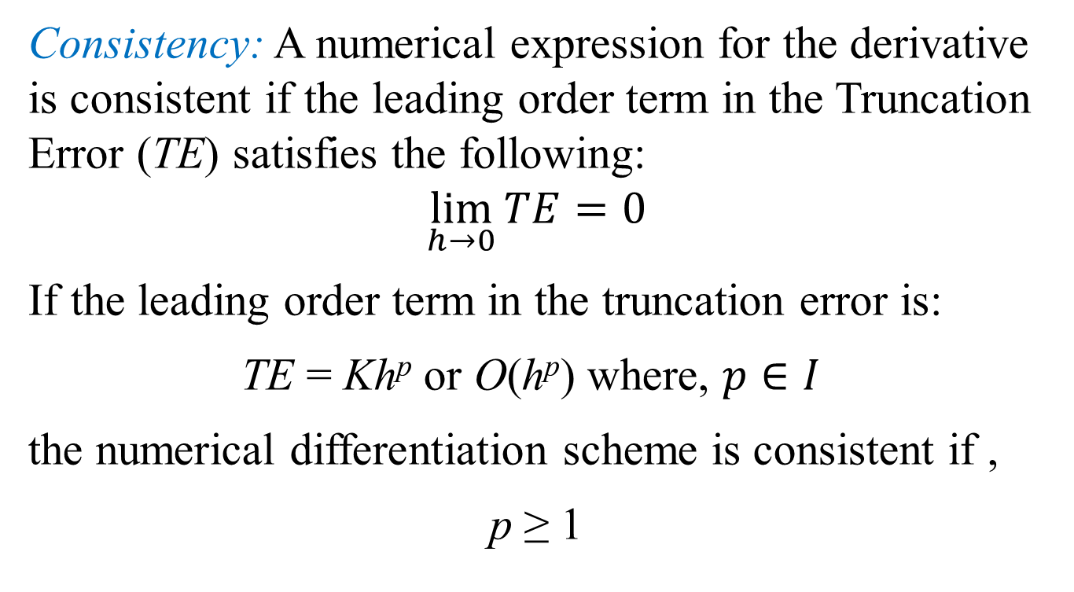
Numerical Differentiation: Finite Difference
Consistency: A numerical expression for the derivative is consistent if the leading order term in the Truncation Error (TE) satisfies the following:
$$\lim_{h→0}{TE}=0$$
If the leading order term in the truncation error is:
TE = Kh^{p} or O(h^{p}) where, $p∈I$
the numerical differentiation scheme is consistent if ,
p ≥ 1

Slide 18
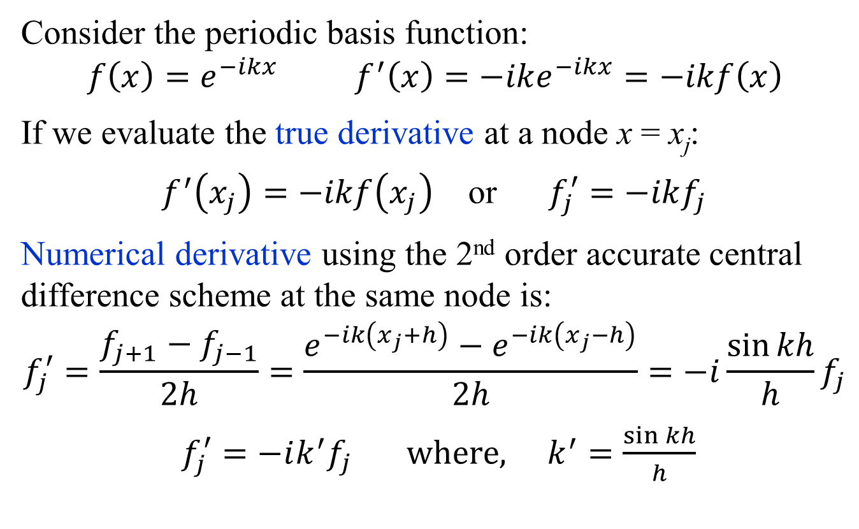
Modified Wave Number Analysis: Periodic Functions
Consider the periodic basis function:
$$f\left(x\right)=e^{−ikx} f^{′}\left(x\right)=−ike^{−ikx}=−ikf\left(x\right)$$
If we evaluate the true derivative at a node x = x_{j}:
$f^{′}\left(x_{j}\right)=−ikf\left(x_{j}\right)$ or $f_{j}^{′}=−ikf_{j}$
Numerical derivative using the 2nd order accurate central difference scheme at the same node is:
$$f_{j}^{′}=\frac{f_{j+1}−f_{j−1}}{2h}=\frac{e^{−ik\left(x_{j}+h\right)}−e^{−ik\left(x_{j}−h\right)}}{2h}=−i\frac{\sin{kh}}{h}f_{j}$$
$f_{j}^{′}=−ik^{′}f_{j} where, k^{′}=\frac{\sin{kh}}{h}$

Slide 19
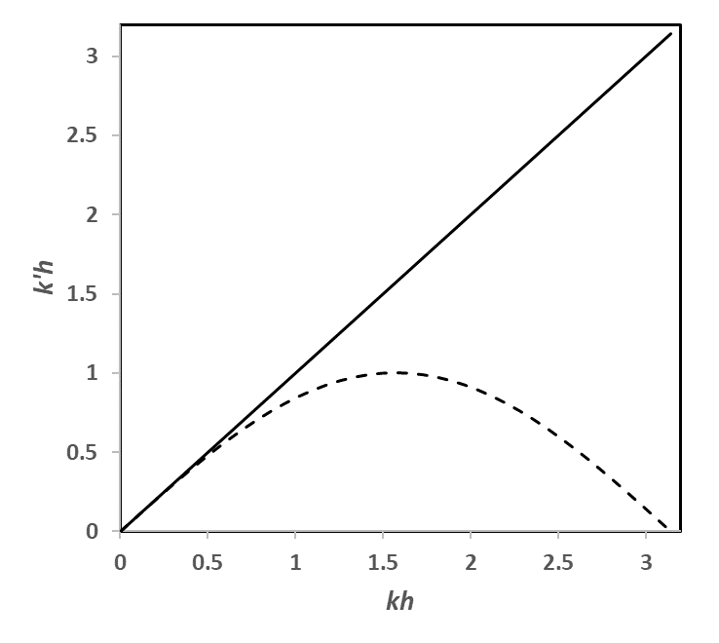

Modified Wave Number Analysis: Periodic Functions
True derivative at a node x = x_{j}: $f_{j}^{′}=−ikf_{j}$
Numerical derivative using the 2nd order central difference scheme at the same node: $f_{j}^{′}=−ik^{′}f_{j}$
$$k^{′}=\frac{\sin{kh}}{h}$$
or
$$k^{′}h=\sin{kh}$$

Slide 20
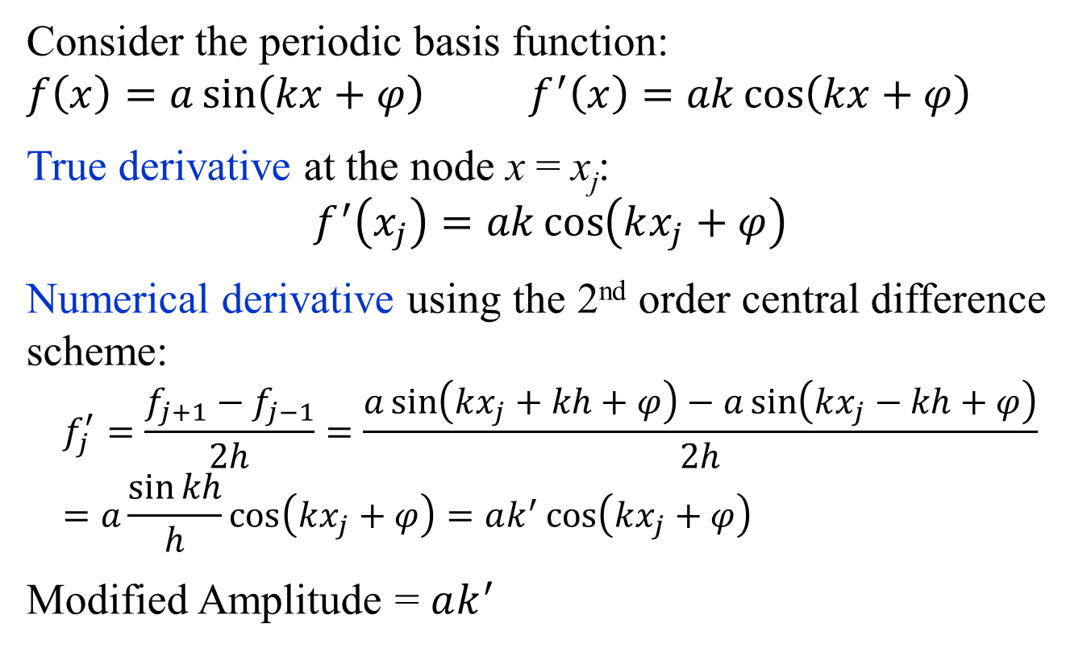
Amplitude Error and Phase Error Analysis: Periodic Functions
Consider the periodic basis function:
$$f\left(x\right)=a\sin\left(kx+φ\right) f^{′}\left(x\right)=ak\cos\left(kx+φ\right)$$
True derivative at the node x = x_{j}:
$$f^{′}\left(x_{j}\right)=ak\cos\left(kx_{j}+φ\right)$$
Numerical derivative using the 2nd order central difference scheme:
$$f_{j}^{′}=\frac{f_{j+1}−f_{j−1}}{2h}=\frac{a\sin\left(kx_{j}+kh+φ\right)−a\sin\left(kx_{j}−kh+φ\right)}{2h}=a\frac{\sin{kh}}{h}\cos\left(kx_{j}+φ\right)=ak^{′}\cos\left(kx_{j}+φ\right)$$
Modified Amplitude = $ak^{′}$

Slide 21
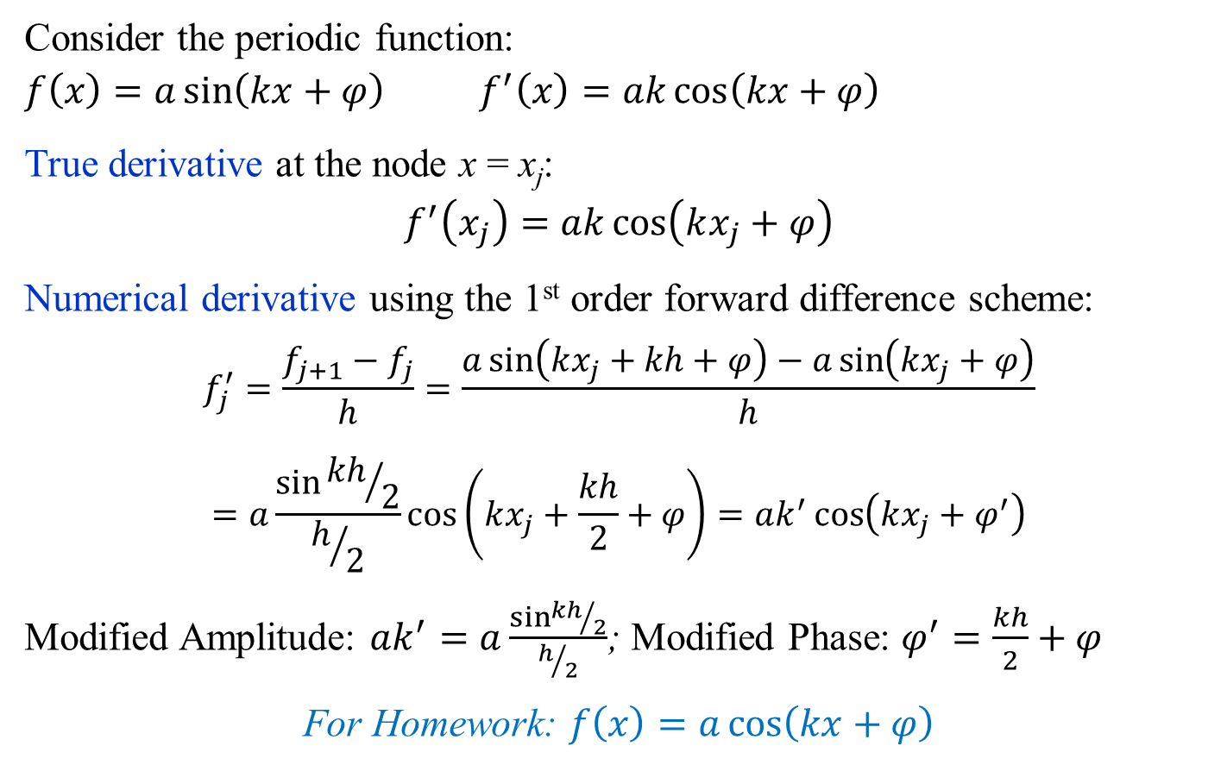
Amplitude Error and Phase Error Analysis: Periodic Functions
Consider the periodic function:
$$f\left(x\right)=a\sin\left(kx+φ\right) f^{′}\left(x\right)=ak\cos\left(kx+φ\right)$$
True derivative at the node x = x_{j}:
$$f^{′}\left(x_{j}\right)=ak\cos\left(kx_{j}+φ\right)$$
Numerical derivative using the 1st order forward difference scheme:
$$f_{j}^{′}=\frac{f_{j+1}−f_{j}}{h}=\frac{a\sin\left(kx_{j}+kh+φ\right)−a\sin\left(kx_{j}+φ\right)}{h}=a\frac{\sin{{kh}/2}}{h/2}\cos\left(kx_{j}+\frac{kh}{2}+φ\right)=ak^{′}\cos\left(kx_{j}+φ^{′}\right)$$
Modified Amplitude: $ak^{′}=a\frac{\sin{{kh}/2}}{h/2}$; Modified Phase: $φ^{′}=\frac{kh}{2}+φ$
For Homework: $f\left(x\right)=a\cos\left(kx+φ\right)$

Slide 22

General Technique for Construction of Finite Difference Scheme of Arbitrary Order
General finite difference scheme for uniform grid size h:
$$f_{i}^{′}=\sum_{k=−m}^{n}{a_{k}f_{i+k}}+O\left(h^{p}\right)$$
or
$$f_{i}^{′′}=\sum_{k=−m}^{n}{a_{k}f_{i+k}}+O\left(h^{p}\right)$$
or
$$f_{i}^{q}=\sum_{k=−m}^{n}{a_{k}f_{i+k}}+O\left(h^{p}\right)$$
Let us take an example with q = 1, m = 2 and n = 0
Method of Undetermined Coefficients

Slide 23
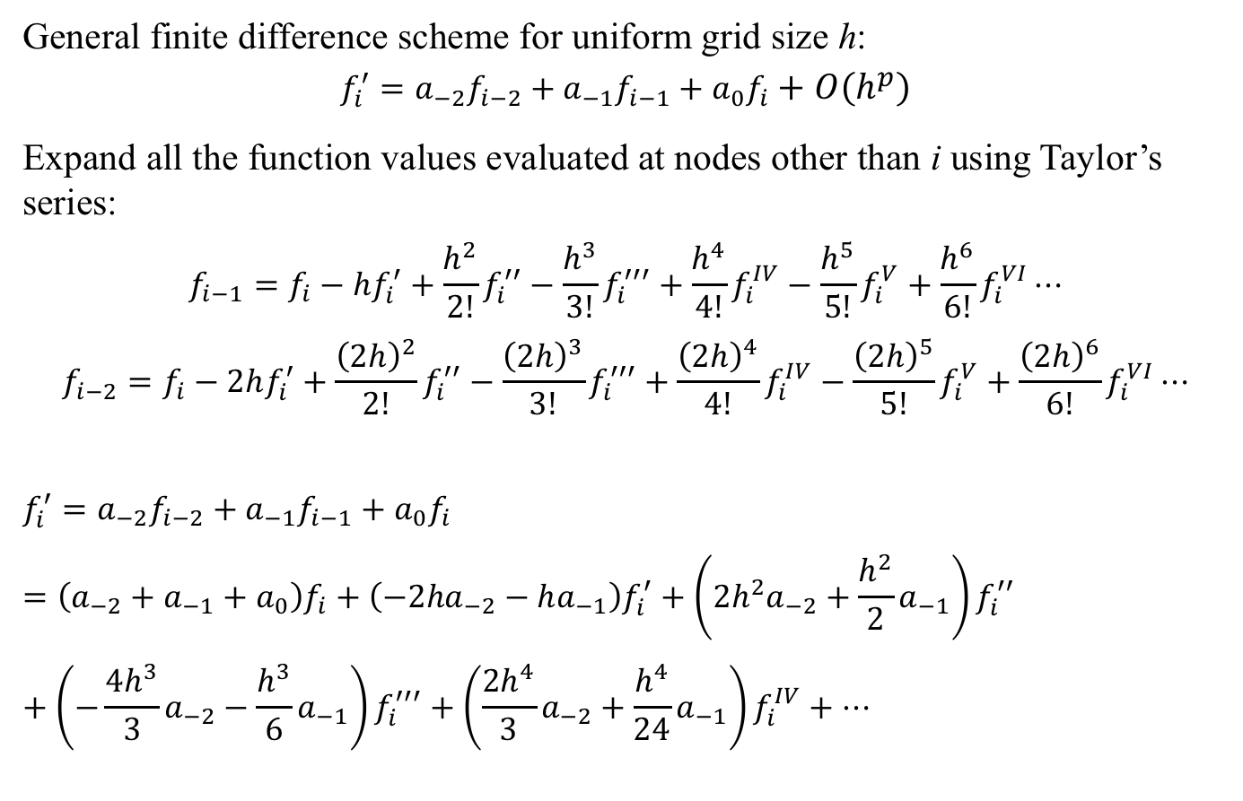
General Technique for Construction of Finite Difference Scheme of Arbitrary Order: Example
General finite difference scheme for uniform grid size h:
$$f_{i}^{′}=a_{−2}f_{i−2}+a_{−1}f_{i−1}+a_{0}f_{i}+O\left(h^{p}\right)$$
Expand all the function values evaluated at nodes other than i using Taylor’s series:
$$f_{i−1}=f_{i}−hf_{i}^{′}+\frac{h^{2}}{2!}f_{i}^{′′}−\frac{h^{3}}{3!}f_{i}^{′′′}+\frac{h^{4}}{4!}f_{i}^{IV}−\frac{h^{5}}{5!}f_{i}^{V}+\frac{h^{6}}{6!}f_{i}^{VI}⋯$$
$$f_{i−2}=f_{i}−2hf_{i}^{′}+\frac{{\left(2h\right)}^{2}}{2!}f_{i}^{′′}−\frac{{\left(2h\right)}^{3}}{3!}f_{i}^{′′′}+\frac{{\left(2h\right)}^{4}}{4!}f_{i}^{IV}−\frac{{\left(2h\right)}^{5}}{5!}f_{i}^{V}+\frac{{\left(2h\right)}^{6}}{6!}f_{i}^{VI}⋯$$
$$f_{i}^{′}=a_{−2}f_{i−2}+a_{−1}f_{i−1}+a_{0}f_{i}=\left(a_{−2}+a_{−1}+a_{0}\right)f_{i}+\left({−2ha}_{−2}−ha_{−1}\right)f_{i}^{′}+\left({2h^{2}a}_{−2}+\frac{h^{2}}{2}a_{−1}\right)f_{i}^{′′}+\left({−\frac{{4h}^{3}}{3}a}_{−2}−\frac{h^{3}}{6}a_{−1}\right)f_{i}^{′′′}+\left({\frac{{2h}^{4}}{3}a}_{−2}+\frac{h^{4}}{24}a_{−1}\right)f_{i}^{IV}+⋯$$

Slide 24
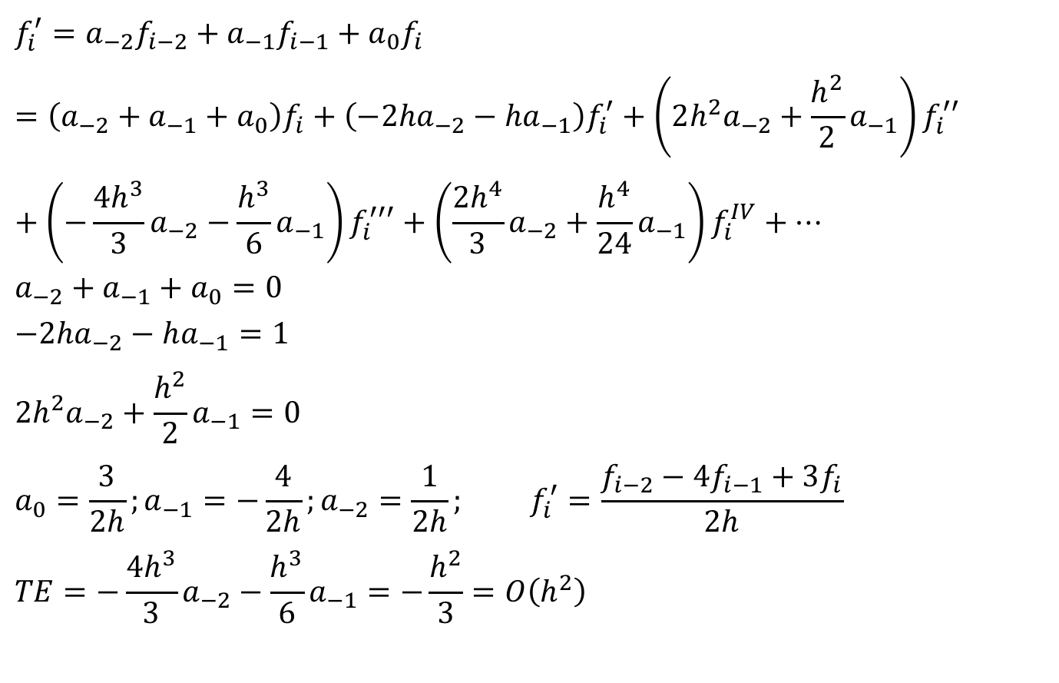
General Technique for Construction of Finite Difference Scheme of Arbitrary Order: Example
$$f_{i}^{′}=a_{−2}f_{i−2}+a_{−1}f_{i−1}+a_{0}f_{i}=\left(a_{−2}+a_{−1}+a_{0}\right)f_{i}+\left({−2ha}_{−2}−ha_{−1}\right)f_{i}^{′}+\left({{2h}^{2}a}_{−2}+\frac{h^{2}}{2}a_{−1}\right)f_{i}^{′′}+\left({−\frac{{4h}^{3}}{3}a}_{−2}−\frac{h^{3}}{6}a_{−1}\right)f_{i}^{′′′}+\left({\frac{{2h}^{4}}{3}a}_{−2}+\frac{h^{4}}{24}a_{−1}\right)f_{i}^{IV}+⋯$$
$$a_{−2}+a_{−1}+a_{0}=0$$
$${−2ha}_{−2}−ha_{−1}=1$$
$${{2h}^{2}a}_{−2}+\frac{h^{2}}{2}a_{−1}=0$$
$$a_{0}=\frac{3}{2h};a_{−1}=−\frac{4}{2h};a_{−2}=\frac{1}{2h}; f_{i}^{′}=\frac{f_{i−2}−4f_{i−1}+3f_{i}}{2h}$$
$$TE={−\frac{{4h}^{3}}{3}a}_{−2}−\frac{h^{3}}{6}a_{−1}=−\frac{h^{2}}{3}=O\left(h^{2}\right)$$

Slide 25
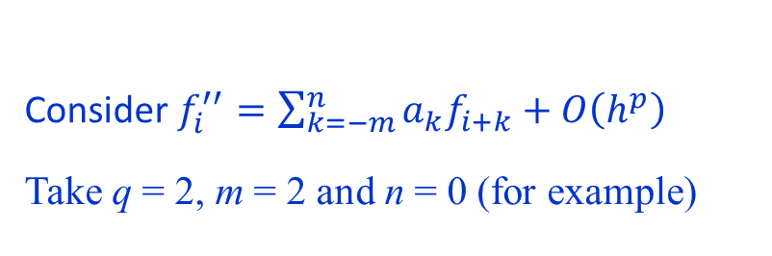
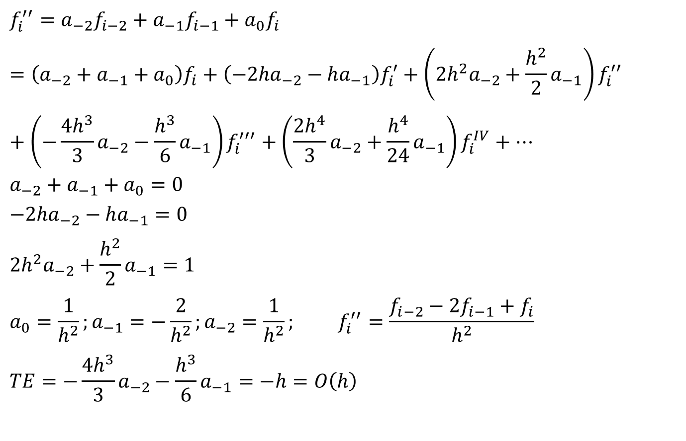
General Technique for Construction of Finite Difference Scheme of Arbitrary Order: Example
$$f_{i}^{′′}=a_{−2}f_{i−2}+a_{−1}f_{i−1}+a_{0}f_{i}=\left(a_{−2}+a_{−1}+a_{0}\right)f_{i}+\left({−2ha}_{−2}−ha_{−1}\right)f_{i}^{′}+\left({{2h}^{2}a}_{−2}+\frac{h^{2}}{2}a_{−1}\right)f_{i}^{′′}+\left({−\frac{{4h}^{3}}{3}a}_{−2}−\frac{h^{3}}{6}a_{−1}\right)f_{i}^{′′′}+\left({\frac{{2h}^{4}}{3}a}_{−2}+\frac{h^{4}}{24}a_{−1}\right)f_{i}^{IV}+⋯$$
$$a_{−2}+a_{−1}+a_{0}=0$$
$${−2ha}_{−2}−ha_{−1}=0$$
$${{2h}^{2}a}_{−2}+\frac{h^{2}}{2}a_{−1}=1$$
$$a_{0}=\frac{1}{h^{2}};a_{−1}=−\frac{2}{h^{2}};a_{−2}=\frac{1}{h^{2}}; f_{i}^{′′}=\frac{f_{i−2}−2f_{i−1}+f_{i}}{h^{2}}$$
$$TE={−\frac{{4h}^{3}}{3}a}_{−2}−\frac{h^{3}}{6}a_{−1}=−h=O\left(h\right)$$
Consider$f_{i}^{′′}=\sum_{k=−m}^{n}{a_{k}f_{i+k}}+O\left(h^{p}\right)$
Take q = 2, m = 2 and n = 0 (for example)

Slide 26





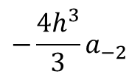

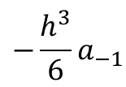







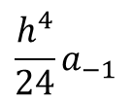





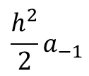





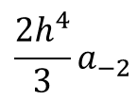


General Technique for Construction of Finite Difference Scheme of Arbitrary Order: Example
General finite difference scheme for uniform grid size h:
$$f_{i}^{′}=a_{−2}f_{i−2}+a_{−1}f_{i−1}+a_{0}f_{i}+O\left(h^{p}\right)$$
$$f_{i}$$
$$f_{i}^{′}$$
$$f_{i}^{′′}$$
$$f_{i}^{′′′}$$
$$f_{i}^{IV}$$
LHS
$$f_{i}^{′}$$
$$0$$
$$1$$
$$0$$
$$0$$
$$0$$
RHS
$$a_{0}f_{i}$$
$$a_{0}$$
$$0$$
$$0$$
$$0$$
$$0$$
$$a_{−1}$$
$$−ha_{−1}$$
$$\frac{h^{2}}{2}a_{−1}$$
$$−\frac{h^{3}}{6}a_{−1}$$
$$\frac{h^{4}}{24}a_{−1}$$
RHS
$$a_{−1}f_{i−1}$$
RHS
$${−\frac{{4h}^{3}}{3}a}_{−2}$$
$${\frac{{2h}^{4}}{3}a}_{−2}$$
$$a_{−2}f_{i−2}$$
$$a_{−2}$$
$${−2ha}_{−2}$$
$${2h^{2}a}_{−2}$$

