Slide 1
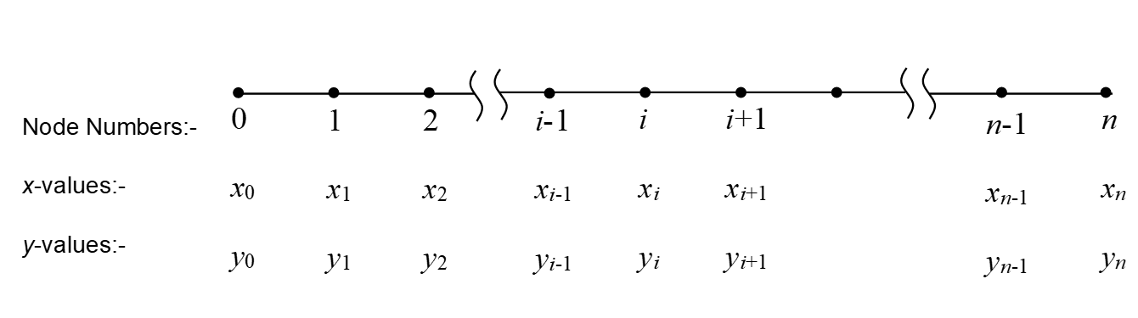
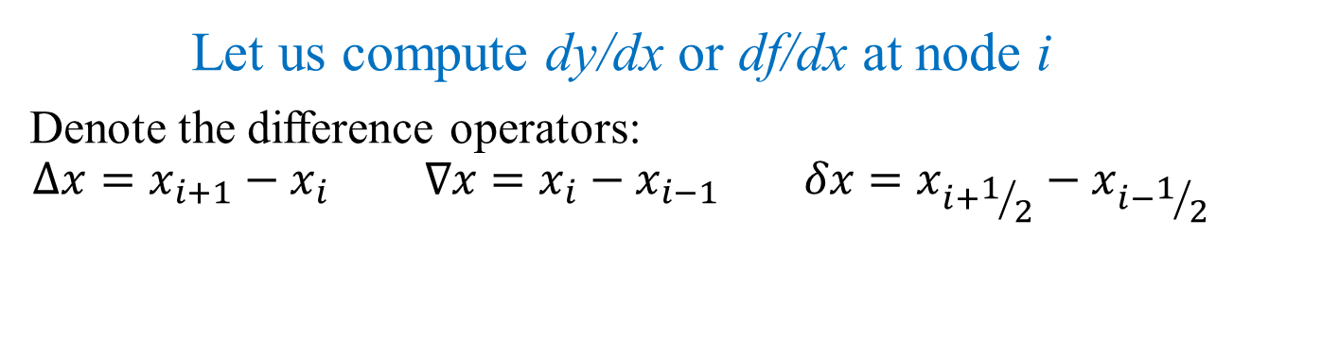
Numerical Differentiation
Let us compute dy/dx or df/dx at node i
Denote the difference operators:
$$∆x=x_{i+1}−x_{i} ∇x=x_{i}−x_{i−1} δx=x_{i+1/2}−x_{i−1/2}$$

Slide 2
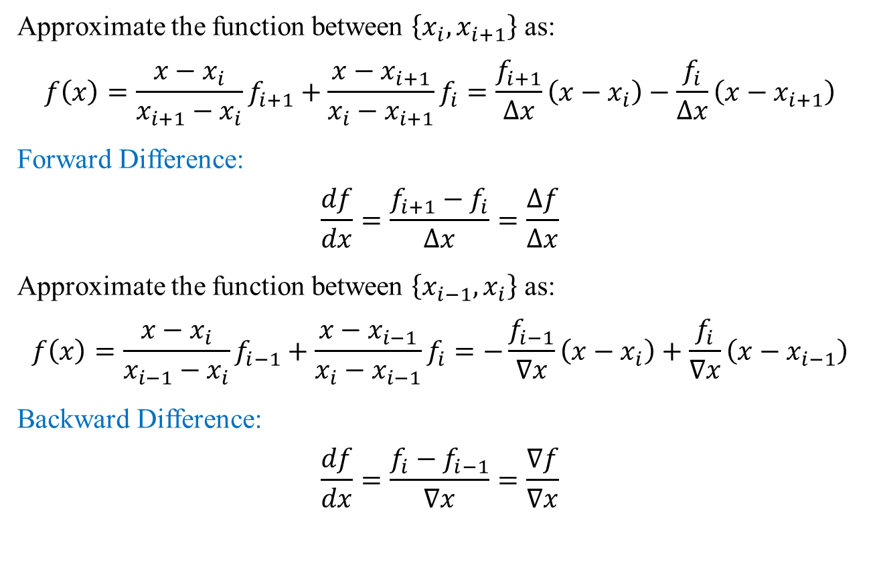
Numerical Differentiation: Finite Difference
Approximate the function between $\left\{x_{i},x_{i+1}\right\}$ as:
$$f\left(x\right)=\frac{x−x_{i}}{x_{i+1}−x_{i}}f_{i+1}+\frac{x−x_{i+1}}{x_{i}−x_{i+1}}f_{i}=\frac{f_{i+1}}{∆x}\left(x−x_{i}\right)−\frac{f_{i}}{∆x}\left(x−x_{i+1}\right)$$
Forward Difference:
$$\frac{df}{dx}=\frac{f_{i+1}−f_{i}}{∆x}=\frac{∆f}{∆x}$$
Approximate the function between $\left\{x_{i−1},x_{i}\right\}$ as:
$$f\left(x\right)=\frac{x−x_{i}}{x_{i−1}−x_{i}}f_{i−1}+\frac{x−x_{i−1}}{x_{i}−x_{i−1}}f_{i}=−\frac{f_{i−1}}{∇x}\left(x−x_{i}\right)+\frac{f_{i}}{∇x}\left(x−x_{i−1}\right)$$
Backward Difference:
$$\frac{df}{dx}=\frac{f_{i}−f_{i−1}}{∇x}=\frac{∇f}{∇x}$$

Slide 3
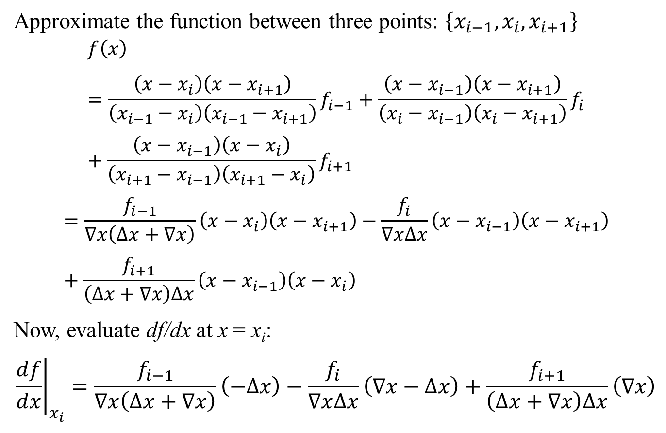
Numerical Differentiation: Finite Difference
Approximate the function between three points: $\left\{x_{i−1},x_{i},x_{i+1}\right\}$
$$f\left(x\right)=\frac{\left(x−x_{i}\right)\left(x−x_{i+1}\right)}{\left(x_{i−1}−x_{i}\right)\left(x_{i−1}−x_{i+1}\right)}f_{i−1}+\frac{\left(x−x_{i−1}\right)\left(x−x_{i+1}\right)}{\left(x_{i}−x_{i−1}\right)\left(x_{i}−x_{i+1}\right)}f_{i}+\frac{\left(x−x_{i−1}\right)\left(x−x_{i}\right)}{\left(x_{i+1}−x_{i−1}\right)\left(x_{i+1}−x_{i}\right)}f_{i+1}$$
$$=\frac{f_{i−1}}{∇x\left(∆x+∇x\right)}\left(x−x_{i}\right)\left(x−x_{i+1}\right)−\frac{f_{i}}{∇x∆x}\left(x−x_{i−1}\right)\left(x−x_{i+1}\right)+\frac{f_{i+1}}{\left(∆x+∇x\right)∆x}\left(x−x_{i−1}\right)\left(x−x_{i}\right)$$
Now, evaluate df/dx at x = x_{i}:
$${\left.\frac{df}{dx}\right|}_{x_{i}}=\frac{f_{i−1}}{∇x\left(∆x+∇x\right)}\left(−∆x\right)−\frac{f_{i}}{∇x∆x}\left(∇x−∆x\right)+\frac{f_{i+1}}{\left(∆x+∇x\right)∆x}\left(∇x\right)$$

Slide 4
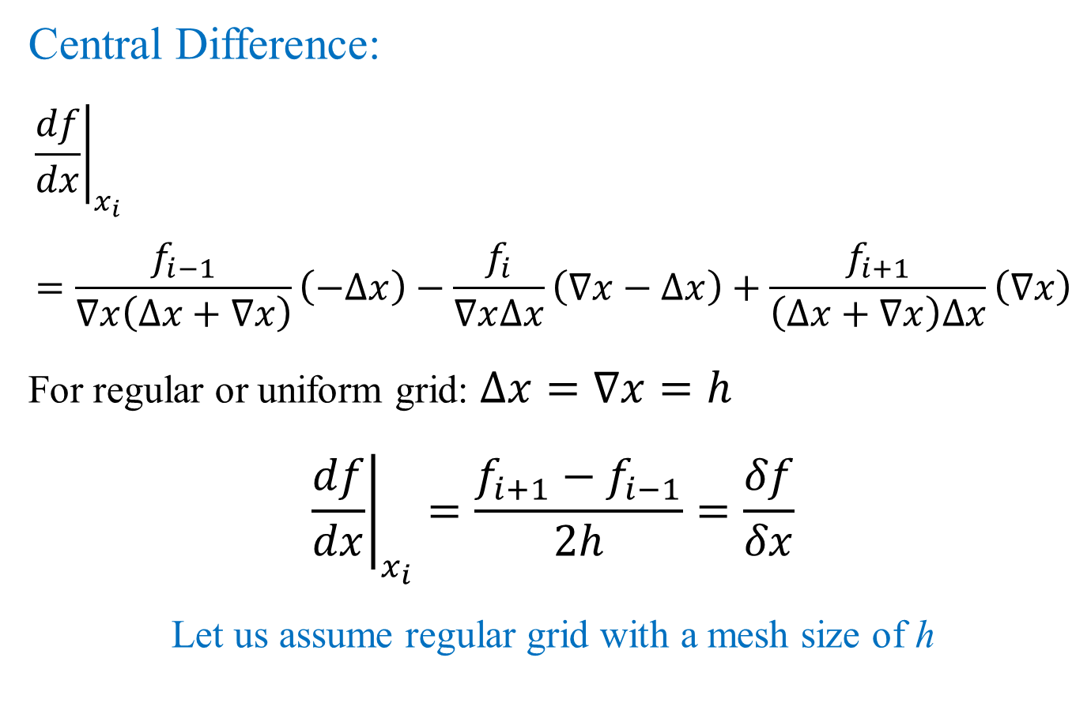
Numerical Differentiation: Finite Difference
Central Difference:
$${\left.\frac{df}{dx}\right|}_{x_{i}}=\frac{f_{i−1}}{∇x\left(∆x+∇x\right)}\left(−∆x\right)−\frac{f_{i}}{∇x∆x}\left(∇x−∆x\right)+\frac{f_{i+1}}{\left(∆x+∇x\right)∆x}\left(∇x\right)$$
For regular or uniform grid: $∆x=∇x=h$
$${\left.\frac{df}{dx}\right|}_{x_{i}}=\frac{f_{i+1}−f_{i−1}}{2h}=\frac{δf}{δx}$$
Let us assume regular grid with a mesh size of h

Slide 5
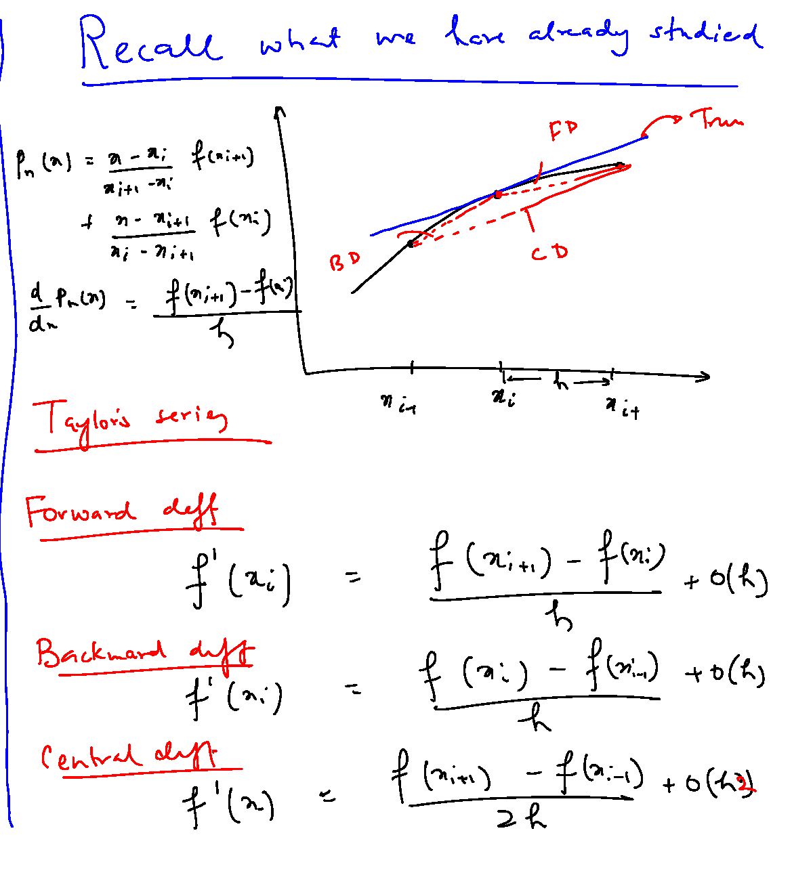

Slide 6
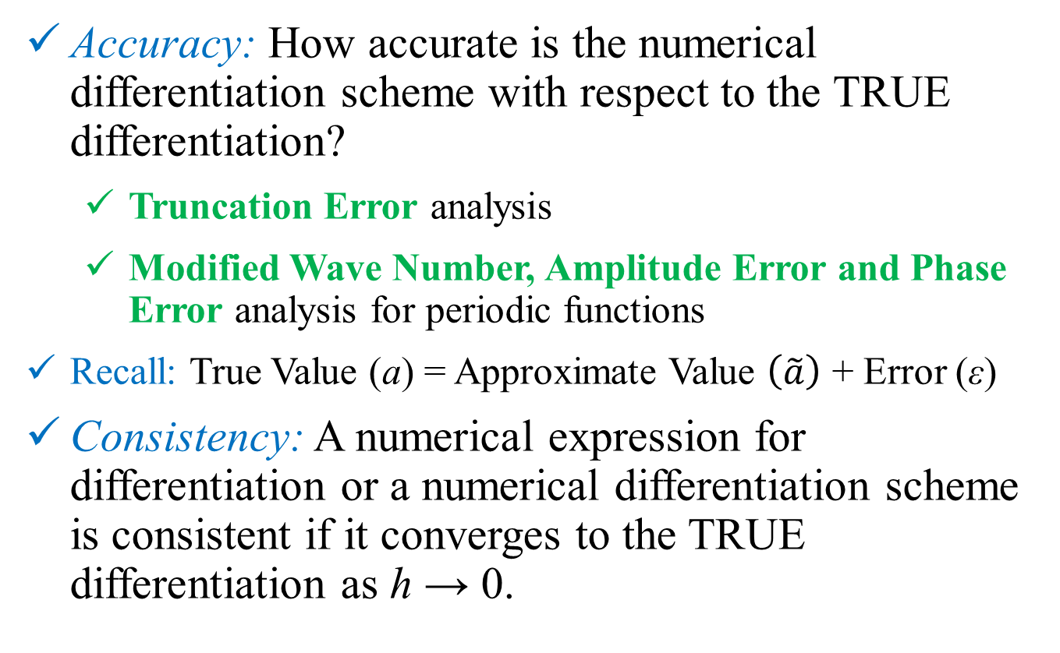
Numerical Differentiation: Finite Difference
Accuracy: How accurate is the numerical differentiation scheme with respect to the TRUE differentiation?
Truncation Error analysis
Modified Wave Number, Amplitude Error and Phase Error analysis for periodic functions
Recall: True Value (a) = Approximate Value $\left(\tilde{a}\right)$ + Error (ε)
Consistency: A numerical expression for differentiation or a numerical differentiation scheme is consistent if it converges to the TRUE differentiation as h → 0.

Slide 7
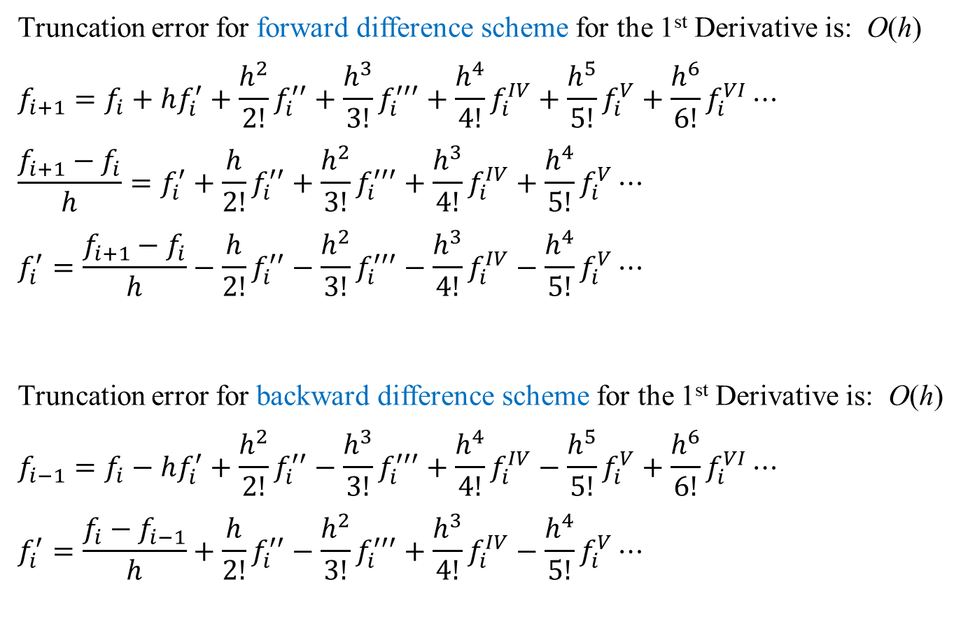
Truncation Error Analysis: First Derivative
Truncation error for forward difference scheme for the 1st Derivative is: O(h)
$$f_{i+1}=f_{i}+hf_{i}^{′}+\frac{h^{2}}{2!}f_{i}^{′′}+\frac{h^{3}}{3!}f_{i}^{′′′}+\frac{h^{4}}{4!}f_{i}^{IV}+\frac{h^{5}}{5!}f_{i}^{V}+\frac{h^{6}}{6!}f_{i}^{VI}⋯$$
$$\frac{f_{i+1}−f_{i}}{h}=f_{i}^{′}+\frac{h}{2!}f_{i}^{′′}+\frac{h^{2}}{3!}f_{i}^{′′′}+\frac{h^{3}}{4!}f_{i}^{IV}+\frac{h^{4}}{5!}f_{i}^{V}⋯$$
$$f_{i}^{′}=\frac{f_{i+1}−f_{i}}{h}−\frac{h}{2!}f_{i}^{′′}−\frac{h^{2}}{3!}f_{i}^{′′′}−\frac{h^{3}}{4!}f_{i}^{IV}−\frac{h^{4}}{5!}f_{i}^{V}⋯$$
Truncation error for backward difference scheme for the 1st Derivative is: O(h)
$$f_{i−1}=f_{i}−hf_{i}^{′}+\frac{h^{2}}{2!}f_{i}^{′′}−\frac{h^{3}}{3!}f_{i}^{′′′}+\frac{h^{4}}{4!}f_{i}^{IV}−\frac{h^{5}}{5!}f_{i}^{V}+\frac{h^{6}}{6!}f_{i}^{VI}⋯$$
$$f_{i}^{′}=\frac{f_{i}−f_{i−1}}{h}+\frac{h}{2!}f_{i}^{′′}−\frac{h^{2}}{3!}f_{i}^{′′′}+\frac{h^{3}}{4!}f_{i}^{IV}−\frac{h^{4}}{5!}f_{i}^{V}⋯$$

Slide 8
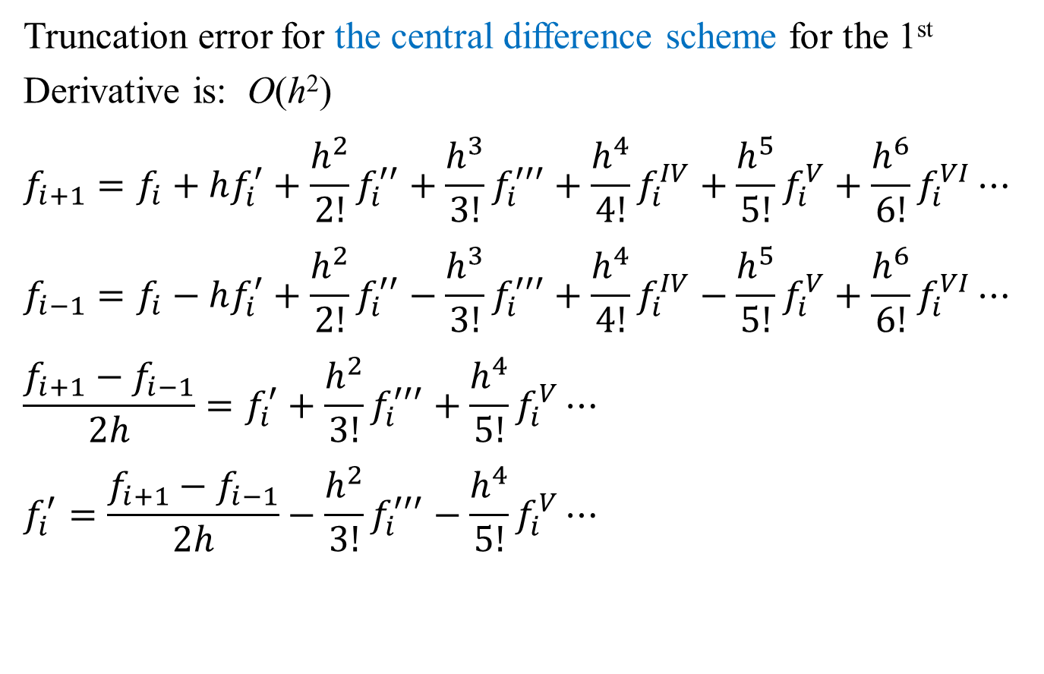
Truncation Error Analysis: First Derivative
Truncation error for the central difference scheme for the 1st Derivative is: O(h²)
$$f_{i+1}=f_{i}+hf_{i}^{′}+\frac{h^{2}}{2!}f_{i}^{′′}+\frac{h^{3}}{3!}f_{i}^{′′′}+\frac{h^{4}}{4!}f_{i}^{IV}+\frac{h^{5}}{5!}f_{i}^{V}+\frac{h^{6}}{6!}f_{i}^{VI}⋯$$
$$f_{i−1}=f_{i}−hf_{i}^{′}+\frac{h^{2}}{2!}f_{i}^{′′}−\frac{h^{3}}{3!}f_{i}^{′′′}+\frac{h^{4}}{4!}f_{i}^{IV}−\frac{h^{5}}{5!}f_{i}^{V}+\frac{h^{6}}{6!}f_{i}^{VI}⋯$$
$$\frac{f_{i+1}−f_{i−1}}{2h}=f_{i}^{′}+\frac{h^{2}}{3!}f_{i}^{′′′}+\frac{h^{4}}{5!}f_{i}^{V}⋯$$
$$f_{i}^{′}=\frac{f_{i+1}−f_{i−1}}{2h}−\frac{h^{2}}{3!}f_{i}^{′′′}−\frac{h^{4}}{5!}f_{i}^{V}⋯$$

Slide 9
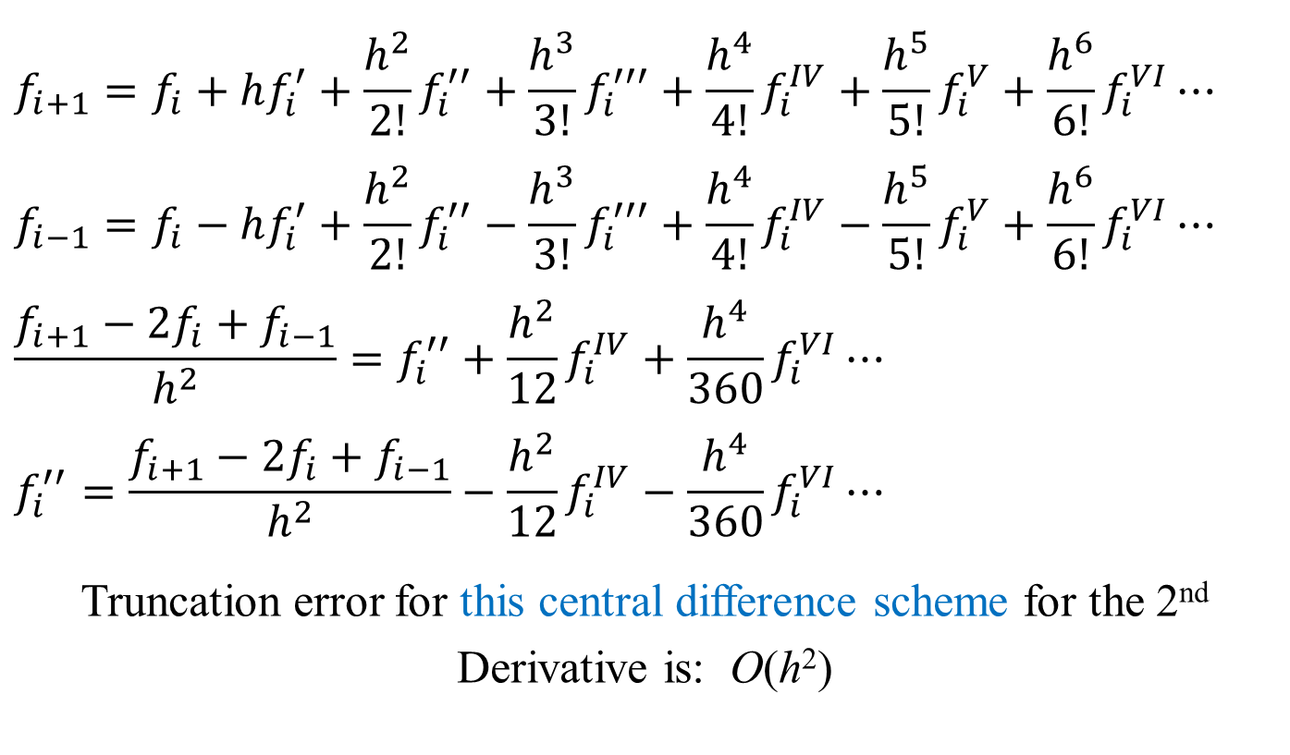
Truncation Error Analysis: Second Derivative
$$f_{i+1}=f_{i}+hf_{i}^{′}+\frac{h^{2}}{2!}f_{i}^{′′}+\frac{h^{3}}{3!}f_{i}^{′′′}+\frac{h^{4}}{4!}f_{i}^{IV}+\frac{h^{5}}{5!}f_{i}^{V}+\frac{h^{6}}{6!}f_{i}^{VI}⋯$$
$$f_{i−1}=f_{i}−hf_{i}^{′}+\frac{h^{2}}{2!}f_{i}^{′′}−\frac{h^{3}}{3!}f_{i}^{′′′}+\frac{h^{4}}{4!}f_{i}^{IV}−\frac{h^{5}}{5!}f_{i}^{V}+\frac{h^{6}}{6!}f_{i}^{VI}⋯$$
$$\frac{f_{i+1}−2f_{i}+f_{i−1}}{h^{2}}=f_{i}^{′′}+\frac{h^{2}}{12}f_{i}^{IV}+\frac{h^{4}}{360}f_{i}^{VI}⋯$$
$$f_{i}^{′′}=\frac{f_{i+1}−2f_{i}+f_{i−1}}{h^{2}}−\frac{h^{2}}{12}f_{i}^{IV}−\frac{h^{4}}{360}f_{i}^{VI}⋯$$
Truncation error for this central difference scheme for the 2nd Derivative is: O(h²)

Slide 10
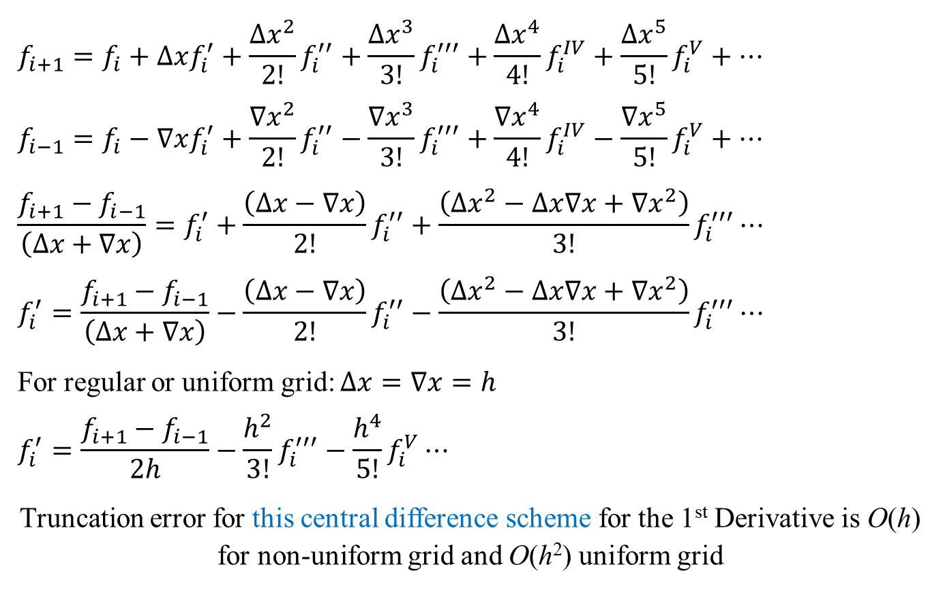
Truncation Error Analysis: Non-Uniform Grid
$$f_{i+1}=f_{i}+∆xf_{i}^{′}+\frac{{∆x}^{2}}{2!}f_{i}^{′′}+\frac{∆x^{3}}{3!}f_{i}^{′′′}+\frac{{∆x}^{4}}{4!}f_{i}^{IV}+\frac{{∆x}^{5}}{5!}f_{i}^{V}+⋯$$
$$f_{i−1}=f_{i}−∇xf_{i}^{′}+\frac{{∇x}^{2}}{2!}f_{i}^{′′}−\frac{{∇x}^{3}}{3!}f_{i}^{′′′}+\frac{{∇x}^{4}}{4!}f_{i}^{IV}−\frac{{∇x}^{5}}{5!}f_{i}^{V}+⋯$$
$$\frac{f_{i+1}−f_{i−1}}{\left(∆x+∇x\right)}=f_{i}^{′}+\frac{\left(∆x−∇x\right)}{2!}f_{i}^{′′}+\frac{\left({∆x}^{2}−∆x∇x+{∇x}^{2}\right)}{3!}f_{i}^{′′′}⋯$$
$$f_{i}^{′}=\frac{f_{i+1}−f_{i−1}}{\left(∆x+∇x\right)}−\frac{\left(∆x−∇x\right)}{2!}f_{i}^{′′}−\frac{\left({∆x}^{2}−∆x∇x+{∇x}^{2}\right)}{3!}f_{i}^{′′′}⋯$$
For regular or uniform grid: $∆x=∇x=h$
$$f_{i}^{′}=\frac{f_{i+1}−f_{i−1}}{2h}−\frac{h^{2}}{3!}f_{i}^{′′′}−\frac{h^{4}}{5!}f_{i}^{V}⋯$$
Truncation error for this central difference scheme for the 1st Derivative is O(h) for non-uniform grid and O(h²) uniform grid

Slide 11
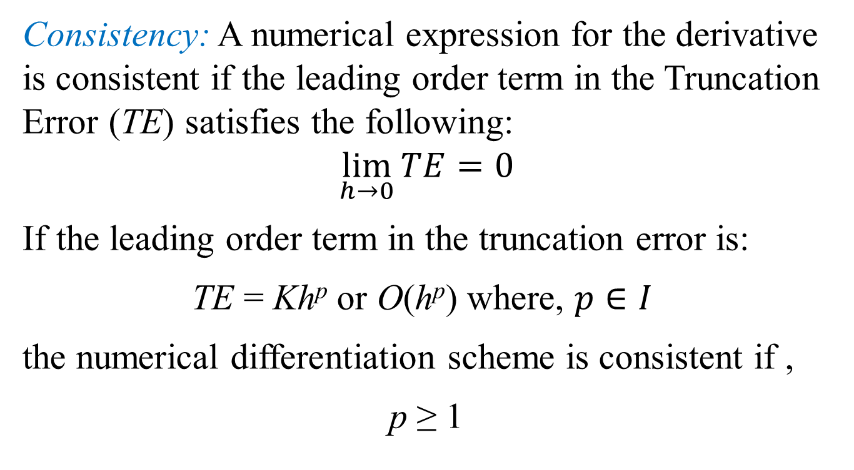
Numerical Differentiation: Finite Difference
Consistency: A numerical expression for the derivative is consistent if the leading order term in the Truncation Error (TE) satisfies the following:
$$\lim_{h→0}{TE}=0$$
If the leading order term in the truncation error is:
TE = Kh^{p} or O(h^{p}) where, $p∈I$
the numerical differentiation scheme is consistent if ,
p ≥ 1

Slide 12

General Technique for Construction of Finite Difference Scheme of Arbitrary Order
General finite difference scheme for uniform grid size h:
$$f_{i}^{′}=\sum_{k=−m}^{n}{a_{k}f_{i+k}}+O\left(h^{p}\right)$$
or
$$f_{i}^{′′}=\sum_{k=−m}^{n}{a_{k}f_{i+k}}+O\left(h^{p}\right)$$
or
$$f_{i}^{q}=\sum_{k=−m}^{n}{a_{k}f_{i+k}}+O\left(h^{p}\right)$$
Let us take an example with q = 1, m = 2 and n = 0
Method of Undetermined Coefficients

Slide 13
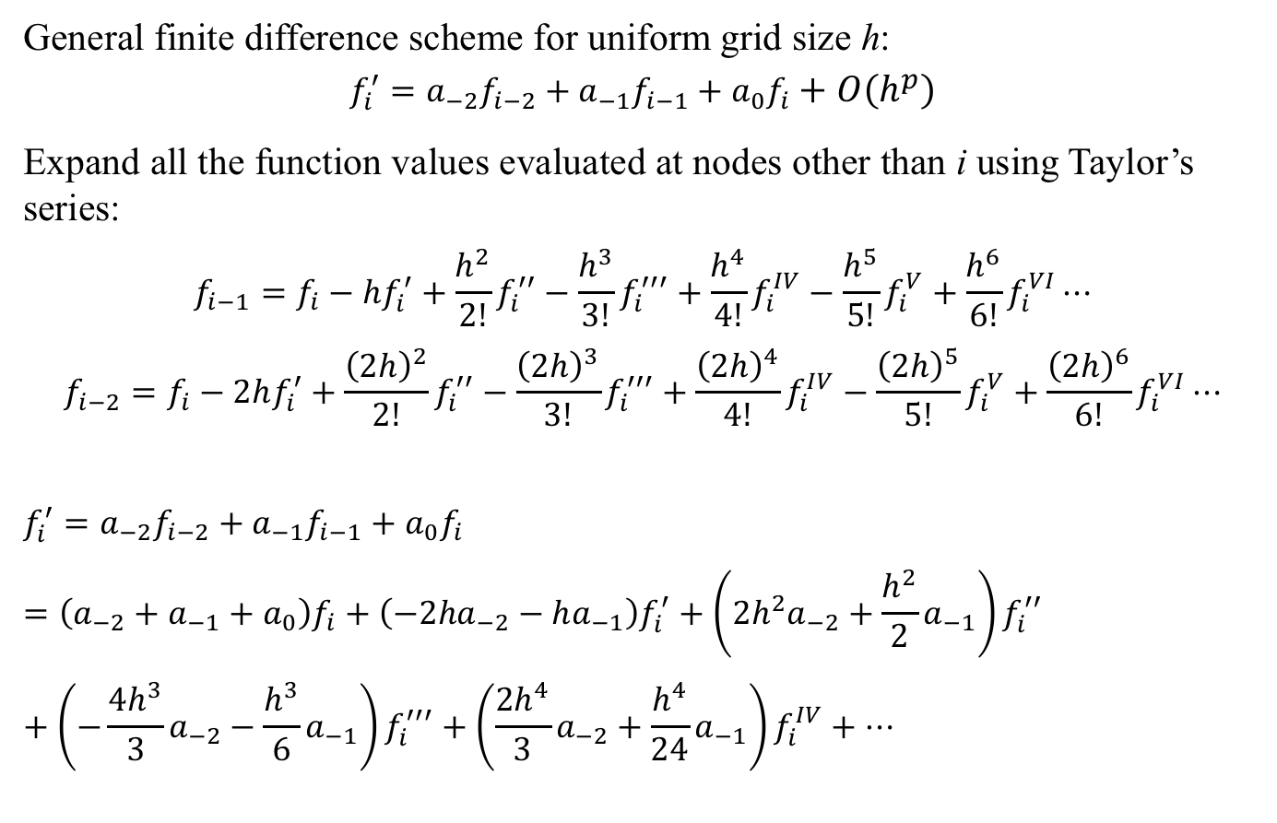
General Technique for Construction of Finite Difference Scheme of Arbitrary Order: Example
General finite difference scheme for uniform grid size h:
$$f_{i}^{′}=a_{−2}f_{i−2}+a_{−1}f_{i−1}+a_{0}f_{i}+O\left(h^{p}\right)$$
Expand all the function values evaluated at nodes other than i using Taylor’s series:
$$f_{i−1}=f_{i}−hf_{i}^{′}+\frac{h^{2}}{2!}f_{i}^{′′}−\frac{h^{3}}{3!}f_{i}^{′′′}+\frac{h^{4}}{4!}f_{i}^{IV}−\frac{h^{5}}{5!}f_{i}^{V}+\frac{h^{6}}{6!}f_{i}^{VI}⋯$$
$$f_{i−2}=f_{i}−2hf_{i}^{′}+\frac{{\left(2h\right)}^{2}}{2!}f_{i}^{′′}−\frac{{\left(2h\right)}^{3}}{3!}f_{i}^{′′′}+\frac{{\left(2h\right)}^{4}}{4!}f_{i}^{IV}−\frac{{\left(2h\right)}^{5}}{5!}f_{i}^{V}+\frac{{\left(2h\right)}^{6}}{6!}f_{i}^{VI}⋯$$
$$f_{i}^{′}=a_{−2}f_{i−2}+a_{−1}f_{i−1}+a_{0}f_{i}=\left(a_{−2}+a_{−1}+a_{0}\right)f_{i}+\left({−2ha}_{−2}−ha_{−1}\right)f_{i}^{′}+\left({2h^{2}a}_{−2}+\frac{h^{2}}{2}a_{−1}\right)f_{i}^{′′}+\left({−\frac{{4h}^{3}}{3}a}_{−2}−\frac{h^{3}}{6}a_{−1}\right)f_{i}^{′′′}+\left({\frac{{2h}^{4}}{3}a}_{−2}+\frac{h^{4}}{24}a_{−1}\right)f_{i}^{IV}+⋯$$

Slide 14
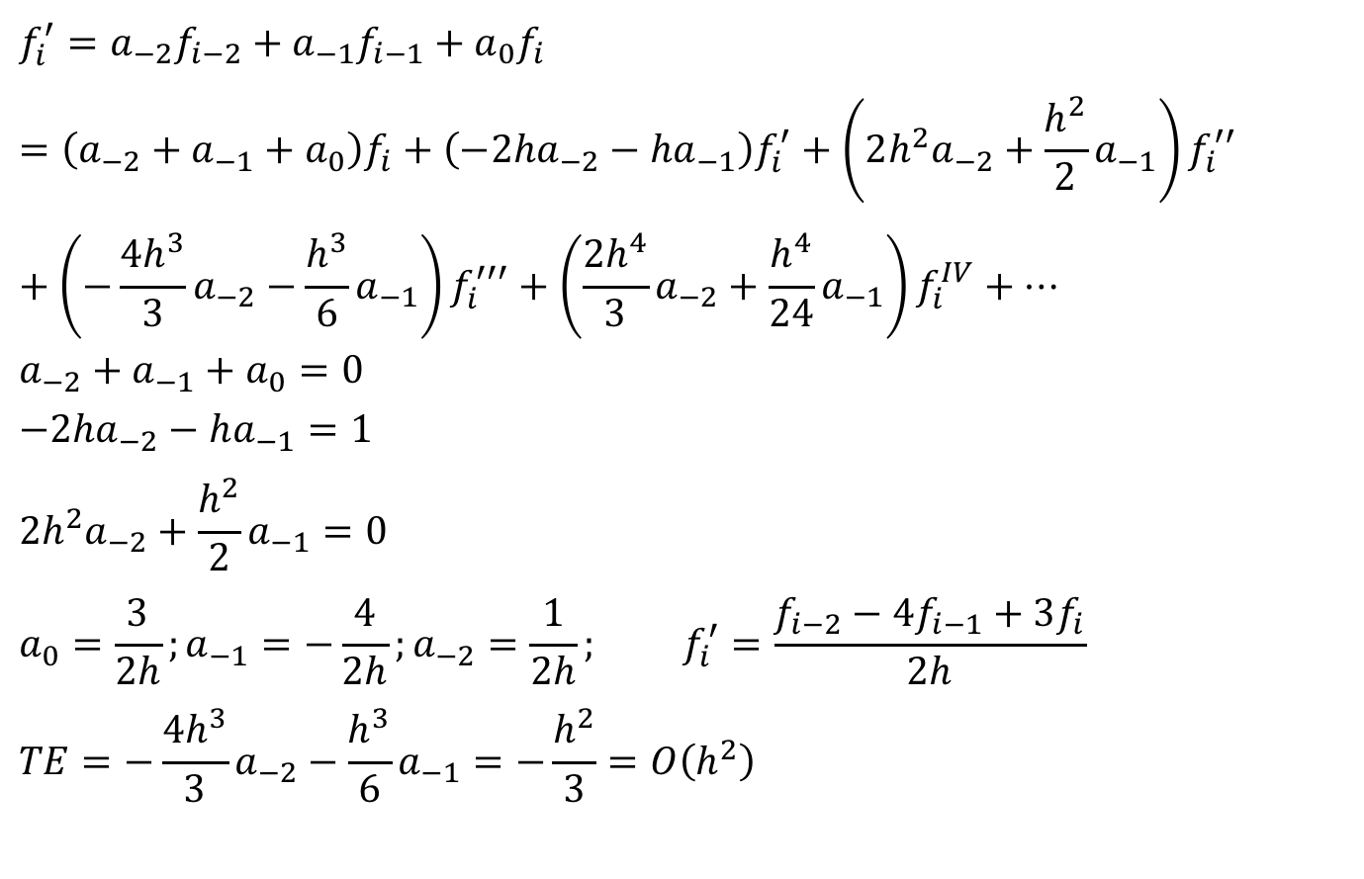
General Technique for Construction of Finite Difference Scheme of Arbitrary Order: Example
$$f_{i}^{′}=a_{−2}f_{i−2}+a_{−1}f_{i−1}+a_{0}f_{i}=\left(a_{−2}+a_{−1}+a_{0}\right)f_{i}+\left({−2ha}_{−2}−ha_{−1}\right)f_{i}^{′}+\left({{2h}^{2}a}_{−2}+\frac{h^{2}}{2}a_{−1}\right)f_{i}^{′′}+\left({−\frac{{4h}^{3}}{3}a}_{−2}−\frac{h^{3}}{6}a_{−1}\right)f_{i}^{′′′}+\left({\frac{{2h}^{4}}{3}a}_{−2}+\frac{h^{4}}{24}a_{−1}\right)f_{i}^{IV}+⋯$$
$$a_{−2}+a_{−1}+a_{0}=0$$
$${−2ha}_{−2}−ha_{−1}=1$$
$${{2h}^{2}a}_{−2}+\frac{h^{2}}{2}a_{−1}=0$$
$$a_{0}=\frac{3}{2h};a_{−1}=−\frac{4}{2h};a_{−2}=\frac{1}{2h}; f_{i}^{′}=\frac{f_{i−2}−4f_{i−1}+3f_{i}}{2h}$$
$$TE={−\frac{{4h}^{3}}{3}a}_{−2}−\frac{h^{3}}{6}a_{−1}=−\frac{h^{2}}{3}=O\left(h^{2}\right)$$

Slide 15
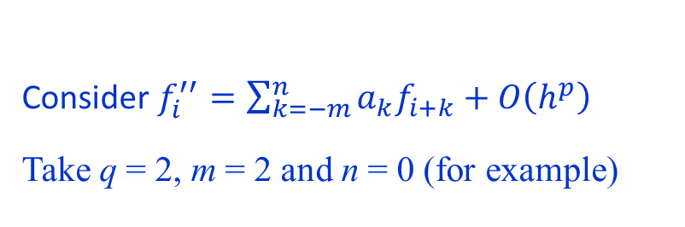
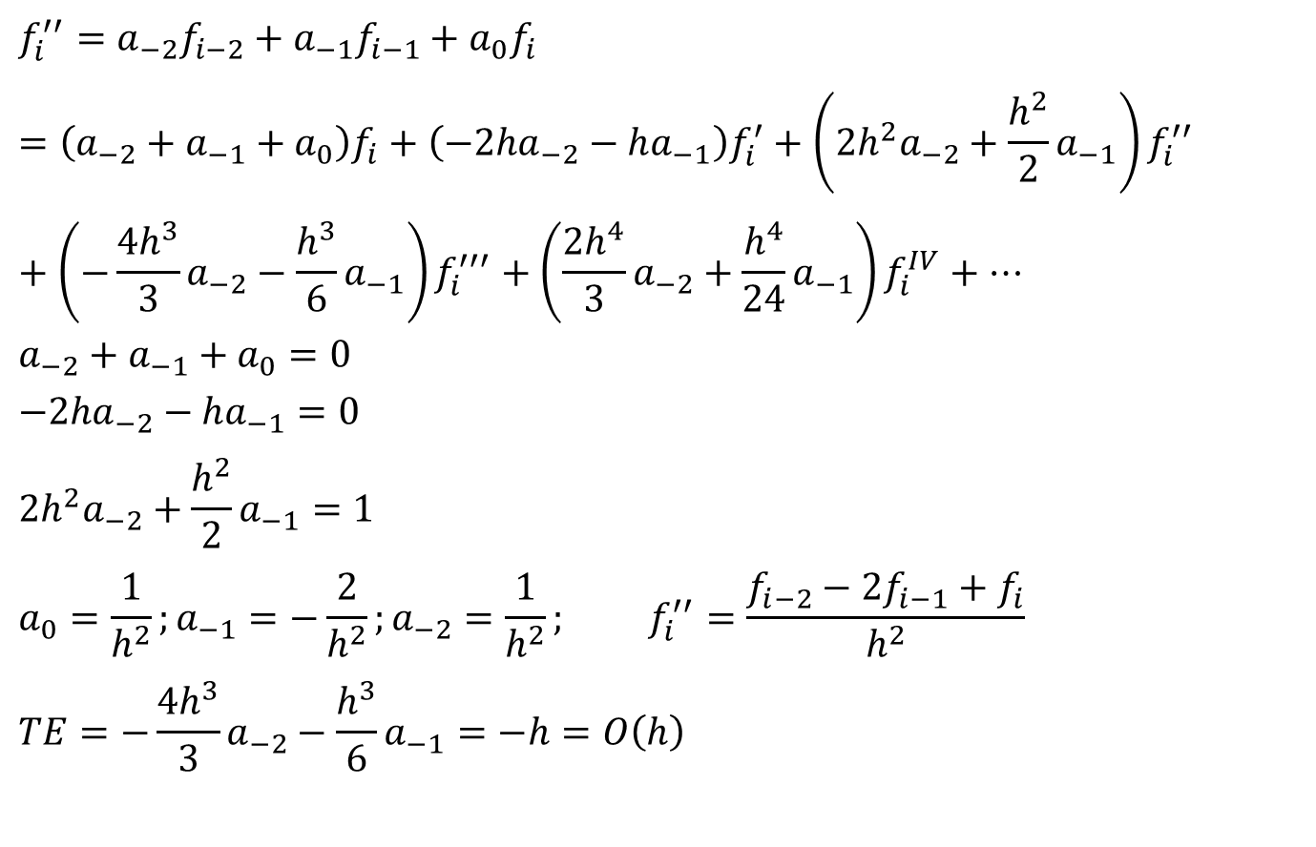
General Technique for Construction of Finite Difference Scheme of Arbitrary Order: Example
$$f_{i}^{′′}=a_{−2}f_{i−2}+a_{−1}f_{i−1}+a_{0}f_{i}=\left(a_{−2}+a_{−1}+a_{0}\right)f_{i}+\left({−2ha}_{−2}−ha_{−1}\right)f_{i}^{′}+\left({{2h}^{2}a}_{−2}+\frac{h^{2}}{2}a_{−1}\right)f_{i}^{′′}+\left({−\frac{{4h}^{3}}{3}a}_{−2}−\frac{h^{3}}{6}a_{−1}\right)f_{i}^{′′′}+\left({\frac{{2h}^{4}}{3}a}_{−2}+\frac{h^{4}}{24}a_{−1}\right)f_{i}^{IV}+⋯$$
$$a_{−2}+a_{−1}+a_{0}=0$$
$${−2ha}_{−2}−ha_{−1}=0$$
$${{2h}^{2}a}_{−2}+\frac{h^{2}}{2}a_{−1}=1$$
$$a_{0}=\frac{1}{h^{2}};a_{−1}=−\frac{2}{h^{2}};a_{−2}=\frac{1}{h^{2}}; f_{i}^{′′}=\frac{f_{i−2}−2f_{i−1}+f_{i}}{h^{2}}$$
$$TE={−\frac{{4h}^{3}}{3}a}_{−2}−\frac{h^{3}}{6}a_{−1}=−h=O\left(h\right)$$
Consider$f_{i}^{′′}=\sum_{k=−m}^{n}{a_{k}f_{i+k}}+O\left(h^{p}\right)$
Take q = 2, m = 2 and n = 0 (for example)

Slide 16





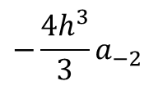

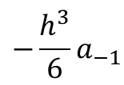







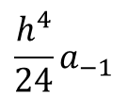





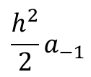





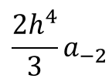


General Technique for Construction of Finite Difference Scheme of Arbitrary Order: Example
General finite difference scheme for uniform grid size h:
$$f_{i}^{′}=a_{−2}f_{i−2}+a_{−1}f_{i−1}+a_{0}f_{i}+O\left(h^{p}\right)$$
$$f_{i}$$
$$f_{i}^{′}$$
$$f_{i}^{′′}$$
$$f_{i}^{′′′}$$
$$f_{i}^{IV}$$
LHS
$$f_{i}^{′}$$
$$0$$
$$1$$
$$0$$
$$0$$
$$0$$
RHS
$$a_{0}f_{i}$$
$$a_{0}$$
$$0$$
$$0$$
$$0$$
$$0$$
$$a_{−1}$$
$$−ha_{−1}$$
$$\frac{h^{2}}{2}a_{−1}$$
$$−\frac{h^{3}}{6}a_{−1}$$
$$\frac{h^{4}}{24}a_{−1}$$
RHS
$$a_{−1}f_{i−1}$$
RHS
$${−\frac{{4h}^{3}}{3}a}_{−2}$$
$${\frac{{2h}^{4}}{3}a}_{−2}$$
$$a_{−2}f_{i−2}$$
$$a_{−2}$$
$${−2ha}_{−2}$$
$${2h^{2}a}_{−2}$$

Slide 17
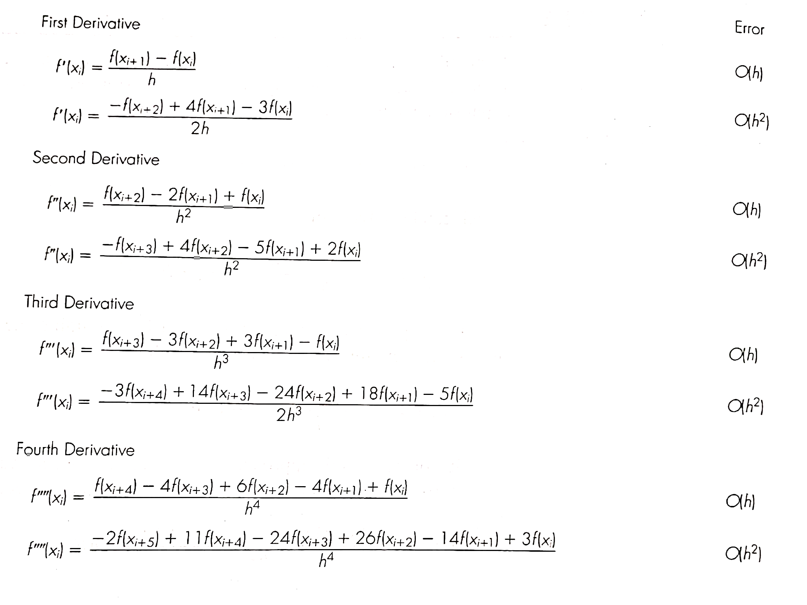
Forward Finite Difference Schemes of Arbitrary Orders

Slide 18
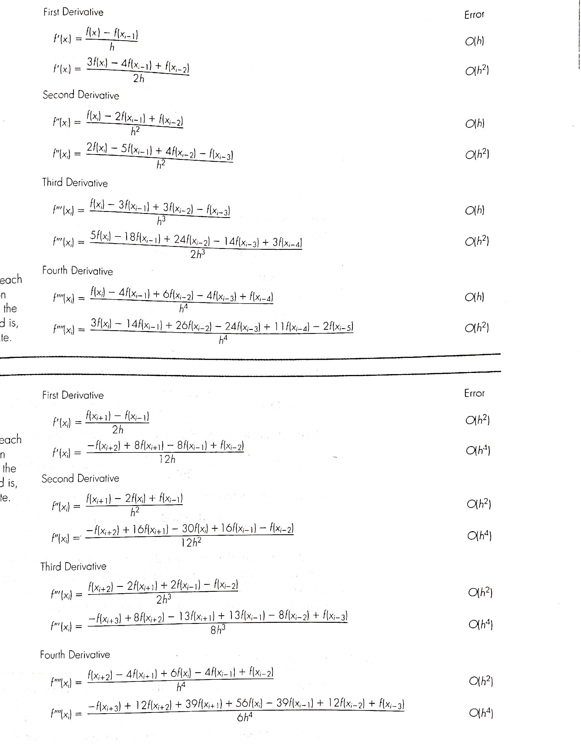
Backward Finite Difference Schemes of Arbitrary Orders

Slide 19
Central Finite Difference Schemes of Arbitrary Orders

Slide 20
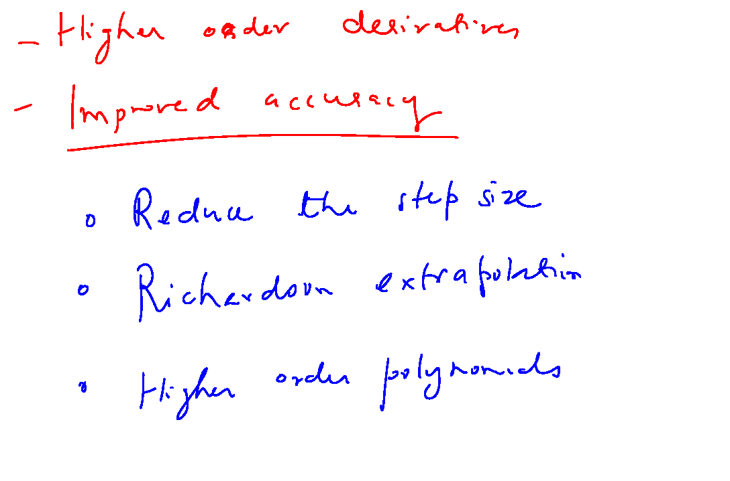

Slide 21
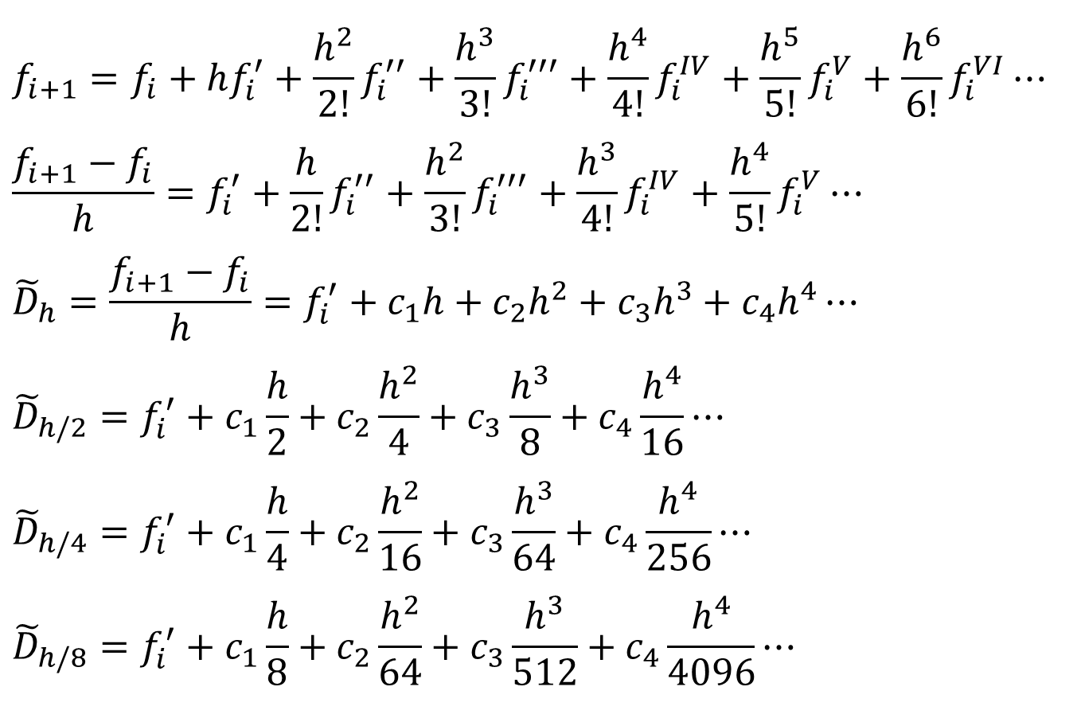
Richardson’s Extrapolation
$$f_{i+1}=f_{i}+hf_{i}^{′}+\frac{h^{2}}{2!}f_{i}^{′′}+\frac{h^{3}}{3!}f_{i}^{′′′}+\frac{h^{4}}{4!}f_{i}^{IV}+\frac{h^{5}}{5!}f_{i}^{V}+\frac{h^{6}}{6!}f_{i}^{VI}⋯$$
$$\frac{f_{i+1}−f_{i}}{h}=f_{i}^{′}+\frac{h}{2!}f_{i}^{′′}+\frac{h^{2}}{3!}f_{i}^{′′′}+\frac{h^{3}}{4!}f_{i}^{IV}+\frac{h^{4}}{5!}f_{i}^{V}⋯$$
$${\tilde{D}}_{h}=\frac{f_{i+1}−f_{i}}{h}=f_{i}^{′}+c_{1}h+c_{2}h^{2}+c_{3}h^{3}+c_{4}h^{4}⋯$$
$${\tilde{D}}_{h/2}=f_{i}^{′}+c_{1}\frac{h}{2}+c_{2}\frac{h^{2}}{4}+c_{3}\frac{h^{3}}{8}+c_{4}\frac{h^{4}}{16}⋯$$
$${\tilde{D}}_{h/4}=f_{i}^{′}+c_{1}\frac{h}{4}+c_{2}\frac{h^{2}}{16}+c_{3}\frac{h^{3}}{64}+c_{4}\frac{h^{4}}{256}⋯$$
$${\tilde{D}}_{h/8}=f_{i}^{′}+c_{1}\frac{h}{8}+c_{2}\frac{h^{2}}{64}+c_{3}\frac{h^{3}}{512}+c_{4}\frac{h^{4}}{4096}⋯$$

Slide 22
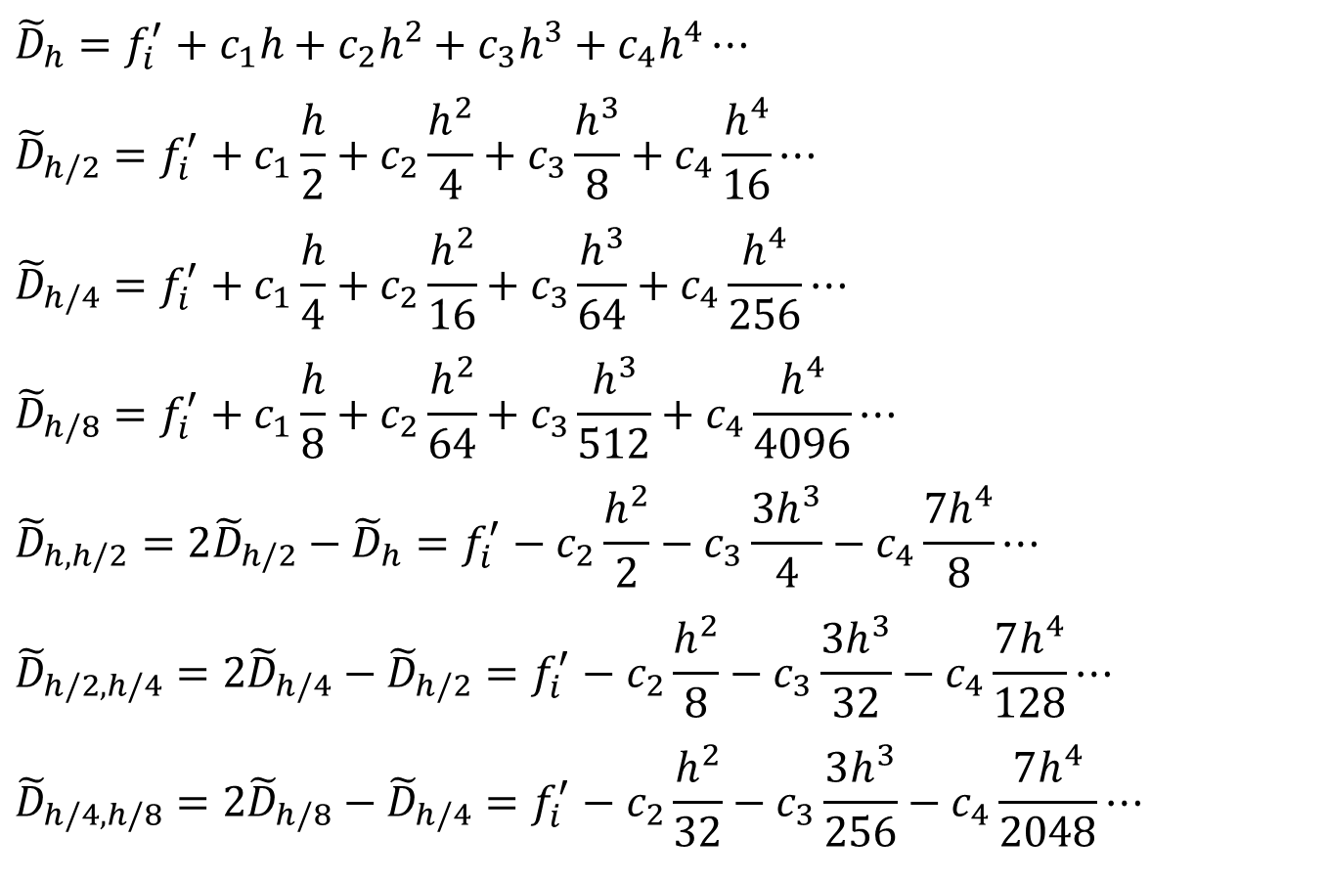
Richardson’s Extrapolation
$${\tilde{D}}_{h}=f_{i}^{′}+c_{1}h+c_{2}h^{2}+c_{3}h^{3}+c_{4}h^{4}⋯$$
$${\tilde{D}}_{h/2}=f_{i}^{′}+c_{1}\frac{h}{2}+c_{2}\frac{h^{2}}{4}+c_{3}\frac{h^{3}}{8}+c_{4}\frac{h^{4}}{16}⋯$$
$${\tilde{D}}_{h/4}=f_{i}^{′}+c_{1}\frac{h}{4}+c_{2}\frac{h^{2}}{16}+c_{3}\frac{h^{3}}{64}+c_{4}\frac{h^{4}}{256}⋯$$
$${\tilde{D}}_{h/8}=f_{i}^{′}+c_{1}\frac{h}{8}+c_{2}\frac{h^{2}}{64}+c_{3}\frac{h^{3}}{512}+c_{4}\frac{h^{4}}{4096}⋯$$
$${\tilde{D}}_{h,h/2}=2{\tilde{D}}_{h/2}−{\tilde{D}}_{h}=f_{i}^{′}−c_{2}\frac{h^{2}}{2}−c_{3}\frac{3h^{3}}{4}−c_{4}\frac{7h^{4}}{8}⋯$$
$${\tilde{D}}_{h/2,h/4}=2{\tilde{D}}_{h/4}−{\tilde{D}}_{h/2}=f_{i}^{′}−c_{2}\frac{h^{2}}{8}−c_{3}\frac{3h^{3}}{32}−c_{4}\frac{7h^{4}}{128}⋯$$
$${\tilde{D}}_{h/4,h/8}=2{\tilde{D}}_{h/8}−{\tilde{D}}_{h/4}=f_{i}^{′}−c_{2}\frac{h^{2}}{32}−c_{3}\frac{3h^{3}}{256}−c_{4}\frac{7h^{4}}{2048}⋯$$
Combine terms to result in derivative estimates of TE O(h²)

Slide 23
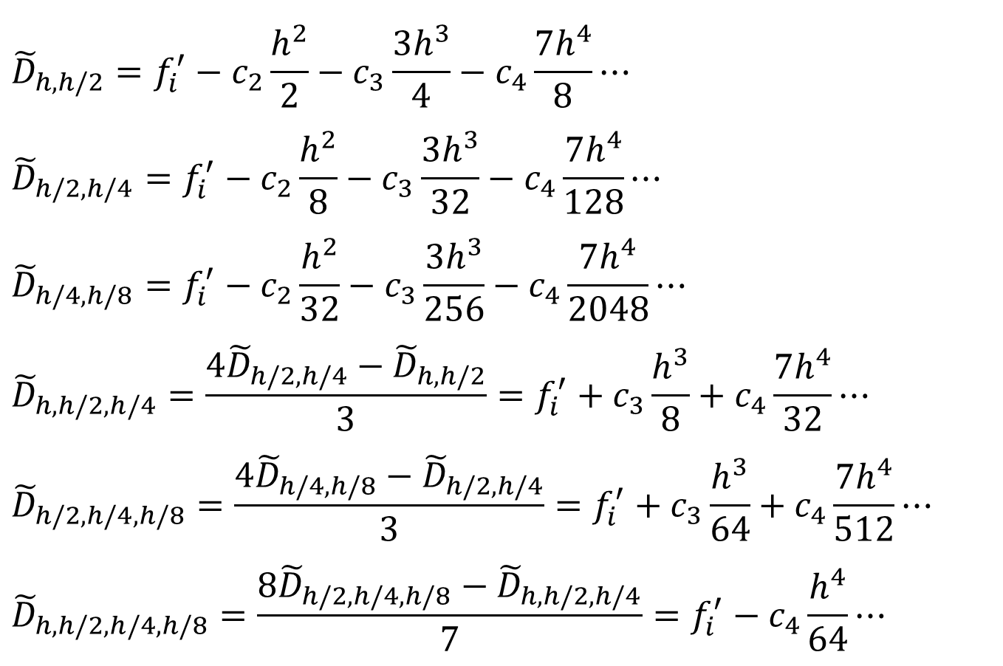
Richardson’s Extrapolation
$${\tilde{D}}_{h,h/2}=f_{i}^{′}−c_{2}\frac{h^{2}}{2}−c_{3}\frac{3h^{3}}{4}−c_{4}\frac{7h^{4}}{8}⋯$$
$${\tilde{D}}_{h/2,h/4}=f_{i}^{′}−c_{2}\frac{h^{2}}{8}−c_{3}\frac{3h^{3}}{32}−c_{4}\frac{7h^{4}}{128}⋯$$
$${\tilde{D}}_{h/4,h/8}=f_{i}^{′}−c_{2}\frac{h^{2}}{32}−c_{3}\frac{3h^{3}}{256}−c_{4}\frac{7h^{4}}{2048}⋯$$
$${\tilde{D}}_{h,h/2,h/4}=\frac{4{\tilde{D}}_{h/2,h/4}−{\tilde{D}}_{h,h/2}}{3}=f_{i}^{′}+c_{3}\frac{h^{3}}{8}+c_{4}\frac{7h^{4}}{32}⋯$$
$${\tilde{D}}_{h/2,h/4,h/8}=\frac{4{\tilde{D}}_{h/4,h/8}−{\tilde{D}}_{h/2,h/4}}{3}=f_{i}^{′}+c_{3}\frac{h^{3}}{64}+c_{4}\frac{7h^{4}}{512}⋯$$
$${\tilde{D}}_{h,h/2,h/4,h/8}=\frac{8{\tilde{D}}_{h/2,h/4,h/8}−{\tilde{D}}_{h,h/2,h/4}}{7}=f_{i}^{′}−c_{4}\frac{h^{4}}{64}⋯$$
Combine terms to result in derivative estimates of TE O(h³)

Slide 24
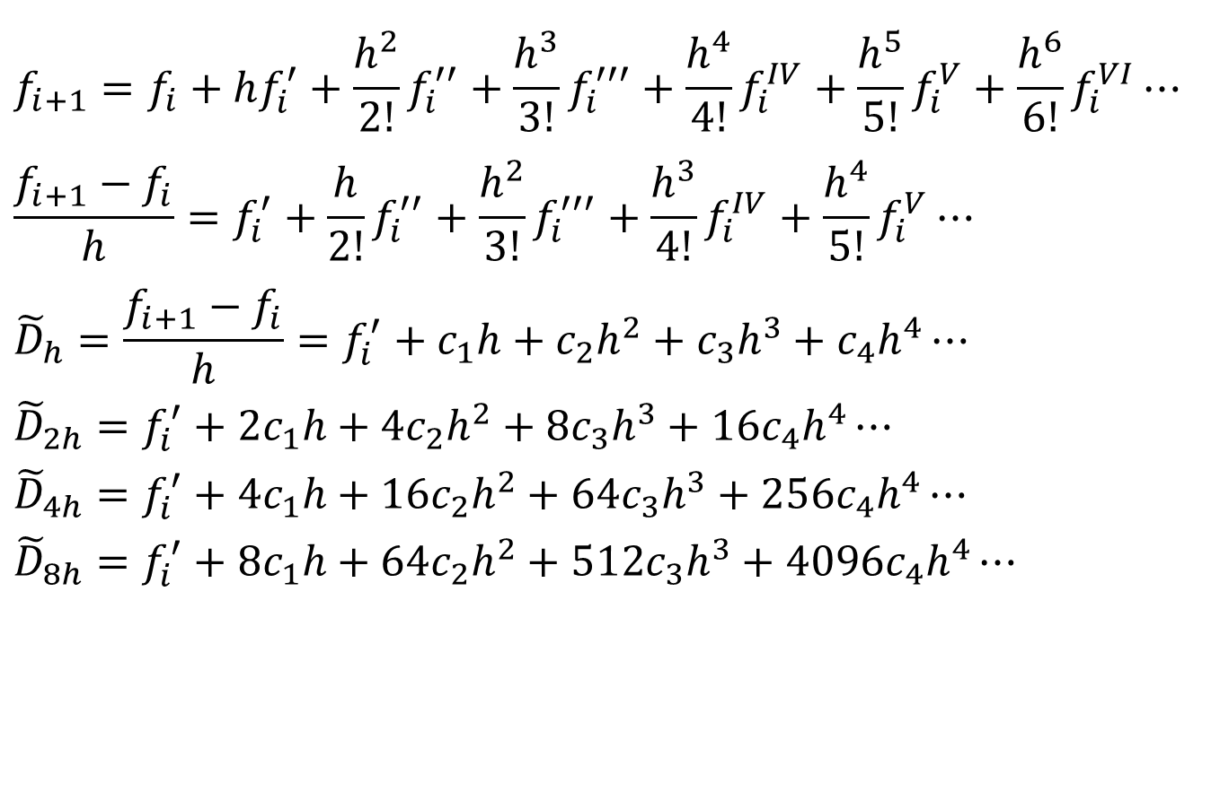
Richardson’s Extrapolation
$$f_{i+1}=f_{i}+hf_{i}^{′}+\frac{h^{2}}{2!}f_{i}^{′′}+\frac{h^{3}}{3!}f_{i}^{′′′}+\frac{h^{4}}{4!}f_{i}^{IV}+\frac{h^{5}}{5!}f_{i}^{V}+\frac{h^{6}}{6!}f_{i}^{VI}⋯$$
$$\frac{f_{i+1}−f_{i}}{h}=f_{i}^{′}+\frac{h}{2!}f_{i}^{′′}+\frac{h^{2}}{3!}f_{i}^{′′′}+\frac{h^{3}}{4!}f_{i}^{IV}+\frac{h^{4}}{5!}f_{i}^{V}⋯$$
$${\tilde{D}}_{h}=\frac{f_{i+1}−f_{i}}{h}=f_{i}^{′}+c_{1}h+c_{2}h^{2}+c_{3}h^{3}+c_{4}h^{4}⋯$$
$${\tilde{D}}_{2h}=f_{i}^{′}+2c_{1}h+4c_{2}h^{2}+8c_{3}h^{3}+16c_{4}h^{4}⋯$$
$${\tilde{D}}_{4h}=f_{i}^{′}+4c_{1}h+16c_{2}h^{2}+64c_{3}h^{3}+256c_{4}h^{4}⋯$$
$${\tilde{D}}_{8h}=f_{i}^{′}+8c_{1}h+64c_{2}h^{2}+512c_{3}h^{3}+4096c_{4}h^{4}⋯$$

Slide 25
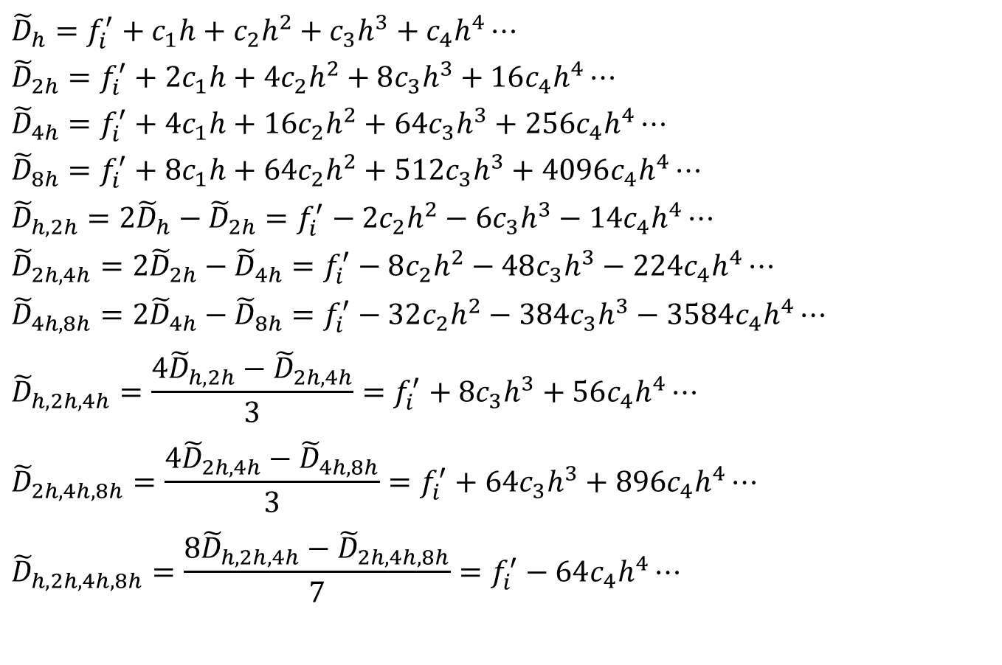
Richardson’s Extrapolation
$${\tilde{D}}_{h}=f_{i}^{′}+c_{1}h+c_{2}h^{2}+c_{3}h^{3}+c_{4}h^{4}⋯$$
$${\tilde{D}}_{2h}=f_{i}^{′}+2c_{1}h+4c_{2}h^{2}+8c_{3}h^{3}+16c_{4}h^{4}⋯$$
$${\tilde{D}}_{4h}=f_{i}^{′}+4c_{1}h+16c_{2}h^{2}+64c_{3}h^{3}+256c_{4}h^{4}⋯$$
$${\tilde{D}}_{8h}=f_{i}^{′}+8c_{1}h+64c_{2}h^{2}+512c_{3}h^{3}+4096c_{4}h^{4}⋯$$
$${\tilde{D}}_{h,2h}=2{\tilde{D}}_{h}−{\tilde{D}}_{2h}=f_{i}^{′}−2c_{2}h^{2}−6c_{3}h^{3}−14c_{4}h^{4}⋯$$
$${\tilde{D}}_{2h,4h}=2{\tilde{D}}_{2h}−{\tilde{D}}_{4h}=f_{i}^{′}−8c_{2}h^{2}−48c_{3}h^{3}−224c_{4}h^{4}⋯$$
$${\tilde{D}}_{4h,8h}=2{\tilde{D}}_{4h}−{\tilde{D}}_{8h}=f_{i}^{′}−32c_{2}h^{2}−384c_{3}h^{3}−3584c_{4}h^{4}⋯$$
$${\tilde{D}}_{h,2h,4h}=\frac{4{\tilde{D}}_{h,2h}−{\tilde{D}}_{2h,4h}}{3}=f_{i}^{′}+8c_{3}h^{3}+56c_{4}h^{4}⋯$$
$${\tilde{D}}_{2h,4h,8h}=\frac{4{\tilde{D}}_{2h,4h}−{\tilde{D}}_{4h,8h}}{3}=f_{i}^{′}+64c_{3}h^{3}+896c_{4}h^{4}⋯$$
$${\tilde{D}}_{h,2h,4h,8h}=\frac{8{\tilde{D}}_{h,2h,4h}−{\tilde{D}}_{2h,4h,8h}}{7}=f_{i}^{′}−64c_{4}h^{4}⋯$$

Slide 26
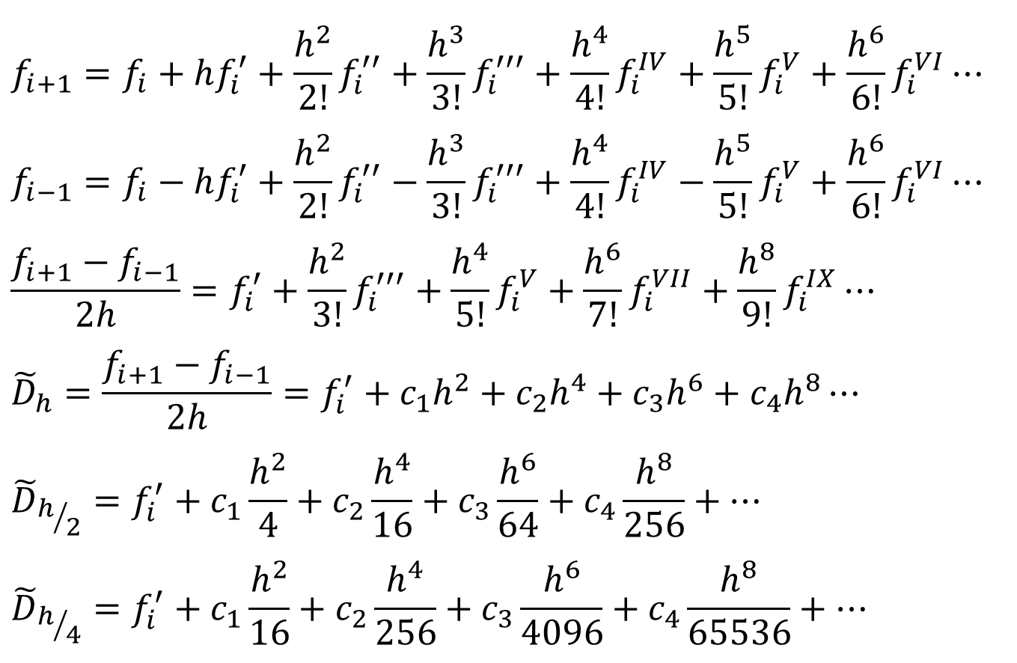
Richardson’s Extrapolation
$$f_{i+1}=f_{i}+hf_{i}^{′}+\frac{h^{2}}{2!}f_{i}^{′′}+\frac{h^{3}}{3!}f_{i}^{′′′}+\frac{h^{4}}{4!}f_{i}^{IV}+\frac{h^{5}}{5!}f_{i}^{V}+\frac{h^{6}}{6!}f_{i}^{VI}⋯$$
$$f_{i−1}=f_{i}−hf_{i}^{′}+\frac{h^{2}}{2!}f_{i}^{′′}−\frac{h^{3}}{3!}f_{i}^{′′′}+\frac{h^{4}}{4!}f_{i}^{IV}−\frac{h^{5}}{5!}f_{i}^{V}+\frac{h^{6}}{6!}f_{i}^{VI}⋯$$
$$\frac{f_{i+1}−f_{i−1}}{2h}=f_{i}^{′}+\frac{h^{2}}{3!}f_{i}^{′′′}+\frac{h^{4}}{5!}f_{i}^{V}+\frac{h^{6}}{7!}f_{i}^{VII}+\frac{h^{8}}{9!}f_{i}^{IX}⋯$$
$${\tilde{D}}_{h}=\frac{f_{i+1}−f_{i−1}}{2h}=f_{i}^{′}+c_{1}h^{2}+c_{2}h^{4}+c_{3}h^{6}+c_{4}h^{8}⋯$$
$${\tilde{D}}_{h/2}=f_{i}^{′}+c_{1}\frac{h^{2}}{4}+c_{2}\frac{h^{4}}{16}+c_{3}\frac{h^{6}}{64}+c_{4}\frac{h^{8}}{256}+⋯$$
$${\tilde{D}}_{h/4}=f_{i}^{′}+c_{1}\frac{h^{2}}{16}+c_{2}\frac{h^{4}}{256}+c_{3}\frac{h^{6}}{4096}+c_{4}\frac{h^{8}}{65536}+⋯$$

Slide 27
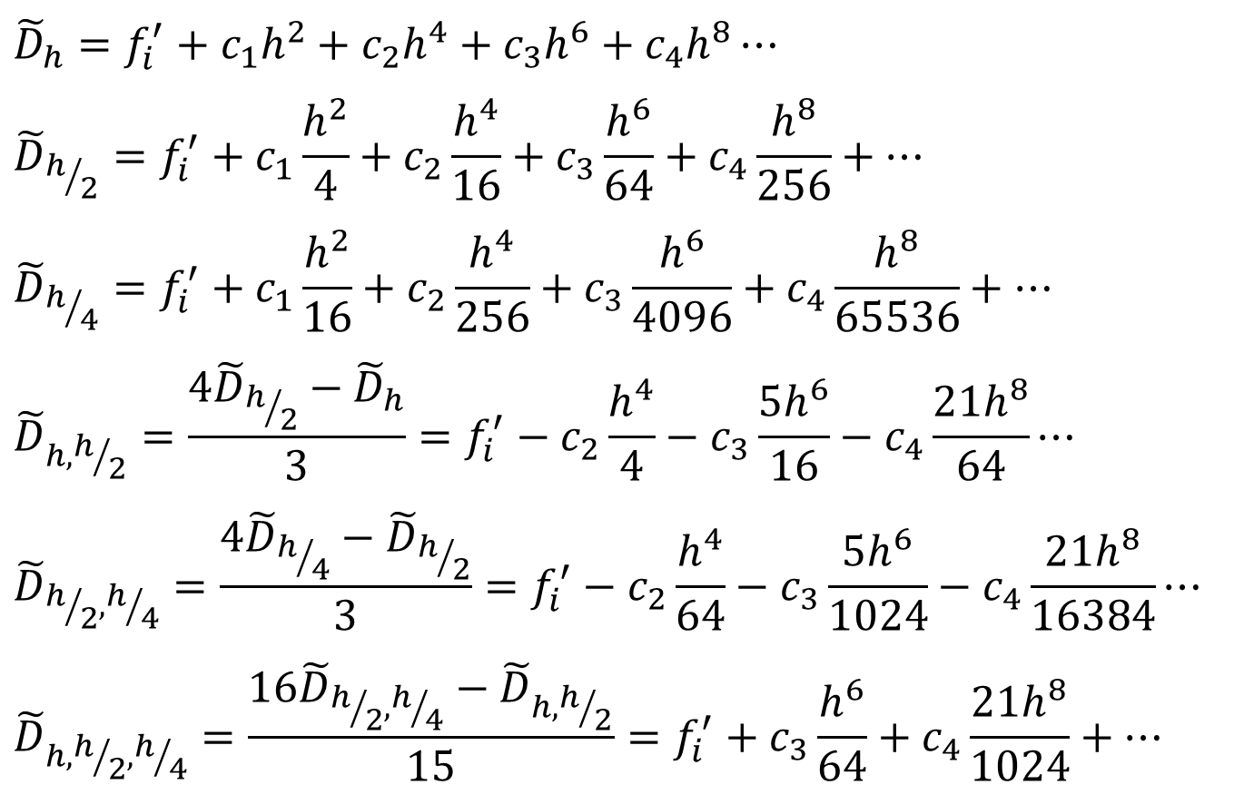
Richardson’s Extrapolation
$${\tilde{D}}_{h}=f_{i}^{′}+c_{1}h^{2}+c_{2}h^{4}+c_{3}h^{6}+c_{4}h^{8}⋯$$
$${\tilde{D}}_{h/2}=f_{i}^{′}+c_{1}\frac{h^{2}}{4}+c_{2}\frac{h^{4}}{16}+c_{3}\frac{h^{6}}{64}+c_{4}\frac{h^{8}}{256}+⋯$$
$${\tilde{D}}_{h/4}=f_{i}^{′}+c_{1}\frac{h^{2}}{16}+c_{2}\frac{h^{4}}{256}+c_{3}\frac{h^{6}}{4096}+c_{4}\frac{h^{8}}{65536}+⋯$$
$${\tilde{D}}_{h,h/2}=\frac{4{\tilde{D}}_{h/2}−{\tilde{D}}_{h}}{3}=f_{i}^{′}−c_{2}\frac{h^{4}}{4}−c_{3}\frac{{5h}^{6}}{16}−c_{4}\frac{21h^{8}}{64}⋯$$
$${\tilde{D}}_{h/2,h/4}=\frac{4{\tilde{D}}_{h/4}−{\tilde{D}}_{h/2}}{3}=f_{i}^{′}−c_{2}\frac{h^{4}}{64}−c_{3}\frac{{5h}^{6}}{1024}−c_{4}\frac{21h^{8}}{16384}⋯$$
$${\tilde{D}}_{h,h/2,h/4}=\frac{16{\tilde{D}}_{h/2,h/4}−{\tilde{D}}_{h,h/2}}{15}=f_{i}^{′}+c_{3}\frac{h^{6}}{64}+c_{4}\frac{21h^{8}}{1024}+⋯$$

Slide 28
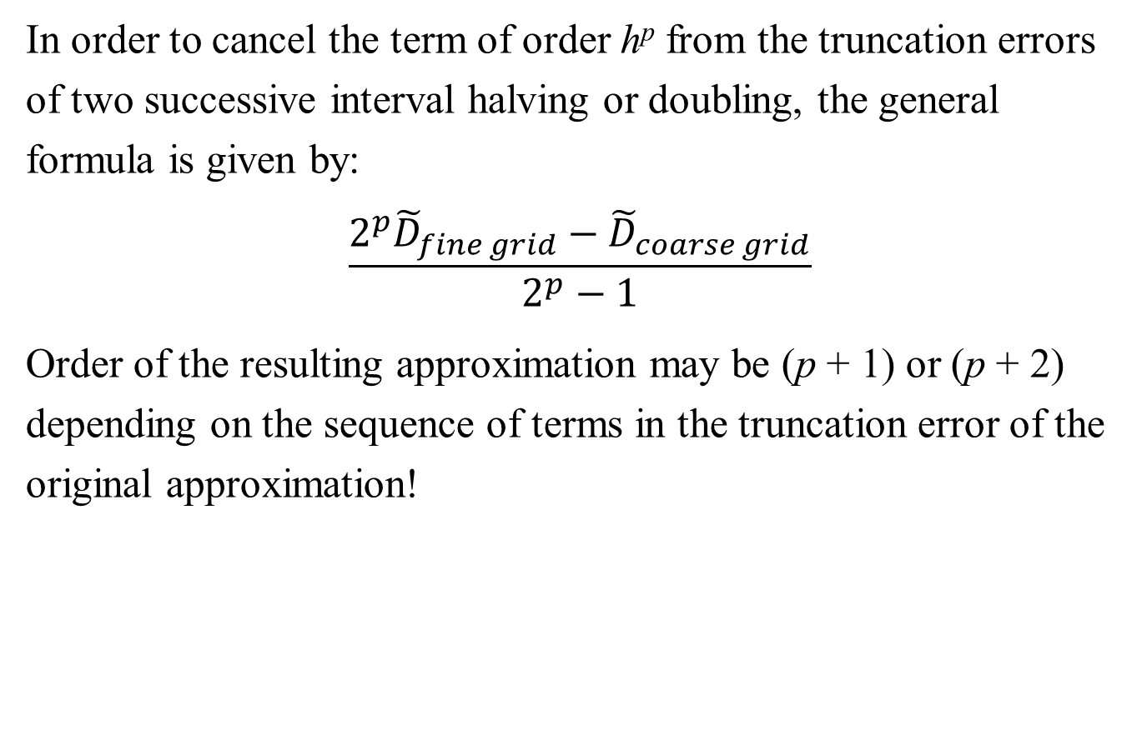
Richardson’s Extrapolation
In order to cancel the term of order h^{p} from the truncation errors of two successive interval halving or doubling, the general formula is given by:
$$\frac{2^{p}{\tilde{D}}_{fine grid}−{\tilde{D}}_{coarse grid}}{2^{p}−1}$$
Order of the resulting approximation may be (p + 1) or (p + 2) depending on the sequence of terms in the truncation error of the original approximation!

Slide 29
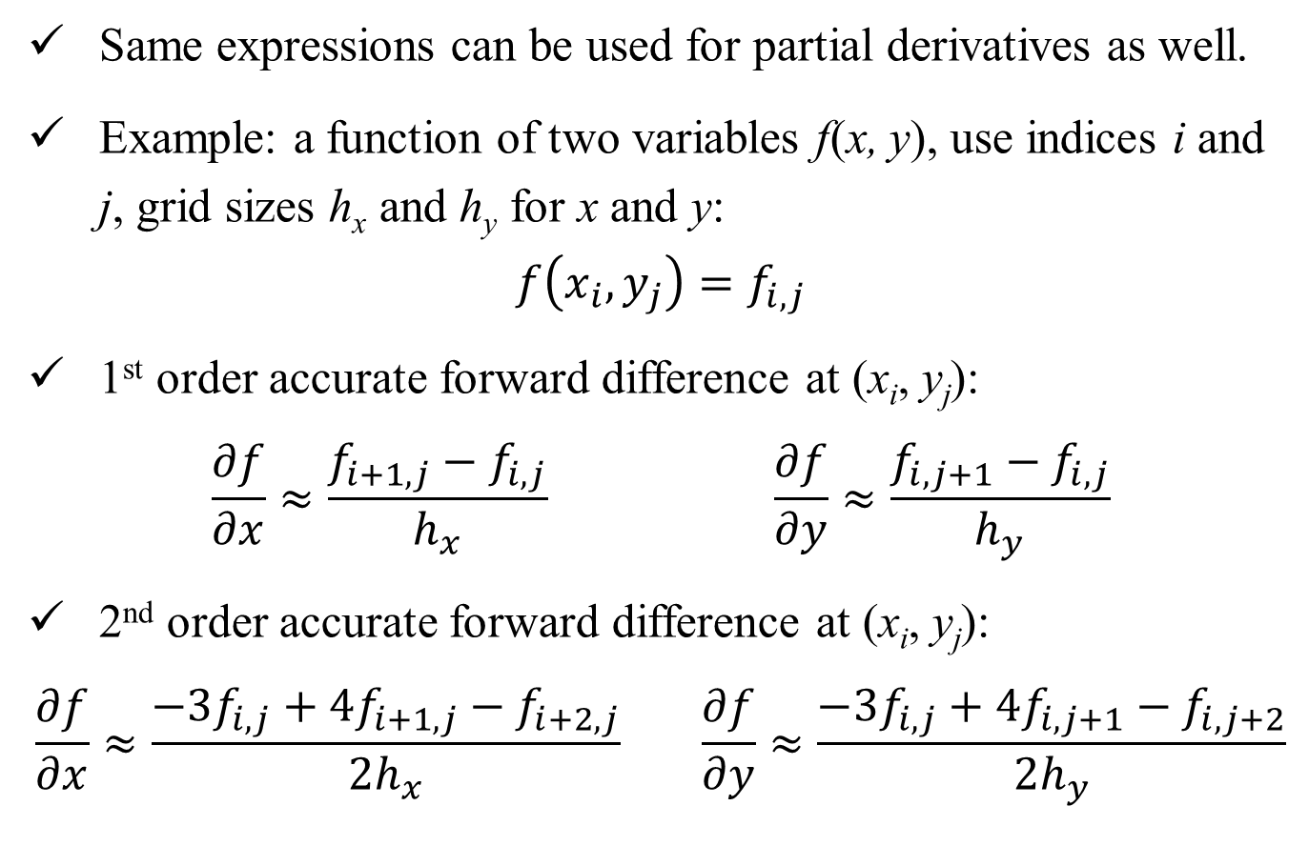
Partial Derivatives
Same expressions can be used for partial derivatives as well.
Example: a function of two variables f(x, y), use indices i and j, grid sizes h_{x} and h_{y} for x and y:
$$f\left(x_{i},y_{j}\right)=f_{i,j}$$
1st order accurate forward difference at (x_{i}, y_{j}):
$$\frac{∂f}{∂x}≈\frac{f_{i+1,j}−f_{i,j}}{h_{x}} \frac{∂f}{∂y}≈\frac{f_{i,j+1}−f_{i,j}}{h_{y}}$$
2nd order accurate forward difference at (x_{i}, y_{j}):
$$\frac{∂f}{∂x}≈\frac{−{3f}_{i,j}+4f_{i+1,j}−f_{i+2,j}}{2h_{x}} \frac{∂f}{∂y}≈\frac{−{3f}_{i,j}+4f_{i,j+1}−f_{i,j+2}}{{2h}_{y}}$$

Slide 30
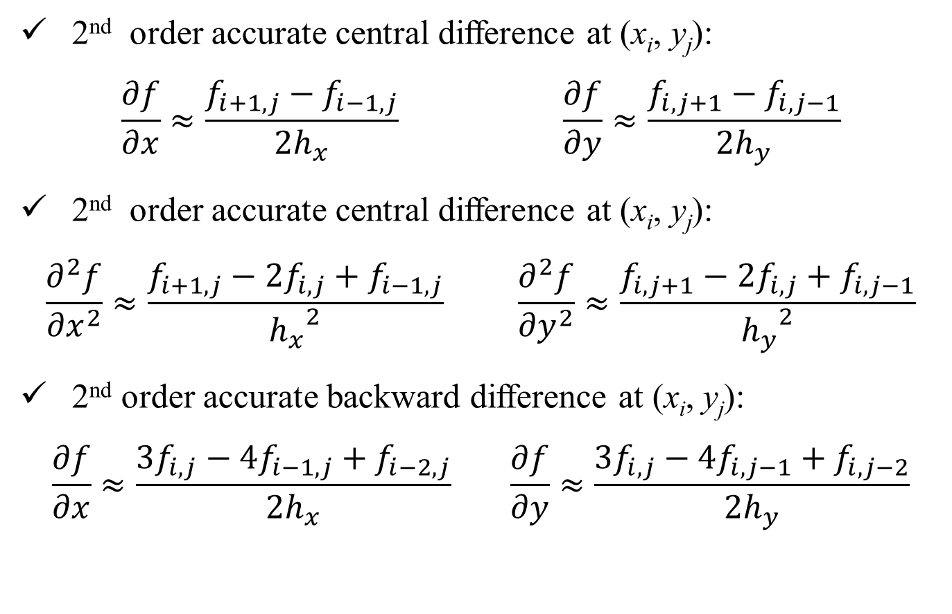
Partial Derivatives
2nd order accurate central difference at (x_{i}, y_{j}):
$$\frac{∂f}{∂x}≈\frac{f_{i+1,j}−f_{i−1,j}}{2h_{x}} \frac{∂f}{∂y}≈\frac{f_{i,j+1}−f_{i,j−1}}{{2h}_{y}}$$
2nd order accurate central difference at (x_{i}, y_{j}):
$$\frac{∂^{2}f}{{∂x}^{2}}≈\frac{f_{i+1,j}−2f_{i,j}+f_{i−1,j}}{{h_{x}}^{2}} \frac{∂^{2}f}{{∂y}^{2}}≈\frac{f_{i,j+1}−2f_{i,j}+f_{i,j−1}}{{h_{y}}^{2}}$$
2nd order accurate backward difference at (x_{i}, y_{j}):
$$\frac{∂f}{∂x}≈\frac{{3f}_{i,j}−4f_{i−1,j}+f_{i−2,j}}{2h_{x}} \frac{∂f}{∂y}≈\frac{{3f}_{i,j}−4f_{i,j−1}+f_{i,j−2}}{{2h}_{y}}$$

Slide 31
Tutorial 10 Problem 2
Sol:

