Slide 1

ESO 208A: Computational Methods in Engineering Numerical Integration
Abhas Singh
Department of Civil Engineering
IIT Kanpur
Acknowledgements: Profs. Saumyen Guha and Shivam Tripathi (CE)

Slide 2
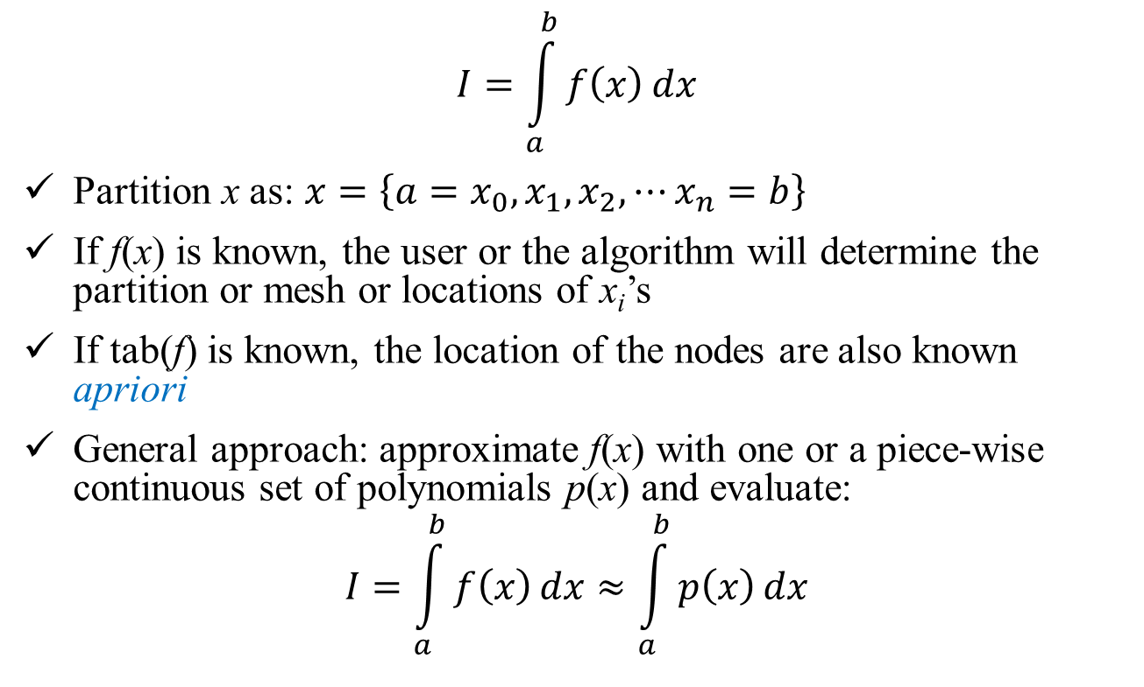
Numerical Integration
$$I=\int_{a}^{b}{f\left(x\right)}dx$$
Partition x as: $x=\left\{a=x_{0},x_{1},x_{2},⋯x_{n}=b\right\}$
If f(x) is known, the user or the algorithm will determine the partition or mesh or locations of x_{i}’s
If tab(f) is known, the location of the nodes are also known apriori
General approach: approximate f(x) with one or a piece-wise continuous set of polynomials p(x) and evaluate:
$$I=\int_{a}^{b}{f\left(x\right)}dx≈\int_{a}^{b}{p\left(x\right)}dx$$

Slide 3

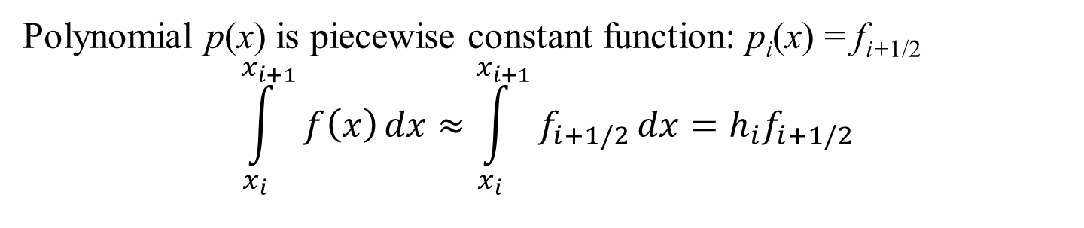
Numerical Integration: Rectangular Rule
f_{i+1/2}
f_{i+2}
$$h_{i}=x_{i+1}−x_{i}$$
f_{n}
f_{i}
f_{i+1}
f₁
f_{i-1}
f₀
a = x₀
x₁
x_{i-1}
x_{i}
x_{i+1/2}
x_{i+1}
x_{i+2}
b = x_{n}
Polynomial p(x) is piecewise constant function: p_{i}(x) = f_{i+1/2}
$$\int_{x_{i}}^{x_{i+1}}{f\left(x\right)}dx≈\int_{x_{i}}^{x_{i+1}}{f_{i+1/2}}dx=h_{i}f_{i+1/2}$$

Slide 4
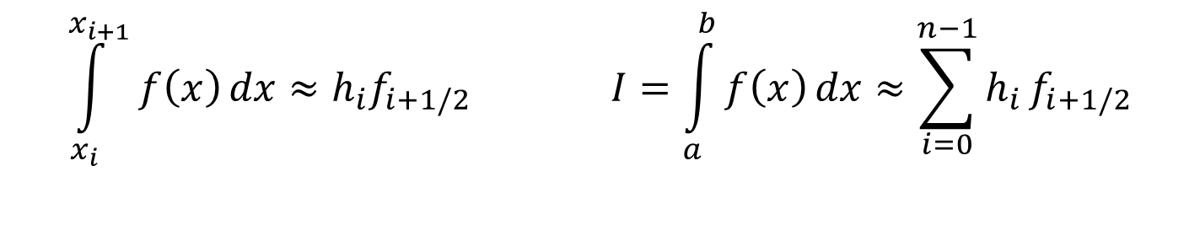
Numerical Integration: Rectangular Rule
f_{i+1/2}
f_{i+2}
$$h_{i}=x_{i+1}−x_{i}$$
f_{n}
f_{i}
f_{i+1}
f₁
f_{i-1}
f₀
a = x₀
x₁
x_{i-1}
x_{i}
x_{i+1/2}
x_{i+1}
x_{i+2}
b = x_{n}
$$\int_{x_{i}}^{x_{i+1}}{f\left(x\right)}dx≈h_{i}f_{i+1/2} I=\int_{a}^{b}{f\left(x\right)}dx≈\sum_{i=0}^{n−1}{h_{i}}f_{i+1/2}$$

Slide 5
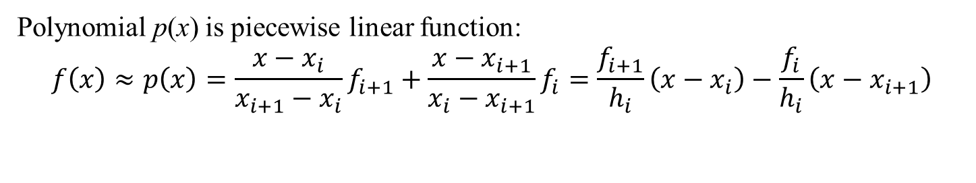
Numerical Integration: Trapezoidal Rule
$$h_{i}=x_{i+1}−x_{i}$$
f_{i+2}
f_{i}
f_{n}
f_{i+1}
f₁
f_{i-1}
f₀
a = x₀
x₁
x_{i-1}
x_{i}
x_{i+1}
x_{i+2}
b = x_{n}
Polynomial p(x) is piecewise linear function:
$$f\left(x\right)≈p\left(x\right)=\frac{x−x_{i}}{x_{i+1}−x_{i}}f_{i+1}+\frac{x−x_{i+1}}{x_{i}−x_{i+1}}f_{i}=\frac{f_{i+1}}{h_{i}}\left(x−x_{i}\right)−\frac{f_{i}}{h_{i}}\left(x−x_{i+1}\right)$$

Slide 6
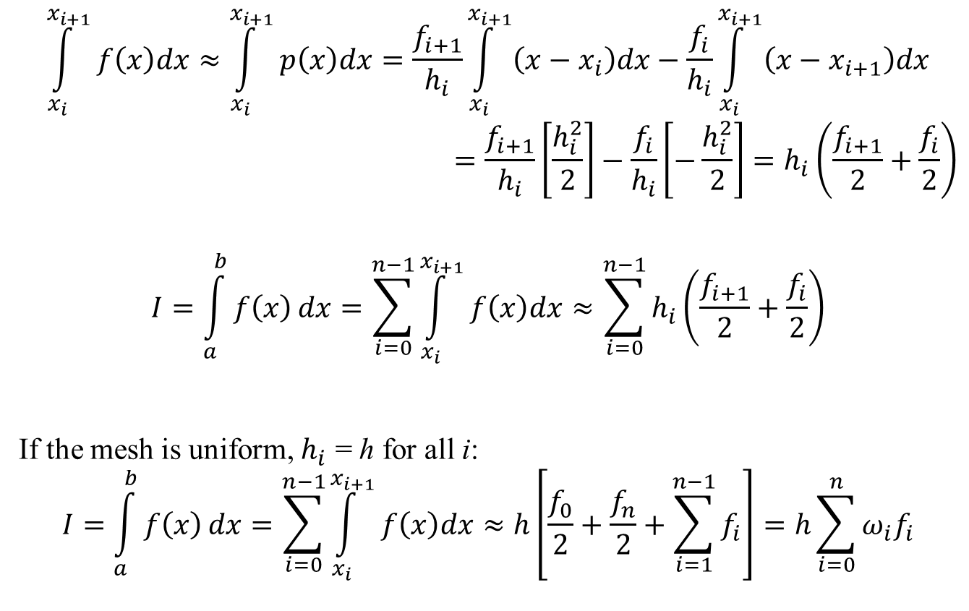
Numerical Integration: Trapezoidal Rule
$$\int_{x_{i}}^{x_{i+1}}{f\left(x\right)dx}≈\int_{x_{i}}^{x_{i+1}}{p\left(x\right)dx}=\frac{f_{i+1}}{h_{i}}\int_{x_{i}}^{x_{i+1}}{\left(x−x_{i}\right)dx}−\frac{f_{i}}{h_{i}}\int_{x_{i}}^{x_{i+1}}{\left(x−x_{i+1}\right)dx}$$
$$=\frac{f_{i+1}}{h_{i}}\left[\frac{h_{i}^{2}}{2}\right]−\frac{f_{i}}{h_{i}}\left[−\frac{h_{i}^{2}}{2}\right]=h_{i}\left(\frac{f_{i+1}}{2}+\frac{f_{i}}{2}\right)$$
$$I=\int_{a}^{b}{f\left(x\right)}dx=\sum_{i=0}^{n−1}{\int_{x_{i}}^{x_{i+1}}{f\left(x\right)dx}}≈\sum_{i=0}^{n−1}{h_{i}\left(\frac{f_{i+1}}{2}+\frac{f_{i}}{2}\right)}$$
If the mesh is uniform, $h_{i}$ = h for all i:
$$I=\int_{a}^{b}{f\left(x\right)}dx=\sum_{i=0}^{n−1}{\int_{x_{i}}^{x_{i+1}}{f\left(x\right)dx}}≈h\left[\frac{f_{0}}{2}+\frac{f_{n}}{2}+\sum_{i=1}^{n−1}{f_{i}}\right]=h\sum_{i=0}^{n}{ω_{i}f_{i}}$$

Slide 7
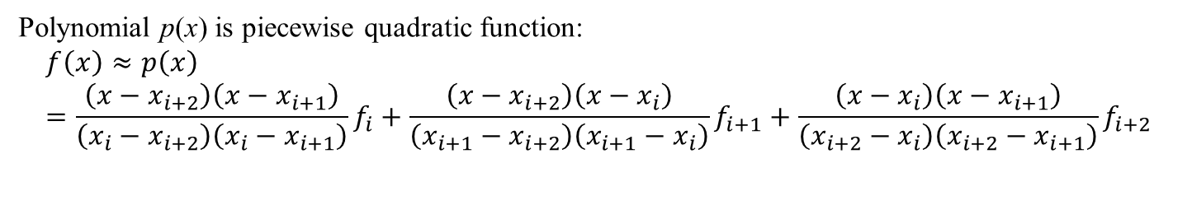
Numerical Integration: Simpson’s Rules
$$h_{i}=x_{i+1}−x_{i}$$
f_{i+2}
f_{i}
f_{n}
f_{i+1}
f₁
f_{i-1}
f₀
a = x₀
x₁
x_{i-1}
x_{i}
x_{i+1}
x_{i+2}
b = x_{n}
Polynomial p(x) is piecewise quadratic function:
$$f\left(x\right)≈p\left(x\right)=\frac{\left(x−x_{i+2}\right)\left(x−x_{i+1}\right)}{\left(x_{i}−x_{i+2}\right)\left(x_{i}−x_{i+1}\right)}f_{i}+\frac{\left(x−x_{i+2}\right)\left(x−x_{i}\right)}{\left(x_{i+1}−x_{i+2}\right)\left(x_{i+1}−x_{i}\right)}f_{i+1}+\frac{\left(x−x_{i}\right)\left(x−x_{i+1}\right)}{\left(x_{i+2}−x_{i}\right)\left(x_{i+2}−x_{i+1}\right)}f_{i+2}$$

Slide 8
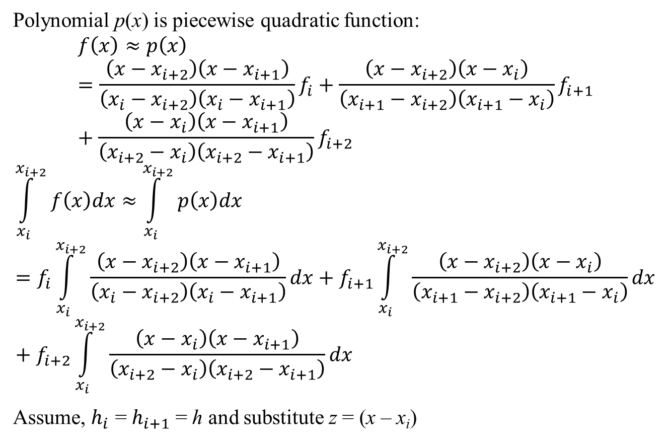
Numerical Integration: Simpson’s Rules
Polynomial p(x) is piecewise quadratic function:
$$f\left(x\right)≈p\left(x\right)=\frac{\left(x−x_{i+2}\right)\left(x−x_{i+1}\right)}{\left(x_{i}−x_{i+2}\right)\left(x_{i}−x_{i+1}\right)}f_{i}+\frac{\left(x−x_{i+2}\right)\left(x−x_{i}\right)}{\left(x_{i+1}−x_{i+2}\right)\left(x_{i+1}−x_{i}\right)}f_{i+1}+\frac{\left(x−x_{i}\right)\left(x−x_{i+1}\right)}{\left(x_{i+2}−x_{i}\right)\left(x_{i+2}−x_{i+1}\right)}f_{i+2}$$
$$\int_{x_{i}}^{x_{i+2}}{f\left(x\right)dx}≈\int_{x_{i}}^{x_{i+2}}{p\left(x\right)dx}=f_{i}\int_{x_{i}}^{x_{i+2}}{\frac{\left(x−x_{i+2}\right)\left(x−x_{i+1}\right)}{\left(x_{i}−x_{i+2}\right)\left(x_{i}−x_{i+1}\right)}dx}+f_{i+1}\int_{x_{i}}^{x_{i+2}}{\frac{\left(x−x_{i+2}\right)\left(x−x_{i}\right)}{\left(x_{i+1}−x_{i+2}\right)\left(x_{i+1}−x_{i}\right)}dx}+f_{i+2}\int_{x_{i}}^{x_{i+2}}{\frac{\left(x−x_{i}\right)\left(x−x_{i+1}\right)}{\left(x_{i+2}−x_{i}\right)\left(x_{i+2}−x_{i+1}\right)}dx}$$
Assume, $h_{i}$ = $h_{i+1}$ = h and substitute z = (x – x_{i})

Slide 9
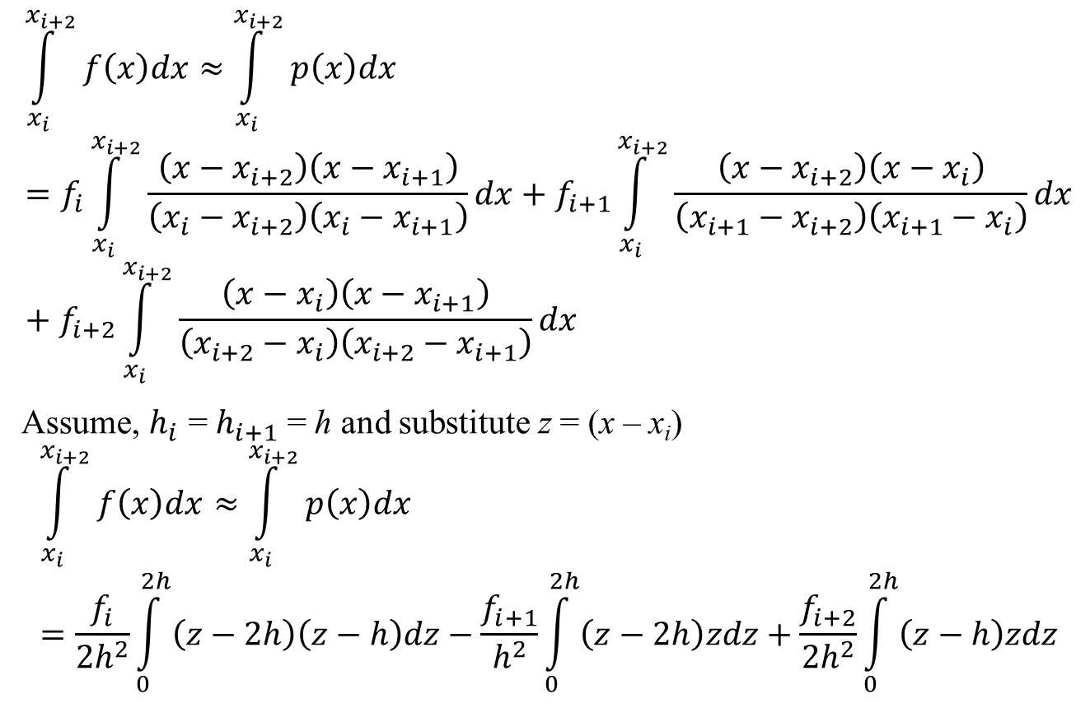
Numerical Integration: Simpson’s Rules
$$\int_{x_{i}}^{x_{i+2}}{f\left(x\right)dx}≈\int_{x_{i}}^{x_{i+2}}{p\left(x\right)dx}=f_{i}\int_{x_{i}}^{x_{i+2}}{\frac{\left(x−x_{i+2}\right)\left(x−x_{i+1}\right)}{\left(x_{i}−x_{i+2}\right)\left(x_{i}−x_{i+1}\right)}dx}+f_{i+1}\int_{x_{i}}^{x_{i+2}}{\frac{\left(x−x_{i+2}\right)\left(x−x_{i}\right)}{\left(x_{i+1}−x_{i+2}\right)\left(x_{i+1}−x_{i}\right)}dx}+f_{i+2}\int_{x_{i}}^{x_{i+2}}{\frac{\left(x−x_{i}\right)\left(x−x_{i+1}\right)}{\left(x_{i+2}−x_{i}\right)\left(x_{i+2}−x_{i+1}\right)}dx}$$
Assume, $h_{i}$ = $h_{i+1}$ = h and substitute z = (x – x_{i})
$$\int_{x_{i}}^{x_{i+2}}{f\left(x\right)dx}≈\int_{x_{i}}^{x_{i+2}}{p\left(x\right)dx}=\frac{f_{i}}{{2h}^{2}}\int_{0}^{2h}{\left(z−2h\right)\left(z−h\right)dz}−\frac{f_{i+1}}{h^{2}}\int_{0}^{2h}{\left(z−2h\right)zdz}+\frac{f_{i+2}}{{2h}^{2}}\int_{0}^{2h}{\left(z−h\right)zdz}$$

Slide 10
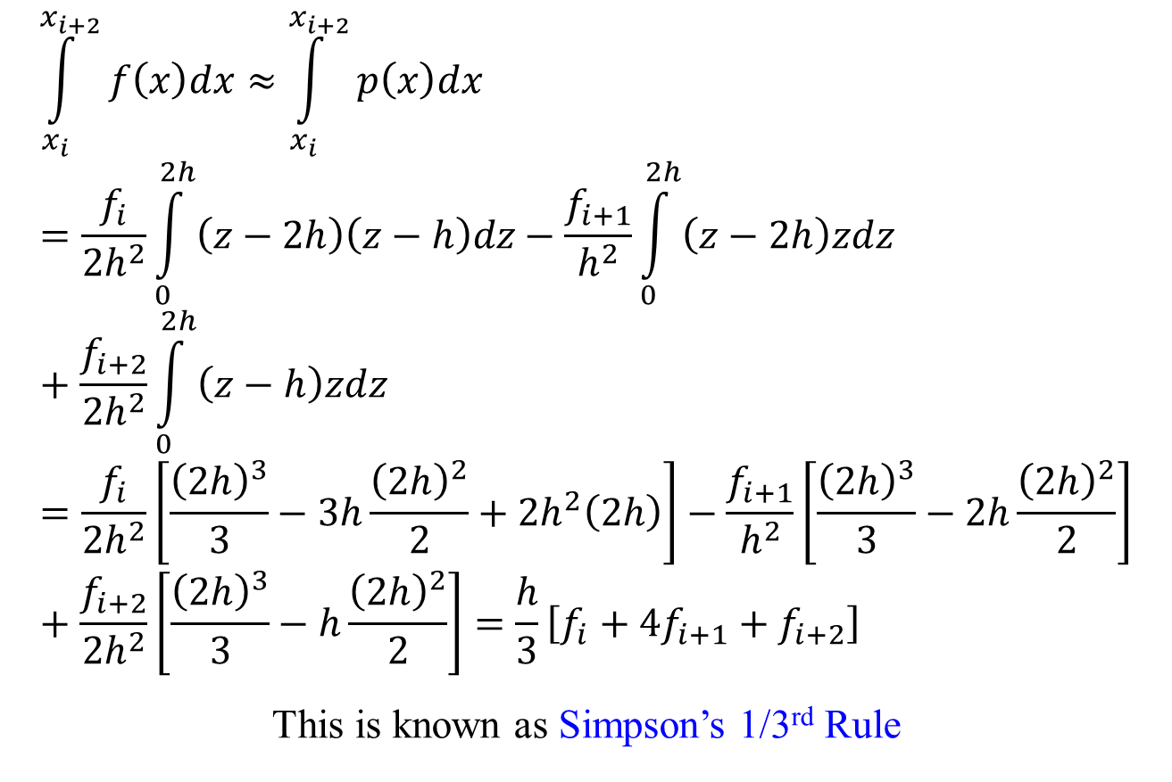
Numerical Integration: Simpson’s Rules
$$\int_{x_{i}}^{x_{i+2}}{f\left(x\right)dx}≈\int_{x_{i}}^{x_{i+2}}{p\left(x\right)dx}=\frac{f_{i}}{{2h}^{2}}\int_{0}^{2h}{\left(z−2h\right)\left(z−h\right)dz}−\frac{f_{i+1}}{h^{2}}\int_{0}^{2h}{\left(z−2h\right)zdz}+\frac{f_{i+2}}{{2h}^{2}}\int_{0}^{2h}{\left(z−h\right)zdz}=\frac{f_{i}}{{2h}^{2}}\left[\frac{{\left(2h\right)}^{3}}{3}−3h\frac{{\left(2h\right)}^{2}}{2}+{2h}^{2}\left(2h\right)\right]−\frac{f_{i+1}}{h^{2}}\left[\frac{{\left(2h\right)}^{3}}{3}−2h\frac{{\left(2h\right)}^{2}}{2}\right]+\frac{f_{i+2}}{{2h}^{2}}\left[\frac{{\left(2h\right)}^{3}}{3}−h\frac{{\left(2h\right)}^{2}}{2}\right]=\frac{h}{3}\left[f_{i}+4f_{i+1}+f_{i+2}\right]$$
This is known as Simpson’s 1/3rd Rule

Slide 11

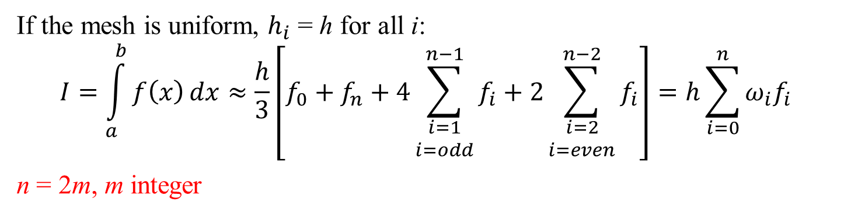
Numerical Integration: Simpson’s Rules
$$h=x_{i+1}−x_{i} ∀i$$
f_{i+2}
f_{i}
f_{n}
f_{i+1}
f₁
f_{i-1}
f₀
a = x₀
x₁
x_{i-1}
x_{i}
x_{i+1}
x_{i+2}
b = x_{n}
If the mesh is uniform, $h_{i}$ = h for all i:
$$I=\int_{a}^{b}{f\left(x\right)}dx≈\frac{h}{3}\left[f_{0}+f_{n}+4\sum_{\begin{matrix}i=1 \\ i=odd\end{matrix}}^{n−1}{f_{i}}+2\sum_{\begin{matrix}i=2 \\ i=even\end{matrix}}^{n−2}{f_{i}}\right]=h\sum_{i=0}^{n}{ω_{i}f_{i}}$$
n = 2m, m integer

Slide 12
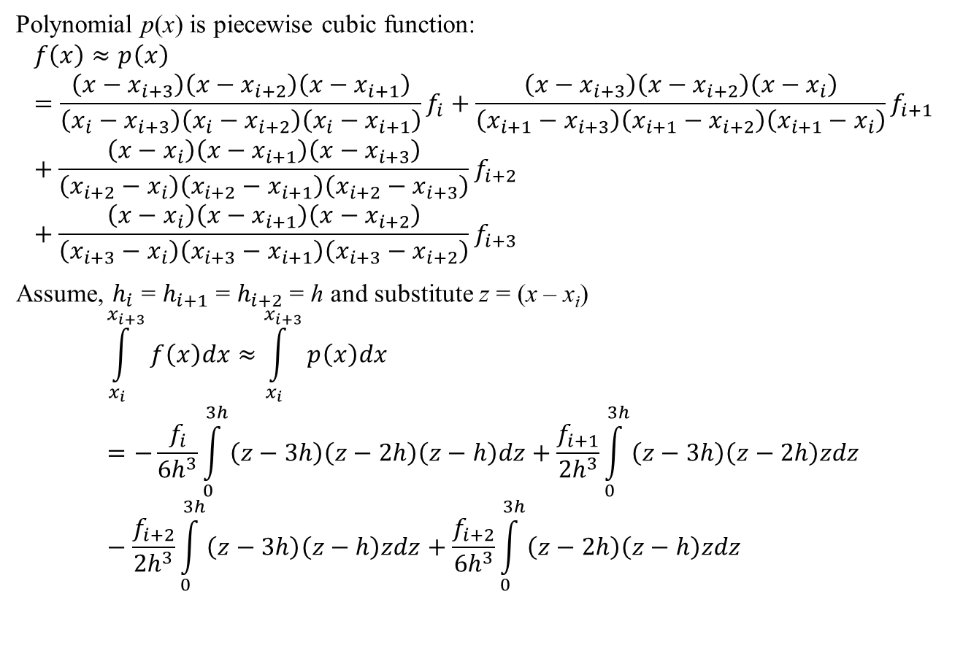
Numerical Integration: Simpson’s Rules
Polynomial p(x) is piecewise cubic function:
$$f\left(x\right)≈p\left(x\right)=\frac{\left(x−x_{i+3}\right)\left(x−x_{i+2}\right)\left(x−x_{i+1}\right)}{\left(x_{i}−x_{i+3}\right)\left(x_{i}−x_{i+2}\right)\left(x_{i}−x_{i+1}\right)}f_{i}+\frac{\left(x−x_{i+3}\right)\left(x−x_{i+2}\right)\left(x−x_{i}\right)}{\left(x_{i+1}−x_{i+3}\right)\left(x_{i+1}−x_{i+2}\right)\left(x_{i+1}−x_{i}\right)}f_{i+1}+\frac{\left(x−x_{i}\right)\left(x−x_{i+1}\right)\left(x−x_{i+3}\right)}{\left(x_{i+2}−x_{i}\right)\left(x_{i+2}−x_{i+1}\right)\left(x_{i+2}−x_{i+3}\right)}f_{i+2}+\frac{\left(x−x_{i}\right)\left(x−x_{i+1}\right)\left(x−x_{i+2}\right)}{\left(x_{i+3}−x_{i}\right)\left(x_{i+3}−x_{i+1}\right)\left(x_{i+3}−x_{i+2}\right)}f_{i+3}$$
Assume, $h_{i}$ = $h_{i+1}$ = $h_{i+2}$= h and substitute z = (x – x_{i})
$$\int_{x_{i}}^{x_{i+3}}{f\left(x\right)dx}≈\int_{x_{i}}^{x_{i+3}}{p\left(x\right)dx}=−\frac{f_{i}}{{6h}^{3}}\int_{0}^{3h}{\left(z−3h\right)\left(z−2h\right)\left(z−h\right)dz}+\frac{f_{i+1}}{{2h}^{3}}\int_{0}^{3h}{\left(z−3h\right)\left(z−2h\right)zdz}−\frac{f_{i+2}}{{2h}^{3}}\int_{0}^{3h}{\left(z−3h\right)\left(z−h\right)zdz}+\frac{f_{i+2}}{{6h}^{3}}\int_{0}^{3h}{\left(z−2h\right)\left(z−h\right)zdz}$$

Slide 13
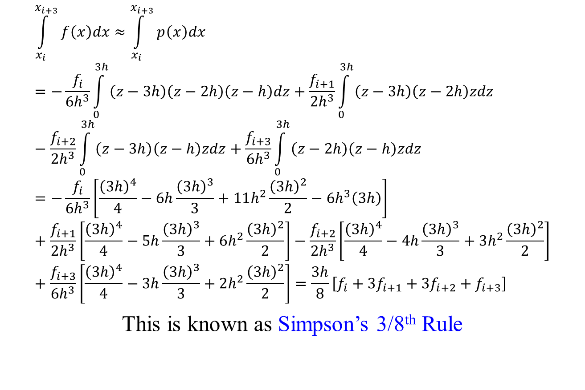
Numerical Integration: Simpson’s Rules
$$\int_{x_{i}}^{x_{i+3}}{f\left(x\right)dx}≈\int_{x_{i}}^{x_{i+3}}{p\left(x\right)dx}=−\frac{f_{i}}{{6h}^{3}}\int_{0}^{3h}{\left(z−3h\right)\left(z−2h\right)\left(z−h\right)dz}+\frac{f_{i+1}}{{2h}^{3}}\int_{0}^{3h}{\left(z−3h\right)\left(z−2h\right)zdz}−\frac{f_{i+2}}{{2h}^{3}}\int_{0}^{3h}{\left(z−3h\right)\left(z−h\right)zdz}+\frac{f_{i+3}}{{6h}^{3}}\int_{0}^{3h}{\left(z−2h\right)\left(z−h\right)zdz}=−\frac{f_{i}}{{6h}^{3}}\left[\frac{{\left(3h\right)}^{4}}{4}−6h\frac{{\left(3h\right)}^{3}}{3}+11h^{2}\frac{{\left(3h\right)}^{2}}{2}−{6h}^{3}\left(3h\right)\right]+\frac{f_{i+1}}{{2h}^{3}}\left[\frac{{\left(3h\right)}^{4}}{4}−5h\frac{{\left(3h\right)}^{3}}{3}+6h^{2}\frac{{\left(3h\right)}^{2}}{2}\right]−\frac{f_{i+2}}{{2h}^{3}}\left[\frac{{\left(3h\right)}^{4}}{4}−4h\frac{{\left(3h\right)}^{3}}{3}+3h^{2}\frac{{\left(3h\right)}^{2}}{2}\right]+\frac{f_{i+3}}{{6h}^{3}}\left[\frac{{\left(3h\right)}^{4}}{4}−3h\frac{{\left(3h\right)}^{3}}{3}+2h^{2}\frac{{\left(3h\right)}^{2}}{2}\right]=\frac{3h}{8}\left[f_{i}+3f_{i+1}+{3f}_{i+2}+f_{i+3}\right]$$
This is known as Simpson’s 3/8th Rule

Slide 14
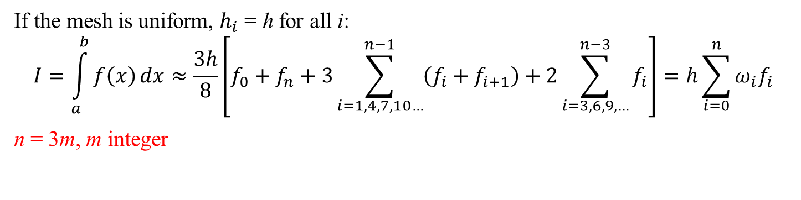
Numerical Integration: Simpson’s Rules
$$h=x_{i+1}−x_{i} ∀i$$
f_{i+2}
f_{i}
f_{n}
f_{i+1}
f₁
f_{i-1}
f₀
a = x₀
x₁
x_{i-1}
x_{i}
x_{i+1}
x_{i+2}
b = x_{n}
If the mesh is uniform, $h_{i}$ = h for all i:
$$I=\int_{a}^{b}{f\left(x\right)}dx≈\frac{3h}{8}\left[f_{0}+f_{n}+3\sum_{i=1,4,7,10…}^{n−1}{\left(f_{i}+f_{i+1}\right)}+2\sum_{i=3,6,9,…}^{n−3}{f_{i}}\right]=h\sum_{i=0}^{n}{ω_{i}f_{i}}$$
n = 3m, m integer

Slide 15
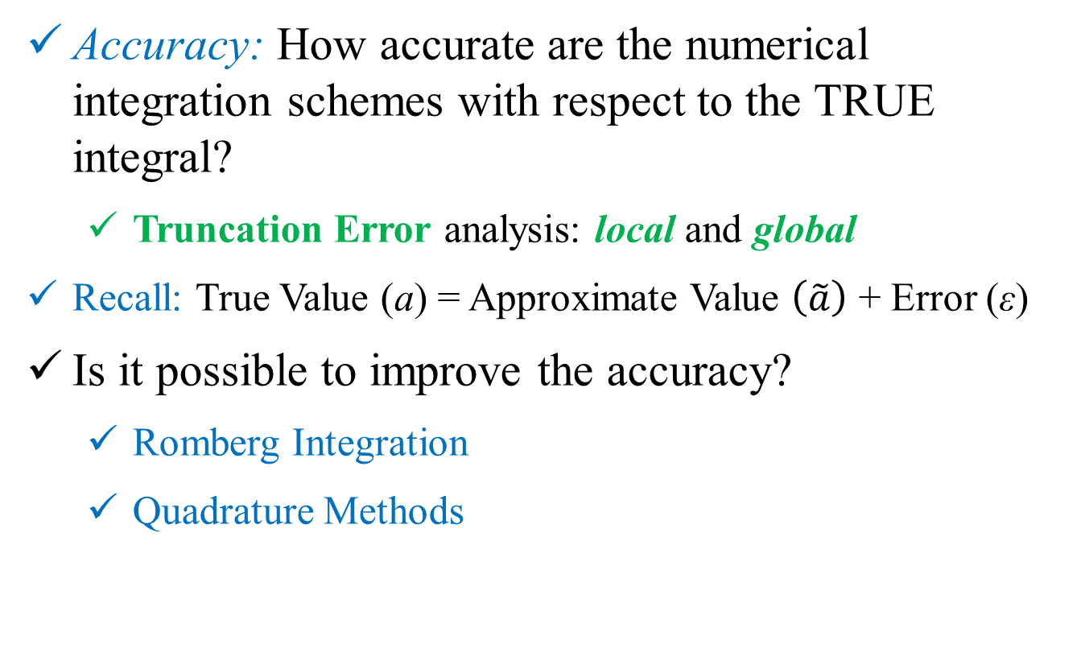
Numerical Integration
Accuracy: How accurate are the numerical integration schemes with respect to the TRUE integral?
Truncation Error analysis: local and global
Recall: True Value (a) = Approximate Value $\left(\tilde{a}\right)$ + Error (ε)
Is it possible to improve the accuracy?
Romberg Integration
Quadrature Methods

Slide 16
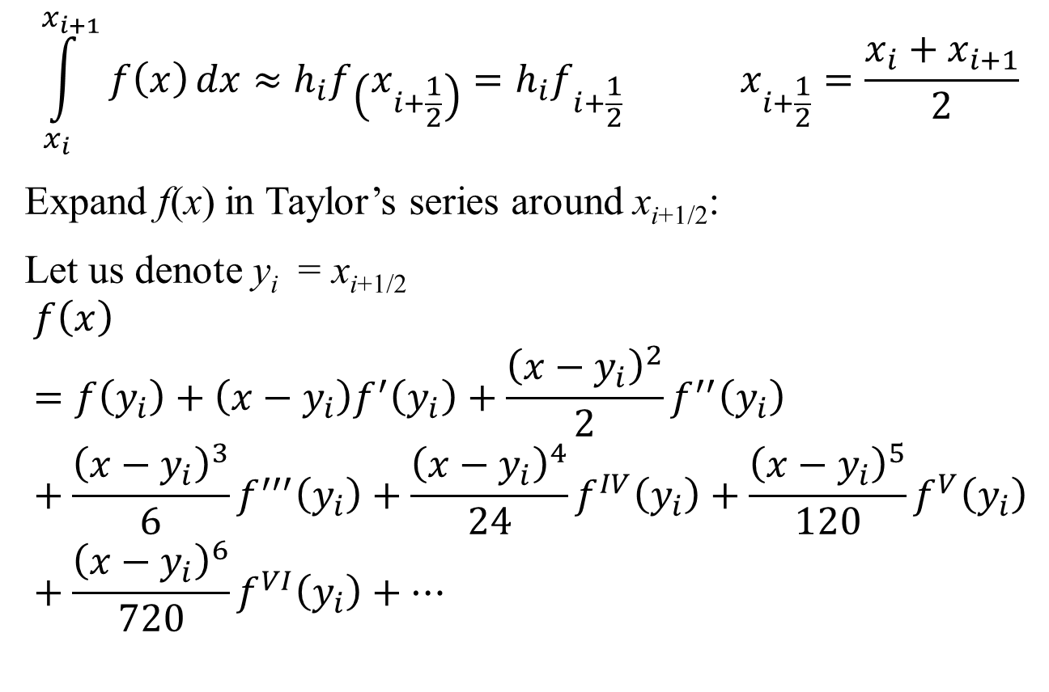
Numerical Integration: Rectangular Rule
$$\int_{x_{i}}^{x_{i+1}}{f\left(x\right)}dx≈h_{i}f\left(x_{i+\frac{1}{2}}\right)=h_{i}f_{i+\frac{1}{2}} x_{i+\frac{1}{2}}=\frac{x_{i}+x_{i+1}}{2}$$
Expand f(x) in Taylor’s series around x_{i+1/2}:
Let us denote y_{i} = x_{i+1/2}
$$f\left(x\right)=f\left(y_{i}\right)+\left(x−y_{i}\right)f^{′}\left(y_{i}\right)+\frac{{\left(x−y_{i}\right)}^{2}}{2}f^{′′}\left(y_{i}\right)+\frac{{\left(x−y_{i}\right)}^{3}}{6}f^{′′′}\left(y_{i}\right)+\frac{{\left(x−y_{i}\right)}^{4}}{24}f^{IV}\left(y_{i}\right)+\frac{{\left(x−y_{i}\right)}^{5}}{120}f^{V}\left(y_{i}\right)+\frac{{\left(x−y_{i}\right)}^{6}}{720}f^{VI}\left(y_{i}\right)+⋯$$

Slide 17
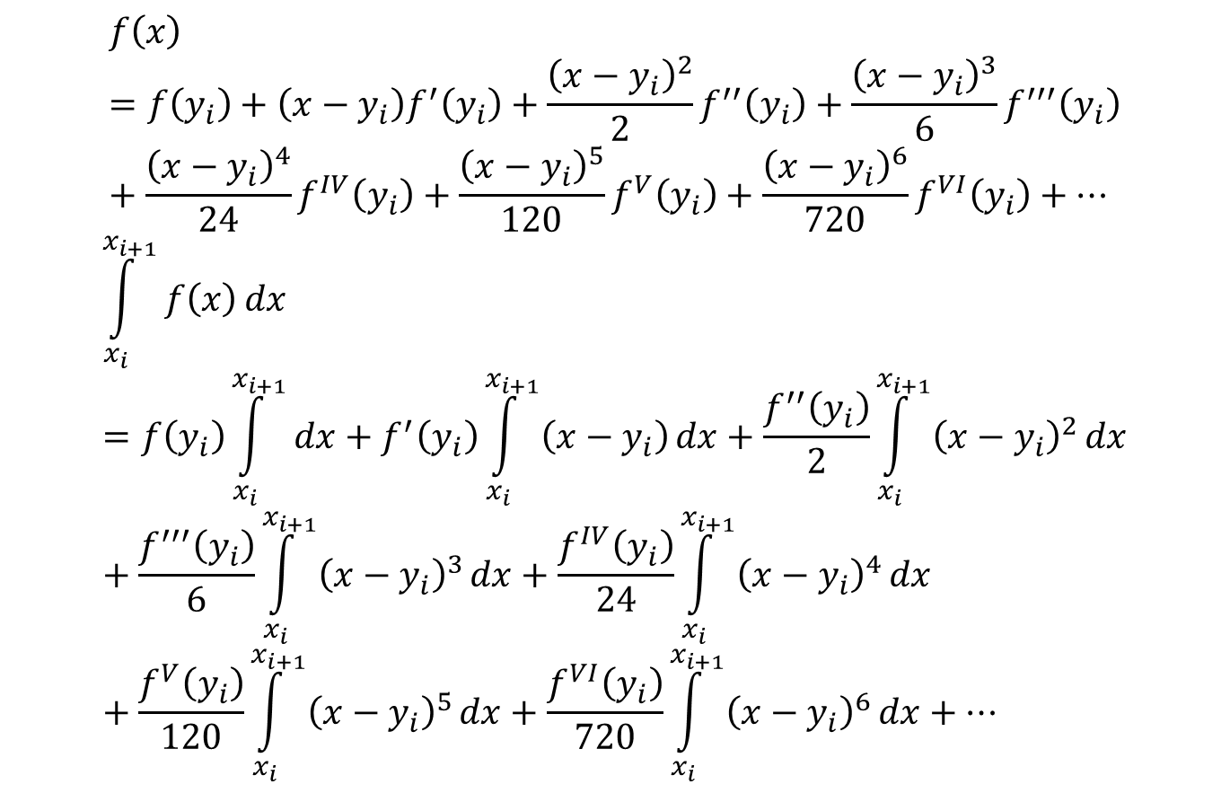
Numerical Integration: Rectangular Rule
$$f\left(x\right)=f\left(y_{i}\right)+\left(x−y_{i}\right)f^{′}\left(y_{i}\right)+\frac{{\left(x−y_{i}\right)}^{2}}{2}f^{′′}\left(y_{i}\right)+\frac{{\left(x−y_{i}\right)}^{3}}{6}f^{′′′}\left(y_{i}\right)+\frac{{\left(x−y_{i}\right)}^{4}}{24}f^{IV}\left(y_{i}\right)+\frac{{\left(x−y_{i}\right)}^{5}}{120}f^{V}\left(y_{i}\right)+\frac{{\left(x−y_{i}\right)}^{6}}{720}f^{VI}\left(y_{i}\right)+⋯$$
$$\int_{x_{i}}^{x_{i+1}}{f\left(x\right)}dx=f\left(y_{i}\right)\int_{x_{i}}^{x_{i+1}}{dx}+f^{′}\left(y_{i}\right)\int_{x_{i}}^{x_{i+1}}{\left(x−y_{i}\right)}dx+\frac{f^{′′}\left(y_{i}\right)}{2}\int_{x_{i}}^{x_{i+1}}{{\left(x−y_{i}\right)}^{2}}dx+\frac{f^{′′′}\left(y_{i}\right)}{6}\int_{x_{i}}^{x_{i+1}}{{\left(x−y_{i}\right)}^{3}}dx+\frac{f^{IV}\left(y_{i}\right)}{24}\int_{x_{i}}^{x_{i+1}}{{\left(x−y_{i}\right)}^{4}}dx+\frac{f^{V}\left(y_{i}\right)}{120}\int_{x_{i}}^{x_{i+1}}{{\left(x−y_{i}\right)}^{5}}dx+\frac{f^{VI}\left(y_{i}\right)}{720}\int_{x_{i}}^{x_{i+1}}{{\left(x−y_{i}\right)}^{6}}dx+⋯$$
0
0
0

Slide 18
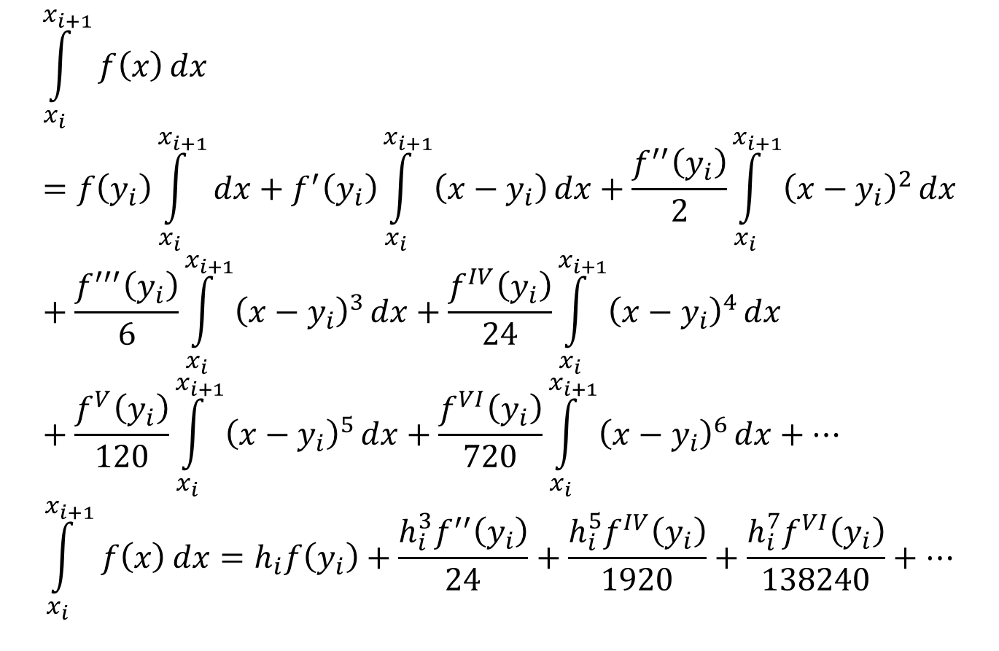
Numerical Integration: Rectangular Rule
$$\int_{x_{i}}^{x_{i+1}}{f\left(x\right)}dx=f\left(y_{i}\right)\int_{x_{i}}^{x_{i+1}}{dx}+f^{′}\left(y_{i}\right)\int_{x_{i}}^{x_{i+1}}{\left(x−y_{i}\right)}dx+\frac{f^{′′}\left(y_{i}\right)}{2}\int_{x_{i}}^{x_{i+1}}{{\left(x−y_{i}\right)}^{2}}dx+\frac{f^{′′′}\left(y_{i}\right)}{6}\int_{x_{i}}^{x_{i+1}}{{\left(x−y_{i}\right)}^{3}}dx+\frac{f^{IV}\left(y_{i}\right)}{24}\int_{x_{i}}^{x_{i+1}}{{\left(x−y_{i}\right)}^{4}}dx+\frac{f^{V}\left(y_{i}\right)}{120}\int_{x_{i}}^{x_{i+1}}{{\left(x−y_{i}\right)}^{5}}dx+\frac{f^{VI}\left(y_{i}\right)}{720}\int_{x_{i}}^{x_{i+1}}{{\left(x−y_{i}\right)}^{6}}dx+⋯$$
$$\int_{x_{i}}^{x_{i+1}}{f\left(x\right)}dx=h_{i}f\left(y_{i}\right)+\frac{h_{i}^{3}f^{′′}\left(y_{i}\right)}{24}+\frac{h_{i}^{5}f^{IV}\left(y_{i}\right)}{1920}+\frac{h_{i}^{7}f^{VI}\left(y_{i}\right)}{138240}+⋯$$
0
0
0

Slide 19
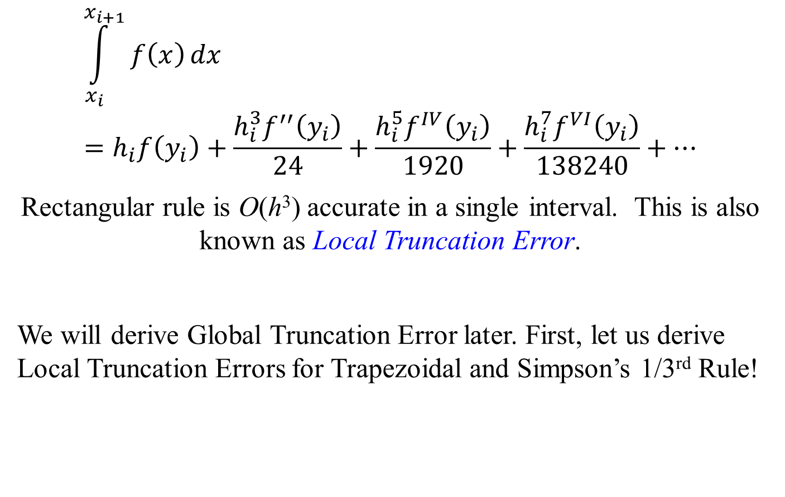
Numerical Integration: Rectangular Rule
$$\int_{x_{i}}^{x_{i+1}}{f\left(x\right)}dx=h_{i}f\left(y_{i}\right)+\frac{h_{i}^{3}f^{′′}\left(y_{i}\right)}{24}+\frac{h_{i}^{5}f^{IV}\left(y_{i}\right)}{1920}+\frac{h_{i}^{7}f^{VI}\left(y_{i}\right)}{138240}+⋯$$
Rectangular rule is O(h³) accurate in a single interval. This is also known as Local Truncation Error.
We will derive Global Truncation Error later. First, let us derive Local Truncation Errors for Trapezoidal and Simpson’s 1/3rd Rule!

Slide 20
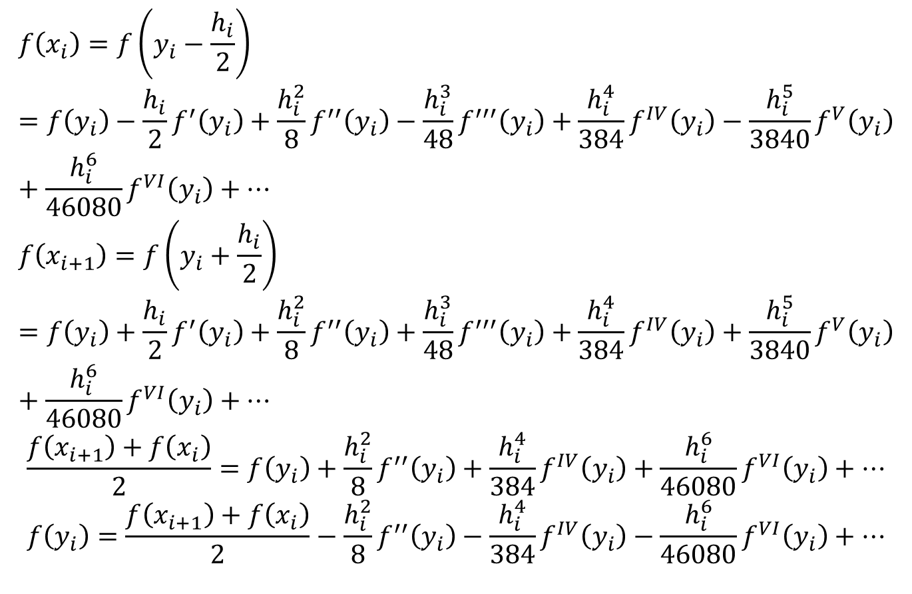
Local Truncation Error: Trapezoidal Rule
$$f\left(x_{i}\right)=f\left(y_{i}−\frac{h_{i}}{2}\right)=f\left(y_{i}\right)−\frac{h_{i}}{2}f^{′}\left(y_{i}\right)+\frac{h_{i}^{2}}{8}f^{′′}\left(y_{i}\right)−\frac{h_{i}^{3}}{48}f^{′′′}\left(y_{i}\right)+\frac{h_{i}^{4}}{384}f^{IV}\left(y_{i}\right)−\frac{h_{i}^{5}}{3840}f^{V}\left(y_{i}\right)+\frac{h_{i}^{6}}{46080}f^{VI}\left(y_{i}\right)+⋯$$
$$f\left(x_{i+1}\right)=f\left(y_{i}+\frac{h_{i}}{2}\right)=f\left(y_{i}\right)+\frac{h_{i}}{2}f^{′}\left(y_{i}\right)+\frac{h_{i}^{2}}{8}f^{′′}\left(y_{i}\right)+\frac{h_{i}^{3}}{48}f^{′′′}\left(y_{i}\right)+\frac{h_{i}^{4}}{384}f^{IV}\left(y_{i}\right)+\frac{h_{i}^{5}}{3840}f^{V}\left(y_{i}\right)+\frac{h_{i}^{6}}{46080}f^{VI}\left(y_{i}\right)+⋯$$
$$\frac{f\left(x_{i+1}\right)+f\left(x_{i}\right)}{2}=f\left(y_{i}\right)+\frac{h_{i}^{2}}{8}f^{′′}\left(y_{i}\right)+\frac{h_{i}^{4}}{384}f^{IV}\left(y_{i}\right)+\frac{h_{i}^{6}}{46080}f^{VI}\left(y_{i}\right)+⋯$$
$$f\left(y_{i}\right)=\frac{f\left(x_{i+1}\right)+f\left(x_{i}\right)}{2}−\frac{h_{i}^{2}}{8}f^{′′}\left(y_{i}\right)−\frac{h_{i}^{4}}{384}f^{IV}\left(y_{i}\right)−\frac{h_{i}^{6}}{46080}f^{VI}\left(y_{i}\right)+⋯$$

Slide 21
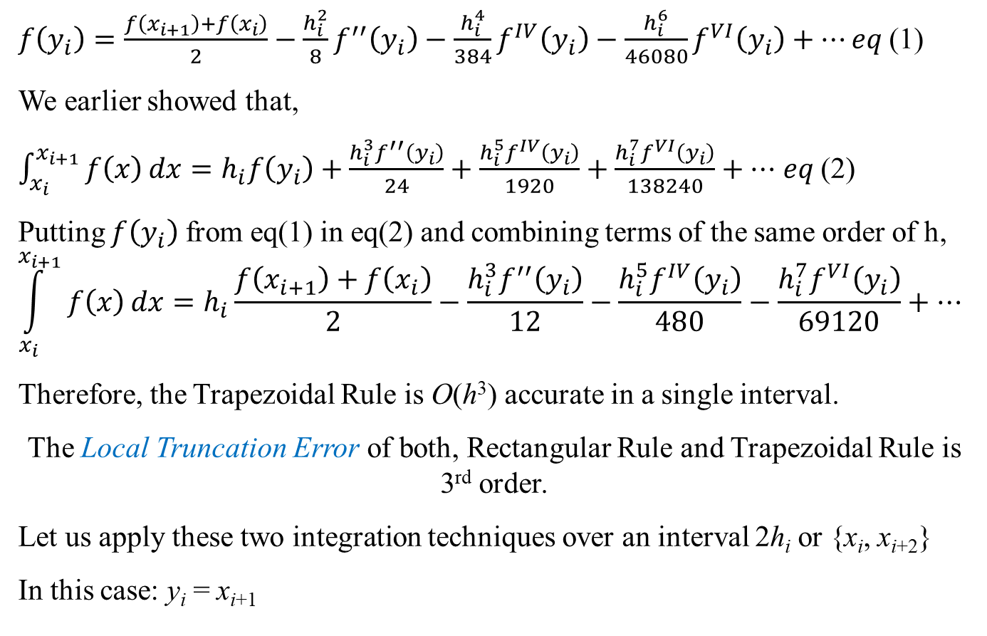
Local Truncation Error: Trapezoidal Rule
$f\left(y_{i}\right)=\frac{f\left(x_{i+1}\right)+f\left(x_{i}\right)}{2}−\frac{h_{i}^{2}}{8}f^{′′}\left(y_{i}\right)−\frac{h_{i}^{4}}{384}f^{IV}\left(y_{i}\right)−\frac{h_{i}^{6}}{46080}f^{VI}\left(y_{i}\right)+⋯eq$(1)
We earlier showed that,
$\int_{x_{i}}^{x_{i+1}}{f\left(x\right)}dx=h_{i}f\left(y_{i}\right)+\frac{h_{i}^{3}f^{′′}\left(y_{i}\right)}{24}+\frac{h_{i}^{5}f^{IV}\left(y_{i}\right)}{1920}+\frac{h_{i}^{7}f^{VI}\left(y_{i}\right)}{138240}+⋯$ $eq$(2)
Putting $f\left(y_{i}\right)$ from eq(1) in eq(2) and combining terms of the same order of h,
$$\int_{x_{i}}^{x_{i+1}}{f\left(x\right)}dx=h_{i}\frac{f\left(x_{i+1}\right)+f\left(x_{i}\right)}{2}−\frac{h_{i}^{3}f^{′′}\left(y_{i}\right)}{12}−\frac{h_{i}^{5}f^{IV}\left(y_{i}\right)}{480}−\frac{h_{i}^{7}f^{VI}\left(y_{i}\right)}{69120}+⋯$$
Therefore, the Trapezoidal Rule is O(h³) accurate in a single interval.
The Local Truncation Error of both, Rectangular Rule and Trapezoidal Rule is 3rd order.
Let us apply these two integration techniques over an interval 2h_{i} or {x_{i}, x_{i+2}}
In this case: y_{i} = x_{i+1}
Notes:
Show how we get the second expression: two slides back while analysing Rectangular appxm

Slide 22
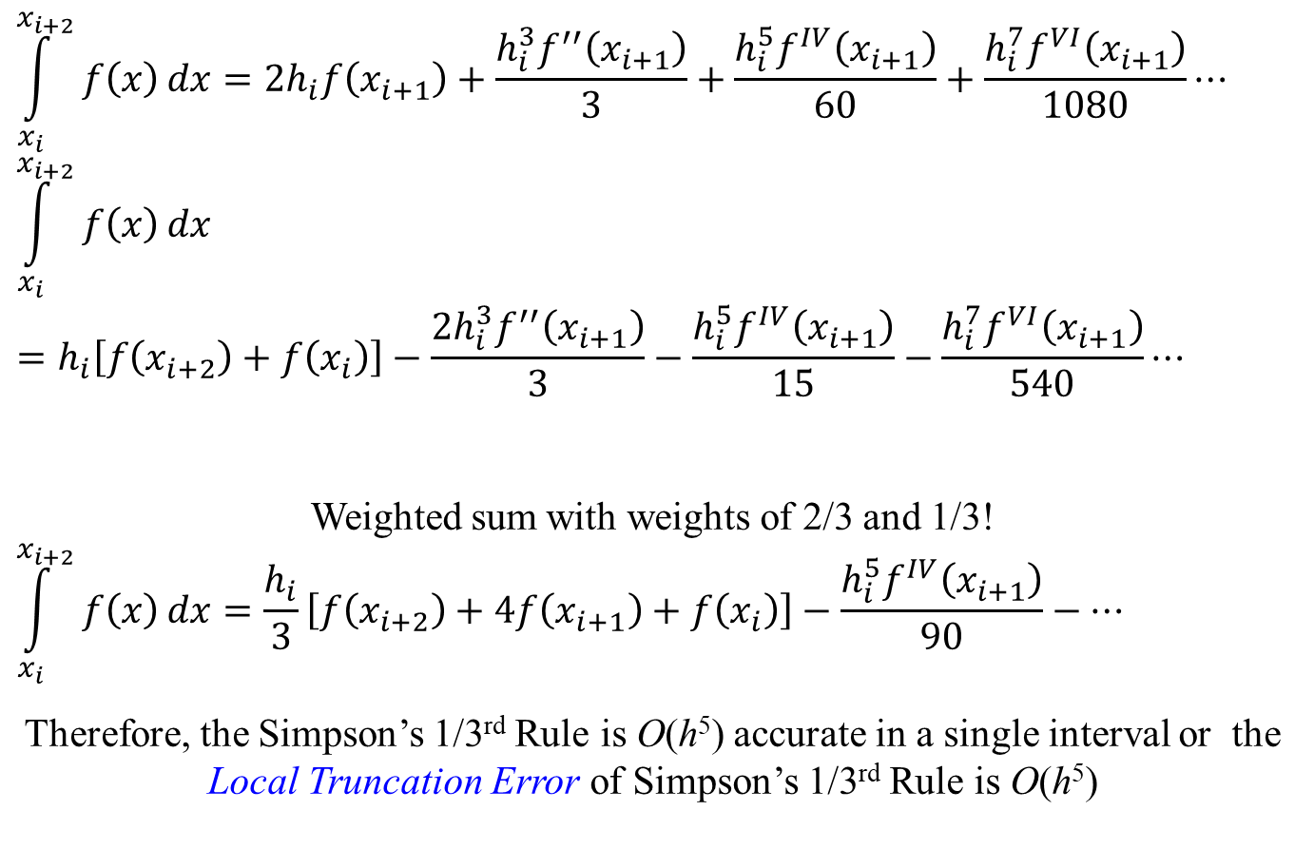
Numerical Integration: Simpson’s 1/3rd Rule
$$\int_{x_{i}}^{x_{i+2}}{f\left(x\right)}dx=2h_{i}f\left(x_{i+1}\right)+\frac{h_{i}^{3}f^{′′}\left(x_{i+1}\right)}{3}+\frac{h_{i}^{5}f^{IV}\left(x_{i+1}\right)}{60}+\frac{h_{i}^{7}f^{VI}\left(x_{i+1}\right)}{1080}⋯$$
$$\int_{x_{i}}^{x_{i+2}}{f\left(x\right)}dx=h_{i}\left[f\left(x_{i+2}\right)+f\left(x_{i}\right)\right]−\frac{2h_{i}^{3}f^{′′}\left(x_{i+1}\right)}{3}−\frac{h_{i}^{5}f^{IV}\left(x_{i+1}\right)}{15}−\frac{h_{i}^{7}f^{VI}\left(x_{i+1}\right)}{540}⋯$$
Weighted sum with weights of 2/3 and 1/3!
$$\int_{x_{i}}^{x_{i+2}}{f\left(x\right)}dx=\frac{h_{i}}{3}\left[f\left(x_{i+2}\right)+4f\left(x_{i+1}\right)+f\left(x_{i}\right)\right]−\frac{h_{i}^{5}f^{IV}\left(x_{i+1}\right)}{90}−⋯$$
Therefore, the Simpson’s 1/3rd Rule is O(h⁵) accurate in a single interval or the Local Truncation Error of Simpson’s 1/3rd Rule is O(h⁵)

Slide 23
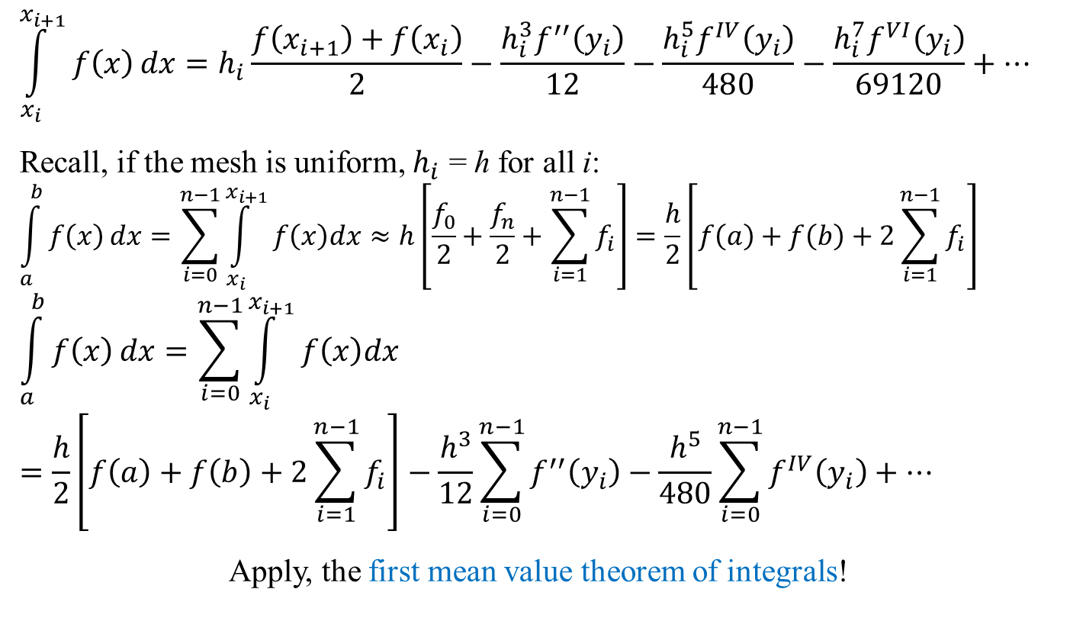
Global Truncation Error: Trapezoidal Rule
$$\int_{x_{i}}^{x_{i+1}}{f\left(x\right)}dx=h_{i}\frac{f\left(x_{i+1}\right)+f\left(x_{i}\right)}{2}−\frac{h_{i}^{3}f^{′′}\left(y_{i}\right)}{12}−\frac{h_{i}^{5}f^{IV}\left(y_{i}\right)}{480}−\frac{h_{i}^{7}f^{VI}\left(y_{i}\right)}{69120}+⋯$$
Recall, if the mesh is uniform, $h_{i}$ = h for all i:
$$\int_{a}^{b}{f\left(x\right)}dx=\sum_{i=0}^{n−1}{\int_{x_{i}}^{x_{i+1}}{f\left(x\right)dx}}≈h\left[\frac{f_{0}}{2}+\frac{f_{n}}{2}+\sum_{i=1}^{n−1}{f_{i}}\right]=\frac{h}{2}\left[f\left(a\right)+f\left(b\right)+2\sum_{i=1}^{n−1}{f_{i}}\right]$$
$$\int_{a}^{b}{f\left(x\right)}dx=\sum_{i=0}^{n−1}{\int_{x_{i}}^{x_{i+1}}{f\left(x\right)dx}}=\frac{h}{2}\left[f\left(a\right)+f\left(b\right)+2\sum_{i=1}^{n−1}{f_{i}}\right]−\frac{h^{3}}{12}\sum_{i=0}^{n−1}{f^{′′}\left(y_{i}\right)}−\frac{h^{5}}{480}\sum_{i=0}^{n−1}{f^{IV}\left(y_{i}\right)}+⋯$$
Apply, the first mean value theorem of integrals!

Slide 24
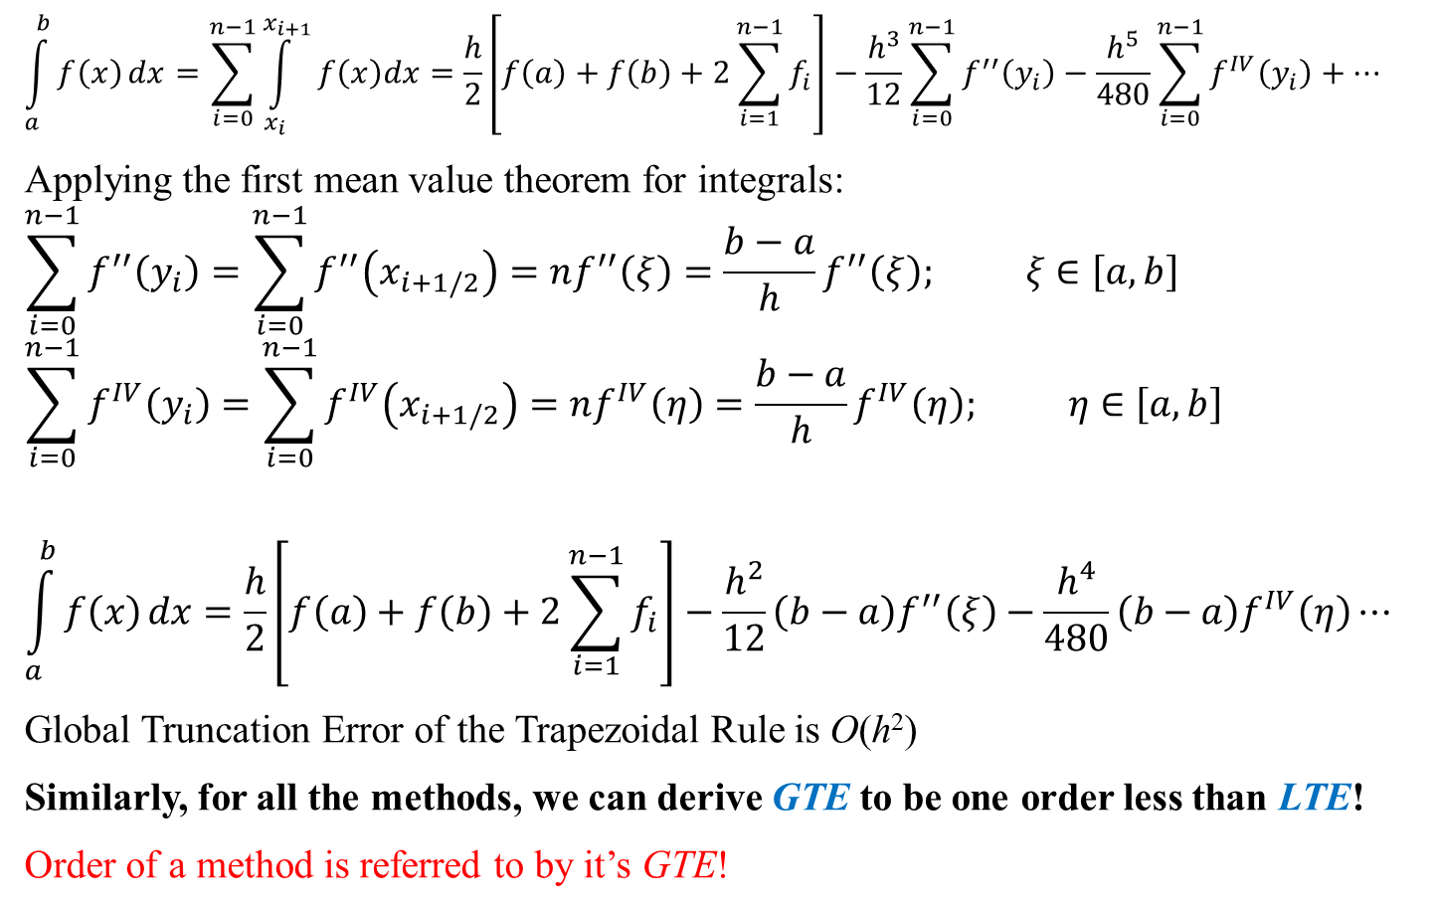
Global Truncation Error: Trapezoidal Rule
$$\int_{a}^{b}{f\left(x\right)}dx=\sum_{i=0}^{n−1}{\int_{x_{i}}^{x_{i+1}}{f\left(x\right)dx}}=\frac{h}{2}\left[f\left(a\right)+f\left(b\right)+2\sum_{i=1}^{n−1}{f_{i}}\right]−\frac{h^{3}}{12}\sum_{i=0}^{n−1}{f^{′′}\left(y_{i}\right)}−\frac{h^{5}}{480}\sum_{i=0}^{n−1}{f^{IV}\left(y_{i}\right)}+⋯$$
Applying the first mean value theorem for integrals:
$$\sum_{i=0}^{n−1}{f^{′′}\left(y_{i}\right)}=\sum_{i=0}^{n−1}{f^{′′}\left(x_{i+1/2}\right)}=nf^{′′}\left(ξ\right)=\frac{b−a}{h}f^{′′}\left(ξ\right); ξ∈\left[a,b\right]$$
$$\sum_{i=0}^{n−1}{f^{IV}\left(y_{i}\right)}=\sum_{i=0}^{n−1}{f^{IV}\left(x_{i+1/2}\right)}=nf^{IV}\left(η\right)=\frac{b−a}{h}f^{IV}\left(η\right); η∈\left[a,b\right]$$
$$\int_{a}^{b}{f\left(x\right)}dx=\frac{h}{2}\left[f\left(a\right)+f\left(b\right)+2\sum_{i=1}^{n−1}{f_{i}}\right]−\frac{h^{2}}{12}\left(b−a\right)f^{′′}\left(ξ\right)−\frac{h^{4}}{480}\left(b−a\right)f^{IV}\left(η\right)⋯$$
Global Truncation Error of the Trapezoidal Rule is O(h²)
Similarly, for all the methods, we can derive GTE to be one order less than LTE!
Order of a method is referred to by it’s GTE!

Slide 25
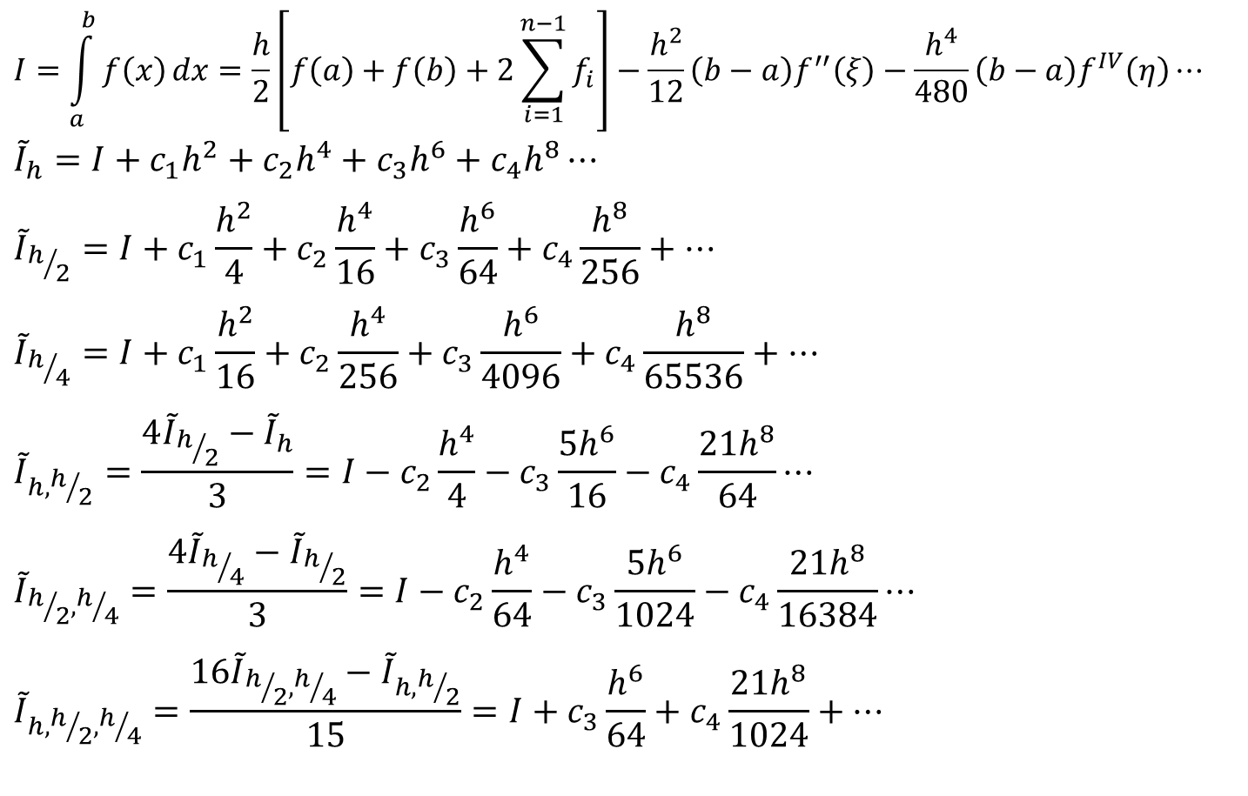
Romberg Integration
$$I=\int_{a}^{b}{f\left(x\right)}dx=\frac{h}{2}\left[f\left(a\right)+f\left(b\right)+2\sum_{i=1}^{n−1}{f_{i}}\right]−\frac{h^{2}}{12}\left(b−a\right)f^{′′}\left(ξ\right)−\frac{h^{4}}{480}\left(b−a\right)f^{IV}\left(η\right)⋯$$
$${\tilde{I}}_{h}=I+c_{1}h^{2}+c_{2}h^{4}+c_{3}h^{6}+c_{4}h^{8}⋯$$
$${\tilde{I}}_{h/2}=I+c_{1}\frac{h^{2}}{4}+c_{2}\frac{h^{4}}{16}+c_{3}\frac{h^{6}}{64}+c_{4}\frac{h^{8}}{256}+⋯$$
$${\tilde{I}}_{h/4}=I+c_{1}\frac{h^{2}}{16}+c_{2}\frac{h^{4}}{256}+c_{3}\frac{h^{6}}{4096}+c_{4}\frac{h^{8}}{65536}+⋯$$
$${\tilde{I}}_{h,h/2}=\frac{4{\tilde{I}}_{h/2}−{\tilde{I}}_{h}}{3}=I−c_{2}\frac{h^{4}}{4}−c_{3}\frac{{5h}^{6}}{16}−c_{4}\frac{21h^{8}}{64}⋯$$
$${\tilde{I}}_{h/2,h/4}=\frac{4{\tilde{I}}_{h/4}−{\tilde{I}}_{h/2}}{3}=I−c_{2}\frac{h^{4}}{64}−c_{3}\frac{{5h}^{6}}{1024}−c_{4}\frac{21h^{8}}{16384}⋯$$
$${\tilde{I}}_{h,h/2,h/4}=\frac{16{\tilde{I}}_{h/2,h/4}−{\tilde{I}}_{h,h/2}}{15}=I+c_{3}\frac{h^{6}}{64}+c_{4}\frac{21h^{8}}{1024}+⋯$$

Slide 26
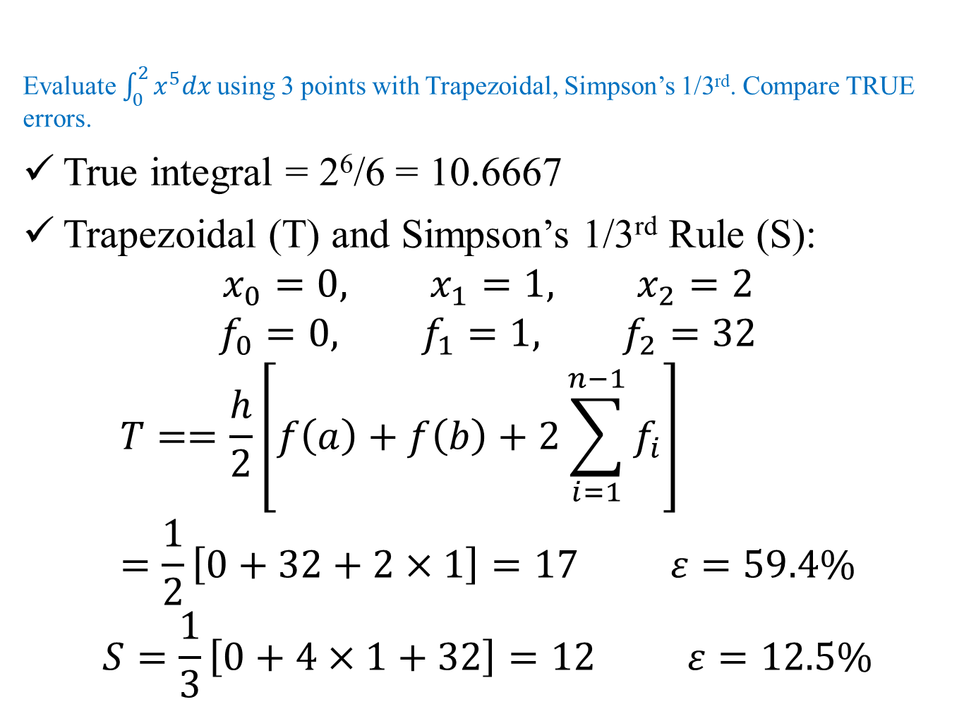
Numerical Integration: Example
Evaluate $\int_{0}^{2}{x^{5}dx}$ using 3 points with Trapezoidal, Simpson’s 1/3rd. Compare TRUE errors.
True integral = 2⁶/6 = 10.6667
Trapezoidal (T) and Simpson’s 1/3rd Rule (S):
$$x_{0}=0, x_{1}=1, x_{2}=2$$
$$f_{0}=0, f_{1}=1, f_{2}=32$$
$$T==\frac{h}{2}\left[f\left(a\right)+f\left(b\right)+2\sum_{i=1}^{n−1}{f_{i}}\right]=\frac{1}{2}\left[0+32+2×1\right]=17 ε=59.4\%$$
$$S=\frac{1}{3}\left[0+4×1+32\right]=12 ε=12.5\%$$

