Slide 1
Problem Solving on Errors and Error Analysis Lecture 3

Slide 2
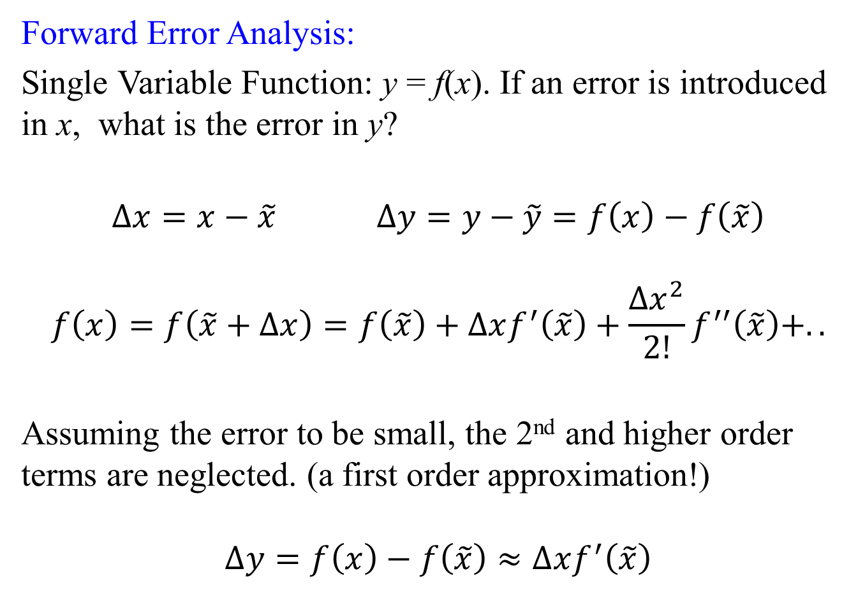
Forward Error Analysis:
Single Variable Function: y = f(x). If an error is introduced in x, what is the error in y?
$∆x=x−\tilde{x}$ $∆y=y−\tilde{y}=f\left(x\right)−f\left(\tilde{x}\right)$
$$f\left(x\right)=f\left(\tilde{x}+∆x\right)=f\left(\tilde{x}\right)+∆xf^{′}\left(\tilde{x}\right)+\frac{{∆x}^{2}}{2!}f^{′′}\left(\tilde{x}\right)+..$$
Assuming the error to be small, the 2nd and higher order terms are neglected. (a first order approximation!)
$$∆y=f\left(x\right)−f\left(\tilde{x}\right)≈∆xf^{′}\left(\tilde{x}\right)$$

Slide 3
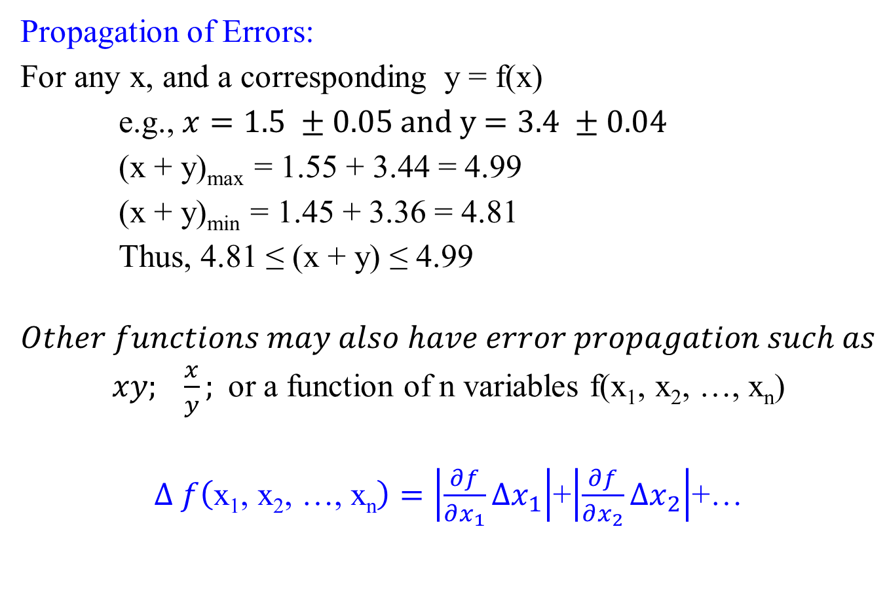
Propagation of Errors:
For any x, and a corresponding y = f(x)
e.g., $x=1.5 ±0.05$ and y$=3.4 ±0.04$
(x + y)_{max} = 1.55 + 3.44 = 4.99
(x + y)_{min} = 1.45 + 3.36 = 4.81
Thus, 4.81 ≤ (x + y) ≤ 4.99
$$Other functions may also have error propagation such as$$
$xy; \frac{x}{y};$or a function of n variables f(x₁, x₂, …, x_{n})
$∆ f\left(\text{x}\text{1}\text{, }\text{x}\text{2}\text{, …, }\text{xn}\right)=\left|\frac{∂f}{∂x_{1}}∆x_{1}\right|$+$\left|\frac{∂f}{∂x_{2}}∆x_{2}\right|$+…

Slide 4
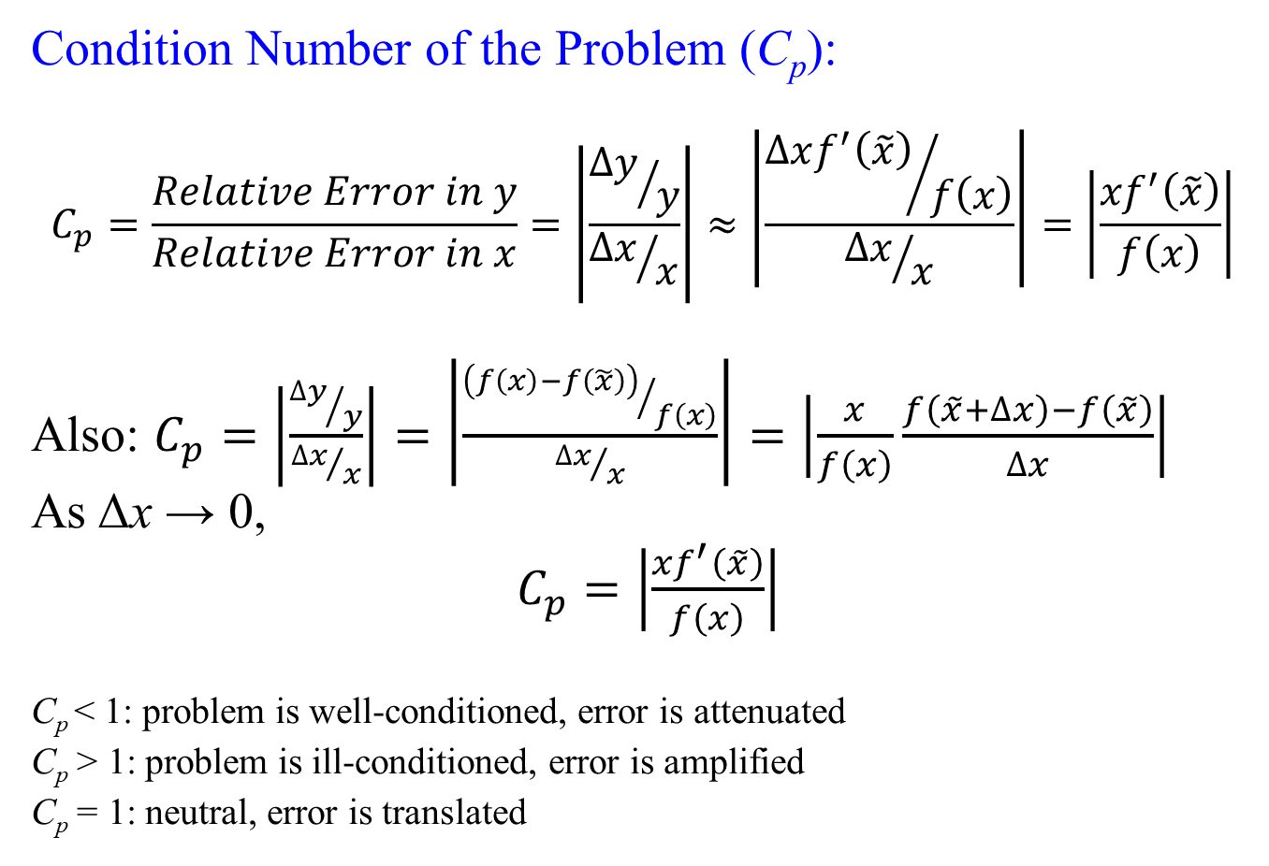
Condition Number of the Problem (C_{p}):
$$C_{p}=\frac{Relative Error in y}{Relative Error in x}=\left|\frac{{∆y}/y}{{∆x}/x}\right|≈\left|\frac{{∆xf^{′}\left(\tilde{x}\right)}/{f\left(x\right)}}{{∆x}/x}\right|=\left|\frac{{xf}^{′}\left(\tilde{x}\right)}{f\left(x\right)}\right|$$
Also: $C_{p}=\left|\frac{{∆y}/y}{{∆x}/x}\right|=\left|\frac{{\left(f\left(x\right)−f\left(\tilde{x}\right)\right)}/{f\left(x\right)}}{{∆x}/x}\right|=\left|\frac{x}{f\left(x\right)}\frac{f\left(\tilde{x}+∆x\right)−f\left(\tilde{x}\right)}{∆x}\right|$
As Δx → 0,
$C_{p}=\left|\frac{{xf}^{′}\left(\tilde{x}\right)}{f\left(x\right)}\right|$
C_{p} < 1: problem is well-conditioned, error is attenuated
C_{p} > 1: problem is ill-conditioned, error is amplified
C_{p} = 1: neutral, error is translated

Slide 5
Backward Error Analysis:
What is the perturbation required in the input in order to explain the error in the output if the computation is carried out by true mathematical function without any error?
Computation using numerical algorithm
Computation using mathematical problem
Error in the Output
Hypothetical error in the Input computed using backward error analysis
Both computations are using the original Mathematical Model
Error in the Output

Slide 6
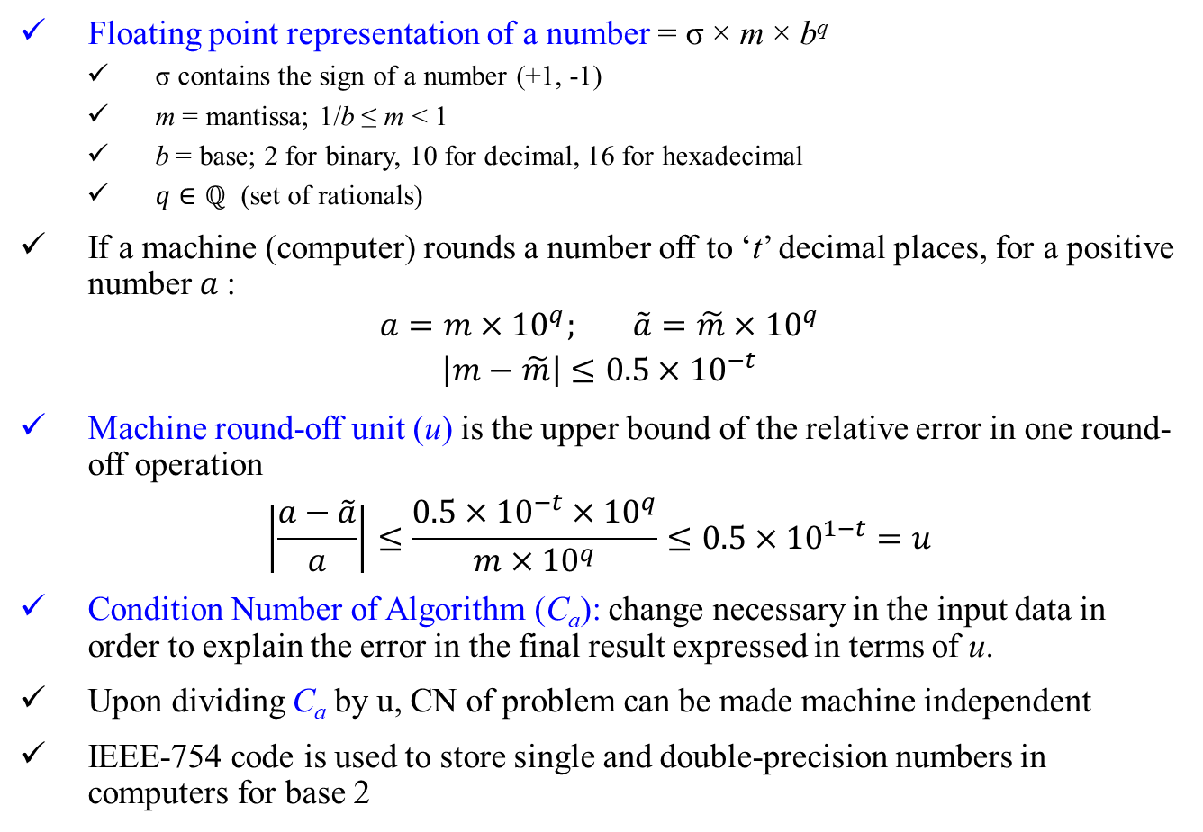
Floating point representation of a number = σ × m × b^{q}
σ contains the sign of a number (+1, -1)
m = mantissa; 1/b ≤ m < 1
b = base; 2 for binary, 10 for decimal, 16 for hexadecimal
$q∈ℚ$ (set of rationals)
If a machine (computer) rounds a number off to ‘t’ decimal places, for a positive number $a$:
$$a=m×{10}^{q}; \tilde{a}=\tilde{m}×{10}^{q}$$
$$\left|m−\tilde{m}\right|≤0.5×{10}^{−t}$$
Machine round-off unit (u) is the upper bound of the relative error in one round-off operation
$$\left|\frac{a−\tilde{a}}{a}\right|≤\frac{0.5×{10}^{−t}×{10}^{q}}{m×{10}^{q}}≤0.5×{10}^{1−t}=u$$
Condition Number of Algorithm (C_{a}): change necessary in the input data in order to explain the error in the final result expressed in terms of u.
Upon dividing C_{a} by u, CN of problem can be made machine independent
IEEE-754 code is used to store single and double-precision numbers in computers for base 2

Slide 7
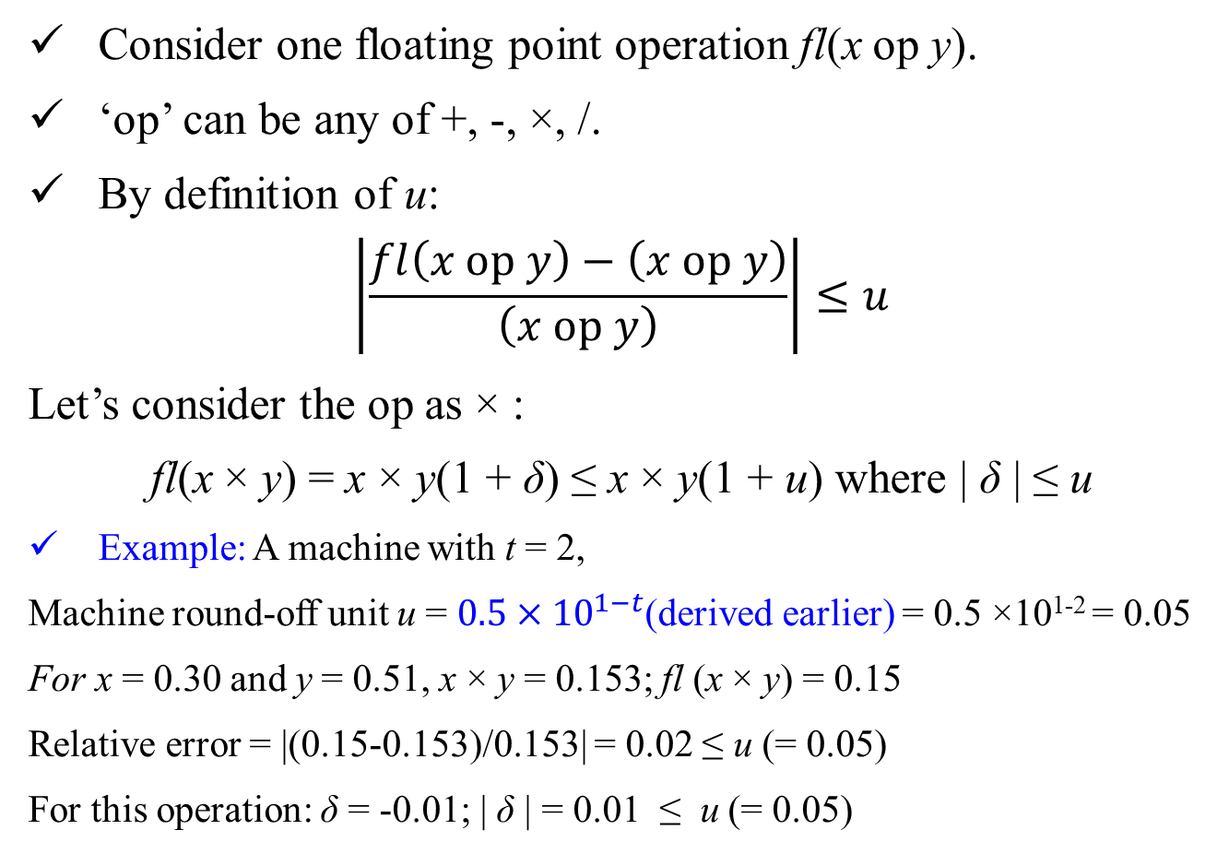
Consider one floating point operation fl(x op y).
‘op’ can be any of +, -, ×, /.
By definition of u:
$$\left|\frac{fl\left(x op y\right)−\left(x op y\right)}{\left(x op y\right)}\right|≤u$$
Let’s consider the op as × :
fl(x × y) = x × y(1 + δ) ≤ x × y(1 + u) where | δ | ≤ u
Example: A machine with t = 2,
Machine round-off unit u = $0.5×{10}^{1−t}$(derived earlier) = 0.5 ×10¹⁻² = 0.05
For x = 0.30 and y = 0.51, x × y = 0.153; fl (x × y) = 0.15
Relative error = |(0.15-0.153)/0.153| = 0.02 ≤ u (= 0.05)
For this operation: δ = -0.01; | δ | = 0.01 ≤ u (= 0.05)

Slide 8
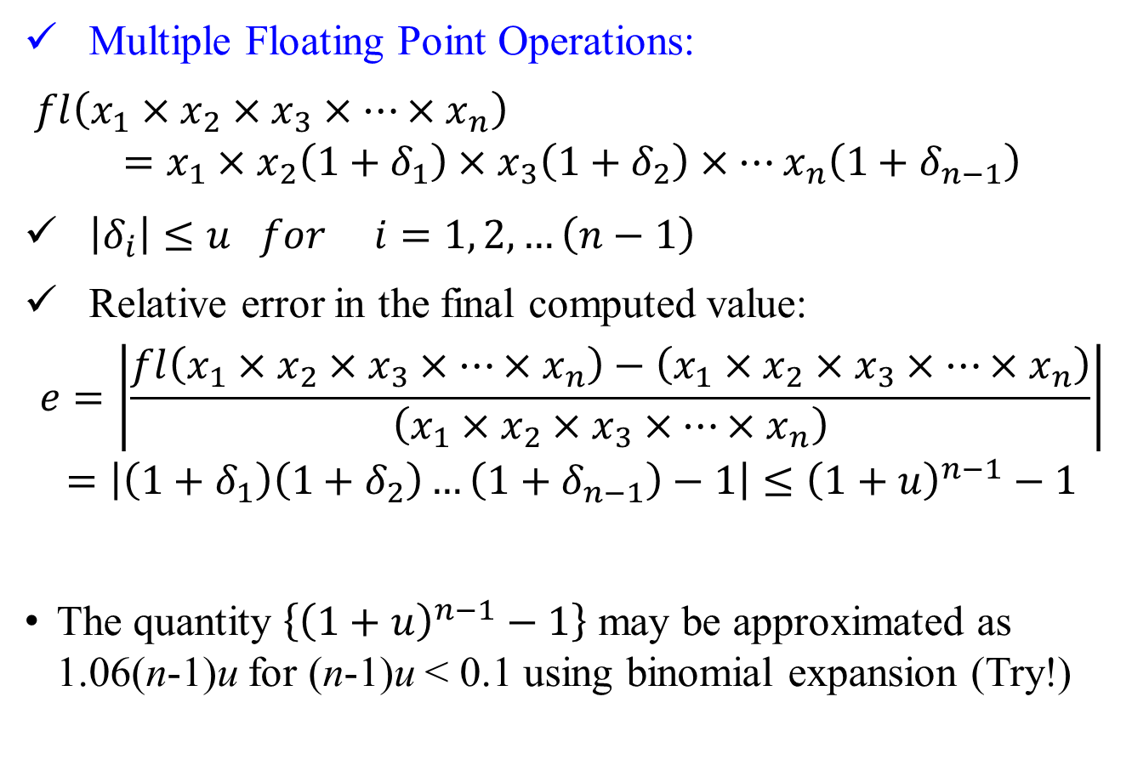
Multiple Floating Point Operations:
$fl\left(x_{1}×x_{2}×x_{3}×…×x_{n}\right)$
$$=x_{1}×x_{2}\left(1+δ_{1}\right)×x_{3}\left(1+δ_{2}\right)×…x_{n}\left(1+δ_{n−1}\right)$$
$\left|δ_{i}\right|≤u for i=1, 2, …\left(n−1\right)$
Relative error in the final computed value:
$$e=\left|\frac{fl\left(x_{1}×x_{2}×x_{3}×…×x_{n}\right)−\left(x_{1}×x_{2}×x_{3}×…×x_{n}\right)}{\left(x_{1}×x_{2}×x_{3}×…×x_{n}\right)}\right|$$
$$=\left|\left(1+δ_{1}\right)\left(1+δ_{2}\right)…\left(1+δ_{n−1}\right)−1\right|≤{\left(1+u\right)}^{n−1}−1$$
The quantity $\left\{{\left(1+u\right)}^{n−1}−1\right\}$ may be approximated as 1.06(n-1)u for (n-1)u < 0.1 using binomial expansion (Try!)

Slide 9
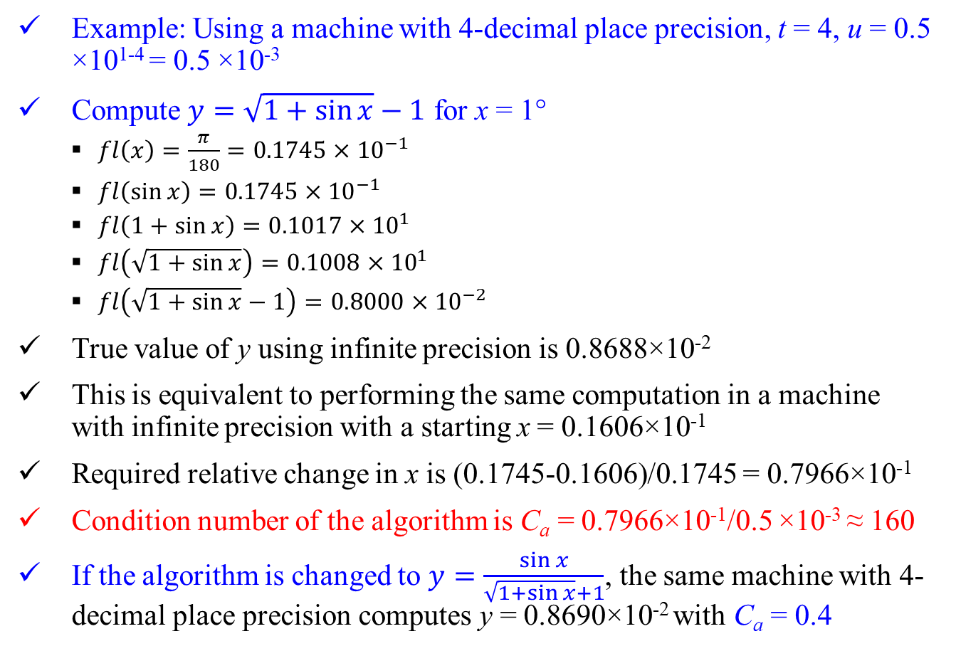
Example: Using a machine with 4-decimal place precision, t = 4, u = 0.5 ×10¹⁻⁴ = 0.5 ×10⁻³
Compute $y=\sqrt{1+\sin{x}}−1$ for x = 1°
$fl\left(x\right)=\frac{π}{180}=0.1745×{10}^{−1}$
$fl\left(\sin{x}\right)=0.1745×{10}^{−1}$
$fl\left(1+sin{x}\right)=0.1017×{10}^{1}$
$fl\left(\sqrt{1+\sin{x}}\right)=0.1008×{10}^{1}$
$fl\left(\sqrt{1+\sin{x}}−1\right)=0.8000×{10}^{−2}$
True value of y using infinite precision is 0.8688×10⁻²
This is equivalent to performing the same computation in a machine with infinite precision with a starting x = 0.1606×10⁻¹
Required relative change in x is (0.1745-0.1606)/0.1745 = 0.7966×10⁻¹
Condition number of the algorithm is C_{a} = 0.7966×10⁻¹/0.5 ×10⁻³ ≈ 160
If the algorithm is changed to $y=\frac{\sin{x}}{\sqrt{1+\sin{x}}+1}$, the same machine with 4-decimal place precision computes y = 0.8690×10⁻² with C_{a} = 0.4
Avoid subtraction and addition of numbers close to each other to prevent large round off errors

Slide 10
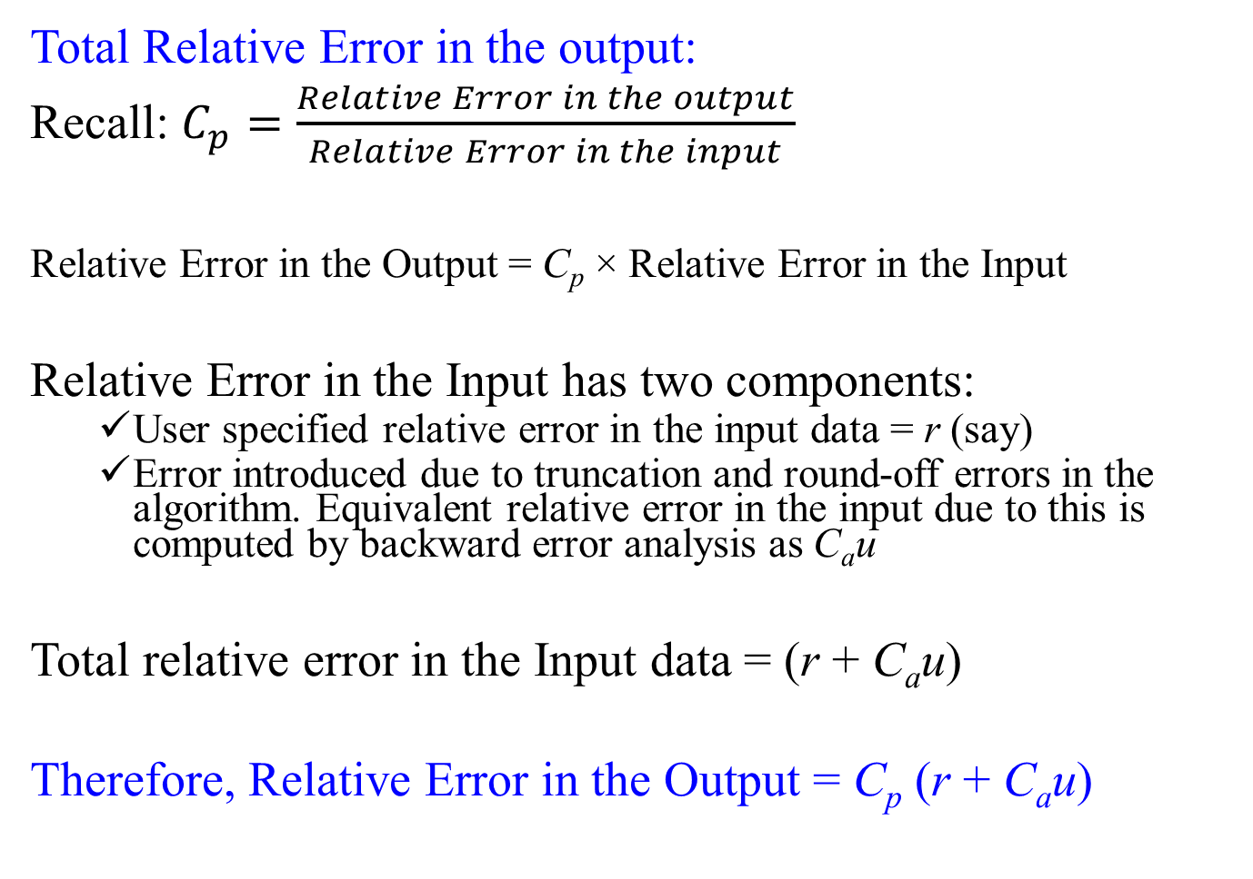
Total Relative Error in the output:
Recall: $C_{p}=\frac{Relative Error in the output}{Relative Error in the input}$
Relative Error in the Output = C_{p} × Relative Error in the Input
Relative Error in the Input has two components:
User specified relative error in the input data = r (say)
Error introduced due to truncation and round-off errors in the algorithm. Equivalent relative error in the input due to this is computed by backward error analysis as C_{a}u
Total relative error in the Input data = (r + C_{a}u)
Therefore, Relative Error in the Output = C_{p} (r + C_{a}u)

Slide 11
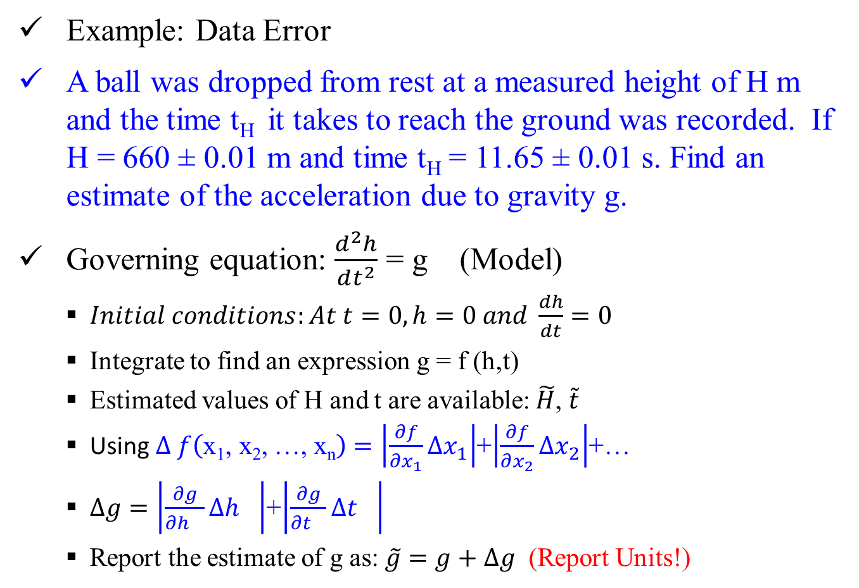
Example: Data Error
A ball was dropped from rest at a measured height of H m and the time t_{H} it takes to reach the ground was recorded. If H = 660 ± 0.01 m and time t_{H} = 11.65 ± 0.01 s. Find an estimate of the acceleration due to gravity g.
Governing equation: $\frac{d^{2}h}{dt^{2}}$ = g (Model)
$Initial conditions:At t=0, h=0 and {\frac{dh}{dt}=0}^{}$
Integrate to find an expression g = f (h,t)
Estimated values of H and t are available: $\tilde{H}$, $\tilde{t}$
Using $∆ f\left(\text{x}\text{1}\text{, }\text{x}\text{2}\text{, …, }\text{xn}\right)=\left|\frac{∂f}{∂x_{1}}∆x_{1}\right|$+$\left|\frac{∂f}{∂x_{2}}∆x_{2}\right|$+…
$∆g=\left|\frac{∂g}{∂h_{}}∆h_{}\right|$+$\left|\frac{∂g}{∂t_{}}∆t_{}\right|$
Report the estimate of g as: $\tilde{g}$ $=g+$ $∆g$ (Report Units!)

Slide 12
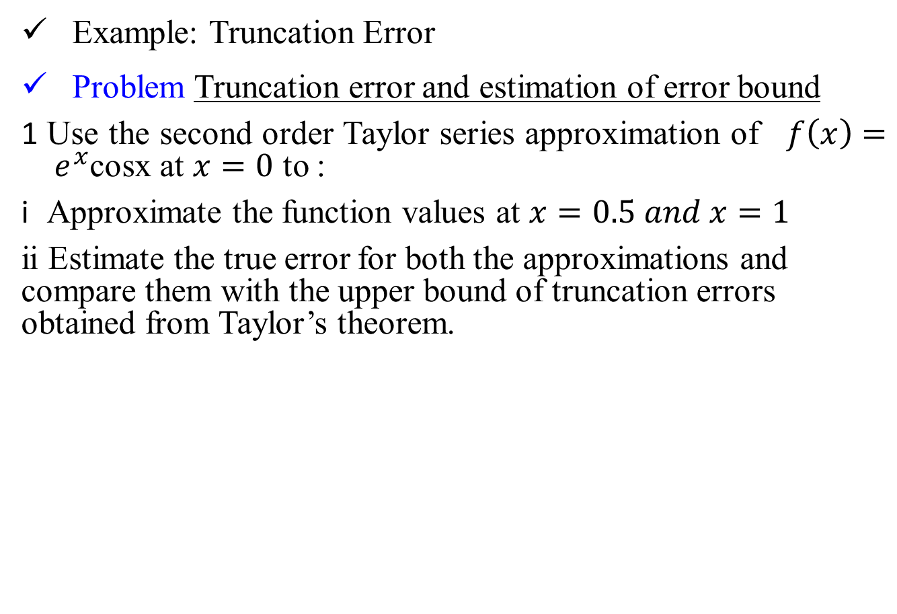
Example: Truncation Error
Problem Truncation error and estimation of error bound
Use the second order Taylor series approximation of $f\left(x\right)= e^{x}$cosx at $x=0$ to :
Approximate the function values at $x=0.5 and x=1$
ii Estimate the true error for both the approximations and compare them with the upper bound of truncation errors obtained from Taylor’s theorem.

Slide 13
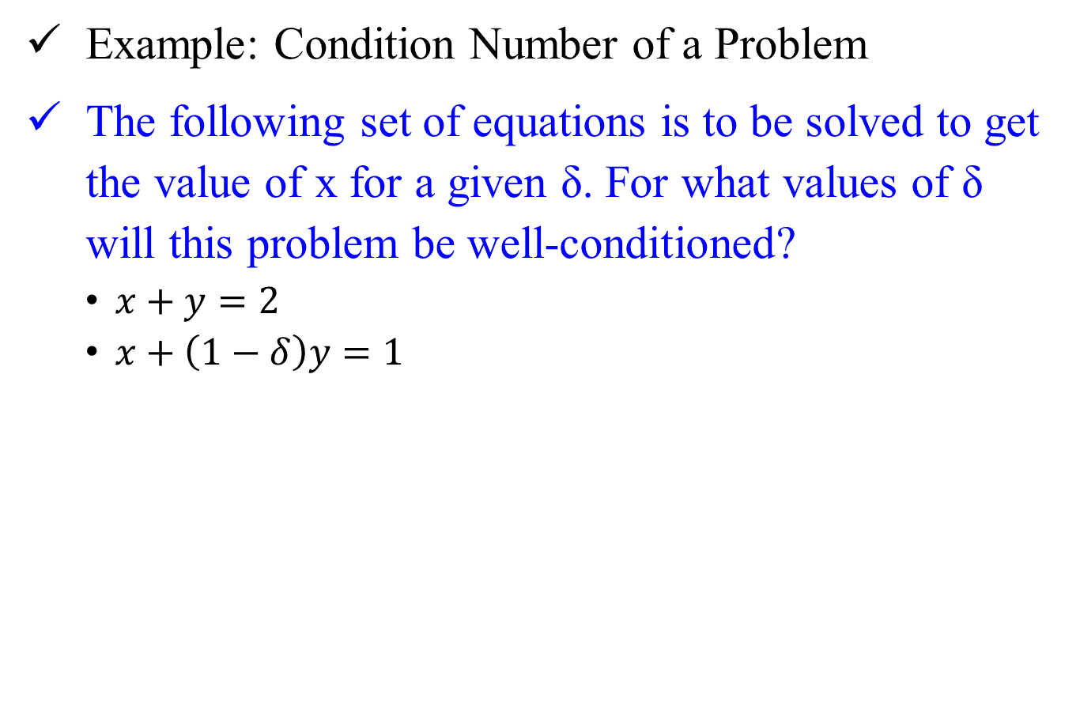
Example: Condition Number of a Problem
The following set of equations is to be solved to get the value of x for a given δ. For what values of δ will this problem be well-conditioned?
$x+y=2$
$x+\left(1−δ\right)y=1$

