Slide 1
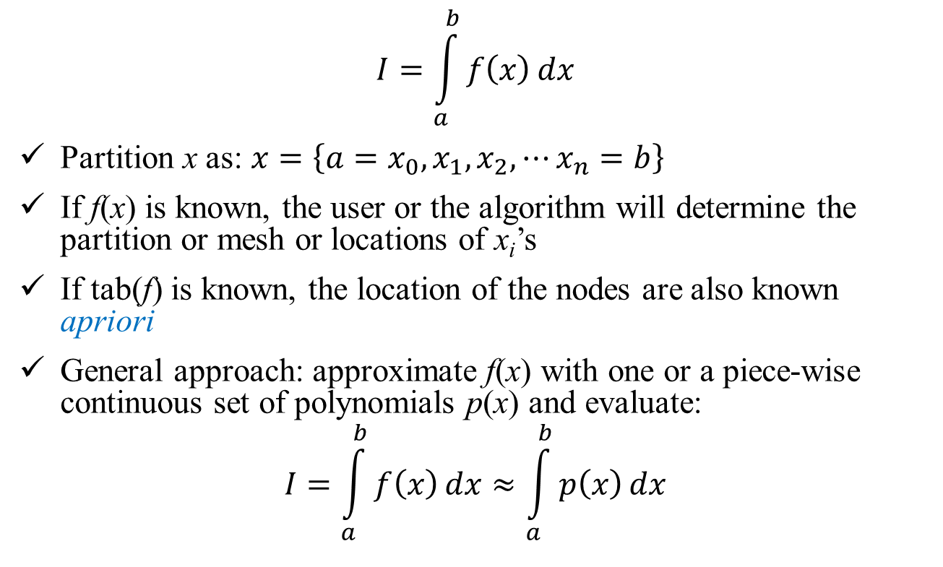
Numerical Integration (Contd)
$$I=\int_{a}^{b}{f\left(x\right)}dx$$
Partition x as: $x=\left\{a=x_{0},x_{1},x_{2},⋯x_{n}=b\right\}$
If f(x) is known, the user or the algorithm will determine the partition or mesh or locations of x_{i}’s
If tab(f) is known, the location of the nodes are also known apriori
General approach: approximate f(x) with one or a piece-wise continuous set of polynomials p(x) and evaluate:
$$I=\int_{a}^{b}{f\left(x\right)}dx≈\int_{a}^{b}{p\left(x\right)}dx$$

Slide 2

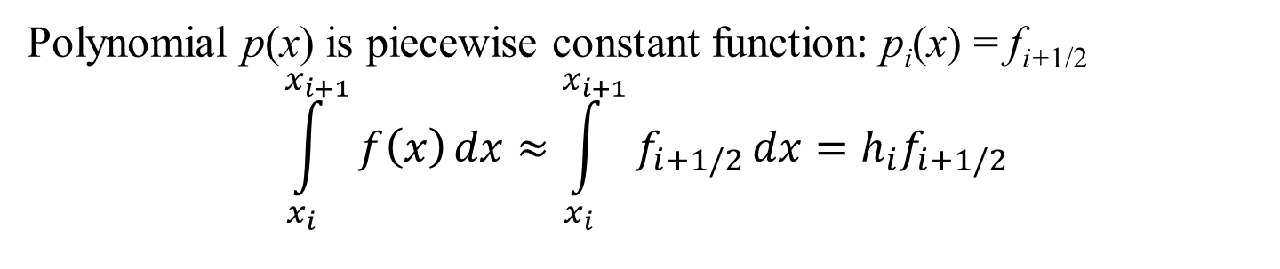
Numerical Integration: Rectangular Rule
f_{i+1/2}
f_{i+2}
$$h_{i}=x_{i+1}−x_{i}$$
f_{n}
f_{i}
f_{i+1}
f₁
f_{i-1}
f₀
a = x₀
x₁
x_{i-1}
x_{i}
x_{i+1/2}
x_{i+1}
x_{i+2}
b = x_{n}
Polynomial p(x) is piecewise constant function: p_{i}(x) = f_{i+1/2}
$$\int_{x_{i}}^{x_{i+1}}{f\left(x\right)}dx≈\int_{x_{i}}^{x_{i+1}}{f_{i+1/2}}dx=h_{i}f_{i+1/2}$$

Slide 3
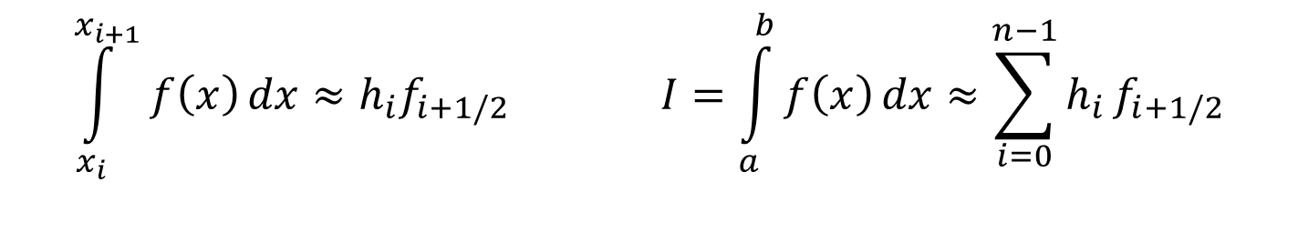
Numerical Integration: Rectangular Rule
f_{i+1/2}
f_{i+2}
$$h_{i}=x_{i+1}−x_{i}$$
f_{n}
f_{i}
f_{i+1}
f₁
f_{i-1}
f₀
a = x₀
x₁
x_{i-1}
x_{i}
x_{i+1/2}
x_{i+1}
x_{i+2}
b = x_{n}
$$\int_{x_{i}}^{x_{i+1}}{f\left(x\right)}dx≈h_{i}f_{i+1/2} I=\int_{a}^{b}{f\left(x\right)}dx≈\sum_{i=0}^{n−1}{h_{i}}f_{i+1/2}$$

Slide 4
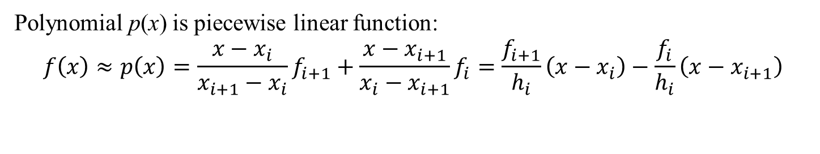
Numerical Integration: Trapezoidal Rule
$$h_{i}=x_{i+1}−x_{i}$$
f_{i+2}
f_{i}
f_{n}
f_{i+1}
f₁
f_{i-1}
f₀
a = x₀
x₁
x_{i-1}
x_{i}
x_{i+1}
x_{i+2}
b = x_{n}
Polynomial p(x) is piecewise linear function:
$$f\left(x\right)≈p\left(x\right)=\frac{x−x_{i}}{x_{i+1}−x_{i}}f_{i+1}+\frac{x−x_{i+1}}{x_{i}−x_{i+1}}f_{i}=\frac{f_{i+1}}{h_{i}}\left(x−x_{i}\right)−\frac{f_{i}}{h_{i}}\left(x−x_{i+1}\right)$$

Slide 5
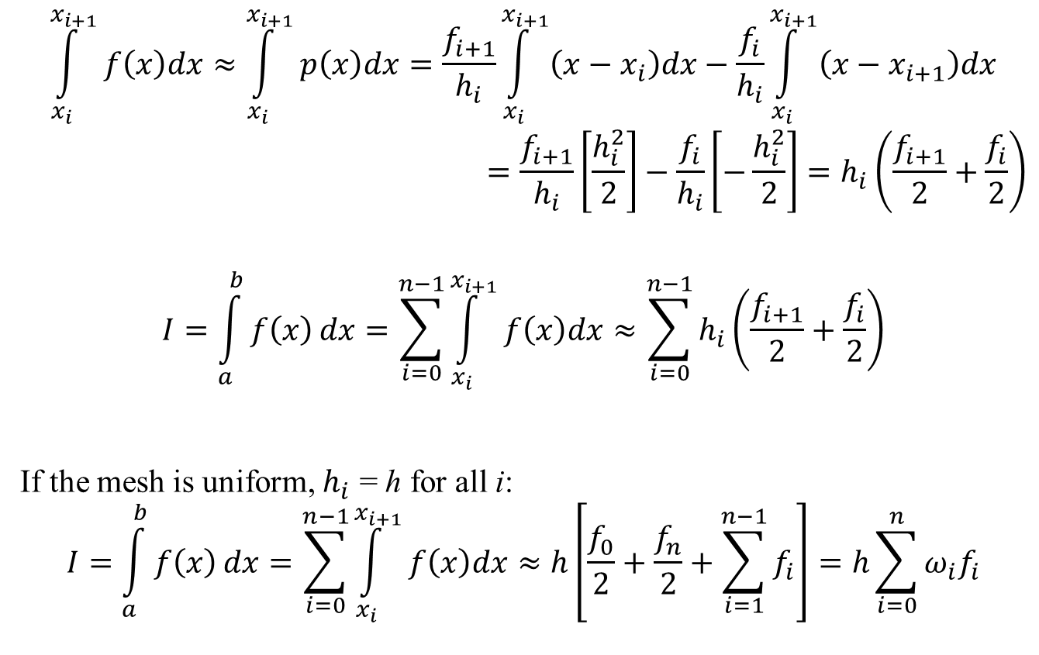
Numerical Integration: Trapezoidal Rule
$$\int_{x_{i}}^{x_{i+1}}{f\left(x\right)dx}≈\int_{x_{i}}^{x_{i+1}}{p\left(x\right)dx}=\frac{f_{i+1}}{h_{i}}\int_{x_{i}}^{x_{i+1}}{\left(x−x_{i}\right)dx}−\frac{f_{i}}{h_{i}}\int_{x_{i}}^{x_{i+1}}{\left(x−x_{i+1}\right)dx}$$
$$=\frac{f_{i+1}}{h_{i}}\left[\frac{h_{i}^{2}}{2}\right]−\frac{f_{i}}{h_{i}}\left[−\frac{h_{i}^{2}}{2}\right]=h_{i}\left(\frac{f_{i+1}}{2}+\frac{f_{i}}{2}\right)$$
$$I=\int_{a}^{b}{f\left(x\right)}dx=\sum_{i=0}^{n−1}{\int_{x_{i}}^{x_{i+1}}{f\left(x\right)dx}}≈\sum_{i=0}^{n−1}{h_{i}\left(\frac{f_{i+1}}{2}+\frac{f_{i}}{2}\right)}$$
If the mesh is uniform, $h_{i}$ = h for all i:
$$I=\int_{a}^{b}{f\left(x\right)}dx=\sum_{i=0}^{n−1}{\int_{x_{i}}^{x_{i+1}}{f\left(x\right)dx}}≈h\left[\frac{f_{0}}{2}+\frac{f_{n}}{2}+\sum_{i=1}^{n−1}{f_{i}}\right]=h\sum_{i=0}^{n}{ω_{i}f_{i}}$$

Slide 6
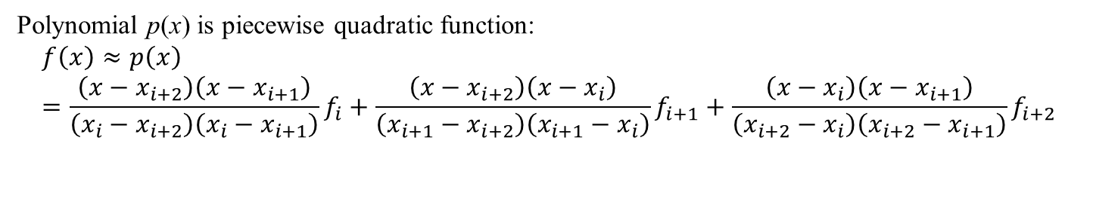
Numerical Integration: Simpson’s Rules
$$h_{i}=x_{i+1}−x_{i}$$
f_{i+2}
f_{i}
f_{n}
f_{i+1}
f₁
f_{i-1}
f₀
a = x₀
x₁
x_{i-1}
x_{i}
x_{i+1}
x_{i+2}
b = x_{n}
Polynomial p(x) is piecewise quadratic function:
$$f\left(x\right)≈p\left(x\right)=\frac{\left(x−x_{i+2}\right)\left(x−x_{i+1}\right)}{\left(x_{i}−x_{i+2}\right)\left(x_{i}−x_{i+1}\right)}f_{i}+\frac{\left(x−x_{i+2}\right)\left(x−x_{i}\right)}{\left(x_{i+1}−x_{i+2}\right)\left(x_{i+1}−x_{i}\right)}f_{i+1}+\frac{\left(x−x_{i}\right)\left(x−x_{i+1}\right)}{\left(x_{i+2}−x_{i}\right)\left(x_{i+2}−x_{i+1}\right)}f_{i+2}$$

Slide 7
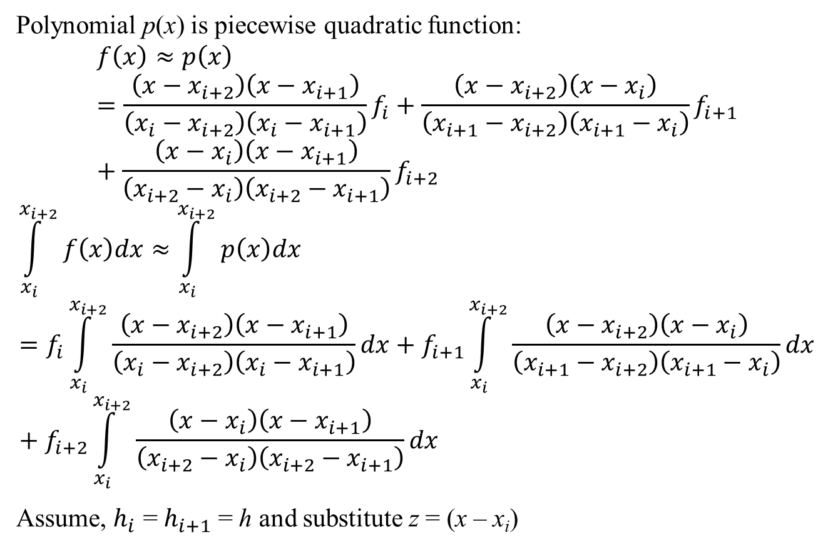
Numerical Integration: Simpson’s Rules
Polynomial p(x) is piecewise quadratic function:
$$f\left(x\right)≈p\left(x\right)=\frac{\left(x−x_{i+2}\right)\left(x−x_{i+1}\right)}{\left(x_{i}−x_{i+2}\right)\left(x_{i}−x_{i+1}\right)}f_{i}+\frac{\left(x−x_{i+2}\right)\left(x−x_{i}\right)}{\left(x_{i+1}−x_{i+2}\right)\left(x_{i+1}−x_{i}\right)}f_{i+1}+\frac{\left(x−x_{i}\right)\left(x−x_{i+1}\right)}{\left(x_{i+2}−x_{i}\right)\left(x_{i+2}−x_{i+1}\right)}f_{i+2}$$
$$\int_{x_{i}}^{x_{i+2}}{f\left(x\right)dx}≈\int_{x_{i}}^{x_{i+2}}{p\left(x\right)dx}=f_{i}\int_{x_{i}}^{x_{i+2}}{\frac{\left(x−x_{i+2}\right)\left(x−x_{i+1}\right)}{\left(x_{i}−x_{i+2}\right)\left(x_{i}−x_{i+1}\right)}dx}+f_{i+1}\int_{x_{i}}^{x_{i+2}}{\frac{\left(x−x_{i+2}\right)\left(x−x_{i}\right)}{\left(x_{i+1}−x_{i+2}\right)\left(x_{i+1}−x_{i}\right)}dx}+f_{i+2}\int_{x_{i}}^{x_{i+2}}{\frac{\left(x−x_{i}\right)\left(x−x_{i+1}\right)}{\left(x_{i+2}−x_{i}\right)\left(x_{i+2}−x_{i+1}\right)}dx}$$
Assume, $h_{i}$ = $h_{i+1}$ = h and substitute z = (x – x_{i})

Slide 8
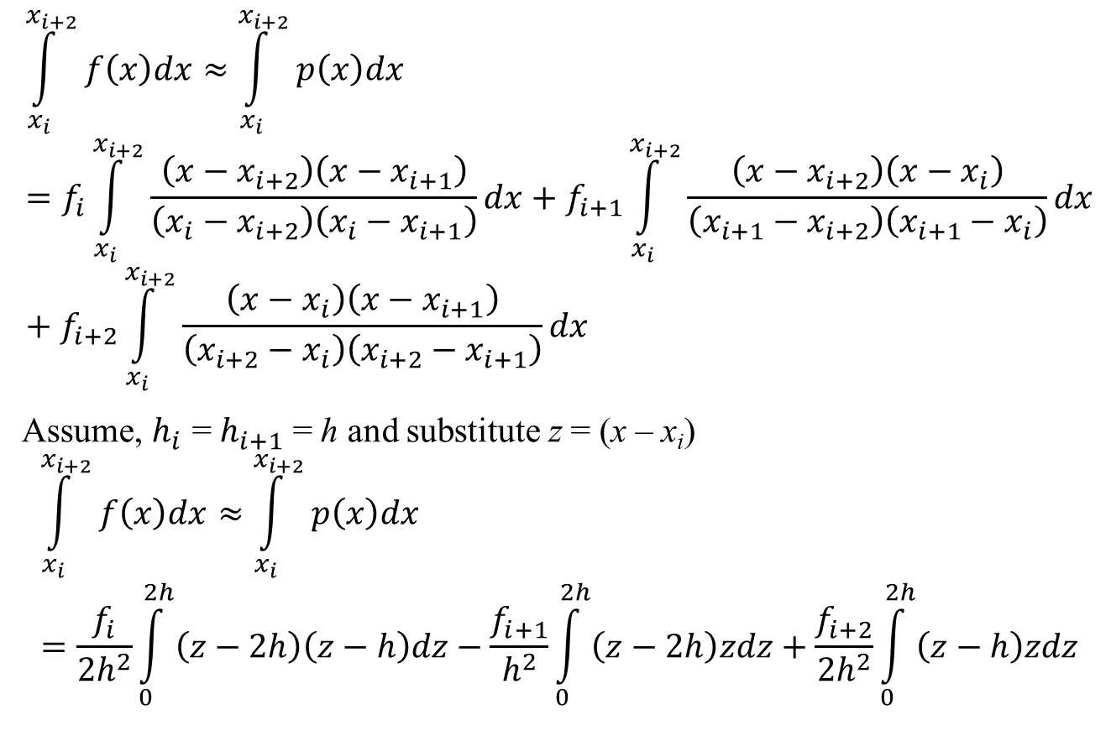
Numerical Integration: Simpson’s Rules
$$\int_{x_{i}}^{x_{i+2}}{f\left(x\right)dx}≈\int_{x_{i}}^{x_{i+2}}{p\left(x\right)dx}=f_{i}\int_{x_{i}}^{x_{i+2}}{\frac{\left(x−x_{i+2}\right)\left(x−x_{i+1}\right)}{\left(x_{i}−x_{i+2}\right)\left(x_{i}−x_{i+1}\right)}dx}+f_{i+1}\int_{x_{i}}^{x_{i+2}}{\frac{\left(x−x_{i+2}\right)\left(x−x_{i}\right)}{\left(x_{i+1}−x_{i+2}\right)\left(x_{i+1}−x_{i}\right)}dx}+f_{i+2}\int_{x_{i}}^{x_{i+2}}{\frac{\left(x−x_{i}\right)\left(x−x_{i+1}\right)}{\left(x_{i+2}−x_{i}\right)\left(x_{i+2}−x_{i+1}\right)}dx}$$
Assume, $h_{i}$ = $h_{i+1}$ = h and substitute z = (x – x_{i})
$$\int_{x_{i}}^{x_{i+2}}{f\left(x\right)dx}≈\int_{x_{i}}^{x_{i+2}}{p\left(x\right)dx}=\frac{f_{i}}{{2h}^{2}}\int_{0}^{2h}{\left(z−2h\right)\left(z−h\right)dz}−\frac{f_{i+1}}{h^{2}}\int_{0}^{2h}{\left(z−2h\right)zdz}+\frac{f_{i+2}}{{2h}^{2}}\int_{0}^{2h}{\left(z−h\right)zdz}$$

Slide 9
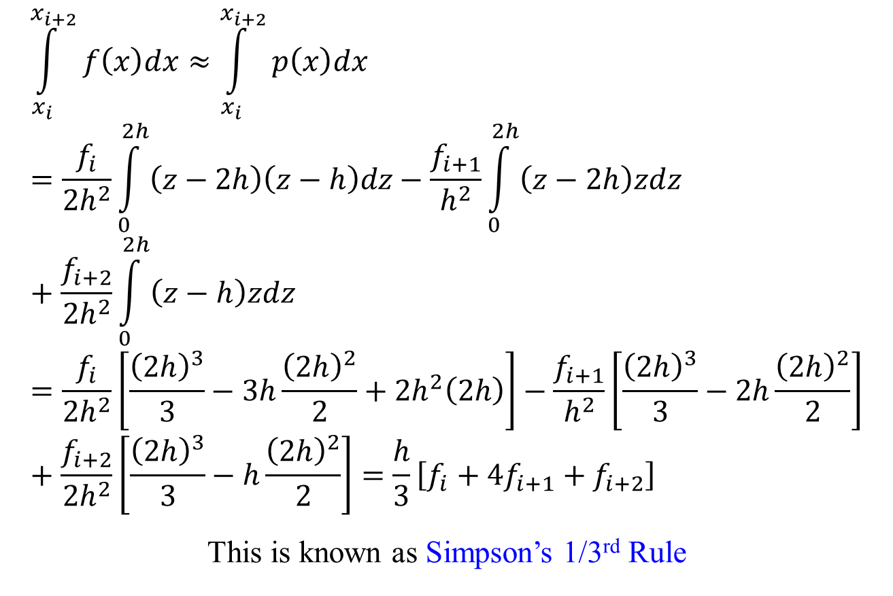
Numerical Integration: Simpson’s Rules
$$\int_{x_{i}}^{x_{i+2}}{f\left(x\right)dx}≈\int_{x_{i}}^{x_{i+2}}{p\left(x\right)dx}=\frac{f_{i}}{{2h}^{2}}\int_{0}^{2h}{\left(z−2h\right)\left(z−h\right)dz}−\frac{f_{i+1}}{h^{2}}\int_{0}^{2h}{\left(z−2h\right)zdz}+\frac{f_{i+2}}{{2h}^{2}}\int_{0}^{2h}{\left(z−h\right)zdz}=\frac{f_{i}}{{2h}^{2}}\left[\frac{{\left(2h\right)}^{3}}{3}−3h\frac{{\left(2h\right)}^{2}}{2}+{2h}^{2}\left(2h\right)\right]−\frac{f_{i+1}}{h^{2}}\left[\frac{{\left(2h\right)}^{3}}{3}−2h\frac{{\left(2h\right)}^{2}}{2}\right]+\frac{f_{i+2}}{{2h}^{2}}\left[\frac{{\left(2h\right)}^{3}}{3}−h\frac{{\left(2h\right)}^{2}}{2}\right]=\frac{h}{3}\left[f_{i}+4f_{i+1}+f_{i+2}\right]$$
This is known as Simpson’s 1/3rd Rule

Slide 10

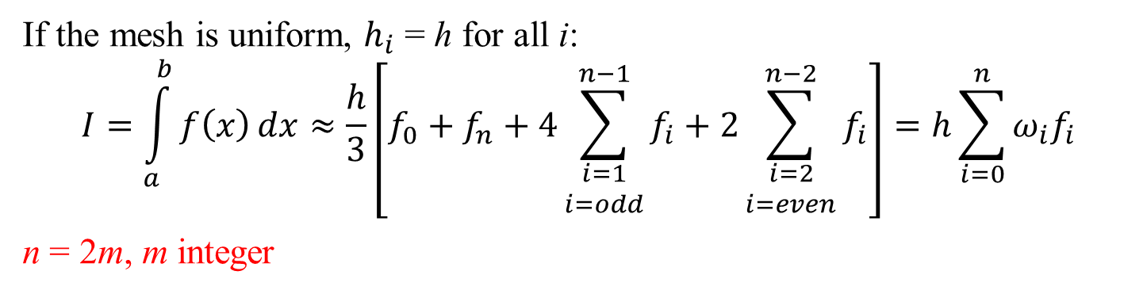
Numerical Integration: Simpson’s Rules
$$h=x_{i+1}−x_{i} ∀i$$
f_{i+2}
f_{i}
f_{n}
f_{i+1}
f₁
f_{i-1}
f₀
a = x₀
x₁
x_{i-1}
x_{i}
x_{i+1}
x_{i+2}
b = x_{n}
If the mesh is uniform, $h_{i}$ = h for all i:
$$I=\int_{a}^{b}{f\left(x\right)}dx≈\frac{h}{3}\left[f_{0}+f_{n}+4\sum_{\begin{matrix}i=1 \\ i=odd\end{matrix}}^{n−1}{f_{i}}+2\sum_{\begin{matrix}i=2 \\ i=even\end{matrix}}^{n−2}{f_{i}}\right]=h\sum_{i=0}^{n}{ω_{i}f_{i}}$$
n = 2m, m integer

Slide 11
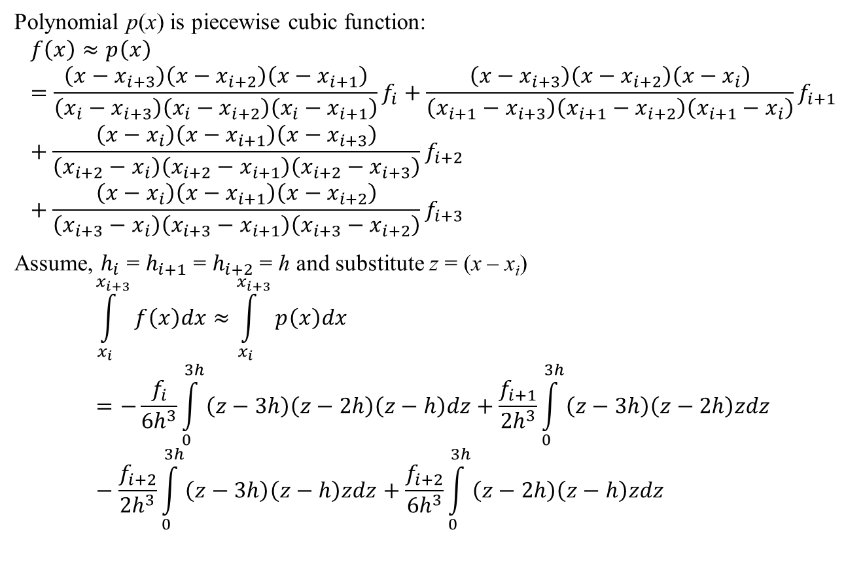
Numerical Integration: Simpson’s Rules
Polynomial p(x) is piecewise cubic function:
$$f\left(x\right)≈p\left(x\right)=\frac{\left(x−x_{i+3}\right)\left(x−x_{i+2}\right)\left(x−x_{i+1}\right)}{\left(x_{i}−x_{i+3}\right)\left(x_{i}−x_{i+2}\right)\left(x_{i}−x_{i+1}\right)}f_{i}+\frac{\left(x−x_{i+3}\right)\left(x−x_{i+2}\right)\left(x−x_{i}\right)}{\left(x_{i+1}−x_{i+3}\right)\left(x_{i+1}−x_{i+2}\right)\left(x_{i+1}−x_{i}\right)}f_{i+1}+\frac{\left(x−x_{i}\right)\left(x−x_{i+1}\right)\left(x−x_{i+3}\right)}{\left(x_{i+2}−x_{i}\right)\left(x_{i+2}−x_{i+1}\right)\left(x_{i+2}−x_{i+3}\right)}f_{i+2}+\frac{\left(x−x_{i}\right)\left(x−x_{i+1}\right)\left(x−x_{i+2}\right)}{\left(x_{i+3}−x_{i}\right)\left(x_{i+3}−x_{i+1}\right)\left(x_{i+3}−x_{i+2}\right)}f_{i+3}$$
Assume, $h_{i}$ = $h_{i+1}$ = $h_{i+2}$= h and substitute z = (x – x_{i})
$$\int_{x_{i}}^{x_{i+3}}{f\left(x\right)dx}≈\int_{x_{i}}^{x_{i+3}}{p\left(x\right)dx}=−\frac{f_{i}}{{6h}^{3}}\int_{0}^{3h}{\left(z−3h\right)\left(z−2h\right)\left(z−h\right)dz}+\frac{f_{i+1}}{{2h}^{3}}\int_{0}^{3h}{\left(z−3h\right)\left(z−2h\right)zdz}−\frac{f_{i+2}}{{2h}^{3}}\int_{0}^{3h}{\left(z−3h\right)\left(z−h\right)zdz}+\frac{f_{i+2}}{{6h}^{3}}\int_{0}^{3h}{\left(z−2h\right)\left(z−h\right)zdz}$$

Slide 12
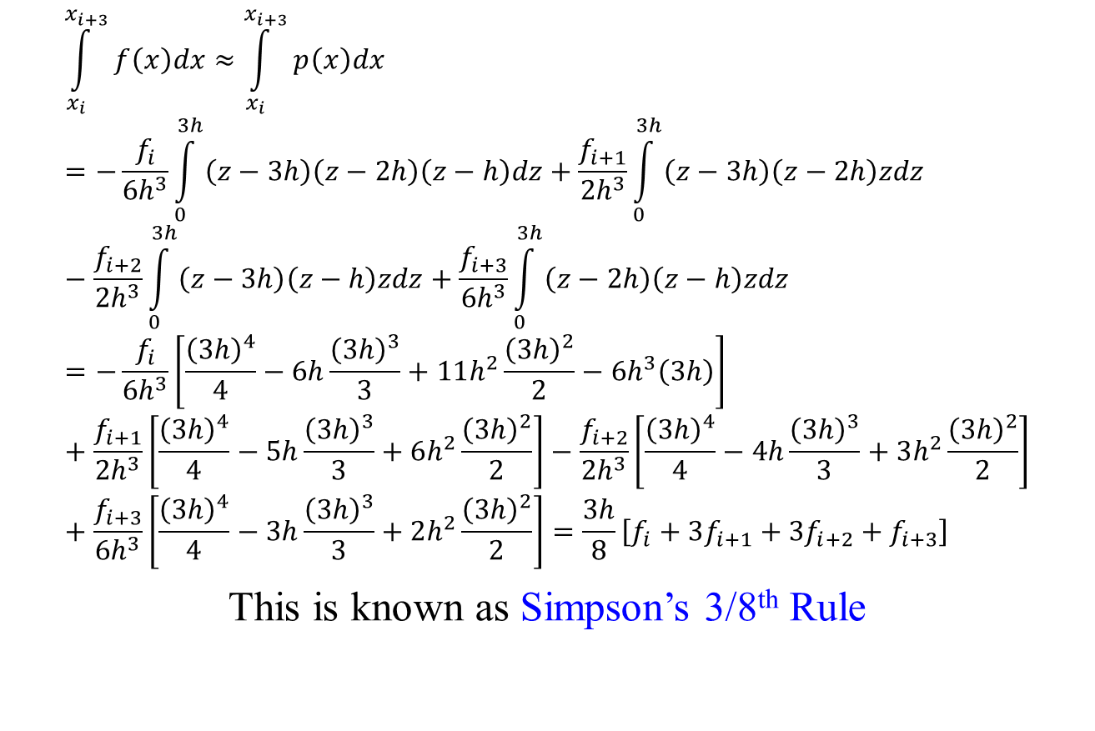
Numerical Integration: Simpson’s Rules
$$\int_{x_{i}}^{x_{i+3}}{f\left(x\right)dx}≈\int_{x_{i}}^{x_{i+3}}{p\left(x\right)dx}=−\frac{f_{i}}{{6h}^{3}}\int_{0}^{3h}{\left(z−3h\right)\left(z−2h\right)\left(z−h\right)dz}+\frac{f_{i+1}}{{2h}^{3}}\int_{0}^{3h}{\left(z−3h\right)\left(z−2h\right)zdz}−\frac{f_{i+2}}{{2h}^{3}}\int_{0}^{3h}{\left(z−3h\right)\left(z−h\right)zdz}+\frac{f_{i+3}}{{6h}^{3}}\int_{0}^{3h}{\left(z−2h\right)\left(z−h\right)zdz}=−\frac{f_{i}}{{6h}^{3}}\left[\frac{{\left(3h\right)}^{4}}{4}−6h\frac{{\left(3h\right)}^{3}}{3}+11h^{2}\frac{{\left(3h\right)}^{2}}{2}−{6h}^{3}\left(3h\right)\right]+\frac{f_{i+1}}{{2h}^{3}}\left[\frac{{\left(3h\right)}^{4}}{4}−5h\frac{{\left(3h\right)}^{3}}{3}+6h^{2}\frac{{\left(3h\right)}^{2}}{2}\right]−\frac{f_{i+2}}{{2h}^{3}}\left[\frac{{\left(3h\right)}^{4}}{4}−4h\frac{{\left(3h\right)}^{3}}{3}+3h^{2}\frac{{\left(3h\right)}^{2}}{2}\right]+\frac{f_{i+3}}{{6h}^{3}}\left[\frac{{\left(3h\right)}^{4}}{4}−3h\frac{{\left(3h\right)}^{3}}{3}+2h^{2}\frac{{\left(3h\right)}^{2}}{2}\right]=\frac{3h}{8}\left[f_{i}+3f_{i+1}+{3f}_{i+2}+f_{i+3}\right]$$
This is known as Simpson’s 3/8th Rule

Slide 13
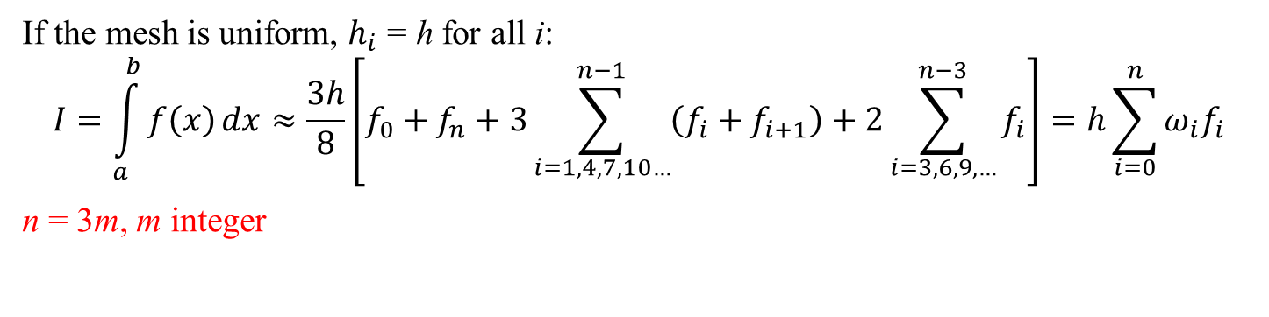
Numerical Integration: Simpson’s Rules
$$h=x_{i+1}−x_{i} ∀i$$
f_{i+2}
f_{i}
f_{n}
f_{i+1}
f₁
f_{i-1}
f₀
a = x₀
x₁
x_{i-1}
x_{i}
x_{i+1}
x_{i+2}
b = x_{n}
If the mesh is uniform, $h_{i}$ = h for all i:
$$I=\int_{a}^{b}{f\left(x\right)}dx≈\frac{3h}{8}\left[f_{0}+f_{n}+3\sum_{i=1,4,7,10…}^{n−1}{\left(f_{i}+f_{i+1}\right)}+2\sum_{i=3,6,9,…}^{n−3}{f_{i}}\right]=h\sum_{i=0}^{n}{ω_{i}f_{i}}$$
n = 3m, m integer

Slide 14
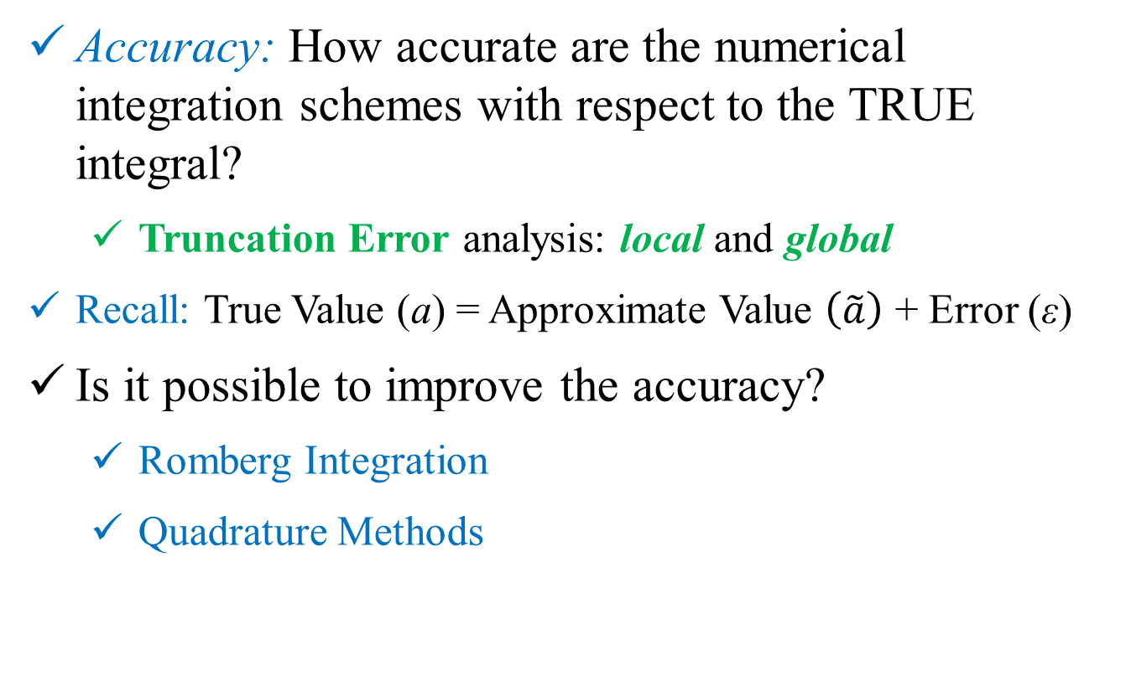
Numerical Integration
Accuracy: How accurate are the numerical integration schemes with respect to the TRUE integral?
Truncation Error analysis: local and global
Recall: True Value (a) = Approximate Value $\left(\tilde{a}\right)$ + Error (ε)
Is it possible to improve the accuracy?
Romberg Integration
Quadrature Methods

Slide 15
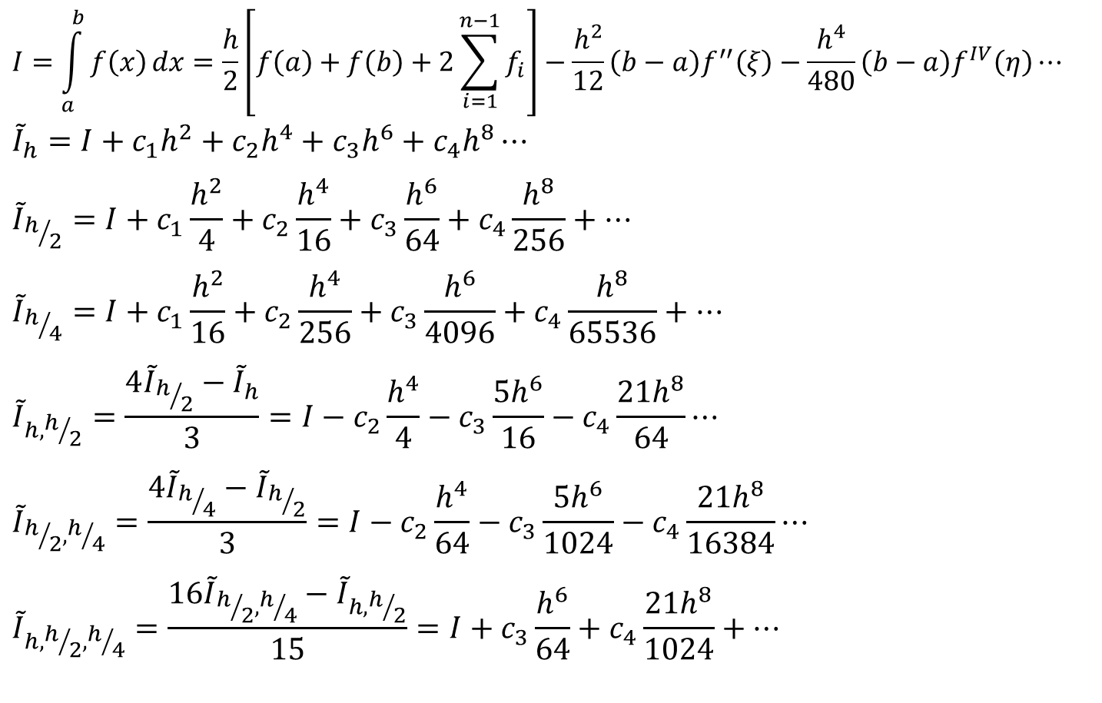
Romberg Integration
$$I=\int_{a}^{b}{f\left(x\right)}dx=\frac{h}{2}\left[f\left(a\right)+f\left(b\right)+2\sum_{i=1}^{n−1}{f_{i}}\right]−\frac{h^{2}}{12}\left(b−a\right)f^{′′}\left(ξ\right)−\frac{h^{4}}{480}\left(b−a\right)f^{IV}\left(η\right)⋯$$
$${\tilde{I}}_{h}=I+c_{1}h^{2}+c_{2}h^{4}+c_{3}h^{6}+c_{4}h^{8}⋯$$
$${\tilde{I}}_{h/2}=I+c_{1}\frac{h^{2}}{4}+c_{2}\frac{h^{4}}{16}+c_{3}\frac{h^{6}}{64}+c_{4}\frac{h^{8}}{256}+⋯$$
$${\tilde{I}}_{h/4}=I+c_{1}\frac{h^{2}}{16}+c_{2}\frac{h^{4}}{256}+c_{3}\frac{h^{6}}{4096}+c_{4}\frac{h^{8}}{65536}+⋯$$
$${\tilde{I}}_{h,h/2}=\frac{4{\tilde{I}}_{h/2}−{\tilde{I}}_{h}}{3}=I−c_{2}\frac{h^{4}}{4}−c_{3}\frac{{5h}^{6}}{16}−c_{4}\frac{21h^{8}}{64}⋯$$
$${\tilde{I}}_{h/2,h/4}=\frac{4{\tilde{I}}_{h/4}−{\tilde{I}}_{h/2}}{3}=I−c_{2}\frac{h^{4}}{64}−c_{3}\frac{{5h}^{6}}{1024}−c_{4}\frac{21h^{8}}{16384}⋯$$
$${\tilde{I}}_{h,h/2,h/4}=\frac{16{\tilde{I}}_{h/2,h/4}−{\tilde{I}}_{h,h/2}}{15}=I+c_{3}\frac{h^{6}}{64}+c_{4}\frac{21h^{8}}{1024}+⋯$$

Slide 16
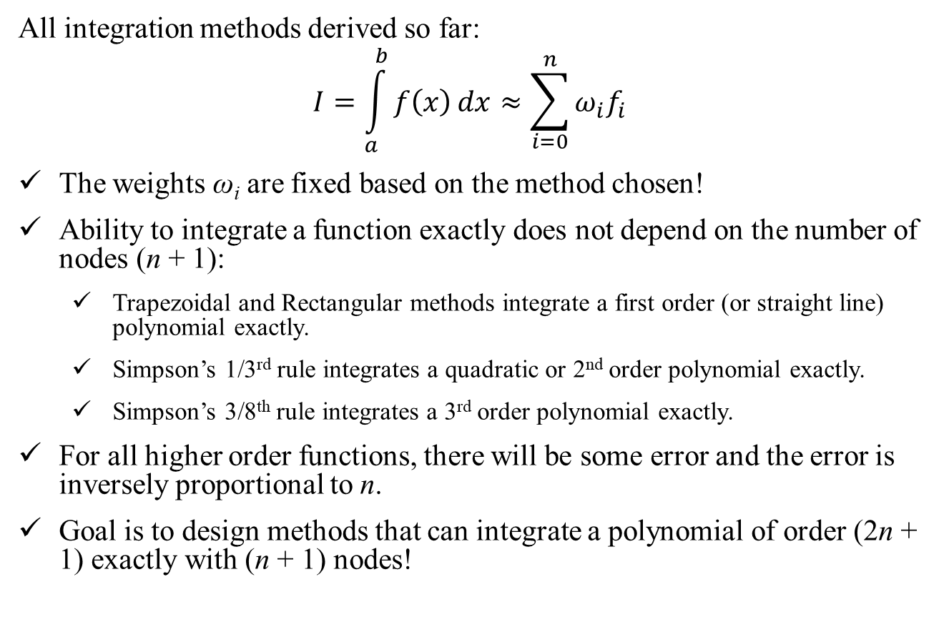
Gauss Quadrature
All integration methods derived so far:
$$I=\int_{a}^{b}{f\left(x\right)}dx≈\sum_{i=0}^{n}{ω_{i}f_{i}}$$
The weights ω_{i} are fixed based on the method chosen!
Ability to integrate a function exactly does not depend on the number of nodes (n + 1):
Trapezoidal and Rectangular methods integrate a first order (or straight line) polynomial exactly.
Simpson’s 1/3rd rule integrates a quadratic or 2nd order polynomial exactly.
Simpson’s 3/8th rule integrates a 3rd order polynomial exactly.
For all higher order functions, there will be some error and the error is inversely proportional to n.
Goal is to design methods that can integrate a polynomial of order (2n + 1) exactly with (n + 1) nodes!

Slide 17
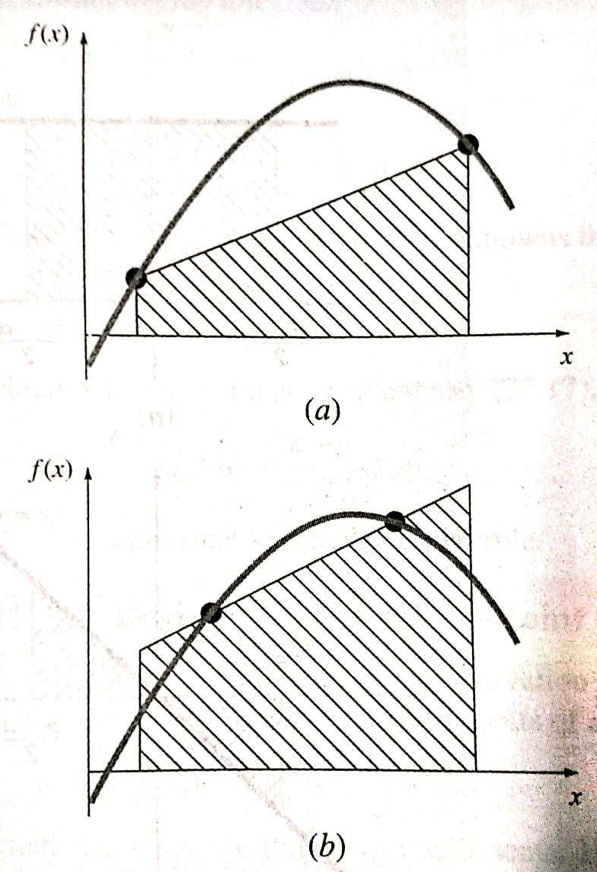
(a) Graphical depiction of Trapezoidal Rule
(b) Improved integral estimate by taking the area under the straight line passing through two intermediate points. By positioning these points wisely, the positive and negative errors are balanced, and an improved integral estimate results
Source: Chapra and Canale, pg 641 (2012)

Slide 18
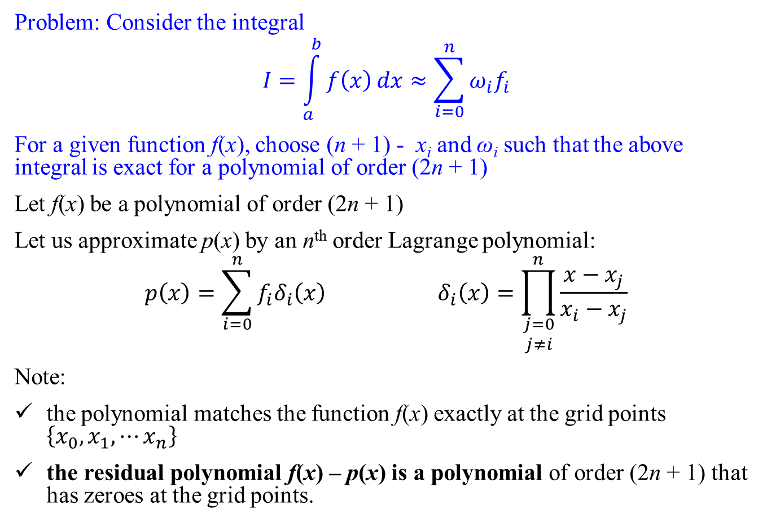
Gauss Quadrature
Problem: Consider the integral
$$I=\int_{a}^{b}{f\left(x\right)}dx≈\sum_{i=0}^{n}{ω_{i}f_{i}}$$
For a given function f(x), choose (n + 1) - x_{i} and ω_{i} such that the above integral is exact for a polynomial of order (2n + 1)
Let f(x) be a polynomial of order (2n + 1)
Let us approximate p(x) by an n^{th} order Lagrange polynomial:
$$p\left(x\right)=\sum_{i=0}^{n}{f_{i}δ_{i}\left(x\right)} δ_{i}\left(x\right)=\prod_{\begin{matrix}j=0 \\ j≠i\end{matrix}}^{n}{\frac{x−x_{j}}{x_{i}−x_{j}}}$$
Note:
the polynomial matches the function f(x) exactly at the grid points $\left\{x_{0},x_{1}, ⋯x_{n}\right\}$
the residual polynomial f(x) – p(x) is a polynomial of order (2n + 1) that has zeroes at the grid points.

Slide 19
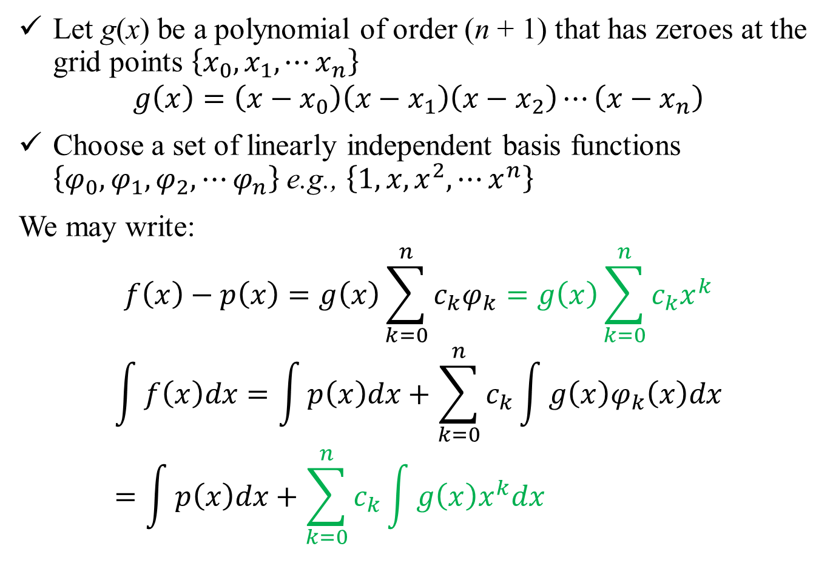
Gauss Quadrature
Let g(x) be a polynomial of order (n + 1) that has zeroes at the grid points $\left\{x_{0},x_{1}, ⋯x_{n}\right\}$
$$g\left(x\right)=\left(x−x_{0}\right)\left(x−x_{1}\right)\left(x−x_{2}\right)⋯\left(x−x_{n}\right)$$
Choose a set of linearly independent basis functions $\left\{φ_{0},φ_{1},φ_{2},⋯φ_{n}\right\}$ e.g., $\left\{1,x,x^{2},⋯x^{n}\right\}$
We may write:
$$f\left(x\right)−p\left(x\right)=g\left(x\right)\sum_{k=0}^{n}{c_{k}φ_{k}}=g\left(x\right)\sum_{k=0}^{n}{c_{k}x^{k}}$$
$$\int{f\left(x\right)dx}=\int{p\left(x\right)dx}+\sum_{k=0}^{n}{c_{k}\int{g\left(x\right)φ_{k}\left(x\right)dx}}=\int{p\left(x\right)dx}+\sum_{k=0}^{n}{c_{k}\int{g\left(x\right)x^{k}dx}}$$

Slide 20
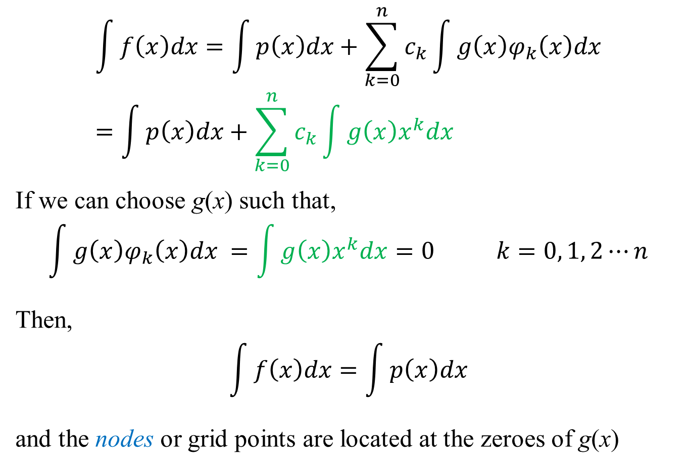
Gauss Quadrature
$$\int{f\left(x\right)dx}=\int{p\left(x\right)dx}+\sum_{k=0}^{n}{c_{k}\int{g\left(x\right)φ_{k}\left(x\right)dx}}=\int{p\left(x\right)dx}+\sum_{k=0}^{n}{c_{k}\int{g\left(x\right)x^{k}dx}}$$
If we can choose g(x) such that,
$$\int{g\left(x\right)φ_{k}\left(x\right)dx} =\int{g\left(x\right)x^{k}dx}=0 k=0, 1, 2⋯n$$
Then,
$$\int{f\left(x\right)dx}=\int{p\left(x\right)dx}$$
and the nodes or grid points are located at the zeroes of g(x)

Slide 21
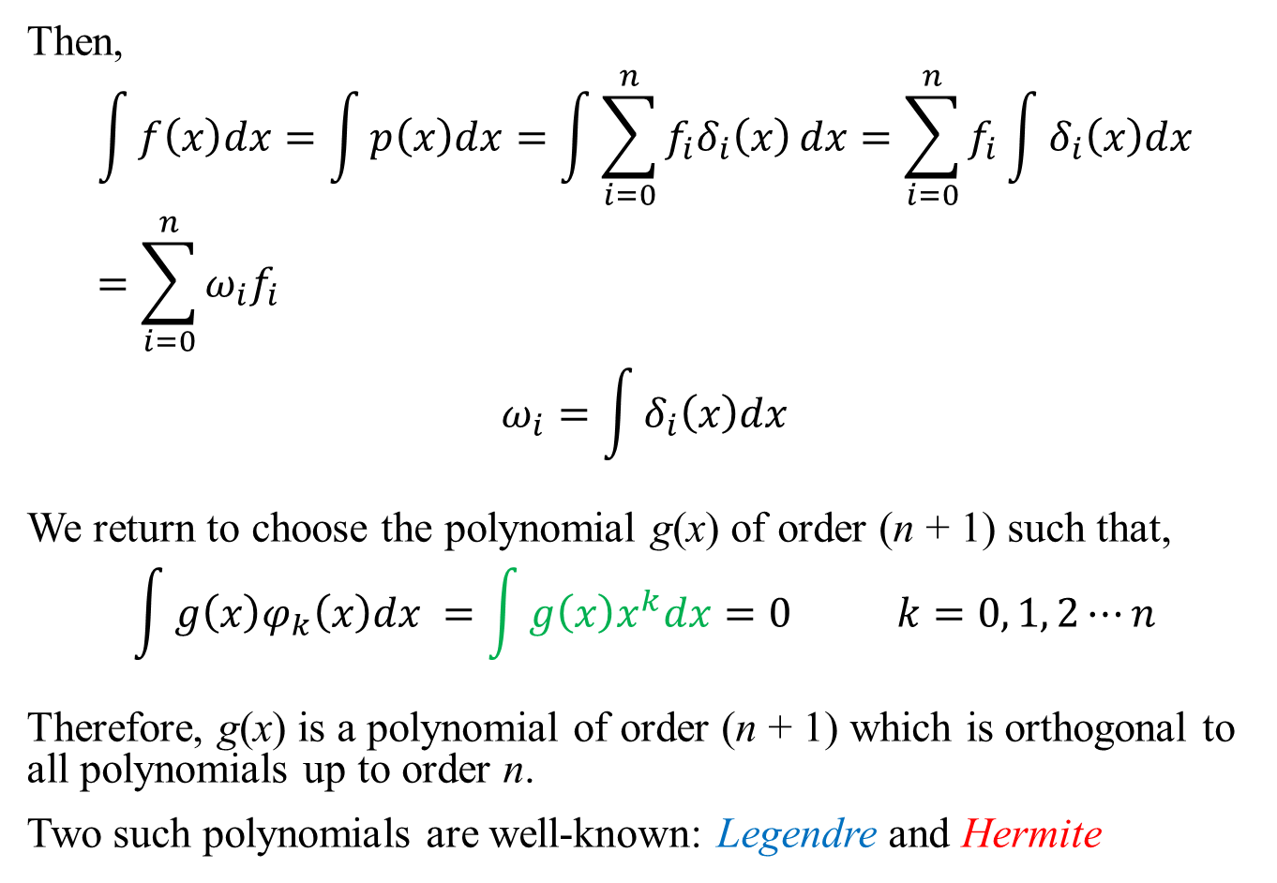
Gauss Quadrature
Then,
$$\int{f\left(x\right)dx}=\int{p\left(x\right)dx}=\int{\sum_{i=0}^{n}{f_{i}δ_{i}\left(x\right)}dx}=\sum_{i=0}^{n}{f_{i}\int{δ_{i}\left(x\right)dx}}=\sum_{i=0}^{n}{ω_{i}f_{i}}$$
$$ω_{i}=\int{δ_{i}\left(x\right)dx}$$
We return to choose the polynomial g(x) of order (n + 1) such that,
$$\int{g\left(x\right)φ_{k}\left(x\right)dx} =\int{g\left(x\right)x^{k}dx}=0 k=0, 1, 2⋯n$$
Therefore, g(x) is a polynomial of order (n + 1) which is orthogonal to all polynomials up to order n.
Two such polynomials are well-known: Legendre and Hermite

Slide 22
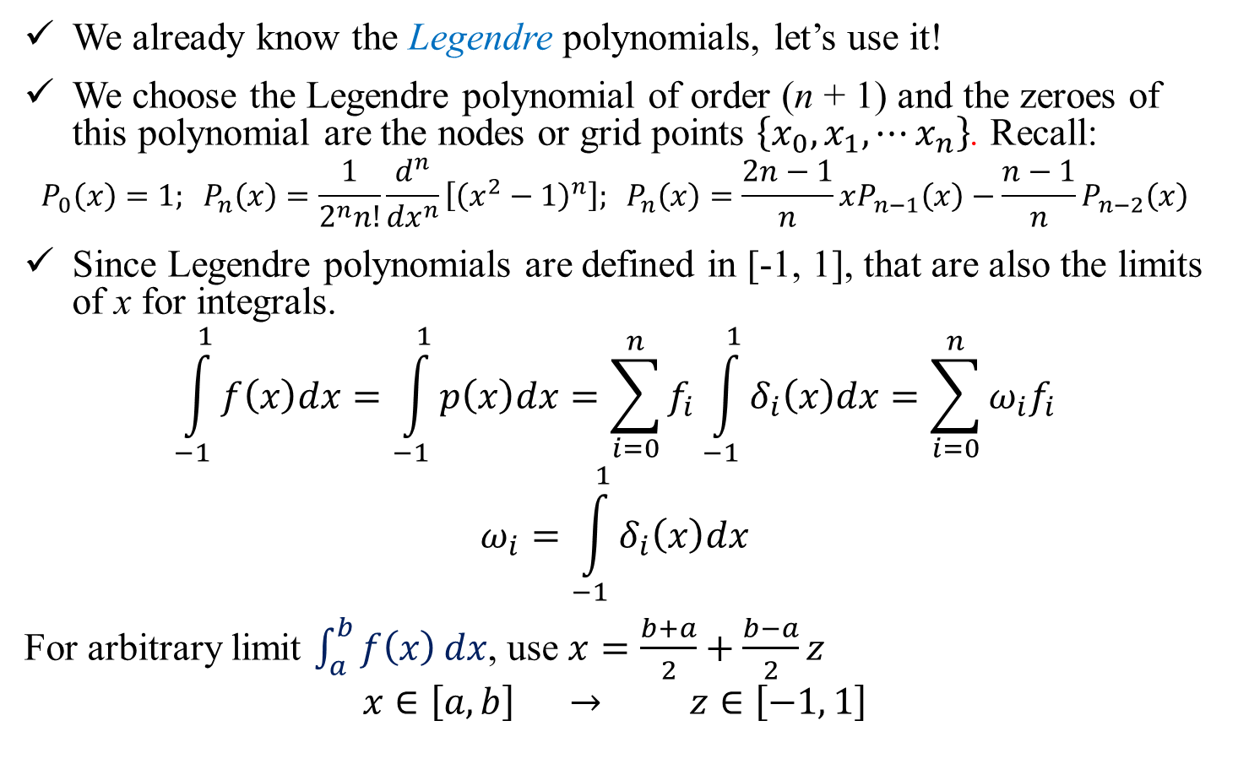
Gauss-Legendre Quadrature
We already know the Legendre polynomials, let’s use it!
We choose the Legendre polynomial of order (n + 1) and the zeroes of this polynomial are the nodes or grid points $\left\{x_{0},x_{1}, ⋯x_{n}\right\}$. Recall:
$$P_{0}\left(x\right)=1; P_{n}\left(x\right)=\frac{1}{2^{n}n!}\frac{d^{n}}{{dx}^{n}}\left[{\left(x^{2}−1\right)}^{n}\right]; P_{n}\left(x\right)=\frac{2n−1}{n}xP_{n−1}\left(x\right)−\frac{n−1}{n}P_{n−2}\left(x\right)$$
Since Legendre polynomials are defined in [-1, 1], that are also the limits of x for integrals.
$$\int_{−1}^{1}{f\left(x\right)dx}=\int_{−1}^{1}{p\left(x\right)dx}=\sum_{i=0}^{n}{f_{i}\int_{−1}^{1}{δ_{i}\left(x\right)dx}}=\sum_{i=0}^{n}{ω_{i}f_{i}}$$
$$ω_{i}=\int_{−1}^{1}{δ_{i}\left(x\right)dx}$$
For arbitrary limit $\int_{a}^{b}{f\left(x\right)}dx$, use $x=\frac{b+a}{2}+\frac{b−a}{2}z$
$$x∈\left[a, b\right] → z∈\left[−1, 1\right]$$

Slide 23
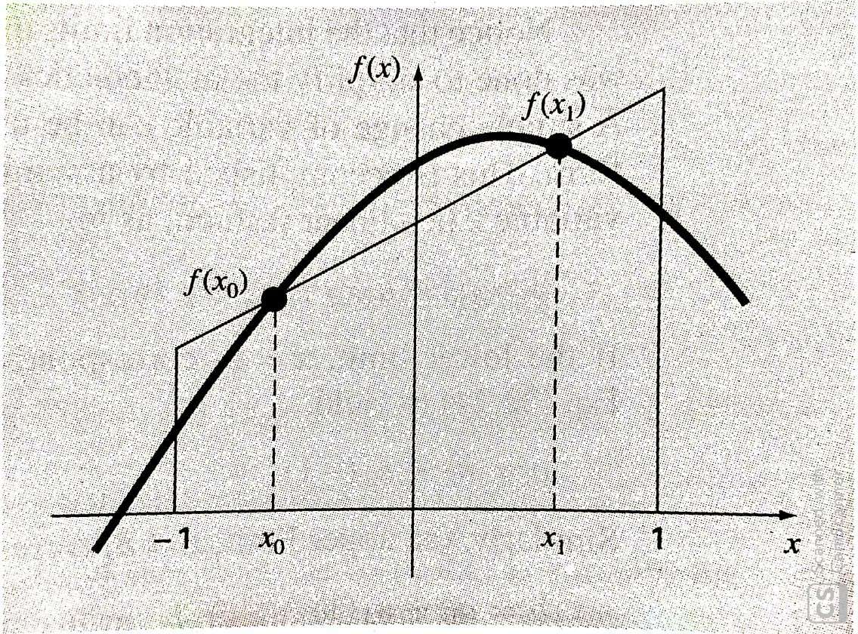

Slide 24
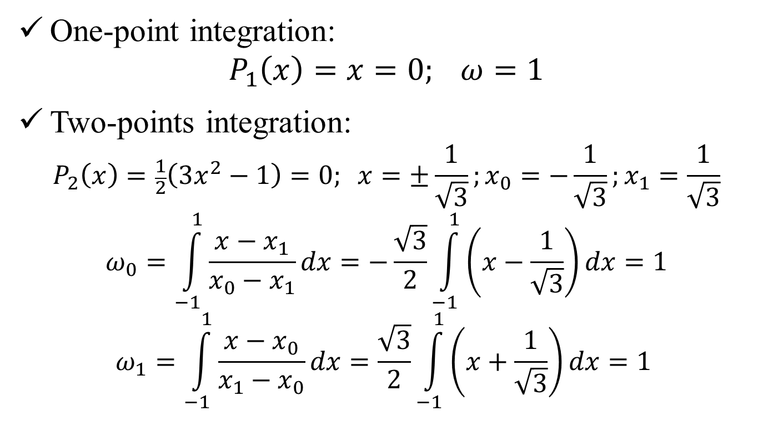
Gauss-Legendre Quadrature: Example
One-point integration:
$$P_{1}\left(x\right)=x=0; ω=1$$
Two-points integration:
$$P_{2}\left(x\right)=\frac{1}{2}\left(3x^{2}−1\right)=0; x=±\frac{1}{\sqrt{3}};x_{0}=−\frac{1}{\sqrt{3}};x_{1}=\frac{1}{\sqrt{3}}$$
$$ω_{0}=\int_{−1}^{1}{\frac{x−x_{1}}{x_{0}−x_{1}}dx}=−\frac{\sqrt{3}}{2}\int_{−1}^{1}{\left(x−\frac{1}{\sqrt{3}}\right)dx}=1$$
$$ω_{1}=\int_{−1}^{1}{\frac{x−x_{0}}{x_{1}−x_{0}}dx}=\frac{\sqrt{3}}{2}\int_{−1}^{1}{\left(x+\frac{1}{\sqrt{3}}\right)dx}=1$$

Slide 25
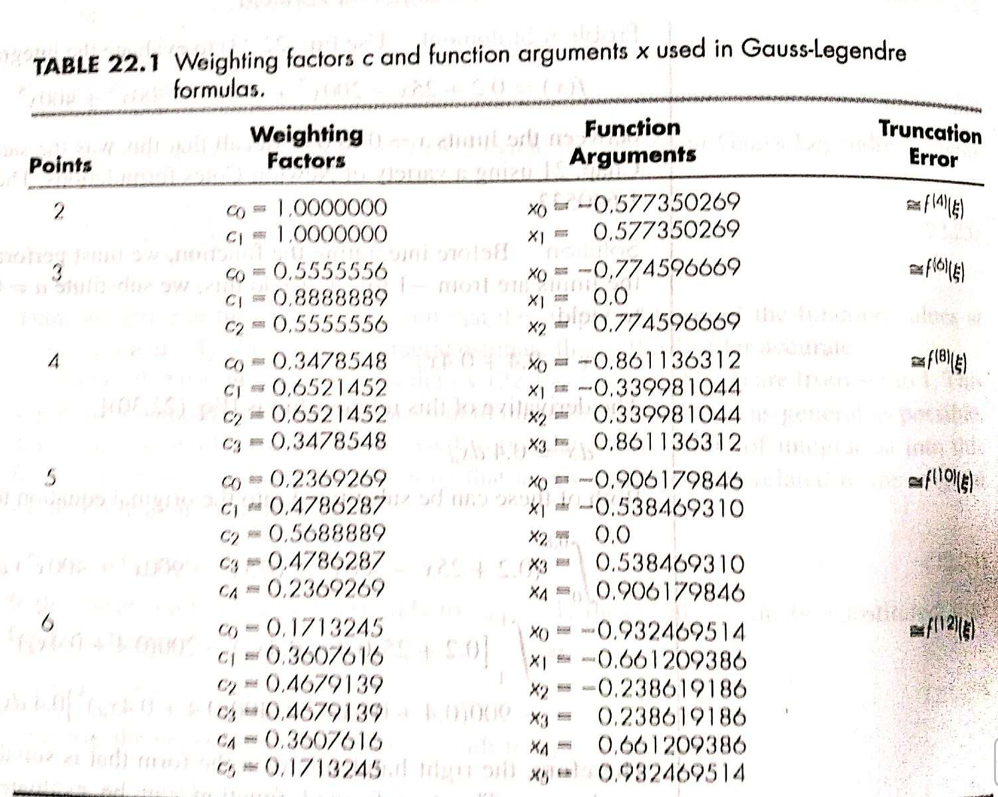

Slide 26
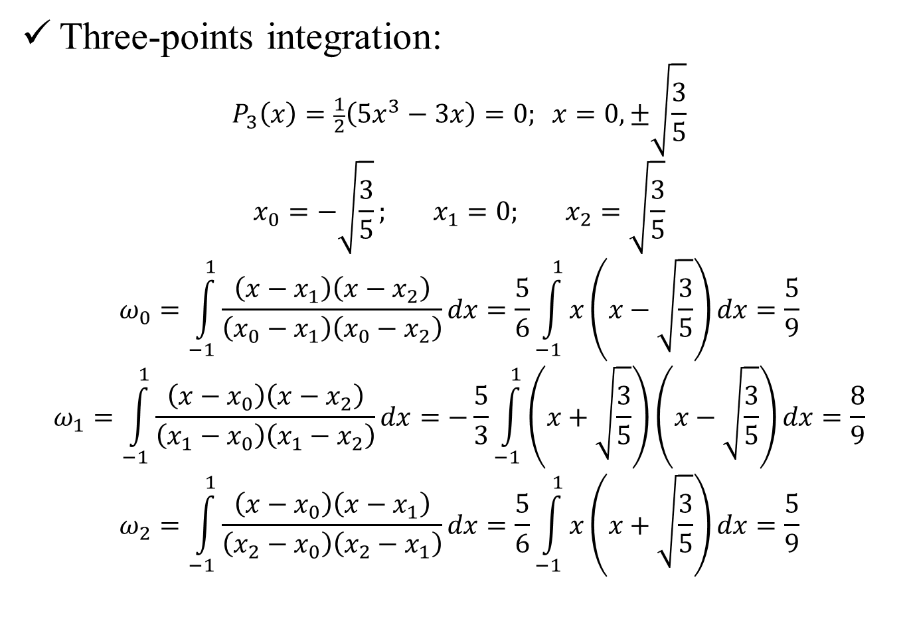
Gauss-Legendre Quadrature: Example
Three-points integration:
$$P_{3}\left(x\right)=\frac{1}{2}\left(5x^{3}−3x\right)=0; x=0,±\sqrt{\frac{3}{5}}$$
$$x_{0}=−\sqrt{\frac{3}{5}}; x_{1}=0; x_{2}=\sqrt{\frac{3}{5}}$$
$$ω_{0}=\int_{−1}^{1}{\frac{\left(x−x_{1}\right)\left(x−x_{2}\right)}{\left(x_{0}−x_{1}\right)\left(x_{0}−x_{2}\right)}dx}=\frac{5}{6}\int_{−1}^{1}{x\left(x−\sqrt{\frac{3}{5}}\right)dx}=\frac{5}{9}$$
$$ω_{1}=\int_{−1}^{1}{\frac{\left(x−x_{0}\right)\left(x−x_{2}\right)}{\left(x_{1}−x_{0}\right)\left(x_{1}−x_{2}\right)}dx}=−\frac{5}{3}\int_{−1}^{1}{\left(x+\sqrt{\frac{3}{5}}\right)\left(x−\sqrt{\frac{3}{5}}\right)dx}=\frac{8}{9}$$
$$ω_{2}=\int_{−1}^{1}{\frac{\left(x−x_{0}\right)\left(x−x_{1}\right)}{\left(x_{2}−x_{0}\right)\left(x_{2}−x_{1}\right)}dx}=\frac{5}{6}\int_{−1}^{1}{x\left(x+\sqrt{\frac{3}{5}}\right)dx}=\frac{5}{9}$$

Slide 27

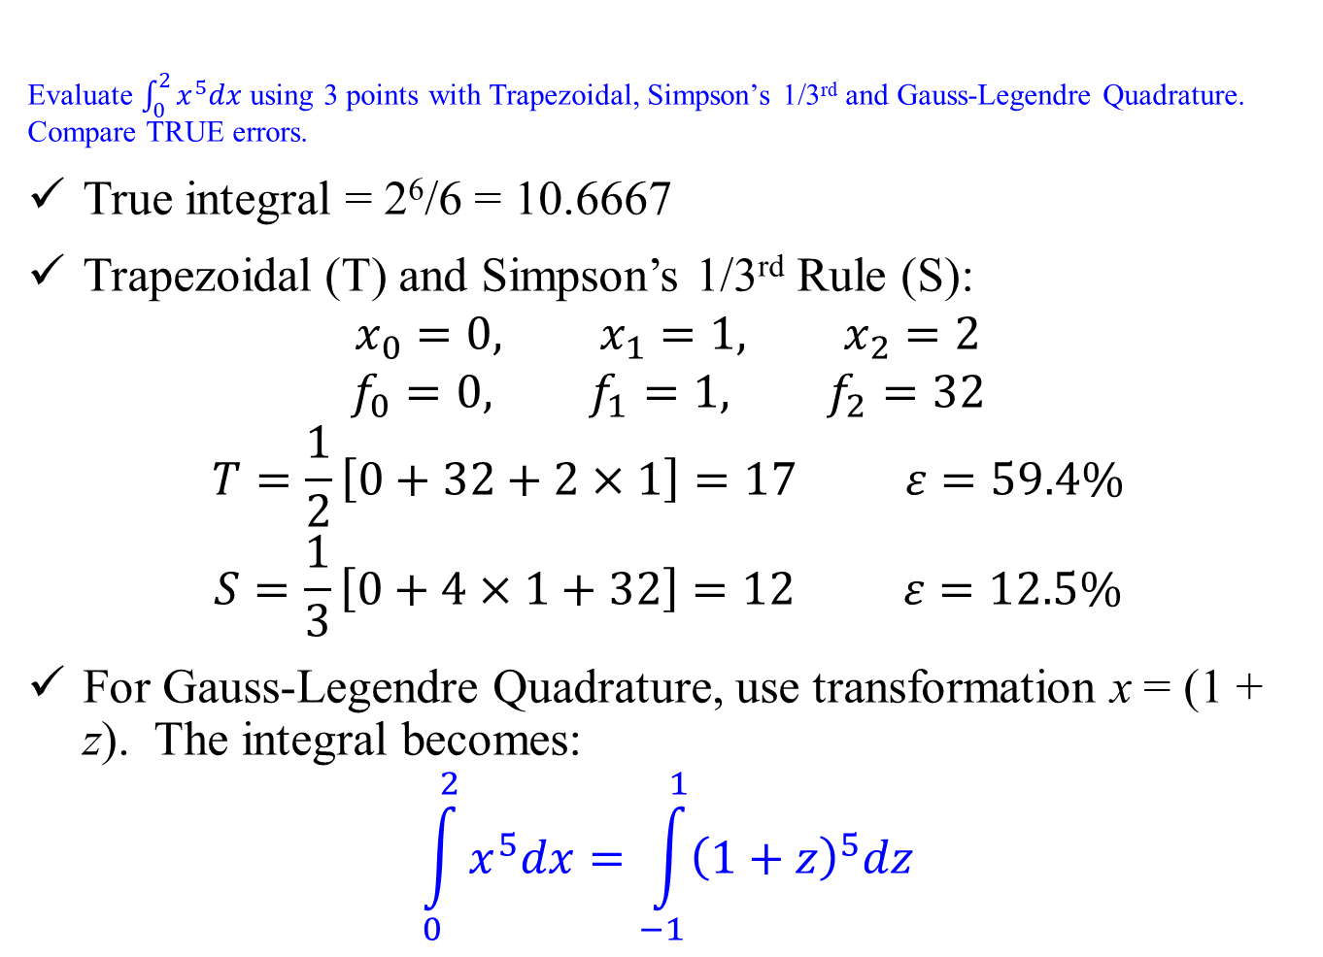
Numerical Integration: Example
Evaluate $\int_{0}^{2}{x^{5}dx}$ using 3 points with Trapezoidal, Simpson’s 1/3rd and Gauss-Legendre Quadrature. Compare TRUE errors.
True integral = 2⁶/6 = 10.6667
Trapezoidal (T) and Simpson’s 1/3rd Rule (S):
$$x_{0}=0, x_{1}=1, x_{2}=2$$
$$f_{0}=0, f_{1}=1, f_{2}=32$$
$$T=\frac{1}{2}\left[0+32+2×1\right]=17 ε=59.4\%$$
$$S=\frac{1}{3}\left[0+4×1+32\right]=12 ε=12.5\%$$
For Gauss-Legendre Quadrature, use transformation x = (1 + z). The integral becomes:
$$\int_{0}^{2}{x^{5}dx}=\int_{−1}^{1}{{\left(1+z\right)}^{5}dz}$$
$$\text{x}\text{=}\frac{\text{(}\text{b}\text{+}\text{a}\text{)}\text{ + }\text{(}\text{b}\text{−}\text{a}\text{)}\text{z}}{2}$$

Slide 28
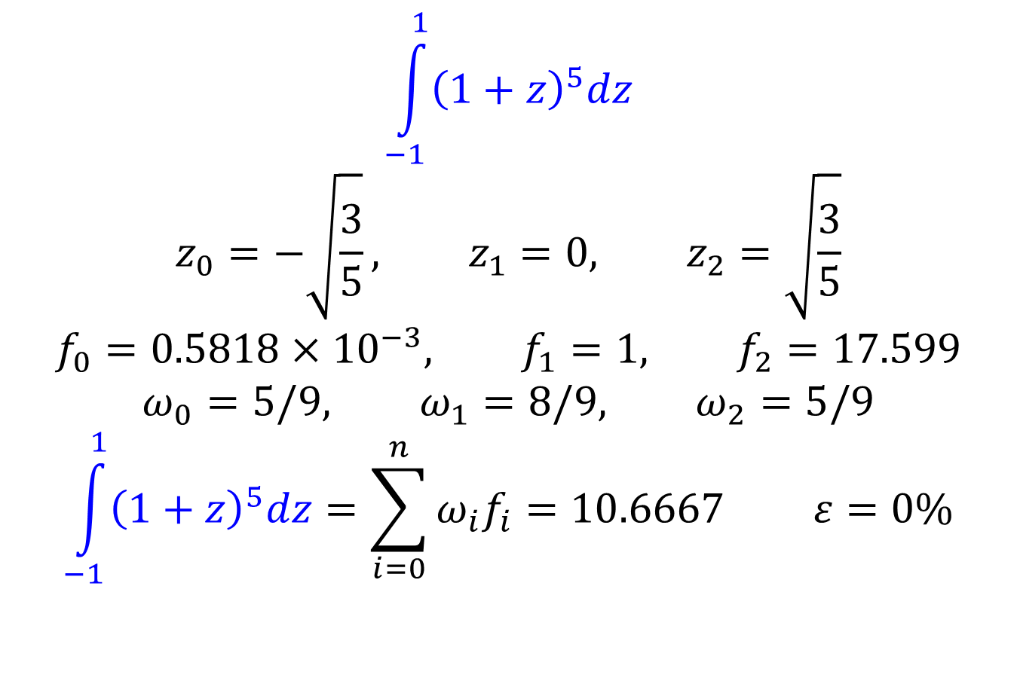
Numerical Integration: Example
$$\int_{−1}^{1}{{\left(1+z\right)}^{5}dz}$$
$$z_{0}=−\sqrt{\frac{3}{5}}, z_{1}=0, z_{2}=\sqrt{\frac{3}{5}}$$
$$f_{0}=0.5818×{10}^{−3}, f_{1}=1, f_{2}=17.599$$
$$ω_{0}=5/9, ω_{1}=8/9, ω_{2}=5/9$$
$$\int_{−1}^{1}{{\left(1+z\right)}^{5}dz}=\sum_{i=0}^{n}{ω_{i}f_{i}}=10.6667 ε=0\%$$

Slide 29
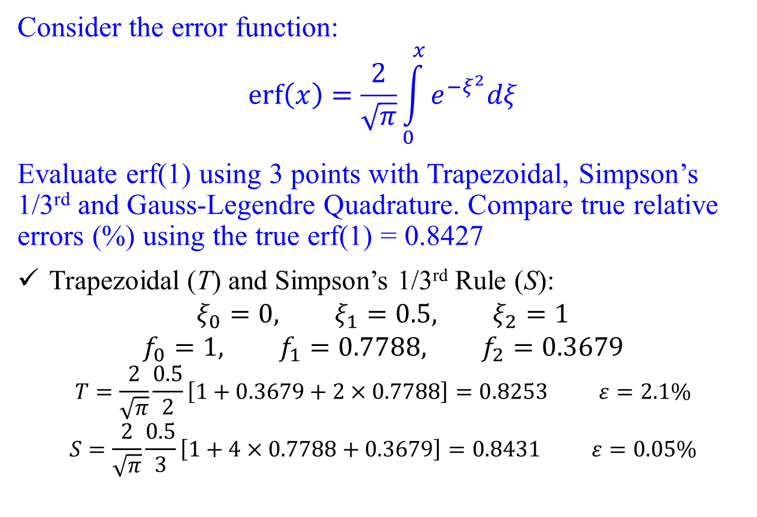
Numerical Integration: Example
Consider the error function:
$$erf\left(x\right)=\frac{2}{\sqrt{π}}\int_{0}^{x}{e^{−ξ^{2}}dξ}$$
Evaluate erf(1) using 3 points with Trapezoidal, Simpson’s 1/3rd and Gauss-Legendre Quadrature. Compare true relative errors (%) using the true erf(1) = 0.8427
Trapezoidal (T) and Simpson’s 1/3rd Rule (S):
$$ξ_{0}=0, ξ_{1}=0.5, ξ_{2}=1$$
$$f_{0}=1, f_{1}=0.7788, f_{2}=0.3679$$
$$T=\frac{2}{\sqrt{π}}\frac{0.5}{2}\left[1+0.3679+2×0.7788\right]=0.8253 ε=2.1\%$$
$$S=\frac{2}{\sqrt{π}}\frac{0.5}{3}\left[1+4×0.7788+0.3679\right]=0.8431 ε=0.05\%$$

Slide 30
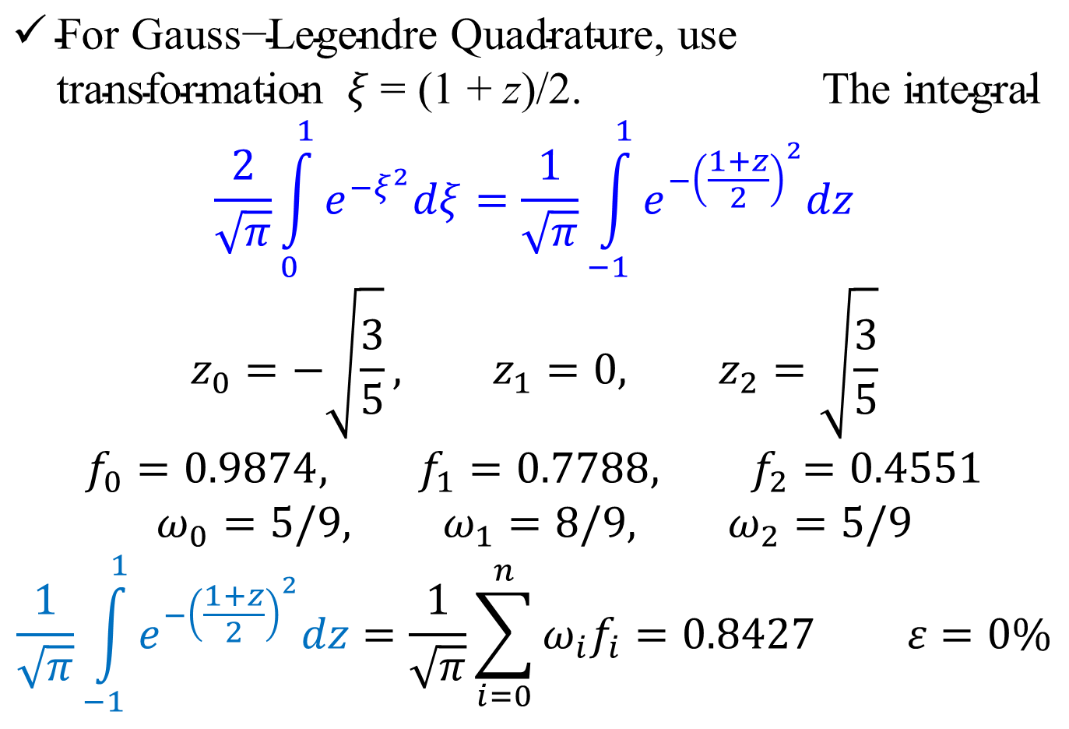
Numerical Integration: Example
$\text{For} \text{Gauss}\text{−}\text{Legendre} \text{Quadrature}\text{, }\text{use} \text{transformation} ξ\text{ = (1 + }\text{z}\text{)}\text{/2}\text{. } \text{The} \text{integral}$
$$\frac{2}{\sqrt{π}}\int_{0}^{1}{e^{−ξ^{2}}dξ}=\frac{1}{\sqrt{π}}\int_{−1}^{1}{e^{−{\left(\frac{1+z}{2}\right)}^{2}}dz}$$
$$z_{0}=−\sqrt{\frac{3}{5}}, z_{1}=0, z_{2}=\sqrt{\frac{3}{5}}$$
$$f_{0}=0.9874, f_{1}=0.7788, f_{2}=0.4551$$
$$ω_{0}=5/9, ω_{1}=8/9, ω_{2}=5/9$$
$$\frac{1}{\sqrt{π}}\int_{−1}^{1}{e^{−{\left(\frac{1+z}{2}\right)}^{2}}dz}=\frac{1}{\sqrt{π}}\sum_{i=0}^{n}{ω_{i}f_{i}}=0.8427 ε=0\%$$
I

