Slide 1

ESO 208A: Computational Methods in Engineering Ordinary Differential Equation: Multi-Step, BDF, Runge-Kutta
Abhas Singh
Department of Civil Engineering
IIT Kanpur
Acknowledgements: Profs. Saumyen Guha and Shivam Tripathi (CE)

Slide 2
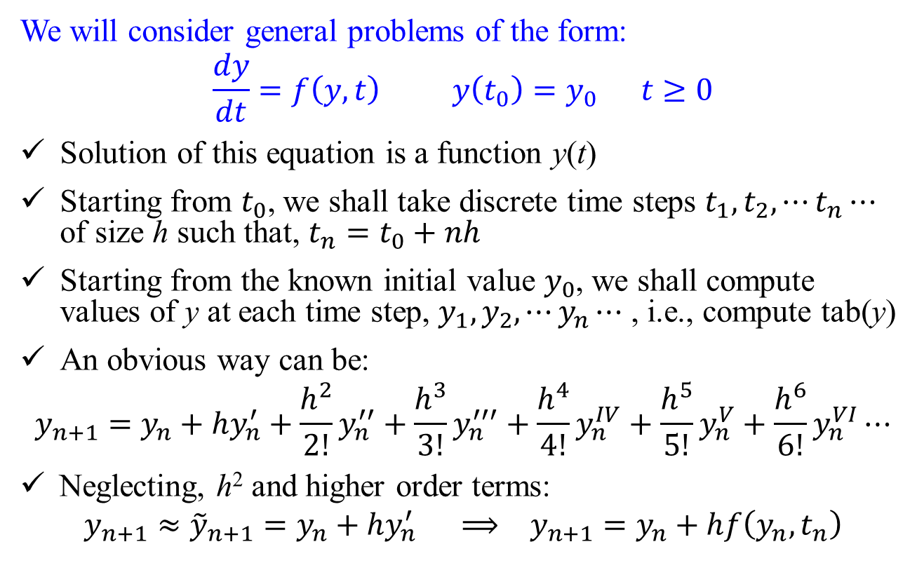
ODE: Introduction
We will consider general problems of the form:
$$\frac{dy}{dt}=f\left(y,t\right) y\left(t_{0}\right)=y_{0} t≥0$$
Solution of this equation is a function y(t)
Starting from $t_{0}$, we shall take discrete time steps $t_{1},t_{2},⋯t_{n}⋯$ of size h such that, $t_{n}=t_{0}+nh$
Starting from the known initial value $y_{0}$, we shall compute values of y at each time step, $y_{1},y_{2},⋯y_{n}⋯$ , i.e., compute tab(y)
An obvious way can be:
$$y_{n+1}=y_{n}+hy_{n}^{′}+\frac{h^{2}}{2!}y_{n}^{′′}+\frac{h^{3}}{3!}y_{n}^{′′′}+\frac{h^{4}}{4!}y_{n}^{IV}+\frac{h^{5}}{5!}y_{n}^{V}+\frac{h^{6}}{6!}y_{n}^{VI}⋯$$
Neglecting, h² and higher order terms:
$$y_{n+1}≈{\tilde{y}}_{n+1}=y_{n}+hy_{n}^{′} ⟹ y_{n+1}=y_{n}+hf\left(y_{n},t_{n}\right)$$

Slide 3
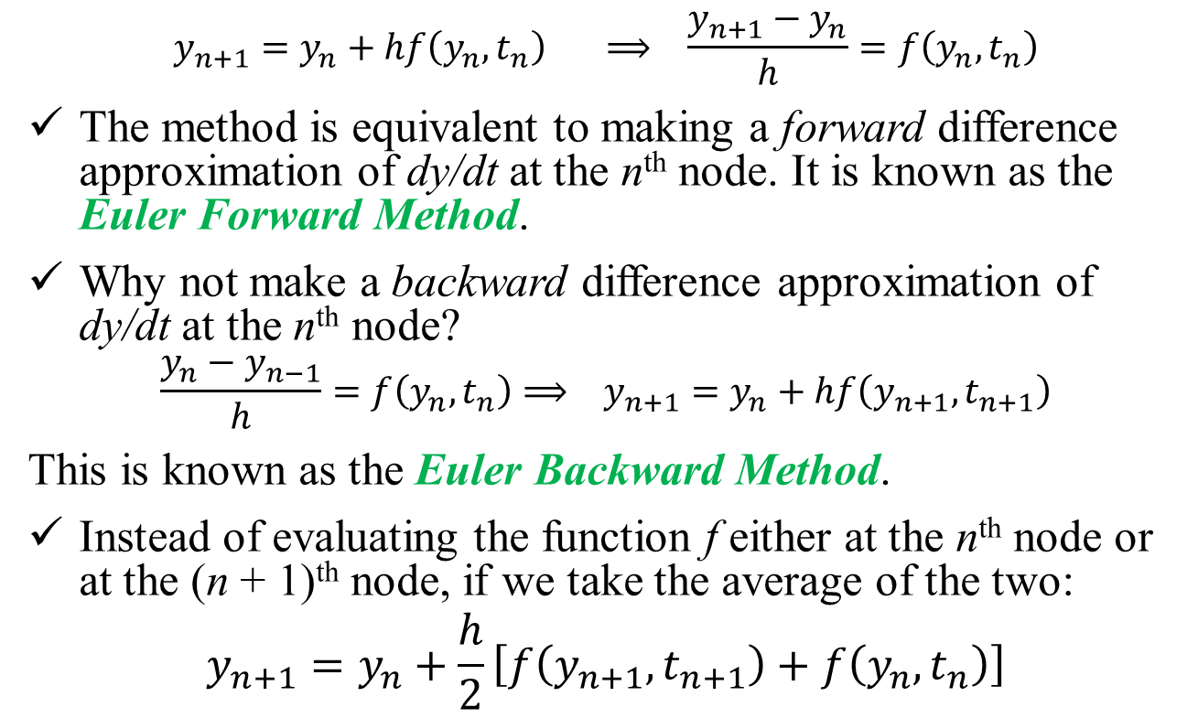
ODE: Introduction
$$y_{n+1}=y_{n}+hf\left(y_{n},t_{n}\right) ⟹ \frac{y_{n+1}−y_{n}}{h}=f\left(y_{n},t_{n}\right)$$
The method is equivalent to making a forward difference approximation of dy/dt at the n^{th} node. It is known as the Euler Forward Method.
Why not make a backward difference approximation of dy/dt at the n^{th} node?
$$\frac{y_{n}−y_{n−1}}{h}=f\left(y_{n},t_{n}\right)⟹ y_{n+1}=y_{n}+hf\left(y_{n+1},t_{n+1}\right)$$
This is known as the Euler Backward Method.
Instead of evaluating the function f either at the n^{th} node or at the (n + 1)^{th} node, if we take the average of the two:
$$y_{n+1}=y_{n}+\frac{h}{2}\left[f\left(y_{n+1},t_{n+1}\right)+f\left(y_{n},t_{n}\right)\right]$$

Slide 4
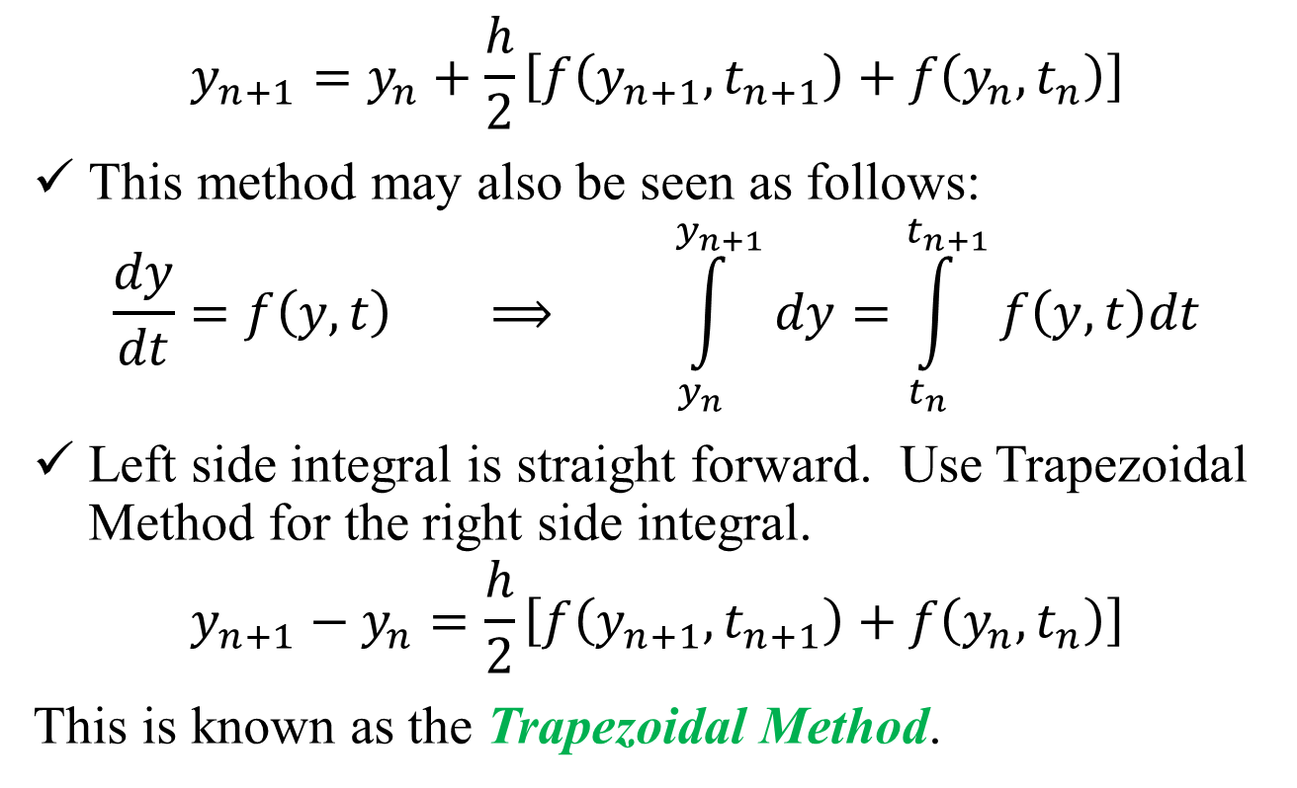
ODE: Introduction
$$y_{n+1}=y_{n}+\frac{h}{2}\left[f\left(y_{n+1},t_{n+1}\right)+f\left(y_{n},t_{n}\right)\right]$$
This method may also be seen as follows:
$$\frac{dy}{dt}=f\left(y,t\right) ⟹ \int_{y_{n}}^{y_{n+1}}{dy}=\int_{t_{n}}^{t_{n+1}}{f\left(y,t\right)dt}$$
Left side integral is straight forward. Use Trapezoidal Method for the right side integral.
$$y_{n+1}−y_{n}=\frac{h}{2}\left[f\left(y_{n+1},t_{n+1}\right)+f\left(y_{n},t_{n}\right)\right]$$
This is known as the Trapezoidal Method.

Slide 5
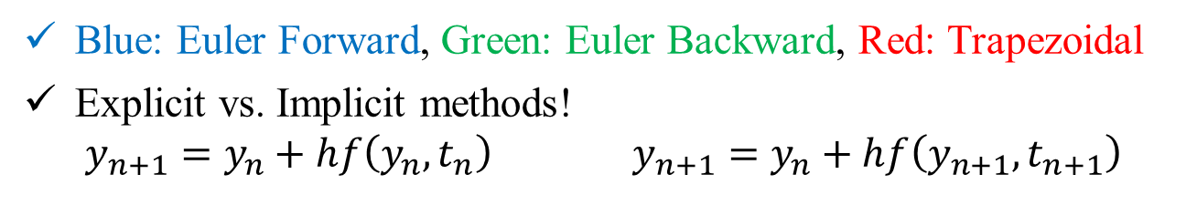
ODE: Introduction
Blue: Euler Forward, Green: Euler Backward, Red: Trapezoidal
Explicit vs. Implicit methods!
$$y_{n+1}=y_{n}+hf\left(y_{n},t_{n}\right) y_{n+1}=y_{n}+hf\left(y_{n+1},t_{n+1}\right)$$

Slide 6
Ordinary Differential Equation
The methods for Initial Value Problems (IVPs):
Multi-step Methods
Explicit: Euler Forward, Adams-Bashforth
Implicit: Euler Backward, Trapezoidal and Adams-Moulton
Backward Difference Formulae (BDF)
Runge-Kutta Methods
Applications, Startup, Combination Methods (Predictor-Corrector)
Consistency, Stability, Convergence
Application to System of ODEs
Boundary Value Problems (BVPs)
Shooting Method
Direct Methods

Slide 7
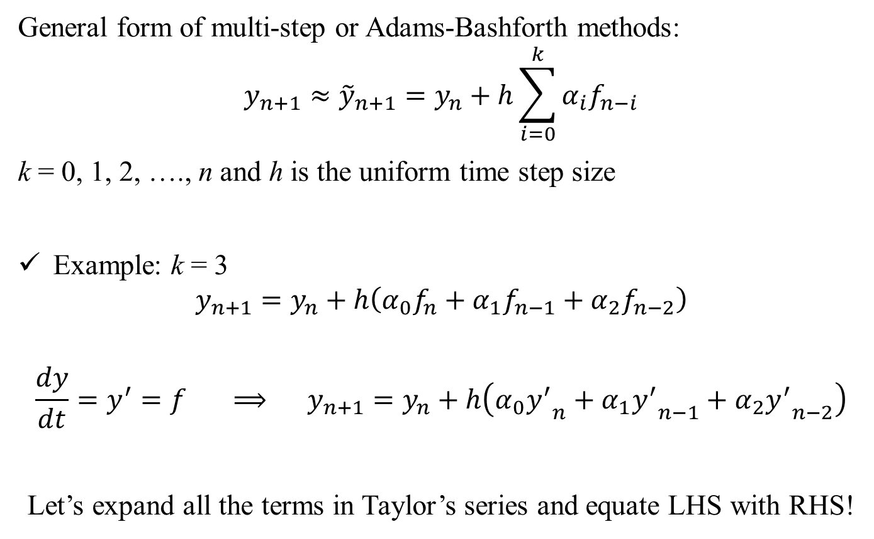
Multi-Step Methods: Explicit
,
General form of multi-step or Adams-Bashforth methods:
$$y_{n+1}≈{\tilde{y}}_{n+1}=y_{n}+h\sum_{i=0}^{k}{α_{i}f_{n−i}}$$
k = 0, 1, 2, …., n and h is the uniform time step size
Example: k = 3
$$y_{n+1}=y_{n}+h\left(α_{0}f_{n}+α_{1}f_{n−1}+α_{2}f_{n−2}\right)$$
$$\frac{dy}{dt}=y^{′}=f ⟹ y_{n+1}=y_{n}+h\left(α_{0}{y^{′}}_{n}+α_{1}{y^{′}}_{n−1}+α_{2}{y^{′}}_{n−2}\right)$$
Let’s expand all the terms in Taylor’s series and equate LHS with RHS!

Slide 8
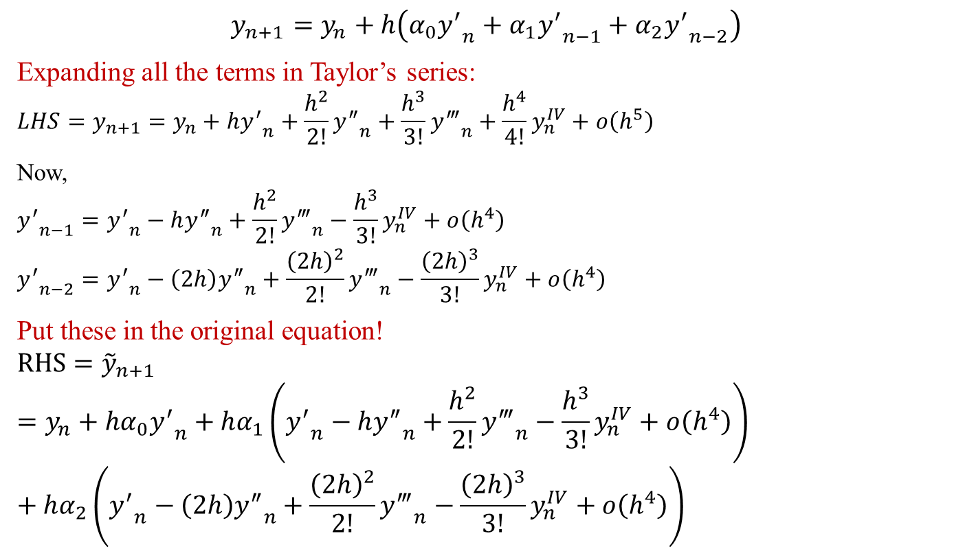
Multi-Step Methods: Explicit
,
$$y_{n+1}=y_{n}+h\left(α_{0}{y^{′}}_{n}+α_{1}{y^{′}}_{n−1}+α_{2}{y^{′}}_{n−2}\right)$$
Expanding all the terms in Taylor’s series:
$$LHS=y_{n+1}=y_{n}+h{y^{′}}_{n}+\frac{h^{2}}{2!}{y^{″}}_{n}+\frac{h^{3}}{3!}{y^{‴}}_{n}+\frac{h^{4}}{4!}y_{n}^{IV}+ο\left(h^{5}\right)$$
Now,
$${y^{′}}_{n−1}={y^{′}}_{n}−h{y^{″}}_{n}+\frac{h^{2}}{2!}{y^{‴}}_{n}−\frac{h^{3}}{3!}y_{n}^{IV}+ο\left(h^{4}\right)$$
$${y^{′}}_{n−2}={y^{′}}_{n}−\left(2h\right){y^{″}}_{n}+\frac{{\left(2h\right)}^{2}}{2!}{y^{‴}}_{n}−\frac{{\left(2h\right)}^{3}}{3!}y_{n}^{IV}+ο\left(h^{4}\right)$$
Put these in the original equation!
$$RHS={\tilde{y}}_{n+1}=y_{n}+hα_{0}{y^{′}}_{n}+hα_{1}\left({y^{′}}_{n}−h{y^{″}}_{n}+\frac{h^{2}}{2!}{y^{‴}}_{n}−\frac{h^{3}}{3!}y_{n}^{IV}+ο\left(h^{4}\right)\right)+hα_{2}\left({y^{′}}_{n}−\left(2h\right){y^{″}}_{n}+\frac{{\left(2h\right)}^{2}}{2!}{y^{‴}}_{n}−\frac{{\left(2h\right)}^{3}}{3!}y_{n}^{IV}+ο\left(h^{4}\right)\right)$$

Slide 9
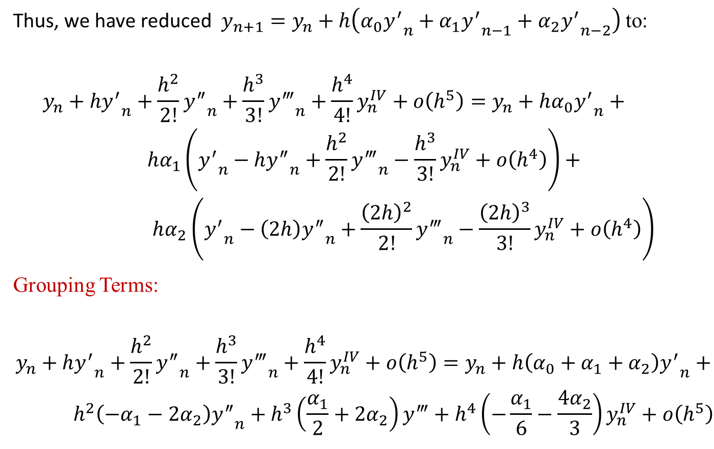
Multi-Step Methods: Explicit
,
Thus, we have reduced $y_{n+1}=y_{n}+h\left(α_{0}{y^{′}}_{n}+α_{1}{y^{′}}_{n−1}+α_{2}{y^{′}}_{n−2}\right)$ to:
$$\begin{matrix}y_{n}+h{y^{′}}_{n}+\frac{h^{2}}{2!}{y^{″}}_{n}+\frac{h^{3}}{3!}{y^{‴}}_{n}+\frac{h^{4}}{4!}y_{n}^{IV}+ο\left(h^{5}\right)=y_{n}+hα_{0}{y^{′}}_{n}+ \\ hα_{1}\left({y^{′}}_{n}−h{y^{″}}_{n}+\frac{h^{2}}{2!}{y^{‴}}_{n}−\frac{h^{3}}{3!}y_{n}^{IV}+ο\left(h^{4}\right)\right)+ \\ hα_{2}\left({y^{′}}_{n}−\left(2h\right){y^{″}}_{n}+\frac{{\left(2h\right)}^{2}}{2!}{y^{‴}}_{n}−\frac{{\left(2h\right)}^{3}}{3!}y_{n}^{IV}+ο\left(h^{4}\right)\right)\end{matrix}$$
Grouping Terms:
$$\begin{matrix}y_{n}+h{y^{′}}_{n}+\frac{h^{2}}{2!}{y^{″}}_{n}+\frac{h^{3}}{3!}{y^{‴}}_{n}+\frac{h^{4}}{4!}y_{n}^{IV}+ο\left(h^{5}\right)=y_{n}+h\left(α_{0}+α_{1}+α_{2}\right){y^{′}}_{n}+ \\ h^{2}\left(−α_{1}−2α_{2}\right){y^{″}}_{n}+h^{3}\left(\frac{α_{1}}{2}+2α_{2}\right)y^{‴}+h^{4}\left(−\frac{α_{1}}{6}−\frac{4α_{2}}{3}\right)y_{n}^{IV}+ο\left(h^{5}\right)\end{matrix}$$

Slide 10
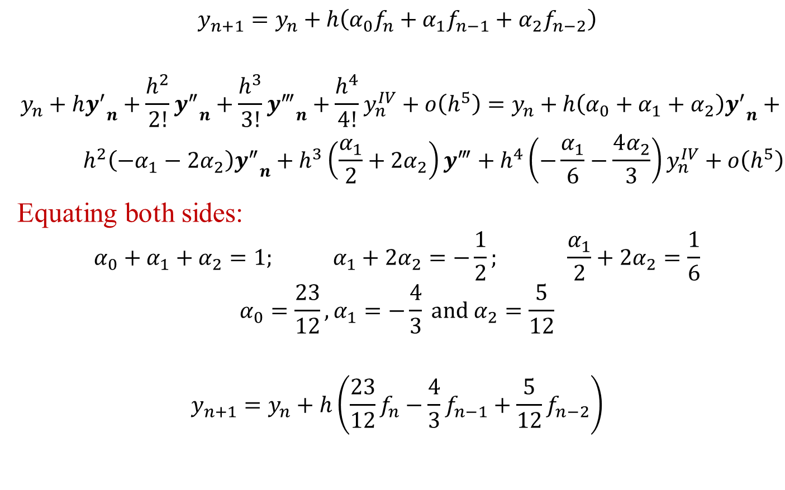
Multi-Step Methods: Explicit
,
$$y_{n+1}=y_{n}+h\left(α_{0}f_{n}+α_{1}f_{n−1}+α_{2}f_{n−2}\right)$$
$$\begin{matrix}y_{n}+h{y^{′}}_{n}+\frac{h^{2}}{2!}{y^{″}}_{n}+\frac{h^{3}}{3!}{y^{‴}}_{n}+\frac{h^{4}}{4!}y_{n}^{IV}+ο\left(h^{5}\right)=y_{n}+h\left(α_{0}+α_{1}+α_{2}\right){y^{′}}_{n}+ \\ h^{2}\left(−α_{1}−2α_{2}\right){y^{″}}_{n}+h^{3}\left(\frac{α_{1}}{2}+2α_{2}\right)y^{‴}+h^{4}\left(−\frac{α_{1}}{6}−\frac{4α_{2}}{3}\right)y_{n}^{IV}+ο\left(h^{5}\right)\end{matrix}$$
Equating both sides:
$$α_{0}+α_{1}+α_{2}=1; α_{1}+2α_{2}=−\frac{1}{2}; \frac{α_{1}}{2}+2α_{2}=\frac{1}{6}$$
$$α_{0}=\frac{23}{12},α_{1}=−\frac{4}{3} \text{and} α_{2}=\frac{5}{12}$$
$$y_{n+1}=y_{n}+h\left(\frac{23}{12}f_{n}−\frac{4}{3}f_{n−1}+\frac{5}{12}f_{n−2}\right)$$

Slide 11
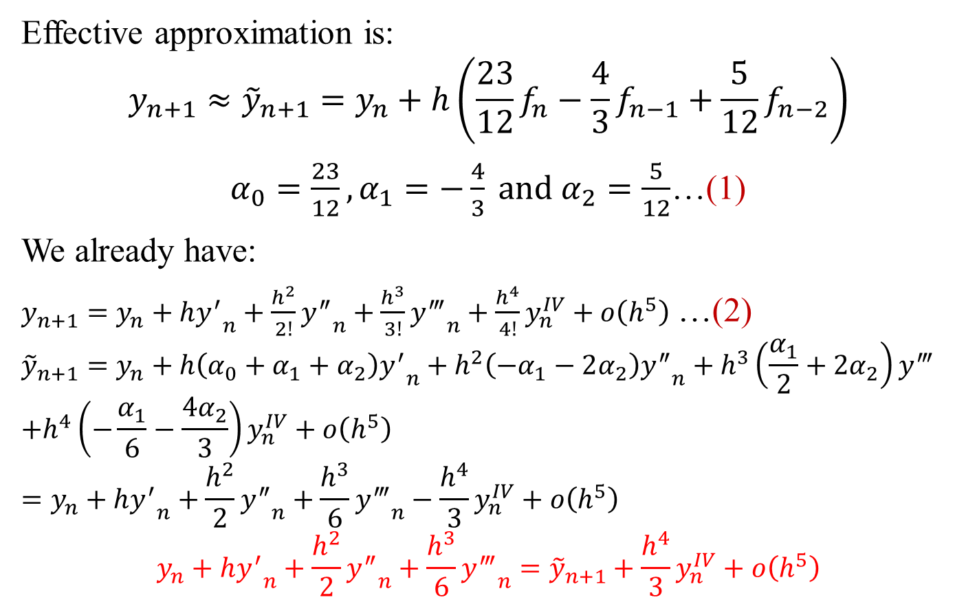
Multi-Step Methods: Explicit
,
Effective approximation is:
$$y_{n+1}≈{\tilde{y}}_{n+1}=y_{n}+h\left(\frac{23}{12}f_{n}−\frac{4}{3}f_{n−1}+\frac{5}{12}f_{n−2}\right)$$
$α_{0}=\frac{23}{12},α_{1}=−\frac{4}{3} \text{and} α_{2}=\frac{5}{12}$…(1)
We already have:
$y_{n+1}=y_{n}+h{y^{′}}_{n}+\frac{h^{2}}{2!}{y^{″}}_{n}+\frac{h^{3}}{3!}{y^{‴}}_{n}+\frac{h^{4}}{4!}y_{n}^{IV}+ο\left(h^{5}\right)$ …(2)
$${\tilde{y}}_{n+1}=y_{n}+h\left(α_{0}+α_{1}+α_{2}\right){y^{′}}_{n}+h^{2}\left(−α_{1}−2α_{2}\right){y^{″}}_{n}+h^{3}\left(\frac{α_{1}}{2}+2α_{2}\right)y^{‴}$$
$$+h^{4}\left(−\frac{α_{1}}{6}−\frac{4α_{2}}{3}\right)y_{n}^{IV}+ο\left(h^{5}\right)$$
$$=y_{n}+h{y^{′}}_{n}+\frac{h^{2}}{2}{y^{″}}_{n}+\frac{h^{3}}{6}{y^{‴}}_{n}−\frac{h^{4}}{3}y_{n}^{IV}+ο\left(h^{5}\right)$$
$$y_{n}+h{y^{′}}_{n}+\frac{h^{2}}{2}{y^{″}}_{n}+\frac{h^{3}}{6}{y^{‴}}_{n}={\tilde{y}}_{n+1}+\frac{h^{4}}{3}y_{n}^{IV}+ο\left(h^{5}\right)$$
…(3)

Slide 12
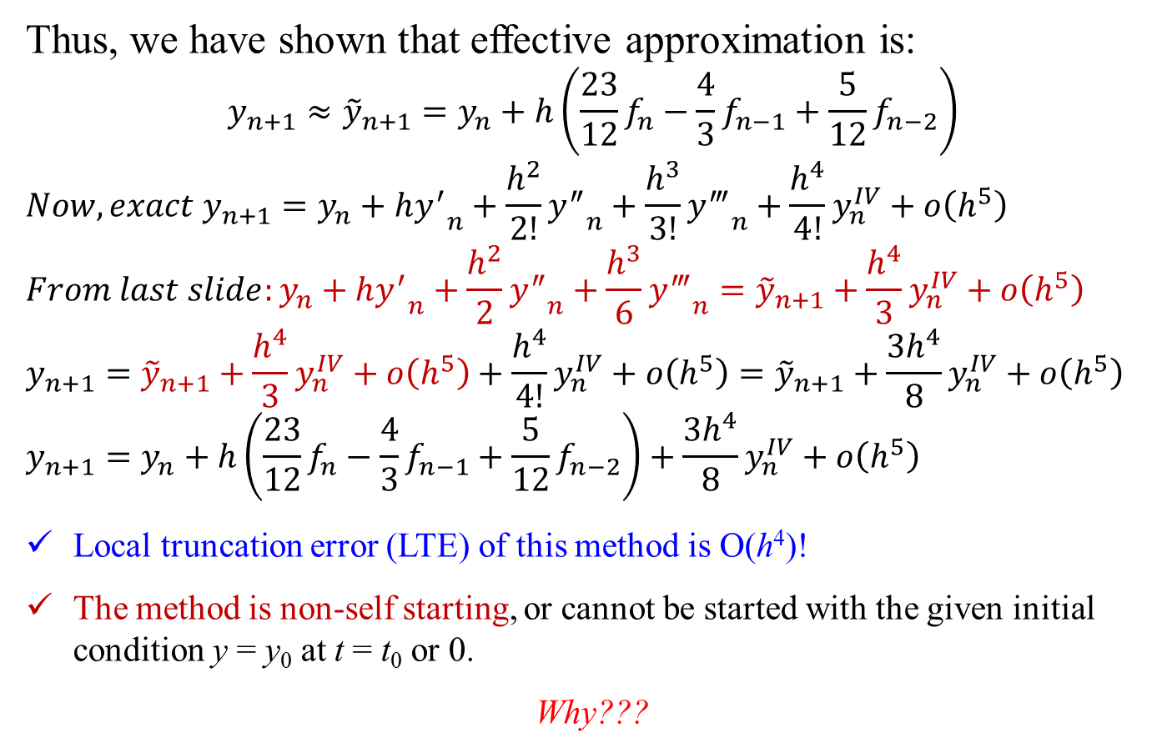
Multi-Step Methods: Explicit
,
Thus, we have shown that effective approximation is:
$$y_{n+1}≈{\tilde{y}}_{n+1}=y_{n}+h\left(\frac{23}{12}f_{n}−\frac{4}{3}f_{n−1}+\frac{5}{12}f_{n−2}\right)$$
$${Now, exact y}_{n+1}=y_{n}+h{y^{′}}_{n}+\frac{h^{2}}{2!}{y^{″}}_{n}+\frac{h^{3}}{3!}{y^{‴}}_{n}+\frac{h^{4}}{4!}y_{n}^{IV}+ο\left(h^{5}\right)$$
$${From last slide:y}_{n}+h{y^{′}}_{n}+\frac{h^{2}}{2}{y^{″}}_{n}+\frac{h^{3}}{6}{y^{‴}}_{n}={\tilde{y}}_{n+1}+\frac{h^{4}}{3}y_{n}^{IV}+ο\left(h^{5}\right)$$
$$y_{n+1}={\tilde{y}}_{n+1}+\frac{h^{4}}{3}y_{n}^{IV}+ο\left(h^{5}\right)+\frac{h^{4}}{4!}y_{n}^{IV}+ο\left(h^{5}\right)={\tilde{y}}_{n+1}+\frac{3h^{4}}{8}y_{n}^{IV}+ο\left(h^{5}\right)$$
$$y_{n+1}=y_{n}+h\left(\frac{23}{12}f_{n}−\frac{4}{3}f_{n−1}+\frac{5}{12}f_{n−2}\right)+\frac{3h^{4}}{8}y_{n}^{IV}+ο\left(h^{5}\right)$$
Local truncation error (LTE) of this method is O(h⁴)!
The method is non-self starting, or cannot be started with the given initial condition y = y₀ at t = t₀ or 0.
Why???

Slide 13
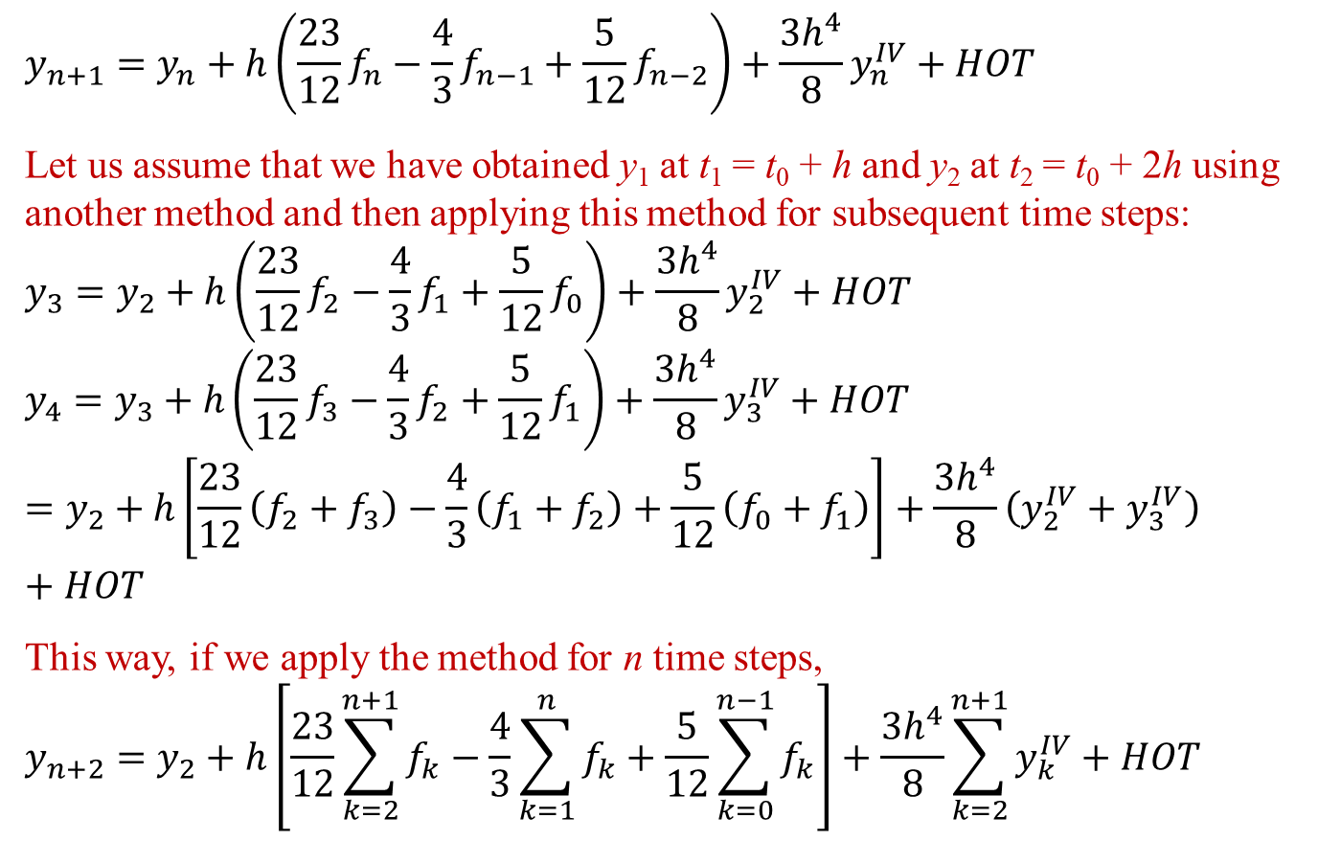
Multi-Step Methods: Explicit
,
$$y_{n+1}=y_{n}+h\left(\frac{23}{12}f_{n}−\frac{4}{3}f_{n−1}+\frac{5}{12}f_{n−2}\right)+\frac{3h^{4}}{8}y_{n}^{IV}+HOT$$
Let us assume that we have obtained y₁ at t₁ = t₀ + h and y₂ at t₂ = t₀ + 2h using another method and then applying this method for subsequent time steps:
$$y_{3}=y_{2}+h\left(\frac{23}{12}f_{2}−\frac{4}{3}f_{1}+\frac{5}{12}f_{0}\right)+\frac{3h^{4}}{8}y_{2}^{IV}+HOT$$
$$y_{4}=y_{3}+h\left(\frac{23}{12}f_{3}−\frac{4}{3}f_{2}+\frac{5}{12}f_{1}\right)+\frac{3h^{4}}{8}y_{3}^{IV}+HOT=y_{2}+h\left[\frac{23}{12}\left(f_{2}+f_{3}\right)−\frac{4}{3}\left(f_{1}+f_{2}\right)+\frac{5}{12}\left(f_{0}+f_{1}\right)\right]+\frac{3h^{4}}{8}\left(y_{2}^{IV}+y_{3}^{IV}\right)+HOT$$
This way, if we apply the method for n time steps,
$$y_{n+2}=y_{2}+h\left[\frac{23}{12}\sum_{k=2}^{n+1}{f_{k}}−\frac{4}{3}\sum_{k=1}^{n}{f_{k}}+\frac{5}{12}\sum_{k=0}^{n−1}{f_{k}}\right]+\frac{3h^{4}}{8}\sum_{k=2}^{n+1}{y_{k}^{IV}}+HOT$$

Slide 14
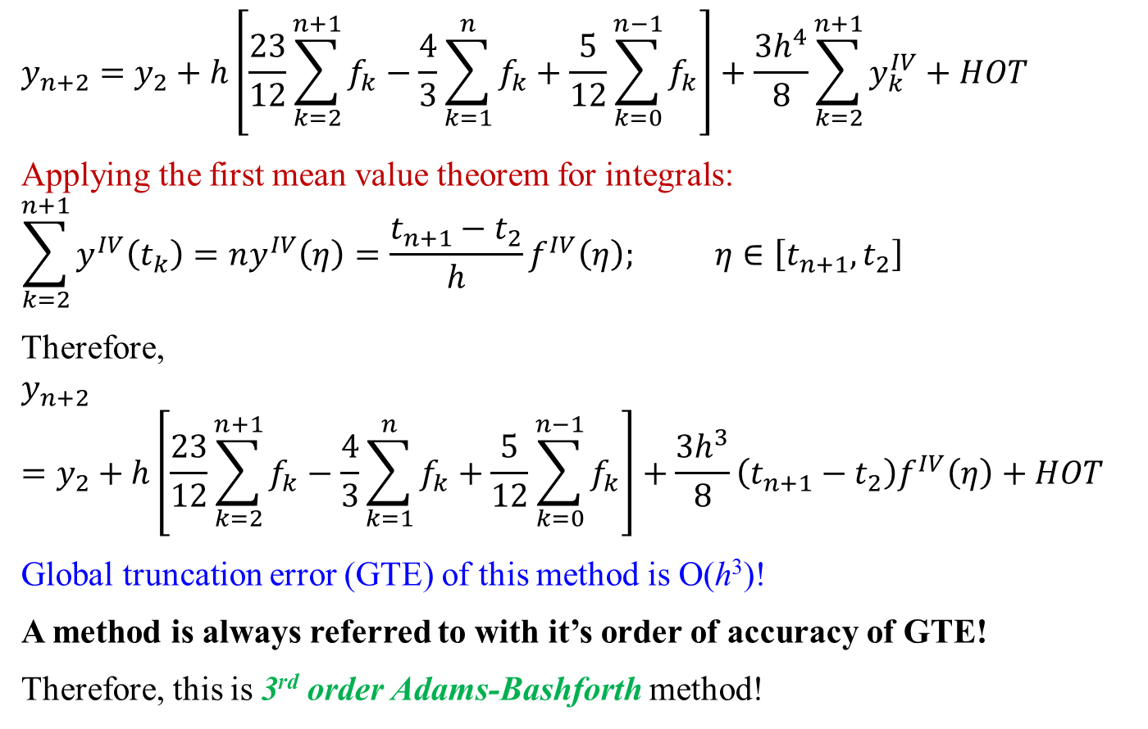
Multi-Step Methods: Explicit
,
$$y_{n+2}=y_{2}+h\left[\frac{23}{12}\sum_{k=2}^{n+1}{f_{k}}−\frac{4}{3}\sum_{k=1}^{n}{f_{k}}+\frac{5}{12}\sum_{k=0}^{n−1}{f_{k}}\right]+\frac{3h^{4}}{8}\sum_{k=2}^{n+1}{y_{k}^{IV}}+HOT$$
Applying the first mean value theorem for integrals:
$$\sum_{k=2}^{n+1}{y^{IV}\left(t_{k}\right)}=ny^{IV}\left(η\right)=\frac{t_{n+1}−t_{2}}{h}f^{IV}\left(η\right); η∈\left[t_{n+1},t_{2}\right]$$
Therefore,
$$y_{n+2}=y_{2}+h\left[\frac{23}{12}\sum_{k=2}^{n+1}{f_{k}}−\frac{4}{3}\sum_{k=1}^{n}{f_{k}}+\frac{5}{12}\sum_{k=0}^{n−1}{f_{k}}\right]+\frac{3h^{3}}{8}\left(t_{n+1}−t_{2}\right)f^{IV}\left(η\right)+HOT$$
Global truncation error (GTE) of this method is O(h³)!
A method is always referred to with it’s order of accuracy of GTE!
Therefore, this is 3rd order Adams-Bashforth method!

Slide 15

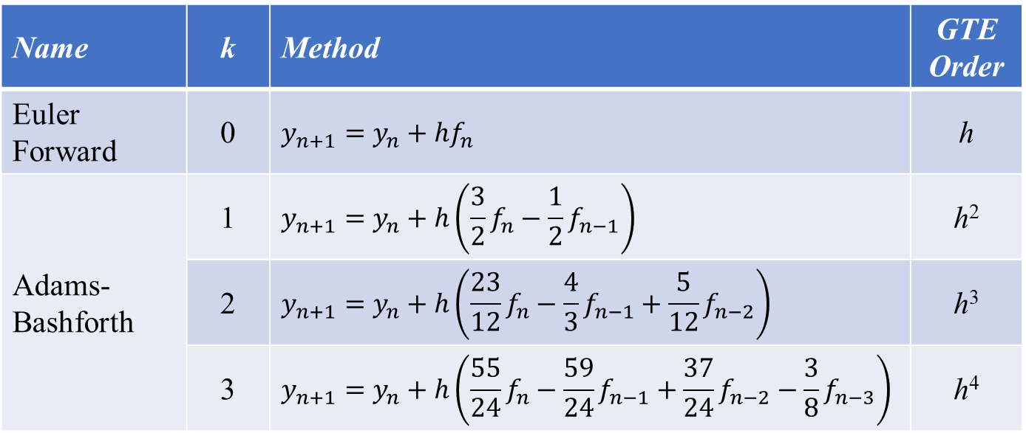
Multi-Step Methods: Explicit
,
$$y_{n+1}=y_{n}+h\sum_{i=0}^{k}{α_{i}f_{n−i}}$$
Some commonly used explicit methods:
Name | k | Method | GTE Order
Euler Forward | 0 | $$y_{n+1}=y_{n}+hf_{n}$$ | h
Adams-Bashforth | 1 | $$y_{n+1}=y_{n}+h\left(\frac{3}{2}f_{n}−\frac{1}{2}f_{n−1}\right)$$ | h²
 | 2 | $$y_{n+1}=y_{n}+h\left(\frac{23}{12}f_{n}−\frac{4}{3}f_{n−1}+\frac{5}{12}f_{n−2}\right)$$ | h³
 | 3 | $$y_{n+1}=y_{n}+h\left(\frac{55}{24}f_{n}−\frac{59}{24}f_{n−1}+\frac{37}{24}f_{n−2}−\frac{3}{8}f_{n−3}\right)$$ | h⁴

Slide 16
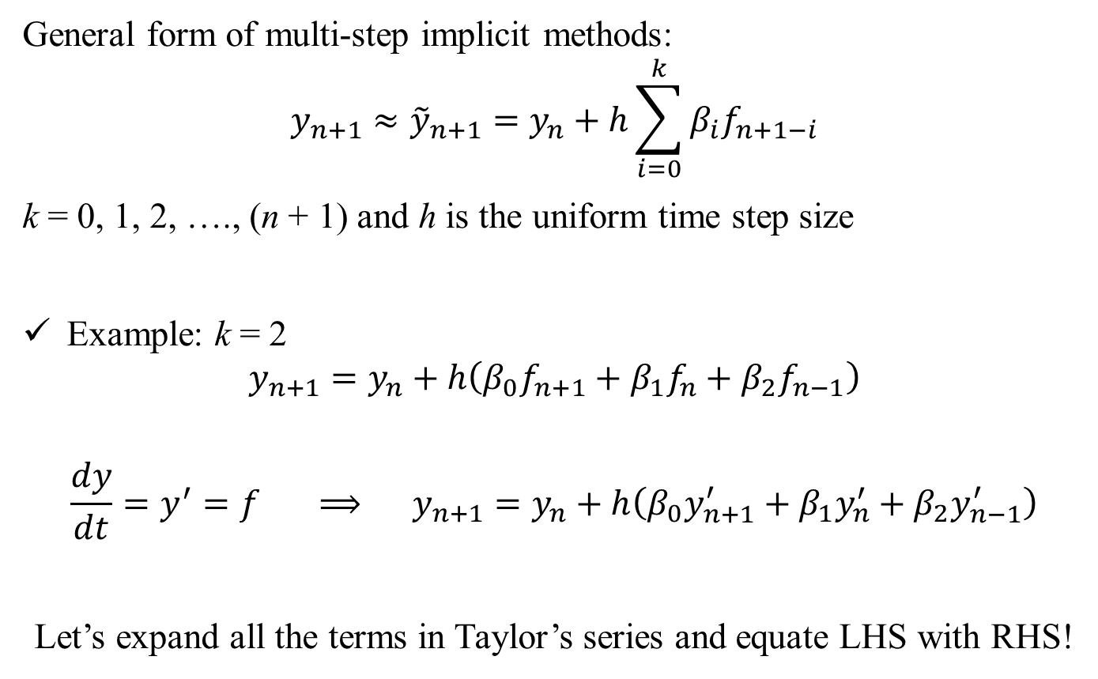

Multi-Step Methods: Implicit
,
General form of multi-step implicit methods:
$$y_{n+1}≈{\tilde{y}}_{n+1}=y_{n}+h\sum_{i=0}^{k}{β_{i}f_{n+1−i}}$$
k = 0, 1, 2, …., (n + 1) and h is the uniform time step size
Example: k = 2
$$y_{n+1}=y_{n}+h\left(β_{0}f_{n+1}+β_{1}f_{n}+β_{2}f_{n−1}\right)$$
$$\frac{dy}{dt}=y^{′}=f ⟹ y_{n+1}=y_{n}+h\left(β_{0}y_{n+1}^{′}+β_{1}y_{n}^{′}+β_{2}y_{n−1}^{′}\right)$$
Let’s expand all the terms in Taylor’s series and equate LHS with RHS!
$$y_{n+1}=y_{n}+h\left(β_{0}f_{n+1}+β_{1}f_{n}+β_{2}f_{n−1}\right)$$

Slide 17
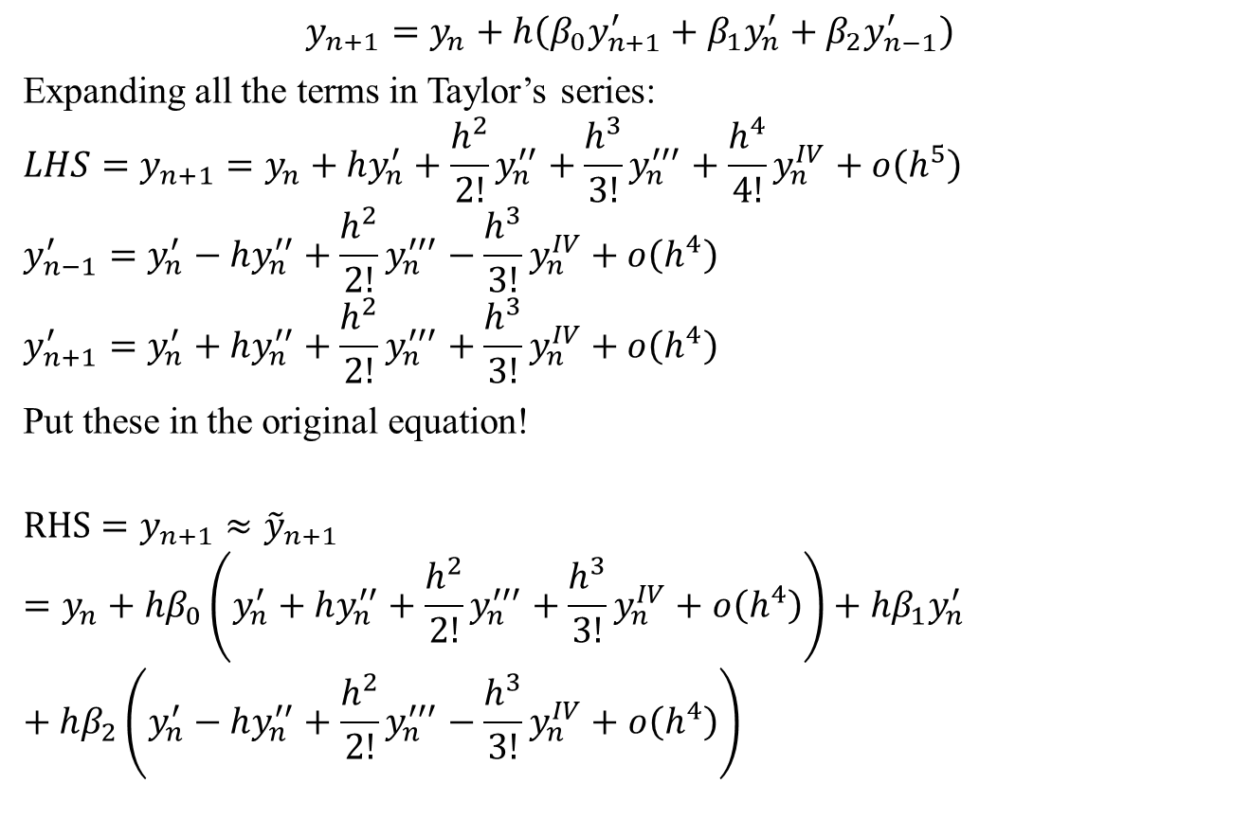
Multi-Step Methods: Implicit
,
$$y_{n+1}=y_{n}+h\left(β_{0}y_{n+1}^{′}+β_{1}y_{n}^{′}+β_{2}y_{n−1}^{′}\right)$$
Expanding all the terms in Taylor’s series:
$$LHS=y_{n+1}=y_{n}+hy_{n}^{′}+\frac{h^{2}}{2!}y_{n}^{′′}+\frac{h^{3}}{3!}y_{n}^{′′′}+\frac{h^{4}}{4!}y_{n}^{IV}+ο\left(h^{5}\right)$$
$$y_{n−1}^{′}=y_{n}^{′}−hy_{n}^{′′}+\frac{h^{2}}{2!}y_{n}^{′′′}−\frac{h^{3}}{3!}y_{n}^{IV}+ο\left(h^{4}\right)$$
$$y_{n+1}^{′}=y_{n}^{′}+hy_{n}^{′′}+\frac{h^{2}}{2!}y_{n}^{′′′}+\frac{h^{3}}{3!}y_{n}^{IV}+ο\left(h^{4}\right)$$
Put these in the original equation!
$$RHS=y_{n+1}≈{\tilde{y}}_{n+1}=y_{n}+hβ_{0}\left(y_{n}^{′}+hy_{n}^{′′}+\frac{h^{2}}{2!}y_{n}^{′′′}+\frac{h^{3}}{3!}y_{n}^{IV}+ο\left(h^{4}\right)\right)+hβ_{1}y_{n}^{′}+hβ_{2}\left(y_{n}^{′}−hy_{n}^{′′}+\frac{h^{2}}{2!}y_{n}^{′′′}−\frac{h^{3}}{3!}y_{n}^{IV}+ο\left(h^{4}\right)\right)$$

Slide 18
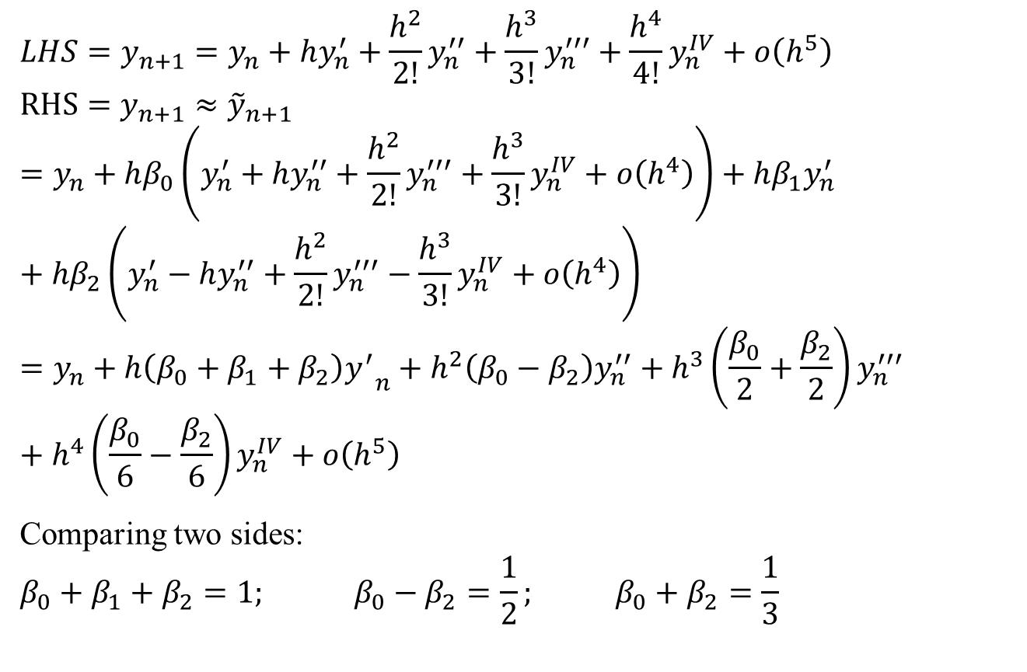
Multi-Step Methods: Implicit
,
$$LHS=y_{n+1}=y_{n}+hy_{n}^{′}+\frac{h^{2}}{2!}y_{n}^{′′}+\frac{h^{3}}{3!}y_{n}^{′′′}+\frac{h^{4}}{4!}y_{n}^{IV}+ο\left(h^{5}\right)$$
$$RHS=y_{n+1}≈{\tilde{y}}_{n+1}=y_{n}+hβ_{0}\left(y_{n}^{′}+hy_{n}^{′′}+\frac{h^{2}}{2!}y_{n}^{′′′}+\frac{h^{3}}{3!}y_{n}^{IV}+ο\left(h^{4}\right)\right)+hβ_{1}y_{n}^{′}+hβ_{2}\left(y_{n}^{′}−hy_{n}^{′′}+\frac{h^{2}}{2!}y_{n}^{′′′}−\frac{h^{3}}{3!}y_{n}^{IV}+ο\left(h^{4}\right)\right)=y_{n}+h\left(β_{0}+β_{1}+β_{2}\right){y^{′}}_{n}+h^{2}\left(β_{0}−β_{2}\right)y_{n}^{′′}+h^{3}\left(\frac{β_{0}}{2}+\frac{β_{2}}{2}\right)y_{n}^{′′′}+h^{4}\left(\frac{β_{0}}{6}−\frac{β_{2}}{6}\right)y_{n}^{IV}+ο\left(h^{5}\right)$$
Comparing two sides:
$$β_{0}+β_{1}+β_{2}=1; β_{0}−β_{2}=\frac{1}{2}; β_{0}+β_{2}=\frac{1}{3}$$

Slide 19
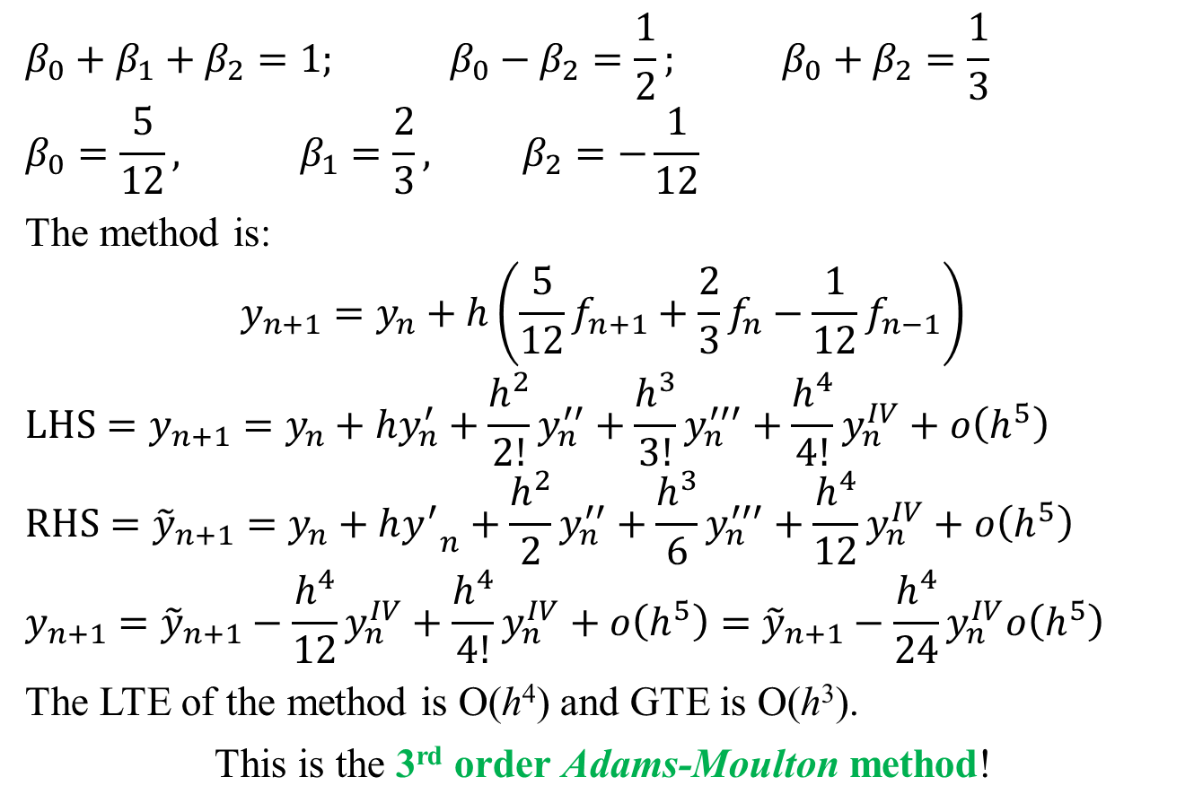
Multi-Step Methods: Implicit
,
$$β_{0}+β_{1}+β_{2}=1; β_{0}−β_{2}=\frac{1}{2}; β_{0}+β_{2}=\frac{1}{3}$$
$$β_{0}=\frac{5}{12}, β_{1}=\frac{2}{3}\text{,} β_{2}=−\frac{1}{12}$$
The method is:
$$y_{n+1}=y_{n}+h\left(\frac{5}{12}f_{n+1}+\frac{2}{3}f_{n}−\frac{1}{12}f_{n−1}\right)$$
$$LHS=y_{n+1}=y_{n}+hy_{n}^{′}+\frac{h^{2}}{2!}y_{n}^{′′}+\frac{h^{3}}{3!}y_{n}^{′′′}+\frac{h^{4}}{4!}y_{n}^{IV}+ο\left(h^{5}\right)$$
$$RHS={\tilde{y}}_{n+1}=y_{n}+h{y^{′}}_{n}+\frac{h^{2}}{2}y_{n}^{′′}+\frac{h^{3}}{6}y_{n}^{′′′}+\frac{h^{4}}{12}y_{n}^{IV}+ο\left(h^{5}\right)$$
$$y_{n+1}={\tilde{y}}_{n+1}−\frac{h^{4}}{12}y_{n}^{IV}+\frac{h^{4}}{4!}y_{n}^{IV}+ο\left(h^{5}\right)={\tilde{y}}_{n+1}−\frac{h^{4}}{24}y_{n}^{IV}ο\left(h^{5}\right)$$
The LTE of the method is O(h⁴) and GTE is O(h³).
This is the 3rd order Adams-Moulton method!

Slide 20

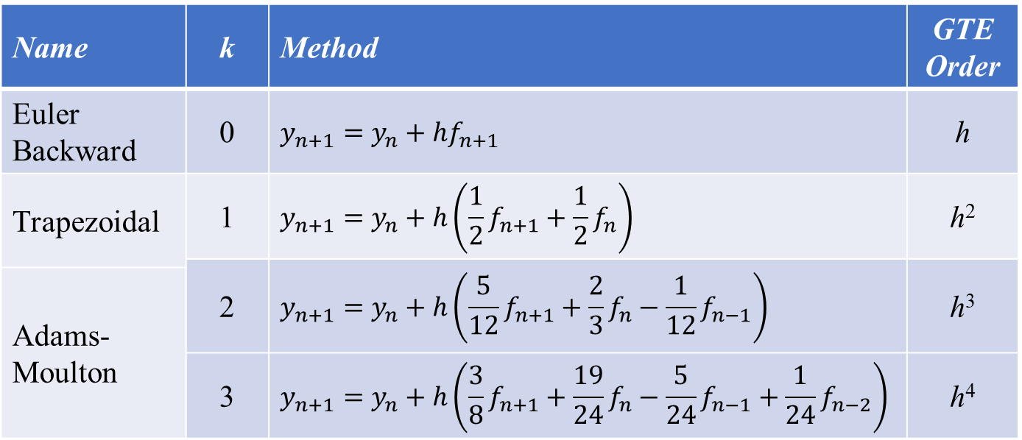
Multi-Step Methods: Implicit
,
$$y_{n+1}≈{\tilde{y}}_{n+1}=y_{n}+h\sum_{i=0}^{k}{β_{i}f_{n+1−i}}$$
Some commonly used implicit methods:
Name | k | Method | GTE Order
Euler Backward | 0 | $$y_{n+1}=y_{n}+hf_{n+1}$$ | h
Trapezoidal | 1 | $$y_{n+1}=y_{n}+h\left(\frac{1}{2}f_{n+1}+\frac{1}{2}f_{n}\right)$$ | h²
 | 2 | $$y_{n+1}=y_{n}+h\left(\frac{5}{12}f_{n+1}+\frac{2}{3}f_{n}−\frac{1}{12}f_{n−1}\right)$$ | h³
Adams-Moulton
 | 3 | $$y_{n+1}=y_{n}+h\left(\frac{3}{8}f_{n+1}+\frac{19}{24}f_{n}−\frac{5}{24}f_{n−1}+\frac{1}{24}f_{n−2}\right)$$ | h⁴

Slide 21
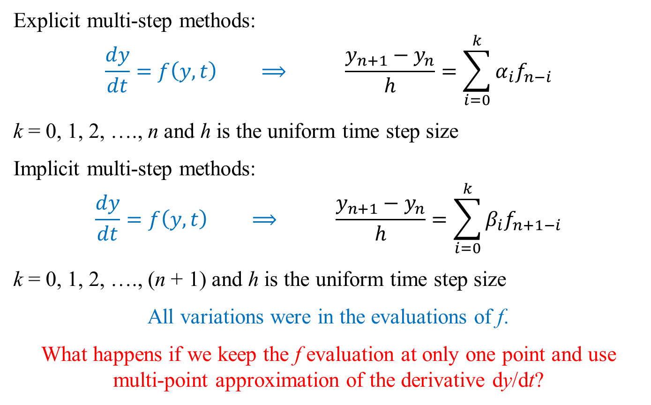
Backward Difference Formulae (BDF)
,
Explicit multi-step methods:
$$\frac{dy}{dt}=f\left(y,t\right) ⟹ \frac{y_{n+1}−y_{n}}{h}=\sum_{i=0}^{k}{α_{i}f_{n−i}}$$
k = 0, 1, 2, …., n and h is the uniform time step size
Implicit multi-step methods:
$$\frac{dy}{dt}=f\left(y,t\right) ⟹ \frac{y_{n+1}−y_{n}}{h}=\sum_{i=0}^{k}{β_{i}f_{n+1−i}}$$
k = 0, 1, 2, …., (n + 1) and h is the uniform time step size
All variations were in the evaluations of f.
What happens if we keep the f evaluation at only one point and use multi-point approximation of the derivative dy/dt?

Slide 22
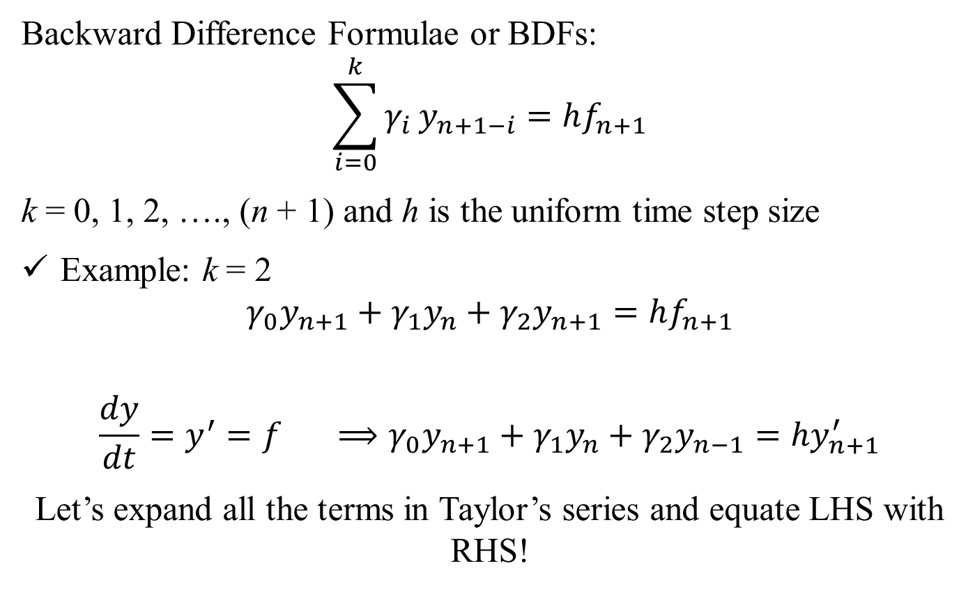
Backward Difference Formulae (BDF)
,
Backward Difference Formulae or BDFs:
$$\sum_{i=0}^{k}{γ_{i}}y_{n+1−i}=hf_{n+1}$$
k = 0, 1, 2, …., (n + 1) and h is the uniform time step size
Example: k = 2
$$γ_{0}y_{n+1}+γ_{1}y_{n}+γ_{2}y_{n+1}=hf_{n+1}$$
$$\frac{dy}{dt}=y^{′}=f ⟹γ_{0}y_{n+1}+γ_{1}y_{n}+γ_{2}y_{n−1}=hy_{n+1}^{′}$$
Let’s expand all the terms in Taylor’s series and equate LHS with RHS!

Slide 23
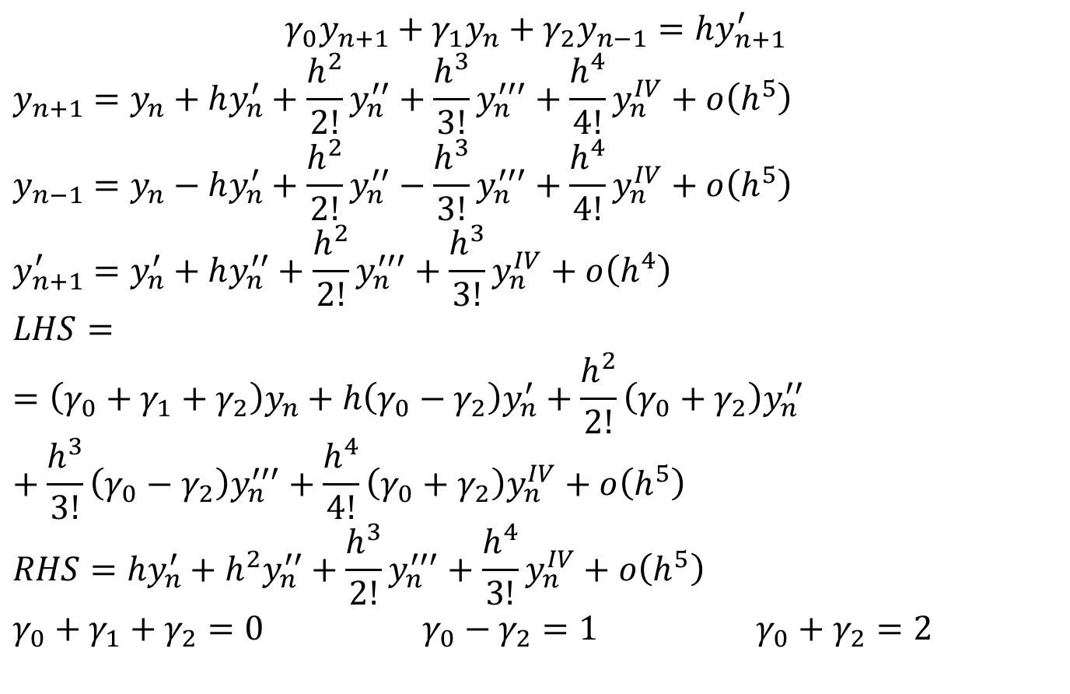
Backward Difference Formulae (BDF)
,
$$γ_{0}y_{n+1}+γ_{1}y_{n}+γ_{2}y_{n−1}=hy_{n+1}^{′}$$
$$y_{n+1}=y_{n}+hy_{n}^{′}+\frac{h^{2}}{2!}y_{n}^{′′}+\frac{h^{3}}{3!}y_{n}^{′′′}+\frac{h^{4}}{4!}y_{n}^{IV}+ο\left(h^{5}\right)$$
$$y_{n−1}=y_{n}−hy_{n}^{′}+\frac{h^{2}}{2!}y_{n}^{′′}−\frac{h^{3}}{3!}y_{n}^{′′′}+\frac{h^{4}}{4!}y_{n}^{IV}+ο\left(h^{5}\right)$$
$$y_{n+1}^{′}=y_{n}^{′}+hy_{n}^{′′}+\frac{h^{2}}{2!}y_{n}^{′′′}+\frac{h^{3}}{3!}y_{n}^{IV}+ο\left(h^{4}\right)$$
$$LHS==\left(γ_{0}+γ_{1}+γ_{2}\right)y_{n}+h\left(γ_{0}−γ_{2}\right)y_{n}^{′}+\frac{h^{2}}{2!}\left(γ_{0}+γ_{2}\right)y_{n}^{′′}+\frac{h^{3}}{3!}\left(γ_{0}−γ_{2}\right)y_{n}^{′′′}+\frac{h^{4}}{4!}\left(γ_{0}+γ_{2}\right)y_{n}^{IV}+ο\left(h^{5}\right)$$
$$RHS={hy}_{n}^{′}+h^{2}y_{n}^{′′}+\frac{h^{3}}{2!}y_{n}^{′′′}+\frac{h^{4}}{3!}y_{n}^{IV}+ο\left(h^{5}\right)$$
$$γ_{0}+γ_{1}+γ_{2}=0 γ_{0}−γ_{2}=1 γ_{0}+γ_{2}=2$$

Slide 24
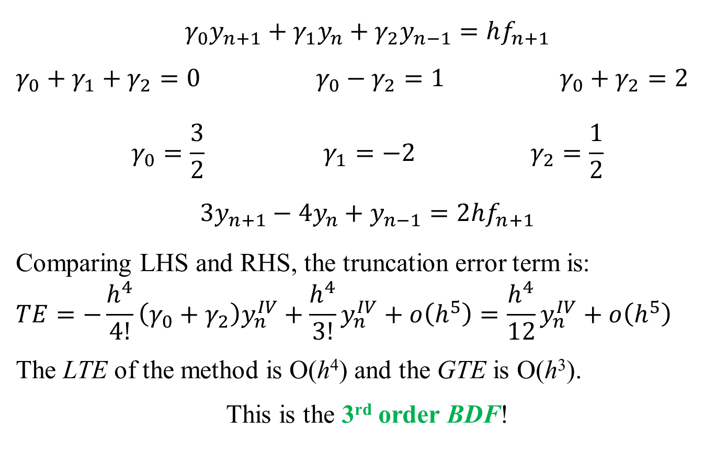
Backward Difference Formulae (BDF)
,
$$γ_{0}y_{n+1}+γ_{1}y_{n}+γ_{2}y_{n−1}=hf_{n+1}$$
$$γ_{0}+γ_{1}+γ_{2}=0 γ_{0}−γ_{2}=1 γ_{0}+γ_{2}=2$$
$$γ_{0}=\frac{3}{2} γ_{1}=−2 γ_{2}=\frac{1}{2}$$
$$3y_{n+1}−4y_{n}+y_{n−1}=2hf_{n+1}$$
Comparing LHS and RHS, the truncation error term is:
$$TE=−\frac{h^{4}}{4!}\left(γ_{0}+γ_{2}\right)y_{n}^{IV}+\frac{h^{4}}{3!}y_{n}^{IV}+ο\left(h^{5}\right)=\frac{h^{4}}{12}y_{n}^{IV}+ο\left(h^{5}\right)$$
The LTE of the method is O(h⁴) and the GTE is O(h³).
This is the 3rd order BDF!

