Slide 1
Ordinary Differential Equation
The methods for Initial Value Problems (IVPs):
Multi-step Methods
Explicit: Euler Forward, Adams-Bashforth
Implicit: Euler Backward, Trapezoidal and Adams-Moulton
Backward Difference Formulae (BDF)
Runge-Kutta Methods
Applications, Startup, Combination Methods (Predictor-Corrector)
Consistency, Stability, Convergence
Application to System of ODEs
Boundary Value Problems (BVPs)
Shooting Method
Direct Methods

Slide 2
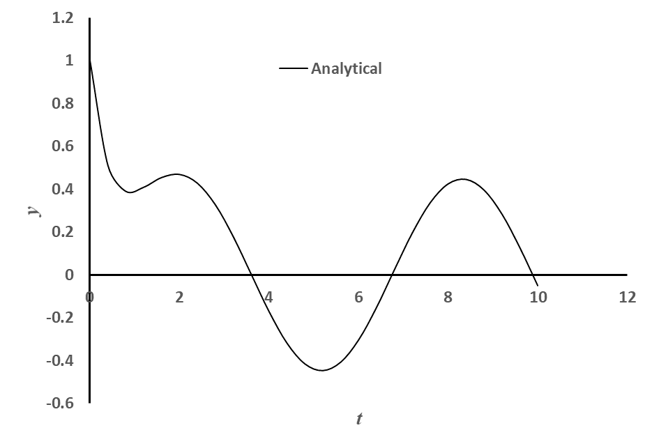
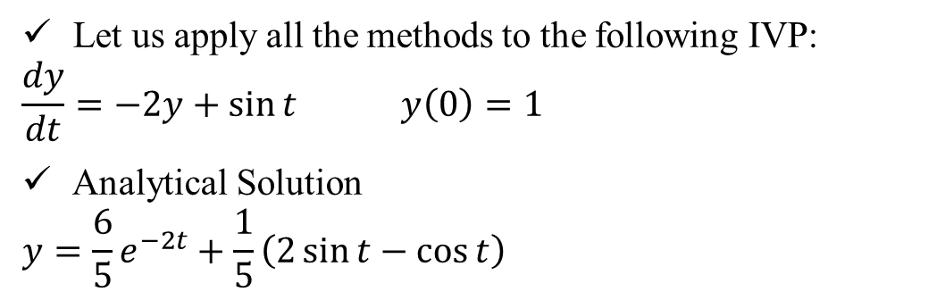
Example Problem (Contd)
,
Let us apply all the methods to the following IVP:
$$\frac{dy}{dt}=−2y+\sin{t} y\left(0\right)=1$$
Analytical Solution
$$y=\frac{6}{5}e^{−2t}+\frac{1}{5}\left(2\sin{t}−\cos{t}\right)$$

Slide 3

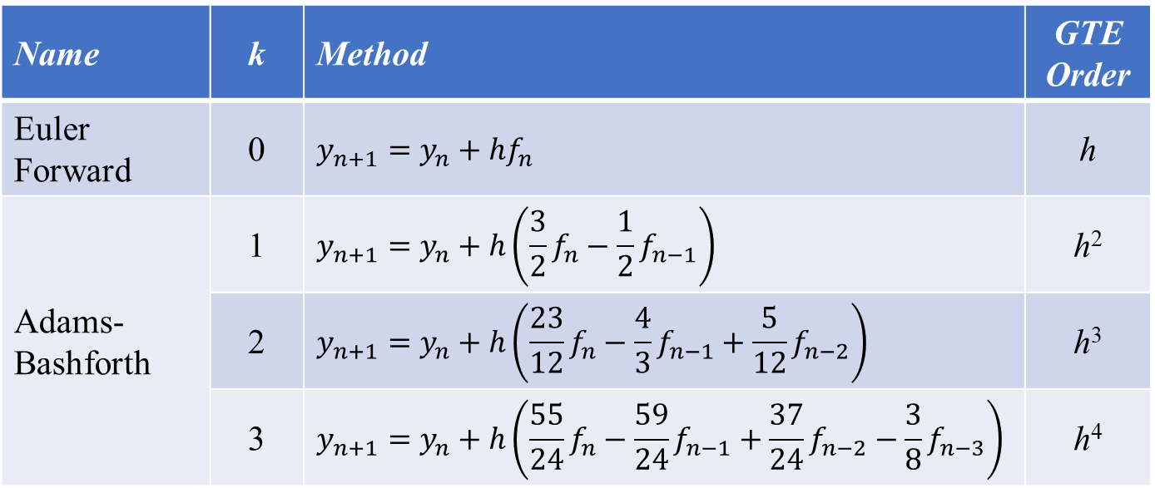
Application: Multi-Step Methods (explicit)
,
$$y_{n+1}=y_{n}+h\sum_{i=0}^{k}{α_{i}f_{n−i}}$$
Some commonly used explicit methods:
Name | k | Method | GTE Order
Euler Forward | 0 | $$y_{n+1}=y_{n}+hf_{n}$$ | h
Adams-Bashforth | 1 | $$y_{n+1}=y_{n}+h\left(\frac{3}{2}f_{n}−\frac{1}{2}f_{n−1}\right)$$ | h²
 | 2 | $$y_{n+1}=y_{n}+h\left(\frac{23}{12}f_{n}−\frac{4}{3}f_{n−1}+\frac{5}{12}f_{n−2}\right)$$ | h³
 | 3 | $$y_{n+1}=y_{n}+h\left(\frac{55}{24}f_{n}−\frac{59}{24}f_{n−1}+\frac{37}{24}f_{n−2}−\frac{3}{8}f_{n−3}\right)$$ | h⁴

Slide 4
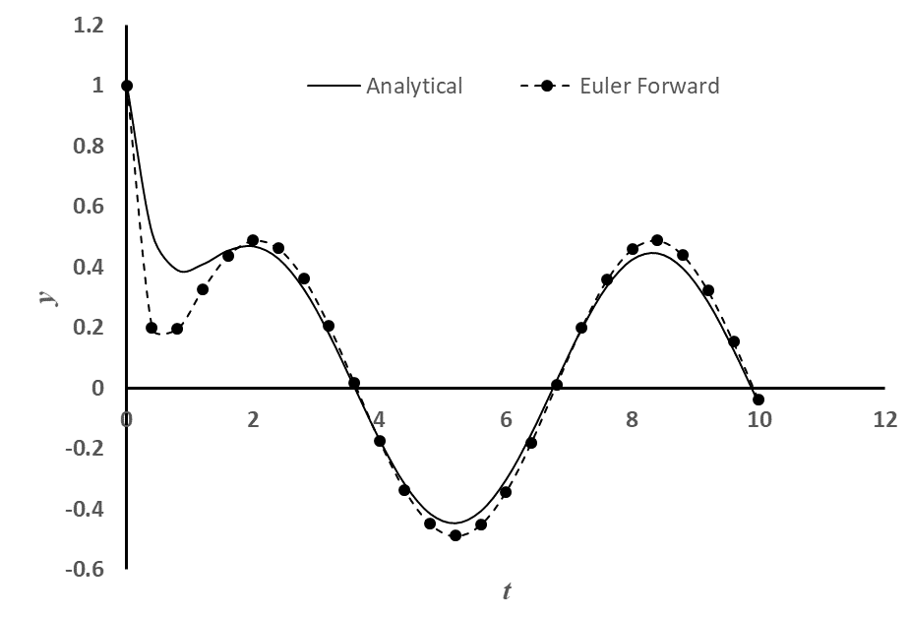
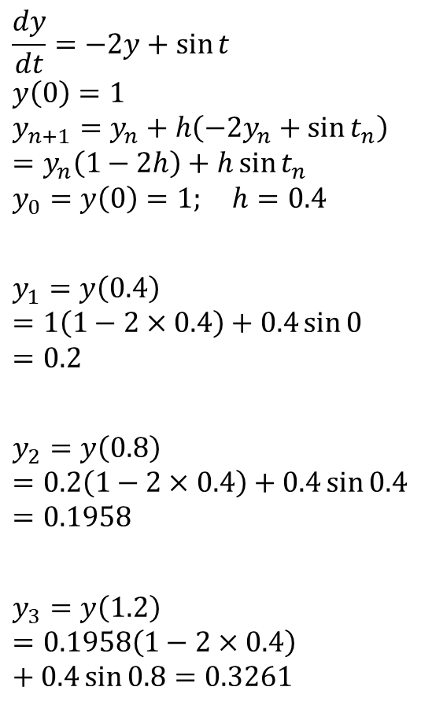
Euler Forward
,
$$\frac{dy}{dt}=−2y+\sin{t}$$
$$y\left(0\right)=1$$
$$y_{n+1}=y_{n}+h\left(−2y_{n}+\sin{t_{n}}\right)=y_{n}\left(1−2h\right)+h\sin{t_{n}}$$
$$y_{0}=y\left(0\right)=1; h=0.4$$
$$y_{1}=y\left(0.4\right)=1\left(1−2×0.4\right)+0.4\sin{0}=0.2$$
$$y_{2}=y\left(0.8\right)=0.2\left(1−2×0.4\right)+0.4\sin{0.4}=0.1958$$
$$y_{3}=y\left(1.2\right)=0.1958\left(1−2×0.4\right)+0.4\sin{0.8}=0.3261$$
Continuing like this for 25 time steps to t = 10

Slide 5
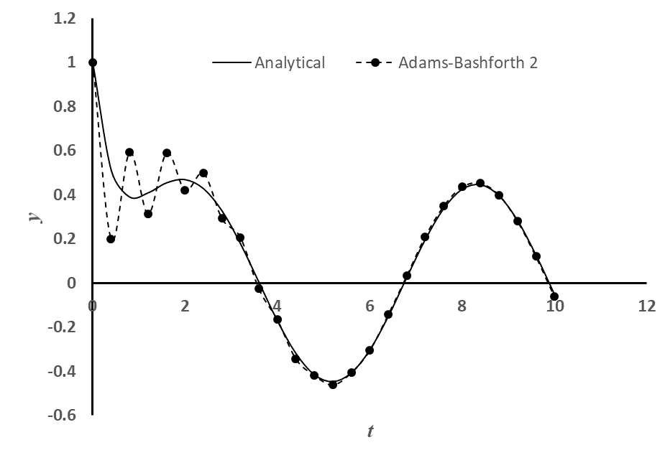
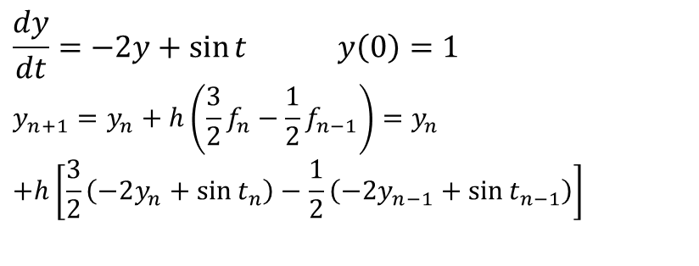
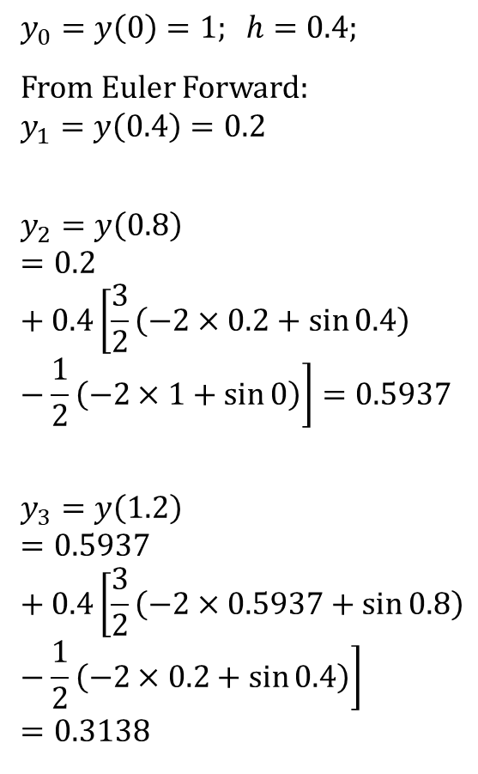
Adams-Bashforth (2nd Order)
,
$$\frac{dy}{dt}=−2y+\sin{t} y\left(0\right)=1$$
$$y_{n+1}={y_{n}+h\left(\frac{3}{2}f_{n}−\frac{1}{2}f_{n−1}\right)=y}_{n}$$
$$+h\left[\frac{3}{2}\left(−2y_{n}+\sin{t_{n}}\right)−\frac{1}{2}\left(−2y_{n−1}+\sin{t_{n−1}}\right)\right]$$
$$y_{0}=y\left(0\right)=1; h=0.4;$$
From Euler Forward:
$$y_{1}=y\left(0.4\right)=0.2$$
$$y_{2}=y\left(0.8\right)=0.2+0.4\left[\frac{3}{2}\left(−2×0.2+\sin{0.4}\right)−\frac{1}{2}\left(−2×1+\sin{0}\right)\right]=0.5937$$
$$y_{3}=y\left(1.2\right)=0.5937+0.4\left[\frac{3}{2}\left(−2×0.5937+\sin{0.8}\right)−\frac{1}{2}\left(−2×0.2+\sin{0.4}\right)\right]=0.3138$$
Continuing like this up to t = 10

Slide 6
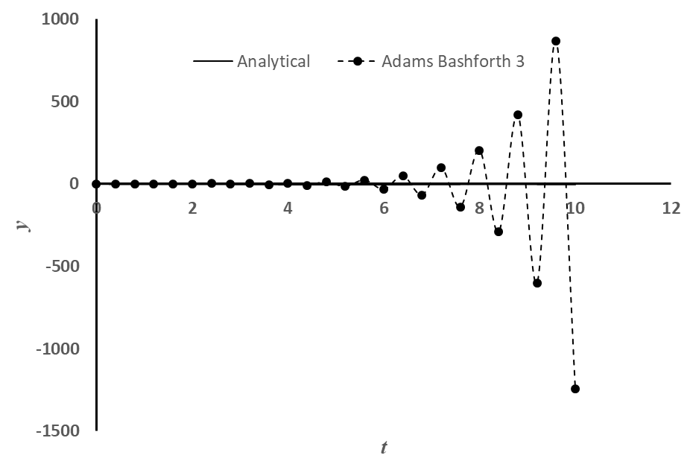
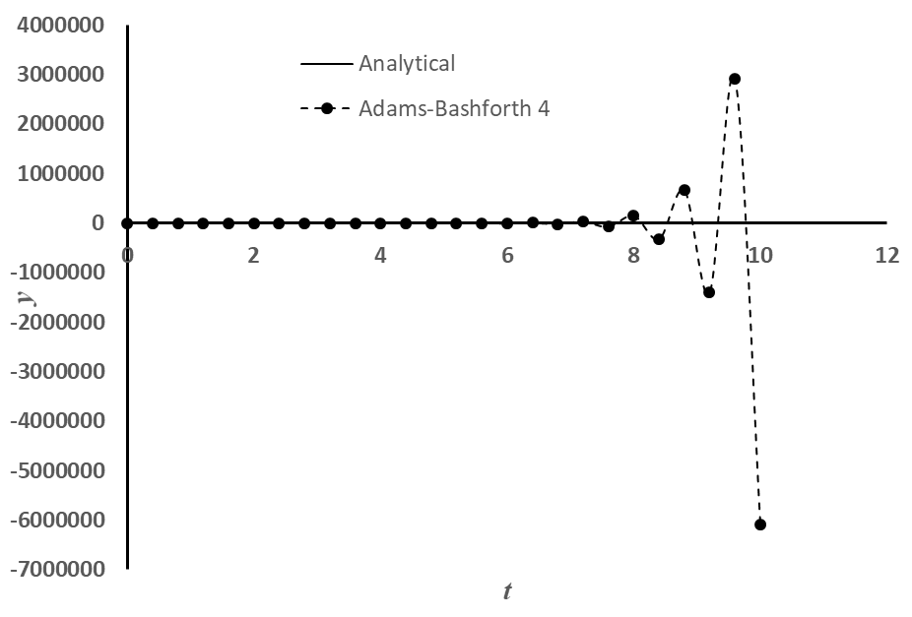
Euler Forward, Adams-Bashforth (2nd, 3rd and 4th Order)
,

Slide 7
Observations: explicit multi-step methods
A few things to note for multi-step explicit methods: Euler Forward, Adams-Bashforth
All methods above the first order cannot start by themselves:
how to solve the start-up problem?
Some strange oscillation showing up in some of the methods (uncontrolled growth, instability):
Is there a system to this?
Can it be predicted? How to know when this will happen?
Can it be avoided? If yes, then how?

Slide 8

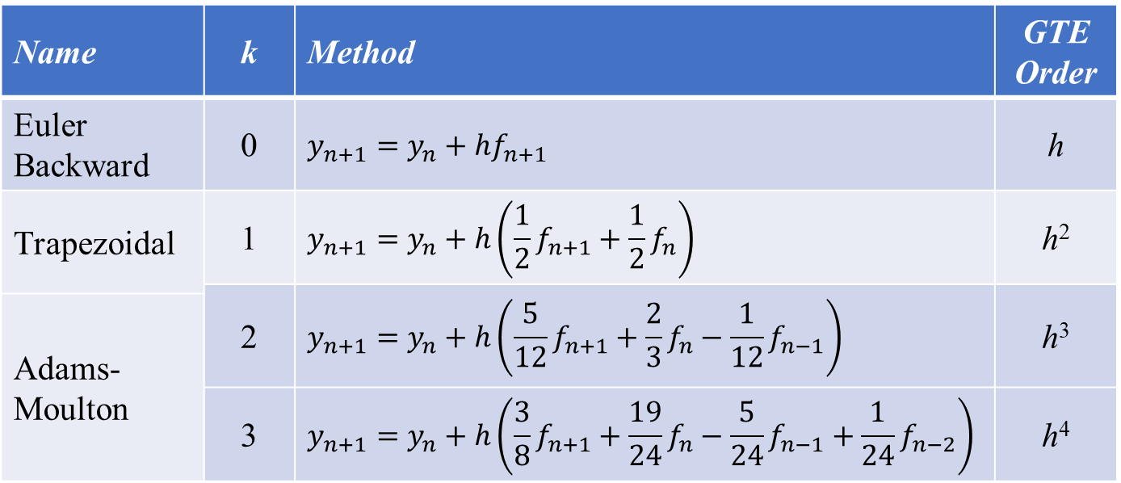
Application: Multi-Step Methods (implicit)
,
$$y_{n+1}≈{\tilde{y}}_{n+1}=y_{n}+h\sum_{i=0}^{k}{β_{i}f_{n+1−i}}$$
Some commonly used implicit methods:
Name | k | Method | GTE Order
Euler Backward | 0 | $$y_{n+1}=y_{n}+hf_{n+1}$$ | h
Trapezoidal | 1 | $$y_{n+1}=y_{n}+h\left(\frac{1}{2}f_{n+1}+\frac{1}{2}f_{n}\right)$$ | h²
 | 2 | $$y_{n+1}=y_{n}+h\left(\frac{5}{12}f_{n+1}+\frac{2}{3}f_{n}−\frac{1}{12}f_{n−1}\right)$$ | h³
Adams-Moulton
 | 3 | $$y_{n+1}=y_{n}+h\left(\frac{3}{8}f_{n+1}+\frac{19}{24}f_{n}−\frac{5}{24}f_{n−1}+\frac{1}{24}f_{n−2}\right)$$ | h⁴

Slide 9
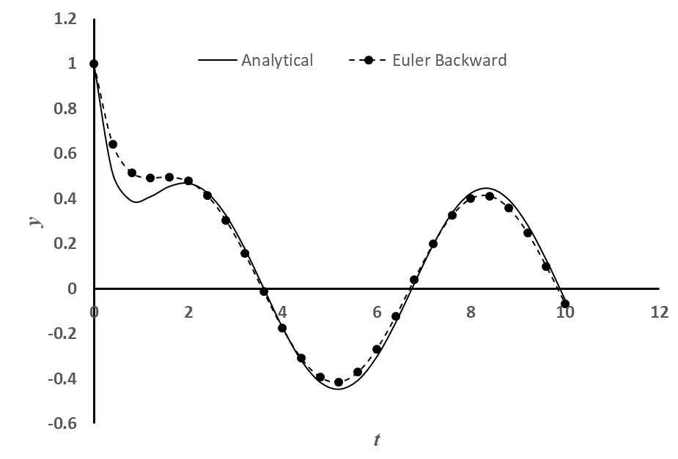
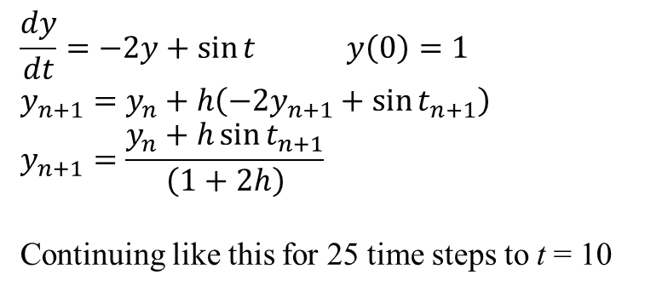
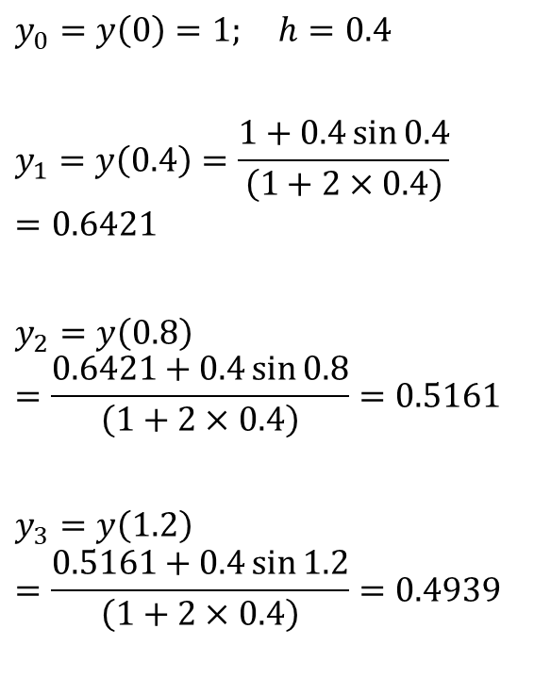
Euler Backward
,
$$\frac{dy}{dt}=−2y+\sin{t} y\left(0\right)=1$$
$$y_{n+1}=y_{n}+h\left(−2y_{n+1}+\sin{t_{n+1}}\right)$$
$$y_{n+1}=\frac{y_{n}+h\sin{t_{n+1}}}{\left(1+2h\right)}$$
Continuing like this for 25 time steps to t = 10
$$y_{0}=y\left(0\right)=1; h=0.4$$
$$y_{1}=y\left(0.4\right)=\frac{1+0.4\sin{0.4}}{\left(1+2×0.4\right)}=0.6421$$
$$y_{2}=y\left(0.8\right)=\frac{0.6421+0.4\sin{0.8}}{\left(1+2×0.4\right)}=0.5161$$
$$y_{3}=y\left(1.2\right)=\frac{0.5161+0.4\sin{1.2}}{\left(1+2×0.4\right)}=0.4939$$

Slide 10
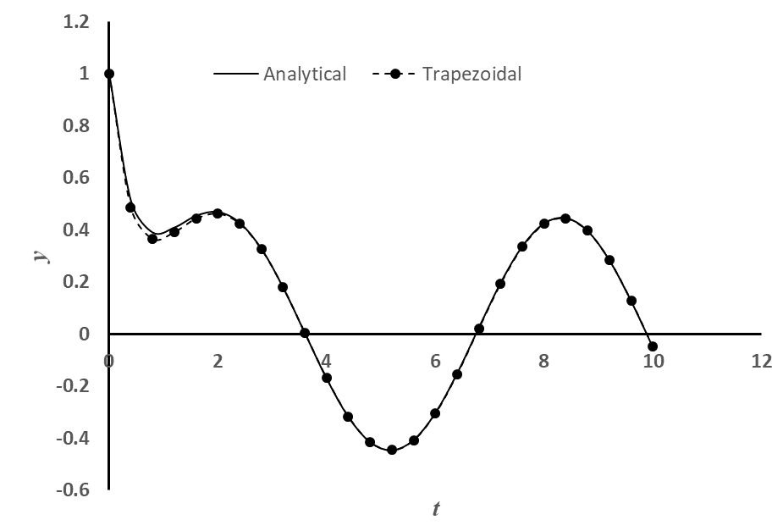
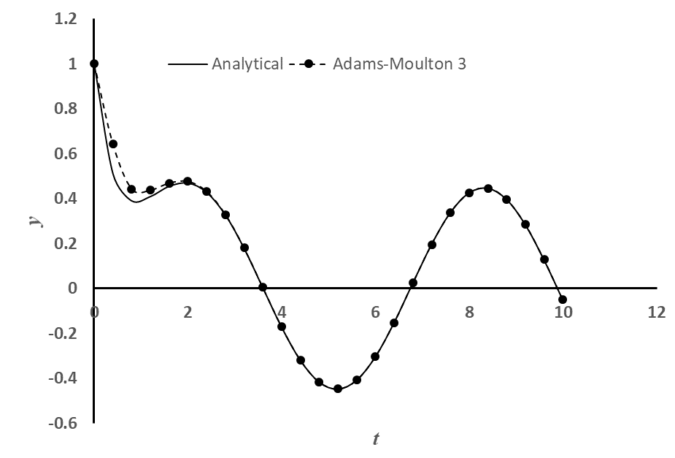

Euler Backward, Trapezoidal, Adams-Moulton (3rd and 4th Order)
,

Slide 11
Observations: implicit multi-step methods
A few things to note for multi-step implicit methods: Euler Backward, Trapezoidal, Adams-Moulton
All methods above the second order cannot start by themselves. Accuracy of the higher order method is affected if the starting values are used from the lower order methods.
how to solve the start-up problem?
All implicit multi-step methods may involve solution of non-linear equations (if f contains a non-linear function of the dependent variable y)
Is there a way to avoid this solution of non-linear equations?
No numerical oscillations (instability) observed in any of the implicit methods:
Why the same order explicit multi-step methods show oscillation but implicit ones don’t?
Do they show oscillation under any conditions or are they oscillation-proof under all conditions?

Slide 12

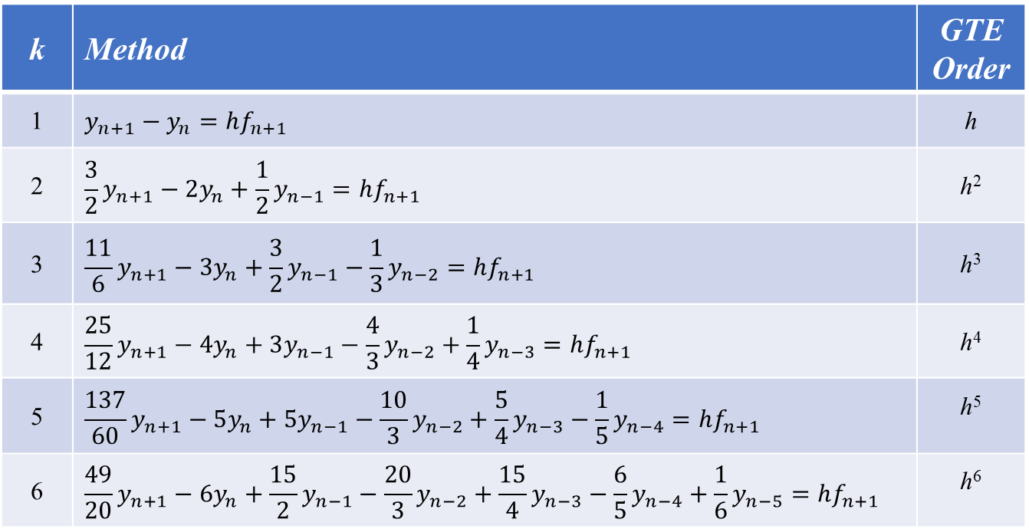
Application: Backward Difference Formulae (BDF)
,
$$\sum_{i=0}^{k}{γ_{i}}y_{n+1−i}=hf_{n+1}$$
1st Order BDF is Euler Backward. Let’s apply the rest.
k | Method | GTE Order
1 | $$y_{n+1}−y_{n}=hf_{n+1}$$ | h
2 | $$\frac{3}{2}y_{n+1}−2y_{n}+\frac{1}{2}y_{n−1}=hf_{n+1}$$ | h²
3 | $$\frac{11}{6}y_{n+1}−3y_{n}+\frac{3}{2}y_{n−1}−\frac{1}{3}y_{n−2}=hf_{n+1}$$ | h³
4 | $$\frac{25}{12}y_{n+1}−4y_{n}+3y_{n−1}−\frac{4}{3}y_{n−2}+\frac{1}{4}y_{n−3}=hf_{n+1}$$ | h⁴
5 | $$\frac{137}{60}y_{n+1}−5y_{n}+5y_{n−1}−\frac{10}{3}y_{n−2}+\frac{5}{4}y_{n−3}−\frac{1}{5}y_{n−4}=hf_{n+1}$$ | h⁵
6 | $$\frac{49}{20}y_{n+1}−6y_{n}+\frac{15}{2}y_{n−1}−\frac{20}{3}y_{n−2}+\frac{15}{4}y_{n−3}−\frac{6}{5}y_{n−4}+\frac{1}{6}y_{n−5}=hf_{n+1}$$ | h⁶

Slide 13
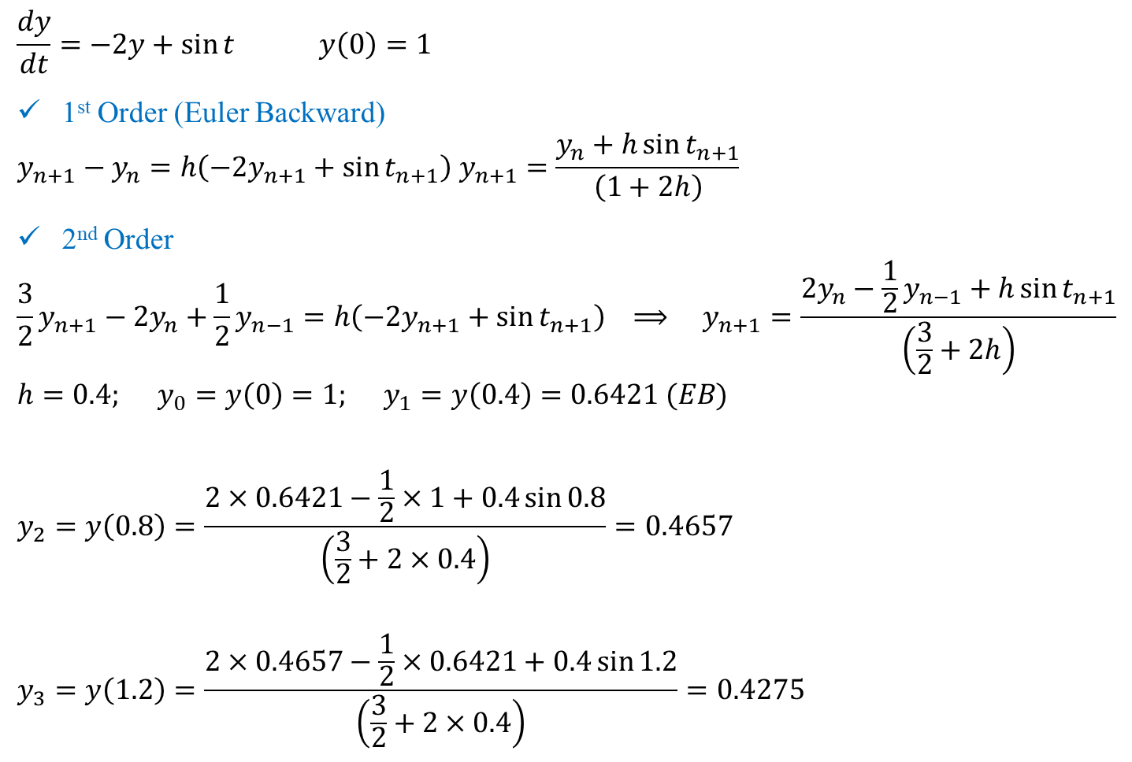
BDF (1st and 2nd Order)
,
$$\frac{dy}{dt}=−2y+\sin{t} y\left(0\right)=1$$
1st Order (Euler Backward)
$$y_{n+1}−y_{n}=h\left(−2y_{n+1}+\sin{t_{n+1}}\right) y_{n+1}=\frac{y_{n}+h\sin{t_{n+1}}}{\left(1+2h\right)}$$
2nd Order
$$\frac{3}{2}y_{n+1}−2y_{n}+\frac{1}{2}y_{n−1}=h\left(−2y_{n+1}+\sin{t_{n+1}}\right) ⟹ y_{n+1}=\frac{2y_{n}−\frac{1}{2}y_{n−1}+h\sin{t_{n+1}}}{\left(\frac{3}{2}+2h\right)}$$
$$h=0.4; y_{0}=y\left(0\right)=1; y_{1}=y\left(0.4\right)=0.6421 (EB)$$
$$y_{2}=y\left(0.8\right)=\frac{2×0.6421−\frac{1}{2}×1+0.4\sin{0.8}}{\left(\frac{3}{2}+2×0.4\right)}=0.4657$$
$$y_{3}=y\left(1.2\right)=\frac{2×0.4657−\frac{1}{2}×0.6421+0.4\sin{1.2}}{\left(\frac{3}{2}+2×0.4\right)}=0.4275$$

Slide 14
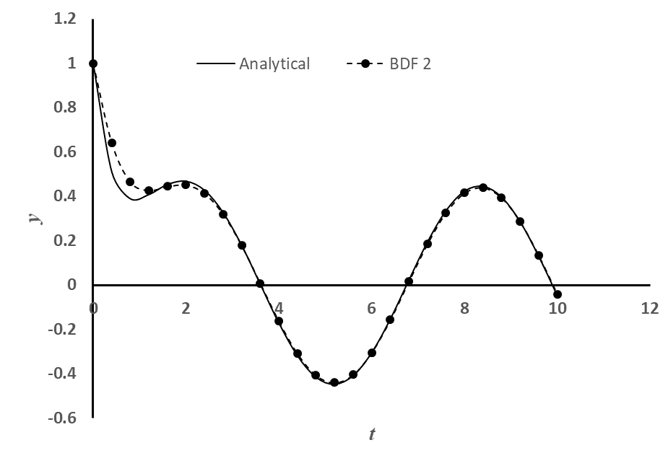
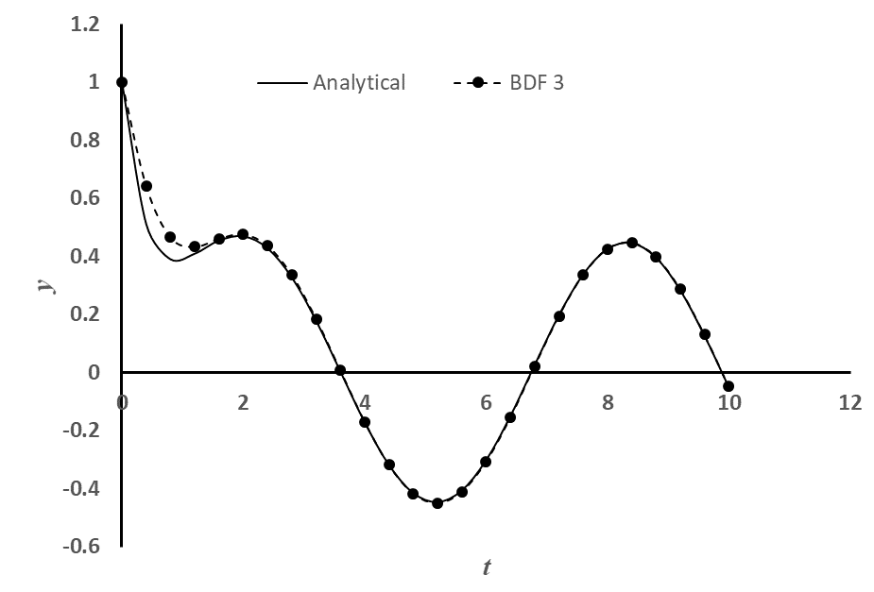



BDF (1st to 6th Order)
,

Slide 15
Observations: BDF methods
A few things to note for the BDF:
All methods above the first order cannot start by themselves. Accuracy of the higher order method is affected if the starting values are used from the lower order methods.
how to solve the start-up problem?
All BDF may involve solution of non-linear equations (if f contains a non-linear function of the dependent variable y)
Is there a way to avoid this solution of non-linear equations?
No numerical oscillations (instability) observed in any of the BDFs:
Why the same order explicit multi-step methods show oscillation but BDFs do not?
Do they show oscillation under any conditions or are they oscillation-proof under all conditions?

Slide 16
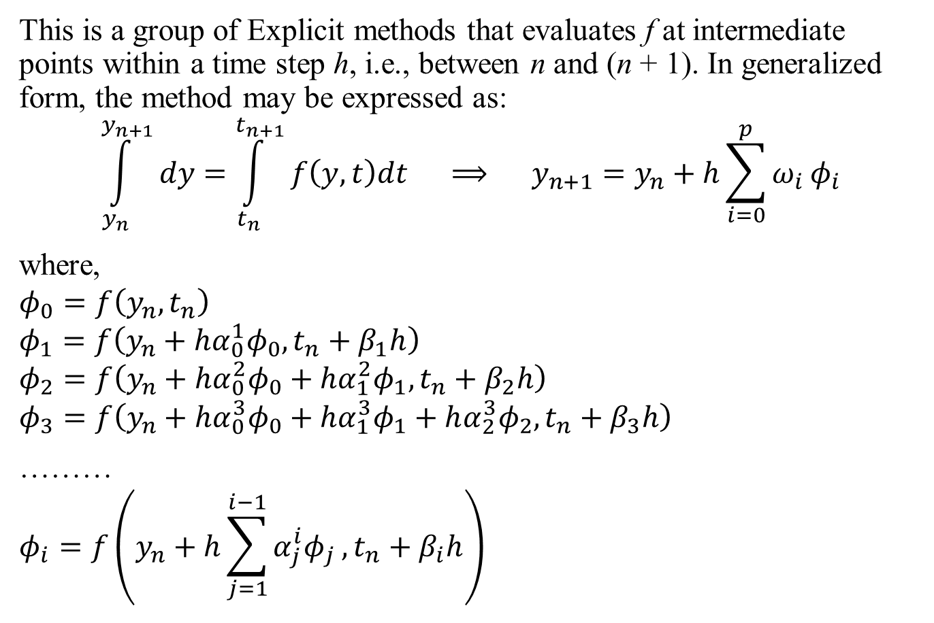
Runge-Kutta (R-K) Methods
,
This is a group of Explicit methods that evaluates f at intermediate points within a time step h, i.e., between n and (n + 1). In generalized form, the method may be expressed as:
$$\int_{y_{n}}^{y_{n+1}}{dy}=\int_{t_{n}}^{t_{n+1}}{f\left(y,t\right)dt} ⟹ y_{n+1}=y_{n}+h\sum_{i=0}^{p}{ω_{i}}φ_{i}$$
where,
$$φ_{0}=f\left(y_{n},t_{n}\right)$$
$$φ_{1}=f\left(y_{n}+hα_{0}^{1}φ_{0},t_{n}+β_{1}h\right)$$
$$φ_{2}=f\left(y_{n}+hα_{0}^{2}φ_{0}+hα_{1}^{2}φ_{1},t_{n}+β_{2}h\right)$$
$$φ_{3}=f\left(y_{n}+hα_{0}^{3}φ_{0}+hα_{1}^{3}φ_{1}+hα_{2}^{3}φ_{2},t_{n}+β_{3}h\right)$$
………
$$φ_{i}=f\left(y_{n}+h\sum_{j=1}^{i−1}{α_{j}^{i}φ_{j}},t_{n}+β_{i}h\right)$$

Slide 17
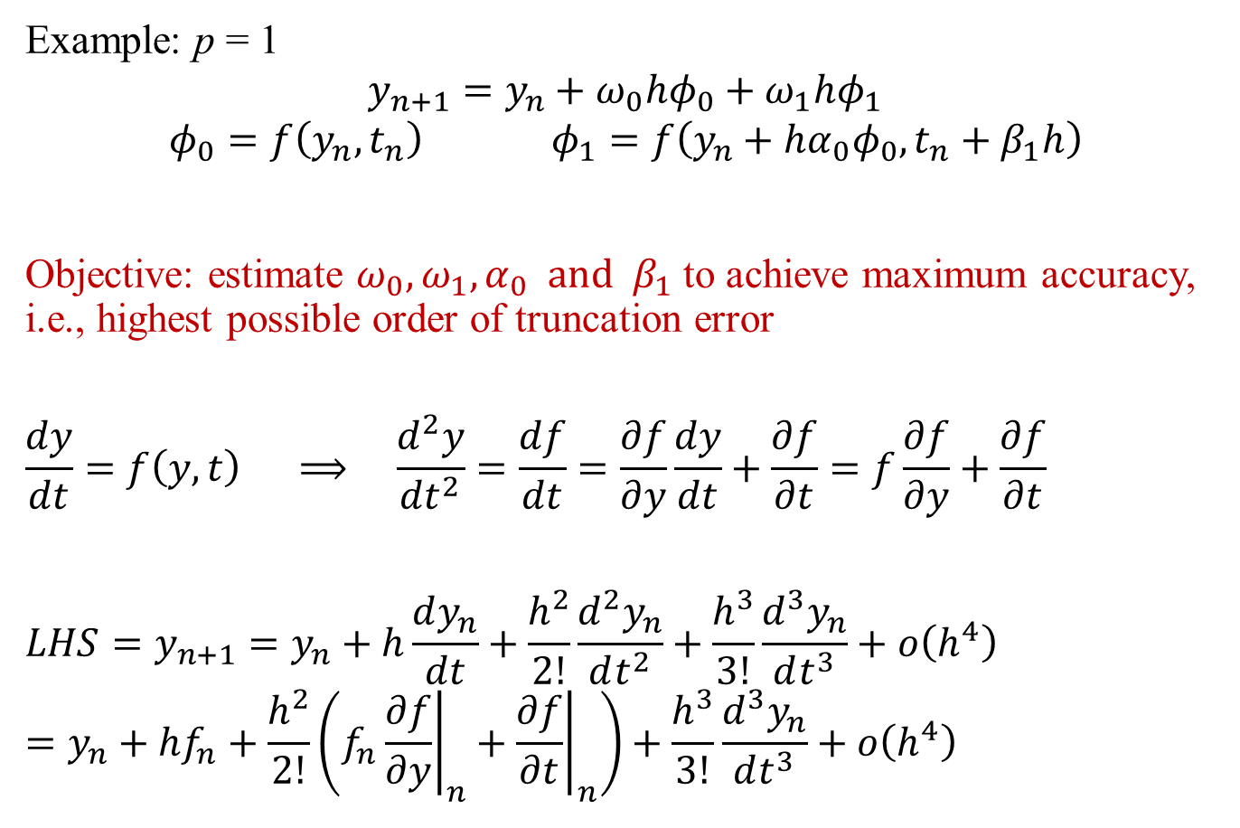
Runge-Kutta (R-K) Methods
,
Example: p = 1
$$y_{n+1}=y_{n}+ω_{0}hφ_{0}+ω_{1}hφ_{1}$$
$$φ_{0}=f\left(y_{n},t_{n}\right) φ_{1}=f\left(y_{n}+hα_{0}φ_{0},t_{n}+β_{1}h\right)$$
Objective: estimate $ω_{0},ω_{1},α_{0} and β_{1}$ to achieve maximum accuracy, i.e., highest possible order of truncation error
$$\frac{dy}{dt}=f\left(y,t\right) ⟹ \frac{d^{2}y}{dt^{2}}=\frac{df}{dt}=\frac{∂f}{∂y}\frac{dy}{dt}+\frac{∂f}{∂t}=f\frac{∂f}{∂y}+\frac{∂f}{∂t}$$
$$LHS=y_{n+1}=y_{n}+h\frac{dy_{n}}{dt}+\frac{h^{2}}{2!}\frac{d^{2}y_{n}}{dt^{2}}+\frac{h^{3}}{3!}\frac{d^{3}y_{n}}{dt^{3}}+ο\left(h^{4}\right)=y_{n}+hf_{n}+\frac{h^{2}}{2!}\left(f_{n}{\left.\frac{∂f}{∂y}\right|}_{n}+{\left.\frac{∂f}{∂t}\right|}_{n}\right)+\frac{h^{3}}{3!}\frac{d^{3}y_{n}}{dt^{3}}+ο\left(h^{4}\right)$$

Slide 18
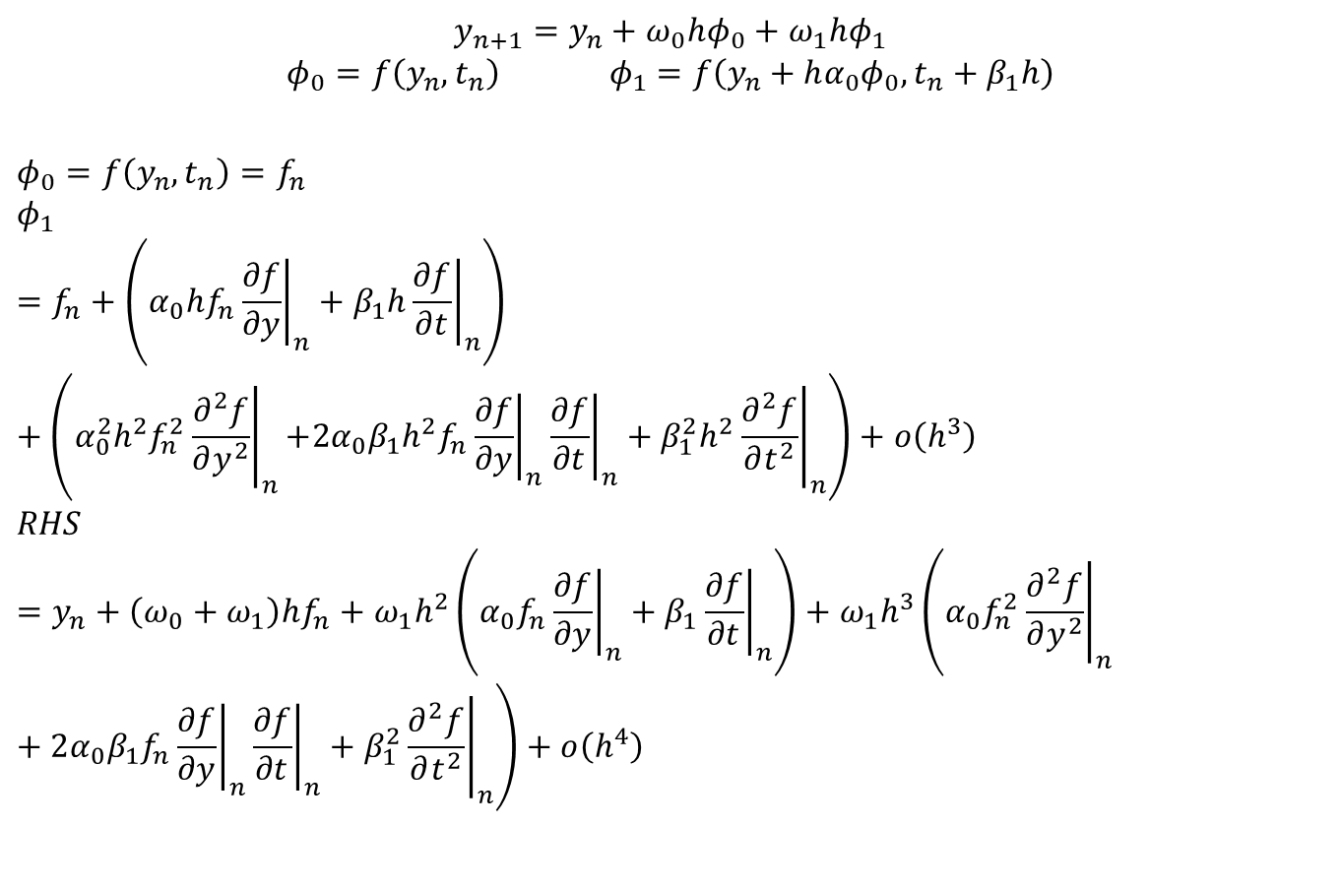
Runge-Kutta (R-K) Methods
,
$$y_{n+1}=y_{n}+ω_{0}hφ_{0}+ω_{1}hφ_{1}$$
$$φ_{0}=f\left(y_{n},t_{n}\right) φ_{1}=f\left(y_{n}+hα_{0}φ_{0},t_{n}+β_{1}h\right)$$
$$φ_{0}=f\left(y_{n},t_{n}\right)=f_{n}$$
$$φ_{1}=f_{n}+\left.\left(α_{0}hf_{n}{\left.\frac{∂f}{∂y}\right|}_{n}+β_{1}h{\left.\frac{∂f}{∂t}\right|}_{n}\right.\right)+\left(α_{0}^{2}h^{2}f_{n}^{2}{\left.\frac{∂^{2}f}{∂y^{2}}\right|}_{n}\right.\left.+2α_{0}β_{1}h^{2}f_{n}{\left.\frac{∂f}{∂y}\right|}_{n}{\left.\frac{∂f}{∂t}\right|}_{n}+β_{1}^{2}h^{2}{\left.\frac{∂^{2}f}{∂t^{2}}\right|}_{n}\right)+ο\left(h^{3}\right)$$
$$RHS=y_{n}+\left(ω_{0}+ω_{1}\right)hf_{n}+ω_{1}h^{2}\left.\left(α_{0}f_{n}{\left.\frac{∂f}{∂y}\right|}_{n}+β_{1}{\left.\frac{∂f}{∂t}\right|}_{n}\right.\right)+ω_{1}h^{3}\left(α_{0}f_{n}^{2}{\left.\frac{∂^{2}f}{∂y^{2}}\right|}_{n}\right.+2α_{0}β_{1}f_{n}{\left.\frac{∂f}{∂y}\right|}_{n}{\left.\frac{∂f}{∂t}\right|}_{n}+\left.β_{1}^{2}{\left.\frac{∂^{2}f}{∂t^{2}}\right|}_{n}\right)+ο\left(h^{4}\right)$$

Slide 19
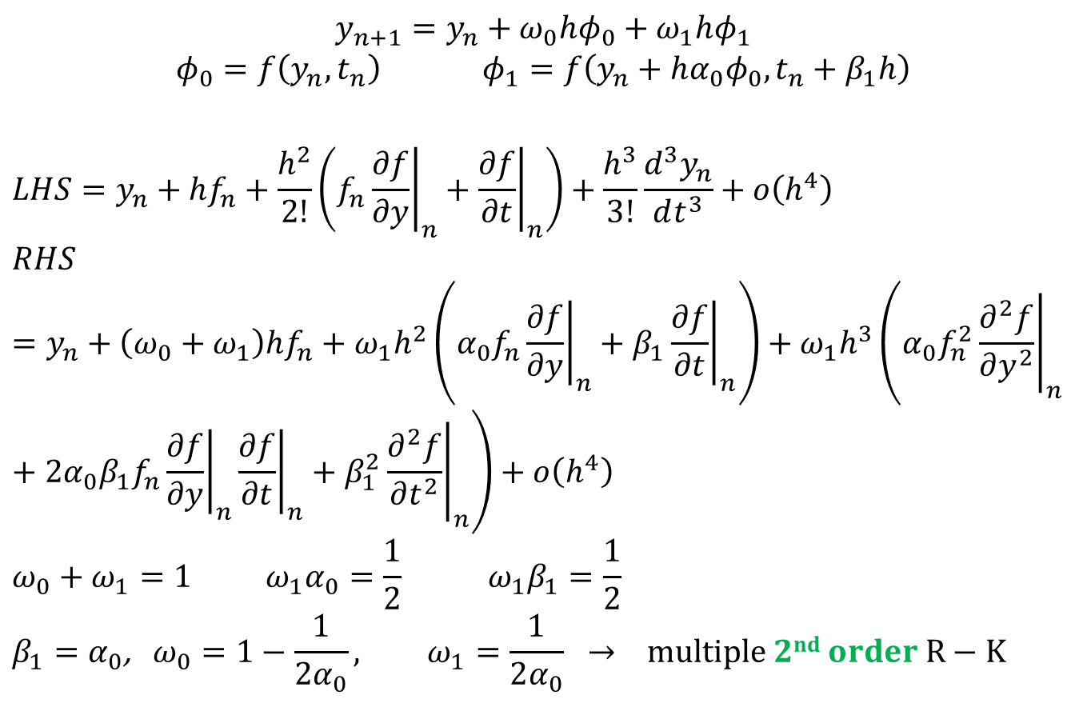
Runge-Kutta (R-K) Methods
,
$$y_{n+1}=y_{n}+ω_{0}hφ_{0}+ω_{1}hφ_{1}$$
$$φ_{0}=f\left(y_{n},t_{n}\right) φ_{1}=f\left(y_{n}+hα_{0}φ_{0},t_{n}+β_{1}h\right)$$
$$LHS=y_{n}+hf_{n}+\frac{h^{2}}{2!}\left(f_{n}{\left.\frac{∂f}{∂y}\right|}_{n}+{\left.\frac{∂f}{∂t}\right|}_{n}\right)+\frac{h^{3}}{3!}\frac{d^{3}y_{n}}{dt^{3}}+ο\left(h^{4}\right)$$
$$RHS=y_{n}+\left(ω_{0}+ω_{1}\right)hf_{n}+ω_{1}h^{2}\left.\left(α_{0}f_{n}{\left.\frac{∂f}{∂y}\right|}_{n}+β_{1}{\left.\frac{∂f}{∂t}\right|}_{n}\right.\right)+ω_{1}h^{3}\left(α_{0}f_{n}^{2}{\left.\frac{∂^{2}f}{∂y^{2}}\right|}_{n}\right.+2α_{0}β_{1}f_{n}{\left.\frac{∂f}{∂y}\right|}_{n}{\left.\frac{∂f}{∂t}\right|}_{n}+\left.β_{1}^{2}{\left.\frac{∂^{2}f}{∂t^{2}}\right|}_{n}\right)+ο\left(h^{4}\right)$$
$$ω_{0}+ω_{1}=1 ω_{1}α_{0}=\frac{1}{2} ω_{1}β_{1}=\frac{1}{2}$$
$$β_{1}=α_{0}\text{, }ω_{0}=1−\frac{1}{2α_{0}}, ω_{1}=\frac{1}{2α_{0}} → multiple 2nd order R−K$$

Slide 20
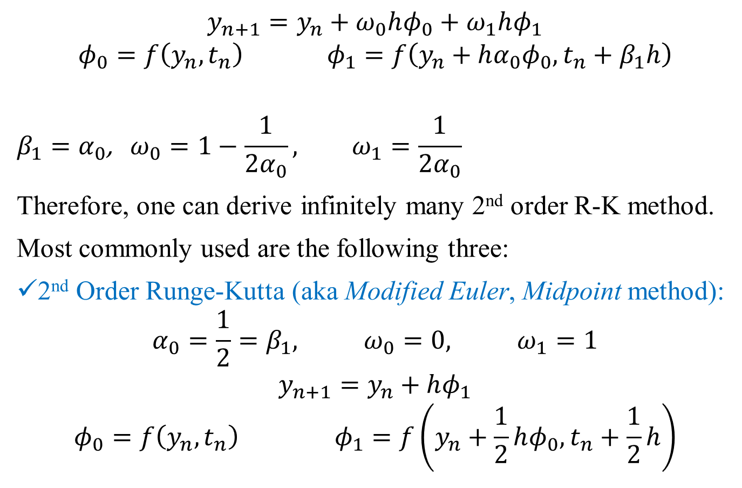
Runge-Kutta (R-K) Methods
,
$$y_{n+1}=y_{n}+ω_{0}hφ_{0}+ω_{1}hφ_{1}$$
$$φ_{0}=f\left(y_{n},t_{n}\right) φ_{1}=f\left(y_{n}+hα_{0}φ_{0},t_{n}+β_{1}h\right)$$
$$β_{1}=α_{0}\text{, }ω_{0}=1−\frac{1}{2α_{0}}, ω_{1}=\frac{1}{2α_{0}}$$
Therefore, one can derive infinitely many 2nd order R-K method.
Most commonly used are the following three:
2nd Order Runge-Kutta (aka Modified Euler, Midpoint method):
$$α_{0}=\frac{1}{2}=β_{1}, ω_{0}=0, ω_{1}=1$$
$$y_{n+1}=y_{n}+hφ_{1}$$
$$φ_{0}=f\left(y_{n},t_{n}\right) φ_{1}=f\left(y_{n}+\frac{1}{2}hφ_{0},t_{n}+\frac{1}{2}h\right)$$

Slide 21
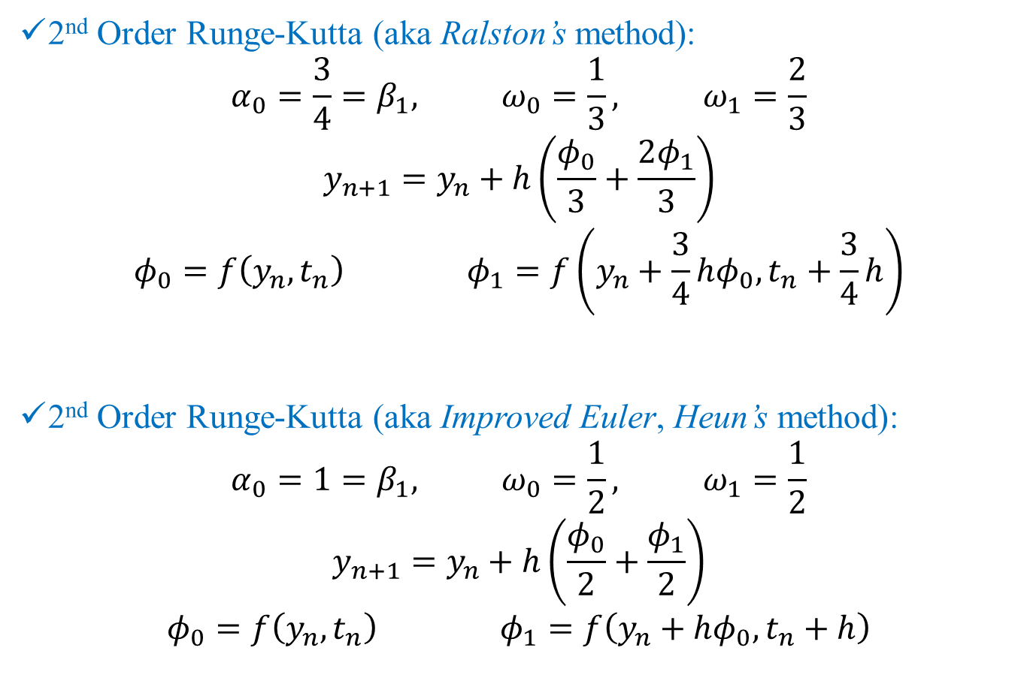
Runge-Kutta (R-K) Methods
,
2nd Order Runge-Kutta (aka Ralston’s method):
$$α_{0}=\frac{3}{4}=β_{1}, ω_{0}=\frac{1}{3}, ω_{1}=\frac{2}{3}$$
$$y_{n+1}=y_{n}+h\left(\frac{φ_{0}}{3}+\frac{2φ_{1}}{3}\right)$$
$$φ_{0}=f\left(y_{n},t_{n}\right) φ_{1}=f\left(y_{n}+\frac{3}{4}hφ_{0},t_{n}+\frac{3}{4}h\right)$$
2nd Order Runge-Kutta (aka Improved Euler, Heun’s method):
$$α_{0}=1=β_{1}, ω_{0}=\frac{1}{2}, ω_{1}=\frac{1}{2}$$
$$y_{n+1}=y_{n}+h\left(\frac{φ_{0}}{2}+\frac{φ_{1}}{2}\right)$$
$$φ_{0}=f\left(y_{n},t_{n}\right) φ_{1}=f\left(y_{n}+hφ_{0},t_{n}+h\right)$$

Slide 22
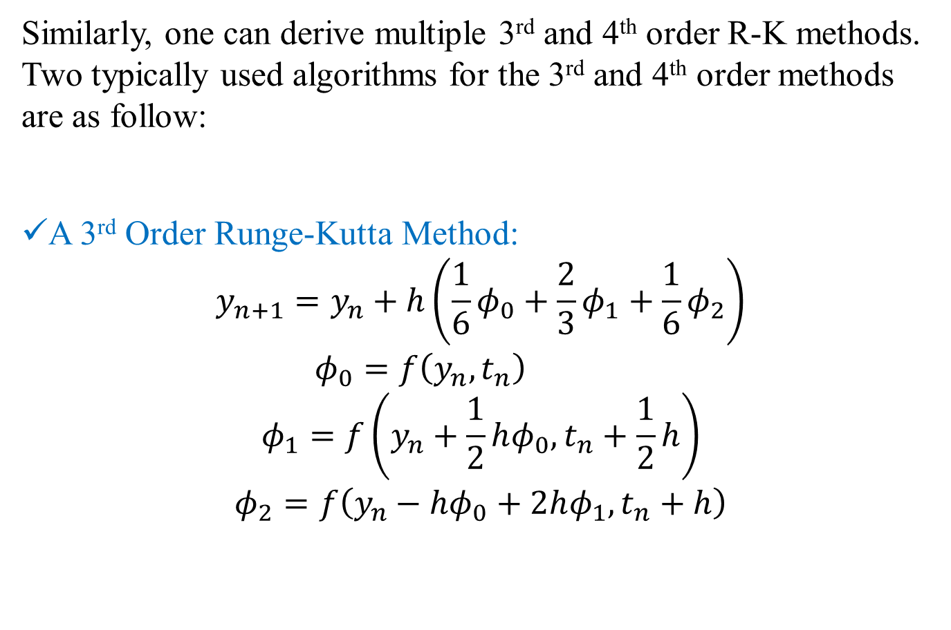
Runge-Kutta (R-K) Methods
,
Similarly, one can derive multiple 3rd and 4th order R-K methods. Two typically used algorithms for the 3rd and 4th order methods are as follow:
A 3rd Order Runge-Kutta Method:
$$y_{n+1}=y_{n}+h\left(\frac{1}{6}φ_{0}+\frac{2}{3}φ_{1}+\frac{1}{6}φ_{2}\right)$$
$$φ_{0}=f\left(y_{n},t_{n}\right)$$
$$φ_{1}=f\left(y_{n}+\frac{1}{2}hφ_{0},t_{n}+\frac{1}{2}h\right)$$
$$φ_{2}=f\left(y_{n}−hφ_{0}+2hφ_{1},t_{n}+h\right)$$

Slide 23
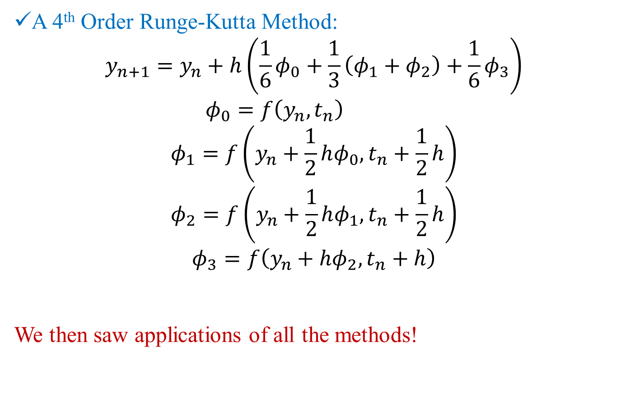
Runge-Kutta (R-K) Methods
,
A 4th Order Runge-Kutta Method:
$$y_{n+1}=y_{n}+h\left(\frac{1}{6}φ_{0}+\frac{1}{3}\left(φ_{1}+φ_{2}\right)+\frac{1}{6}φ_{3}\right)$$
$$φ_{0}=f\left(y_{n},t_{n}\right)$$
$$φ_{1}=f\left(y_{n}+\frac{1}{2}hφ_{0},t_{n}+\frac{1}{2}h\right)$$
$$φ_{2}=f\left(y_{n}+\frac{1}{2}hφ_{1},t_{n}+\frac{1}{2}h\right)$$
$$φ_{3}=f\left(y_{n}+hφ_{2},t_{n}+h\right)$$
We then saw applications of all the methods!

Slide 24
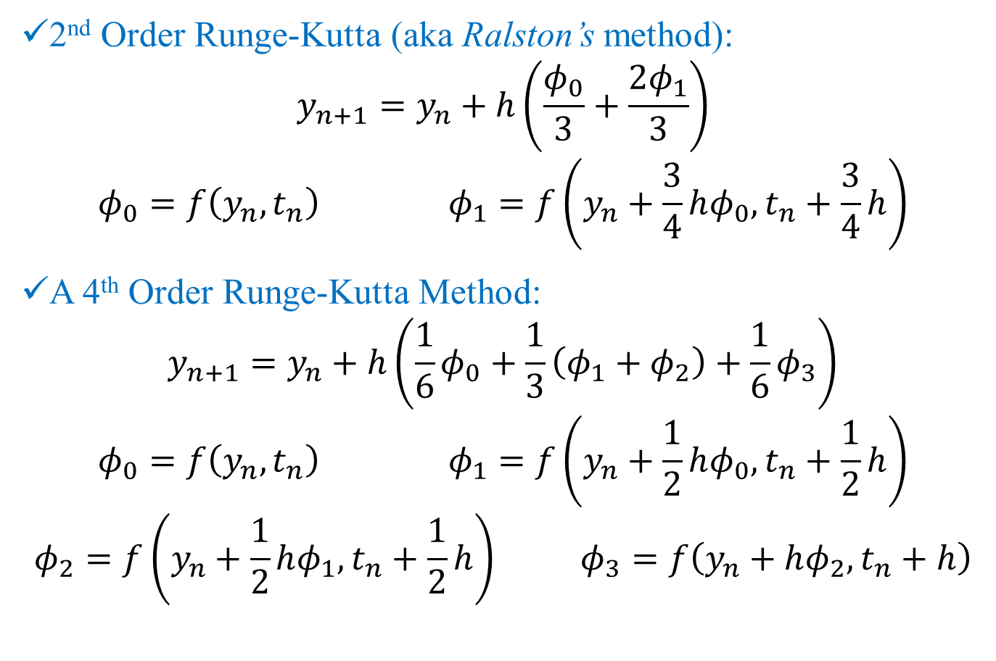
Applications: Runge-Kutta (R-K) Methods
,
2nd Order Runge-Kutta (aka Ralston’s method):
$$y_{n+1}=y_{n}+h\left(\frac{φ_{0}}{3}+\frac{2φ_{1}}{3}\right)$$
$$φ_{0}=f\left(y_{n},t_{n}\right) φ_{1}=f\left(y_{n}+\frac{3}{4}hφ_{0},t_{n}+\frac{3}{4}h\right)$$
A 4th Order Runge-Kutta Method:
$$y_{n+1}=y_{n}+h\left(\frac{1}{6}φ_{0}+\frac{1}{3}\left(φ_{1}+φ_{2}\right)+\frac{1}{6}φ_{3}\right)$$
$$φ_{0}=f\left(y_{n},t_{n}\right) φ_{1}=f\left(y_{n}+\frac{1}{2}hφ_{0},t_{n}+\frac{1}{2}h\right)$$
$$φ_{2}=f\left(y_{n}+\frac{1}{2}hφ_{1},t_{n}+\frac{1}{2}h\right) φ_{3}=f\left(y_{n}+hφ_{2},t_{n}+h\right)$$

Slide 25
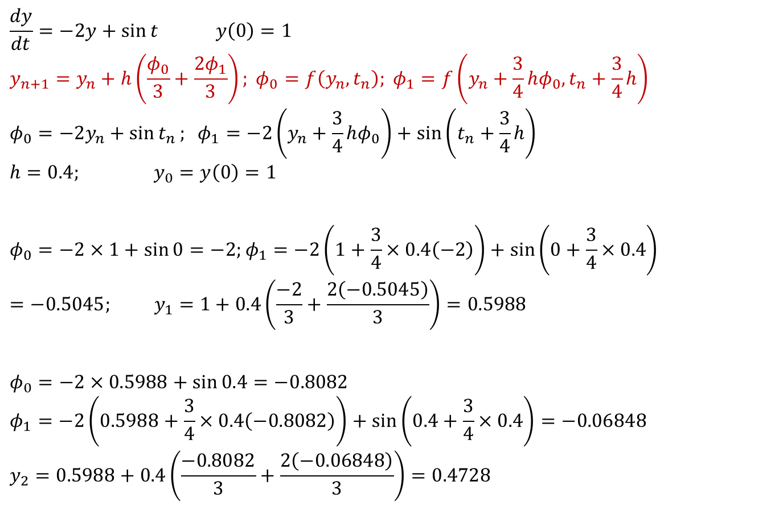
Runge-Kutta (R-K) Method (2nd Order)
,
$$\frac{dy}{dt}=−2y+\sin{t} y\left(0\right)=1$$
$$y_{n+1}=y_{n}+h\left(\frac{φ_{0}}{3}+\frac{2φ_{1}}{3}\right); φ_{0}=f\left(y_{n},t_{n}\right); φ_{1}=f\left(y_{n}+\frac{3}{4}hφ_{0},t_{n}+\frac{3}{4}h\right)$$
$$φ_{0}=−2y_{n}+\sin{t_{n}}; φ_{1}=−2\left(y_{n}+\frac{3}{4}hφ_{0}\right)+\sin\left(t_{n}+\frac{3}{4}h\right)$$
$$h=0.4; y_{0}=y\left(0\right)=1$$
$$φ_{0}=−2×1+\sin{0}=−2;φ_{1}=−2\left(1+\frac{3}{4}×0.4\left(−2\right)\right)+\sin\left(0+\frac{3}{4}×0.4\right)=−0.5045; y_{1}=1+0.4\left(\frac{−2}{3}+\frac{2\left(−0.5045\right)}{3}\right)=0.5988$$
$$φ_{0}=−2×0.5988+\sin{0.4}=−0.8082$$
$$φ_{1}=−2\left(0.5988+\frac{3}{4}×0.4\left(−0.8082\right)\right)+\sin\left(0.4+\frac{3}{4}×0.4\right)=−0.06848$$
$$y_{2}=0.5988+0.4\left(\frac{−0.8082}{3}+\frac{2\left(−0.06848\right)}{3}\right)=0.4728$$

Slide 26
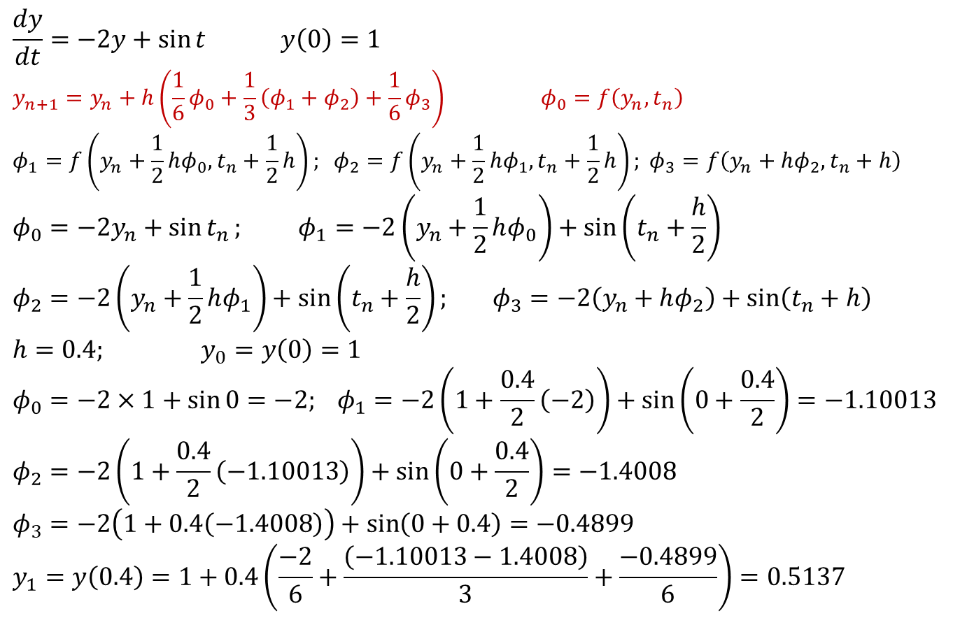
Runge-Kutta (R-K) Method (4th Order)
,
$$\frac{dy}{dt}=−2y+\sin{t} y\left(0\right)=1$$
$$y_{n+1}=y_{n}+h\left(\frac{1}{6}φ_{0}+\frac{1}{3}\left(φ_{1}+φ_{2}\right)+\frac{1}{6}φ_{3}\right) φ_{0}=f\left(y_{n},t_{n}\right)$$
$$φ_{1}=f\left(y_{n}+\frac{1}{2}hφ_{0},t_{n}+\frac{1}{2}h\right); φ_{2}=f\left(y_{n}+\frac{1}{2}hφ_{1},t_{n}+\frac{1}{2}h\right); φ_{3}=f\left(y_{n}+hφ_{2},t_{n}+h\right)$$
$$φ_{0}=−2y_{n}+\sin{t_{n}}; φ_{1}=−2\left(y_{n}+\frac{1}{2}hφ_{0}\right)+\sin\left(t_{n}+\frac{h}{2}\right)$$
$$φ_{2}=−2\left(y_{n}+\frac{1}{2}hφ_{1}\right)+\sin\left(t_{n}+\frac{h}{2}\right); φ_{3}=−2\left(y_{n}+hφ_{2}\right)+\sin\left(t_{n}+h\right)$$
$$h=0.4; y_{0}=y\left(0\right)=1$$
$$φ_{0}=−2×1+\sin{0}=−2; φ_{1}=−2\left(1+\frac{0.4}{2}\left(−2\right)\right)+\sin\left(0+\frac{0.4}{2}\right)=−1.10013$$
$$φ_{2}=−2\left(1+\frac{0.4}{2}\left(−1.10013\right)\right)+\sin\left(0+\frac{0.4}{2}\right)=−1.4008$$
$$φ_{3}=−2\left(1+0.4\left(−1.4008\right)\right)+\sin\left(0+0.4\right)=−0.4899$$
$$y_{1}=y\left(0.4\right)=1+0.4\left(\frac{−2}{6}+\frac{\left(−1.10013−1.4008\right)}{3}+\frac{−0.4899}{6}\right)=0.5137$$

Slide 27
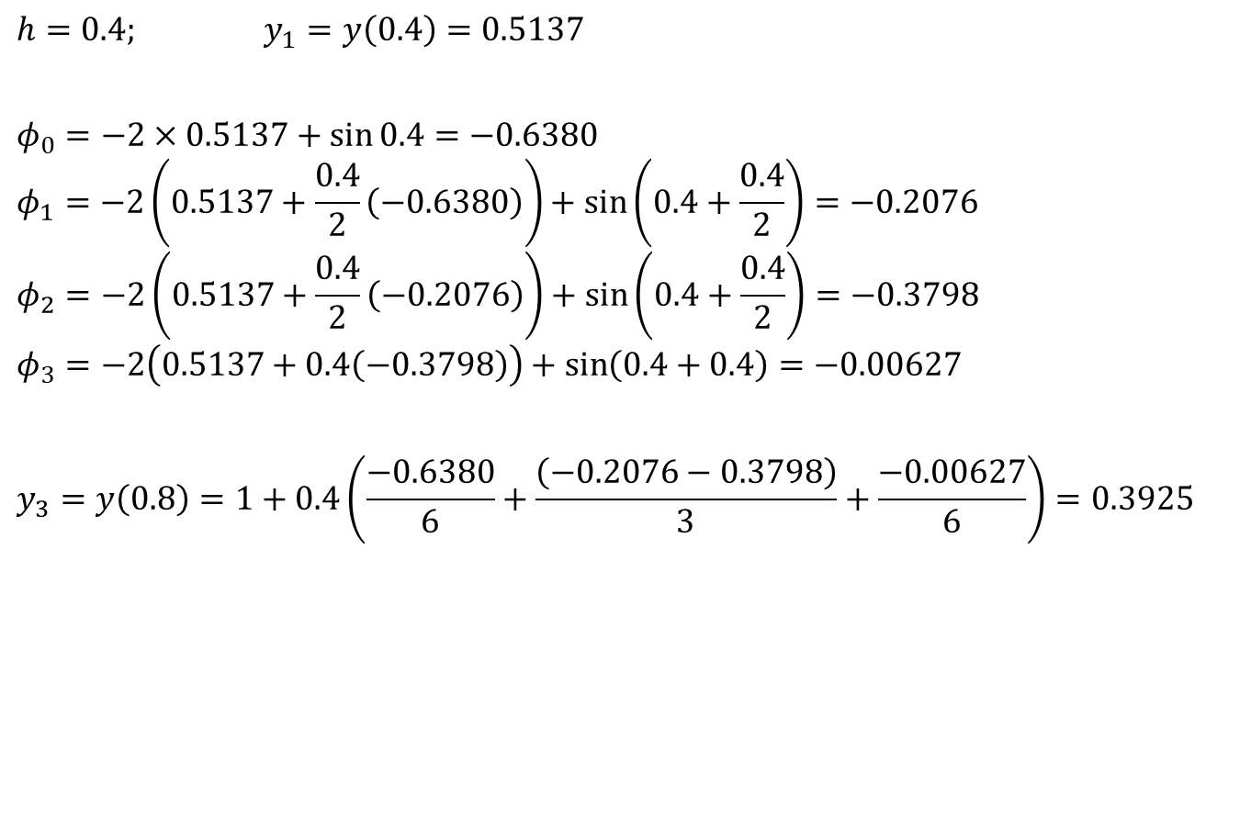
Runge-Kutta (R-K) Method (4th Order)
,
$$h=0.4; y_{1}=y\left(0.4\right)=0.5137$$
$$φ_{0}=−2×0.5137+\sin{0.4}=−0.6380$$
$$φ_{1}=−2\left(0.5137+\frac{0.4}{2}\left(−0.6380\right)\right)+\sin\left(0.4+\frac{0.4}{2}\right)=−0.2076$$
$$φ_{2}=−2\left(0.5137+\frac{0.4}{2}\left(−0.2076\right)\right)+\sin\left(0.4+\frac{0.4}{2}\right)=−0.3798$$
$$φ_{3}=−2\left(0.5137+0.4\left(−0.3798\right)\right)+\sin\left(0.4+0.4\right)=−0.00627$$
$$y_{3}=y\left(0.8\right)=1+0.4\left(\frac{−0.6380}{6}+\frac{\left(−0.2076−0.3798\right)}{3}+\frac{−0.00627}{6}\right)=0.3925$$

Slide 28


Runge-Kutta Methods (2nd and 4th Order)
,
A few things to note for the R-K:
All order methods are explicit!
None of them involve solution of non-linear equations
None of them have start-up problems!
At every time steps, number of FLOPs are larger for the R-K methods!
No numerical oscillations (instability) observed in any of the R-Ks:
Why the same order explicit multi-step methods show oscillation but R-Ks do not?
Do they show oscillation under any conditions or are they oscillation-proof under all conditions?

Slide 29
Applications: Summary of Concerns
Accuracy of the higher order multi-step and BDF methods are affected if the starting values are used from the lower order methods.
How to start these non-self starting algorithms?
All implicit methods (multi-step and BDF) may involve solution of non-linear equations (if f contains a non-linear function of the dependent variable y)
Is there a way to avoid this solution of non-linear equations?
Numerical oscillations (instability) observed in some methods and not in some!
Is there a way to predict and therefore, choose correct parameters for algorithm so that the numerical oscillations can be avoided?

Slide 30
How to start the non-self starting algorithms?
Three commonly used options:
Passive Richardson’s Extrapolation
Active Richardson’s Extrapolation
With same lower order method
With progressively higher order methods
Using the same order Runge-Kutta method!

Slide 31
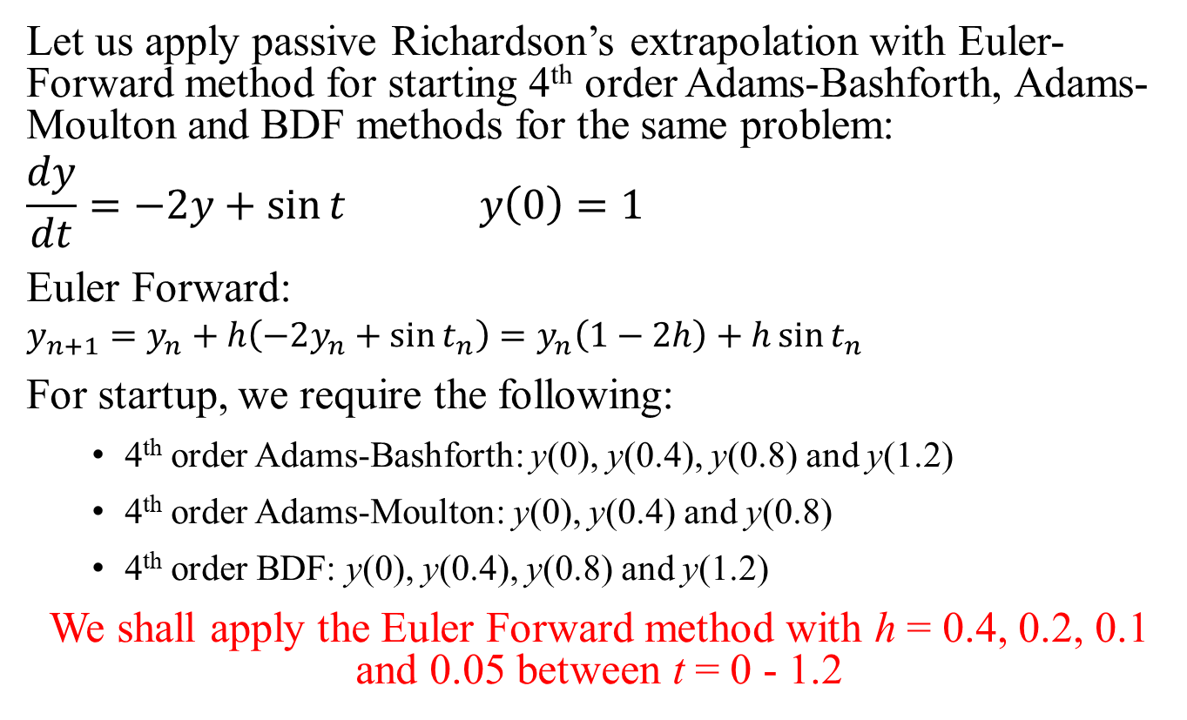
Application: Passive Richardson’s extrapolation
Let us apply passive Richardson’s extrapolation with Euler-Forward method for starting 4th order Adams-Bashforth, Adams-Moulton and BDF methods for the same problem:
$$\frac{dy}{dt}=−2y+\sin{t} y\left(0\right)=1$$
Euler Forward:
$$y_{n+1}=y_{n}+h\left(−2y_{n}+\sin{t_{n}}\right)=y_{n}\left(1−2h\right)+h\sin{t_{n}}$$
For startup, we require the following:
4th order Adams-Bashforth: y(0), y(0.4), y(0.8) and y(1.2)
4th order Adams-Moulton: y(0), y(0.4) and y(0.8)
4th order BDF: y(0), y(0.4), y(0.8) and y(1.2)
We shall apply the Euler Forward method with h = 0.4, 0.2, 0.1 and 0.05 between t = 0 - 1.2

Slide 32
Time | EF(h = 0.4) | Time | EF(h = 0.2) | Time | EF(h = 0.1) | Time | EF(h = 0.05)
0 | 1 | 0 | 1 | 0 | 1 | 0 | 1
0.4 | 0.2 | 0.2 | 0.6 | 0.1 | 0.8 | 0.05 | 0.9
0.8 | 0.195767 | 0.4 | 0.399734 | 0.2 | 0.649983 | 0.1 | 0.812499
1.2 | 0.326096 | 0.6 | 0.317724 | 0.3 | 0.539854 | 0.15 | 0.736241
 |  | 0.8 | 0.303563 | 0.4 | 0.461435 | 0.2 | 0.670089
 |  | 1 | 0.325609 | 0.5 | 0.40809 | 0.25 | 0.613013
 |  | 1.2 | 0.36366 | 0.6 | 0.374414 | 0.3 | 0.564082
 |  |  |  | 0.7 | 0.355996 | 0.35 | 0.52245
 |  |  |  | 0.8 | 0.349218 | 0.4 | 0.48735
 |  |  |  | 0.9 | 0.35111 | 0.45 | 0.458086
 |  |  |  | 1 | 0.359221 | 0.5 | 0.434025
 |  |  |  | 1.1 | 0.371524 | 0.55 | 0.414594
 |  |  |  | 1.2 | 0.38634 | 0.6 | 0.399269
 |  |  |  |  |  | 0.65 | 0.387574
 |  |  |  |  |  | 0.7 | 0.379076
 |  |  |  |  |  | 0.75 | 0.373379
 |  |  |  |  |  | 0.8 | 0.370123
 |  |  |  |  |  | 0.85 | 0.368979
 |  |  |  |  |  | 0.9 | 0.369645
 |  |  |  |  |  | 0.95 | 0.371847
 |  |  |  |  |  | 1 | 0.375333
 |  |  |  |  |  | 1.05 | 0.379873
 |  |  |  |  |  | 1.1 | 0.385257
 |  |  |  |  |  | 1.15 | 0.391292
 |  |  |  |  |  | 1.2 | 0.397801

Slide 33
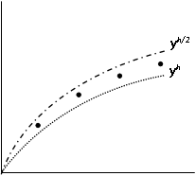
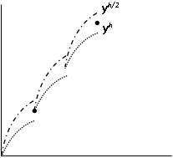
Active vs. Passive Richardson’s Extrapolation
Passive
Active

Slide 34
Passive Richardson’s Extrapolation with Euler Forward: 4th order method start-up
t | EF(0.4) | EF(0.2) | EF(0.1) | EF(0.05)
0 | 1 | 1 | 1 | 1
0.4 | 0.2 | 0.399734 | 0.4614349 | 0.487349766
0.8 | 0.195767 | 0.303563 | 0.3492184 | 0.370123455
1.2 | 0.326096 | 0.36366 | 0.3863398 | 0.397800748
t | EF(0.4,0.2) | EF(0.2,0.1) | EF(0.1,0.05) | EF(0.4,0.2,0.1) | EF(0.2,0.1,0.05) | EF(h^4)
0 | 1 | 1 | 1 | 1 | 1 | 1
0.4 | 0.599468 | 0.523136 | 0.513265 | 0.497692 | 0.509974186 | 0.511729
0.8 | 0.411358 | 0.394874 | 0.391029 | 0.389379 | 0.389746793 | 0.389799
1.2 | 0.401223 | 0.40902 | 0.409262 | 0.411619 | 0.409342235 | 0.409017
With these four initial values, any 4th order multi-step or BDF methods can start!

Slide 35
Active Richardson’s Extrapolation with Euler Forward: 4th order method start-up
Time | EF(h = 0.4) | Time | EF(h = 0.2) | Time | EF(h = 0.1) | Time | EF(h = 0.05)
0 | 1 | 0 | 1 | 0 | 1 | 0 | 1
0.4 | 0.2 | 0.2 | 0.6 | 0.1 | 0.8 | 0.05 | 0.9
 |  | 0.4 | 0.399734 | 0.2 | 0.649983 | 0.1 | 0.812499
 |  |  |  | 0.3 | 0.539854 | 0.15 | 0.736241
 |  |  |  | 0.4 | 0.461435 | 0.2 | 0.670089
 |  |  |  |  |  | 0.25 | 0.613013
 |  |  |  |  |  | 0.3 | 0.564082
 |  |  |  |  |  | 0.35 | 0.52245
 |  |  |  |  |  | 0.4 | 0.48735
t | EF(0.4,0.2) | EF(0.2,0.1) | EF(0.1,0.05) | EF(0.4,0.2,0.1) | EF(0.2,0.1,0.05) | EF(h^4)
0.4 | 0.599468 | 0.523136 | 0.513265 | 0.497692 | 0.509974186 | 0.511729
We will now apply the Euler Forward and Richardson’s extrapolation with the extrapolated initial value at t = 0.4 and go up to t = 0.8

Slide 36
Active Richardson’s Extrapolation with Euler Forward: 4th order method start-up
Time | EF(h = 0.4) | Time | EF(h = 0.2) | Time | EF(h = 0.1) | Time | EF(h = 0.05)
0.4 | 0.511729 | 0.4 | 0.511729 | 0.4 | 0.511729 | 0.4 | 0.511729
0.8 | 0.258113 | 0.6 | 0.384921 | 0.5 | 0.448325 | 0.45 | 0.480027
 |  | 0.8 | 0.343881 | 0.6 | 0.406602 | 0.5 | 0.453772
 |  |  |  | 0.7 | 0.381746 | 0.55 | 0.432366
 |  |  |  | 0.8 | 0.369819 | 0.6 | 0.415264
 |  |  |  |  |  | 0.65 | 0.40197
 |  |  |  |  |  | 0.7 | 0.392032
 |  |  |  |  |  | 0.75 | 0.38504
 |  |  |  |  |  | 0.8 | 0.380618
t | EF(0.4,0.2) | EF(0.2,0.1) | EF(0.1,0.05) | EF(0.4,0.2,0.1) | EF(0.2,0.1,0.05) | EF(h^4)
0.8 | 0.429649 | 0.395756 | 0.391417 | 0.3844589 | 0.389970418 | 0.390758
We will now apply the Euler Forward and Richardson’s extrapolation with the extrapolated initial value at t = 0.8 and go up to t = 1.2

Slide 37
Active Richardson’s Extrapolation with Euler Forward: 4th order method start-up
Time | EF(h = 0.4) | Time | EF(h = 0.2) | Time | EF(h = 0.1) | Time | EF(h = 0.05)
0.8 | 0.390758 | 0.8 | 0.390758 | 0.8 | 0.390758 | 0.8 | 0.390758
1.2 | 0.365094 | 1 | 0.377926 | 0.9 | 0.384342 | 0.85 | 0.38755
 |  | 1.2 | 0.39505 | 1 | 0.385806 | 0.9 | 0.386359
 |  |  |  | 1.1 | 0.392792 | 0.95 | 0.386889
 |  |  |  | 1.2 | 0.403354 | 1 | 0.388871
 |  |  |  |  |  | 1.05 | 0.392058
 |  |  |  |  |  | 1.1 | 0.396223
 |  |  |  |  |  | 1.15 | 0.401161
 |  |  |  |  |  | 1.2 | 0.406683
t | EF(0.4,0.2) | EF(0.2,0.1) | EF(0.1,0.05) | EF(0.4,0.2,0.1) | EF(0.2,0.1,0.05) | EF(h^4)
1.2 | 0.425005 | 0.411659 | 0.410012 | 0.4072102 | 0.40946293 | 0.409785
With four initial values at t = 0, 0.4, 0.8 and 1.2, any 4th order multi-step or BDF methods can start!

Slide 38
4th Order R-K: 4th order method start-up
t | φ₀ | φ₁ | φ₂ | φ₃ | y
0 |  |  |  |  | 1
0.4 | -2 | -1.00133 | -1.4008 | -0.48994 | 0.51372
0.8 | -0.63802 | -0.20759 | -0.37976 | -0.00627 | 0.392453
1.2 | -0.06755 | 0.083584 | 0.02313 | 0.128628 | 0.410754
With four initial values at t = 0, 0.4, 0.8 and 1.2, any 4th order multi-step or BDF methods can start!

Slide 39
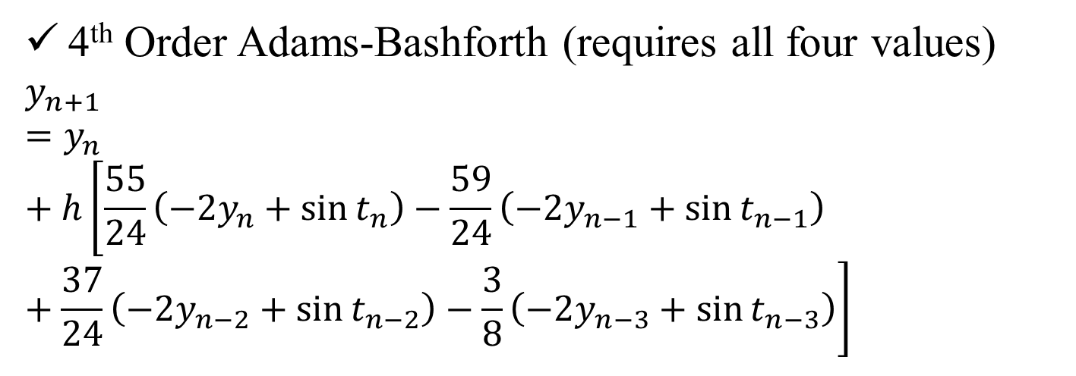
Startup of 4th Order Methods
,
t | y (Passive) | y (Active) | y (R-K)
0 | 1 | 1 | 1
0.4 | 0.511729 | 0.511729 | 0.51372
0.8 | 0.389799 | 0.390758 | 0.392453
1.2 | 0.409017 | 0.409785 | 0.410754
4th Order Adams-Bashforth (requires all four values)
$$y_{n+1}=y_{n}+h\left[\frac{55}{24}\left(−2y_{n}+\sin{t_{n}}\right)−\frac{59}{24}\left(−2y_{n−1}+\sin{t_{n−1}}\right)+\frac{37}{24}\left(−2y_{n−2}+\sin{t_{n−2}}\right)−\frac{3}{8}\left(−2y_{n−3}+\sin{t_{n−3}}\right)\right]$$

Slide 40
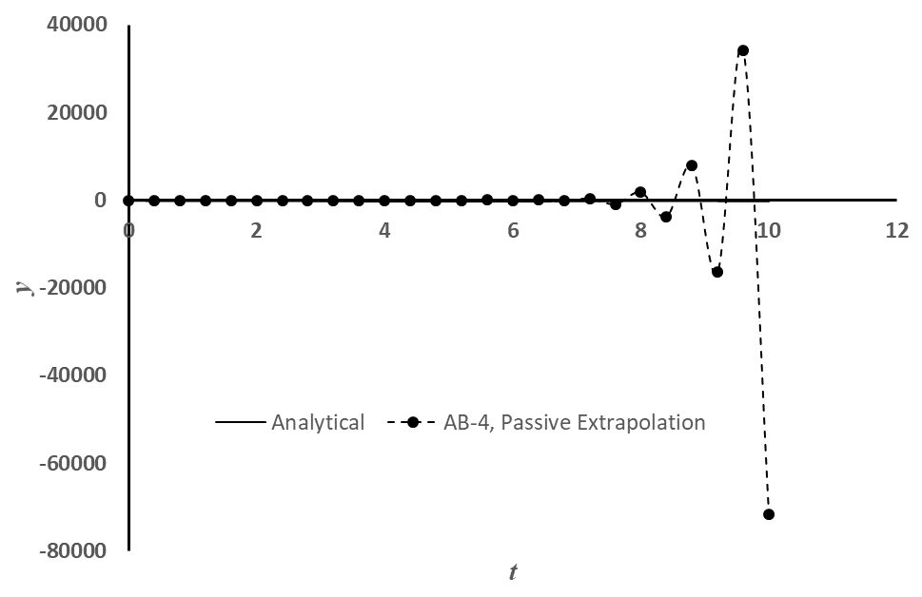
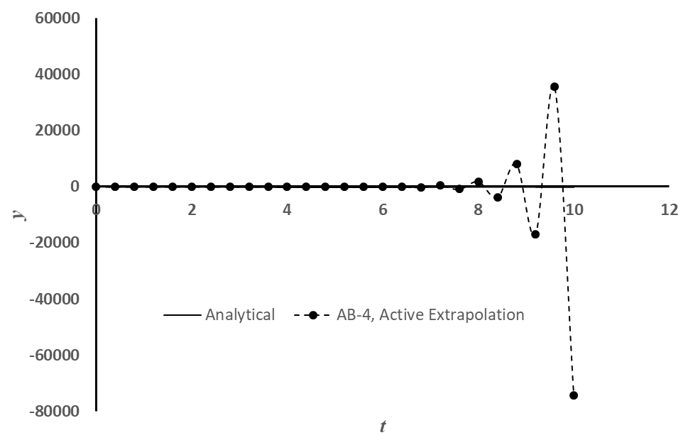
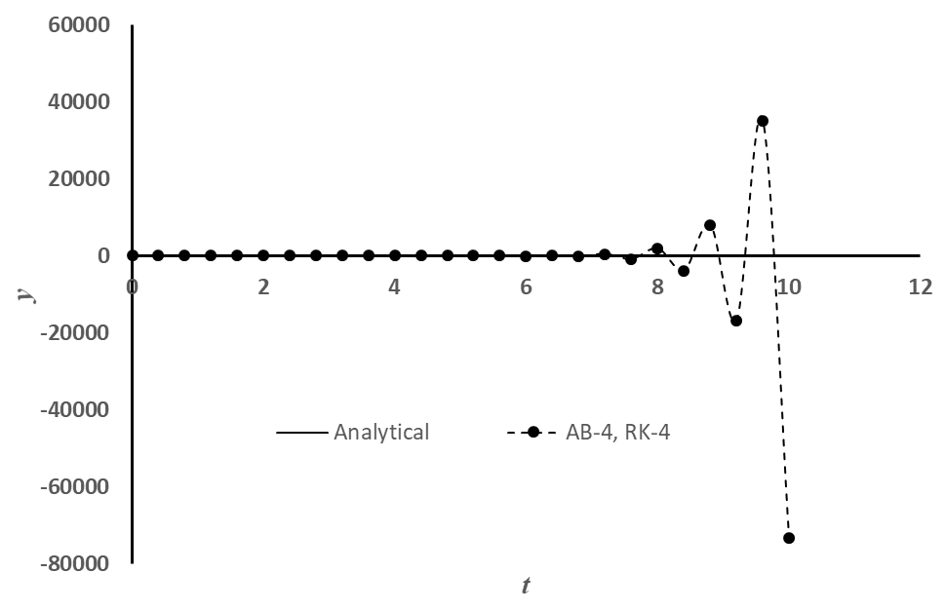
Startup of 4th Order Adams-Bashforth
,
Proper start-up does not solve the stability problem!

Slide 41
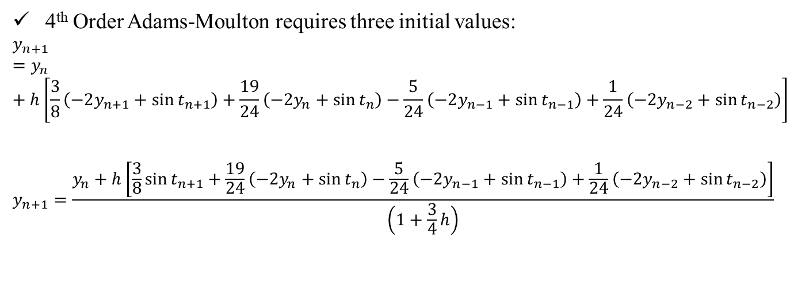
Startup of 4th Order Adams-Moulton
,
t | y (Passive) | y (Active) | y (R-K)
0 | 1 | 1 | 1
0.4 | 0.511729 | 0.511729 | 0.51372
0.8 | 0.389799 | 0.390758 | 0.392453
1.2 | 0.409017 | 0.409785 | 0.410754
4th Order Adams-Moulton requires three initial values:
$$y_{n+1}=y_{n}+h\left[\frac{3}{8}\left(−2y_{n+1}+\sin{t_{n+1}}\right)+\frac{19}{24}\left(−2y_{n}+\sin{t_{n}}\right)−\frac{5}{24}\left(−2y_{n−1}+\sin{t_{n−1}}\right)+\frac{1}{24}\left(−2y_{n−2}+\sin{t_{n−2}}\right)\right]$$
$$y_{n+1}=\frac{y_{n}+h\left[\frac{3}{8}\sin{t_{n+1}}+\frac{19}{24}\left(−2y_{n}+\sin{t_{n}}\right)−\frac{5}{24}\left(−2y_{n−1}+\sin{t_{n−1}}\right)+\frac{1}{24}\left(−2y_{n−2}+\sin{t_{n−2}}\right)\right]}{\left(1+\frac{3}{4}h\right)}$$

Slide 42
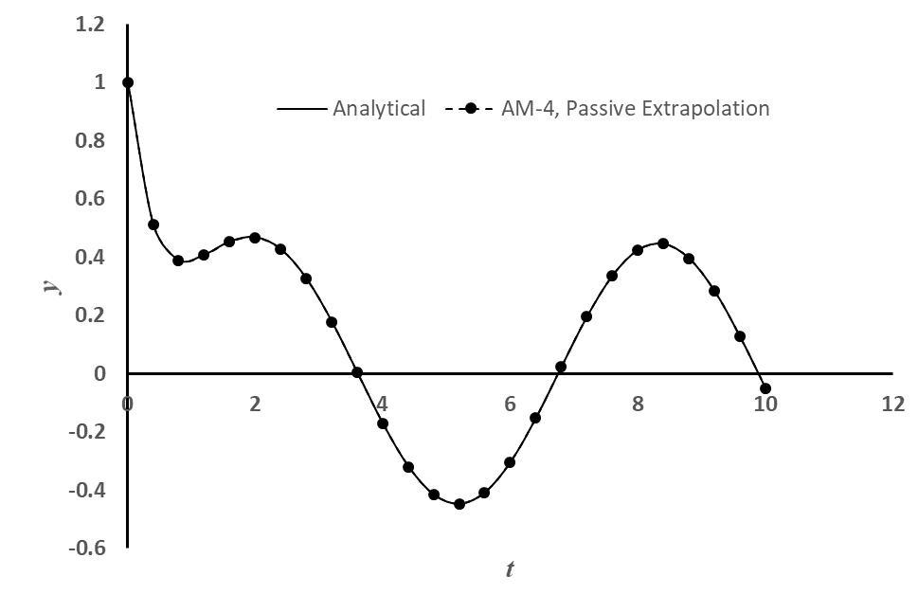
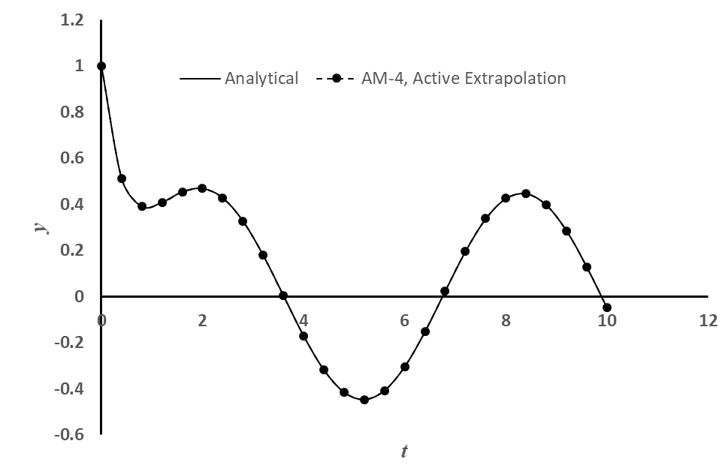

Startup of 4th Order Adams-Moulton
,

Slide 43
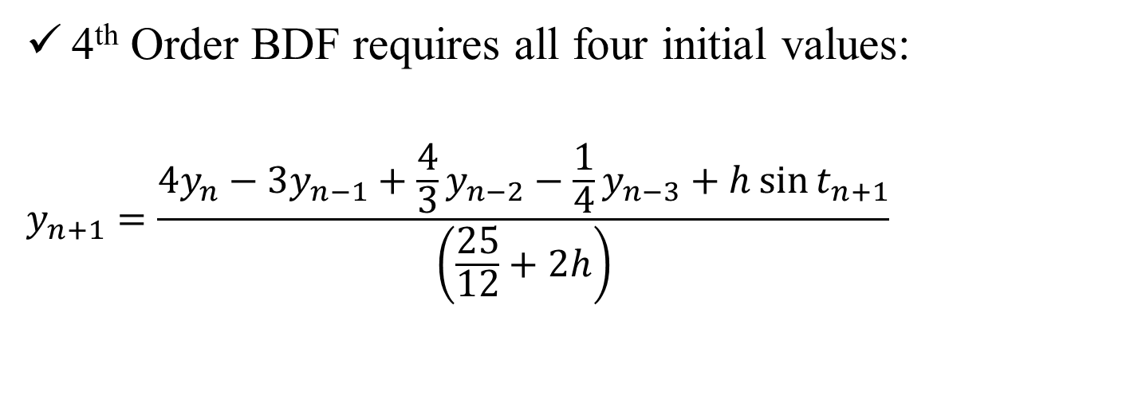
Startup of 4th Order BDF
,
t | y (Passive) | y (Active) | y (R-K)
0 | 1 | 1 | 1
0.4 | 0.511729 | 0.511729 | 0.51372
0.8 | 0.389799 | 0.390758 | 0.392453
1.2 | 0.409017 | 0.409785 | 0.410754
4th Order BDF requires all four initial values:
$$y_{n+1}=\frac{4y_{n}−3y_{n−1}+\frac{4}{3}y_{n−2}−\frac{1}{4}y_{n−3}+h\sin{t_{n+1}}}{\left(\frac{25}{12}+2h\right)}$$

Slide 44

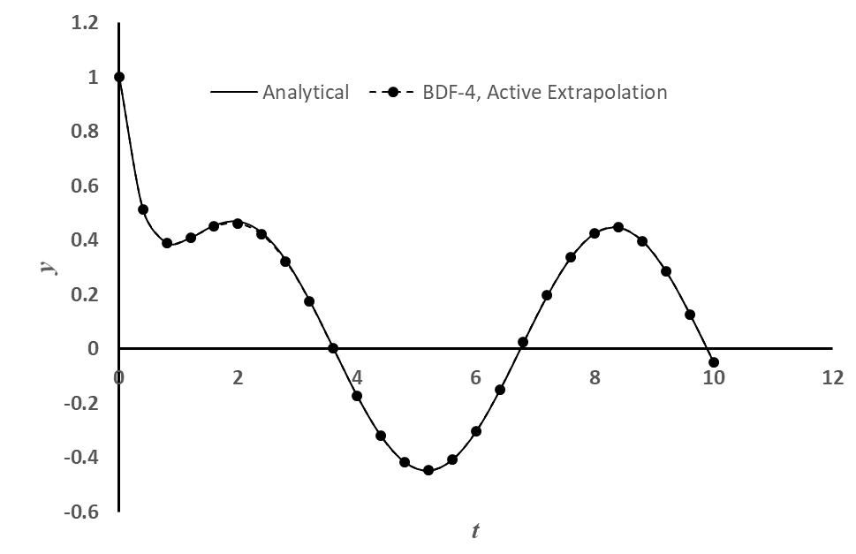
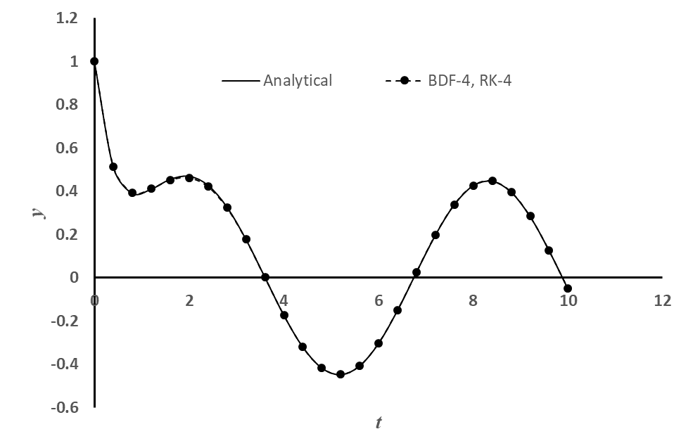
Startup of 4th Order Adams-Moulton
,

Slide 45
How to start the non-self starting algorithms?
Three commonly used options:
Passive Richardson’s Extrapolation
Active Richardson’s Extrapolation
With same lower order method
With progressively higher order methods
Using the same order Runge-Kutta method!
A word of caution:
Active Richardson’s extrapolation may destroy the good stability property of a numerical method (under certain situation). It’s generally not recommended!

Slide 46
Applications: Summary of Concerns
Accuracy of the higher order multi-step and BDF methods are affected if the starting values are used from the lower order methods.
How to start these non-self starting algorithms?
All implicit methods (multi-step and BDF) may involve solution of non-linear equations (if f contains a non-linear function of the dependent variable y)
Is there a way to avoid this solution of non-linear equations?
Numerical oscillations (instability) observed in some methods and not in some!
Is there a way to predict and therefore, choose correct parameters for algorithm so that the numerical oscillations can be avoided?

Slide 47
Combination Methods: Predictor-Corrector
How to avoid solution of non-linear equations in implicit methods (multi-step and BDF):
Use a Predictor method (an explicit method) to compute a value of y_{n+1}
Use the predicted value of y_{n+1} in a Corrector method (an implicit method) to obtain the value of y_{n+1}
All these methods can be applied in two ways:
Single application of corrector equation
Repeated or multiple or iterative application of corrector equation until the change in the value of y_{n+1} is below a specified ε.

Slide 48
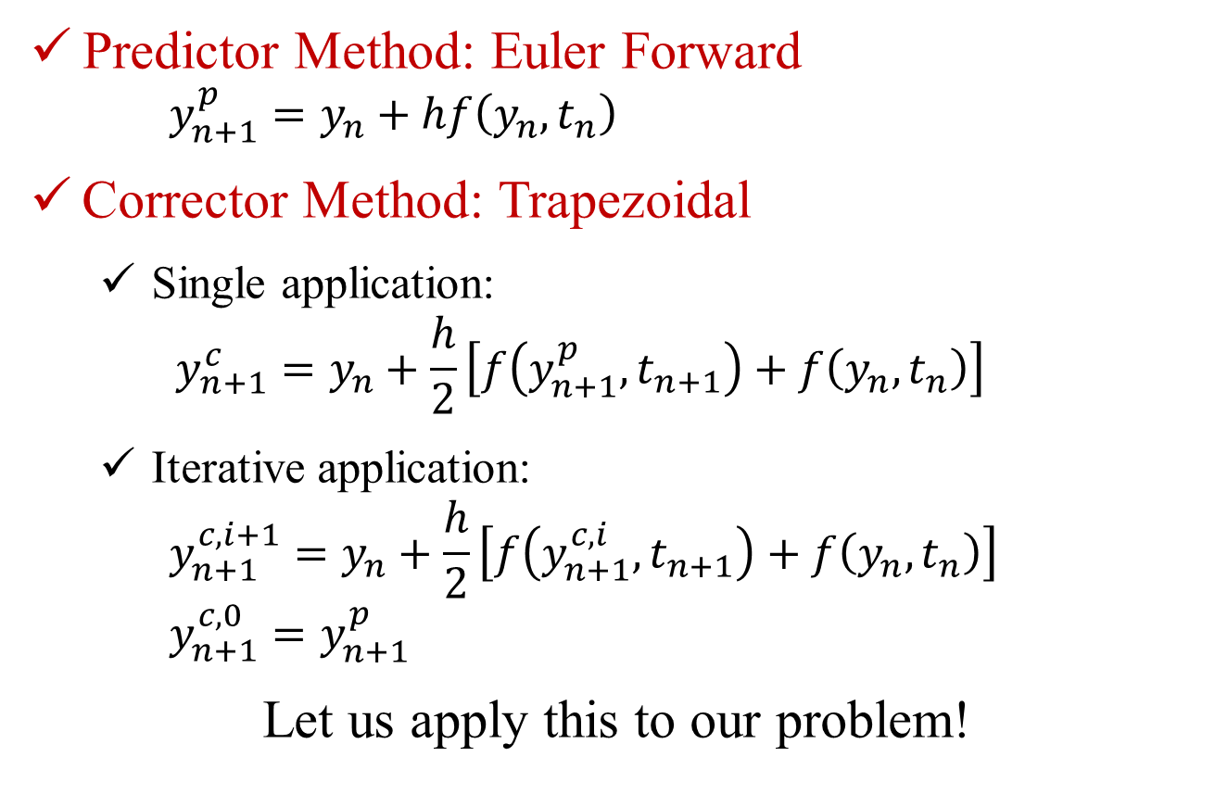
Predictor-Corrector: Heun’s Method
Predictor Method: Euler Forward
$$y_{n+1}^{p}=y_{n}+hf\left(y_{n},t_{n}\right)$$
Corrector Method: Trapezoidal
Single application:
$$y_{n+1}^{c}=y_{n}+\frac{h}{2}\left[f\left(y_{n+1}^{p},t_{n+1}\right)+f\left(y_{n},t_{n}\right)\right]$$
Iterative application:
$$y_{n+1}^{c, i+1}=y_{n}+\frac{h}{2}\left[f\left(y_{n+1}^{c, i},t_{n+1}\right)+f\left(y_{n},t_{n}\right)\right]$$
$$y_{n+1}^{c, 0}=y_{n+1}^{p}$$
Let us apply this to our problem!

Slide 49
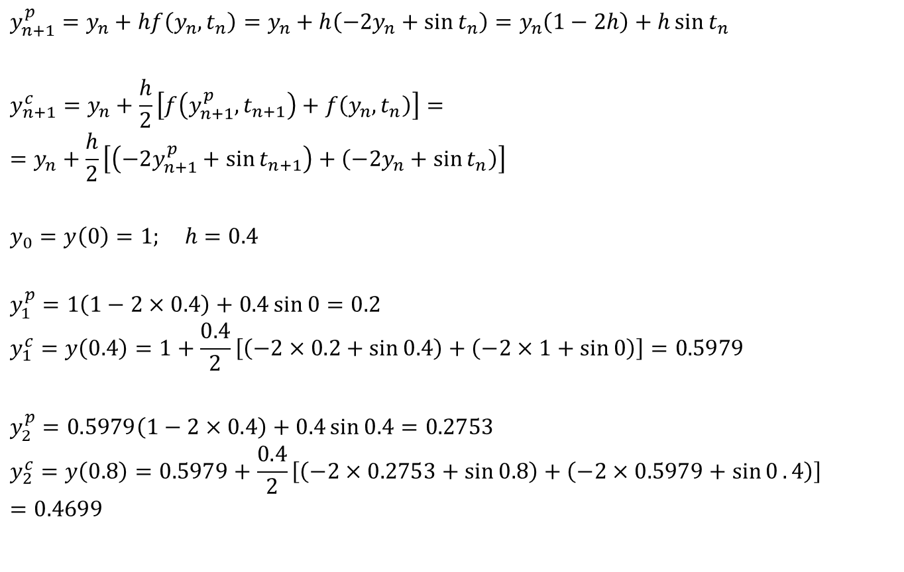
Heun’s Method: Single corrector application
$$y_{n+1}^{p}=y_{n}+hf\left(y_{n},t_{n}\right)=y_{n}+h\left(−2y_{n}+\sin{t_{n}}\right)=y_{n}\left(1−2h\right)+h\sin{t_{n}}$$
$$y_{n+1}^{c}=y_{n}+\frac{h}{2}\left[f\left(y_{n+1}^{p},t_{n+1}\right)+f\left(y_{n},t_{n}\right)\right]==y_{n}+\frac{h}{2}\left[\left(−2y_{n+1}^{p}+\sin{t_{n+1}}\right)+\left(−2y_{n}+\sin{t_{n}}\right)\right]$$
$$y_{0}=y\left(0\right)=1; h=0.4$$
$$y_{1}^{p}=1\left(1−2×0.4\right)+0.4\sin{0}=0.2$$
$$y_{1}^{c}=y\left(0.4\right)=1+\frac{0.4}{2}\left[\left(−2×0.2+\sin{0.4}\right)+\left(−2×1+\sin{0}\right)\right]=0.5979$$
$$y_{2}^{p}=0.5979\left(1−2×0.4\right)+0.4\sin{0.4}=0.2753$$
$$y_{2}^{c}=y\left(0.8\right)=0.5979+\frac{0.4}{2}\left[\left(−2×0.2753+\sin{0.8}\right)+\left(−2×0.5979+\sin{0}.4\right)\right]=0.4699$$

