Slide 1
Ordinary Differential Equation
The methods for Initial Value Problems (IVPs):
Multi-step Methods
Explicit: Euler Forward, Adams-Bashforth
Implicit: Euler Backward, Trapezoidal and Adams-Moulton
Backward Difference Formulae (BDF)
Runge-Kutta Methods
Applications, Startup, Combination Methods (Predictor-Corrector)
Consistency, Stability, Convergence
Application to System of ODEs
Boundary Value Problems (BVPs)
Shooting Method
Direct Methods

Slide 2
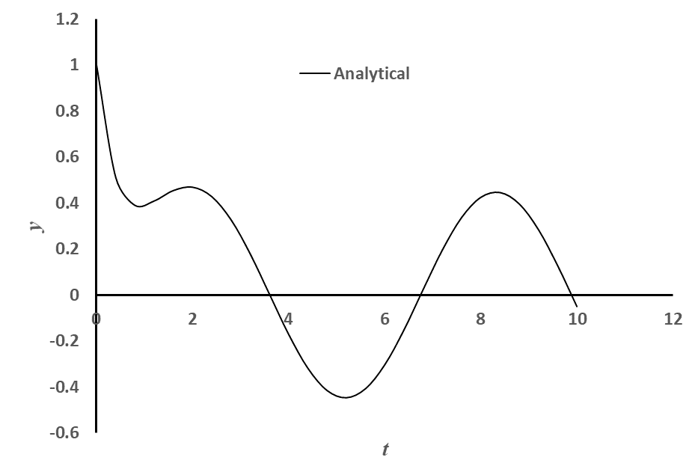
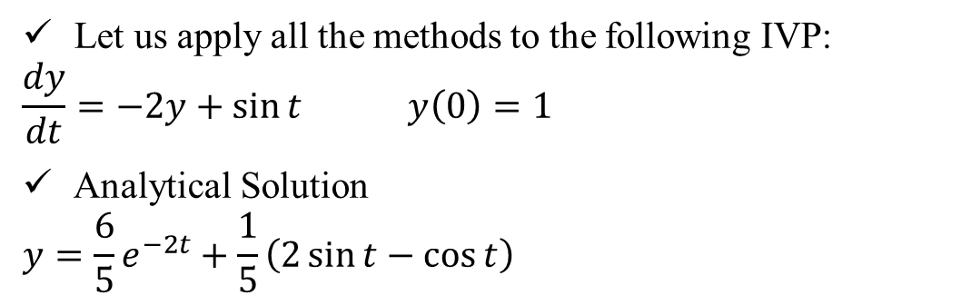
Example Problem (Contd)
,
Let us apply all the methods to the following IVP:
$$\frac{dy}{dt}=−2y+\sin{t} y\left(0\right)=1$$
Analytical Solution
$$y=\frac{6}{5}e^{−2t}+\frac{1}{5}\left(2\sin{t}−\cos{t}\right)$$

Slide 3
Applications: Summary of Concerns
Accuracy of the higher order multi-step and BDF methods are affected if the starting values are used from the lower order methods.
How to start these non-self starting algorithms?
All implicit methods (multi-step and BDF) may involve solution of non-linear equations (if f contains a non-linear function of the dependent variable y)
Is there a way to avoid this solution of non-linear equations?
Numerical oscillations (instability) observed in some methods and not in some!
Is there a way to predict and therefore, choose correct parameters for algorithm so that the numerical oscillations can be avoided?

Slide 4
How to start the non-self starting algorithms?
Three commonly used options:
Passive Richardson’s Extrapolation
Active Richardson’s Extrapolation
With same lower order method
With progressively higher order methods
Using the same order Runge-Kutta method!

Slide 5
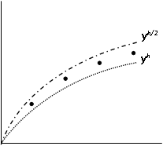
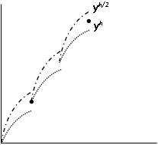
Active vs. Passive Richardson’s Extrapolation
Passive
Active

Slide 6
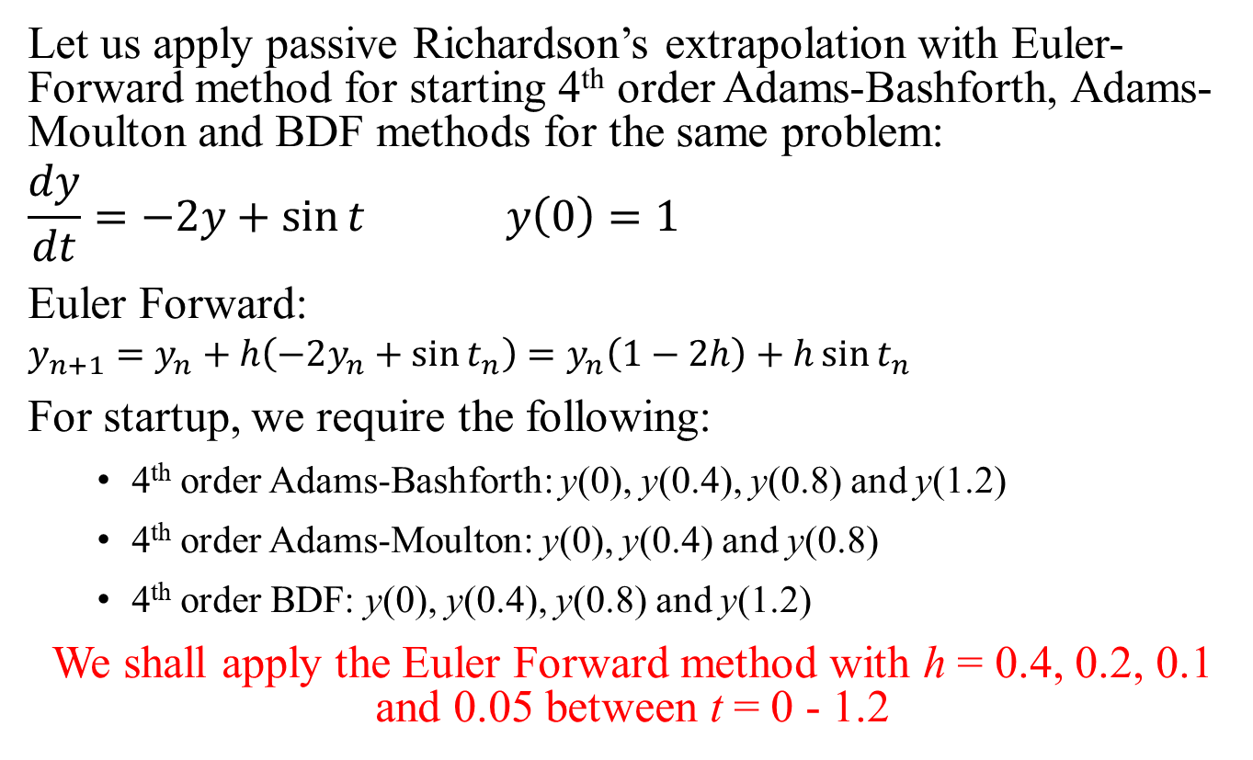
Application: Passive Richardson’s extrapolation
Let us apply passive Richardson’s extrapolation with Euler-Forward method for starting 4th order Adams-Bashforth, Adams-Moulton and BDF methods for the same problem:
$$\frac{dy}{dt}=−2y+\sin{t} y\left(0\right)=1$$
Euler Forward:
$$y_{n+1}=y_{n}+h\left(−2y_{n}+\sin{t_{n}}\right)=y_{n}\left(1−2h\right)+h\sin{t_{n}}$$
For startup, we require the following:
4th order Adams-Bashforth: y(0), y(0.4), y(0.8) and y(1.2)
4th order Adams-Moulton: y(0), y(0.4) and y(0.8)
4th order BDF: y(0), y(0.4), y(0.8) and y(1.2)
We shall apply the Euler Forward method with h = 0.4, 0.2, 0.1 and 0.05 between t = 0 - 1.2

Slide 7
Time | EF(h = 0.4) | Time | EF(h = 0.2) | Time | EF(h = 0.1) | Time | EF(h = 0.05)
0 | 1 | 0 | 1 | 0 | 1 | 0 | 1
0.4 | 0.2 | 0.2 | 0.6 | 0.1 | 0.8 | 0.05 | 0.9
0.8 | 0.195767 | 0.4 | 0.399734 | 0.2 | 0.649983 | 0.1 | 0.812499
1.2 | 0.326096 | 0.6 | 0.317724 | 0.3 | 0.539854 | 0.15 | 0.736241
 |  | 0.8 | 0.303563 | 0.4 | 0.461435 | 0.2 | 0.670089
 |  | 1 | 0.325609 | 0.5 | 0.40809 | 0.25 | 0.613013
 |  | 1.2 | 0.36366 | 0.6 | 0.374414 | 0.3 | 0.564082
 |  |  |  | 0.7 | 0.355996 | 0.35 | 0.52245
 |  |  |  | 0.8 | 0.349218 | 0.4 | 0.48735
 |  |  |  | 0.9 | 0.35111 | 0.45 | 0.458086
 |  |  |  | 1 | 0.359221 | 0.5 | 0.434025
 |  |  |  | 1.1 | 0.371524 | 0.55 | 0.414594
 |  |  |  | 1.2 | 0.38634 | 0.6 | 0.399269
 |  |  |  |  |  | 0.65 | 0.387574
 |  |  |  |  |  | 0.7 | 0.379076
 |  |  |  |  |  | 0.75 | 0.373379
 |  |  |  |  |  | 0.8 | 0.370123
 |  |  |  |  |  | 0.85 | 0.368979
 |  |  |  |  |  | 0.9 | 0.369645
 |  |  |  |  |  | 0.95 | 0.371847
 |  |  |  |  |  | 1 | 0.375333
 |  |  |  |  |  | 1.05 | 0.379873
 |  |  |  |  |  | 1.1 | 0.385257
 |  |  |  |  |  | 1.15 | 0.391292
 |  |  |  |  |  | 1.2 | 0.397801

Slide 8
Passive Richardson’s Extrapolation with Euler Forward: 4th order method start-up
t | EF(0.4) | EF(0.2) | EF(0.1) | EF(0.05)
0 | 1 | 1 | 1 | 1
0.4 | 0.2 | 0.399734 | 0.4614349 | 0.487349766
0.8 | 0.195767 | 0.303563 | 0.3492184 | 0.370123455
1.2 | 0.326096 | 0.36366 | 0.3863398 | 0.397800748
t | EF(0.4,0.2) | EF(0.2,0.1) | EF(0.1,0.05) | EF(0.4,0.2,0.1) | EF(0.2,0.1,0.05) | EF(h^4)
0 | 1 | 1 | 1 | 1 | 1 | 1
0.4 | 0.599468 | 0.523136 | 0.513265 | 0.497692 | 0.509974186 | 0.511729
0.8 | 0.411358 | 0.394874 | 0.391029 | 0.389379 | 0.389746793 | 0.389799
1.2 | 0.401223 | 0.40902 | 0.409262 | 0.411619 | 0.409342235 | 0.409017
With these four initial values, any 4th order multi-step or BDF methods can start!

Slide 9
Active Richardson’s Extrapolation with Euler Forward: 4th order method start-up
Time | EF(h = 0.4) | Time | EF(h = 0.2) | Time | EF(h = 0.1) | Time | EF(h = 0.05)
0 | 1 | 0 | 1 | 0 | 1 | 0 | 1
0.4 | 0.2 | 0.2 | 0.6 | 0.1 | 0.8 | 0.05 | 0.9
 |  | 0.4 | 0.399734 | 0.2 | 0.649983 | 0.1 | 0.812499
 |  |  |  | 0.3 | 0.539854 | 0.15 | 0.736241
 |  |  |  | 0.4 | 0.461435 | 0.2 | 0.670089
 |  |  |  |  |  | 0.25 | 0.613013
 |  |  |  |  |  | 0.3 | 0.564082
 |  |  |  |  |  | 0.35 | 0.52245
 |  |  |  |  |  | 0.4 | 0.48735
t | EF(0.4,0.2) | EF(0.2,0.1) | EF(0.1,0.05) | EF(0.4,0.2,0.1) | EF(0.2,0.1,0.05) | EF(h^4)
0.4 | 0.599468 | 0.523136 | 0.513265 | 0.497692 | 0.509974186 | 0.511729
We will now apply the Euler Forward and Richardson’s extrapolation with the extrapolated initial value at t = 0.4 and go up to t = 0.8

Slide 10
Active Richardson’s Extrapolation with Euler Forward: 4th order method start-up
Time | EF(h = 0.4) | Time | EF(h = 0.2) | Time | EF(h = 0.1) | Time | EF(h = 0.05)
0.4 | 0.511729 | 0.4 | 0.511729 | 0.4 | 0.511729 | 0.4 | 0.511729
0.8 | 0.258113 | 0.6 | 0.384921 | 0.5 | 0.448325 | 0.45 | 0.480027
 |  | 0.8 | 0.343881 | 0.6 | 0.406602 | 0.5 | 0.453772
 |  |  |  | 0.7 | 0.381746 | 0.55 | 0.432366
 |  |  |  | 0.8 | 0.369819 | 0.6 | 0.415264
 |  |  |  |  |  | 0.65 | 0.40197
 |  |  |  |  |  | 0.7 | 0.392032
 |  |  |  |  |  | 0.75 | 0.38504
 |  |  |  |  |  | 0.8 | 0.380618
t | EF(0.4,0.2) | EF(0.2,0.1) | EF(0.1,0.05) | EF(0.4,0.2,0.1) | EF(0.2,0.1,0.05) | EF(h^4)
0.8 | 0.429649 | 0.395756 | 0.391417 | 0.3844589 | 0.389970418 | 0.390758
We will now apply the Euler Forward and Richardson’s extrapolation with the extrapolated initial value at t = 0.8 and go up to t = 1.2

Slide 11
Active Richardson’s Extrapolation with Euler Forward: 4th order method start-up
Time | EF(h = 0.4) | Time | EF(h = 0.2) | Time | EF(h = 0.1) | Time | EF(h = 0.05)
0.8 | 0.390758 | 0.8 | 0.390758 | 0.8 | 0.390758 | 0.8 | 0.390758
1.2 | 0.365094 | 1 | 0.377926 | 0.9 | 0.384342 | 0.85 | 0.38755
 |  | 1.2 | 0.39505 | 1 | 0.385806 | 0.9 | 0.386359
 |  |  |  | 1.1 | 0.392792 | 0.95 | 0.386889
 |  |  |  | 1.2 | 0.403354 | 1 | 0.388871
 |  |  |  |  |  | 1.05 | 0.392058
 |  |  |  |  |  | 1.1 | 0.396223
 |  |  |  |  |  | 1.15 | 0.401161
 |  |  |  |  |  | 1.2 | 0.406683
t | EF(0.4,0.2) | EF(0.2,0.1) | EF(0.1,0.05) | EF(0.4,0.2,0.1) | EF(0.2,0.1,0.05) | EF(h^4)
1.2 | 0.425005 | 0.411659 | 0.410012 | 0.4072102 | 0.40946293 | 0.409785
With four initial values at t = 0, 0.4, 0.8 and 1.2, any 4th order multi-step or BDF methods can start!

Slide 12
4th Order R-K: 4th order method start-up
t | φ₀ | φ₁ | φ₂ | φ₃ | y
0 |  |  |  |  | 1
0.4 | -2 | -1.00133 | -1.4008 | -0.48994 | 0.51372
0.8 | -0.63802 | -0.20759 | -0.37976 | -0.00627 | 0.392453
1.2 | -0.06755 | 0.083584 | 0.02313 | 0.128628 | 0.410754
With four initial values at t = 0, 0.4, 0.8 and 1.2, any 4th order multi-step or BDF methods can start!

Slide 13
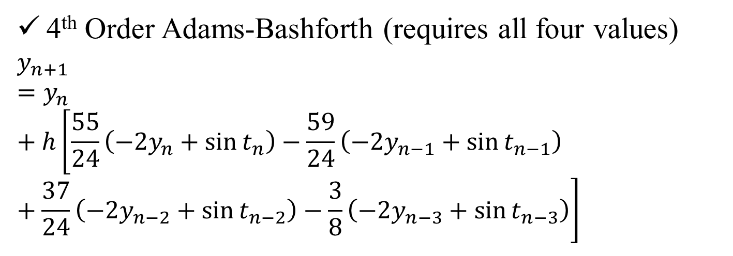
Startup of 4th Order Methods
,
t | y (Passive) | y (Active) | y (R-K)
0 | 1 | 1 | 1
0.4 | 0.511729 | 0.511729 | 0.51372
0.8 | 0.389799 | 0.390758 | 0.392453
1.2 | 0.409017 | 0.409785 | 0.410754
4th Order Adams-Bashforth (requires all four values)
$$y_{n+1}=y_{n}+h\left[\frac{55}{24}\left(−2y_{n}+\sin{t_{n}}\right)−\frac{59}{24}\left(−2y_{n−1}+\sin{t_{n−1}}\right)+\frac{37}{24}\left(−2y_{n−2}+\sin{t_{n−2}}\right)−\frac{3}{8}\left(−2y_{n−3}+\sin{t_{n−3}}\right)\right]$$

Slide 14
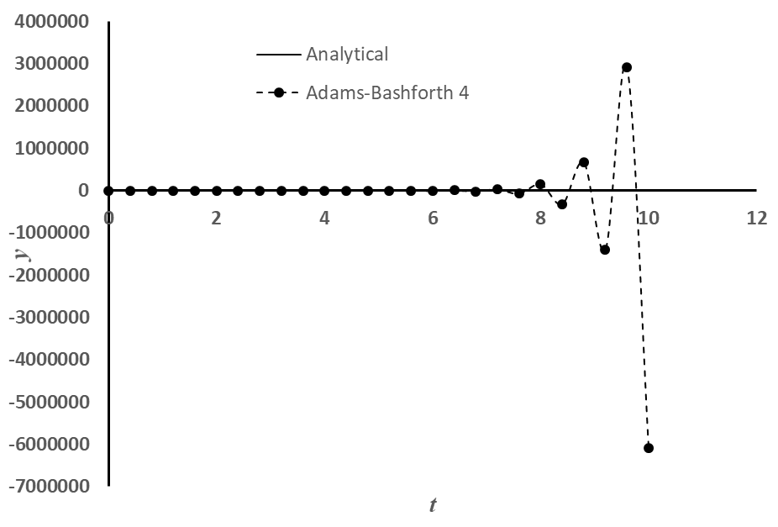
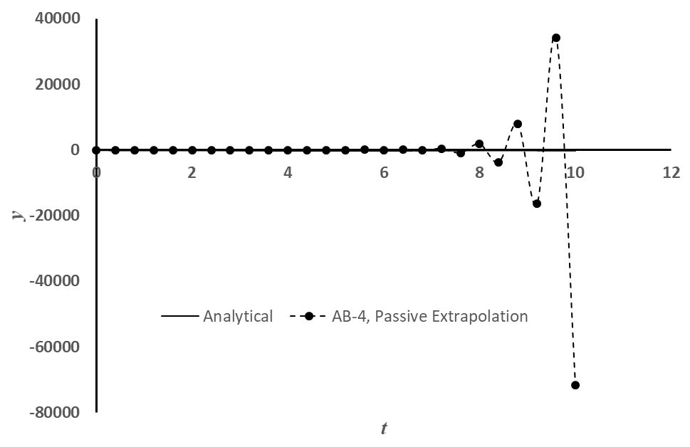
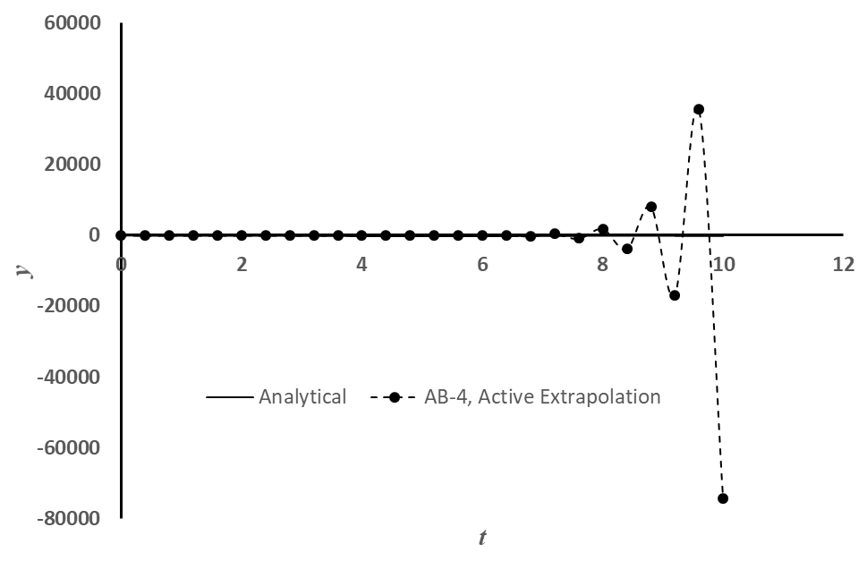
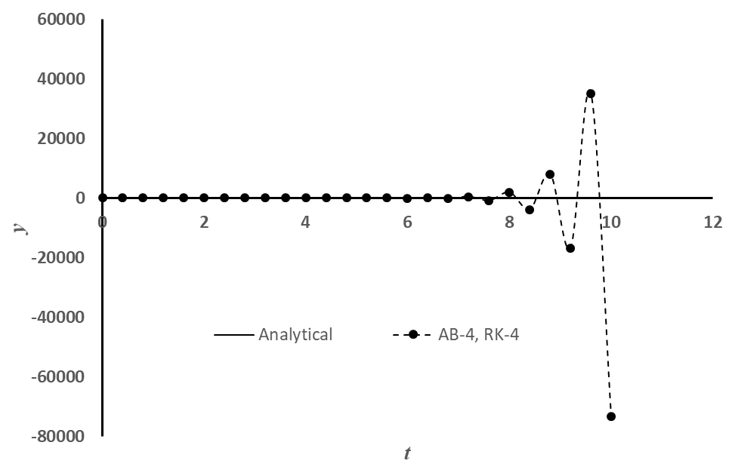
Startup of 4th Order Adams-Bashforth
,
Proper start-up does not solve the stability problem!

Slide 15
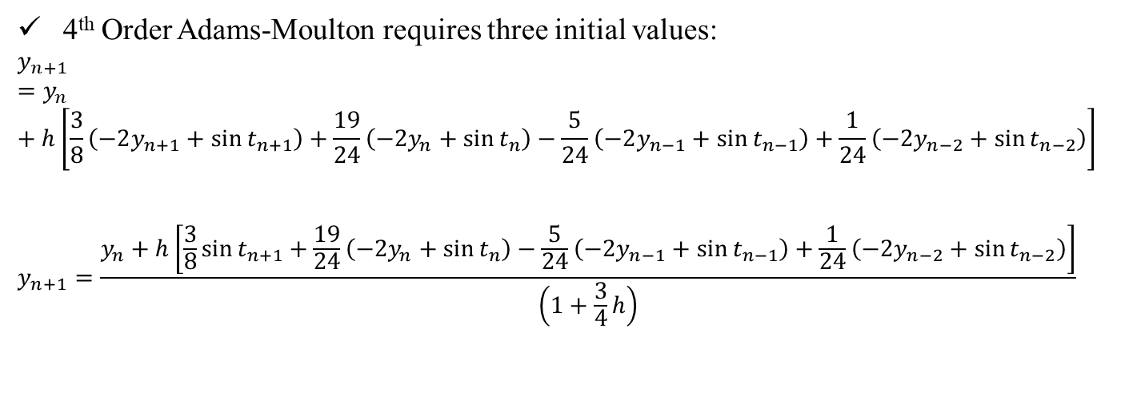
Startup of 4th Order Adams-Moulton
,
t | y (Passive) | y (Active) | y (R-K)
0 | 1 | 1 | 1
0.4 | 0.511729 | 0.511729 | 0.51372
0.8 | 0.389799 | 0.390758 | 0.392453
1.2 | 0.409017 | 0.409785 | 0.410754
4th Order Adams-Moulton requires three initial values:
$$y_{n+1}=y_{n}+h\left[\frac{3}{8}\left(−2y_{n+1}+\sin{t_{n+1}}\right)+\frac{19}{24}\left(−2y_{n}+\sin{t_{n}}\right)−\frac{5}{24}\left(−2y_{n−1}+\sin{t_{n−1}}\right)+\frac{1}{24}\left(−2y_{n−2}+\sin{t_{n−2}}\right)\right]$$
$$y_{n+1}=\frac{y_{n}+h\left[\frac{3}{8}\sin{t_{n+1}}+\frac{19}{24}\left(−2y_{n}+\sin{t_{n}}\right)−\frac{5}{24}\left(−2y_{n−1}+\sin{t_{n−1}}\right)+\frac{1}{24}\left(−2y_{n−2}+\sin{t_{n−2}}\right)\right]}{\left(1+\frac{3}{4}h\right)}$$

Slide 16
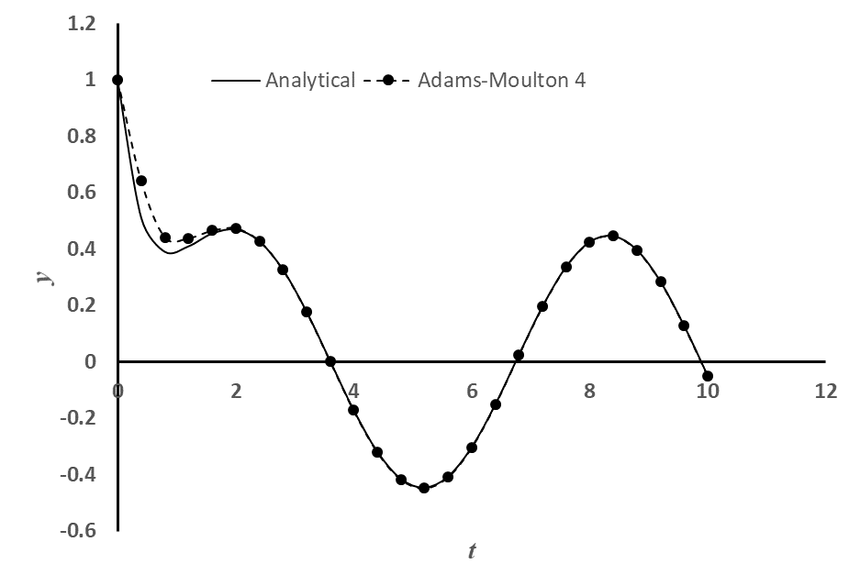
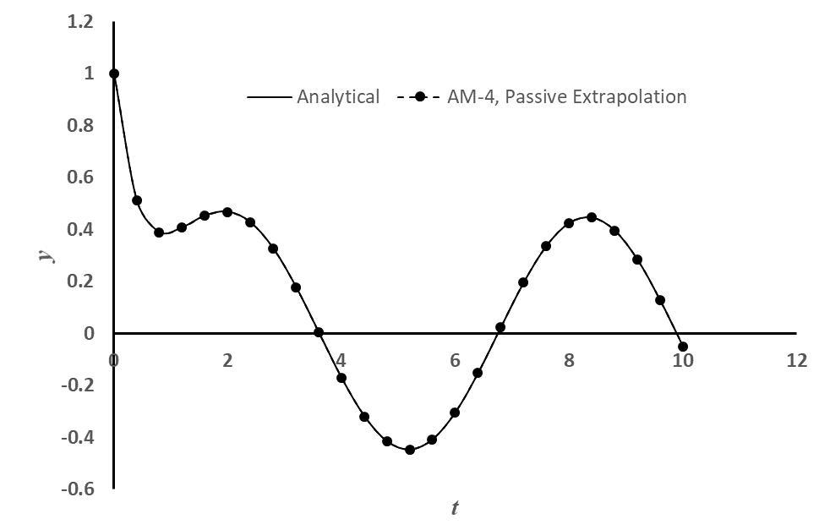
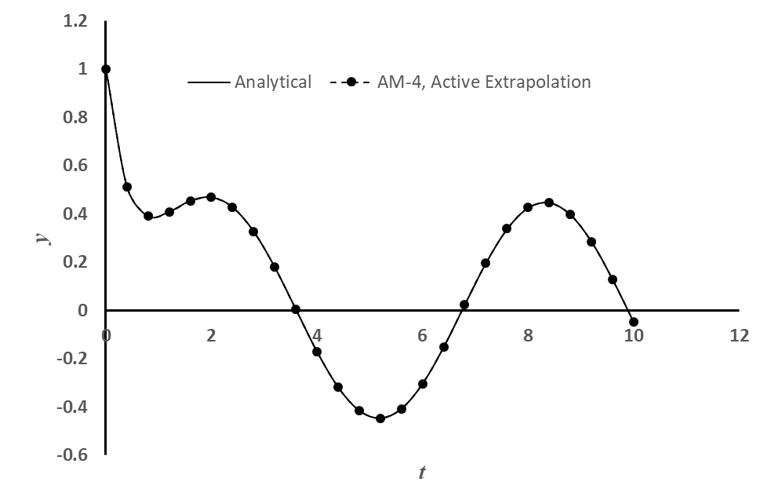
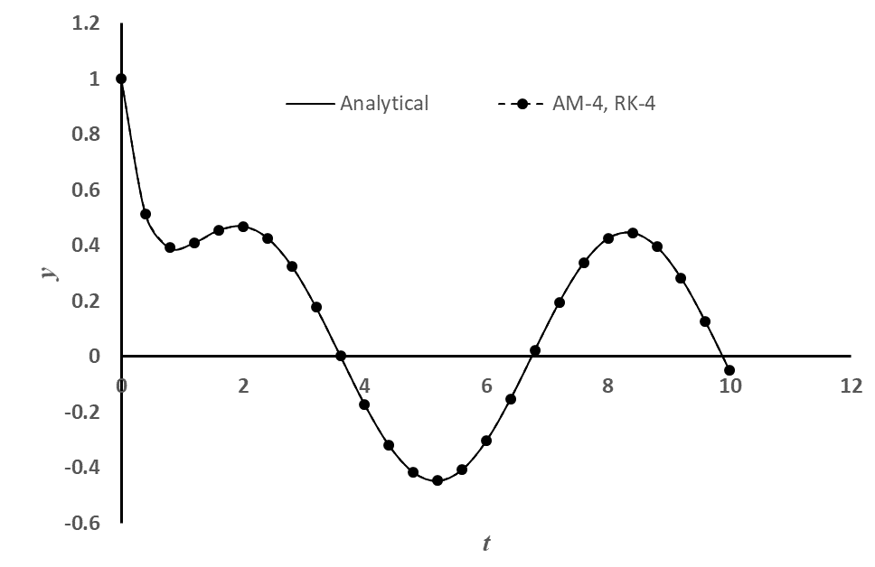
Startup of 4th Order Adams-Moulton
,

Slide 17
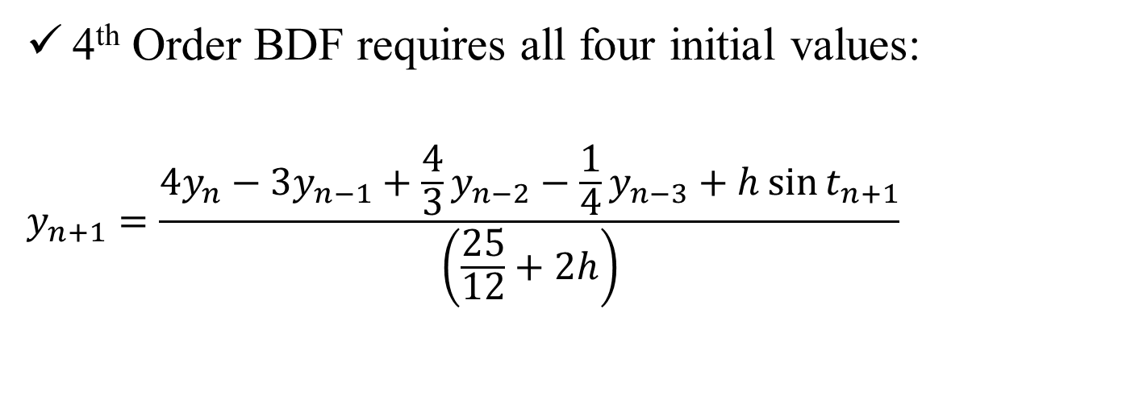
Startup of 4th Order BDF
,
t | y (Passive) | y (Active) | y (R-K)
0 | 1 | 1 | 1
0.4 | 0.511729 | 0.511729 | 0.51372
0.8 | 0.389799 | 0.390758 | 0.392453
1.2 | 0.409017 | 0.409785 | 0.410754
4th Order BDF requires all four initial values:
$$y_{n+1}=\frac{4y_{n}−3y_{n−1}+\frac{4}{3}y_{n−2}−\frac{1}{4}y_{n−3}+h\sin{t_{n+1}}}{\left(\frac{25}{12}+2h\right)}$$

Slide 18
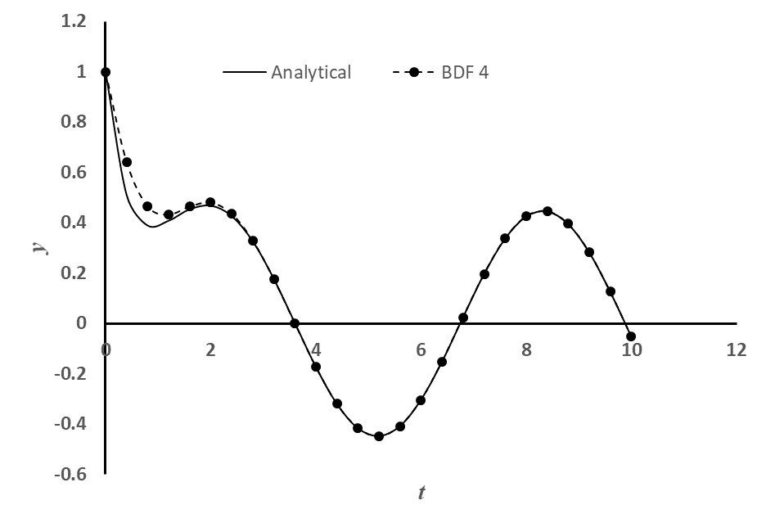

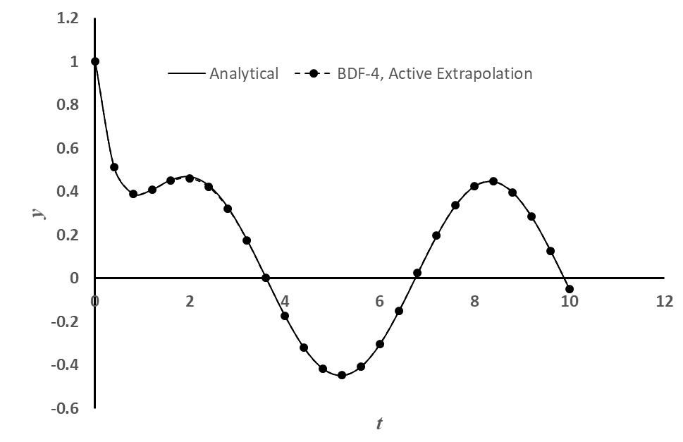
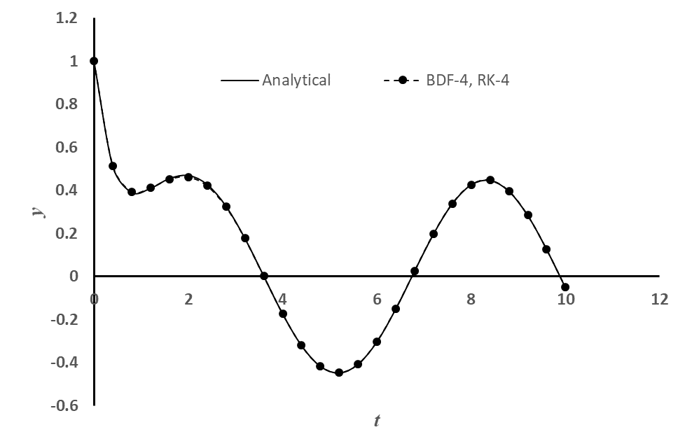
Startup of 4th Order Adams-Moulton
,

Slide 19
How to start the non-self starting algorithms?
Three commonly used options:
Passive Richardson’s Extrapolation
Active Richardson’s Extrapolation
With same lower order method
With progressively higher order methods
Using the same order Runge-Kutta method!
A word of caution:
Active Richardson’s extrapolation may destroy the good stability property of a numerical method (under certain situation). It’s generally not recommended!

Slide 20
Applications: Summary of Concerns
Accuracy of the higher order multi-step and BDF methods are affected if the starting values are used from the lower order methods.
How to start these non-self starting algorithms?
All implicit methods (multi-step and BDF) may involve solution of non-linear equations (if f contains a non-linear function of the dependent variable y)
Is there a way to avoid this solution of non-linear equations?
Numerical oscillations (instability) observed in some methods and not in some!
Is there a way to predict and therefore, choose correct parameters for algorithm so that the numerical oscillations can be avoided?

Slide 21
Combination Methods: Predictor-Corrector
How to avoid solution of non-linear equations in implicit methods (multi-step and BDF):
Use a Predictor method (an explicit method) to compute a value of y_{n+1}
Use the predicted value of y_{n+1} in a Corrector method (an implicit method) to obtain the value of y_{n+1}
All these methods can be applied in two ways:
Single application of corrector equation
Repeated or multiple or iterative application of corrector equation until the change in the value of y_{n+1} is below a specified ε.

Slide 22
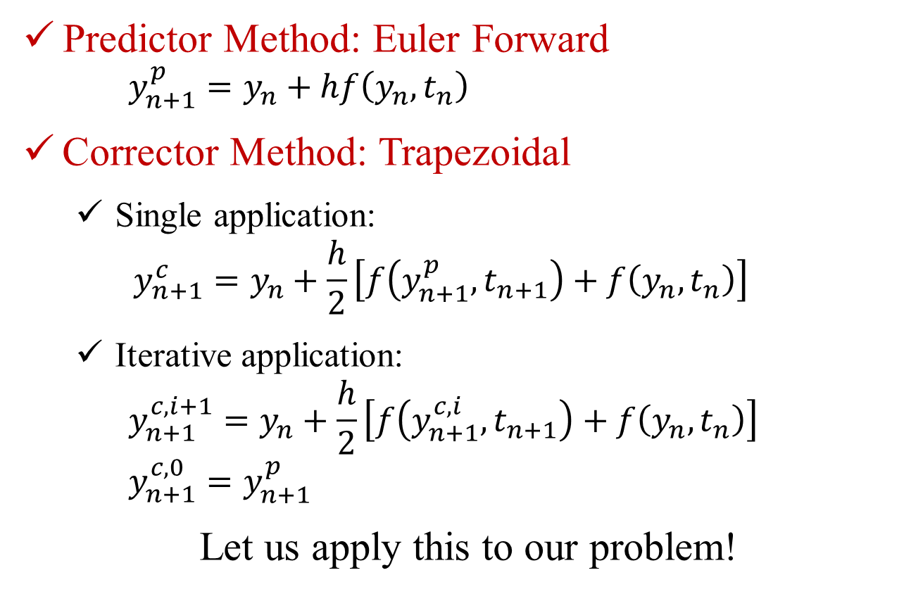
Predictor-Corrector: Heun’s Method
Predictor Method: Euler Forward
$$y_{n+1}^{p}=y_{n}+hf\left(y_{n},t_{n}\right)$$
Corrector Method: Trapezoidal
Single application:
$$y_{n+1}^{c}=y_{n}+\frac{h}{2}\left[f\left(y_{n+1}^{p},t_{n+1}\right)+f\left(y_{n},t_{n}\right)\right]$$
Iterative application:
$$y_{n+1}^{c, i+1}=y_{n}+\frac{h}{2}\left[f\left(y_{n+1}^{c, i},t_{n+1}\right)+f\left(y_{n},t_{n}\right)\right]$$
$$y_{n+1}^{c, 0}=y_{n+1}^{p}$$
Let us apply this to our problem!

Slide 23
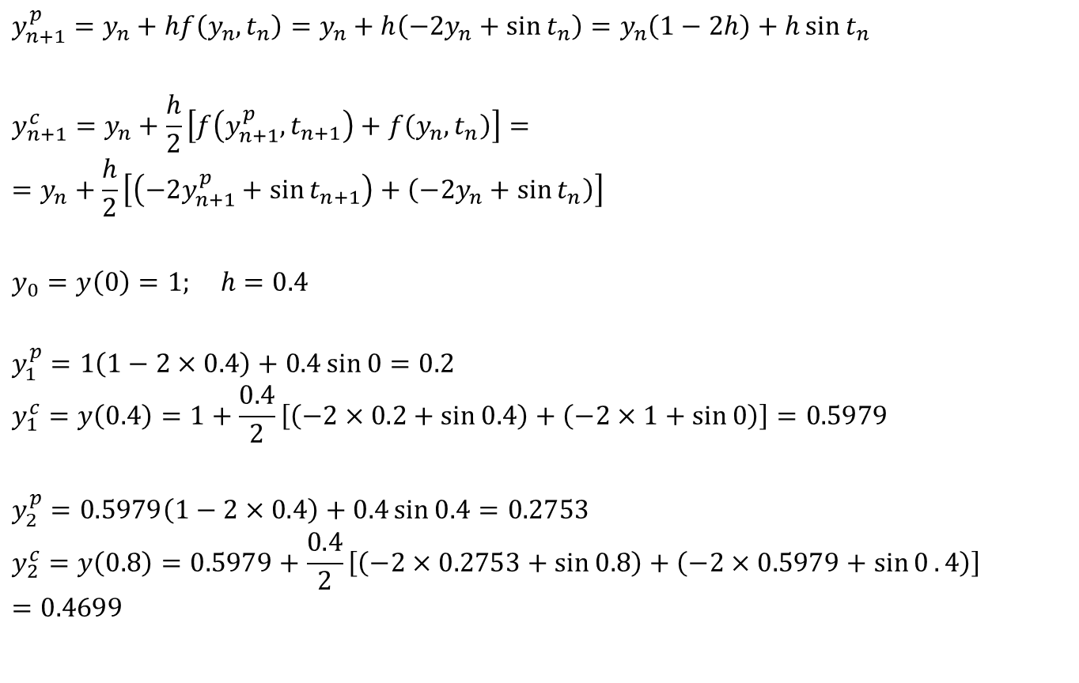
Heun’s Method: Single corrector application
$$y_{n+1}^{p}=y_{n}+hf\left(y_{n},t_{n}\right)=y_{n}+h\left(−2y_{n}+\sin{t_{n}}\right)=y_{n}\left(1−2h\right)+h\sin{t_{n}}$$
$$y_{n+1}^{c}=y_{n}+\frac{h}{2}\left[f\left(y_{n+1}^{p},t_{n+1}\right)+f\left(y_{n},t_{n}\right)\right]==y_{n}+\frac{h}{2}\left[\left(−2y_{n+1}^{p}+\sin{t_{n+1}}\right)+\left(−2y_{n}+\sin{t_{n}}\right)\right]$$
$$y_{0}=y\left(0\right)=1; h=0.4$$
$$y_{1}^{p}=1\left(1−2×0.4\right)+0.4\sin{0}=0.2$$
$$y_{1}^{c}=y\left(0.4\right)=1+\frac{0.4}{2}\left[\left(−2×0.2+\sin{0.4}\right)+\left(−2×1+\sin{0}\right)\right]=0.5979$$
$$y_{2}^{p}=0.5979\left(1−2×0.4\right)+0.4\sin{0.4}=0.2753$$
$$y_{2}^{c}=y\left(0.8\right)=0.5979+\frac{0.4}{2}\left[\left(−2×0.2753+\sin{0.8}\right)+\left(−2×0.5979+\sin{0}.4\right)\right]=0.4699$$

Slide 24
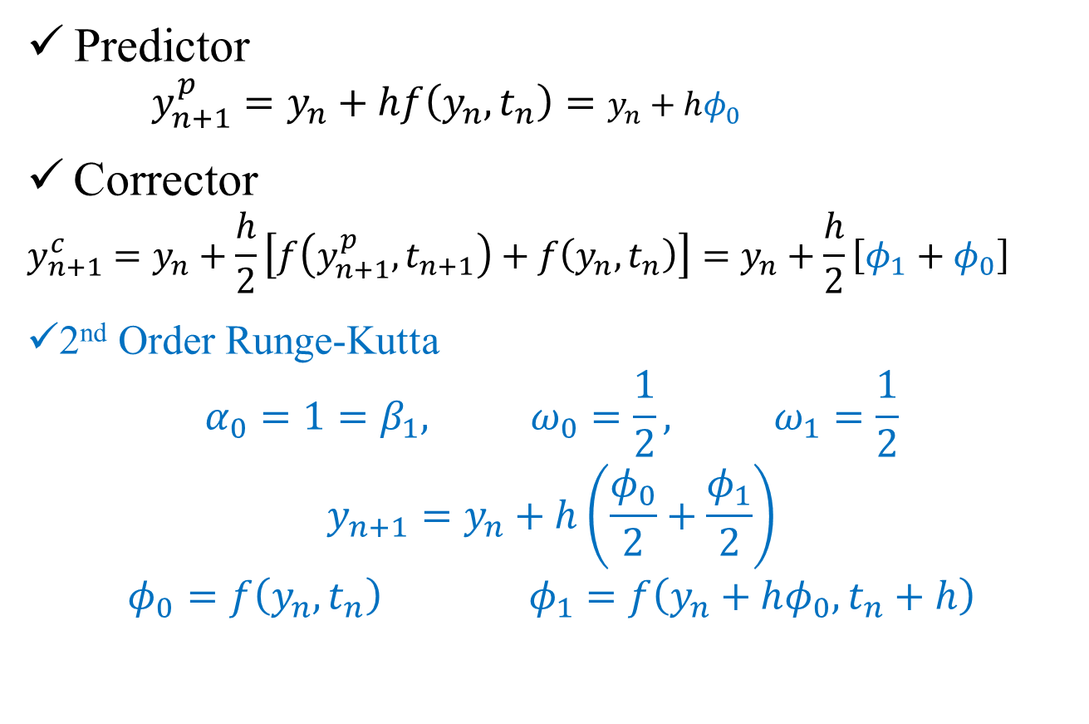
Heun’s Method (Single Corrector) vs. R-K (2nd Order)
Predictor
$$y_{n+1}^{p}=y_{n}+hf\left(y_{n},t_{n}\right)=y_{n}+hφ_{0}$$
Corrector
$$y_{n+1}^{c}=y_{n}+\frac{h}{2}\left[f\left(y_{n+1}^{p},t_{n+1}\right)+f\left(y_{n},t_{n}\right)\right]=y_{n}+\frac{h}{2}\left[φ_{1}+φ_{0}\right]$$
2nd Order Runge-Kutta
$$α_{0}=1=β_{1}, ω_{0}=\frac{1}{2}, ω_{1}=\frac{1}{2}$$
$$y_{n+1}=y_{n}+h\left(\frac{φ_{0}}{2}+\frac{φ_{1}}{2}\right)$$
$$φ_{0}=f\left(y_{n},t_{n}\right) φ_{1}=f\left(y_{n}+hφ_{0},t_{n}+h\right)$$

Slide 25
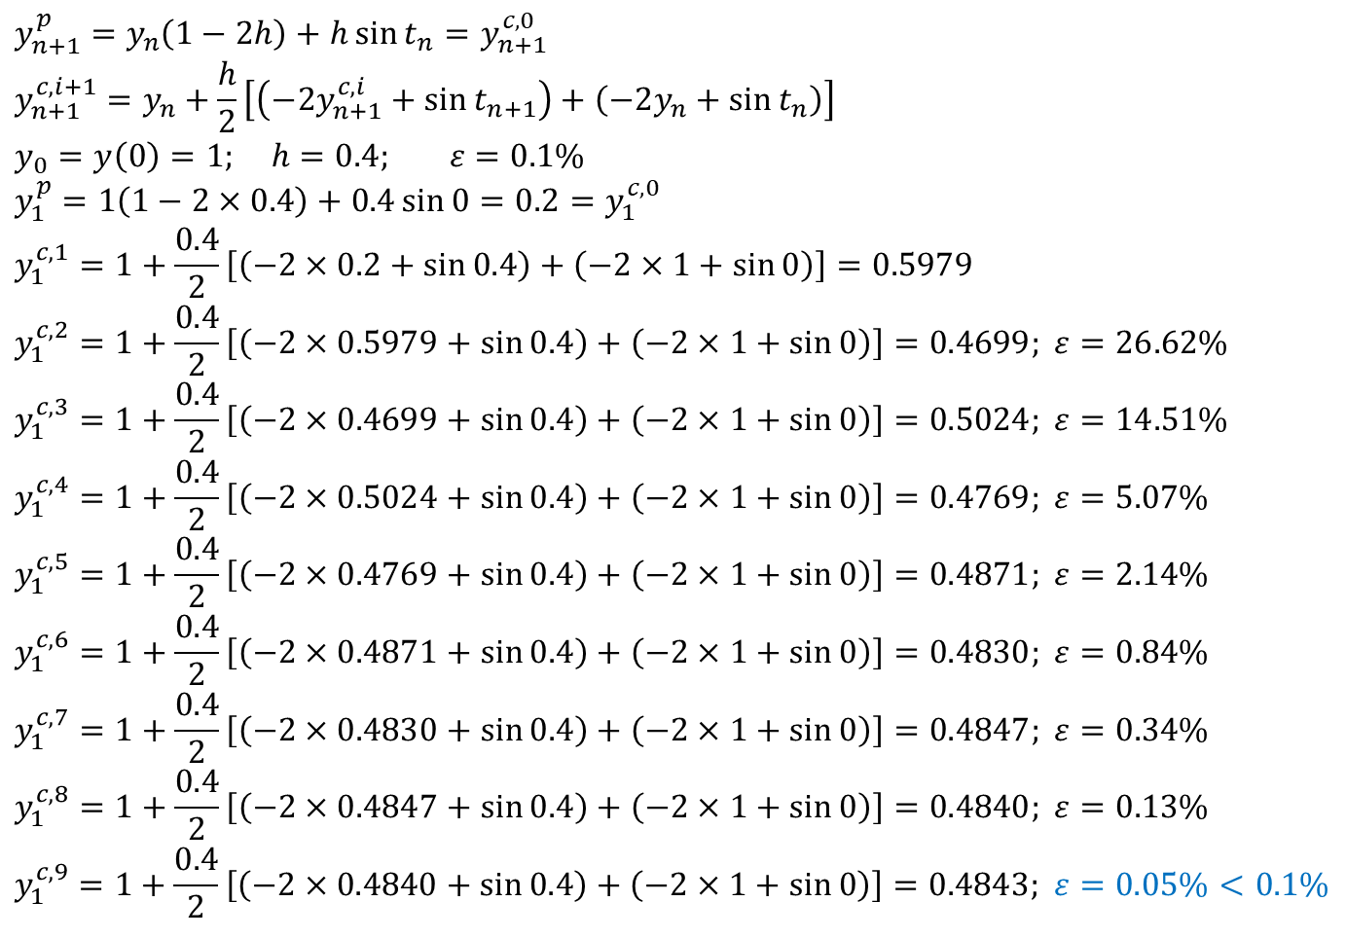
Heun’s Method: Iterative corrector application
$$y_{n+1}^{p}=y_{n}\left(1−2h\right)+h\sin{t_{n}}=y_{n+1}^{c,0}$$
$$y_{n+1}^{c,i+1}=y_{n}+\frac{h}{2}\left[\left(−2y_{n+1}^{c,i}+\sin{t_{n+1}}\right)+\left(−2y_{n}+\sin{t_{n}}\right)\right]$$
$$y_{0}=y\left(0\right)=1; h=0.4; ε=0.1\%$$
$$y_{1}^{p}=1\left(1−2×0.4\right)+0.4\sin{0}=0.2=y_{1}^{c,0}$$
$$y_{1}^{c,1}=1+\frac{0.4}{2}\left[\left(−2×0.2+\sin{0.4}\right)+\left(−2×1+\sin{0}\right)\right]=0.5979$$
$$y_{1}^{c,2}=1+\frac{0.4}{2}\left[\left(−2×0.5979+\sin{0.4}\right)+\left(−2×1+\sin{0}\right)\right]=0.4699; ε=26.62\%$$
$$y_{1}^{c,3}=1+\frac{0.4}{2}\left[\left(−2×0.4699+\sin{0.4}\right)+\left(−2×1+\sin{0}\right)\right]=0.5024; ε=14.51\%$$
$$y_{1}^{c,4}=1+\frac{0.4}{2}\left[\left(−2×0.5024+\sin{0.4}\right)+\left(−2×1+\sin{0}\right)\right]=0.4769; ε=5.07\%$$
$$y_{1}^{c,5}=1+\frac{0.4}{2}\left[\left(−2×0.4769+\sin{0.4}\right)+\left(−2×1+\sin{0}\right)\right]=0.4871; ε=2.14\%$$
$$y_{1}^{c,6}=1+\frac{0.4}{2}\left[\left(−2×0.4871+\sin{0.4}\right)+\left(−2×1+\sin{0}\right)\right]=0.4830; ε=0.84\%$$
$$y_{1}^{c,7}=1+\frac{0.4}{2}\left[\left(−2×0.4830+\sin{0.4}\right)+\left(−2×1+\sin{0}\right)\right]=0.4847; ε=0.34\%$$
$$y_{1}^{c,8}=1+\frac{0.4}{2}\left[\left(−2×0.4847+\sin{0.4}\right)+\left(−2×1+\sin{0}\right)\right]=0.4840; ε=0.13\%$$
$$y_{1}^{c,9}=1+\frac{0.4}{2}\left[\left(−2×0.4840+\sin{0.4}\right)+\left(−2×1+\sin{0}\right)\right]=0.4843; ε=0.05\%<0.1\%$$

Slide 26
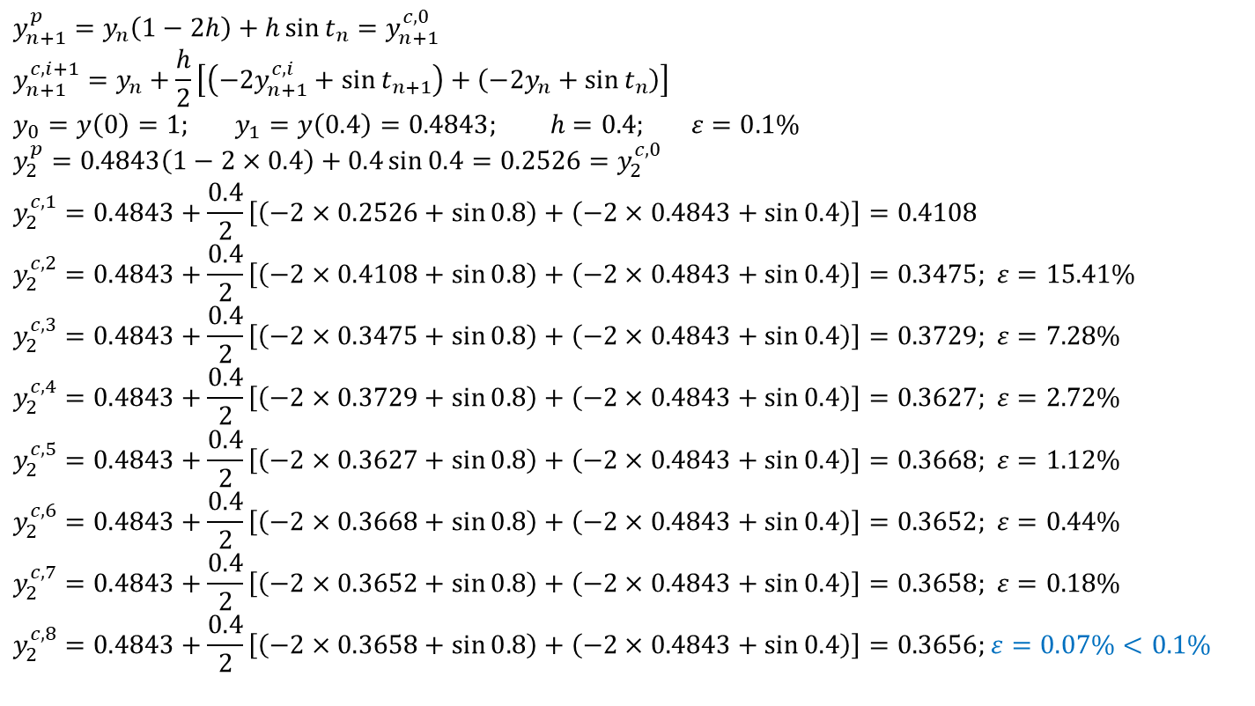
Heun’s Method: Iterative corrector application
$$y_{n+1}^{p}=y_{n}\left(1−2h\right)+h\sin{t_{n}}=y_{n+1}^{c,0}$$
$$y_{n+1}^{c,i+1}=y_{n}+\frac{h}{2}\left[\left(−2y_{n+1}^{c,i}+\sin{t_{n+1}}\right)+\left(−2y_{n}+\sin{t_{n}}\right)\right]$$
$$y_{0}=y\left(0\right)=1; y_{1}=y\left(0.4\right)=0.4843; h=0.4; ε=0.1\%$$
$$y_{2}^{p}=0.4843\left(1−2×0.4\right)+0.4\sin{0.4}=0.2526=y_{2}^{c,0}$$
$$y_{2}^{c,1}=0.4843+\frac{0.4}{2}\left[\left(−2×0.2526+\sin{0.8}\right)+\left(−2×0.4843+\sin{0.4}\right)\right]=0.4108$$
$$y_{2}^{c,2}=0.4843+\frac{0.4}{2}\left[\left(−2×0.4108+\sin{0.8}\right)+\left(−2×0.4843+\sin{0.4}\right)\right]=0.3475; ε=15.41\%$$
$$y_{2}^{c,3}=0.4843+\frac{0.4}{2}\left[\left(−2×0.3475+\sin{0.8}\right)+\left(−2×0.4843+\sin{0.4}\right)\right]=0.3729; ε=7.28\%$$
$$y_{2}^{c,4}=0.4843+\frac{0.4}{2}\left[\left(−2×0.3729+\sin{0.8}\right)+\left(−2×0.4843+\sin{0.4}\right)\right]=0.3627; ε=2.72\%$$
$$y_{2}^{c,5}=0.4843+\frac{0.4}{2}\left[\left(−2×0.3627+\sin{0.8}\right)+\left(−2×0.4843+\sin{0.4}\right)\right]=0.3668; ε=1.12\%$$
$$y_{2}^{c,6}=0.4843+\frac{0.4}{2}\left[\left(−2×0.3668+\sin{0.8}\right)+\left(−2×0.4843+\sin{0.4}\right)\right]=0.3652; ε=0.44\%$$
$$y_{2}^{c,7}=0.4843+\frac{0.4}{2}\left[\left(−2×0.3652+\sin{0.8}\right)+\left(−2×0.4843+\sin{0.4}\right)\right]=0.3658; ε=0.18\%$$
$$y_{2}^{c,8}=0.4843+\frac{0.4}{2}\left[\left(−2×0.3658+\sin{0.8}\right)+\left(−2×0.4843+\sin{0.4}\right)\right]=0.3656;ε=0.07\%<0.1\%$$

Slide 27

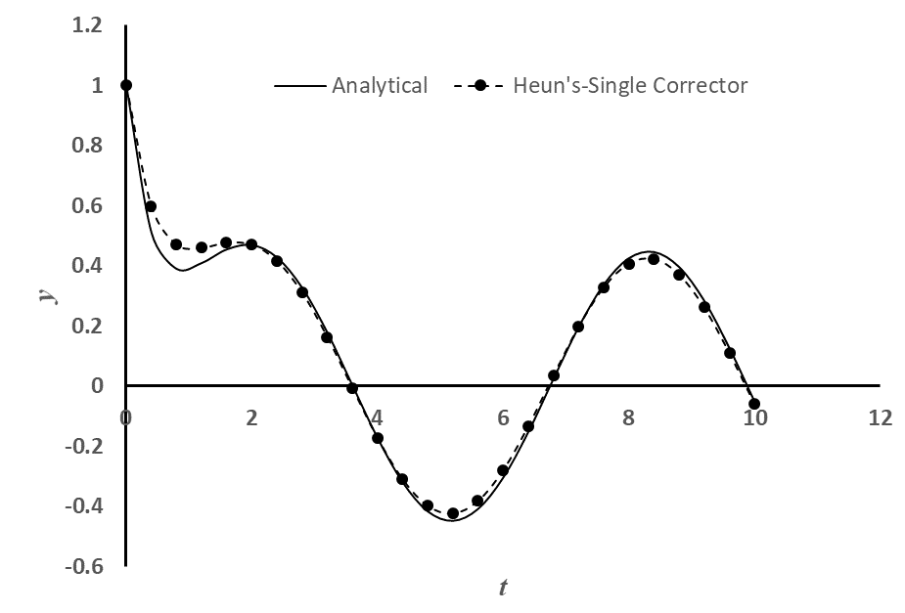
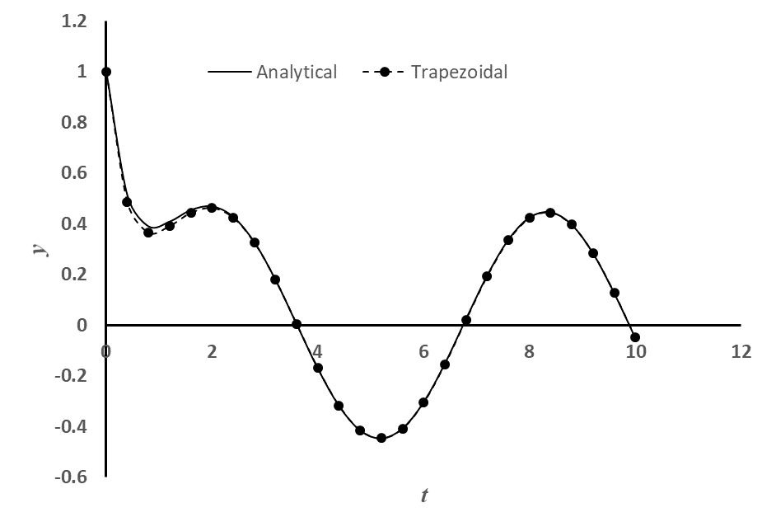
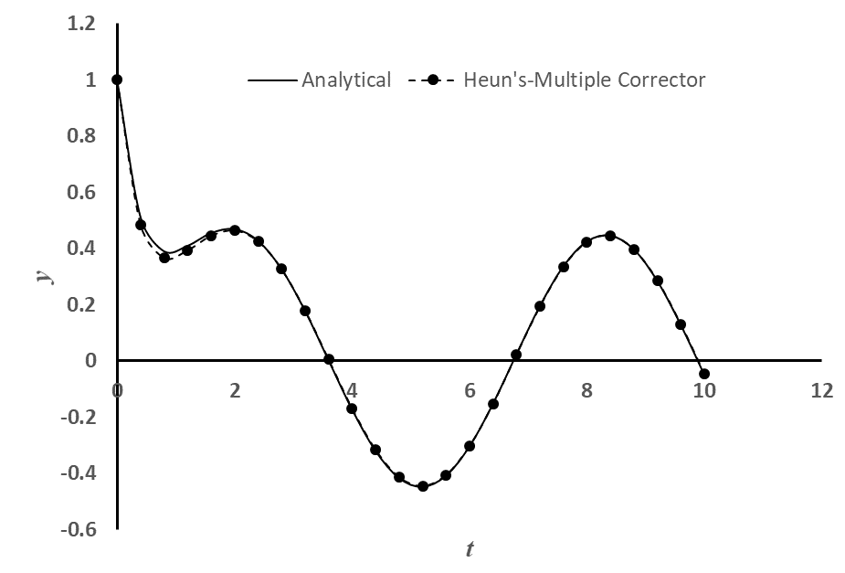
Predictor-Corrector: Heun’s Methods Comparison
,

Slide 28
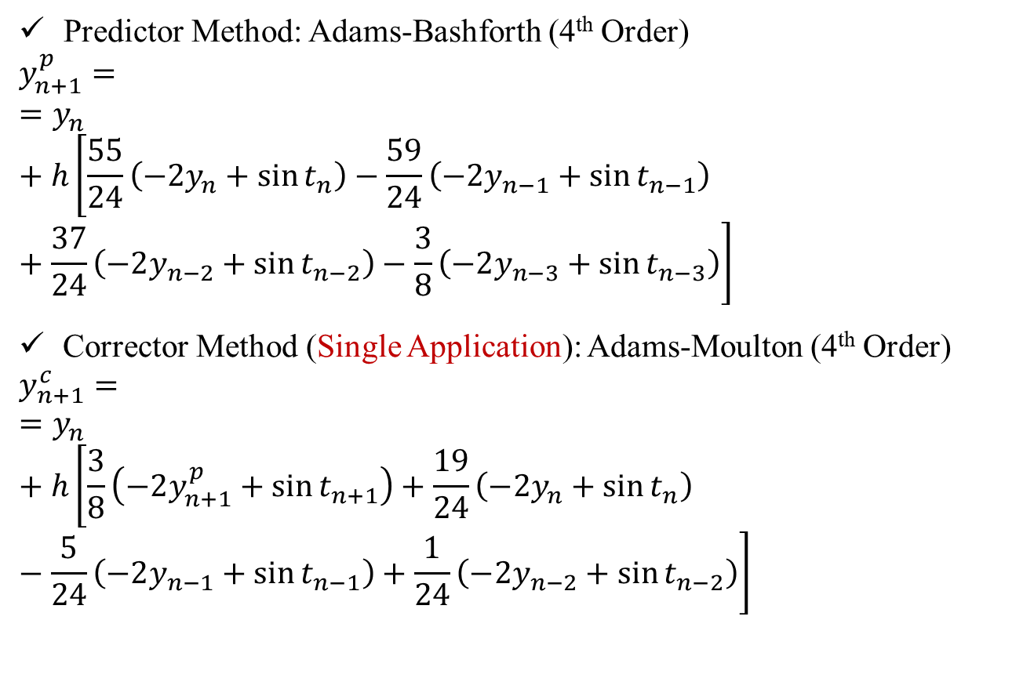
Predictor-Corrector: Adams Method
Predictor Method: Adams-Bashforth (4th Order)
$$y_{n+1}^{p}==y_{n}+h\left[\frac{55}{24}\left(−2y_{n}+\sin{t_{n}}\right)−\frac{59}{24}\left(−2y_{n−1}+\sin{t_{n−1}}\right)+\frac{37}{24}\left(−2y_{n−2}+\sin{t_{n−2}}\right)−\frac{3}{8}\left(−2y_{n−3}+\sin{t_{n−3}}\right)\right]$$
Corrector Method (Single Application): Adams-Moulton (4th Order)
$$y_{n+1}^{c}==y_{n}+h\left[\frac{3}{8}\left(−2y_{n+1}^{p}+\sin{t_{n+1}}\right)+\frac{19}{24}\left(−2y_{n}+\sin{t_{n}}\right)−\frac{5}{24}\left(−2y_{n−1}+\sin{t_{n−1}}\right)+\frac{1}{24}\left(−2y_{n−2}+\sin{t_{n−2}}\right)\right]$$

Slide 29
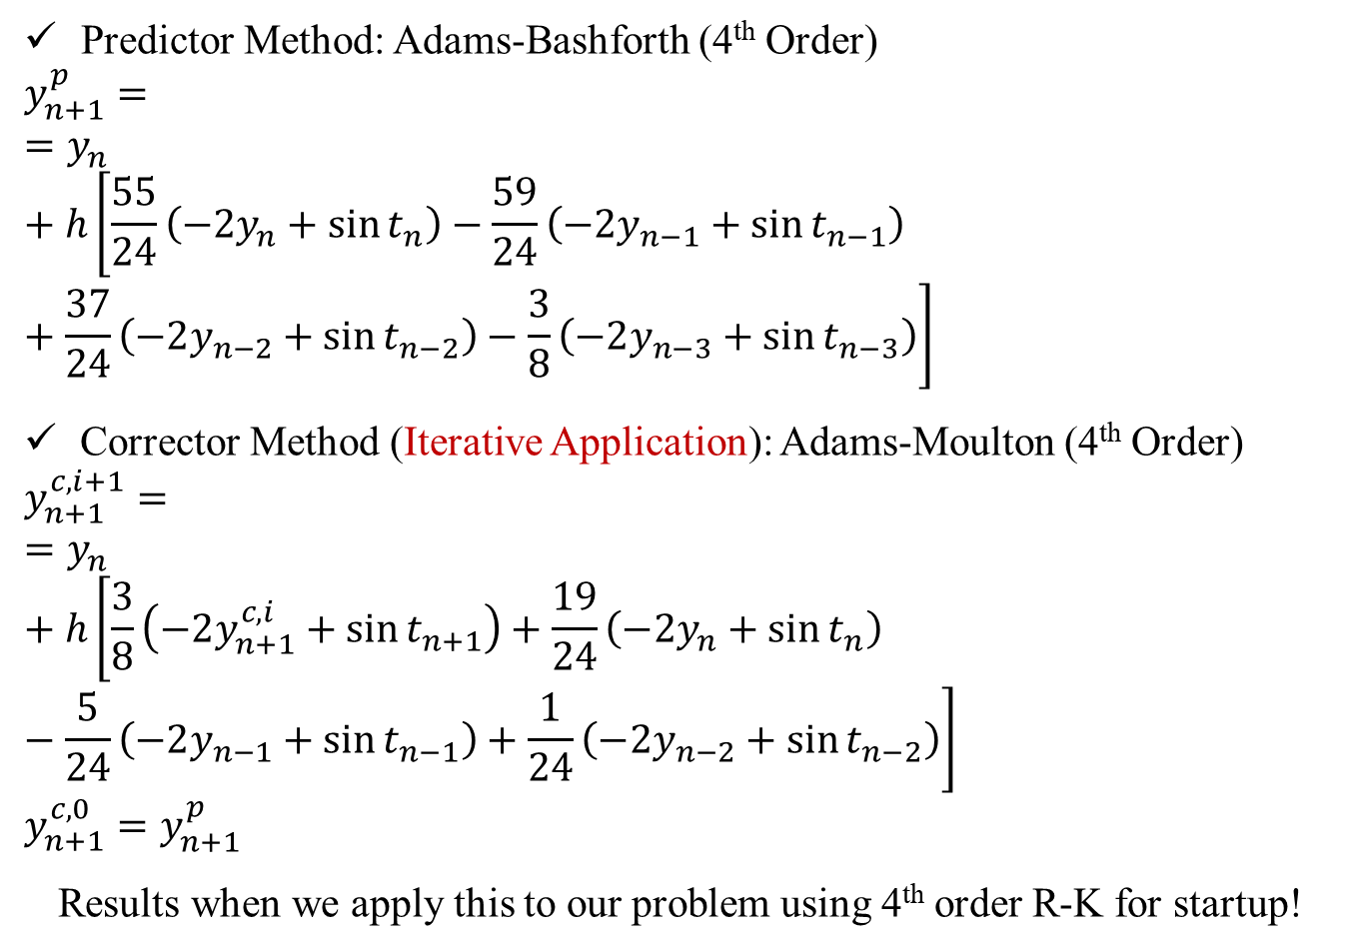
Predictor-Corrector: Adams Method
Predictor Method: Adams-Bashforth (4th Order)
$$y_{n+1}^{p}==y_{n}+h\left[\frac{55}{24}\left(−2y_{n}+\sin{t_{n}}\right)−\frac{59}{24}\left(−2y_{n−1}+\sin{t_{n−1}}\right)+\frac{37}{24}\left(−2y_{n−2}+\sin{t_{n−2}}\right)−\frac{3}{8}\left(−2y_{n−3}+\sin{t_{n−3}}\right)\right]$$
Corrector Method (Iterative Application): Adams-Moulton (4th Order)
$$y_{n+1}^{c,i+1}==y_{n}+h\left[\frac{3}{8}\left(−2y_{n+1}^{c,i}+\sin{t_{n+1}}\right)+\frac{19}{24}\left(−2y_{n}+\sin{t_{n}}\right)−\frac{5}{24}\left(−2y_{n−1}+\sin{t_{n−1}}\right)+\frac{1}{24}\left(−2y_{n−2}+\sin{t_{n−2}}\right)\right]$$
$$y_{n+1}^{c, 0}=y_{n+1}^{p}$$
Results when we apply this to our problem using 4th order R-K for startup!

Slide 30
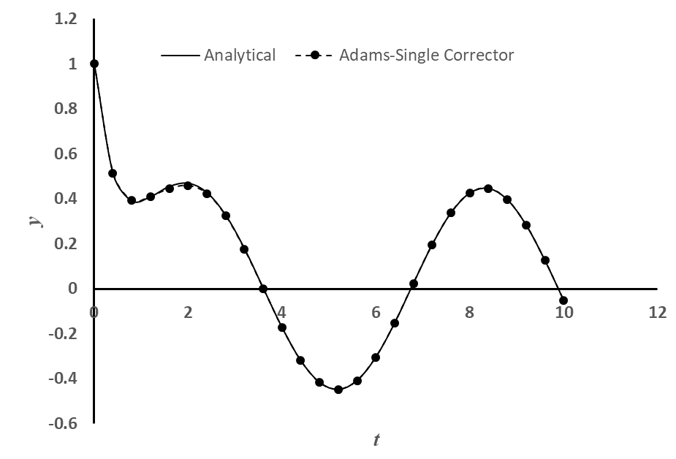

Predictor-Corrector: Adams Methods Comparison
,

Slide 31
Combination Methods: Predictor-Corrector
Predictor-Corrector methods only avoid the solution of non-linear equation. They still require appropriate startup to produce proper results!
Predictor-Corrector method have the same stability properties as the corrector method
Adams-Bashforth (4th order) was unstable for this problem with h = 0.4 but the predictor-corrector method produced correct results because of the influence of the corrector method Adams-Moulton (4th order), which was stable!
Iterative application of corrector produces more accurate results but at the expense of higher FLOPs.

Slide 32
Applications: Summary of Concerns
Accuracy of the higher order multi-step and BDF methods are affected if the starting values are used from the lower order methods.
How to start these non-self starting algorithms?
All implicit methods (multi-step and BDF) may involve solution of non-linear equations (if f contains a non-linear function of the dependent variable y)
Is there a way to avoid this solution of non-linear equations?
Numerical oscillations (instability) observed in some methods and not in some!
Is there a way to predict and therefore, choose correct parameters for algorithm so that the numerical oscillations can be avoided?
We will do Convergence Analysis!

Slide 33

ESO 208A: Computational Methods in Engineering Ordinary Differential Equation: Boundary Value Problems
Abhas Singh
Department of Civil Engineering
IIT Kanpur
Acknowledgements: Profs. Saumyen Guha and Shivam Tripathi (CE)

Slide 34
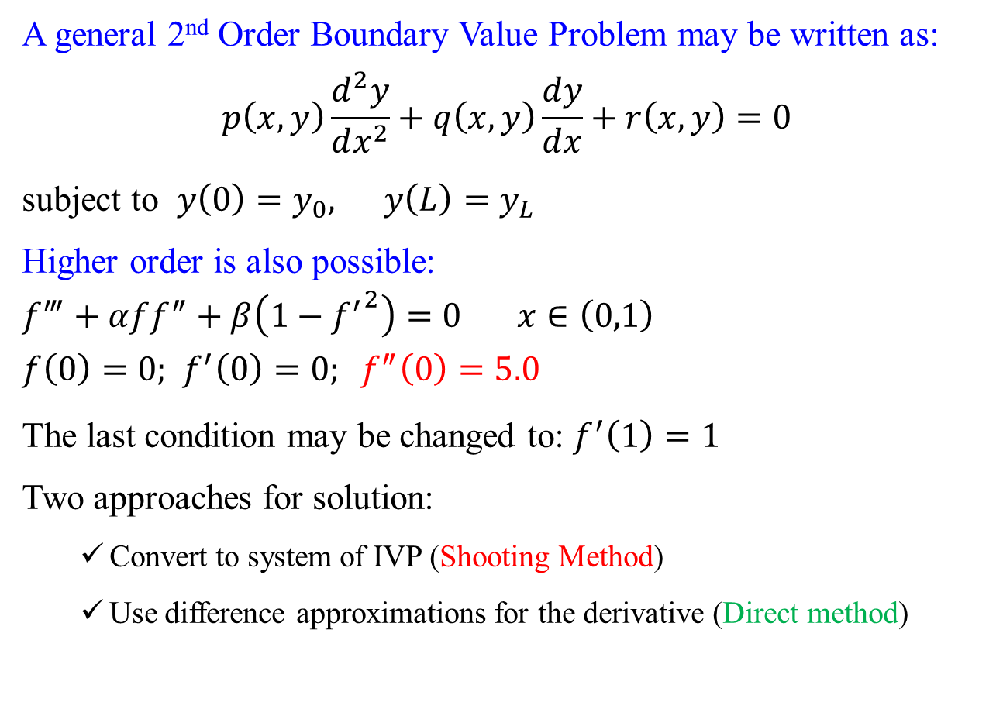
Boundary Value Problems
A general 2nd Order Boundary Value Problem may be written as:
$$p\left(x,y\right)\frac{d^{2}y}{dx^{2}}+q\left(x,y\right)\frac{dy}{dx}+r\left(x,y\right)=0$$
subject to $y\left(0\right)=y_{0}, y\left(L\right)=y_{L}$
Higher order is also possible:
$$f^{‴}+αff^{″}+β\left(1−{f^{′}}^{2}\right)=0 x∈\left(0,1\right)$$
$$f\left(0\right)=0\text{; } f^{′}\left(0\right)=0; f^{″}\left(0\right)=5.0$$
The last condition may be changed to: $f^{′}\left(1\right)=1$
Two approaches for solution:
Convert to system of IVP (Shooting Method)
Use difference approximations for the derivative (Direct method)

Slide 35
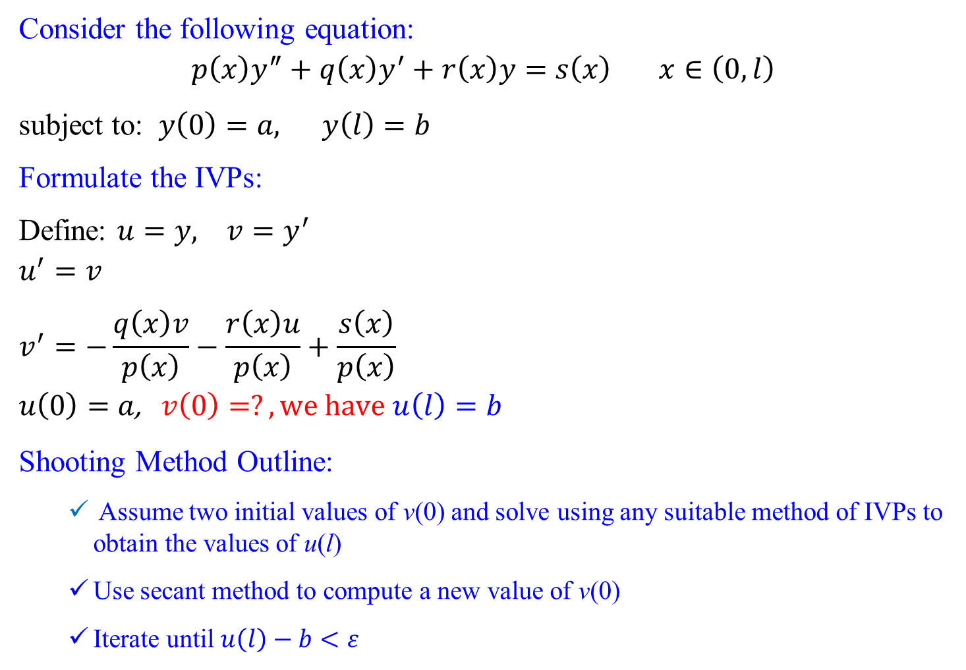
Shooting Method
Consider the following equation:
$$p\left(x\right)y^{″}+q\left(x\right)y^{′}+r\left(x\right)y=s\left(x\right) x∈\left(0,l\right)$$
subject to: $y\left(0\right)=a, y\left(l\right)=b$
Formulate the IVPs:
Define: $u=y, v=y^{′}$
$$u^{′}=v$$
$$v^{′}=−\frac{q\left(x\right)v}{p\left(x\right)}−\frac{r\left(x\right)u}{p\left(x\right)}+\frac{s\left(x\right)}{p\left(x\right)}$$
$$u\left(0\right)=a\text{,} v\left(0\right)=?, we have u\left(l\right)=b$$
Shooting Method Outline:
Assume two initial values of v(0) and solve using any suitable method of IVPs to obtain the values of u(l)
Use secant method to compute a new value of v(0)
Iterate until $u\left(l\right)−b<ε$

Slide 36
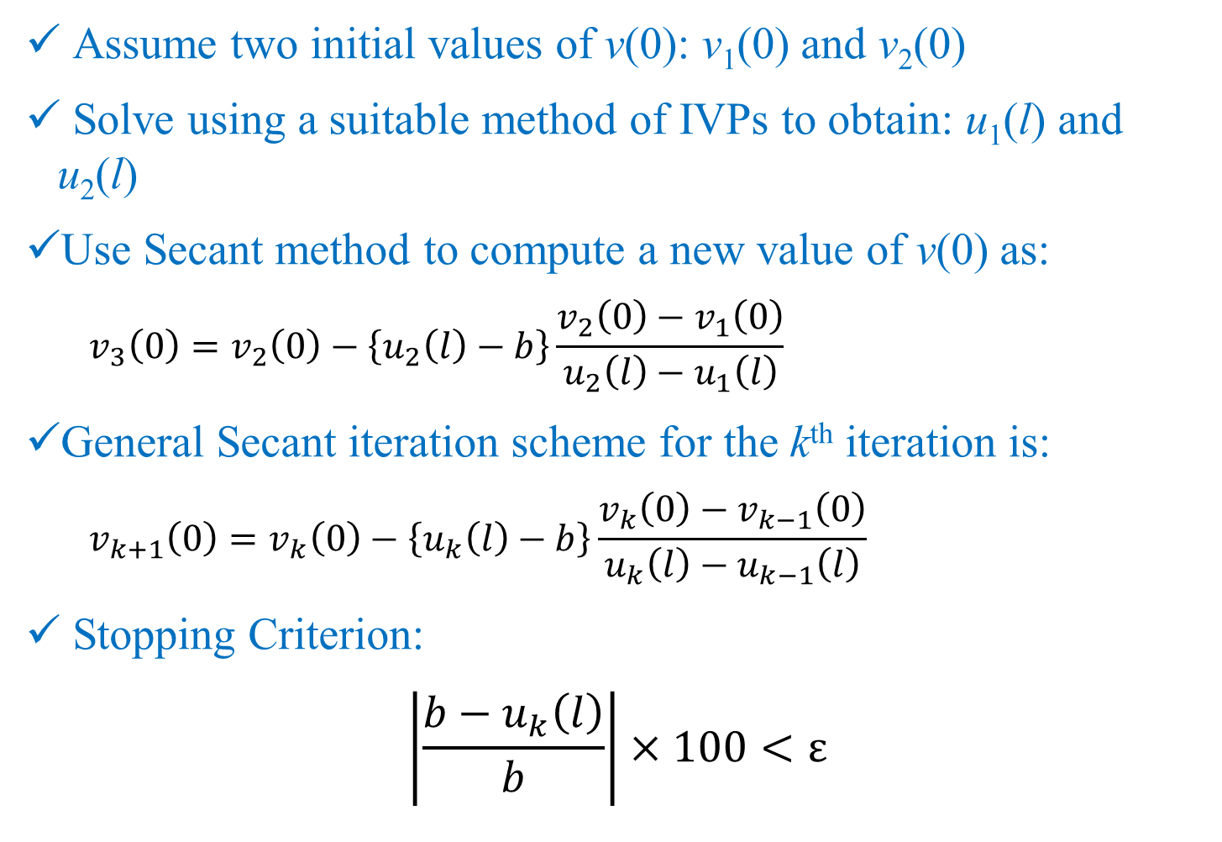
Shooting Method
Assume two initial values of v(0): v₁(0) and v₂(0)
Solve using a suitable method of IVPs to obtain: u₁(l) and u₂(l)
Use Secant method to compute a new value of v(0) as:
$$v_{3}\left(0\right)=v_{2}\left(0\right)−\left\{u_{2}\left(l\right)−b\right\}\frac{v_{2}\left(0\right)−v_{1}\left(0\right)}{u_{2}\left(l\right)−u_{1}\left(l\right)}$$
General Secant iteration scheme for the k^{th} iteration is:
$$v_{k+1}\left(0\right)=v_{k}\left(0\right)−\left\{u_{k}\left(l\right)−b\right\}\frac{v_{k}\left(0\right)−v_{k−1}\left(0\right)}{u_{k}\left(l\right)−u_{k−1}\left(l\right)}$$
Stopping Criterion:
$$\left|\frac{b−u_{k}\left(l\right)}{b}\right|×100<ε$$

Slide 37
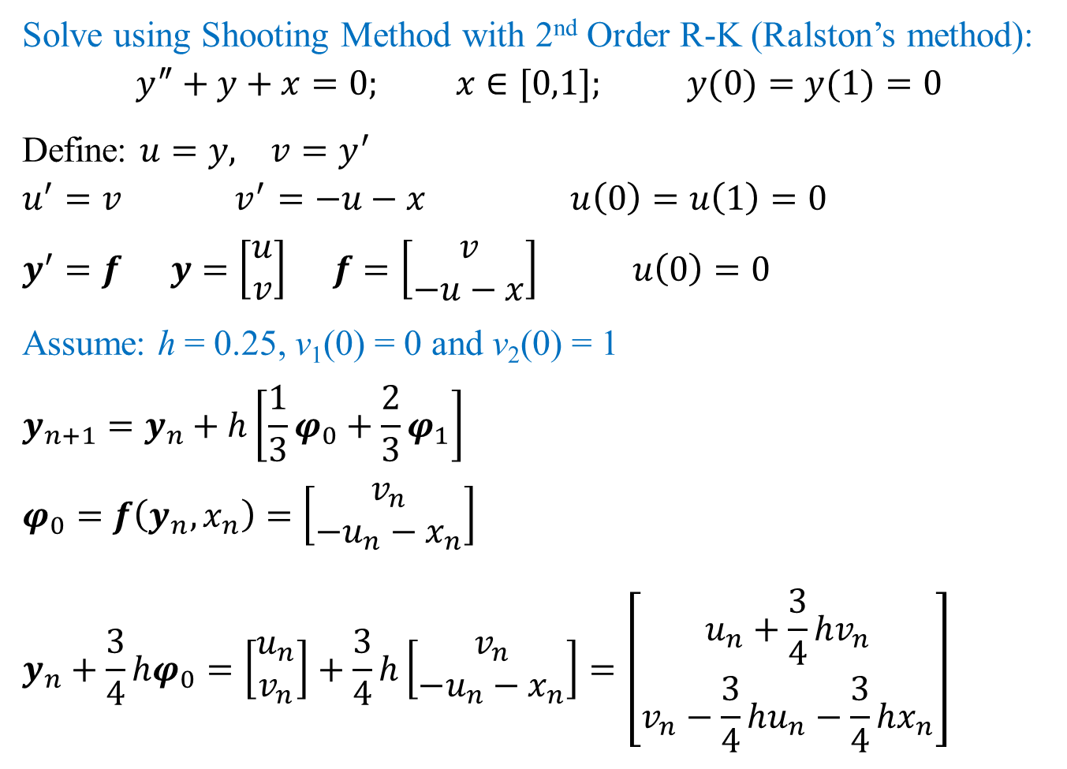
Shooting Method: Example
Solve using Shooting Method with 2nd Order R-K (Ralston’s method):
$$y^{″}+y+x=0; x∈[0,1]; y(0)=y(1)=0$$
Define: $u=y, v=y^{′}$
$$u^{′}=v v^{′}=−u−x u\left(0\right)=u\left(1\right)=0$$
$$y^{′}=f y=\left[\begin{matrix}u \\ v\end{matrix}\right] f=\left[\begin{matrix}v \\ −u−x\end{matrix}\right] u\left(0\right)=0$$
Assume: h = 0.25, v₁(0) = 0 and v₂(0) = 1
$$y_{n+1}=y_{n}+h\left[\frac{1}{3}φ_{0}+\frac{2}{3}φ_{1}\right]$$
$$φ_{0}=f\left(y_{n},x_{n}\right)=\left[\begin{matrix}v_{n} \\ −u_{n}−x_{n}\end{matrix}\right]$$
$$y_{n}+\frac{3}{4}hφ_{0}=\left[\begin{matrix}u_{n} \\ v_{n}\end{matrix}\right]+\frac{3}{4}h\left[\begin{matrix}v_{n} \\ −u_{n}−x_{n}\end{matrix}\right]=\left[\begin{matrix}u_{n}+\frac{3}{4}hv_{n} \\ v_{n}−\frac{3}{4}hu_{n}−\frac{3}{4}hx_{n}\end{matrix}\right]$$

Slide 38
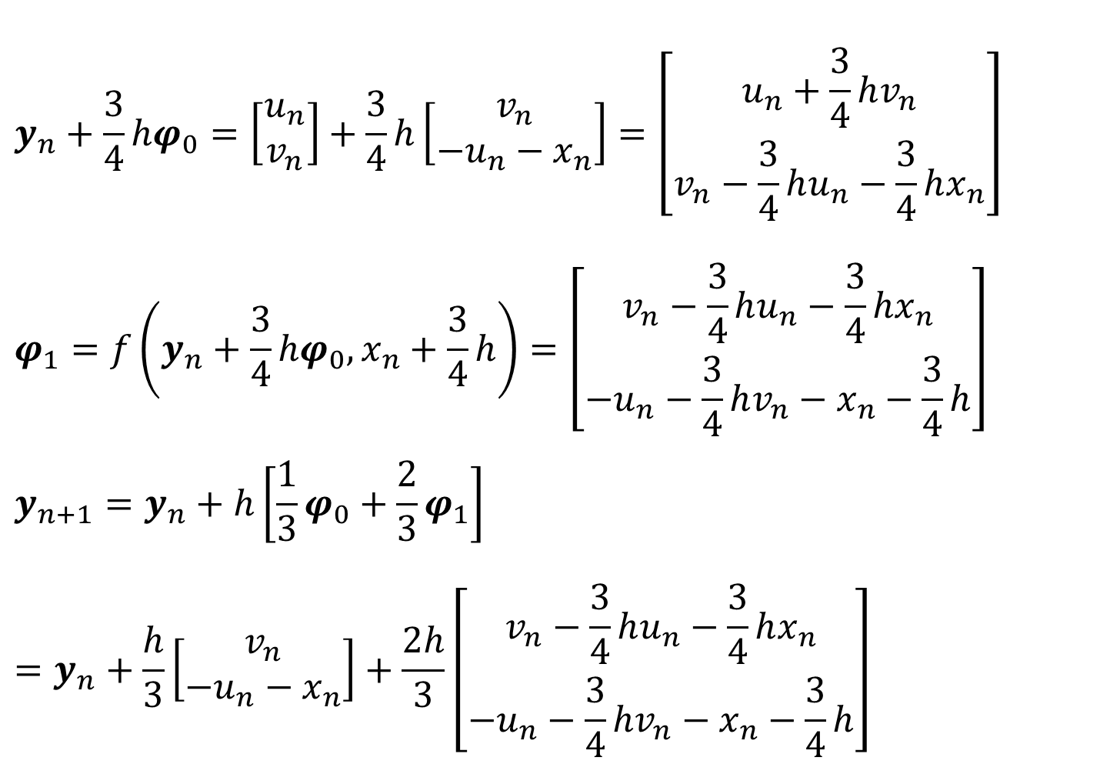
Shooting Method: Example
$$y_{n}+\frac{3}{4}hφ_{0}=\left[\begin{matrix}u_{n} \\ v_{n}\end{matrix}\right]+\frac{3}{4}h\left[\begin{matrix}v_{n} \\ −u_{n}−x_{n}\end{matrix}\right]=\left[\begin{matrix}u_{n}+\frac{3}{4}hv_{n} \\ v_{n}−\frac{3}{4}hu_{n}−\frac{3}{4}hx_{n}\end{matrix}\right]$$
$$φ_{1}=f\left(y_{n}+\frac{3}{4}hφ_{0},x_{n}+\frac{3}{4}h\right)=\left[\begin{matrix}v_{n}−\frac{3}{4}hu_{n}−\frac{3}{4}hx_{n} \\ −u_{n}−\frac{3}{4}hv_{n}−x_{n}−\frac{3}{4}h\end{matrix}\right]$$
$$y_{n+1}=y_{n}+h\left[\frac{1}{3}φ_{0}+\frac{2}{3}φ_{1}\right]=y_{n}+\frac{h}{3}\left[\begin{matrix}v_{n} \\ −u_{n}−x_{n}\end{matrix}\right]+\frac{2h}{3}\left[\begin{matrix}v_{n}−\frac{3}{4}hu_{n}−\frac{3}{4}hx_{n} \\ −u_{n}−\frac{3}{4}hv_{n}−x_{n}−\frac{3}{4}h\end{matrix}\right]$$

Slide 39
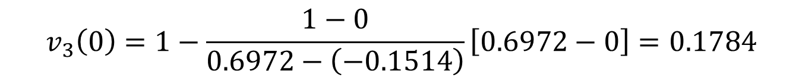
v1(0)= | 0.0000
x | u = y | v | φ01 | φ02 | φ11 | φ12
0 | 0.0000 | 0.0000 | 0.0000 | 0.0000 | 0.0000 | -0.1875
0.25 | 0.0000 | -0.0313 | -0.0313 | -0.2500 | -0.0781 | -0.4316
0.5 | -0.0156 | -0.1240 | -0.1240 | -0.4844 | -0.2148 | -0.6486
0.75 | -0.0618 | -0.2725 | -0.2725 | -0.6882 | -0.4015 | -0.8246
1 | -0.1514 | -0.4673
v2(0)= | 1.0000
x | u = y | v | φ01 | φ02 | φ11 | φ12
0 | 0.0000 | 1.0000 | 1.0000 | 0.0000 | 1.0000 | -0.3750
0.25 | 0.2500 | 0.9375 | 0.9375 | -0.5000 | 0.8438 | -0.8633
0.5 | 0.4688 | 0.7520 | 0.7520 | -0.9688 | 0.5703 | -1.2972
0.75 | 0.6265 | 0.4550 | 0.4550 | -1.3765 | 0.1969 | -1.6493
1 | 0.6972 | 0.0654
$$v_{3}\left(0\right)=1−\frac{1−0}{0.6972−\left(−0.1514\right)}\left[0.6972−0\right]=0.1784$$

Slide 40
v3(0)= | 0.1784
x | u | v | φ01 | φ02 | φ11 | φ12
0 | 0.0000 | 0.1784 | 0.1784 | 0.0000 | 0.1784 | -0.2210
0.25 | 0.0446 | 0.1416 | 0.1416 | -0.2946 | 0.0863 | -0.5086
0.5 | 0.0708 | 0.0323 | 0.0323 | -0.5708 | -0.0748 | -0.7643
0.75 | 0.0610 | -0.1427 | -0.1427 | -0.8110 | -0.2948 | -0.9718
1 | 0.0000 | -0.3722
Right BC is satisfied. So, we may stop.

Slide 41
Direct Method
Choose grid size (h) and divide the spatial domain (a, b) into n-intervals with (n + 1) nodes, n = (b – a)/h
Alternatively, choose n and estimate, h = (b – a)/n
Choose order and type of approximation, i.e. forward/backward/central difference approximations for the derivatives
Both are governed by practical problem requirements!

Slide 42
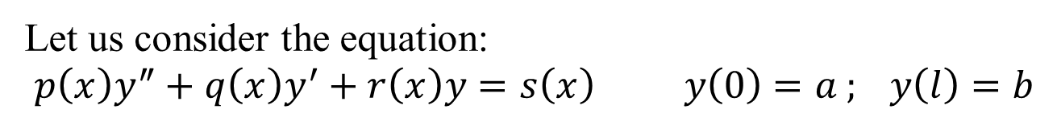
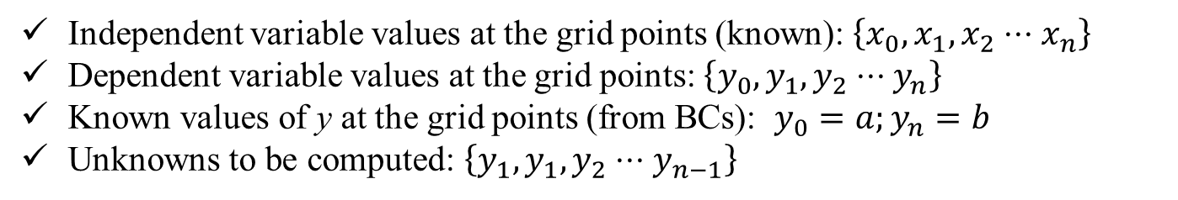
Direct Method
Let us consider the equation:
$$p\left(x\right)y^{″}+q\left(x\right)y^{′}+r\left(x\right)y=s\left(x\right) y\left(0\right)=a ; y\left(l\right)=b$$
Independent variable values at the grid points (known): $\left\{x_{0},x_{1},x_{2}⋅⋅⋅x_{n}\right\}$
Dependent variable values at the grid points: $\left\{y_{0},y_{1},y_{2}⋅⋅⋅y_{n}\right\}$
Known values of y at the grid points (from BCs): $y_{0}=a;y_{n}=b$
Unknowns to be computed: $\left\{y_{1},y_{1},y_{2}⋅⋅⋅y_{n−1}\right\}$

Slide 43
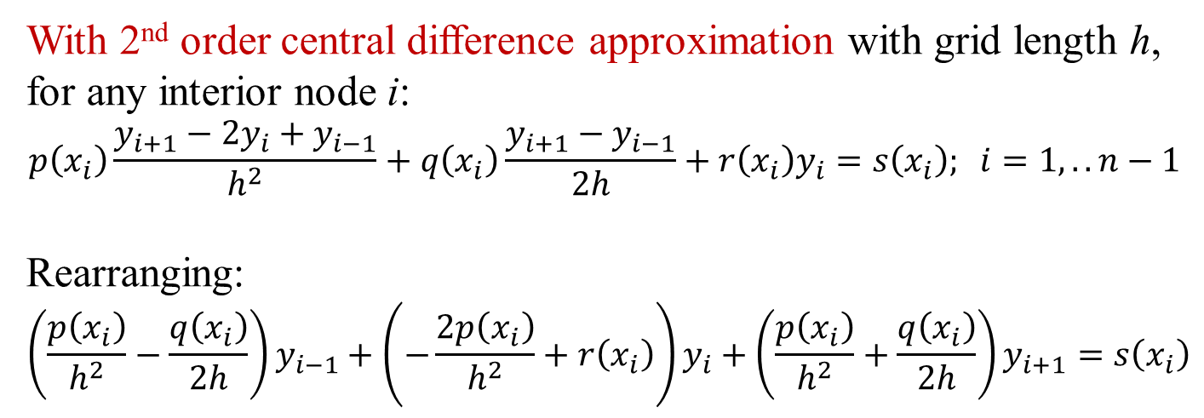
Direct Method
$$p\left(x\right)y^{″}+q\left(x\right)y^{′}+r\left(x\right)y=s\left(x\right) y\left(0\right)=a ; y\left(l\right)=b$$
With 2nd order central difference approximation with grid length h, for any interior node i:
$$p\left(x_{i}\right)\frac{y_{i+1}−2y_{i}+y_{i−1}}{h^{2}}+q\left(x_{i}\right)\frac{y_{i+1}−y_{i−1}}{2h}+r\left(x_{i}\right)y_{i}=s\left(x_{i}\right); i=1,..n−1$$
Rearranging:
$$\left(\frac{p\left(x_{i}\right)}{h^{2}}−\frac{q\left(x_{i}\right)}{2h}\right)y_{i−1}+\left(−\frac{2p\left(x_{i}\right)}{h^{2}}+r\left(x_{i}\right)\right)y_{i}+\left(\frac{p\left(x_{i}\right)}{h^{2}}+\frac{q\left(x_{i}\right)}{2h}\right)y_{i+1}=s\left(x_{i}\right)$$

Slide 44
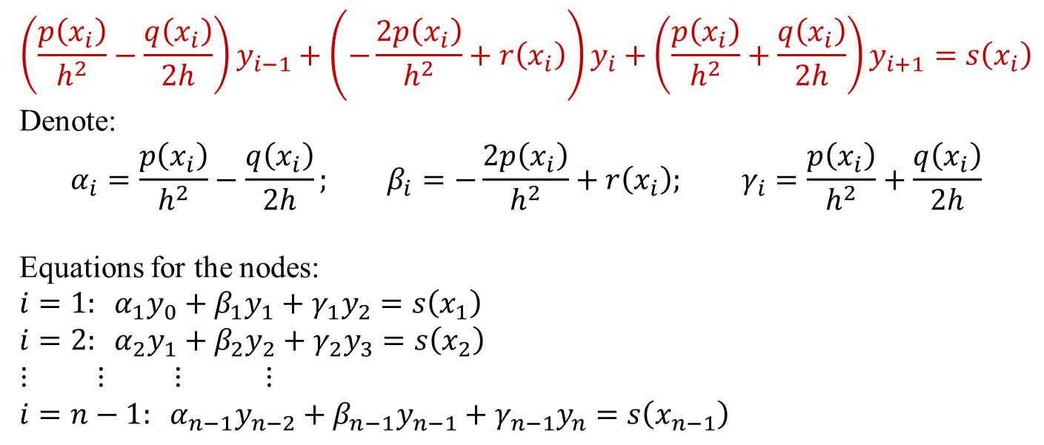
Direct Method
$$\left(\frac{p\left(x_{i}\right)}{h^{2}}−\frac{q\left(x_{i}\right)}{2h}\right)y_{i−1}+\left(−\frac{2p\left(x_{i}\right)}{h^{2}}+r\left(x_{i}\right)\right)y_{i}+\left(\frac{p\left(x_{i}\right)}{h^{2}}+\frac{q\left(x_{i}\right)}{2h}\right)y_{i+1}=s\left(x_{i}\right)$$
Denote:
$$α_{i}=\frac{p\left(x_{i}\right)}{h^{2}}−\frac{q\left(x_{i}\right)}{2h}; β_{i}=−\frac{2p\left(x_{i}\right)}{h^{2}}+r\left(x_{i}\right)\text{;} γ_{i}=\frac{p\left(x_{i}\right)}{h^{2}}+\frac{q\left(x_{i}\right)}{2h}$$
Equations for the nodes:
$$i=1: α_{1}y_{0}+β_{1}y_{1}+γ_{1}y_{2}=s\left(x_{1}\right)$$
$$i=2: α_{2}y_{1}+β_{2}y_{2}+γ_{2}y_{3}=s\left(x_{2}\right)$$
$$⋮ ⋮ ⋮ ⋮$$
$$i=n−1: α_{n−1}y_{n−2}+β_{n−1}y_{n−1}+γ_{n−1}y_{n}=s\left(x_{n−1}\right)$$

Slide 45
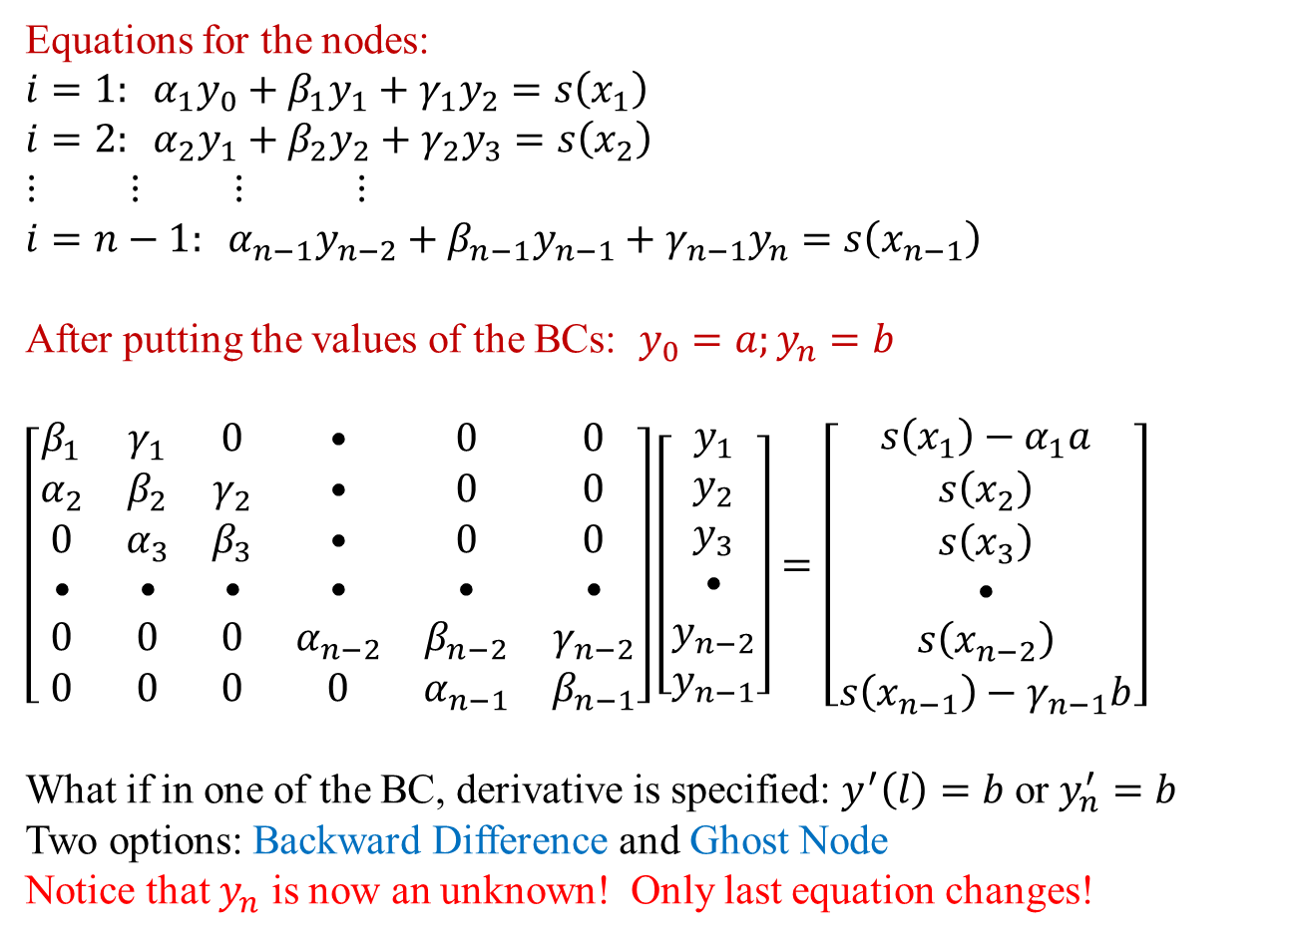
Direct Method
Equations for the nodes:
$$i=1: α_{1}y_{0}+β_{1}y_{1}+γ_{1}y_{2}=s\left(x_{1}\right)$$
$$i=2: α_{2}y_{1}+β_{2}y_{2}+γ_{2}y_{3}=s\left(x_{2}\right)$$
$$⋮ ⋮ ⋮ ⋮$$
$$i=n−1: α_{n−1}y_{n−2}+β_{n−1}y_{n−1}+γ_{n−1}y_{n}=s\left(x_{n−1}\right)$$
After putting the values of the BCs: $y_{0}=a;y_{n}=b$
$$\left[\begin{matrix}β_{1} & γ_{1} & 0 & • & 0 & 0 \\ α_{2} & β_{2} & γ_{2} & • & 0 & 0 \\ 0 & α_{3} & β_{3} & • & 0 & 0 \\ • & • & • & • & • & • \\ 0 & 0 & 0 & α_{n−2} & β_{n−2} & γ_{n−2} \\ 0 & 0 & 0 & 0 & α_{n−1} & β_{n−1}\end{matrix}\right]\left[\begin{matrix}y_{1} \\ y_{2} \\ y_{3} \\ • \\ y_{n−2} \\ y_{n−1}\end{matrix}\right]=\left[\begin{matrix}s\left(x_{1}\right)−α_{1}a \\ s\left(x_{2}\right) \\ s\left(x_{3}\right) \\ • \\ s\left(x_{n−2}\right) \\ s\left(x_{n−1}\right)−γ_{n−1}b\end{matrix}\right]$$
What if in one of the BC, derivative is specified: $y^{′}\left(l\right)=b$ or $y_{n}^{′}=b$
Two options: Backward Difference and Ghost Node
Notice that $y_{n}$ is now an unknown! Only last equation changes!

Slide 46
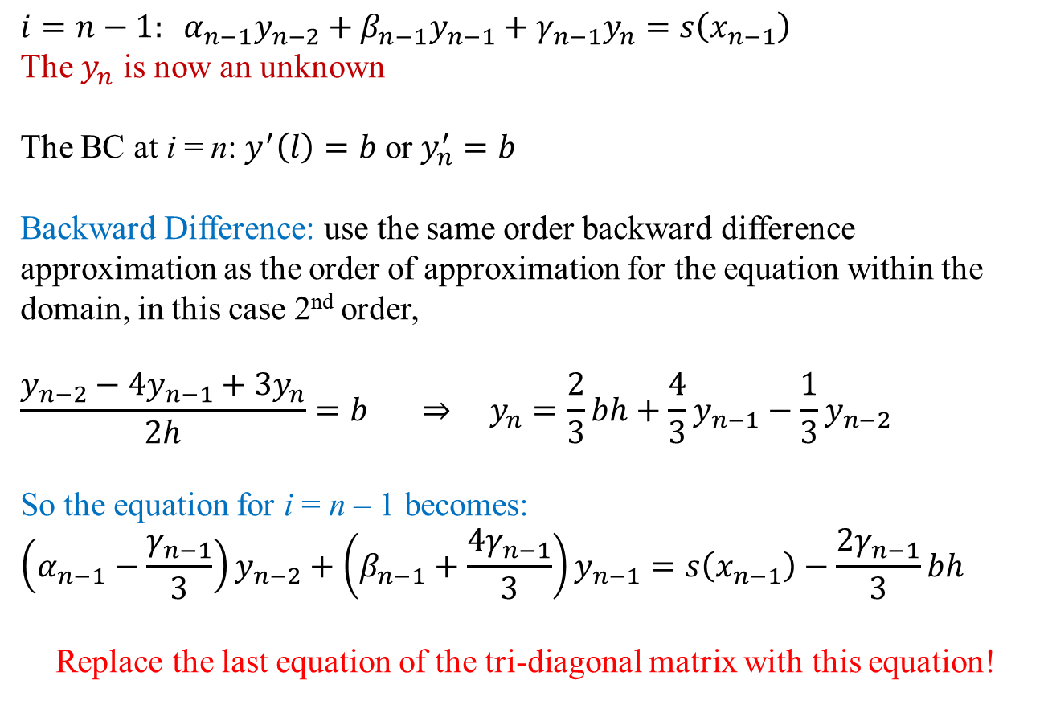
Direct Method
$$i=n−1: α_{n−1}y_{n−2}+β_{n−1}y_{n−1}+γ_{n−1}y_{n}=s\left(x_{n−1}\right)$$
The $y_{n}$ is now an unknown
The BC at i = n: $y^{′}\left(l\right)=b$ or $y_{n}^{′}=b$
Backward Difference: use the same order backward difference approximation as the order of approximation for the equation within the domain, in this case 2nd order,
$$\frac{y_{n−2}−4y_{n−1}+3y_{n}}{2h}=b ⇒ y_{n}=\frac{2}{3}bh+\frac{4}{3}y_{n−1}−\frac{1}{3}y_{n−2}$$
So the equation for i = n – 1 becomes:
$$\left(α_{n−1}−\frac{γ_{n−1}}{3}\right)y_{n−2}+\left(β_{n−1}+\frac{{4γ}_{n−1}}{3}\right)y_{n−1}=s\left(x_{n−1}\right)−\frac{2γ_{n−1}}{3}bh$$
Replace the last equation of the tri-diagonal matrix with this equation!

Slide 47
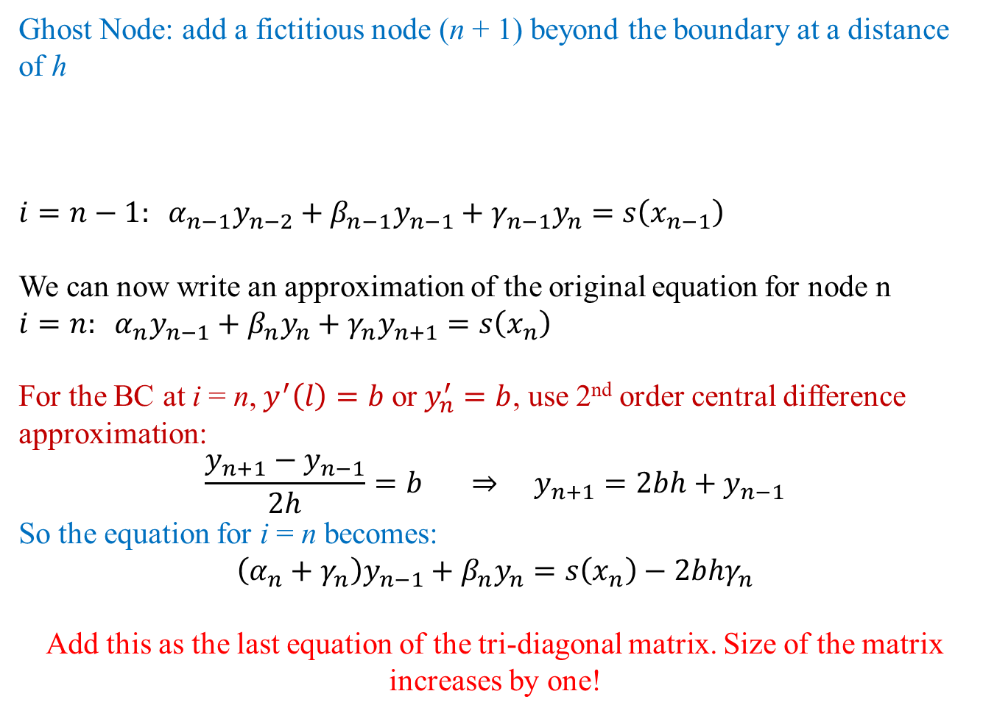
Direct Method
Ghost Node: add a fictitious node (n + 1) beyond the boundary at a distance of h
$$i=n−1: α_{n−1}y_{n−2}+β_{n−1}y_{n−1}+γ_{n−1}y_{n}=s\left(x_{n−1}\right)$$
We can now write an approximation of the original equation for node n
$$i=n: α_{n}y_{n−1}+β_{n}y_{n}+γ_{n}y_{n+1}=s\left(x_{n}\right)$$
For the BC at i = n, $y^{′}\left(l\right)=b$ or $y_{n}^{′}=b$, use 2nd order central difference approximation:
$$\frac{y_{n+1}−y_{n−1}}{2h}=b ⇒ y_{n+1}=2bh+y_{n−1}$$
So the equation for i = n becomes:
$$\left(α_{n}+γ_{n}\right)y_{n−1}+β_{n}y_{n}=s\left(x_{n}\right)−2bhγ_{n}$$
Add this as the last equation of the tri-diagonal matrix. Size of the matrix increases by one!
n – 2
n – 1
n
n + 1

Slide 48
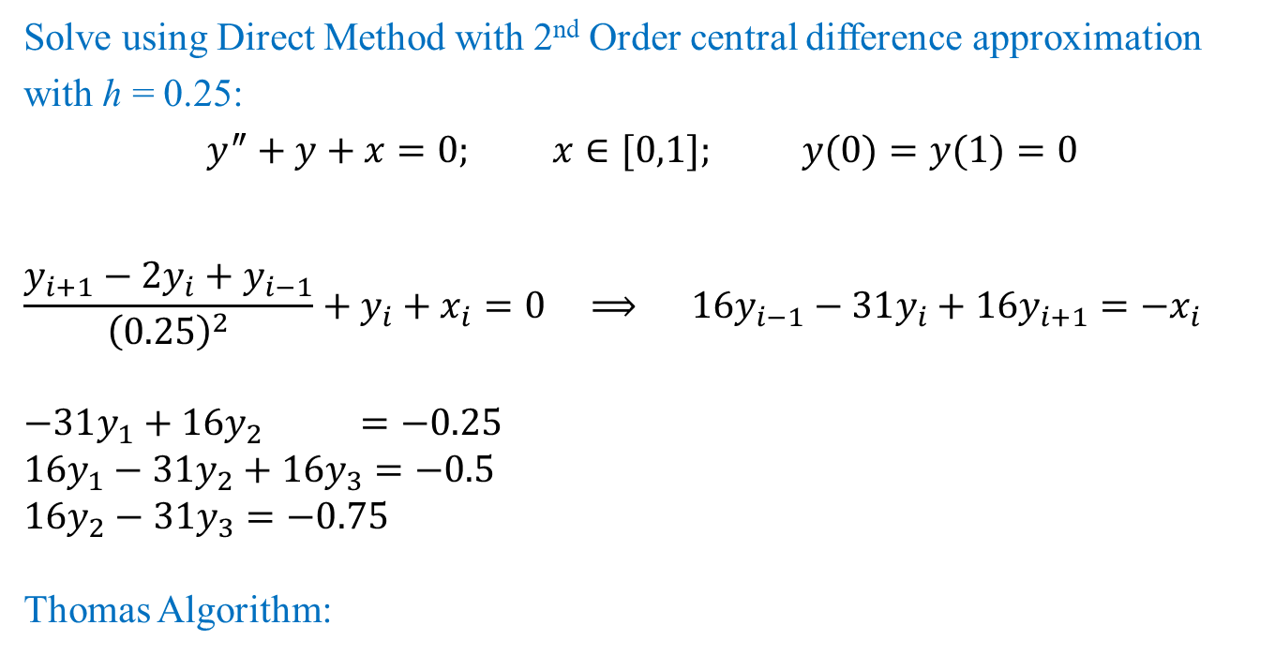
Direct Method: Example
Solve using Direct Method with 2nd Order central difference approximation with h = 0.25:
$$y^{″}+y+x=0; x∈[0,1]; y(0)=y(1)=0$$
$$\frac{y_{i+1}−2y_{i}+y_{i−1}}{{\left(0.25\right)}^{2}}+y_{i}+x_{i}=0 ⟹ 1\text{6}y_{i−1}−31y_{i}+16y_{i+1}=−x_{i}$$
$$−31y_{1}+16y_{2} =−0.25$$
$$16y_{1}−31y_{2}+16y_{3}=−0.5$$
$$1\text{6}y_{2}−31y_{3}=−0.75$$
Thomas Algorithm:
l | d | u | b | alpha | s | x
 | -31 | 16 | -0.25 | -31.0000 | -0.2500 | 0.0443
16 | -31 | 16 | -0.5 | -22.7419 | -0.6290 | 0.0702
16 | -31 |  | -0.75 | -19.7433 | -1.1926 | 0.0604

Slide 49
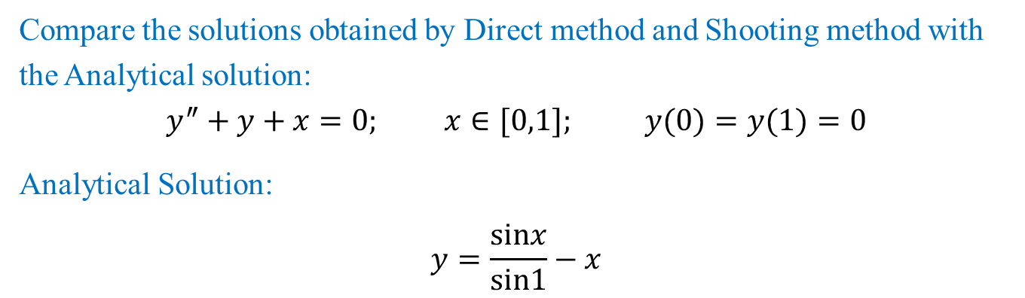
Direct Method: Example
Compare the solutions obtained by Direct method and Shooting method with the Analytical solution:
$$y^{″}+y+x=0; x∈[0,1]; y(0)=y(1)=0$$
Analytical Solution:
$$y=\frac{sinx}{sin1}−x$$
x | y | TRUE | Shooting | Error | Direct | Error
0 | y0 | 0 | 0 | 0 | 0 | 0
0.25 | y1 | 0.04401365 | 0.04460208 | 1.33691304 | 0.04427401 | 0.59154281
0.5 | y2 | 0.06974696 | 0.07079153 | 1.49764749 | 0.0701559 | 0.58631705
0.75 | y3 | 0.06005617 | 0.06101881 | 1.60290267 | 0.06040305 | 0.57759244
1 | y4 | 0 | 2.7756E-17 | 0 | 0 | 0
Can you identify, why the solution with shooting method using 2nd order R-K does not give good solution for this problem?

