Slide 1
Ordinary Differential Equation
The methods for Initial Value Problems (IVPs):
Multi-step Methods
Explicit: Euler Forward, Adams-Bashforth
Implicit: Euler Backward, Trapezoidal and Adams-Moulton
Backward Difference Formulae (BDF)
Runge-Kutta Methods
Applications, Startup, Combination Methods (Predictor-Corrector)
Consistency, Stability, Convergence
Application to System of ODEs
Boundary Value Problems (BVPs)
Shooting Method
Direct Methods

Slide 2

ESO 208A: Computational Methods in Engineering Ordinary Differential Equation: Boundary Value Problems
Abhas Singh
Department of Civil Engineering
IIT Kanpur
Acknowledgements: Profs. Saumyen Guha and Shivam Tripathi (CE)

Slide 3
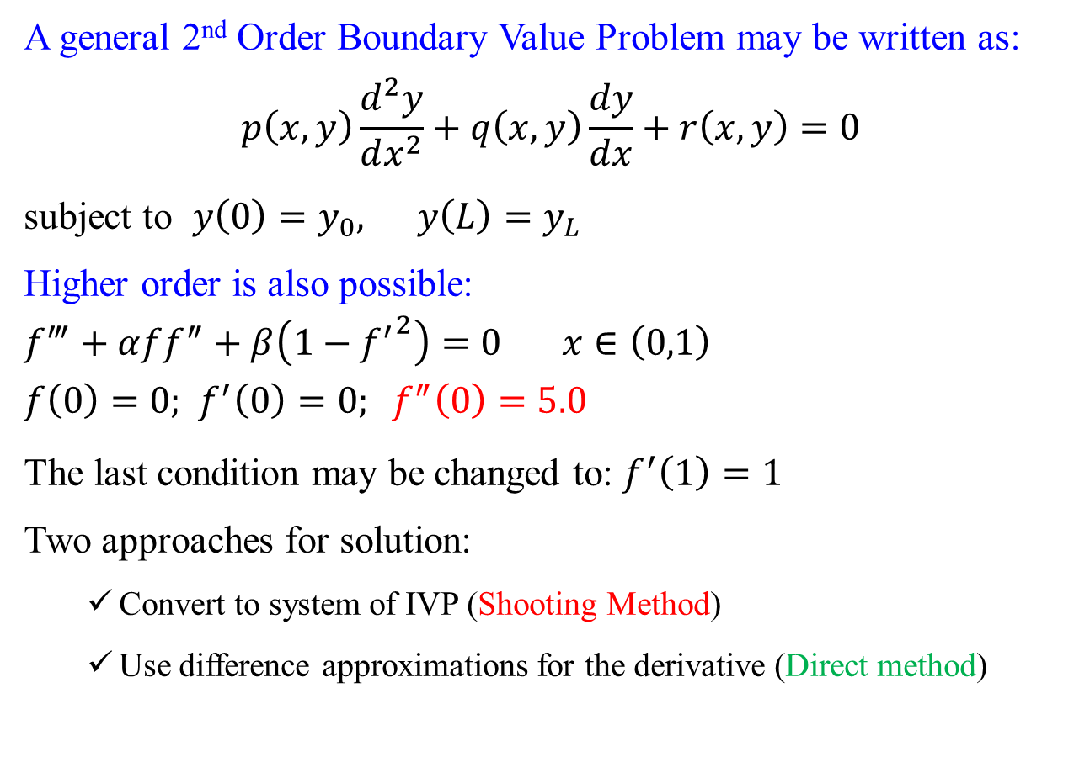
Boundary Value Problems
A general 2nd Order Boundary Value Problem may be written as:
$$p\left(x,y\right)\frac{d^{2}y}{dx^{2}}+q\left(x,y\right)\frac{dy}{dx}+r\left(x,y\right)=0$$
subject to $y\left(0\right)=y_{0}, y\left(L\right)=y_{L}$
Higher order is also possible:
$$f^{‴}+αff^{″}+β\left(1−{f^{′}}^{2}\right)=0 x∈\left(0,1\right)$$
$$f\left(0\right)=0\text{; } f^{′}\left(0\right)=0; f^{″}\left(0\right)=5.0$$
The last condition may be changed to: $f^{′}\left(1\right)=1$
Two approaches for solution:
Convert to system of IVP (Shooting Method)
Use difference approximations for the derivative (Direct method)

Slide 4
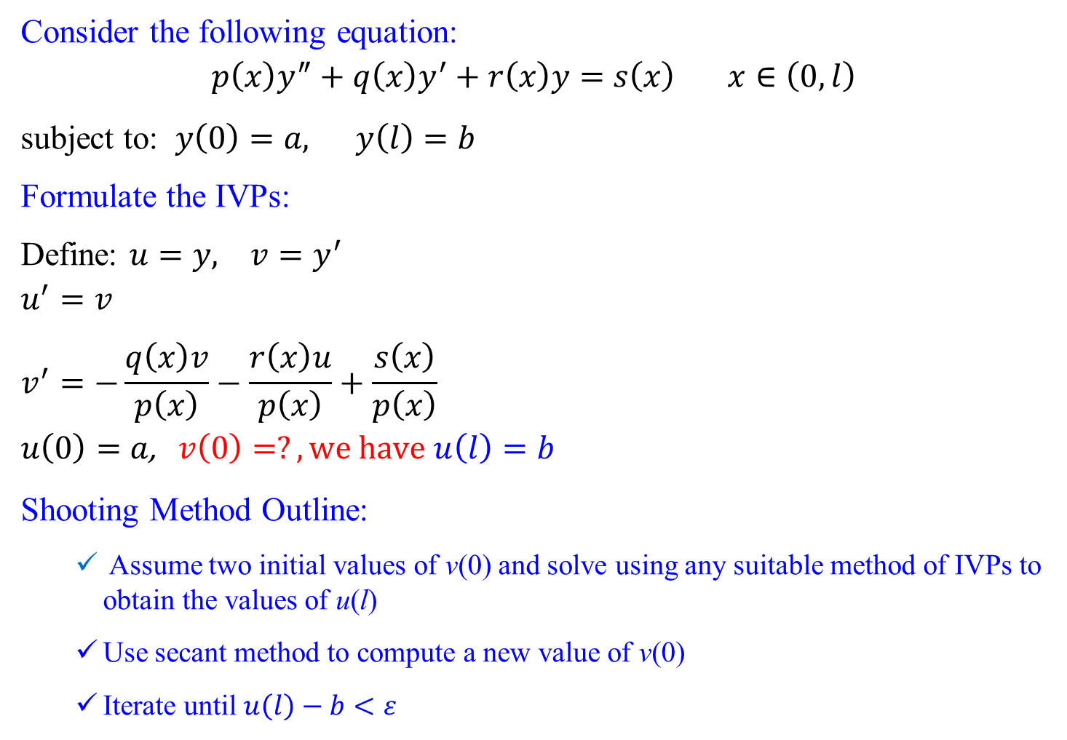
Shooting Method
Consider the following equation:
$$p\left(x\right)y^{″}+q\left(x\right)y^{′}+r\left(x\right)y=s\left(x\right) x∈\left(0,l\right)$$
subject to: $y\left(0\right)=a, y\left(l\right)=b$
Formulate the IVPs:
Define: $u=y, v=y^{′}$
$$u^{′}=v$$
$$v^{′}=−\frac{q\left(x\right)v}{p\left(x\right)}−\frac{r\left(x\right)u}{p\left(x\right)}+\frac{s\left(x\right)}{p\left(x\right)}$$
$$u\left(0\right)=a\text{,} v\left(0\right)=?, we have u\left(l\right)=b$$
Shooting Method Outline:
Assume two initial values of v(0) and solve using any suitable method of IVPs to obtain the values of u(l)
Use secant method to compute a new value of v(0)
Iterate until $u\left(l\right)−b<ε$

Slide 5
Open Methods: Secant (Recap)
Principle: Use a difference approximation for the slope or derivative in the Newton-Raphson method. This is equivalent to approximating the tangent with a secant.
Problem: f(x) = 0, find a root x = α such that f(α) = 0
f(x₀)
f(x₁)
f(x₂)
x₀
x₁
x₂
y = f(x)
x₃

Slide 6
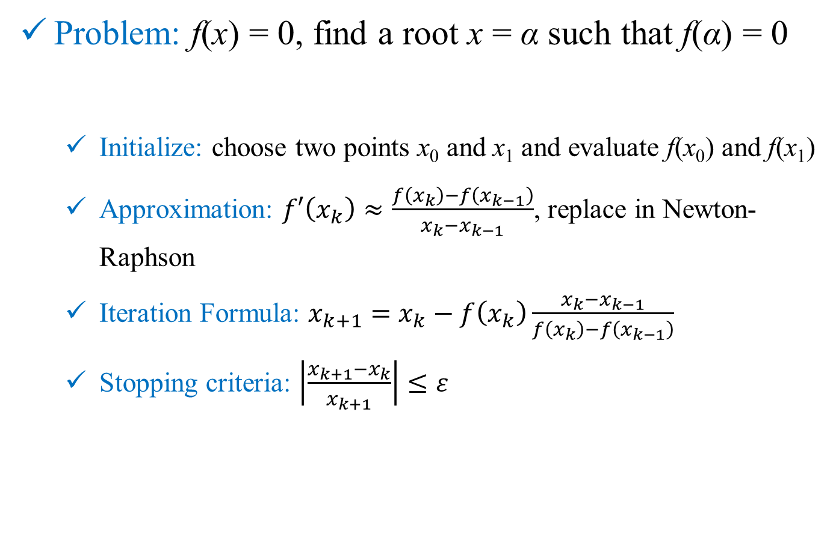
Open Methods: Secant (Recap)
Problem: f(x) = 0, find a root x = α such that f(α) = 0
Initialize: choose two points x₀ and x₁ and evaluate f(x₀) and f(x₁)
Approximation: $f′\left(x_{k}\right)≈\frac{f\left(x_{k}\right)−f\left(x_{k−1}\right)}{x_{k}−x_{k−1}}$, replace in Newton-Raphson
Iteration Formula: $x_{k+1}=x_{k}−f\left(x_{k}\right)\frac{x_{k}−x_{k−1}}{f\left(x_{k}\right)−f\left(x_{k−1}\right)}$
Stopping criteria: $\left|\frac{x_{k+1}−x_{k}}{x_{k+1}}\right|≤ε$

Slide 7
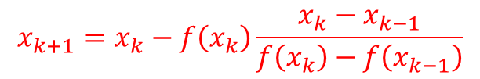
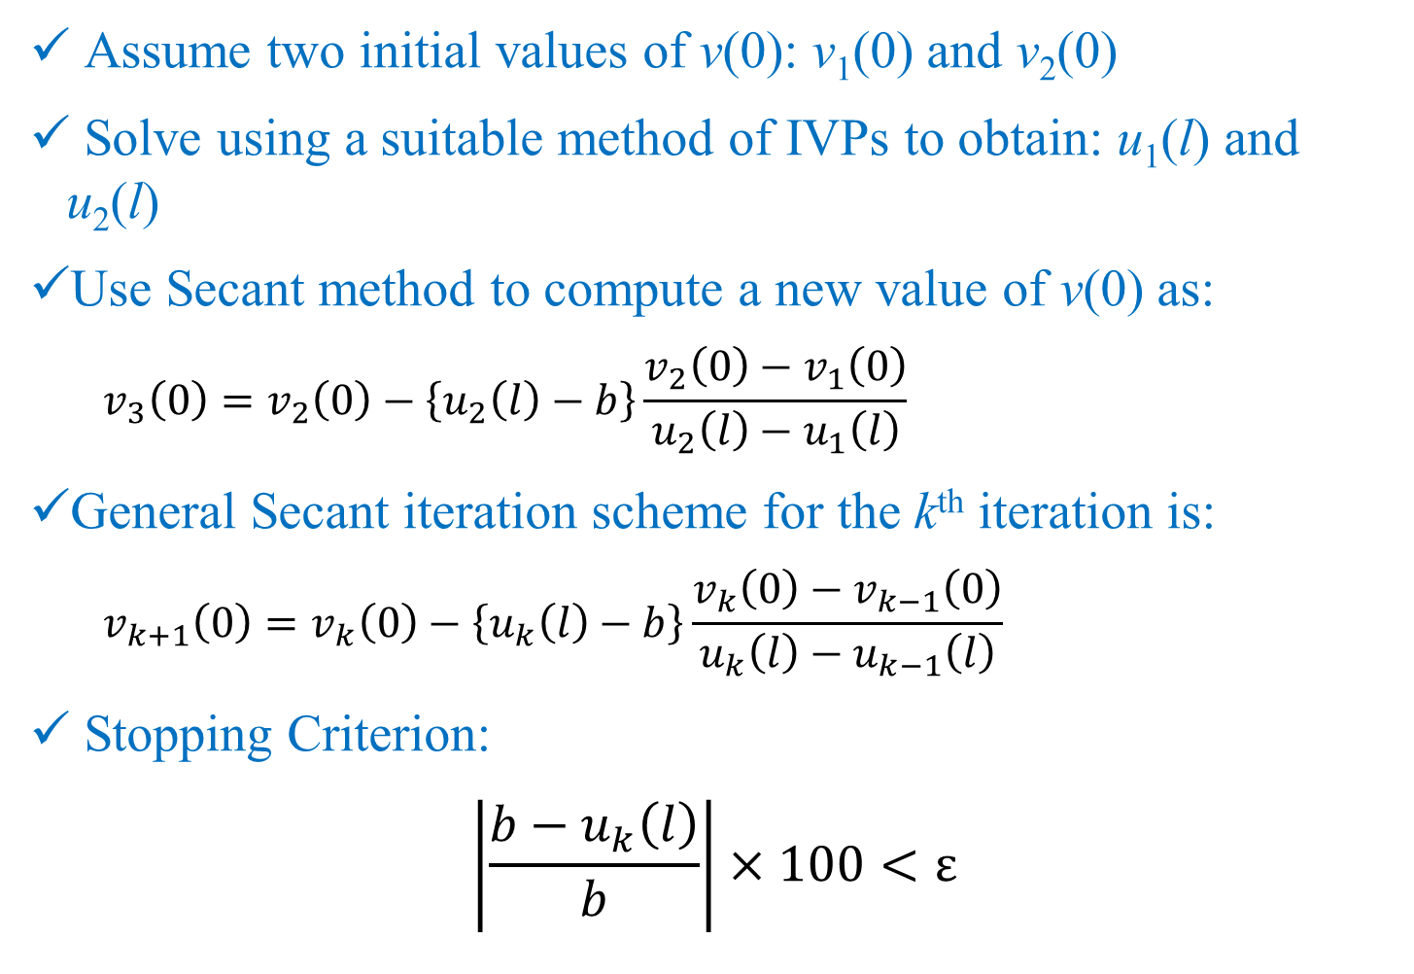
Shooting Method
Assume two initial values of v(0): v₁(0) and v₂(0)
Solve using a suitable method of IVPs to obtain: u₁(l) and u₂(l)
Use Secant method to compute a new value of v(0) as:
$$v_{3}\left(0\right)=v_{2}\left(0\right)−\left\{u_{2}\left(l\right)−b\right\}\frac{v_{2}\left(0\right)−v_{1}\left(0\right)}{u_{2}\left(l\right)−u_{1}\left(l\right)}$$
General Secant iteration scheme for the k^{th} iteration is:
$$v_{k+1}\left(0\right)=v_{k}\left(0\right)−\left\{u_{k}\left(l\right)−b\right\}\frac{v_{k}\left(0\right)−v_{k−1}\left(0\right)}{u_{k}\left(l\right)−u_{k−1}\left(l\right)}$$
Stopping Criterion:
$$\left|\frac{b−u_{k}\left(l\right)}{b}\right|×100<ε$$
$$x_{k+1}=x_{k}−f\left(x_{k}\right)\frac{x_{k}−x_{k−1}}{f\left(x_{k}\right)−f\left(x_{k−1}\right)}$$

Slide 8
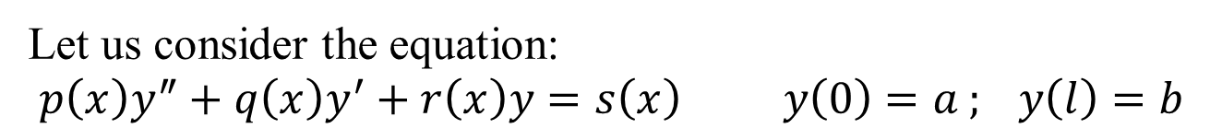
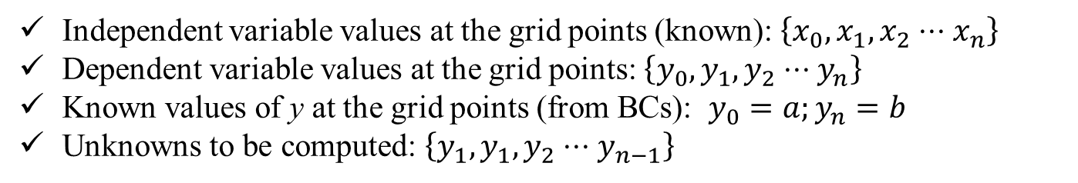
Direct Method
Let us consider the equation:
$$p\left(x\right)y^{″}+q\left(x\right)y^{′}+r\left(x\right)y=s\left(x\right) y\left(0\right)=a ; y\left(l\right)=b$$
Independent variable values at the grid points (known): $\left\{x_{0},x_{1},x_{2}⋅⋅⋅x_{n}\right\}$
Dependent variable values at the grid points: $\left\{y_{0},y_{1},y_{2}⋅⋅⋅y_{n}\right\}$
Known values of y at the grid points (from BCs): $y_{0}=a;y_{n}=b$
Unknowns to be computed: $\left\{y_{1},y_{1},y_{2}⋅⋅⋅y_{n−1}\right\}$

Slide 9
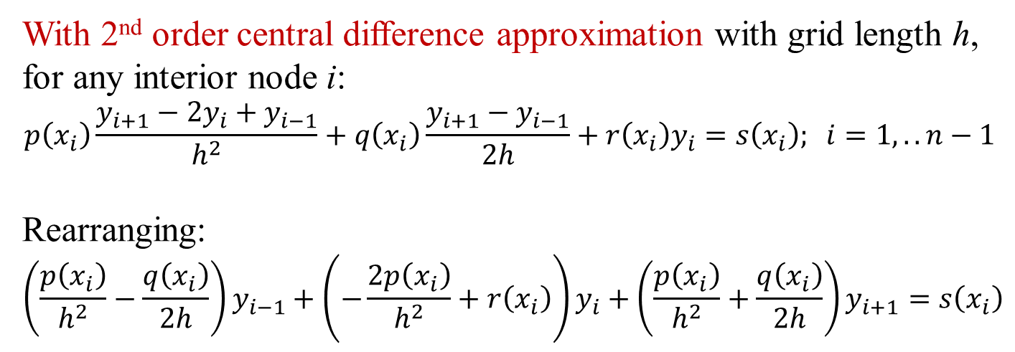
Direct Method
$$p\left(x\right)y^{″}+q\left(x\right)y^{′}+r\left(x\right)y=s\left(x\right) y\left(0\right)=a ; y\left(l\right)=b$$
With 2nd order central difference approximation with grid length h, for any interior node i:
$$p\left(x_{i}\right)\frac{y_{i+1}−2y_{i}+y_{i−1}}{h^{2}}+q\left(x_{i}\right)\frac{y_{i+1}−y_{i−1}}{2h}+r\left(x_{i}\right)y_{i}=s\left(x_{i}\right); i=1,..n−1$$
Rearranging:
$$\left(\frac{p\left(x_{i}\right)}{h^{2}}−\frac{q\left(x_{i}\right)}{2h}\right)y_{i−1}+\left(−\frac{2p\left(x_{i}\right)}{h^{2}}+r\left(x_{i}\right)\right)y_{i}+\left(\frac{p\left(x_{i}\right)}{h^{2}}+\frac{q\left(x_{i}\right)}{2h}\right)y_{i+1}=s\left(x_{i}\right)$$

Slide 10
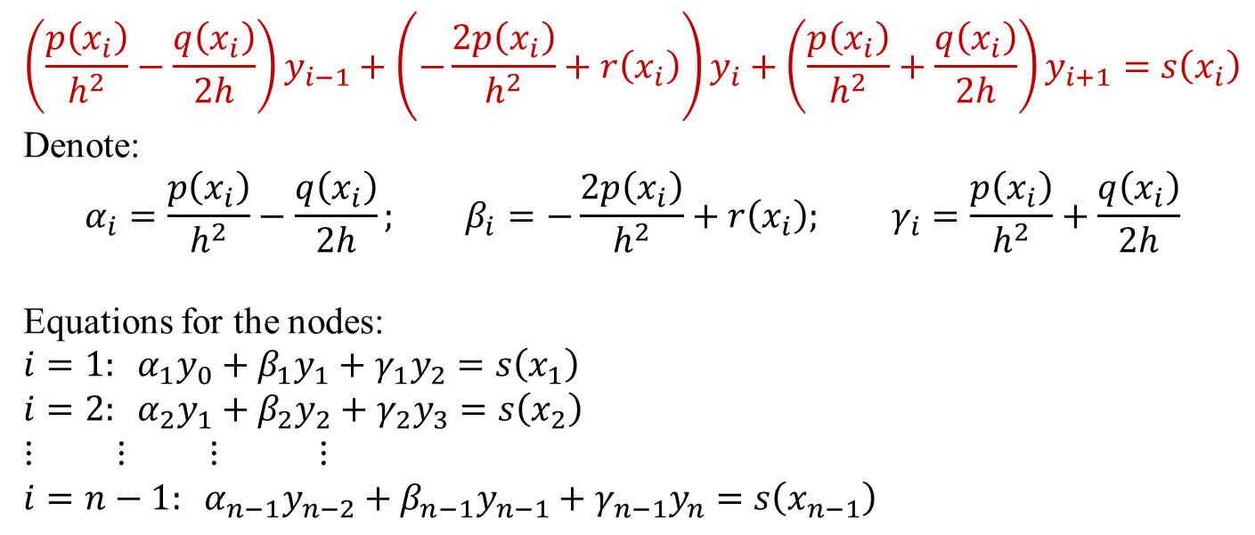
Direct Method
$$\left(\frac{p\left(x_{i}\right)}{h^{2}}−\frac{q\left(x_{i}\right)}{2h}\right)y_{i−1}+\left(−\frac{2p\left(x_{i}\right)}{h^{2}}+r\left(x_{i}\right)\right)y_{i}+\left(\frac{p\left(x_{i}\right)}{h^{2}}+\frac{q\left(x_{i}\right)}{2h}\right)y_{i+1}=s\left(x_{i}\right)$$
Denote:
$$α_{i}=\frac{p\left(x_{i}\right)}{h^{2}}−\frac{q\left(x_{i}\right)}{2h}; β_{i}=−\frac{2p\left(x_{i}\right)}{h^{2}}+r\left(x_{i}\right)\text{;} γ_{i}=\frac{p\left(x_{i}\right)}{h^{2}}+\frac{q\left(x_{i}\right)}{2h}$$
Equations for the nodes:
$$i=1: α_{1}y_{0}+β_{1}y_{1}+γ_{1}y_{2}=s\left(x_{1}\right)$$
$$i=2: α_{2}y_{1}+β_{2}y_{2}+γ_{2}y_{3}=s\left(x_{2}\right)$$
$$⋮ ⋮ ⋮ ⋮$$
$$i=n−1: α_{n−1}y_{n−2}+β_{n−1}y_{n−1}+γ_{n−1}y_{n}=s\left(x_{n−1}\right)$$

Slide 11
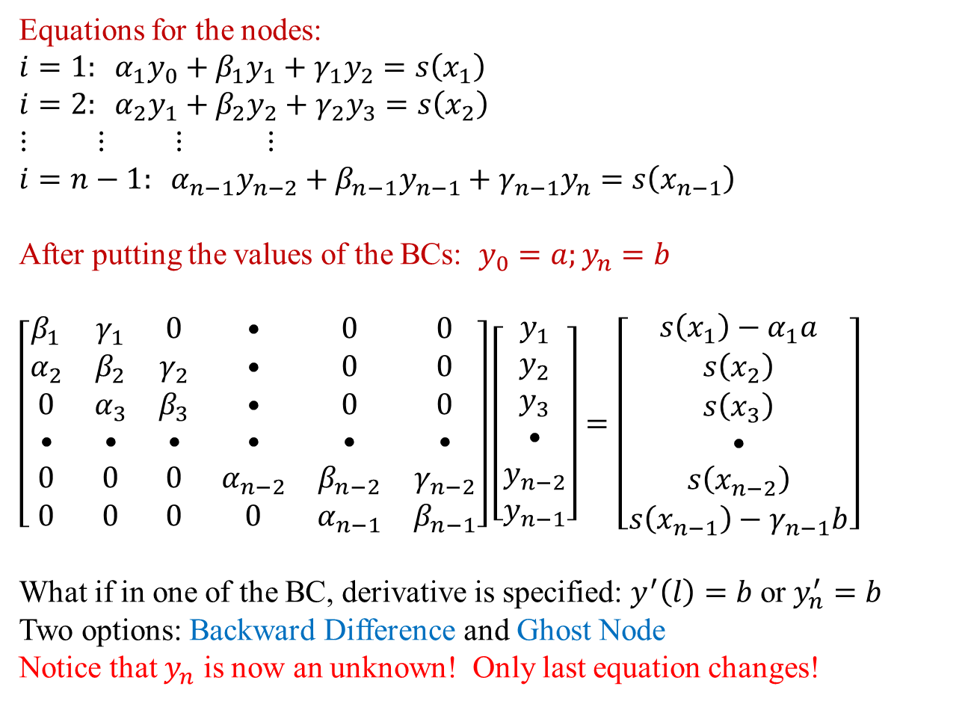
Direct Method
Equations for the nodes:
$$i=1: α_{1}y_{0}+β_{1}y_{1}+γ_{1}y_{2}=s\left(x_{1}\right)$$
$$i=2: α_{2}y_{1}+β_{2}y_{2}+γ_{2}y_{3}=s\left(x_{2}\right)$$
$$⋮ ⋮ ⋮ ⋮$$
$$i=n−1: α_{n−1}y_{n−2}+β_{n−1}y_{n−1}+γ_{n−1}y_{n}=s\left(x_{n−1}\right)$$
After putting the values of the BCs: $y_{0}=a;y_{n}=b$
$$\left[\begin{matrix}β_{1} & γ_{1} & 0 & • & 0 & 0 \\ α_{2} & β_{2} & γ_{2} & • & 0 & 0 \\ 0 & α_{3} & β_{3} & • & 0 & 0 \\ • & • & • & • & • & • \\ 0 & 0 & 0 & α_{n−2} & β_{n−2} & γ_{n−2} \\ 0 & 0 & 0 & 0 & α_{n−1} & β_{n−1}\end{matrix}\right]\left[\begin{matrix}y_{1} \\ y_{2} \\ y_{3} \\ • \\ y_{n−2} \\ y_{n−1}\end{matrix}\right]=\left[\begin{matrix}s\left(x_{1}\right)−α_{1}a \\ s\left(x_{2}\right) \\ s\left(x_{3}\right) \\ • \\ s\left(x_{n−2}\right) \\ s\left(x_{n−1}\right)−γ_{n−1}b\end{matrix}\right]$$
What if in one of the BC, derivative is specified: $y^{′}\left(l\right)=b$ or $y_{n}^{′}=b$
Two options: Backward Difference and Ghost Node
Notice that $y_{n}$ is now an unknown! Only last equation changes!

Slide 12
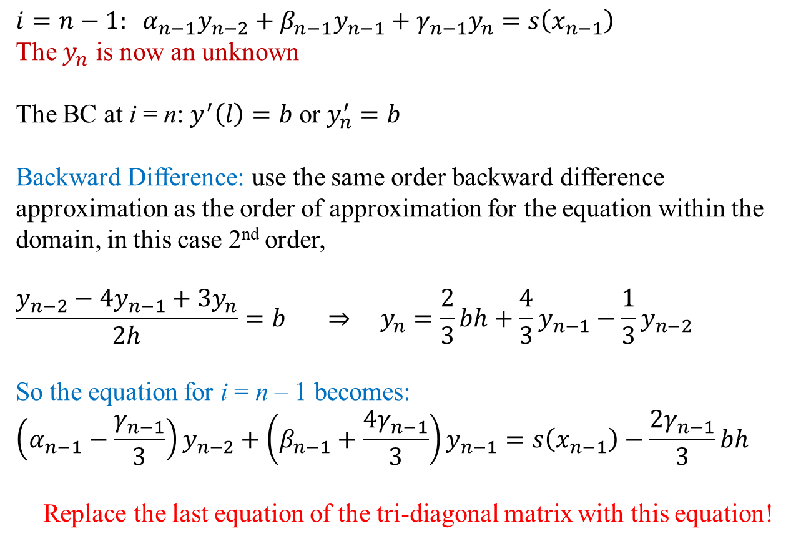
Direct Method
$$i=n−1: α_{n−1}y_{n−2}+β_{n−1}y_{n−1}+γ_{n−1}y_{n}=s\left(x_{n−1}\right)$$
The $y_{n}$ is now an unknown
The BC at i = n: $y^{′}\left(l\right)=b$ or $y_{n}^{′}=b$
Backward Difference: use the same order backward difference approximation as the order of approximation for the equation within the domain, in this case 2nd order,
$$\frac{y_{n−2}−4y_{n−1}+3y_{n}}{2h}=b ⇒ y_{n}=\frac{2}{3}bh+\frac{4}{3}y_{n−1}−\frac{1}{3}y_{n−2}$$
So the equation for i = n – 1 becomes:
$$\left(α_{n−1}−\frac{γ_{n−1}}{3}\right)y_{n−2}+\left(β_{n−1}+\frac{{4γ}_{n−1}}{3}\right)y_{n−1}=s\left(x_{n−1}\right)−\frac{2γ_{n−1}}{3}bh$$
Replace the last equation of the tri-diagonal matrix with this equation!

Slide 13
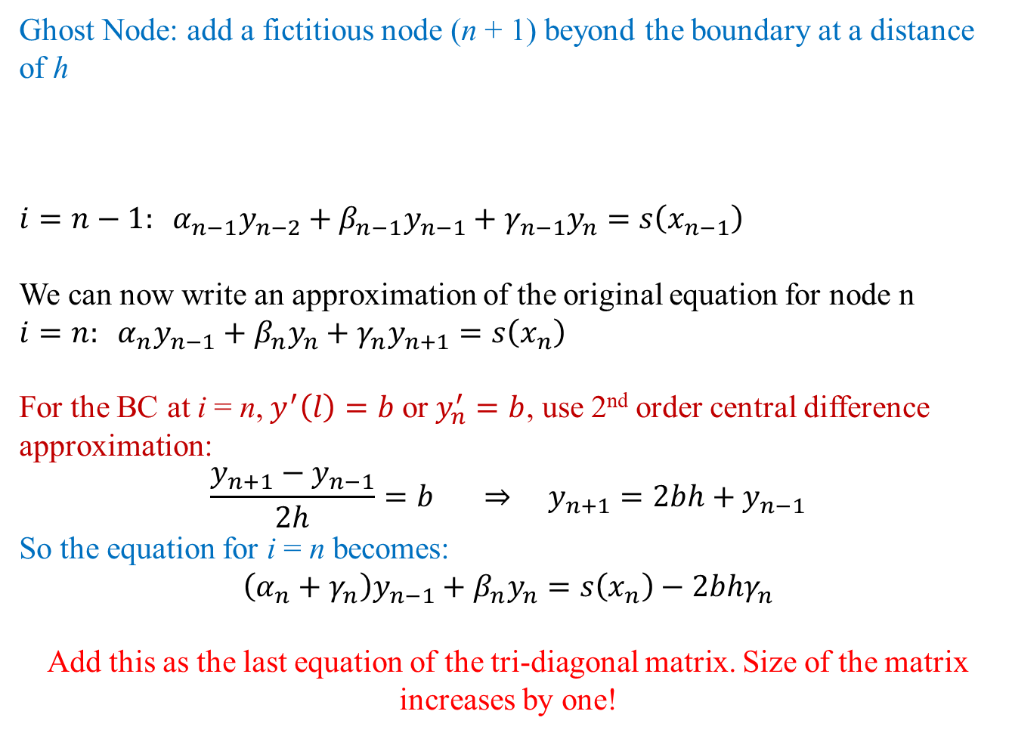
Direct Method
Ghost Node: add a fictitious node (n + 1) beyond the boundary at a distance of h
$$i=n−1: α_{n−1}y_{n−2}+β_{n−1}y_{n−1}+γ_{n−1}y_{n}=s\left(x_{n−1}\right)$$
We can now write an approximation of the original equation for node n
$$i=n: α_{n}y_{n−1}+β_{n}y_{n}+γ_{n}y_{n+1}=s\left(x_{n}\right)$$
For the BC at i = n, $y^{′}\left(l\right)=b$ or $y_{n}^{′}=b$, use 2nd order central difference approximation:
$$\frac{y_{n+1}−y_{n−1}}{2h}=b ⇒ y_{n+1}=2bh+y_{n−1}$$
So the equation for i = n becomes:
$$\left(α_{n}+γ_{n}\right)y_{n−1}+β_{n}y_{n}=s\left(x_{n}\right)−2bhγ_{n}$$
Add this as the last equation of the tri-diagonal matrix. Size of the matrix increases by one!
n – 2
n – 1
n
n + 1

Slide 14
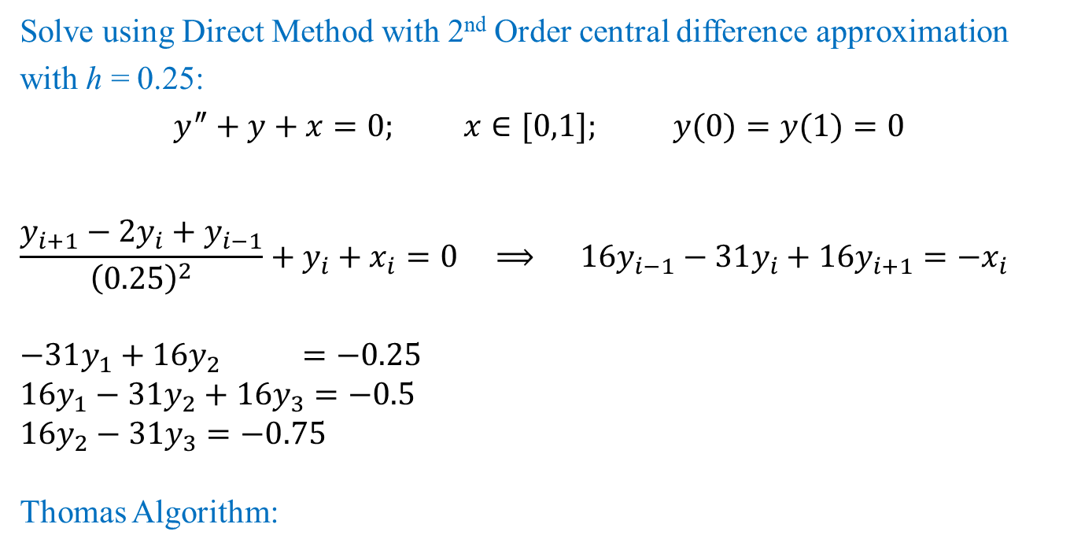
Direct Method: Example
Solve using Direct Method with 2nd Order central difference approximation with h = 0.25:
$$y^{″}+y+x=0; x∈[0,1]; y(0)=y(1)=0$$
$$\frac{y_{i+1}−2y_{i}+y_{i−1}}{{\left(0.25\right)}^{2}}+y_{i}+x_{i}=0 ⟹ 1\text{6}y_{i−1}−31y_{i}+16y_{i+1}=−x_{i}$$
$$−31y_{1}+16y_{2} =−0.25$$
$$16y_{1}−31y_{2}+16y_{3}=−0.5$$
$$1\text{6}y_{2}−31y_{3}=−0.75$$
Thomas Algorithm:
l | d | u | b | alpha | s | x
 | -31 | 16 | -0.25 | -31.0000 | -0.2500 | 0.0443
16 | -31 | 16 | -0.5 | -22.7419 | -0.6290 | 0.0702
16 | -31 |  | -0.75 | -19.7433 | -1.1926 | 0.0604

Slide 15
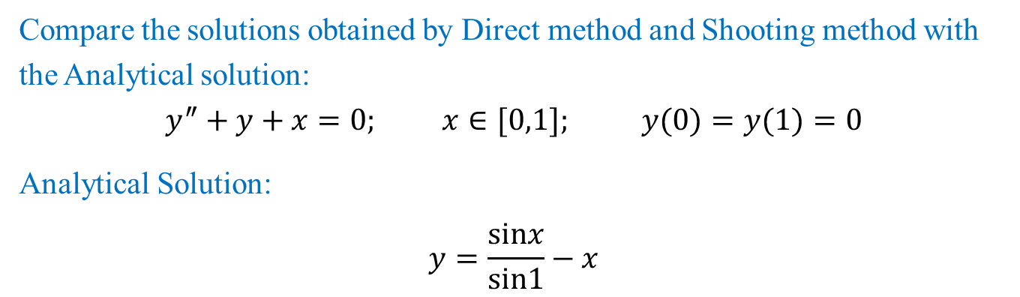
Direct Method: Example
Compare the solutions obtained by Direct method and Shooting method with the Analytical solution:
$$y^{″}+y+x=0; x∈[0,1]; y(0)=y(1)=0$$
Analytical Solution:
$$y=\frac{sinx}{sin1}−x$$
x | y | TRUE | Shooting | Error | Direct | Error
0 | y0 | 0 | 0 | 0 | 0 | 0
0.25 | y1 | 0.04401365 | 0.04460208 | 1.33691304 | 0.04427401 | 0.59154281
0.5 | y2 | 0.06974696 | 0.07079153 | 1.49764749 | 0.0701559 | 0.58631705
0.75 | y3 | 0.06005617 | 0.06101881 | 1.60290267 | 0.06040305 | 0.57759244
1 | y4 | 0 | 2.7756E-17 | 0 | 0 | 0
Can you identify, why the solution with shooting method using 2nd order R-K does not give good solution for this problem?

Slide 16
Ordinary Differential Equation
The methods for Initial Value Problems (IVPs):
Multi-step Methods
Explicit: Euler Forward, Adams-Bashforth
Implicit: Euler Backward, Trapezoidal and Adams-Moulton
Backward Difference Formulae (BDF)
Runge-Kutta Methods
Applications, Startup, Combination Methods (Predictor-Corrector)
Consistency, Stability, Convergence
Application to System of ODEs
Boundary Value Problems (BVPs)
Shooting Method
Direct Methods

Slide 17
Applications: Summary of Concerns
Accuracy of the higher order multi-step and BDF methods are affected if the starting values are used from the lower order methods.
How to start these non-self starting algorithms?
All implicit methods (multi-step and BDF) may involve solution of non-linear equations (if f contains a non-linear function of the dependent variable y)
Is there a way to avoid this solution of non-linear equations?
Numerical oscillations (instability) observed in some methods and not in some!
Is there a way to predict and therefore, choose correct parameters for algorithm so that the numerical oscillations can be avoided?
We will do Convergence Analysis!

Slide 18
ESO 208A: Computational Methods in Engineering Ordinary Differential Equation: Consistency, Stability, Convergence
Abhas Singh
Department of Civil Engineering
IIT Kanpur
Acknowledgements: Profs. Saumyen Guha and Shivam Tripathi (CE)

Slide 19
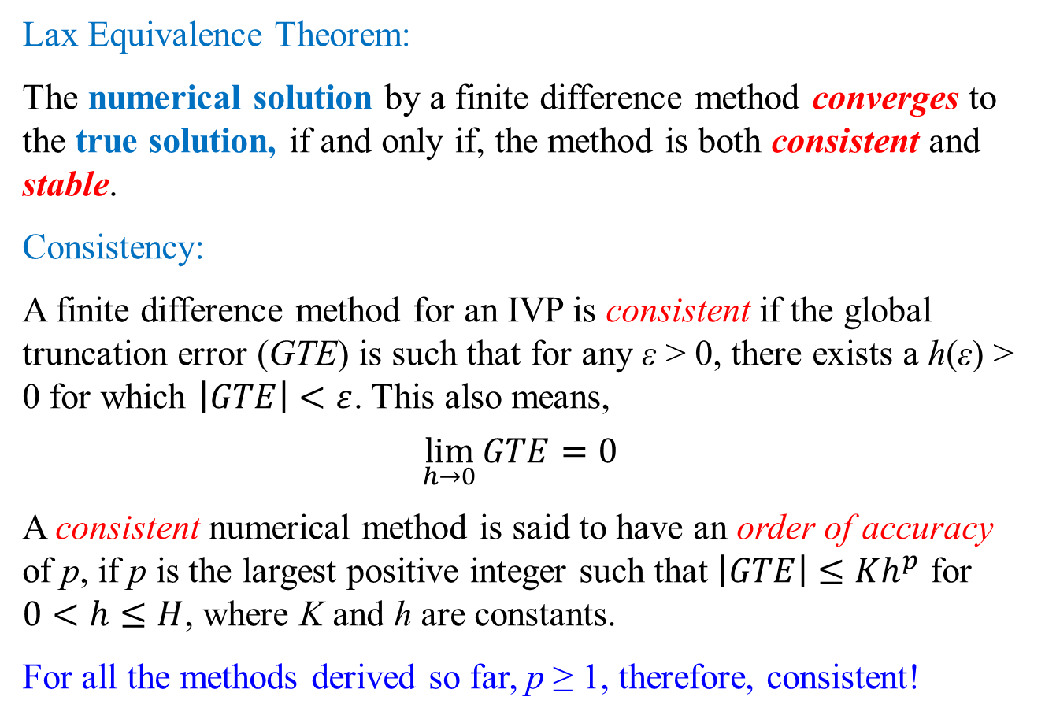
Numerical Methods for IVPs: Convergence
Lax Equivalence Theorem:
The numerical solution by a finite difference method converges to the true solution, if and only if, the method is both consistent and stable.
Consistency:
A finite difference method for an IVP is consistent if the global truncation error (GTE) is such that for any ε > 0, there exists a h(ε) > 0 for which $\left|GTE\right|<ε$. This also means,
$$\lim_{h→0}{GTE}=0$$
A consistent numerical method is said to have an order of accuracy of p, if p is the largest positive integer such that $\left|GTE\right|≤Kh^{p}$ for $0<h≤H$, where K and h are constants.
For all the methods derived so far, p ≥ 1, therefore, consistent!

Slide 20
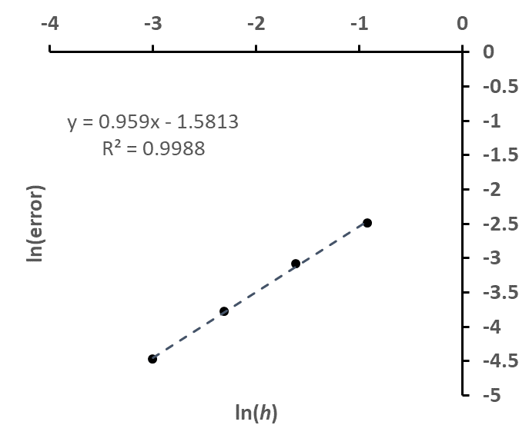
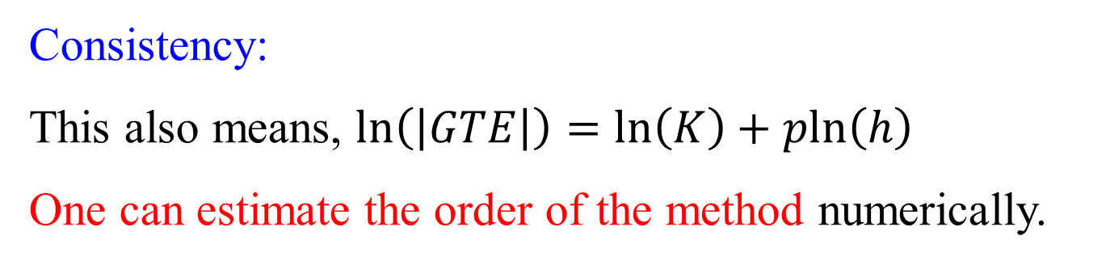
Numerical Methods for IVPs: Consistency
Consistency:
This also means, $ln\left(\left|GTE\right|\right)=ln\left(K\right)+pln\left(h\right)$
One can estimate the order of the method numerically.
This is the same result of the Euler Forward method used for startup using different values of h. The absolute values of true errors were computed at h = 1.2

Slide 21
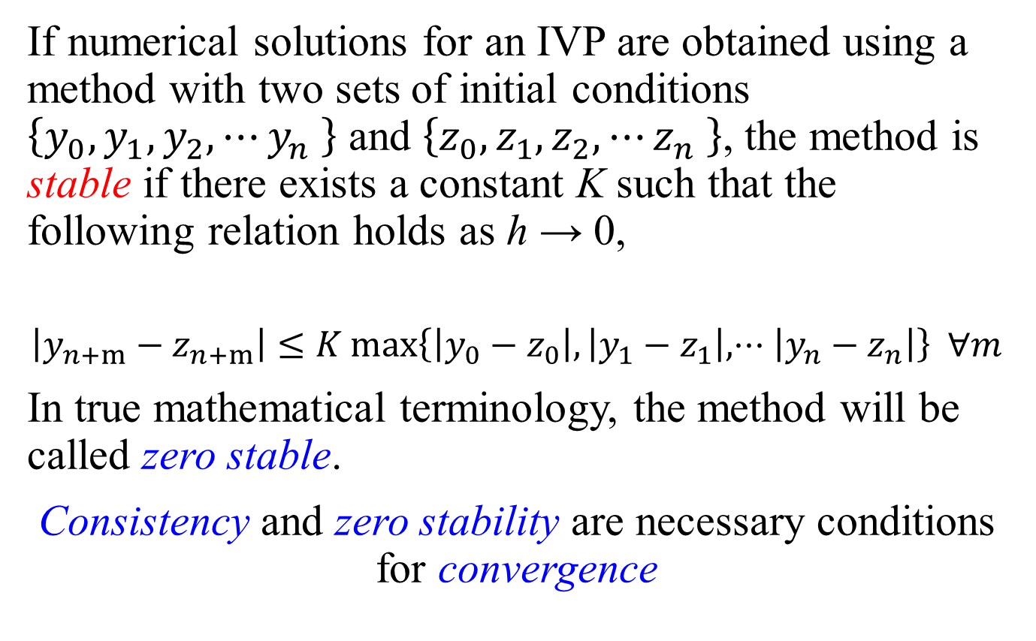
Numerical Methods for IVPs: Stability
If numerical solutions for an IVP are obtained using a method with two sets of initial conditions $\left\{y_{0},y_{1},y_{2},⋯y_{n} \right\}$ and $\left\{z_{0},z_{1},z_{2},⋯z_{n} \right\}$, the method is stable if there exists a constant K such that the following relation holds as h → 0,
$$\left|y_{n+m}−z_{n+m}\right|≤K max\left\{\left|y_{0}−z_{0}\right|,\left|y_{1}−z_{1}\right|,⋅⋅⋅\left|y_{n}−z_{n}\right|\right\} ∀m$$
In true mathematical terminology, the method will be called zero stable.
Consistency and zero stability are necessary conditions for convergence

Slide 22
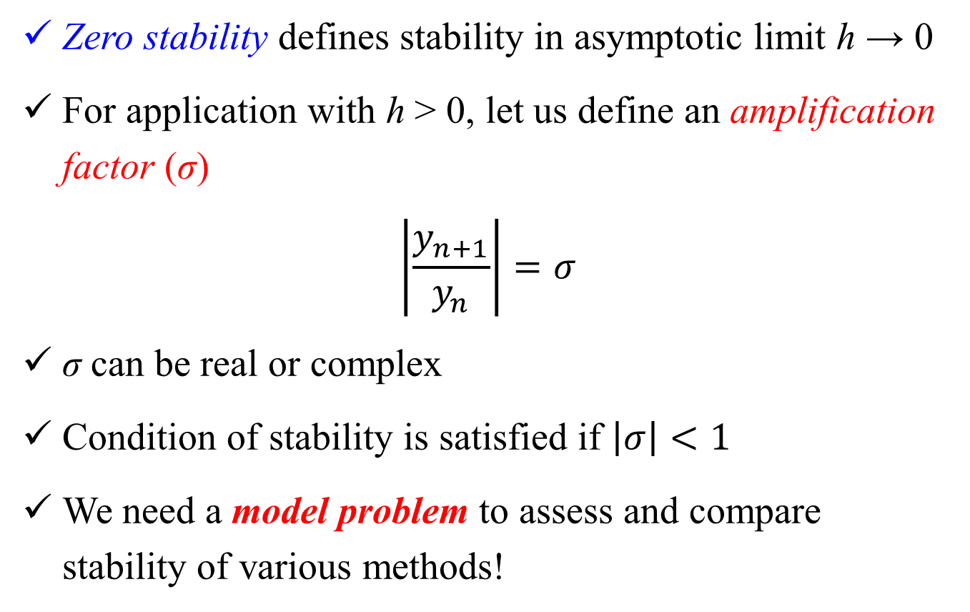
Numerical Methods for IVPs: Stability
Zero stability defines stability in asymptotic limit h → 0
For application with h > 0, let us define an amplification factor (σ)
$$\left|\frac{y_{n+1}}{y_{n}}\right|=σ$$
σ can be real or complex
Condition of stability is satisfied if $\left|σ\right|<1$
We need a model problem to assess and compare stability of various methods!

Slide 23
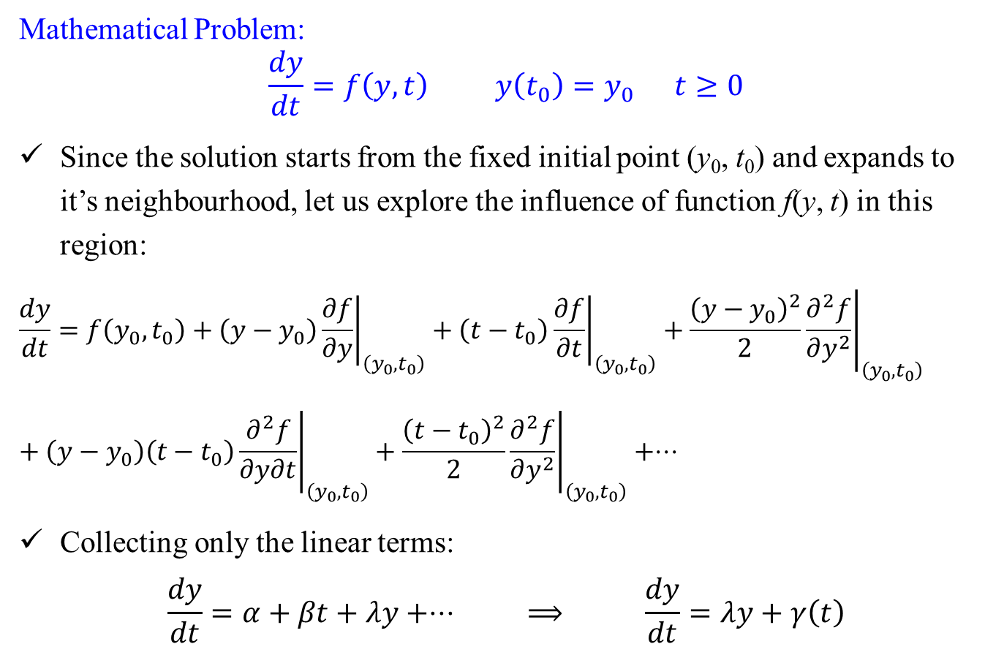
Stability: Model Problem
Mathematical Problem:
$$\frac{dy}{dt}=f\left(y,t\right) y\left(t_{0}\right)=y_{0} t≥0$$
Since the solution starts from the fixed initial point (y₀, t₀) and expands to it’s neighbourhood, let us explore the influence of function f(y, t) in this region:
$$\begin{matrix}\frac{dy}{dt}=f\left(y_{0},t_{0}\right)+\left(y−y_{0}\right){\left.\frac{∂f}{∂y}\right|}_{\left(y_{0},t_{0}\right)}+\left(t−t_{0}\right){\left.\frac{∂f}{∂t}\right|}_{\left(y_{0},t_{0}\right)}+\frac{{\left(y−y_{0}\right)}^{2}}{2}{\left.\frac{∂^{2}f}{∂y^{2}}\right|}_{\left(y_{0},t_{0}\right)} \\ \end{matrix}+\left(y−y_{0}\right)\left(t−t_{0}\right){\left.\frac{∂^{2}f}{∂y∂t}\right|}_{\left(y_{0},t_{0}\right)}+\frac{{\left(t−t_{0}\right)}^{2}}{2}{\left.\frac{∂^{2}f}{∂y^{2}}\right|}_{\left(y_{0},t_{0}\right)}+⋅⋅⋅$$
Collecting only the linear terms:
$$\frac{dy}{dt}=α+βt+λy+⋅⋅⋅ ⟹ \frac{dy}{dt}=λy+γ\left(t\right)$$

Slide 24
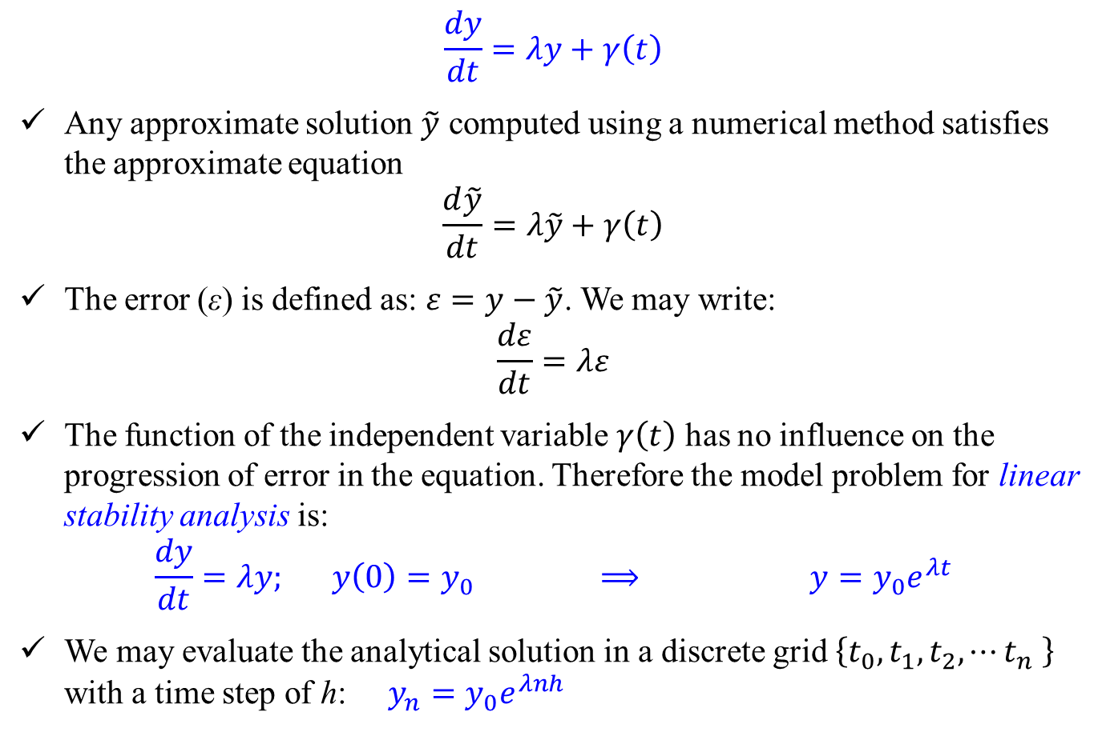
Stability: Model Problem
$$\frac{dy}{dt}=λy+γ\left(t\right)$$
Any approximate solution $\tilde{y}$ computed using a numerical method satisfies the approximate equation
$$\frac{d\tilde{y}}{dt}=λ\tilde{y}+γ\left(t\right)$$
The error (ε) is defined as: $ε=y−\tilde{y}$. We may write:
$$\frac{dε}{dt}=λε$$
The function of the independent variable $γ\left(t\right)$ has no influence on the progression of error in the equation. Therefore the model problem for linear stability analysis is:
$$\frac{dy}{dt}=λy; y\left(0\right)=y_{0} ⟹ y=y_{0}e^{λt}$$
We may evaluate the analytical solution in a discrete grid $\left\{t_{0},t_{1},t_{2},⋯t_{n} \right\}$ with a time step of h: $y_{n}=y_{0}e^{λnh}$

Slide 25
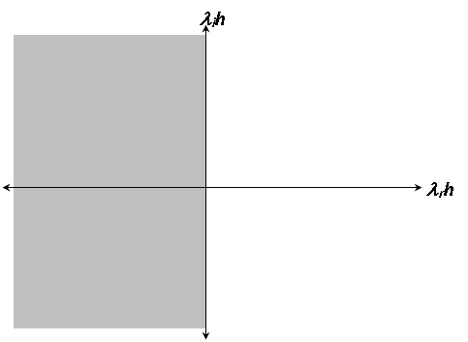
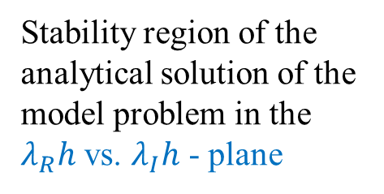
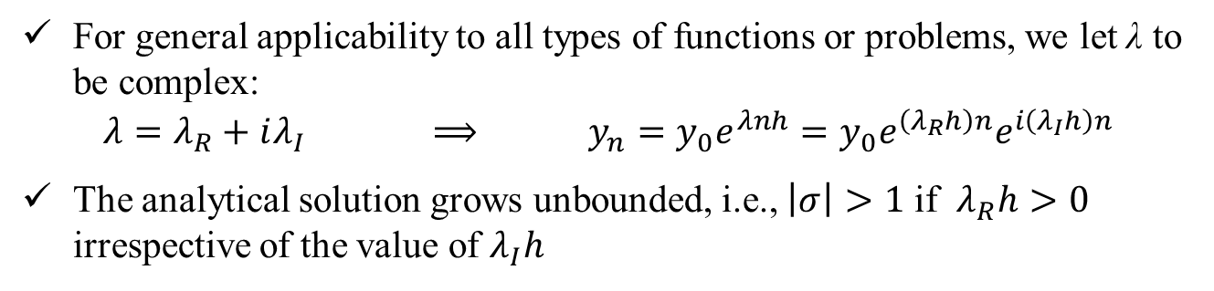
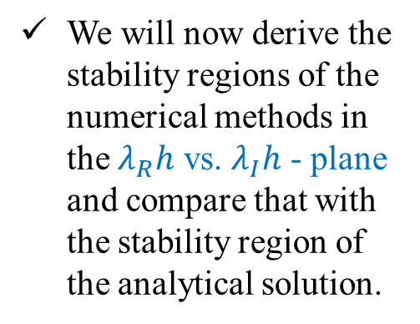


Stability: Model Problem
For general applicability to all types of functions or problems, we let λ to be complex:
$$λ=λ_{R}+iλ_{I} ⟹ y_{n}=y_{0}e^{λnh}=y_{0}e^{\left(λ_{R}h\right)n}e^{i\left(λ_{I}h\right)n}$$
The analytical solution grows unbounded, i.e., $\left|σ\right|>1$ if $λ_{R}h>0$ irrespective of the value of $λ_{I}h$
$$λ_{I}h$$
We will now derive the stability regions of the numerical methods in the $λ_{R}h$ vs. $λ_{I}h$ - plane and compare that with the stability region of the analytical solution.
$$λ_{R}h$$
Stability region of the analytical solution of the model problem in the $λ_{R}h$ vs. $λ_{I}h$ - plane

Slide 26

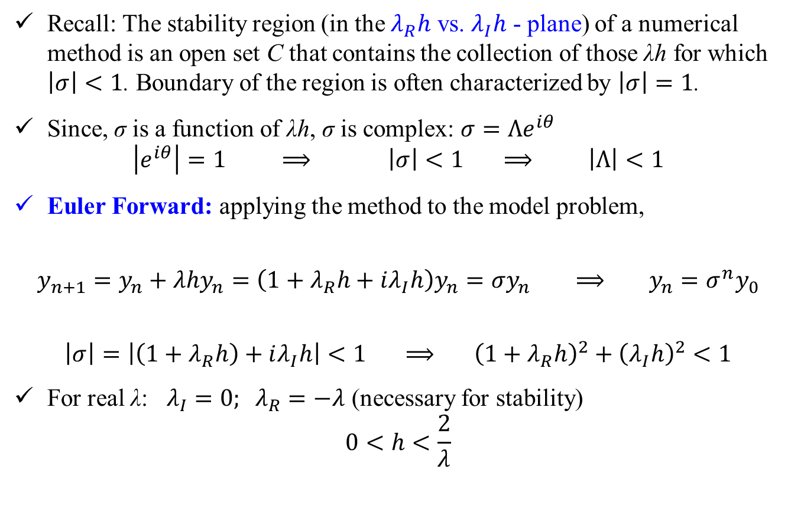
Stability: Multi-Step Methods (explicit) Example
Recall: The stability region (in the $λ_{R}h$ vs. $λ_{I}h$ - plane) of a numerical method is an open set C that contains the collection of those λh for which $\left|σ\right|<1$. Boundary of the region is often characterized by $\left|σ\right|=1$.
Since, σ is a function of λh, σ is complex: $σ=Λe^{iθ}$
$$\left|e^{iθ}\right|=1 ⟹ \left|σ\right|<1 ⟹ \left|Λ\right|<1$$
Euler Forward: applying the method to the model problem,
$$y_{n+1}=y_{n}+λhy_{n}=\left(1+λ_{R}h+iλ_{I}h\right)y_{n}=σy_{n} ⟹ y_{n}=σ^{n}y_{0}$$
$$\left|σ\right|=\left|\left(1+λ_{R}h\right)+iλ_{I}h\right|<1 ⟹ {\left(1+λ_{R}h\right)}^{2}+{\left(λ_{I}h\right)}^{2}<1$$
For real λ: $λ_{I}=0; λ_{R}=−λ$ (necessary for stability)
$$0<h<\frac{2}{λ}$$
$$\frac{dy}{dt}=λy; y\left(0\right)=y_{0}$$

Slide 27
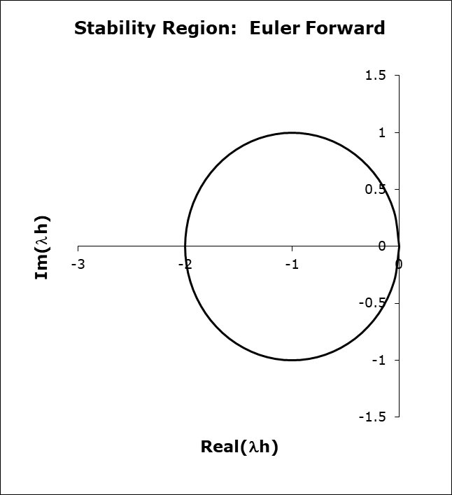
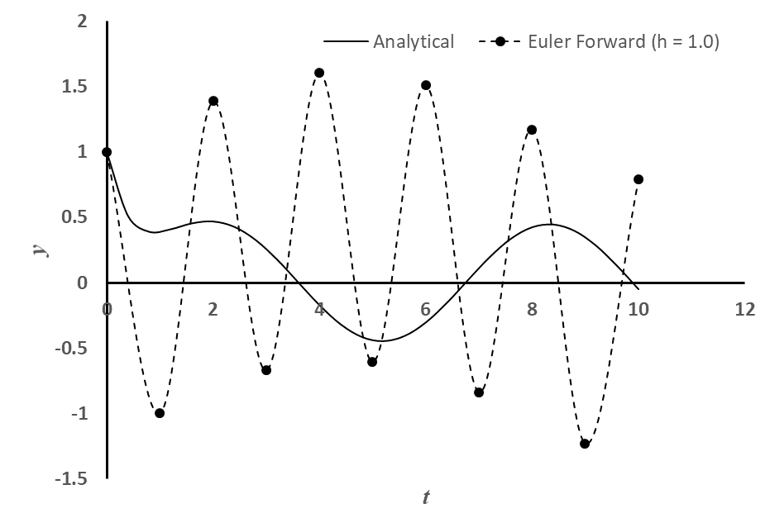
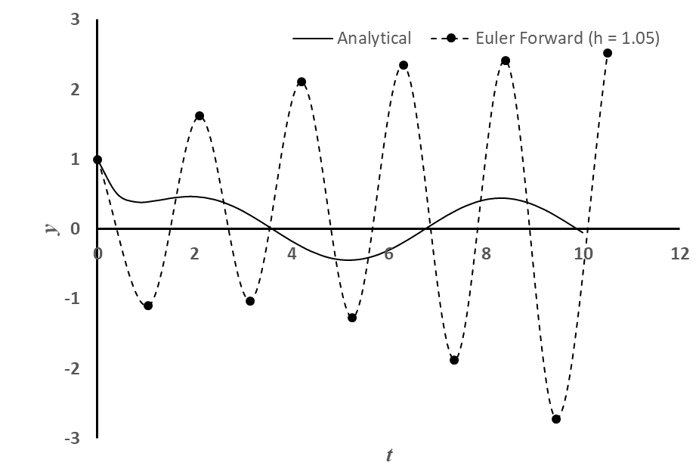
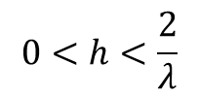
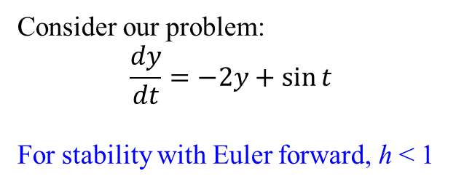
Stability: Multi-Step Methods (explicit) Example
Consider our problem:
$$\frac{dy}{dt}=−2y+\sin{t}$$
For stability with Euler forward, h < 1
$$0<h<\frac{2}{λ}$$

Slide 28
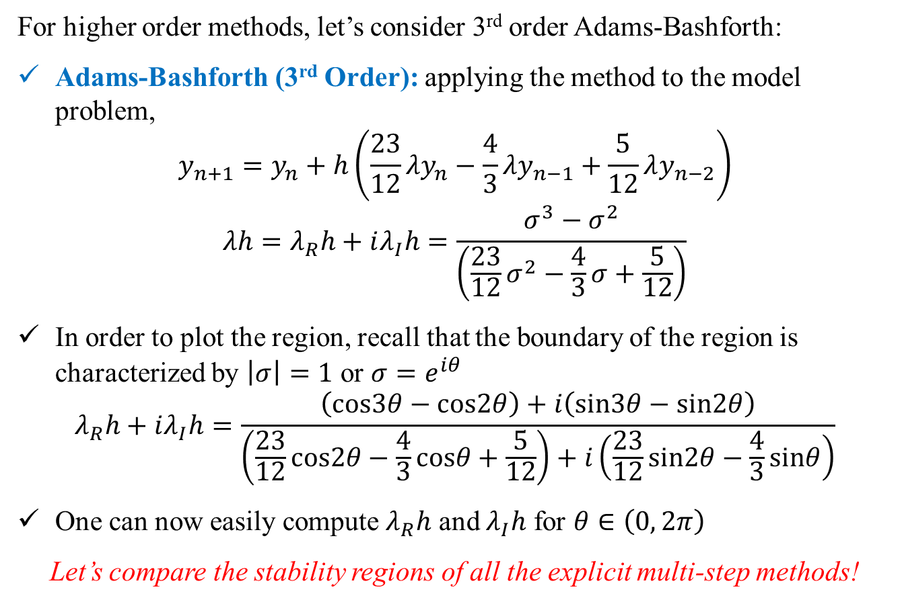
Stability: Multi-Step Methods (explicit) Example
For higher order methods, let’s consider 3rd order Adams-Bashforth:
Adams-Bashforth (3rd Order): applying the method to the model problem,
$$y_{n+1}=y_{n}+h\left(\frac{23}{12}λy_{n}−\frac{4}{3}λy_{n−1}+\frac{5}{12}λy_{n−2}\right)$$
$$λh=λ_{R}h+iλ_{I}h=\frac{σ^{3}−σ^{2}}{\left(\frac{23}{12}σ^{2}−\frac{4}{3}σ+\frac{5}{12}\right)}$$
In order to plot the region, recall that the boundary of the region is characterized by $\left|σ\right|=1$ or $σ=e^{iθ}$
$$λ_{R}h+iλ_{I}h=\frac{\left(cos3θ−cos2θ\right)+i\left(sin3θ−sin2θ\right)}{\left(\frac{23}{12}cos2θ−\frac{4}{3}cosθ+\frac{5}{12}\right)+i\left(\frac{23}{12}sin2θ−\frac{4}{3}sinθ\right)}$$
One can now easily compute $λ_{R}h$ and $λ_{I}h$ for $θ∈\left(0, 2π\right)$
Let’s compare the stability regions of all the explicit multi-step methods!

Slide 29
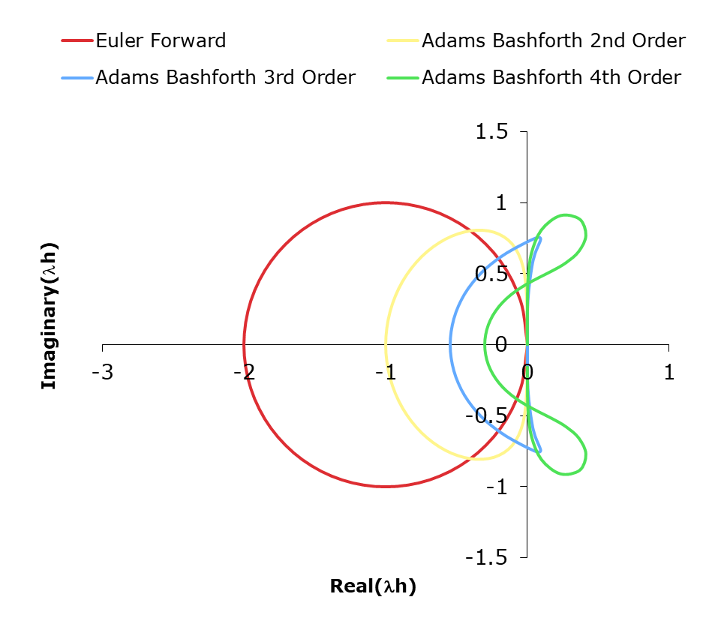
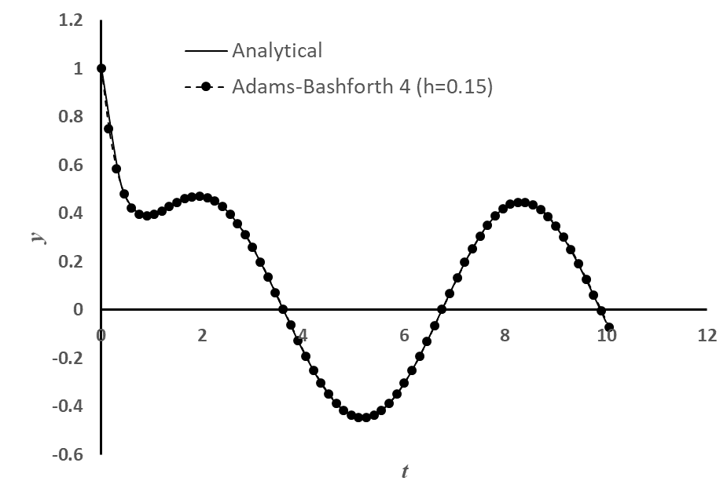

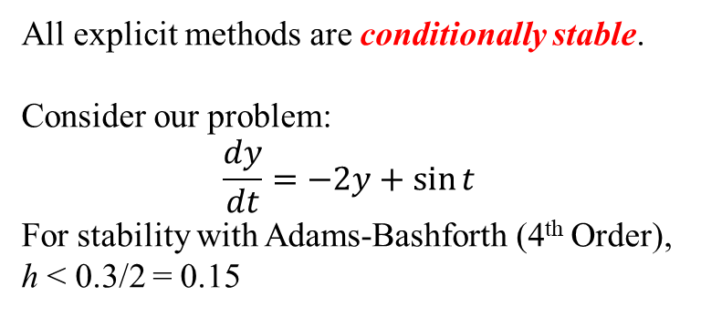
Stability: Multi-Step Methods (explicit) Example
All explicit methods are conditionally stable.
Consider our problem:
$$\frac{dy}{dt}=−2y+\sin{t}$$
For stability with Adams-Bashforth (4th Order), h < 0.3/2 = 0.15

Slide 30
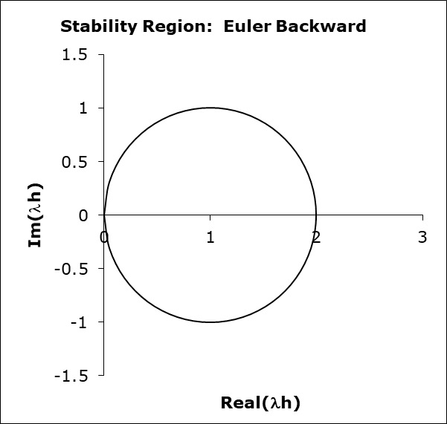
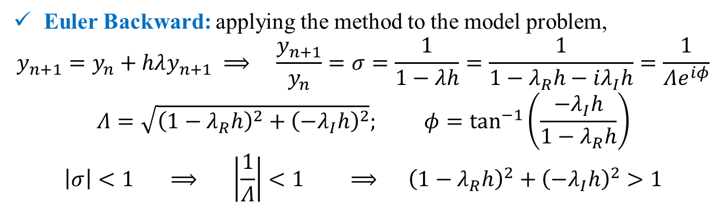
Stability: Multi-Step (Implicit)
Euler Backward: applying the method to the model problem,
$$y_{n+1}=y_{n}+hλy_{n+1} ⟹ \frac{y_{n+1}}{y_{n}}=σ=\frac{1}{1−λh}=\frac{1}{1−λ_{R}h−iλ_{I}h}=\frac{1}{Λe^{iφ}}$$
$$Λ=\sqrt{{\left(1−λ_{R}h\right)}^{2}+{\left(−λ_{I}h\right)}^{2}}; φ=\tan^{−1}\left(\frac{−λ_{I}h}{1−λ_{R}h}\right)$$
$$\left|σ\right|<1 ⟹ \left|\frac{1}{Λ}\right|<1 ⟹ {\left(1−λ_{R}h\right)}^{2}+{\left(−λ_{I}h\right)}^{2}>1$$
Euler Backward method is stable everywhere outside the circle!
Homework: Stability region of the Trapezoidal Method!

Slide 31
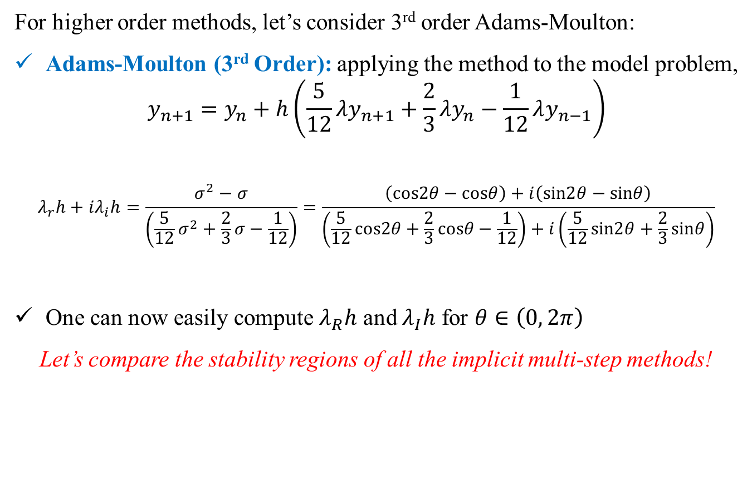
Stability: Multi-Step Methods (implicit) Example
For higher order methods, let’s consider 3rd order Adams-Moulton:
Adams-Moulton (3rd Order): applying the method to the model problem,
$$y_{n+1}=y_{n}+h\left(\frac{5}{12}λy_{n+1}+\frac{2}{3}λy_{n}−\frac{1}{12}λy_{n−1}\right)$$
$$λ_{r}h+iλ_{i}h=\frac{σ^{2}−σ}{\left(\frac{5}{12}σ^{2}+\frac{2}{3}σ−\frac{1}{12}\right)}=\frac{\left(cos2θ−cosθ\right)+i\left(sin2θ−sinθ\right)}{\left(\frac{5}{12}cos2θ+\frac{2}{3}cosθ−\frac{1}{12}\right)+i\left(\frac{5}{12}sin2θ+\frac{2}{3}sinθ\right)}$$
One can now easily compute $λ_{R}h$ and $λ_{I}h$ for $θ∈\left(0, 2π\right)$
Let’s compare the stability regions of all the implicit multi-step methods!

Slide 32
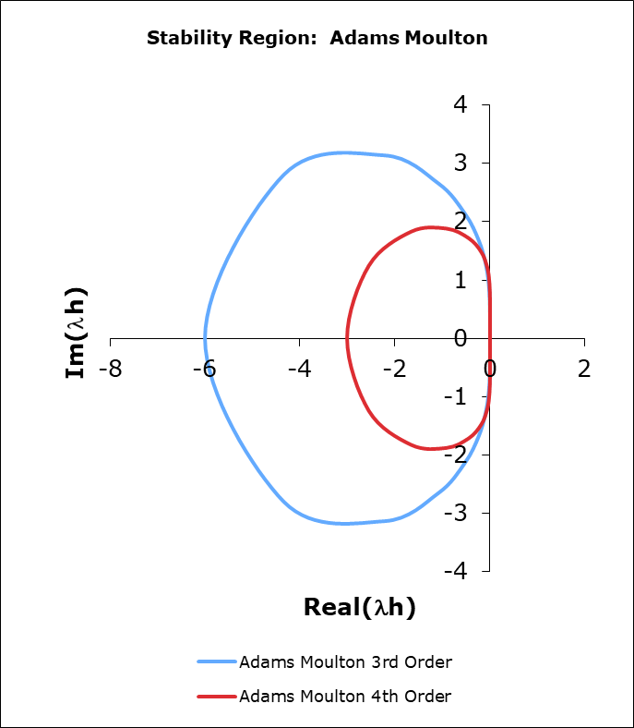
Stability: Multi-Step Methods (implicit) Example
Euler backward method is unconditionally stable! (It is stable everywhere, where the analytical problem is also stable)
Trapezoidal: find as homework!
Adams-Moulton 3rd and 4th order methods are conditionally stable!
Pay attention to the stability for purely imaginary λ!

Slide 33
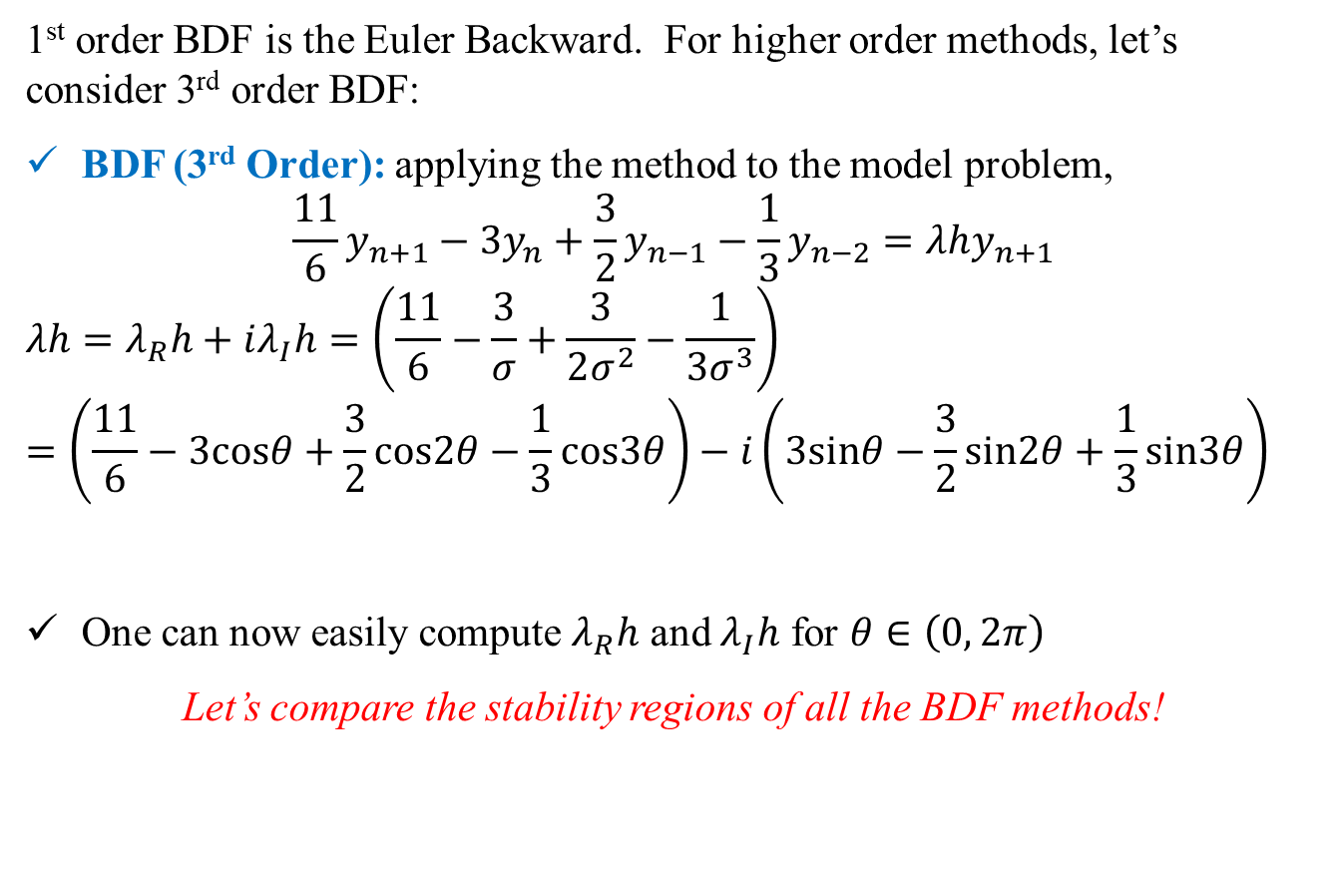
Stability: BDF Methods Example
1st order BDF is the Euler Backward. For higher order methods, let’s consider 3rd order BDF:
BDF (3rd Order): applying the method to the model problem,
$$\frac{11}{6}y_{n+1}−3y_{n}+\frac{3}{2}y_{n−1}−\frac{1}{3}y_{n−2}=λhy_{n+1}$$
$$λh=λ_{R}h+iλ_{I}h=\left(\frac{11}{6}−\frac{3}{σ}+\frac{3}{2σ^{2}}−\frac{1}{3σ^{3}}\right)=\left(\frac{11}{6}−3cosθ+\frac{3}{2}cos2θ−\frac{1}{3}cos3θ\right)−i\left(3sinθ−\frac{3}{2}sin2θ+\frac{1}{3}sin3θ\right)$$
One can now easily compute $λ_{R}h$ and $λ_{I}h$ for $θ∈\left(0, 2π\right)$
Let’s compare the stability regions of all the BDF methods!

Slide 34
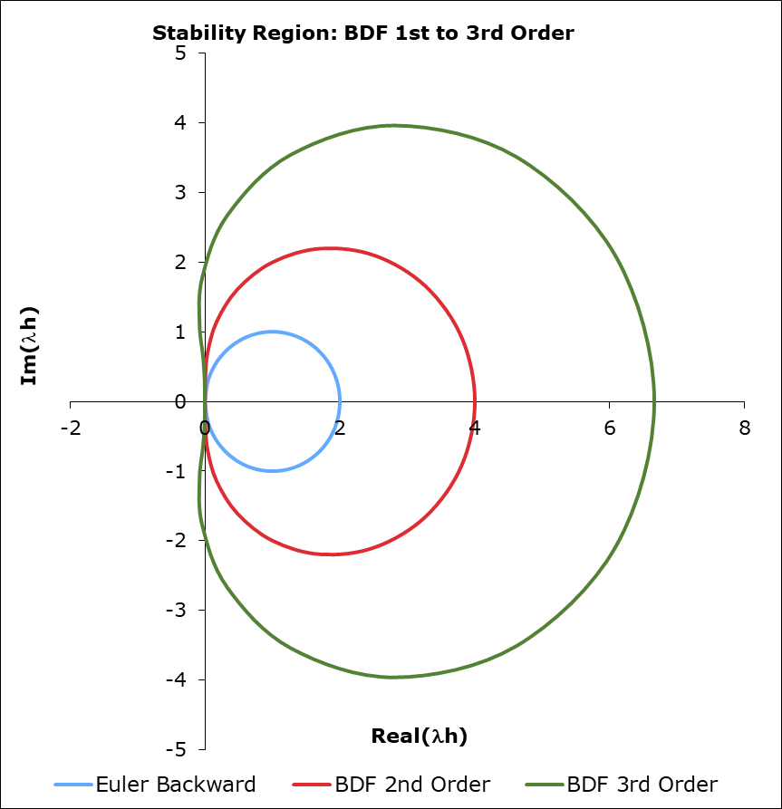
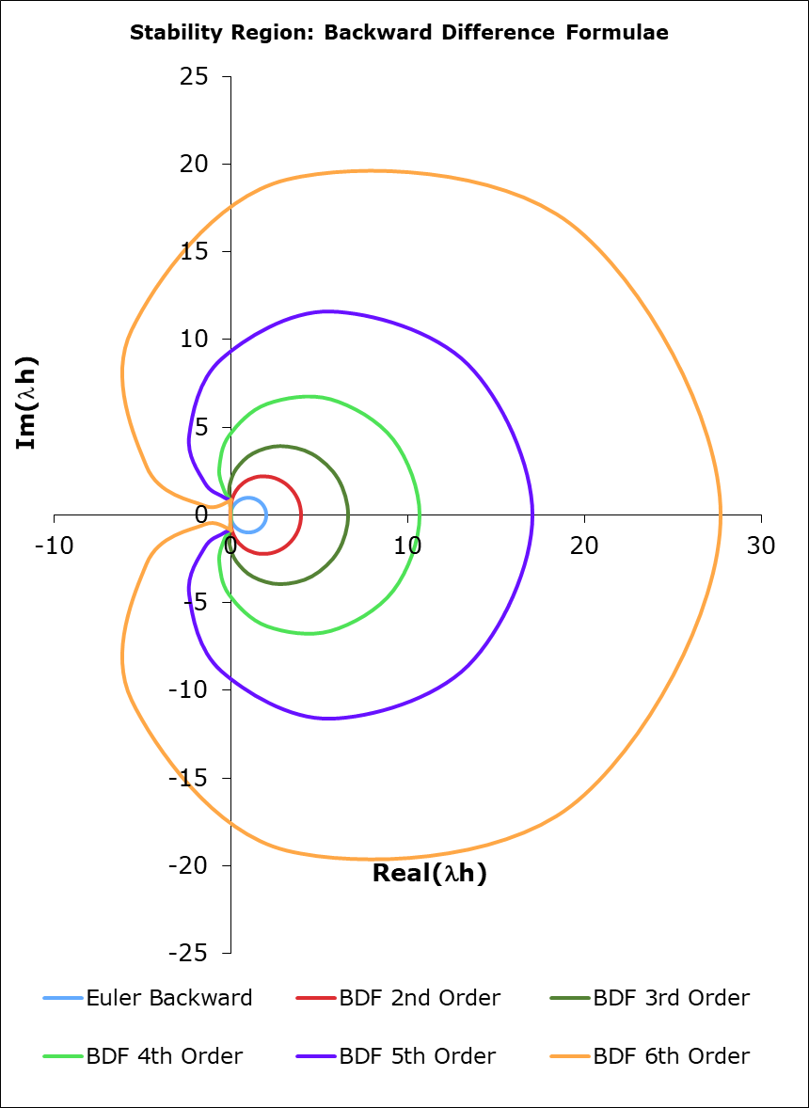
Stability: BDF Methods Example
For all the BDFs: Stability Region is outside the enclosed region!
For real λ, all the BDFs are unconditionally stable!
One can use any h without having to worry about the stability!
Useful for stiff equations!

Slide 35
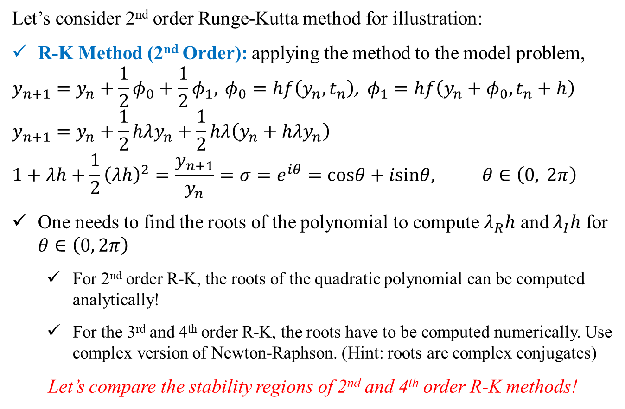
Stability: Runge-Kutta Methods Example
Let’s consider 2nd order Runge-Kutta method for illustration:
R-K Method (2nd Order): applying the method to the model problem,
$$y_{n+1}=y_{n}+\frac{1}{2}φ_{0}+\frac{1}{2}φ_{1}, φ_{0}=hf\left(y_{n},t_{n}\right)\text{, }φ_{1}=hf\left(y_{n}+φ_{0},t_{n}+h\right)$$
$$y_{n+1}=y_{n}+\frac{1}{2}hλy_{n}+\frac{1}{2}hλ\left(y_{n}+hλy_{n}\right)$$
$$1+λh+\frac{1}{2}{\left(λh\right)}^{2}=\frac{y_{n+1}}{y_{n}}=σ=e^{iθ}=cosθ+isinθ, θ∈\left(0, 2π\right)$$
One needs to find the roots of the polynomial to compute $λ_{R}h$ and $λ_{I}h$ for $θ∈\left(0, 2π\right)$
For 2nd order R-K, the roots of the quadratic polynomial can be computed analytically!
For the 3rd and 4th order R-K, the roots have to be computed numerically. Use complex version of Newton-Raphson. (Hint: roots are complex conjugates)
Let’s compare the stability regions of 2nd and 4th order R-K methods!

Slide 36
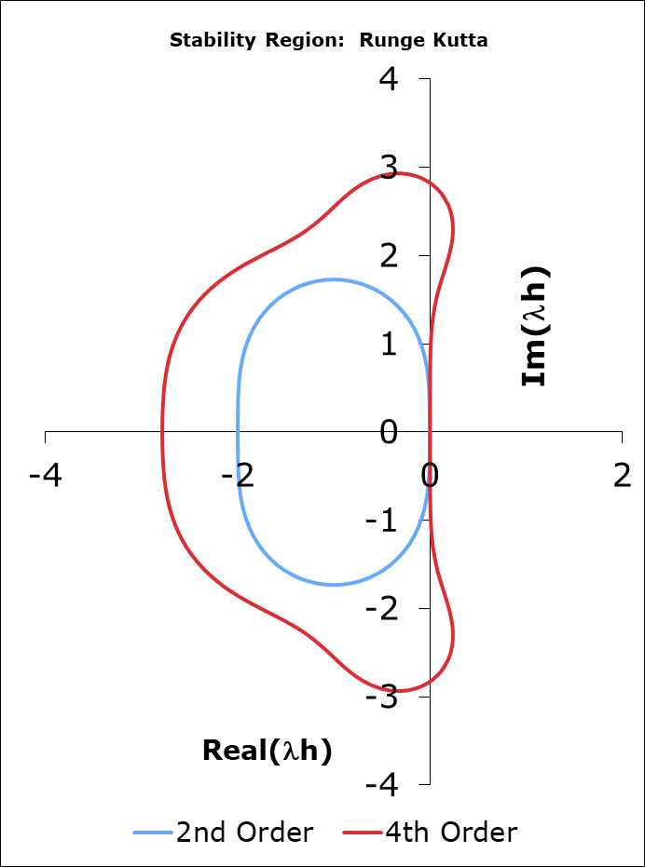
Stability: Runge-Kutta Methods Example
4th order R-K has very good stability properties (λh up to 2.78 on the real part and 2.83 on the imaginary part)
The method is also stable for purely imaginary λh
Homework: For our problem, check the stability limits of the R-K methods!

