Slide 1
Ordinary Differential Equation
The methods for Initial Value Problems (IVPs):
Multi-step Methods
Explicit: Euler Forward, Adams-Bashforth
Implicit: Euler Backward, Trapezoidal and Adams-Moulton
Backward Difference Formulae (BDF)
Runge-Kutta Methods
Applications, Startup, Combination Methods (Predictor-Corrector)
Consistency, Stability, Convergence
Application to System of ODEs
Boundary Value Problems (BVPs)
Shooting Method
Direct Methods

Slide 2
Applications: Summary of Concerns
Accuracy of the higher order multi-step and BDF methods are affected if the starting values are used from the lower order methods.
How to start these non-self starting algorithms?
All implicit methods (multi-step and BDF) may involve solution of non-linear equations (if f contains a non-linear function of the dependent variable y)
Is there a way to avoid this solution of non-linear equations?
Numerical oscillations (instability) observed in some methods and not in some!
Is there a way to predict and therefore, choose correct parameters for algorithm so that the numerical oscillations can be avoided?
We will do Convergence Analysis!

Slide 3
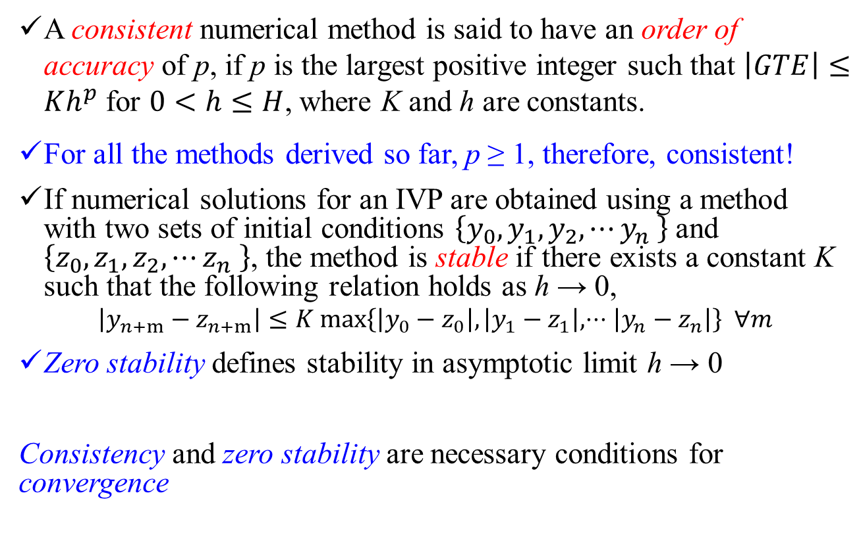
ODE: Consistency, Stability, Convergence (Recap; Text Book S6.3.2)
A consistent numerical method is said to have an order of accuracy of p, if p is the largest positive integer such that $\left|GTE\right|≤Kh^{p}$ for $0<h≤H$, where K and h are constants.
For all the methods derived so far, p ≥ 1, therefore, consistent!
If numerical solutions for an IVP are obtained using a method with two sets of initial conditions $\left\{y_{0},y_{1},y_{2},⋯y_{n} \right\}$ and $\left\{z_{0},z_{1},z_{2},⋯z_{n} \right\}$, the method is stable if there exists a constant K such that the following relation holds as h → 0,
$$\left|y_{n+m}−z_{n+m}\right|≤K max\left\{\left|y_{0}−z_{0}\right|,\left|y_{1}−z_{1}\right|,⋅⋅⋅\left|y_{n}−z_{n}\right|\right\} ∀m$$
Zero stability defines stability in asymptotic limit h → 0
Consistency and zero stability are necessary conditions for convergence

Slide 4
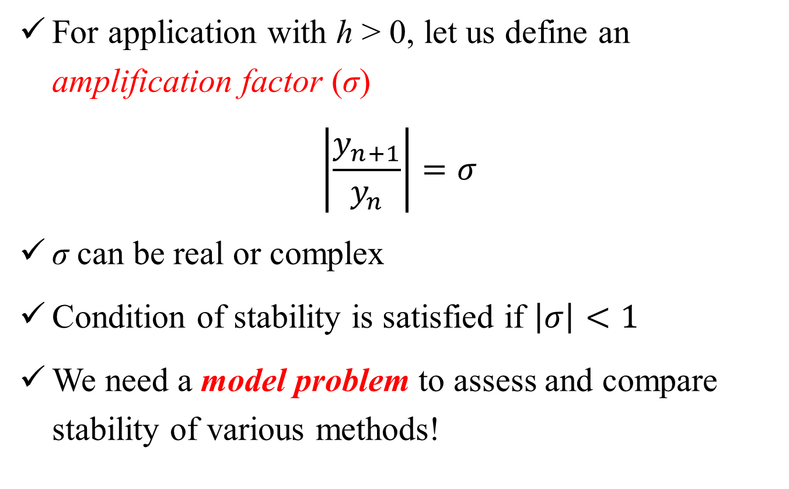
Numerical Methods for IVPs: Stability
For application with h > 0, let us define an amplification factor (σ)
$$\left|\frac{y_{n+1}}{y_{n}}\right|=σ$$
σ can be real or complex
Condition of stability is satisfied if $\left|σ\right|<1$
We need a model problem to assess and compare stability of various methods!

Slide 5
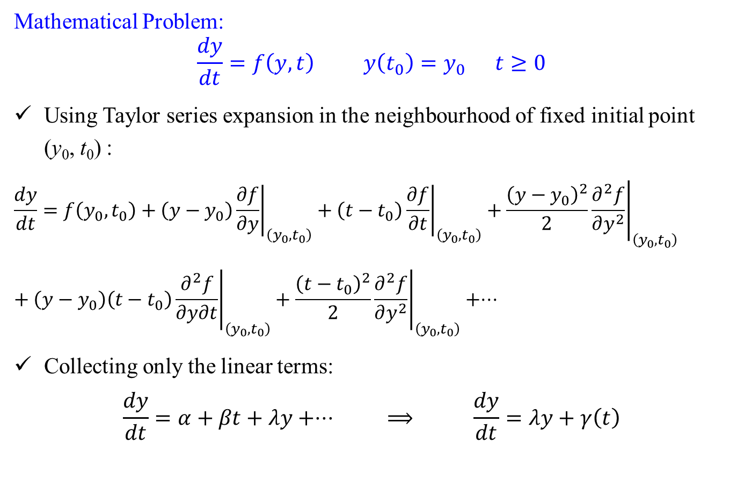
Stability: Model Problem
Mathematical Problem:
$$\frac{dy}{dt}=f\left(y,t\right) y\left(t_{0}\right)=y_{0} t≥0$$
Using Taylor series expansion in the neighbourhood of fixed initial point (y₀, t₀) :
$$\begin{matrix}\frac{dy}{dt}=f\left(y_{0},t_{0}\right)+\left(y−y_{0}\right){\left.\frac{∂f}{∂y}\right|}_{\left(y_{0},t_{0}\right)}+\left(t−t_{0}\right){\left.\frac{∂f}{∂t}\right|}_{\left(y_{0},t_{0}\right)}+\frac{{\left(y−y_{0}\right)}^{2}}{2}{\left.\frac{∂^{2}f}{∂y^{2}}\right|}_{\left(y_{0},t_{0}\right)} \\ \end{matrix}+\left(y−y_{0}\right)\left(t−t_{0}\right){\left.\frac{∂^{2}f}{∂y∂t}\right|}_{\left(y_{0},t_{0}\right)}+\frac{{\left(t−t_{0}\right)}^{2}}{2}{\left.\frac{∂^{2}f}{∂y^{2}}\right|}_{\left(y_{0},t_{0}\right)}+⋅⋅⋅$$
Collecting only the linear terms:
$$\frac{dy}{dt}=α+βt+λy+⋅⋅⋅ ⟹ \frac{dy}{dt}=λy+γ\left(t\right)$$

Slide 6
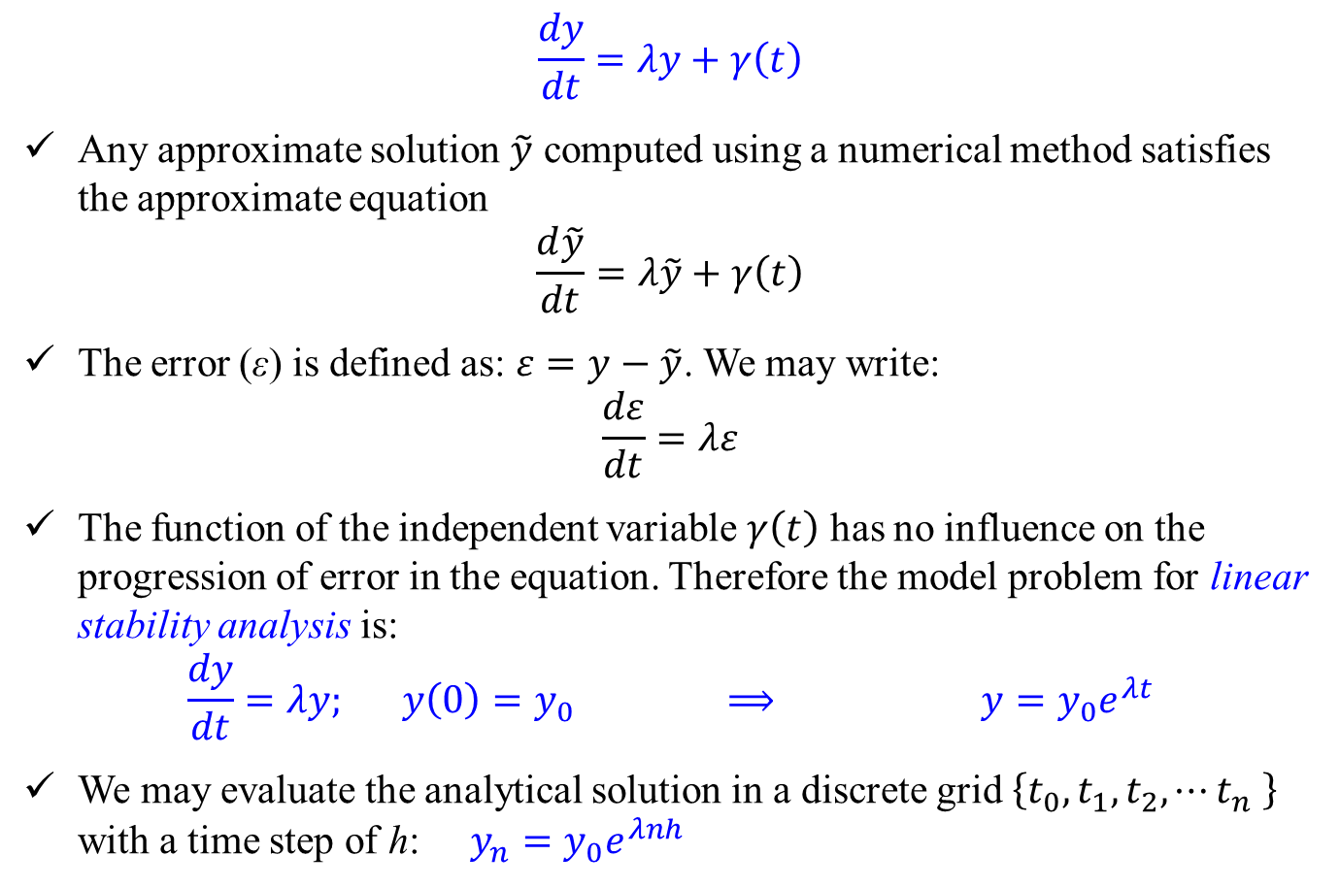
Stability: Model Problem
$$\frac{dy}{dt}=λy+γ\left(t\right)$$
Any approximate solution $\tilde{y}$ computed using a numerical method satisfies the approximate equation
$$\frac{d\tilde{y}}{dt}=λ\tilde{y}+γ\left(t\right)$$
The error (ε) is defined as: $ε=y−\tilde{y}$. We may write:
$$\frac{dε}{dt}=λε$$
The function of the independent variable $γ\left(t\right)$ has no influence on the progression of error in the equation. Therefore the model problem for linear stability analysis is:
$$\frac{dy}{dt}=λy; y\left(0\right)=y_{0} ⟹ y=y_{0}e^{λt}$$
We may evaluate the analytical solution in a discrete grid $\left\{t_{0},t_{1},t_{2},⋯t_{n} \right\}$ with a time step of h: $y_{n}=y_{0}e^{λnh}$

Slide 7
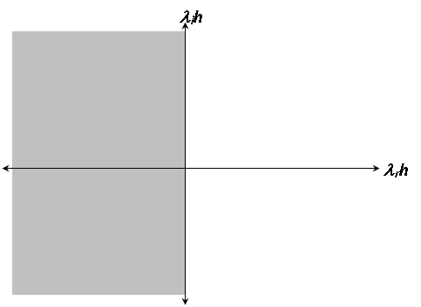
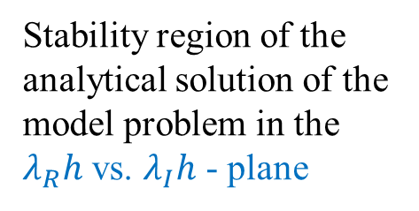
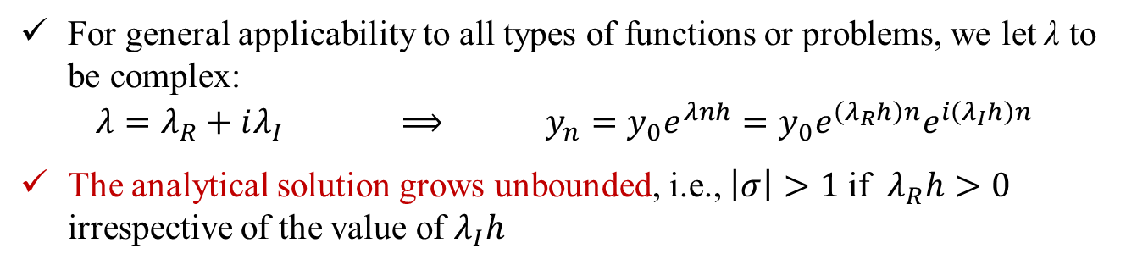
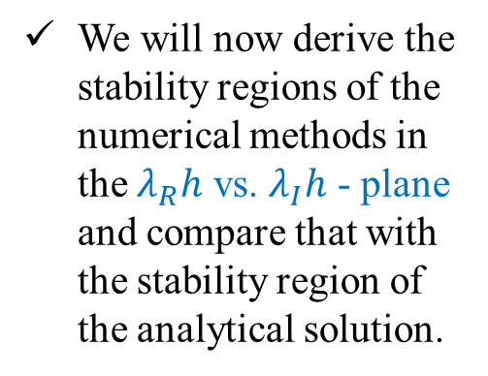


Stability: Model Problem
For general applicability to all types of functions or problems, we let λ to be complex:
$$λ=λ_{R}+iλ_{I} ⟹ y_{n}=y_{0}e^{λnh}=y_{0}e^{\left(λ_{R}h\right)n}e^{i\left(λ_{I}h\right)n}$$
The analytical solution grows unbounded, i.e., $\left|σ\right|>1$ if $λ_{R}h>0$ irrespective of the value of $λ_{I}h$
$$λ_{I}h$$
We will now derive the stability regions of the numerical methods in the $λ_{R}h$ vs. $λ_{I}h$ - plane and compare that with the stability region of the analytical solution.
$$λ_{R}h$$
Stability region of the analytical solution of the model problem in the $λ_{R}h$ vs. $λ_{I}h$ - plane

Slide 8

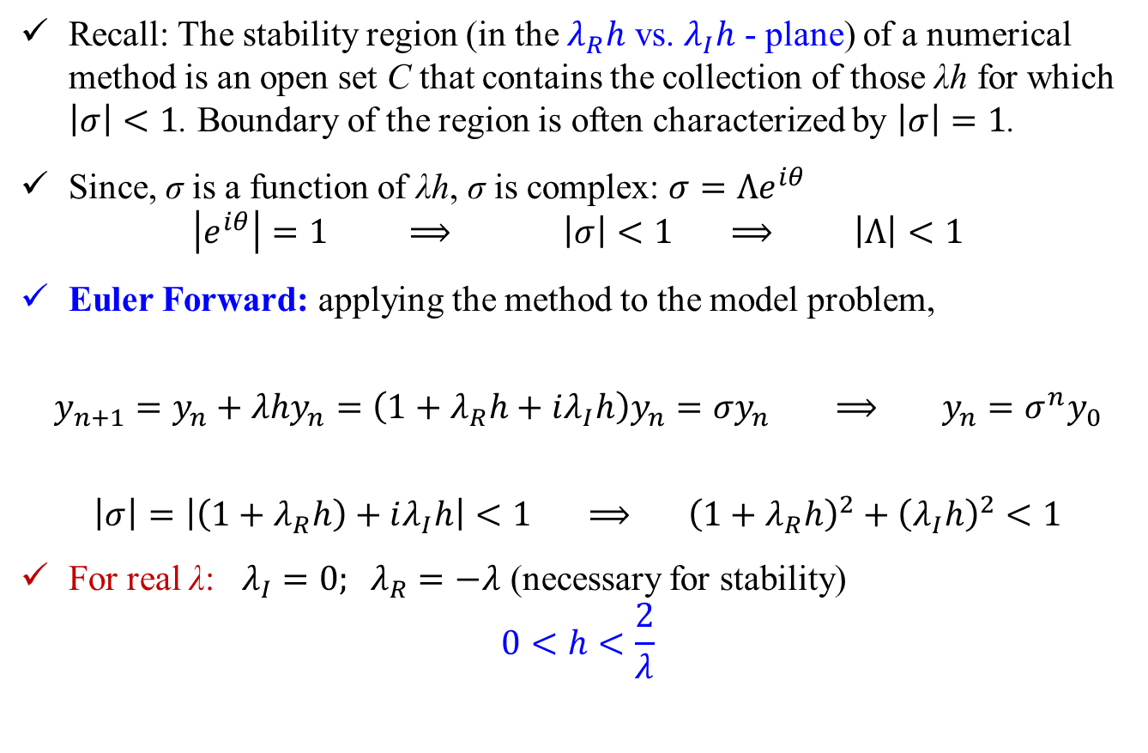
Stability: Multi-Step Methods (explicit) Example
Recall: The stability region (in the $λ_{R}h$ vs. $λ_{I}h$ - plane) of a numerical method is an open set C that contains the collection of those λh for which $\left|σ\right|<1$. Boundary of the region is often characterized by $\left|σ\right|=1$.
Since, σ is a function of λh, σ is complex: $σ=Λe^{iθ}$
$$\left|e^{iθ}\right|=1 ⟹ \left|σ\right|<1 ⟹ \left|Λ\right|<1$$
Euler Forward: applying the method to the model problem,
$$y_{n+1}=y_{n}+λhy_{n}=\left(1+λ_{R}h+iλ_{I}h\right)y_{n}=σy_{n} ⟹ y_{n}=σ^{n}y_{0}$$
$$\left|σ\right|=\left|\left(1+λ_{R}h\right)+iλ_{I}h\right|<1 ⟹ {\left(1+λ_{R}h\right)}^{2}+{\left(λ_{I}h\right)}^{2}<1$$
For real λ: $λ_{I}=0; λ_{R}=−λ$ (necessary for stability)
$$0<h<\frac{2}{λ}$$
$$\frac{dy}{dt}=λy; y\left(0\right)=y_{0}$$

Slide 9
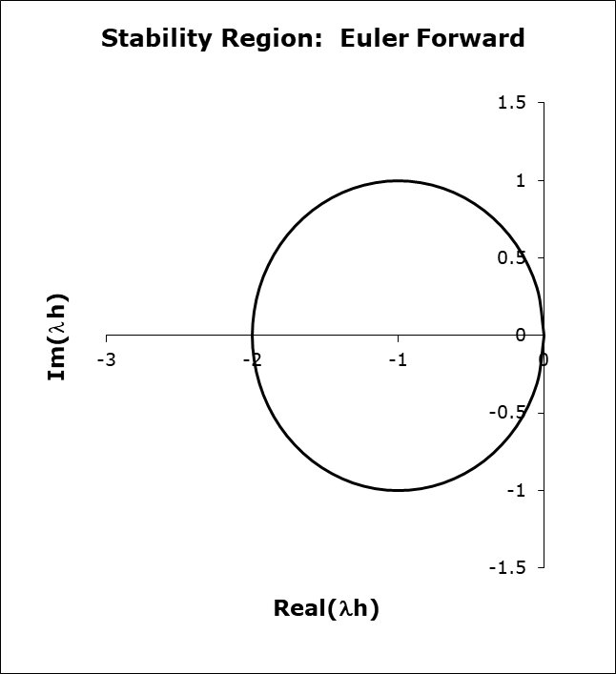
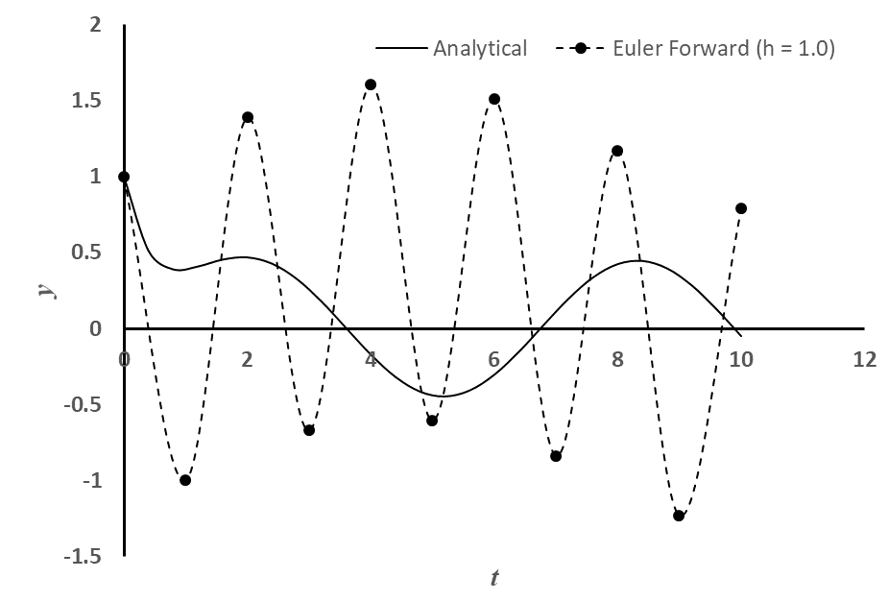
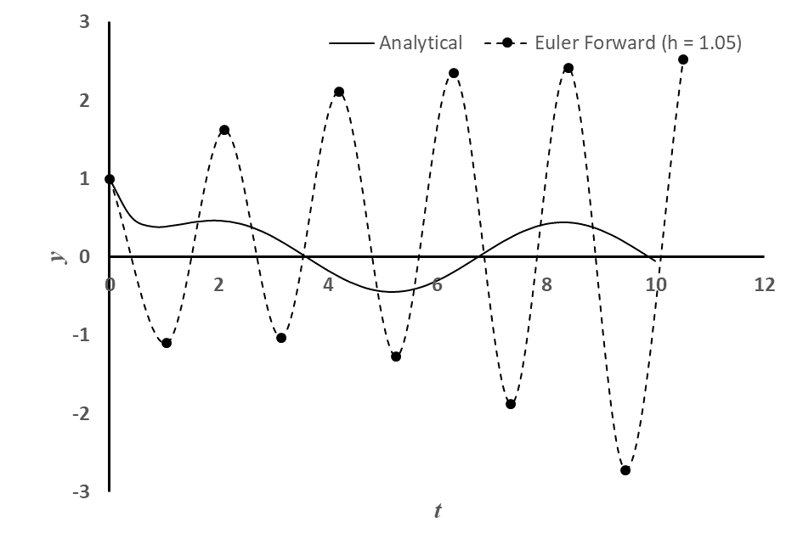
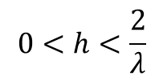
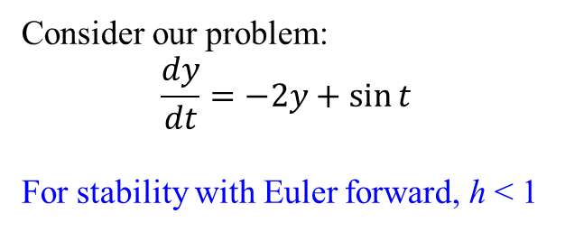
Stability: Multi-Step Methods (explicit) Example
Consider our problem:
$$\frac{dy}{dt}=−2y+\sin{t}$$
For stability with Euler forward, h < 1
$$0<h<\frac{2}{λ}$$

Slide 10
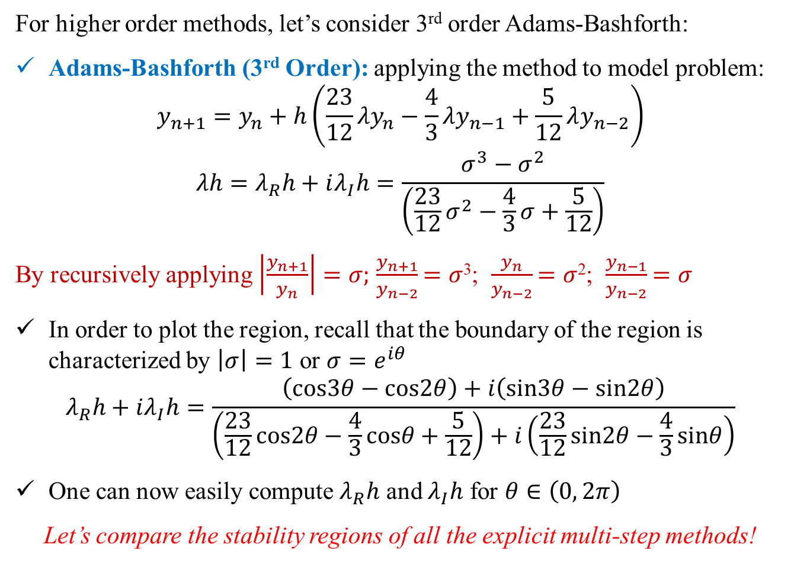
Stability: Multi-Step Methods (explicit) Example
For higher order methods, let’s consider 3rd order Adams-Bashforth:
Adams-Bashforth (3rd Order): applying the method to model problem:
$$y_{n+1}=y_{n}+h\left(\frac{23}{12}λy_{n}−\frac{4}{3}λy_{n−1}+\frac{5}{12}λy_{n−2}\right)$$
$$λh=λ_{R}h+iλ_{I}h=\frac{σ^{3}−σ^{2}}{\left(\frac{23}{12}σ^{2}−\frac{4}{3}σ+\frac{5}{12}\right)}$$
By recursively applying $\left|\frac{y_{n+1}}{y_{n}}\right|=σ;$ $\frac{y_{n+1}}{y_{n−2}}$ $=σ$³; $\frac{y_{n}}{y_{n−2}}$ $=σ$²; $\frac{y_{n−1}}{y_{n−2}}$ $=σ$
In order to plot the region, recall that the boundary of the region is characterized by $\left|σ\right|=1$ or $σ=e^{iθ}$
$$λ_{R}h+iλ_{I}h=\frac{\left(cos3θ−cos2θ\right)+i\left(sin3θ−sin2θ\right)}{\left(\frac{23}{12}cos2θ−\frac{4}{3}cosθ+\frac{5}{12}\right)+i\left(\frac{23}{12}sin2θ−\frac{4}{3}sinθ\right)}$$
One can now easily compute $λ_{R}h$ and $λ_{I}h$ for $θ∈\left(0, 2π\right)$
Let’s compare the stability regions of all the explicit multi-step methods!

Slide 11
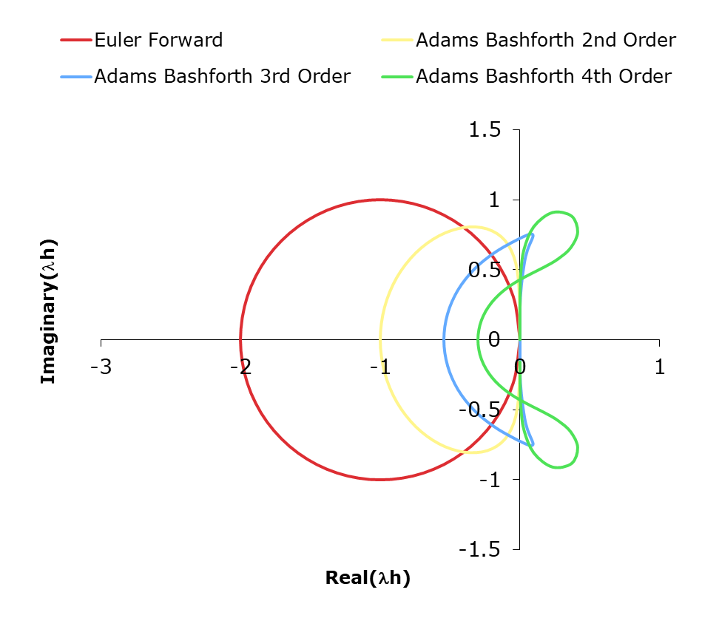
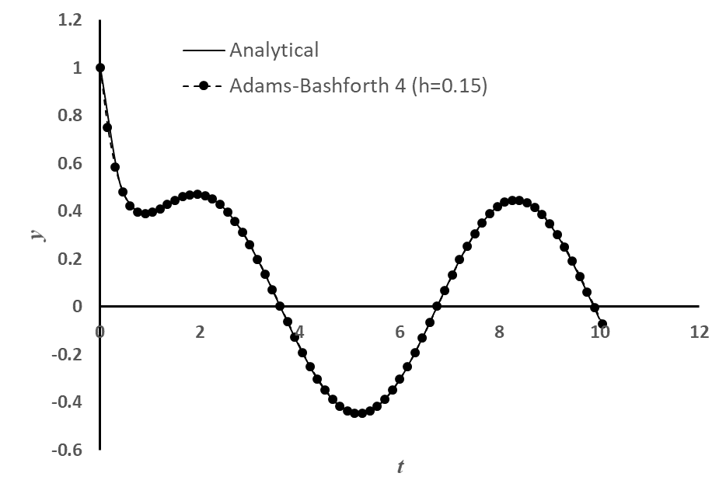

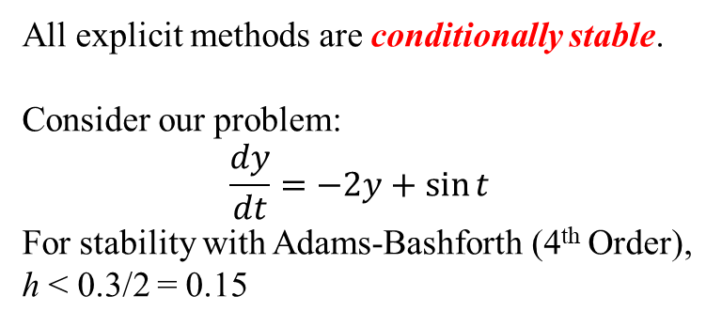
Stability: Multi-Step Methods (explicit) Example
All explicit methods are conditionally stable.
Consider our problem:
$$\frac{dy}{dt}=−2y+\sin{t}$$
For stability with Adams-Bashforth (4th Order), h < 0.3/2 = 0.15

Slide 12
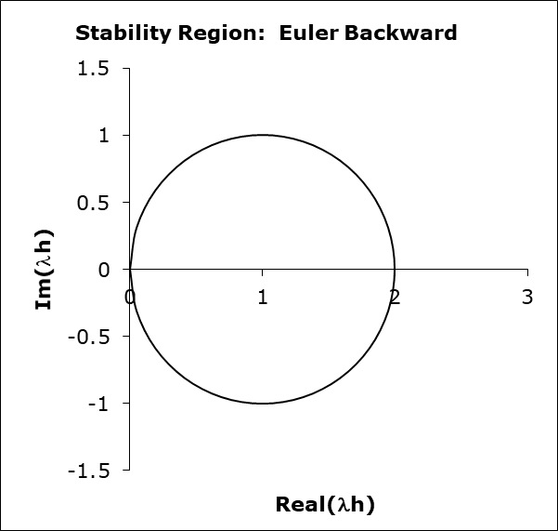
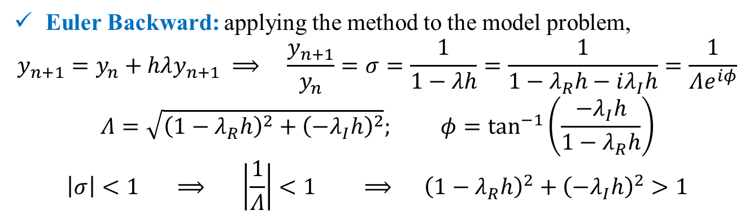
Stability: Multi-Step (Implicit)
Euler Backward: applying the method to the model problem,
$$y_{n+1}=y_{n}+hλy_{n+1} ⟹ \frac{y_{n+1}}{y_{n}}=σ=\frac{1}{1−λh}=\frac{1}{1−λ_{R}h−iλ_{I}h}=\frac{1}{Λe^{iφ}}$$
$$Λ=\sqrt{{\left(1−λ_{R}h\right)}^{2}+{\left(−λ_{I}h\right)}^{2}}; φ=\tan^{−1}\left(\frac{−λ_{I}h}{1−λ_{R}h}\right)$$
$$\left|σ\right|<1 ⟹ \left|\frac{1}{Λ}\right|<1 ⟹ {\left(1−λ_{R}h\right)}^{2}+{\left(−λ_{I}h\right)}^{2}>1$$
Euler Backward method is stable everywhere outside the circle!
Homework: Stability region of the Trapezoidal Method!

Slide 13
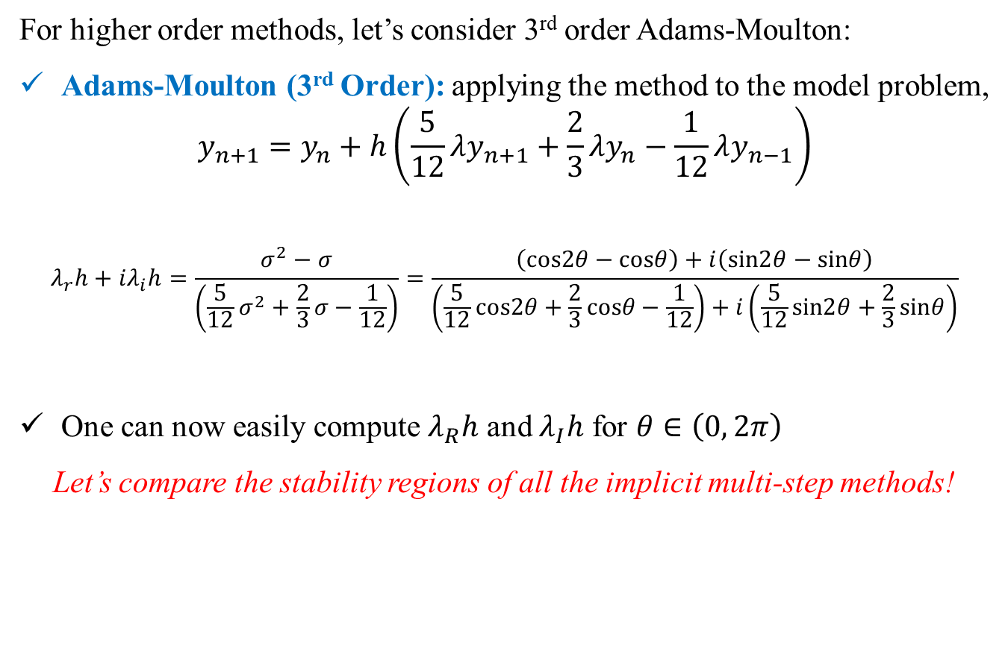
Stability: Multi-Step Methods (implicit) Example
For higher order methods, let’s consider 3rd order Adams-Moulton:
Adams-Moulton (3rd Order): applying the method to the model problem,
$$y_{n+1}=y_{n}+h\left(\frac{5}{12}λy_{n+1}+\frac{2}{3}λy_{n}−\frac{1}{12}λy_{n−1}\right)$$
$$λ_{r}h+iλ_{i}h=\frac{σ^{2}−σ}{\left(\frac{5}{12}σ^{2}+\frac{2}{3}σ−\frac{1}{12}\right)}=\frac{\left(cos2θ−cosθ\right)+i\left(sin2θ−sinθ\right)}{\left(\frac{5}{12}cos2θ+\frac{2}{3}cosθ−\frac{1}{12}\right)+i\left(\frac{5}{12}sin2θ+\frac{2}{3}sinθ\right)}$$
One can now easily compute $λ_{R}h$ and $λ_{I}h$ for $θ∈\left(0, 2π\right)$
Let’s compare the stability regions of all the implicit multi-step methods!

Slide 14
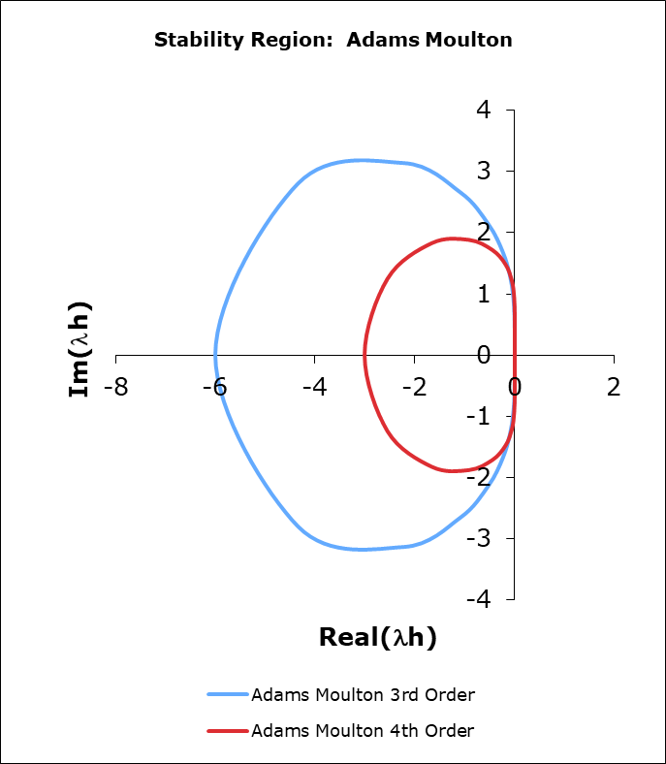
Stability: Multi-Step Methods (implicit) Example
Euler backward method is unconditionally stable! (It is stable everywhere, where the analytical problem is also stable)
Trapezoidal: find as homework!
Adams-Moulton 3rd and 4th order methods are conditionally stable!
Pay attention to the stability for purely imaginary λ!

Slide 15
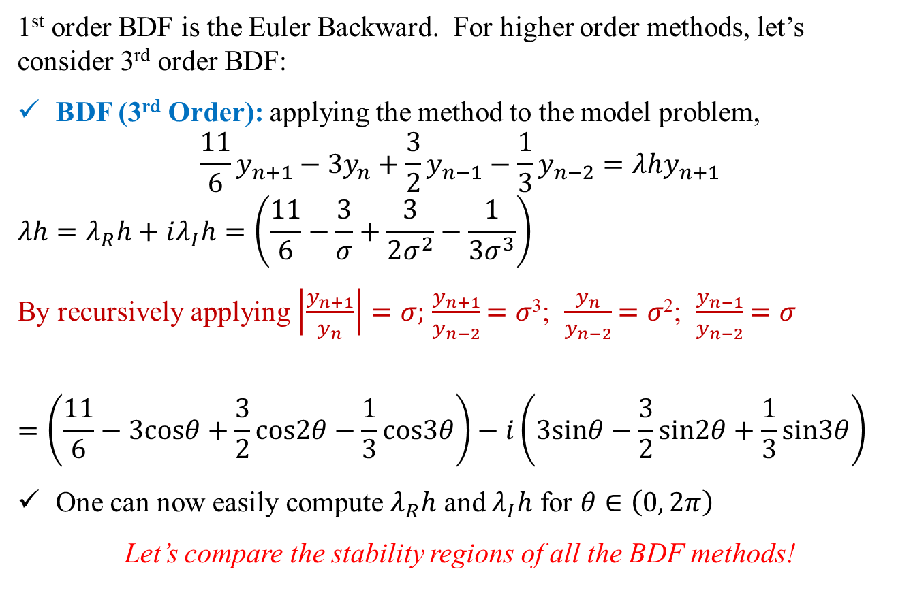
Stability: BDF Methods Example
1st order BDF is the Euler Backward. For higher order methods, let’s consider 3rd order BDF:
BDF (3rd Order): applying the method to the model problem,
$$\frac{11}{6}y_{n+1}−3y_{n}+\frac{3}{2}y_{n−1}−\frac{1}{3}y_{n−2}=λhy_{n+1}$$
$$λh=λ_{R}h+iλ_{I}h=\left(\frac{11}{6}−\frac{3}{σ}+\frac{3}{2σ^{2}}−\frac{1}{3σ^{3}}\right)$$
By recursively applying $\left|\frac{y_{n+1}}{y_{n}}\right|=σ;$ $\frac{y_{n+1}}{y_{n−2}}$ $=σ$³; $\frac{y_{n}}{y_{n−2}}$ $=σ$²; $\frac{y_{n−1}}{y_{n−2}}$ $=σ$
$$=\left(\frac{11}{6}−3cosθ+\frac{3}{2}cos2θ−\frac{1}{3}cos3θ\right)−i\left(3sinθ−\frac{3}{2}sin2θ+\frac{1}{3}sin3θ\right)$$
One can now easily compute $λ_{R}h$ and $λ_{I}h$ for $θ∈\left(0, 2π\right)$
Let’s compare the stability regions of all the BDF methods!

Slide 16
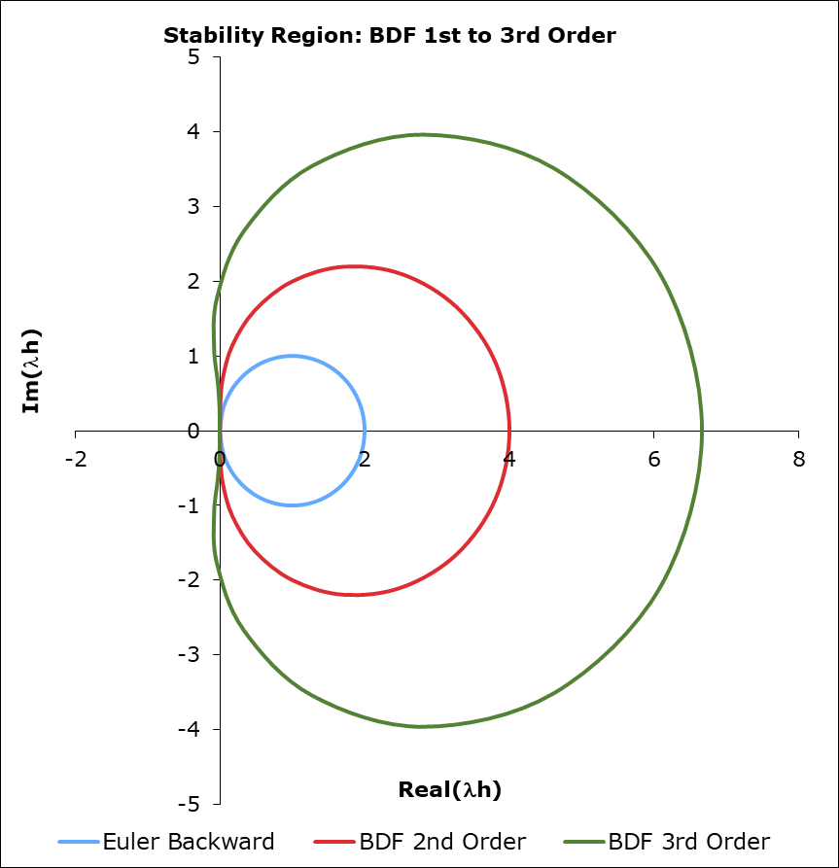
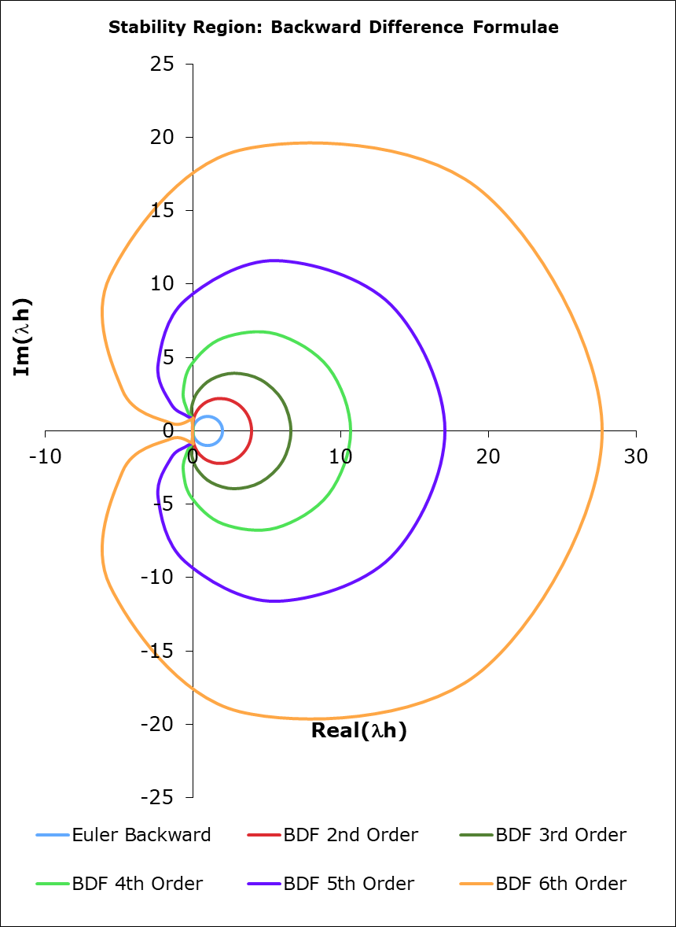
Stability: BDF Methods Example
For all the BDFs: Stability Region is outside the enclosed region!
For real λ, all the BDFs are unconditionally stable!
One can use any h without having to worry about the stability!
Useful for stiff equations!

Slide 17
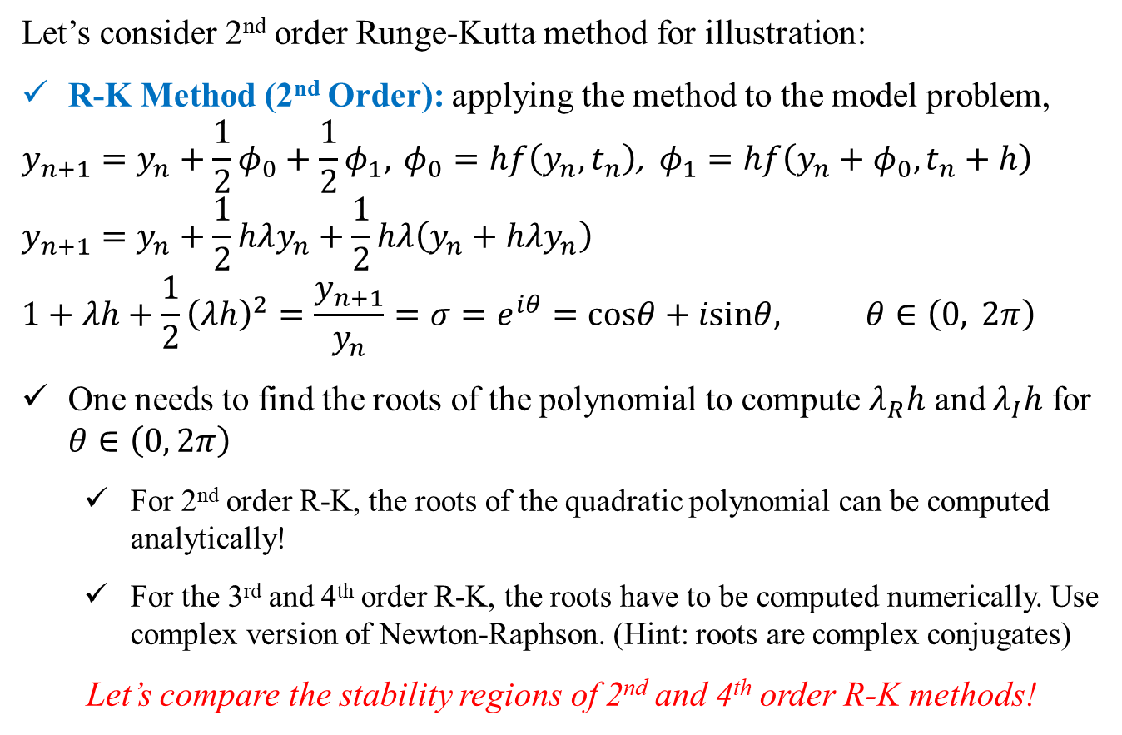
Stability: Runge-Kutta Methods Example
Let’s consider 2nd order Runge-Kutta method for illustration:
R-K Method (2nd Order): applying the method to the model problem,
$$y_{n+1}=y_{n}+\frac{1}{2}φ_{0}+\frac{1}{2}φ_{1}, φ_{0}=hf\left(y_{n},t_{n}\right)\text{, }φ_{1}=hf\left(y_{n}+φ_{0},t_{n}+h\right)$$
$$y_{n+1}=y_{n}+\frac{1}{2}hλy_{n}+\frac{1}{2}hλ\left(y_{n}+hλy_{n}\right)$$
$$1+λh+\frac{1}{2}{\left(λh\right)}^{2}=\frac{y_{n+1}}{y_{n}}=σ=e^{iθ}=cosθ+isinθ, θ∈\left(0, 2π\right)$$
One needs to find the roots of the polynomial to compute $λ_{R}h$ and $λ_{I}h$ for $θ∈\left(0, 2π\right)$
For 2nd order R-K, the roots of the quadratic polynomial can be computed analytically!
For the 3rd and 4th order R-K, the roots have to be computed numerically. Use complex version of Newton-Raphson. (Hint: roots are complex conjugates)
Let’s compare the stability regions of 2nd and 4th order R-K methods!

Slide 18
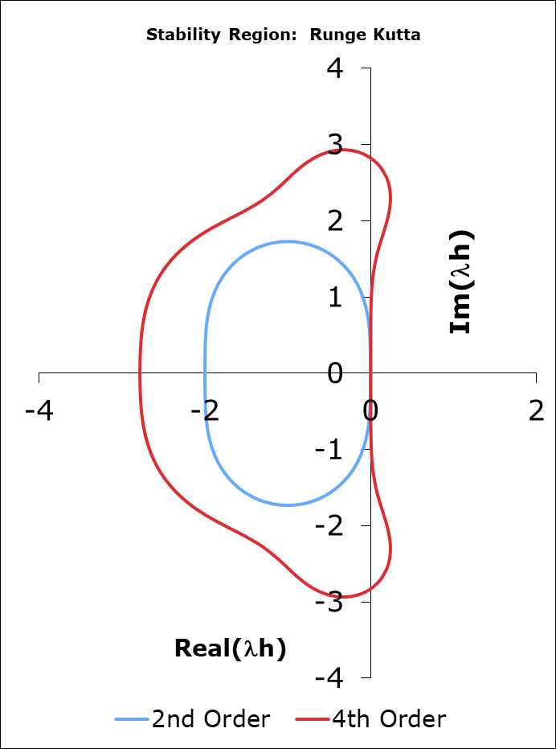
Stability: Runge-Kutta Methods Example
4th order R-K has very good stability properties (λh up to 2.78 on the real part and 2.83 on the imaginary part)
The method is also stable for purely imaginary λh
Homework: For our problem, check the stability limits of the R-K methods!

Slide 19
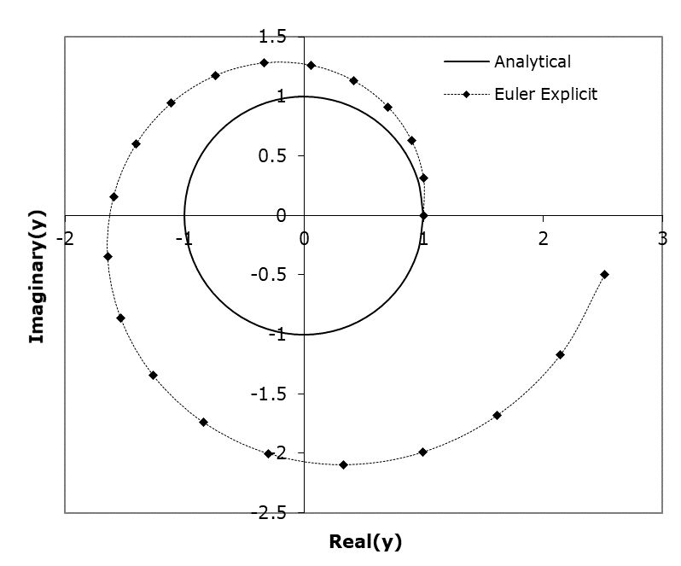
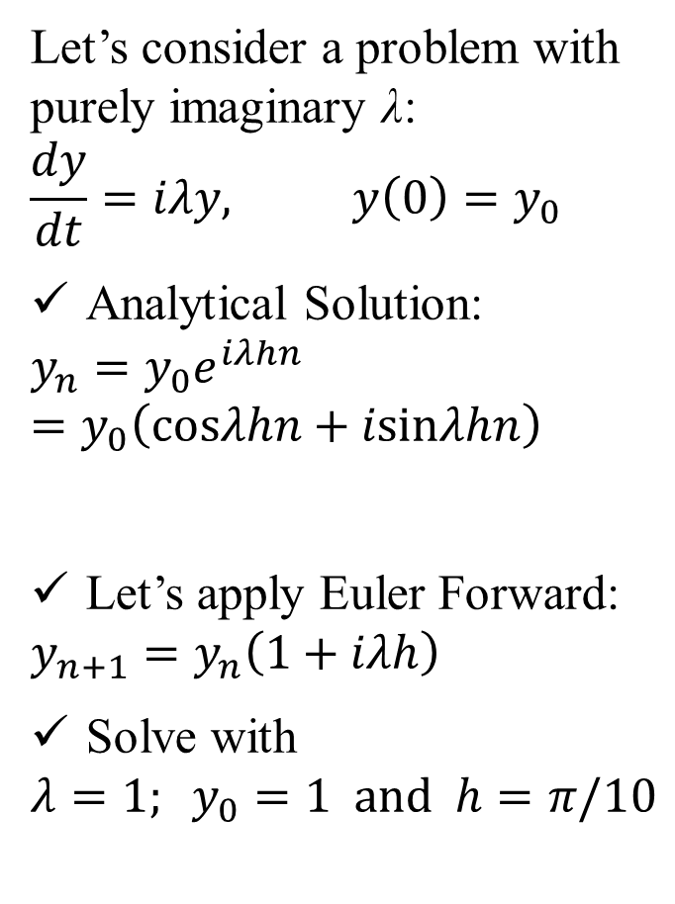
Phase Error
Let’s consider a problem with purely imaginary λ:
$$\frac{dy}{dt}=iλy, y\left(0\right)=y_{0}$$
Analytical Solution:
$$y_{n}=y_{0}e^{iλhn}=y_{0}\left(cosλhn+isinλhn\right)$$
Let’s apply Euler Forward:
$$y_{n+1}=y_{n}\left(1+iλh\right)$$
Solve with
$$λ=1; y_{0}=1 and h=π/10$$
For periodic functions, there are phase error associated with the numerical solution.
Can we quantify them?

Slide 20
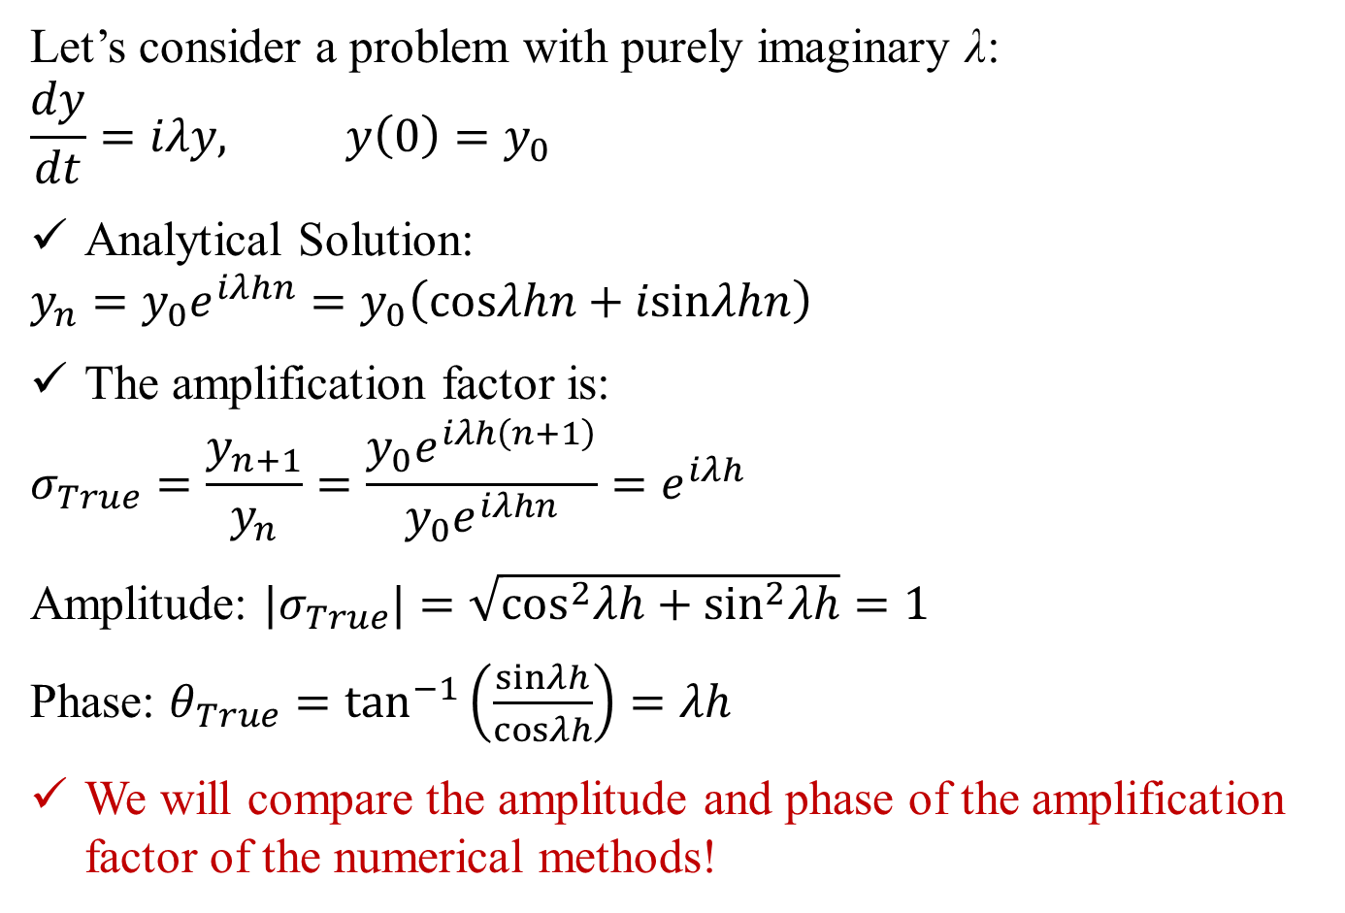
Phase Error
Let’s consider a problem with purely imaginary λ:
$$\frac{dy}{dt}=iλy, y\left(0\right)=y_{0}$$
Analytical Solution:
$$y_{n}=y_{0}e^{iλhn}=y_{0}\left(cosλhn+isinλhn\right)$$
The amplification factor is:
$$σ_{True}=\frac{y_{n+1}}{y_{n}}=\frac{y_{0}e^{iλh\left(n+1\right)}}{y_{0}e^{iλhn}}=e^{iλh}$$
Amplitude: $|σ_{True}|=\sqrt{\cos^{2}λh+\sin^{2}λh}=1$
Phase: $θ_{True}=\tan^{−1}\left(\frac{sinλh}{cosλh}\right)=λh$
We will compare the amplitude and phase of the amplification factor of the numerical methods!

Slide 21
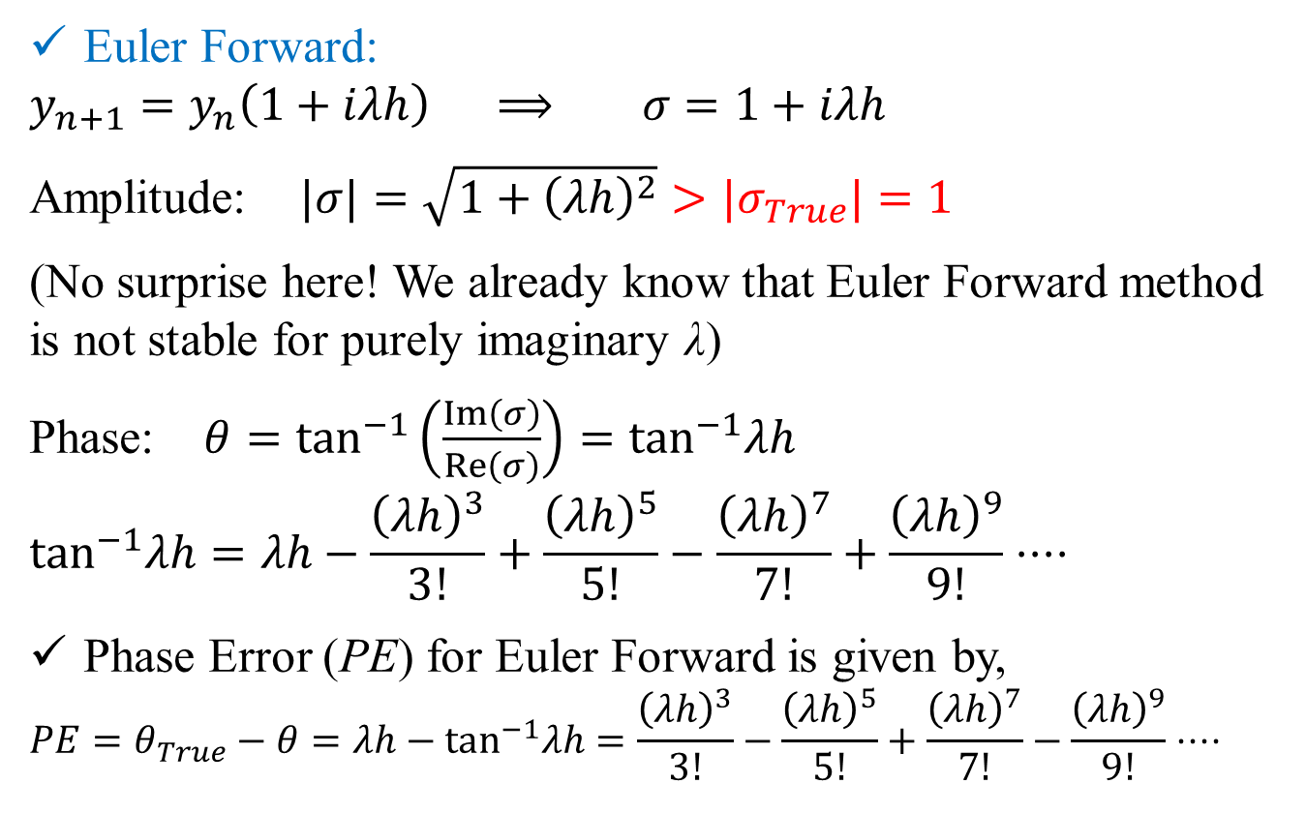
Phase Error
Euler Forward:
$$y_{n+1}=y_{n}\left(1+iλh\right) ⟹ σ=1+iλh$$
Amplitude:$|σ|=\sqrt{1+{\left(λh\right)}^{2}}>|σ_{True}|=1$
(No surprise here! We already know that Euler Forward method is not stable for purely imaginary λ)
Phase: $θ=\tan^{−1}\left(\frac{Im\left(σ\right)}{Re\left(σ\right)}\right)=\tan^{−1}λh$
$$\tan^{−1}λh=λh−\frac{{\left(λh\right)}^{3}}{3!}+\frac{{\left(λh\right)}^{5}}{5!}−\frac{{\left(λh\right)}^{7}}{7!}+\frac{{\left(λh\right)}^{9}}{9!}⋅⋅⋅⋅$$
Phase Error (PE) for Euler Forward is given by,
$$PE=θ_{True}−θ=λh−\tan^{−1}λh=\frac{{\left(λh\right)}^{3}}{3!}−\frac{{\left(λh\right)}^{5}}{5!}+\frac{{\left(λh\right)}^{7}}{7!}−\frac{{\left(λh\right)}^{9}}{9!}⋅⋅⋅⋅$$

Slide 22
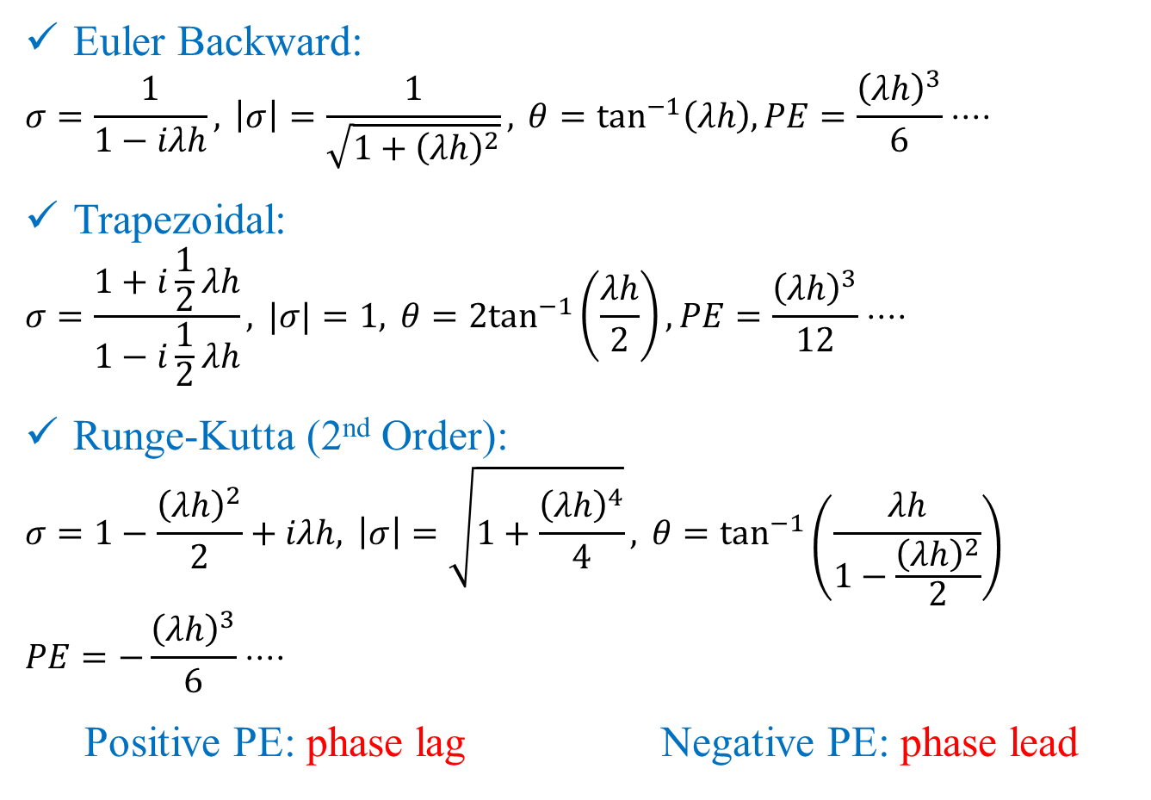
Phase Error
Euler Backward:
$$σ=\frac{1}{1−iλh}, \left|σ\right|=\frac{1}{\sqrt{1+{\left(λh\right)}^{2}}}, θ=\tan^{−1}\left(λh\right),PE=\frac{{\left(λh\right)}^{3}}{6}⋅⋅⋅⋅$$
Trapezoidal:
$$σ=\frac{1+i\frac{1}{2}λh}{1−i\frac{1}{2}λh}, |σ|=1, θ=2\tan^{−1}\left(\frac{λh}{2}\right),PE=\frac{{\left(λh\right)}^{3}}{12}⋅⋅⋅⋅$$
Runge-Kutta (2nd Order):
$$σ=1−\frac{{\left(λh\right)}^{2}}{2}+iλh, \left|σ\right|=\sqrt{1+\frac{{\left(λh\right)}^{4}}{4}}, θ=\tan^{−1}\left(\frac{λh}{1−\frac{{\left(λh\right)}^{2}}{2}}\right)$$
$$PE=−\frac{{\left(λh\right)}^{3}}{6}⋅⋅⋅⋅$$
Positive PE: phase lag Negative PE: phase lead

Slide 23
Arbitrary f
How to choose time step h for arbitrary non-linear f:
Expand f in Taylor’s series around the initial condition,
retain the first two terms (linear terms) to obtain the equivalent model problem
set λ = coefficient of y
compute h from the stability diagram!
To account for the non-linearity, stay well below the stability limit!

