Slide 1
Ordinary Differential Equation
The methods for Initial Value Problems (IVPs):
Multi-step Methods
Explicit: Euler Forward, Adams-Bashforth
Implicit: Euler Backward, Trapezoidal and Adams-Moulton
Backward Difference Formulae (BDF)
Runge-Kutta Methods
Applications, Startup, Combination Methods (Predictor-Corrector)
Consistency, Stability, Convergence
Application to System of ODEs
Boundary Value Problems (BVPs)
Shooting Method
Direct Methods

Slide 2

ESO 208A: Computational Methods in Engineering Ordinary Differential Equation: System of IVPs and Higher Order IVPs
Abhas Singh
Department of Civil Engineering
IIT Kanpur
Acknowledgements: Profs. Saumyen Guha and Shivam Tripathi (CE)

Slide 3
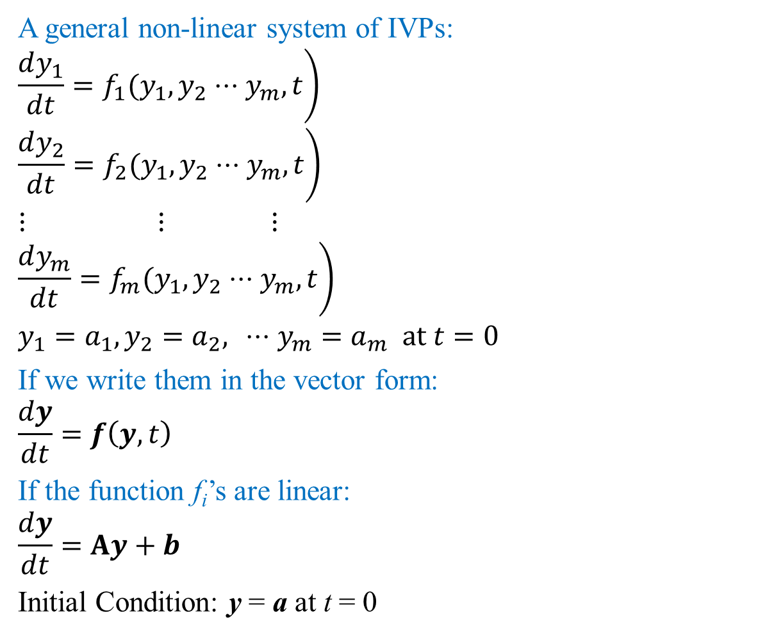
System of IVPs
A general non-linear system of IVPs:
$$\left.\frac{dy_{1}}{dt}=f_{1}(y_{1},y_{2}⋅⋅⋅y_{m},t\right)$$
$$\left.\frac{dy_{2}}{dt}=f_{2}(y_{1},y_{2}⋅⋅⋅y_{m},t\right)$$
$$⋮ ⋮ ⋮$$
$$\left.\frac{dy_{m}}{dt}=f_{m}(y_{1},y_{2}⋅⋅⋅y_{m},t\right)$$
$$y_{1}=a_{1},y_{2}=a_{2}, ⋅⋅⋅y_{m}=a_{m} at t=0$$
If we write them in the vector form:
$$\frac{dy}{dt}=f\left(y,t\right)$$
If the function f_{i}’s are linear:
$$\frac{dy}{dt}=Ay+b$$
Initial Condition: y = a at t = 0

Slide 4
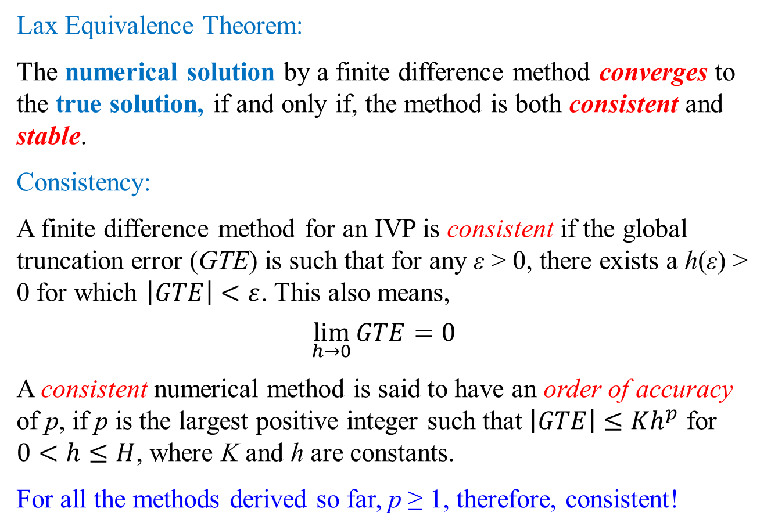
Higher Order IVP
A general m^{th} order IVP:
$$y^{\left(m\right)}=f\left(y^{\left(m−1\right)},y^{\left(m−2\right)},⋅⋅⋅y^{′},y;t\right)$$
$$y=a_{0}, y^{′}=a_{1}, y^{″}=a_{2}\text{,}⋅⋅⋅ y^{\left(m−1\right)}=a_{m−1} at t=0$$
Define a set of variables $\left\{u_{1},u_{2},u_{3},⋅⋅⋅u_{m}\right\}$ as,
$$u_{1}=y, u_{2}=y^{′}, u_{3}=y^{″}\text{,}⋅⋅⋅ u_{m}=y^{\left(m−1\right)}$$
The m^{th} order IVP can be written as a system of IVPs in terms of the new variables as:
$$u_{1}^{′}=u_{2}$$
$$u_{2}^{′}=u_{3}$$
$$u_{3}^{′}=u_{4}$$
$$⋮ ⋮ ⋮$$
$$u_{m−1}^{′}=u_{m}$$
$$u_{m}^{′}=f\left(u_{1},u_{2},u_{3},⋅⋅⋅u_{m};t\right)$$
$$u_{1}^{0}=a_{0}, u_{2}^{0}=a_{1}, u_{3}^{0}=a_{2}\text{,}⋅⋅⋅ u_{m}^{0}=a_{m−1} at t=0$$

Slide 5
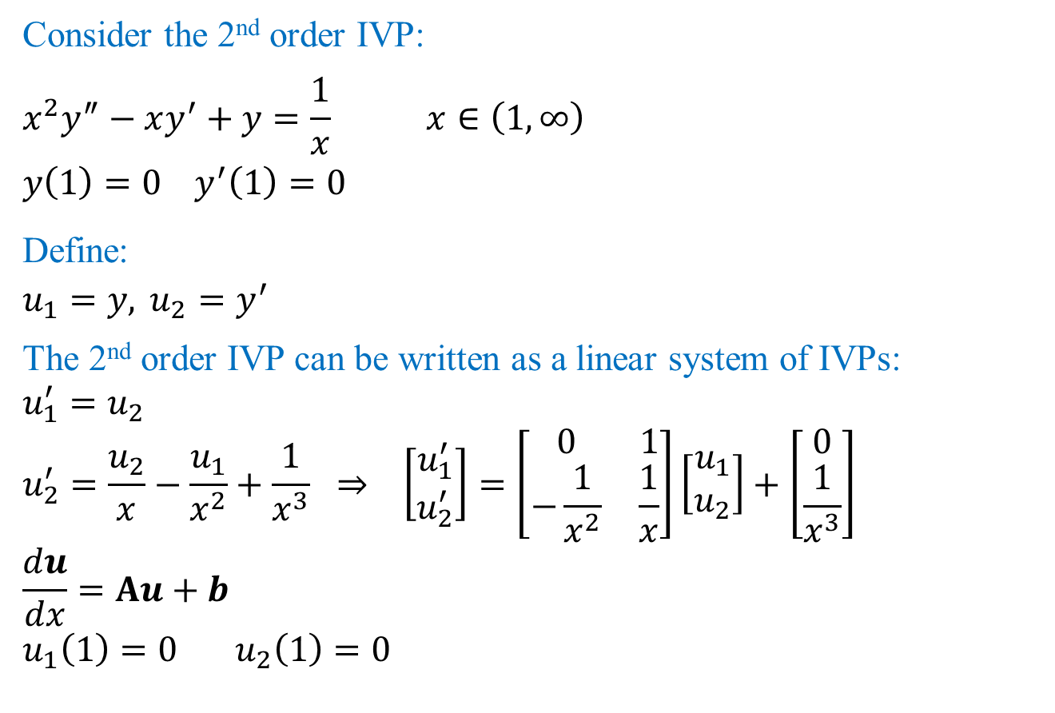
Higher Order IVP: Example
Consider the 2nd order IVP:
$$x^{2}y^{″}−xy^{′}+y=\frac{1}{x} x∈\left(1,∞\right)$$
$$y\left(1\right)=0 y^{′}\left(1\right)=0$$
Define:
$$u_{1}=y, u_{2}=y^{′}$$
The 2nd order IVP can be written as a linear system of IVPs:
$$u_{1}^{′}=u_{2}$$
$$u_{2}^{′}=\frac{u_{2}}{x}−\frac{u_{1}}{x^{2}}+\frac{1}{x^{3}} ⇒ \left[\begin{matrix}u_{1}^{′} \\ u_{2}^{′}\end{matrix}\right]=\left[\begin{matrix}0 & 1 \\ −\frac{1}{x^{2}} & \frac{1}{x}\end{matrix}\right]\left[\begin{matrix}u_{1} \\ u_{2}\end{matrix}\right]+\left[\begin{matrix}0 \\ \frac{1}{x^{3}}\end{matrix}\right]$$
$$\frac{du}{dx}=Au+b$$
$$u_{1}\left(1\right)=0 u_{2}\left(1\right)=0$$

Slide 6
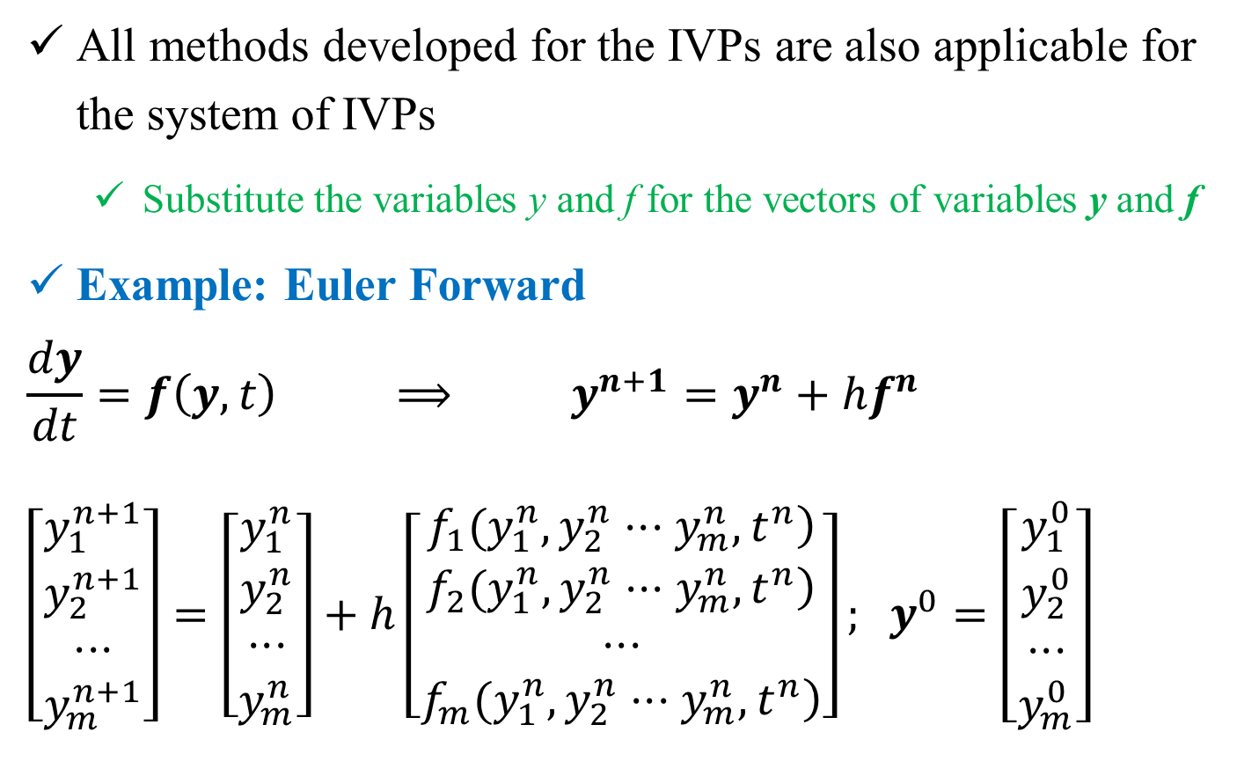
Numerical Methods for System of IVPs
All methods developed for the IVPs are also applicable for the system of IVPs
Substitute the variables y and f for the vectors of variables y and f
Example: Euler Forward
$$\frac{dy}{dt}=f\left(y,t\right) ⟹ y^{n+1}=y^{n}+hf^{n}$$
$$\left[\begin{matrix}y_{1}^{n+1} \\ y_{2}^{n+1} \\ ⋅⋅⋅ \\ y_{m}^{n+1}\end{matrix}\right]=\left[\begin{matrix}y_{1}^{n} \\ y_{2}^{n} \\ ⋅⋅⋅ \\ y_{m}^{n}\end{matrix}\right]+h\left[\begin{matrix}\left.f_{1}(y_{1}^{n},y_{2}^{n}⋅⋅⋅y_{m}^{n},t^{n}\right) \\ \left.f_{2}(y_{1}^{n},y_{2}^{n}⋅⋅⋅y_{m}^{n},t^{n}\right) \\ ⋅⋅⋅ \\ \left.f_{m}(y_{1}^{n},y_{2}^{n}⋅⋅⋅y_{m}^{n},t^{n}\right)\end{matrix}\right]; y^{0}=\left[\begin{matrix}y_{1}^{0} \\ y_{2}^{0} \\ ⋅⋅⋅ \\ y_{m}^{0}\end{matrix}\right]$$

Slide 7
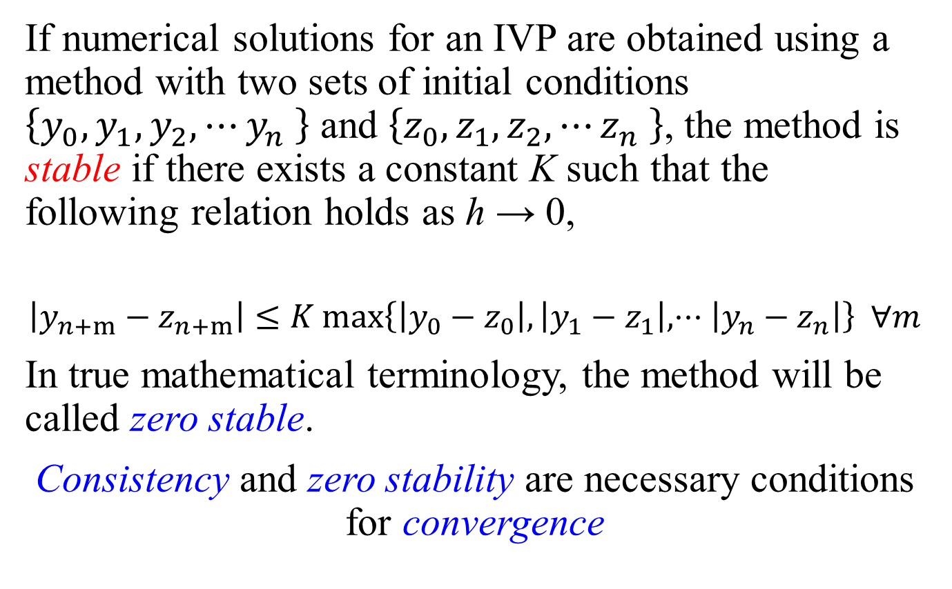
Numerical Methods for System of IVPs
Example: Euler Backward (Linear f)
$$\frac{dy}{dt}=Ay+b$$
$$y^{n+1}=y^{n}+hf^{n+1}=y^{n}+hA^{n+1}y^{n+1}+hb^{n+1}$$
$$\left(I−hA^{n+1}\right)y^{n+1}=y^{n}+hb^{n+1}$$
$$y^{0}=\left[\begin{matrix}y_{1}^{0} \\ y_{2}^{0} \\ ⋅⋅⋅ \\ y_{m}^{0}\end{matrix}\right]$$
A and b are functions of t only. Therefore, they are known at all time steps.

Slide 8
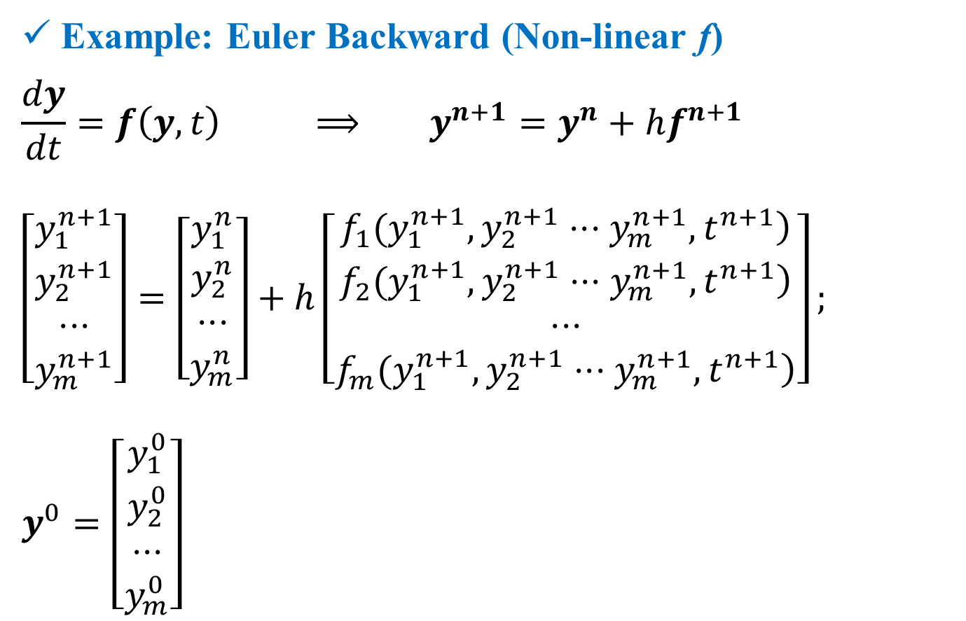
Numerical Methods for System of IVPs
Example: Euler Backward (Non-linear f)
$$\frac{dy}{dt}=f\left(y,t\right) ⟹ y^{n+1}=y^{n}+hf^{n+1}$$
$$\left[\begin{matrix}y_{1}^{n+1} \\ y_{2}^{n+1} \\ ⋅⋅⋅ \\ y_{m}^{n+1}\end{matrix}\right]=\left[\begin{matrix}y_{1}^{n} \\ y_{2}^{n} \\ ⋅⋅⋅ \\ y_{m}^{n}\end{matrix}\right]+h\left[\begin{matrix}\left.f_{1}(y_{1}^{n+1},y_{2}^{n+1}⋅⋅⋅y_{m}^{n+1},t^{n+1}\right) \\ \left.f_{2}(y_{1}^{n+1},y_{2}^{n+1}⋅⋅⋅y_{m}^{n+1},t^{n+1}\right) \\ ⋅⋅⋅ \\ \left.f_{m}(y_{1}^{n+1},y_{2}^{n+1}⋅⋅⋅y_{m}^{n+1},t^{n+1}\right)\end{matrix}\right];$$
$$y^{0}=\left[\begin{matrix}y_{1}^{0} \\ y_{2}^{0} \\ ⋅⋅⋅ \\ y_{m}^{0}\end{matrix}\right]$$

Slide 9
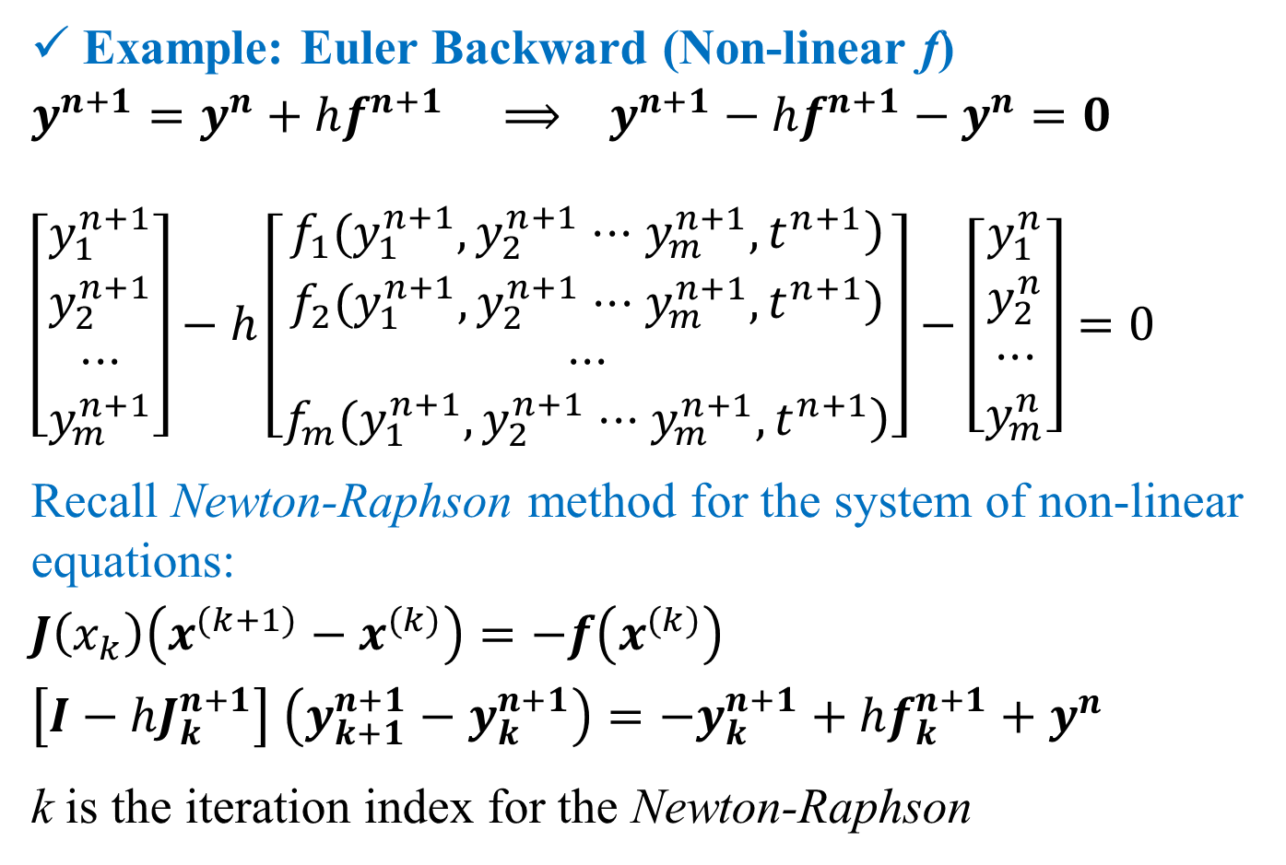
Numerical Methods for System of IVPs
Example: Euler Backward (Non-linear f)
$$y^{n+1}=y^{n}+hf^{n+1} ⟹ y^{n+1}−hf^{n+1}−y^{n}=0$$
$$\left[\begin{matrix}y_{1}^{n+1} \\ y_{2}^{n+1} \\ ⋅⋅⋅ \\ y_{m}^{n+1}\end{matrix}\right]−h\left[\begin{matrix}\left.f_{1}(y_{1}^{n+1},y_{2}^{n+1}⋅⋅⋅y_{m}^{n+1},t^{n+1}\right) \\ \left.f_{2}(y_{1}^{n+1},y_{2}^{n+1}⋅⋅⋅y_{m}^{n+1},t^{n+1}\right) \\ ⋅⋅⋅ \\ \left.f_{m}(y_{1}^{n+1},y_{2}^{n+1}⋅⋅⋅y_{m}^{n+1},t^{n+1}\right)\end{matrix}\right]−\left[\begin{matrix}y_{1}^{n} \\ y_{2}^{n} \\ ⋅⋅⋅ \\ y_{m}^{n}\end{matrix}\right]=0$$
Recall Newton-Raphson method for the system of non-linear equations:
$$J\left(x_{k}\right)\left(x^{(k+1)}−x^{(k)}\right)=−f\left(x^{(k)}\right)$$
$$\left[I−hJ_{k}^{n+1}\right] \left(y_{k+1}^{n+1}−y_{k}^{n+1}\right)=−y_{k}^{n+1}+hf_{k}^{n+1}+y^{n}$$
k is the iteration index for the Newton-Raphson

Slide 10
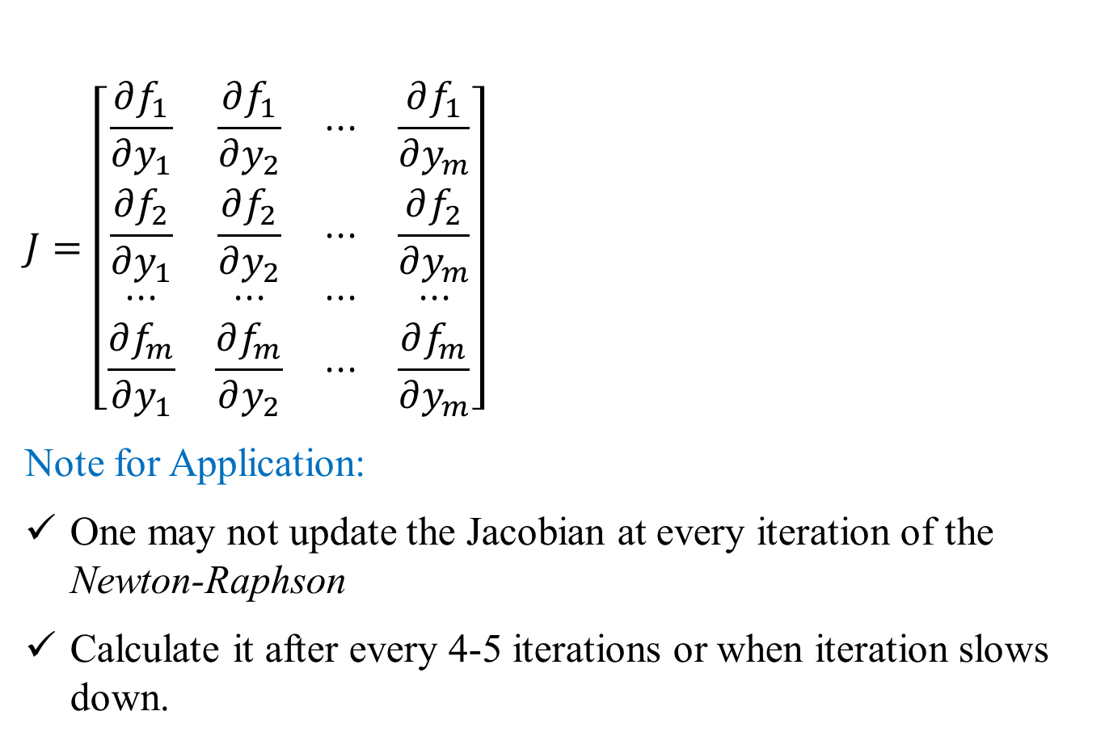
Numerical Methods for System of IVPs
$$J=\left[\begin{matrix}\frac{∂f_{1}}{∂y_{1}} & \frac{∂f_{1}}{∂y_{2}} & ⋅⋅⋅ & \frac{∂f_{1}}{∂y_{m}} \\ \frac{∂f_{2}}{∂y_{1}} & \frac{∂f_{2}}{∂y_{2}} & ⋅⋅⋅ & \frac{∂f_{2}}{∂y_{m}} \\ ⋅⋅⋅ & ⋅⋅⋅ & ⋅⋅⋅ & ⋅⋅⋅ \\ \frac{∂f_{m}}{∂y_{1}} & \frac{∂f_{m}}{∂y_{2}} & ⋅⋅⋅ & \frac{∂f_{m}}{∂y_{m}}\end{matrix}\right]$$
Note for Application:
One may not update the Jacobian at every iteration of the Newton-Raphson
Calculate it after every 4-5 iterations or when iteration slows down.

Slide 11
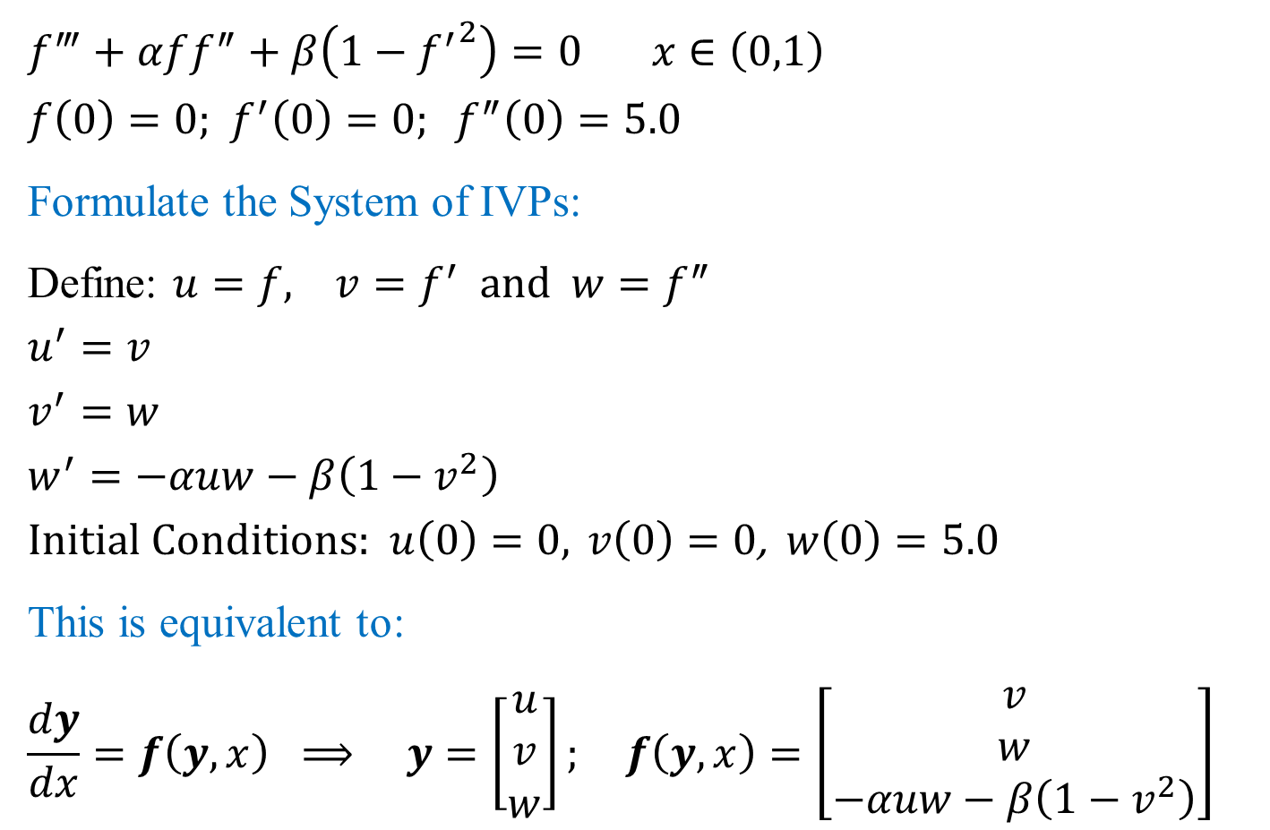
Example application: Higher Order IVP
$$f^{‴}+αff^{″}+β\left(1−{f^{′}}^{2}\right)=0 x∈\left(0,1\right)$$
$$f\left(0\right)=0\text{;} f^{′}\left(0\right)=0; f^{″}\left(0\right)=5.0$$
Formulate the System of IVPs:
Define: $u=f, v=f^{′} \text{and} w=f^{″}$
$$u^{′}=v$$
$$v^{′}=w$$
$$w^{′}=−αuw−β\left(1−v^{2}\right)$$
$$\text{Initial} \text{Conditions}\text{: } u\left(0\right)=0, v\left(0\right)=0\text{,} w\left(0\right)=5.0$$
This is equivalent to:
$$\frac{dy}{dx}=f\left(y,x\right) ⟹ y=\left[\begin{matrix}u \\ v \\ w\end{matrix}\right]; f\left(y,x\right)=\left[\begin{matrix}v \\ w \\ −αuw−β\left(1−v^{2}\right)\end{matrix}\right]$$

Slide 12

Example application: Higher Order IVP
$$f^{‴}+αff^{″}+β\left(1−{f^{′}}^{2}\right)=0 x∈\left(0,1\right)$$
$$f\left(0\right)=0\text{;} f^{′}\left(0\right)=0; f^{″}\left(0\right)=10.0\text{; } α=1.0; β=1.0$$
Define: $u=f, v=f^{′} \text{and} w=f^{″}$
$$\frac{dy}{dx}=f\left(y,x\right) ⟹ y=\left[\begin{matrix}u \\ v \\ w\end{matrix}\right]; f\left(y,x\right)=\left[\begin{matrix}v \\ w \\ −αuw−β\left(1−v^{2}\right)\end{matrix}\right]$$
$$\text{Initial} \text{Conditions}\text{: } u\left(0\right)=0, v\left(0\right)=0\text{,} w\left(0\right)=10.0$$
Euler Forward:
$$y^{n+1}=y^{n}+hf^{n}$$
$$\left[\begin{matrix}u_{n+1} \\ v_{n+1} \\ w_{n+1}\end{matrix}\right]=\left[\begin{matrix}u_{n} \\ v_{n} \\ w_{n}\end{matrix}\right]+h\left[\begin{matrix}v_{n} \\ w_{n} \\ −αu_{n}w_{n}−β\left(1−v_{n}^{2}\right)\end{matrix}\right]=\left[\begin{matrix}u_{n}+hv_{n} \\ v_{n}+hw_{n} \\ w_{n}−hαu_{n}w_{n}−hβ\left(1−v_{n}^{2}\right)\end{matrix}\right]$$

Slide 13

Example application: Higher Order IVP
$$f^{‴}+αff^{″}+β\left(1−{f^{′}}^{2}\right)=0 x∈\left(0,1\right)$$
$$f\left(0\right)=0\text{;} f^{′}\left(0\right)=0; f^{″}\left(0\right)=10.0\text{; } α=1.0; β=1.0$$
Define: $u=f, v=f^{′} \text{and} w=f^{″}$
$$\frac{dy}{dx}=f\left(y,x\right) ⟹ y=\left[\begin{matrix}u \\ v \\ w\end{matrix}\right]; f\left(y,x\right)=\left[\begin{matrix}v \\ w \\ −αuw−β\left(1−v^{2}\right)\end{matrix}\right]$$
$$\text{Initial} \text{Conditions}\text{: } u\left(0\right)=0, v\left(0\right)=0\text{,} w\left(0\right)=10.0$$
Runge-Kutta 4th Order:
$$y_{n+1}=y_{n}+h\left[\frac{1}{6}φ_{0}+\frac{1}{3}\left(φ_{1}+φ_{2}\right)+\frac{1}{6}φ_{3}\right]$$

Slide 14
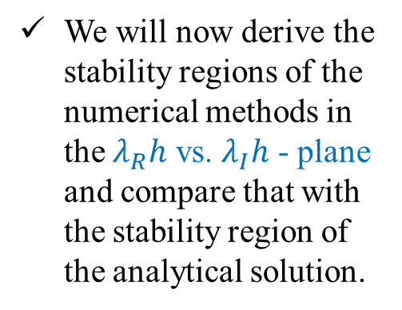
Example application: Higher Order IVP
$$\frac{dy}{dx}=f\left(y,x\right) ⟹ y=\left[\begin{matrix}u \\ v \\ w\end{matrix}\right]; f\left(y,x\right)=\left[\begin{matrix}v \\ w \\ −αuw−β\left(1−v^{2}\right)\end{matrix}\right]$$
$$\text{Initial} \text{Conditions}\text{: } u\left(0\right)=0, v\left(0\right)=0\text{,} w\left(0\right)=10.0$$
Runge-Kutta 4th Order:
$$φ_{0}=f\left(y_{n},x_{n}\right)=\left[\begin{matrix}v_{n} \\ w_{n} \\ −αu_{n}w_{n}−β\left(1−v_{n}^{2}\right)\end{matrix}\right]$$
$$φ_{1}=f\left(y_{n}+\frac{1}{2}hφ_{0},x_{n}+\frac{1}{2}h\right)$$
$$y_{n}+\frac{1}{2}hφ_{0}=\left[\begin{matrix}u_{n} \\ v_{n} \\ w_{n}\end{matrix}\right]+\frac{h}{2}\left[\begin{matrix}v_{n} \\ w_{n} \\ −αu_{n}w_{n}−β\left(1−v_{n}^{2}\right)\end{matrix}\right]=\left[\begin{matrix}u_{n}+\frac{h}{2}v_{n} \\ v_{n}+\frac{h}{2}w_{n} \\ w_{n}−\frac{h}{2}αu_{n}w_{n}−\frac{h}{2}β\left(1−v_{n}^{2}\right)\end{matrix}\right]=\left[\begin{matrix}u_{n1} \\ v_{n1} \\ w_{n1}\end{matrix}\right]$$
$$φ_{1}=\left[\begin{matrix}v_{n1} \\ w_{n1} \\ −αu_{n1}w_{n1}−β\left(1−v_{n1}^{2}\right)\end{matrix}\right]$$

Slide 15
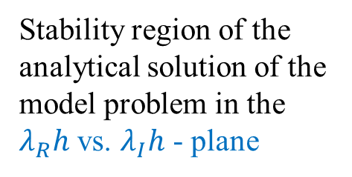
Example application: Higher Order IVP
$$\frac{dy}{dx}=f\left(y,x\right) ⟹ y=\left[\begin{matrix}u \\ v \\ w\end{matrix}\right]; f\left(y,x\right)=\left[\begin{matrix}v \\ w \\ −αuw−β\left(1−v^{2}\right)\end{matrix}\right]$$
$$\text{Initial} \text{Conditions}\text{: } u\left(0\right)=0, v\left(0\right)=0\text{,} w\left(0\right)=10.0$$
Runge-Kutta 4th Order:
$$φ_{2}=f\left(y_{n}+\frac{1}{2}hφ_{1},x_{n}+\frac{1}{2}h\right)$$
$$y_{n}+\frac{1}{2}hφ_{1}=\left[\begin{matrix}u_{n} \\ v_{n} \\ w_{n}\end{matrix}\right]+\frac{h}{2}\left[\begin{matrix}v_{n1} \\ w_{n1} \\ −αu_{n1}w_{n1}−β\left(1−v_{n1}^{2}\right)\end{matrix}\right]=\left[\begin{matrix}u_{n}+\frac{h}{2}v_{n1} \\ v_{n}+\frac{h}{2}w_{n1} \\ w_{n}−\frac{h}{2}αu_{n1}w_{n1}−\frac{h}{2}β\left(1−v_{n1}^{2}\right)\end{matrix}\right]=\left[\begin{matrix}u_{n2} \\ v_{n2} \\ w_{n2}\end{matrix}\right]$$
$$φ_{2}=\left[\begin{matrix}v_{n2} \\ w_{n2} \\ −αu_{n2}w_{n2}−β\left(1−v_{n2}^{2}\right)\end{matrix}\right]$$

Slide 16
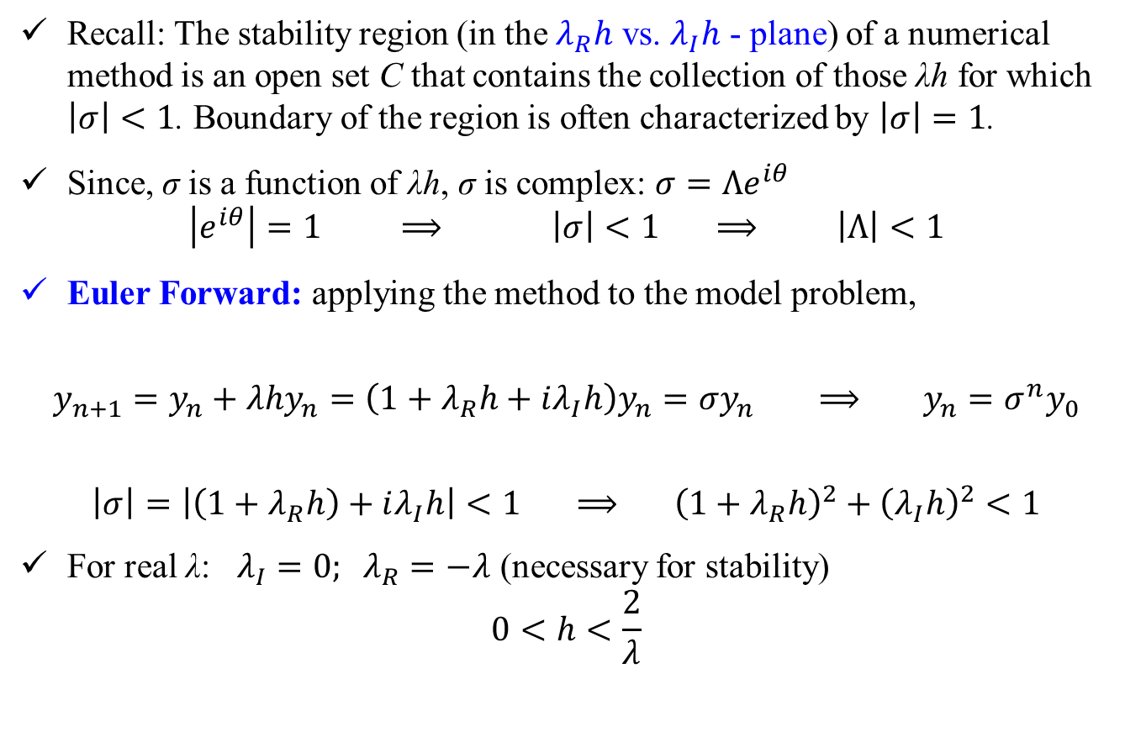
Example application: Higher Order IVP
$$\frac{dy}{dx}=f\left(y,x\right) ⟹ y=\left[\begin{matrix}u \\ v \\ w\end{matrix}\right]; f\left(y,x\right)=\left[\begin{matrix}v \\ w \\ −αuw−β\left(1−v^{2}\right)\end{matrix}\right]$$
$$\text{Initial} \text{Conditions}\text{: } u\left(0\right)=0, v\left(0\right)=0\text{,} w\left(0\right)=10.0$$
Runge-Kutta 4th Order:
$$φ_{3}=f\left(y_{n}+hφ_{2},x_{n}+h\right)$$
$$y_{n}+hφ_{2}=\left[\begin{matrix}u_{n} \\ v_{n} \\ w_{n}\end{matrix}\right]+h\left[\begin{matrix}v_{n2} \\ w_{n2} \\ −αu_{n2}w_{n2}−β\left(1−v_{n2}^{2}\right)\end{matrix}\right]=\left[\begin{matrix}u_{n}+hv_{n2} \\ v_{n}+hw_{n2} \\ w_{n}−hαu_{n2}w_{n2}−hβ\left(1−v_{n2}^{2}\right)\end{matrix}\right]=\left[\begin{matrix}u_{n3} \\ v_{n3} \\ w_{n3}\end{matrix}\right]$$
$$φ_{3}=\left[\begin{matrix}v_{n3} \\ w_{n3} \\ −αu_{n3}w_{n3}−β\left(1−v_{n3}^{2}\right)\end{matrix}\right]$$
$$y_{n+1}=y_{n}+h\left[\frac{1}{6}φ_{0}+\frac{1}{3}\left(φ_{1}+φ_{2}\right)+\frac{1}{6}φ_{3}\right]$$

Slide 17

Example application: Higher Order IVP
$$\frac{dy}{dx}=f\left(y,x\right) ⟹ y=\left[\begin{matrix}u \\ v \\ w\end{matrix}\right]; f\left(y,x\right)=\left[\begin{matrix}v \\ w \\ −αuw−β\left(1−v^{2}\right)\end{matrix}\right]$$
$$\text{Initial} \text{Conditions}\text{: } u\left(0\right)=0, v\left(0\right)=0\text{,} w\left(0\right)=10.0$$
Runge-Kutta 4th Order:
$$y_{n+1}=y_{n}+h\left[\frac{1}{6}φ_{0}+\frac{1}{3}\left(φ_{1}+φ_{2}\right)+\frac{1}{6}φ_{3}\right]$$
$$y_{n+1}=\left[\begin{matrix}u_{n} \\ v_{n} \\ w_{n}\end{matrix}\right]+\frac{h}{6}\left[\begin{matrix}v_{n} \\ w_{n} \\ −αu_{n}w_{n}−β\left(1−v_{n}^{2}\right)\end{matrix}\right]+\frac{h}{3}\left[\begin{matrix}v_{n1} \\ w_{n1} \\ −αu_{n1}w_{n1}−β\left(1−v_{n1}^{2}\right)\end{matrix}\right]+\frac{h}{3}\left[\begin{matrix}v_{n2} \\ w_{n2} \\ −αu_{n2}w_{n2}−β\left(1−v_{n2}^{2}\right)\end{matrix}\right]+\frac{h}{6}\left[\begin{matrix}v_{n3} \\ w_{n3} \\ −αu_{n3}w_{n3}−β\left(1−v_{n3}^{2}\right)\end{matrix}\right]$$

Slide 18
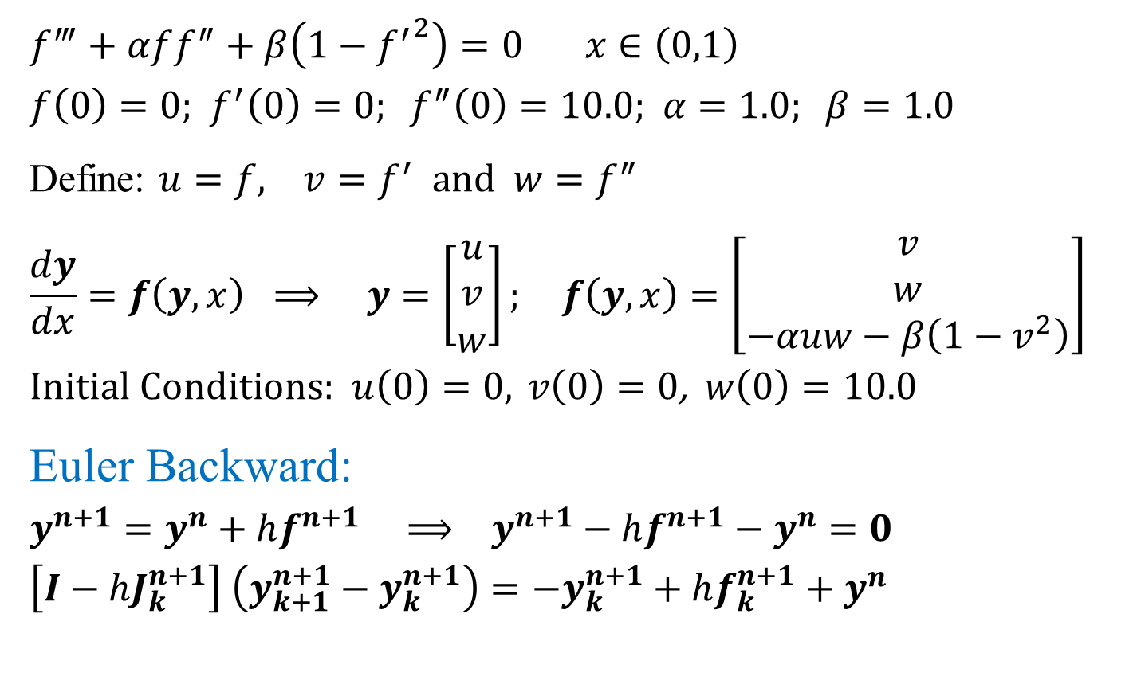
Example application: Higher Order IVP
$$f^{‴}+αff^{″}+β\left(1−{f^{′}}^{2}\right)=0 x∈\left(0,1\right)$$
$$f\left(0\right)=0\text{;} f^{′}\left(0\right)=0; f^{″}\left(0\right)=10.0\text{; } α=1.0; β=1.0$$
Define: $u=f, v=f^{′} \text{and} w=f^{″}$
$$\frac{dy}{dx}=f\left(y,x\right) ⟹ y=\left[\begin{matrix}u \\ v \\ w\end{matrix}\right]; f\left(y,x\right)=\left[\begin{matrix}v \\ w \\ −αuw−β\left(1−v^{2}\right)\end{matrix}\right]$$
$$\text{Initial} \text{Conditions}\text{: } u\left(0\right)=0, v\left(0\right)=0\text{,} w\left(0\right)=10.0$$
Euler Backward:
$$y^{n+1}=y^{n}+hf^{n+1} ⟹ y^{n+1}−hf^{n+1}−y^{n}=0$$
$$\left[I−hJ_{k}^{n+1}\right] \left(y_{k+1}^{n+1}−y_{k}^{n+1}\right)=−y_{k}^{n+1}+hf_{k}^{n+1}+y^{n}$$

Slide 19
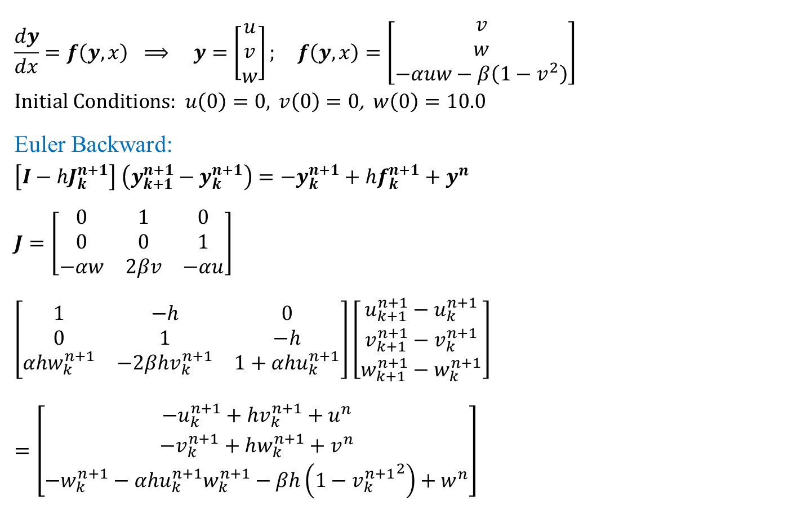
Example application: Higher Order IVP
$$\frac{dy}{dx}=f\left(y,x\right) ⟹ y=\left[\begin{matrix}u \\ v \\ w\end{matrix}\right]; f\left(y,x\right)=\left[\begin{matrix}v \\ w \\ −αuw−β\left(1−v^{2}\right)\end{matrix}\right]$$
$$\text{Initial} \text{Conditions}\text{: } u\left(0\right)=0, v\left(0\right)=0\text{,} w\left(0\right)=10.0$$
Euler Backward:
$$\left[I−hJ_{k}^{n+1}\right] \left(y_{k+1}^{n+1}−y_{k}^{n+1}\right)=−y_{k}^{n+1}+hf_{k}^{n+1}+y^{n}$$
$$J=\left[\begin{matrix}0 & 1 & 0 \\ 0 & 0 & 1 \\ −αw & 2βv & −αu\end{matrix}\right]$$
$$\left[\begin{matrix}1 & −h & 0 \\ 0 & 1 & −h \\ αhw_{k}^{n+1} & −2βhv_{k}^{n+1} & 1+αhu_{k}^{n+1}\end{matrix}\right]\left[\begin{matrix}u_{k+1}^{n+1}−u_{k}^{n+1} \\ v_{k+1}^{n+1}−v_{k}^{n+1} \\ w_{k+1}^{n+1}−w_{k}^{n+1}\end{matrix}\right]=\left[\begin{matrix}−u_{k}^{n+1}+hv_{k}^{n+1}+u^{n} \\ −v_{k}^{n+1}+hw_{k}^{n+1}+v^{n} \\ −w_{k}^{n+1}−αhu_{k}^{n+1}w_{k}^{n+1}−βh\left(1−{v_{k}^{n+1}}^{2}\right)+w^{n}\end{matrix}\right]$$

Slide 20
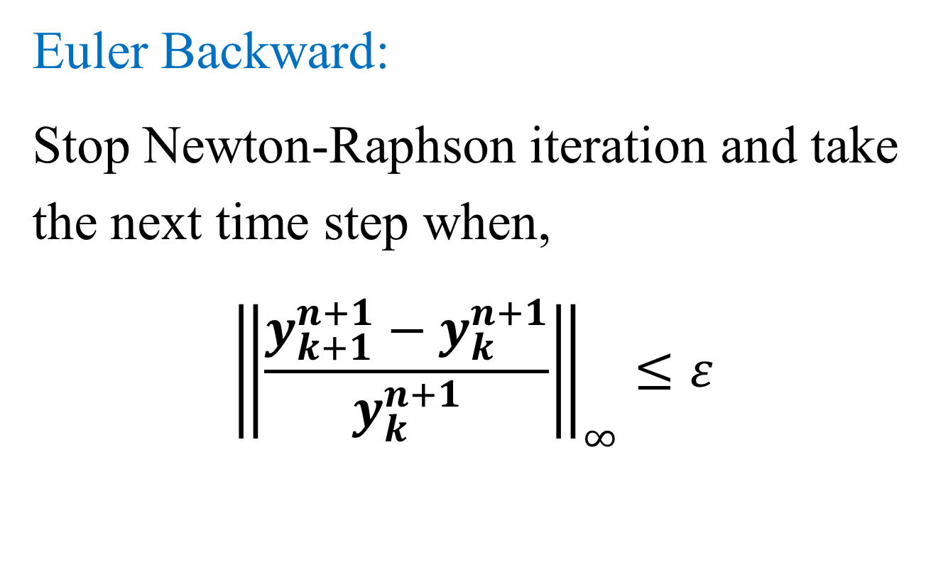
Example application: Higher Order IVP
Euler Backward:
Stop Newton-Raphson iteration and take the next time step when,
$${\left\|\frac{y_{k+1}^{n+1}−y_{k}^{n+1}}{y_{k}^{n+1}}\right\|}_{∞}≤ε$$

Slide 21
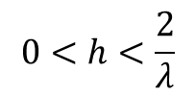
Stability of the System of IVPs
Model Equation:
$$\frac{dy}{dt}=Ay$$
Example: Euler Forward
$$y^{n+1}=\left[I+hA\right]y^{n} ⟹\left\|y^{n+1}\right\|≤\left\|I+hA\right\|\left\|y^{n}\right\|$$
Define:
$$σ=\frac{\left\|y^{n+1}\right\|}{\left\|y^{n}\right\|}$$
For Stability:
$$σ=\frac{\left\|y^{n+1}\right\|}{\left\|y^{n}\right\|}≤\left\|I+hA\right\|<1 ⟹ ρ\left(I+hA\right)≤1$$
If the maximum eigenvalue of A is λ_{max}:
$$\left|1+hλ_{max}\right|≤1 ⟹ h≤\frac{2}{λ_{max}}$$

Slide 22
Stability of the System of IVPs
In higher order IVP or in a system of IVP, the solutions are characterized by the eigenvalues.
One or two equation in the system typically have high eigenvalues close to λ_{max} and the rest of the equations may have eigenvalues of much lower magnitudes!
The time step is restricted by λ_{max}.
Stiff system: large value of (λ_{max}/λ_{min}); typically > 100
As the time progresses, larger time step can be used for the problem but is limited by the stability criteria!
This is the utility of the BDFs:
They are stable for all real and negative λ_{R} up to 6th order
Region of stability for imaginary λ_{I} increases as one increases the time step (increasing λ_{R}h)!

Slide 23
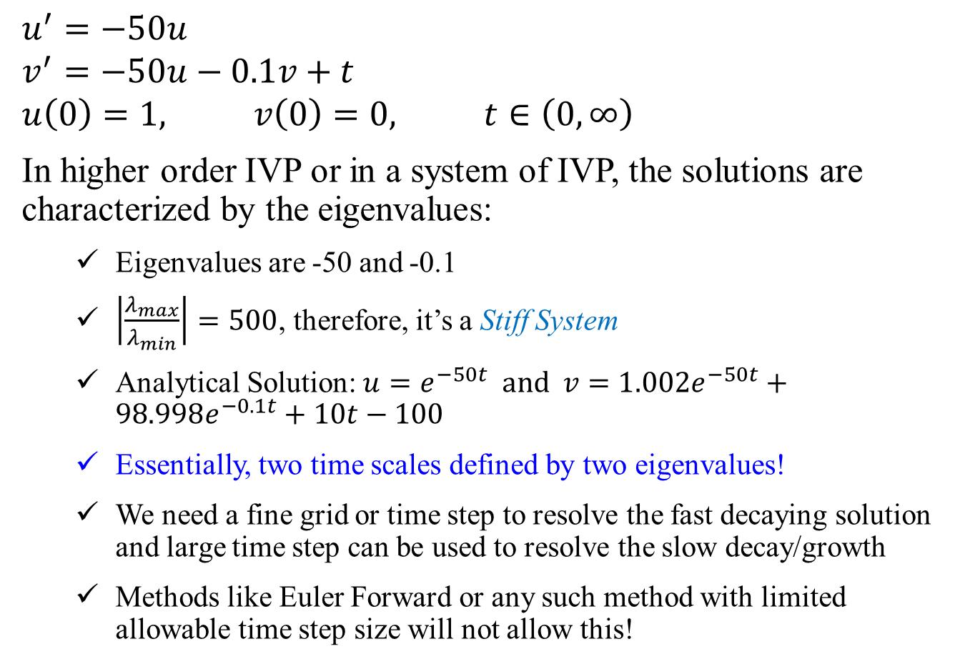
Example: Stiff System
$$u^{′}=−50u$$
$$v^{′}=−50u−0.1v+t$$
$$u\left(0\right)=1, v\left(0\right)=0, t∈\left(0,∞\right)$$
In higher order IVP or in a system of IVP, the solutions are characterized by the eigenvalues:
Eigenvalues are -50 and -0.1
$\left|\frac{λ_{max}}{λ_{min}}\right|=500$, therefore, it’s a Stiff System
Analytical Solution: $u=e^{−50t} \text{and} v=1.002e^{−50t}+98.998e^{−0.1t}+10t−100$
Essentially, two time scales defined by two eigenvalues!
We need a fine grid or time step to resolve the fast decaying solution and large time step can be used to resolve the slow decay/growth
Methods like Euler Forward or any such method with limited allowable time step size will not allow this!

Slide 24
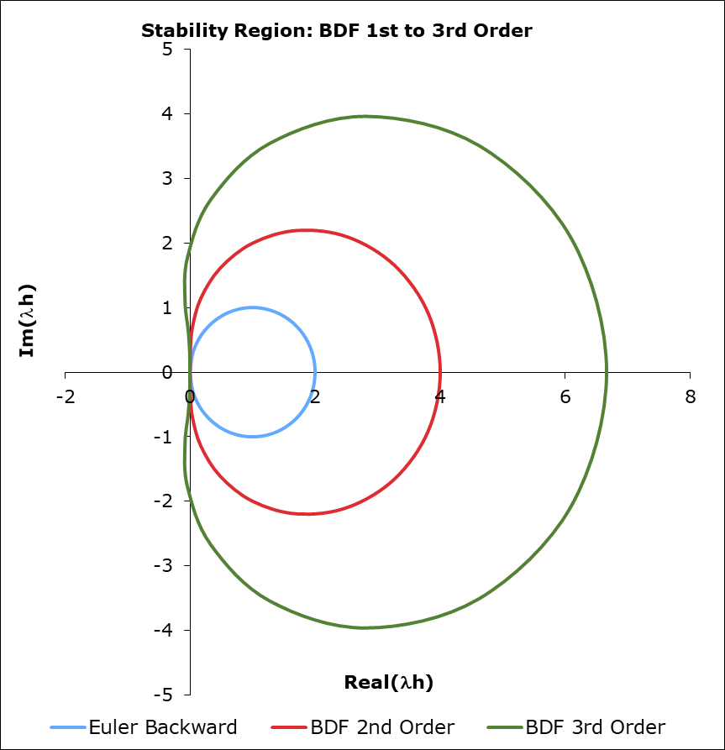
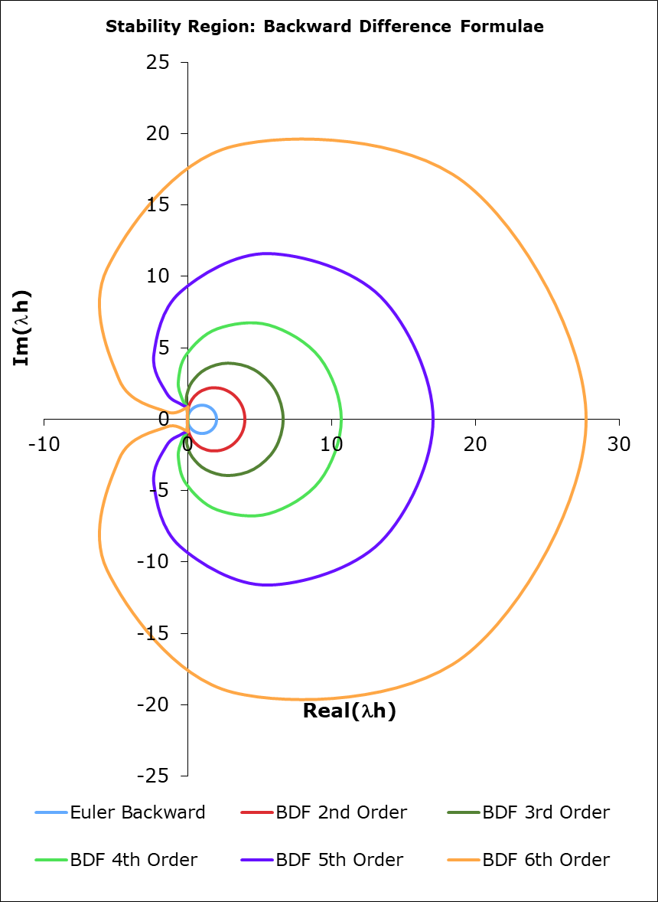
Stability: BDF Methods Example
For all the BDFs: Stability Region is outside the enclosed region!
For real λ, all the BDFs are unconditionally stable!
One can use any h without having to worry about the stability!
Useful for stiff equations!

Slide 25
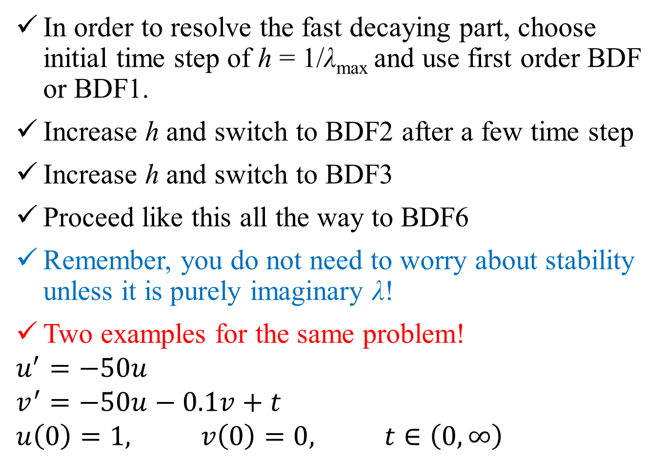
Stability of the System of IVPs
In order to resolve the fast decaying part, choose initial time step of h = 1/λ_{max} and use first order BDF or BDF1.
Increase h and switch to BDF2 after a few time step
Increase h and switch to BDF3
Proceed like this all the way to BDF6
Remember, you do not need to worry about stability unless it is purely imaginary λ!
Two examples for the same problem!
$$u^{′}=−50u$$
$$v^{′}=−50u−0.1v+t$$
$$u\left(0\right)=1, v\left(0\right)=0, t∈\left(0,∞\right)$$

Slide 26
Method | h | t | u | v
 |  | 0 | 1.00E+00 | 0.0000
BDF1 | 0.01 | 0.01 | 6.67E-01 | -0.3329
 | 0.01 | 0.02 | 4.44E-01 | -0.5544
 | 0.01 | 0.03 | 2.96E-01 | -0.7015
 | 0.01 | 0.04 | 1.98E-01 | -0.7991
 | 0.01 | 0.05 | 1.32E-01 | -0.8636
BDF2 | 0.05 | 0.1 | -5.92E-02 | -1.0460
 | 0.05 | 0.15 | -4.60E-02 | -1.0217
 | 0.05 | 0.2 | -1.56E-02 | -0.9776
BDF3 | 0.1 | 0.3 | 5.49E-02 | -0.8725
 | 0.1 | 0.4 | 2.46E-02 | -0.8588
 | 0.1 | 0.5 | -1.99E-03 | -0.8319
 | 0.1 | 0.6 | -3.61E-03 | -0.7706
BDF4 | 0.2 | 0.8 | -2.97E-02 | -0.6428
 | 0.2 | 1 | -5.90E-03 | -0.4285
 | 0.2 | 1.2 | 4.52E-03 | -0.1917
 | 0.2 | 1.4 | -2.44E-04 | 0.0648
 | 0.2 | 1.6 | -1.24E-03 | 0.3596
BDF5 | 0.4 | 2 | 1.85E-03 | 1.0548
 | 0.4 | 2.4 | 3.26E-03 | 1.8780
 | 0.4 | 2.8 | -3.90E-04 | 2.8208
 | 0.4 | 3.2 | -4.31E-04 | 3.8870
 | 0.4 | 3.6 | 3.63E-04 | 5.0691
 | 0.4 | 4 | -4.63E-05 | 6.3605
BDF6 | 0.8 | 4.8 | -4.08E-03 | 9.2541
 | 0.8 | 5.6 | -8.42E-04 | 12.5474

Slide 27
Method | h | t | u | v
 |  | 0 | 1.00E+00 | 0.0000
BDF1 | 0.02 | 0.02 | 5.00E-01 | -0.4986
 | 0.02 | 0.04 | 2.50E-01 | -0.7463
BDF2 | 0.04 | 0.08 | 0.00E+00 | -0.9903
 | 0.04 | 0.12 | -3.57E-02 | -1.0181
 | 0.04 | 0.16 | -2.04E-02 | -0.9932
BDF3 | 0.08 | 0.24 | 4.66E-02 | -0.9024
 | 0.08 | 0.32 | 2.92E-02 | -0.8900
 | 0.08 | 0.4 | 1.88E-03 | -0.8815
 | 0.08 | 0.48 | -3.89E-03 | -0.8451
BDF4 | 0.16 | 0.64 | -3.77E-02 | -0.7767
 | 0.16 | 0.8 | -9.44E-03 | -0.6222
 | 0.16 | 0.96 | 6.24E-03 | -0.4570
 | 0.16 | 1.12 | 3.92E-04 | -0.2904
 | 0.16 | 1.28 | -2.01E-03 | -0.0977
BDF5 | 0.32 | 1.6 | -1.98E-04 | 0.3607
 | 0.32 | 1.92 | 4.53E-03 | 0.9086
 | 0.32 | 2.24 | 8.73E-05 | 1.5310
 | 0.32 | 2.56 | -1.05E-03 | 2.2378
 | 0.32 | 2.88 | 5.08E-04 | 3.0257
 | 0.32 | 3.2 | 1.29E-04 | 3.8877
BDF6 | 0.64 | 3.84 | -4.81E-03 | 5.8257
 | 0.64 | 4.48 | -1.45E-03 | 8.0484

Slide 28
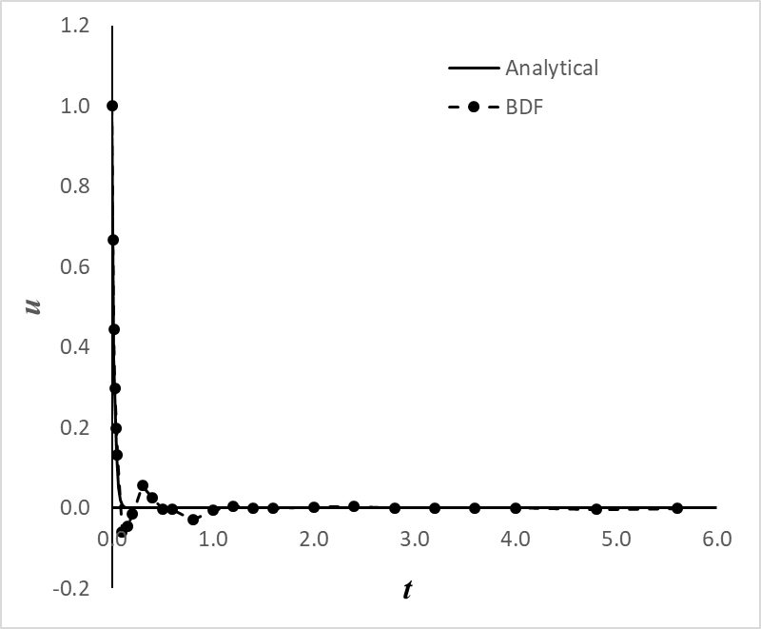
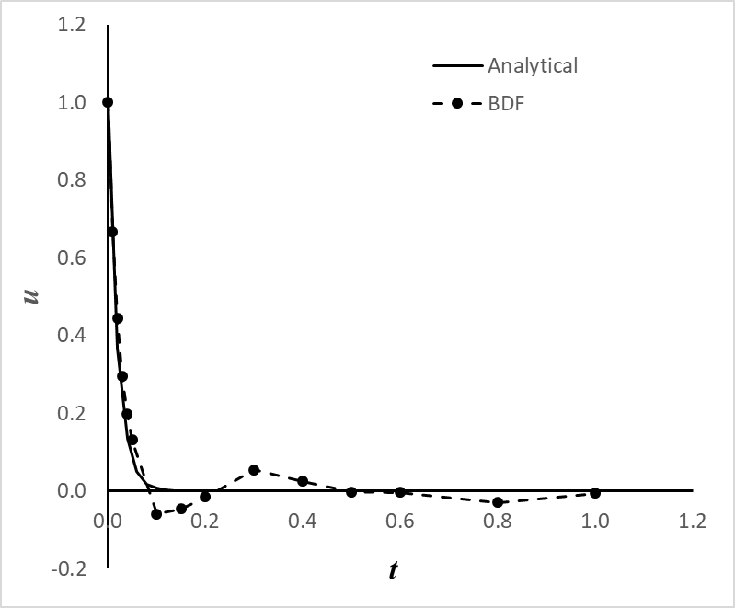
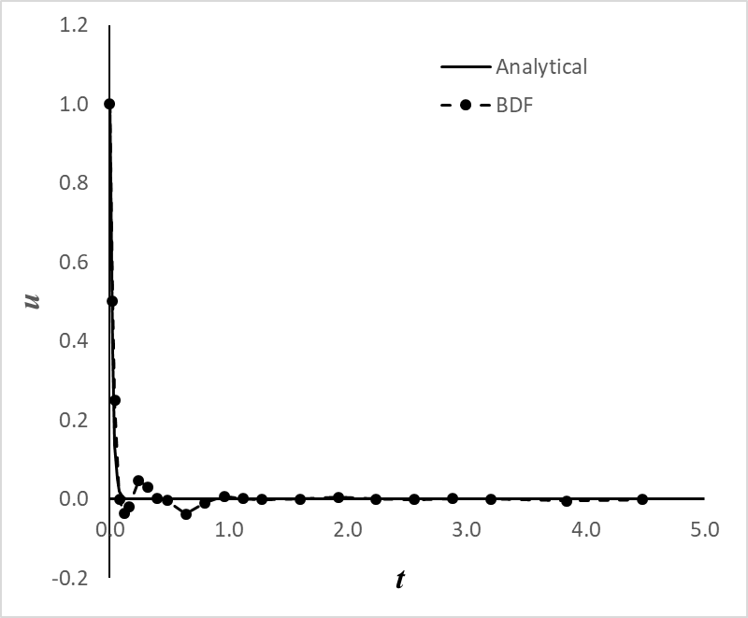


Slide 29
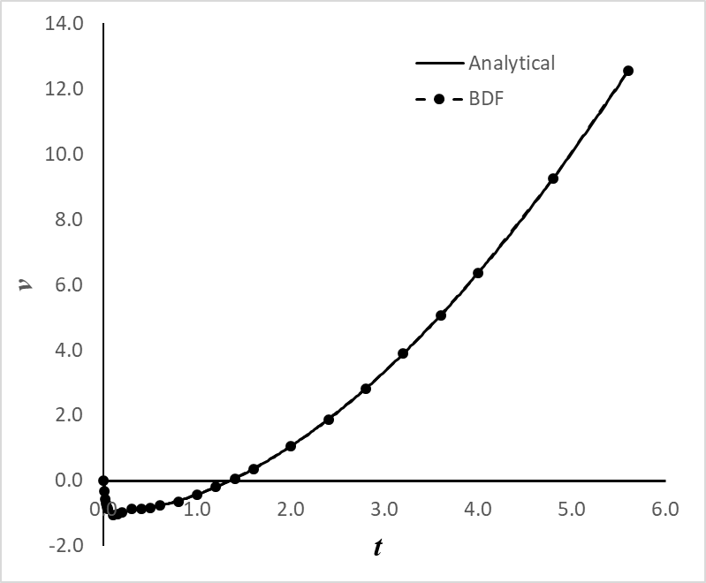
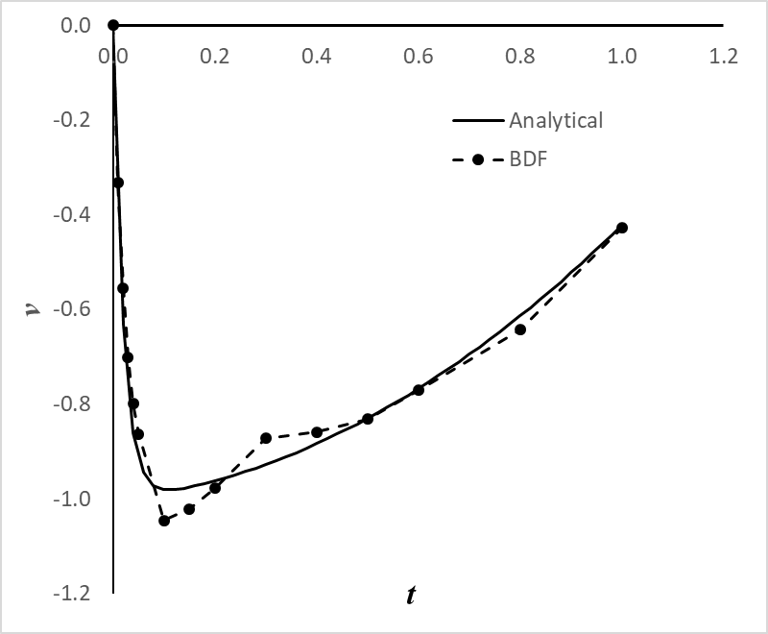
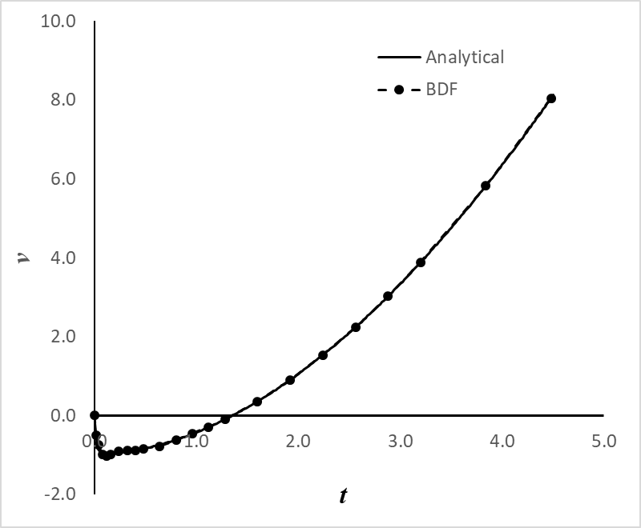
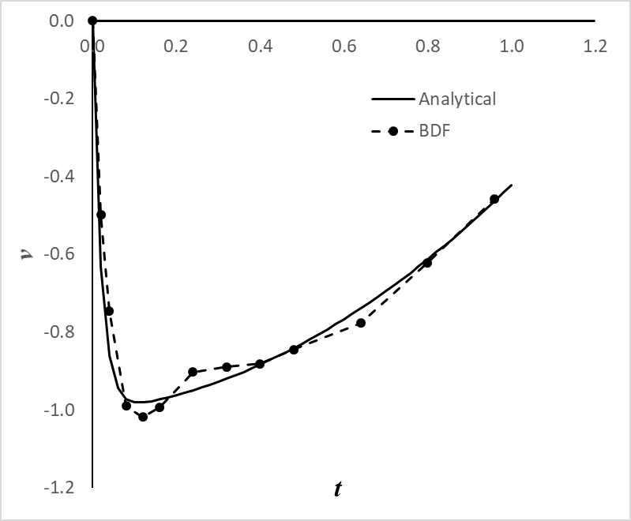

Slide 30

ESO 208A: Computational Methods in Engineering Partial Differential Equations: Introduction, Parabolic Equation
Department of Civil Engineering
IIT Kanpur

Slide 31
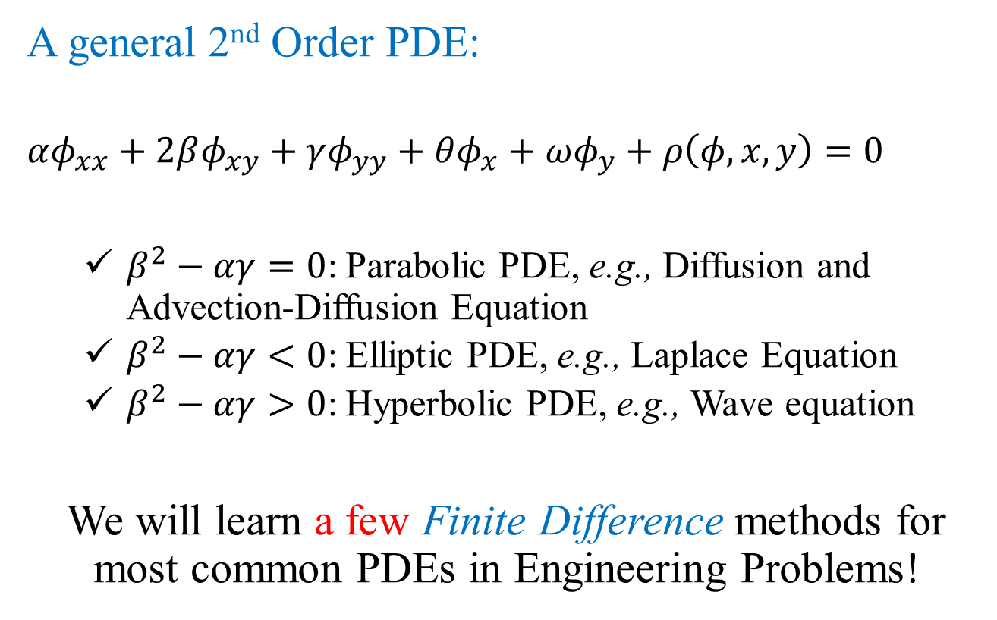
Introduction
A general 2nd Order PDE:
$$αφ_{xx}+2βφ_{xy}+γφ_{yy}+θφ_{x}+ωφ_{y}+ρ\left(φ,x,y\right)=0$$
$β^{2}−αγ=0$: Parabolic PDE, e.g., Diffusion and Advection-Diffusion Equation
$β^{2}−αγ<0$: Elliptic PDE, e.g., Laplace Equation
$β^{2}−αγ>0$: Hyperbolic PDE, e.g., Wave equation
We will learn a few Finite Difference methods for most common PDEs in Engineering Problems!

Slide 32
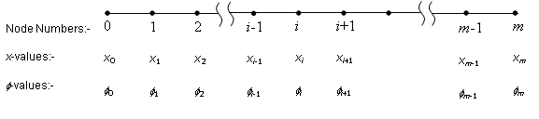
Parabolic PDE: semi-discretization
$$\frac{∂φ}{∂t}=α\frac{∂^{2}φ}{∂x^{2}} \frac{∂φ}{∂t}+u\frac{∂φ}{∂x}=α\frac{∂^{2}φ}{∂x^{2}}$$
$$φ\left(0,t\right)=c_{0}\text{; } φ\left(L,t\right)=c_{L}; φ\left(x,0\right)=f\left(x\right)$$
$$\frac{dφ_{i}}{dt}=α_{i}\frac{φ_{i+1}−2φ_{i}+φ_{i−1}}{Δx^{2}}$$
$$\frac{dφ_{i}}{dt}=−u_{i}\frac{φ_{i+1}−φ_{i−1}}{2Δx}+α_{i}\frac{φ_{i+1}−2φ_{i}+φ_{i−1}}{Δx^{2}}$$

Slide 33
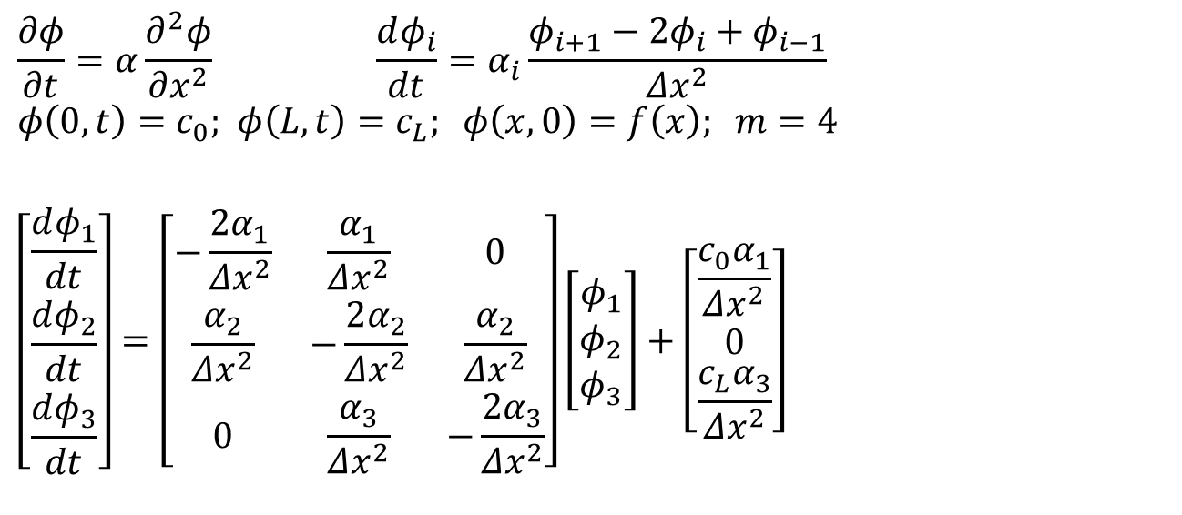
Parabolic PDE: semi-discretization
$$\frac{∂φ}{∂t}=α\frac{∂^{2}φ}{∂x^{2}} \frac{dφ_{i}}{dt}=α_{i}\frac{φ_{i+1}−2φ_{i}+φ_{i−1}}{Δx^{2}}$$
$$φ\left(0,t\right)=c_{0}\text{; } φ\left(L,t\right)=c_{L}; φ\left(x,0\right)=f\left(x\right); m=4$$
$$\left[\begin{matrix}\frac{dφ_{1}}{dt} \\ \frac{dφ_{2}}{dt} \\ \frac{dφ_{3}}{dt}\end{matrix}\right]=\left[\begin{matrix}−\frac{2α_{1}}{Δx^{2}} & \frac{α_{1}}{Δx^{2}} & 0 \\ \frac{α_{2}}{Δx^{2}} & −\frac{2α_{2}}{Δx^{2}} & \frac{α_{2}}{Δx^{2}} \\ 0 & \frac{α_{3}}{Δx^{2}} & −\frac{2α_{3}}{Δx^{2}}\end{matrix}\right]\left[\begin{matrix}φ_{1} \\ φ_{2} \\ φ_{3}\end{matrix}\right]+\left[\begin{matrix}\frac{c_{0}α_{1}}{Δx^{2}} \\ 0 \\ \frac{c_{L}α_{3}}{Δx^{2}}\end{matrix}\right]$$

Slide 34
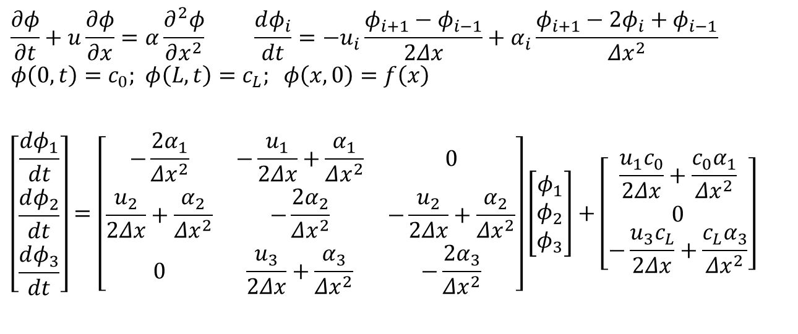
Parabolic PDE: semi-discretization
$$\frac{∂φ}{∂t}+u\frac{∂φ}{∂x}=α\frac{∂^{2}φ}{∂x^{2}} \frac{dφ_{i}}{dt}=−u_{i}\frac{φ_{i+1}−φ_{i−1}}{2Δx}+α_{i}\frac{φ_{i+1}−2φ_{i}+φ_{i−1}}{Δx^{2}}$$
$$φ\left(0,t\right)=c_{0}\text{; } φ\left(L,t\right)=c_{L}; φ\left(x,0\right)=f\left(x\right)$$
$$\left[\begin{matrix}\frac{dφ_{1}}{dt} \\ \frac{dφ_{2}}{dt} \\ \frac{dφ_{3}}{dt}\end{matrix}\right]=\left[\begin{matrix}−\frac{2α_{1}}{Δx^{2}} & −\frac{u_{1}}{2Δx}+\frac{α_{1}}{Δx^{2}} & 0 \\ \frac{u_{2}}{2Δx}+\frac{α_{2}}{Δx^{2}} & −\frac{2α_{2}}{Δx^{2}} & −\frac{u_{2}}{2Δx}+\frac{α_{2}}{Δx^{2}} \\ 0 & \frac{u_{3}}{2Δx}+\frac{α_{3}}{Δx^{2}} & −\frac{2α_{3}}{Δx^{2}}\end{matrix}\right]\left[\begin{matrix}φ_{1} \\ φ_{2} \\ φ_{3}\end{matrix}\right]+\left[\begin{matrix}\frac{u_{1}c_{0}}{2Δx}+\frac{c_{0}α_{1}}{Δx^{2}} \\ 0 \\ −\frac{u_{3}c_{L}}{2Δx}+\frac{c_{L}α_{3}}{Δx^{2}}\end{matrix}\right]$$

Slide 35
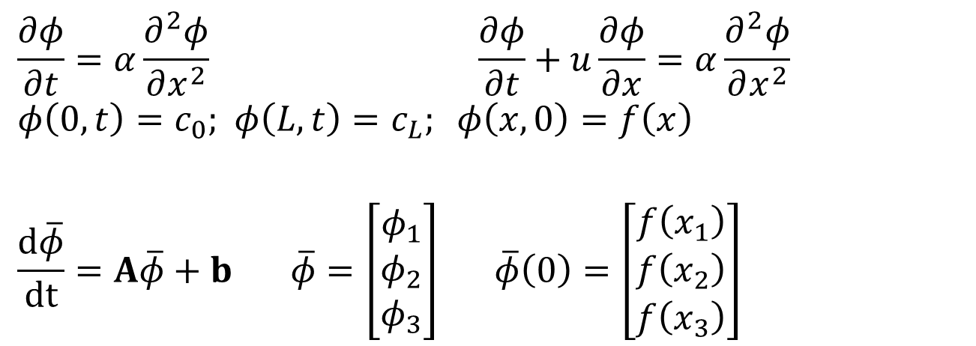
Parabolic PDE: semi-discretization
$$\frac{∂φ}{∂t}=α\frac{∂^{2}φ}{∂x^{2}} \frac{∂φ}{∂t}+u\frac{∂φ}{∂x}=α\frac{∂^{2}φ}{∂x^{2}}$$
$$φ\left(0,t\right)=c_{0}\text{; } φ\left(L,t\right)=c_{L}; φ\left(x,0\right)=f\left(x\right)$$
$$\frac{d\overline{φ}}{dt}=A\overline{φ}+b \overline{φ}=\left[\begin{matrix}φ_{1} \\ φ_{2} \\ φ_{3}\end{matrix}\right] \overline{φ}\left(0\right)=\left[\begin{matrix}f\left(x_{1}\right) \\ f\left(x_{2}\right) \\ f\left(x_{3}\right)\end{matrix}\right]$$

Slide 36
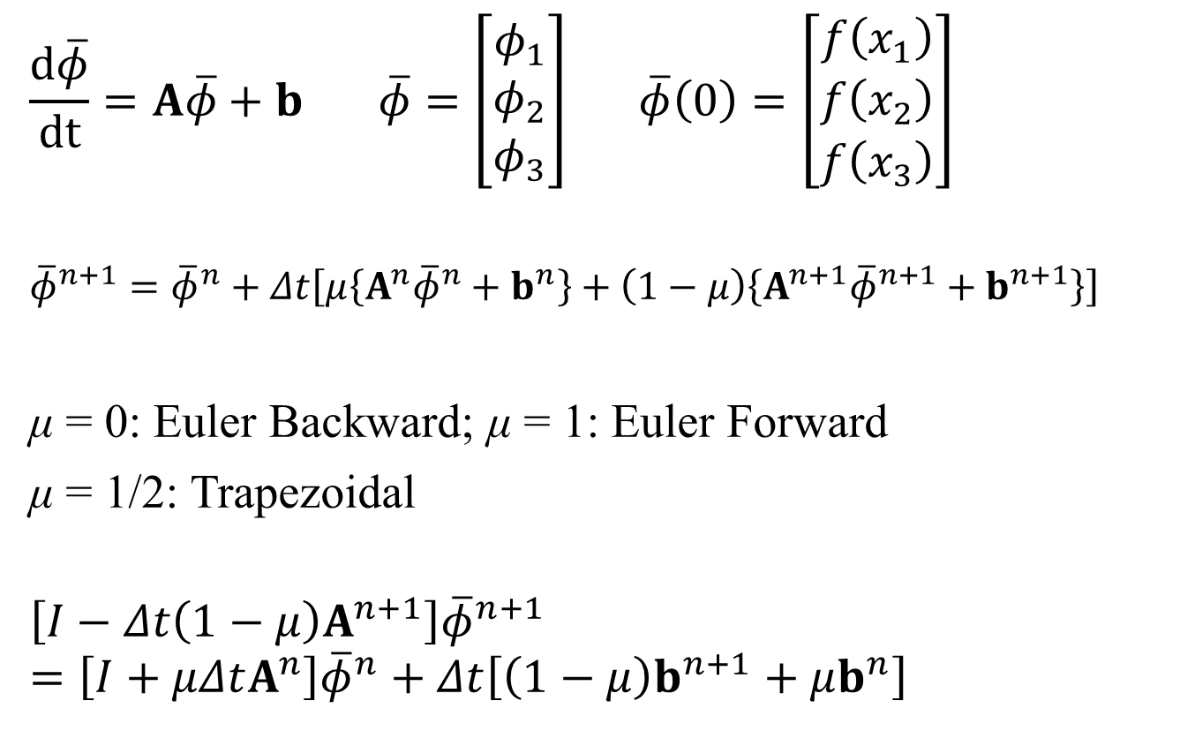
Parabolic PDE: semi-discretization
$$\frac{d\overline{φ}}{dt}=A\overline{φ}+b \overline{φ}=\left[\begin{matrix}φ_{1} \\ φ_{2} \\ φ_{3}\end{matrix}\right] \overline{φ}\left(0\right)=\left[\begin{matrix}f\left(x_{1}\right) \\ f\left(x_{2}\right) \\ f\left(x_{3}\right)\end{matrix}\right]$$
$${\overline{φ}}^{n+1}={\overline{φ}}^{n}+Δt\left[μ\left\{A^{n}{\overline{φ}}^{n}+b^{n}\right\}+\left(1−μ\right)\left\{A^{n+1}{\overline{φ}}^{n+1}+b^{n+1}\right\}\right]$$
μ = 0: Euler Backward; μ = 1: Euler Forward
μ = 1/2: Trapezoidal
$$\left[I−Δt\left(1−μ\right)A^{n+1}\right]{\overline{φ}}^{n+1}=\left[I+μΔtA^{n}\right]{\overline{φ}}^{n}+Δt\left[\left(1−μ\right)b^{n+1}+μb^{n}\right]$$

