Slide 1

ESO 208A: Computational Methods in Engineering Partial Differential Equations: Introduction, Parabolic Equation
Department of Civil Engineering
IIT Kanpur

Slide 2
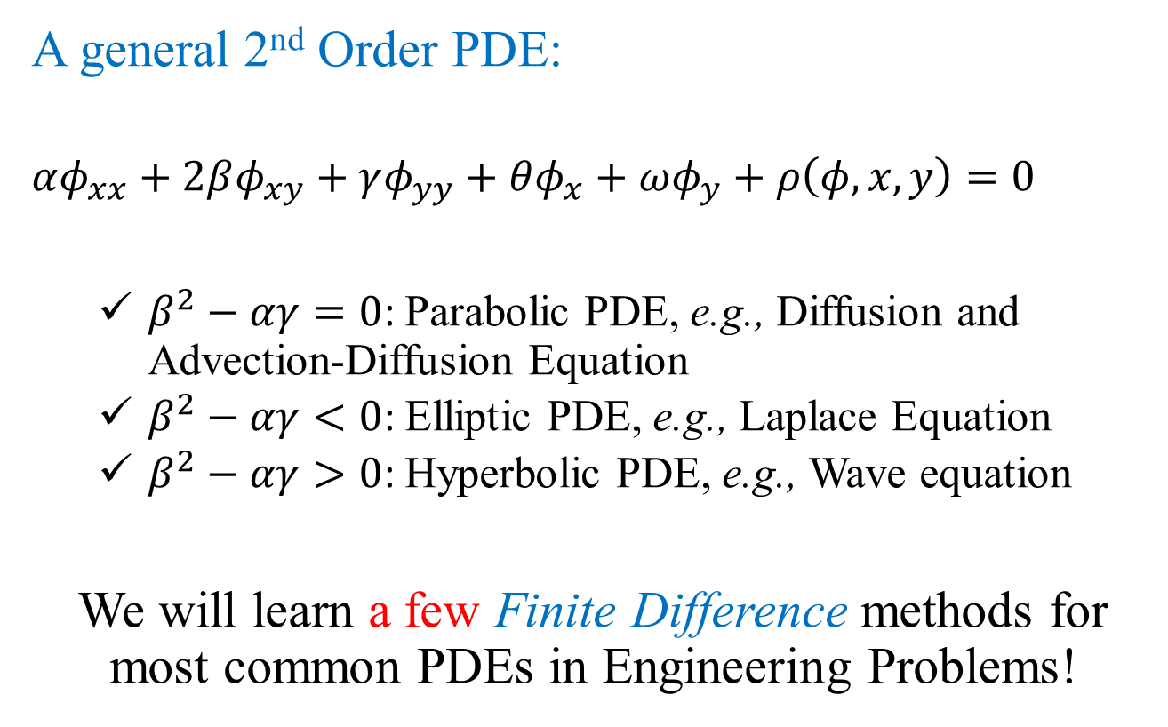
Introduction
A general 2nd Order PDE:
$$αφ_{xx}+2βφ_{xy}+γφ_{yy}+θφ_{x}+ωφ_{y}+ρ\left(φ,x,y\right)=0$$
$β^{2}−αγ=0$: Parabolic PDE, e.g., Diffusion and Advection-Diffusion Equation
$β^{2}−αγ<0$: Elliptic PDE, e.g., Laplace Equation
$β^{2}−αγ>0$: Hyperbolic PDE, e.g., Wave equation
We will learn a few Finite Difference methods for most common PDEs in Engineering Problems!

Slide 3
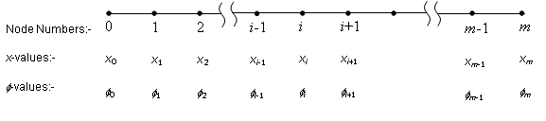
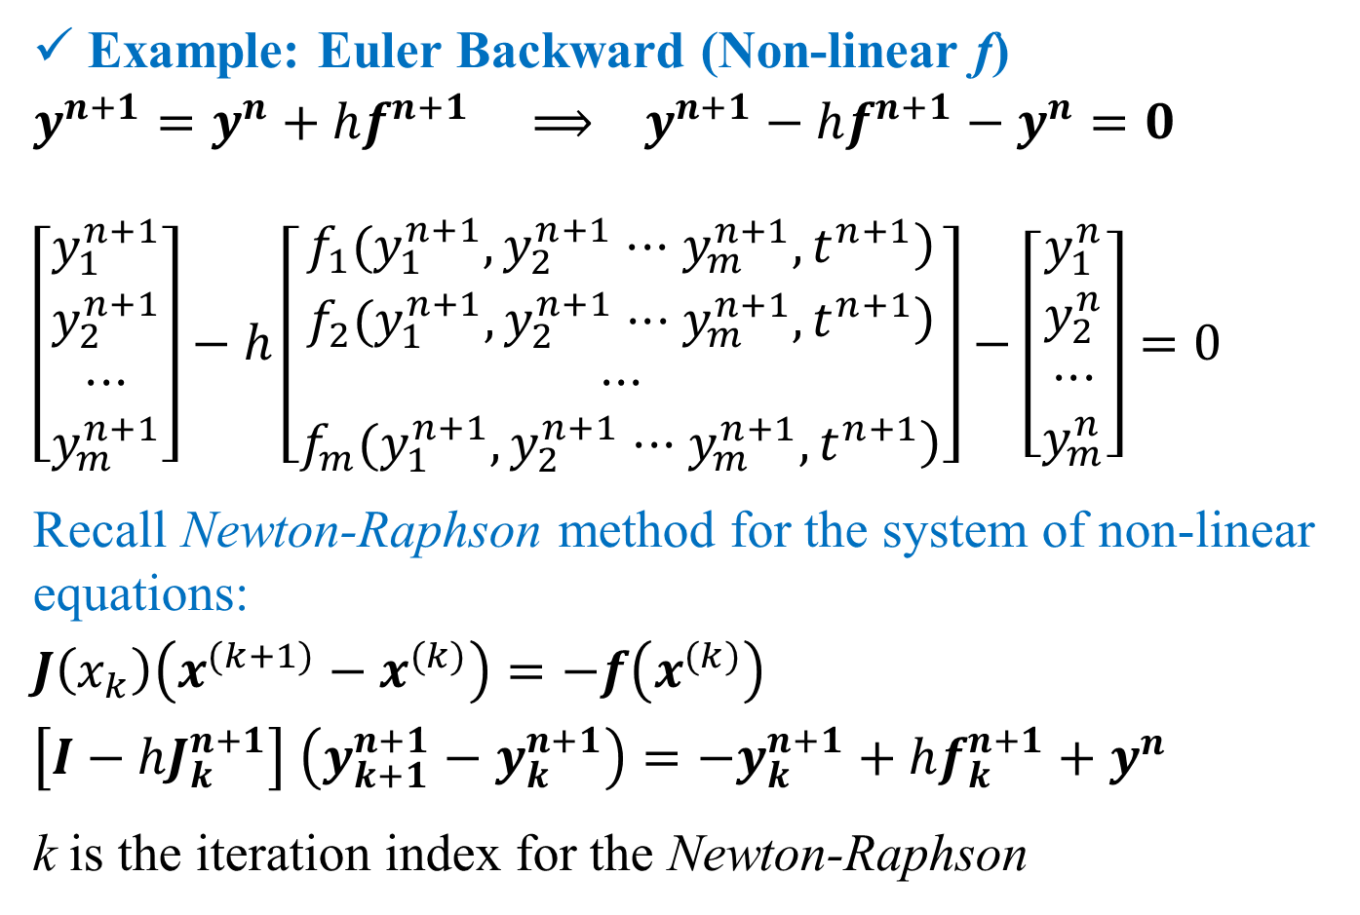
Parabolic PDE: semi-discretization
$$\frac{∂φ}{∂t}=α\frac{∂^{2}φ}{∂x^{2}} \frac{∂φ}{∂t}+u\frac{∂φ}{∂x}=α\frac{∂^{2}φ}{∂x^{2}}$$
$$φ\left(0,t\right)=c_{0}\text{; } φ\left(L,t\right)=c_{L}; φ\left(x,0\right)=f\left(x\right)$$
$$\frac{dφ_{i}}{dt}=α_{i}\frac{φ_{i+1}−2φ_{i}+φ_{i−1}}{Δx^{2}}$$
$$\frac{dφ_{i}}{dt}=−u_{i}\frac{φ_{i+1}−φ_{i−1}}{2Δx}+α_{i}\frac{φ_{i+1}−2φ_{i}+φ_{i−1}}{Δx^{2}}$$
O(h²)
O(h²)
O(h²)

Slide 4
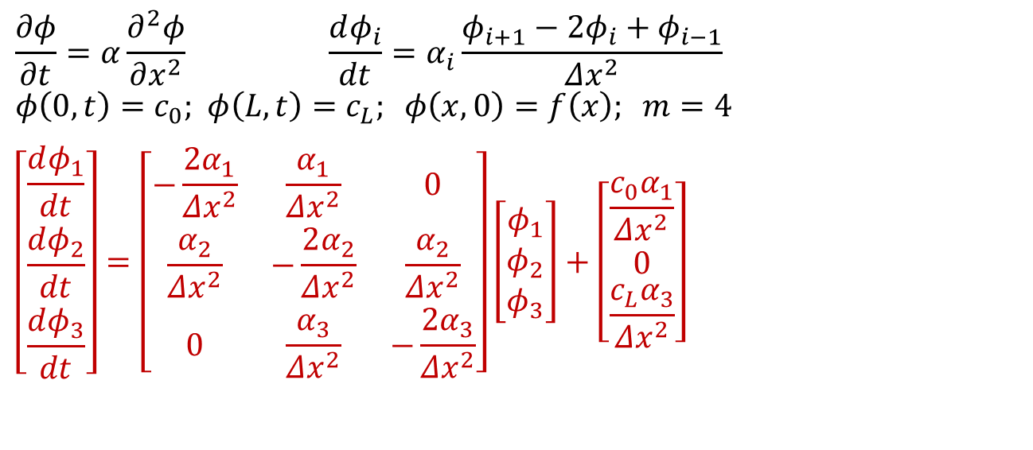

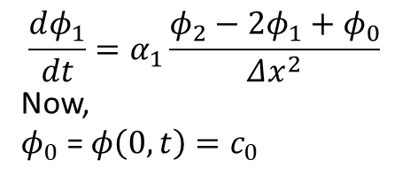
Parabolic PDE: semi-discretization
$$\frac{∂φ}{∂t}=α\frac{∂^{2}φ}{∂x^{2}} \frac{dφ_{i}}{dt}=α_{i}\frac{φ_{i+1}−2φ_{i}+φ_{i−1}}{Δx^{2}}$$
$$φ\left(0,t\right)=c_{0}\text{; } φ\left(L,t\right)=c_{L}; φ\left(x,0\right)=f\left(x\right); m=4$$
$$\left[\begin{matrix}\frac{dφ_{1}}{dt} \\ \frac{dφ_{2}}{dt} \\ \frac{dφ_{3}}{dt}\end{matrix}\right]=\left[\begin{matrix}−\frac{2α_{1}}{Δx^{2}} & \frac{α_{1}}{Δx^{2}} & 0 \\ \frac{α_{2}}{Δx^{2}} & −\frac{2α_{2}}{Δx^{2}} & \frac{α_{2}}{Δx^{2}} \\ 0 & \frac{α_{3}}{Δx^{2}} & −\frac{2α_{3}}{Δx^{2}}\end{matrix}\right]\left[\begin{matrix}φ_{1} \\ φ_{2} \\ φ_{3}\end{matrix}\right]+\left[\begin{matrix}\frac{c_{0}α_{1}}{Δx^{2}} \\ 0 \\ \frac{c_{L}α_{3}}{Δx^{2}}\end{matrix}\right]$$
$$\frac{dφ_{1}}{dt}=α_{1}\frac{φ_{2}−2φ_{1}+φ_{0}}{Δx^{2}}$$
Now,
$φ_{0}$ = $φ\left(0,t\right)=c_{0}$
$$\frac{d\overline{φ}}{dt}=A\overline{φ}+b$$
$$\overline{φ}=\left[\begin{matrix}φ_{1} \\ φ_{2} \\ φ_{3}\end{matrix}\right] \overline{φ}\left(0\right)=\left[\begin{matrix}f\left(x_{1}\right) \\ f\left(x_{2}\right) \\ f\left(x_{3}\right)\end{matrix}\right]$$

Slide 5
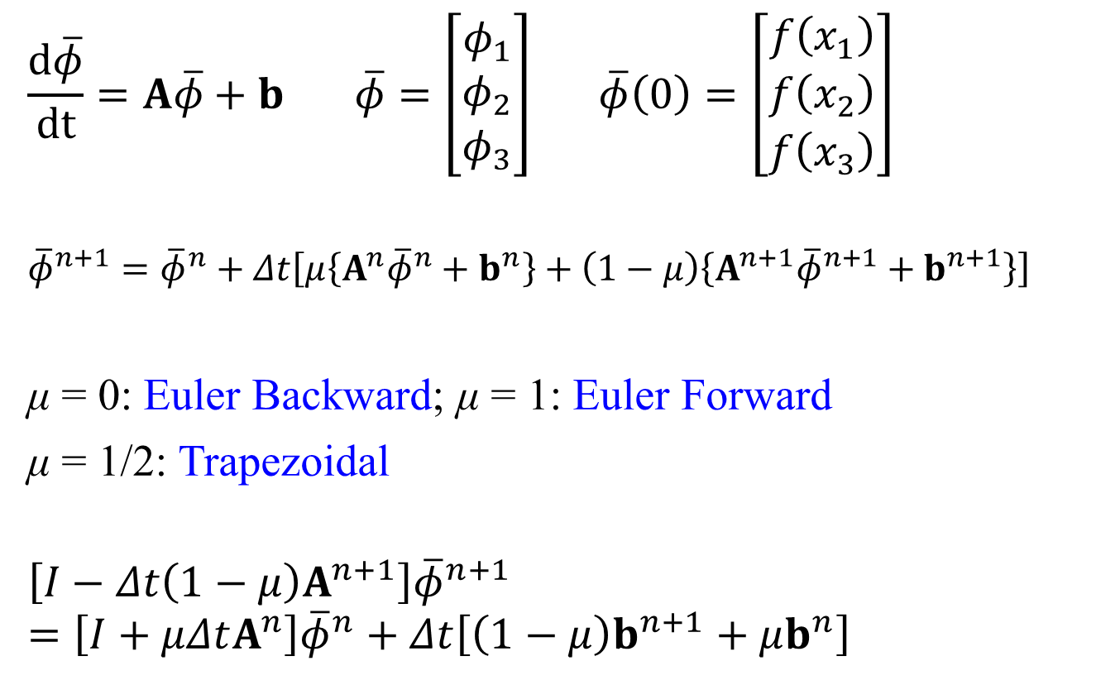
Parabolic PDE: semi-discretization
$$\frac{d\overline{φ}}{dt}=A\overline{φ}+b \overline{φ}=\left[\begin{matrix}φ_{1} \\ φ_{2} \\ φ_{3}\end{matrix}\right] \overline{φ}\left(0\right)=\left[\begin{matrix}f\left(x_{1}\right) \\ f\left(x_{2}\right) \\ f\left(x_{3}\right)\end{matrix}\right]$$
$${\overline{φ}}^{n+1}={\overline{φ}}^{n}+Δt\left[μ\left\{A^{n}{\overline{φ}}^{n}+b^{n}\right\}+\left(1−μ\right)\left\{A^{n+1}{\overline{φ}}^{n+1}+b^{n+1}\right\}\right]$$
μ = 0: Euler Backward; μ = 1: Euler Forward
μ = 1/2: Trapezoidal
$$\left[I−Δt\left(1−μ\right)A^{n+1}\right]{\overline{φ}}^{n+1}=\left[I+μΔtA^{n}\right]{\overline{φ}}^{n}+Δt\left[\left(1−μ\right)b^{n+1}+μb^{n}\right]$$
$\frac{dy}{dt}=f\left(y,t\right) ⟹ y^{n+1}=y^{n}+hf^{n}$ (Euler F) or $y^{n+1}=y^{n}+hf^{n+1}$ (Euler B)

Slide 6
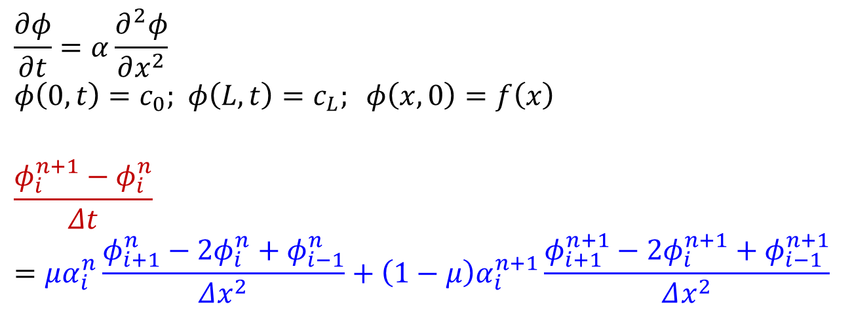
Parabolic PDE: full-discretization
$$\frac{∂φ}{∂t}=α\frac{∂^{2}φ}{∂x^{2}}$$
$$φ\left(0,t\right)=c_{0}\text{; } φ\left(L,t\right)=c_{L}; φ\left(x,0\right)=f\left(x\right)$$
$$\frac{φ_{i}^{n+1}−φ_{i}^{n}}{Δt}=μα_{i}^{n}\frac{φ_{i+1}^{n}−2φ_{i}^{n}+φ_{i−1}^{n}}{Δx^{2}}+\left(1−μ\right)α_{i}^{n+1}\frac{φ_{i+1}^{n+1}−2φ_{i}^{n+1}+φ_{i−1}^{n+1}}{Δx^{2}}$$
O(h)
O(h²)
O(h²)

Slide 7
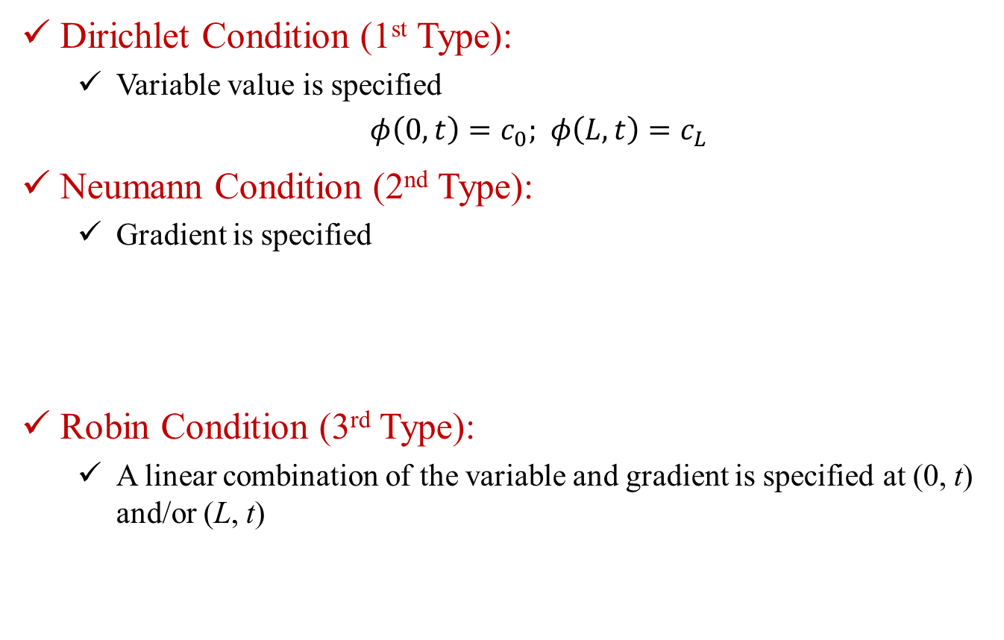
Types of Boundary Conditions
Dirichlet Condition (1st Type):
Variable value is specified
$φ\left(0,t\right)=c_{0}\text{; } φ\left(L,t\right)=c_{L}$
Neumann Condition (2nd Type):
Gradient is specified
Robin Condition (3rd Type):
A linear combination of the variable and gradient is specified at (0, t) and/or (L, t)

Slide 8
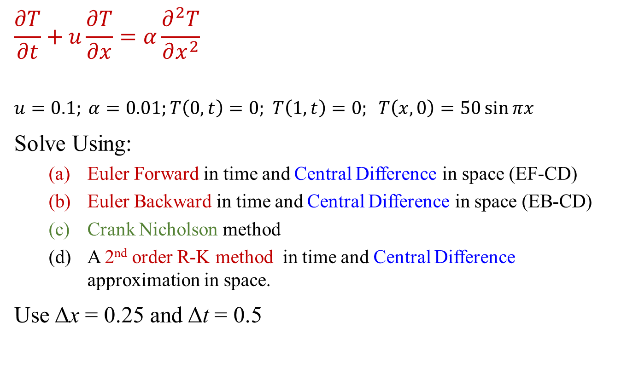
Example
$$\frac{∂T}{∂t}+u\frac{∂T}{∂x}=α\frac{∂^{2}T}{∂x^{2}}$$
$$u=0.1; α=0.01;T\left(0,t\right)=0\text{; } T\left(1,t\right)=0; T\left(x,0\right)=50\sin{πx}$$
Solve Using:
Euler Forward in time and Central Difference in space (EF-CD)
Euler Backward in time and Central Difference in space (EB-CD)
Crank Nicholson method
A 2nd order R-K method in time and Central Difference approximation in space.
Use Δx = 0.25 and Δt = 0.5
0
1
2
3
4

Slide 9
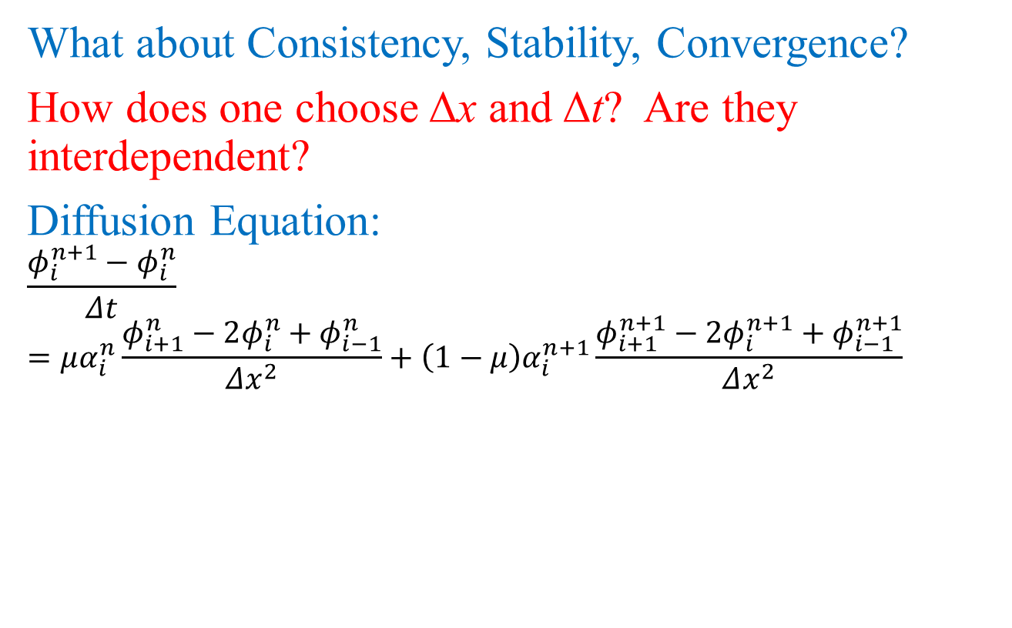

Convergence
What about Consistency, Stability, Convergence?
How does one choose Δx and Δt? Are they interdependent?
Diffusion Equation:
$$\frac{φ_{i}^{n+1}−φ_{i}^{n}}{Δt}=μα_{i}^{n}\frac{φ_{i+1}^{n}−2φ_{i}^{n}+φ_{i−1}^{n}}{Δx^{2}}+\left(1−μ\right)α_{i}^{n+1}\frac{φ_{i+1}^{n+1}−2φ_{i}^{n+1}+φ_{i−1}^{n+1}}{Δx^{2}}$$
Group $α\frac{∆t}{{∆x}^{2}}$ governs the equations.

Slide 10
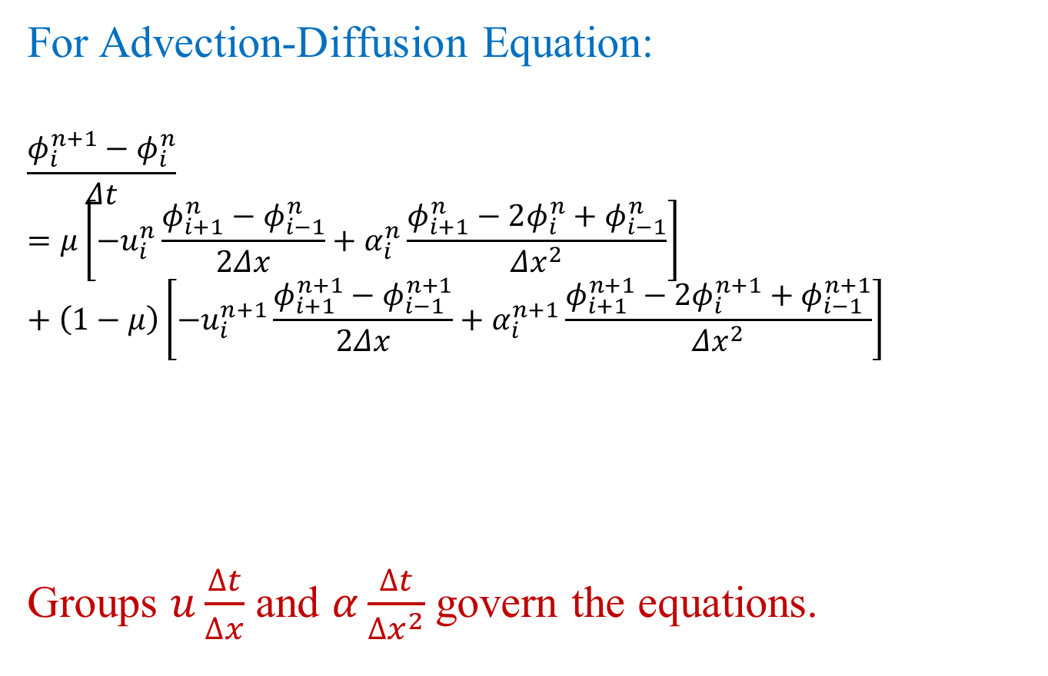
Convergence
For Advection-Diffusion Equation:
$$\frac{φ_{i}^{n+1}−φ_{i}^{n}}{Δt}=μ\left[−u_{i}^{n}\frac{φ_{i+1}^{n}−φ_{i−1}^{n}}{2Δx}+α_{i}^{n}\frac{φ_{i+1}^{n}−2φ_{i}^{n}+φ_{i−1}^{n}}{Δx^{2}}\right]+\left(1−μ\right)\left[−u_{i}^{n+1}\frac{φ_{i+1}^{n+1}−φ_{i−1}^{n+1}}{2Δx}+α_{i}^{n+1}\frac{φ_{i+1}^{n+1}−2φ_{i}^{n+1}+φ_{i−1}^{n+1}}{Δx^{2}}\right]$$
Groups $u\frac{∆t}{∆x}$ and $α\frac{∆t}{{∆x}^{2}}$ govern the equations.

Slide 11
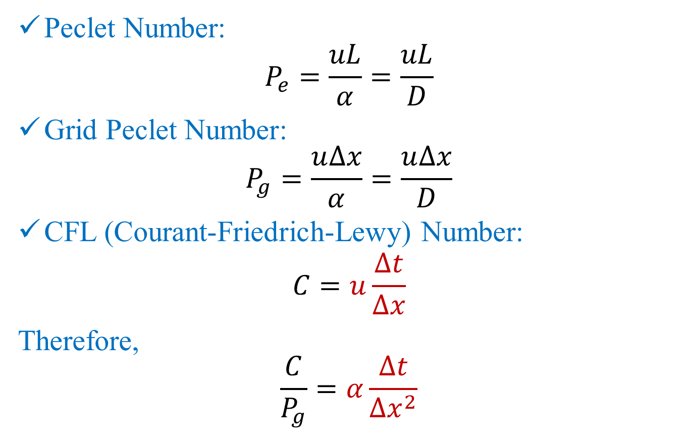
Convergence
Peclet Number:
$$P_{e}=\frac{uL}{α}=\frac{uL}{D}$$
Grid Peclet Number:
$$P_{g}=\frac{u∆x}{α}=\frac{u∆x}{D}$$
CFL (Courant-Friedrich-Lewy) Number:
$$C=u\frac{∆t}{∆x}$$
Therefore,
$$\frac{C}{P_{g}}=α\frac{∆t}{{∆x}^{2}}$$

Slide 12
Convergence
If u and 𝛼 are constants (not functions of x):
Then the solutions depend on these two dimensionless groups or numbers. Therefore, stability and convergence will also depend on these two!

Slide 13
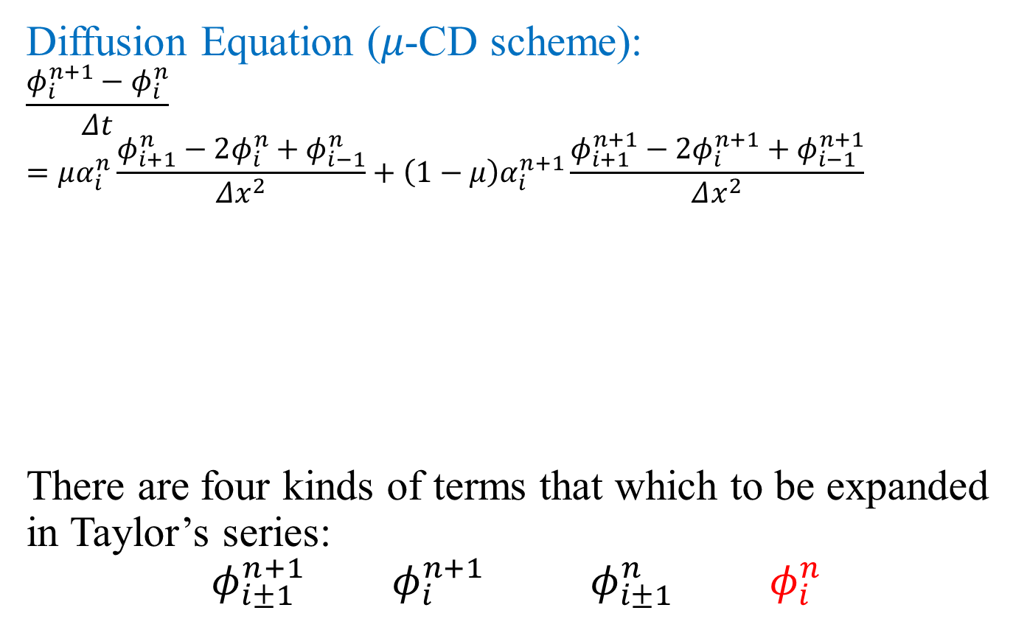
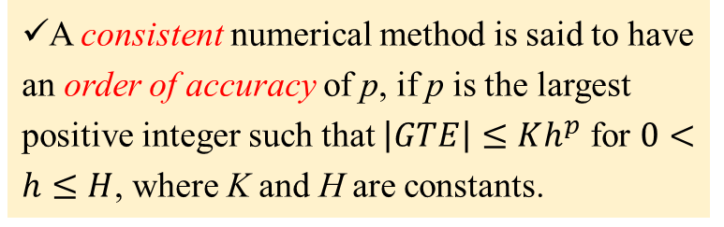
Consistency
A consistent numerical method is said to have an order of accuracy of p, if p is the largest positive integer such that $\left|GTE\right|≤Kh^{p}$ for $0<h≤H$, where K and H are constants.
Diffusion Equation (𝜇-CD scheme):
$$\frac{φ_{i}^{n+1}−φ_{i}^{n}}{Δt}=μα_{i}^{n}\frac{φ_{i+1}^{n}−2φ_{i}^{n}+φ_{i−1}^{n}}{Δx^{2}}+\left(1−μ\right)α_{i}^{n+1}\frac{φ_{i+1}^{n+1}−2φ_{i}^{n+1}+φ_{i−1}^{n+1}}{Δx^{2}}$$
There are four kinds of terms that which to be expanded in Taylor’s series:
$$φ_{i±1}^{n+1} φ_{i}^{n+1} φ_{i±1}^{n} φ_{i}^{n}$$

Slide 14
Consistency
…(1)

Slide 15
In equation (1) on the last slide

Slide 16
Consistency
Diffusion Equation (𝜇-CD scheme):
Truncation Error:

Slide 17
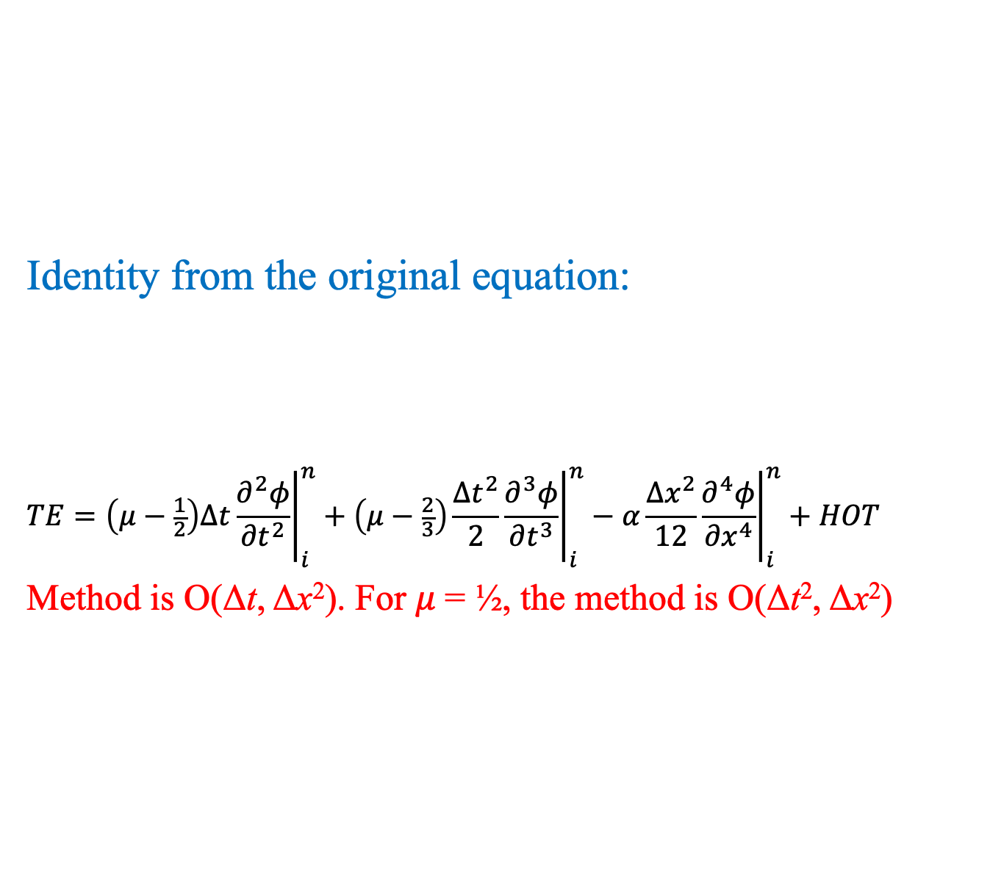
Consistency
Identity from the original equation:
$$TE=\left(μ−\frac{1}{2}\right)∆t{\left.\frac{∂^{2}φ}{{∂t}^{2}}\right|}_{i}^{n}+\left(μ−\frac{2}{3}\right)\frac{{∆t}^{2}}{2}{\left.\frac{∂^{3}φ}{{∂t}^{3}}\right|}_{i}^{n}−α\frac{{∆x}^{2}}{12}{\left.\frac{∂^{4}φ}{{∂x}^{4}}\right|}_{i}^{n}+HOT$$
Method is O(Δt, Δx²). For 𝜇 = ½, the method is O(Δt², Δx²)

Slide 18
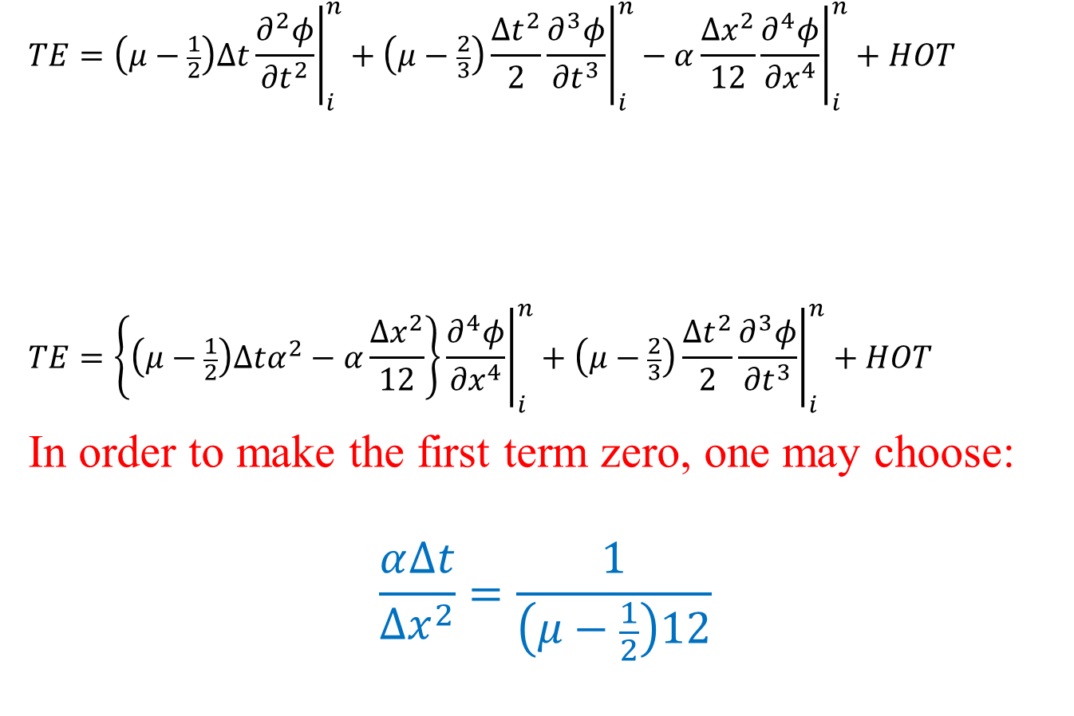
Consistency
$$TE=\left(μ−\frac{1}{2}\right)∆t{\left.\frac{∂^{2}φ}{{∂t}^{2}}\right|}_{i}^{n}+\left(μ−\frac{2}{3}\right)\frac{{∆t}^{2}}{2}{\left.\frac{∂^{3}φ}{{∂t}^{3}}\right|}_{i}^{n}−α\frac{{∆x}^{2}}{12}{\left.\frac{∂^{4}φ}{{∂x}^{4}}\right|}_{i}^{n}+HOT$$
$$TE=\left\{\left(μ−\frac{1}{2}\right)∆tα^{2}−α\frac{{∆x}^{2}}{12}\right\}{\left.\frac{∂^{4}φ}{{∂x}^{4}}\right|}_{i}^{n}+\left(μ−\frac{2}{3}\right)\frac{{∆t}^{2}}{2}{\left.\frac{∂^{3}φ}{{∂t}^{3}}\right|}_{i}^{n}+HOT$$
In order to make the first term zero, one may choose:
$$\frac{α∆t}{{∆x}^{2}}=\frac{1}{\left(μ−\frac{1}{2}\right)12}$$

Slide 19
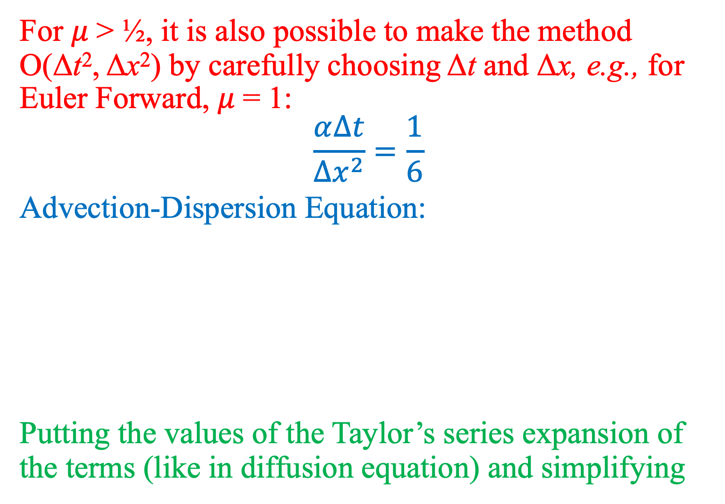
Consistency
For 𝜇 > ½, it is also possible to make the method O(Δt², Δx²) by carefully choosing Δt and Δx, e.g., for Euler Forward, 𝜇 = 1:
$$\frac{α∆t}{{∆x}^{2}}=\frac{1}{6}$$
Advection-Dispersion Equation:
Putting the values of the Taylor’s series expansion of the terms (like in diffusion equation) and simplifying

Slide 20
Consistency
No surprises in the order of accuracy! The method is O(Δt, Δx²). For 𝜇 = ½, the method is O(Δt², Δx²)
New surprise is:
Numerical Diffusion!

Slide 21
Consistency
Strategies to compensate for Numerical Diffusion:
Use modified Diffusion/Dispersion coefficient:
Use Backward difference approximation for the advection term
If you thought that combining schemes that are consistent independently will always give you a consistent scheme for PDE, think again!
Let us look at one scheme that combines two consistent schemes!

Slide 22
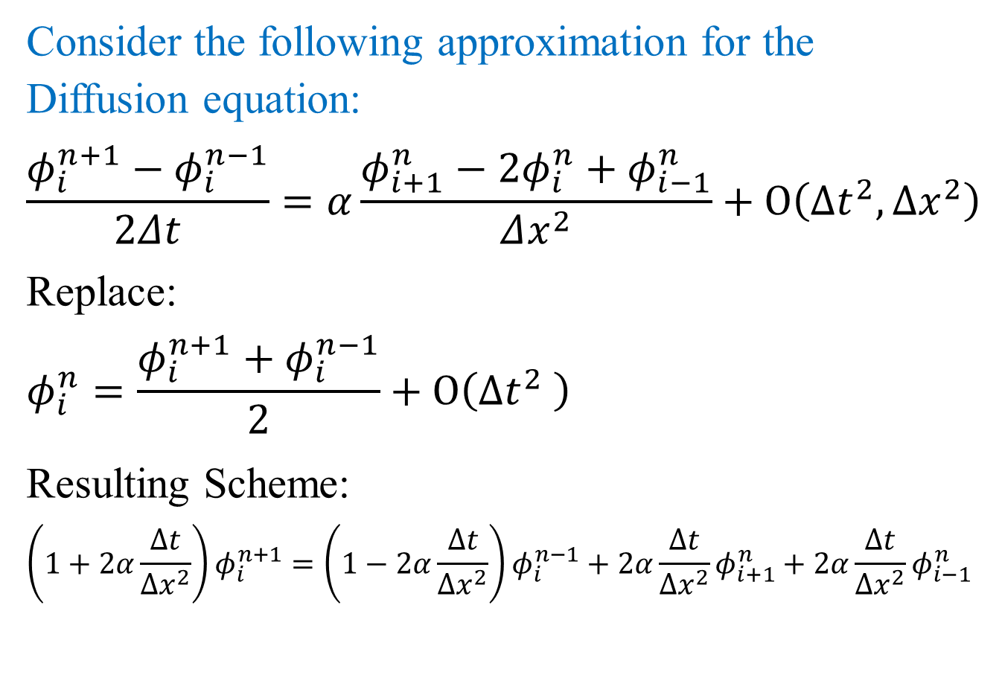
Consistency: inconsistent scheme
Consider the following approximation for the Diffusion equation:
$$\frac{φ_{i}^{n+1}−φ_{i}^{n−1}}{2Δt}=α\frac{φ_{i+1}^{n}−2φ_{i}^{n}+φ_{i−1}^{n}}{Δx^{2}}+O\left({∆t}^{2},{∆x}^{2}\right)$$
Replace:
$$φ_{i}^{n}=\frac{φ_{i}^{n+1}+φ_{i}^{n−1}}{2}+O\left({∆t}^{2} \right)$$
Resulting Scheme:
$$\left(1+2α\frac{∆t}{{∆x}^{2}}\right)φ_{i}^{n+1}=\left(1−2α\frac{∆t}{{∆x}^{2}}\right)φ_{i}^{n−1}+2α\frac{∆t}{{∆x}^{2}}φ_{i+1}^{n}+2α\frac{∆t}{{∆x}^{2}}φ_{i−1}^{n}$$

Slide 23
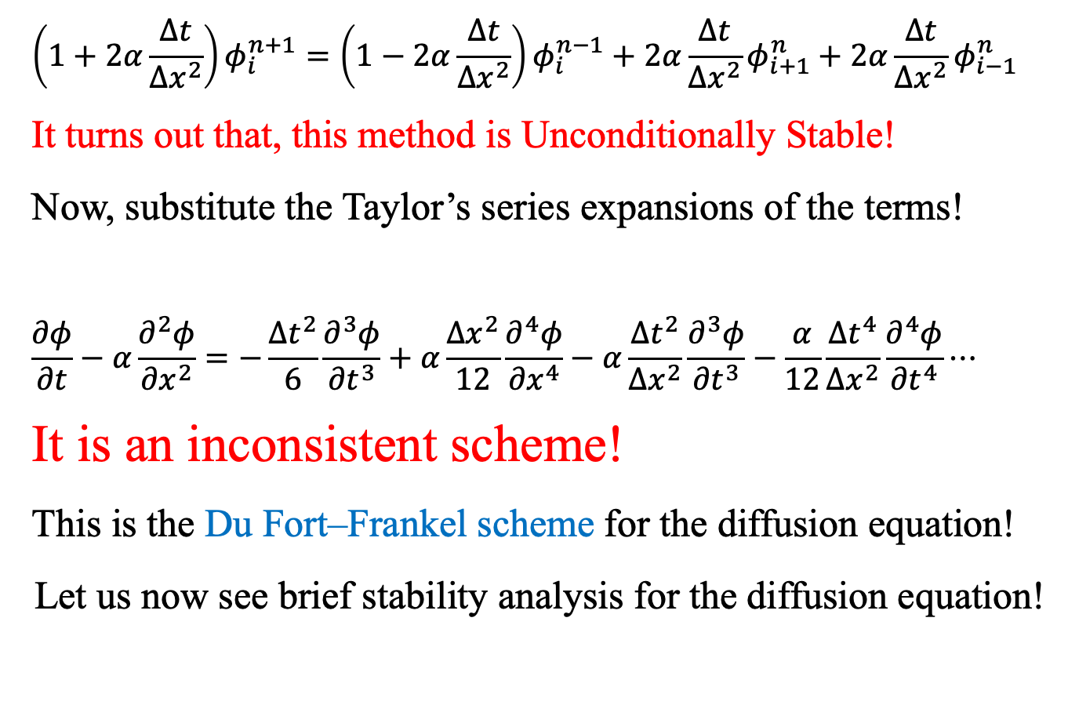
Consistency: inconsistent scheme
$$\left(1+2α\frac{∆t}{{∆x}^{2}}\right)φ_{i}^{n+1}=\left(1−2α\frac{∆t}{{∆x}^{2}}\right)φ_{i}^{n−1}+2α\frac{∆t}{{∆x}^{2}}φ_{i+1}^{n}+2α\frac{∆t}{{∆x}^{2}}φ_{i−1}^{n}$$
It turns out that, this method is Unconditionally Stable!
Now, substitute the Taylor’s series expansions of the terms!
$$\frac{∂φ}{∂t}−α\frac{∂^{2}φ}{{∂x}^{2}}=−\frac{{∆t}^{2}}{6}\frac{∂^{3}φ}{{∂t}^{3}}+α\frac{{∆x}^{2}}{12}\frac{∂^{4}φ}{{∂x}^{4}}−α\frac{{∆t}^{2}}{{∆x}^{2}}\frac{∂^{3}φ}{{∂t}^{3}}−\frac{α}{12}\frac{{∆t}^{4}}{{∆x}^{2}}\frac{∂^{4}φ}{{∂t}^{4}}⋯$$
It is an inconsistent scheme!
This is the Du Fort–Frankel scheme for the diffusion equation!
Let us now see brief stability analysis for the diffusion equation!

Slide 24

Stability: Diffusion Equation
$$\frac{dφ_{i}}{dt}=α\frac{φ_{i+1}−2φ_{i}+φ_{i−1}}{Δx^{2}} ⟹ \frac{d\overline{φ}}{dt}=A\overline{φ}+b$$
Assuming Dirichlet type zero boundary conditions!

Slide 25
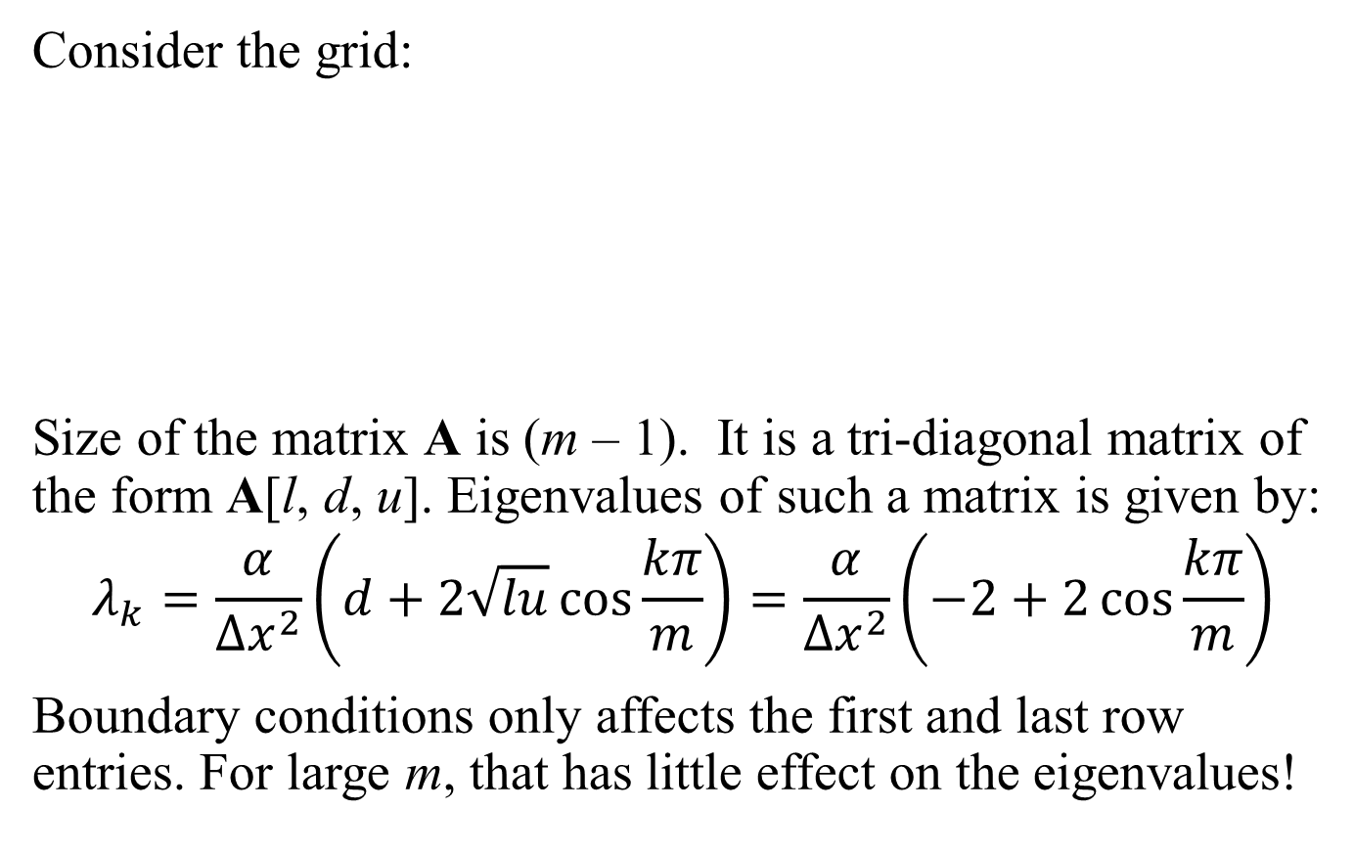
Stability: Diffusion Equation
Consider the grid:
Size of the matrix A is (m – 1). It is a tri-diagonal matrix of the form A[l, d, u]. Eigenvalues of such a matrix is given by:
$$λ_{k}=\frac{α}{{∆x}^{2}}\left(d+2\sqrt{lu}\cos{\frac{kπ}{m}}\right)=\frac{α}{{∆x}^{2}}\left(−2+2\cos{\frac{kπ}{m}}\right)$$
Boundary conditions only affects the first and last row entries. For large m, that has little effect on the eigenvalues!

Slide 26
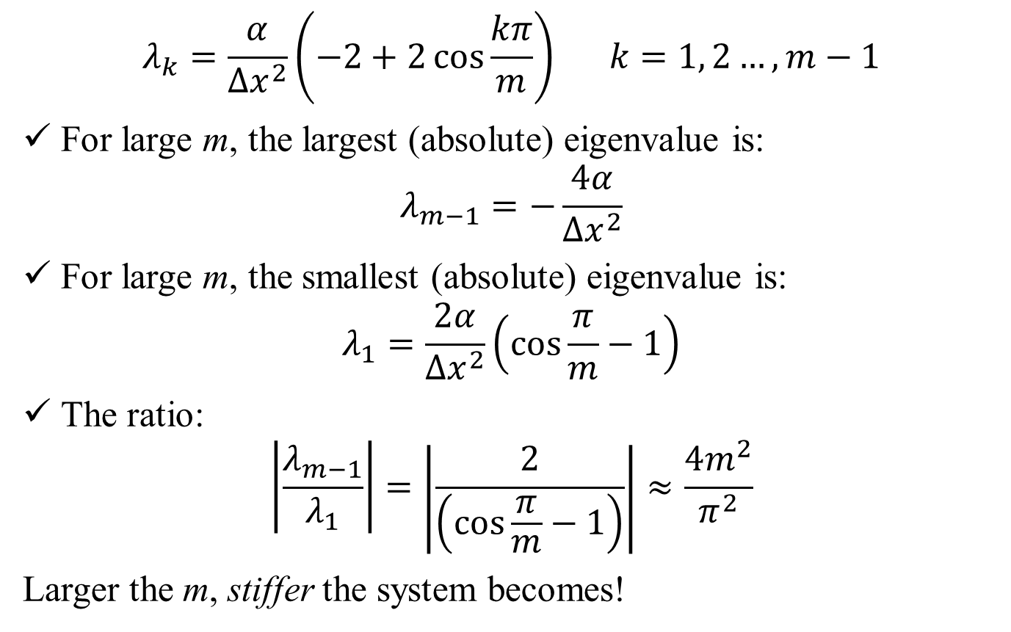
Stability: Diffusion Equation
$$λ_{k}=\frac{α}{{∆x}^{2}}\left(−2+2\cos{\frac{kπ}{m}}\right) k=1, 2…,m−1$$
For large m, the largest (absolute) eigenvalue is:
$$λ_{m−1}=−\frac{4α}{{∆x}^{2}}$$
For large m, the smallest (absolute) eigenvalue is:
$$λ_{1}=\frac{2α}{{∆x}^{2}}\left(\cos{\frac{π}{m}}−1\right)$$
The ratio:
$$\left|\frac{λ_{m−1}}{λ_{1}}\right|=\left|\frac{2}{\left(\cos{\frac{π}{m}}−1\right)}\right|≈\frac{4m^{2}}{π^{2}}$$
Larger the m, stiffer the system becomes!

Slide 27
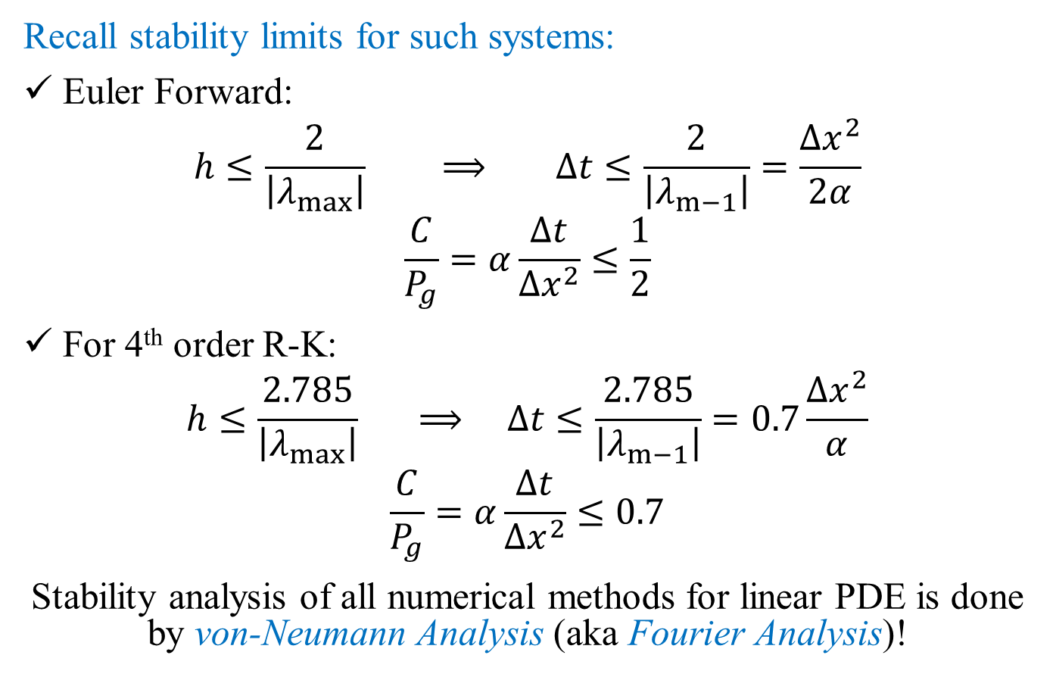
Stability: Diffusion Equation
Recall stability limits for such systems:
Euler Forward:
$$h≤\frac{2}{\left|λ_{max}\right|} ⟹ ∆t≤\frac{2}{\left|λ_{m−1}\right|}=\frac{{∆x}^{2}}{2α}$$
$$\frac{C}{P_{g}}=α\frac{∆t}{{∆x}^{2}}≤\frac{1}{2}$$
For 4th order R-K:
$$h≤\frac{2.785}{\left|λ_{max}\right|} ⟹ ∆t≤\frac{2.785}{\left|λ_{m−1}\right|}=0.7\frac{{∆x}^{2}}{α}$$
$$\frac{C}{P_{g}}=α\frac{∆t}{{∆x}^{2}}≤0.7$$
Stability analysis of all numerical methods for linear PDE is done by von-Neumann Analysis (aka Fourier Analysis)!

