Slide 1

ESO 208A: Computational Methods in Engineering Nonlinear Equations
Abhas Singh
Department of Civil Engineering
IIT Kanpur
Acknowledgements: Profs. Saumyen Guha and Shivam Tripathi (CE)

Slide 2
Roots of Non-Linear Equations:
f(x) = 0
f may be a function belonging to any class: algebraic, trigonometric, hyperbolic, polynomials, logarithmic, exponential, etc.
Five types of methods can broadly be classified:
Graphical method
Bracketing methods: Bisection, Regula-Falsi
Open methods: Fixed point, Newton-Raphson, Secant, Muller
Special methods for polynomials: Bairstow’s
Hybrid methods: Brent’s
Background assumed (MTH 101): intermediate value theorem; nested interval theorem; Cauchy sequence and convergence; Taylor’s and Maclaurin’s series; etc.

Slide 3
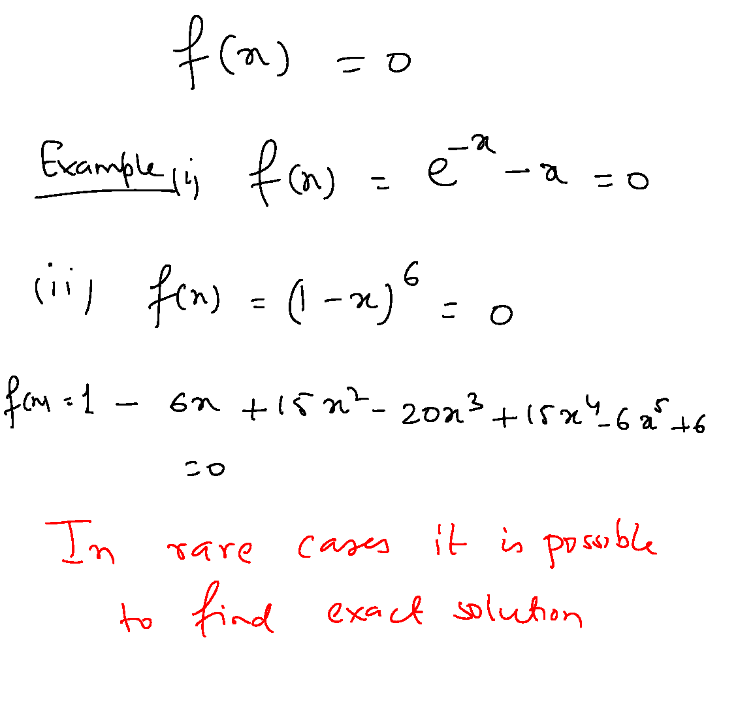
Graphical Method
Involves plotting f(x) curve and finding the solution at the intersection of f(x) with x-axis.

Slide 4
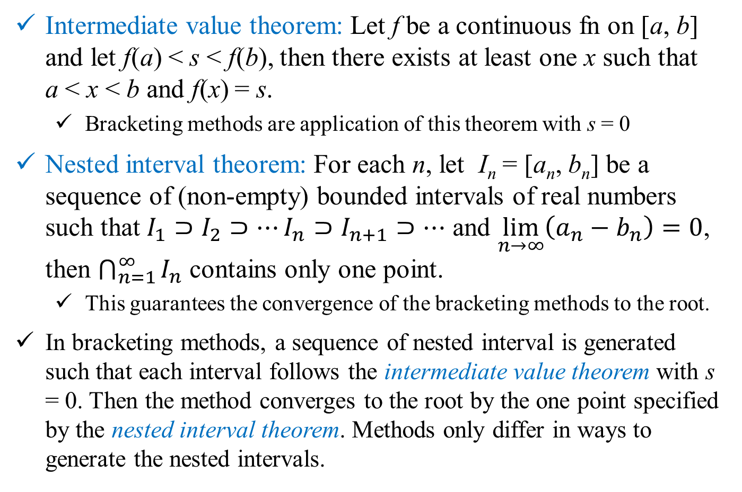
Bracketing Methods
Intermediate value theorem: Let f be a continuous fn on [a, b] and let f(a) < s < f(b), then there exists at least one x such that a < x < b and f(x) = s.
Bracketing methods are application of this theorem with s = 0
Nested interval theorem: For each n, let I_{n} = [a_{n}, b_{n}] be a sequence of (non-empty) bounded intervals of real numbers such that $I_{1}⊃I_{2}⊃⋯I_{n}⊃I_{n+1}⊃⋯$ and $\lim_{n→∞}\left(a_{n}−b_{n}\right)=0$, then $\bigcap_{n=1}^{∞}{I_{n}}$ contains only one point.
This guarantees the convergence of the bracketing methods to the root.
In bracketing methods, a sequence of nested interval is generated such that each interval follows the intermediate value theorem with s = 0. Then the method converges to the root by the one point specified by the nested interval theorem. Methods only differ in ways to generate the nested intervals.

Slide 5
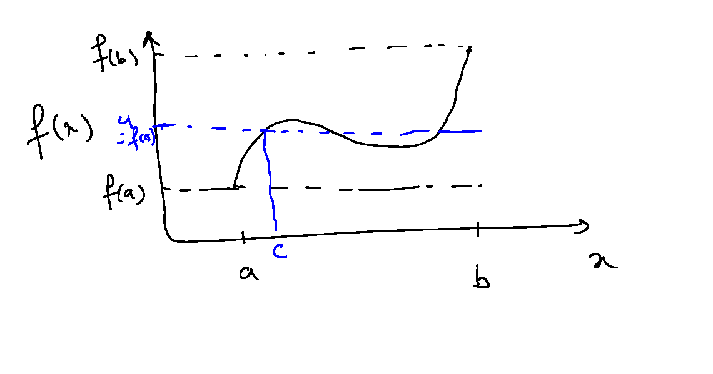
Intermediate Value Theorem

Slide 6
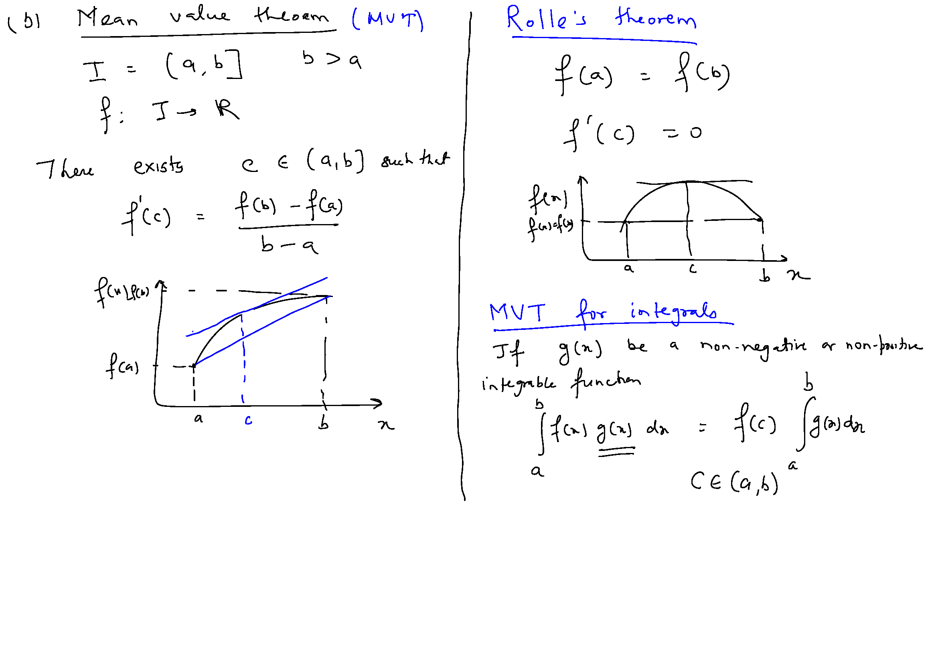

Slide 7
Bisection Method
Principle: Choose an initial interval based on intermediate value theorem and halve the interval at each iteration step to generate the nested intervals.
Initialize: Choose a₀ and b₀ such that, f(a₀)f(b₀) < 0. This is done by trial and error.
Iteration step k:
Compute mid-point m_{k+1} = (a_{k} + b_{k})/2 and functional value f(m_{k+1})
If f(m_{k+1}) = 0, m_{k+1} is the root. (It’s your lucky day!)
If f(a_{k})f(m_{k+1}) < 0: a_{k+1} = a_{k} and b_{k+1} = m_{k+1}; else, a_{k+1} = m_{k+1} and b_{k+1} = b_{k}
After n iterations: size of the interval d_{n} = (b_{n} – a_{n}) = 2^{-n} (b₀ – a₀), stop if d_{n} ≤ ε
Estimate the root (x = α say!) as: α = m_{n+1} ± 2^{-(n+1)} (b₀ – a₀)

Slide 8
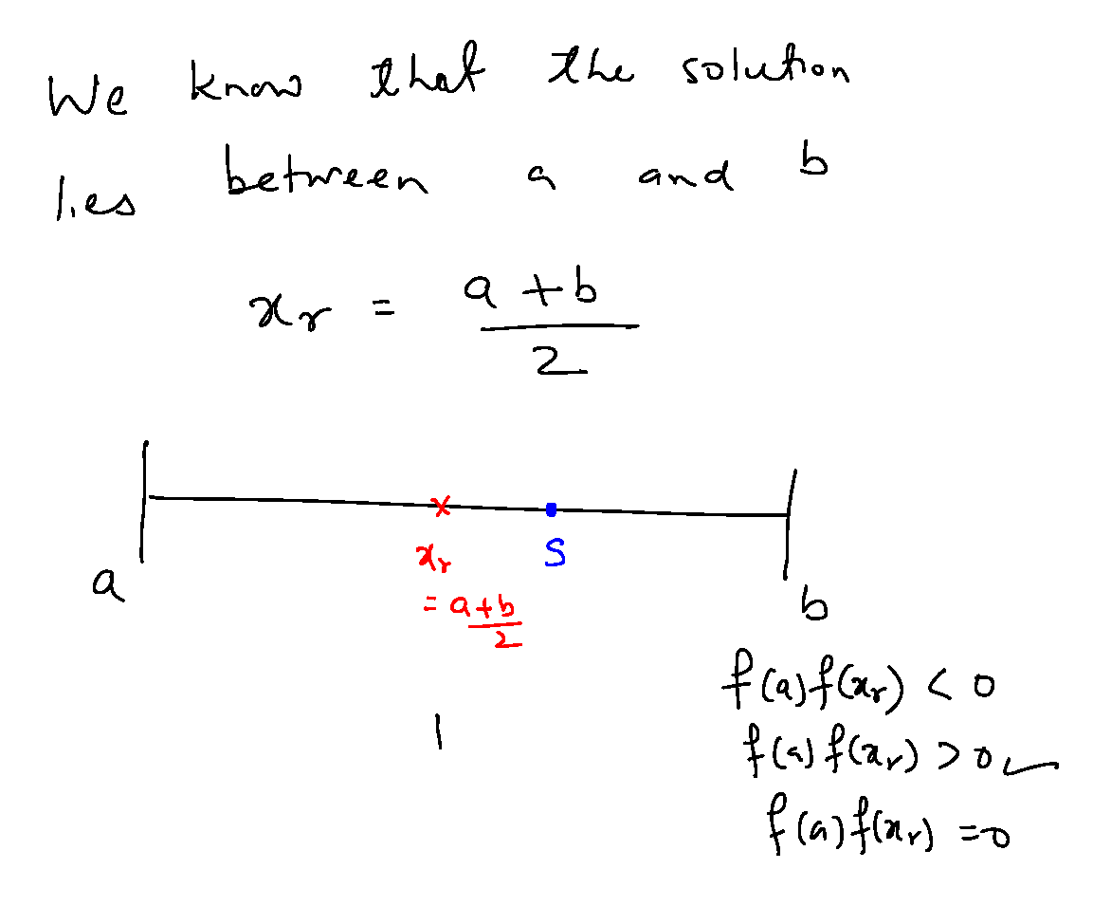
Bisection Method

Slide 9
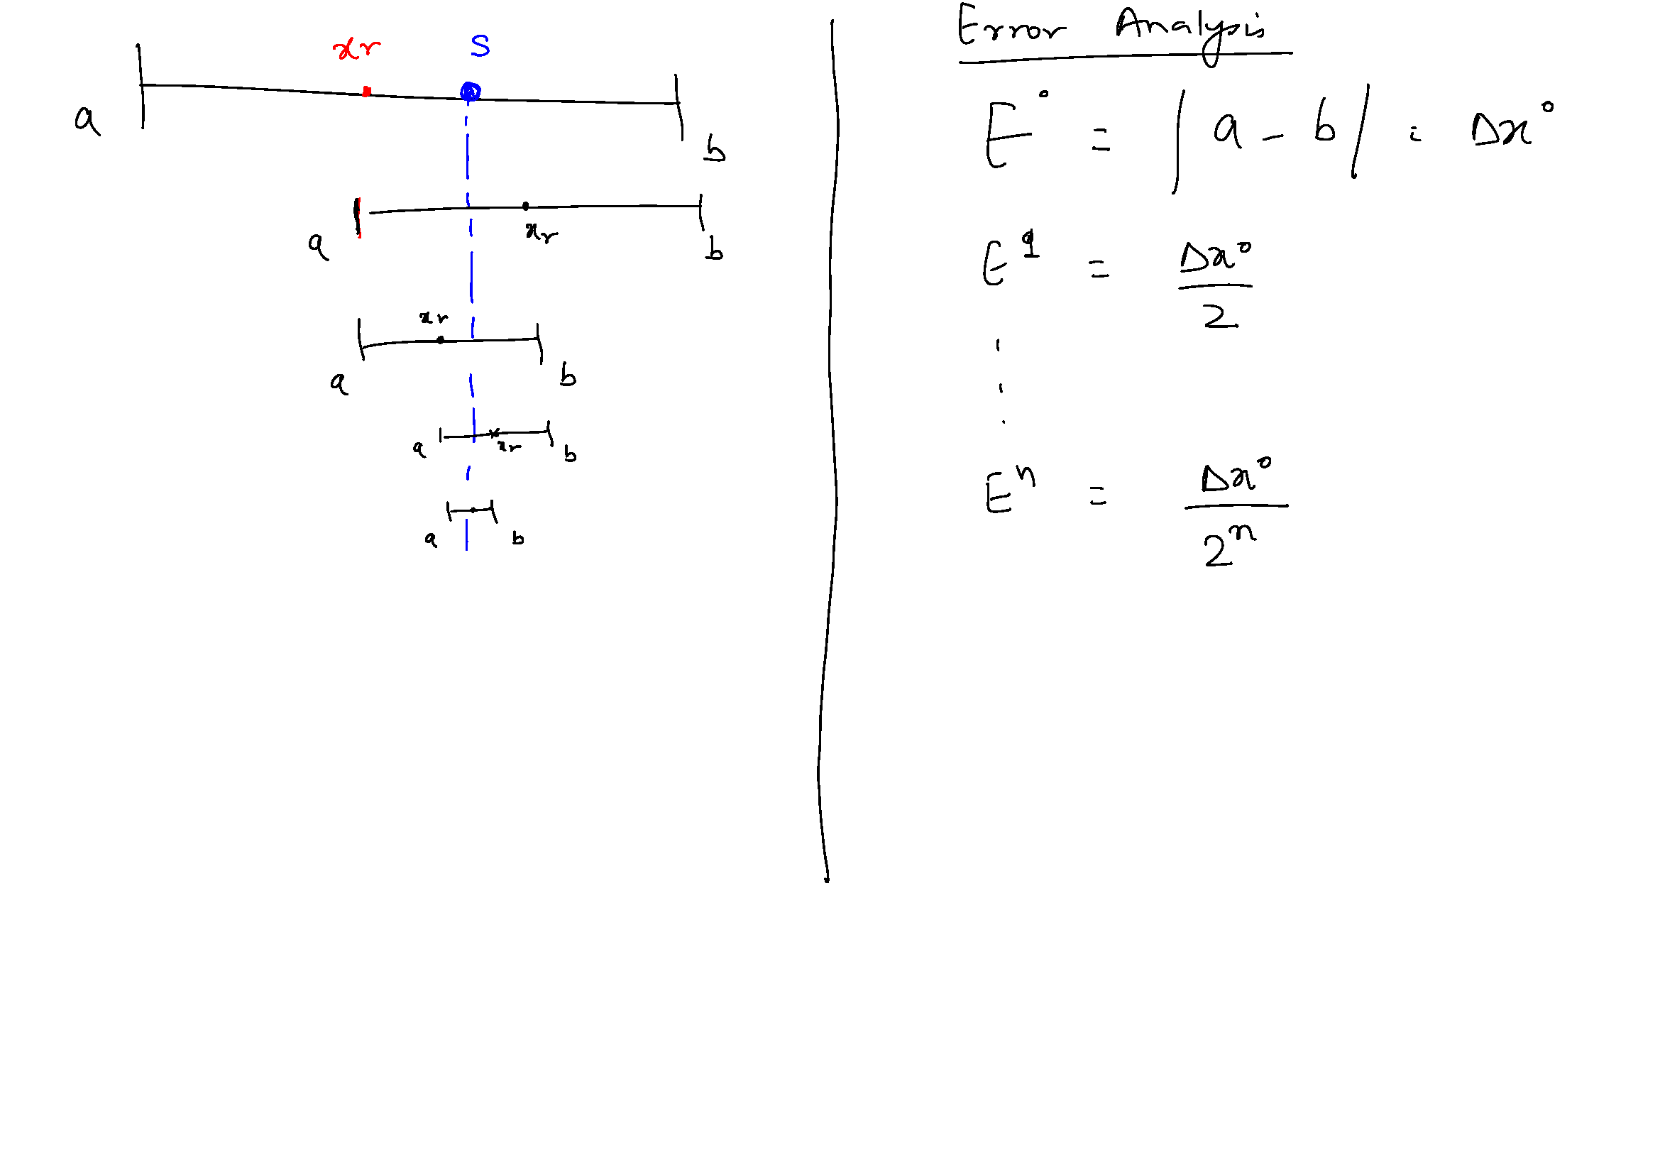
Bisection Method

Slide 10
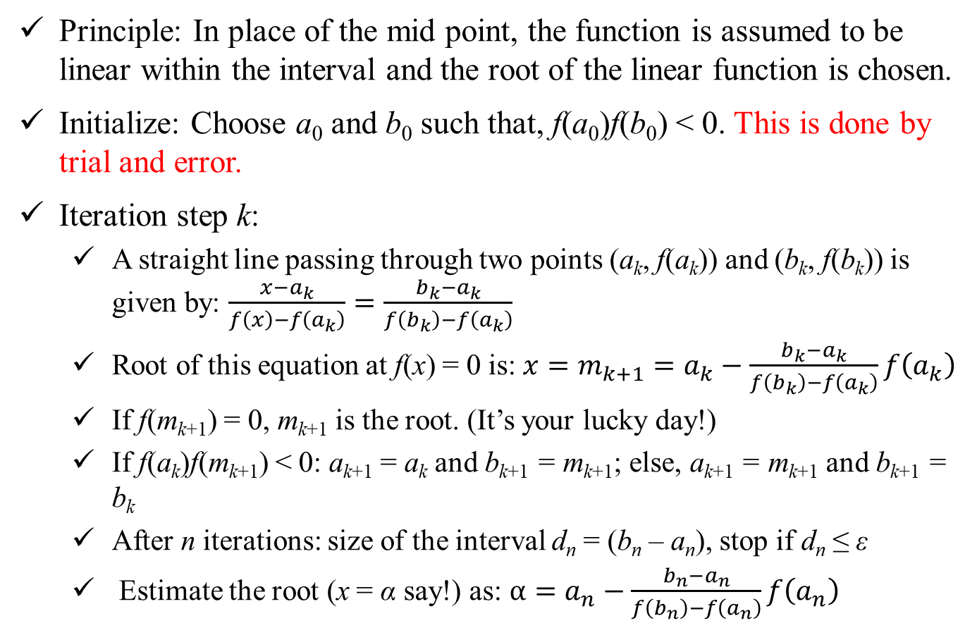
Regula-Falsi or Method of False Position
Principle: In place of the mid point, the function is assumed to be linear within the interval and the root of the linear function is chosen.
Initialize: Choose a₀ and b₀ such that, f(a₀)f(b₀) < 0. This is done by trial and error.
Iteration step k:
A straight line passing through two points (a_{k}, f(a_{k})) and (b_{k}, f(b_{k})) is given by: $\frac{x−a_{k}}{f\left(x\right)−f\left(a_{k}\right)}=\frac{b_{k}−a_{k}}{f\left(b_{k}\right)−f\left(a_{k}\right)}$
Root of this equation at f(x) = 0 is: $x=m_{k+1}=a_{k}−\frac{b_{k}−a_{k}}{f\left(b_{k}\right)−f\left(a_{k}\right)}f\left(a_{k}\right)$
If f(m_{k+1}) = 0, m_{k+1} is the root. (It’s your lucky day!)
If f(a_{k})f(m_{k+1}) < 0: a_{k+1} = a_{k} and b_{k+1} = m_{k+1}; else, a_{k+1} = m_{k+1} and b_{k+1} = b_{k}
After n iterations: size of the interval d_{n} = (b_{n} – a_{n}), stop if d_{n} ≤ ε
Estimate the root (x = α say!) as: $α=a_{n}−\frac{b_{n}−a_{n}}{f\left(b_{n}\right)−f\left(a_{n}\right)}f\left(a_{n}\right)$

Slide 11
Regula-Falsi or Method of False Position
y = f(x)
f(a_{k})
m_{k+1}
b_{k}
a_{k}
f(b_{k})

Slide 12

Example Problem
$f\left(x\right)= e^{−x}−x=0$
True solution = 0.5671
Set up a scheme as follows:
Iterations xl xu xk e er
0 0(guess) 1(guess) s.t. f(xl)f(xu) < 0

Slide 13
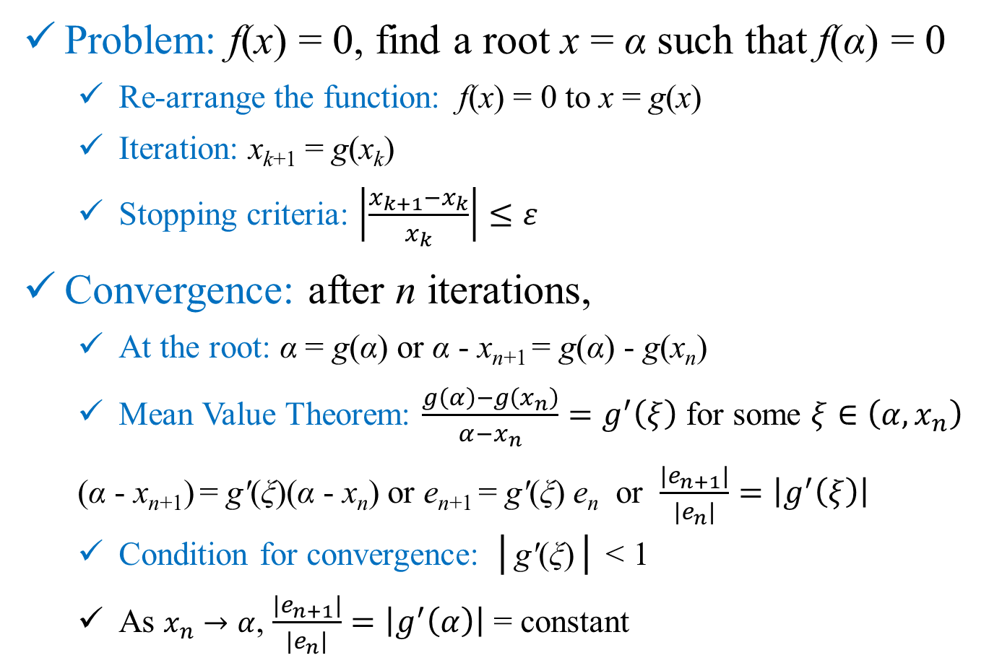
Open Methods: Fixed Point
Problem: f(x) = 0, find a root x = α such that f(α) = 0
Re-arrange the function: f(x) = 0 to x = g(x)
Iteration: x_{k+1} = g(x_{k})
Stopping criteria: $\left|\frac{x_{k+1}−x_{k}}{x_{k}}\right|≤ε$
Convergence: after n iterations,
At the root: α = g(α) or α - x_{n+1} = g(α) - g(x_{n})
Mean Value Theorem: $\frac{g\left(α\right)−g\left(x_{n}\right)}{α−x_{n}}=g^{′}\left(ξ\right)$ for some $ξ∈\left(α,x_{n}\right)$
(α - x_{n+1}) = gʹ(ξ)(α - x_{n}) or e_{n+1} = gʹ(ξ) e_{n} or $\frac{\left|e_{n+1}\right|}{\left|e_{n}\right|}=\left|g^{′}\left(ξ\right)\right|$
Condition for convergence: │gʹ(ξ)│ < 1
As $x_{n}→α$, $\frac{\left|e_{n+1}\right|}{\left|e_{n}\right|}=\left|g^{′}\left(α\right)\right|$ = constant

Slide 14
Open Methods: Fixed Point
y = g(x)
y = x
y = x
y = g(x)
x₃
x₂
x₀
x₁
x₃
x₂
x₁
x₀
Root α
Root α

