Slide 1
Roots of Non-Linear Equations (Recap):
f(x) = 0
f may be a function belonging to any class: algebraic, trigonometric, hyperbolic, polynomials, logarithmic, exponential, etc.
Five types of methods can broadly be classified:
Graphical method
Bracketing methods: Bisection, Regula-Falsi
Open methods: Fixed point, Newton-Raphson, Secant, Muller
Special methods for polynomials: Bairstow’s
Hybrid methods: Brent’s

Slide 2
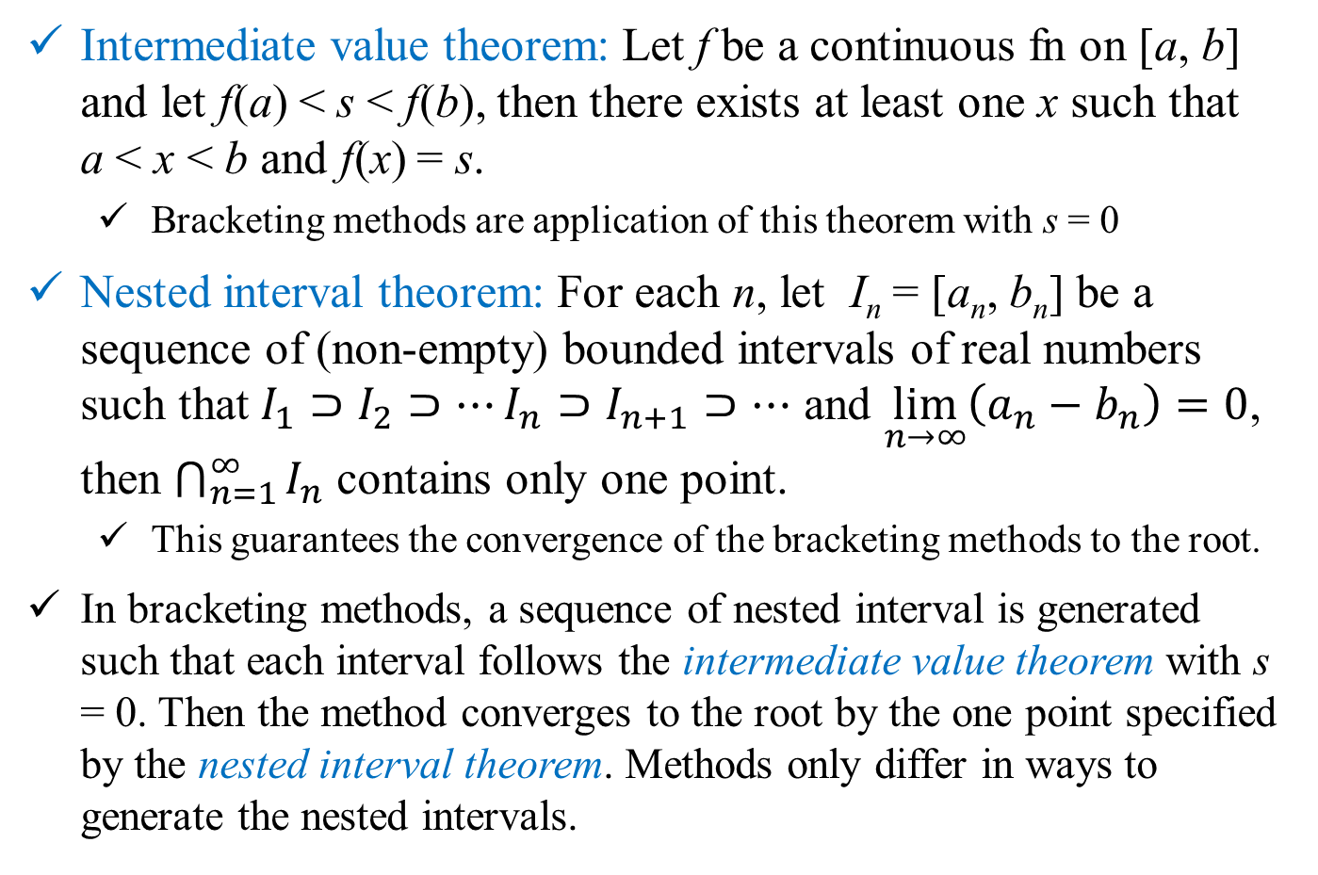
Bracketing Methods
Intermediate value theorem: Let f be a continuous fn on [a, b] and let f(a) < s < f(b), then there exists at least one x such that a < x < b and f(x) = s.
Bracketing methods are application of this theorem with s = 0
Nested interval theorem: For each n, let I_{n} = [a_{n}, b_{n}] be a sequence of (non-empty) bounded intervals of real numbers such that $I_{1}⊃I_{2}⊃⋯I_{n}⊃I_{n+1}⊃⋯$ and $\lim_{n→∞}\left(a_{n}−b_{n}\right)=0$, then $\bigcap_{n=1}^{∞}{I_{n}}$ contains only one point.
This guarantees the convergence of the bracketing methods to the root.
In bracketing methods, a sequence of nested interval is generated such that each interval follows the intermediate value theorem with s = 0. Then the method converges to the root by the one point specified by the nested interval theorem. Methods only differ in ways to generate the nested intervals.

Slide 3
Bisection Method
Principle: Choose an initial interval based on intermediate value theorem and halve the interval at each iteration step to generate the nested intervals.
Initialize: Choose a₀ and b₀ such that, f(a₀)f(b₀) < 0. This is done by trial and error.
Iteration step k:
Compute mid-point m_{k+1} = (a_{k} + b_{k})/2 and functional value f(m_{k+1})
If f(m_{k+1}) = 0, m_{k+1} is the root.
If f(a_{k})f(m_{k+1}) < 0: a_{k+1} = a_{k} and b_{k+1} = m_{k+1}; else, a_{k+1} = m_{k+1} and b_{k+1} = b_{k}
After n iterations: size of the interval d_{n} = (b_{n} – a_{n}) = 2^{-n} (b₀ – a₀), stop if d_{n} ≤ ε
Estimate the root (x = α say!) as: α = m_{n+1} ± 2^{-(n+1)} (b₀ – a₀)

Slide 4
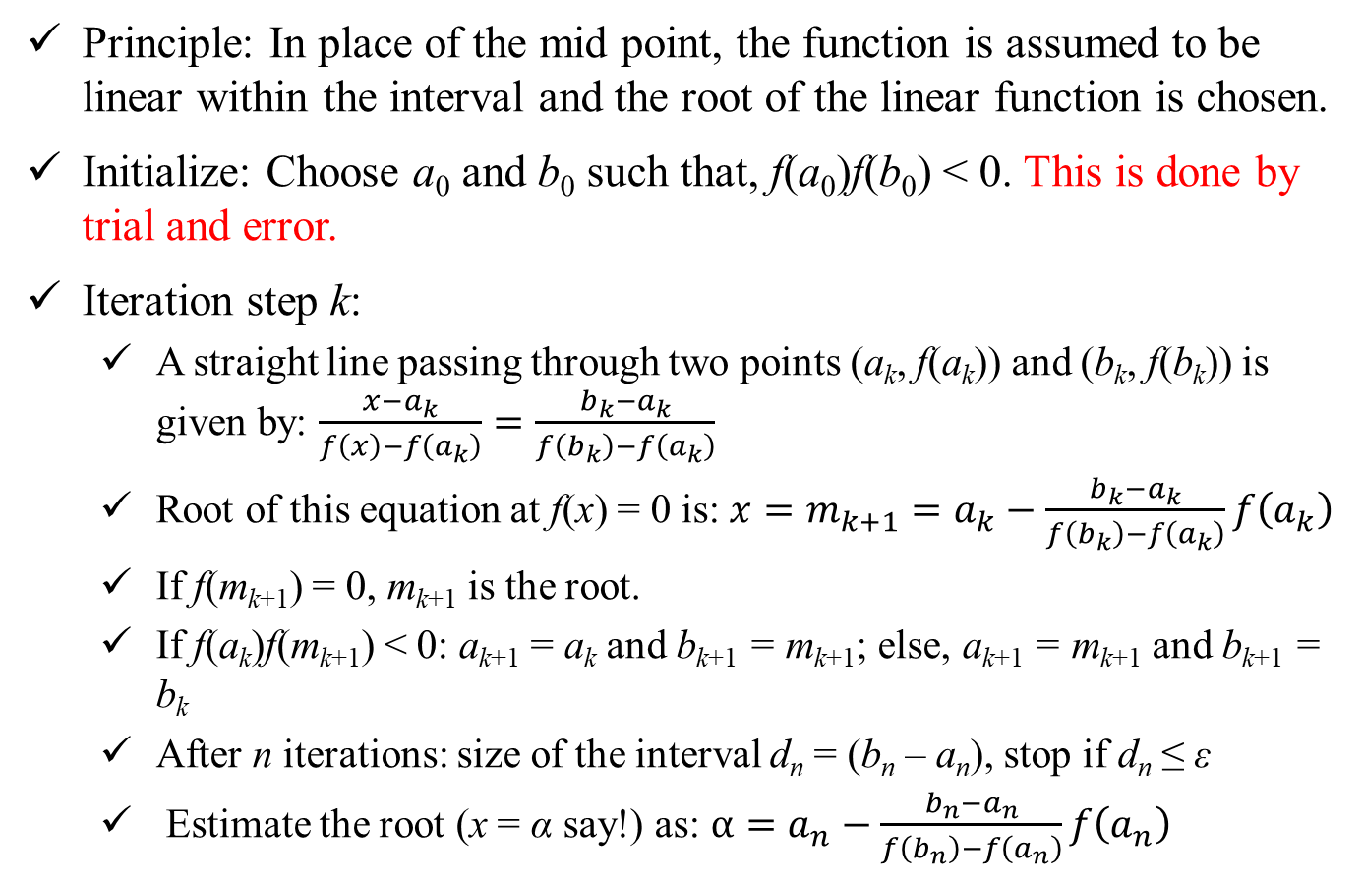
Regula-Falsi or Method of False Position
Principle: In place of the mid point, the function is assumed to be linear within the interval and the root of the linear function is chosen.
Initialize: Choose a₀ and b₀ such that, f(a₀)f(b₀) < 0. This is done by trial and error.
Iteration step k:
A straight line passing through two points (a_{k}, f(a_{k})) and (b_{k}, f(b_{k})) is given by: $\frac{x−a_{k}}{f\left(x\right)−f\left(a_{k}\right)}=\frac{b_{k}−a_{k}}{f\left(b_{k}\right)−f\left(a_{k}\right)}$
Root of this equation at f(x) = 0 is: $x=m_{k+1}=a_{k}−\frac{b_{k}−a_{k}}{f\left(b_{k}\right)−f\left(a_{k}\right)}f\left(a_{k}\right)$
If f(m_{k+1}) = 0, m_{k+1} is the root.
If f(a_{k})f(m_{k+1}) < 0: a_{k+1} = a_{k} and b_{k+1} = m_{k+1}; else, a_{k+1} = m_{k+1} and b_{k+1} = b_{k}
After n iterations: size of the interval d_{n} = (b_{n} – a_{n}), stop if d_{n} ≤ ε
Estimate the root (x = α say!) as: $α=a_{n}−\frac{b_{n}−a_{n}}{f\left(b_{n}\right)−f\left(a_{n}\right)}f\left(a_{n}\right)$

Slide 5
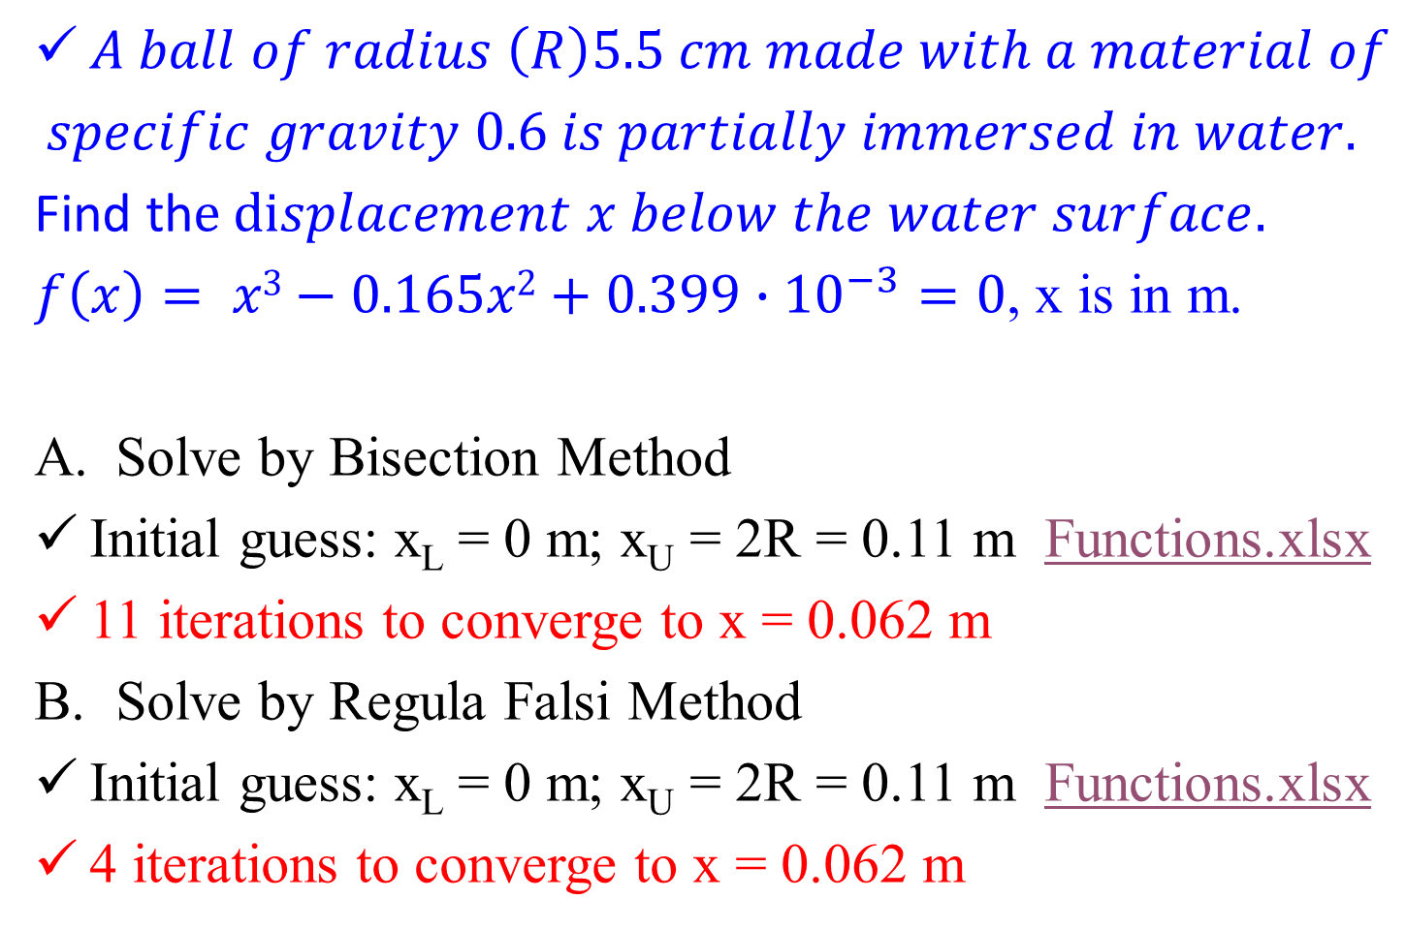
Example Problem
$A ball of radius \left(R\right)5.5 cm made with a material of$
$$specific gravity 0.6 is partially immersed in water.$$
Find th$e displacement x below the water surface.$
$f\left(x\right)= {x3−0.165x2+0.399∙10}^{−3}=0$, x is in m.
Solve by Bisection Method
Initial guess: x_{L} = 0 m; x_{U} = 2R = 0.11 m Functions.xlsx
11 iterations to converge to x = 0.062 m
Solve by Regula Falsi Method
Initial guess: x_{L} = 0 m; x_{U} = 2R = 0.11 m Functions.xlsx
4 iterations to converge to x = 0.062 m

Slide 6
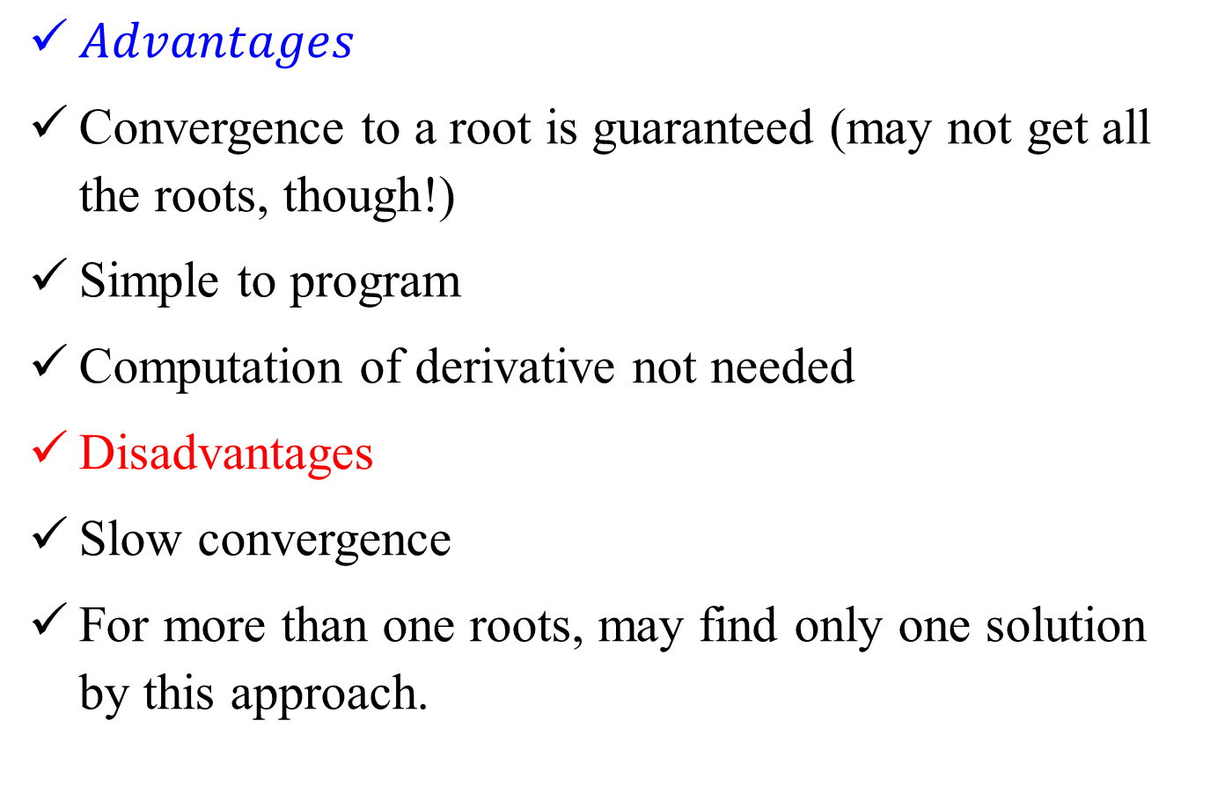
Bracketing Methods:
$Advantages$
Convergence to a root is guaranteed (may not get all the roots, though!)
Simple to program
Computation of derivative not needed
Disadvantages
Slow convergence
For more than one roots, may find only one solution by this approach.

Slide 7
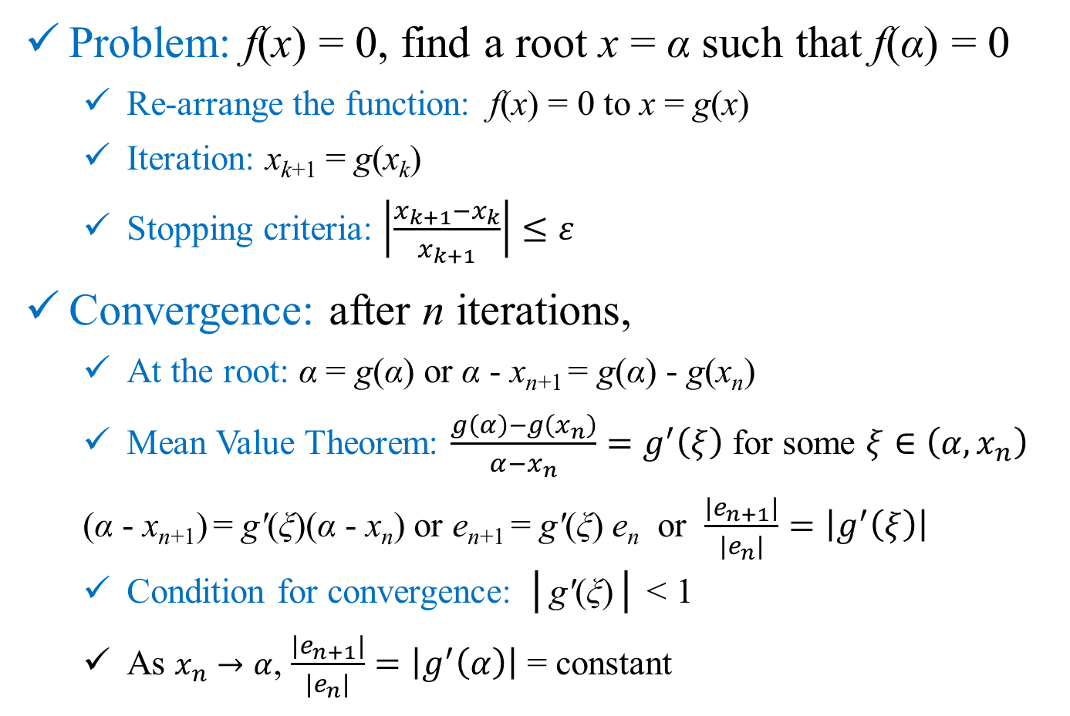
Open Methods: Fixed Point
Problem: f(x) = 0, find a root x = α such that f(α) = 0
Re-arrange the function: f(x) = 0 to x = g(x)
Iteration: x_{k+1} = g(x_{k})
Stopping criteria: $\left|\frac{x_{k+1}−x_{k}}{x_{k+1}}\right|≤ε$
Convergence: after n iterations,
At the root: α = g(α) or α - x_{n+1} = g(α) - g(x_{n})
Mean Value Theorem: $\frac{g\left(α\right)−g\left(x_{n}\right)}{α−x_{n}}=g^{′}\left(ξ\right)$ for some $ξ∈\left(α,x_{n}\right)$
(α - x_{n+1}) = gʹ(ξ)(α - x_{n}) or e_{n+1} = gʹ(ξ) e_{n} or $\frac{\left|e_{n+1}\right|}{\left|e_{n}\right|}=\left|g^{′}\left(ξ\right)\right|$
Condition for convergence: │gʹ(ξ)│ < 1
As $x_{n}→α$, $\frac{\left|e_{n+1}\right|}{\left|e_{n}\right|}=\left|g^{′}\left(α\right)\right|$ = constant

Slide 8
Open Methods: Fixed Point
y = g(x)
y = x
y = x
y = g(x)
x₃
x₂
x₀
x₁
x₃
x₂
x₁
x₀
Root α
Root α

Slide 9
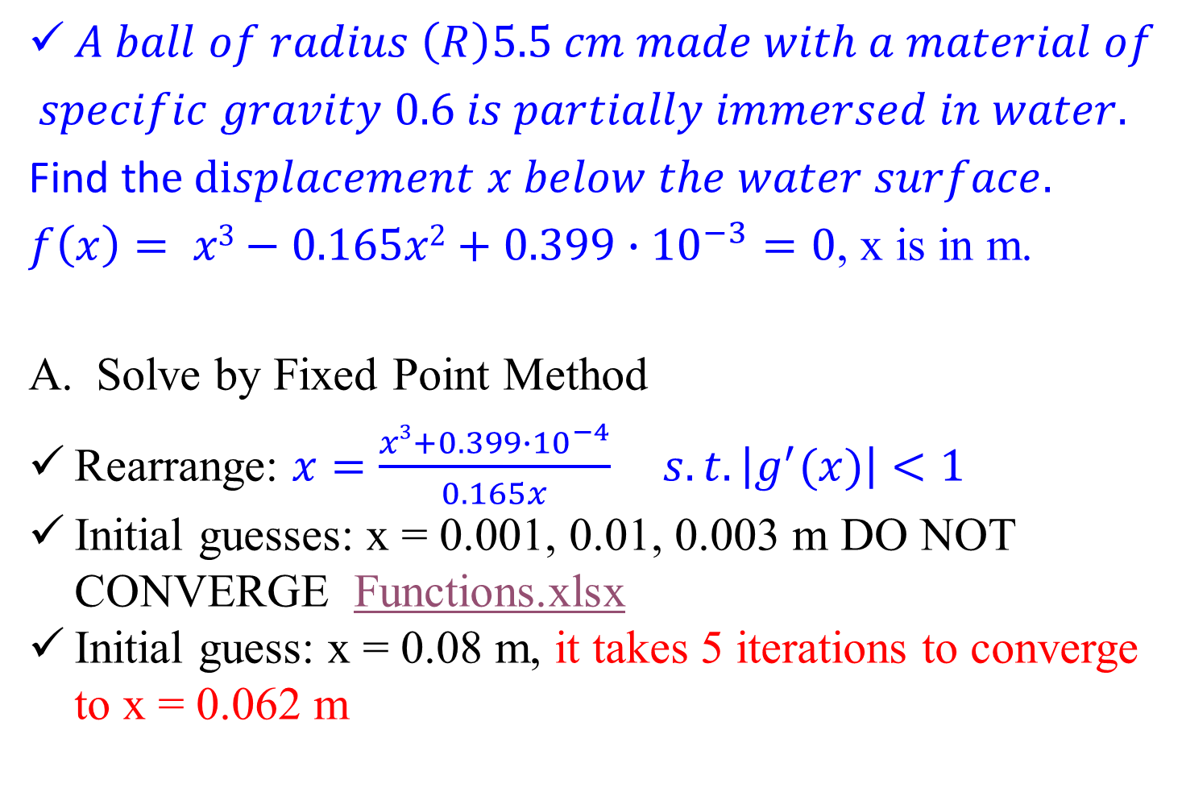
Example Problem
$A ball of radius \left(R\right)5.5 cm made with a material of$
$$specific gravity 0.6 is partially immersed in water.$$
Find th$e displacement x below the water surface.$
$f\left(x\right)= {x3−0.165x2+0.399∙10}^{−3}=0$, x is in m.
Solve by Fixed Point Method
Rearrange: ${x=\frac{x3+0.399∙{10}^{−4}}{0.165x}}^{} s.t. \left|g^{′}(x)\right|<1$
Initial guesses: x = 0.001, 0.01, 0.003 m DO NOT CONVERGE Functions.xlsx
Initial guess: x = 0.08 m, it takes 5 iterations to converge to x = 0.062 m

Slide 10

Example Problem
Solve by Fixed Point Method
Rearrange (alternate): ${x=\sqrt[3]{0.165x^{2}−0.399∙{10}^{−4}}}^{} s.t. \left|g^{′}(x)\right|<1$
Initial guesses: x = 0.001, 0.01, 0.003, 0.08 m all CONVERGE Functions.xlsx

Slide 11
Open Methods: Newton-Raphson
Problem: f(x) = 0, find a root x = α such that f(α) = 0
Principle: Approximate the function as a straight line having same slope as the original function at the point of iteration.
f(x₀)
f(x₁)
x₀
y = f(x)
x₁
x₂

Slide 12
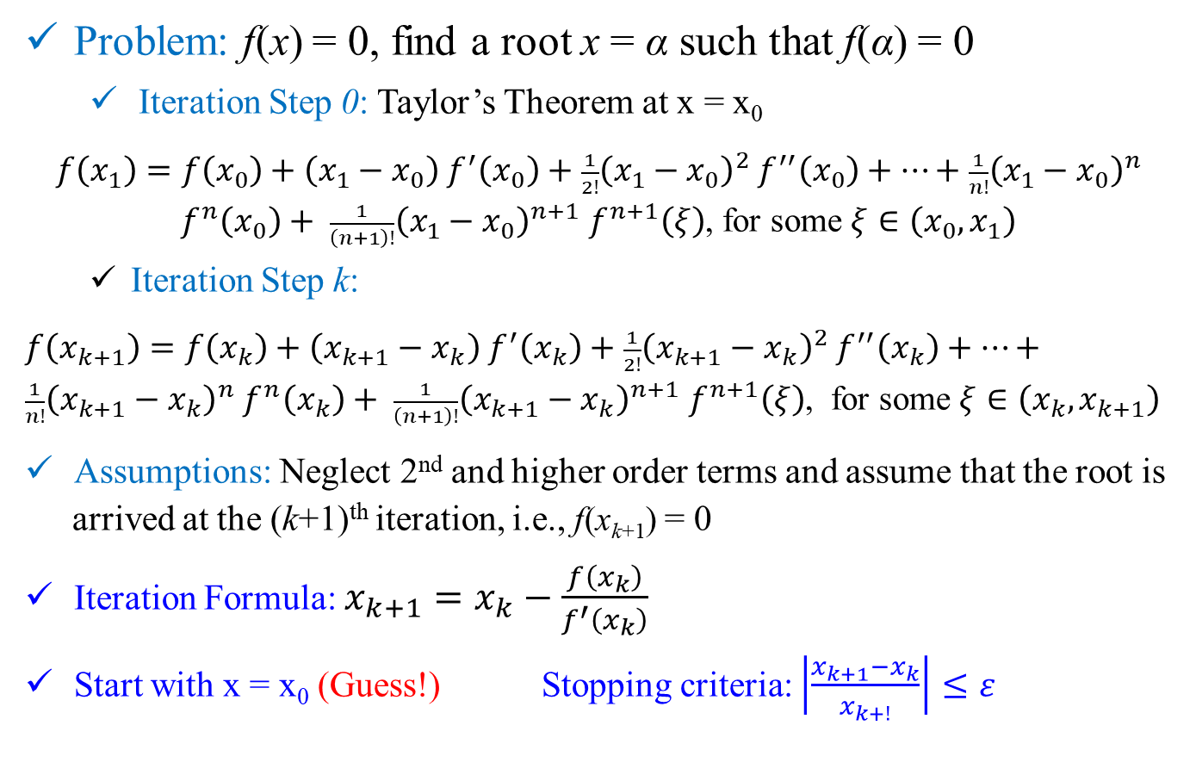
Open Methods: Newton-Raphson
Problem: f(x) = 0, find a root x = α such that f(α) = 0
Iteration Step 0: Taylor’s Theorem at x = x₀
$f\left(x_{1}\right)=f\left(x_{0}\right)+\left(x_{1}−x_{0}\right)$ $f^{′}\left(x_{0}\right)+$ $\frac{1}{2!}{\left(x_{1}−x_{0}\right)}^{2}$ $f^{′′}\left(x_{0}\right)+…+\frac{1}{n!}{\left(x_{1}−x_{0}\right)}^{n}$ $f^{n}\left(x_{0}\right)+ \frac{1}{\left(n+1\right)!}{\left(x_{1}−x_{0}\right)}^{n+1} f^{n+1}\left(ξ\right)$, for some $ξ∈\left(x_{0},x_{1}\right)$
Iteration Step k:
$f\left(x_{k+1}\right)=f\left(x_{k}\right)+\left(x_{k+1}−x_{k}\right)$ $f^{′}\left(x_{k}\right)+$ $\frac{1}{2!}{\left(x_{k+1}−x_{k}\right)}^{2}$ $f^{′′}\left(x_{k}\right)+…+\frac{1}{n!}{\left(x_{k+1}−x_{k}\right)}^{n}$ $f^{n}\left(x_{k}\right)+ \frac{1}{\left(n+1\right)!}{\left(x_{k+1}−x_{k}\right)}^{n+1} f^{n+1}\left(ξ\right)$, for some $ξ∈\left(x_{k},x_{k+1}\right)$
Assumptions: Neglect 2nd and higher order terms and assume that the root is arrived at the (k+1)^{th} iteration, i.e., f(x_{k+1}) = 0
Iteration Formula: $x_{k+1}=x_{k}−\frac{f\left(x_{k}\right)}{f^{′}\left(x_{k}\right)}$
Start with x = x₀ (Guess!) Stopping criteria: $\left|\frac{x_{k+1}−x_{k}}{x_{k+!}}\right|≤ε$

Slide 13
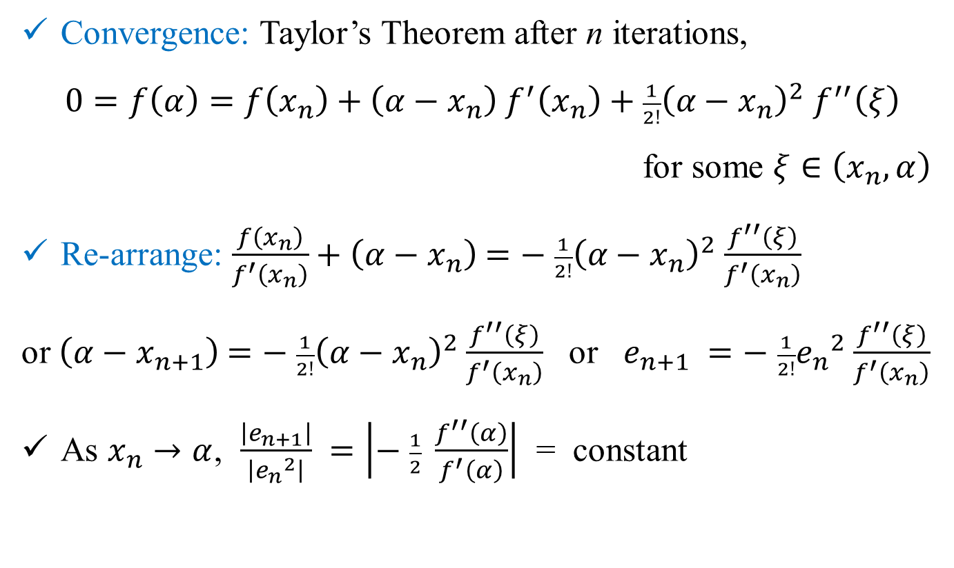
Open Methods: Newton-Raphson
Convergence: Taylor’s Theorem after n iterations,
$0=f\left(α\right)=f\left(x_{n}\right)+\left(α−x_{n}\right)$ $f^{′}\left(x_{n}\right)+$ $\frac{1}{2!}{\left(α−x_{n}\right)}^{2}$ $f^{′′}\left(ξ\right)$
for some $ξ∈\left(x_{n},α\right)$
Re-arrange: $\frac{f\left(x_{n}\right)}{f^{′}\left(x_{n}\right)}+\left(α−x_{n}\right)$ $=−$ $\frac{1}{2!}{\left(α−x_{n}\right)}^{2}$ $\frac{f^{′′}\left(ξ\right)}{f^{′}\left(x_{n}\right)}$
or $\left(α−x_{n+1}\right)$ $=−$ $\frac{1}{2!}{\left(α−x_{n}\right)}^{2}$ $\frac{f^{′′}\left(ξ\right)}{f^{′}\left(x_{n}\right)}$ or $e_{n+1} =−$ $\frac{1}{2!}{e_{n}}^{2}$ $\frac{f^{′′}\left(ξ\right)}{f^{′}\left(x_{n}\right)}$
As $x_{n}→α$, $\frac{\left|e_{n+1}\right|}{\left|{e_{n}}^{2}\right|} =\left|− \frac{1}{2} \frac{f^{′′}\left(α\right)}{f^{′}\left(α\right)}\right|$ = constant

Slide 14
Open Methods: Newton-Raphson
Advantages:
Faster convergence (quadratic)
Disadvantages:
Need to calculate derivate
y = f(x)
f(x₀)
x₁
x₀
f(x₁)
Newton-Raphson method may get stuck!

Slide 15
Open Methods: Secant
Principle: Use a difference approximation for the slope or derivative in the Newton-Raphson method. This is equivalent to approximating the tangent with a secant.
Problem: f(x) = 0, find a root x = α such that f(α) = 0
f(x₀)
f(x₁)
f(x₂)
x₀
x₁
x₂
y = f(x)
x₃

Slide 16
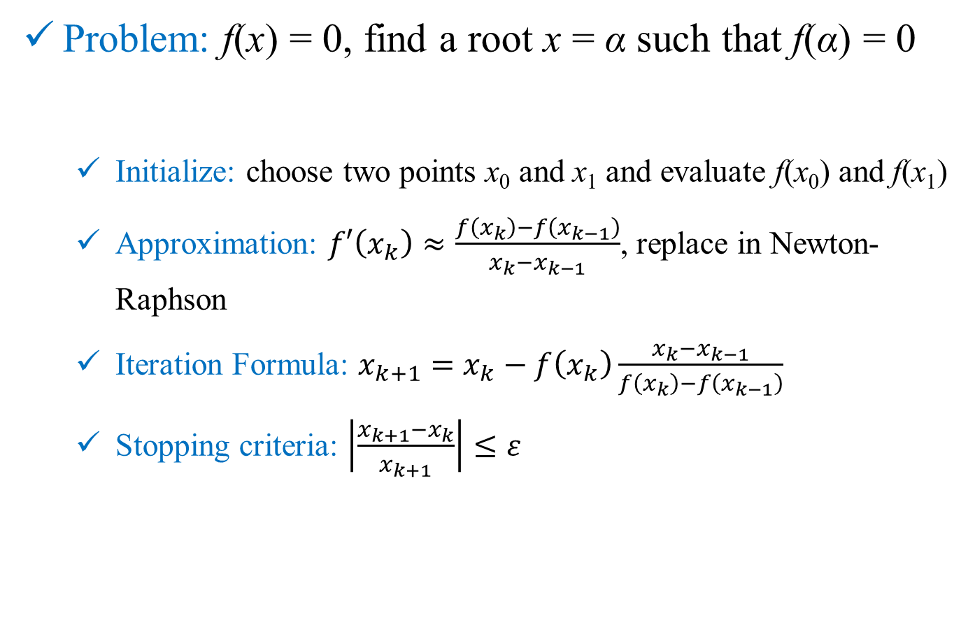
Open Methods: Secant
Problem: f(x) = 0, find a root x = α such that f(α) = 0
Initialize: choose two points x₀ and x₁ and evaluate f(x₀) and f(x₁)
Approximation: $f′\left(x_{k}\right)≈\frac{f\left(x_{k}\right)−f\left(x_{k−1}\right)}{x_{k}−x_{k−1}}$, replace in Newton-Raphson
Iteration Formula: $x_{k+1}=x_{k}−f\left(x_{k}\right)\frac{x_{k}−x_{k−1}}{f\left(x_{k}\right)−f\left(x_{k−1}\right)}$
Stopping criteria: $\left|\frac{x_{k+1}−x_{k}}{x_{k+1}}\right|≤ε$

Slide 17
Open Methods: Secant
Advantages:
Fast convergence (slightly less than quadratic)
Overcomes the disadvantage of having to calculate derivate
y = f(x)
f(x₀)
x₁
x₀
f(x₁)
Secant method may also get stuck!

Slide 18
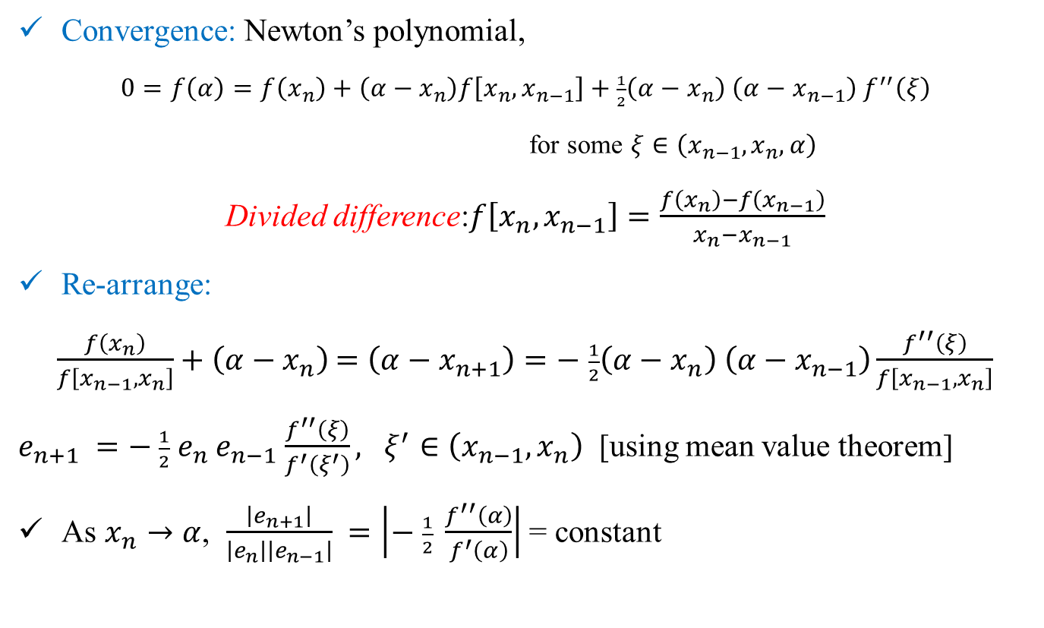
Open Methods: Secant
Convergence: Newton’s polynomial,
$0=f\left(α\right)=f\left(x_{n}\right)+\left(α−x_{n}\right)f\left[x_{n},x_{n−1}\right]+$ $\frac{1}{2}\left(α−x_{n}\right)$ $\left(α−x_{n−1}\right)$ $f^{′′}\left(ξ\right)$
for some $ξ∈\left(x_{n−1},x_{n},α\right)$
Divided difference:$f\left[x_{n},x_{n−1}\right]=\frac{f\left(x_{n}\right)−f\left(x_{n−1}\right)}{x_{n}−x_{n−1}}$
Re-arrange:
$\frac{f\left(x_{n}\right)}{f\left[x_{n−1},x_{n}\right]}+\left(α−x_{n}\right)$ $=\left(α−x_{n+1}\right)=−$ $\frac{1}{2}\left(α−x_{n}\right) \left(α−x_{n−1}\right)\frac{f^{′′}\left(ξ\right)}{f\left[x_{n−1},x_{n}\right]}$
$e_{n+1} =−$ $\frac{1}{2}$ $e_{n}$ $e_{n−1}$ $\frac{f^{′′}\left(ξ\right)}{f^{′}\left(ξ^{′}\right)}, ξ^{′}∈\left(x_{n−1},x_{n}\right)$ [using mean value theorem]
As $x_{n}→α$, $\frac{\left|e_{n+1}\right|}{\left|e_{n}\right|\left|e_{n−1}\right|} =\left|− \frac{1}{2} \frac{f^{′′}\left(α\right)}{f^{′}\left(α\right)}\right|$ = constant

Slide 19
Open Methods: Secant
Derivative of the Newton-Raphson method is evaluated numerically using difference approximation.
Numerical methods for estimation of derivative of a function will be covered in detail later.
Rest of the method is same.

Slide 20
Open Methods: Muller
Principle: fit a quadratic polynomial through three points to approximate the function.
Problem: f(x) = 0, find a root x = α such that f(α) = 0
f(x₀)
f(x₁)
f(x₂)
x₀
x₁
x₂
y = f(x)
x₃

Slide 21
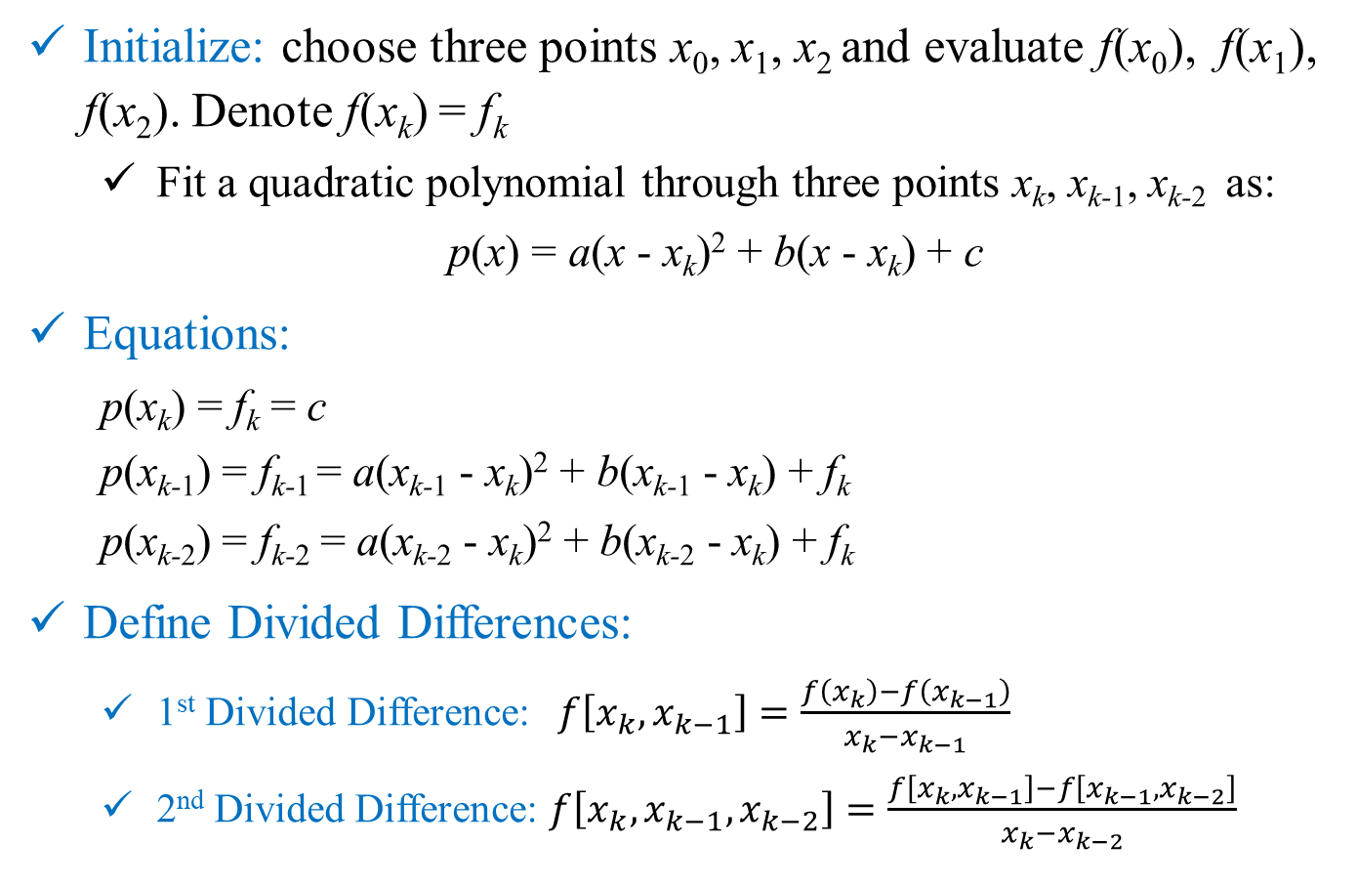
Open Methods: Muller
Initialize: choose three points x₀, x₁, x₂ and evaluate f(x₀), f(x₁), f(x₂). Denote f(x_{k}) = f_{k}
Fit a quadratic polynomial through three points x_{k}, x_{k-1}, x_{k-2} as:
p(x) = a(x - x_{k})² + b(x - x_{k}) + c
Equations:
p(x_{k}) = f_{k} = c
p(x_{k-1}) = f_{k-1} = a(x_{k-1} - x_{k})² + b(x_{k-1} - x_{k}) + f_{k}
p(x_{k-2}) = f_{k-2} = a(x_{k-2} - x_{k})² + b(x_{k-2} - x_{k}) + f_{k}
Define Divided Differences:
1st Divided Difference: $f\left[x_{k},x_{k−1}\right]=\frac{f\left(x_{k}\right)−f\left(x_{k−1}\right)}{x_{k}−x_{k−1}}$
2nd Divided Difference: $f\left[x_{k},x_{k−1},x_{k−2}\right]=\frac{f\left[x_{k},x_{k−1}\right]−f\left[x_{k−1},x_{k−2}\right]}{x_{k}−x_{k−2}}$

Slide 22
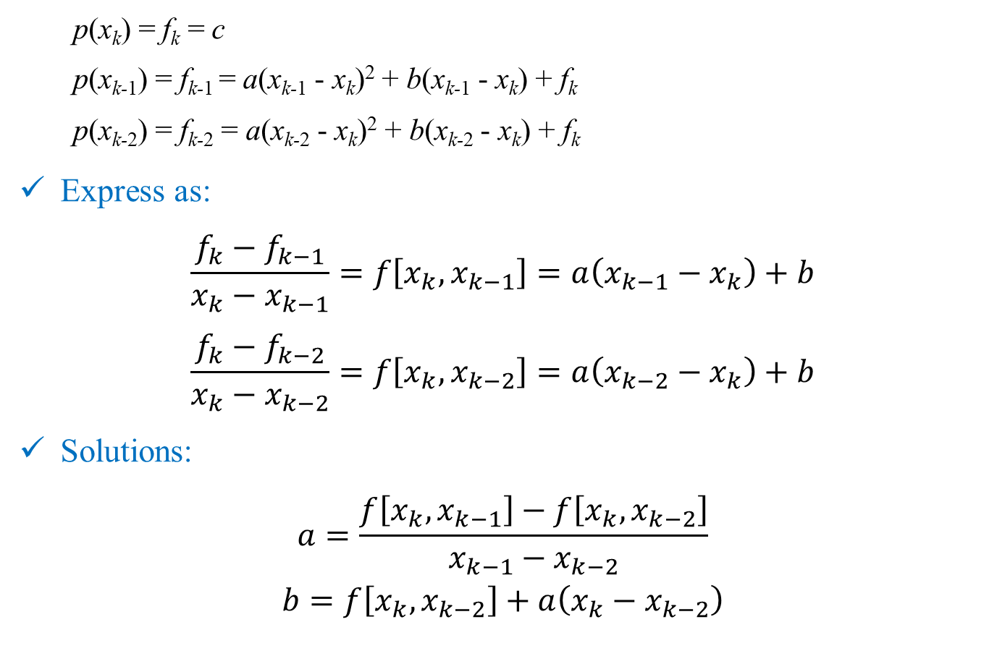
Open Methods: Muller
p(x_{k}) = f_{k} = c
p(x_{k-1}) = f_{k-1} = a(x_{k-1} - x_{k})² + b(x_{k-1} - x_{k}) + f_{k}
p(x_{k-2}) = f_{k-2} = a(x_{k-2} - x_{k})² + b(x_{k-2} - x_{k}) + f_{k}
Express as:
$$\frac{f_{k}−f_{k−1}}{x_{k}−x_{k−1}}=f\left[x_{k},x_{k−1}\right]=a\left(x_{k−1}−x_{k}\right)+b$$
$$\frac{f_{k}−f_{k−2}}{x_{k}−x_{k−2}}=f\left[x_{k},x_{k−2}\right]=a\left(x_{k−2}−x_{k}\right)+b$$
Solutions:
$$a=\frac{f\left[x_{k},x_{k−1}\right]−f\left[x_{k},x_{k−2}\right]}{x_{k−1}−x_{k−2}}$$
$$b=f\left[x_{k},x_{k−2}\right]+a\left(x_{k}−x_{k−2}\right)$$

Slide 23

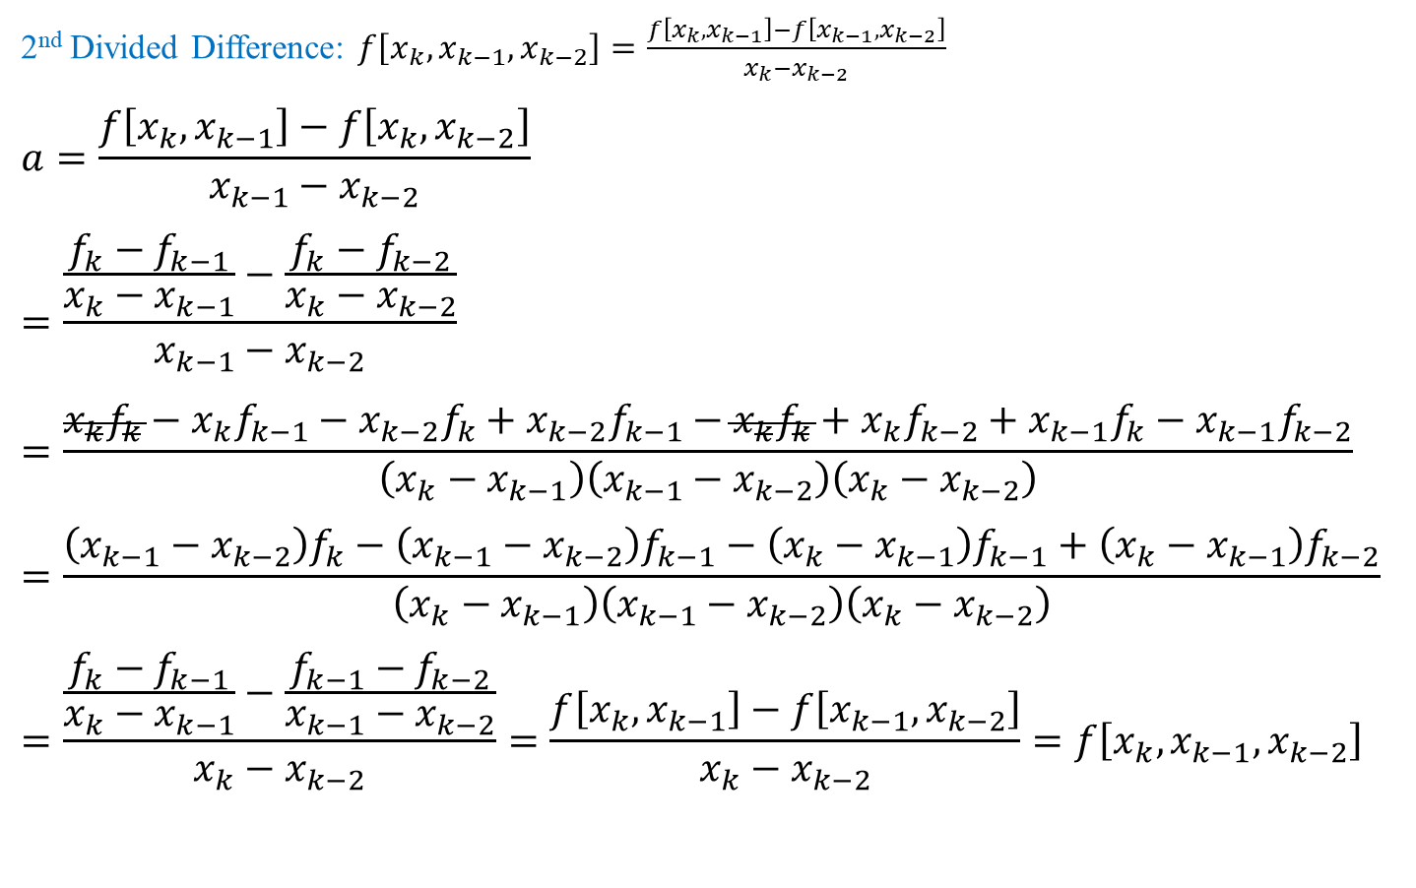
Properties of Divided Differences
2nd Divided Difference: $f\left[x_{k},x_{k−1},x_{k−2}\right]=\frac{f\left[x_{k},x_{k−1}\right]−f\left[x_{k−1},x_{k−2}\right]}{x_{k}−x_{k−2}}$
$$a=\frac{f\left[x_{k},x_{k−1}\right]−f\left[x_{k},x_{k−2}\right]}{x_{k−1}−x_{k−2}}$$
$$=\frac{\frac{f_{k}−f_{k−1}}{x_{k}−x_{k−1}}−\frac{f_{k}−f_{k−2}}{x_{k}−x_{k−2}}}{x_{k−1}−x_{k−2}}$$
$$=\frac{x_{k}f_{k}−x_{k}f_{k−1}−x_{k−2}f_{k}+x_{k−2}f_{k−1}−x_{k}f_{k}+x_{k}f_{k−2}+x_{k−1}f_{k}−x_{k−1}f_{k−2}}{\left(x_{k}−x_{k−1}\right)\left(x_{k−1}−x_{k−2}\right)\left(x_{k}−x_{k−2}\right)}$$
$$=\frac{\left(x_{k−1}−x_{k−2}\right)f_{k}−\left(x_{k−1}−x_{k−2}\right)f_{k−1}−\left(x_{k}−x_{k−1}\right)f_{k−1}+\left(x_{k}−x_{k−1}\right)f_{k−2}}{\left(x_{k}−x_{k−1}\right)\left(x_{k−1}−x_{k−2}\right)\left(x_{k}−x_{k−2}\right)}$$
$$=\frac{\frac{f_{k}−f_{k−1}}{x_{k}−x_{k−1}}−\frac{f_{k−1}−f_{k−2}}{x_{k−1}−x_{k−2}}}{x_{k}−x_{k−2}}=\frac{f\left[x_{k},x_{k−1}\right]−f\left[x_{k−1},x_{k−2}\right]}{x_{k}−x_{k−2}}=f\left[x_{k},x_{k−1},x_{k−2}\right]$$
$$+x_{k−1}f_{k−1}−x_{k−1}f_{k−1}$$

Slide 24
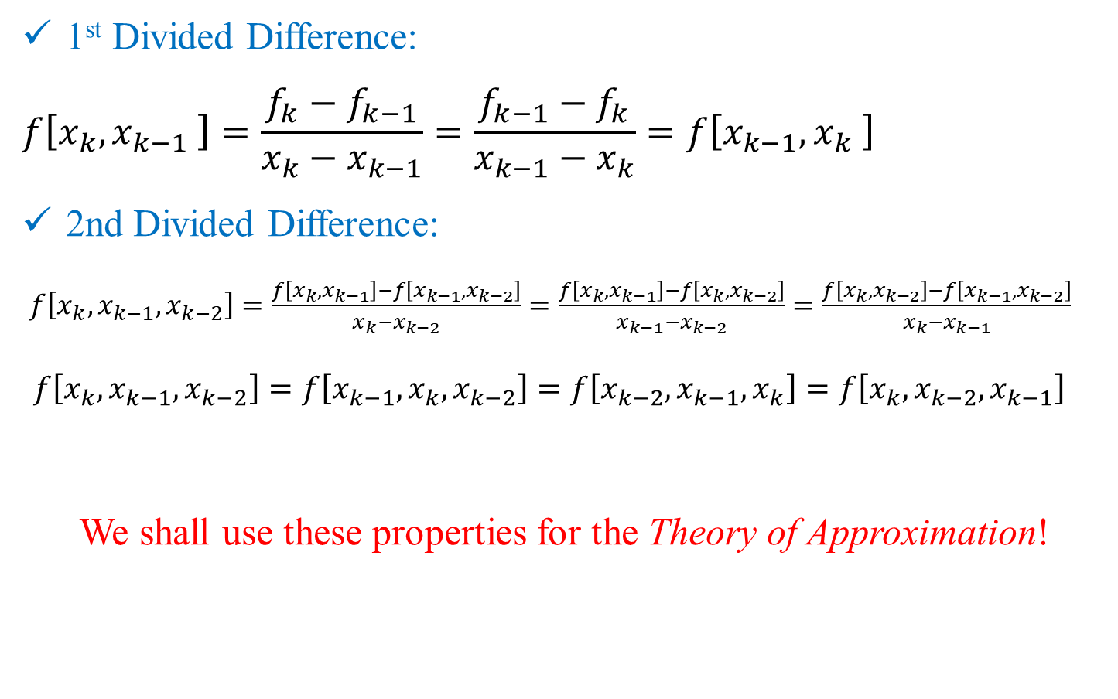
Note: Properties of Divided Differences
1st Divided Difference:
$$f\left[x_{k},x_{k−1} \right]=\frac{f_{k}−f_{k−1}}{x_{k}−x_{k−1}}=\frac{f_{k−1}−f_{k}}{x_{k−1}−x_{k}}=f\left[x_{k−1},x_{k} \right]$$
2nd Divided Difference:
$f\left[x_{k},x_{k−1},x_{k−2}\right]=\frac{f\left[x_{k},x_{k−1}\right]−f\left[x_{k−1},x_{k−2}\right]}{x_{k}−x_{k−2}}=\frac{f\left[x_{k},x_{k−1}\right]−f\left[x_{k},x_{k−2}\right]}{x_{k−1}−x_{k−2}}=\frac{f\left[x_{k},x_{k−2}\right]−f\left[x_{k−1},x_{k−2}\right]}{x_{k}−x_{k−1}}$
$f\left[x_{k},x_{k−1},x_{k−2}\right]=f\left[x_{k−1},x_{k},x_{k−2}\right]=f\left[x_{k−2},x_{k−1},x_{k}\right]=f\left[x_{k},x_{k−2},x_{k−1}\right]$
We shall use these properties for the Theory of Approximation!

Slide 25
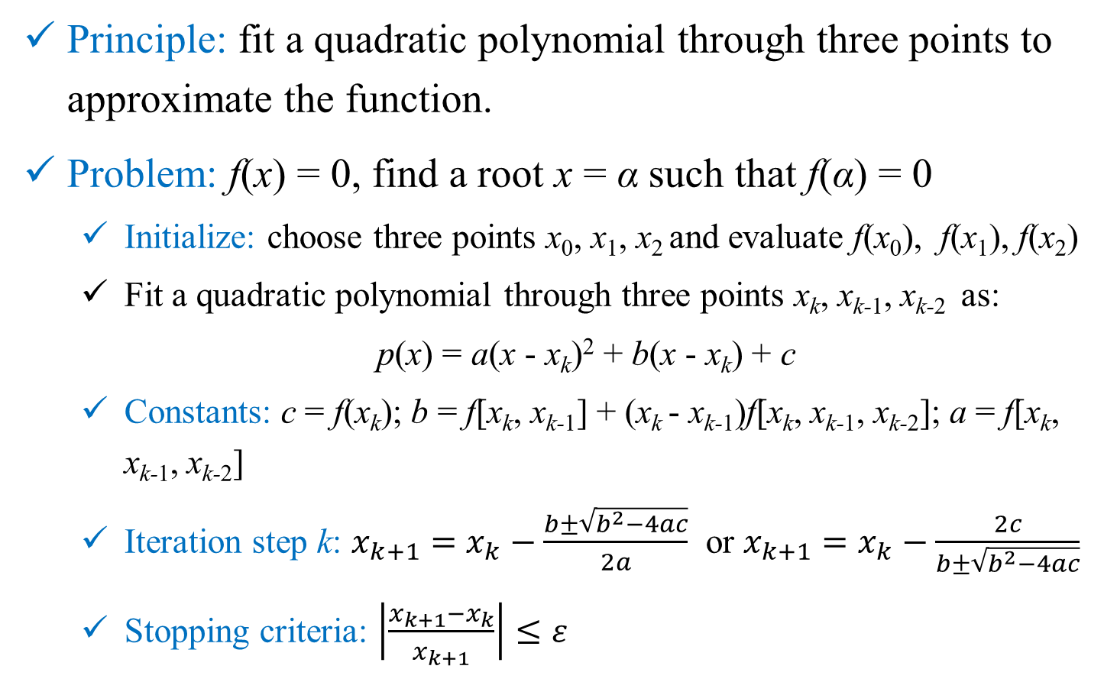
Open Methods: Muller
Principle: fit a quadratic polynomial through three points to approximate the function.
Problem: f(x) = 0, find a root x = α such that f(α) = 0
Initialize: choose three points x₀, x₁, x₂ and evaluate f(x₀), f(x₁), f(x₂)
Fit a quadratic polynomial through three points x_{k}, x_{k-1}, x_{k-2} as:
p(x) = a(x - x_{k})² + b(x - x_{k}) + c
Constants: c = f(x_{k}); b = f[x_{k}, x_{k-1}] + (x_{k} - x_{k-1})f[x_{k}, x_{k-1}, x_{k-2}]; a = f[x_{k}, x_{k-1}, x_{k-2}]
Iteration step k: $x_{k+1}=x_{k}−\frac{b±\sqrt{b^{2}−4ac}}{2a}$ or $x_{k+1}=x_{k}−\frac{2c}{b±\sqrt{b^{2}−4ac}}$
Stopping criteria: $\left|\frac{x_{k+1}−x_{k}}{x_{k+1}}\right|≤ε$

Slide 26
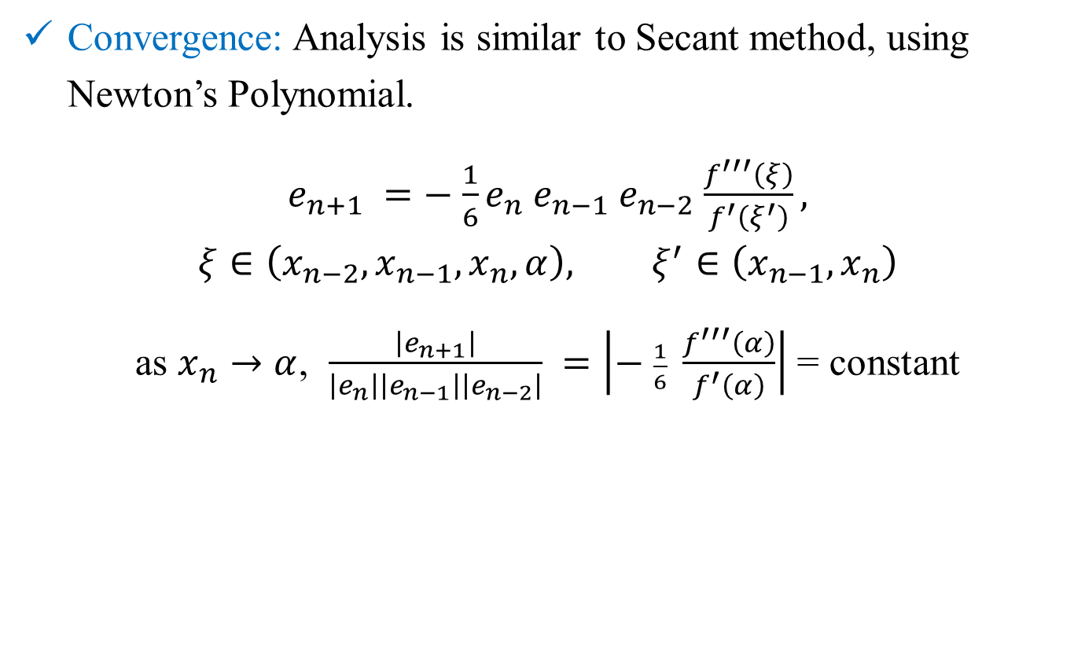
Open Methods: Muller
Convergence: Analysis is similar to Secant method, using Newton’s Polynomial.
$e_{n+1} =−$ $\frac{1}{6}e_{n}$ $e_{n−1}$ $e_{n−2}$ $\frac{f^{′′′}\left(ξ\right)}{f^{′}\left(ξ^{′}\right)},$
$$ξ∈\left({x_{n−2},x}_{n−1},x_{n},α\right), ξ^{′}∈\left(x_{n−1},x_{n}\right)$$
as $x_{n}→α$, $\frac{\left|e_{n+1}\right|}{\left|e_{n}\right|\left|e_{n−1}\right|\left|e_{n−2}\right|} =\left|− \frac{1}{6} \frac{f^{′′′}\left(α\right)}{f^{′}\left(α\right)}\right|$ = constant

