Slide 1
Roots of Non-Linear Equations (Recap):
f(x) = 0
f may be a function belonging to any class: algebraic, trigonometric, hyperbolic, polynomials, logarithmic, exponential, etc.
Five types of methods can broadly be classified:
Graphical method
Bracketing methods: Bisection, Regula-Falsi
Open methods: Fixed point, Newton-Raphson, Secant, Muller
Special methods for polynomials: Bairstow’s
Hybrid methods: Brent’s

Slide 2
Open Methods: Muller
Principle: fit a quadratic polynomial through three points to approximate the function.
Problem: f(x) = 0, find a root x = α such that f(α) = 0
f(x₀)
f(x₁)
f(x₂)
x₀
x₁
x₂
y = f(x)
x₃

Slide 3
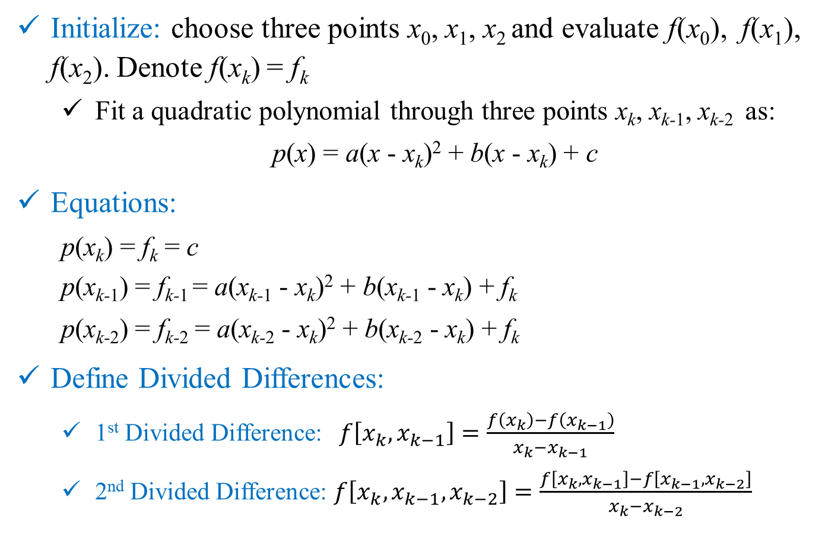
Open Methods: Muller
Initialize: choose three points x₀, x₁, x₂ and evaluate f(x₀), f(x₁), f(x₂). Denote f(x_{k}) = f_{k}
Fit a quadratic polynomial through three points x_{k}, x_{k-1}, x_{k-2} as:
p(x) = a(x - x_{k})² + b(x - x_{k}) + c
Equations:
p(x_{k}) = f_{k} = c
p(x_{k-1}) = f_{k-1} = a(x_{k-1} - x_{k})² + b(x_{k-1} - x_{k}) + f_{k}
p(x_{k-2}) = f_{k-2} = a(x_{k-2} - x_{k})² + b(x_{k-2} - x_{k}) + f_{k}
Define Divided Differences:
1st Divided Difference: $f\left[x_{k},x_{k−1}\right]=\frac{f\left(x_{k}\right)−f\left(x_{k−1}\right)}{x_{k}−x_{k−1}}$
2nd Divided Difference: $f\left[x_{k},x_{k−1},x_{k−2}\right]=\frac{f\left[x_{k},x_{k−1}\right]−f\left[x_{k−1},x_{k−2}\right]}{x_{k}−x_{k−2}}$

Slide 4
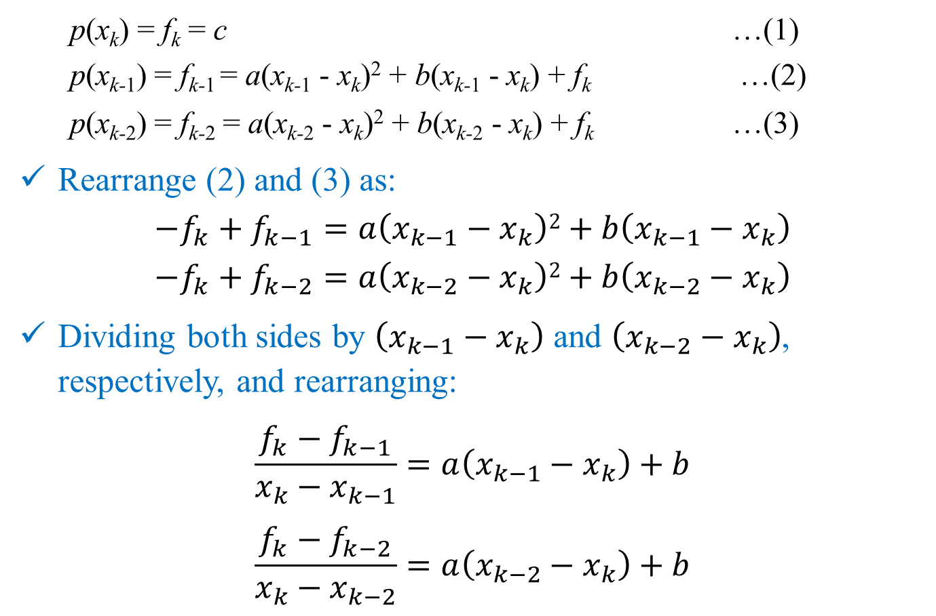
Open Methods: Muller
p(x_{k}) = f_{k} = c …(1)
p(x_{k-1}) = f_{k-1} = a(x_{k-1} - x_{k})² + b(x_{k-1} - x_{k}) + f_{k} …(2)
p(x_{k-2}) = f_{k-2} = a(x_{k-2} - x_{k})² + b(x_{k-2} - x_{k}) + f_{k} …(3)
Rearrange (2) and (3) as:
$$−f_{k}+f_{k−1}=a\left(x_{k−1}−x_{k}\right)2+b\left(x_{k−1}−x_{k}\right)$$
$$−f_{k}+f_{k−2}=a\left(x_{k−2}−x_{k}\right)2+b\left(x_{k−2}−x_{k}\right)$$
Dividing both sides by $\left(x_{k−1}−x_{k}\right)$ and $\left(x_{k−2}−x_{k}\right)$, respectively, and rearranging:
$$\frac{f_{k}−f_{k−1}}{x_{k}−x_{k−1}}=a\left(x_{k−1}−x_{k}\right)+b$$
$$\frac{f_{k}−f_{k−2}}{x_{k}−x_{k−2}}=a\left(x_{k−2}−x_{k}\right)+b$$

Slide 5
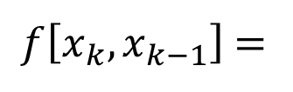

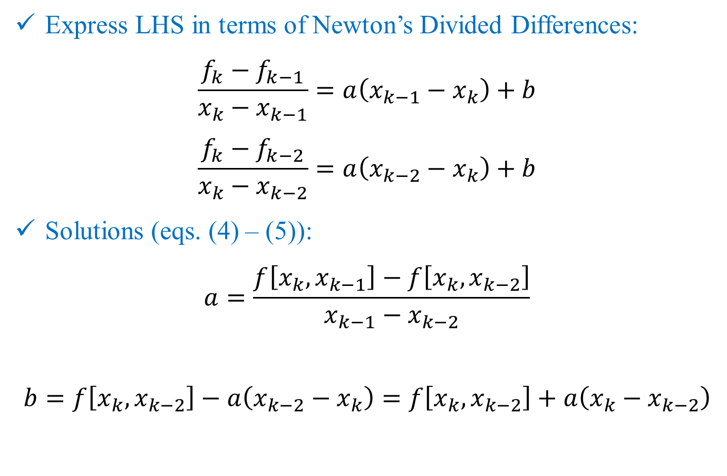


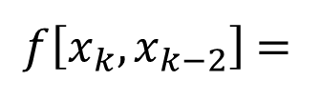
Open Methods: Muller
Express LHS in terms of Newton’s Divided Differences:
$$\frac{f_{k}−f_{k−1}}{x_{k}−x_{k−1}}=a\left(x_{k−1}−x_{k}\right)+b$$
$$\frac{f_{k}−f_{k−2}}{x_{k}−x_{k−2}}=a\left(x_{k−2}−x_{k}\right)+b$$
Solutions (eqs. (4) – (5)):
$$a=\frac{f\left[x_{k},x_{k−1}\right]−f\left[x_{k},x_{k−2}\right]}{x_{k−1}−x_{k−2}}$$
$$b=f\left[x_{k},x_{k−2}\right]−a\left(x_{k−2}−x_{k}\right)=f\left[x_{k},x_{k−2}\right]+a\left(x_{k}−x_{k−2}\right)$$
$f\left[x_{k},x_{k−1}\right]$ =
$$…(4)$$
$f\left[x_{k},x_{k−2}\right]$ =
$$…(5)$$
$$Put a in (5)$$

Slide 6
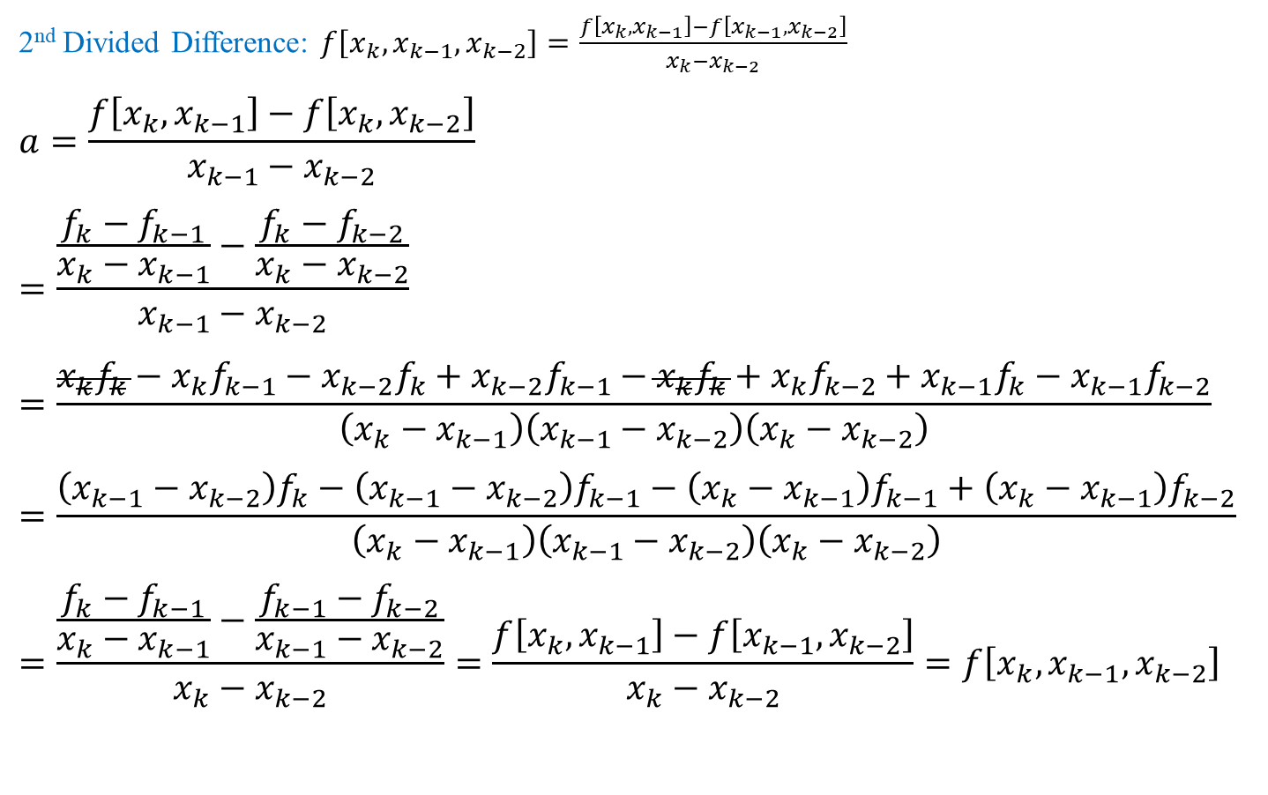
Properties of Divided Differences
2nd Divided Difference: $f\left[x_{k},x_{k−1},x_{k−2}\right]=\frac{f\left[x_{k},x_{k−1}\right]−f\left[x_{k−1},x_{k−2}\right]}{x_{k}−x_{k−2}}$
$$a=\frac{f\left[x_{k},x_{k−1}\right]−f\left[x_{k},x_{k−2}\right]}{x_{k−1}−x_{k−2}}$$
$$=\frac{\frac{f_{k}−f_{k−1}}{x_{k}−x_{k−1}}−\frac{f_{k}−f_{k−2}}{x_{k}−x_{k−2}}}{x_{k−1}−x_{k−2}}$$
$$=\frac{x_{k}f_{k}−x_{k}f_{k−1}−x_{k−2}f_{k}+x_{k−2}f_{k−1}−x_{k}f_{k}+x_{k}f_{k−2}+x_{k−1}f_{k}−x_{k−1}f_{k−2}}{\left(x_{k}−x_{k−1}\right)\left(x_{k−1}−x_{k−2}\right)\left(x_{k}−x_{k−2}\right)}$$
$$=\frac{\left(x_{k−1}−x_{k−2}\right)f_{k}−\left(x_{k−1}−x_{k−2}\right)f_{k−1}−\left(x_{k}−x_{k−1}\right)f_{k−1}+\left(x_{k}−x_{k−1}\right)f_{k−2}}{\left(x_{k}−x_{k−1}\right)\left(x_{k−1}−x_{k−2}\right)\left(x_{k}−x_{k−2}\right)}$$
$$=\frac{\frac{f_{k}−f_{k−1}}{x_{k}−x_{k−1}}−\frac{f_{k−1}−f_{k−2}}{x_{k−1}−x_{k−2}}}{x_{k}−x_{k−2}}=\frac{f\left[x_{k},x_{k−1}\right]−f\left[x_{k−1},x_{k−2}\right]}{x_{k}−x_{k−2}}=f\left[x_{k},x_{k−1},x_{k−2}\right]$$
$+x_{k−1}f_{k−1}−x_{k−1}f_{k−1}$ $to the numerator$

Slide 7
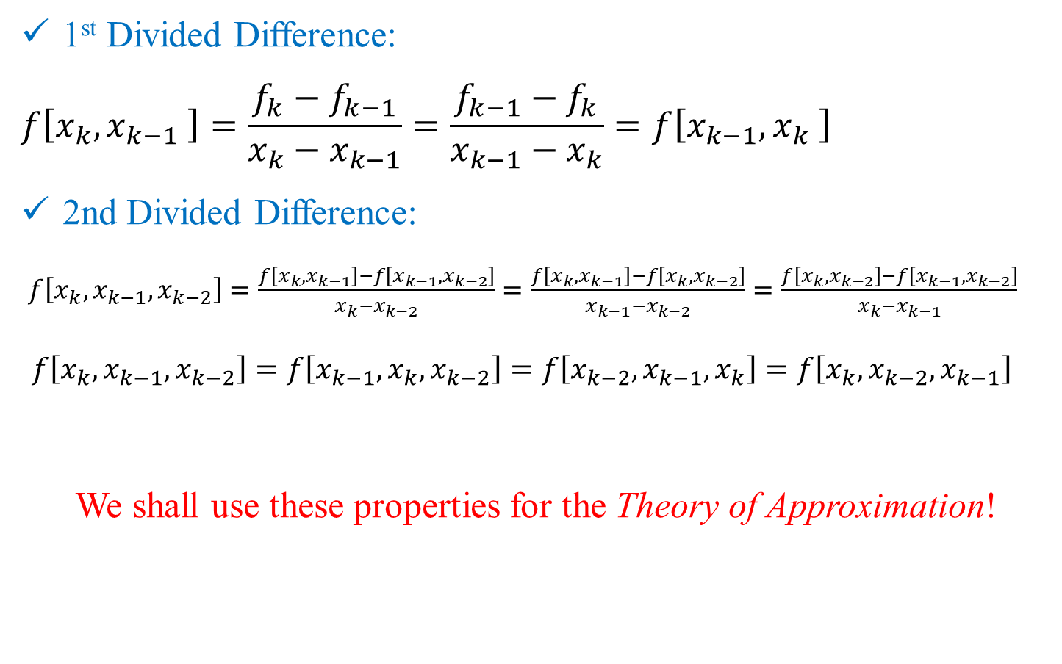
Note: Properties of Divided Differences
1st Divided Difference:
$$f\left[x_{k},x_{k−1} \right]=\frac{f_{k}−f_{k−1}}{x_{k}−x_{k−1}}=\frac{f_{k−1}−f_{k}}{x_{k−1}−x_{k}}=f\left[x_{k−1},x_{k} \right]$$
2nd Divided Difference:
$f\left[x_{k},x_{k−1},x_{k−2}\right]=\frac{f\left[x_{k},x_{k−1}\right]−f\left[x_{k−1},x_{k−2}\right]}{x_{k}−x_{k−2}}=\frac{f\left[x_{k},x_{k−1}\right]−f\left[x_{k},x_{k−2}\right]}{x_{k−1}−x_{k−2}}=\frac{f\left[x_{k},x_{k−2}\right]−f\left[x_{k−1},x_{k−2}\right]}{x_{k}−x_{k−1}}$
$f\left[x_{k},x_{k−1},x_{k−2}\right]=f\left[x_{k−1},x_{k},x_{k−2}\right]=f\left[x_{k−2},x_{k−1},x_{k}\right]=f\left[x_{k},x_{k−2},x_{k−1}\right]$
We shall use these properties for the Theory of Approximation!

Slide 8
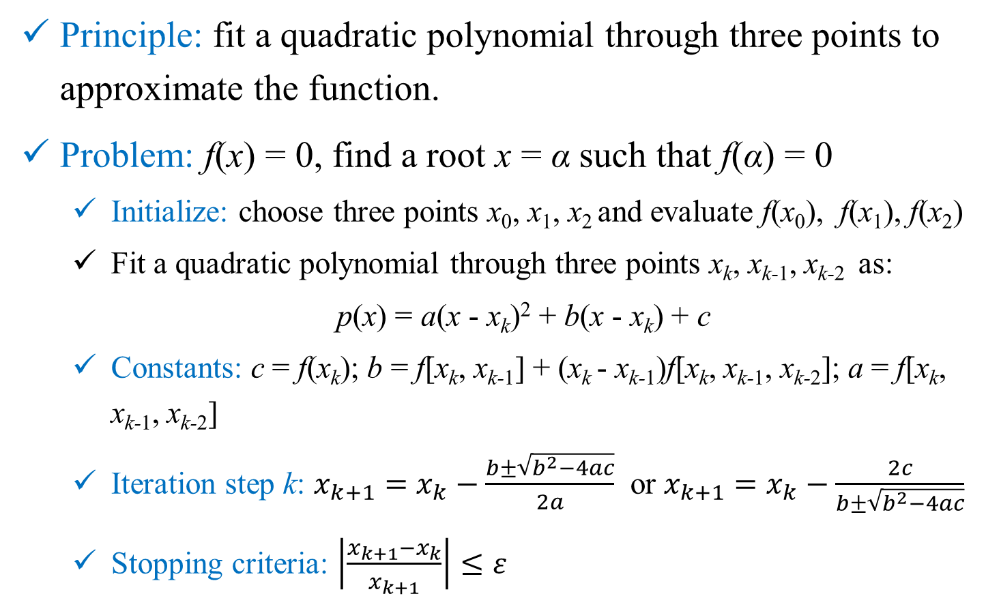
Open Methods: Muller
Principle: fit a quadratic polynomial through three points to approximate the function.
Problem: f(x) = 0, find a root x = α such that f(α) = 0
Initialize: choose three points x₀, x₁, x₂ and evaluate f(x₀), f(x₁), f(x₂)
Fit a quadratic polynomial through three points x_{k}, x_{k-1}, x_{k-2} as:
p(x) = a(x - x_{k})² + b(x - x_{k}) + c
Constants: c = f(x_{k}); b = f[x_{k}, x_{k-1}] + (x_{k} - x_{k-1})f[x_{k}, x_{k-1}, x_{k-2}]; a = f[x_{k}, x_{k-1}, x_{k-2}]
Iteration step k: $x_{k+1}=x_{k}−\frac{b±\sqrt{b^{2}−4ac}}{2a}$ or $x_{k+1}=x_{k}−\frac{2c}{b±\sqrt{b^{2}−4ac}}$
Stopping criteria: $\left|\frac{x_{k+1}−x_{k}}{x_{k+1}}\right|≤ε$

Slide 9
Tutorial 2 Problem 2: Muller
2. Find a root of the following equation using Muller’s method to an approximate error of :
Take three starting values as 1, 2 and 3 in the Muller’s method. Do they converge to the same root as the Secant Method? Compare the number of iterations required in two methods. Prob 2_Tut2.xls

Slide 10
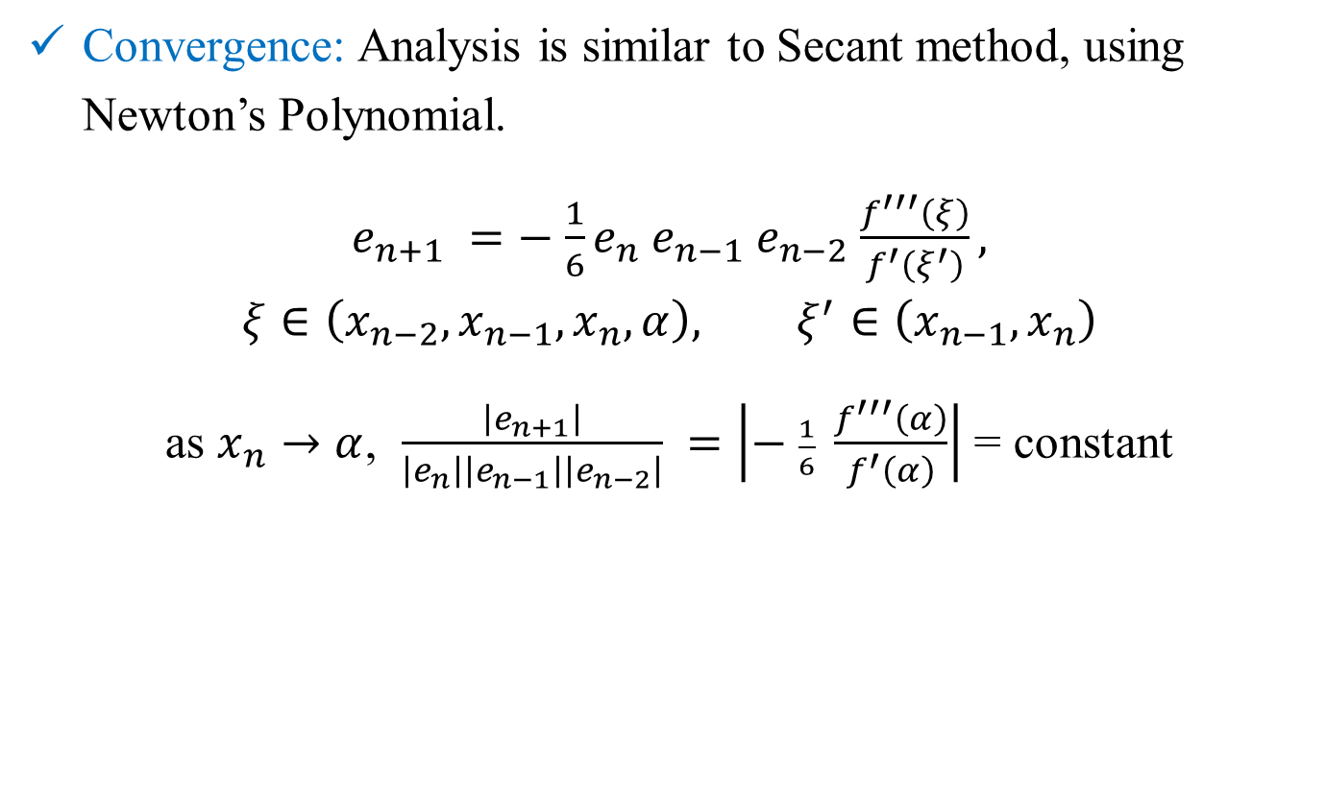
Open Methods: Muller
Convergence: Analysis is similar to Secant method, using Newton’s Polynomial.
$e_{n+1} =−$ $\frac{1}{6}e_{n}$ $e_{n−1}$ $e_{n−2}$ $\frac{f^{′′′}\left(ξ\right)}{f^{′}\left(ξ^{′}\right)},$
$$ξ∈\left({x_{n−2},x}_{n−1},x_{n},α\right), ξ^{′}∈\left(x_{n−1},x_{n}\right)$$
as $x_{n}→α$, $\frac{\left|e_{n+1}\right|}{\left|e_{n}\right|\left|e_{n−1}\right|\left|e_{n−2}\right|} =\left|− \frac{1}{6} \frac{f^{′′′}\left(α\right)}{f^{′}\left(α\right)}\right|$ = constant

Slide 11
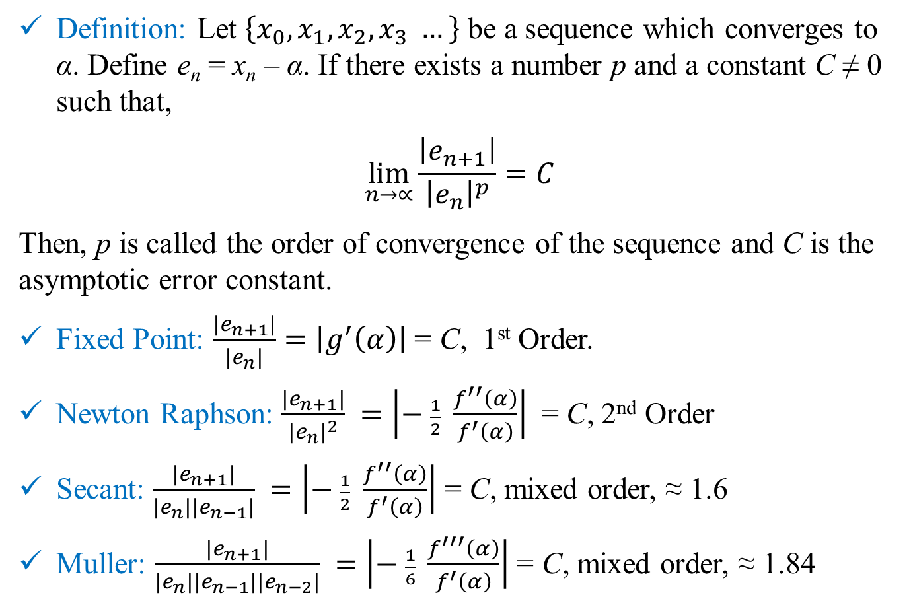
Order of Convergence
Definition: Let $\left\{x_{0},x_{1},x_{2},x_{3} …\right\}$ be a sequence which converges to α. Define e_{n} = x_{n} – α. If there exists a number p and a constant C ≠ 0 such that,
$$\lim_{n→∝}{\frac{\left|e_{n+1}\right|}{{\left|e_{n}\right|}^{p}}}=C$$
Then, p is called the order of convergence of the sequence and C is the asymptotic error constant.
Fixed Point: $\frac{\left|e_{n+1}\right|}{\left|e_{n}\right|}=\left|g^{′}\left(α\right)\right|$ = C, 1st Order.
Newton Raphson: $\frac{\left|e_{n+1}\right|}{{\left|e_{n}\right|}^{2}} =\left|− \frac{1}{2} \frac{f^{′′}\left(α\right)}{f^{′}\left(α\right)}\right|$ = C, 2nd Order
Secant: $\frac{\left|e_{n+1}\right|}{\left|e_{n}\right|\left|e_{n−1}\right|} =\left|− \frac{1}{2} \frac{f^{′′}\left(α\right)}{f^{′}\left(α\right)}\right|$ = C, mixed order, ≈ 1.6
Muller: $\frac{\left|e_{n+1}\right|}{\left|e_{n}\right|\left|e_{n−1}\right|\left|e_{n−2}\right|} =\left|− \frac{1}{6} \frac{f^{′′′}\left(α\right)}{f^{′}\left(α\right)}\right|$ = C, mixed order, ≈ 1.84

Slide 12
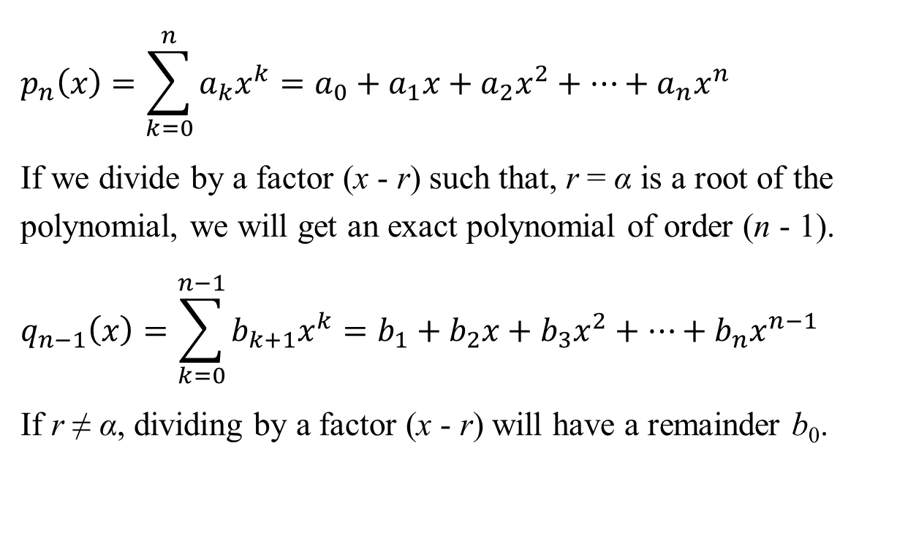
Polynomial Methods: Single Root
$$p_{n}\left(x\right)=\sum_{k=0}^{n}{a_{k}x^{k}}=a_{0}+a_{1}x+a_{2}x^{2}+…+a_{n}x^{n}$$
If we divide by a factor (x - r) such that, r = α is a root of the polynomial, we will get an exact polynomial of order (n - 1).
$$q_{n−1}\left(x\right)=\sum_{k=0}^{n−1}{b_{k+1}x^{k}}=b_{1}+b_{2}x+b_{3}x^{2}+…+b_{n}x^{n−1}$$
If r ≠ α, dividing by a factor (x - r) will have a remainder b₀.

Slide 13
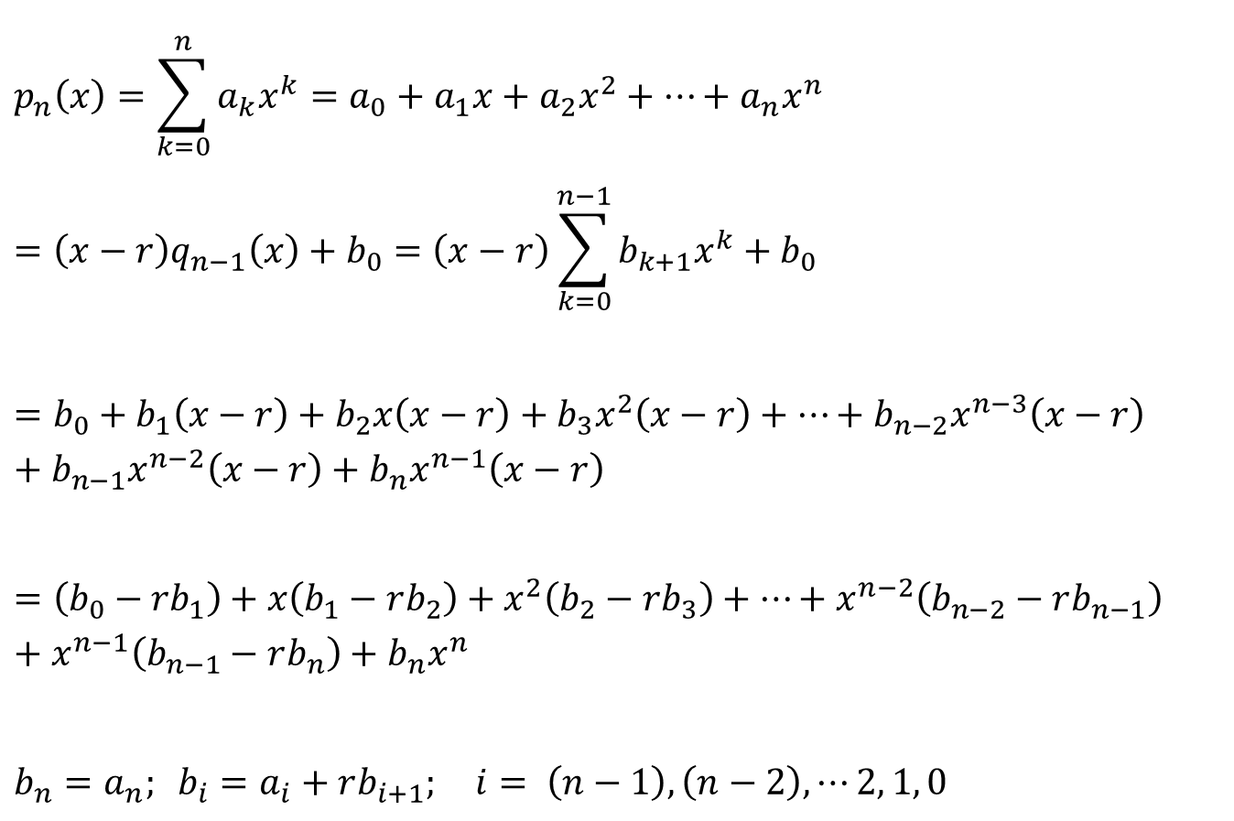
Polynomial Methods: Single Root
$$p_{n}\left(x\right)=\sum_{k=0}^{n}{a_{k}x^{k}}=a_{0}+a_{1}x+a_{2}x^{2}+…+a_{n}x^{n}$$
$$=\left(x−r\right)q_{n−1}\left(x\right)+b_{0}=\left(x−r\right)\sum_{k=0}^{n−1}{b_{k+1}x^{k}}+b_{0}$$
$$=b_{0}+b_{1}\left(x−r\right)+b_{2}x\left(x−r\right)+b_{3}x^{2}\left(x−r\right)+…+b_{n−2}x^{n−3}\left(x−r\right)+b_{n−1}x^{n−2}\left(x−r\right)+b_{n}x^{n−1}\left(x−r\right)$$
$$=\left({b_{0}−rb}_{1}\right)+x\left(b_{1}−rb_{2}\right)+x^{2}\left(b_{2}−rb_{3}\right)+…+x^{n−2}\left(b_{n−2}−rb_{n−1}\right)+x^{n−1}\left(b_{n−1}−rb_{n}\right)+b_{n}x^{n}$$
$$b_{n}=a_{n}; b_{i}=a_{i}+rb_{i+1}; i= \left(n−1\right), \left(n−2\right), ⋯2, 1, 0$$

Slide 14
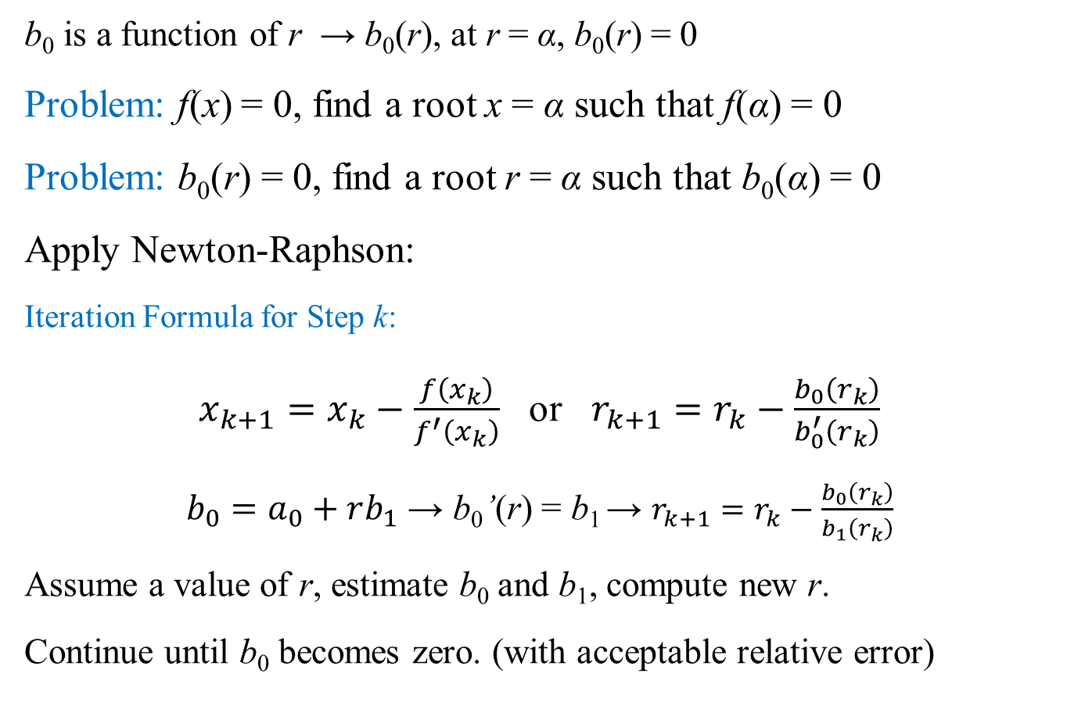
Polynomial Methods: Single Root
b₀ is a function of r → b₀(r), at r = α, b₀(r) = 0
Problem: f(x) = 0, find a root x = α such that f(α) = 0
Problem: b₀(r) = 0, find a root r = α such that b₀(α) = 0
Apply Newton-Raphson:
Iteration Formula for Step k:
$x_{k+1}=x_{k}−\frac{f\left(x_{k}\right)}{f^{′}\left(x_{k}\right)}$ or $r_{k+1}=r_{k}−\frac{b_{0}\left(r_{k}\right)}{b_{0}^{′}\left(r_{k}\right)}$
$b_{0}=a_{0}+rb_{1}$ → b₀’(r) = b₁ → $r_{k+1}=r_{k}−\frac{b_{0}\left(r_{k}\right)}{b_{1}\left(r_{k}\right)}$
Assume a value of r, estimate b₀ and b₁, compute new r.
Continue until b₀ becomes zero. (with acceptable relative error)

Slide 15
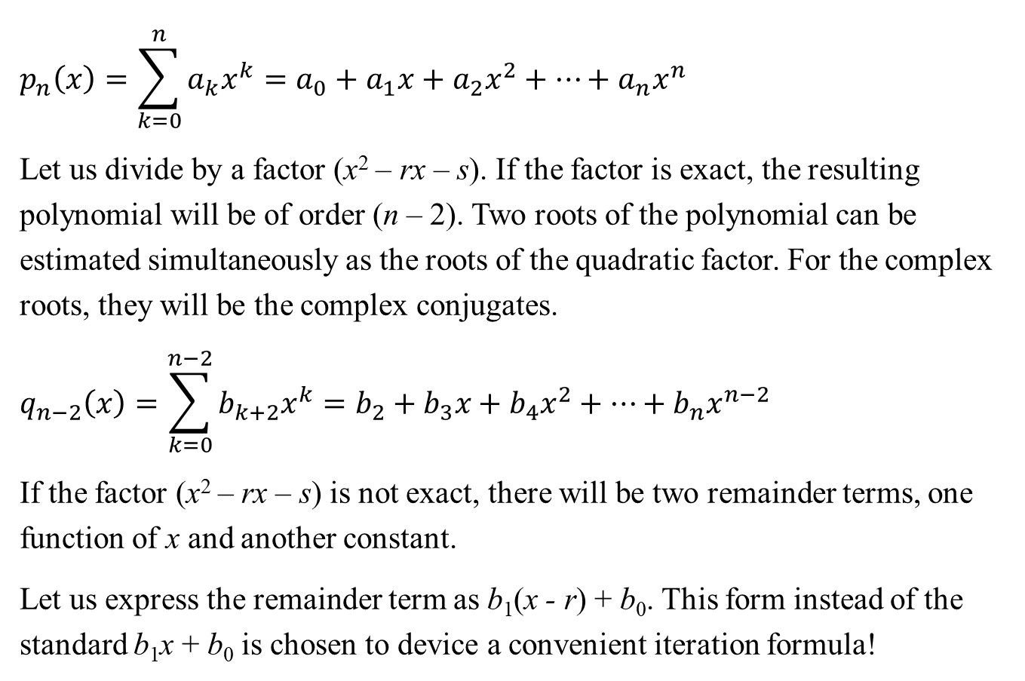
Polynomial Methods: Bairstow
$$p_{n}\left(x\right)=\sum_{k=0}^{n}{a_{k}x^{k}}=a_{0}+a_{1}x+a_{2}x^{2}+…+a_{n}x^{n}$$
Let us divide by a factor (x² – rx – s). If the factor is exact, the resulting polynomial will be of order (n – 2). Two roots of the polynomial can be estimated simultaneously as the roots of the quadratic factor. For the complex roots, they will be the complex conjugates.
$$q_{n−2}\left(x\right)=\sum_{k=0}^{n−2}{b_{k+2}x^{k}}=b_{2}+b_{3}x+b_{4}x^{2}+…+b_{n}x^{n−2}$$
If the factor (x² – rx – s) is not exact, there will be two remainder terms, one function of x and another constant.
Let us express the remainder term as b₁(x - r) + b₀. This form instead of the standard b₁x + b₀ is chosen to device a convenient iteration formula!

Slide 16
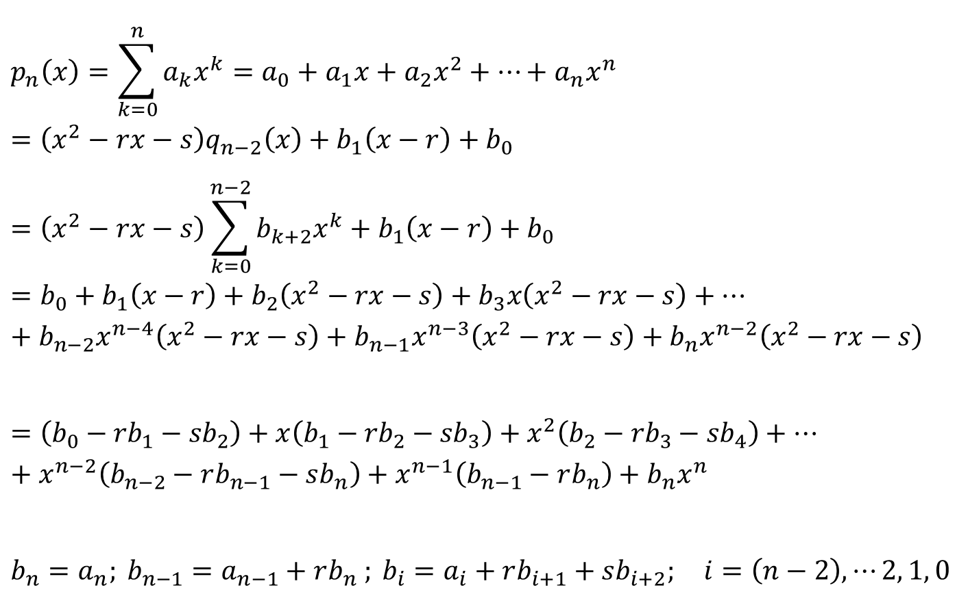
Polynomial Methods: Bairstow
$$p_{n}\left(x\right)=\sum_{k=0}^{n}{a_{k}x^{k}}=a_{0}+a_{1}x+a_{2}x^{2}+…+a_{n}x^{n}=\left(x^{2}−rx−s\right)q_{n−2}\left(x\right)+b_{1}\left(x−r\right)+b_{0}$$
$$=\left(x^{2}−rx−s\right)\sum_{k=0}^{n−2}{b_{k+2}x^{k}}+b_{1}\left(x−r\right)+b_{0}$$
$$=b_{0}+b_{1}\left(x−r\right)+b_{2}\left(x^{2}−rx−s\right)+b_{3}x\left(x^{2}−rx−s\right)+…+b_{n−2}x^{n−4}\left(x^{2}−rx−s\right)+b_{n−1}x^{n−3}\left(x^{2}−rx−s\right)+b_{n}x^{n−2}\left(x^{2}−rx−s\right)$$
$$=\left({b_{0}−rb}_{1}−{sb}_{2}\right)+x\left({b_{1}−rb}_{2}−{sb}_{3}\right)+x^{2}\left({b_{2}−rb}_{3}−{sb}_{4}\right)+…+x^{n−2}\left(b_{n−2}−rb_{n−1}−sb_{n}\right)+x^{n−1}\left(b_{n−1}−rb_{n}\right)+b_{n}x^{n}$$
$$b_{n}=a_{n}; b_{n−1}=a_{n−1}+rb_{n} ; b_{i}=a_{i}+rb_{i+1}+sb_{i+2}; i=\left(n−2\right), ⋯2, 1, 0$$

Slide 17
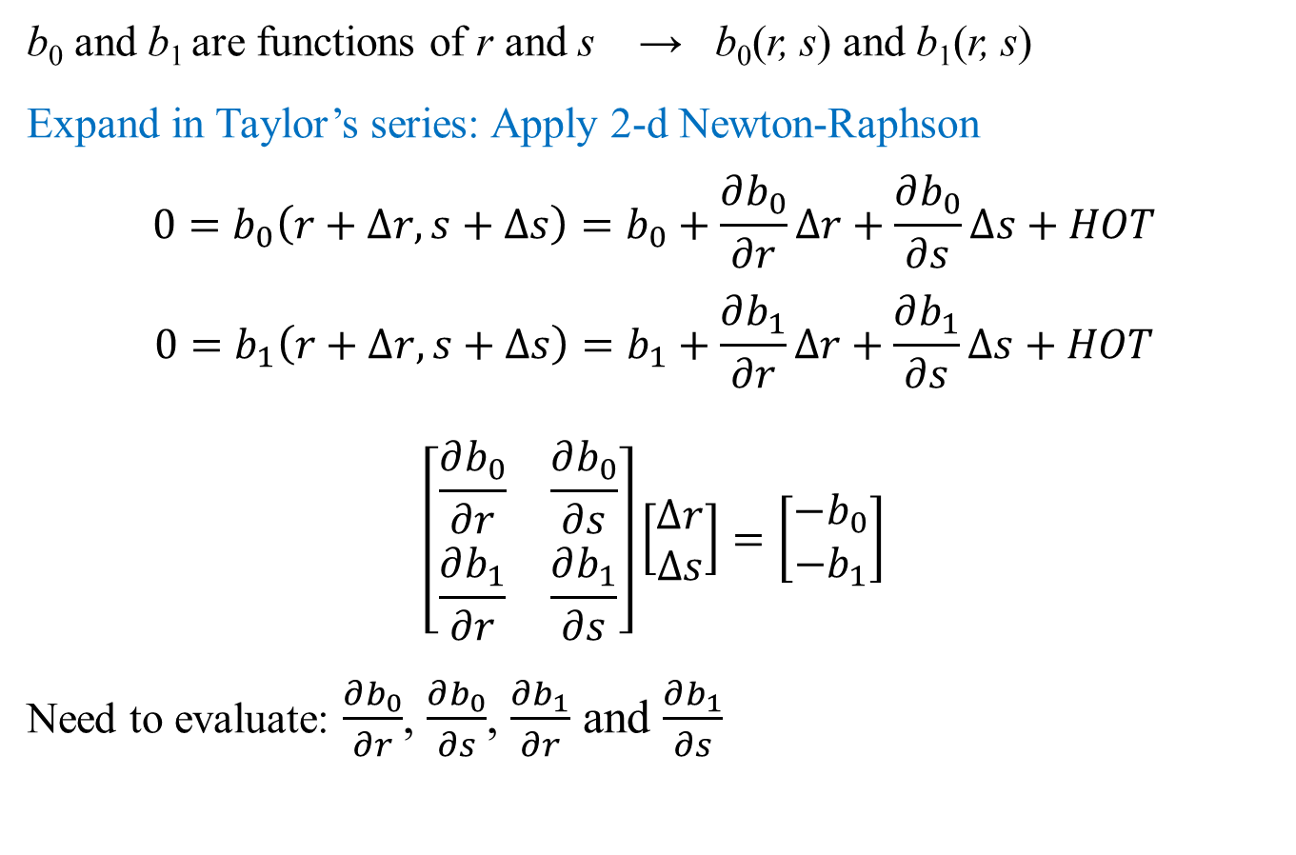
Polynomial Methods: Bairstow
b₀ and b₁ are functions of r and s → b₀(r, s) and b₁(r, s)
Expand in Taylor’s series: Apply 2-d Newton-Raphson
$$0=b_{0}\left(r+∆r, s+∆s\right)=b_{0}+\frac{∂b_{0}}{∂r}∆r+\frac{∂b_{0}}{∂s}∆s+HOT$$
$$0=b_{1}\left(r+∆r, s+∆s\right)=b_{1}+\frac{∂b_{1}}{∂r}∆r+\frac{∂b_{1}}{∂s}∆s+HOT$$
$$\left[\begin{matrix}\frac{∂b_{0}}{∂r} & \frac{∂b_{0}}{∂s} \\ \frac{∂b_{1}}{∂r} & \frac{∂b_{1}}{∂s}\end{matrix}\right]\left[\begin{matrix}∆r \\ ∆s\end{matrix}\right]=\left[\begin{matrix}−b_{0} \\ −b_{1}\end{matrix}\right]$$
Need to evaluate: $\frac{∂b_{0}}{∂r}$, $\frac{∂b_{0}}{∂s}$, $\frac{∂b_{1}}{∂r}$ and $\frac{∂b_{1}}{∂s}$

Slide 18
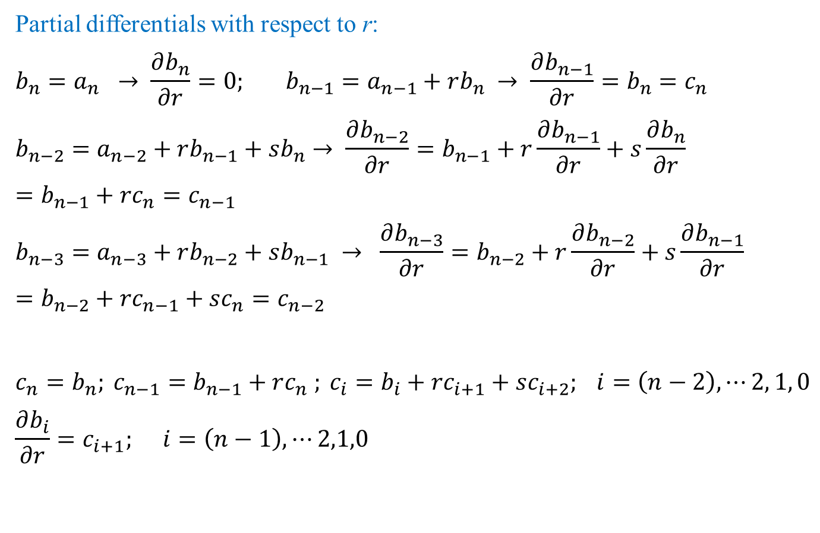
Polynomial Methods: Bairstow
Partial differentials with respect to r:
$$b_{n}=a_{n} → \frac{∂b_{n}}{∂r}=0; b_{n−1}=a_{n−1}+rb_{n} → \frac{∂b_{n−1}}{∂r}=b_{n}=c_{n}$$
$$b_{n−2}=a_{n−2}+rb_{n−1}+sb_{n}→ \frac{∂b_{n−2}}{∂r}=b_{n−1}+r\frac{∂b_{n−1}}{∂r}+s\frac{∂b_{n}}{∂r}=b_{n−1}+rc_{n}=c_{n−1}$$
$$b_{n−3}=a_{n−3}+rb_{n−2}+sb_{n−1} → \frac{∂b_{n−3}}{∂r}=b_{n−2}+r\frac{∂b_{n−2}}{∂r}+s\frac{∂b_{n−1}}{∂r}=b_{n−2}+rc_{n−1}+sc_{n}=c_{n−2}$$
$$c_{n}=b_{n}; c_{n−1}=b_{n−1}+rc_{n} ; c_{i}=b_{i}+rc_{i+1}+sc_{i+2}; i=\left(n−2\right), ⋯2, 1, 0$$
$$\frac{∂b_{i}}{∂r}=c_{i+1}; i=\left(n−1\right),⋯2,1,0$$

Slide 19
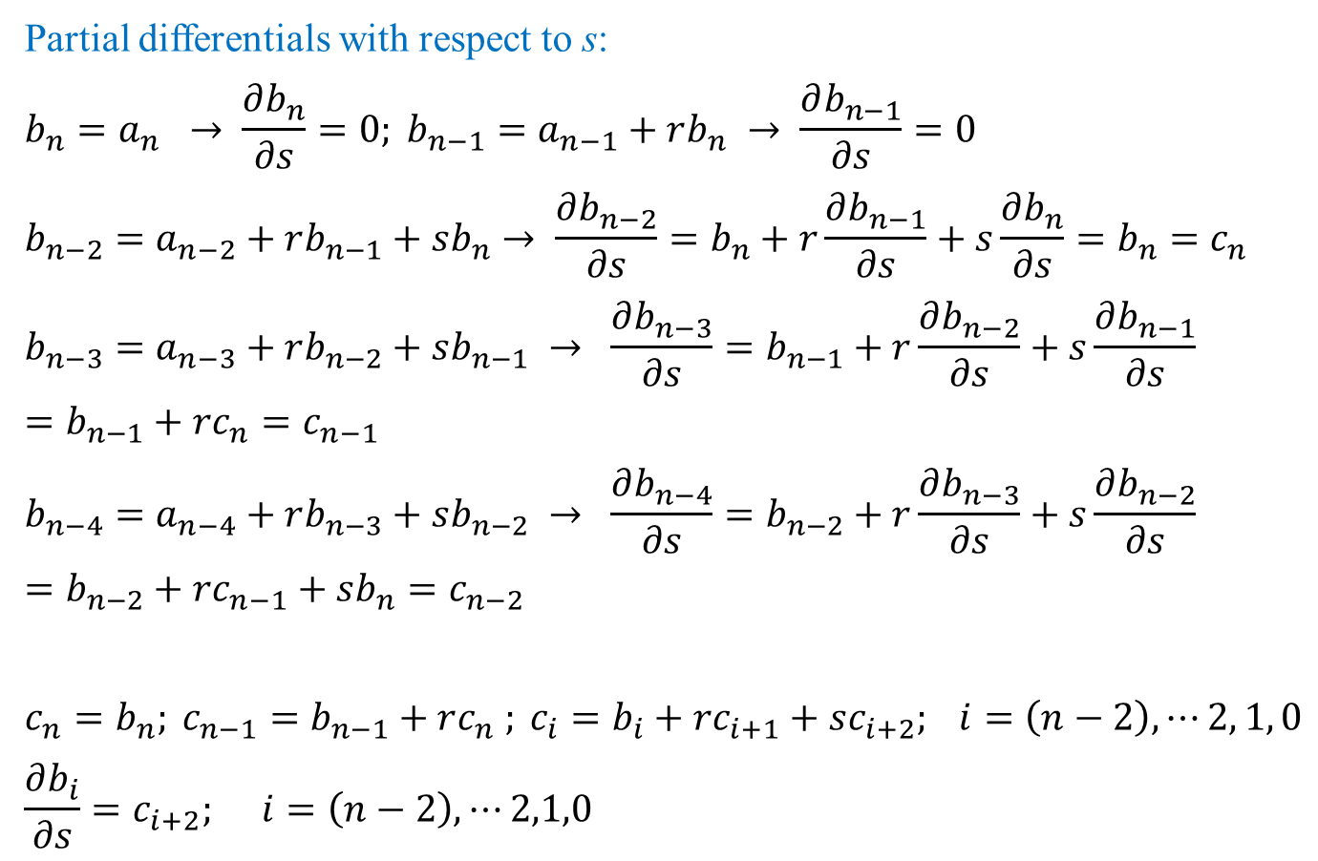
Polynomial Methods: Bairstow
Partial differentials with respect to s:
$$b_{n}=a_{n} → \frac{∂b_{n}}{∂s}=0; b_{n−1}=a_{n−1}+rb_{n} → \frac{∂b_{n−1}}{∂s}=0$$
$$b_{n−2}=a_{n−2}+rb_{n−1}+sb_{n}→ \frac{∂b_{n−2}}{∂s}=b_{n}+r\frac{∂b_{n−1}}{∂s}+s\frac{∂b_{n}}{∂s}=b_{n}=c_{n}$$
$$b_{n−3}=a_{n−3}+rb_{n−2}+sb_{n−1} → \frac{∂b_{n−3}}{∂s}=b_{n−1}+r\frac{∂b_{n−2}}{∂s}+s\frac{∂b_{n−1}}{∂s}=b_{n−1}+rc_{n}=c_{n−1}$$
$$b_{n−4}=a_{n−4}+rb_{n−3}+sb_{n−2} → \frac{∂b_{n−4}}{∂s}=b_{n−2}+r\frac{∂b_{n−3}}{∂s}+s\frac{∂b_{n−2}}{∂s}=b_{n−2}+rc_{n−1}+sb_{n}=c_{n−2}$$
$$c_{n}=b_{n}; c_{n−1}=b_{n−1}+rc_{n} ; c_{i}=b_{i}+rc_{i+1}+sc_{i+2}; i=\left(n−2\right), ⋯2, 1, 0$$
$$\frac{∂b_{i}}{∂s}=c_{i+2}; i=\left(n−2\right),⋯2,1,0$$

Slide 20
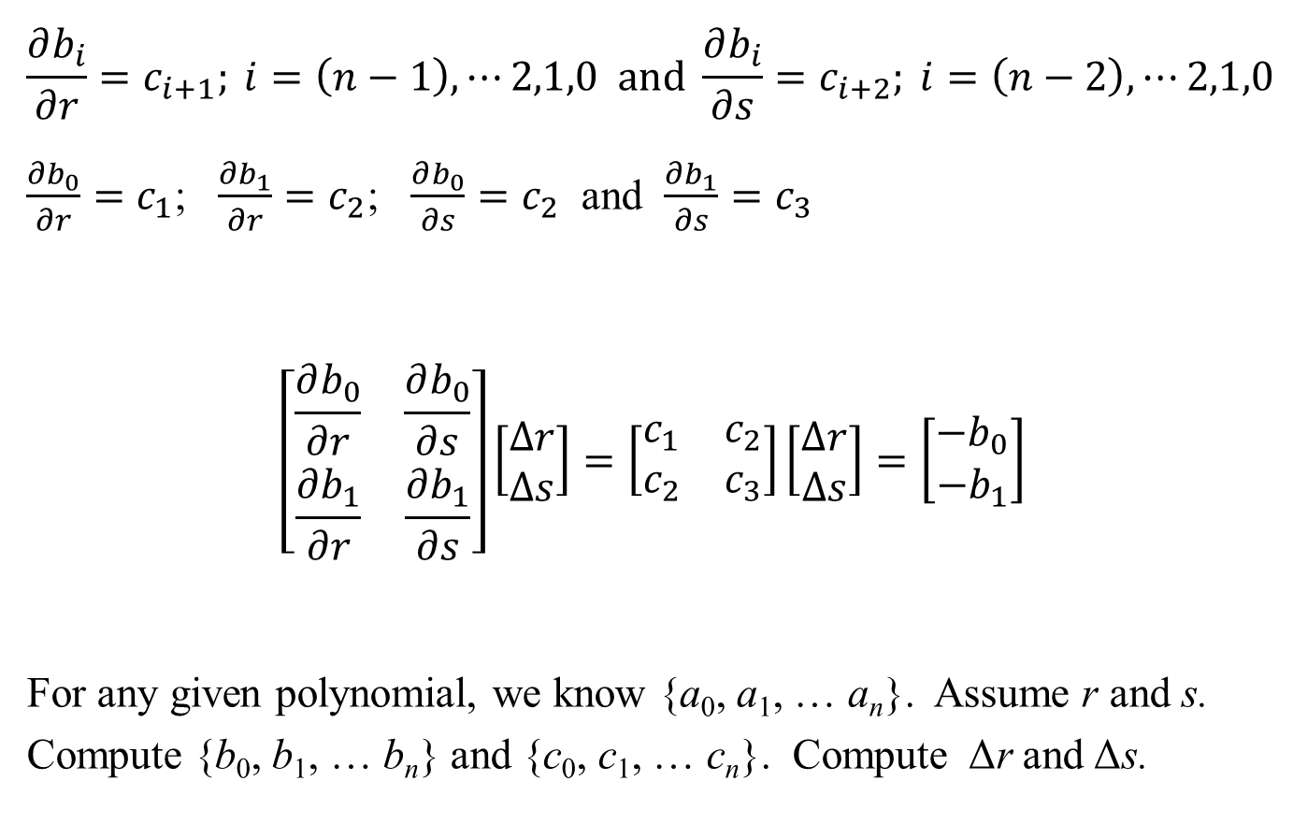
Polynomial Methods: Bairstow
$$\frac{∂b_{i}}{∂r}=c_{i+1}; i=\left(n−1\right),⋯2,1,0 and \frac{∂b_{i}}{∂s}=c_{i+2}; i=\left(n−2\right),⋯2,1,0$$
$\frac{∂b_{0}}{∂r}=c_{1}$; $\frac{∂b_{1}}{∂r}=c_{2}$; $\frac{∂b_{0}}{∂s}=c_{2}$ and $\frac{∂b_{1}}{∂s}=c_{3}$
$$\left[\begin{matrix}\frac{∂b_{0}}{∂r} & \frac{∂b_{0}}{∂s} \\ \frac{∂b_{1}}{∂r} & \frac{∂b_{1}}{∂s}\end{matrix}\right]\left[\begin{matrix}∆r \\ ∆s\end{matrix}\right]=\left[\begin{matrix}c_{1} & c_{2} \\ c_{2} & c_{3}\end{matrix}\right]\left[\begin{matrix}∆r \\ ∆s\end{matrix}\right]=\left[\begin{matrix}−b_{0} \\ −b_{1}\end{matrix}\right]$$
For any given polynomial, we know {a₀, a₁, … a_{n}}. Assume r and s. Compute {b₀, b₁, … b_{n}} and {c₀, c₁, … c_{n}}. Compute Δr and Δs.

Slide 21
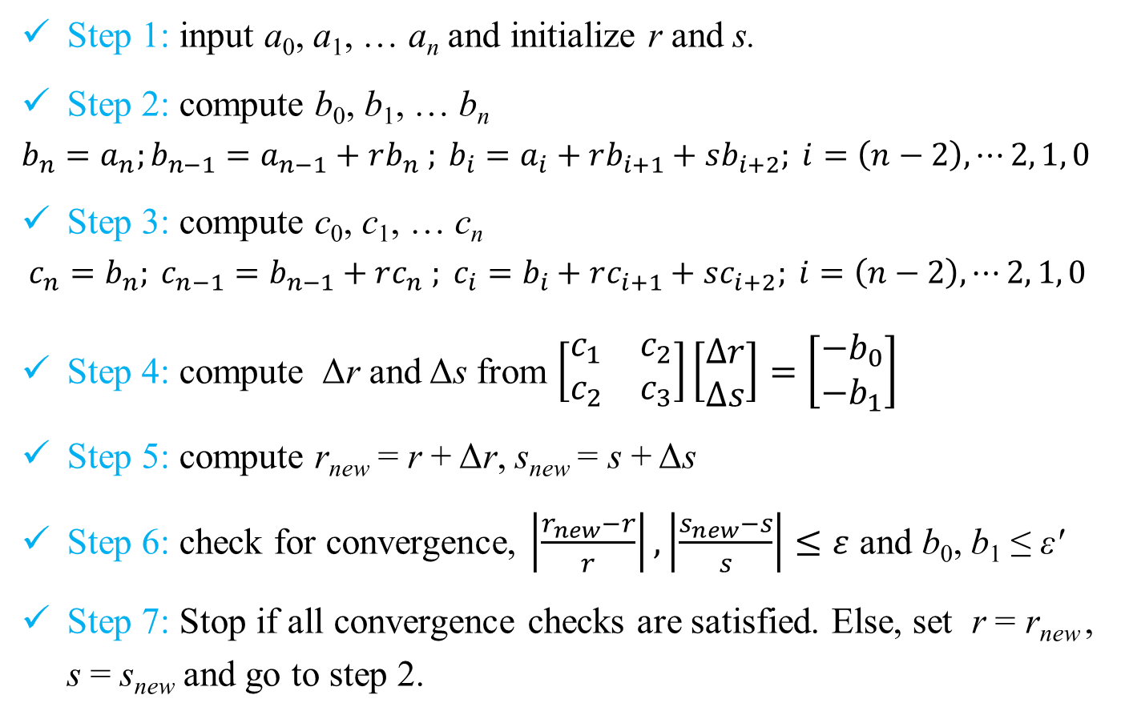
Polynomial Methods: Bairstow Algorithm
Step 1: input a₀, a₁, … a_{n} and initialize r and s.
Step 2: compute b₀, b₁, … b_{n}
$$b_{n}=a_{n};b_{n−1}=a_{n−1}+rb_{n} ; b_{i}=a_{i}+rb_{i+1}+sb_{i+2}; i=\left(n−2\right), ⋯2, 1, 0$$
Step 3: compute c₀, c₁, … c_{n}
$$c_{n}=b_{n}; c_{n−1}=b_{n−1}+rc_{n} ; c_{i}=b_{i}+rc_{i+1}+sc_{i+2}; i=\left(n−2\right), ⋯2, 1, 0$$
Step 4: compute Δr and Δs from $\left[\begin{matrix}c_{1} & c_{2} \\ c_{2} & c_{3}\end{matrix}\right]\left[\begin{matrix}∆r \\ ∆s\end{matrix}\right]=\left[\begin{matrix}−b_{0} \\ −b_{1}\end{matrix}\right]$
Step 5: compute r_{new} = r + Δr, s_{new} = s + Δs
Step 6: check for convergence, $\left|\frac{r_{new}−r}{r}\right|,\left|\frac{s_{new}−s}{s}\right|≤ε$ and b₀, b₁ ≤ εʹ
Step 7: Stop if all convergence checks are satisfied. Else, set r = r_{new} , s = s_{new} and go to step 2.

Slide 22
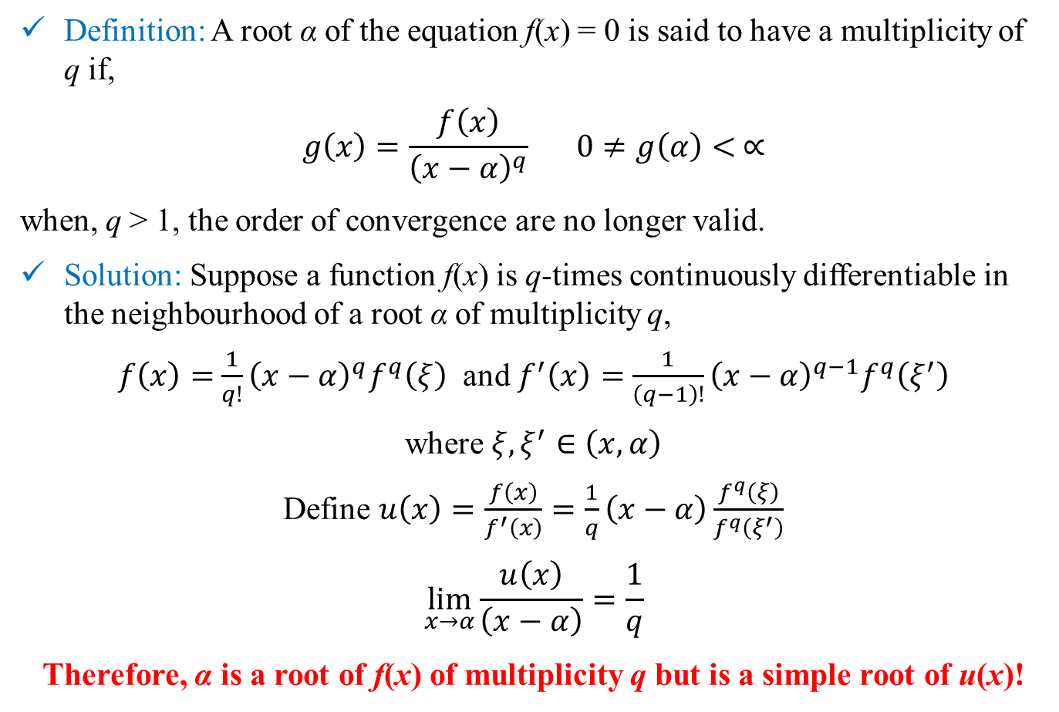
Multiple Roots
Definition: A root α of the equation f(x) = 0 is said to have a multiplicity of q if,
$$g\left(x\right)=\frac{f\left(x\right)}{{\left(x−α\right)}^{q}} 0≠g\left(α\right)< ∝$$
when, q > 1, the order of convergence are no longer valid.
Solution: Suppose a function f(x) is q-times continuously differentiable in the neighbourhood of a root α of multiplicity q,
$f\left(x\right)=$ $\frac{1}{q!}{\left(x−α\right)}^{q}f^{q}\left(ξ\right)$ and $f^{′}\left(x\right)=$ $\frac{1}{\left(q−1\right)!}{\left(x−α\right)}^{q−1}f^{q}\left(ξ^{′}\right)$
where $ξ,ξ^{′}∈\left(x,α\right)$
Define $u\left(x\right)=\frac{f\left(x\right)}{f^{′}\left(x\right)}=\frac{1}{q}\left(x−α\right)\frac{f^{q}\left(ξ\right)}{f^{q}\left(ξ^{′}\right)}$
$$\lim_{x→α}{\frac{u\left(x\right)}{\left(x−α\right)}}=\frac{1}{q}$$
Therefore, α is a root of f(x) of multiplicity q but is a simple root of u(x)!

