Slide 1
Bairstow's Method
Bairstow’s method is an iterative approach loosely related to both Müller and Newton Raphson methods
It is based on dividing the given polynomial by a quadratic polynomial x²-rx-s:

Slide 2
Bairstow's Method
3. The coefficients b’s are obtained very easily by using recursive relation
4. Using Newton Raphson approach, r and s are adjusted so as to make both b_{o} and b₁ approach zero

Slide 3
Bairstow's Method
5. Obtain corrections in r and s by Newton-Raphson method

Slide 4
Bairstow's Method
6. Bairstow (1920) showed that the partial derivatives of b₁ and b₂ are obtained by the recursive relation
7. Iterate the steps untill (Δr/r) and (Δs/s) drops below a specified threshold

Slide 5
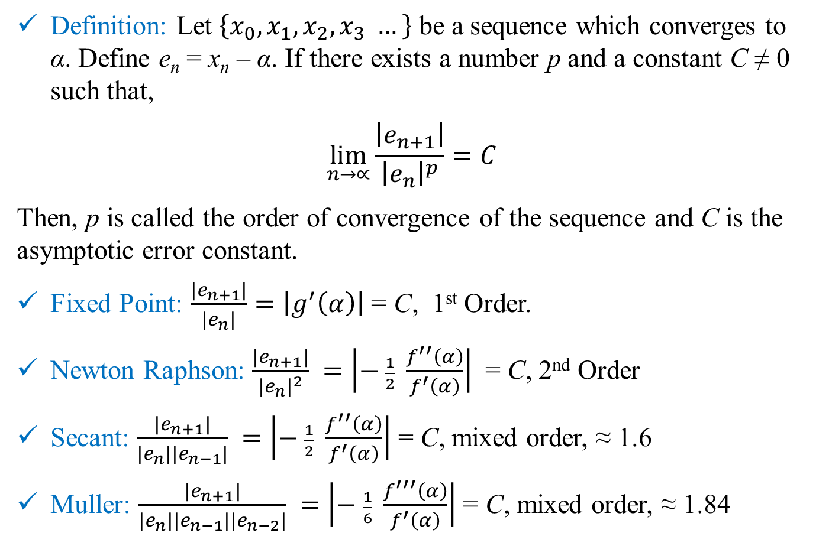
Order of Convergence
Definition: Let $\left\{x_{0},x_{1},x_{2},x_{3} …\right\}$ be a sequence which converges to α. Define e_{n} = x_{n} – α. If there exists a number p and a constant C ≠ 0 such that,
$$\lim_{n→∝}{\frac{\left|e_{n+1}\right|}{{\left|e_{n}\right|}^{p}}}=C$$
Then, p is called the order of convergence of the sequence and C is the asymptotic error constant.
Fixed Point: $\frac{\left|e_{n+1}\right|}{\left|e_{n}\right|}=\left|g^{′}\left(α\right)\right|$ = C, 1st Order.
Newton Raphson: $\frac{\left|e_{n+1}\right|}{{\left|e_{n}\right|}^{2}} =\left|− \frac{1}{2} \frac{f^{′′}\left(α\right)}{f^{′}\left(α\right)}\right|$ = C, 2nd Order
Secant: $\frac{\left|e_{n+1}\right|}{\left|e_{n}\right|\left|e_{n−1}\right|} =\left|− \frac{1}{2} \frac{f^{′′}\left(α\right)}{f^{′}\left(α\right)}\right|$ = C, mixed order, ≈ 1.6
Muller: $\frac{\left|e_{n+1}\right|}{\left|e_{n}\right|\left|e_{n−1}\right|\left|e_{n−2}\right|} =\left|− \frac{1}{6} \frac{f^{′′′}\left(α\right)}{f^{′}\left(α\right)}\right|$ = C, mixed order, ≈ 1.84

Slide 6
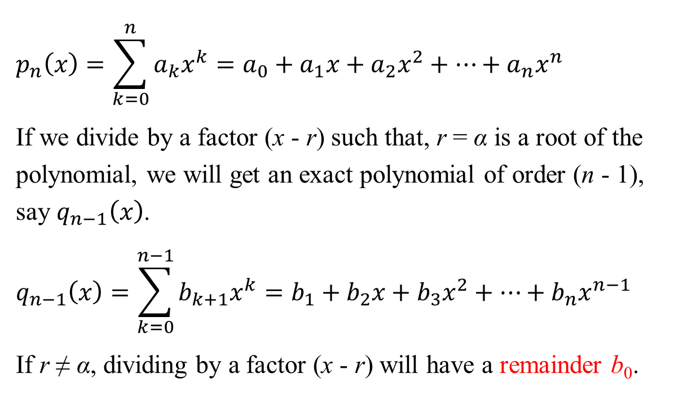
Polynomial Methods: Single Root
$$p_{n}\left(x\right)=\sum_{k=0}^{n}{a_{k}x^{k}}=a_{0}+a_{1}x+a_{2}x^{2}+…+a_{n}x^{n}$$
If we divide by a factor (x - r) such that, r = α is a root of the polynomial, we will get an exact polynomial of order (n - 1), say $q_{n−1}\left(x\right)$.
$$q_{n−1}\left(x\right)=\sum_{k=0}^{n−1}{b_{k+1}x^{k}}=b_{1}+b_{2}x+b_{3}x^{2}+…+b_{n}x^{n−1}$$
If r ≠ α, dividing by a factor (x - r) will have a remainder b₀.

Slide 7
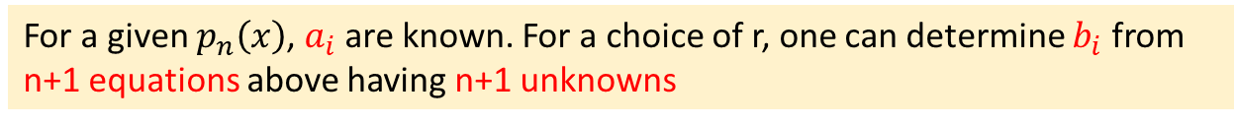
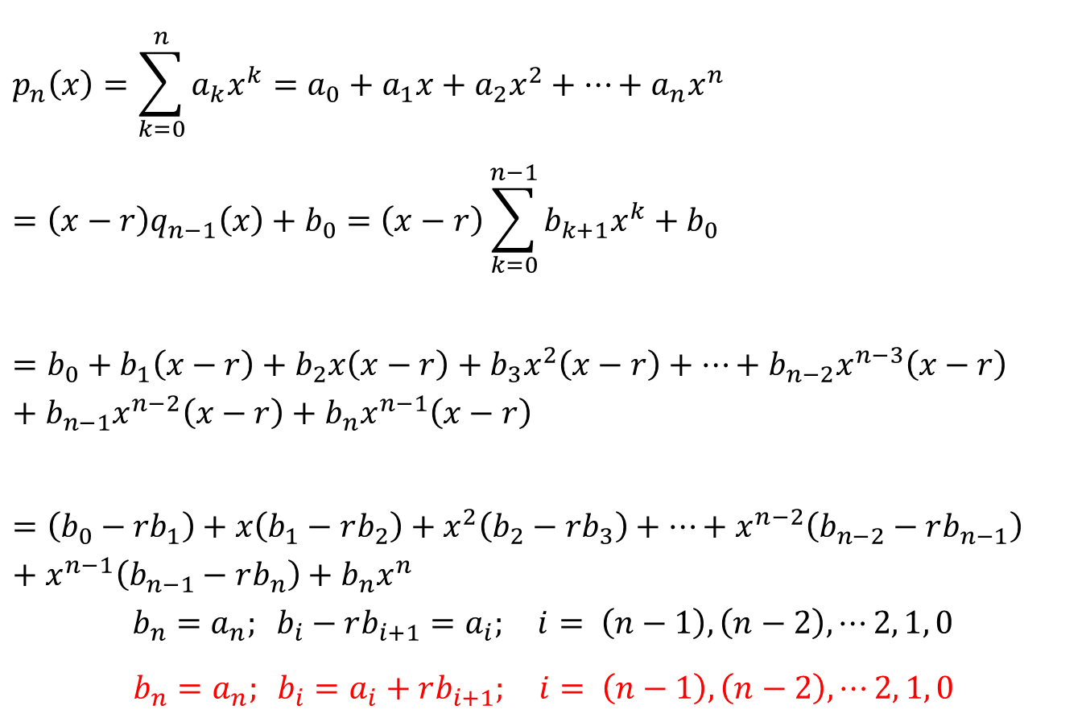
Polynomial Methods: Single Root
$$p_{n}\left(x\right)=\sum_{k=0}^{n}{a_{k}x^{k}}=a_{0}+a_{1}x+a_{2}x^{2}+…+a_{n}x^{n}$$
$$=\left(x−r\right)q_{n−1}\left(x\right)+b_{0}=\left(x−r\right)\sum_{k=0}^{n−1}{b_{k+1}x^{k}}+b_{0}$$
$$=b_{0}+b_{1}\left(x−r\right)+b_{2}x\left(x−r\right)+b_{3}x^{2}\left(x−r\right)+…+b_{n−2}x^{n−3}\left(x−r\right)+b_{n−1}x^{n−2}\left(x−r\right)+b_{n}x^{n−1}\left(x−r\right)$$
$$=\left({b_{0}−rb}_{1}\right)+x\left(b_{1}−rb_{2}\right)+x^{2}\left(b_{2}−rb_{3}\right)+…+x^{n−2}\left(b_{n−2}−rb_{n−1}\right)+x^{n−1}\left(b_{n−1}−rb_{n}\right)+b_{n}x^{n}$$
$$b_{n}=a_{n}; b_{i}−rb_{i+1}=a_{i}; i= \left(n−1\right), \left(n−2\right), ⋯2, 1, 0$$
$b_{n}=a_{n}; b_{i}=a_{i}+rb_{i+1}; i= \left(n−1\right), \left(n−2\right), ⋯2, 1, 0$
For a given $p_{n}\left(x\right)$, $a_{i}$ are known. For a choice of r, one can determine $b_{i}$ from n+1 equations above having n+1 unknowns

Slide 8
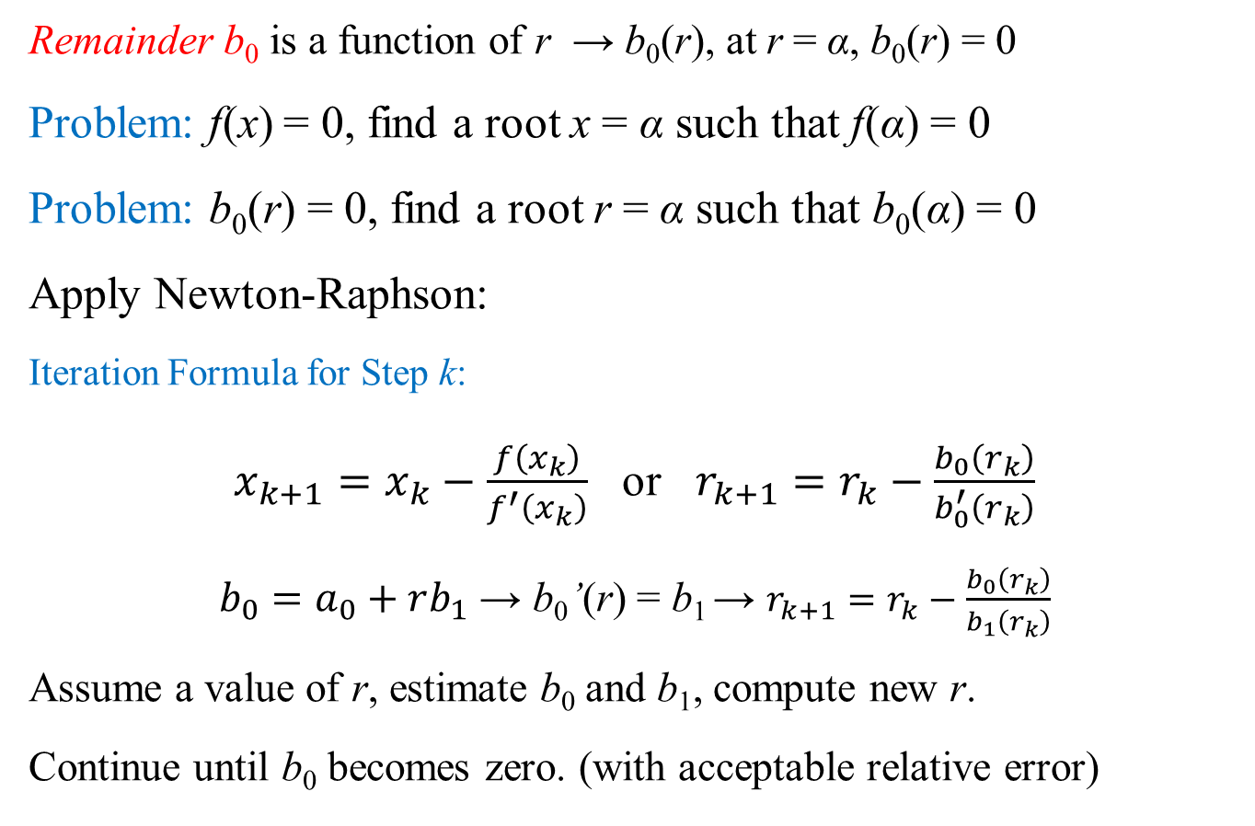
Polynomial Methods: Single Root
Remainder b₀ is a function of r → b₀(r), at r = α, b₀(r) = 0
Problem: f(x) = 0, find a root x = α such that f(α) = 0
Problem: b₀(r) = 0, find a root r = α such that b₀(α) = 0
Apply Newton-Raphson:
Iteration Formula for Step k:
$x_{k+1}=x_{k}−\frac{f\left(x_{k}\right)}{f^{′}\left(x_{k}\right)}$ or $r_{k+1}=r_{k}−\frac{b_{0}\left(r_{k}\right)}{b_{0}^{′}\left(r_{k}\right)}$
$b_{0}=a_{0}+rb_{1}$ → b₀’(r) = b₁ → $r_{k+1}=r_{k}−\frac{b_{0}\left(r_{k}\right)}{b_{1}\left(r_{k}\right)}$
Assume a value of r, estimate b₀ and b₁, compute new r.
Continue until b₀ becomes zero. (with acceptable relative error)

Slide 9
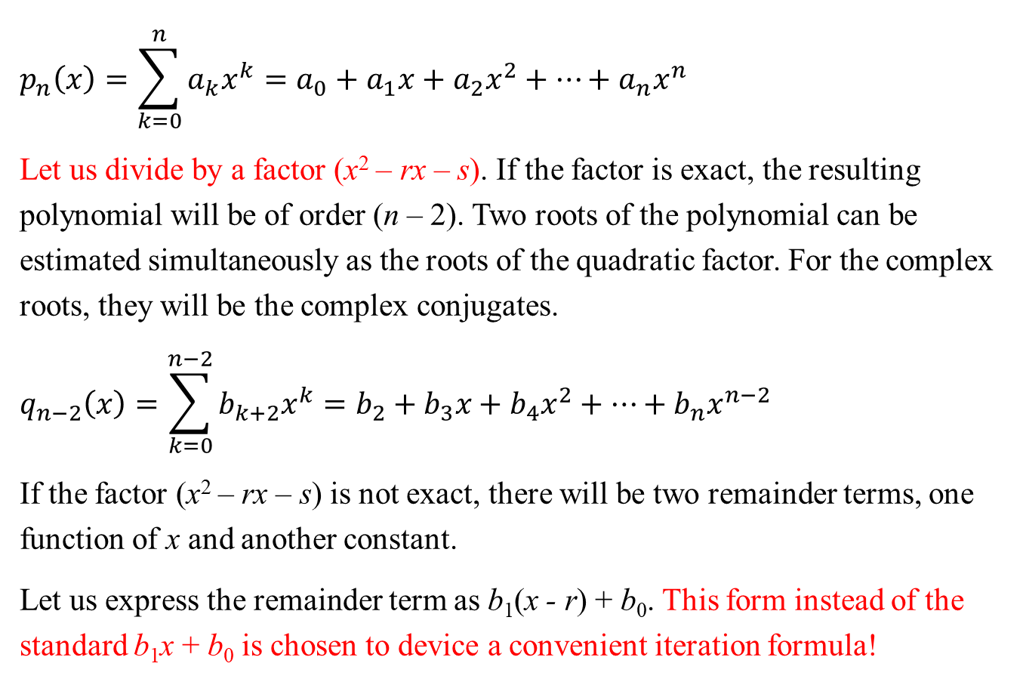
Polynomial Methods: Bairstow's
$$p_{n}\left(x\right)=\sum_{k=0}^{n}{a_{k}x^{k}}=a_{0}+a_{1}x+a_{2}x^{2}+…+a_{n}x^{n}$$
Let us divide by a factor (x² – rx – s). If the factor is exact, the resulting polynomial will be of order (n – 2). Two roots of the polynomial can be estimated simultaneously as the roots of the quadratic factor. For the complex roots, they will be the complex conjugates.
$$q_{n−2}\left(x\right)=\sum_{k=0}^{n−2}{b_{k+2}x^{k}}=b_{2}+b_{3}x+b_{4}x^{2}+…+b_{n}x^{n−2}$$
If the factor (x² – rx – s) is not exact, there will be two remainder terms, one function of x and another constant.
Let us express the remainder term as b₁(x - r) + b₀. This form instead of the standard b₁x + b₀ is chosen to device a convenient iteration formula!

Slide 10
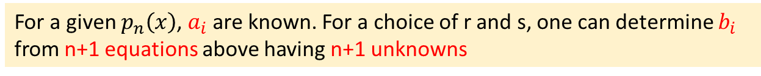
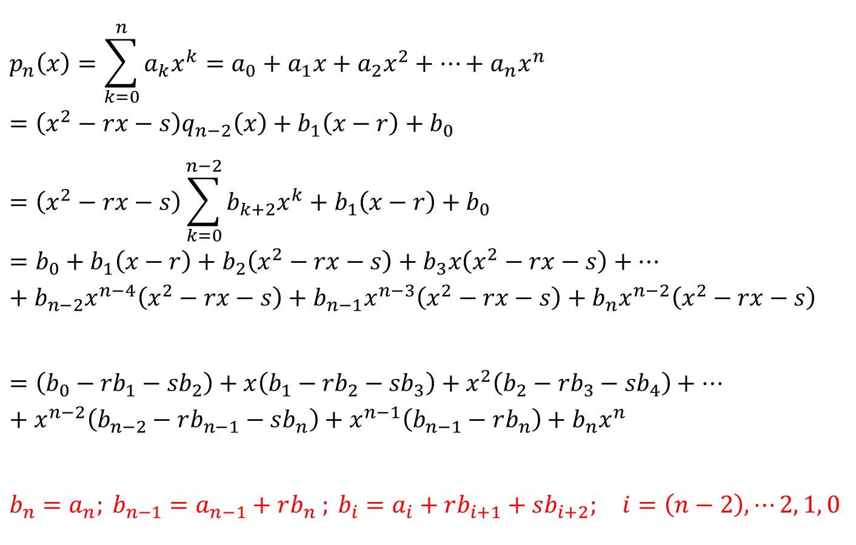
Polynomial Methods: Bairstow's
$$p_{n}\left(x\right)=\sum_{k=0}^{n}{a_{k}x^{k}}=a_{0}+a_{1}x+a_{2}x^{2}+…+a_{n}x^{n}=\left(x^{2}−rx−s\right)q_{n−2}\left(x\right)+b_{1}\left(x−r\right)+b_{0}$$
$$=\left(x^{2}−rx−s\right)\sum_{k=0}^{n−2}{b_{k+2}x^{k}}+b_{1}\left(x−r\right)+b_{0}$$
$$=b_{0}+b_{1}\left(x−r\right)+b_{2}\left(x^{2}−rx−s\right)+b_{3}x\left(x^{2}−rx−s\right)+…+b_{n−2}x^{n−4}\left(x^{2}−rx−s\right)+b_{n−1}x^{n−3}\left(x^{2}−rx−s\right)+b_{n}x^{n−2}\left(x^{2}−rx−s\right)$$
$$=\left({b_{0}−rb}_{1}−{sb}_{2}\right)+x\left({b_{1}−rb}_{2}−{sb}_{3}\right)+x^{2}\left({b_{2}−rb}_{3}−{sb}_{4}\right)+…+x^{n−2}\left(b_{n−2}−rb_{n−1}−sb_{n}\right)+x^{n−1}\left(b_{n−1}−rb_{n}\right)+b_{n}x^{n}$$
$$b_{n}=a_{n}; b_{n−1}=a_{n−1}+rb_{n} ; b_{i}=a_{i}+rb_{i+1}+sb_{i+2}; i=\left(n−2\right), ⋯2, 1, 0$$
For a given $p_{n}\left(x\right)$, $a_{i}$ are known. For a choice of r and s, one can determine $b_{i}$ from n+1 equations above having n+1 unknowns

Slide 11
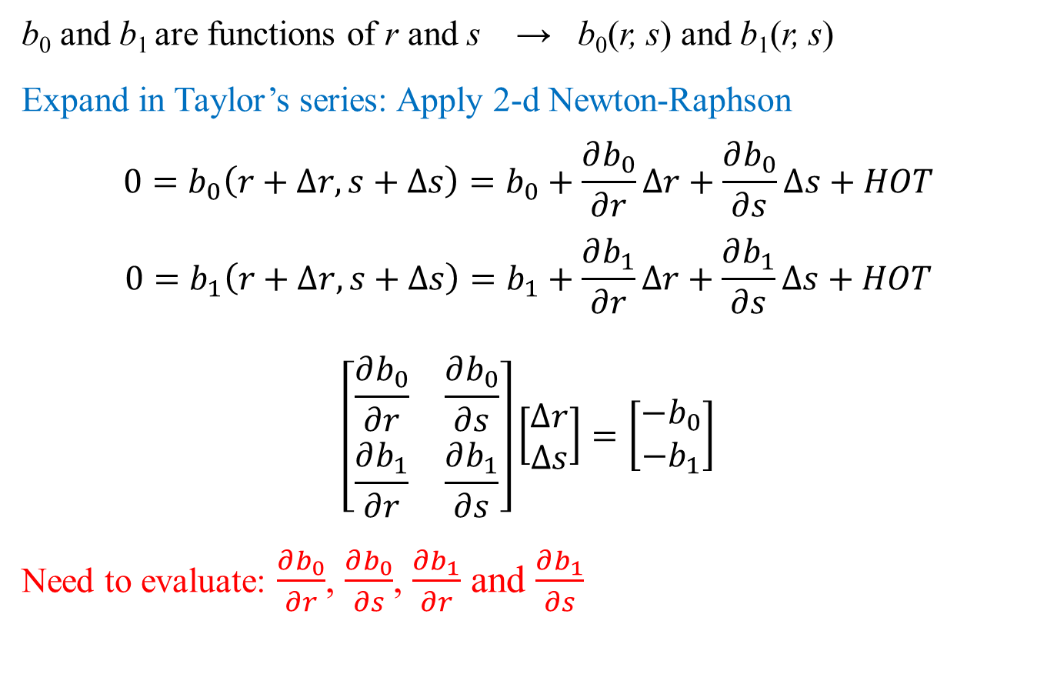
Polynomial Methods: Bairstow's
b₀ and b₁ are functions of r and s → b₀(r, s) and b₁(r, s)
Expand in Taylor’s series: Apply 2-d Newton-Raphson
$$0=b_{0}\left(r+∆r, s+∆s\right)=b_{0}+\frac{∂b_{0}}{∂r}∆r+\frac{∂b_{0}}{∂s}∆s+HOT$$
$$0=b_{1}\left(r+∆r, s+∆s\right)=b_{1}+\frac{∂b_{1}}{∂r}∆r+\frac{∂b_{1}}{∂s}∆s+HOT$$
$$\left[\begin{matrix}\frac{∂b_{0}}{∂r} & \frac{∂b_{0}}{∂s} \\ \frac{∂b_{1}}{∂r} & \frac{∂b_{1}}{∂s}\end{matrix}\right]\left[\begin{matrix}∆r \\ ∆s\end{matrix}\right]=\left[\begin{matrix}−b_{0} \\ −b_{1}\end{matrix}\right]$$
Need to evaluate: $\frac{∂b_{0}}{∂r}$, $\frac{∂b_{0}}{∂s}$, $\frac{∂b_{1}}{∂r}$ and $\frac{∂b_{1}}{∂s}$

Slide 12
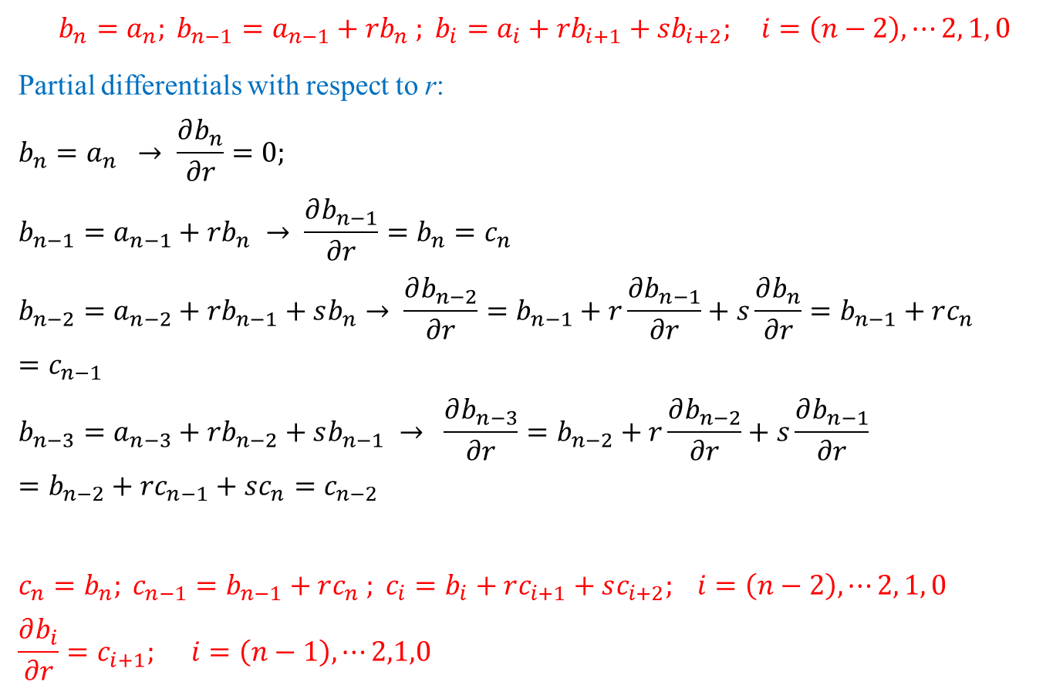
Polynomial Methods: Bairstow's
$$b_{n}=a_{n}; b_{n−1}=a_{n−1}+rb_{n} ; b_{i}=a_{i}+rb_{i+1}+sb_{i+2}; i=\left(n−2\right), ⋯2, 1, 0$$
Partial differentials with respect to r:
$$b_{n}=a_{n} → \frac{∂b_{n}}{∂r}=0;$$
$$b_{n−1}=a_{n−1}+rb_{n} → \frac{∂b_{n−1}}{∂r}=b_{n}=c_{n}$$
$$b_{n−2}=a_{n−2}+rb_{n−1}+sb_{n}→ \frac{∂b_{n−2}}{∂r}=b_{n−1}+r\frac{∂b_{n−1}}{∂r}+s\frac{∂b_{n}}{∂r}=b_{n−1}+rc_{n}=c_{n−1}$$
$$b_{n−3}=a_{n−3}+rb_{n−2}+sb_{n−1} → \frac{∂b_{n−3}}{∂r}=b_{n−2}+r\frac{∂b_{n−2}}{∂r}+s\frac{∂b_{n−1}}{∂r} =b_{n−2}+rc_{n−1}+sc_{n}=c_{n−2}$$
$$c_{n}=b_{n}; c_{n−1}=b_{n−1}+rc_{n} ; c_{i}=b_{i}+rc_{i+1}+sc_{i+2}; i=\left(n−2\right), ⋯2, 1, 0$$
$$\frac{∂b_{i}}{∂r}=c_{i+1}; i=\left(n−1\right),⋯2,1,0$$
= 0

Slide 13
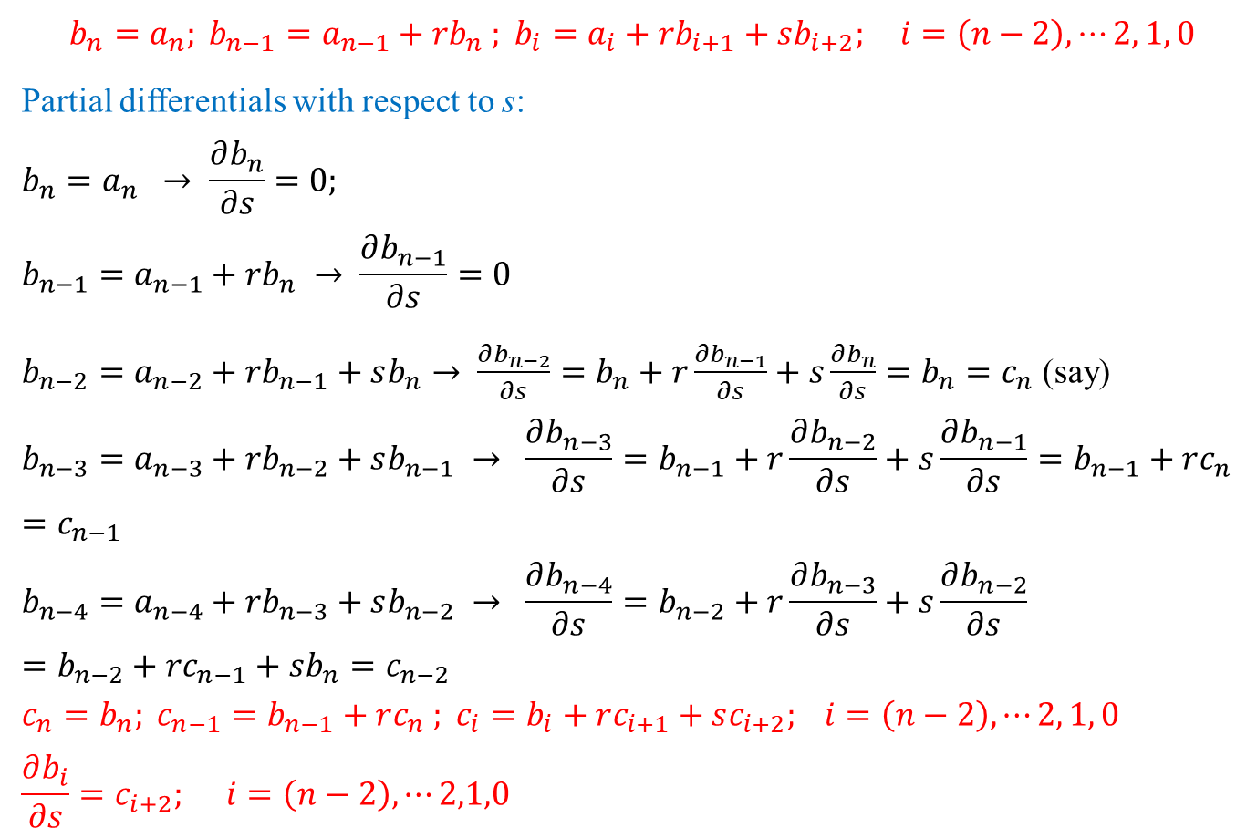
Polynomial Methods: Bairstow's
$$b_{n}=a_{n}; b_{n−1}=a_{n−1}+rb_{n} ; b_{i}=a_{i}+rb_{i+1}+sb_{i+2}; i=\left(n−2\right), ⋯2, 1, 0$$
Partial differentials with respect to s:
$$b_{n}=a_{n} → \frac{∂b_{n}}{∂s}=0;$$
$$b_{n−1}=a_{n−1}+rb_{n} → \frac{∂b_{n−1}}{∂s}=0$$
$b_{n−2}=a_{n−2}+rb_{n−1}+sb_{n}→ \frac{∂b_{n−2}}{∂s}=b_{n}+r\frac{∂b_{n−1}}{∂s}+s\frac{∂b_{n}}{∂s}=b_{n}=c_{n}$ (say)
$$b_{n−3}=a_{n−3}+rb_{n−2}+sb_{n−1} → \frac{∂b_{n−3}}{∂s}=b_{n−1}+r\frac{∂b_{n−2}}{∂s}+s\frac{∂b_{n−1}}{∂s}=b_{n−1}+rc_{n}=c_{n−1}$$
$$b_{n−4}=a_{n−4}+rb_{n−3}+sb_{n−2} → \frac{∂b_{n−4}}{∂s}=b_{n−2}+r\frac{∂b_{n−3}}{∂s}+s\frac{∂b_{n−2}}{∂s}=b_{n−2}+rc_{n−1}+sb_{n}=c_{n−2}$$
$$c_{n}=b_{n}; c_{n−1}=b_{n−1}+rc_{n} ; c_{i}=b_{i}+rc_{i+1}+sc_{i+2}; i=\left(n−2\right), ⋯2, 1, 0$$
$$\frac{∂b_{i}}{∂s}=c_{i+2}; i=\left(n−2\right),⋯2,1,0$$
= 0
= 0

Slide 14
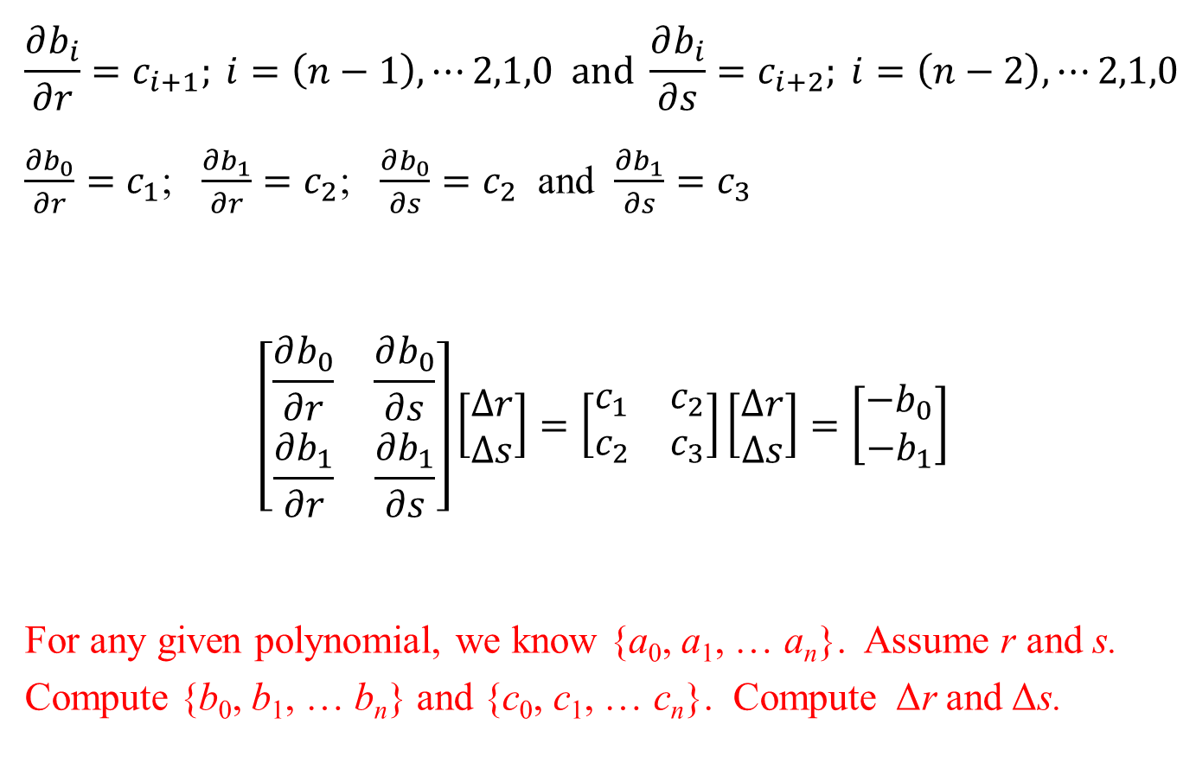
Polynomial Methods: Bairstow's
$$\frac{∂b_{i}}{∂r}=c_{i+1}; i=\left(n−1\right),⋯2,1,0 and \frac{∂b_{i}}{∂s}=c_{i+2}; i=\left(n−2\right),⋯2,1,0$$
$\frac{∂b_{0}}{∂r}=c_{1}$; $\frac{∂b_{1}}{∂r}=c_{2}$; $\frac{∂b_{0}}{∂s}=c_{2}$ and $\frac{∂b_{1}}{∂s}=c_{3}$
$$\left[\begin{matrix}\frac{∂b_{0}}{∂r} & \frac{∂b_{0}}{∂s} \\ \frac{∂b_{1}}{∂r} & \frac{∂b_{1}}{∂s}\end{matrix}\right]\left[\begin{matrix}∆r \\ ∆s\end{matrix}\right]=\left[\begin{matrix}c_{1} & c_{2} \\ c_{2} & c_{3}\end{matrix}\right]\left[\begin{matrix}∆r \\ ∆s\end{matrix}\right]=\left[\begin{matrix}−b_{0} \\ −b_{1}\end{matrix}\right]$$
For any given polynomial, we know {a₀, a₁, … a_{n}}. Assume r and s. Compute {b₀, b₁, … b_{n}} and {c₀, c₁, … c_{n}}. Compute Δr and Δs.

Slide 15
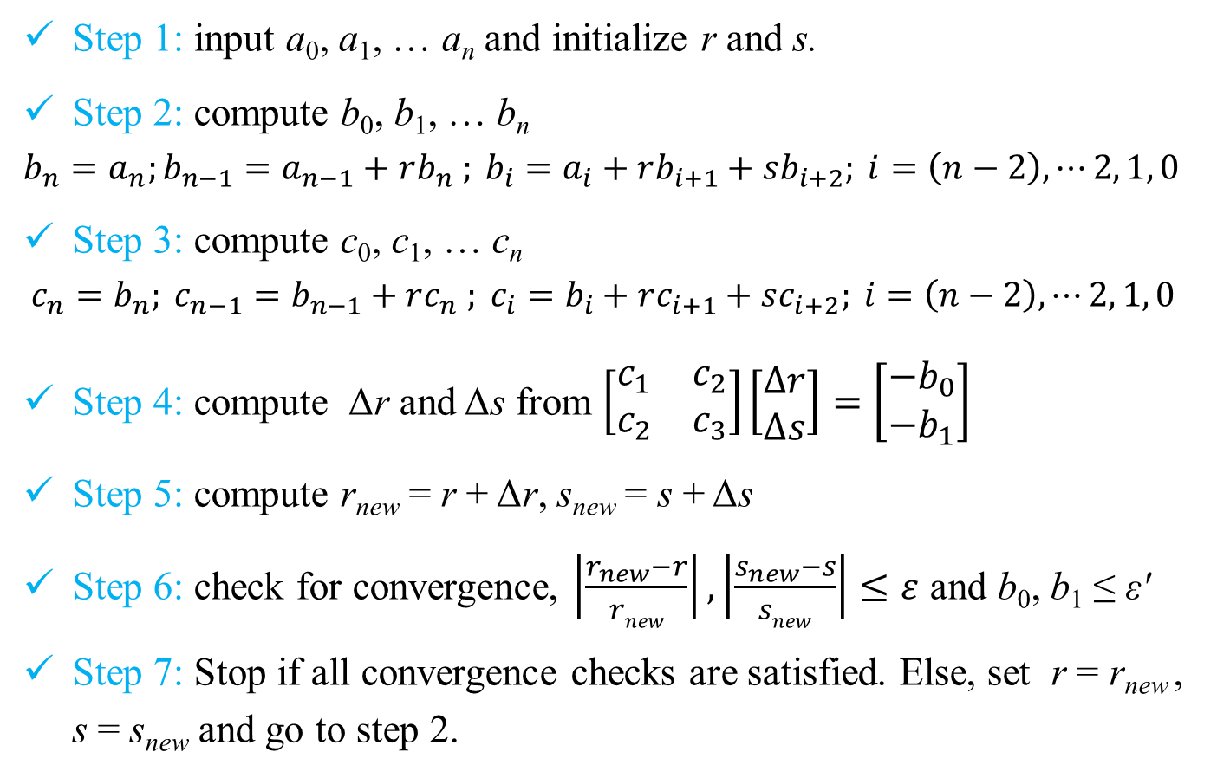
Polynomial Methods: Bairstow's Algorithm
Step 1: input a₀, a₁, … a_{n} and initialize r and s.
Step 2: compute b₀, b₁, … b_{n}
$$b_{n}=a_{n};b_{n−1}=a_{n−1}+rb_{n} ; b_{i}=a_{i}+rb_{i+1}+sb_{i+2}; i=\left(n−2\right), ⋯2, 1, 0$$
Step 3: compute c₀, c₁, … c_{n}
$$c_{n}=b_{n}; c_{n−1}=b_{n−1}+rc_{n} ; c_{i}=b_{i}+rc_{i+1}+sc_{i+2}; i=\left(n−2\right), ⋯2, 1, 0$$
Step 4: compute Δr and Δs from $\left[\begin{matrix}c_{1} & c_{2} \\ c_{2} & c_{3}\end{matrix}\right]\left[\begin{matrix}∆r \\ ∆s\end{matrix}\right]=\left[\begin{matrix}−b_{0} \\ −b_{1}\end{matrix}\right]$
Step 5: compute r_{new} = r + Δr, s_{new} = s + Δs
Step 6: check for convergence, $\left|\frac{r_{new}−r}{rnew}\right|,\left|\frac{s_{new}−s}{snew}\right|≤ε$ and b₀, b₁ ≤ εʹ
Step 7: Stop if all convergence checks are satisfied. Else, set r = r_{new} , s = s_{new} and go to step 2.

Slide 16
Bairstow's Method
Step 8. The roots quadratic polynomial x²-rx-s are obtained as
Step 9. At this point three possibilities exist:
The quotient is a third-order polynomial or greater. The previous values of r and s serve as initial guesses and Bairstow’s method is applied to the quotient to evaluate new r and s values.
The quotient is quadratic. The remaining two roots are evaluated directly, using the above eqn.
The quotient is a 1st order polynomial. The remaining single root can be evaluated simply as x=-s/r.

Slide 17
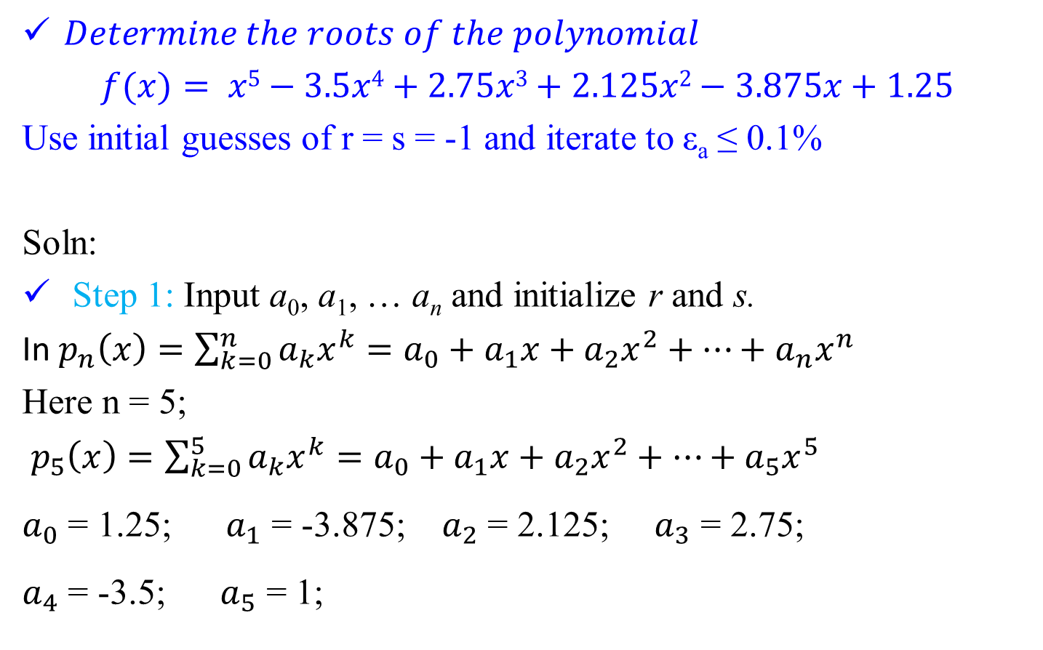
Example Problem
$Determine the roots of the polynomial$
$$f(x)= x5−3.5x4+2.75x3+2.125x2−3.875x+1.25$$
Use initial guesses of r = s = -1 and iterate to ε_{a} ≤ 0.1%
Soln:
Step 1: Input a₀, a₁, … a_{n} and initialize r and s.
In $p_{n}\left(x\right)=\sum_{k=0}^{n}{a_{k}x^{k}}=a_{0}+a_{1}x+a_{2}x^{2}+…+a_{n}x^{n}$
Here n = 5;
$p_{5}\left(x\right)=\sum_{k=0}^{5}{a_{k}x^{k}}=a_{0}+a_{1}x+a_{2}x^{2}+…+a_{5}x^{5}$
$a_{0}$ = 1.25; $a_{1}$ = -3.875; $a_{2}$ = 2.125; $a_{3}$ = 2.75;
$a_{4}$ = -3.5; $a_{5}$ = 1;

Slide 18
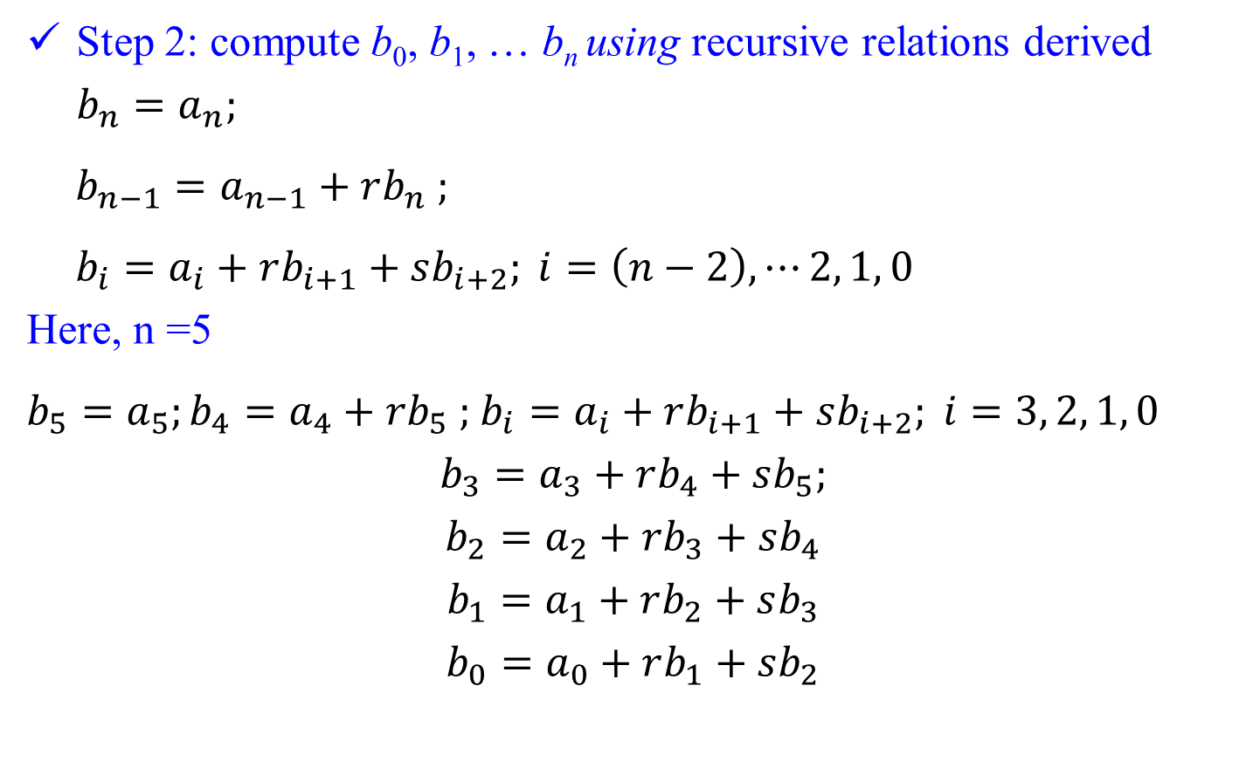
Example Problem
Step 2: compute b₀, b₁, … b_{n} using recursive relations derived $b_{n}=a_{n};$
$b_{n−1}=a_{n−1}+rb_{n} ;$
$b_{i}=a_{i}+rb_{i+1}+sb_{i+2}; i=\left(n−2\right), ⋯2, 1, 0$
Here, n =5
$b_{5}=a_{5};b_{4}=a_{4}+rb_{5} ;$ $b_{i}=a_{i}+rb_{i+1}+sb_{i+2}; i=3, 2, 1, 0$
$$b_{3}=a_{3}+rb_{4}+sb_{5};$$
$$b_{2}=a_{2}+rb_{3}+sb_{4}$$
$$b_{1}=a_{1}+rb_{2}+sb_{3}$$
$$b_{0}=a_{0}+rb_{1}+sb_{2}$$

Slide 19
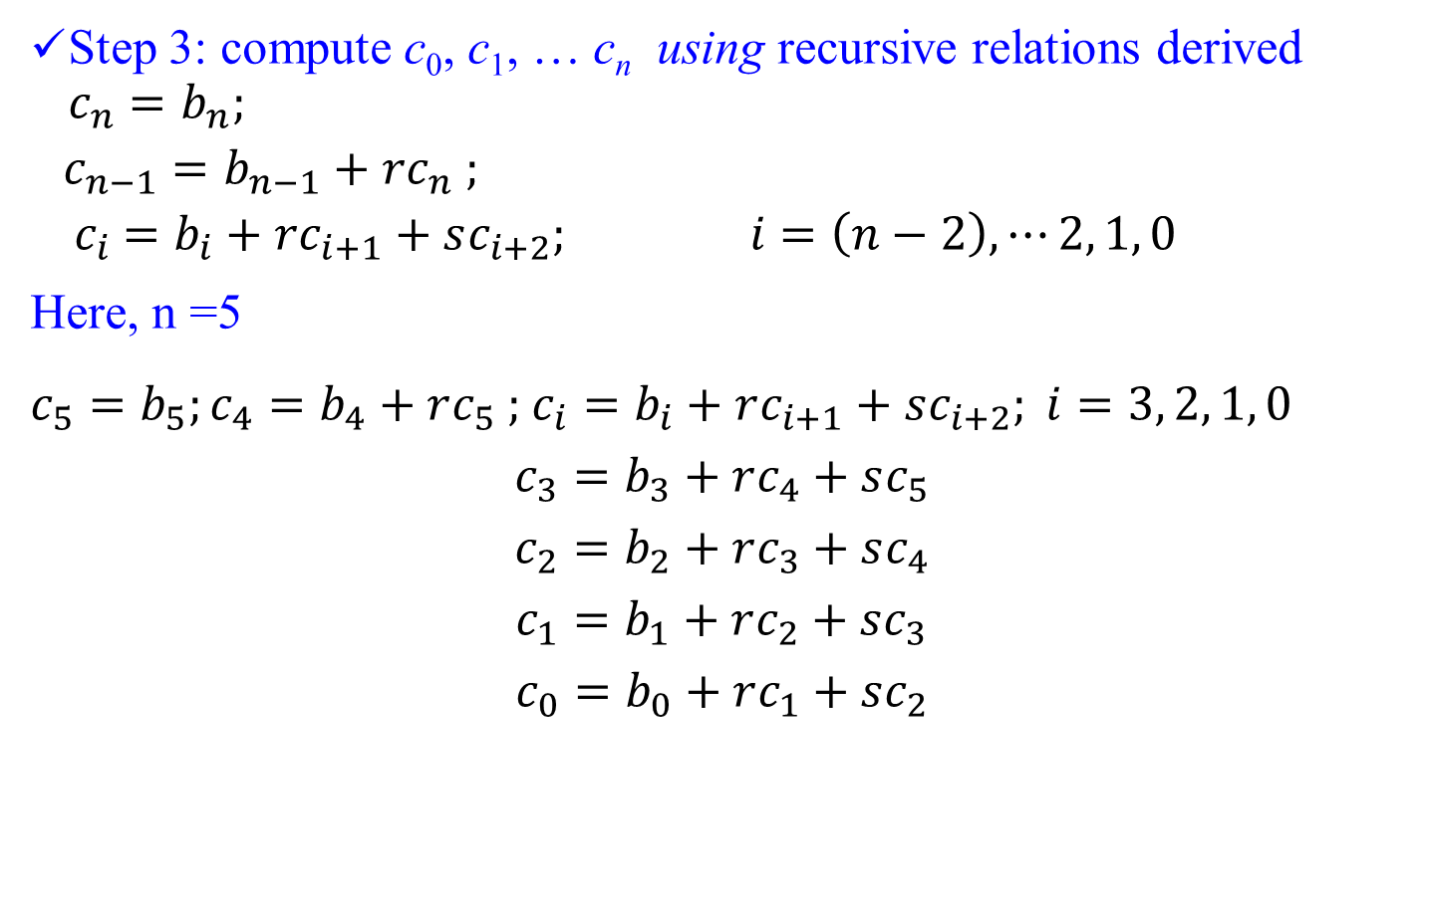
Example Problem
Step 3: compute c₀, c₁, … c_{n} using recursive relations derived $c_{n}=b_{n};$
$$c_{n−1}=b_{n−1}+rc_{n} ;$$
$${ c}_{i} =b_{i}+rc_{i+1}+sc_{i+2}; i=\left(n−2\right), ⋯2, 1, 0$$
Here, n =5
$c_{5}=b_{5};c_{4}=b_{4}+rc_{5} ;$ $c_{i}=b_{i}+rc_{i+1}+sc_{i+2}; i=3, 2, 1, 0$
$$c_{3}=b_{3}+rc_{4}+sc_{5}$$
$$c_{2}=b_{2}+rc_{3}+sc_{4}$$
$$c_{1}=b_{1}+rc_{2}+sc_{3}$$
$$c_{0}=b_{0}+rc_{1}+sc_{2}$$

Slide 20
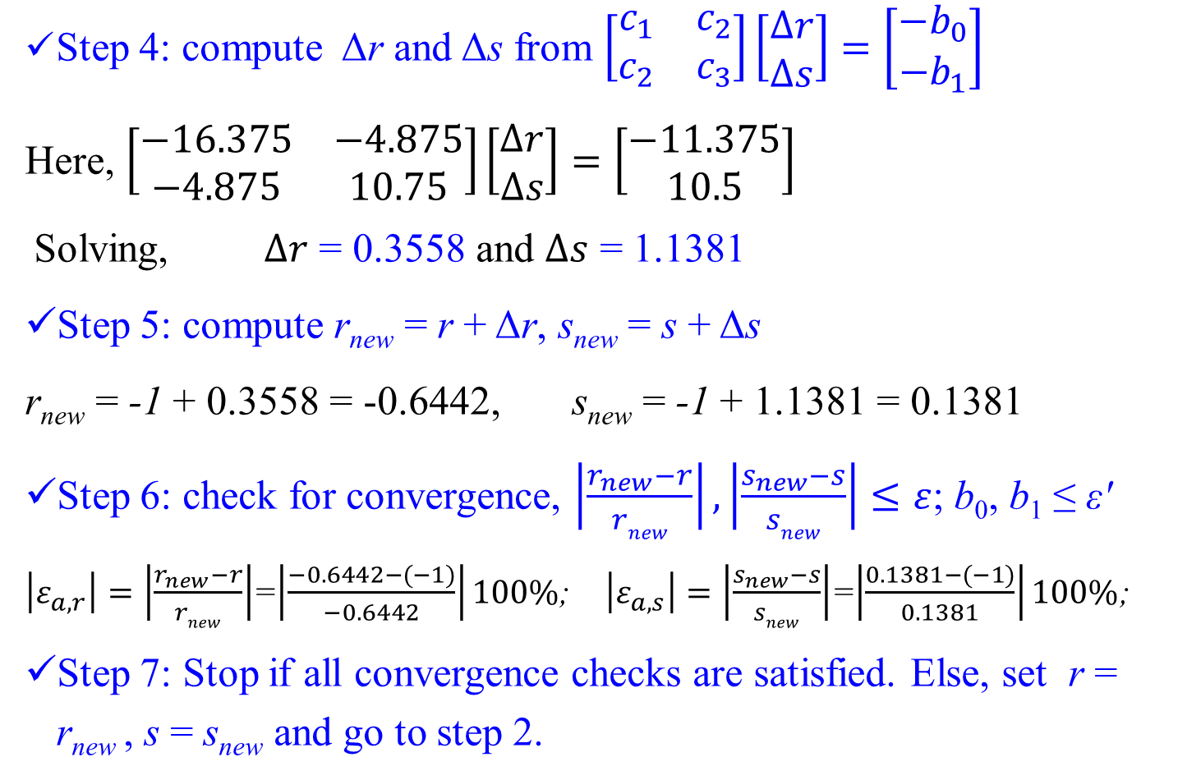
Example Problem
Step 4: compute Δr and Δs from $\left[\begin{matrix}c_{1} & c_{2} \\ c_{2} & c_{3}\end{matrix}\right]\left[\begin{matrix}∆r \\ ∆s\end{matrix}\right]=\left[\begin{matrix}−b_{0} \\ −b_{1}\end{matrix}\right]$
Here, $\left[\begin{matrix}−16.375 & −4.875 \\ −4.875 & 10.75\end{matrix}\right]\left[\begin{matrix}∆r \\ ∆s\end{matrix}\right]=\left[\begin{matrix}−11.375 \\ 10.5\end{matrix}\right]$
Solving, $∆r$ = 0.3558 and $∆s$ = 1.1381
Step 5: compute r_{new} = r + Δr, s_{new} = s + Δs
r_{new} = -1 + 0.3558 = -0.6442, s_{new} = -1 + 1.1381 = 0.1381
Step 6: check for convergence, $\left|\frac{r_{new}−r}{rnew}\right|,\left|\frac{s_{new}−s}{snew}\right|≤ε$; b₀, b₁ ≤ εʹ
$\left|ε_{a,r}\right|=\left|\frac{r_{new}−r}{rnew}\right|$=$\left|\frac{−0.6442−(−1)}{−0.6442}\right|100\%$; $\left|ε_{a,s}\right|=\left|\frac{s_{new}−s}{snew}\right|$=$\left|\frac{0.1381−(−1)}{0.1381}\right|100\%$;
Step 7: Stop if all convergence checks are satisfied. Else, set r = r_{new} , s = s_{new} and go to step 2.

Slide 21
Bairstow's Method
Step 8. The roots quadratic polynomial x²-rx-s are obtained as
Step 9. At this point three possibilities exist:
The quotient is a third-order polynomial or greater. The previous values of r and s serve as initial guesses and Bairstow’s method is applied to the quotient to evaluate new r and s values.
The quotient is quadratic. The remaining two roots are evaluated directly, using the above eqn.
The quotient is a 1st order polynomial. The remaining single root can be evaluated simply as x=-s/r.

Slide 22
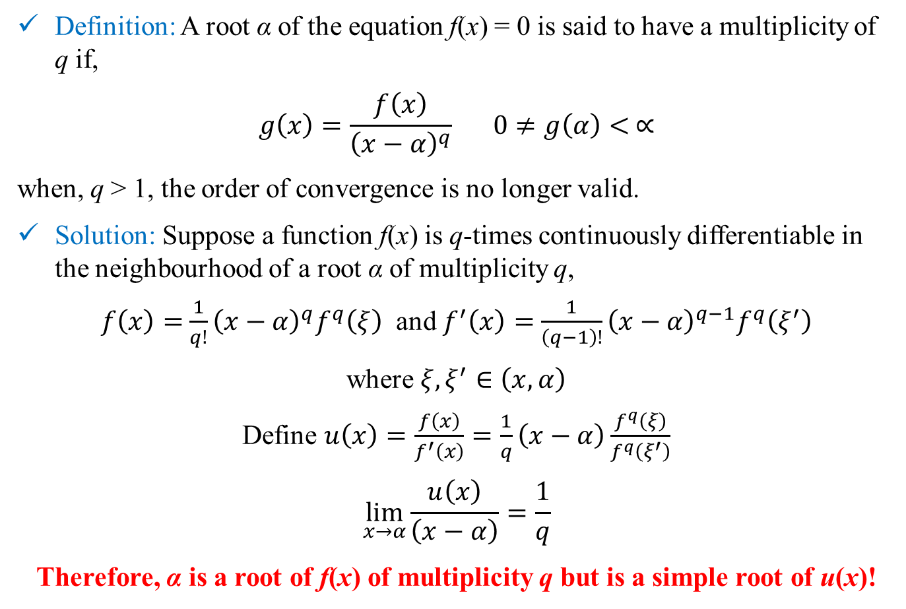
Multiple Roots
Definition: A root α of the equation f(x) = 0 is said to have a multiplicity of q if,
$$g\left(x\right)=\frac{f\left(x\right)}{{\left(x−α\right)}^{q}} 0≠g\left(α\right)< ∝$$
when, q > 1, the order of convergence is no longer valid.
Solution: Suppose a function f(x) is q-times continuously differentiable in the neighbourhood of a root α of multiplicity q,
$f\left(x\right)=$ $\frac{1}{q!}{\left(x−α\right)}^{q}f^{q}\left(ξ\right)$ and $f^{′}\left(x\right)=$ $\frac{1}{\left(q−1\right)!}{\left(x−α\right)}^{q−1}f^{q}\left(ξ^{′}\right)$
where $ξ,ξ^{′}∈\left(x,α\right)$
Define $u\left(x\right)=\frac{f\left(x\right)}{f^{′}\left(x\right)}=\frac{1}{q}\left(x−α\right)\frac{f^{q}\left(ξ\right)}{f^{q}\left(ξ^{′}\right)}$
$$\lim_{x→α}{\frac{u\left(x\right)}{\left(x−α\right)}}=\frac{1}{q}$$
Therefore, α is a root of f(x) of multiplicity q but is a simple root of u(x)!

Slide 23
Revision of Solution of Non-linear Equations
Graphical Method – Provide insights but tedious/subjective
Bracketing methods
Bisection method
False position method
Modified false position method
Open methods
Fixed-point iteration
Newton-Raphson
Secant & Modified Secant
Guaranteed convergence
Linear or better convergence
May diverge
FP - linear convergence
NR – quadratic convergence
Secant – between linear & quadratic
NR – problems near zero gradient

Slide 24
Revision of Solution of Non-linear Equations
Hybrid Methods
Dekker method
Brent method
Multiple roots
Bracketing method – Only for odd number of roots
Newton-Raphson - Linear convergence
Modified Newton Raphson – Quadratic convergence
Known multiplicity
Derivative function
Combination
Bracketing method at the beginning
Open method near convergence

Slide 25
Revision of Solution of Non-linear Equations
Roots of polynomials
Evaluation of polynomials
Division of polynomials
Deflation of polynomials
Effective degree of polynomials
Method of finding roots
Müller method
Bairstow's method
Real and complex rooots

Slide 26
Revision of Solution of Non-linear Equations
Except for rare cases, computers will provide approximate solution.
No method is “universally” better than others.
Domain knowledge should guide the selection of algorithm and guess value(s).

Slide 27
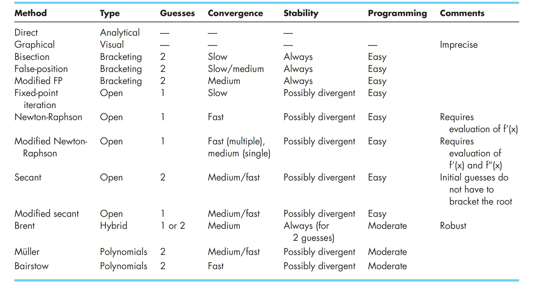
Comparison of different algorithms

