Slide 1
Revision of Solution of Non-linear Equations
Graphical Method – Provide insights but tedious/subjective
Bracketing methods
Bisection method
False position method
Modified false position method
Open methods
Fixed-point iteration
Newton-Raphson
Secant & Modified Secant
Guaranteed convergence
Linear or better convergence
May diverge
FP - linear convergence
NR – quadratic convergence
Secant – between linear & quadratic
NR – problems near zero gradient

Slide 2
Revision of Solution of Non-linear Equations
Hybrid Methods
Dekker method
Brent method
Multiple roots
Bracketing method – Only for odd number of roots
Newton-Raphson - Linear convergence
Modified Newton Raphson – Quadratic convergence
Known multiplicity
Derivative function
Combination
Bracketing method at the beginning
Open method near convergence

Slide 3
Revision of Solution of Non-linear Equations
Roots of polynomials
Evaluation of polynomials
Division of polynomials
Deflation of polynomials
Effective degree of polynomials
Method of finding roots
Müller method
Bairstow's method
Real and complex rooots

Slide 4
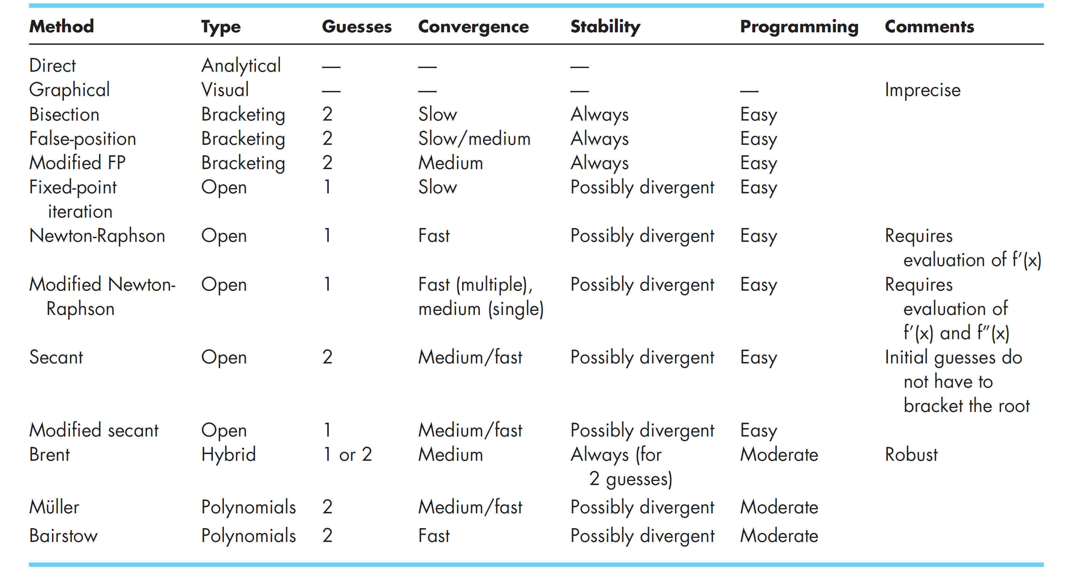
Comparison of different algorithms

Slide 5
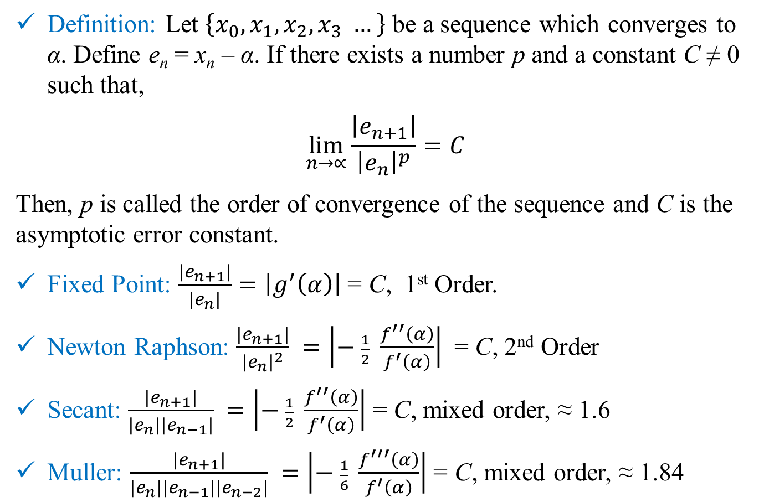
Order of Convergence
Definition: Let $\left\{x_{0},x_{1},x_{2},x_{3} …\right\}$ be a sequence which converges to α. Define e_{n} = x_{n} – α. If there exists a number p and a constant C ≠ 0 such that,
$$\lim_{n→∝}{\frac{\left|e_{n+1}\right|}{{\left|e_{n}\right|}^{p}}}=C$$
Then, p is called the order of convergence of the sequence and C is the asymptotic error constant.
Fixed Point: $\frac{\left|e_{n+1}\right|}{\left|e_{n}\right|}=\left|g^{′}\left(α\right)\right|$ = C, 1st Order.
Newton Raphson: $\frac{\left|e_{n+1}\right|}{{\left|e_{n}\right|}^{2}} =\left|− \frac{1}{2} \frac{f^{′′}\left(α\right)}{f^{′}\left(α\right)}\right|$ = C, 2nd Order
Secant: $\frac{\left|e_{n+1}\right|}{\left|e_{n}\right|\left|e_{n−1}\right|} =\left|− \frac{1}{2} \frac{f^{′′}\left(α\right)}{f^{′}\left(α\right)}\right|$ = C, mixed order, ≈ 1.6
Muller: $\frac{\left|e_{n+1}\right|}{\left|e_{n}\right|\left|e_{n−1}\right|\left|e_{n−2}\right|} =\left|− \frac{1}{6} \frac{f^{′′′}\left(α\right)}{f^{′}\left(α\right)}\right|$ = C, mixed order, ≈ 1.84

Slide 6
Revision of Solution of Non-linear Equations
Except for rare cases, computers will provide approximate solution.
No method is “universally” better than others.
Domain knowledge should guide the selection of algorithm and guess value(s).

Slide 7

ESO 208A: Computational Methods in Engineering System of Linear Equations
Abhas Singh
Department of Civil Engineering
IIT Kanpur
Acknowledgements: Profs. Saumyen Guha and Shivam Tripathi (CE)

Slide 8
System of Linear Equations:
Ax = b
A is a square matrix of size n × n
x and b are vectors of size n
Background assumed (MTH 102): various types of matrices (orthogonal, orthonormal, positive-definite, etc.); matrix operations (transpose, adjoint, multiplication, determinant); vector space; column space; null space; rank; conditions for existence of solution; uniqueness of solution; eigenvalues, eigenvectors; diagonalization; vector and matrix norms; etc.

Slide 9
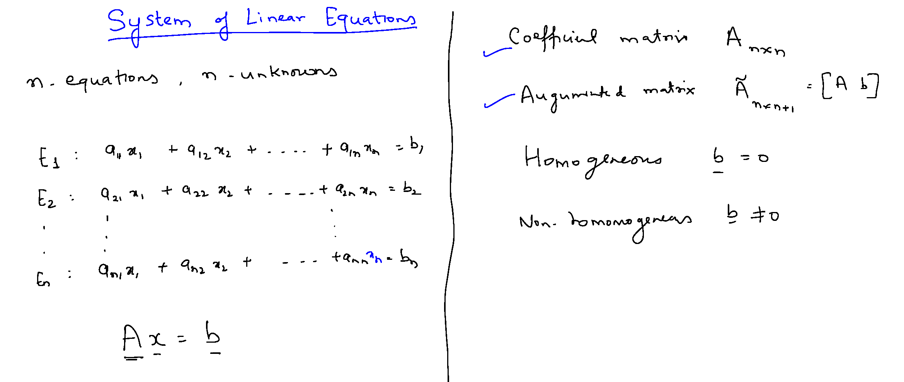

Slide 10
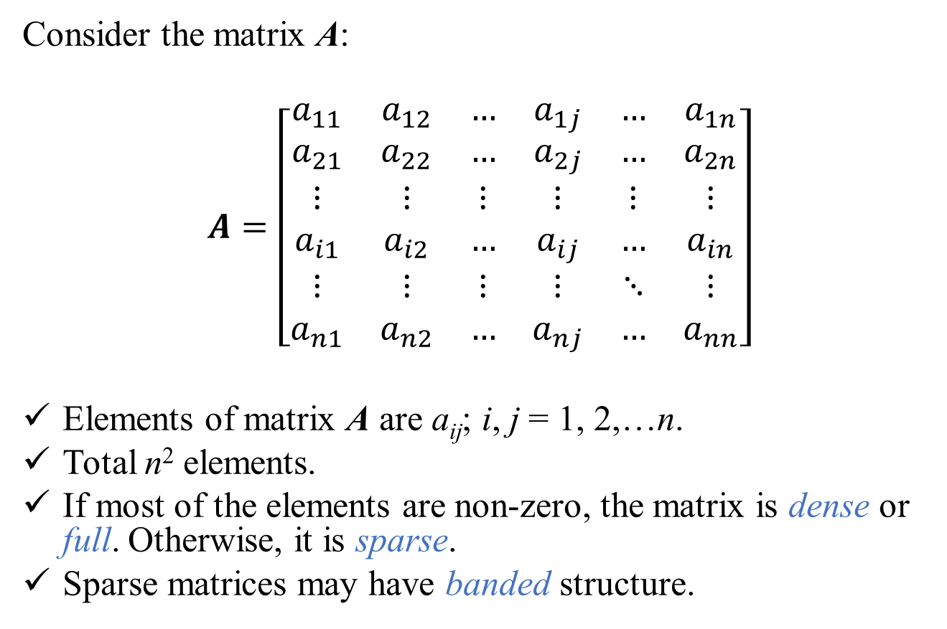
Consider the matrix A:
$$A=\left[\begin{matrix}a_{11} & a_{12} & … & a_{1j} & … & a_{1n} \\ a_{21} & a_{22} & … & a_{2j} & … & a_{2n} \\ ⋮ & ⋮ & ⋮ & ⋮ & ⋮ & ⋮ \\ a_{i1} & a_{i2} & … & a_{ij} & … & a_{in} \\ ⋮ & ⋮ & ⋮ & ⋮ & ⋱ & ⋮ \\ a_{n1} & a_{n2} & … & a_{nj} & … & a_{nn}\end{matrix}\right]$$
Elements of matrix A are a_{ij}; i, j = 1, 2,…n.
Total n² elements.
If most of the elements are non-zero, the matrix is dense or full. Otherwise, it is sparse.
Sparse matrices may have banded structure.

Slide 11
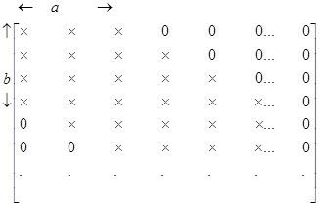
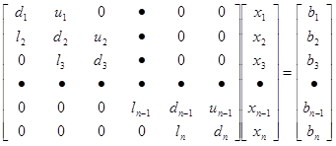
Banded Matrix
Band Width = a + b - 1
A system of equations with Tri-diagonal coefficient matrix. Total number of elements = n². Non-zero elements = 3n-2

Slide 12
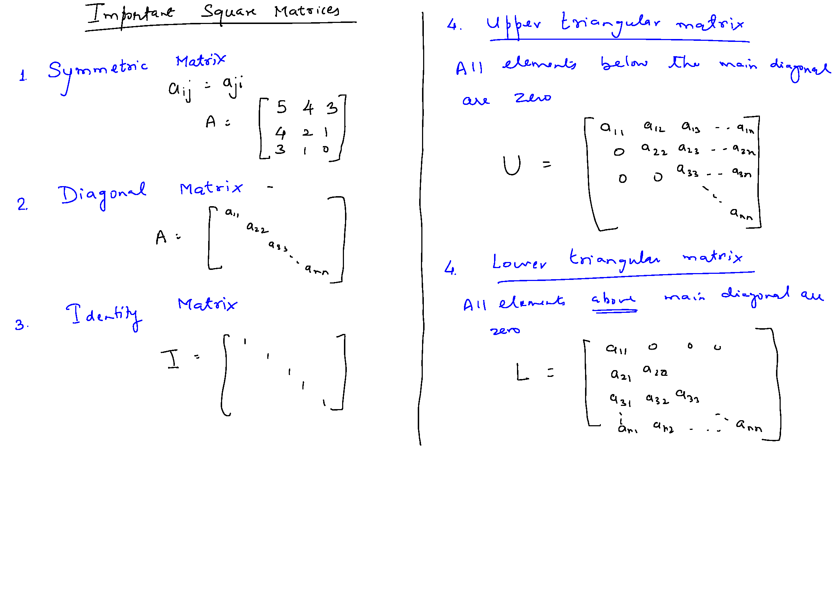

Slide 14
Methods for Solution of the System of Equations:
Ax = b
Direct Methods: one obtains the exact solution (ignoring the round-off errors) in a finite number of steps. These group of methods are more efficient for dense and banded matrices.
Gauss Elimination; Gauss-Jordon Elimination
LU-Decomposition
Thomas Algorithm (for tri-diagonal banded matrix)
Iterative Methods: solution is obtained through successive approximation. Number of computations is a function of desired accuracy/precision of the solution and are not known apriori. More efficient for sparse matrices.
Jacobi Iterations
Gauss Seidal Iterations with Successive Over/Under Relaxation

Slide 15
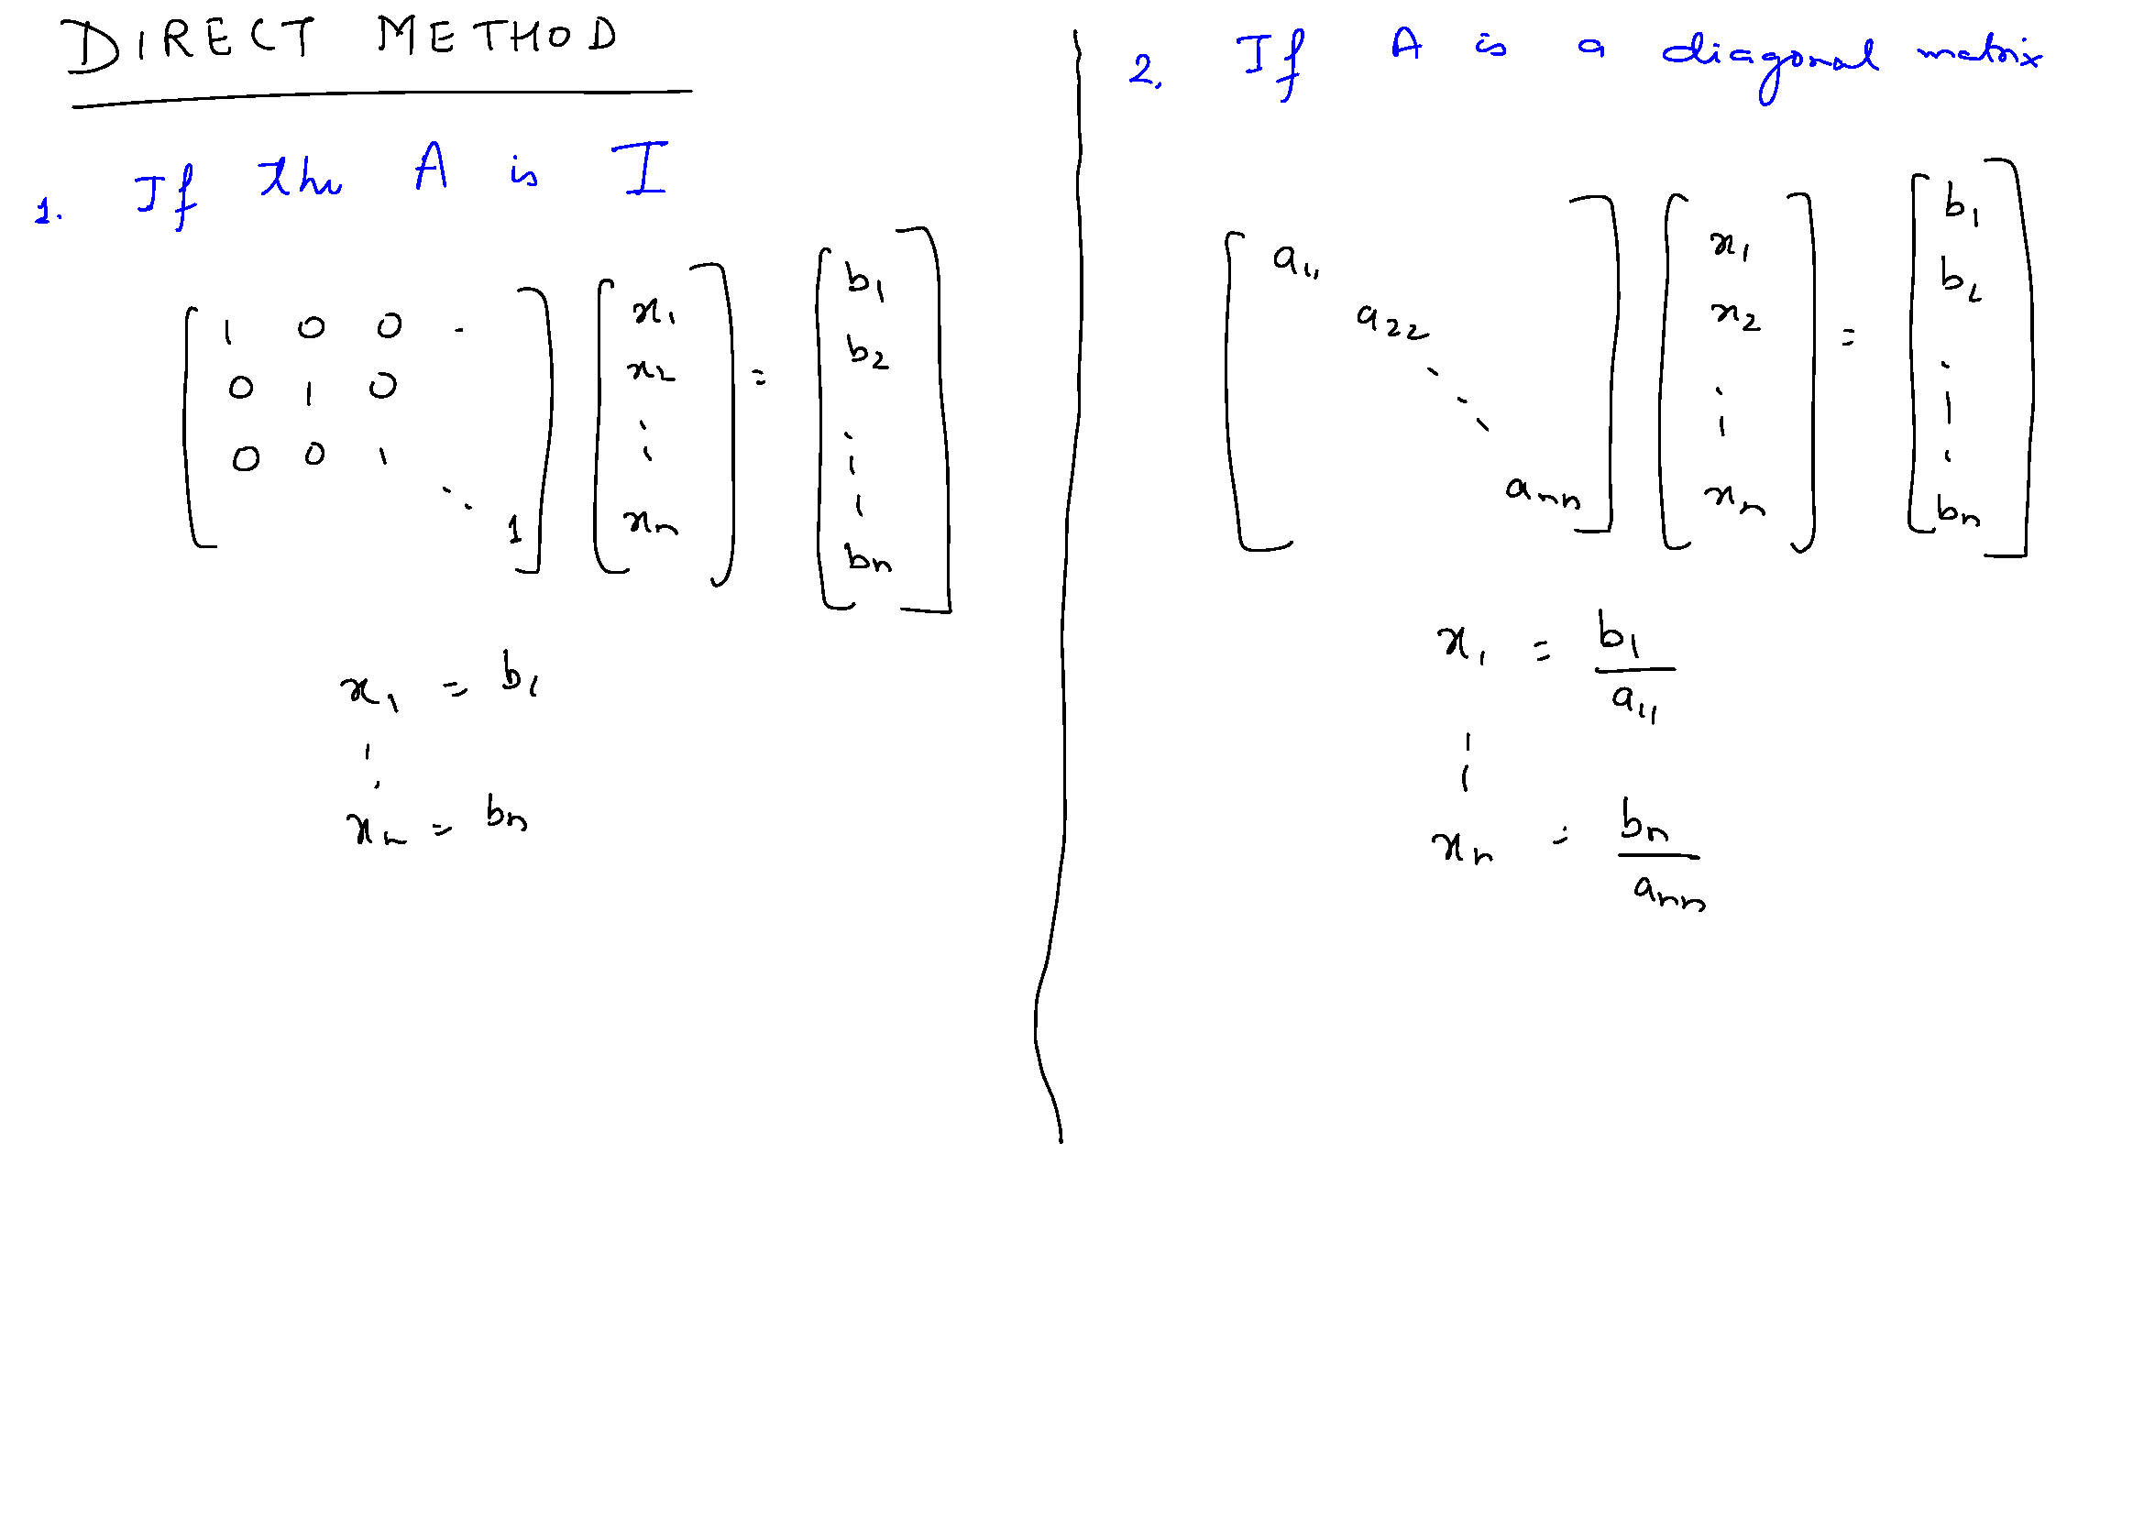

Slide 17
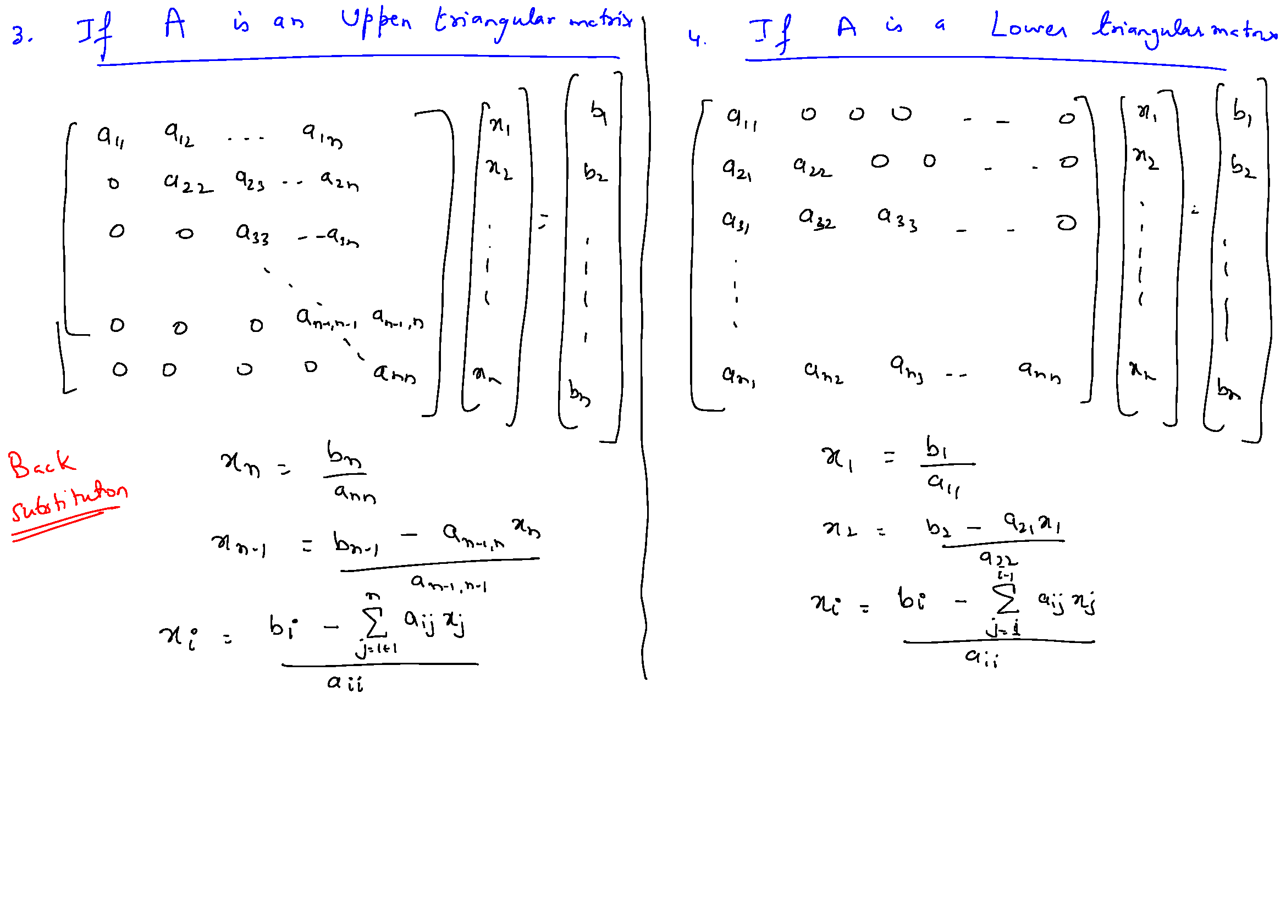

Slide 18
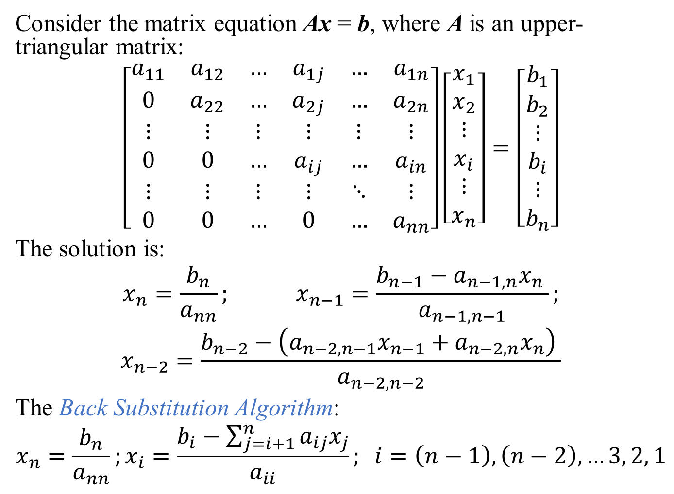
Consider the matrix equation Ax = b, where A is an upper-triangular matrix:
$$\left[\begin{matrix}a_{11} & a_{12} & … & a_{1j} & … & a_{1n} \\ 0 & a_{22} & … & a_{2j} & … & a_{2n} \\ ⋮ & ⋮ & ⋮ & ⋮ & ⋮ & ⋮ \\ 0 & 0 & … & a_{ij} & … & a_{in} \\ ⋮ & ⋮ & ⋮ & ⋮ & ⋱ & ⋮ \\ 0 & 0 & … & 0 & … & a_{nn}\end{matrix}\right]\left[\begin{matrix}x_{1} \\ x_{2} \\ ⋮ \\ x_{i} \\ ⋮ \\ x_{n}\end{matrix}\right]=\left[\begin{matrix}b_{1} \\ b_{2} \\ ⋮ \\ b_{i} \\ ⋮ \\ b_{n}\end{matrix}\right]$$
The solution is:
$$x_{n}=\frac{b_{n}}{a_{nn}}; x_{n−1}=\frac{b_{n−1}−a_{n−1,n}x_{n} }{a_{n−1,n−1}};$$
$$x_{n−2}=\frac{b_{n−2}−\left(a_{n−2,n−1}x_{n−1}+a_{n−2,n}x_{n}\right) }{a_{n−2,n−2}}$$
The Back Substitution Algorithm:
$$x_{n}=\frac{b_{n}}{a_{nn}};x_{i}=\frac{b_{i}−\sum_{j=i+1}^{n}{a_{ij}x_{j}}}{a_{ii}}; i=\left(n−1\right), \left(n−2\right), …3, 2, 1$$

Slide 20
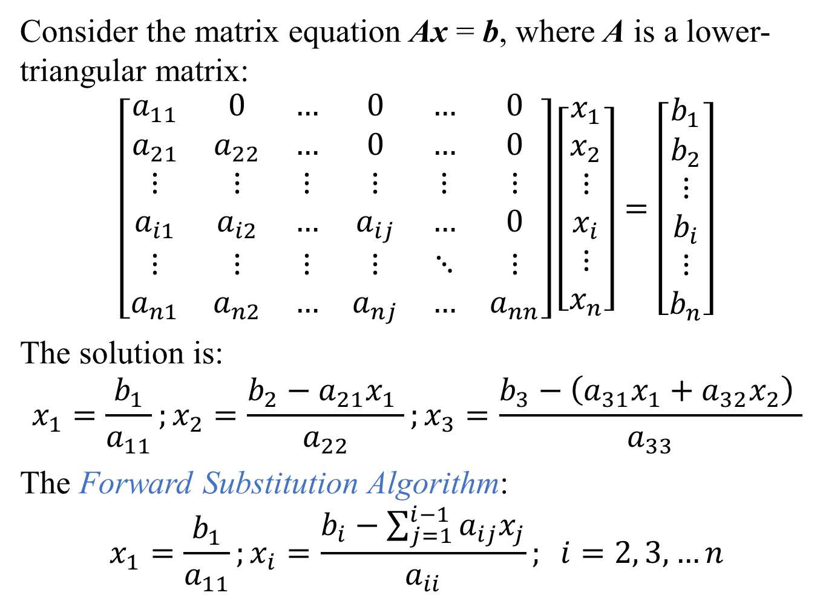
Consider the matrix equation Ax = b, where A is a lower-triangular matrix:
$$\left[\begin{matrix}a_{11} & 0 & … & 0 & … & 0 \\ a_{21} & a_{22} & … & 0 & … & 0 \\ ⋮ & ⋮ & ⋮ & ⋮ & ⋮ & ⋮ \\ a_{i1} & a_{i2} & … & a_{ij} & … & 0 \\ ⋮ & ⋮ & ⋮ & ⋮ & ⋱ & ⋮ \\ a_{n1} & a_{n2} & … & a_{nj} & … & a_{nn}\end{matrix}\right]\left[\begin{matrix}x_{1} \\ x_{2} \\ ⋮ \\ x_{i} \\ ⋮ \\ x_{n}\end{matrix}\right]=\left[\begin{matrix}b_{1} \\ b_{2} \\ ⋮ \\ b_{i} \\ ⋮ \\ b_{n}\end{matrix}\right]$$
The solution is:
$$x_{1}=\frac{b_{1}}{a_{11}};x_{2}=\frac{b_{2}−a_{21}x_{1} }{a_{22}};x_{3}=\frac{b_{3}−\left(a_{31}x_{1}+a_{32}x_{2}\right) }{a_{33}}$$
The Forward Substitution Algorithm:
$$x_{1}=\frac{b_{1}}{a_{11}};x_{i}=\frac{b_{i}−\sum_{j=1}^{i−1}{a_{ij}x_{j}}}{a_{ii}}; i=2, 3, …n$$

Slide 21
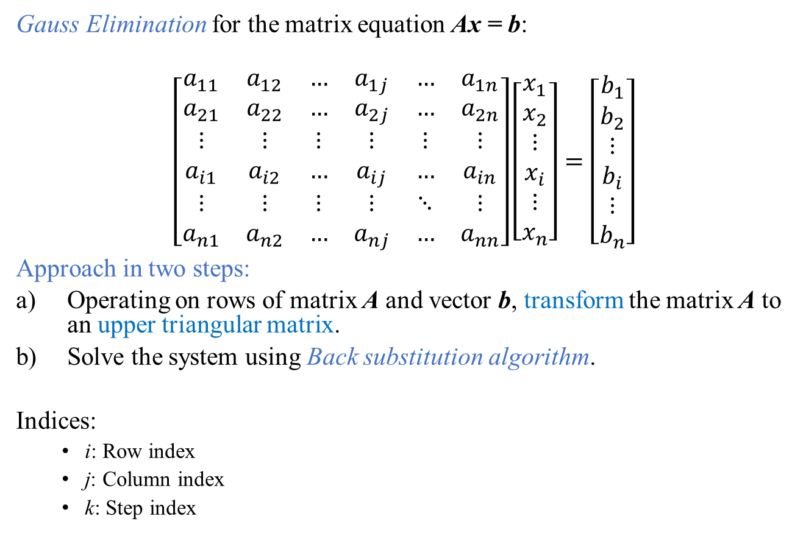
Gauss Elimination for the matrix equation Ax = b:
$$\left[\begin{matrix}a_{11} & a_{12} & … & a_{1j} & … & a_{1n} \\ a_{21} & a_{22} & … & a_{2j} & … & a_{2n} \\ ⋮ & ⋮ & ⋮ & ⋮ & ⋮ & ⋮ \\ a_{i1} & a_{i2} & … & a_{ij} & … & a_{in} \\ ⋮ & ⋮ & ⋮ & ⋮ & ⋱ & ⋮ \\ a_{n1} & a_{n2} & … & a_{nj} & … & a_{nn}\end{matrix}\right]\left[\begin{matrix}x_{1} \\ x_{2} \\ ⋮ \\ x_{i} \\ ⋮ \\ x_{n}\end{matrix}\right]=\left[\begin{matrix}b_{1} \\ b_{2} \\ ⋮ \\ b_{i} \\ ⋮ \\ b_{n}\end{matrix}\right]$$
Approach in two steps:
Operating on rows of matrix A and vector b, transform the matrix A to an upper triangular matrix.
Solve the system using Back substitution algorithm.
Indices:
i: Row index
j: Column index
k: Step index

Slide 22
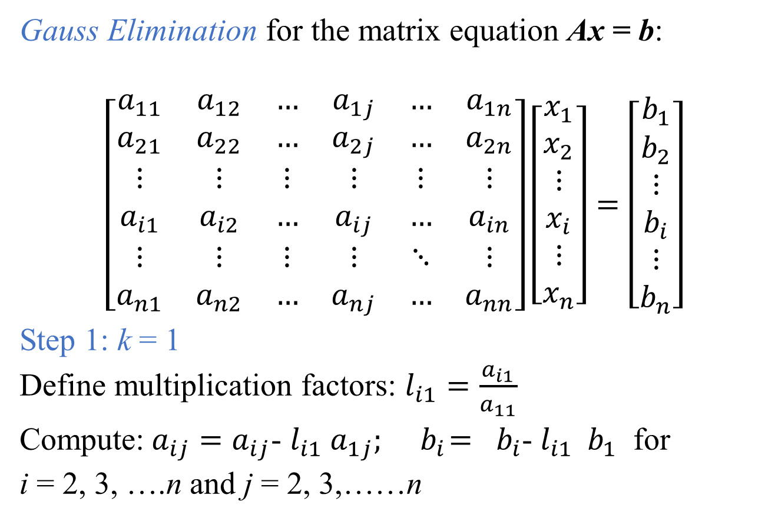
Gauss Elimination for the matrix equation Ax = b:
$$\left[\begin{matrix}a_{11} & a_{12} & … & a_{1j} & … & a_{1n} \\ a_{21} & a_{22} & … & a_{2j} & … & a_{2n} \\ ⋮ & ⋮ & ⋮ & ⋮ & ⋮ & ⋮ \\ a_{i1} & a_{i2} & … & a_{ij} & … & a_{in} \\ ⋮ & ⋮ & ⋮ & ⋮ & ⋱ & ⋮ \\ a_{n1} & a_{n2} & … & a_{nj} & … & a_{nn}\end{matrix}\right]\left[\begin{matrix}x_{1} \\ x_{2} \\ ⋮ \\ x_{i} \\ ⋮ \\ x_{n}\end{matrix}\right]=\left[\begin{matrix}b_{1} \\ b_{2} \\ ⋮ \\ b_{i} \\ ⋮ \\ b_{n}\end{matrix}\right]$$
Step 1: k = 1
Define multiplication factors: $l_{i1}=\frac{a_{i1}}{a_{11}}$
Compute:$a_{ij}=a_{ij}$- $l_{i1}$ $a_{1j}; { b}_{i}={ b}_{i}\text{−} l_{i1}{ b}_{1}$ for
i = 2, 3, ….n and j = 2, 3,……n

Slide 23
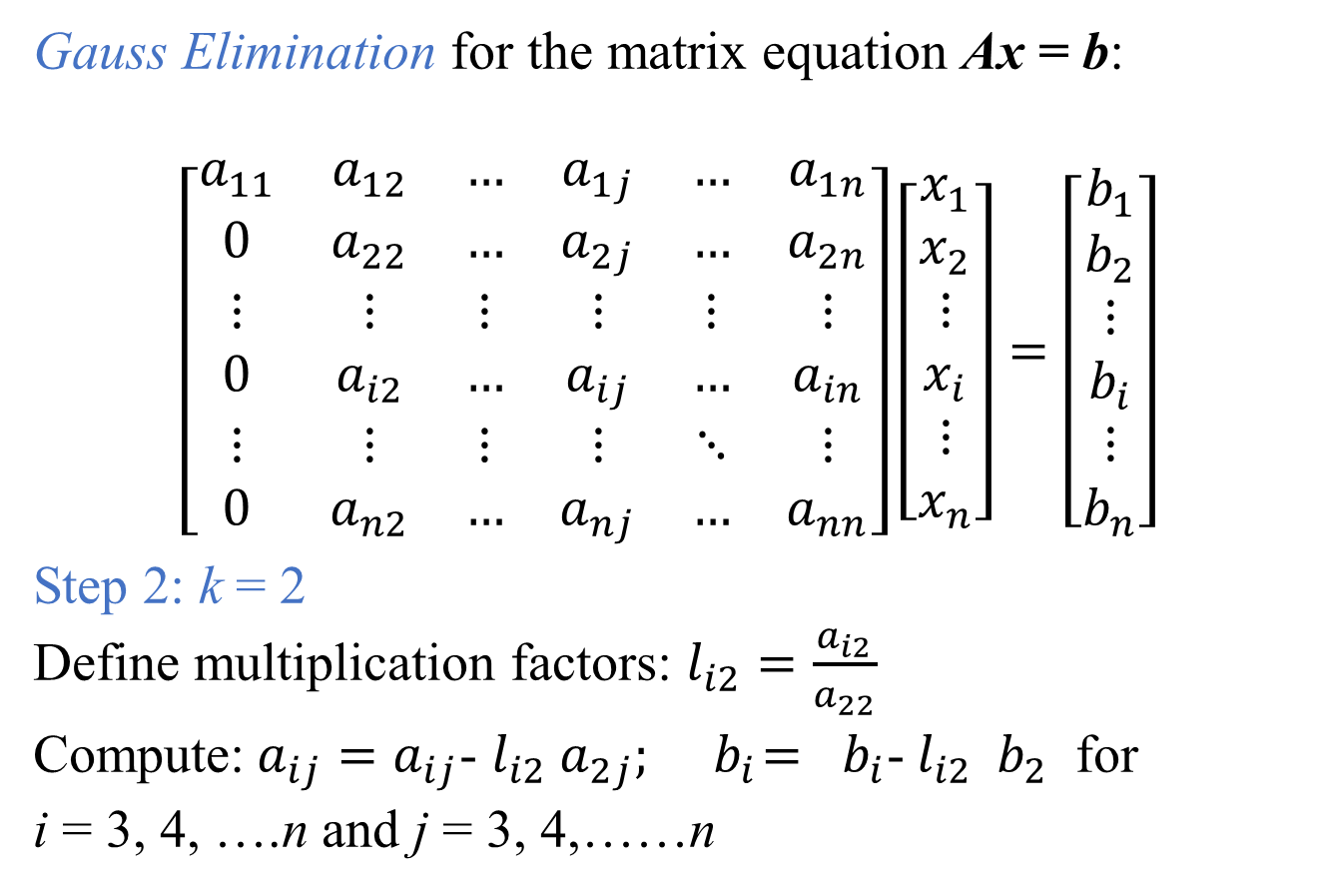
Gauss Elimination for the matrix equation Ax = b:
$$\left[\begin{matrix}a_{11} & a_{12} & … & a_{1j} & … & a_{1n} \\ 0 & a_{22} & … & a_{2j} & … & a_{2n} \\ ⋮ & ⋮ & ⋮ & ⋮ & ⋮ & ⋮ \\ 0 & a_{i2} & … & a_{ij} & … & a_{in} \\ ⋮ & ⋮ & ⋮ & ⋮ & ⋱ & ⋮ \\ 0 & a_{n2} & … & a_{nj} & … & a_{nn}\end{matrix}\right]\left[\begin{matrix}x_{1} \\ x_{2} \\ ⋮ \\ x_{i} \\ ⋮ \\ x_{n}\end{matrix}\right]=\left[\begin{matrix}b_{1} \\ b_{2} \\ ⋮ \\ b_{i} \\ ⋮ \\ b_{n}\end{matrix}\right]$$
Step 2: k = 2
Define multiplication factors: $l_{i2}=\frac{a_{i2}}{a_{22}}$
Compute:$a_{ij}=a_{ij}$- $l_{i2}$ $a_{2j}; { b}_{i}={ b}_{i}\text{−} l_{i2}{ b}_{2}$ for
i = 3, 4, ….n and j = 3, 4,……n

Slide 24
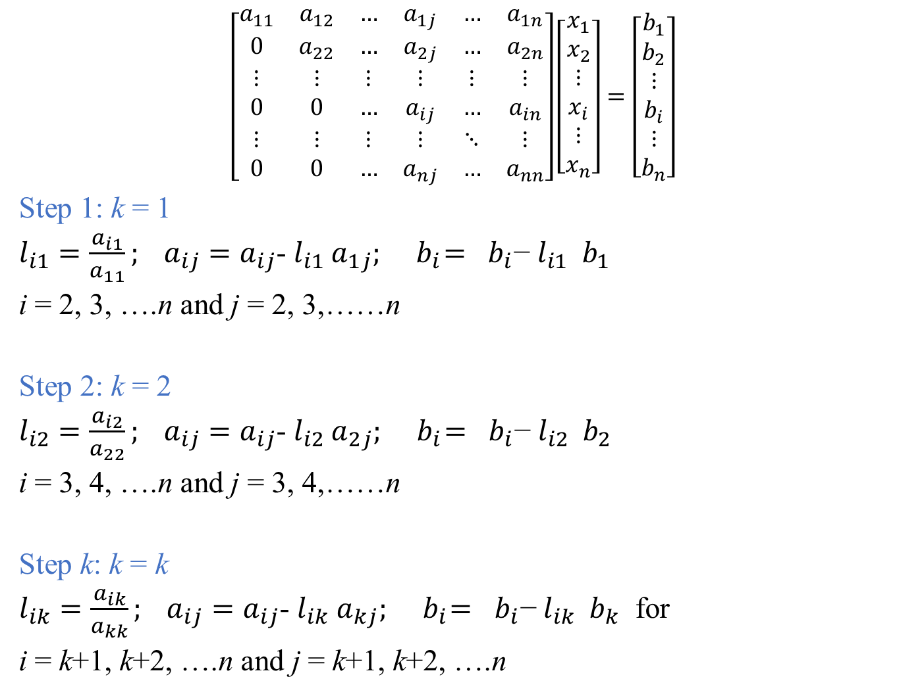
$$\left[\begin{matrix}a_{11} & a_{12} & … & a_{1j} & … & a_{1n} \\ 0 & a_{22} & … & a_{2j} & … & a_{2n} \\ ⋮ & ⋮ & ⋮ & ⋮ & ⋮ & ⋮ \\ 0 & 0 & … & a_{ij} & … & a_{in} \\ ⋮ & ⋮ & ⋮ & ⋮ & ⋱ & ⋮ \\ 0 & 0 & … & a_{nj} & … & a_{nn}\end{matrix}\right]\left[\begin{matrix}x_{1} \\ x_{2} \\ ⋮ \\ x_{i} \\ ⋮ \\ x_{n}\end{matrix}\right]=\left[\begin{matrix}b_{1} \\ b_{2} \\ ⋮ \\ b_{i} \\ ⋮ \\ b_{n}\end{matrix}\right]$$
Step 1: k = 1
$l_{i1}=\frac{a_{i1}}{a_{11}}; a_{ij}=a_{ij}$- $l_{i1}$ $a_{1j}; { b}_{i}={ b}_{i}\text{−} l_{i1}{ b}_{1}$
i = 2, 3, ….n and j = 2, 3,……n
Step 2: k = 2
$l_{i2}=\frac{a_{i2}}{a_{22}}; a_{ij}=a_{ij}$- $l_{i2}$ $a_{2j}; { b}_{i}={ b}_{i}\text{−} l_{i2}{ b}_{2}$
i = 3, 4, ….n and j = 3, 4,……n
Step k: k = k
$l_{ik}=\frac{a_{ik}}{a_{kk}}; a_{ij}=a_{ij}$- $l_{ik}$ $a_{kj}; { b}_{i}={ b}_{i}\text{−} l_{ik}{ b}_{k}$ for
i = k+1, k+2, ….n and j = k+1, k+2, ….n

Slide 25
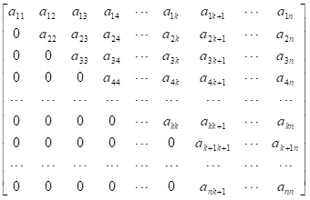
Matrix after the k^{th} Step:
We only need to perform steps up to k = n - 1 in order to make the matrix upper triangular

Slide 26
Gauss Elimination Algorithm
Forward Elimination:
For k = 1, 2, …. (n - 1)
Define multiplication factors: $l_{ik}=\frac{a_{ik}}{a_{kk}}$
Compute:$a_{ij}=a_{ij}$- $l_{ik}$ $a_{kj}; { b}_{i}={ b}_{i}\text{−} l_{ik}{ b}_{k}$ for
i = k+1, k+2, ….n and j = k+1, k+2, ….n
Resulting System of equation is upper triangular. Solve it using the Back-Substitution algorithm:
$$x_{n}=\frac{b_{n}}{a_{nn}};x_{i}=\frac{b_{i}−\sum_{j=i+1}^{n}{a_{ij}x_{j}}}{a_{ii}}; i=\left(n−1\right), \left(n−2\right), …3, 2, 1$$

Slide 27
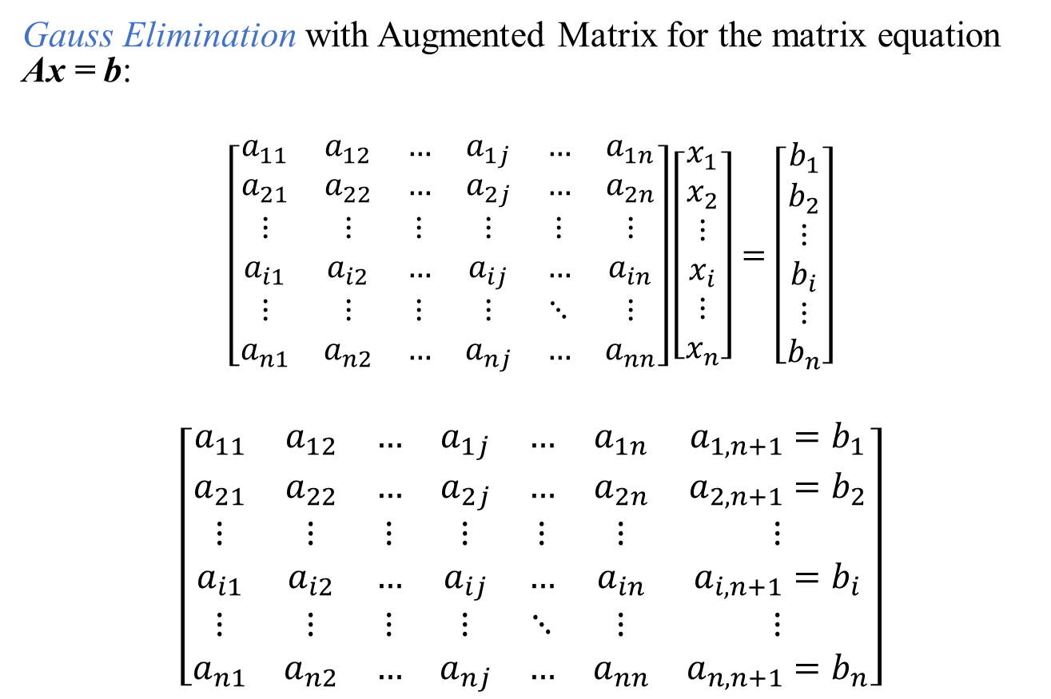
Gauss Elimination with Augmented Matrix for the matrix equation Ax = b:
$$\left[\begin{matrix}a_{11} & a_{12} & … & a_{1j} & … & a_{1n} \\ a_{21} & a_{22} & … & a_{2j} & … & a_{2n} \\ ⋮ & ⋮ & ⋮ & ⋮ & ⋮ & ⋮ \\ a_{i1} & a_{i2} & … & a_{ij} & … & a_{in} \\ ⋮ & ⋮ & ⋮ & ⋮ & ⋱ & ⋮ \\ a_{n1} & a_{n2} & … & a_{nj} & … & a_{nn}\end{matrix}\right]\left[\begin{matrix}x_{1} \\ x_{2} \\ ⋮ \\ x_{i} \\ ⋮ \\ x_{n}\end{matrix}\right]=\left[\begin{matrix}b_{1} \\ b_{2} \\ ⋮ \\ b_{i} \\ ⋮ \\ b_{n}\end{matrix}\right]$$
$$\left[\begin{matrix}a_{11} & a_{12} & … & a_{1j} & … & a_{1n} & a_{1,n+1}=b_{1} \\ a_{21} & a_{22} & … & a_{2j} & … & a_{2n} & a_{2,n+1}=b_{2} \\ ⋮ & ⋮ & ⋮ & ⋮ & ⋮ & ⋮ & ⋮ \\ a_{i1} & a_{i2} & … & a_{ij} & … & a_{in} & a_{i,n+1}=b_{i} \\ ⋮ & ⋮ & ⋮ & ⋮ & ⋱ & ⋮ & ⋮ \\ a_{n1} & a_{n2} & … & a_{nj} & … & a_{nn} & a_{n,n+1}=b_{n}\end{matrix}\right]$$

Slide 28
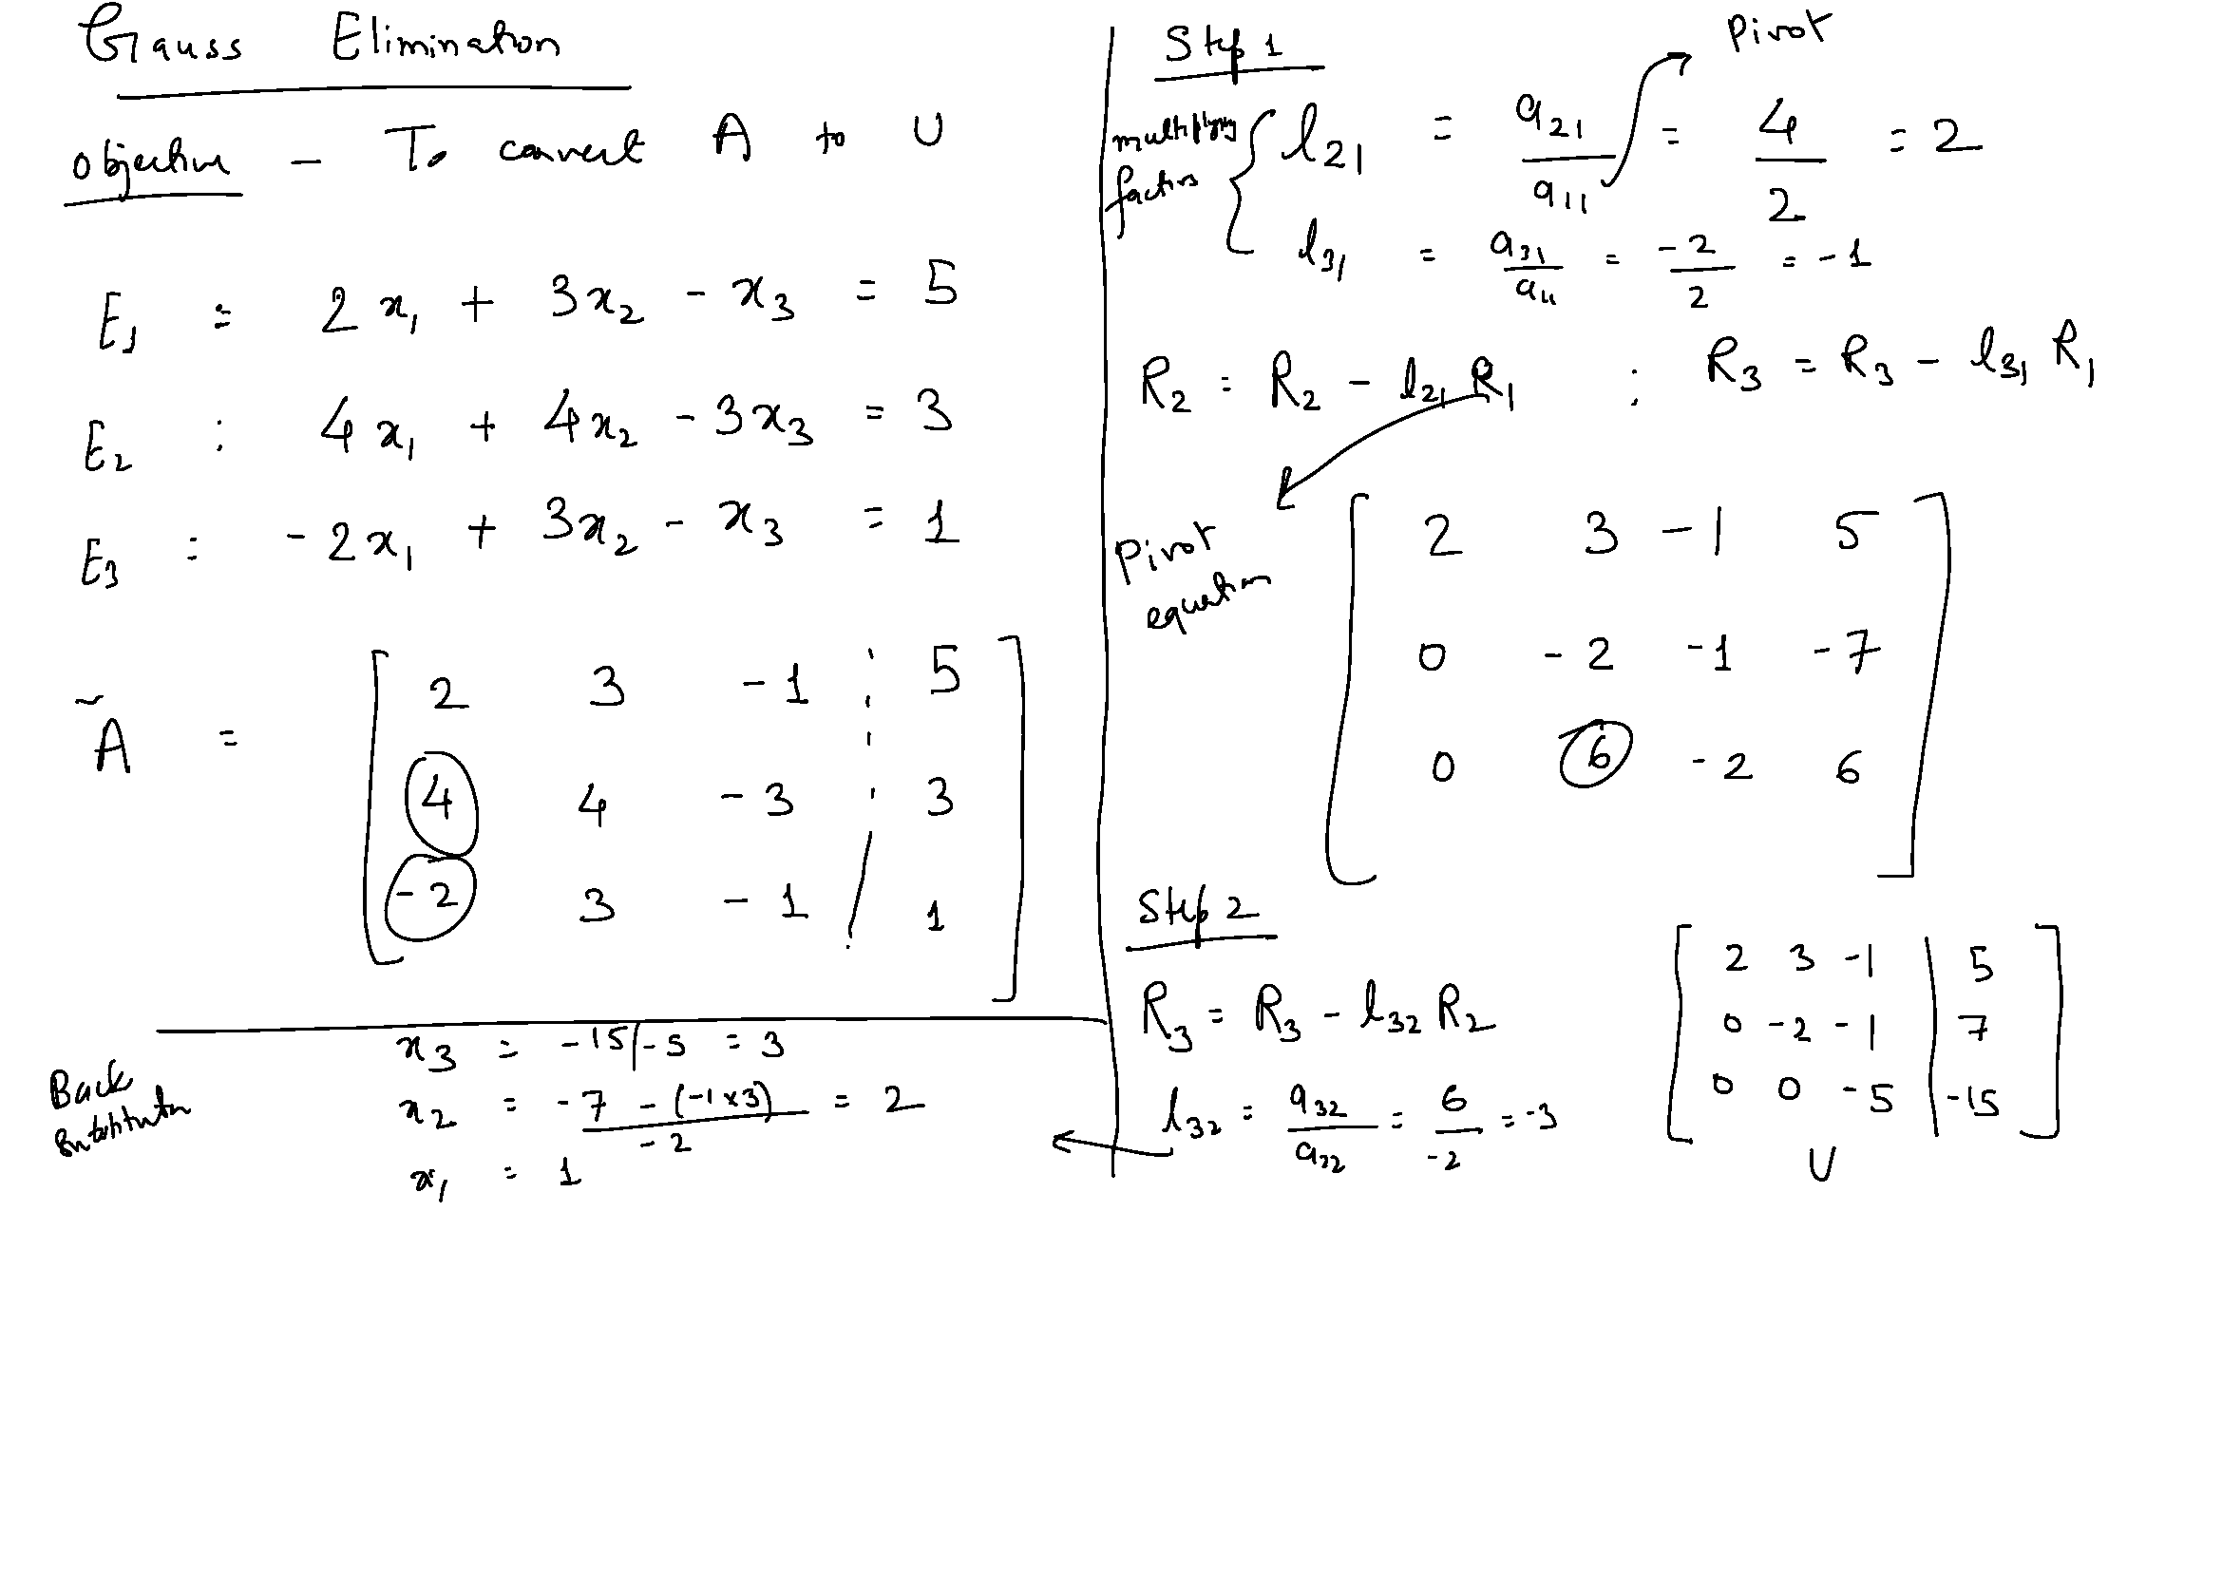

Slide 30
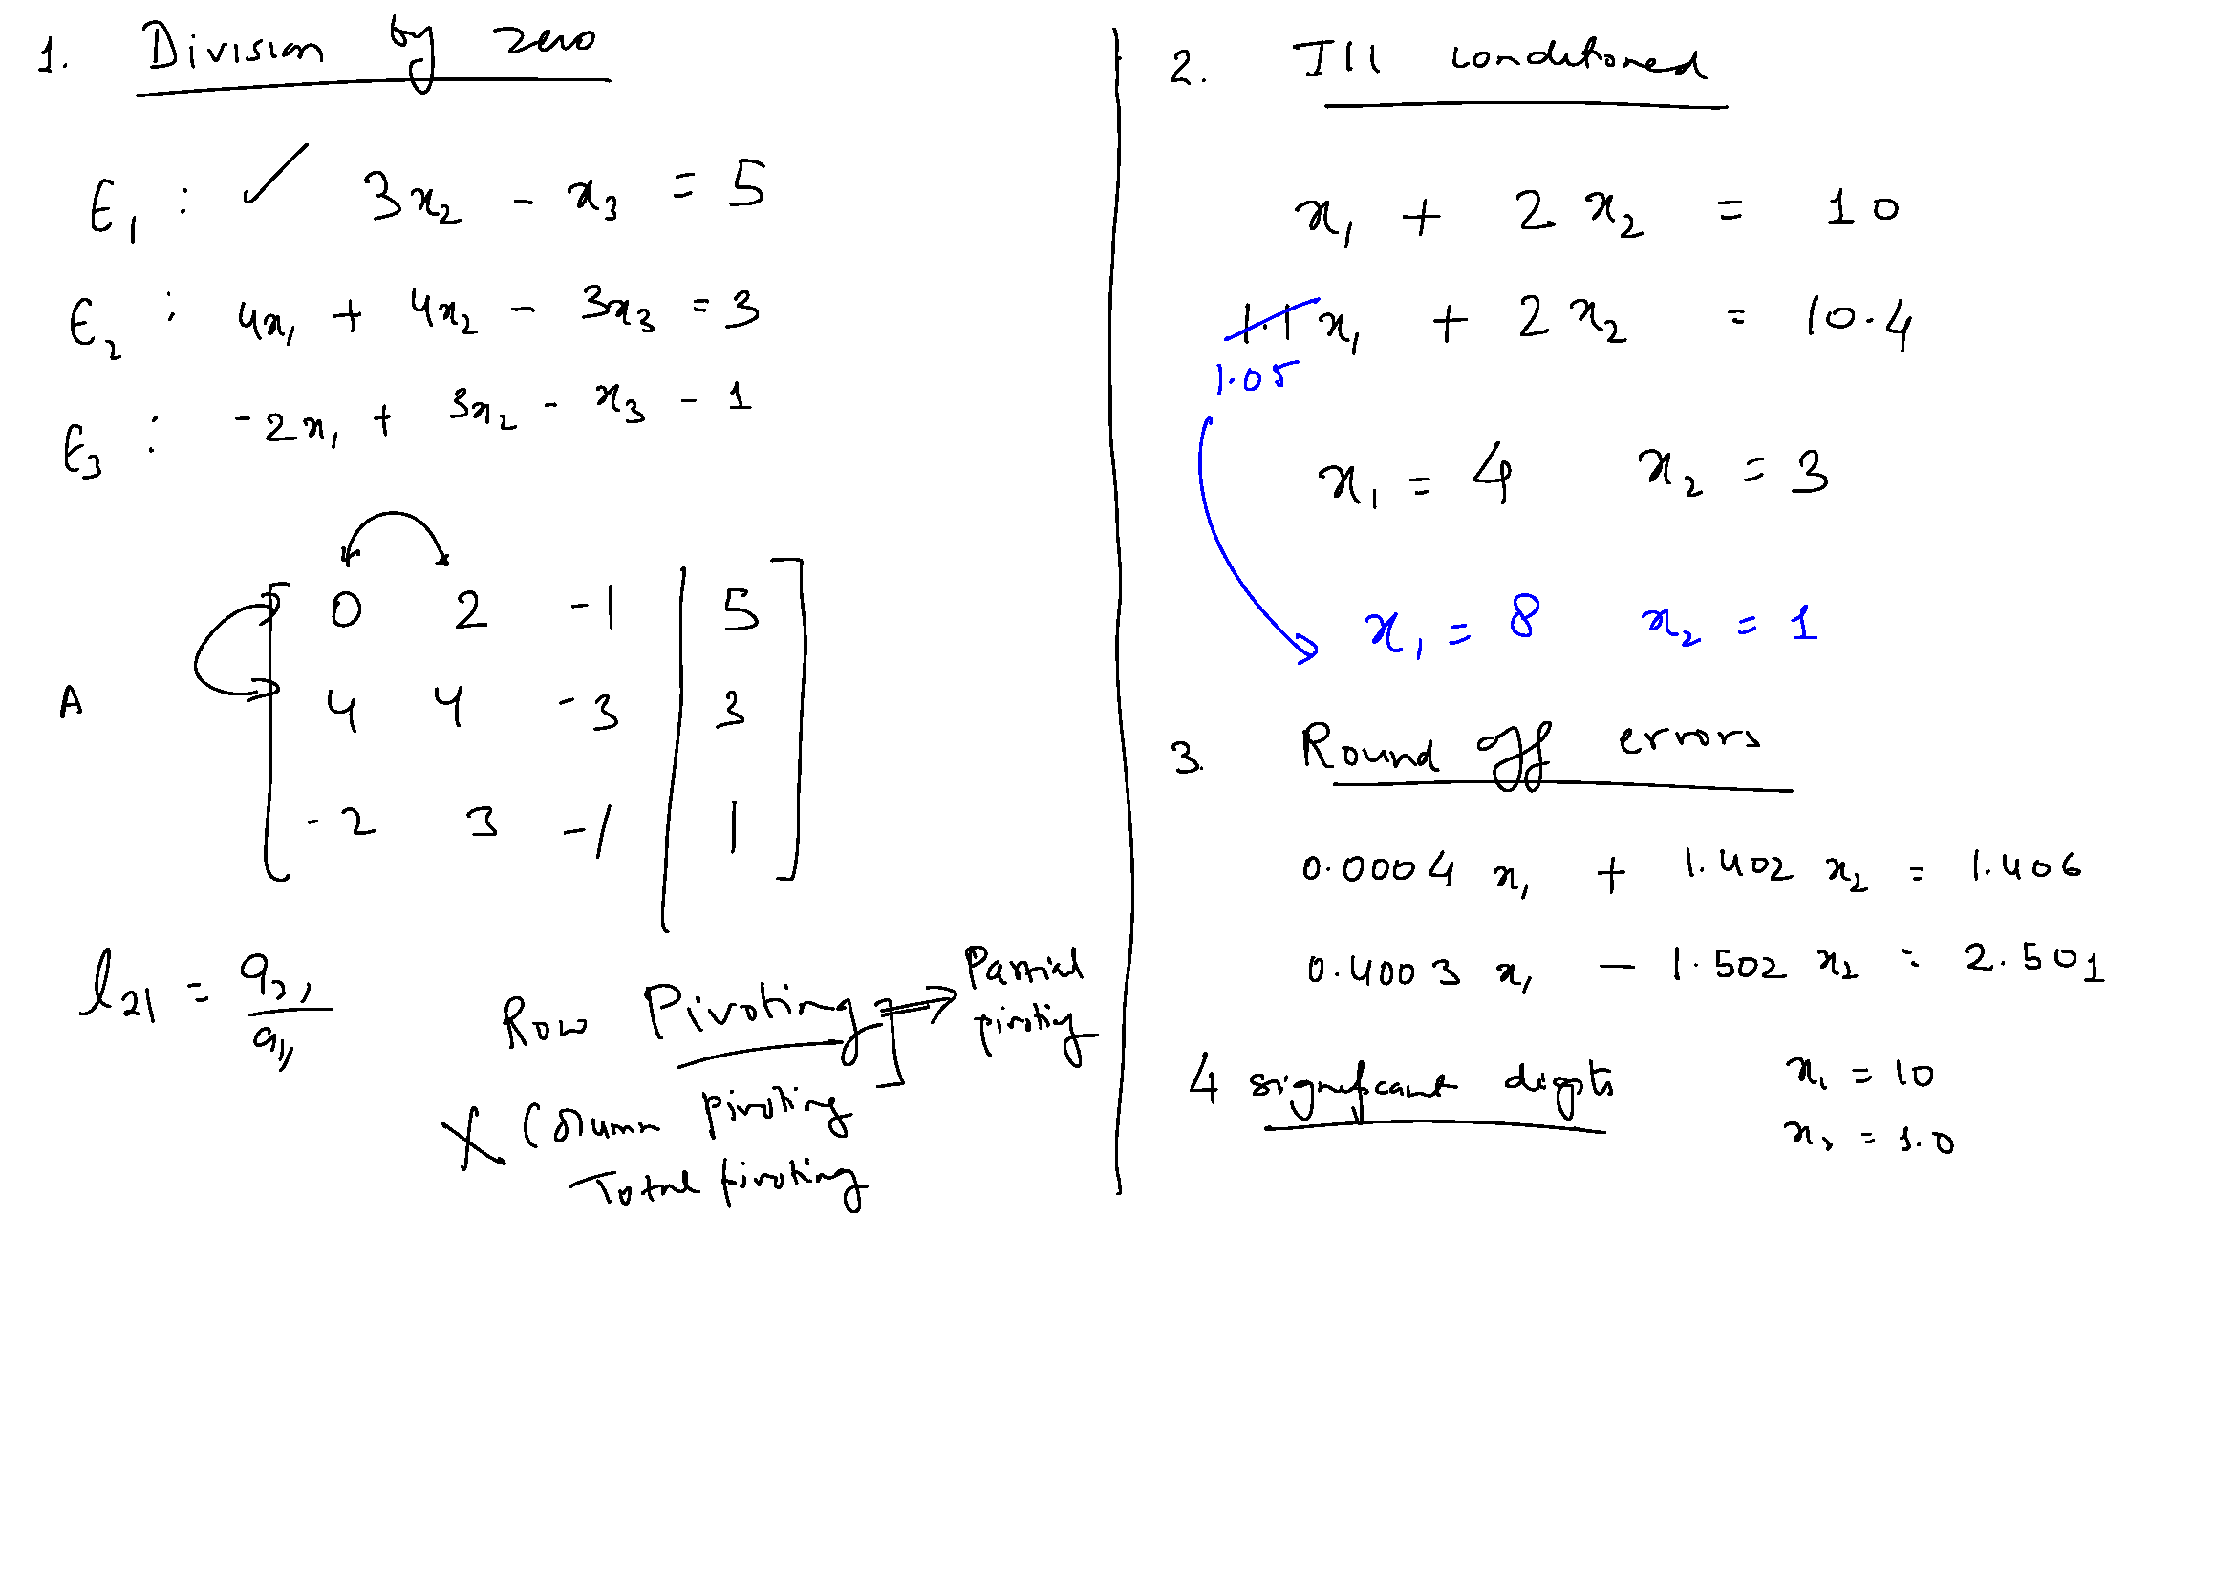

Slide 32
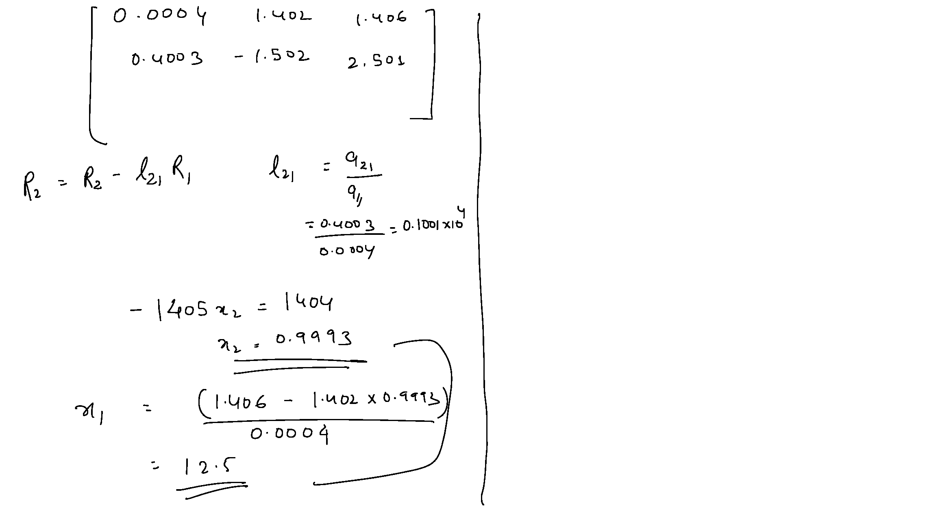

Slide 33
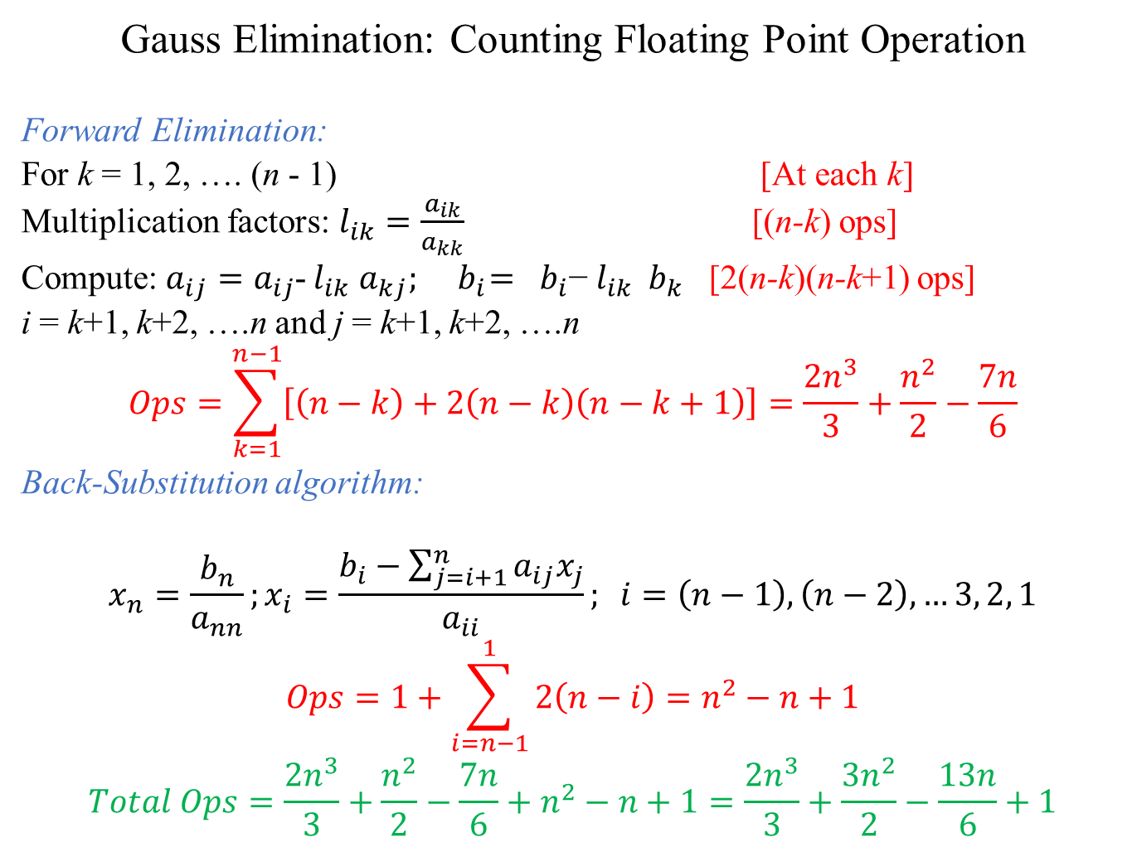
Gauss Elimination: Counting Floating Point Operation
Forward Elimination:
For k = 1, 2, …. (n - 1) [At each k]
Multiplication factors: $l_{ik}=\frac{a_{ik}}{a_{kk}}$ [(n-k) ops]
Compute:$a_{ij}=a_{ij}$- $l_{ik}$ $a_{kj}; { b}_{i}={ b}_{i}\text{−} l_{ik}{ b}_{k}$ [2(n-k)(n-k+1) ops]
i = k+1, k+2, ….n and j = k+1, k+2, ….n
$$Ops=\sum_{k=1}^{n−1}{\left[\left(n−k\right)+2\left(n−k\right)\left(n−k+1\right)\right]=\frac{{2n}^{3}}{3}+\frac{n^{2}}{2}−\frac{7n}{6}}$$
Back-Substitution algorithm:
$$x_{n}=\frac{b_{n}}{a_{nn}};x_{i}=\frac{b_{i}−\sum_{j=i+1}^{n}{a_{ij}x_{j}}}{a_{ii}}; i=\left(n−1\right), \left(n−2\right), …3, 2, 1$$
$$Ops=1+\sum_{i=n−1}^{1}{2\left(n−i\right)}=n^{2}−n+1$$
$$Total Ops=\frac{{2n}^{3}}{3}+\frac{n^{2}}{2}−\frac{7n}{6}+n^{2}−n+1=\frac{{2n}^{3}}{3}+\frac{{3n}^{2}}{2}−\frac{13n}{6}+1$$

Slide 34
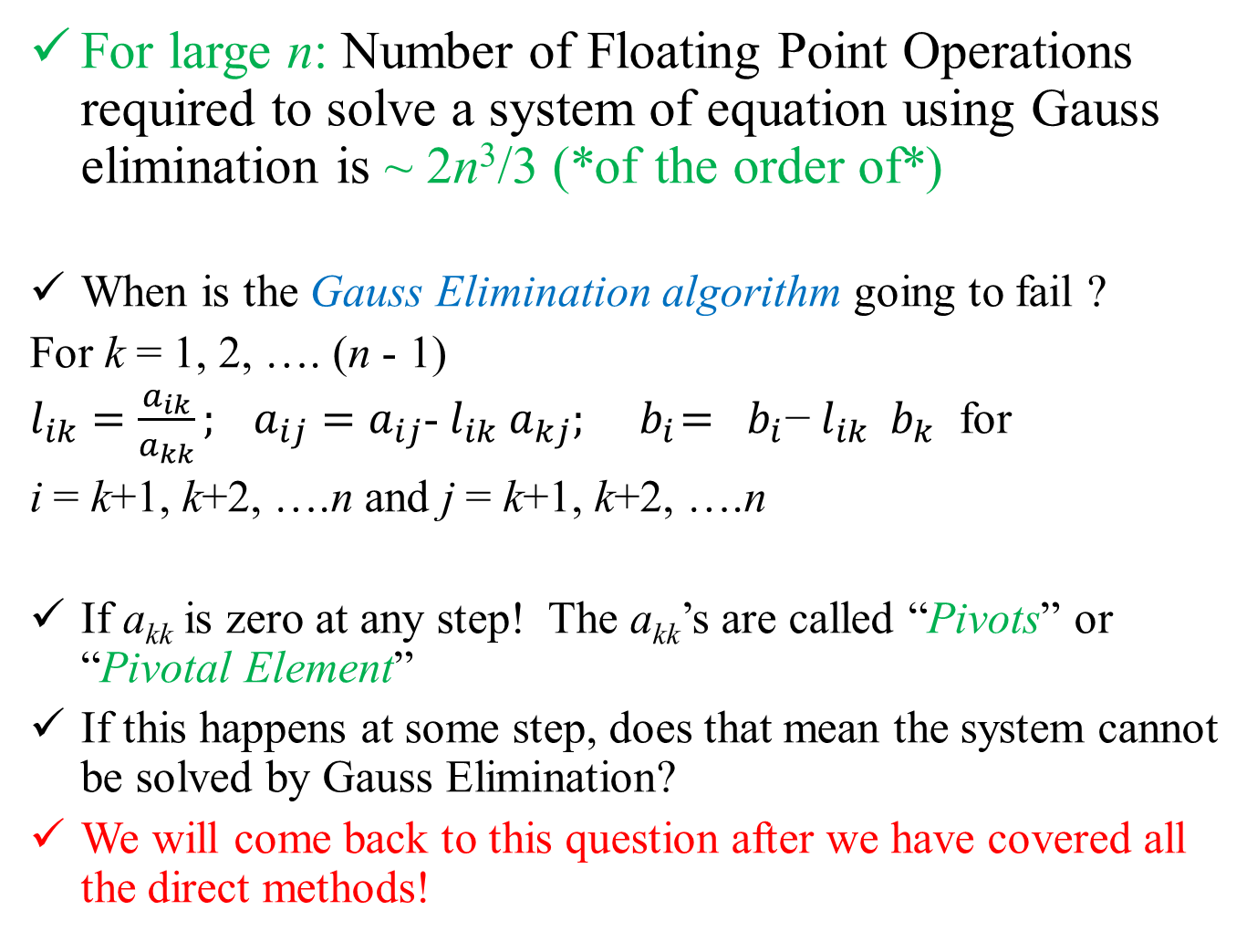
For large n: Number of Floating Point Operations required to solve a system of equation using Gauss elimination is ⁓ 2n³/3 (*of the order of*)
When is the Gauss Elimination algorithm going to fail ?
For k = 1, 2, …. (n - 1)
$l_{ik}=\frac{a_{ik}}{a_{kk}}; a_{ij}=a_{ij}$- $l_{ik}$ $a_{kj}; { b}_{i}={ b}_{i}\text{−} l_{ik}{ b}_{k}$ for
i = k+1, k+2, ….n and j = k+1, k+2, ….n
If a_{kk} is zero at any step! The a_{kk}’s are called “Pivots” or “Pivotal Element”
If this happens at some step, does that mean the system cannot be solved by Gauss Elimination?
We will come back to this question after we have covered all the direct methods!

Slide 35
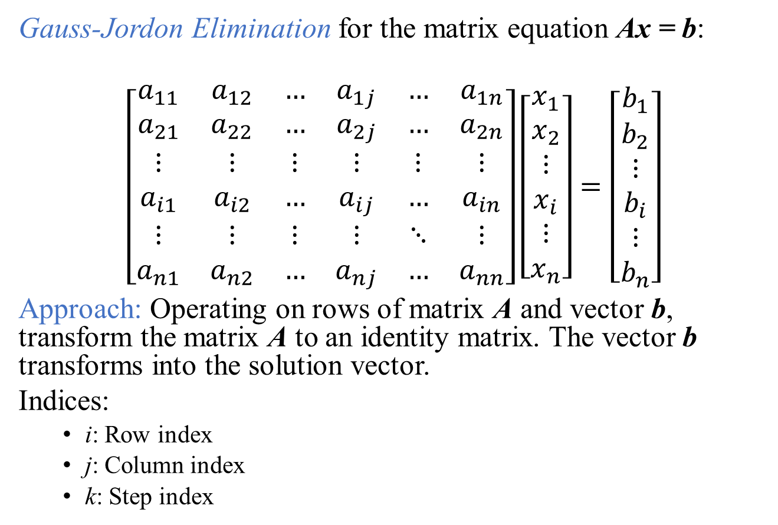
Gauss-Jordon Elimination for the matrix equation Ax = b:
$$\left[\begin{matrix}a_{11} & a_{12} & … & a_{1j} & … & a_{1n} \\ a_{21} & a_{22} & … & a_{2j} & … & a_{2n} \\ ⋮ & ⋮ & ⋮ & ⋮ & ⋮ & ⋮ \\ a_{i1} & a_{i2} & … & a_{ij} & … & a_{in} \\ ⋮ & ⋮ & ⋮ & ⋮ & ⋱ & ⋮ \\ a_{n1} & a_{n2} & … & a_{nj} & … & a_{nn}\end{matrix}\right]\left[\begin{matrix}x_{1} \\ x_{2} \\ ⋮ \\ x_{i} \\ ⋮ \\ x_{n}\end{matrix}\right]=\left[\begin{matrix}b_{1} \\ b_{2} \\ ⋮ \\ b_{i} \\ ⋮ \\ b_{n}\end{matrix}\right]$$
Approach: Operating on rows of matrix A and vector b, transform the matrix A to an identity matrix. The vector b transforms into the solution vector.
Indices:
i: Row index
j: Column index
k: Step index

Slide 36
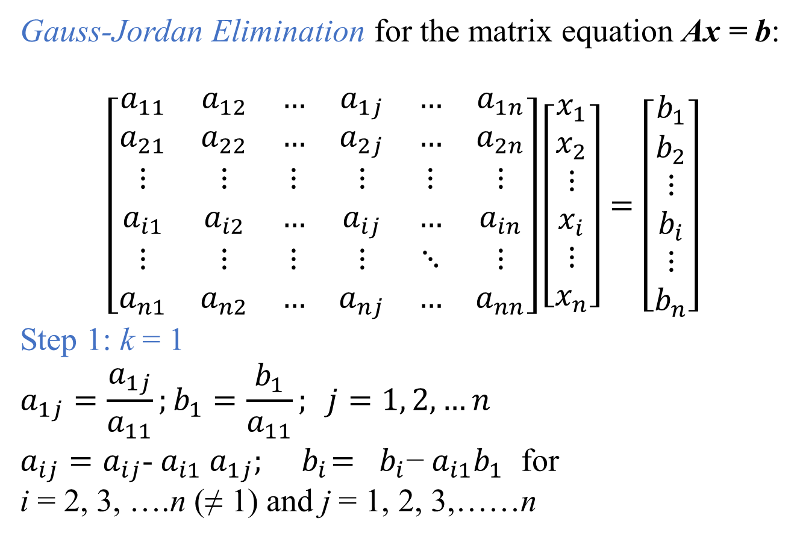
Gauss-Jordan Elimination for the matrix equation Ax = b:
$$\left[\begin{matrix}a_{11} & a_{12} & … & a_{1j} & … & a_{1n} \\ a_{21} & a_{22} & … & a_{2j} & … & a_{2n} \\ ⋮ & ⋮ & ⋮ & ⋮ & ⋮ & ⋮ \\ a_{i1} & a_{i2} & … & a_{ij} & … & a_{in} \\ ⋮ & ⋮ & ⋮ & ⋮ & ⋱ & ⋮ \\ a_{n1} & a_{n2} & … & a_{nj} & … & a_{nn}\end{matrix}\right]\left[\begin{matrix}x_{1} \\ x_{2} \\ ⋮ \\ x_{i} \\ ⋮ \\ x_{n}\end{matrix}\right]=\left[\begin{matrix}b_{1} \\ b_{2} \\ ⋮ \\ b_{i} \\ ⋮ \\ b_{n}\end{matrix}\right]$$
Step 1: k = 1
$$a_{1j}=\frac{a_{1j}}{a_{11}};b_{1}=\frac{b_{1}}{a_{11}}; j=1, 2,…n$$
$a_{ij}=a_{ij}$- $a_{i1}$ $a_{1j}; { b}_{i}={ b}_{i}\text{−} a_{i1}b_{1}$ for
i = 2, 3, ….n (≠ 1) and j = 1, 2, 3,……n

Slide 37
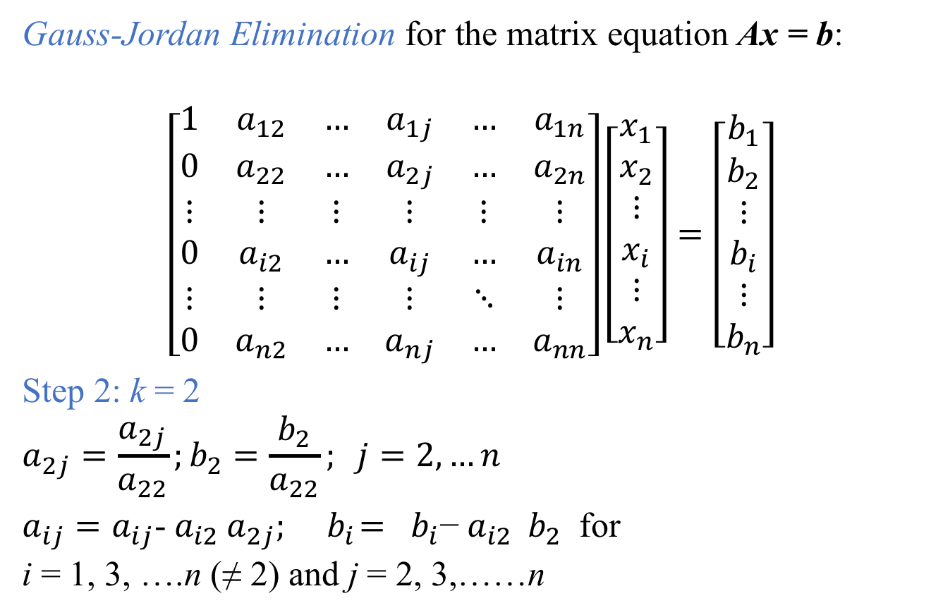
Gauss-Jordan Elimination for the matrix equation Ax = b:
$$\left[\begin{matrix}1 & a_{12} & … & a_{1j} & … & a_{1n} \\ 0 & a_{22} & … & a_{2j} & … & a_{2n} \\ ⋮ & ⋮ & ⋮ & ⋮ & ⋮ & ⋮ \\ 0 & a_{i2} & … & a_{ij} & … & a_{in} \\ ⋮ & ⋮ & ⋮ & ⋮ & ⋱ & ⋮ \\ 0 & a_{n2} & … & a_{nj} & … & a_{nn}\end{matrix}\right]\left[\begin{matrix}x_{1} \\ x_{2} \\ ⋮ \\ x_{i} \\ ⋮ \\ x_{n}\end{matrix}\right]=\left[\begin{matrix}b_{1} \\ b_{2} \\ ⋮ \\ b_{i} \\ ⋮ \\ b_{n}\end{matrix}\right]$$
Step 2: k = 2
$$a_{2j}=\frac{a_{2j}}{a_{22}};b_{2}=\frac{b_{2}}{a_{22}}; j=2,…n$$
$a_{ij}=a_{ij}$- $a_{i2}$ $a_{2j}; { b}_{i}={ b}_{i}\text{−} a_{i2}{ b}_{2}$ for
i = 1, 3, ….n (≠ 2) and j = 2, 3,……n

Slide 38
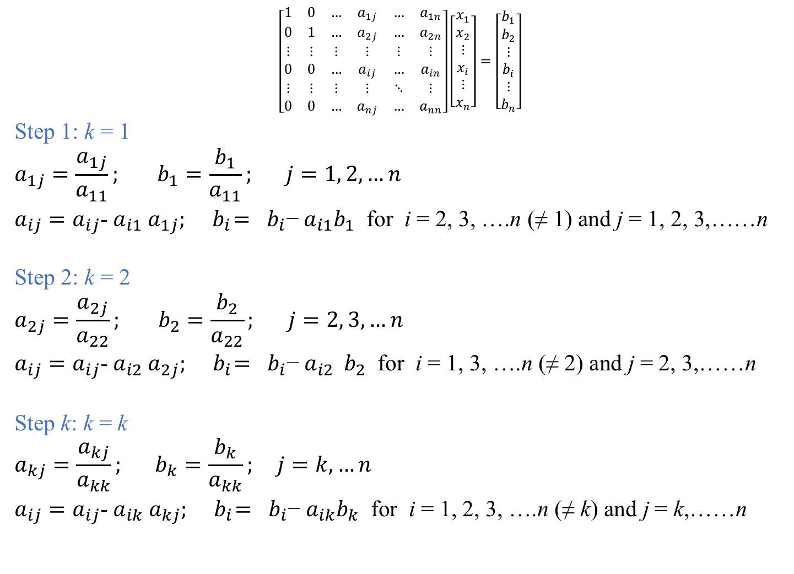
$$\left[\begin{matrix}1 & 0 & … & a_{1j} & … & a_{1n} \\ 0 & 1 & … & a_{2j} & … & a_{2n} \\ ⋮ & ⋮ & ⋮ & ⋮ & ⋮ & ⋮ \\ 0 & 0 & … & a_{ij} & … & a_{in} \\ ⋮ & ⋮ & ⋮ & ⋮ & ⋱ & ⋮ \\ 0 & 0 & … & a_{nj} & … & a_{nn}\end{matrix}\right]\left[\begin{matrix}x_{1} \\ x_{2} \\ ⋮ \\ x_{i} \\ ⋮ \\ x_{n}\end{matrix}\right]=\left[\begin{matrix}b_{1} \\ b_{2} \\ ⋮ \\ b_{i} \\ ⋮ \\ b_{n}\end{matrix}\right]$$
Step 1: k = 1
$$a_{1j}=\frac{a_{1j}}{a_{11}}; b_{1}=\frac{b_{1}}{a_{11}}; j=1, 2,…n$$
$a_{ij}=a_{ij}$- $a_{i1}$ $a_{1j}; { b}_{i}={ b}_{i}\text{−} a_{i1}b_{1}$ for i = 2, 3, ….n (≠ 1) and j = 1, 2, 3,……n
Step 2: k = 2
$$a_{2j}=\frac{a_{2j}}{a_{22}}; b_{2}=\frac{b_{2}}{a_{22}}; j=2, 3,…n$$
$a_{ij}=a_{ij}$- $a_{i2}$ $a_{2j}; { b}_{i}={ b}_{i}\text{−} a_{i2}{ b}_{2}$ for i = 1, 3, ….n (≠ 2) and j = 2, 3,……n
Step k: k = k
$$a_{kj}=\frac{a_{kj}}{a_{kk}}; b_{k}=\frac{b_{k}}{a_{kk}}; j=k,…n$$
$a_{ij}=a_{ij}$- $a_{ik}$ $a_{kj}; { b}_{i}={ b}_{i}\text{−} a_{ik}b_{k}$ for i = 1, 2, 3, ….n (≠ k) and j = k,……n

Slide 39
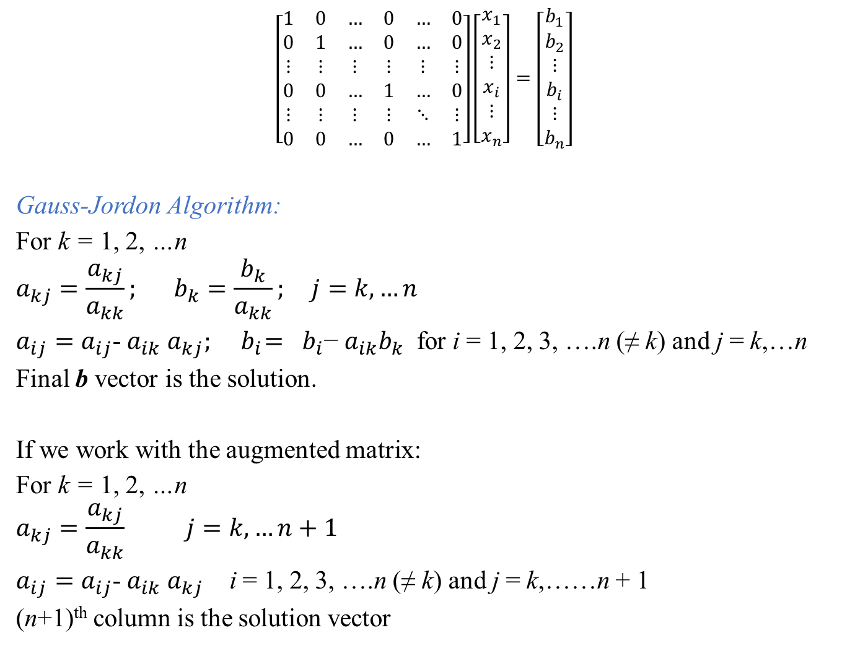
$$\left[\begin{matrix}1 & 0 & … & 0 & … & 0 \\ 0 & 1 & … & 0 & … & 0 \\ ⋮ & ⋮ & ⋮ & ⋮ & ⋮ & ⋮ \\ 0 & 0 & … & 1 & … & 0 \\ ⋮ & ⋮ & ⋮ & ⋮ & ⋱ & ⋮ \\ 0 & 0 & … & 0 & … & 1\end{matrix}\right]\left[\begin{matrix}x_{1} \\ x_{2} \\ ⋮ \\ x_{i} \\ ⋮ \\ x_{n}\end{matrix}\right]=\left[\begin{matrix}b_{1} \\ b_{2} \\ ⋮ \\ b_{i} \\ ⋮ \\ b_{n}\end{matrix}\right]$$
Gauss-Jordon Algorithm:
For k = 1, 2, …n
$$a_{kj}=\frac{a_{kj}}{a_{kk}}; b_{k}=\frac{b_{k}}{a_{kk}}; j=k,…n$$
$a_{ij}=a_{ij}$- $a_{ik}$ $a_{kj}; { b}_{i}={ b}_{i}\text{−} a_{ik}b_{k}$ for i = 1, 2, 3, ….n (≠ k) and j = k,…n
Final b vector is the solution.
If we work with the augmented matrix:
For k = 1, 2, …n
$$a_{kj}=\frac{a_{kj}}{a_{kk}} j=k,…n+1$$
$a_{ij}=a_{ij}$- $a_{ik}$ $a_{kj}$ i = 1, 2, 3, ….n (≠ k) and j = k,……n + 1
(n+1)^{th} column is the solution vector

Slide 40
Homework: Calculate the number of floating point operations required for the solution using the Gauss-Jordon Algorithm!
When is the Gauss-Jordon algorithm going to fail ?
Inverse of a matrix (n × n) can be computed using the Gauss-Jordon Algorithm:
Augment an identity matrix of order n with the matrix to be inverted. Resulting matrix will be (n × 2n)
Carry out the operations using Gauss-Jordon Algorithm
Original matrix will become an identity matrix and the augmented identity matrix will become its inverse!

Slide 41
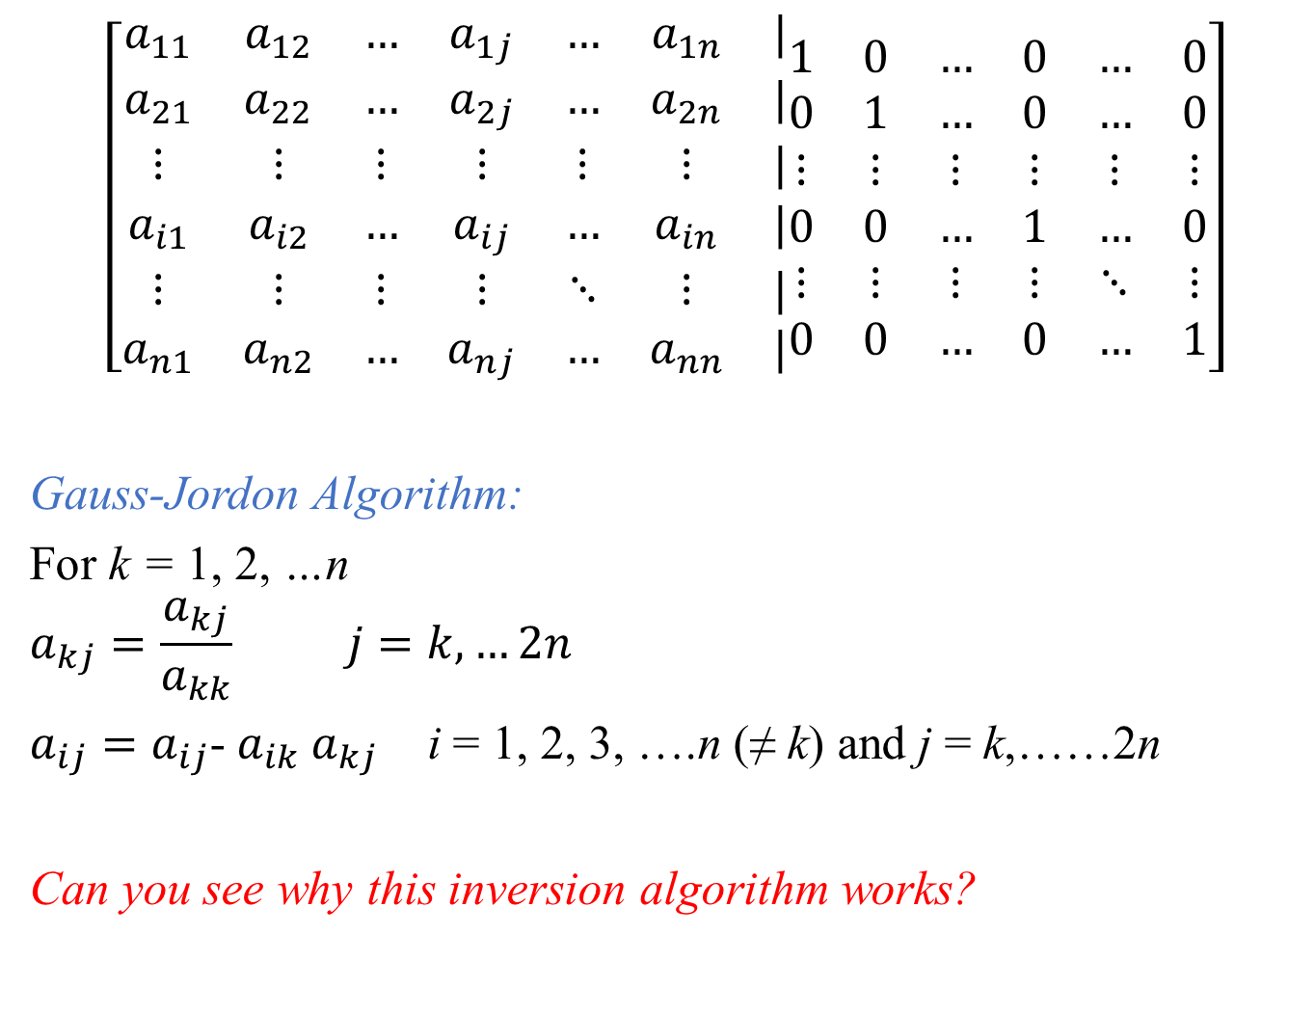
$$\left[\begin{matrix}a_{11} & a_{12} & … & a_{1j} & … & a_{1n} & | \\ a_{21} & a_{22} & … & a_{2j} & … & a_{2n} & | \\ ⋮ & ⋮ & ⋮ & ⋮ & ⋮ & ⋮ & | \\ a_{i1} & a_{i2} & … & a_{ij} & … & a_{in} & | \\ ⋮ & ⋮ & ⋮ & ⋮ & ⋱ & ⋮ & | \\ a_{n1} & a_{n2} & … & a_{nj} & … & a_{nn} & |\end{matrix}\begin{matrix}1 & 0 & … & 0 & … & 0 \\ 0 & 1 & … & 0 & … & 0 \\ ⋮ & ⋮ & ⋮ & ⋮ & ⋮ & ⋮ \\ 0 & 0 & … & 1 & … & 0 \\ ⋮ & ⋮ & ⋮ & ⋮ & ⋱ & ⋮ \\ 0 & 0 & … & 0 & … & 1\end{matrix}\right]$$
Gauss-Jordon Algorithm:
For k = 1, 2, …n
$$a_{kj}=\frac{a_{kj}}{a_{kk}} j=k,…2n$$
$a_{ij}=a_{ij}$- $a_{ik}$ $a_{kj}$ i = 1, 2, 3, ….n (≠ k) and j = k,……2n
Can you see why this inversion algorithm works?

