Slide 1
Methods for Solution of the System of Equations (ReCap):
Ax = b
Direct Methods: one obtains the exact solution (ignoring the round-off errors) in a finite number of steps. These group of methods are more efficient for dense and banded matrices.
Gauss Elimination; Gauss-Jordon Elimination
LU-Decomposition
Thomas Algorithm (for tri-diagonal banded matrix)
Iterative Methods: solution is obtained through successive approximation. Number of computations is a function of desired accuracy/precision of the solution and are not known apriori. More efficient for sparse matrices.
Jacobi Iterations
Gauss Seidal Iterations with Successive Over/Under Relaxation

Slide 2
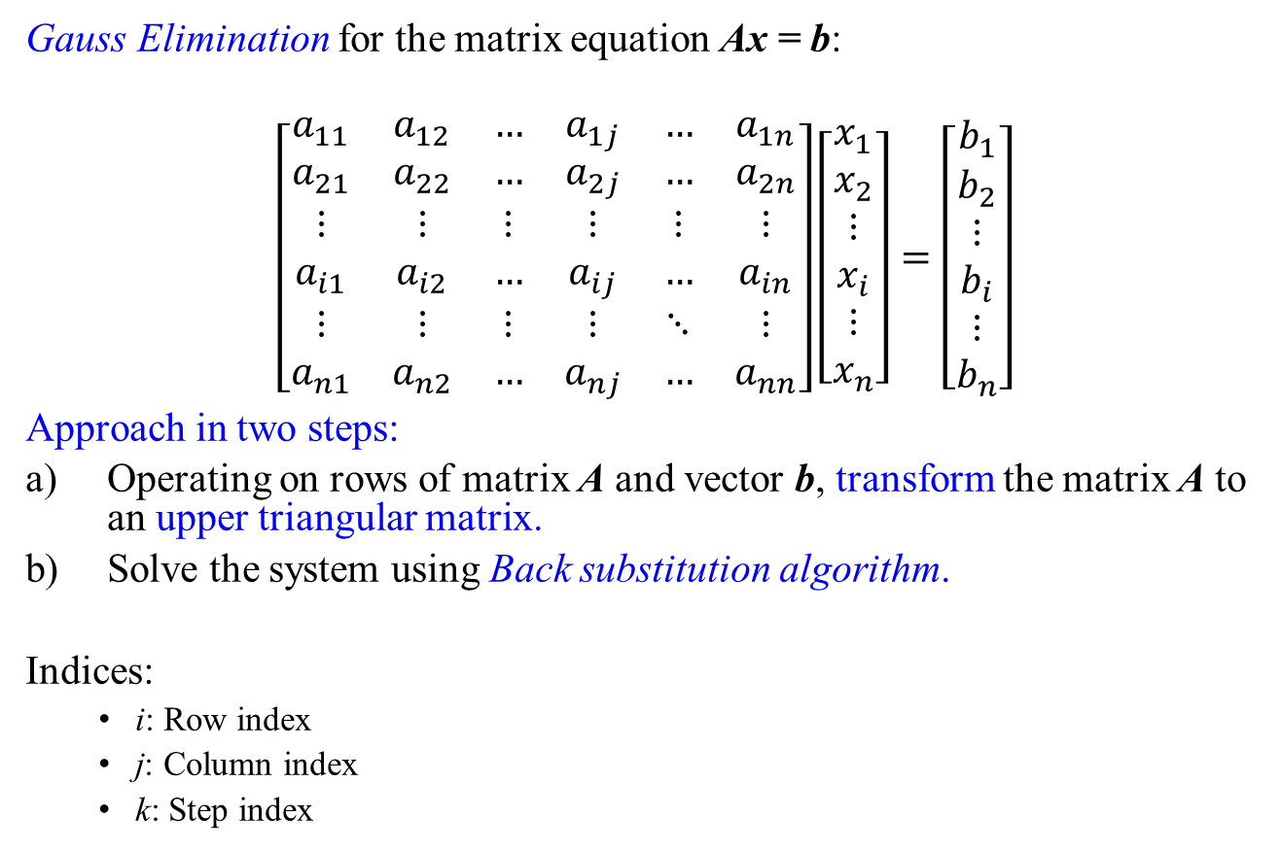
Gauss Elimination for the matrix equation Ax = b:
$$\left[\begin{matrix}a_{11} & a_{12} & … & a_{1j} & … & a_{1n} \\ a_{21} & a_{22} & … & a_{2j} & … & a_{2n} \\ ⋮ & ⋮ & ⋮ & ⋮ & ⋮ & ⋮ \\ a_{i1} & a_{i2} & … & a_{ij} & … & a_{in} \\ ⋮ & ⋮ & ⋮ & ⋮ & ⋱ & ⋮ \\ a_{n1} & a_{n2} & … & a_{nj} & … & a_{nn}\end{matrix}\right]\left[\begin{matrix}x_{1} \\ x_{2} \\ ⋮ \\ x_{i} \\ ⋮ \\ x_{n}\end{matrix}\right]=\left[\begin{matrix}b_{1} \\ b_{2} \\ ⋮ \\ b_{i} \\ ⋮ \\ b_{n}\end{matrix}\right]$$
Approach in two steps:
Operating on rows of matrix A and vector b, transform the matrix A to an upper triangular matrix.
Solve the system using Back substitution algorithm.
Indices:
i: Row index
j: Column index
k: Step index

Slide 3
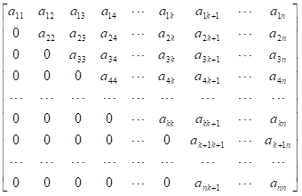
Matrix after the k^{th} Step:
We only need to perform steps up to k = n - 1 in order to make the matrix upper triangular

Slide 4
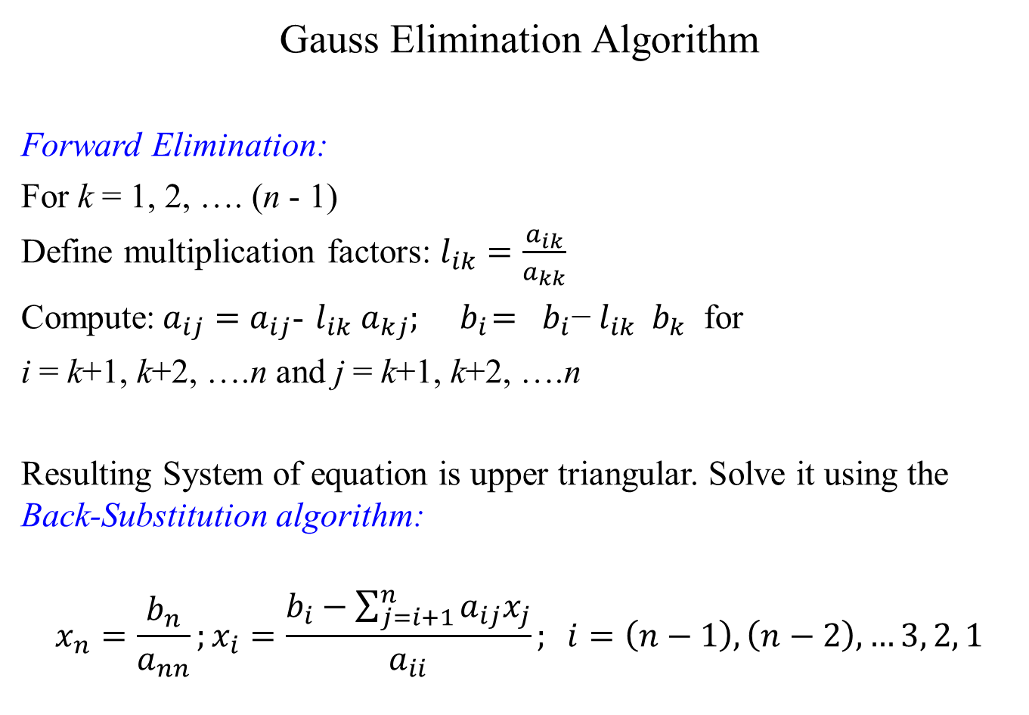
Gauss Elimination Algorithm
Forward Elimination:
For k = 1, 2, …. (n - 1)
Define multiplication factors: $l_{ik}=\frac{a_{ik}}{a_{kk}}$
Compute:$a_{ij}=a_{ij}$- $l_{ik}$ $a_{kj}; { b}_{i}={ b}_{i}\text{−} l_{ik}{ b}_{k}$ for
i = k+1, k+2, ….n and j = k+1, k+2, ….n
Resulting System of equation is upper triangular. Solve it using the Back-Substitution algorithm:
$$x_{n}=\frac{b_{n}}{a_{nn}};x_{i}=\frac{b_{i}−\sum_{j=i+1}^{n}{a_{ij}x_{j}}}{a_{ii}}; i=\left(n−1\right), \left(n−2\right), …3, 2, 1$$

Slide 5
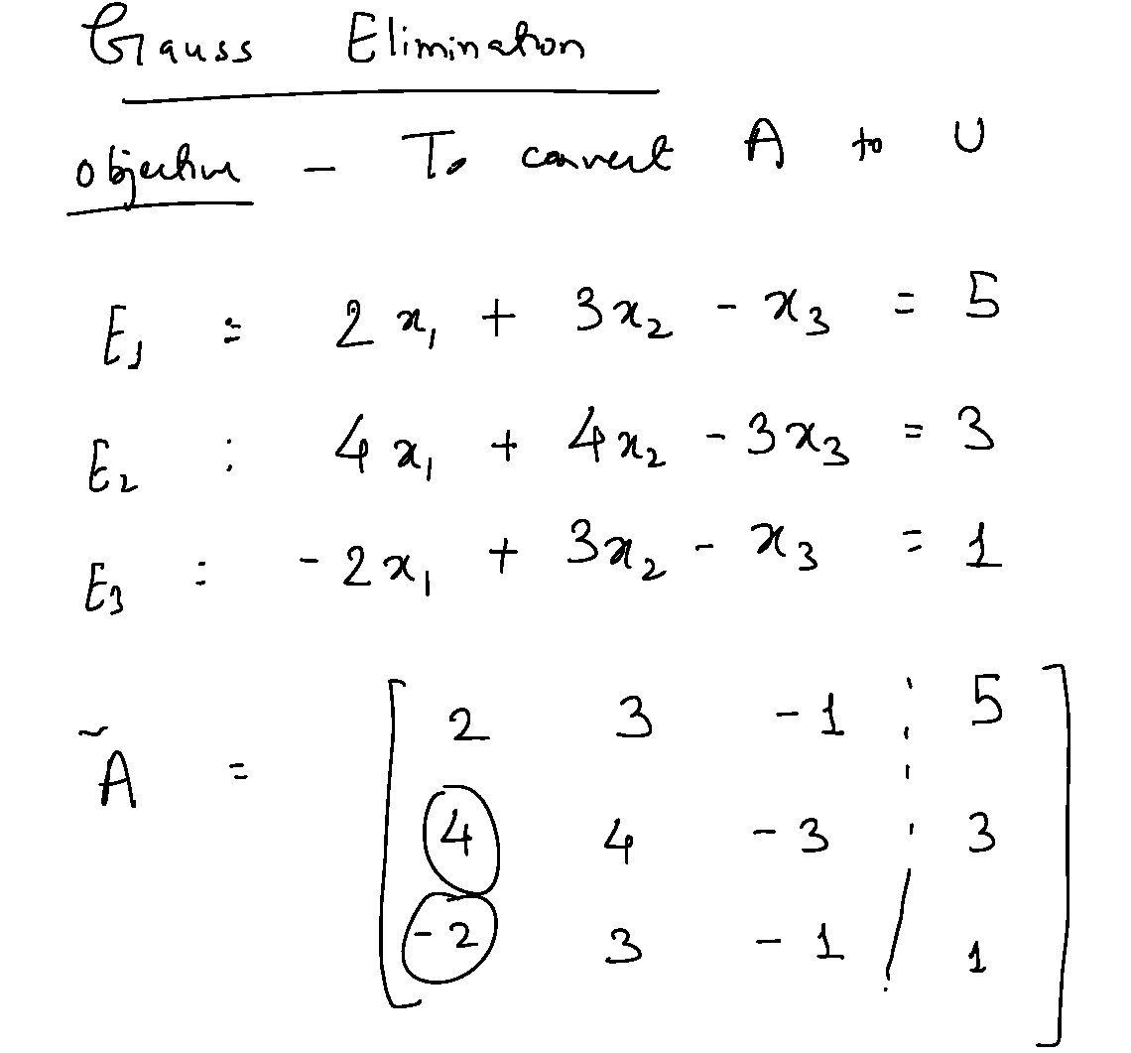

Slide 6
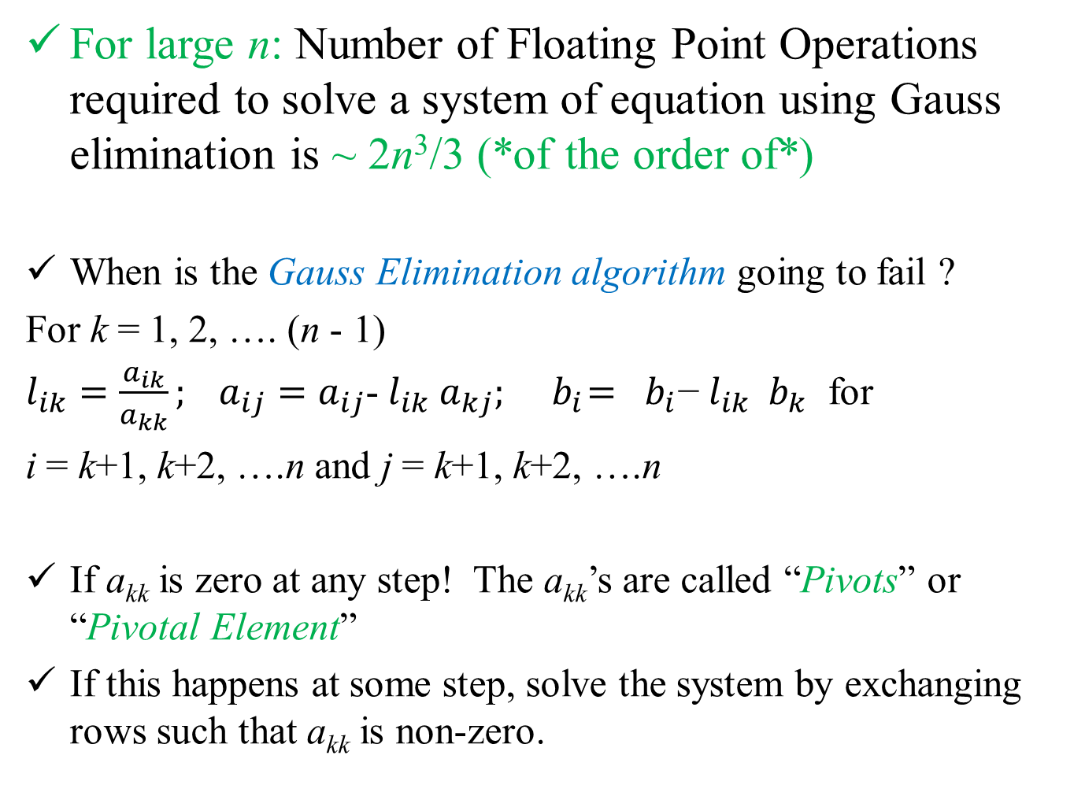
For large n: Number of Floating Point Operations required to solve a system of equation using Gauss elimination is ⁓ 2n³/3 (*of the order of*)
When is the Gauss Elimination algorithm going to fail ?
For k = 1, 2, …. (n - 1)
$l_{ik}=\frac{a_{ik}}{a_{kk}}; a_{ij}=a_{ij}$- $l_{ik}$ $a_{kj}; { b}_{i}={ b}_{i}\text{−} l_{ik}{ b}_{k}$ for
i = k+1, k+2, ….n and j = k+1, k+2, ….n
If a_{kk} is zero at any step! The a_{kk}’s are called “Pivots” or “Pivotal Element”
If this happens at some step, solve the system by exchanging rows such that a_{kk} is non-zero.

Slide 7
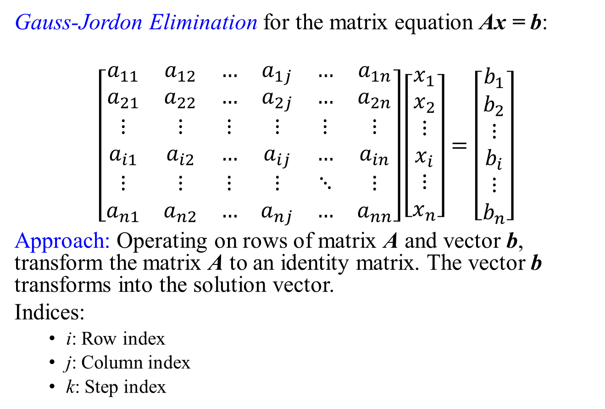
Gauss-Jordon Elimination for the matrix equation Ax = b:
$$\left[\begin{matrix}a_{11} & a_{12} & … & a_{1j} & … & a_{1n} \\ a_{21} & a_{22} & … & a_{2j} & … & a_{2n} \\ ⋮ & ⋮ & ⋮ & ⋮ & ⋮ & ⋮ \\ a_{i1} & a_{i2} & … & a_{ij} & … & a_{in} \\ ⋮ & ⋮ & ⋮ & ⋮ & ⋱ & ⋮ \\ a_{n1} & a_{n2} & … & a_{nj} & … & a_{nn}\end{matrix}\right]\left[\begin{matrix}x_{1} \\ x_{2} \\ ⋮ \\ x_{i} \\ ⋮ \\ x_{n}\end{matrix}\right]=\left[\begin{matrix}b_{1} \\ b_{2} \\ ⋮ \\ b_{i} \\ ⋮ \\ b_{n}\end{matrix}\right]$$
Approach: Operating on rows of matrix A and vector b, transform the matrix A to an identity matrix. The vector b transforms into the solution vector.
Indices:
i: Row index
j: Column index
k: Step index

Slide 8
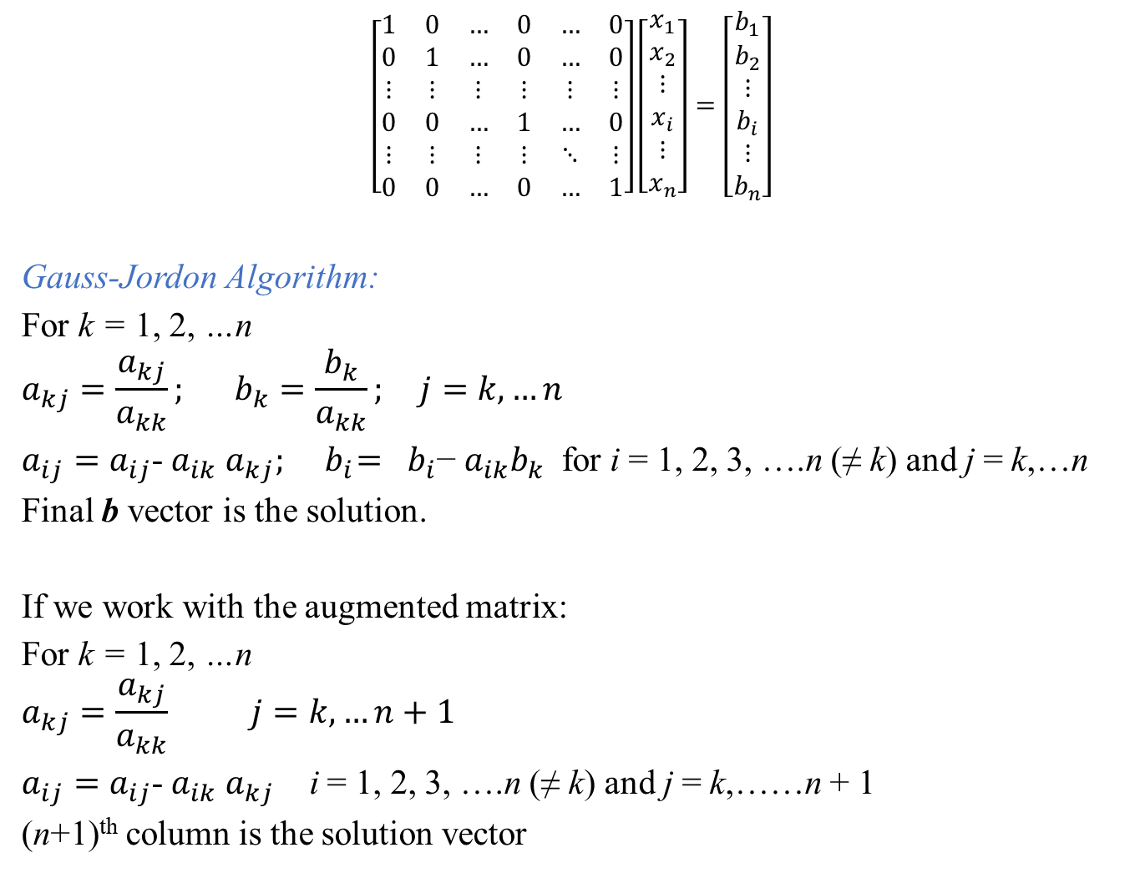
$$\left[\begin{matrix}1 & 0 & … & 0 & … & 0 \\ 0 & 1 & … & 0 & … & 0 \\ ⋮ & ⋮ & ⋮ & ⋮ & ⋮ & ⋮ \\ 0 & 0 & … & 1 & … & 0 \\ ⋮ & ⋮ & ⋮ & ⋮ & ⋱ & ⋮ \\ 0 & 0 & … & 0 & … & 1\end{matrix}\right]\left[\begin{matrix}x_{1} \\ x_{2} \\ ⋮ \\ x_{i} \\ ⋮ \\ x_{n}\end{matrix}\right]=\left[\begin{matrix}b_{1} \\ b_{2} \\ ⋮ \\ b_{i} \\ ⋮ \\ b_{n}\end{matrix}\right]$$
Gauss-Jordon Algorithm:
For k = 1, 2, …n
$$a_{kj}=\frac{a_{kj}}{a_{kk}}; b_{k}=\frac{b_{k}}{a_{kk}}; j=k,…n$$
$a_{ij}=a_{ij}$- $a_{ik}$ $a_{kj}; { b}_{i}={ b}_{i}\text{−} a_{ik}b_{k}$ for i = 1, 2, 3, ….n (≠ k) and j = k,…n
Final b vector is the solution.
If we work with the augmented matrix:
For k = 1, 2, …n
$$a_{kj}=\frac{a_{kj}}{a_{kk}} j=k,…n+1$$
$a_{ij}=a_{ij}$- $a_{ik}$ $a_{kj}$ i = 1, 2, 3, ….n (≠ k) and j = k,……n + 1
(n+1)^{th} column is the solution vector

Slide 9
Homework: Calculate the number of floating point operations required for the solution using the Gauss-Jordon Algorithm!
When is the Gauss-Jordon algorithm going to fail ?
Inverse of a matrix (n × n) can be computed using the Gauss-Jordon Algorithm:
Augment an identity matrix of order n with the matrix to be inverted. Resulting matrix will be (n × 2n)
Carry out the operations using Gauss-Jordon Algorithm
Original matrix will become an identity matrix and the augmented identity matrix will become its inverse!

Slide 10
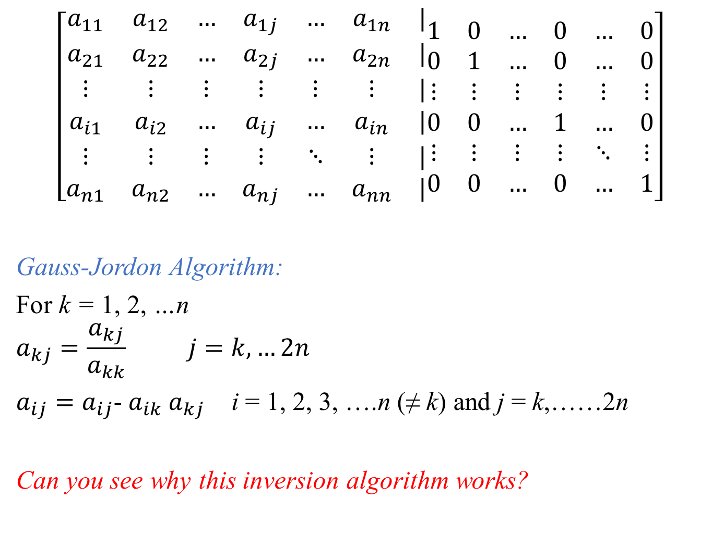
$$\left[\begin{matrix}a_{11} & a_{12} & … & a_{1j} & … & a_{1n} & | \\ a_{21} & a_{22} & … & a_{2j} & … & a_{2n} & | \\ ⋮ & ⋮ & ⋮ & ⋮ & ⋮ & ⋮ & | \\ a_{i1} & a_{i2} & … & a_{ij} & … & a_{in} & | \\ ⋮ & ⋮ & ⋮ & ⋮ & ⋱ & ⋮ & | \\ a_{n1} & a_{n2} & … & a_{nj} & … & a_{nn} & |\end{matrix}\begin{matrix}1 & 0 & … & 0 & … & 0 \\ 0 & 1 & … & 0 & … & 0 \\ ⋮ & ⋮ & ⋮ & ⋮ & ⋮ & ⋮ \\ 0 & 0 & … & 1 & … & 0 \\ ⋮ & ⋮ & ⋮ & ⋮ & ⋱ & ⋮ \\ 0 & 0 & … & 0 & … & 1\end{matrix}\right]$$
Gauss-Jordon Algorithm:
For k = 1, 2, …n
$$a_{kj}=\frac{a_{kj}}{a_{kk}} j=k,…2n$$
$a_{ij}=a_{ij}$- $a_{ik}$ $a_{kj}$ i = 1, 2, 3, ….n (≠ k) and j = k,……2n
Can you see why this inversion algorithm works?

Slide 11
LU-Decomposition: A general method
Ax = b
In most engineering problems, the matrix A remains constant while the vector b changes with time. The matrix A describes the system and the vector b describes the external forcing. e.g., all network problems (pipes, electrical, canal, road, reactors, etc.); structural frames; many financial analyses.
If all b’s are available together, one can solve the system by augmented matrix but in practice, they are not!
Instead of performing ⁓ n³ floating point operations to solve whenever a new b becomes available, it is possible to solve the system by performing ⁓ n² floating point operations if a LU Decomposition is available for matrix A
LU-decomposition requires ⁓ n³ floating point operations!

Slide 12
Consider the system: (b changes!)
Ax = b
Perform a decomposition of the form A = LU, where L is a lower-triangular and U is an upper-triangular matrix!
LU-decomposition requires ⁓ n³ floating point operations!
For any given b, solve Ax = LUx = b
This is equivalent to solving two triangular systems:
Solve Ly = b using forward substitution to obtain y (~n² operations)
Solve Ux = y using back substitution to obtain x (~n² operations)
Most frequently used method for engineering applications!
We will derive LU-decomposition from Gauss Elimination!

Slide 13
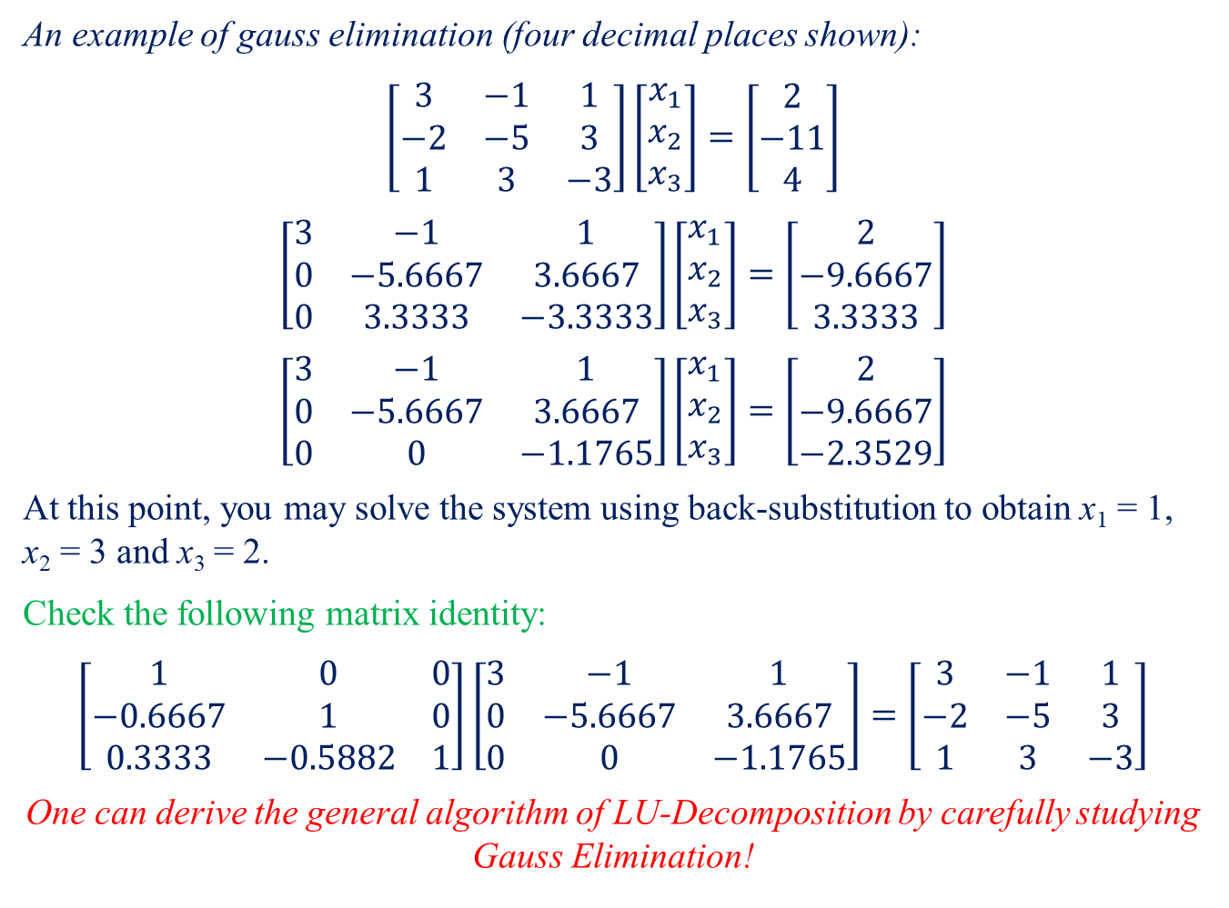
An example of gauss elimination (four decimal places shown):
$$\left[\begin{matrix}3 & −1 & 1 \\ −2 & −5 & 3 \\ 1 & 3 & −3\end{matrix}\right]\left[\begin{matrix}x_{1} \\ x_{2} \\ x_{3}\end{matrix}\right]=\left[\begin{matrix}2 \\ −11 \\ 4\end{matrix}\right]$$
$$\left[\begin{matrix}3 & −1 & 1 \\ 0 & −5.6667 & 3.6667 \\ 0 & 3.3333 & −3.3333\end{matrix}\right]\left[\begin{matrix}x_{1} \\ x_{2} \\ x_{3}\end{matrix}\right]=\left[\begin{matrix}2 \\ −9.6667 \\ 3.3333\end{matrix}\right]$$
$$\left[\begin{matrix}3 & −1 & 1 \\ 0 & −5.6667 & 3.6667 \\ 0 & 0 & −1.1765\end{matrix}\right]\left[\begin{matrix}x_{1} \\ x_{2} \\ x_{3}\end{matrix}\right]=\left[\begin{matrix}2 \\ −9.6667 \\ −2.3529\end{matrix}\right]$$
At this point, you may solve the system using back-substitution to obtain x₁ = 1, x₂ = 3 and x₃ = 2.
Check the following matrix identity:
$$\left[\begin{matrix}1 & 0 & 0 \\ −0.6667 & 1 & 0 \\ 0.3333 & −0.5882 & 1\end{matrix}\right]\left[\begin{matrix}3 & −1 & 1 \\ 0 & −5.6667 & 3.6667 \\ 0 & 0 & −1.1765\end{matrix}\right]=\left[\begin{matrix}3 & −1 & 1 \\ −2 & −5 & 3 \\ 1 & 3 & −3\end{matrix}\right]$$
One can derive the general algorithm of LU-Decomposition by carefully studying Gauss Elimination!
l₂₁ = -2/3 = -0.6667
l₃₁ = 1/3 = 0.3333
l₃₂ =
-3.3333/5.6667
= -0.5882

Slide 14
Matrix after the k^{th} Step:
Changed 0-times
Changed 1-time
Changed 2-times
Changed 3-times
Changed (k-1)-times
Changed 1-time and became zero
Changed k- times and became zero
Changed 2-times and became zero

Slide 15
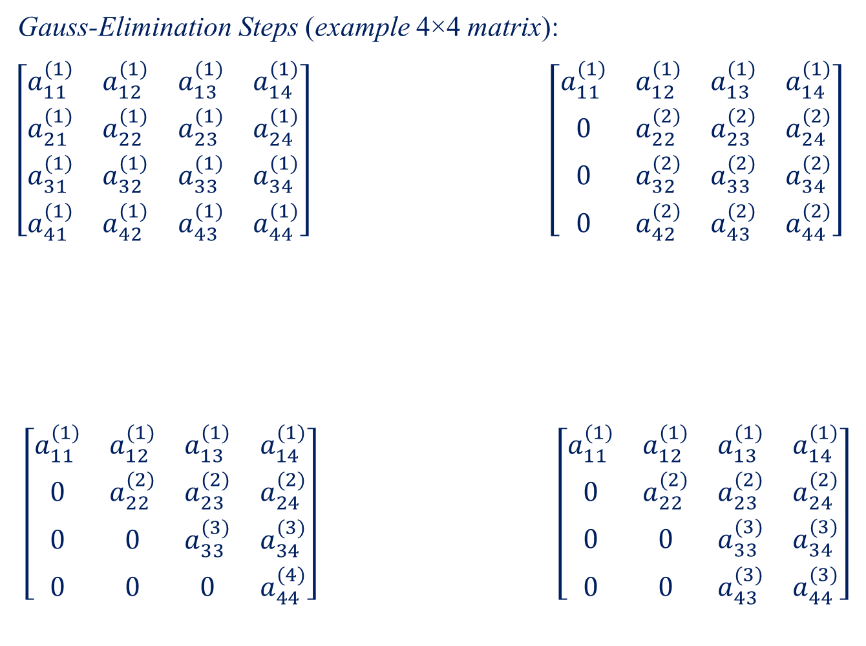
Gauss-Elimination Steps (example 4×4 matrix):
$\left[\begin{matrix}a_{11}^{(1)} & a_{12}^{(1)} & a_{13}^{(1)} & a_{14}^{(1)} \\ a_{21}^{(1)} & a_{22}^{(1)} & a_{23}^{(1)} & a_{24}^{(1)} \\ a_{31}^{(1)} & a_{32}^{(1)} & a_{33}^{(1)} & a_{34}^{(1)} \\ a_{41}^{(1)} & a_{42}^{(1)} & a_{43}^{(1)} & a_{44}^{(1)}\end{matrix}\right]$ $\left[\begin{matrix}a_{11}^{(1)} & a_{12}^{(1)} & a_{13}^{(1)} & a_{14}^{(1)} \\ 0 & a_{22}^{(2)} & a_{23}^{(2)} & a_{24}^{(2)} \\ 0 & a_{32}^{(2)} & a_{33}^{(2)} & a_{34}^{(2)} \\ 0 & a_{42}^{(2)} & a_{43}^{(2)} & a_{44}^{(2)}\end{matrix}\right]$
$$\left[\begin{matrix}a_{11}^{(1)} & a_{12}^{(1)} & a_{13}^{(1)} & a_{14}^{(1)} \\ 0 & a_{22}^{(2)} & a_{23}^{(2)} & a_{24}^{(2)} \\ 0 & 0 & a_{33}^{(3)} & a_{34}^{(3)} \\ 0 & 0 & 0 & a_{44}^{(4)}\end{matrix}\right] \left[\begin{matrix}a_{11}^{(1)} & a_{12}^{(1)} & a_{13}^{(1)} & a_{14}^{(1)} \\ 0 & a_{22}^{(2)} & a_{23}^{(2)} & a_{24}^{(2)} \\ 0 & 0 & a_{33}^{(3)} & a_{34}^{(3)} \\ 0 & 0 & a_{43}^{(3)} & a_{44}^{(3)}\end{matrix}\right]$$
Step 1
Step 2
Step 3

Slide 16
Changed 0-times
Changed 1-time
Changed 2-times
Changed 3-times
Changed (k-1)-times
Changed 1-time and became zero
Changed k- times and became zero
Changed 2-times and became zero
For elements above and on the diagonal i ≤ j:
a_{ij} is actively modified for the first (i - 1) steps and remains constant for the rest (n - i) steps
For elements below on the diagonal j < i:
a_{ij} is actively modified for the first j steps and remains at zero for the rest (n - j) steps
Combined statement:
Any element a_{ij} is actively modified for the first p steps where, p = min {(i-1), j}

Slide 17
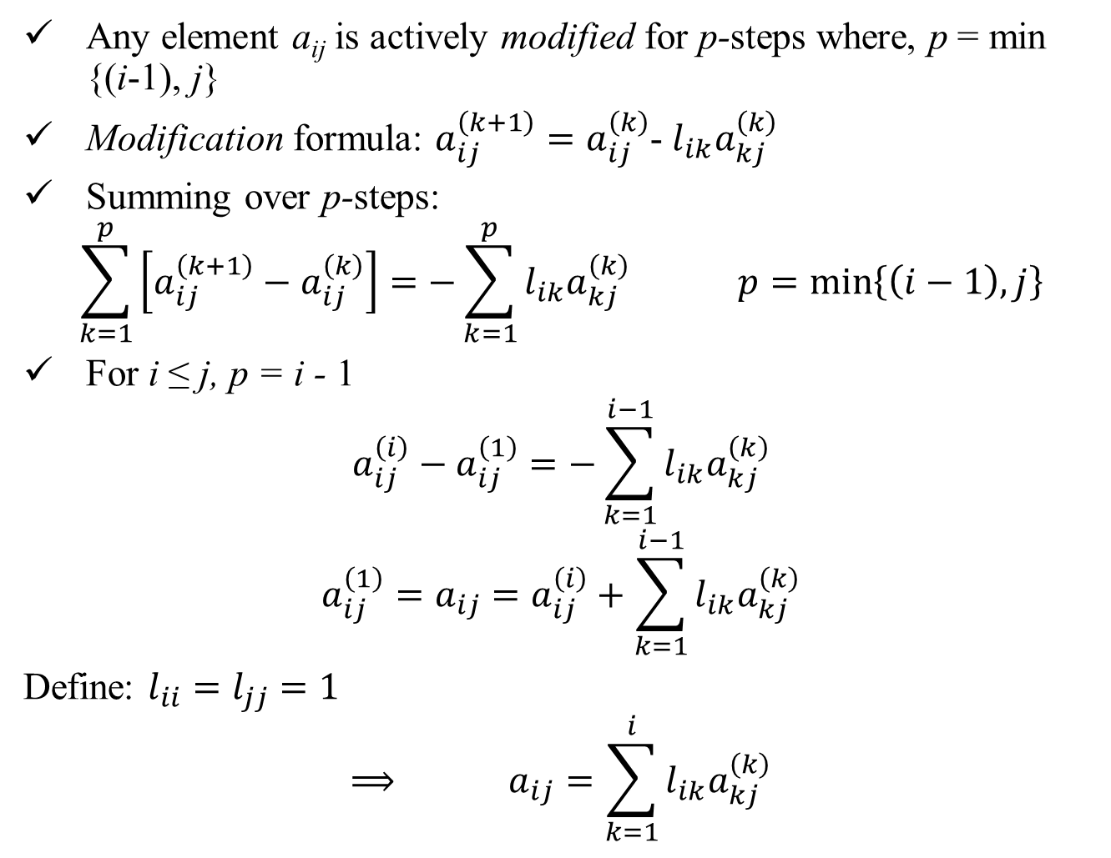
Any element a_{ij} is actively modified for p-steps where, p = min {(i-1), j}
Modification formula: $a_{ij}^{\left(k+1\right)}=a_{ij}^{\left(k\right)}$- $l_{ik}a_{kj}^{\left(k\right)}$
Summing over p-steps:
$$\sum_{k=1}^{p}{\left[a_{ij}^{\left(k+1\right)}−a_{ij}^{\left(k\right)}\right]}=−\sum_{k=1}^{p}{l_{ik}a_{kj}^{\left(k\right)}} p=\min\left\{\left(i−1\right),j\right\}$$
For i ≤ j, p = i - 1
$$a_{ij}^{\left(i\right)}−a_{ij}^{\left(1\right)}=−\sum_{k=1}^{i−1}{l_{ik}a_{kj}^{\left(k\right)}}$$
$$a_{ij}^{\left(1\right)}=a_{ij}=a_{ij}^{\left(i\right)}+\sum_{k=1}^{i−1}{l_{ik}a_{kj}^{\left(k\right)}}$$
Define: $l_{ii}=l_{jj}=1$
$$⟹ a_{ij}=\sum_{k=1}^{i}{l_{ik}a_{kj}^{\left(k\right)}}$$

Slide 18

For i ≤ j, p = i - 1
$$a_{ij}=\sum_{k=1}^{i}{l_{ik}a_{kj}^{\left(k\right)}}$$
For j < i, p = j
$$a_{ij}^{\left(j+1\right)}−a_{ij}^{\left(1\right)}=−\sum_{k=1}^{j}{l_{ik}a_{kj}^{\left(k\right)}}$$
But $a_{ij}^{\left(j+1\right)}=0$
$${⇒ a}_{ij}^{\left(1\right)}=a_{ij}=\sum_{k=1}^{j}{l_{ik}a_{kj}^{\left(k\right)}}$$
Combining two statements:
$$a_{ij}=\sum_{k=1}^{p}{l_{ik}a_{kj}^{\left(k\right)}} p=\min\left\{i,j\right\}$$

Slide 19
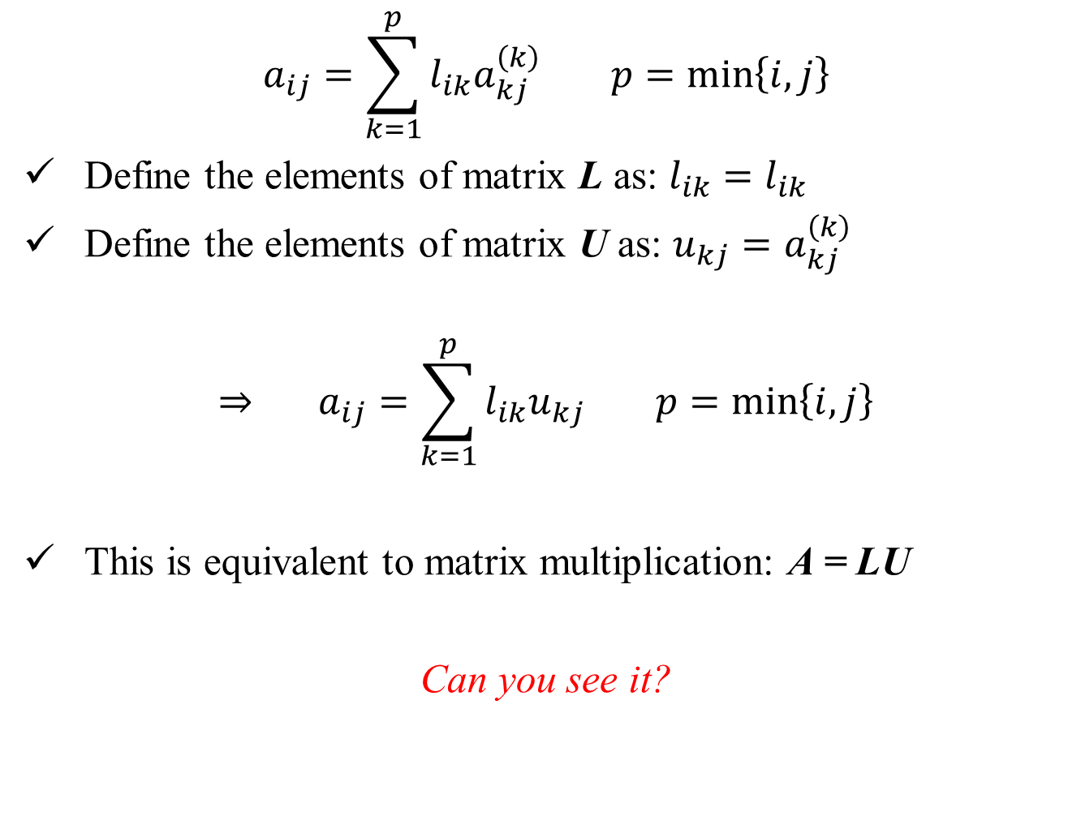
$$a_{ij}=\sum_{k=1}^{p}{l_{ik}a_{kj}^{\left(k\right)}} p=\min\left\{i,j\right\}$$
Define the elements of matrix L as: $l_{ik}=l_{ik}$
Define the elements of matrix U as: $u_{kj}=a_{kj}^{\left(k\right)}$
$$⇒ a_{ij}=\sum_{k=1}^{p}{l_{ik}u_{kj}} p=\min\left\{i,j\right\}$$
This is equivalent to matrix multiplication: A = LU
Can you see it?

Slide 20
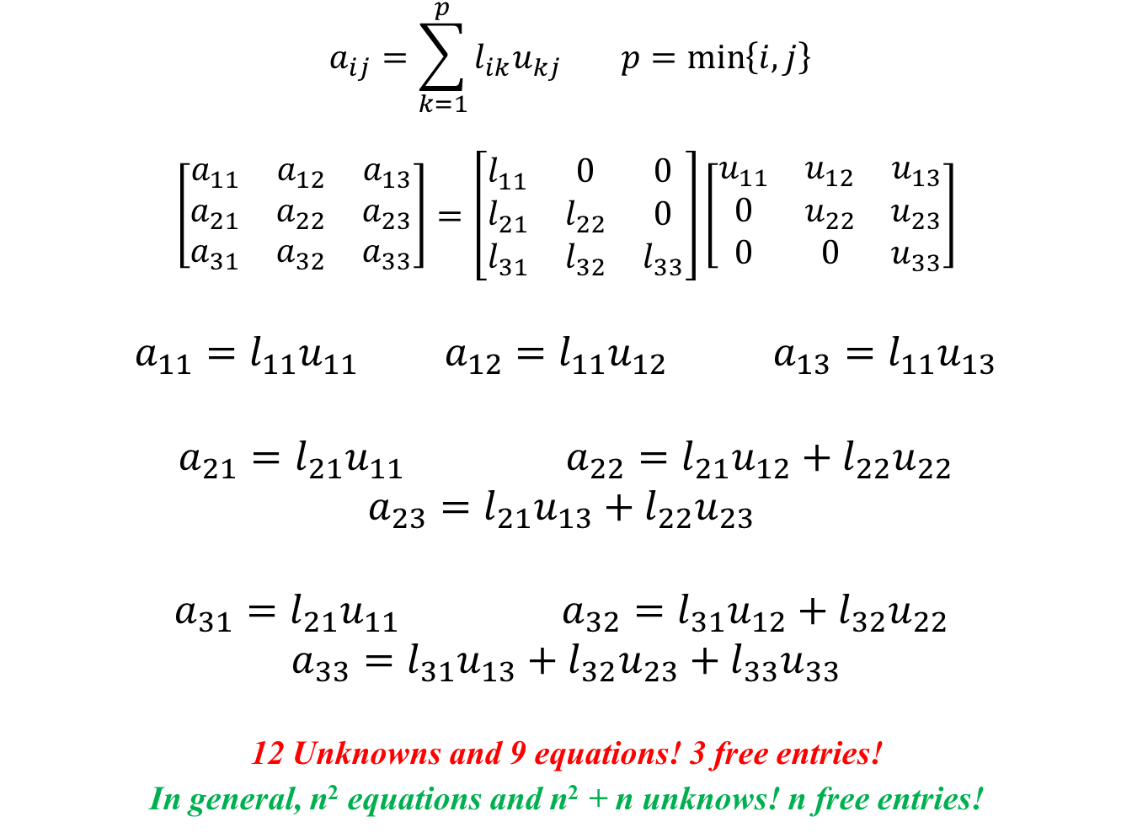
$$a_{ij}=\sum_{k=1}^{p}{l_{ik}u_{kj}} p=\min\left\{i,j\right\}$$
$$\left[\begin{matrix}a_{11} & a_{12} & a_{13} \\ a_{21} & a_{22} & a_{23} \\ a_{31} & a_{32} & a_{33}\end{matrix}\right]=\left[\begin{matrix}l_{11} & 0 & 0 \\ l_{21} & l_{22} & 0 \\ l_{31} & l_{32} & l_{33}\end{matrix}\right]\left[\begin{matrix}u_{11} & u_{12} & u_{13} \\ 0 & u_{22} & u_{23} \\ 0 & 0 & u_{33}\end{matrix}\right]$$
$a_{11}=l_{11}u_{11}$ $a_{12}=l_{11}u_{12}$ $a_{13}=l_{11}u_{13}$
$a_{21}=l_{21}u_{11}$ $a_{22}=l_{21}u_{12}+l_{22}u_{22}$
$$a_{23}=l_{21}u_{13}+l_{22}u_{23}$$
$a_{31}=l_{21}u_{11}$ $a_{32}=l_{31}u_{12}+l_{32}u_{22}$
$$a_{33}=l_{31}u_{13}+l_{32}u_{23}+l_{33}u_{33}$$
12 Unknowns and 9 equations! 3 free entries!
In general, n² equations and n² + n unknows! n free entries!

Slide 21
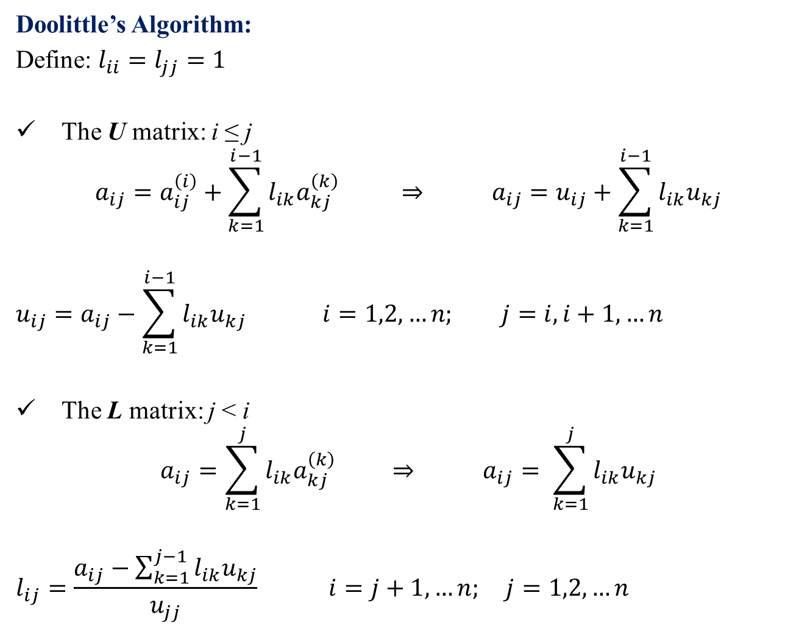
Doolittle’s Algorithm:
Define: $l_{ii}=l_{jj}=1$
The U matrix: i ≤ j
$$a_{ij}=a_{ij}^{\left(i\right)}+\sum_{k=1}^{i−1}{l_{ik}a_{kj}^{\left(k\right)}} ⇒ a_{ij}=u_{ij}+\sum_{k=1}^{i−1}{l_{ik}u_{kj}}$$
$$u_{ij}=a_{ij}−\sum_{k=1}^{i−1}{l_{ik}u_{kj}} i=1,2,…n; j=i,i+1,…n$$
The L matrix: j < i
$$a_{ij}=\sum_{k=1}^{j}{l_{ik}a_{kj}^{\left(k\right)}} ⇒ a_{ij}= \sum_{k=1}^{j}{l_{ik}u_{kj}}$$
$$l_{ij}=\frac{a_{ij}−\sum_{k=1}^{j−1}{l_{ik}u_{kj}}}{u_{jj}} i=j+1,…n; j=1,2,…n$$

Slide 22
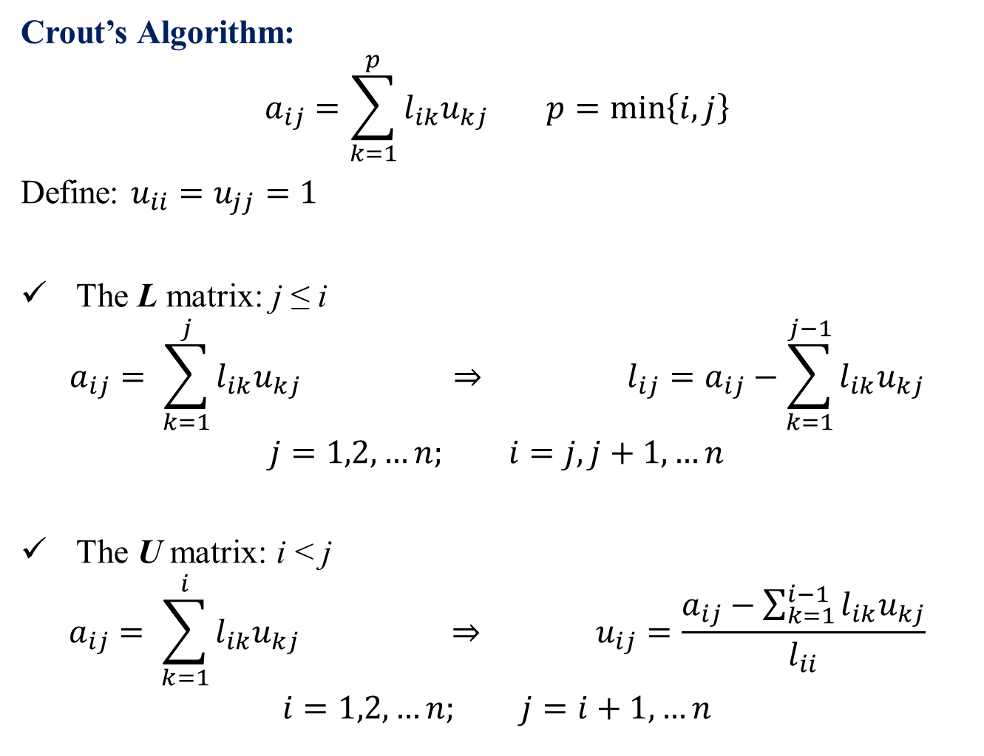
Crout’s Algorithm:
$$a_{ij}=\sum_{k=1}^{p}{l_{ik}u_{kj}} p=\min\left\{i,j\right\}$$
Define: $u_{ii}=u_{jj}=1$
The L matrix: j ≤ i
$$a_{ij}= \sum_{k=1}^{j}{l_{ik}u_{kj}} ⇒ l_{ij}=a_{ij}−\sum_{k=1}^{j−1}{l_{ik}u_{kj}}$$
$$j=1,2,…n; i=j, j+1,…n$$
The U matrix: i < j
$$a_{ij}= \sum_{k=1}^{i}{l_{ik}u_{kj}} ⇒ u_{ij}=\frac{a_{ij}−\sum_{k=1}^{i−1}{l_{ik}u_{kj}}}{l_{ii}}$$
$$i=1,2,…n; j=i+1,…n$$

Slide 23

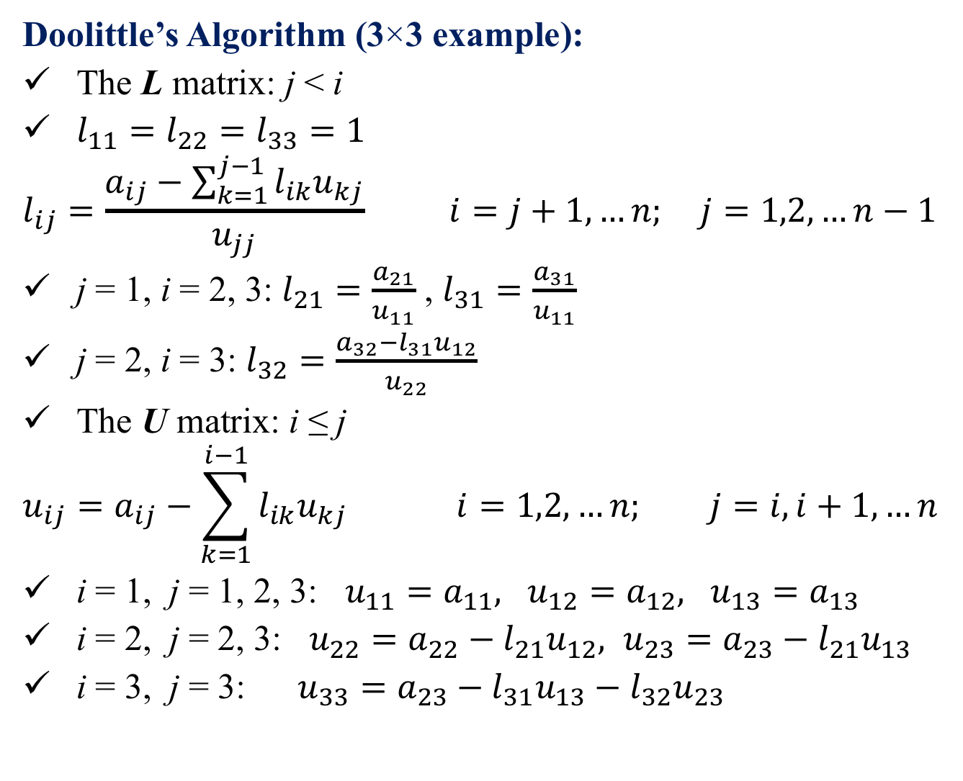

Doolittle’s Algorithm (3×3 example):
The L matrix: j < i
$l_{11}=l_{22}=l_{33}=1$
$$l_{ij}=\frac{a_{ij}−\sum_{k=1}^{j−1}{l_{ik}u_{kj}}}{u_{jj}} i=j+1,…n; j=1,2,…n−1$$
j = 1, i = 2, 3: $l_{21}=\frac{a_{21}}{u_{11}}$ , $l_{31}=\frac{a_{31}}{u_{11}}$
j = 2, i = 3: $l_{32}=\frac{a_{32}−l_{31}u_{12}}{u_{22}}$
The U matrix: i ≤ j
$$u_{ij}=a_{ij}−\sum_{k=1}^{i−1}{l_{ik}u_{kj}} i=1,2,…n; j=i,i+1,…n$$
i = 1, j = 1, 2, 3: $u_{11}=a_{11}, u_{12}=a_{12}, u_{13}=a_{13}$
i = 2, j = 2, 3: $u_{22}=a_{22}−l_{21}u_{12}, u_{23}=a_{23}−l_{21}u_{13}$
i = 3, j = 3: $u_{33}=a_{23}−l_{31}u_{13}−l_{32}u_{23}$
2
4
$$\left[\begin{matrix}1 & 0 & 0 \\ l_{21} & 1 & 0 \\ l_{31} & l_{32} & 1\end{matrix}\right]$$
1
$$\left[\begin{matrix}u_{11} & u_{12} & u_{13} \\ 0 & u_{22} & u_{23} \\ 0 & 0 & u_{33}\end{matrix}\right]$$
3
5

Slide 24

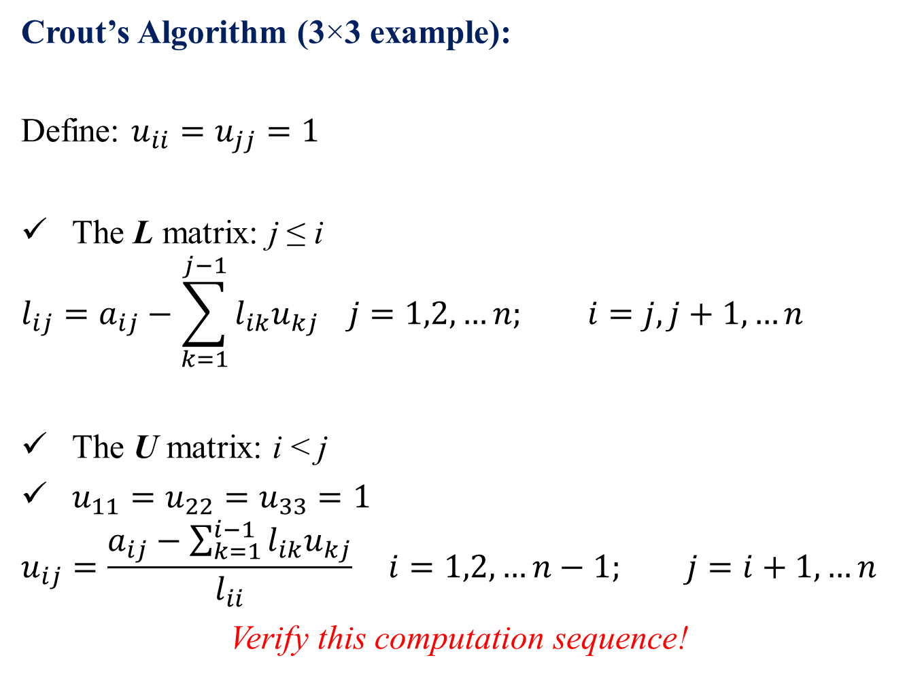

Crout’s Algorithm (3×3 example):
Define: $u_{ii}=u_{jj}=1$
The L matrix: j ≤ i
$$l_{ij}=a_{ij}−\sum_{k=1}^{j−1}{l_{ik}u_{kj}} j=1,2,…n; i=j, j+1,…n$$
The U matrix: i < j
$u_{11}=u_{22}=u_{33}=1$
$$u_{ij}=\frac{a_{ij}−\sum_{k=1}^{i−1}{l_{ik}u_{kj}}}{l_{ii}} i=1,2,…n−1; j=i+1,…n$$
Verify this computation sequence!
1
3
5
$$\left[\begin{matrix}l_{11} & 0 & 0 \\ l_{21} & l_{22} & 0 \\ l_{31} & l_{32} & l_{33}\end{matrix}\right]$$
2
$$\left[\begin{matrix}1 & u_{12} & u_{13} \\ 0 & 1 & u_{23} \\ 0 & 0 & 1\end{matrix}\right]$$
4

