Slide 1
INTRODUCTION Process Dynamics
Module # 1.3
Lectures on
CHEMICAL PROCESS CONTROL
Theory and Practice

Slide 2
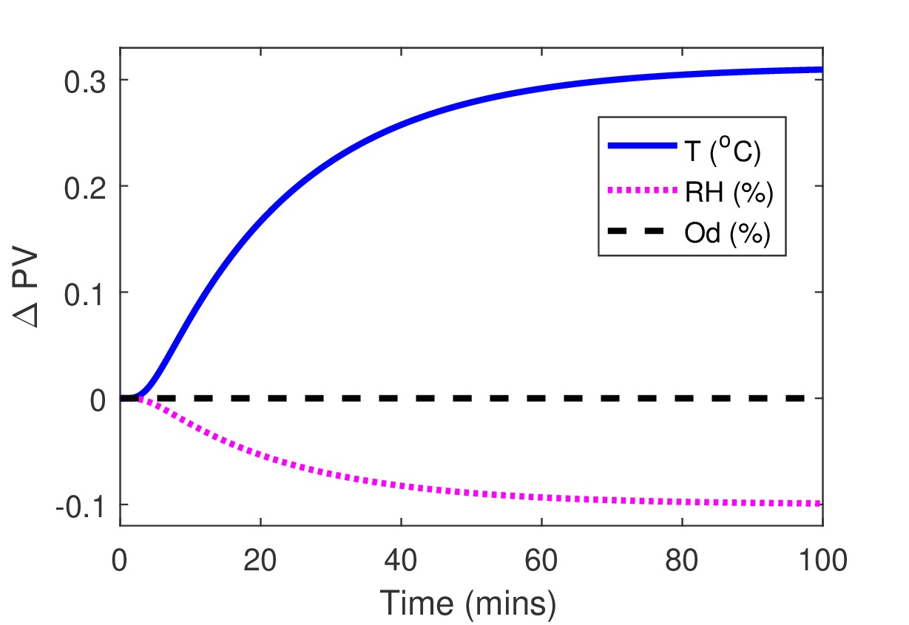
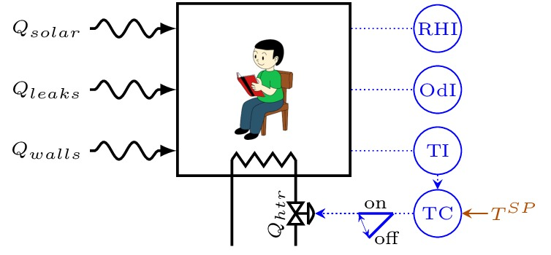
Process Dynamics
Output PV trajectory over time in response to input PV changes
Process with no control
Process with a control system installed
Output PV Dynamics: No control
ROOM EXAMPLE

Slide 3
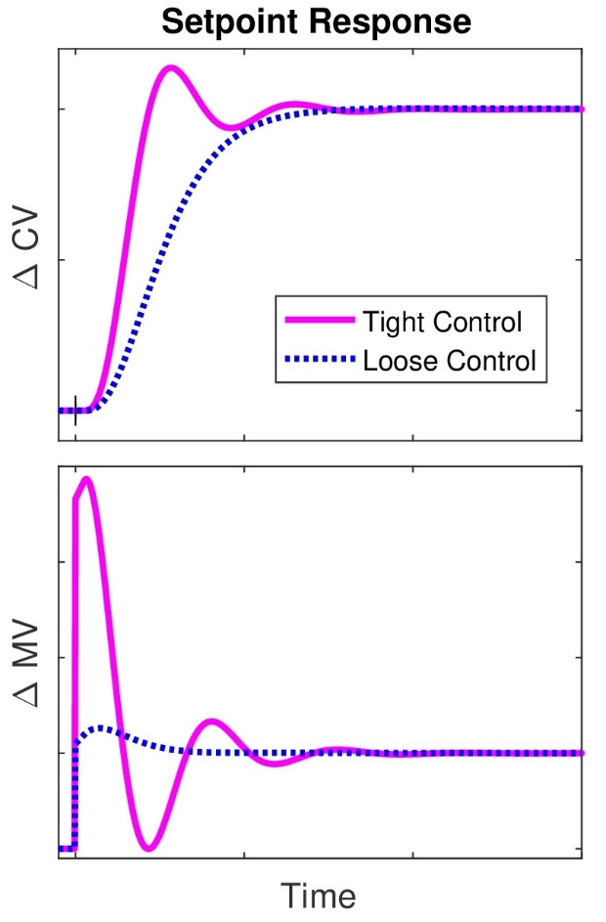
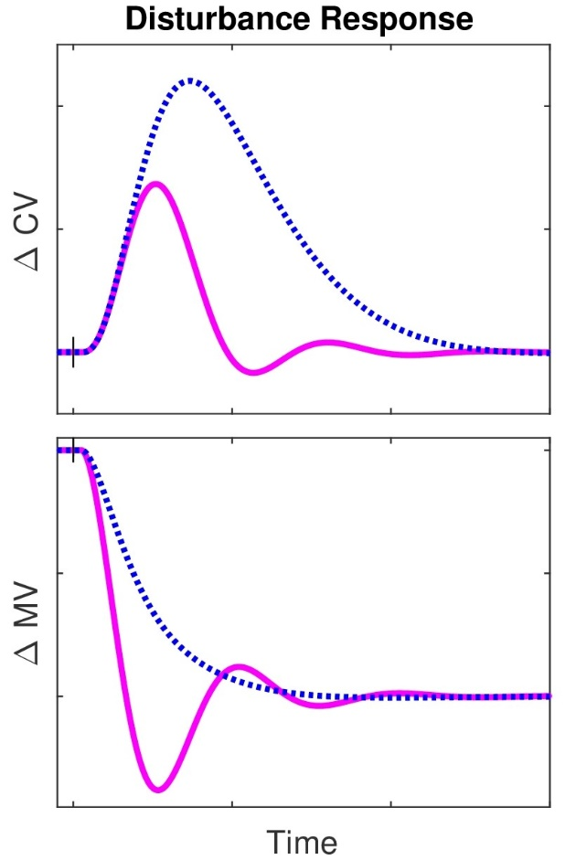
Dynamics with Control
Two types of responses
Response to a CV setpoint change (SERVO)
Response to a disturbance change (REGULATOR)
REGULATOR
SERVO

Slide 4
Basic Dynamic Responses

Slide 5
Basic Dynamic Responses

Slide 6
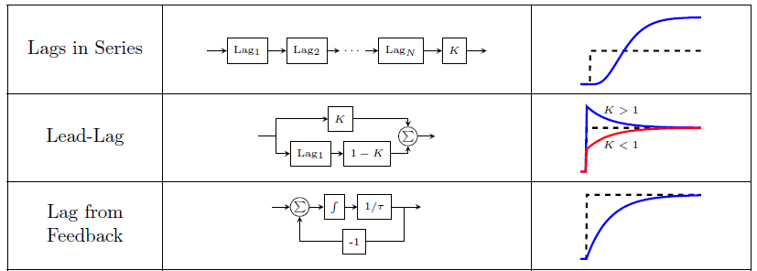
Complex Responses by Combining Basic Responses
SERIES, PARALLEL & FEEDBACK STRUCTURES

Slide 7
Complex Responses by Combining Basic Responses
Examples in Nature?

Slide 8
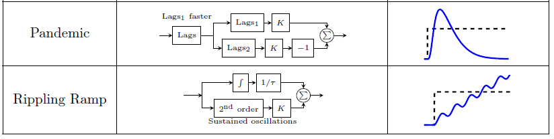
Complex Responses by Combining Basic Responses
Examples in Nature?

Slide 9
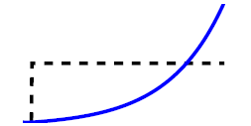
Exercise: Combining Basic Responses
Real-life example?

Slide 10
Summary
Nature exhibits a variety of dynamic responses
The variety of responses well represented by a combination of basic dynamic response elements
Series
Parallel
Feedback or recycle
The basic dynamic response elements
Pure gain
Pure dead time
Pure integrator
First order lag
Second order lag

