Slide 1
INTRODUCTION SISO Control Algorithms
Module # 1.4
Lectures on
CHEMICAL PROCESS CONTROL
Theory and Practice

Slide 2
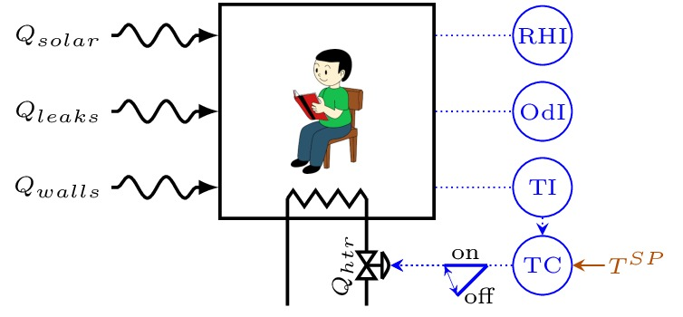
SISO Feedback Control Algorithms
Feedback Control Algorithm
Quantitative relationship between MV and CV
u_{t} = f(y_{t})
Simple Control Algorithms
On Off Control
Proportional Control
Integral Control
Proportional Integral Control
Proportional Integral Derivative Control

Slide 3
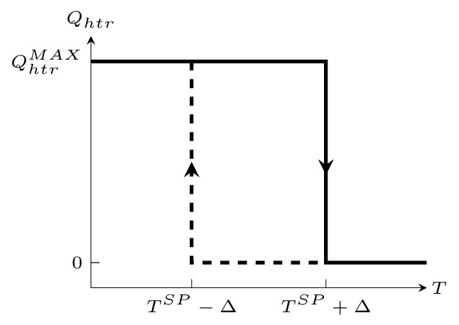
On-Off Control

Slide 4
Proportional Control
Expect Offset

Slide 5
How to Remove Offset?
At FSS
Want
Integral Controller
Integral control gives ZERO OFFSET for constant setpoint

Slide 6
Proportional Integral Control
Combine both proportional and integral modes
Zero offset due to integral mode

Slide 7
The Derivative Mode
To act when error is small but PV rate of change is large
PID

Slide 8
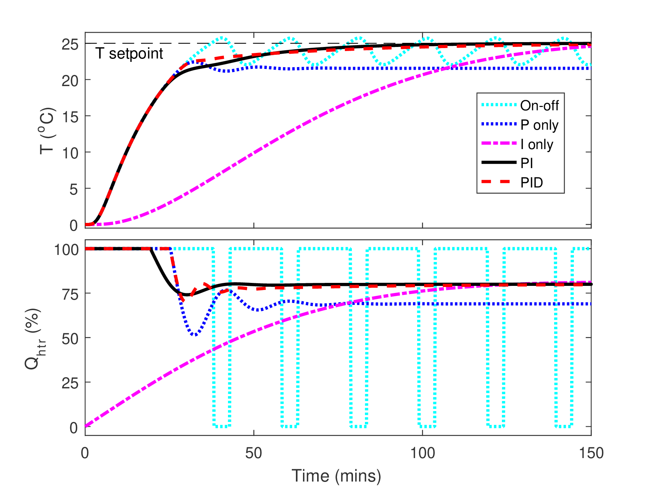
Room SISO Temperature Control

Slide 9
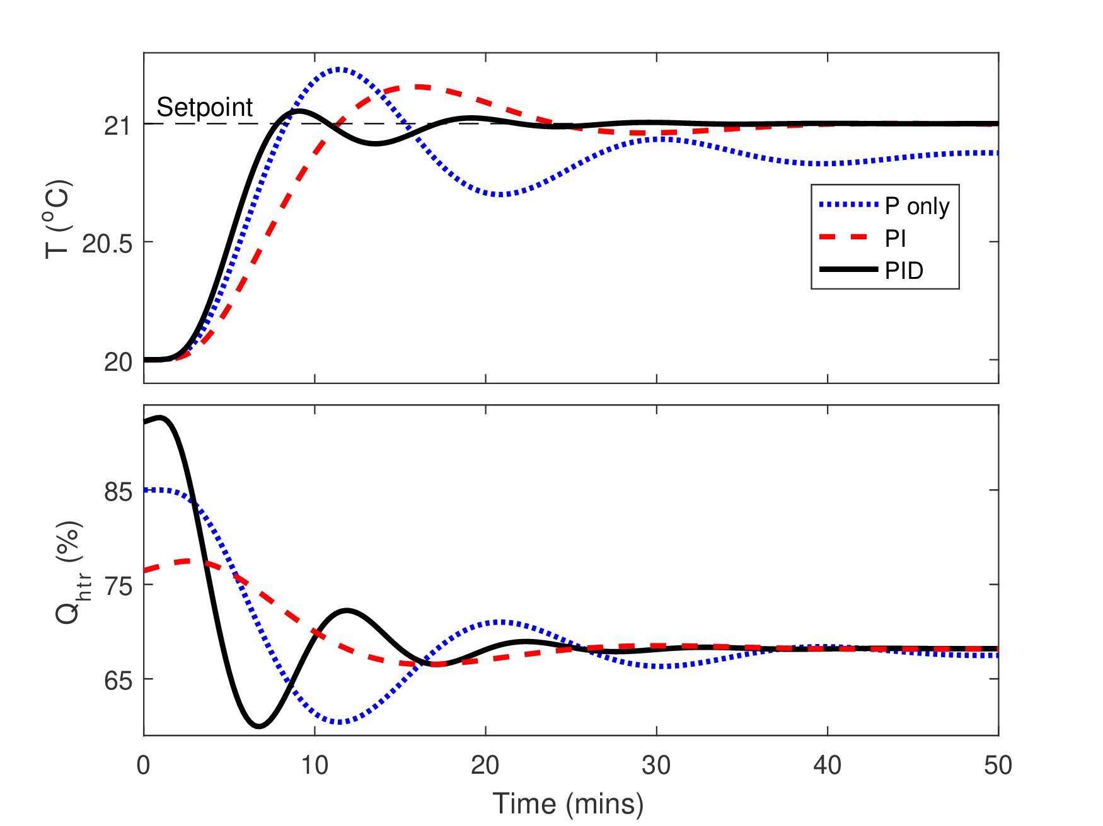
T Setpoint Change Response

Slide 10
More Complex Control Algorithms
Feedforward Ideas
Counter effect of a measured disturbance by adjusting MV
Requires MV-CV and disturbance-CV dynamic models
Major correction via feedforward. Minor correction via feedback
Model based control
Major correction via model
Minor correction via feedback
Model based control + feedback
Complexity vs Simplicity
Simple and robust but loose PV control
Complex and tight PV control but fragile

Slide 11

Feedback, Feedforward or Model-Based?
Balancing a Bike

Slide 12


Feedback, Feedforward or Model-Based?
Wading Through Traffic

Slide 13
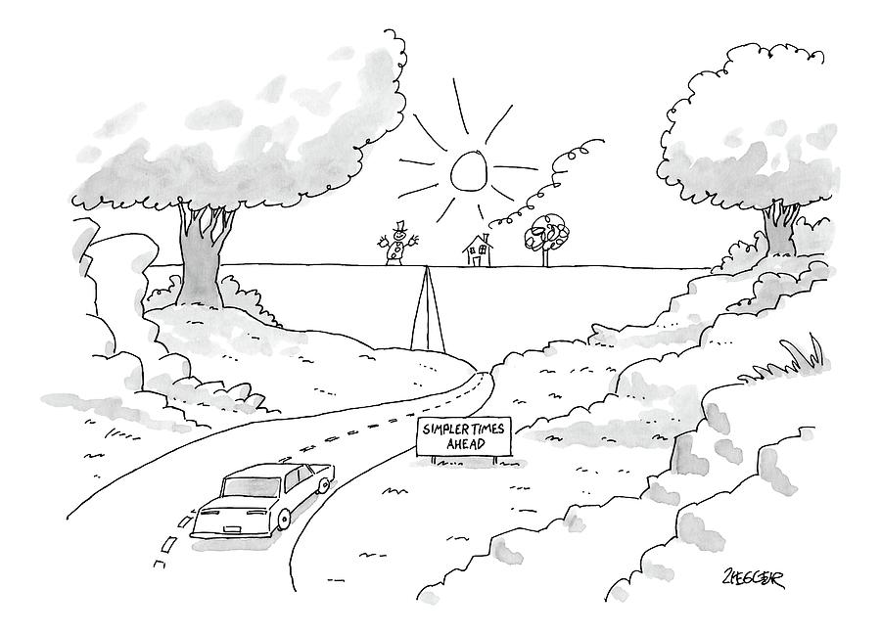
Feedback, Feedforward or Model-Based?
Driving on a Highway

Slide 14

Feedback, Feedforward or Model-Based?
Near Exact Grocery Weighing

Slide 15

Feedback, Feedforward or Model-Based?
Fine Tuning Guitar Strings

Slide 16
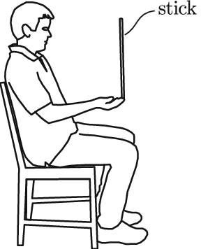
Feedback, Feedforward or Model-Based?
Balancing a Stick

Slide 17
Summary
PV feedback based adjustment of MV a powerful means for control
Common SISO feedback control algorithms
On-off
PID
Most commonly employed industrial algorithm (>90%)
Integral mode gives off-set free control
Derivative mode allows accelerated MV adjustment
More complex algorithms possible
Feedforward + feedback
Model + feedback
Prefer simplicity over complexity

