Slide 1
INTRODUCTION
Process Control: Major Steps
Module # 1.5
Lectures on
CHEMICAL PROCESS CONTROL
Theory and Practice

Slide 2
Formulating a Control Problem
Concretize an abstract idea into quantifiable metrics
  User comfort = ‘Right’ temperature and humidity
Clearly articulate desired state of output PVs
  What PVs to control
  Setpoints and acceptable deviation around setpoints
Properly account for control dofs
  Gets complicated for chemical processes
One MV controls one CV
  Controlled PV may shift from one to another PV
Clearly prioritize control objectives
  # of constraints >> # of MVs
  Fixes what PVs are controlled and what PVs float

Slide 3
Solving the Control Problem
Control a PV using an MV with ‘strong’ and ‘predictable’ response
  Close-by pairing
Use output PV feedback for control
Prefer simplest control system that achieves the objectives
  Simple is robust
  Complex is fragile
  Multiple SISO controllers with enhancements
Control using PV feedback is simple and effective
Good economics = Proper choice of CVs and setpoints
  Active constraints
  Invariants

Slide 4
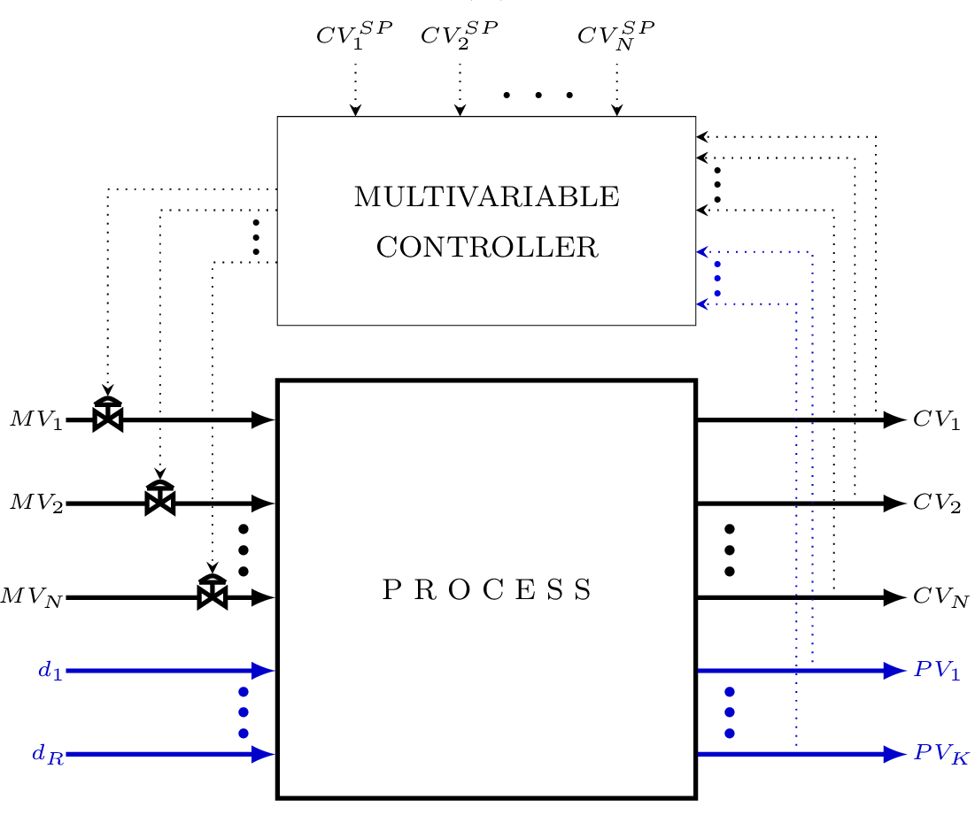
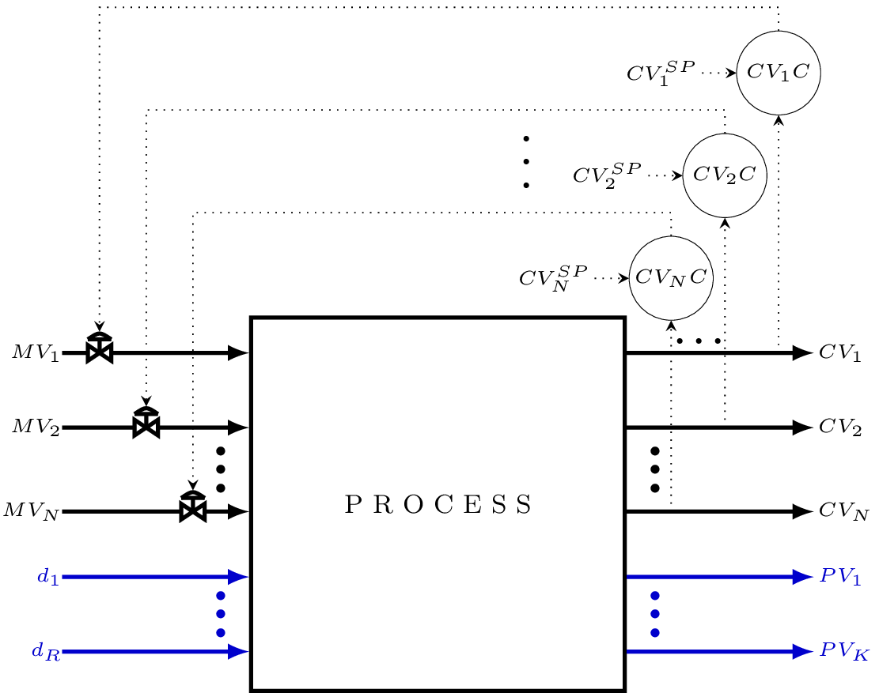
Centralized vs Decentralized Control
CENTRALIZED CONTROL
DECENTRALIZED CONTROL
ENHANCED DECENTRALIZED CONTROL
Decentralized + local enhancements (feedforward, model based etc)

Slide 5
Enhanced Decentralized Control
Formulation of Prioritized Control Objectives
  What PVs to control
  Degree-of-tightness of control (loose vs tight)
  Prioritization
Enhanced Decentralized Control System Design
  Control structure design (CV-MV pairing)
  Targeted enhancements to decentralized control structure
  Individual controller design (algorithm and parameter tuning)
Process understanding is the key to good control

