Slide 1
Dynamic Modelling Approaches
Module 3.1
Lectures on
CHEMICAL PROCESS CONTROL
Theory and Practice

Slide 2
Dynamic Modelling and Simulation
Essential for process understanding
Allows tinkering with process inputs
At worst, a simulation may crash
Allows testing and validating control strategies
What works and makes sense?
What does not work and is non-sense?
Why?
Pushing the envelope
Superior control algorithms and strategies
Synthesis of area specific knowledge
Discipline specific do’s and don’ts
Pedagogical resource

Slide 3
Dynamic Modelling Approaches
Dynamic Process Model
Empirical
First Principles
Change MV
Record PV response
Propose simplest combination of basic dynamic elements that fits PV response shape
Best fit basic dynamic element parameters
Develop dynamic model from conservation laws and thermodynamic/other constraints
Material, energy and momentum balance
Phase equilibrium, rheology etc
Fit model parameters to plant data

Slide 4
Empirical Approach
PARAMETERS
Lag time
Gain
Delay Time
IDENTIFICATION
DESIGN CONTROLLER
VALIDATE PERFORMANCE
Servo & regulator

Slide 5
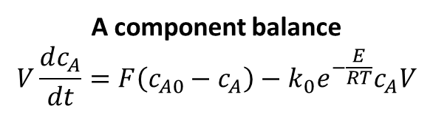
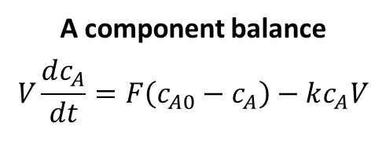
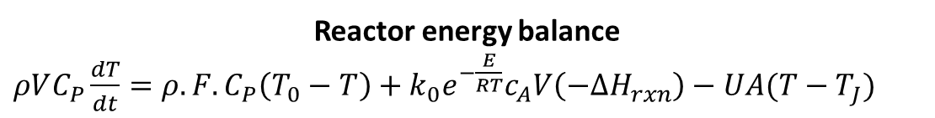
The First Principles Approach
F₀, c_{A0}
ISOTHERMAL CSTR
Total material balance
F₀ = F at all times
ASSUMPTIONS
Isothermal
Well mixed
Fixed volume
F₀
F
Process
r = k c_{A}
A component balance
$$V\frac{dc_{A}}{dt}=F\left(c_{A0}−c_{A}\right)−kc_{A}V$$
c_{A0}
c_{A}
A → B
F, c_{A}
COUPLED NON-LINEAR ODES WITH ALGEBRAIC CONSTRAINTS
Solve numerically
Linearize and solve analytically (not guaranteed)
F₀, c_{A0}, T₀
NON-ISOTHERMAL CSTR
Total material balance
F₀ = F at all times
F₀
F
ASSUMPTIONS
Well mixed reactor
Well mixed jacket
Fixed volume
Constant C_{P} ρ U -ΔH_{rxn}
Arrhenius rate constant
c_{A0}
Process
c_{A}
T₀
A component balance
$$V\frac{dc_{A}}{dt}=F\left(c_{A0}−c_{A}\right)−k_{0}e^{−\frac{E}{RT}}c_{A}V$$
T
T_{J}
r = k c_{A}
T_{J}
A → B
Reactor energy balance
$ρVC_{P}\frac{dT}{dt}=ρ.F.C_{P}\left(T_{0}−T\right)+k_{0}e^{−\frac{E}{RT}}c_{A}V\left(−{∆H}_{rxn}\right)−UA(T−T_{J})$
F, c_{A}, T

Slide 6
The First Principles Approach
Develop process model equations
Realistic assumptions
Dynamic balances
Material, energy, component or momentum balances
Process constraints
Phase equilibrium (equal fugacity), thermal equilibrium, given specifications etc
Relevant material properties
Thermodynamics: Enthalpy, specific heat, heat of reaction, activity coefficients etc
Kinetics: Reaction rate expressions and parameters
Constitutive: Viscosity expression
Develop numerical procedure for solving system of DAEs
Simulate, test and validate process model (including parameter fitting)
Apply control system equations on top of process model
Simulate, test and validate process control performance

Slide 7
Dynamic Modelling Approaches
Dynamic Process Model
Empirical
First Principles
Change MV
Record PV response
Propose simplest combination of basic dynamic elements that fits PV response shape
Best fit basic dynamic element parameters
Develop dynamic model from conservation laws and thermodynamic/other constraints
Material, energy and momentum balance
Phase equilibrium, rheology etc
Fit model parameters to plant data
System of non-linear DAEs
Solved numerically
May get analytical solutions by linearization
Theory under development. Too complex
System of linear ODEs
Elegant analytical solutions
Well established theory
Complex (including plant testing & fitting)
Applies to a wider operating range
Helps develop process understanding
Very practical and simple
Applies in vicinity of MV-PV response test

Slide 8
Summary
Dynamic process models essential for control studies
Empirical
First Principles
Empirical Approach
Simple and practical
Applies ‘locally’
Analytical solutions
Well established linear control theory
First principles approach
Apply material and energy balances
Non-linear models
Capable of describing process behavior over a large operating space
Realistic but complex
Usually solved numerically
Effect of principal disturbances can be modeled
Develops process understanding

