Slide 1
Dynamic Modelling First Principles Models Simple Systems I
Module 3.2.1
Lectures on
CHEMICAL PROCESS CONTROL
Theory and Practice

Slide 2
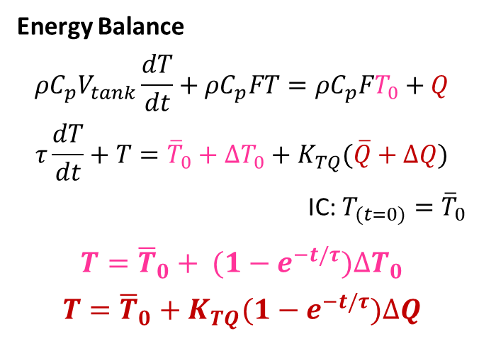
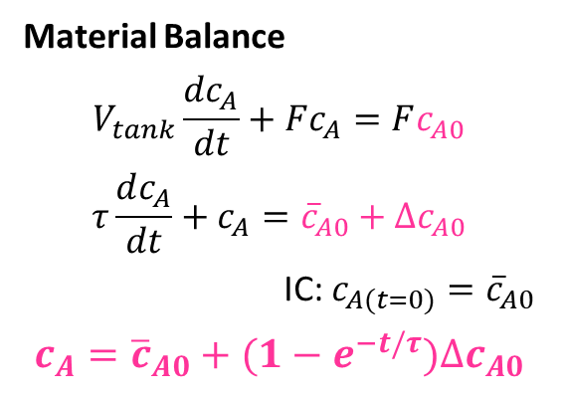
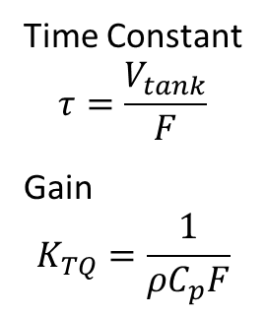
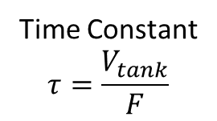
Heated Surge Vessel
F₀, c_{A0}, T₀
F₀, c_{A0}, T₀
ASSUMPTIONS
Well mixed
No heat loss
Constant properties
Constant V and F₀
Q given
Material Balance
$$V_{tank}\frac{dc_{A}}{dt}+Fc_{A}=Fc_{A0}$$
$$τ\frac{dc_{A}}{dt}+c_{A}={\overline{c}}_{A0}+∆c_{A0}$$
IC: $c_{A(t=0)}={\overline{c}}_{A0}$
$$c_{A}={\overline{c}}_{A0}+(1−e^{−t/τ})∆c_{A0}$$
Q
Time Constant
$$τ=\frac{V_{tank}}{F}$$
F, c_{A}, T
F, c_{A}, T
First order ODE
Gain
Time constant
Energy Balance
$${{ρC}_{p}V}_{tank}\frac{dT}{dt}+{ρC}_{p}FT={{ρC}_{p}FT}_{0}+Q$$
$$τ\frac{dT}{dt}+T={\overline{T}}_{0}+∆T_{0}+K_{TQ}(\overline{Q}+∆Q)$$
IC: $T_{(t=0)}={\overline{T}}_{0}$
$$T={\overline{T}}_{0}+ (1−e^{−t/τ})∆T_{0}$$
$$T={\overline{T}}_{0}+K_{TQ}(1−e^{−t/τ})∆Q$$
PROBLEM
c_{A} response to change in c_{A0}
T response to change in T₀
T response to change in Q
Time Constant
$$τ=\frac{V_{tank}}{F}$$
Gain
$$K_{TQ}=\frac{1}{{ρC}_{p}F}$$
Depend on operating conditions

Slide 3
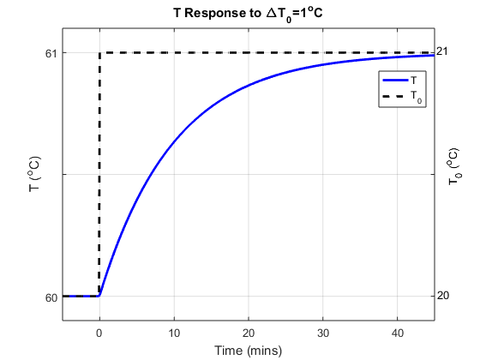
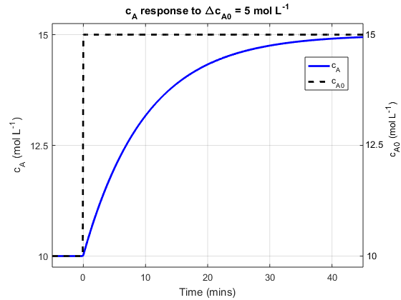
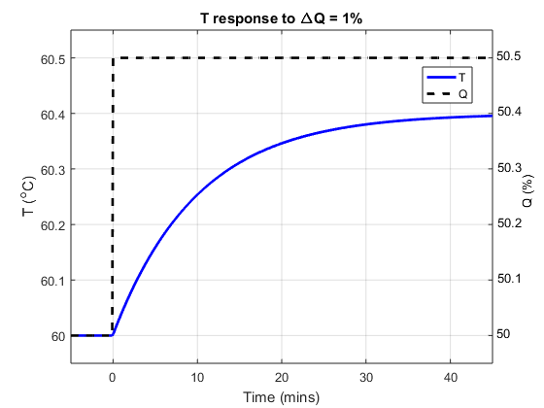
Heated Surge Vessel Dynamic Responses
1m³/min, 10 kmol/m³
20 ºC
C_{p} = 2.55 kJ/kg K
ρ = 800 kg/m³
81.6 MJ/min
10 m³
60 ºC

Slide 4
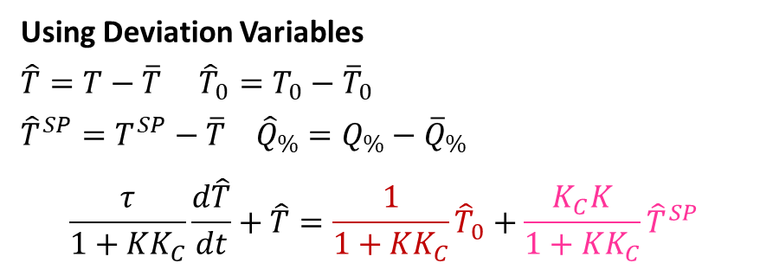
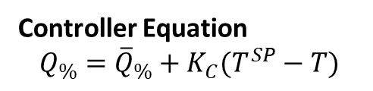
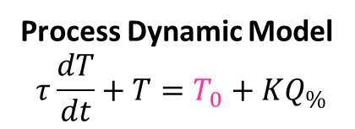
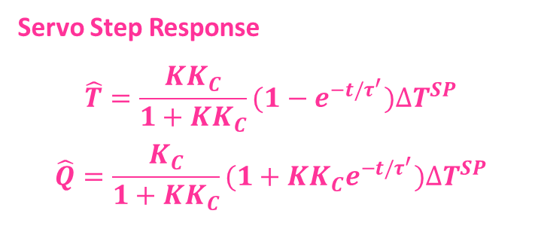
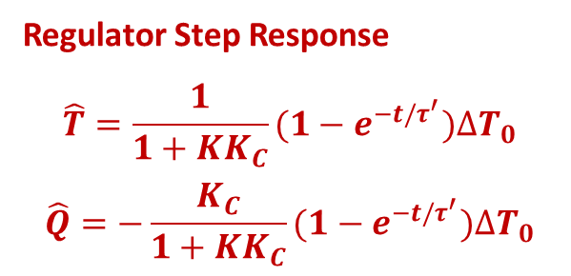
Heated Surge Vessel Proportional Temperature Control
F₀, c_{A0}, T₀
Regulator Step Response
$$\hat{T}=\frac{1}{1+{KK}_{C}}(1−e^{−t/τ^{′}})∆T_{0}$$
$$\hat{Q}=−\frac{K_{C}}{1+{KK}_{C}}(1−e^{−t/τ^{′}})∆T_{0}$$
T^{SP}
TC
F, c_{A}, T
Process Dynamic Model
$$τ\frac{dT}{dt}+T=T_{0}+KQ_{\%}$$
Controller Equation
$$Q_{\%}={\overline{Q}}_{\%}+K_{C}(T^{SP}−T)$$
Servo Step Response
$$\hat{T}=\frac{{KK}_{C}}{1+{KK}_{C}}(1−e^{−t/τ^{′}})∆T^{SP}$$
$$\hat{Q}=\frac{K_{C}}{1+{KK}_{C}}(1+{{KK}_{C}e}^{−t/τ^{′}})∆T^{SP}$$
Using Deviation Variables
$\hat{T}=T−\overline{T}$ ${\hat{T}}_{0}=T_{0}−{\overline{T}}_{0}$
${\hat{T}}^{SP}=T^{SP}−\overline{T}$ ${\hat{Q}}_{\%}=Q_{\%}−{\overline{Q}}_{\%}$
$$\frac{τ}{1+{KK}_{C}}\frac{d\hat{T}}{dt}+\hat{T}=\frac{1}{1+{KK}_{C}}{\hat{T}}_{0}+\frac{K_{C}K}{1+{KK}_{C}}{\hat{T}}^{SP}$$

Slide 5
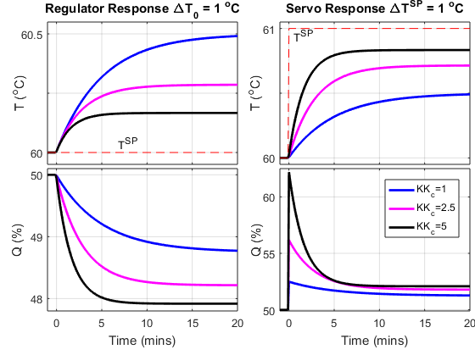
Heated Surge Vessel Proportional Temperature Control: Dynamic Response
OBSERVATIONS
Smooth exponential response
Response speed increases with K_{C}
Aggression in Q increases with K_{C}
Steady state offset from T^{SP}
Offset magnitude decreases with K_{C}

Slide 6
Exercise
F₀
A P controller manipulates outflow F to hold tank level
Obtain servo response (level setpoint step change)
Obtain regulator response (F₀ step change)
F

Slide 7
Summary
Dynamics of very simple systems described by a first order ODE
First order ODE is parameterized by gain and time constant
Gain and time constant change with operating conditions
Usually decrease with throughput
Response is usually described by a decaying exponential (e^{-at})
First order ODE solved using integrating factor approach
Proportional control of a first order system
Dynamics described by a first order ODE
ODE parameters depend on operating conditions (K and τ) and controller gain (K_{C})
Gives smooth dynamic response
Results in offset from a constant setpoint
Higher controller gain causes
CV response time constant to decrease
Lower offset from CV setpoint

