Slide 1
Dynamic Modelling First Principles Models Simple Systems II
Module 3.2.2
Lectures on
CHEMICAL PROCESS CONTROL
Theory and Practice

Slide 2
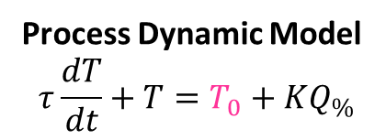

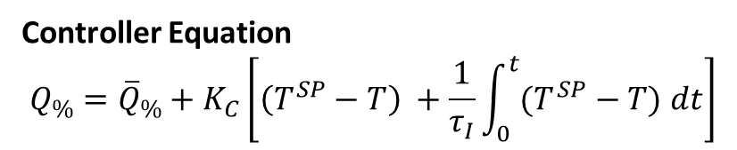
Heated Surge Vessel Proportional Integral Control
F₀, c_{A0}, T₀
1m³/min, 10 kmol/m³
20 ºC
C_{p} = 2.55 kJ/kg K
ρ = 800 kg/m³
T^{SP}
TC
81.6 MJ/min
10 m³
60 ºC
F, c_{A}, T
Process Dynamic Model
$$τ\frac{dT}{dt}+T=T_{0}+KQ_{\%}$$
Controller Equation
$$Q_{\%}={\overline{Q}}_{\%}+K_{C}\left[\left(T^{SP}−T\right) +\frac{1}{τ_{I}}\int_{0}^{t}{(T^{SP}−T) dt}\right]$$
$$τ=10\min{ K=0.4}$$

Slide 3
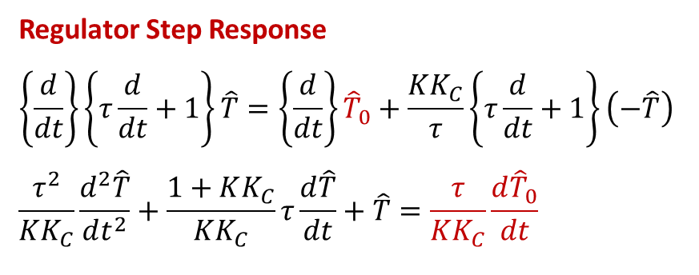
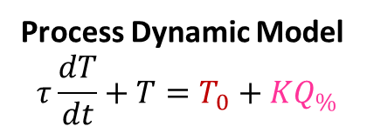
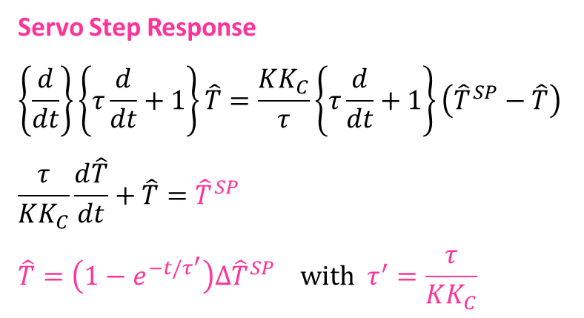

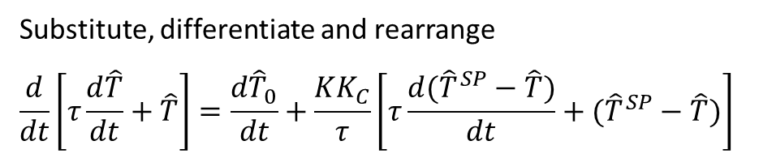
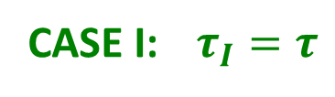
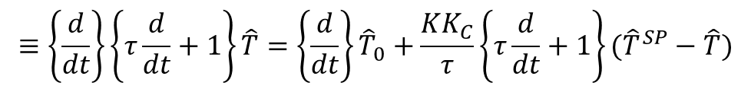
Heated Surge Vessel Proportional Integral Temperature Control ($τ_{I}=τ$)
Process Dynamic Model
$$τ\frac{dT}{dt}+T=T_{0}+KQ_{\%}$$
Controller Equation
$$Q_{\%}={\overline{Q}}_{\%}+K_{C}\left[\left(T^{SP}−T\right) +\frac{1}{τ_{I}}\int_{0}^{t}{(T^{SP}−T) dt}\right]$$
CASE I: $τ_{I}=τ$
Substitute, differentiate and rearrange
$$\frac{d}{dt}\left[τ\frac{d\hat{T}}{dt}+\hat{T}\right]=\frac{d{\hat{T}}_{0}}{dt}+\frac{KK_{C}}{τ}\left[τ\frac{d({\hat{T}}^{SP}−\hat{T})}{dt}+({\hat{T}}^{SP}−\hat{T})\right]$$
$$≡\left\{\frac{d}{dt}\right\}\left\{τ\frac{d}{dt}+1\right\}\hat{T}=\left\{\frac{d}{dt}\right\}{\hat{T}}_{0}+\frac{KK_{C}}{τ}\left\{τ\frac{d}{dt}+1\right\}({\hat{T}}^{SP}−\hat{T})$$
Servo Step Response
$$\left\{\frac{d}{dt}\right\}\left\{τ\frac{d}{dt}+1\right\}\hat{T}=\frac{KK_{C}}{τ}\left\{τ\frac{d}{dt}+1\right\}\left({\hat{T}}^{SP}−\hat{T}\right)$$
$$\frac{τ}{KK_{C}}\frac{d\hat{T}}{dt}+\hat{T}={\hat{T}}^{SP}$$
$$\hat{T}=\left(1−e^{−t/τ^{′}}\right)∆{\hat{T}}^{SP} with τ^{′}=\frac{τ}{KK_{C}}$$
Regulator Step Response
$$\left\{\frac{d}{dt}\right\}\left\{τ\frac{d}{dt}+1\right\}\hat{T}=\left\{\frac{d}{dt}\right\}{\hat{T}}_{0}+\frac{KK_{C}}{τ}\left\{τ\frac{d}{dt}+1\right\}\left(−\hat{T}\right)$$
$$\frac{τ^{2}}{KK_{C}}\frac{d^{2}\hat{T}}{dt^{2}}+\frac{1+KK_{C}}{KK_{C}}τ\frac{d\hat{T}}{dt}+\hat{T}=\frac{τ}{KK_{C}}\frac{d{\hat{T}}_{0}}{dt}$$
Need to solve second order linear ODE

Slide 4
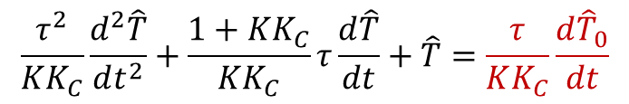
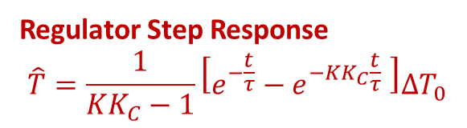

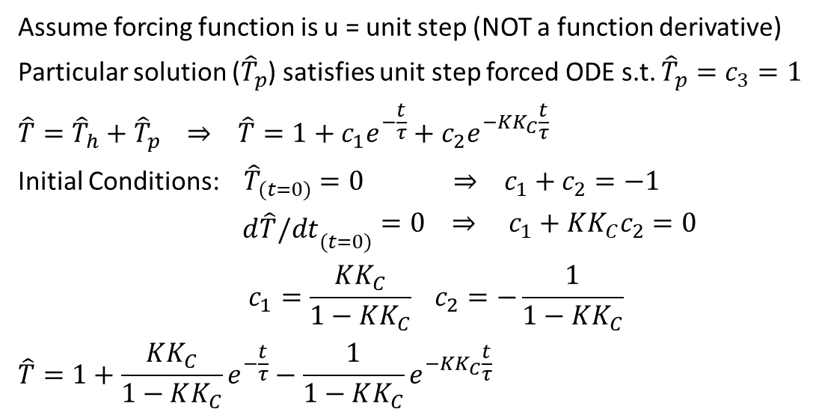
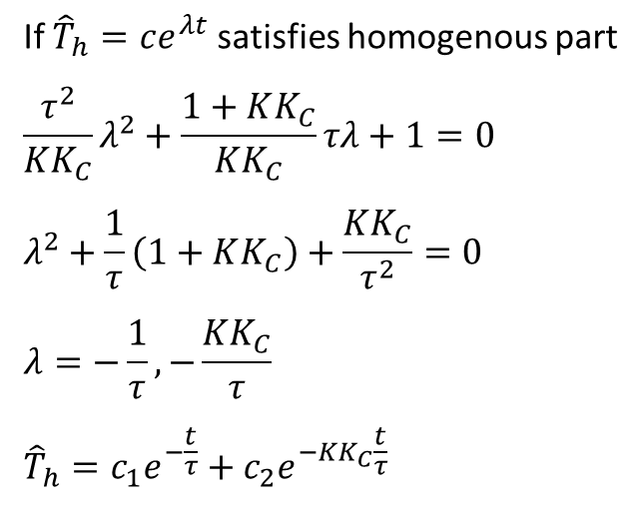
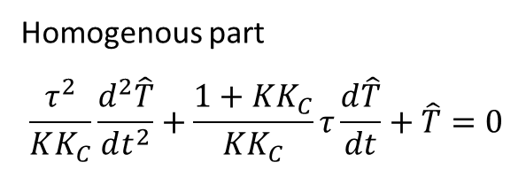
Heated Surge Vessel PI Temperature Control ($τ_{I}=τ$)
ODE solution using method of constant coefficients
$$\frac{τ^{2}}{KK_{C}}\frac{d^{2}\hat{T}}{dt^{2}}+\frac{1+KK_{C}}{KK_{C}}τ\frac{d\hat{T}}{dt}+\hat{T}=\frac{τ}{KK_{C}}\frac{d{\hat{T}}_{0}}{dt}$$
Homogenous part
$$\frac{τ^{2}}{KK_{C}}\frac{d^{2}\hat{T}}{dt^{2}}+\frac{1+KK_{C}}{KK_{C}}τ\frac{d\hat{T}}{dt}+\hat{T}=0$$
Assume forcing function is u = unit step (NOT a function derivative)
Particular solution (${\hat{T}}_{p}$) satisfies unit step forced ODE s.t. ${\hat{T}}_{p}=c_{3}=1$
$$\hat{T}={\hat{T}}_{h}+{\hat{T}}_{p} ⇒ \hat{T}=1+c_{1}e^{−\frac{t}{τ}}+c_{2}e^{−KK_{C}\frac{t}{τ}}$$
Initial Conditions: ${\hat{T}}_{(t=0)}=0 ⇒ c_{1}+c_{2}=−1$
${\begin{aligned} \\ d\hat{T}/dt\end{aligned}}_{(t=0)}=0 ⇒ c_{1}+KK_{C}c_{2}=0$
$$c_{1}=\frac{KK_{C}}{1−KK_{C}} c_{2}=−\frac{1}{1−KK_{C}}$$
$$\hat{T}=1+\frac{KK_{C}}{1−KK_{C}}e^{−\frac{t}{τ}}−\frac{1}{1−KK_{C}}e^{−KK_{C}\frac{t}{τ}}$$
If ${\hat{T}}_{h}=ce^{λt}$ satisfies homogenous part
$$\frac{τ^{2}}{KK_{C}}λ^{2}+\frac{1+KK_{C}}{KK_{C}}τλ+1=0$$
$$λ^{2}+\frac{1}{τ}\left(1+KK_{C}\right)+\frac{KK_{C}}{τ^{2}}=0$$
$$λ=−\frac{1}{τ},−\frac{KK_{C}}{τ}$$
$${\hat{T}}_{h}=c_{1}e^{−\frac{t}{τ}}+c_{2}e^{−KK_{C}\frac{t}{τ}}$$
Solution to Unit Step forcing
Actual forcing function
τ/KK_{C} ∙ [derivative of ∆T₀ step]
Solution must be
τ/KK_{C} ∙ [derivative of {solution to ∆T₀ step}]
Regulator Step Response
$$\hat{T}=\frac{1}{KK_{C}−1}\left[e^{−\frac{t}{τ}}−e^{−KK_{C}\frac{t}{τ}} \right]∆T_{0}$$

Slide 5
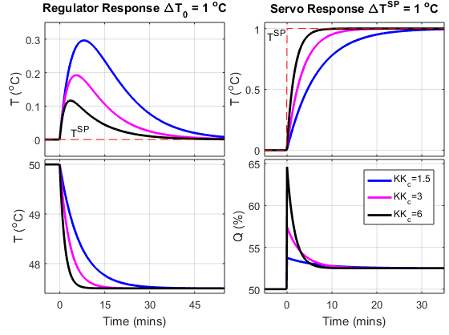
Heated Surge Vessel PI Temperature Control (τ_{I} = τ): Dynamic Response
OBSERVATIONS
Smooth response. No oscillations
Response speed increases with K_{C}
Aggression in Q increases with K_{C}
No steady state offset from T^{SP}

Slide 6

Exercise
More realistic model
Temperature sensor dynamics: $τ_{s}\frac{dT_{m}}{dt}+T_{m}=T$ τ_{s} = 0.5 min
Heater dynamics: $τ_{h}\frac{dQ}{dt}+Q=Q_{C}$ τ_{h} = 2 min
Obtain ODE relating T_{m} to T₀ and Q_{C}
Obtain dynamic response of T_{m} to step change in T₀ or Q_{C}

Slide 7
Summary
PI controlled system dynamics
Described by a simple ODE with parameters depending on
Process operating conditions (K and τ) & controller tuning parameters (K_{C} and τ_{I} = τ)
Servo response
ODE is first order for τ_{I} = τ due to cancellation of {d/dt + 1} term
Regulator response
Second order ODE solved using method of constant coefficients
Smooth exponential response that speeds up as K_{C} is increased
Integral action removes offset from constant setpoint
Method of constant coefficients
y = y_{h} + y_{p} (solution is sum of homogenous and particular solution)
Homogenous solution (y_{h})
Satisfies unforced ODE
Linear combination of exponential terms Σc_{i}e^{λit}
λ_{i} obtained as solution of characteristic equation
Particular solution (y_{p})
Satisfies forced ODE and has same form as the forcing function (e.g. y_{p} = c_{k} for a step forcing function)
Unknown c’s obtained from ODE initial conditions

