Slide 1
Dynamic Modelling First Principles Models Simple Systems III
Module 3.2.3
Lectures on
CHEMICAL PROCESS CONTROL
Theory and Practice

Slide 2
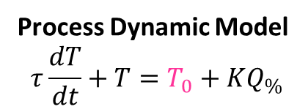

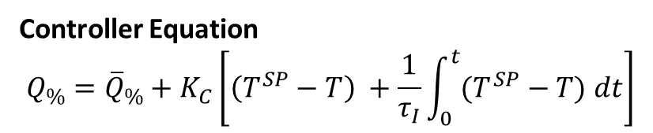
Heated Surge Vessel Dynamic Responses
F₀, c_{A0}, T₀
1m³/min, 10 kmol/m³
20 ºC
C_{p} = 2.55 kJ/kg K
ρ = 800 kg/m³
T^{SP}
TC
81.6 MJ/min
10 m³
60 ºC
F, c_{A}, T
Process Dynamic Model
$$τ\frac{dT}{dt}+T=T_{0}+KQ_{\%}$$
Controller Equation
$$Q_{\%}={\overline{Q}}_{\%}+K_{C}\left[\left(T^{SP}−T\right) +\frac{1}{τ_{I}}\int_{0}^{t}{(T^{SP}−T) dt}\right]$$
$$τ=10\min{ K=0.4}$$

Slide 3
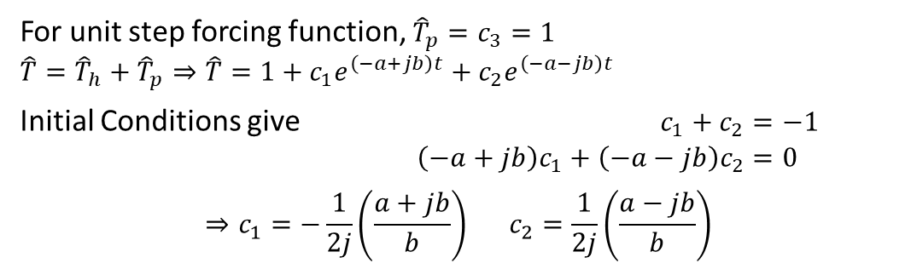
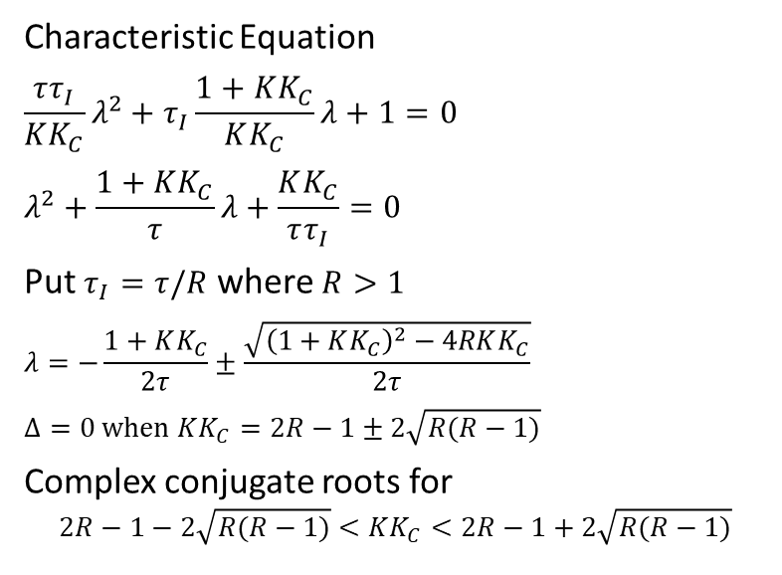

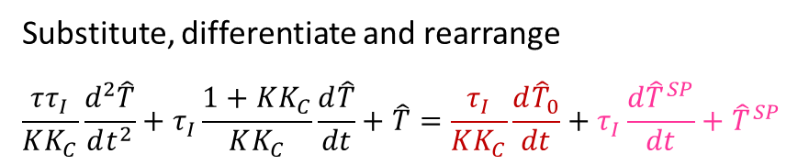

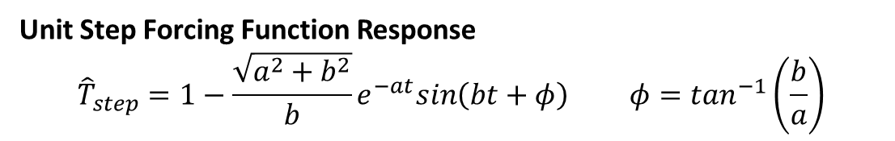
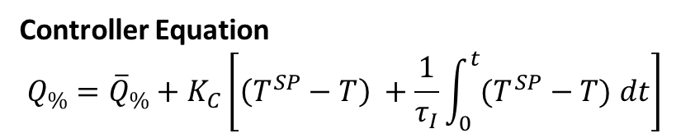
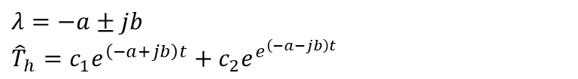
Heated Surge Vessel PI Temperature Control ($τ_{I}<τ$)
Process Dynamic Model
$$τ\frac{dT}{dt}+T=T_{0}+KQ_{\%}$$
Controller Equation
$$Q_{\%}={\overline{Q}}_{\%}+K_{C}\left[\left(T^{SP}−T\right) +\frac{1}{τ_{I}}\int_{0}^{t}{(T^{SP}−T) dt}\right]$$
CASE II: $τ_{I}<τ$
Substitute, differentiate and rearrange
$$\frac{ττ_{I}}{KK_{C}}\frac{d^{2}\hat{T}}{dt^{2}}+τ_{I}\frac{1+KK_{C}}{KK_{C}}\frac{d\hat{T}}{dt}+\hat{T}=\frac{τ_{I}}{KK_{C}}\frac{d{\hat{T}}_{0}}{dt}+τ_{I}\frac{d{\hat{T}}^{SP}}{dt}+{\hat{T}}^{SP}$$
$$λ=−a±jb$$
$${\hat{T}}_{h}=c_{1}e^{\left(−a+jb\right)t}+c_{2}e^{e^{\left(−a−jb\right)t}}$$
Characteristic Equation
$$\frac{ττ_{I}}{KK_{C}}λ^{2}+τ_{I}\frac{1+KK_{C}}{KK_{C}}λ+1=0$$
$$λ^{2}+\frac{1+KK_{C}}{τ}λ+\frac{KK_{C}}{ττ_{I}}=0$$
Put $τ_{I}=τ/R$ where $R>1$
$$λ=−\frac{1+KK_{C}}{2τ}±\frac{\sqrt{{\left(1+KK_{C}\right)}^{2}−4RKK_{C}}}{2τ}$$
$$Δ=0 when KK_{C}=2R−1±2\sqrt{R(R−1)}$$
Complex conjugate roots for
$$2R−1−2\sqrt{R(R−1)}<KK_{C}<2R−1+2\sqrt{R(R−1)}$$
For unit step forcing function, ${\hat{T}}_{p}=c_{3}=1$
$$\hat{T}={\hat{T}}_{h}+{\hat{T}}_{p}⇒\hat{T}=1+c_{1}e^{\left(−a+jb\right)t}+c_{2}e^{\left(−a−jb\right)t}$$
Initial Conditions give $c_{1}+c_{2}=−1$
$\left(−a+jb\right)c_{1}+\left(−a−jb\right)c_{2}=0$
$$⇒c_{1}=−\frac{1}{2j}\left(\frac{a+jb}{b}\right) c_{2}=\frac{1}{2j}\left(\frac{a−jb}{b}\right)$$
Unit Step Forcing Function Response
$${\hat{T}}_{step}=1−\frac{\sqrt{a^{2}+b^{2}}}{b}e^{−at}sin\left(bt+φ\right) φ=\tan^{−1}\left(\frac{b}{a}\right)$$

Slide 4
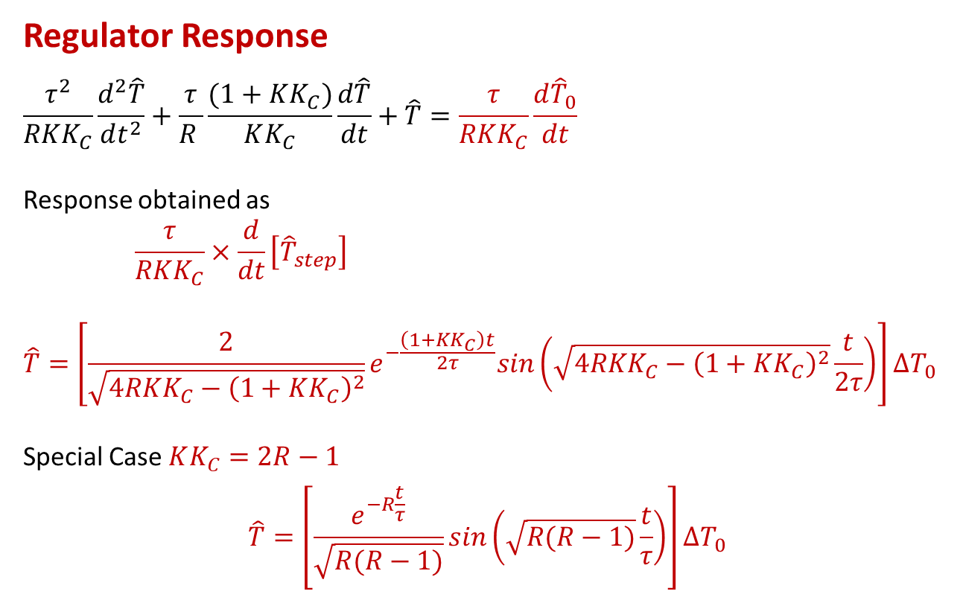

Heated Surge Vessel PI Temperature Control ($τ_{I}<τ$)
$τ_{I}=τ/R$ where $R>1$ & $\left(2R−1\right)−2\sqrt{R(R−1)}<KK_{C}<\left(2R−1\right)+2\sqrt{R(R−1)}$
Regulator Response
$$\frac{τ^{2}}{RKK_{C}}\frac{d^{2}\hat{T}}{dt^{2}}+\frac{τ}{R }\frac{(1+KK_{C})}{KK_{C}}\frac{d\hat{T}}{dt}+\hat{T}=\frac{τ}{RKK_{C}}\frac{d{\hat{T}}_{0}}{dt}$$
Response obtained as
$$\frac{τ}{RKK_{C}}×\frac{d}{dt}\left[{\hat{T}}_{step}\right]$$
$$\hat{T}=\left[\frac{2}{\sqrt{4RKK_{C}−{\left(1+KK_{C}\right)}^{2}}}e^{−\frac{\left(1+KK_{C}\right)t}{2τ}}sin\left(\sqrt{4RKK_{C}−{\left(1+KK_{C}\right)}^{2}}\frac{t}{2τ}\right)\right]∆T_{0}$$
Special Case $KK_{C}=2R−1$
$$\hat{T}=\left[\frac{e^{−R\frac{t}{τ}}}{\sqrt{R(R−1)}}sin\left(\sqrt{R(R−1)}\frac{t}{τ}\right)\right]∆T_{0}$$

Slide 6
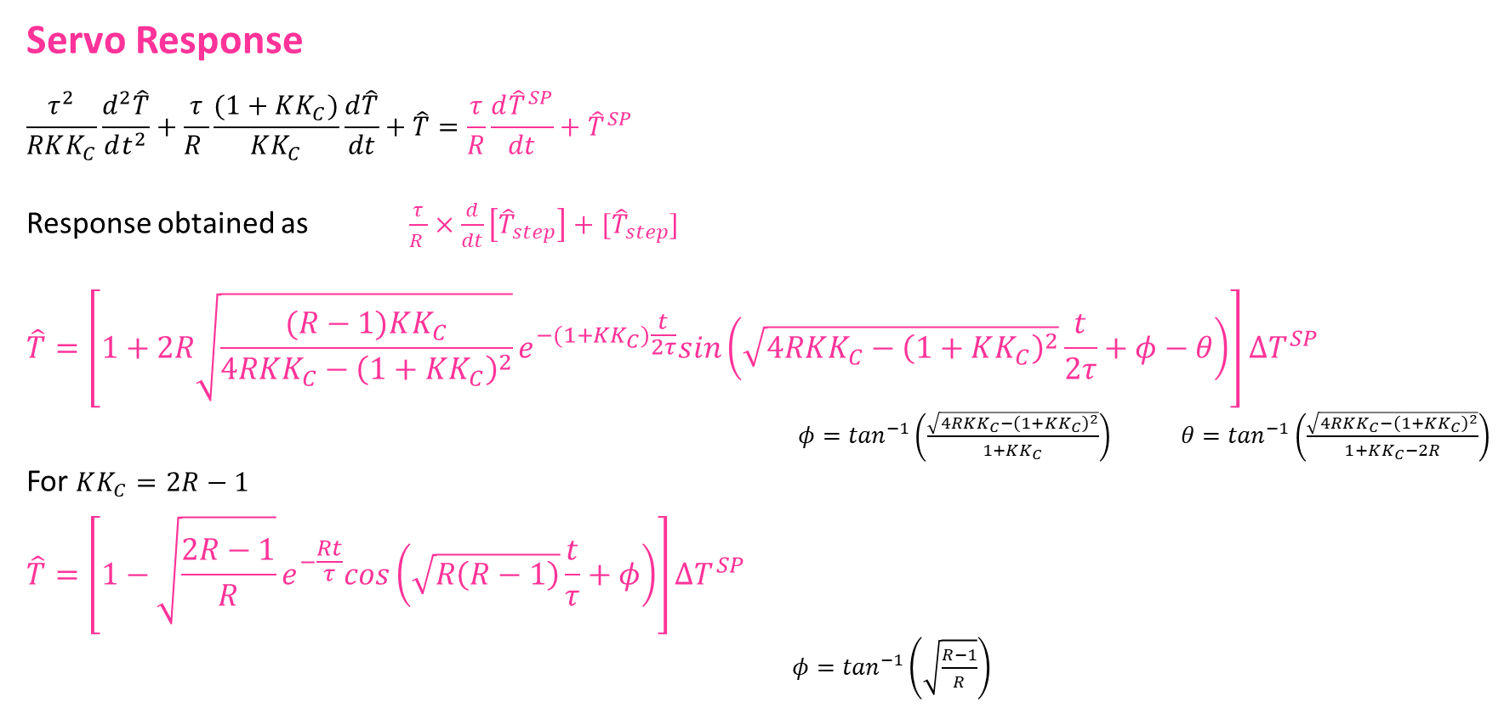
Heated Surge Vessel PI Temperature Control ($τ_{I}<τ$)
$τ_{I}=τ/R$ where $R>1$ & $\left(2R−1\right)−2\sqrt{R(R−1)}<KK_{C}<\left(2R−1\right)+2\sqrt{R(R−1)}$
Servo Response
$$\frac{τ^{2}}{RKK_{C}}\frac{d^{2}\hat{T}}{dt^{2}}+\frac{τ}{R }\frac{(1+KK_{C})}{KK_{C}}\frac{d\hat{T}}{dt}+\hat{T}=\frac{τ}{R}\frac{d{\hat{T}}^{SP}}{dt}+{\hat{T}}^{SP}$$
Response obtained as $\frac{τ}{R }×\frac{d}{dt}\left[{\hat{T}}_{step}\right]+[{\hat{T}}_{step}]$
$$\hat{T}=\left[1+2R\sqrt{\frac{(R−1)KK_{C}}{4RKK_{C}−{\left(1+KK_{C}\right)}^{2}}}e^{−(1+KK_{C})\frac{t}{2τ}}sin\left(\sqrt{4RKK_{C}−{\left(1+KK_{C}\right)}^{2}}\frac{t}{2τ}+φ−θ\right)\right]∆T^{SP}$$
$φ=\tan^{−1}\left(\frac{\sqrt{4RKK_{C}−{\left(1+KK_{C}\right)}^{2}}}{1+KK_{C}}\right)$ $θ=\tan^{−1}\left(\frac{\sqrt{4RKK_{C}−{\left(1+KK_{C}\right)}^{2}}}{1+KK_{C}−2R}\right)$
For $KK_{C}=2R−1$
$$\hat{T}=\left[1−\sqrt{\frac{2R−1}{R}}e^{−\frac{Rt}{τ}}cos\left(\sqrt{R\left(R−1\right)}\frac{t}{τ}+φ\right)\right]∆T^{SP}$$
$φ=\tan^{−1}\left(\sqrt{\frac{R−1}{R}}\right)$

Slide 7
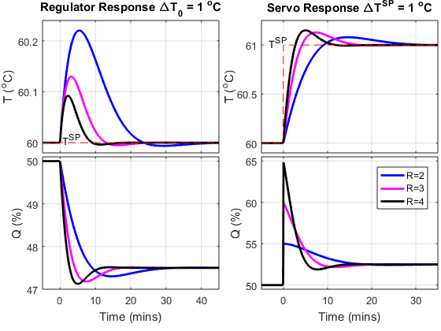

Heated Surge Vessel PI Temperature Control ($τ_{I}<τ$): Dynamic Response
KK_{C} = 2R-1
OBSERVATIONS
Oscillatory response
Response speed increases with R
Aggression in Q increases with R
No steady state offset from T^{SP}

Slide 8
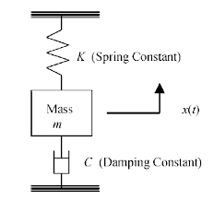
Exercise
Consider a damped spring-mass system.
Derive the ODE describing the motion of the mass attached to the spring
Solve the ODE for a step change in the equilibrium position of the mass when
The roots of the ODE characteristic equation are complex conjugate pairs.
The roots of the ODE characteristic equation are real and repeated
The roots of the ODE characteristic equation are real and distinct
Is it possible to have purely imaginary roots. If so, solve the corresponding ODE

Slide 9
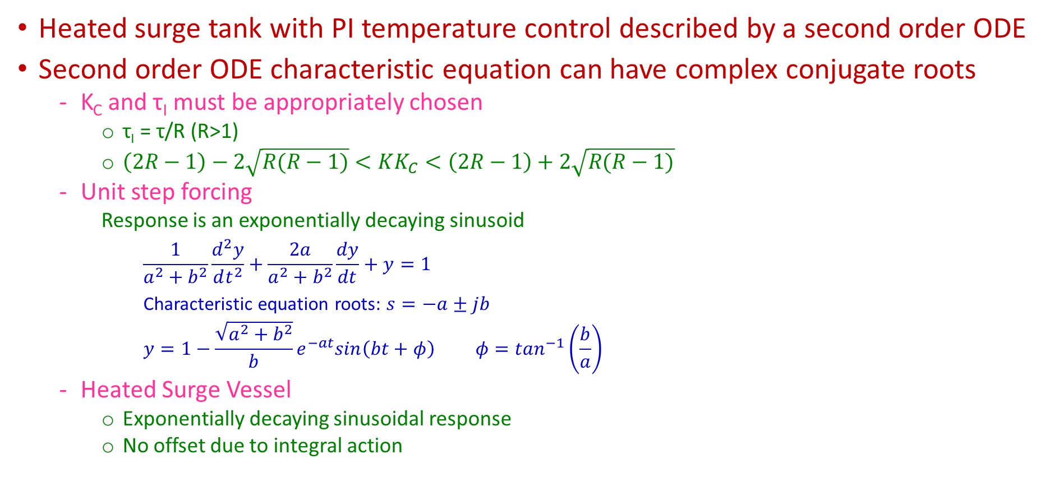
Summary
Heated surge tank with PI temperature control described by a second order ODE
Second order ODE characteristic equation can have complex conjugate roots
K_{C} and τ_{I} must be appropriately chosen
τ_{I} = τ/R (R>1)
$\left(2R−1\right)−2\sqrt{R(R−1)}<KK_{C}<\left(2R−1\right)+2\sqrt{R(R−1)}$
Unit step forcing
Response is an exponentially decaying sinusoid
$$\frac{1}{a^{2}+b^{2}}\frac{d^{2}y}{dt^{2}}+\frac{2a}{a^{2}+b^{2}}\frac{dy}{dt}+y=1$$
Characteristic equation roots: $s=−a±jb$
$$y=1−\frac{\sqrt{a^{2}+b^{2}}}{b}e^{−at}sin\left(bt+φ\right) φ=\tan^{−1}\left(\frac{b}{a}\right)$$
Heated Surge Vessel
Exponentially decaying sinusoidal response
No offset due to integral action

