Slide 1
Dynamic Modelling First Principles Models Simple Systems IV
Module 3.2.4
Lectures on
CHEMICAL PROCESS CONTROL
Theory and Practice

Slide 2
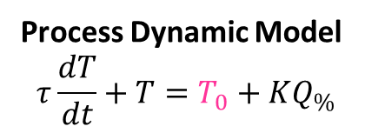

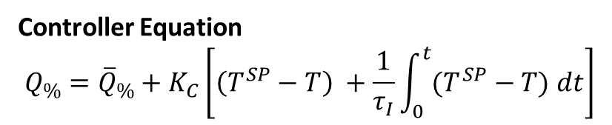
Heated Surge Vessel Dynamic Responses
F₀, c_{A0}, T₀
1m³/min, 10 kmol/m³
20 ºC
C_{p} = 2.55 kJ/kg K
ρ = 800 kg/m³
T^{SP}
TC
81.6 MJ/min
10 m³
60 ºC
F, c_{A}, T
Process Dynamic Model
$$τ\frac{dT}{dt}+T=T_{0}+KQ_{\%}$$
Controller Equation
$$Q_{\%}={\overline{Q}}_{\%}+K_{C}\left[\left(T^{SP}−T\right) +\frac{1}{τ_{I}}\int_{0}^{t}{(T^{SP}−T) dt}\right]$$
$$τ=10\min{ K=0.4}$$

Slide 4
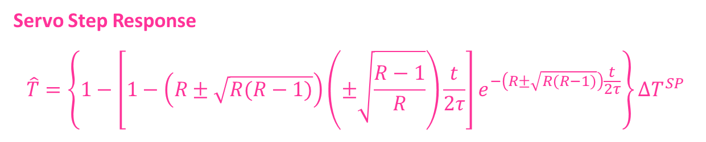
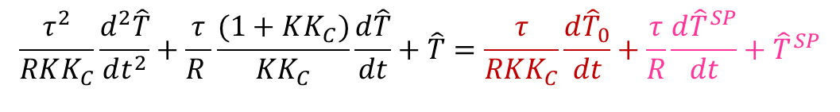
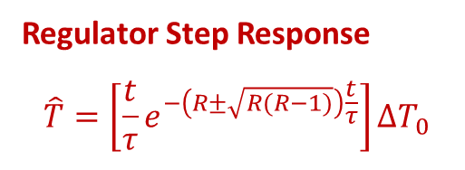

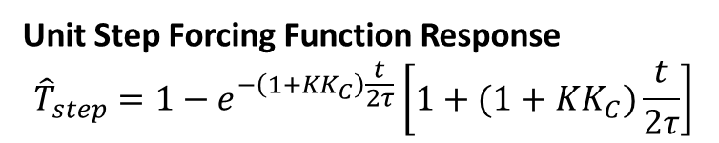
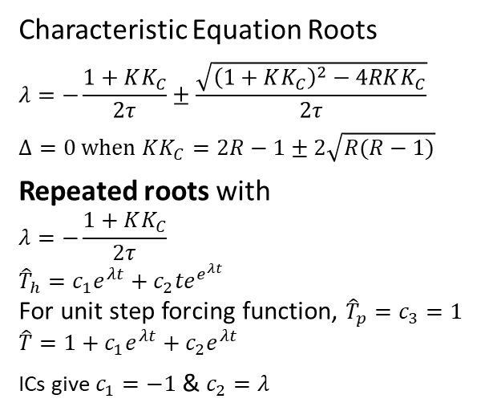
Heated Surge Vessel PI Temperature Control ($τ_{I}<τ$)
$τ_{I}=τ/R$ where $R>1$ & $KK_{C}=\left(2R−1\right)±2\sqrt{R(R−1)}$
$$\frac{τ^{2}}{RKK_{C}}\frac{d^{2}\hat{T}}{dt^{2}}+\frac{τ}{R }\frac{(1+KK_{C})}{KK_{C}}\frac{d\hat{T}}{dt}+\hat{T}=\frac{τ}{RKK_{C}}\frac{d{\hat{T}}_{0}}{dt}+\frac{τ}{R}\frac{d{\hat{T}}^{SP}}{dt}+{\hat{T}}^{SP}$$
Characteristic Equation Roots
$$λ=−\frac{1+KK_{C}}{2τ}±\frac{\sqrt{{\left(1+KK_{C}\right)}^{2}−4RKK_{C}}}{2τ}$$
$$Δ=0 when KK_{C}=2R−1±2\sqrt{R(R−1)}$$
Repeated roots with
$$λ=−\frac{1+KK_{C}}{2τ}$$
$${\hat{T}}_{h}=c_{1}e^{λt}+c_{2}{te}^{e^{λt}}$$
For unit step forcing function, ${\hat{T}}_{p}=c_{3}=1$
$$\hat{T}=1+c_{1}e^{λt}+c_{2}e^{λt}$$
ICs give $c_{1}=−1$ & $c_{2}=λ$
Regulator Step Response
$$\hat{T}=\left[{\frac{t}{τ}e}^{−\left(R±\sqrt{R(R−1)}\right)\frac{t}{τ}}\right]∆T_{0}$$
Servo Step Response
$$\hat{T}=\left\{1−\left[1−\left(R±\sqrt{R(R−1)}\right)\left(±\sqrt{\frac{R−1}{R}}\right)\frac{t}{2τ}\right]e^{−\left(R±\sqrt{R(R−1)}\right)\frac{t}{2τ}}\right\}∆T^{SP}$$
Unit Step Forcing Function Response
$${\hat{T}}_{step}=1−e^{−\left(1+KK_{C}\right)\frac{t}{2τ}}\left[1+(1+KK_{C})\frac{t}{2τ}\right]$$

Slide 6
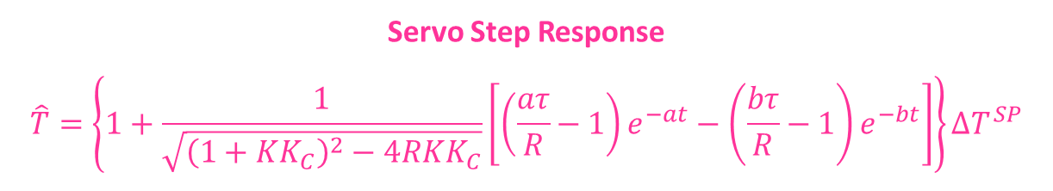
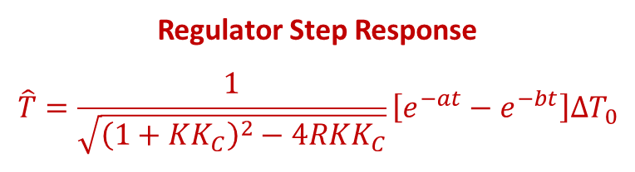
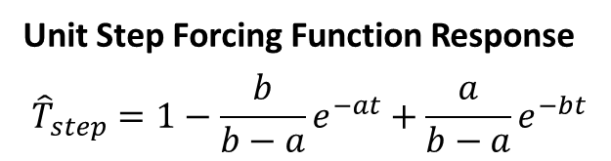
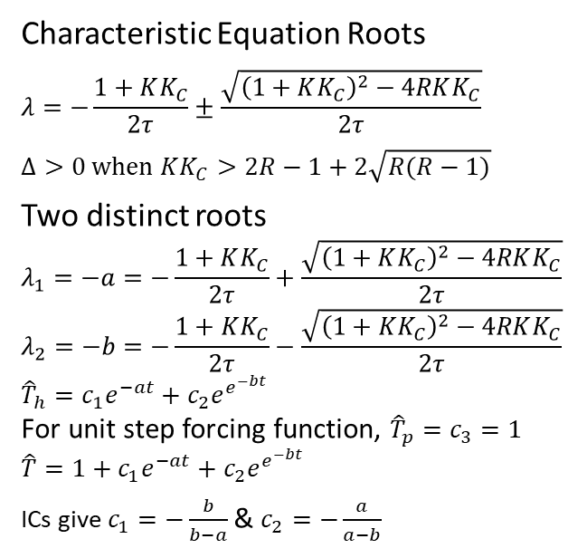
Heated Surge Vessel PI Temperature Control ($τ_{I}<τ$)
$τ_{I}=τ/R$ where $R>1$ & $KK_{C}>\left(2R−1\right)+2\sqrt{R(R−1)}$
$$\frac{τ^{2}}{RKK_{C}}\frac{d^{2}\hat{T}}{dt^{2}}+\frac{τ}{R }\frac{(1+KK_{C})}{KK_{C}}\frac{d\hat{T}}{dt}+\hat{T}=\frac{τ}{RKK_{C}}\frac{d{\hat{T}}_{0}}{dt}+\frac{τ}{R}\frac{d{\hat{T}}^{SP}}{dt}+{\hat{T}}^{SP}$$
Characteristic Equation Roots
$$λ=−\frac{1+KK_{C}}{2τ}±\frac{\sqrt{{\left(1+KK_{C}\right)}^{2}−4RKK_{C}}}{2τ}$$
$$Δ>0 when KK_{C}>2R−1+2\sqrt{R(R−1)}$$
Two distinct roots
$$λ_{1}=−a=−\frac{1+KK_{C}}{2τ}+\frac{\sqrt{{\left(1+KK_{C}\right)}^{2}−4RKK_{C}}}{2τ}$$
$$λ_{2}=−b=−\frac{1+KK_{C}}{2τ}−\frac{\sqrt{{\left(1+KK_{C}\right)}^{2}−4RKK_{C}}}{2τ}$$
$${\hat{T}}_{h}=c_{1}e^{−at}+c_{2}e^{e^{−bt}}$$
For unit step forcing function, ${\hat{T}}_{p}=c_{3}=1$
$$\hat{T}=1+c_{1}e^{−at}+c_{2}e^{e^{−bt}}$$
ICs give $c_{1}=−\frac{b}{b−a}$ & $c_{2}=−\frac{a}{a−b}$
Unit Step Forcing Function Response
$${\hat{T}}_{step}=1−\frac{b}{b−a}e^{−at}+\frac{a}{b−a}e^{−bt}$$
Regulator Step Response
$$\hat{T}=\frac{1}{\sqrt{{\left(1+KK_{C}\right)}^{2}−4RKK_{C}}}\left[e^{−at}−e^{−bt}\right]∆T_{0}$$
Servo Step Response
$$\hat{T}=\left\{1+\frac{1}{\sqrt{{\left(1+KK_{C}\right)}^{2}−4RKK_{C}}}\left[\left(\frac{aτ}{R}−1\right)e^{−at}−{\left(\frac{bτ}{R}−1\right)e}^{−bt}\right]\right\}∆T^{SP}$$

Slide 7
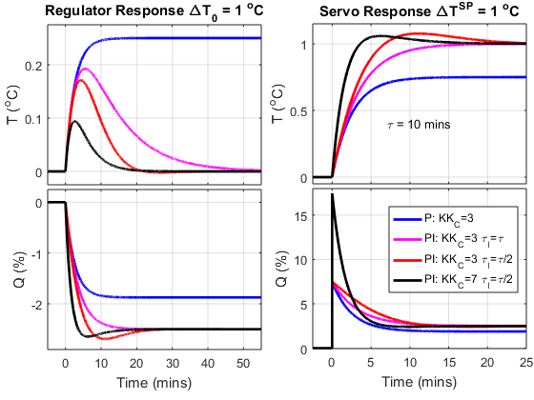
Heated Sursge Tank TC Dynamic Results
Offset with P control
No offset with PI control
Overshoot possible with I action
Faster servo response completion

Slide 8
Exercise
Two identical adiabatic tanks-in-series.
Obtain ODE describing response of exit concentration c_{A} to step change in inlet concentration c_{A0}
Two identical tanks in series with first tank loading second tank
Obtain ODE describing response of exit concentration c_{A} to step change in inlet concentration c_{A0}

Slide 9
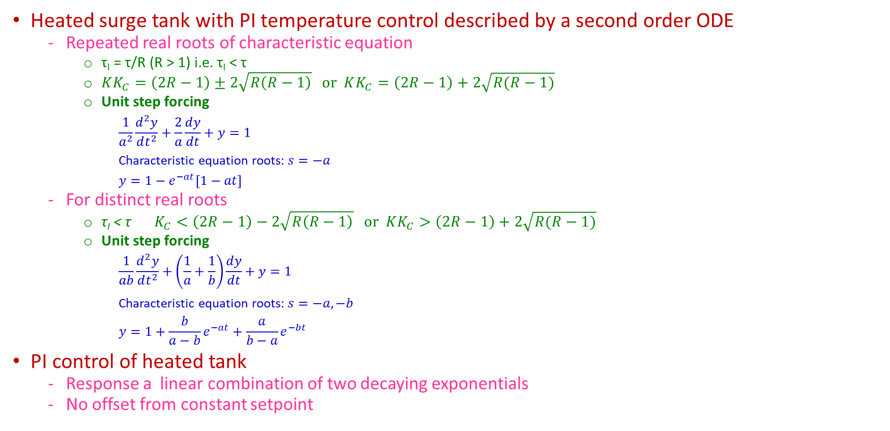
Summary
Heated surge tank with PI temperature control described by a second order ODE
Repeated real roots of characteristic equation
τ_{I} = τ/R (R > 1) i.e. τ_{I} < τ
$KK_{C}=\left(2R−1\right)±2\sqrt{R\left(R−1\right)} or KK_{C}=\left(2R−1\right)+2\sqrt{R(R−1)}$
Unit step forcing
$$\frac{1}{a^{2}}\frac{d^{2}y}{dt^{2}}+\frac{2}{a}\frac{dy}{dt}+y=1$$
Characteristic equation roots: $s=−a$
$$y=1−e^{−at}\left[1−at\right]$$
For distinct real roots
τ_{I} < τ $K_{C}<\left(2R−1\right)−2\sqrt{R\left(R−1\right)} or KK_{C}>\left(2R−1\right)+2\sqrt{R(R−1)}$
Unit step forcing
$$\frac{1}{ab}\frac{d^{2}y}{dt^{2}}+\left(\frac{1}{a}+\frac{1}{b}\right)\frac{dy}{dt}+y=1$$
Characteristic equation roots: $s=−a,−b$
$$y=1+\frac{b}{a−b}e^{−at}+\frac{a}{b−a}e^{−bt}$$
PI control of heated tank
Response a linear combination of two decaying exponentials
No offset from constant setpoint

