Slide 1
Dynamic Modelling First Principles Models Linearizable Systems
Module 3.3.1
Lectures on
CHEMICAL PROCESS CONTROL
Theory and Practice

Slide 2
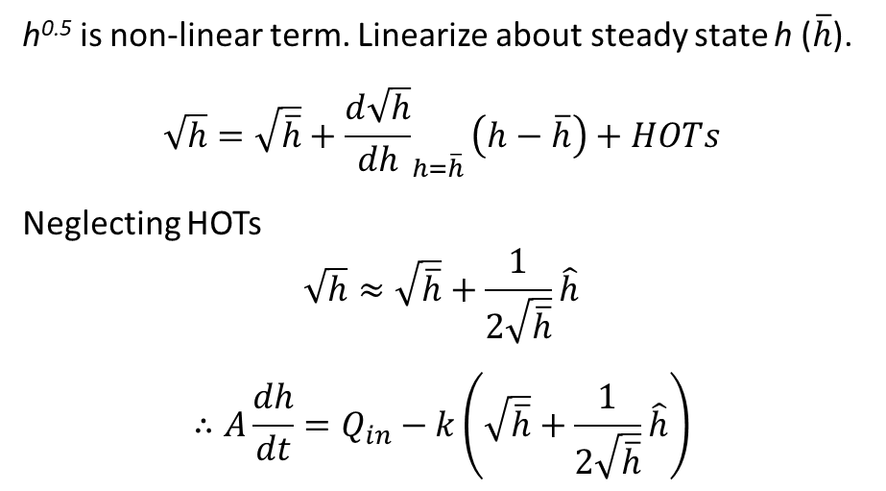
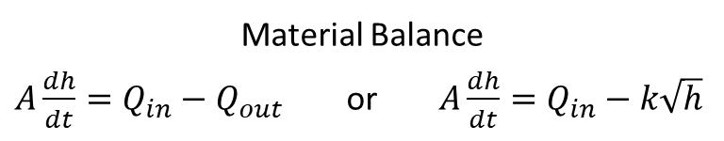
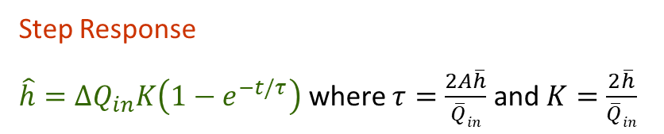
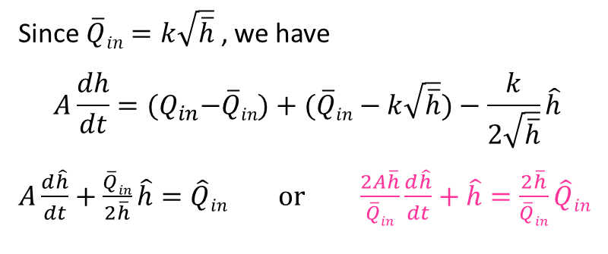
Linearization Example 1: Tank Gravity Flow
Q_{in}
Obtain and solve dynamic model describing the variation in tank height h to a small change in Q_{in}
Material Balance
$A\frac{dh}{dt}=Q_{in}−Q_{out}$ or $A\frac{dh}{dt}=Q_{in}−k\sqrt{h}$
h
Q_{out} = k h^{0.5}
Since $\overline{Q}in=k\sqrt{\overline{h}}$ , we have
$$A\frac{dh}{dt}={(Q}_{in}−\overline{Q}in)+(\overline{Q}in−k\sqrt{\overline{h}})−\frac{k}{2\sqrt{\overline{h}}}\hat{h}$$
$A\frac{d\hat{h}}{dt}+\frac{\overline{Q}in}{2\overline{h}}\hat{h}=\hat{Q}in$ or $\frac{2A\overline{h}}{\overline{Q}in}\frac{d\hat{h}}{dt}+\hat{h}=\frac{2\overline{h}}{\overline{Q}in}\hat{Q}in$
h^{0.5} is non-linear term. Linearize about steady state h ($\overline{h}$).
$$\sqrt{h}=\sqrt{\overline{h}}+{\frac{d\sqrt{h}}{dh}}_{h=\overline{h}}\left(h−\overline{h}\right)+HOTs$$
Neglecting HOTs
$$\sqrt{h}≈\sqrt{\overline{h}}+\frac{1}{2\sqrt{\overline{h}}}\hat{h}$$
$$∴A\frac{dh}{dt}=Q_{in}−k\left(\sqrt{\overline{h}}+\frac{1}{2\sqrt{\overline{h}}}\hat{h}\right)$$
Step Response
$\hat{h}=∆Q_{in}K\left(1−e^{−t/τ}\right)$ where $τ=\frac{2A\overline{h}}{\overline{Q}in}$ and $K=\frac{2\overline{h}}{\overline{Q}in}$
Operating condition dependent K and τ

Slide 3
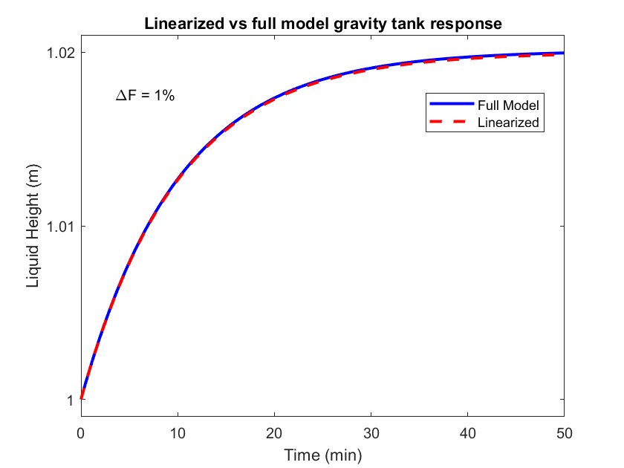
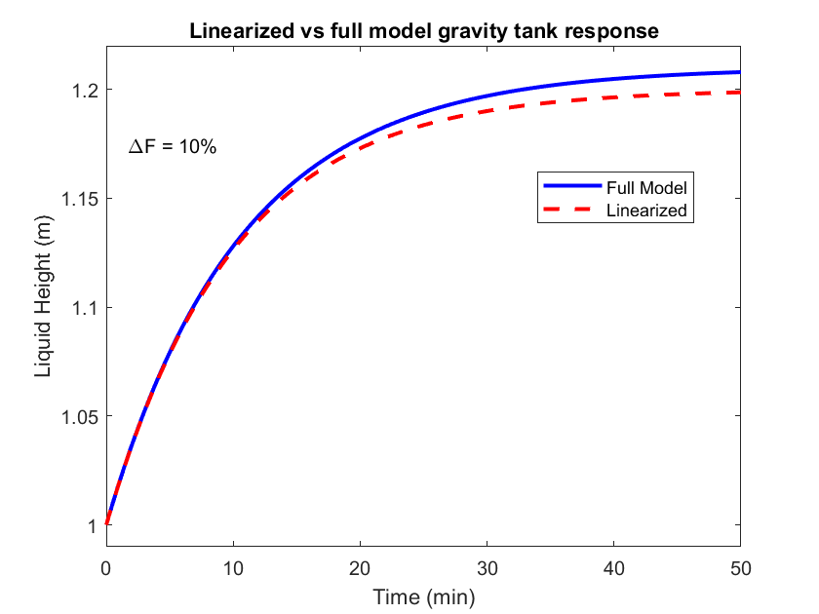
Tank Gravity Flow Rigorous vs Linearized Response
k =1 m^{5/2} min⁻¹ A = 1 m² F = 1 m³ min⁻¹

Slide 4
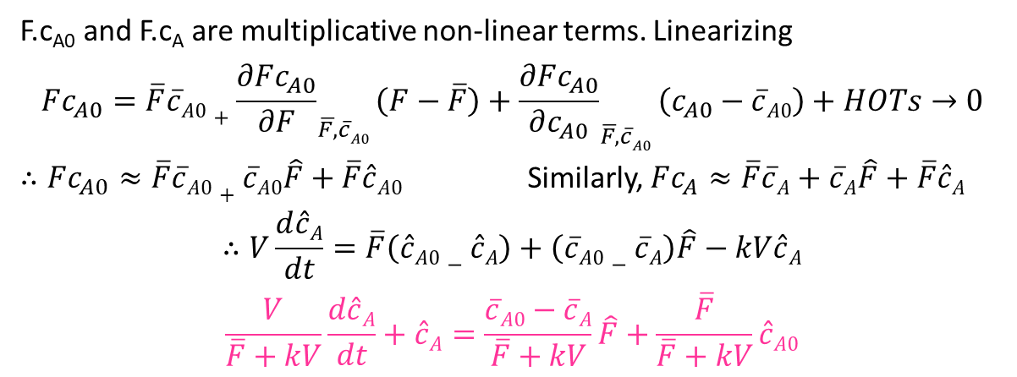
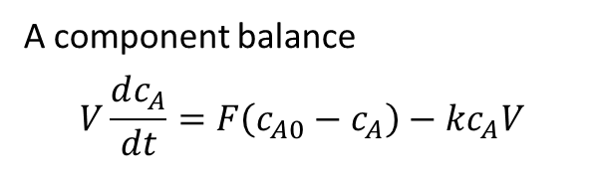
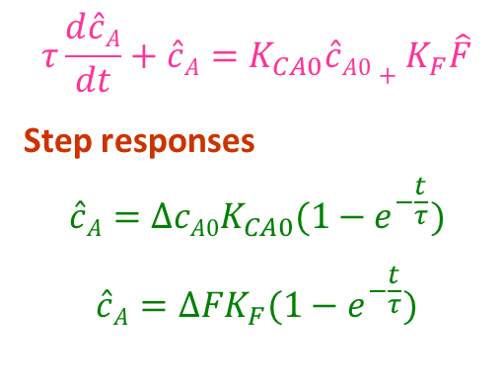
Linearization Example 2: Simple CSTR
F₀, c_{A0}
Given V and T are constant
Obtain dynamic response of c_{A} to step change in c_{A0} or F₀
r = k c_{A}
A component balance
$$V\frac{dc_{A}}{dt}=F\left(c_{A0}−c_{A}\right)−kc_{A}V$$
A → B
V constant => F = F₀ at all times
F, c_{A}
F.c_{A0} and F.c_{A} are multiplicative non-linear terms. Linearizing
$$Fc_{A0}=\overline{F}\overline{c}A0+{\frac{∂Fc_{A0}}{∂F}}_{\overline{F,}\overline{c}A0}\left(F−\overline{F}\right)+{\frac{∂Fc_{A0}}{∂c_{A0}}}_{\overline{F,}\overline{c}A0}\left(c_{A0}−\overline{c}A0\right)+HOTs→0$$
$∴Fc_{A0}≈\overline{F}\overline{c}A0+\overline{c}A0\hat{F}+\overline{F}\hat{c}A0$ Similarly, $Fc_{A}≈\overline{F}\overline{c}A+\overline{c}A\hat{F}+\overline{F}\hat{c}A$
$$∴V\frac{d\hat{c}A}{dt}=\overline{F}\left(\hat{c}A0−\hat{c}A\right)+\left(\overline{c}A0−\overline{c}A\right)\hat{F}−kV\hat{c}A$$
$$\frac{V}{\overline{F}+kV}\frac{d\hat{c}A}{dt}+\hat{c}A=\frac{\overline{c}A0−\overline{c}A}{\overline{F}+kV}\hat{F}+\frac{\overline{F}}{\overline{F}+kV}\hat{c}A0$$
$$τ\frac{d\hat{c}A}{dt}+\hat{c}A=K_{CA0}\hat{c}A0+K_{F}\hat{F}$$
Step responses
$$\hat{c}A=∆cA0K_{CA0}(1−e^{−\frac{t}{τ}})$$
$$\hat{c}A=∆FK_{F}(1−e^{−\frac{t}{τ}})$$

Slide 5
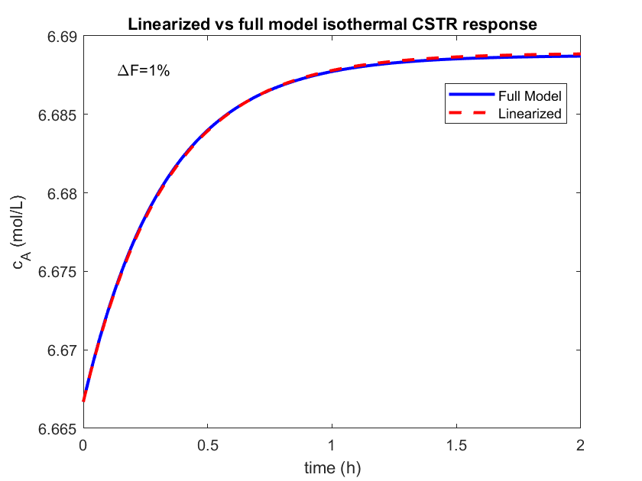
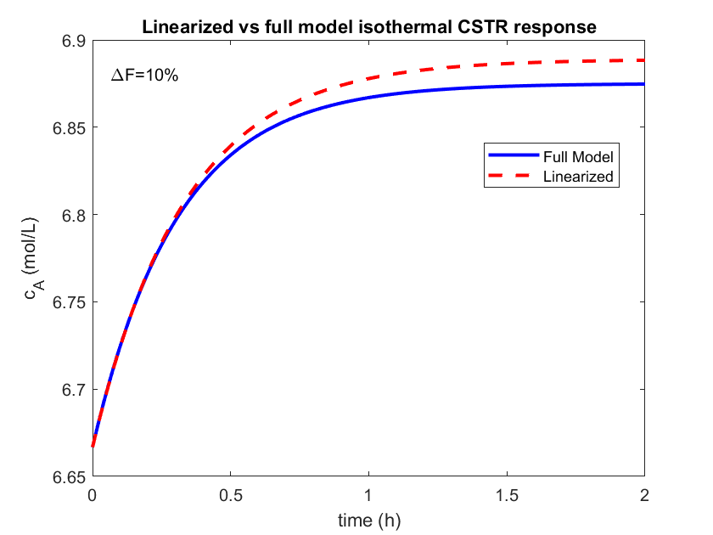
Simple CSTR Rigorous vs Linearized Response
A → B reaction with r = k_{T} c_{A}
V =2 .5 m³ F = 5m³ h⁻¹ T = 200 °C c_{A0} = 10 mol L⁻¹ k_{200°C} = 1 h⁻¹

Slide 7
Exercise
A → B isothermal CSTR with second order reaction
Linearize ODE relating c_{A} to a change in c_{A0} or F
Obtain response of c_{A} to a change in c_{A0} or F
A → B (exothermic), non-isothermal CSTR with jacketed cooling
Obtain ODE relating c_{A} to a change in c_{A0}, F, T_{J} or T₀ (no T terms in ODE)
Obtain ODE relating T to a change in c_{A0}, F, T_{J} or T₀ (no c_{A} terms in ODE)
Hot – cold water mixing in a shower. Mixer volume is V.
Obtain, linearize and analytically solve ODE relating T to a change in F_{H}, F_{C}, T_{H} and T_{C}
F_{H} adjusted by a P controller to hold T. Obtain
Servo response
Regulator response
Repeat for PI controller

Slide 8
Summary
Non-linear ODEs usually describe dynamics of process systems
First order Taylor series approximation of non-linear ODE terms around initial steady state converts non-linear to a linear ODE
Linear ODE can be solved analytically
Linear ODE a good approximation of system dynamics for small perturbations around initial steady state

