Slide 1
Dynamic Modelling First Principles Models Complex Systems
Module 3.3.2
Lectures on
CHEMICAL PROCESS CONTROL
Theory and Practice

Slide 2
Multicomponent Flash Drum
ASSUMPTIONS
Negligible vapour hold up
Instantaneous vapour dynamics (perfect PC)
Negligible ambient losses
T_{V} = T_{L} = T (thermal equilibrium)
P_{V} = P_{L} = P
Vapor liquid equilibrium
Constant molar heat capacity and latent heat
PC
TC
FC
F
T_{F} P_{F} z
PRV
LC
STEADY STATE DOF ANALYSIS
# of variables 3(C+2)
Material balances C
Energy balance 1
VLE constraints C
Given feed conditions C+2
Specified drum pressure 1
T_{V} = T_{L} 1
P_{V} = P_{L} 1
Given F T_{F} P_{F} z & P
Build steady state & dynamic model of flash drum
3C+2

Slide 3
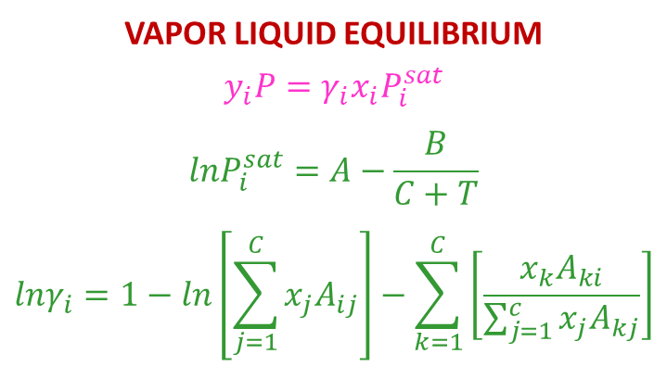
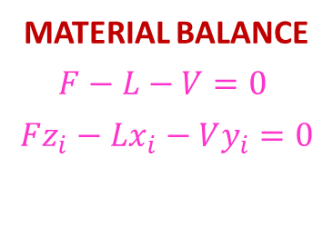
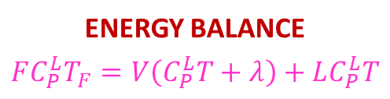
Flash Drum: Steady State Solution
MATERIAL BALANCE
$$F−L−V=0$$
$$Fz_{i}−Lx_{i}−Vy_{i}=0$$
Read F z T_{F} P_{F} P
Guess T
VAPOR LIQUID EQUILIBRIUM
$$y_{i}P=γ_{i}x_{i}P_{i}^{sat}$$
$${lnP}_{i}^{sat}=A−\frac{B}{C+T}$$
$$lnγ_{i}=1−ln\left[\sum_{j=1}^{C}{x_{j}A_{ij}}\right]−\sum_{k=1}^{C}{\left[\frac{x_{k}A_{ki}}{\sum_{j=1}^{c}{x_{j}A_{kj}}}\right]}$$
Perform TP flash to get
V, x, y
No
Obtain V_{EB} from energy balance
Is |V-V_{EB}| < tol
Yes
Stop
ENERGY BALANCE
$$FC_{P}^{L}T_{F}=V\left(C_{P}^{L}T+λ\right)+LC_{P}^{L}T$$

Slide 4
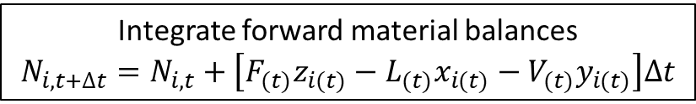

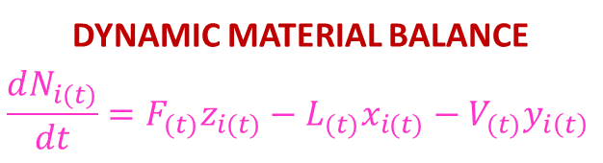
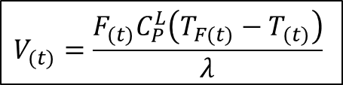
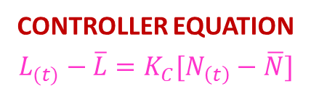
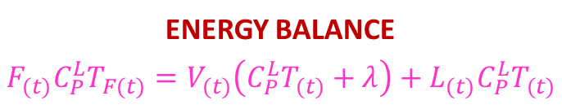
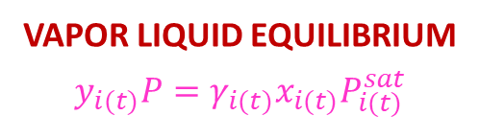
Flash Drum: Dynamic Simulation
Obtain initial steady state solution
DYNAMIC MATERIAL BALANCE
$$\frac{dN_{i(t)}}{dt}=F_{(t)}z_{i(t)}−L_{(t)}x_{i(t)}−V_{(t)}y_{i\left(t\right)}$$
Initialize N₍₀₎ $x_{(0)}=\overline{x}$ t = 0
Read F_{(t)} z_{(t)} T_{F(t)} P_{F(t)}
BubbleT Calculation at t
Gives [T_{(t)}, y_{(t)}] given (P, x_{(t)})
CONTROLLER EQUATION
$$L_{(t)}−\overline{L}=K_{C}[N_{\left(t\right)}−\overline{N}]$$
Obtain L_{(t)} from controller equation
t = t + Δt
VAPOR LIQUID EQUILIBRIUM
$$y_{i(t)}P=γ_{i(t)}x_{i(t)}P_{i(t)}^{sat}$$
$$V_{(t)}=\frac{F_{(t)}C_{P}^{L}\left(T_{F(t)}−T_{(t)}\right)}{λ}$$
Integrate forward material balances
$$N_{i,t+∆t}=N_{i,t}+\left[F_{(t)}z_{i(t)}−L_{(t)}x_{i(t)}−V_{(t)}y_{i(t)}\right]∆t$$
ENERGY BALANCE
$$F_{(t)}C_{P}^{L}T_{F(t)}=V_{(t)}\left(C_{P}^{L}T_{(t)}+λ\right)+L_{(t)}C_{P}^{L}T_{(t)}$$
No
Is t > t_{end}
Yes
Stop

Slide 5
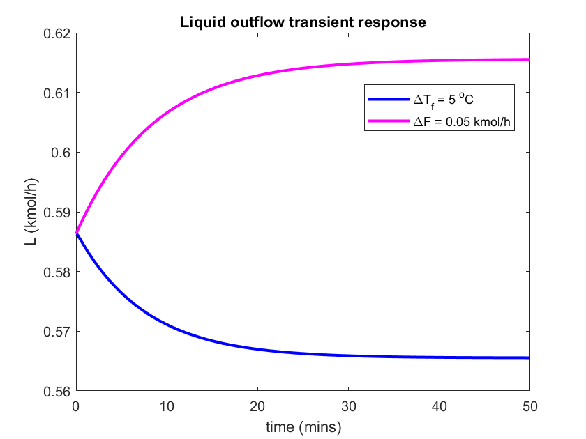
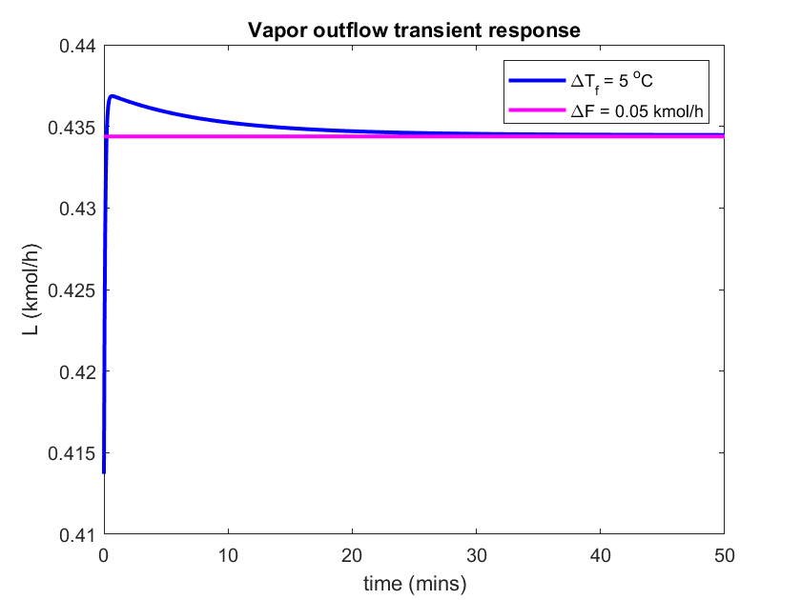
Flash Drum Simulation
Benzene-Toluene-Xylene Flash
Nominal Steady State
0.4196 kmol/h
[0.4902 0.3192 0.1906]
1 kmol/min
Equimolar
200 °C
100 kPa
107.61 °C
0.5864 kmol/h
[0.2226 0.3433 0.4340]

Slide 6
Summary
Non-linear DAEs usually describe dynamics of realistic process systems
Linearization is usually not possible for such systems
Realistic systems must be solved numerically
Commercial simulators (Aspen Plus Hysys)perform the numerical calculations
Obtaining steady state solution
Dynamics around the steady state

