Slide 1
Dynamic Modelling Empirical Modelling
Module 3.4
Lectures on
CHEMICAL PROCESS CONTROL
Theory and Practice

Slide 2
Empirical Modelling Approach
Obtain process reaction curve
Propose a combination of basic response types that can well fit the process reaction curve
Adjust basic response type parameters to well fit process reaction curve
Use fitted model to test control system performance

Slide 3

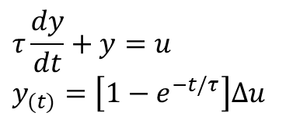


Basic Dynamic Elements
$$y_{(t)}=Ku_{(t)}$$
$$y_{(t)}=Ku_{(t−θ)}$$
$$y_{(t)}=\int_{0}^{t}{u_{(τ)}dτ}$$
$$τ\frac{dy}{dt}+y=u$$
$$y_{(t)}=\left[1−e^{−t/τ}\right]∆u$$

Slide 4
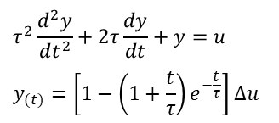
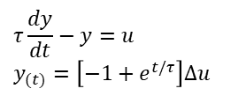
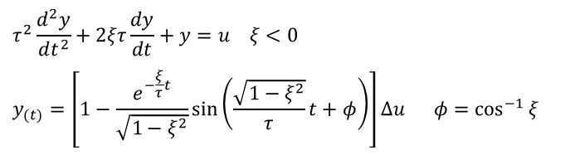
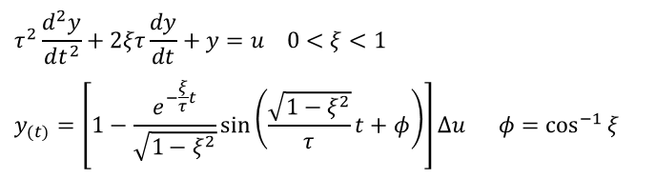
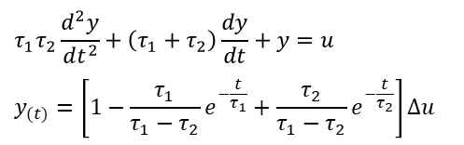
Basic Dynamic Responses
$$τ_{1}τ_{2}\frac{d^{2}y}{dt^{2}}+\left(τ_{1}+τ_{2}\right)\frac{dy}{dt}+y=u$$
$$y_{(t)}=\left[1−\frac{τ_{1}}{τ_{1}−τ_{2}}e^{−\frac{t}{τ_{1}}}+\frac{τ_{2}}{τ_{1}−τ_{2}}e^{−\frac{t}{τ_{2}}}\right]∆u$$
$$τ^{2}\frac{d^{2}y}{dt^{2}}+2τ\frac{dy}{dt}+y=u$$
$$y_{(t)}=\left[1−\left(1+\frac{t}{τ}\right)e^{−\frac{t}{τ}}\right]∆u$$
$$τ^{2}\frac{d^{2}y}{dt^{2}}+2ξτ\frac{dy}{dt}+y=u 0<ξ<1$$
$$y_{(t)}=\left[1−\frac{e^{−\frac{ξ}{τ}t}}{\sqrt{1−ξ^{2}}}\sin\left(\frac{\sqrt{1−ξ^{2}}}{τ}t+φ\right)\right]∆u φ=\cos^{−1}{ξ}$$
$$τ^{2}\frac{d^{2}y}{dt^{2}}+2ξτ\frac{dy}{dt}+y=u ξ<0$$
$$y_{(t)}=\left[1−\frac{e^{−\frac{ξ}{τ}t}}{\sqrt{1−ξ^{2}}}\sin\left(\frac{\sqrt{1−ξ^{2}}}{τ}t+φ\right)\right]∆u φ=\cos^{−1}{ξ}$$
$$τ\frac{dy}{dt}−y=u$$
$$y_{(t)}=\left[−1+e^{t/τ}\right]∆u$$

Slide 5
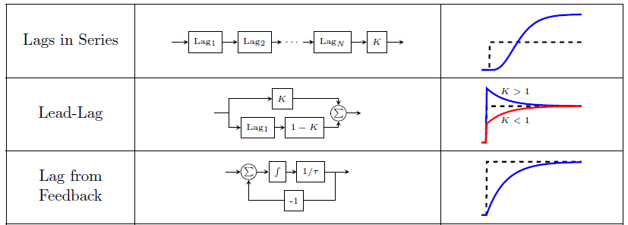
Complex Responses by Combining Basic Responses
SERIES, PARALLEL & FEEDBACK STRUCTURES

Slide 6
Complex Responses by Combining Basic Responses

Slide 7
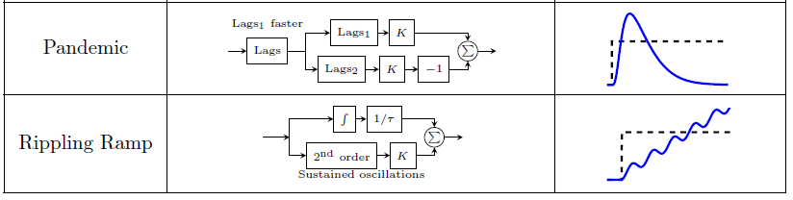
Complex Responses by Combining Basic Responses

Slide 8
Empirical Modelling Approach
PARAMETERS
Lag time τ
Gain K
Delay Time θ
IDENTIFICATION
DESIGN CONTROLLER
VALIDATE PERFORMANCE
Servo & regulator

Slide 9
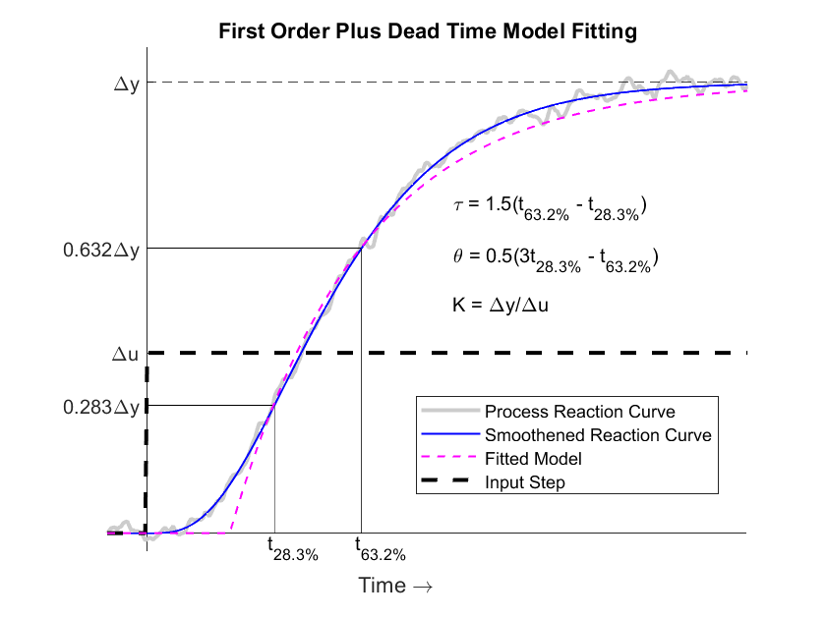
FOPDT Model Fitting – Method I

Slide 10
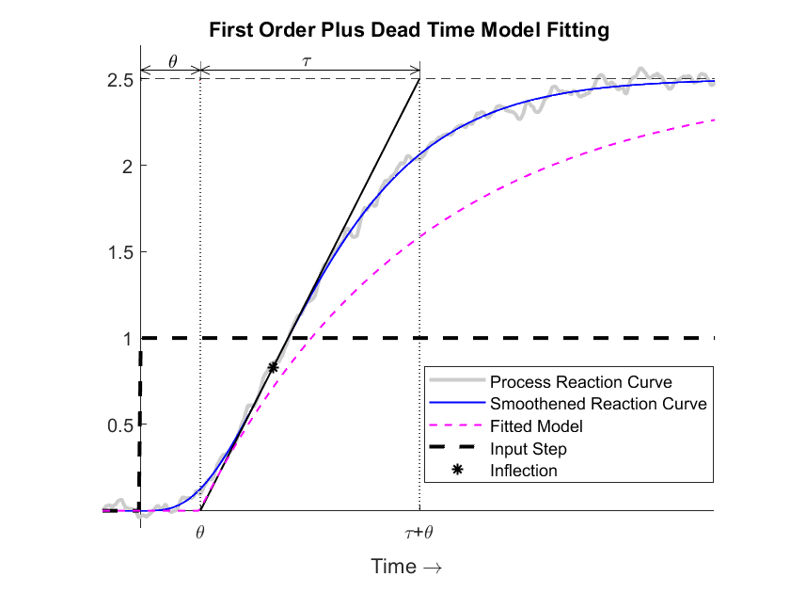
FOPDT Model Fitting – Method II

Slide 11
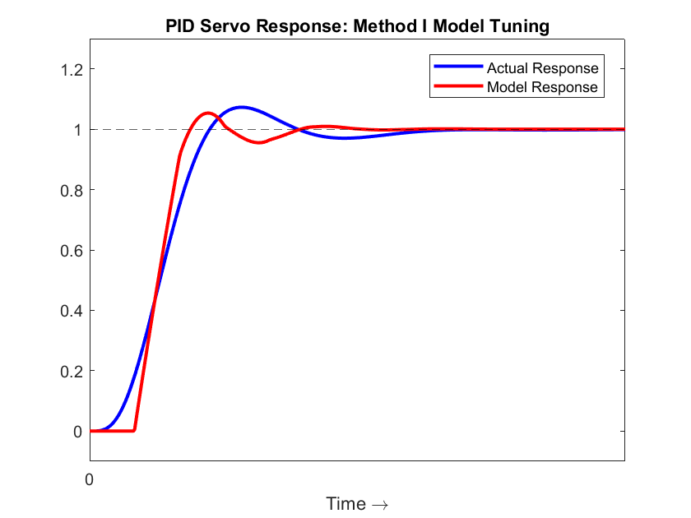
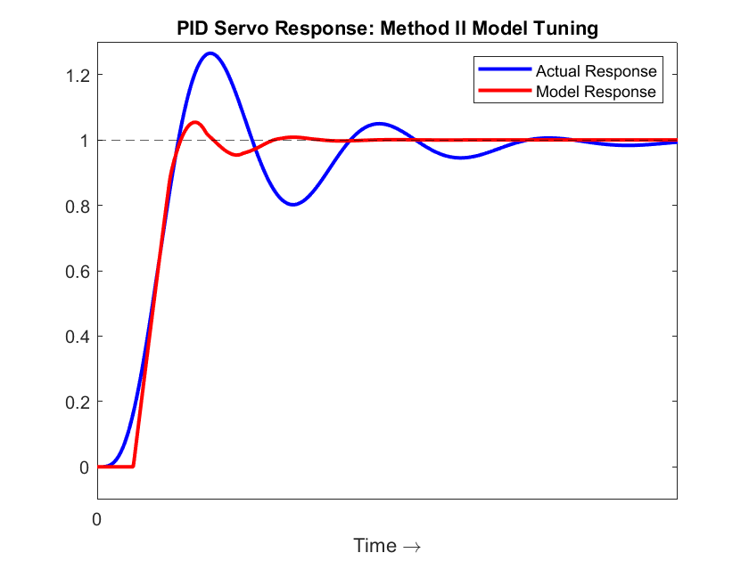
FOPDT Model Tuned Performance
PLANT-MODEL MISMATCH

Slide 12
Summary
Empirical Approach
Simple and practical
Applies ‘locally’ to any system (EE, ME, ChE etc)
Key Step
Proposing a combination of basic response types to well fit process reaction curve
First order plus dead time model fitting
Method I
t_{63.2%} and t_{28.3%} give time constant and dead time
Good fit
Method II
Tangent at the inflection point gives time constant and dead time
Not so good fit
Method II closed loop performance inferior due to plant-model mismatch

