Slide 1
Laplace Domain Analysis Introduction to Laplace Transforms
Module 4.1.1
Lectures on
CHEMICAL PROCESS CONTROL
Theory and Practice

Slide 2
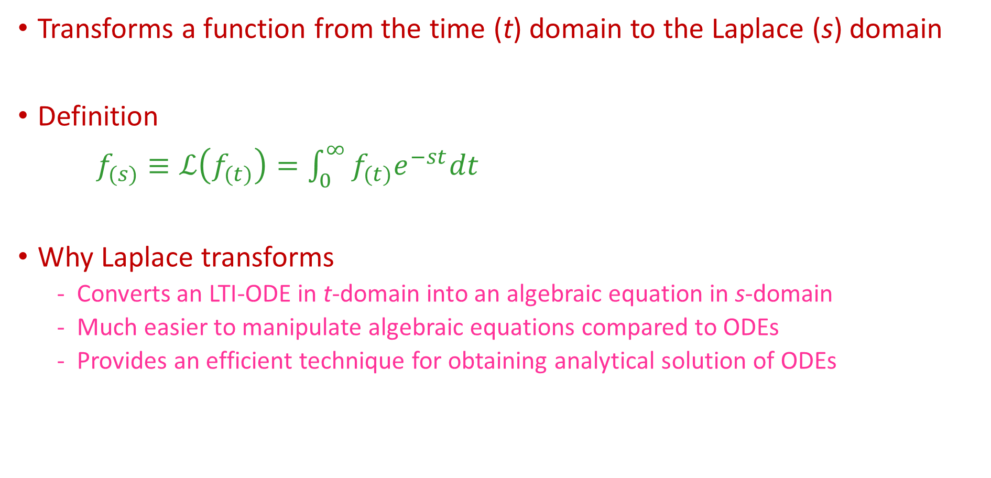
Laplace Tranforms
Transforms a function from the time (t) domain to the Laplace (s) domain
Definition
$f_{(s)}≡ℒ\left(f_{(t)}\right)=\int_{0}^{∞}{f_{(t)}e^{−st}dt}$
Why Laplace transforms
Converts an LTI-ODE in t-domain into an algebraic equation in s-domain
Much easier to manipulate algebraic equations compared to ODEs
Provides an efficient technique for obtaining analytical solution of ODEs

Slide 3
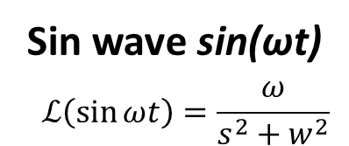
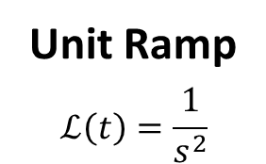
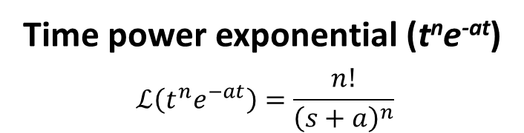
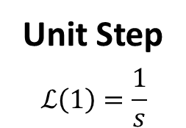
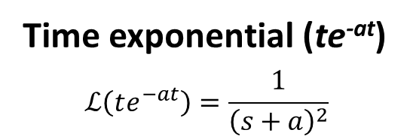
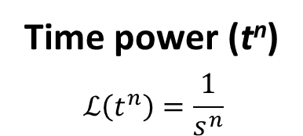
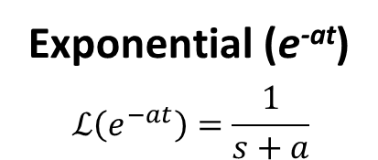
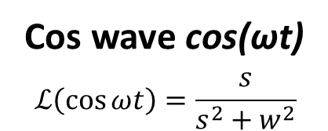
Laplace Transform of Common Functions
Unit Step
$$ℒ\left(1\right)=\frac{1}{s}$$
Unit Ramp
$$ℒ\left(t\right)=\frac{1}{s^{2}}$$
Time power (t^{n})
$$ℒ\left(t^{n}\right)=\frac{1}{s^{n}}$$
Exponential (e^{-at})
$$ℒ\left(e^{−at}\right)=\frac{1}{s+a}$$
Time exponential (te^{-at})
$$ℒ\left(te^{−at}\right)=\frac{1}{{\left(s+a\right)}^{2}}$$
Time power exponential (t^{n}e^{-at})
$$ℒ\left(t^{n}e^{−at}\right)=\frac{n!}{{\left(s+a\right)}^{n}}$$
Sin wave sin(ωt)
$$ℒ\left(\sin{ωt}\right)=\frac{ω}{s^{2}+w^{2}}$$
Cos wave cos(ωt)
$$ℒ\left(\cos{ωt}\right)=\frac{s}{s^{2}+w^{2}}$$

Slide 4
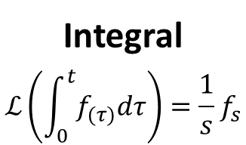
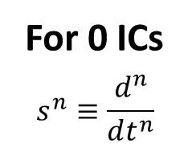
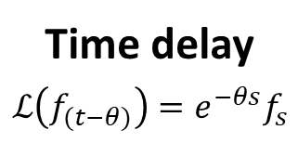
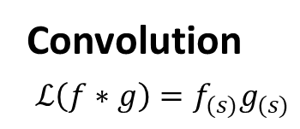
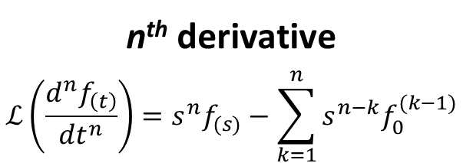
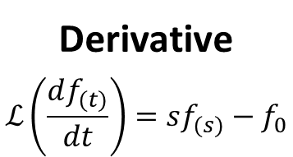
Laplace Transform of Time Function Operators
Time delay
$$ℒ\left(f_{(t−θ)}\right)=e^{−θs}f_{s}$$
Derivative
$$ℒ\left(\frac{df_{(t)}}{dt}\right)=sf_{(s)}−f_{0}$$
n^{th} derivative
$$ℒ\left(\frac{d^{n}f_{\left(t\right)}}{dt^{n}}\right)=s^{n}f_{(s)}−\sum_{k=1}^{n}{s^{n−k}f_{0}^{(k−1)}}$$
Integral
$$ℒ\left(\int_{0}^{t}{f_{(τ)}dτ}\right)=\frac{1}{s}f_{s}$$
For 0 ICs
$$s^{n}≡\frac{d^{n}}{dt^{n}}$$
Convolution
$$ℒ\left(f∗g\right)=f_{(s)}g_{(s)}$$

Slide 5
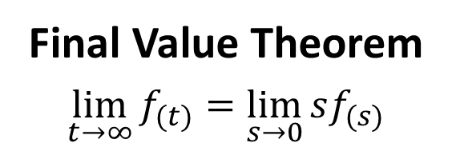
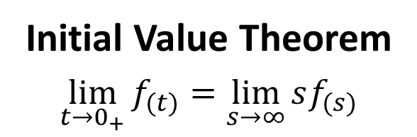
Initial and Final Value Theorem
Initial Value Theorem
$$\lim_{t→0_{+}}{f_{(t)}=\lim_{s→∞}{sf_{(s)}}}$$
Final Value Theorem
$$\lim_{t→∞}{f_{(t)}=\lim_{s→0}{sf_{(s)}}}$$

Slide 6
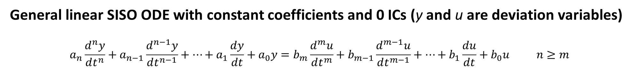
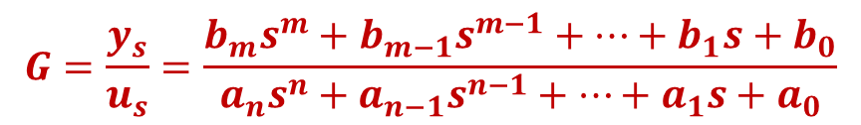
The Transfer Function
General linear SISO ODE with constant coefficients and 0 ICs (y and u are deviation variables)
$$a_{n}\frac{d^{n}y}{dt^{n}}+a_{n−1}\frac{d^{n−1}y}{dt^{n−1}}+⋯+a_{1}\frac{dy}{dt}+a_{0}y=b_{m}\frac{d^{m}u}{dt^{m}}+b_{m−1}\frac{d^{m−1}u}{dt^{m−1}}+⋯+b_{1}\frac{du}{dt}+b_{0}u n≥m$$
Laplace transform both sides
$$a_{n}s^{n}y_{s}+a_{n−1}s^{n−1}y_{s}+⋯+a_{1}sy_{s}+a_{0}y_{s}=b_{m}s^{m}u_{s}+b_{m−1}s^{m−1}u_{s}+⋯+b_{1}su_{s}+b_{0}u_{s}$$
$$G=\frac{y_{s}}{u_{s}}=\frac{b_{m}s^{m}+b_{m−1}s^{m−1}+⋯+b_{1}s+b_{0}}{a_{n}s^{n}+a_{n−1}s^{n−1}+⋯+a_{1}s+a_{0}}$$
Compact ODE Representation
Transfer Function
BLOCK DIAGRAM
u
G
y

Slide 7
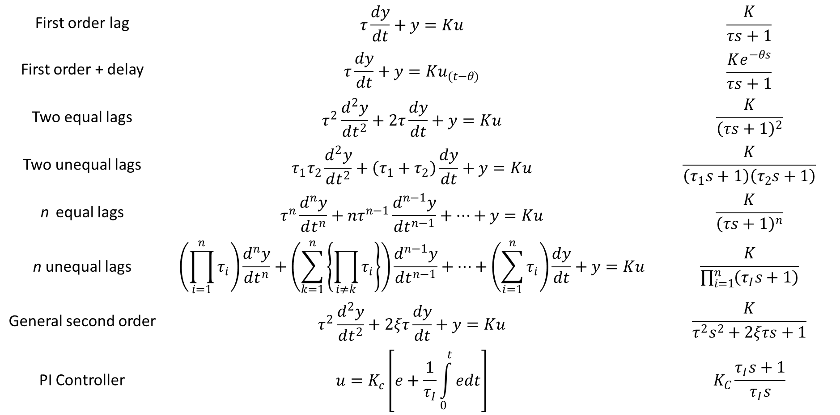
Common Transfer Functions
First order lag | $$τ\frac{dy}{dt}+y=Ku$$ | $$\frac{K}{τs+1}$$
First order + delay | $$τ\frac{dy}{dt}+y=Ku_{(t−θ)}$$ | $$\frac{Ke^{−θs}}{τs+1}$$
Two equal lags | $$τ^{2}\frac{d^{2}y}{dt^{2}}+2τ\frac{dy}{dt}+y=Ku$$ | $$\frac{K}{{\left(τs+1\right)}^{2}}$$
Two unequal lags | $$τ_{1}τ_{2}\frac{d^{2}y}{dt^{2}}+\left(τ_{1}+τ_{2}\right)\frac{dy}{dt}+y=Ku$$ | $$\frac{K}{\left(τ_{1}s+1\right)\left(τ_{2}s+1\right)}$$
n equal lags | $$τ^{n}\frac{d^{n}y}{dt^{n}}+{nτ}^{n−1}\frac{d^{n−1}y}{dt^{n−1}}+⋯+y=Ku$$ | $$\frac{K}{{\left(τs+1\right)}^{n}}$$
n unequal lags | $$\left(\prod_{i=1}^{n}{τ_{i}}\right)\frac{d^{n}y}{dt^{n}}+\left(\sum_{k=1}^{n}{\left\{\prod_{i≠k}{τ_{i}}\right\}}\right)\frac{d^{n−1}y}{dt^{n−1}}+⋯+\left(\sum_{i=1}^{n}{τ_{i}}\right)\frac{dy}{dt}+y=Ku$$ | $$\frac{K}{\prod_{i=1}^{n}{\left(τ_{I}s+1\right)}}$$
General second order | $$τ^{2}\frac{d^{2}y}{dt^{2}}+2ξτ\frac{dy}{dt}+y=Ku$$ | $$\frac{K}{τ^{2}s^{2}+2ξτs+1}$$
PI Controller | $$u=K_{c}\left[e+\frac{1}{τ_{I}}\int_{0}^{t}{edt}\right]$$ | $$K_{C}\frac{τ_{I}s+1}{τ_{I}s}$$

Slide 8

Exercise
Derive transfer function for a PID controller
$$u=K_{c}\left[e+\frac{1}{τ_{I}}\int_{0}^{t}{edt+τ_{D}\frac{de}{dt}}\right]$$
Is the transfer function physically realizable?

Slide 9
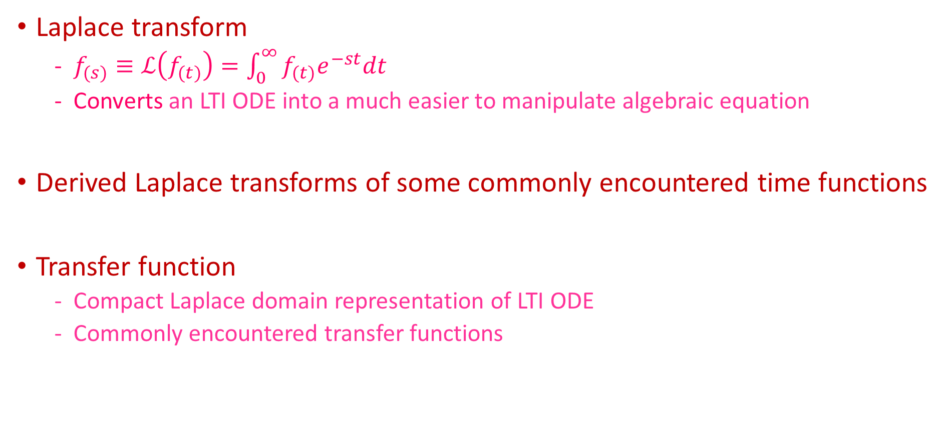
Summary
Laplace transform
$f_{(s)}≡ℒ\left(f_{(t)}\right)=\int_{0}^{∞}{f_{(t)}e^{−st}dt}$
Converts an LTI ODE into a much easier to manipulate algebraic equation
Derived Laplace transforms of some commonly encountered time functions
Transfer function
Compact Laplace domain representation of LTI ODE
Commonly encountered transfer functions

