Slide 1
Laplace Domain Analysis The Transfer Function
Module 4.2
Lectures on
CHEMICAL PROCESS CONTROL
Theory and Practice

Slide 2
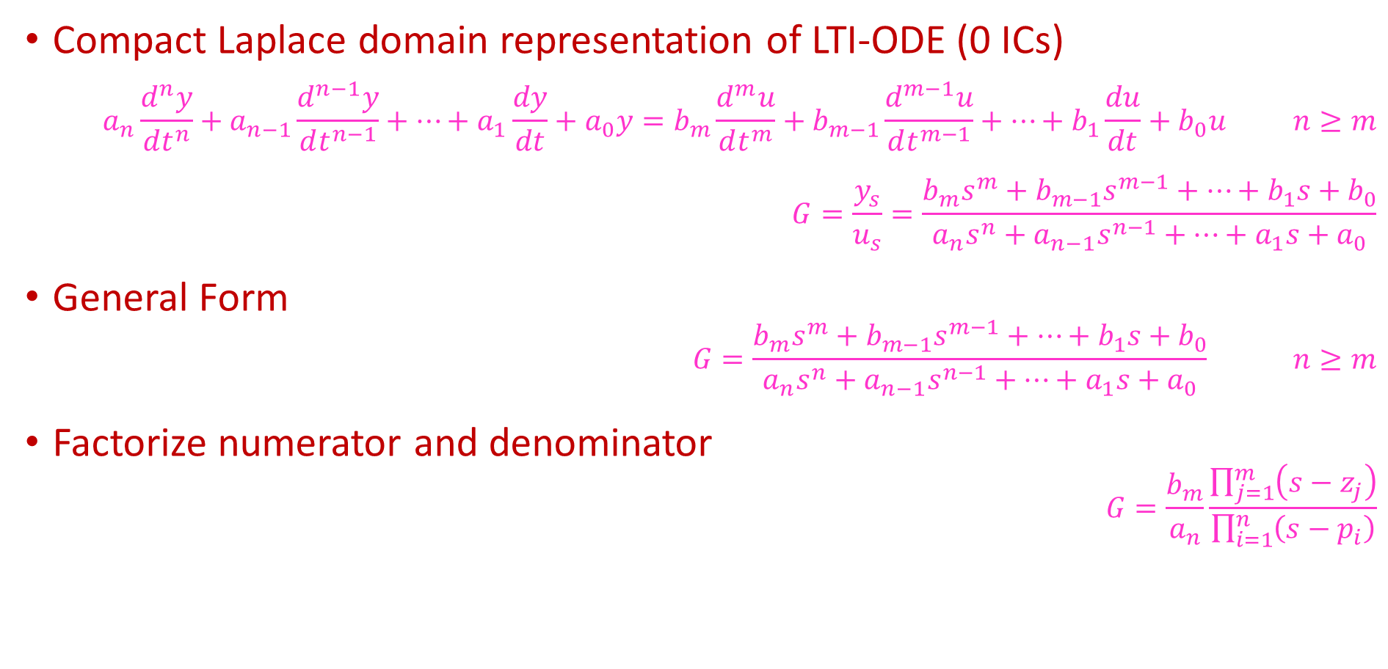
The Transfer Function
Compact Laplace domain representation of LTI-ODE (0 ICs)
$$a_{n}\frac{d^{n}y}{dt^{n}}+a_{n−1}\frac{d^{n−1}y}{dt^{n−1}}+⋯+a_{1}\frac{dy}{dt}+a_{0}y=b_{m}\frac{d^{m}u}{dt^{m}}+b_{m−1}\frac{d^{m−1}u}{dt^{m−1}}+⋯+b_{1}\frac{du}{dt}+b_{0}u n≥m$$
$$G=\frac{y_{s}}{u_{s}}=\frac{b_{m}s^{m}+b_{m−1}s^{m−1}+⋯+b_{1}s+b_{0}}{a_{n}s^{n}+a_{n−1}s^{n−1}+⋯+a_{1}s+a_{0}}$$
General Form
$$G=\frac{b_{m}s^{m}+b_{m−1}s^{m−1}+⋯+b_{1}s+b_{0}}{a_{n}s^{n}+a_{n−1}s^{n−1}+⋯+a_{1}s+a_{0}} n≥m$$
Factorize numerator and denominator
$$G=\frac{b_{m}}{a_{n}}\frac{\prod_{j=1}^{m}{\left(s−z_{j}\right)}}{\prod_{i=1}^{n}{\left(s−p_{i}\right)}}$$
ZEROES of G
BLOCK DIAGRAM
u
G
y
POLES of G

Slide 3
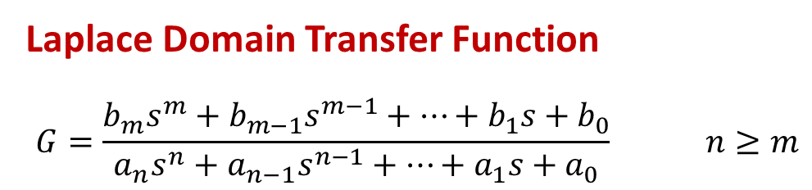
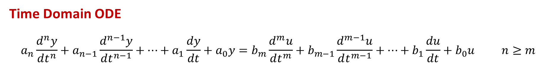
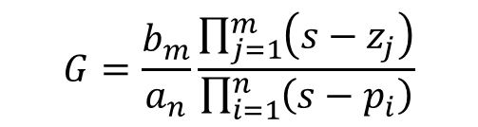
The Transfer Function
Time Domain ODE
$$a_{n}\frac{d^{n}y}{dt^{n}}+a_{n−1}\frac{d^{n−1}y}{dt^{n−1}}+⋯+a_{1}\frac{dy}{dt}+a_{0}y=b_{m}\frac{d^{m}u}{dt^{m}}+b_{m−1}\frac{d^{m−1}u}{dt^{m−1}}+⋯+b_{1}\frac{du}{dt}+b_{0}u n≥m$$
Laplace Domain Transfer Function
$$G=\frac{b_{m}s^{m}+b_{m−1}s^{m−1}+⋯+b_{1}s+b_{0}}{a_{n}s^{n}+a_{n−1}s^{n−1}+⋯+a_{1}s+a_{0}} n≥m$$
ODE
Characteristic Equation
Polynomial
Transfer Function
Denominator
Polynomial
≡
$$G=\frac{b_{m}}{a_{n}}\frac{\prod_{j=1}^{m}{\left(s−z_{j}\right)}}{\prod_{i=1}^{n}{\left(s−p_{i}\right)}}$$
POLES OF THE TRANSFER FUNCTION ARE THE ROOTS OF THE ODE CHARACTERISTIC EQUATION

Slide 4
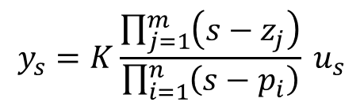
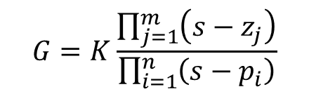
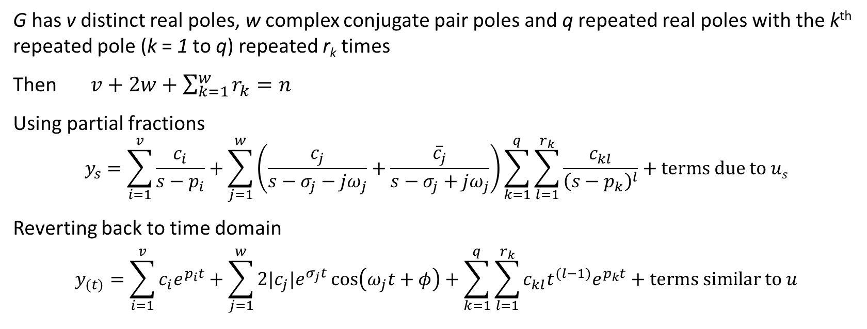
Nature of Forced LTI-ODE Solution
$$G=K\frac{\prod_{j=1}^{m}{\left(s−z_{j}\right)}}{\prod_{i=1}^{n}{\left(s−p_{i}\right)}}$$
$$y_{s}=K\frac{\prod_{j=1}^{m}{\left(s−z_{j}\right)}}{\prod_{i=1}^{n}{\left(s−p_{i}\right)}} u_{s}$$
u
G
y
G has v distinct real poles, w complex conjugate pair poles and q repeated real poles with the k^{th} repeated pole (k = 1 to q) repeated r_{k} times
Then $v+2w+\sum_{k=1}^{w}{r_{k}}=n$
Using partial fractions
$$y_{s}=\sum_{i=1}^{v}{\frac{c_{i}}{s−p_{i}}+\sum_{j=1}^{w}{\left(\frac{c_{j}}{s−σ_{j}−jω_{j}}+\frac{{\overline{c}}_{j}}{s−σ_{j}+jω_{j}}\right)}\sum_{k=1}^{q}{\sum_{l=1}^{r_{k}}{\frac{c_{kl}}{{\left(s−p_{k}\right)}^{l}}}}}+terms due to us$$
Reverting back to time domain
$$y_{(t)}=\sum_{i=1}^{v}{c_{i}e^{p_{i}t}}+\sum_{j=1}^{w}{2|c_{j}|e^{σ_{j}t}\cos\left(ω_{j}t+φ\right)}+\sum_{k=1}^{q}{\sum_{l=1}^{r_{k}}{c_{kl}t^{(l−1)}e^{p_{k}t}}+terms similar to u}$$

Slide 5
Poles and Transient Response
$$G=K\frac{\prod_{j=1}^{m}{\left(s−z_{j}\right)}}{\prod_{i=1}^{n}{\left(s−p_{i}\right)}}$$
$$y_{s}=K\frac{\prod_{j=1}^{m}{\left(s−z_{j}\right)}}{\prod_{i=1}^{n}{\left(s−p_{i}\right)}} u_{s}$$
u
G
y
$$y_{(t)}=\sum_{i=1}^{v}{c_{i}e^{p_{i}t}}+\sum_{j=1}^{w}{2|c_{j}|e^{σ_{j}t}\cos\left(ω_{j}t+φ\right)}+\sum_{k=1}^{q}{\sum_{l=1}^{r_{k}}{c_{kl}t^{(l−1)}e^{p_{k}t}}+terms similar to u}$$
Poles, p, determine the e^{pt} terms (eigenfunctions) in transient response
Poles may be real (distinct or repeated) or complex conjugate
Imaginary part in complex conjugate pairs results in oscillations
If real part of pole is negative, corresponding eigenfunction decays with time
If real part of pole is positive, corresponding eigenfunction blows up with time
If all poles in LHP, system is stable
If any pole in RHP, system is unstable

Slide 6
System Stability
Im
If ANY transfer function pole (characteristic equation root) is in RHP, system is UNSTABLE
LEFT HALF PLANE
STABLE
RIGHT HALF PLANE
UNSTABLE
Re
Only if ALL transfer function poles (characteristic equation roots) are in LHP, system is STABLE
S or λ plane

Slide 7
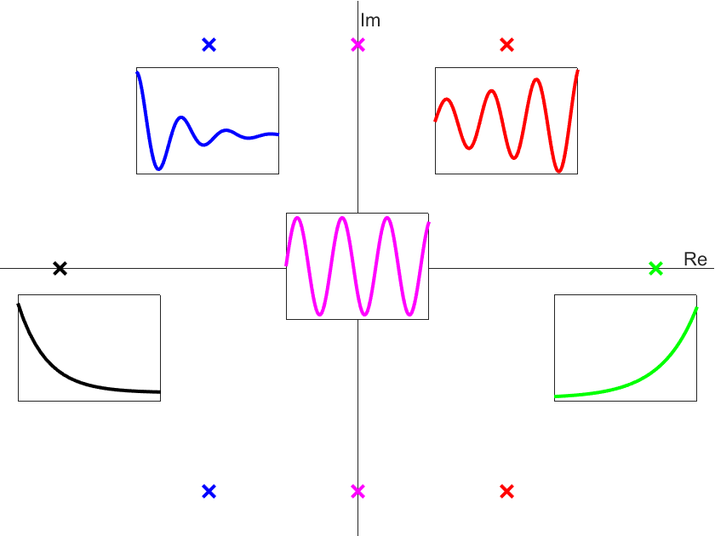
Pole Location and Corresponding Transients
Frequency
of
oscillation
Complex part
of
pole
=

Slide 8
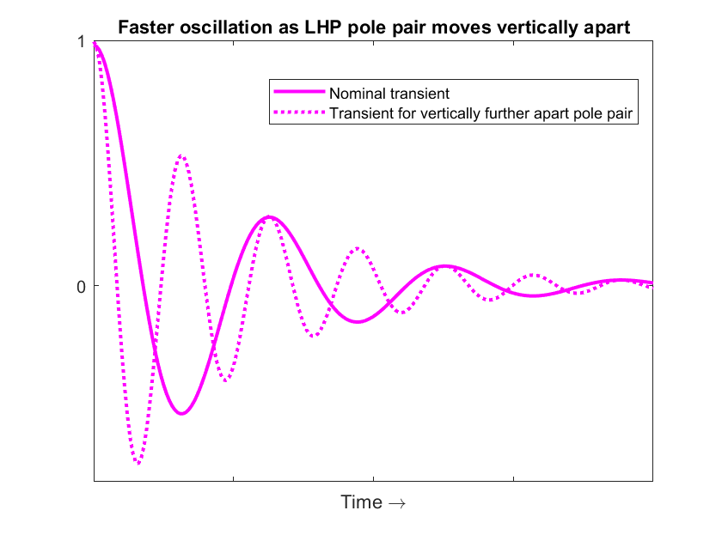
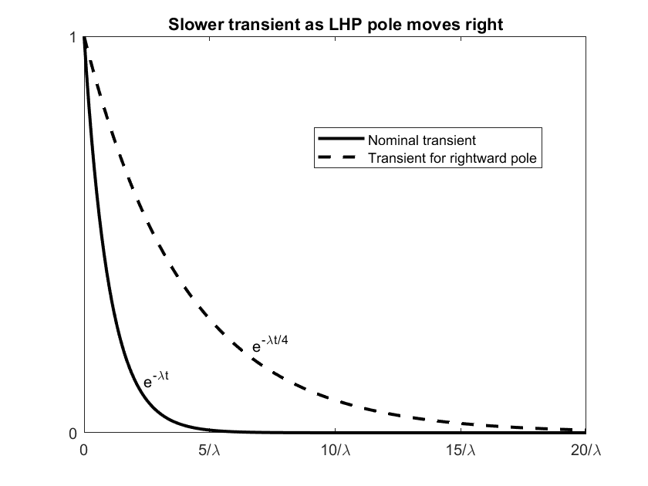
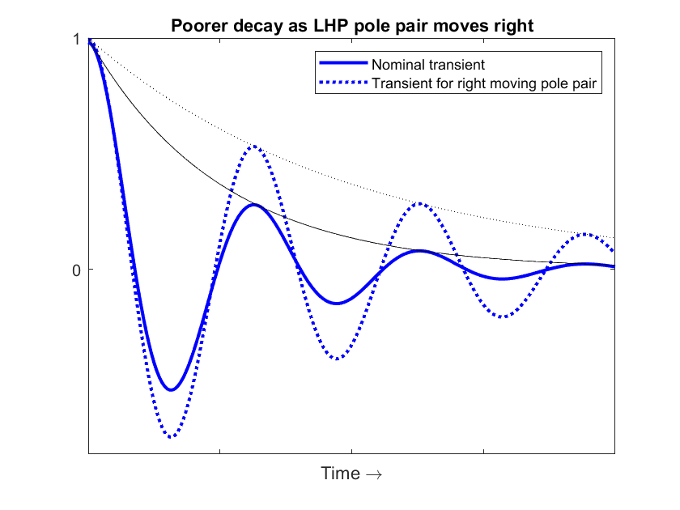
Pole Location and Transient Response Speed
Im
Re
S or λ plane

Slide 9
Zeroes and Transient Response
$$G=K\frac{\prod_{j=1}^{m}{\left(s−z_{j}\right)}}{\prod_{i=1}^{n}{\left(s−p_{i}\right)}}$$
$$y_{s}=K\frac{\prod_{j=1}^{m}{\left(s−z_{j}\right)}}{\prod_{i=1}^{n}{\left(s−p_{i}\right)}} u_{s}$$
u
G
y
$$y_{(t)}=\sum_{i=1}^{v}{c_{i}e^{p_{i}t}}+\sum_{j=1}^{w}{2|c_{j}|e^{σ_{j}t}\cos\left(ω_{j}t+φ\right)}+\sum_{k=1}^{q}{\sum_{l=1}^{r_{k}}{c_{kl}t^{(l−1)}e^{p_{k}t}}+terms similar to u}$$
Zeroes, z, affect the partial fraction coefficients
Zeroes affect the dynamic response through the coefficients
RHP zero causes inverse response
Zeroes have no role in determining the eigenfunctions (transient modes)

Slide 10


Pole-Zero Map & Dominant Poles
Im
All poles in LHP $⟹$ Stable system
For a stable system, pole closest to the RHP has the slowest transient
$⟹$
It dominates the
transient response
If other poles are sufficiently away from dominant pole,
Transient response ≈ Response due to dominant poles
cos⁻¹ξ
Re
DOMINANT POLE APPROXIMATION
In a feedback control loop, some of the closed loop poles move towards RHP as KC is increased
KEY FEEDBACK CONTROL IDEA
Tune controller such that dominant closed loop pole is sufficiently away from RHP
Typical criteria 0 < ξ < 0.5
S or λ plane

Slide 11
Summary
Transfer function
Implicitly assumes 0 ICs
Compact ODE representation in Laplace domain
Numerator polynomial (roots are zeroes) and denominator polynomial (roots are poles)
Transfer function zeroes
Affect transient response by affecting the partial fraction coefficients
Transfer Function Poles
Are the roots of the ODE characteristic equation
May be real distinct, real repeated or complex conjugate pairs
Determine the eigenfunctions (e^{pt} terms) in the transient response
Transient response is linear combination of eigenfunctions
Complex conjugate roots cause sinusoidal oscillations of frequency = imaginary part
System is stable if all poles in LHP. Else unstable
Dominant pole
In a stable system, pole closest to RHP dominates the transient response
Feedback controller tuned s.t. dominant closed loop pole sufficiently way from RHP

