Slide 1
Laplace Domain Analysis Using Block Diagrams
Module 4.3
Lectures on
CHEMICAL PROCESS CONTROL
Theory and Practice

Slide 2
Block Diagram
Graphical representation of equations
Clearly reveals information flow
Cause and effect
Feedback loops (if any)
Single Equation
z = x + y
System of Equations
z = k₁y + w
y = k₂x - v
x = k₃z + u
x
Σ
z
v
Feedback can cause instability
y
-1
w
x
y
z
u
Σ
k₂
Σ
k₁
Σ
k₃

Slide 3
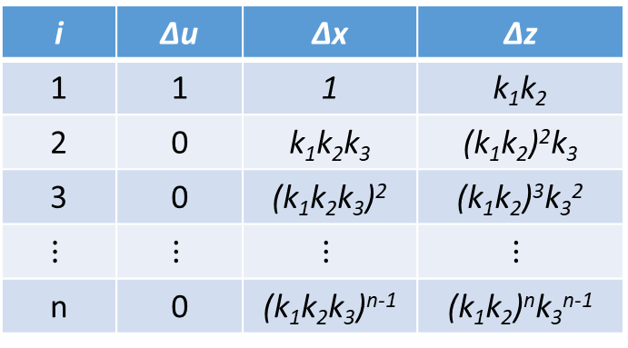
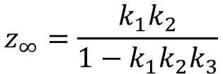
Feedback and Instability
System of Equations
Δz_{i} = k₁ Δy_{i} + Δw_{i}
Δy_{i} = k₂ Δx_{i} - Δv_{i}
Δx_{i} = k₃ Δz_{i} + Δu_{i}
i | Δu | Δx | Δz
1 | 1 | 1 | k₁k₂
2 | 0 | k₁k₂k₃ | (k₁k₂)²k₃
3 | 0 | (k₁k₂k₃)² | (k₁k₂)³k₃²
$$⋮$$ | $$⋮$$ | $$⋮$$ | $$⋮$$
n | 0 | (k₁k₂k₃)^{n-1} | (k₁k₂)^{n}k₃^{n-1}
v
-1
w
$$z_{n}=k_{1}k_{2}\left[1+\left\{k_{1}k_{2}k_{3}\right\}+{\left\{k_{1}k_{2}k_{3}\right\}}^{2}+⋯+{\left\{k_{1}k_{2}k_{3}\right\}}^{n−1}\right]$$
x
y
z
u
Σ
k₂
Σ
k₁
Σ
z∞ blows up if k₁k₂k₃ > 1
z∞ bounded if k₁k₂k₃ < 1
$$z_{∞}=\frac{k_{1}k_{2}}{1−k_{1}k_{2}k_{3}}$$
k₃
Feedback may result in instability

Slide 4


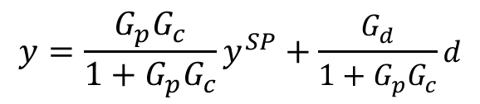
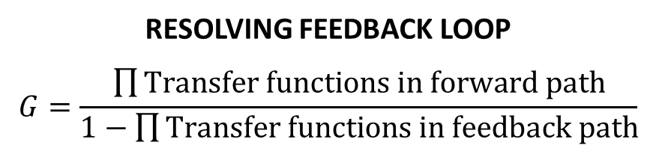
Working with Block Diagrams
d
d
y = G_{p}u + G_{d}d
u = G_{c}e
e = y^{SP} – y
$$\frac{G_{d}}{1+G_{p}G_{c}}$$
?
G_{d}
e
G_{c}
u
G_{p}
$$\frac{G_{p}G_{c}}{1+G_{p}G_{c}}$$
y^{SP}
Σ
Σ
y
y^{SP}
Σ
y
?
$$y=\frac{G_{p}G_{c}}{1+G_{p}G_{c}}y^{SP}+\frac{G_{d}}{1+G_{p}G_{c}}d$$
-1
Servo tf
Regulator tf
RESOLVING FEEDBACK LOOP
$$G=\frac{\prod{Transfer functions in forward path}}{1−\prod{Transfer functions in feedback path}}$$
CLOSED LOOP CHARACTERISTIC EQUATION
1 + G_{p}G_{c} = 0

Slide 5


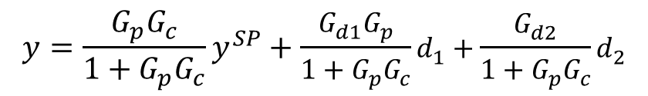

Example 1
d₁
d₁
d₂
$$\frac{G_{d1}G_{p}}{1+G_{p}G_{c}}$$
G_{d1}
G_{d2}
e
G_{c}
u
G_{p}
$$\frac{G_{p}G_{c}}{1+G_{p}G_{c}}$$
y^{SP}
Σ
Σ
Σ
y
y^{SP}
Σ
y
$$\frac{G_{d2}}{1+G_{p}G_{c}}$$
-1
d₂
$$y=\frac{G_{p}G_{c}}{1+G_{p}G_{c}}y^{SP}+\frac{G_{d1}G_{p}}{1+G_{p}G_{c}}d_{1}+\frac{G_{d2}}{1+G_{p}G_{c}}d_{2}$$
Servo tf
Regulator tf₁
Regulator tf₂

Slide 6

Example 2
d
d
y^{SP}
Σ
G*
G_{p}
Σ
y
y^{SP}
Σ
Σ
G*
G_{p}
Σ
y
G_{m}
-1
Σ
G_{m}
-1
-1
Equivalent Simple Feedback Loop?
d
y^{SP}
Σ
G_{c}
G_{p}
Σ
y
$$G_{c}=\frac{G^{∗}}{1−G^{∗}G_{m}}$$
-1

Slide 7
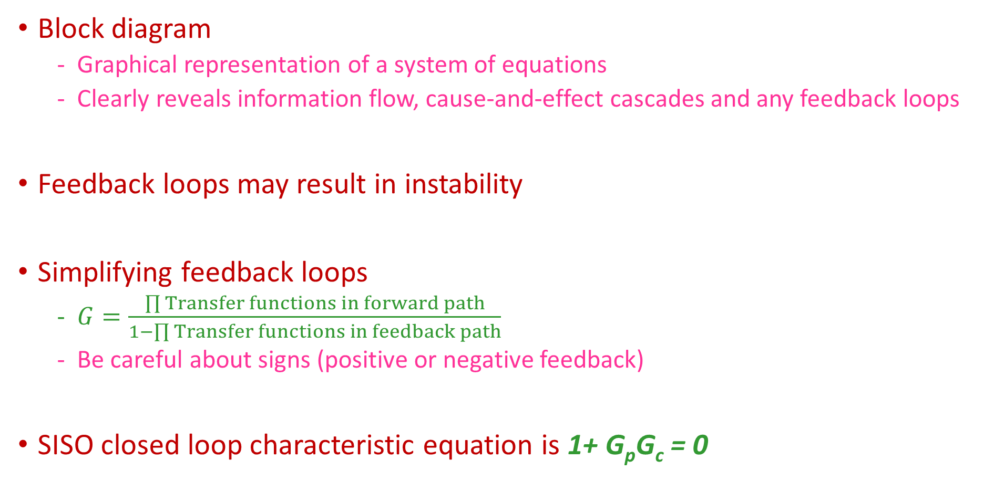
Summary
Block diagram
Graphical representation of a system of equations
Clearly reveals information flow, cause-and-effect cascades and any feedback loops
Feedback loops may result in instability
Simplifying feedback loops
$G=\frac{\prod{Transfer functions in forward path}}{1−\prod{Transfer functions in feedback path}}$
Be careful about signs (positive or negative feedback)
SISO closed loop characteristic equation is 1+ G_{p}G_{c} = 0

