Slide 1
Laplace Domain Analysis Block Diagrams for Process Systems
Module 4.4
Lectures on
CHEMICAL PROCESS CONTROL
Theory and Practice

Slide 2
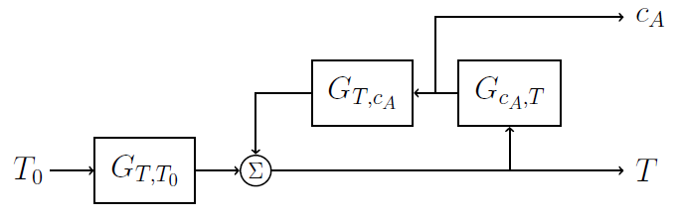
Non-Isothermal CSTR
F₀ c_{A0} T₀
Block diagram for effect of T₀ on T and c_{A}
T_{J}
A → B
r = k c_{A}
F c_{A} T
EXERCISE
Block diagrams for effect of
c_{A0}, F₀ or T_{J} on T and c_{A}

Slide 3
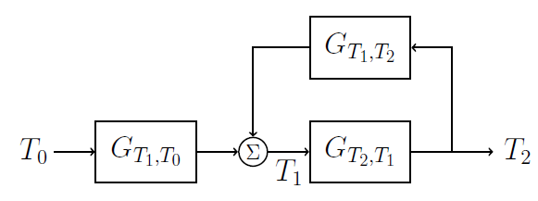
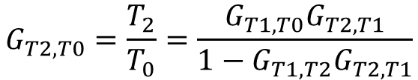
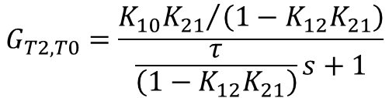



Exothermic Reactor-FEHE
Block diagram for effect of T₀ on T₂
T₀
FEHE
Reactor
T₂
T₁
$$K_{12}$$
T₃
$$K_{10}$$
$$\frac{K_{21}}{τs+1}$$
RECYCLE EFFECT
Much higher gain
Much larger time constant (ie slow dynamics)
Possible instability if K₁₂K₂₁ > 1
$$G_{T2,T0}=\frac{T_{2}}{T_{0}}=\frac{G_{T1,T0}G_{T2,T1}}{1−G_{T1,T2}G_{T2,T1}}$$
$$G_{T2,T0}=\frac{{K_{10}K_{21}}/{\left(1−K_{12}K_{21}\right)}}{\frac{τ}{\left(1−K_{12}K_{21}\right)}s+1}$$

Slide 4
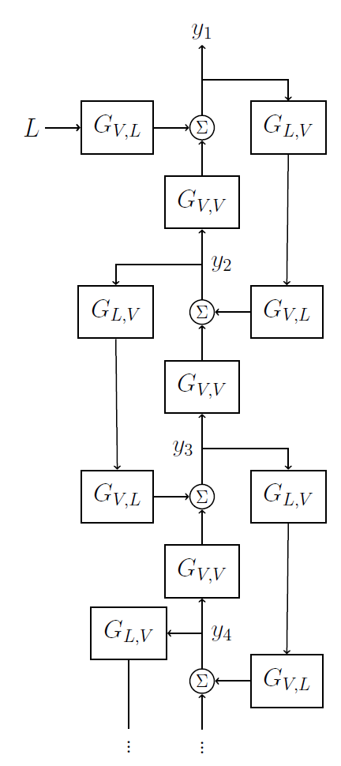

Distillation Column
V, y₁
L, x
Block diagram for effect of L on y₁
$$⋮$$
EXERCISE
Derive transfer function relating y₁ and L

Slide 5
Summary
Physical process structure determines the block diagram structure
CSTR example
Coupled material and energy balance
Reactor FEHE example
Energy recycle causes large increase in process gain and time constant
Process may become unstable
Distillation column example
Interacting lags in series

