Slide 1
Laplace Domain Analysis SISO Feedback Loops Analysis and Design
Module 4.4
Lectures on
CHEMICAL PROCESS CONTROL
Theory and Practice

Slide 2


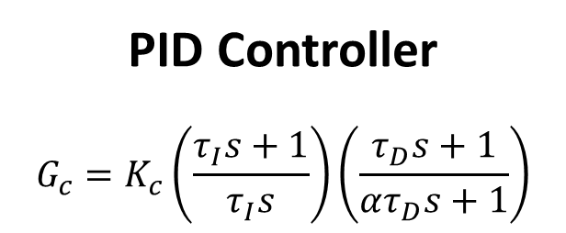
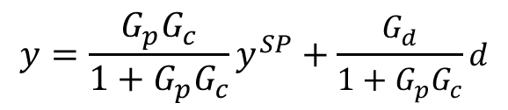
SISO Feedback Loop
d
d
$$\frac{G_{d}}{1+G_{p}G_{c}}$$
G_{d}
e
G_{c}
u
G_{p}
$$\frac{G_{p}G_{c}}{1+G_{p}G_{c}}$$
y^{SP}
Σ
Σ
y
y^{SP}
Σ
y
$$y=\frac{G_{p}G_{c}}{1+G_{p}G_{c}}y^{SP}+\frac{G_{d}}{1+G_{p}G_{c}}d$$
-1
Servo tf
Regulator tf
PID Controller
$$G_{c}=K_{c}\left(\frac{τ_{I}s+1}{τ_{I}s}\right)\left(\frac{τ_{D}s+1}{ατ_{D}s+1}\right)$$
CLOSED LOOP CHARACTERISTIC EQUATION
1 + G_{p}G_{c} = 0

Slide 3
PID Controller: Analysis and Design
ANALYSIS
Given a dynamic system, what are its dynamic response characteristics
DESIGN
For desired closed loop response characteristics, obtain controller tuning (K_{c}, τ_{I} and τ_{D})
Metrics Characterizing Closed Loop Response
Time Domain:
Rise time, peak time, POR, DR
Laplace Domain:
Closed loop damping coefficient (ξ) of dominant pole-pair

Slide 4
Is the System Stable?
Governed by system characteristic equation roots (transfer function poles)
If any root / pole in RHP, system is unstable
If all roots in LHP, system is stable
Need a simple technique for # of RHP poles
Without calculating all roots
Routh array is that simple technique
Write down characteristic equation p(s) = 0
Prepare Routh array of p(s)
# of RHP roots = # of sign changes in first column of Routh array
For closed loop systems, Routh array may be used to calculate limiting K_{C} at which system goes unstable

Slide 5
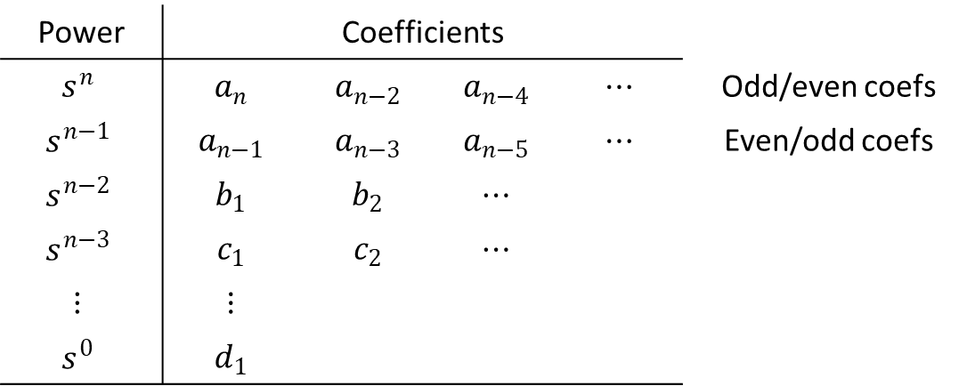
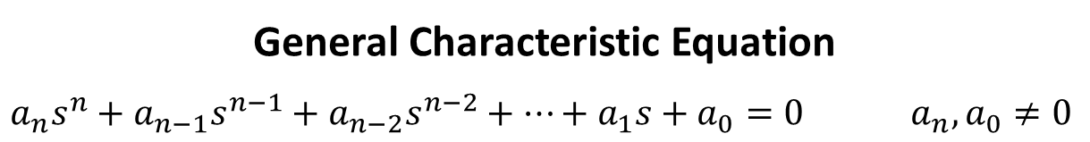



The Routh Array
General Characteristic Equation
$$a_{n}s^{n}+a_{n−1}s^{n−1}+a_{n−2}s^{n−2}+⋯+a_{1}s+a_{0}=0 a_{n},a_{0}≠0$$
Power | Coefficients
$$s^{n}$$ | $$a_{n}$$ | $$a_{n−2}$$ | $$a_{n−4}$$ | $$⋯$$ | Odd/even coefs
$$s^{n−1}$$ | $$a_{n−1}$$ | $$a_{n−3}$$ | $$a_{n−5}$$ | $$⋯$$ | Even/odd coefs
$$s^{n−2}$$ | $$b_{1}$$ | $$b_{2}$$ | $$⋯$$
$$s^{n−3}$$ | $$c_{1}$$ | $$c_{2}$$ | $$⋯$$
$$⋮$$ | $$⋮$$
$$s^{0}$$ | $$d_{1}$$
$$b_{1}=\frac{a_{n−1}a_{n−2}−a_{n}a_{n−3}}{a_{n−1}}$$
$$b_{2}=\frac{a_{n−1}a_{n−4}−a_{n}a_{n−5}}{a_{n−1}}$$
$$c_{1}=\frac{b_{1}a_{n−3}−a_{n−1}b_{2}}{b_{1}}$$
# of RHP roots/poles = # of sign changes in first column of Routh array

Slide 6
Routh Array: Special Cases
Common factor in a row
Divide all elements by the common factor
Zero first element in a row
Replace 0 by infinitesimal δ and complete array
Look at signs of elements above and below δ
If same sign, then a purely imaginary conjugate root pair is indicated
If sign change, # of sign changes = # of RHP roots
Alternatively, replace s by x⁻¹ and obtain Routh array for revised p(x) = 0
Entire row is zero
Replace zero row by coefficients of d/ds[Auxiliary Polynomial] and proceed
Auxiliary polynomial = polynomial for row above zero row
Indicates complex conjugate root pairs or (+a, -a) root pairs
Auxiliary polynomial always of even degree
Roots of auxiliary polynomial give conjugate/(+a,-a) roots pairs

Slide 7
Routh Array Example 1
$$p(s)≡120s^{5}+274s^{4}+225s^{3}+85s^{2}+15s+3=0$$
ROUTH ARRAY
s⁵ 120 (8) 225 (15) 15 (1) common factor 15
s⁴ 274 85 3
s³ 12.52 0.912 0
s² 65 3
s¹ 0.335 0
s⁰ 3
0 sign changes in first column $⟹$ 0 RHP roots $⟹$ Stable system

Slide 8
Routh Array Example 2
$$p(s)≡120s^{5}+274s^{4}+225s^{3}+85s^{2}+15s+5=0$$
ROUTH ARRAY
s⁵ 120 (8) 225 (15) 15 (1) common factor 15
s⁴ 274 85 5
s³ 12.52 0.8540 0
s² 66.31 5
s¹ -0.09 0
s⁰ 5
2 sign changes in first column $⟹$ 2 RHP roots $⟹$ Unstable system

Slide 9
Routh Array Example 3
$$p(s)≡120s^{5}+274s^{4}+225s^{3}+85s^{2}+15s+4.571=0$$
ROUTH ARRAY
s⁵ 120 (8) 225 (15) 15 (1) common factor 15
s⁴ 274 85 4.571
s³ 12.52 0.8665 0
s² 66.03 4.571
s¹ δ 0
s⁰ 4.571
Purely imaginary root pair corresponds to 66.03s² + 4.571 = 0 $⟹$ s = ± 0.2631j
No RHP root. 2 purely imaginary root pair $⟹$ System with sustained oscillations

Slide 10
Routh Array Example 4
$$p\left(s\right)≡s^{5}+3s^{4}+3s^{3}+9s^{2}−4s−12=0$$
ROUTH ARRAY
s⁵ 1 3 -4
s⁴ 3 (1) 9 (3) -12 (-4) Common factor 3
s³ 0 (4) (2) 0 (6) (3) Aux polynominal. 2 common
s² 1.5 -4
s¹ 8.33
s⁰ -4
Aux poly: s⁴ + 3s² – 4 = 0 $⟹$ s = ±2j & s = ±1 are roots of p(s) = 0. Remaining root s = -3
p(s) ≡ (s+1)(s-1)(s+2j)(s-2j)(s+3)
1 sign changes in first column $⟹$ 1 RHP root $⟹$ Unstable system

Slide 11
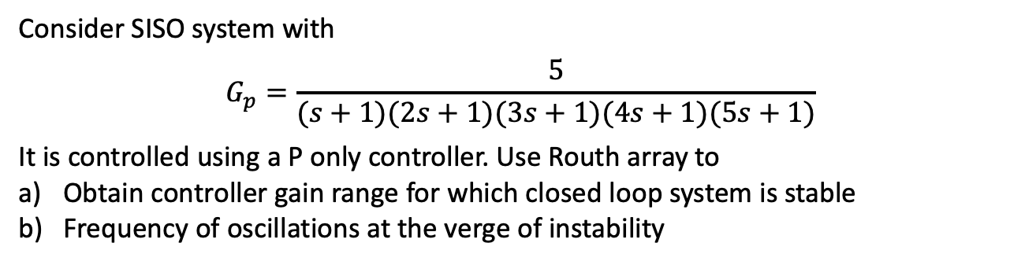
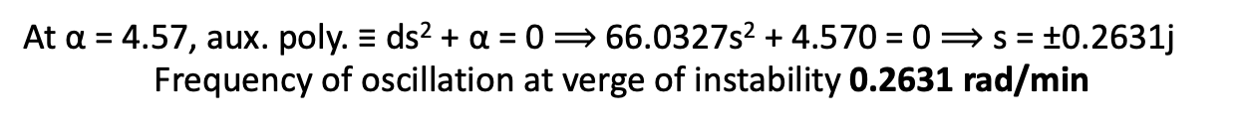
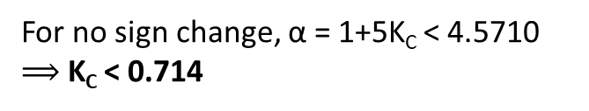

Routh Array Example 5
Routh Array Example 5
Consider SISO system with
$$G_{p}=\frac{5}{(s+1)(2s+1)(3s+1)(4s+1)(5s+1)}$$
It is controlled using a P only controller. Use Routh array to
Obtain controller gain range for which closed loop system is stable
Frequency of oscillations at the verge of instability
$$CLCE≡1+K_{c}G_{p}=0 ⟹120s^{5}+274s^{4}+225s^{3}+85s^{2}+15s+1+5Kc=0$$
ROUTH ARRAY
s⁵ 120 (8) 225 (15) 15 (1) common factor 15
s⁴ 274 85 α
s³ b=12.52 c=1-0.0292α
s² d=63.112+0.6391α α
s¹ e 0
s⁰ α
$$e=\frac{−0.0187α^{2}−13.7219α+63.1120}{d}$$
For no sign change, α = 1+5K_{C} < 4.5710 $⟹$ K_{C} < 0.714
At α = 4.57, aux. poly. ≡ ds² + α = 0 $⟹$ 66.0327s² + 4.570 = 0 $⟹$ s = ±0.2631j
Frequency of oscillation at verge of instability 0.2631 rad/min

Slide 12
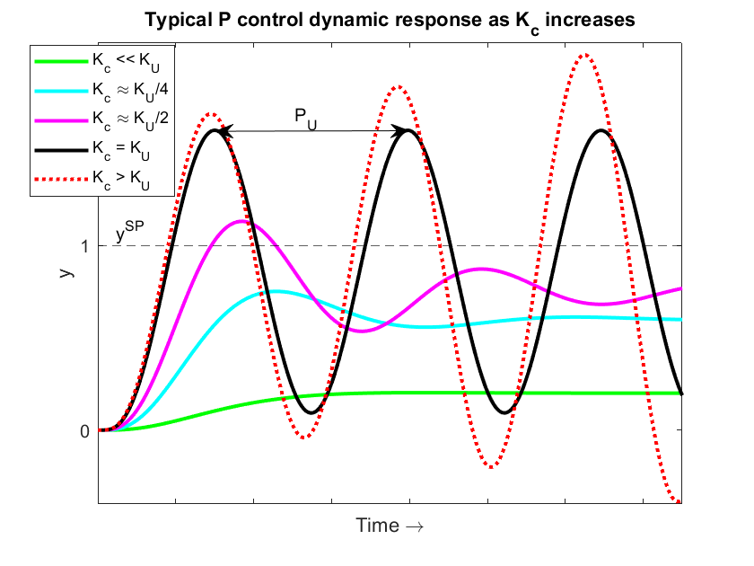
Ultimate Gain and Period
Ultimate gain (K_{U})
Proportional controller gain for which sustained closed loop oscillations occur
Ultimate period (P_{U})
Sustained oscillation period at K_{U}
K_{U}, P_{U} used for empirical tuning

Slide 13
Empirical Tuning Rules
Give K_{C}, τ_{I} and τ_{D} in terms of K_{U} and P_{U}
Experience based tuning rules (empirical)
Zeigler-Nichols
Developed for quarter decay ratio regulator response in typical systems
Aggressive
Use when aggressive control is desired (e.g. exothermic reactor T control)
Tyreus-Luyben
Used on most process systems for gentle changes in MVs (smooth operation)

Slide 14
Empirical Tuning Rules
ZIEGLER-NICHOLS
Controller | K_{C} | τ_{I} | τ_{D}
P only | K_{U}/2 | - | -
PI | K_{U}/2.2 | P_{U}/1.2 | -
PID | K_{U}/1.7 | P_{U}/2 | P_{U}/8
TYREUS-LUYBEN
Controller | K_{C} | τ_{I} | τ_{D}
PI | K_{U}/3.2 | 2.2P_{U} | -
PID | K_{U}/2.2 | 2.2P_{U} | P_{U}/6.3
Lag Dominant
CIANCONE-MARLIN
Controller | K_{C} | τ_{I} | τ_{D}
PI | K_{U}/3.3 | P_{U}/4 | -
PID | K_{U}/3.3 | P_{U}/4.4 | P_{U}/8.1
Delay Dominant

Slide 15
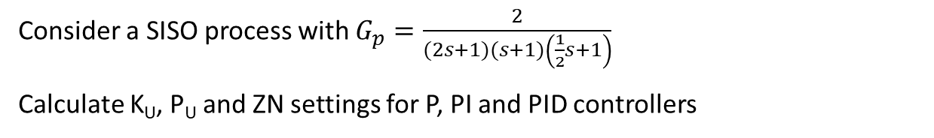
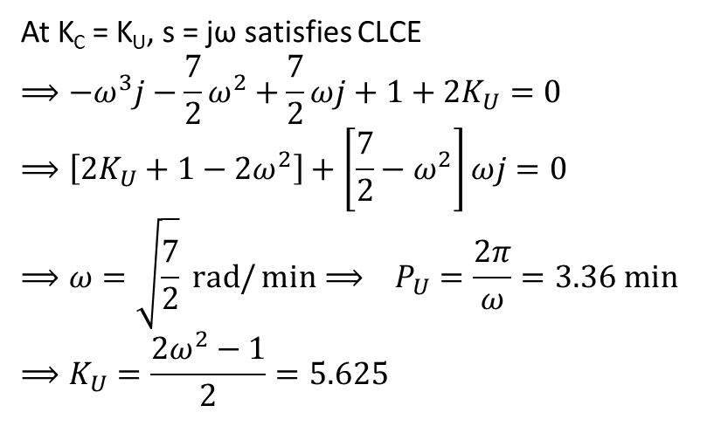
Example 1
Consider a SISO process with $G_{p}=\frac{2}{(2s+1)(s+1)\left(\frac{1}{2}s+1\right)}$
Calculate K_{U}, P_{U} and ZN settings for P, PI and PID controllers
$$CLCE≡1+K_{c}G_{p}=0 ⟹s^{3}+\frac{7}{2}s^{2}+\frac{7}{2}s+1+2K_{c}=0$$
At K_{C} = K_{U}, s = jω satisfies CLCE
$$⟹−ω^{3}j−\frac{7}{2}ω^{2}+\frac{7}{2}ωj+1+2K_{U}=0$$
$$⟹\left[2K_{U}+1−2ω^{2}\right]+\left[\frac{7}{2}−ω^{2}\right]ωj=0$$
$$⟹ω=\sqrt{\frac{7}{2}} rad/\min{⟹ P_{U}=\frac{2π}{ω}=3.36 min}$$
$$⟹K_{U}=\frac{2ω^{2}−1}{2}=5.625$$
ZIEGLER-NICHOLS
Controller | K_{C} | τ_{I} (min) | τ_{D} (min)
P only | 2.81 | - | -
PI | 2.56 | 2.80 | -
PID | 3.31 | 1.68 | 0.42

Slide 16
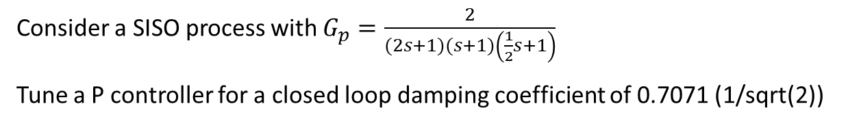
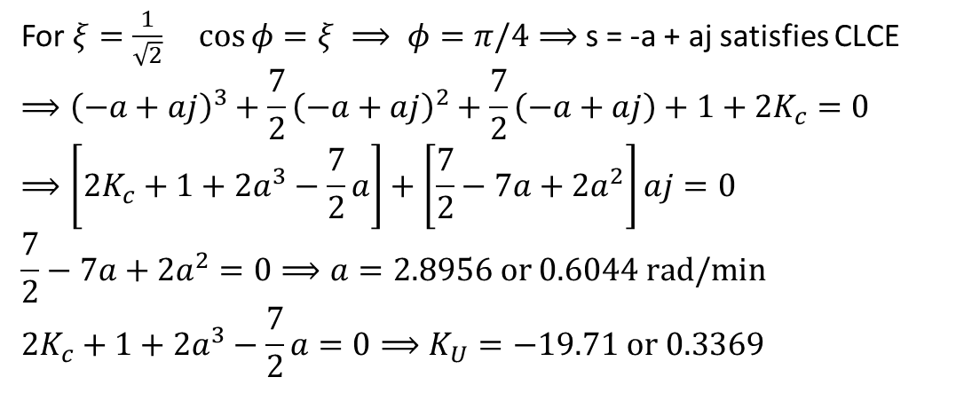
Example 2
Consider a SISO process with $G_{p}=\frac{2}{(2s+1)(s+1)\left(\frac{1}{2}s+1\right)}$
Tune a P controller for a closed loop damping coefficient of 0.7071 (1/sqrt(2))
$$CLCE≡1+K_{c}G_{p}=0 ⟹s^{3}+\frac{7}{2}s^{2}+\frac{7}{2}s+1+2K_{c}=0$$
For $ξ=\frac{1}{\sqrt{2}} \cos{φ=ξ ⟹ φ=π/4⟹}$ s = -a + aj satisfies CLCE
$$⟹{\left(−a+aj\right)}^{3}+\frac{7}{2}{\left(−a+aj\right)}^{2}+\frac{7}{2}\left(−a+aj\right)+1+2K_{c}=0$$
$$⟹\left[2K_{c}+1+2a^{3}−\frac{7}{2}a\right]+\left[\frac{7}{2}−7a+2a^{2}\right]aj=0$$
$$\frac{7}{2}−7a+2a^{2}=0⟹a=2.8956 or 0.6044 rad/min$$
$$2K_{c}+1+2a^{3}−\frac{7}{2}a=0⟹K_{U}=−19.71 or 0.3369$$
K_{c} = 0.3369

Slide 17
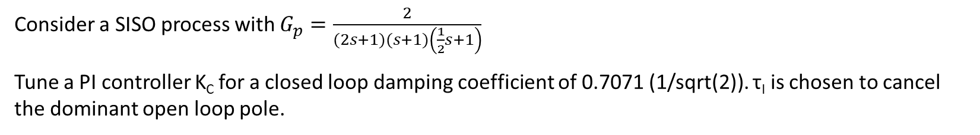
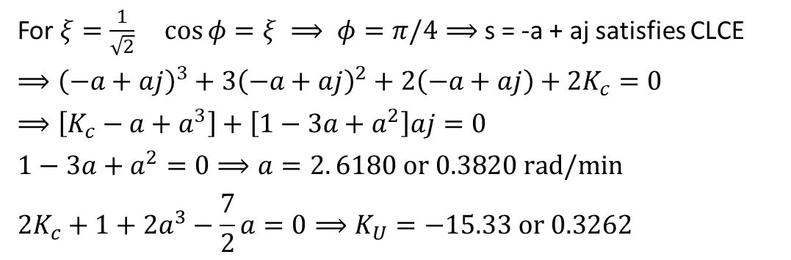
Example 3
Consider a SISO process with $G_{p}=\frac{2}{(2s+1)(s+1)\left(\frac{1}{2}s+1\right)}$
Tune a PI controller K_{C} for a closed loop damping coefficient of 0.7071 (1/sqrt(2)). τ_{I} is chosen to cancel the dominant open loop pole.
$$CLCE≡1+K_{c}\frac{τ_{I}s+1}{τ_{I}s}\frac{2}{\left(2s+1\right)\left(s+1\right)\left(\frac{1}{2}s+1\right)}=0 τ_{I}=2 min ⟹s^{3}+3s^{2}+2s+2K_{c}=0$$
For $ξ=\frac{1}{\sqrt{2}} \cos{φ=ξ ⟹ φ=π/4⟹}$ s = -a + aj satisfies CLCE
$$⟹{\left(−a+aj\right)}^{3}+3{\left(−a+aj\right)}^{2}+2\left(−a+aj\right)+2K_{c}=0$$
$$⟹\left[K_{c}−a+a^{3}\right]+\left[1−3a+a^{2}\right]aj=0$$
$$1−3a+a^{2}=0⟹a=2. 6180 or 0.3820 rad/min$$
$$2K_{c}+1+2a^{3}−\frac{7}{2}a=0⟹K_{U}=−15.33 or 0.3262$$
K_{c} = 0.3262

Slide 18
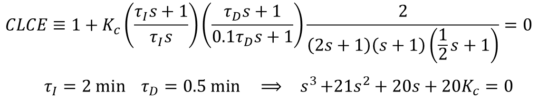
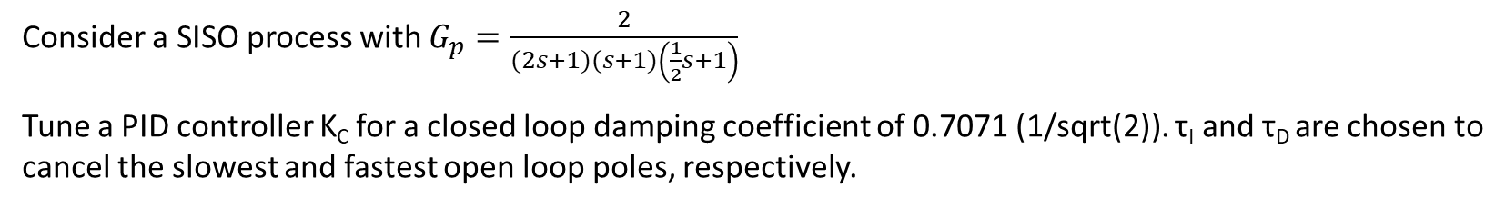
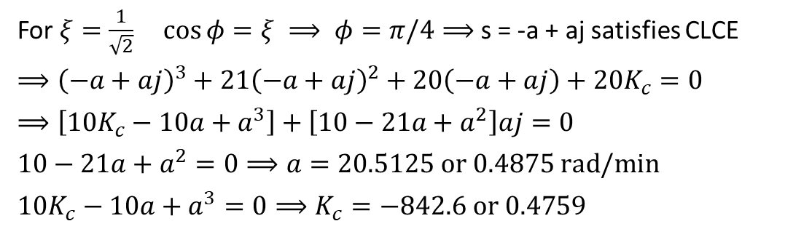
Example 4
Consider a SISO process with $G_{p}=\frac{2}{(2s+1)(s+1)\left(\frac{1}{2}s+1\right)}$
Tune a PID controller K_{C} for a closed loop damping coefficient of 0.7071 (1/sqrt(2)). τ_{I} and τ_{D} are chosen to cancel the slowest and fastest open loop poles, respectively.
$$CLCE≡1+K_{c}\left(\frac{τ_{I}s+1}{τ_{I}s}\right)\left(\frac{τ_{D}s+1}{{0.1τ}_{D}s+1}\right)\frac{2}{\left(2s+1\right)\left(s+1\right)\left(\frac{1}{2}s+1\right)}=0$$
$$τ_{I}=2 min{ τ}_{D}=0.5 min ⟹{ s}^{3}+21s^{2}+20s+20K_{c}=0$$
For $ξ=\frac{1}{\sqrt{2}} \cos{φ=ξ ⟹ φ=π/4⟹}$ s = -a + aj satisfies CLCE
$$⟹{\left(−a+aj\right)}^{3}+21{\left(−a+aj\right)}^{2}+20\left(−a+aj\right)+2{0K}_{c}=0$$
$$⟹\left[{10K}_{c}−10a+a^{3}\right]+\left[10−21a+a^{2}\right]aj=0$$
$$10−21a+a^{2}=0⟹a=20.5125 or 0.4875 rad/min$$
$${10K}_{c}−10a+a^{3}=0⟹K_{c}=−842.6 or 0.4759$$
K_{c} = 0.4759

Slide 19
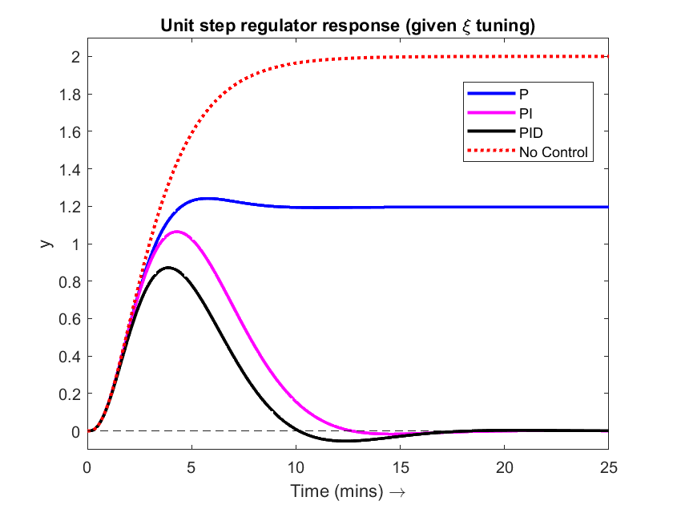
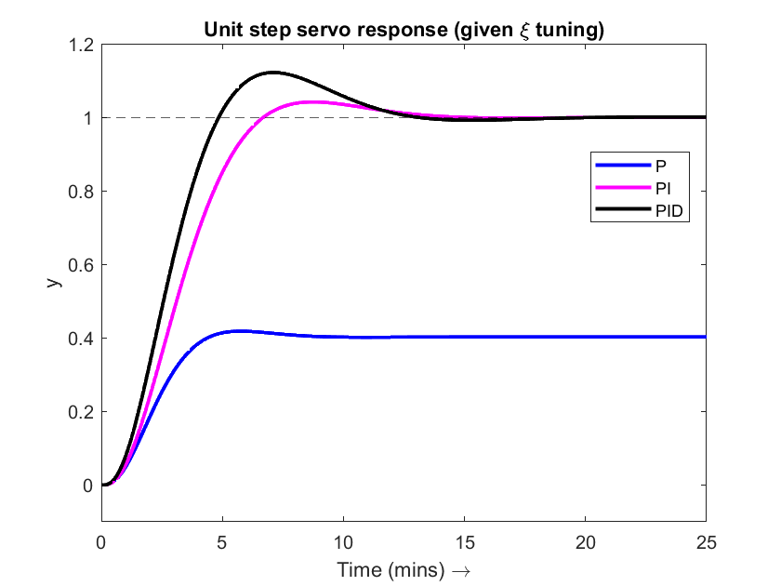
Dynamic Responses

Slide 20
Summary
Dynamic System Analysis vs Design for Dynamic Performance Spec
Routh Array
A simple tool for determining system stability
Controller tuning limit(s) for system stability
Ultimate gain and Ultimate period
Correspond to P controller gain at verge of instability
Used in empirical tuning rules for PID tuning
Controller design
K_{C} adjusted so that dominant closed loop pole pair has desired ξ
Governed by closed loop characteristic equation

