Slide 1
Laplace Domain Analysis Root Locus Construction Rules
Module 4.6.1
Lectures on
CHEMICAL PROCESS CONTROL
Theory and Practice

Slide 2
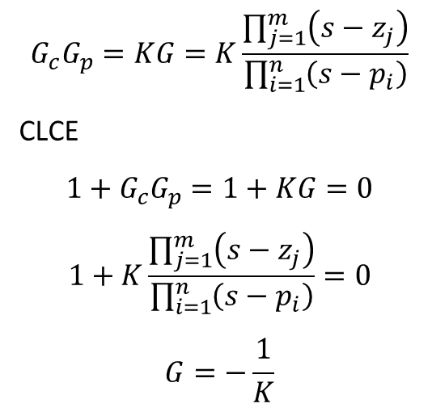
Root Locus
d
Locus of closed loop characteristic equation roots as controller gain magnitude |K_{C}| is varied from 0 to ∞
G_{d}
y^{SP}
Σ
e
G_{c}
u
G_{p}
y
Σ
$$G_{c}G_{p}=KG=K\frac{\prod_{j=1}^{m}{\left(s−z_{j}\right)}}{\prod_{i=1}^{n}{\left(s−p_{i}\right)}}$$
CLCE
$$1+G_{c}G_{p}=1+KG=0$$
$$1+K\frac{\prod_{j=1}^{m}{\left(s−z_{j}\right)}}{\prod_{i=1}^{n}{\left(s−p_{i}\right)}}=0$$
$$G=−\frac{1}{K}$$
-1

Slide 3
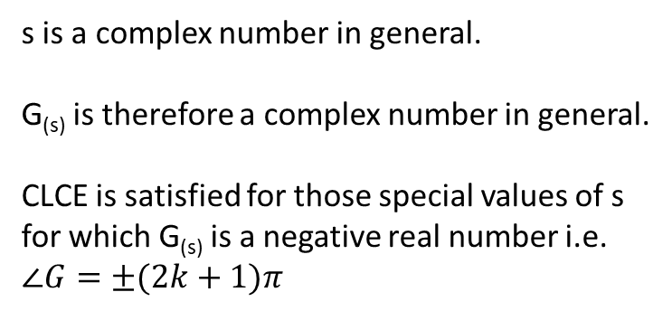
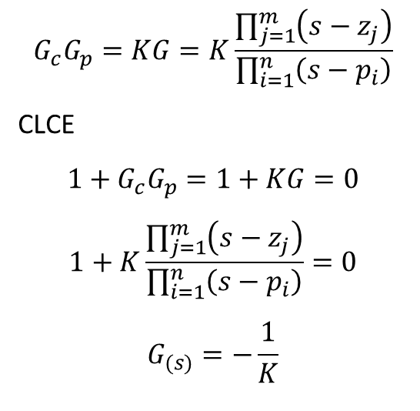
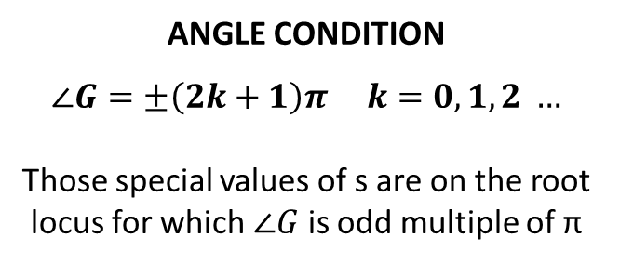
Root Locus: Angle Condition
d
$$G_{c}G_{p}=KG=K\frac{\prod_{j=1}^{m}{\left(s−z_{j}\right)}}{\prod_{i=1}^{n}{\left(s−p_{i}\right)}}$$
CLCE
$$1+G_{c}G_{p}=1+KG=0$$
$$1+K\frac{\prod_{j=1}^{m}{\left(s−z_{j}\right)}}{\prod_{i=1}^{n}{\left(s−p_{i}\right)}}=0$$
$$G_{(s)}=−\frac{1}{K}$$
G_{d}
y^{SP}
Σ
e
G_{c}
u
G_{p}
Σ
y
-1
s is a complex number in general.
G_{(s)} is therefore a complex number in general.
CLCE is satisfied for those special values of s for which G_{(s)} is a negative real number i.e. $∠G=±(2k+1)π$
ANGLE CONDITION
$$∠G=±\left(2k+1\right)π k=0, 1, 2 …$$
Those special values of s are on the root locus for which $∠G$ is odd multiple of π

Slide 4
s-plane and G-plane Mapping

Slide 5
Locus Construction Rules
RULE 1 Locus has n branches
RULE 2 Loci begin at n open loop poles
RULE 3 Loci end at m open loop zeroes and n-m asymptotes
RULE 4 Root locus is symmetric about real axis

Slide 6
Locus Construction Rules
RULE 5 Locus on real axis
Locus exists on real axis is # of poles and zeroes to right is odd
Locus does not exist on real axis if # of poles and zeroes to right is even

Slide 7
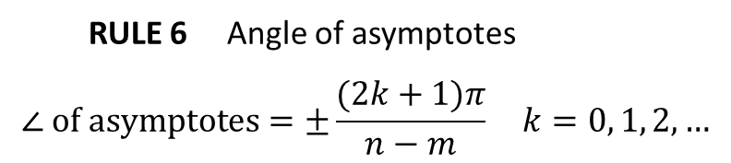
Locus Construction Rules
RULE 6 Angle of asymptotes
$$∠ of asymptotes=±\frac{(2k+1)π}{n−m} k=0, 1, 2, …$$

Slide 8
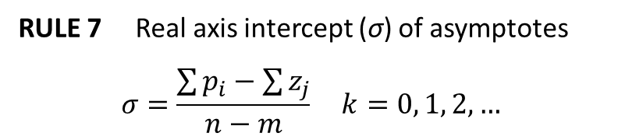
Locus Construction Rules
RULE 7 Real axis intercept (σ) of asymptotes
$$σ=\frac{\sum{p_{i}−\sum{z_{j}}}}{n−m} k=0, 1, 2, …$$

Slide 9
Locus Construction Rules
RULE 8 Locus break-out and break-in points on real axis
At break-out (break-in) point (i.e. CLCE has repeated real roots), |G_{(s)}| is maximum (minimum)

Slide 10
Locus Construction Rules
RULE 9 Angle of departure from complex pole
Angle of departure is 180° - angle subtended by other poles + angle subtended by other zeroes
RULE 10 Angle of arrival at complex zero
Angle of arrival is 180° + angle subtended by other poles - angle subtended by other zeroes

Slide 11
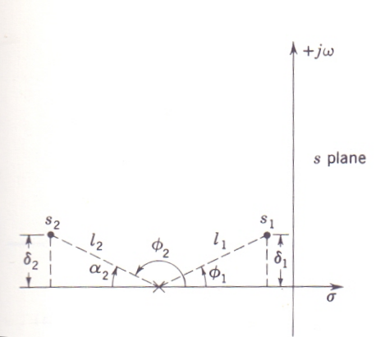
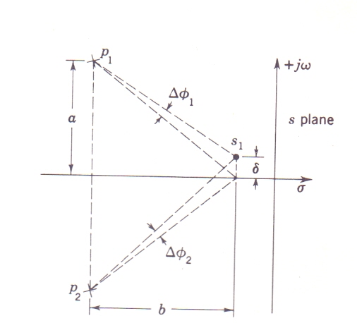
Locus Construction Rules
RULE 11 Angle condition in vicinity of break-out (in) point

Slide 12
Locus Construction Rules
RULE 12 Conservation of roots
If n – m ≥ 2, then sum of CLCE roots = sum of open loop poles

Slide 13
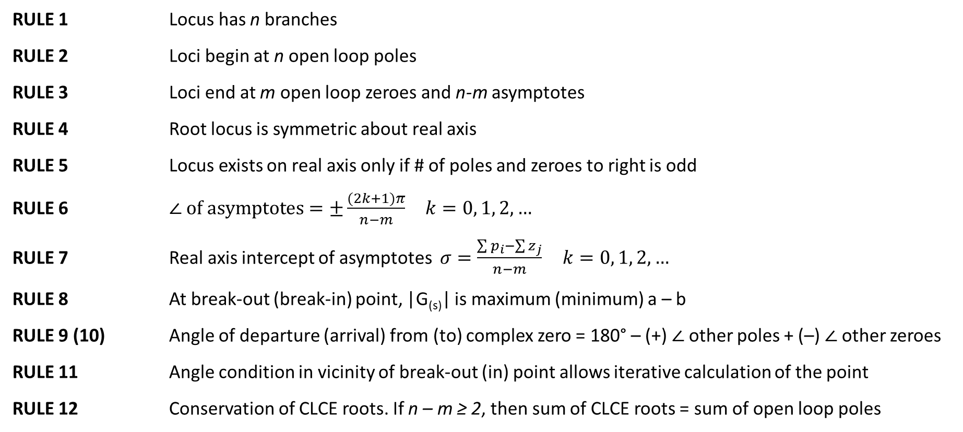
Construction Rules’ Summary
RULE 1 Locus has n branches
RULE 2 Loci begin at n open loop poles
RULE 3 Loci end at m open loop zeroes and n-m asymptotes
RULE 4 Root locus is symmetric about real axis
RULE 5 Locus exists on real axis only if # of poles and zeroes to right is odd
RULE 6 $∠ of asymptotes=±\frac{(2k+1)π}{n−m} k=0, 1, 2, …$
RULE 7 Real axis intercept of asymptotes $σ=\frac{\sum{p_{i}−\sum{z_{j}}}}{n−m} k=0, 1, 2, …$
RULE 8 At break-out (break-in) point, |G_{(s)}| is maximum (minimum) a – b
RULE 9 (10) Angle of departure (arrival) from (to) complex zero = 180° – (+) $∠$other poles + (–) $∠$other zeroes
RULE 11 Angle condition in vicinity of break-out (in) point allows iterative calculation of the point
RULE 12 Conservation of CLCE roots. If n – m ≥ 2, then sum of CLCE roots = sum of open loop poles

