Slide 1
Laplace Domain Analysis Root Locus Controller Design
Module 4.6.2
Lectures on
CHEMICAL PROCESS CONTROL
Theory and Practice

Slide 2
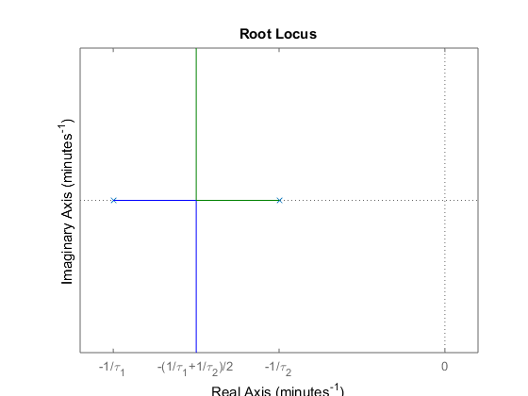
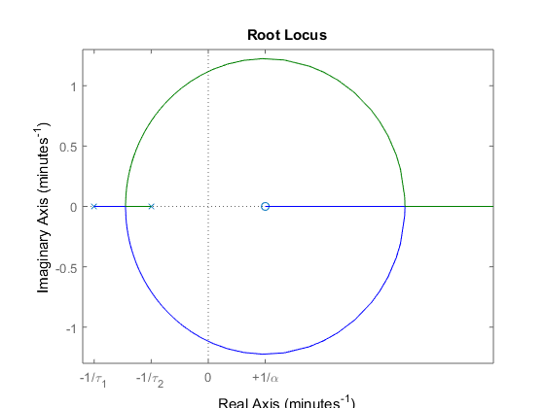
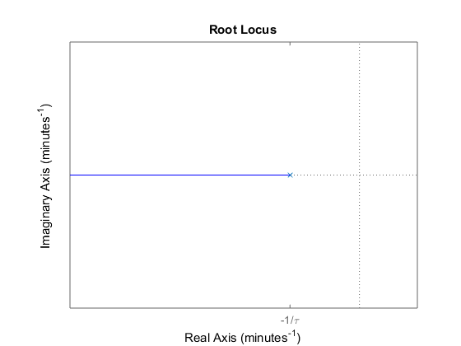
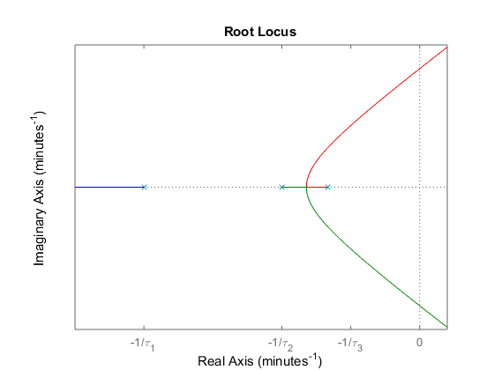
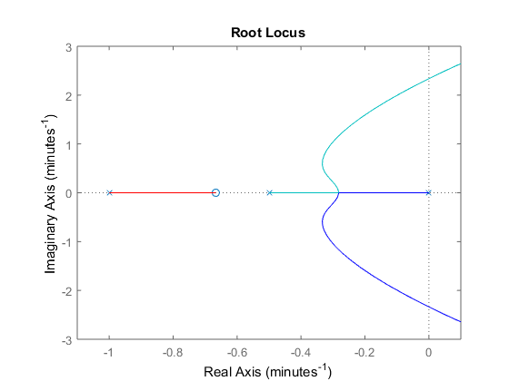



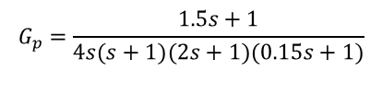
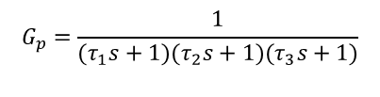
Example Root Loci
d
G_{d}
$$G_{p}=\frac{1}{(τ_{1}s+1)(τ_{2}s+1)}$$
$$G_{p}=\frac{−αs+1}{(τ_{1}s+1)(τ_{2}s+1)}$$
y^{SP}
Σ
e
K_{c}
u
G_{p}
Σ
y
-1
$$G_{p}=\frac{1}{(τ_{1}s+1)(τ_{2}s+1)(τ_{3}s+1)}$$
$$G_{p}=\frac{1.5s+1}{4s(s+1)(2s+1)(0.15s+1)}$$
$$G_{p}=\frac{1}{τs+1}$$

Slide 3
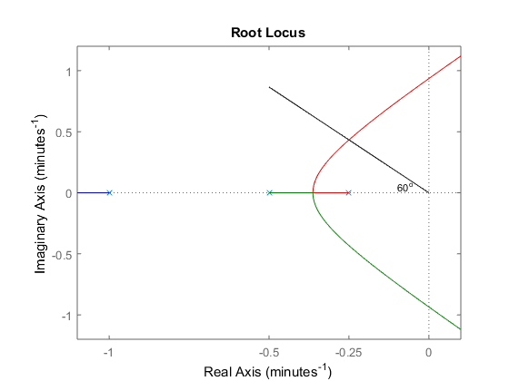
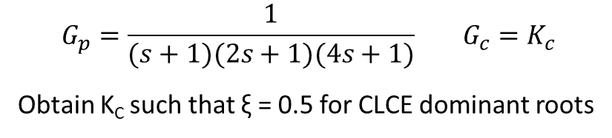
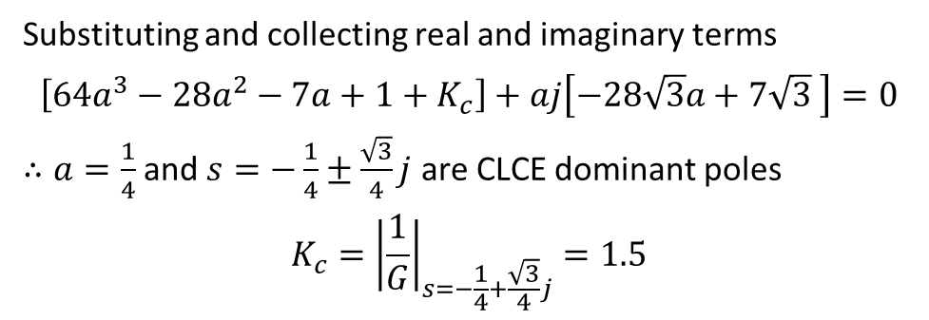
P Controller Design Using Root Locus
d
$$G_{p}=\frac{1}{(s+1)(2s+1)(4s+1)} G_{c}=K_{c}$$
Obtain K_{C} such that ξ = 0.5 for CLCE dominant roots
G_{d}
y^{SP}
Σ
e
G_{c}
u
G_{p}
Σ
y
For ξ = 0.5, $s=−a+\sqrt{3}aj$ satisfies CLCE ≡ $8s^{3}+14s^{2}+7s+1+K_{c}=0$
-1
Substituting and collecting real and imaginary terms
$$\left[64a^{3}−28a^{2}−7a+1+K_{c}\right]+aj\left[−28\sqrt{3}a+7\sqrt{3} \right]=0$$
$∴a=\frac{1}{4}$ and $s=−\frac{1}{4}±\frac{\sqrt{3}}{4}j$ are CLCE dominant poles
$$K_{c}={\left|\frac{1}{G}\right|}_{s=−\frac{1}{4}+\frac{\sqrt{3}}{4}j}=1.5$$

Slide 4
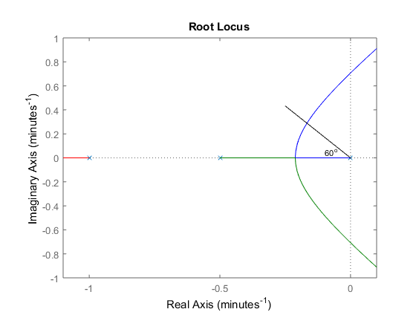
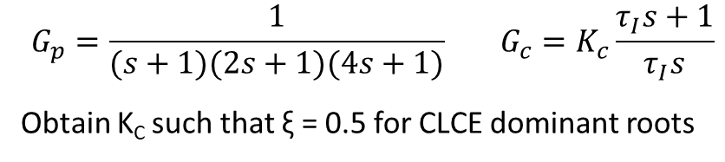
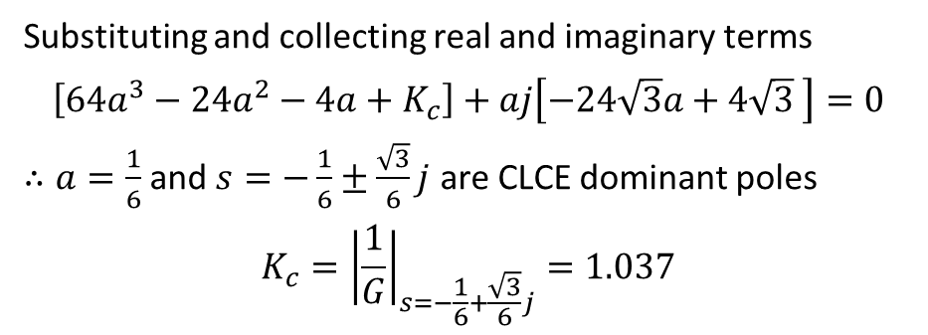
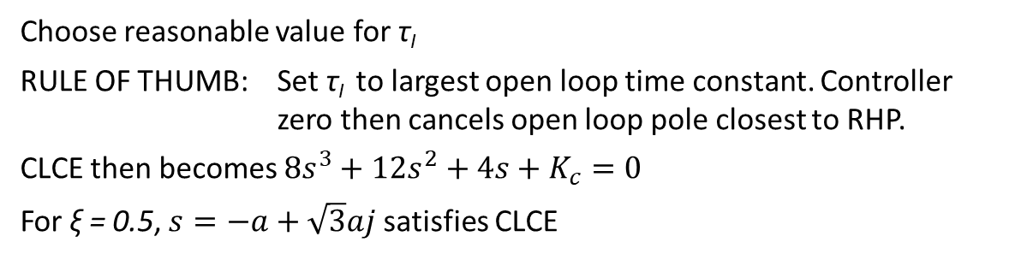
PI Controller Design Using Root Locus
d
$$G_{p}=\frac{1}{(s+1)(2s+1)(4s+1)} G_{c}=K_{c}\frac{τ_{I}s+1}{τ_{I}s}$$
Obtain K_{C} such that ξ = 0.5 for CLCE dominant roots
G_{d}
y^{SP}
Σ
e
G_{c}
u
G_{p}
Σ
y
Choose reasonable value for τ_{I}
RULE OF THUMB: Set τ_{I} to largest open loop time constant. Controller zero then cancels open loop pole closest to RHP.
CLCE then becomes $8s^{3}+12s^{2}+4s+K_{c}=0$
For ξ = 0.5, $s=−a+\sqrt{3}aj$ satisfies CLCE
-1
Substituting and collecting real and imaginary terms
$$\left[64a^{3}−24a^{2}−4a+K_{c}\right]+aj\left[−24\sqrt{3}a+4\sqrt{3} \right]=0$$
$∴a=\frac{1}{6}$ and $s=−\frac{1}{6}±\frac{\sqrt{3}}{6}j$ are CLCE dominant poles
$$K_{c}={\left|\frac{1}{G}\right|}_{s=−\frac{1}{6}+\frac{\sqrt{3}}{6}j}=1.037$$

Slide 5
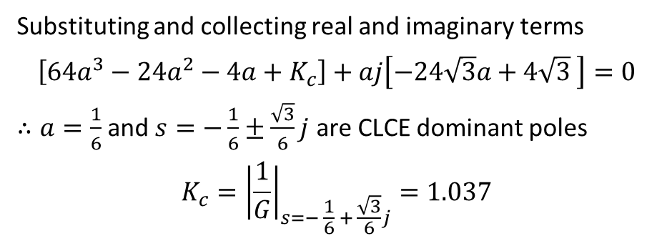
PI Controller Design Using Root Locus
d
$$G_{p}=\frac{1}{(s+1)(2s+1)(4s+1)} G_{c}=K_{c}\frac{τ_{I}s+1}{τ_{I}s}$$
Obtain K_{C} such that ξ = 0.5 for CLCE dominant roots
G_{d}
y^{SP}
Σ
e
G_{c}
u
G_{p}
Σ
y
Choose reasonable value for τ_{I}
RULE OF THUMB: Set τ_{I} to largest open loop time constant. Controller zero then cancels open loop pole closest to RHP.
CLCE then becomes $8s^{3}+12s^{2}+4s+K_{c}=0$
For ξ = 0.5, $s=−a+\sqrt{3}aj$ satisfies CLCE
-1
Substituting and collecting real and imaginary terms
$$\left[64a^{3}−24a^{2}−4a+K_{c}\right]+aj\left[−24\sqrt{3}a+4\sqrt{3} \right]=0$$
$∴a=\frac{1}{6}$ and $s=−\frac{1}{6}±\frac{\sqrt{3}}{6}j$ are CLCE dominant poles
$$K_{c}={\left|\frac{1}{G}\right|}_{s=− \frac{1}{6} + \frac{\sqrt{3}}{6}j}=1.037$$

Slide 6
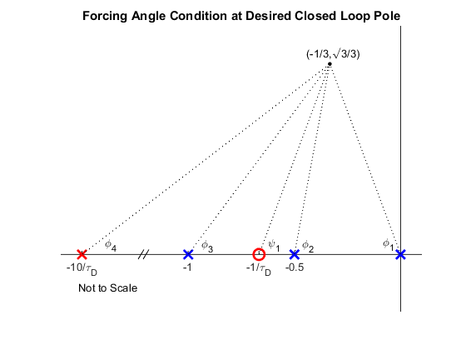
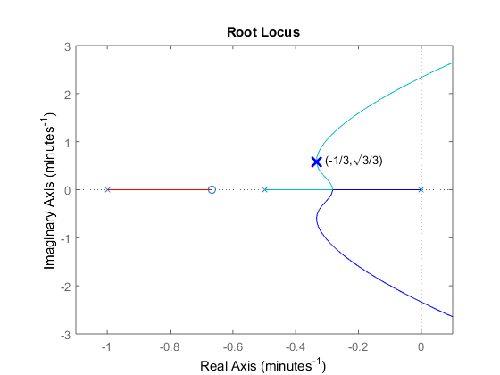
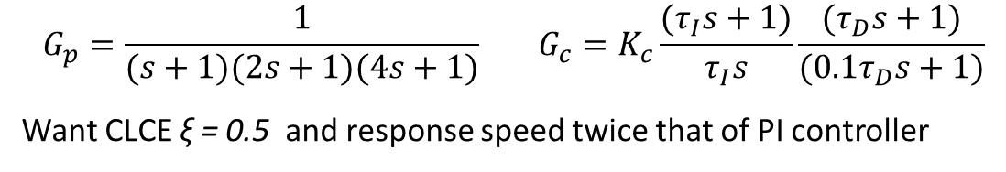
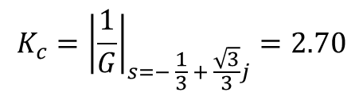
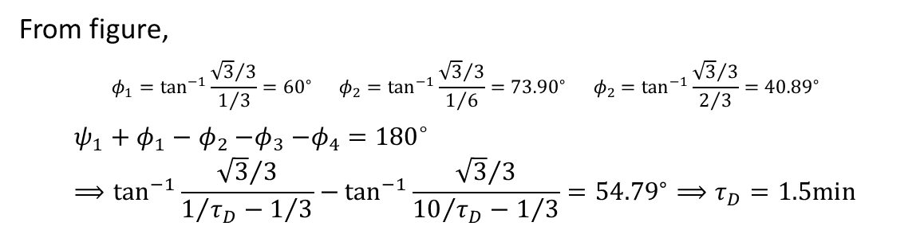
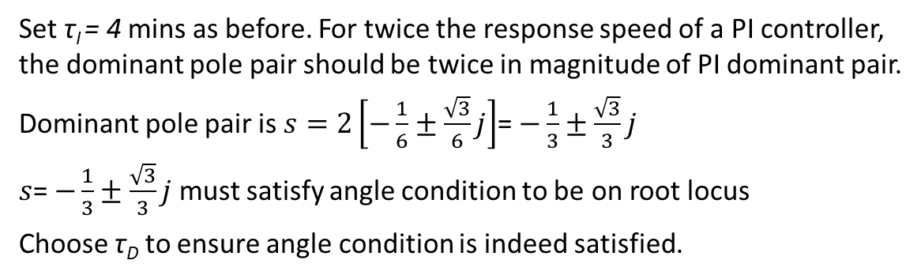
PID Controller Design Using Root Locus
$$G_{p}=\frac{1}{(s+1)(2s+1)(4s+1)} G_{c}=K_{c}\frac{(τ_{I}s+1)}{τ_{I}s}\frac{{(τ}_{D}s+1)}{(0.1τ_{D}s+1)}$$
Want CLCE ξ = 0.5 and response speed twice that of PI controller
Set τ_{I} = 4 mins as before. For twice the response speed of a PI controller, the dominant pole pair should be twice in magnitude of PI dominant pair.
Dominant pole pair is $s=2\left[−\frac{1}{6}±\frac{\sqrt{3}}{6}j\right]$= $−\frac{1}{3}±\frac{\sqrt{3}}{3}j$
$s$= $−\frac{1}{3}±\frac{\sqrt{3}}{3}j$ must satisfy angle condition to be on root locus
Choose τ_{D} to ensure angle condition is indeed satisfied.
From figure,
$$φ_{1}=\tan^{−1}{\frac{{\sqrt{3}}/3}{1/3}}={60}^{∘} φ_{2}=\tan^{−1}{\frac{{\sqrt{3}}/3}{1/6}}={73.90}^{∘} φ_{2}=\tan^{−1}{\frac{{\sqrt{3}}/3}{2/3}}={40.89}^{∘}$$
$$ψ_{1}+φ_{1}−φ_{2}{−φ}_{3}−φ_{4}={180}^{∘}⟹\tan^{−1}{\frac{{\sqrt{3}}/3}{1/{τ_{D}−1/3}}−}\tan^{−1}{\frac{{\sqrt{3}}/3}{{10}/{τ_{D}−1/3}}={54.79}^{∘}}⟹τ_{D}=1.5min$$
$$K_{c}={\left|\frac{1}{G}\right|}_{s=− \frac{1}{3} + \frac{\sqrt{3}}{3}j}=2.70$$

Slide 7
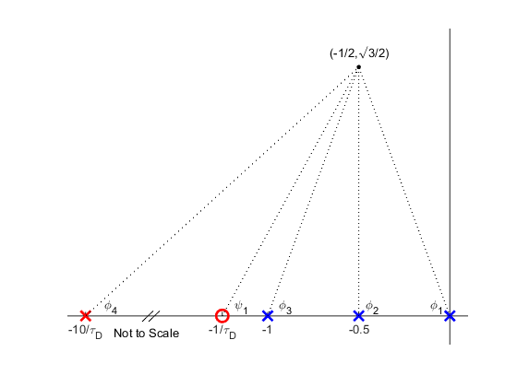
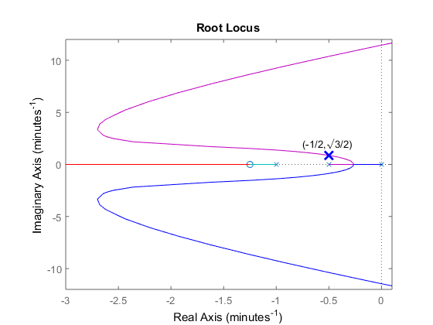

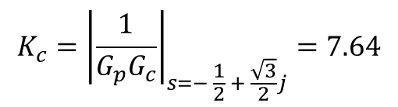
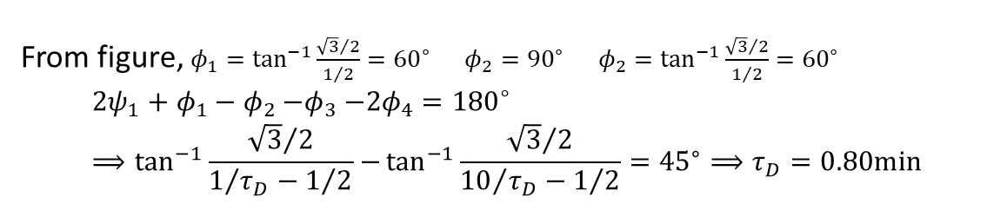
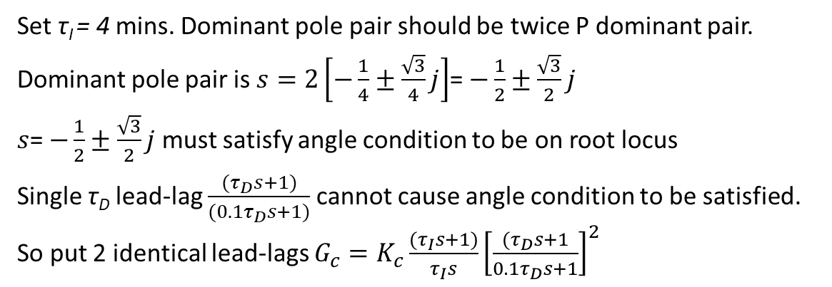
PIDD Controller Design Using Root Locus
$$G_{p}=\frac{1}{(s+1)(2s+1)(4s+1)}$$
Want CLCE ξ = 0.5 and response speed twice that of P controller
Set τ_{I} = 4 mins. Dominant pole pair should be twice P dominant pair.
Dominant pole pair is $s=2\left[−\frac{1}{4}±\frac{\sqrt{3}}{4}j\right]$= $−\frac{1}{2}±\frac{\sqrt{3}}{2}j$
$s$= $−\frac{1}{2}±\frac{\sqrt{3}}{2}j$ must satisfy angle condition to be on root locus
Single τ_{D} lead-lag $\frac{{(τ}_{D}s+1)}{(0.1τ_{D}s+1)}$ cannot cause angle condition to be satisfied. So put 2 identical lead-lags $G_{c}=K_{c}\frac{(τ_{I}s+1)}{τ_{I}s}{\left[\frac{{(τ}_{D}s+1}{0.1τ_{D}s+1}\right]}^{2}$
From figure, $φ_{1}=\tan^{−1}{\frac{{\sqrt{3}}/2}{1/2}}={60}^{∘} φ_{2}={90}^{∘} φ_{2}=\tan^{−1}{\frac{{\sqrt{3}}/2}{1/2}}={60}^{∘}$
$${2ψ}_{1}+φ_{1}−φ_{2}{−φ}_{3}−{2φ}_{4}={180}^{∘}⟹\tan^{−1}{\frac{{\sqrt{3}}/2}{1/{τ_{D}−1/2}}−}\tan^{−1}{\frac{{\sqrt{3}}/2}{{10}/{τ_{D}−1/2}}={45}^{∘}}⟹τ_{D}=0.80min$$
$$K_{c}={\left|\frac{1}{G_{p}G_{c}}\right|}_{s=− \frac{1}{2} + \frac{\sqrt{3}}{2}j}=7.64$$

Slide 8
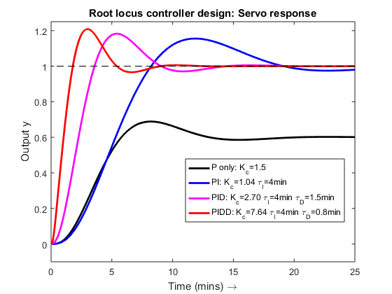
Closed Loop Servo Response

Slide 9
Root Locus Design Procedure Summary
Obtain desired closed loop pole location (region)
Degree of oscillatoriness (damping coefficient ξ)
Speed of response
For zero offset, set τ_{I} to cancel slowest (closest to RHP) open loop pole
Choose τ_{D} lead-lag to force locus to pass through desired closed loop pole
Angle condition gives necessary τ_{D}
Magnitude condition gives necessary K_{C}
Use only if simple PI control does not give fast enough closed loop response
Derivative lead-lag is used to pull root locus sufficiently to the left for faster response
May require double derivative for very fast closed loop response
Amplifies noise
Root locus construction rules allow easy visualization of reshaped root locus

Slide 10
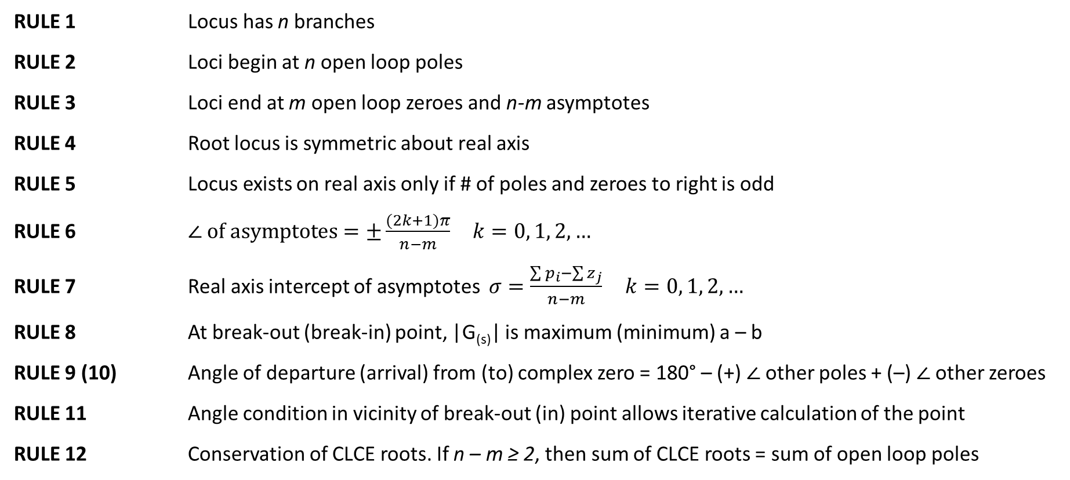
Construction Rules’ Summary
RULE 1 Locus has n branches
RULE 2 Loci begin at n open loop poles
RULE 3 Loci end at m open loop zeroes and n-m asymptotes
RULE 4 Root locus is symmetric about real axis
RULE 5 Locus exists on real axis only if # of poles and zeroes to right is odd
RULE 6 $∠ of asymptotes=±\frac{(2k+1)π}{n−m} k=0, 1, 2, …$
RULE 7 Real axis intercept of asymptotes $σ=\frac{\sum{p_{i}−\sum{z_{j}}}}{n−m} k=0, 1, 2, …$
RULE 8 At break-out (break-in) point, |G_{(s)}| is maximum (minimum) a – b
RULE 9 (10) Angle of departure (arrival) from (to) complex zero = 180° – (+) $∠$other poles + (–) $∠$other zeroes
RULE 11 Angle condition in vicinity of break-out (in) point allows iterative calculation of the point
RULE 12 Conservation of CLCE roots. If n – m ≥ 2, then sum of CLCE roots = sum of open loop poles

