Slide 1
Laplace Domain Analysis Internal Model Control
Module 4.7.2
Lectures on
CHEMICAL PROCESS CONTROL
Theory and Practice

Slide 2


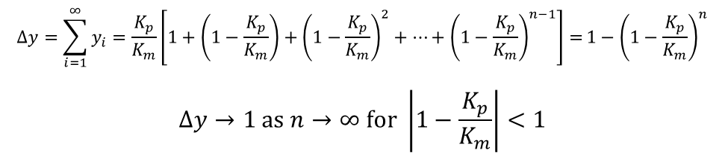
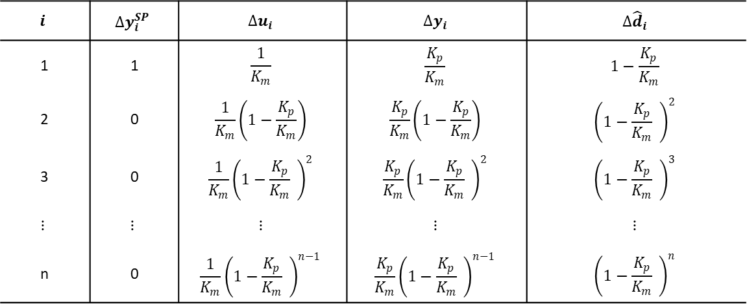
The Basic Idea
Use model of process to make changes to control input
Combine with feedback for further corrections
Motivating Example
$$i$$ | $$∆y_{i}^{SP}$$ | $$∆u_{i}$$ | $$∆y_{i}$$ | $$∆{\hat{d}}_{i}$$
1 | 1 | $$\frac{1}{K_{m}}$$ | $$\frac{K_{p}}{K_{m}}$$ | $$1−\frac{K_{p}}{K_{m}}$$
2 | 0 | $$\frac{1}{K_{m}}\left(1−\frac{K_{p}}{K_{m}}\right)$$ | $$\frac{K_{p}}{K_{m}}\left(1−\frac{K_{p}}{K_{m}}\right)$$ | $${\left(1−\frac{K_{p}}{K_{m}} \right)}^{2}$$
3 | 0 | $${\frac{1}{K_{m}}\left(1−\frac{K_{p}}{K_{m}} \right)}^{2}$$ | $${\frac{K_{p}}{K_{m}}\left(1−\frac{K_{p}}{K_{m}} \right)}^{2}$$ | $${\left(1−\frac{K_{p}}{K_{m}} \right)}^{3}$$
$$⋮$$ | $$⋮$$ | $$⋮$$ | $$⋮$$ | $$⋮$$
n | 0 | $${\frac{1}{K_{m}}\left(1−\frac{K_{p}}{K_{m}} \right)}^{n−1}$$ | $${\frac{K_{p}}{K_{m}}\left(1−\frac{K_{p}}{K_{m}} \right)}^{n−1}$$ | $${\left(1−\frac{K_{p}}{K_{m}} \right)}^{n}$$
?
d
y^{SP}
Σ
(K_{p})⁻¹
u
K_{p}
y
Σ
K_{p}
-1
Σ
-1
$$\hat{d}$$
d
y^{SP}
Σ
(K_{m})⁻¹
u
K_{p}
y
Σ
$$∆y=\sum_{i=1}^{∞}{y_{i}=\frac{K_{p}}{K_{m}}\left[1+\left(1−\frac{K_{p}}{K_{m}}\right)+{\left(1−\frac{K_{p}}{K_{m}}\right)}^{2}+⋯+{\left(1−\frac{K_{p}}{K_{m}}\right)}^{n−1}\right]=}1−{\left(1−\frac{K_{p}}{K_{m}}\right)}^{n}$$
$$∆y→1 as n→∞ for \left|1−\frac{K_{p}}{K_{m}}\right|<1$$
K_{m}
-1
Σ
-1
$$\hat{d}$$

Slide 3
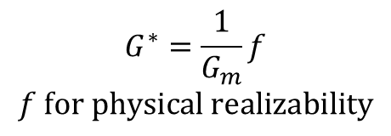

The IMC Structure
d
d
y^{SP}
Σ
G*
G_{p}
Σ
y
y^{SP}
Σ
Σ
G*
G_{p}
Σ
y
G_{m}
-1
Σ
G_{m}
-1
-1
Equivalent Simple Feedback Loop?
d
$$G^{∗}=\frac{1}{G_{m}}f$$
$$f for physical realizability$$
$$G_{c}=\frac{G^{∗}}{1−G^{∗}G_{m}}$$
y^{SP}
Σ
G_{c}
G_{p}
Σ
y
Use for deriving feedback control laws
-1

Slide 4
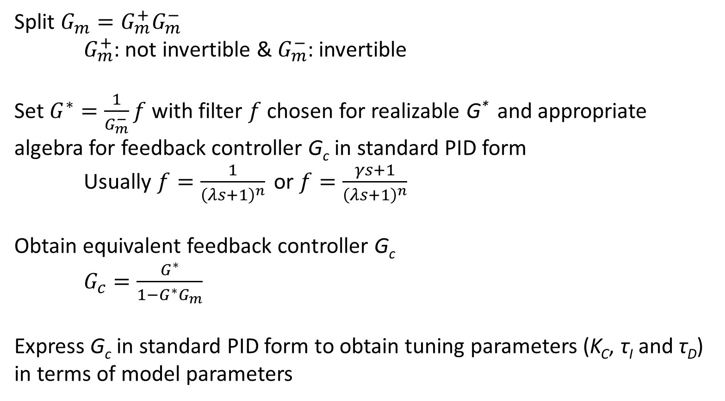
IMC Design Procedure
Split $G_{m}=G_{m}^{+}G_{m}^{−}$
$G_{m}^{+}$: not invertible & $G_{m}^{−}$: invertible
Set $G^{∗}=\frac{1}{G_{m}^{−}}f$ with filter $f$ chosen for realizable G* and appropriate algebra for feedback controller G_{c} in standard PID form
Usually $f=\frac{1}{{\left(λs+1\right)}^{n}}$ or $f=\frac{γs+1}{{\left(λs+1\right)}^{n}}$
Obtain equivalent feedback controller G_{c}
$G_{c}=\frac{G^{∗}}{1−G^{∗}G_{m}}$
Express G_{c} in standard PID form to obtain tuning parameters (K_{C}, τ_{I} and τ_{D}) in terms of model parameters

Slide 5
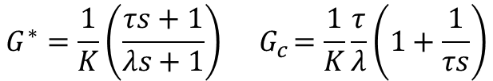

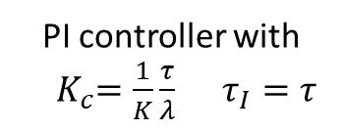
IMC Design: First order lag
PI controller with
${ K}_{c}=\frac{1}{K}\frac{τ}{λ} τ_{I}=τ$
$$G_{p}=\frac{K}{τs+1}$$
$$G^{∗}=\frac{1}{K}\left(\frac{τs+1}{λs+1}\right){ G}_{c}=\frac{1}{K}\frac{τ}{λ}\left(1+\frac{1}{τs}\right)$$

Slide 6

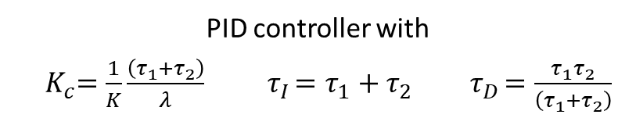
IMC Design: Second order lag
$$G_{p}=\frac{K}{\left(τ_{1}s+1\right)\left(τ_{1}s+1\right)}$$
$$G^{∗}=\frac{1}{K}\frac{\left(τ_{1}s+1\right)\left(τ_{1}s+1\right)}{λs+1}{ G}_{c}=\frac{1}{K}\frac{\left(τ_{1}+τ_{2}\right)}{λ}\left[1+\frac{1}{\left(τ_{1}+τ_{2}\right)s}+\frac{τ_{1}τ_{2}}{\left(τ_{1}+τ_{2}\right)}s\right]$$
PID controller with
${ K}_{c}=\frac{1}{K}\frac{\left(τ_{1}+τ_{2}\right)}{λ} { τ}_{I}=τ_{1}+τ_{2}{ τ}_{D}=\frac{τ_{1}τ_{2}}{\left(τ_{1}+τ_{2}\right)}$

Slide 7
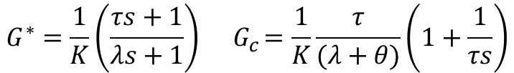

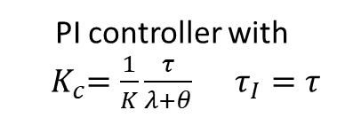
IMC Design: FOPDT_{I}
PI controller with
${ K}_{c}=\frac{1}{K}\frac{τ}{λ+θ} τ_{I}=τ$
$$G_{p}=\frac{Ke^{−θs}}{τs+1}≈\frac{K\left(1−θs\right)}{τs+1}$$
$$G^{∗}=\frac{1}{K}\left(\frac{τs+1}{λs+1}\right){ G}_{c}=\frac{1}{K}\frac{τ}{(λ+θ)}\left(1+\frac{1}{τs}\right)$$

Slide 8
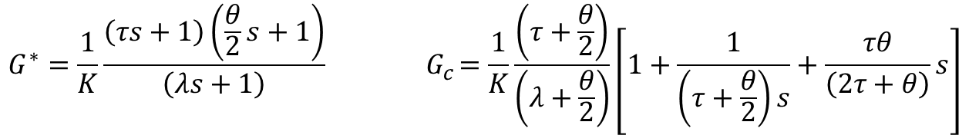
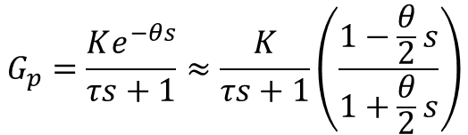
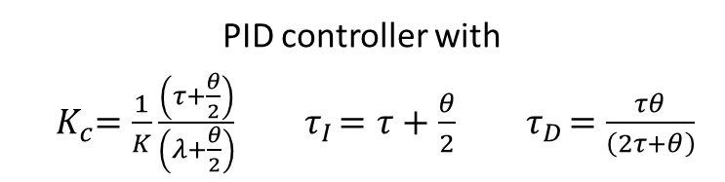
IMC Design: FOPDT_{II}
$$G_{p}=\frac{Ke^{−θs}}{τs+1}≈\frac{K}{τs+1}\left(\frac{1−\frac{θ}{2}s}{1+\frac{θ}{2}s}\right)$$
$$G^{∗}=\frac{1}{K}\frac{\left(τs+1\right)\left(\frac{θ}{2}s+1\right)}{\left(λs+1\right)}{ G}_{c}=\frac{1}{K}\frac{\left(τ+\frac{θ}{2}\right)}{\left(λ+\frac{θ}{2}\right)}\left[1+\frac{1}{\left(τ+\frac{θ}{2}\right)s}+\frac{τθ}{\left(2τ+θ\right)}s\right]$$
PID controller with
${ K}_{c}=\frac{1}{K}\frac{\left(τ+\frac{θ}{2}\right)}{\left(λ+\frac{θ}{2}\right)}{ τ}_{I}=τ+\frac{θ}{2}{ τ}_{D}=\frac{τθ}{\left(2τ+θ\right)}$

Slide 9


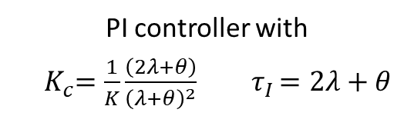
IMC Design: Integrator + Dead Time
PI controller with
${ K}_{c}=\frac{1}{K}\frac{\left(2λ+θ\right)}{{\left(λ+θ\right)}^{2}}{ τ}_{I}=2λ+θ$
$$G_{p}=\frac{Ke^{−θs}}{s}≈\frac{K\left(1−θs\right)}{s}$$
$$G^{∗}=\frac{1}{K}\frac{s\left(γs+1\right)}{{\left(λs+1\right)}^{2}}{ G}_{c}=\frac{1}{K}\frac{\left(2λ+θ\right)}{{\left(λ+θ\right)}^{2}}\left[1+\frac{1}{\left(2λ+θ\right)s}\right]$$

Slide 10
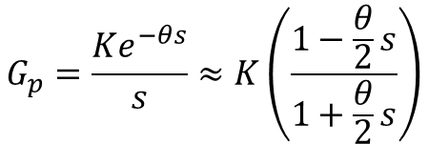
Exercise
$$G_{p}=\frac{Ke^{−θs}}{s}≈K\left(\frac{1−\frac{θ}{2}s}{1+\frac{θ}{2}s}\right)$$
Derive PID controller tuning using IMC design

Slide 11
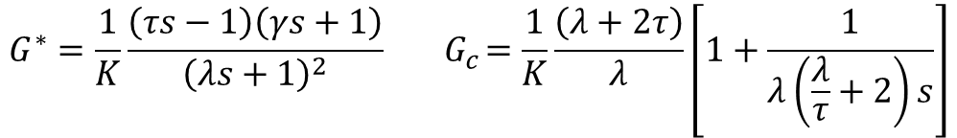

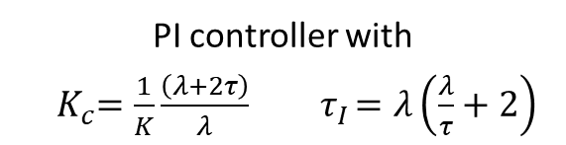
IMC Design: Unstable Process
PI controller with
${ K}_{c}=\frac{1}{K}\frac{\left(λ+2τ\right)}{λ}{ τ}_{I}=λ\left(\frac{λ}{τ}+2\right)$
$$G_{p}=\frac{K}{τs−1}$$
$$G^{∗}=\frac{1}{K}\frac{\left(τs−1\right)\left(γs+1\right)}{{\left(λs+1\right)}^{2}}{ G}_{c}=\frac{1}{K}\frac{\left(λ+2τ\right)}{λ}\left[1+\frac{1}{λ\left(\frac{λ}{τ}+2\right)s}\right]$$

Slide 12
Summary
IMC design suggests
Standard feedback control is equivalent to internal model based control with feedback correction for plant-model mismatch or disturbances
The IMC structure is robust to plant-model mismatch
Provides a systematic method for deriving tuning rules for simple process transfer functions
IMC based tuning results in
Good servo response
Sluggish regulator response for lag-dominant processes

