Slide 1
Advanced Controller Structures Cascade Control
Module 4.8.2
Lectures on
CHEMICAL PROCESS CONTROL
Theory and Practice

Slide 2
Cascade Control
Master (primary) controller sets setpoint of a slave (secondary) controller. Slave output PV is strongly related to the master output PV
CSTR Temperature Control
Column Composition Control
TC
CC
TT
TC
LC
TC
TT
FC

Slide 3
Why and Tuning
Pros
Speeds up primary PV control
Slave loop removes local disturbances
Slave loop removes local non-linearities
Cons
More instrumentation and loops to be tuned
Tuning
Inside-out
Tune innermost first (outer loops on manual)
Then tune next outer loop (inner loops on auto)
Inner loops may be P only (for higher controller gain than PI)
Slave loop dynamic speed >> Master loop dynamic speed

Slide 4
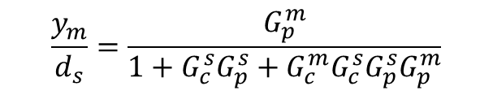
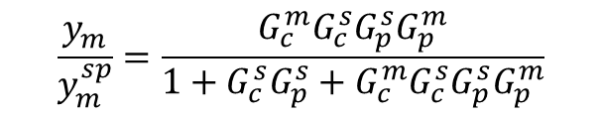
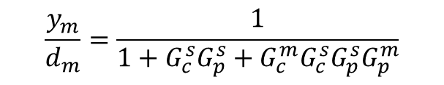
Series Cascade
d_{s}
d_{m}
y_{m}^{SP}
G_{c}^{m}
y_{s}^{SP}
G_{c}^{s}
u
G_{p}^{s}
y_{s}
G_{p}^{m}
Σ
Σ
Σ
Σ
y_{m}
Slave Loop
-1
Master Loop
-1
$$\frac{y_{m}}{y_{m}^{sp}}=\frac{G_{c}^{m}G_{c}^{s}G_{p}^{s}G_{p}^{m}}{1+G_{c}^{s}G_{p}^{s}+G_{c}^{m}G_{c}^{s}G_{p}^{s}G_{p}^{m}}$$
$$\frac{y_{m}}{d_{s}}=\frac{G_{p}^{m}}{1+G_{c}^{s}G_{p}^{s}+G_{c}^{m}G_{c}^{s}G_{p}^{s}G_{p}^{m}}$$
$$\frac{y_{m}}{d_{m}}=\frac{1}{1+G_{c}^{s}G_{p}^{s}+G_{c}^{m}G_{c}^{s}G_{p}^{s}G_{p}^{m}}$$

Slide 5
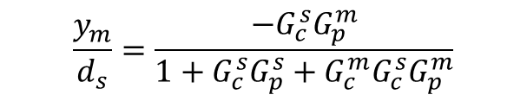
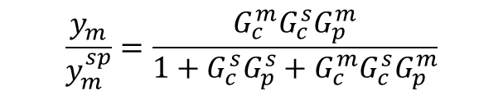
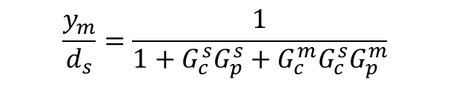
Parallel Cascade
-1
Slave Loop
d_{s}
y_{m}^{SP}
G_{c}^{m}
y_{s}^{SP}
G_{c}^{s}
u
G_{p}^{s}
Σ
Σ
Σ
y_{s}
d_{m}
G_{p}^{m}
Σ
y_{m}
Master Loop
-1
$$\frac{y_{m}}{y_{m}^{sp}}=\frac{G_{c}^{m}G_{c}^{s}G_{p}^{m}}{1+G_{c}^{s}G_{p}^{s}+G_{c}^{m}G_{c}^{s}G_{p}^{m}}$$
$$\frac{y_{m}}{d_{s}}=\frac{{−G}_{c}^{s}G_{p}^{m}}{1+G_{c}^{s}G_{p}^{s}+G_{c}^{m}G_{c}^{s}G_{p}^{m}}$$
$$\frac{y_{m}}{d_{s}}=\frac{1}{1+G_{c}^{s}G_{p}^{s}+G_{c}^{m}G_{c}^{s}G_{p}^{m}}$$

Slide 6
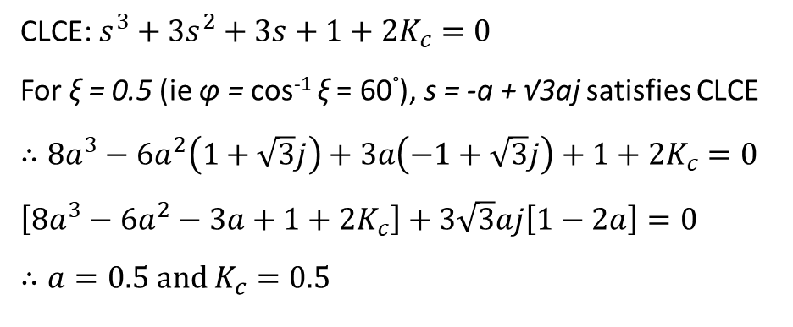
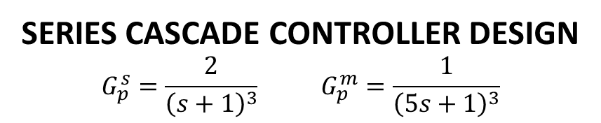
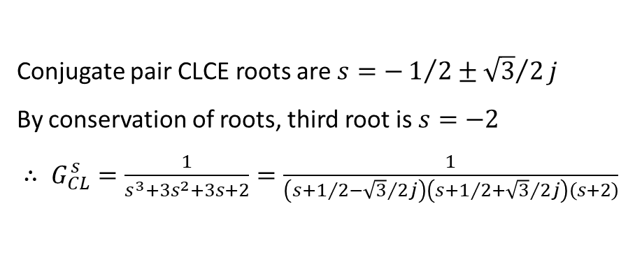
Example
SERIES CASCADE CONTROLLER DESIGN
$$G_{p}^{s}=\frac{2}{{\left(s+1\right)}^{3}} G_{p}^{m}=\frac{1}{{\left(5s+1\right)}^{3}}$$
Slave controller is P only. Master controller is PI.
Slave and master controllers tuned for ξ = 0.5.
Master controller τ_{I} chosen to cancel dominant open loop pole.
Compare performance with a simple PI controller tuned for ξ = 0.5.
SLAVE CONTROLLER DESIGN
CLCE: $s^{3}+3s^{2}+3s+1+2K_{c}=0$
For ξ = 0.5 (ie φ = cos⁻¹ ξ = 60°), s = -a + √3aj satisfies CLCE
$∴8a^{3}−6a^{2}\left(1+\sqrt{3}j\right)+3a\left(−1+\sqrt{3}j\right)+1+2K_{c}=0$
$\left[8a^{3}−6a^{2}−3a+1+2K_{c}\right]+3\sqrt{3}aj\left[1−2a\right]=0$
$$∴a=0.5 and K_{c}=0.5$$
Conjugate pair CLCE roots are $s=−1/2±{\sqrt{3}}/2j$
By conservation of roots, third root is $s=−2$
$∴ G_{CL}^{s}=\frac{1}{s^{3}+3s^{2}+3s+2}=\frac{1}{\left(s+1/2−{\sqrt{3}}/2j\right)\left(s+1/2+{\sqrt{3}}/2j\right)\left(s+2\right)}$

Slide 7
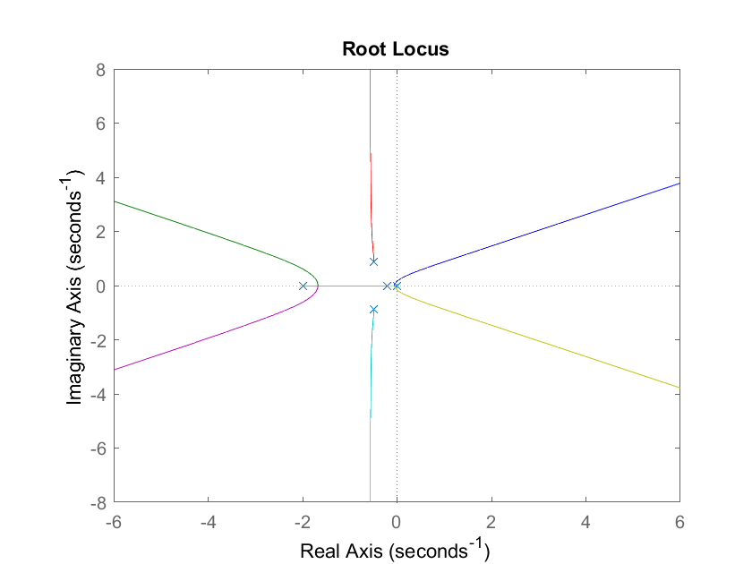
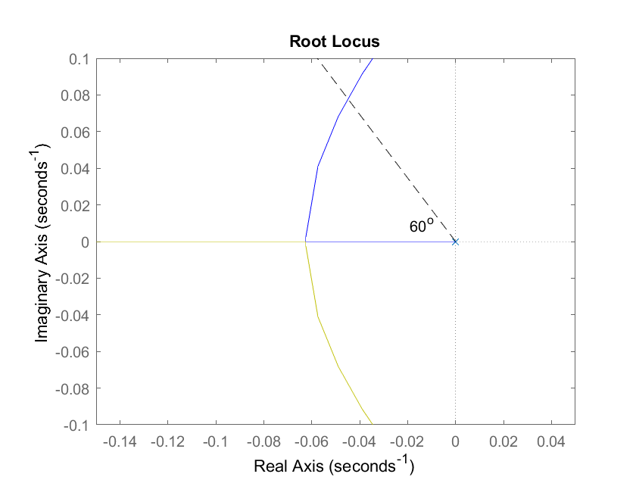
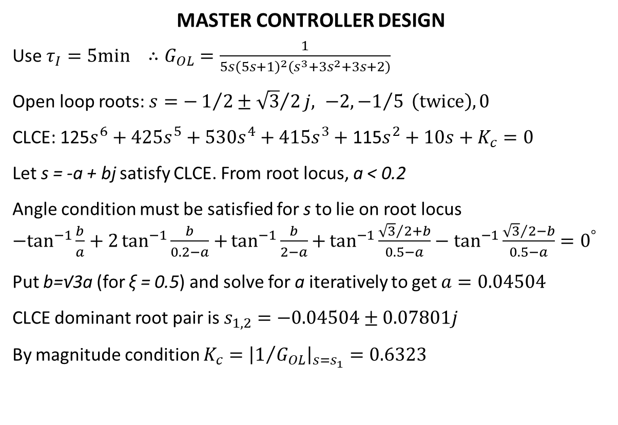
Example_{continued}
MASTER CONTROLLER DESIGN
Use $τ_{I}=5min ∴G_{OL}=\frac{1}{{5s\left(5s+1\right)}^{2}\left(s^{3}+3s^{2}+3s+2\right)}$
Open loop roots: $s=−1/2±{\sqrt{3}}/2j, −2, {−1}/5 \left(twice\right), 0$
CLCE: 125$s^{6}+425s^{5}+530s^{4}+\text{415}s^{3}+\text{1}\text{1}\text{5}s^{2}+10s+K_{c}=0$
Let s = -a + bj satisfy CLCE. From root locus, a < 0.2
Angle condition must be satisfied for s to lie on root locus
${−tan}^{−1}{\frac{b}{a}+2\tan^{−1}{\frac{b}{0.2−a}+}}\tan^{−1}{\frac{b}{2−a}+}\tan^{−1}{\frac{{\sqrt{3}}/{2+b}}{0.5−a}}−\tan^{−1}{\frac{{\sqrt{3}}/2−b}{0.5−a}}=0^{°}$
Put b=√3a (for ξ = 0.5) and solve for a iteratively to get $a=0.04504$
CLCE dominant root pair is $s_{1,2}=−0.04504±0.07801j$
By magnitude condition $K_{c}={\left|1/{G_{OL}}\right|}_{s=s_{1}}=0.6323$
CASCADE CONTROLLER DESIGN
Slave Loop: K_{c} = 0.5 (P only) K_{c} = 0.1875 τ_{I} = 1 min
Master Loop: K_{c} = 0.6323 τ_{I} = 5 min K_{c} = 0.2815 τ_{I} = 5 min

Slide 8
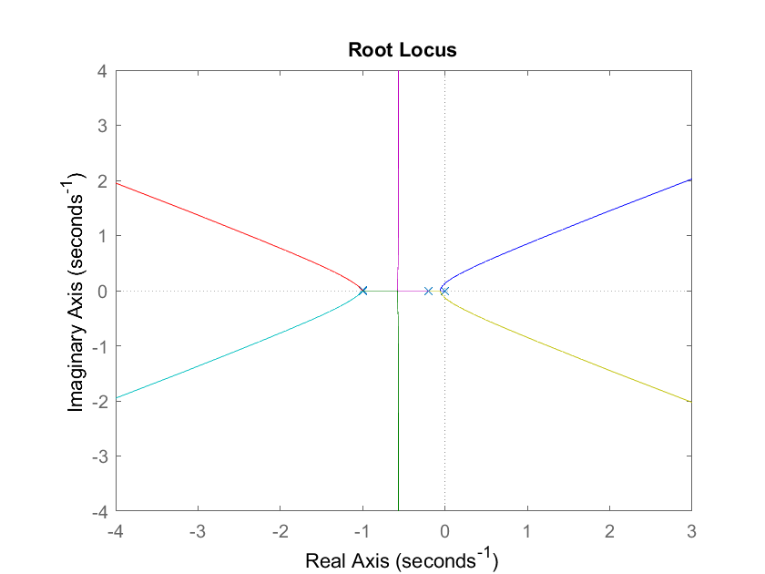
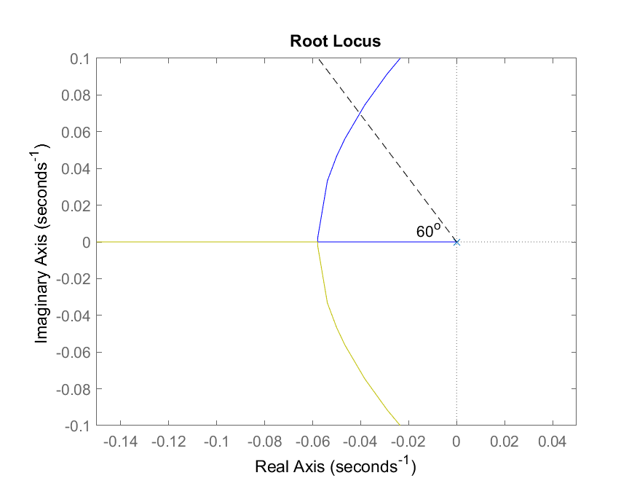
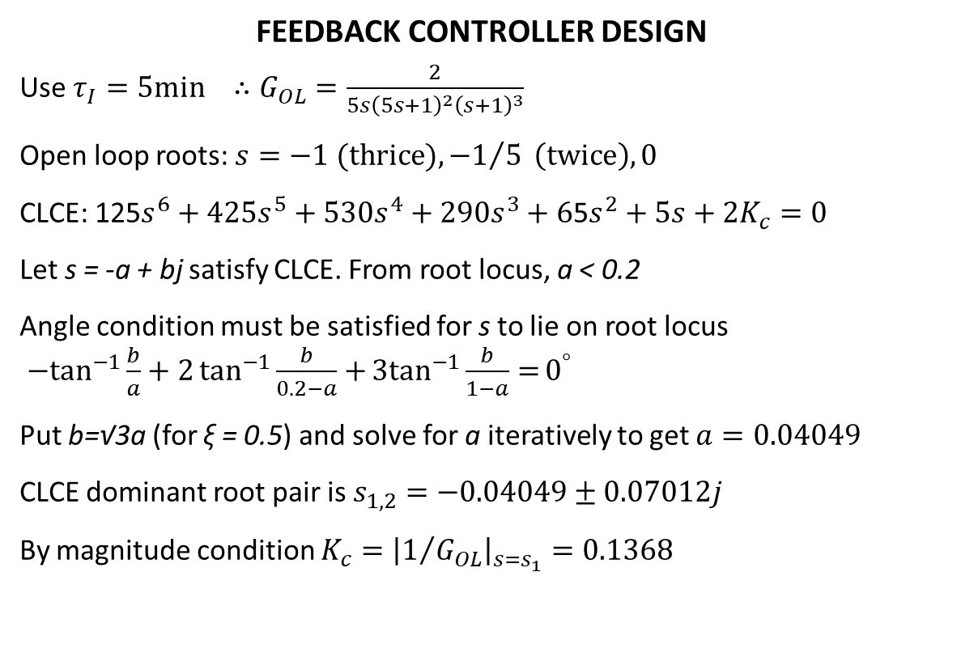
Example_{continued}
FEEDBACK CONTROLLER DESIGN
Use $τ_{I}=5min ∴G_{OL}=\frac{2}{{5s\left(5s+1\right)}^{2}{\left(s+1\right)}^{3}}$
Open loop roots: $s=−1 (thrice), {−1}/5 \left(twice\right), 0$
CLCE: 125$s^{6}+425s^{5}+530s^{4}+\text{290}s^{3}+\text{6}\text{5}s^{2}+5s+{2K}_{c}=0$
Let s = -a + bj satisfy CLCE. From root locus, a < 0.2
Angle condition must be satisfied for s to lie on root locus
${−tan}^{−1}{\frac{b}{a}+2\tan^{−1}{\frac{b}{0.2−a}+}}{3tan}^{−1}{\frac{b}{1−a}=}0^{°}$
Put b=√3a (for ξ = 0.5) and solve for a iteratively to get $a=0.04049$
CLCE dominant root pair is $s_{1,2}=−0.04049±0.07012j$
By magnitude condition $K_{c}={\left|1/{G_{OL}}\right|}_{s=s_{1}}=0.1368$

Slide 9
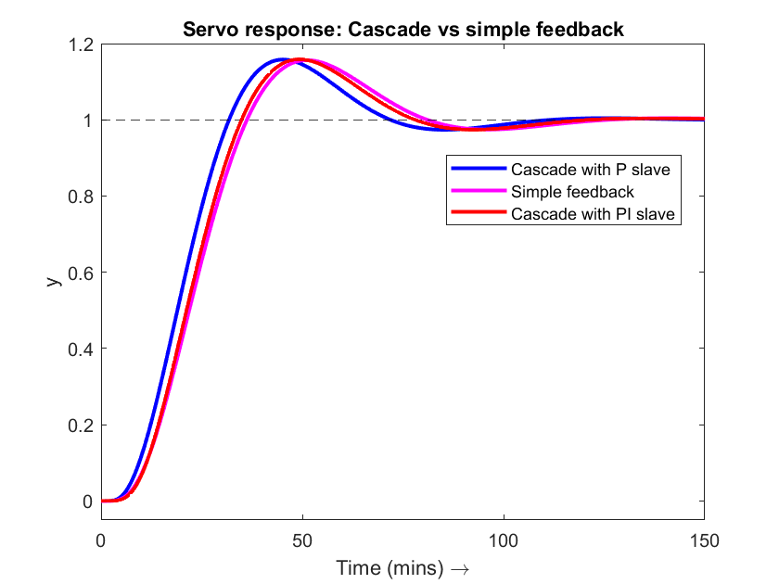
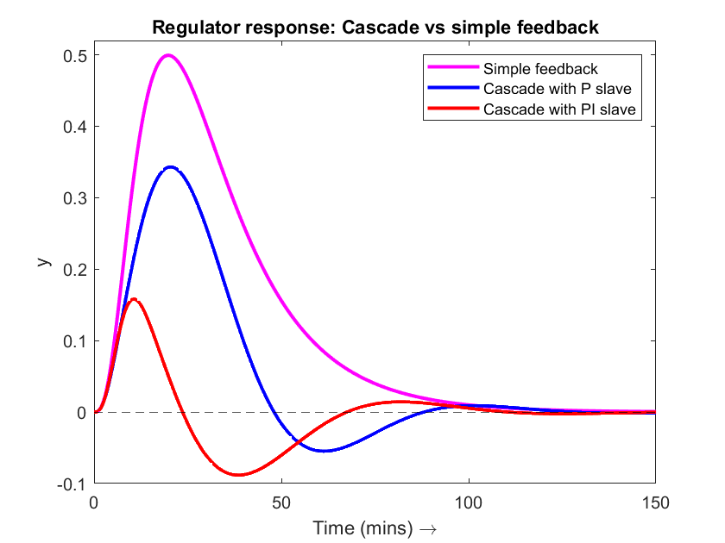
Example: Dynamic Results

Slide 10
Summary
Cascade control
Used when controlling a secondary (fast) PV helps regulate a primary (slow) PV
Set point of slave (fast) loop remotely set by master (slow) loop
Inside-out tuning
Slave loop
Removes local disturbances
Removes local non-linearities
Flow controller mitigates valve non-linear characteristic
Somewhat speeds up the master loop response
Slave loop dynamic speed >> Master loop dynamic speed
Very commonly employed in process industry due to time scale separation

