Slide 1
Advanced Controller Structures Miscellaneous Structures Valve Positioning, Override, Split-Range, Selective
Module 4.8.3
Lectures on
CHEMICAL PROCESS CONTROL
Theory and Practice

Slide 2
Valve Positioning or Optimizing Control
Keeps a valve nearly fully open (or closed) to optimize an economic objective function
Requires clear process insight to develop the ‘optimizing’ control strategy
Common Examples
Floating pressure control in a column
Maximizing throughput in a cooling capacity limited reactor
Minimizing RPM of a utility supply pump

Slide 3
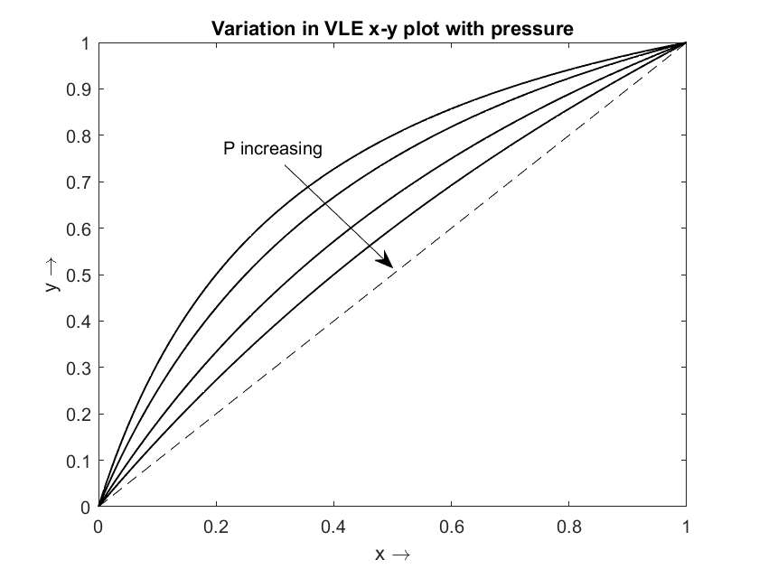
VPC Example 1
Column Condenser Valve Position Control
Used in difficult separations (tall towers) to reduce reboiler duty
Operate column at as low a pressure as possible
Separation is then easier
Reboiler duty would then be lower for same degree of separation
Since condenser sets column pressure, operate column such that condenser valve is nearly fully open

Slide 4
VPC Example 1 _{continued}
Column VPC
PC
VPC
80%
Ensures column operation at near open condenser valve
20% back-off given to ensure pressure control during surges
VPC can be a slow pure I controller

Slide 5
VPC Example 2
Maximizing throughput in a cooling capacity limited exothermic CSTR
VPC
80%
Ensures tight reactor temperature control
CSTR operates at near full cooling capacity
20% backoff for guaranteeing temperature control
VPC may be a slow I controller
FC
TT
TC
Fresh feed reactant
TT
TC
Cooling
Water out
FC
Cooling Water in

Slide 6
VPC Example 3
Minimizing High Wattage Variable Speed Pump Power
F_{demand}
80%
FC
VPC
Unnecessary ΔP across valve if not near fully open. Implies pump RPM too high.
Adjust pump RPM such that valve is nearly fully open. Ensures near minimum power consumption
20% back-off to ensure ability to meet F_{demand} surge

Slide 7
Override Control
Two or more controllers compete for manipulating a control valve
The control configuration (or structure) in not fixed and changes depending on operating scenario
Structural changes become necessary to ensure proper process regulation
Usually driven by safety concerns
Eg cut down reboiler steam as column sump level goes too low
Loss of control dof due to a unit maxing out
Usually requires inventory (material balance) control system reconfiguration
Reset windup protection necessary when competing controllers are PI

Slide 8
Overrides Example 1
Distillation Column Steam Valve Manipulation
TC
20%
OLC
LS
ΔPC
FC
50%
LC
Normally, steam valve under temperature control
If ΔP too high (approaching flooding), ΔPC cuts steam flow (TC lost)
If sump level too low, low level override cuts steam flow (TC lost)

Slide 9
Overrides Example 2
TPM
LS
OLC
U₁^{SP} + Δ
Inventory Control System Reconfiguration
FC
U₁^{SP}
LC
LS
FC
T^{SP}
TC
T^{SP} - Δ
OTC
LS
ΔPC
ΔP^{SP}
Control structure switches between
“In the direction of flow” (nominal)
“In opposite direction of flow” (constrained)
FC
LC

Slide 10
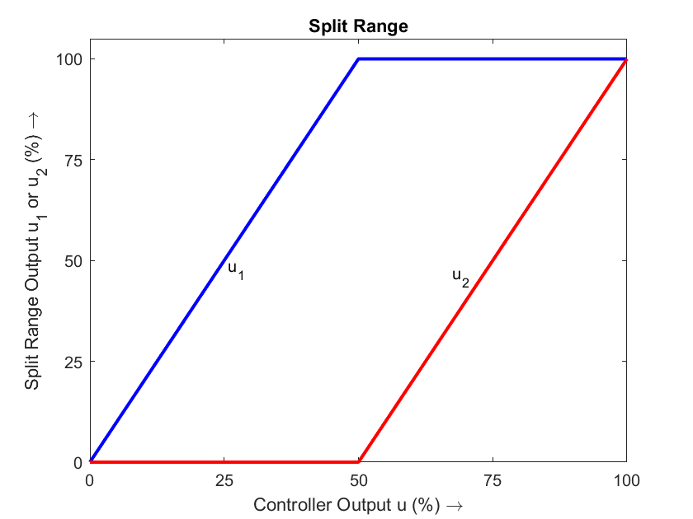
Split Range Control
Controller output range (0-100%) split to move two or more final control elements
SPLIT RANGE
u₂
u
u₁
PC
to flare
to fuel gas system
KNOCK-OUT POT
LC

Slide 11
Selective Control Example
Packed Bed Reactor Hot Spot Temperature Control
Set
PC
Steam
LC
Boiler feed water
TC
HS

Slide 12
Summary
Valve position control
Holds a valve position nearly fully open or closed for economic benefit
Override control
Multiple controllers compete for control valve manipulation
Necessary for wide process operating space
Split range control
Splits controller output to adjust two or more control valves
Selective control
Uses high or low selector blocks
Process understanding and insight is key to proper use of these advanced control strategies

