Slide 1
Model Predictive Control Dynamic Matrix Control
Modeule 6.3
Process Dynamics and Control
Supplementary Material
Indian Institute of Technology Kanpur

Slide 2
The MPC Paradigm
y^{SP}
y reference
MPC PROCEDURE
Obtain current y measurement
Calculate reference trajectory
Calculate u_{optimum}
Implement current move
Repeat at next sampling instant
y future (predicted)
y past
. . .
u past
u future
. . .
. . .
. . .
. . .
. . .
-4 -3 -2 -1 0 1 2 3 4 M P
time
M: Control Horizon
P: Prediction Horizon
GIVEN
A predictive model that predicts y for candidate control move sequences
QUESTION
Of all the candidate future control move sequences, which one causes the predicted y to best follow the reference trajectory
SOLUTION
Usually solved as an optimization problem

Slide 3
Dynamic Matrix Control
Unit Step Process Reaction Curve
g_{N-1}
g_{N}
y
Unit Step Response Coefficients
g = [g₁ g₂ g₃ … g_{N-1} g_{N}]
u
g₂
g₃
. . .
. . .
. . .
. . .
g₁
0 1 2 3 N-1 N
time
Input Change Sequence
u₁
u₂
Any general input change sequence is a superposition of appropriately delayed steps
u
u₀
0 1 2 3
u = u₀ + u₁ + u₂
time
u₀
u₁
Predicted output response is superposition of appropriately delayed step responses
time
0 1 2 3
u₂

Slide 4
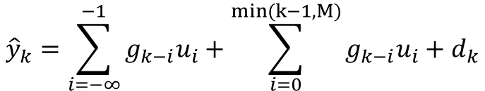
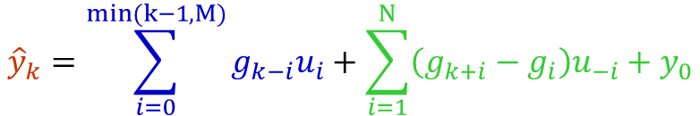
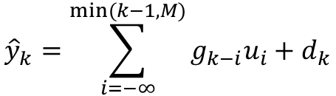
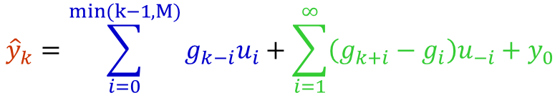
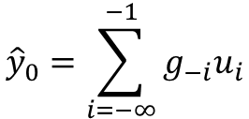

SISO DMC: Predictive Model
y^{SP}
d
y reference
+
y future (predicted)
u
Process
+
y
y past
. . .
u past
u future
$${\hat{y}}_{k}=\sum_{i=−∞}^{min⁡(k−1,M)}{g_{k−i}u_{i}}+d_{k}$$
. . .
. . .
. . .
. . .
. . .
-4 -3 -2 -1 0 1 2 3 4 M P
k
k
$${\hat{y}}_{k}=\sum_{i=−∞}^{−1}{g_{k−i}u_{i}}+\sum_{i=0}^{min(k−1, M)}{g_{k−i}u_{i}}+d_{k}$$
time
$${\hat{y}}_{0}=\sum_{i=−∞}^{−1}{g_{−i}u_{i}}$$
$$d_{k}={\hat{d}}_{k}={\hat{d}}_{0}=y_{0}−{\hat{y}}_{0}$$
$${\hat{y}}_{k}=\sum_{i=0}^{min(k−1, M)}{g_{k−i}u_{i}}+\sum_{i=1}^{∞}{\left(g_{k+i}−g_{i}\right)u_{−i}}+y_{0}$$
$${\hat{y}}_{k}=\sum_{i=0}^{min(k−1, M)}{g_{k−i}u_{i}}+\sum_{i=1}^{N}{\left(g_{k+i}−g_{i}\right)u_{−i}}+y_{0}$$
Effect of control moves
Effect of past moves
Forced response
Free response

Slide 5




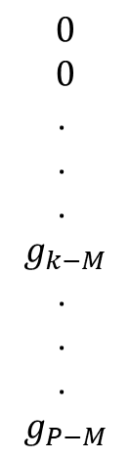

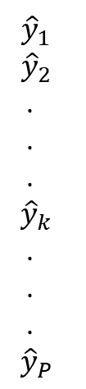
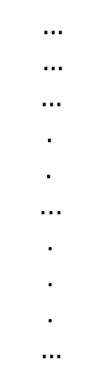


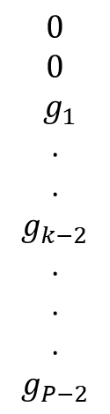
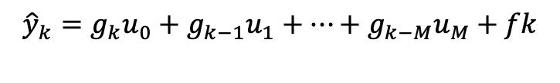
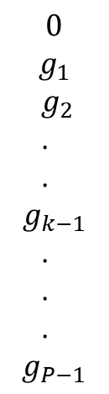

DMC Predictive Model
$${\hat{y}}_{k}=\sum_{i=0}^{min(k−1, M)}{g_{k−i}u_{i}}+\sum_{i=1}^{N}{\left(g_{k+i}−g_{i}\right)u_{−i}}+y_{0}$$
$${\hat{y}}_{1}$$
$${\hat{y}}_{2}$$
.
.
.
$${\hat{y}}_{k}$$
.
.
.
$${\hat{y}}_{P}$$
$$g_{1}$$
$$g_{2}$$
.
.
.
$$g_{k}$$
.
.
.
$$g_{P}$$
$$0$$
$$g_{1}$$
$g_{2}$
.
.
$$g_{k−1}$$
.
.
.
$$g_{P−1}$$
$$0$$
$$0$$
$g_{1}$
.
.
$$g_{k−2}$$
.
.
.
$$g_{P−2}$$
$$…$$
$$…$$
$…$
$.$
$.$
...
.
.
.
$…$
$$0$$
$$0$$
.
.
.
$$g_{k−M}$$
.
.
.
$$g_{P−M}$$
$$f_{1}$$
$$f_{2}$$
.
.
.
$$f_{k}$$
.
.
.
$$f_{P}$$
$$u_{0}$$
$$u_{1}$$
$u_{2}$
.
.
.
$$u_{M}$$
$${\hat{y}}_{1}=g_{1}u_{0}+f_{1}$$
=
+
$${\hat{y}}_{2}=g_{2}u_{0}+g_{1}u_{1}+f_{2}$$
.
.
.
$${\hat{y}}_{k}=g_{k}u_{0}+g_{k−1}u_{1}+…+g_{k−M}u_{M}+fk$$
.
.
.
$$\hat{y}=Gu+f$$
$${\hat{y}}_{P}=g_{P}u_{0}+g_{P−1}u_{1}+…+g_{P−M}u_{M}+f_{P}$$

Slide 6
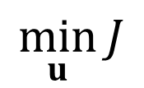
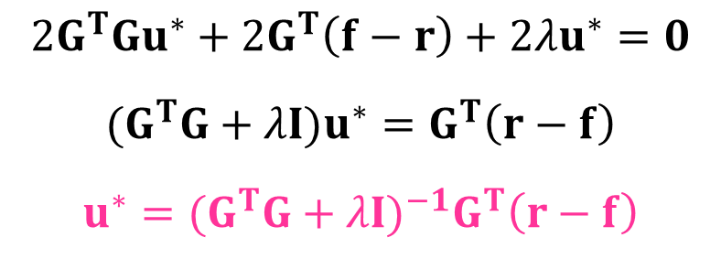
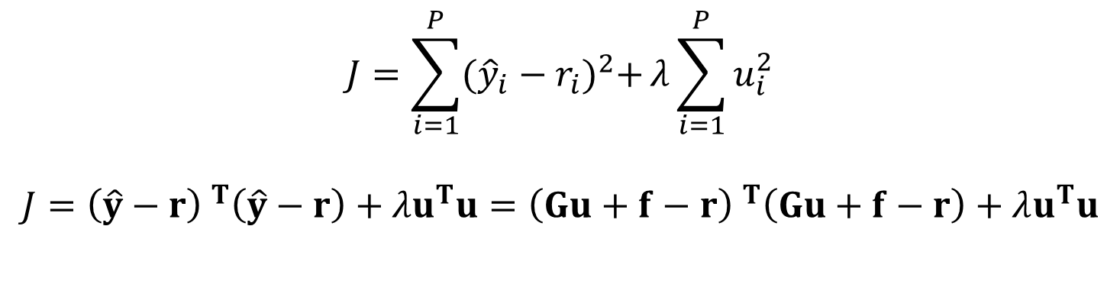
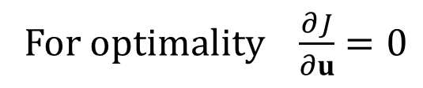

DMC Optimum Control Move Sequence
$$J=\sum_{i=1}^{P}{{({{\hat{y}}_{i}−r}_{i})}^{2}+}λ\sum_{i=1}^{P}{u_{i}^{2}}$$
$$J={\left(\hat{y}−r\right) }^{T}\left(\hat{y}−r\right)+λu^{T}u={\left(Gu+f−r\right) }^{T}\left(Gu+f−r\right)+λu^{T}u$$
$$\min_{u}{J}$$
$$Put \hat{y}=Gu+f$$
$$J=u^{T}G^{T}Gu+u^{T}G^{T}\left(f−r\right)+{(f−r)}^{T}Gu+{\left(f−r\right)}^{T}\left(f−r\right)+λu^{T}u$$
$$2G^{T}Gu^{∗}+2G^{T}\left(f−r\right)+2λu^{∗}=0$$
$${(G}^{T}G+λI)u^{∗}=G^{T}\left(r−f\right)$$
$$u^{∗}={{(G}^{T}G+λI)}^{−1}G^{T}\left(r−f\right)$$
For optimality $\frac{∂J}{∂u}=0$
Implement first element of u* and repeat procedure at next instant

Slide 7
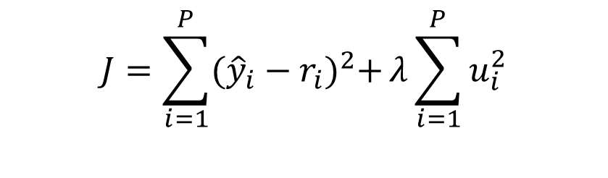
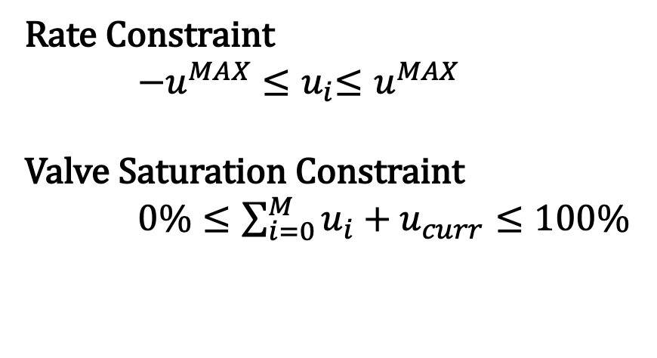

Constrained DMC
$$J=\sum_{i=1}^{P}{{({{\hat{y}}_{i}−r}_{i})}^{2}+}λ\sum_{i=1}^{P}{u_{i}^{2}}$$
$$\min_{u}{J}$$
$$\hat{y}=Gu+f$$
Rate Constraint
${−u^{MAX}≤u}_{i}≤u^{MAX}$
Valve Saturation Constraint
$0\%≤\sum_{i=0}^{M}{u_{i}+u_{curr}≤100\%}$
Easily solved using quadratic programming
Subroutine quadprog in Matlab

Slide 8
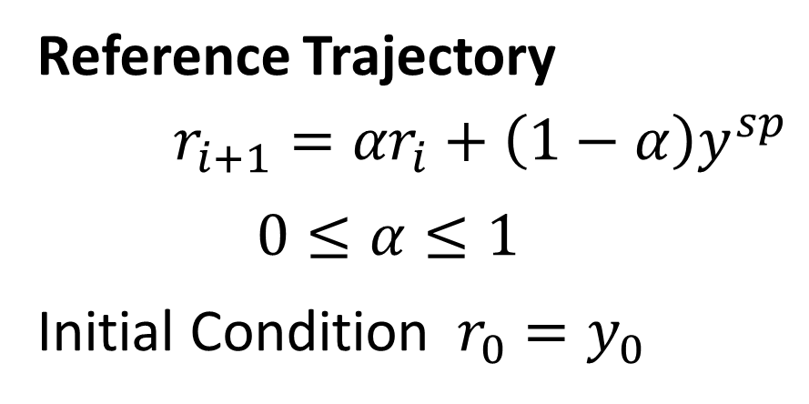
Reference Trajectory and Tuning
y^{SP}
v
v
Reference Trajectory
$r_{i+1}={αr}_{i}+\left(1−α\right)y^{sp}$
$0≤α≤1$
Initial Condition $r_{0}=y_{0}$
v
α↑
y₀
time
CONTROLLER TUNING
M, P, α, λ: Tuning parameters
Usually M, P and α are chosen to reasonable values and λ adjusted for stable and tight closed loop control
No standard tuning procedures for MPC (Hit-and-trial)

Slide 9

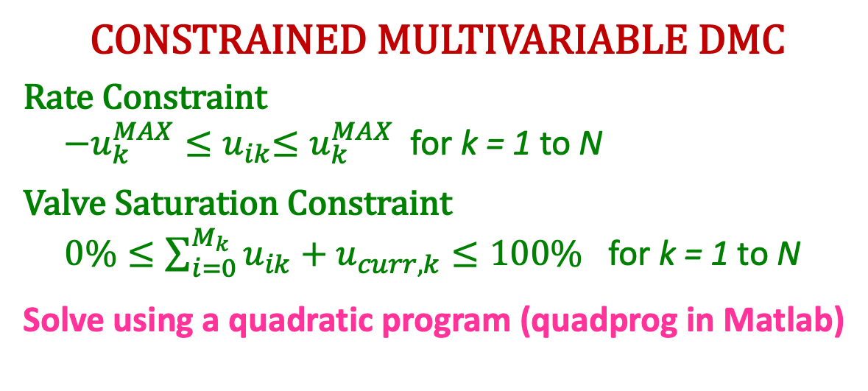

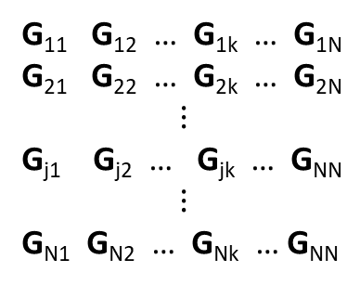



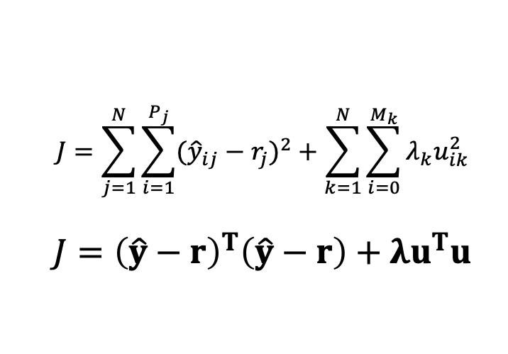




Multivariable DMC
$${\hat{y}}_{1}$$
$${\hat{y}}_{2}$$
$$⋮$$
$${\hat{y}}_{j}$$
$$⋮$$
$${\hat{y}}_{N}$$
G₁₁ G₁₂ … G_{1k} … G_{1N}
G₂₁ G₂₂ … G_{2k} … G_{2N}
$$⋮$$
G_{j1} G_{j2} … G_{jk} … G_{NN}
$$⋮$$
G_{N1} G_{N2} … G_{Nk} … G_{NN}
u₁
u₂
$$⋮$$
u_{k}
$$⋮$$
u_{N}
f₁
f₂
$$⋮$$
f_{j}
$$⋮$$
f_{N}
$$⋮$$
DMC
Controller
$$⋮$$
=
+
u₁
y₁
u₂
y₂
$$\hat{y}=Gu+f$$
$$⋮$$
PROCESS
$$⋮$$
u_{N}
y_{N}
CONSTRAINED MULTIVARIABLE DMC
Rate Constraint
${−u_{k}^{MAX}≤u}_{ik}≤u_{k}^{MAX}$ for k = 1 to N
Valve Saturation Constraint
$0\%≤\sum_{i=0}^{M_{k}}{u_{ik}+u_{curr,k}≤100\%}$ for k = 1 to N
Solve using a quadratic program (quadprog in Matlab)
$$J=\sum_{j=1}^{N}{\sum_{i=1}^{P_{j}}{({\hat{y}}_{ij}−r_{j})^{2}+\sum_{k=1}^{N}{\sum_{i=0}^{M_{k}}{λ_{k}u_{ik}^{2}}}}}$$
$$J={\left(\hat{y}−r\right)}^{T}\left(\hat{y}−r\right)+λu^{T}u$$
$$u^{∗}={{(G}^{T}G+λI)}^{−1}G^{T}\left(r−f\right)$$

Slide 10
Some Comments
MPC does not address stability directly. Classical methods do.
Stability addressed indirectly by adjusting the objective function using primarily λ (move suppression factor)
Since objective function itself is getting tuned to ensure stability, it makes little sense to claim “optimality” of control moves compared to classical control methods
The (pseudo)inversion of the dynamic matrix makes the technique truly multivariable
Same formalism can handle SISO, MIMO (square and non-square) systems
MPC performance degrades significantly with increasing plant model mismatch. Models and tuning must be periodically updated
No systematic MPC tuning procedures (unlike classical methods)

